Slide 1
Ekaterina Tsapulina – JINR, 2020/24/11
MPD - ITS
About Logistics to Export Equipment.
General organizational process.

Slide 2
MPD - ITS
Agenda
General paperwork procedure,
First shipment details,
Open Questions / Comments.

Slide 3
MPD - ITS
General paperwork procedure
STEP 1 (JINR and CCNU).
Define and agree on the set of equipment and the timeline
STEP 2 (JINR and CCNU).
Elaborate and confirm the
basis document
STEP 3 (JINR).
Prepare the
documents for the Export Control Group
Collaboration
Contract or
Addendum
STEP 4 (JINR).
Export Control Group requests permission from the Customs in Russia (using docs from steps 2, 3)
Implementation
Agreement or
Technical
passports
Service note document
STEP 5 (JINR and CCNU).
Start planning and arranging of the shipment
Certified copies and translations of the basis document

Slide 4
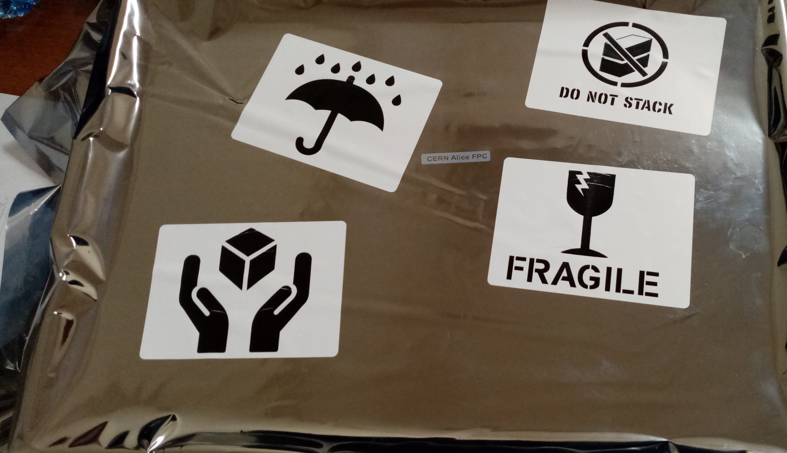
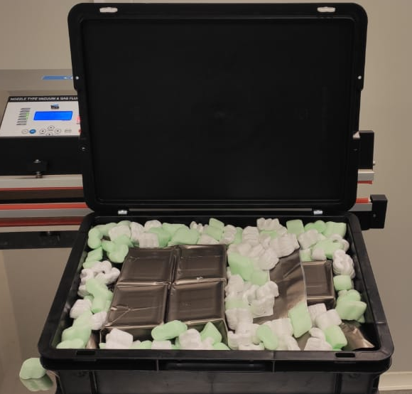
MPD - ITS
First shipment details (1 of 2)
Preparations by JINR:
DONE:
240 full-scale dummy chips, 15 FPCS – carefully put in trays and packed,
Basis document (Addendum №1 to MoU_NICA_Wuhan) – draft in English and Russian prepared,
Documents for the Export Control Group – prepared, not signed

Slide 5
MPD - ITS
First shipment details (2 of 2)
Preparations by JINR:
TO BE PERFORMED:
Send Addendum №1 (English, Russian) to CCNU for signing and stamping,
Sign and stamp the documents for the Export Control Group,
Initiate requesting permission for exporting.
Preparations by CCNU:
TO BE PERFORMED:
Sign, put a stamp and send through the post the originals of Addendum №1 (English and Russian) once received from JINR,
Initiate preparation of the documents for Customs in China in advance.

Slide 6
MPD - ITS
Open Questions / Comments
Any questions / concerns are welcomed
Thank you!

