Slide 1
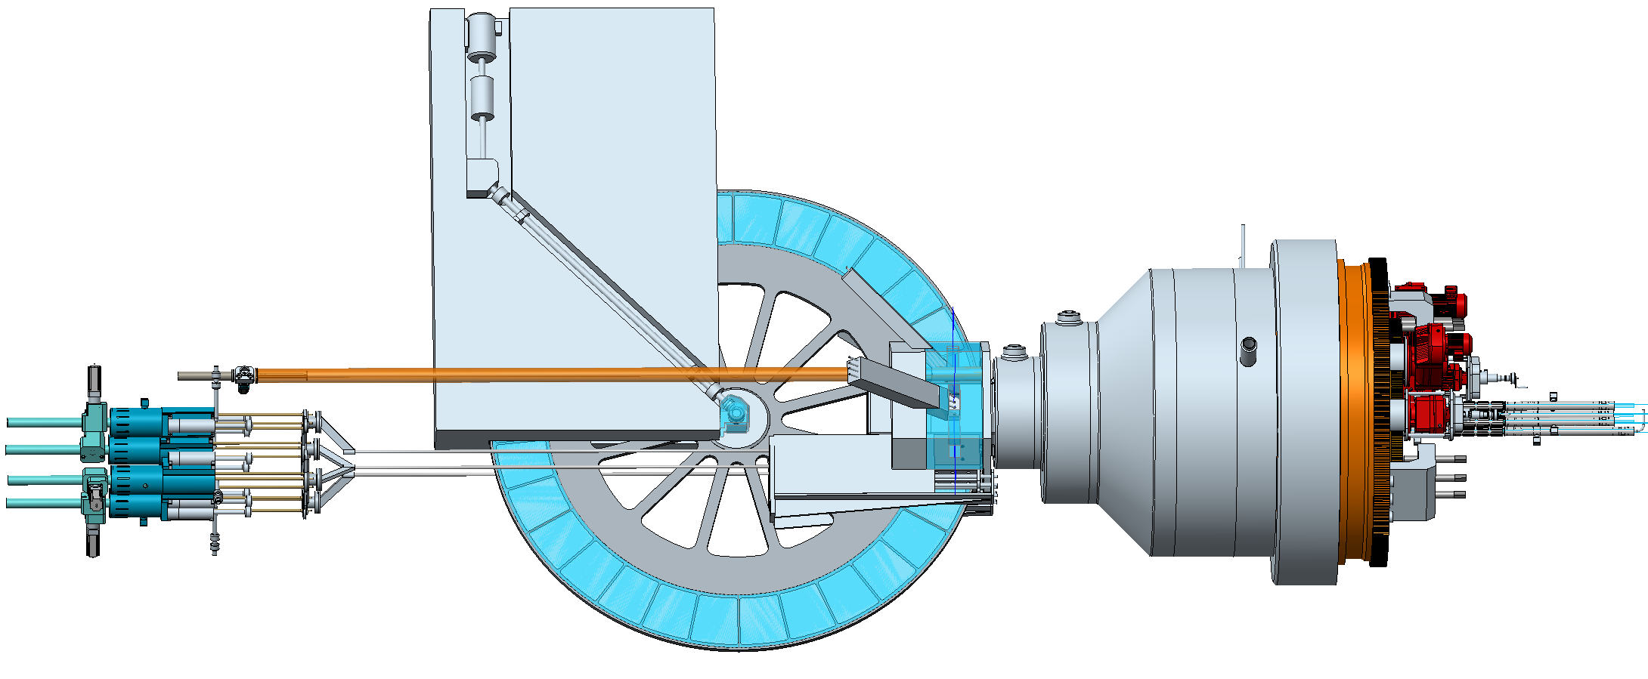
Progress report on the development of a new neutron source at FLNP
V.Shvetsov
53rd meeting of the PAC for Condensed Matter Physics
Jan 25 2021, Zoom

Slide 2
Inroduction

Slide 5
Activity in the second half of 2020
Bochvar Institute of Inorganic Materials starts participating in project under the signed contract;
NIKIET developed two versions of the IBR-3 design, based on the traditional fuel assembly and the wall-less FA;
FLNP team proposed the modification of the composition of the peripheral fuel elements in order to improve the controllability of the reactor;
Tomorrow (January 26) we’ll have the regular videoconference to discuss another option of the reactor design, proposed by FLNP – reactor core, based on individual FE;
Experimental and simulation activity on studying the background conditions at the IBR-2 was continued;
IBR-2 pulse power fluctuations studying;

Slide 6
VNIINM activity

Slide 7
First report from VNIINM

Slide 8
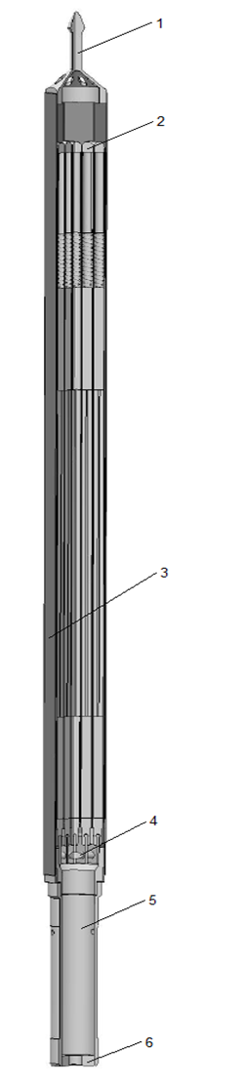
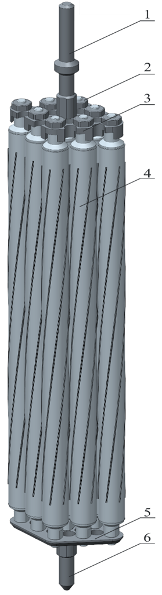

Slide 9
Actual tasks for VNIINM
Generalization of available data on the physicochemical properties of neptunium nitride;
Experimental investigation of the fuel material and feasibility study of the production process of the fuel pellets;
Development of the FE design;

Slide 10
NIKIET activity

Slide 11
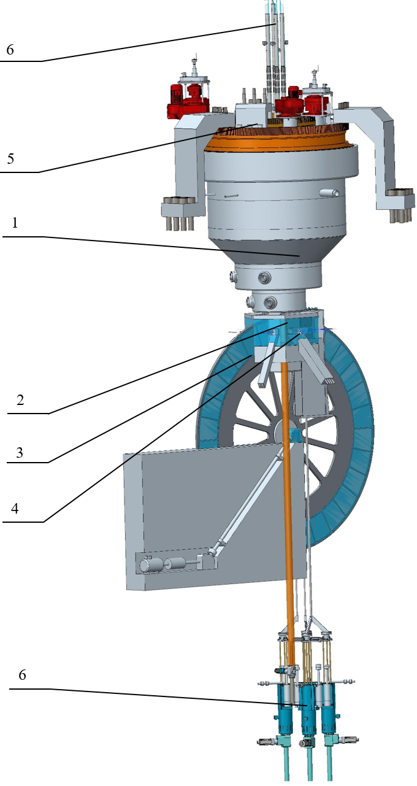
IBR-3 design
1 – reactor;
2 – stationary reflector;
3 – reactivity modulator;
4 – moderators;
5 – rotary plugs;
6 – CPS actuators;
Dimensions:
– height (including CPS actuators) 14,2 м;
– core height 3,54 м;
– core diameter 3,2 м;
– modulator wheel diameter 3,72 м.

Slide 12
IBR-3 parameters
Parameter | Value
 | Core with shroud fuel assemblies |  | Core with wall-less fuel assemblies
Average thermal power, MW | 15
Operational mode | Pulsed
Pulse repetition rate, Hz | 10
Fuel | NpN
Fuel element cladding | SS ChS-68-ID
Coolant | Na
Reflectors | Ni alloy + Be
Premoderators | Water
Coolant inlet temperature, °С | 290
Coolant outlet temperature, °С | 390
Coolant flow, kg/s | 58
Number of the FE | 928 | 612
Fuel load, kg | 712 | 635
Neutron flux density, 10¹³ cm⁻²∙s⁻¹ | 9,5 (WM-1) | 11,0 (WM-4)

Slide 13
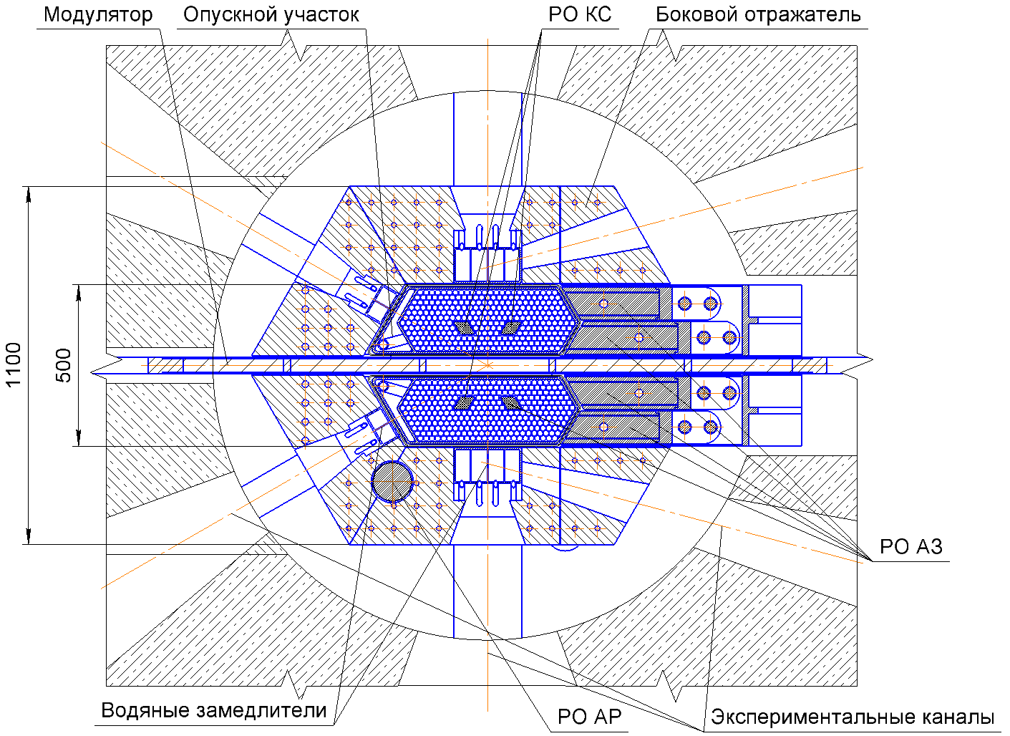
Core central section (wall less fuel assemblies)
Reactivity modulator
Downward section
COR CR
Side reflector
Abbreviations:
ARC – automatic reactivity controller;
CR – control rod;
COR – compensating rod;
CPS – Control and protection system;
CPS CR
Water premoderators
ARC CR
Axes of the experimental channels

Slide 14
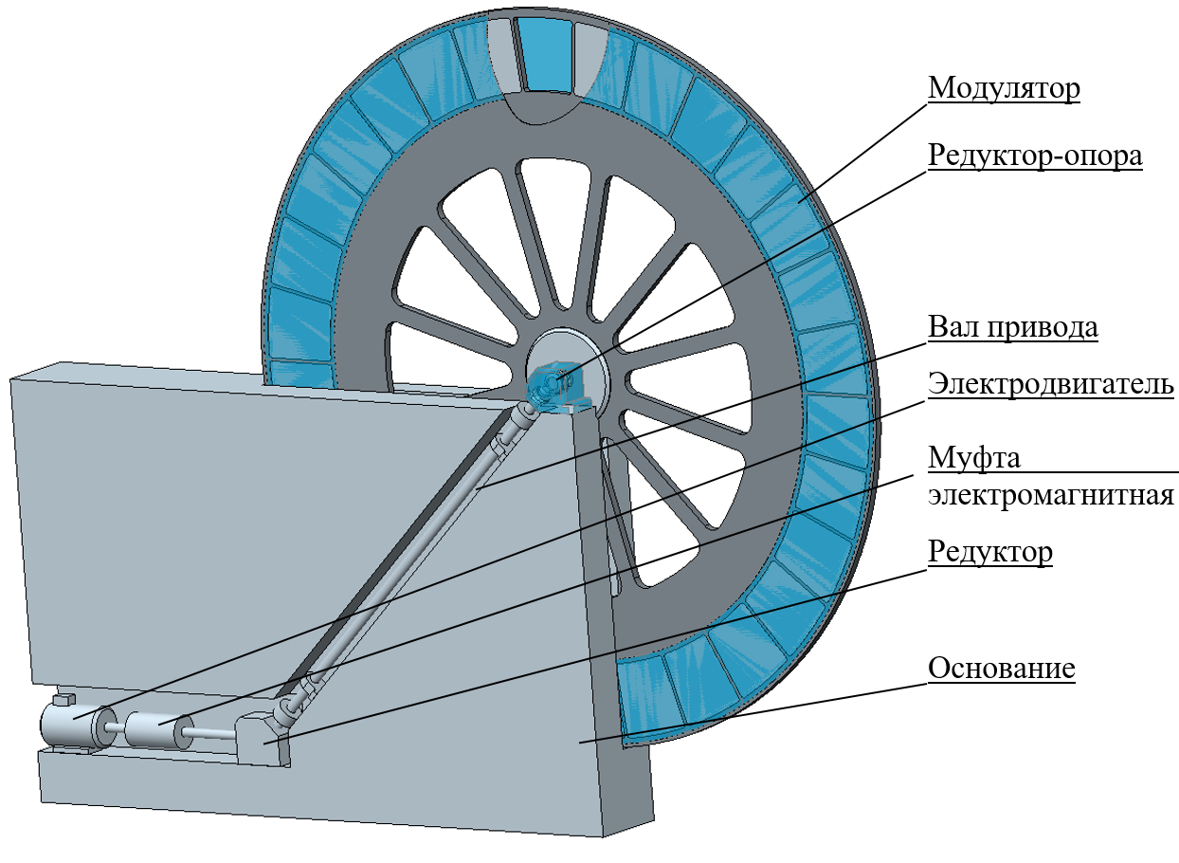
Reactivity modulator
Modulator wheel
Gear support
Drive shaft
Electric motor
Electromagnetic clutch
Reduction gear
Basement

Slide 15
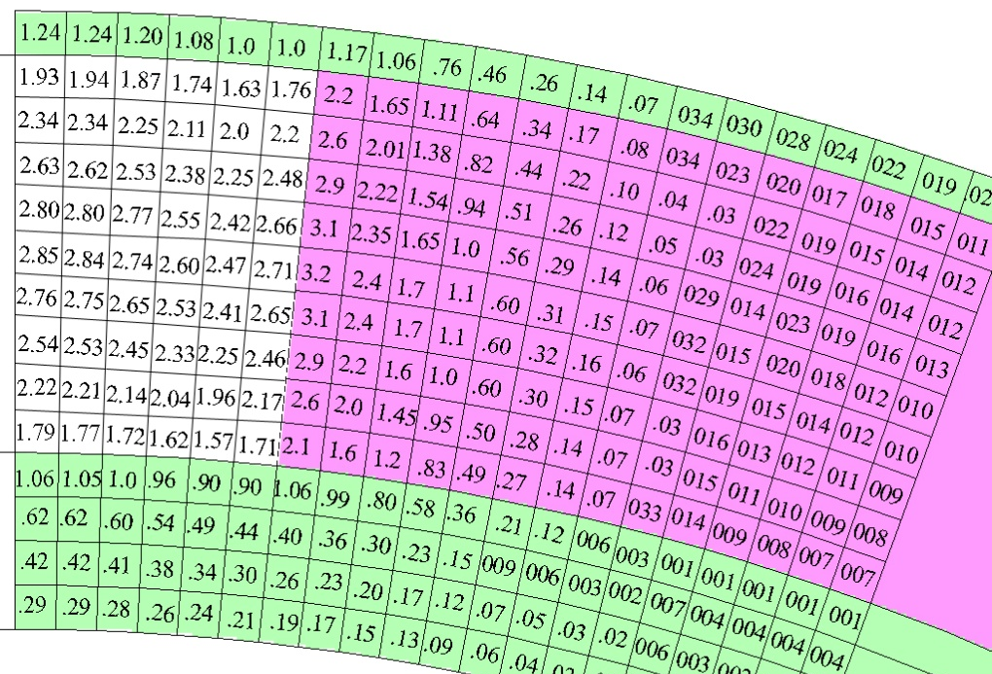
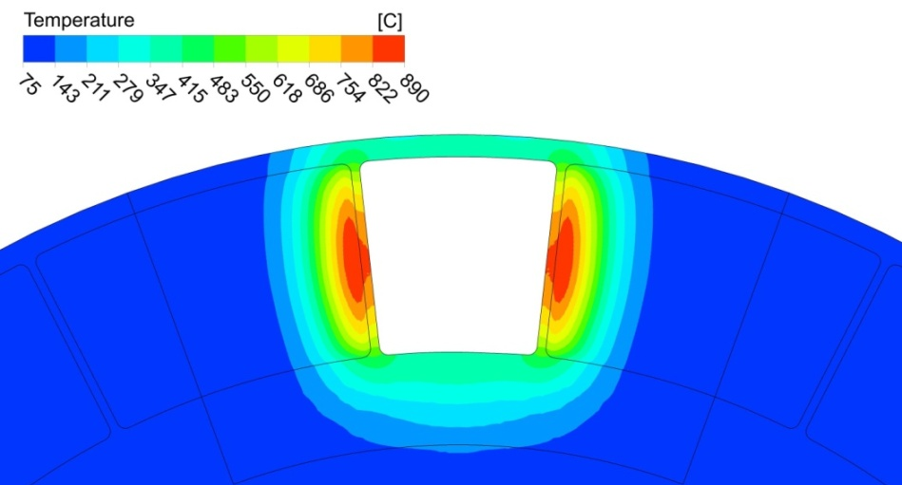
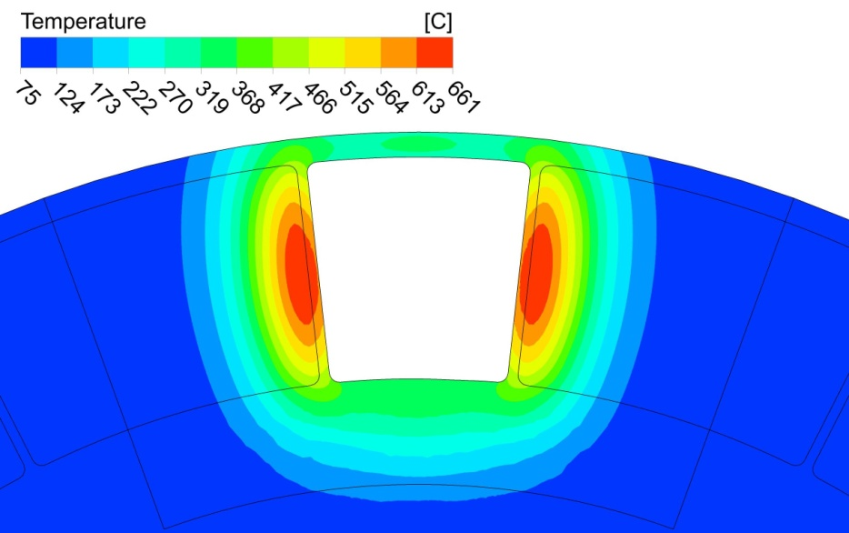
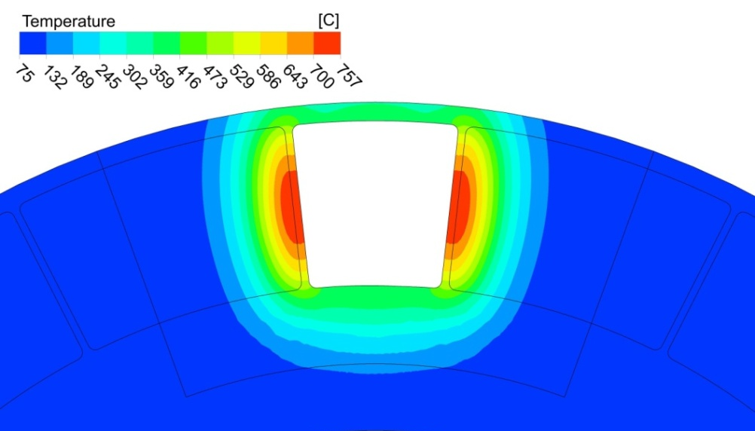
Reactivity modulator thermal calculations
Heat release distribution in cells
Thermal conductivity coefficient 5 W/m⋅K
Thermal conductivity coefficient 15 W/ m⋅K
Without side walls

Slide 16
Current stage of the JINR-NIKIET interaction
In parallel with IBR-3 design two FLNP teams and NIKIET continued investigations of the power fluctuations at IBR-2;
We have serious grounds to explain these fluctuations by the design of the IBR-2 fuel assemblies;
Now we’re ready to modify the requirement specifications in our contract with NIKIET to request from Dollezhal Institute the core design without fuel assemblies – just with individual fuel elements;

Slide 17
FLNP and JINR activity

Slide 19
For the first time we have found the cyclic changes of the IBR-2 fluctuations

Slide 20
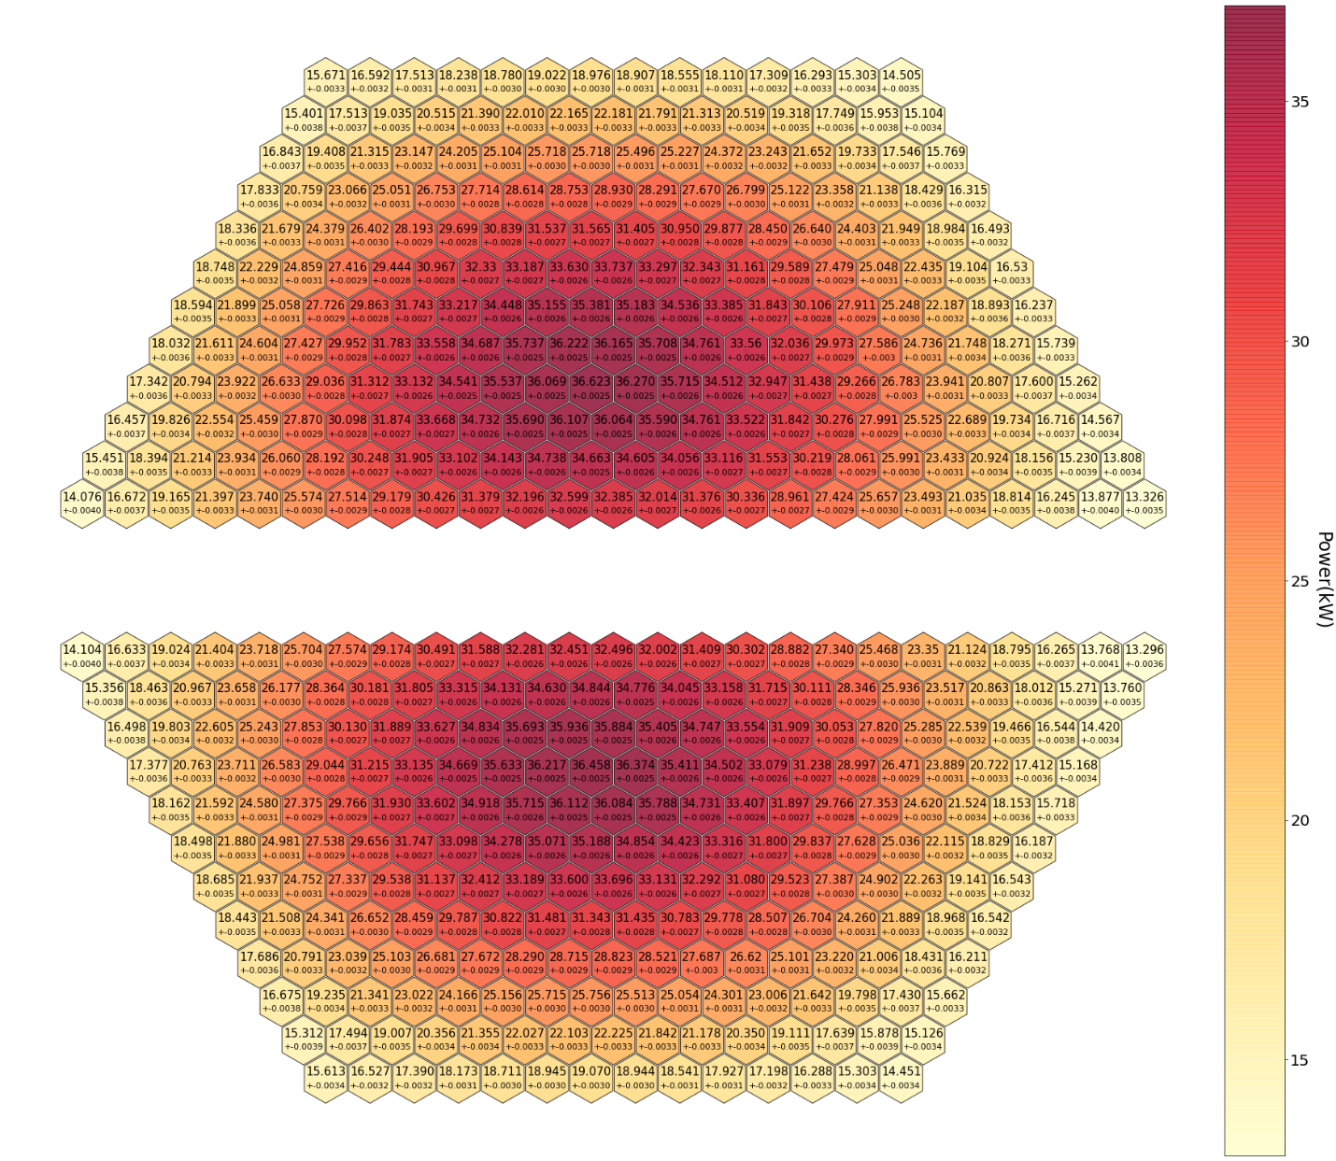
Power distribution in peripheral FE with 50% U-235 (50% enriched)
More than 50 geometries/compositions calculated, using LIT GOVORUN supercomputer, special thanks to LIT team!

Slide 21

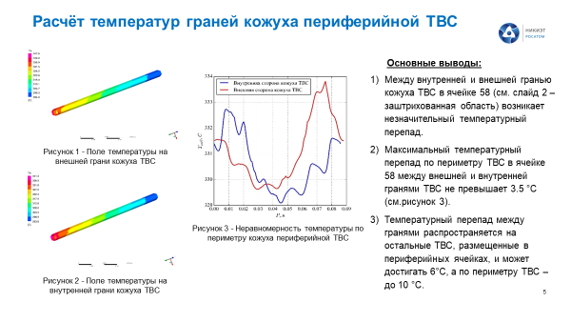

Slide 22
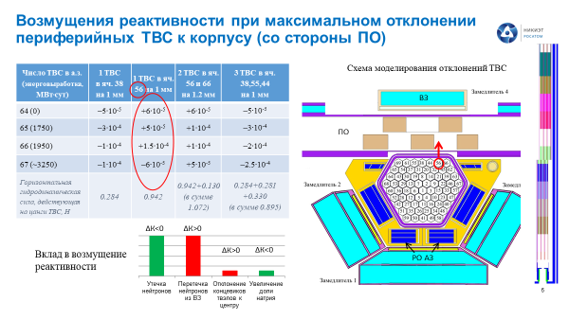

Slide 23
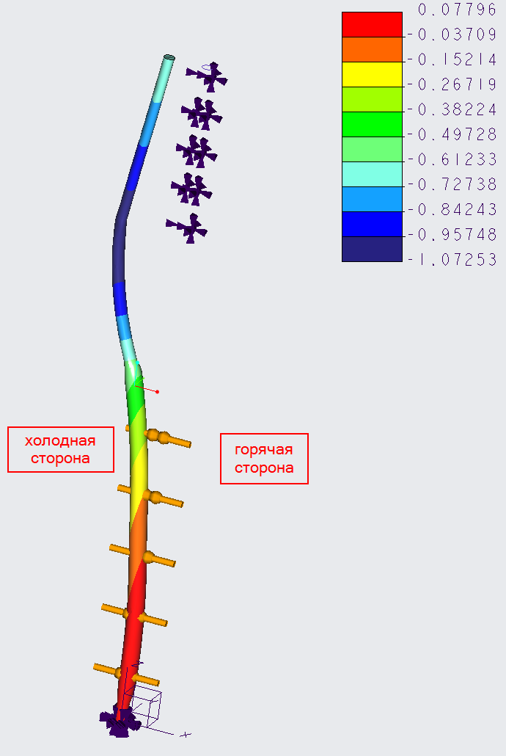
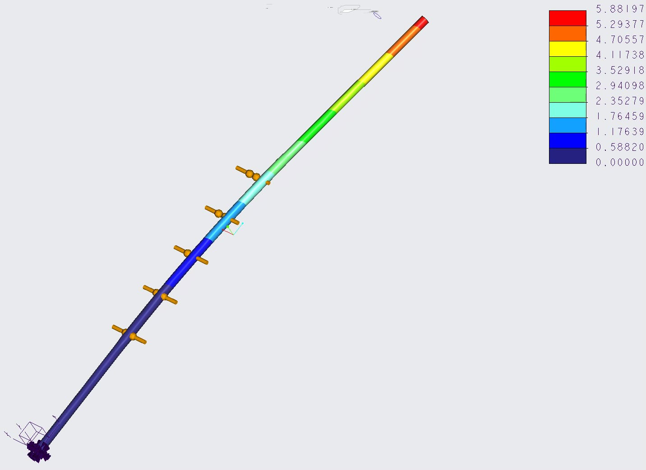
FE bend calculations

Slide 24
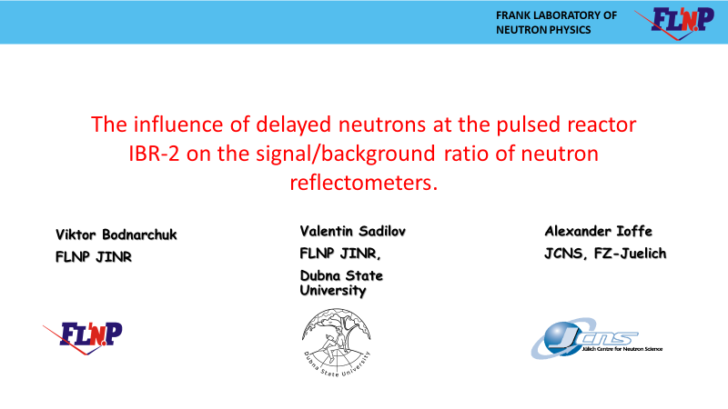

Slide 25
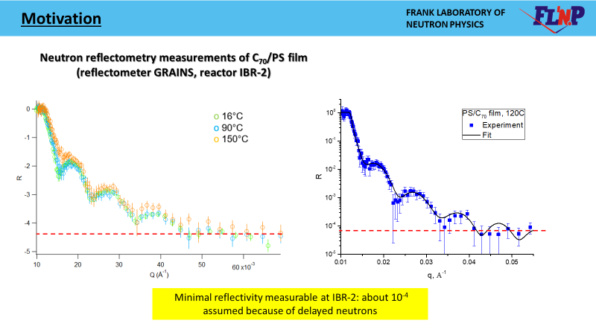

Slide 26
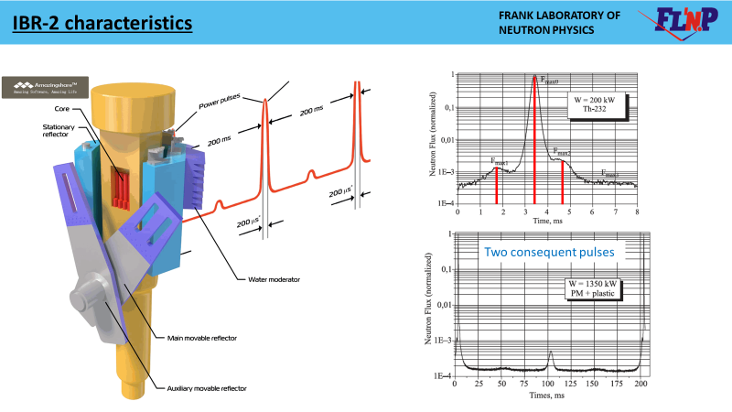
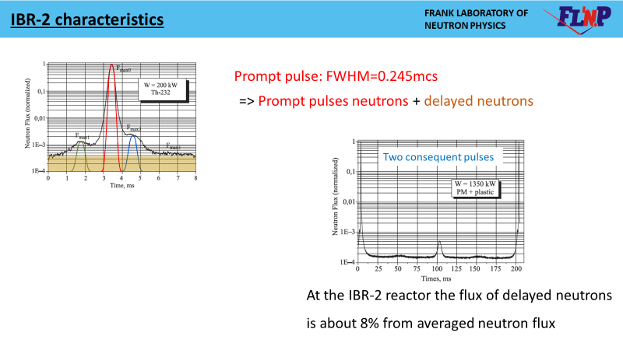

Slide 27
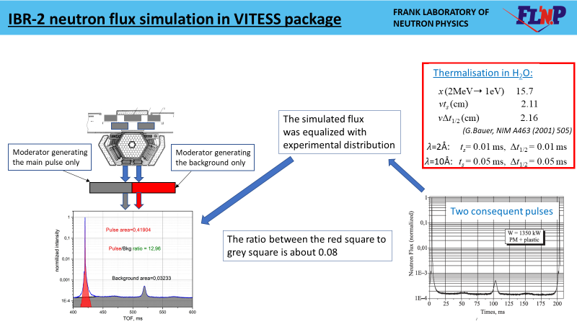
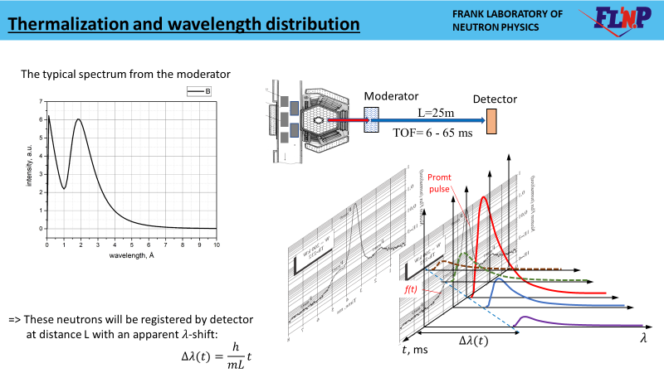

Slide 28
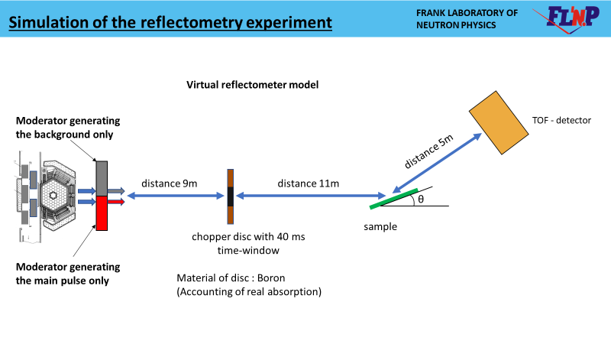
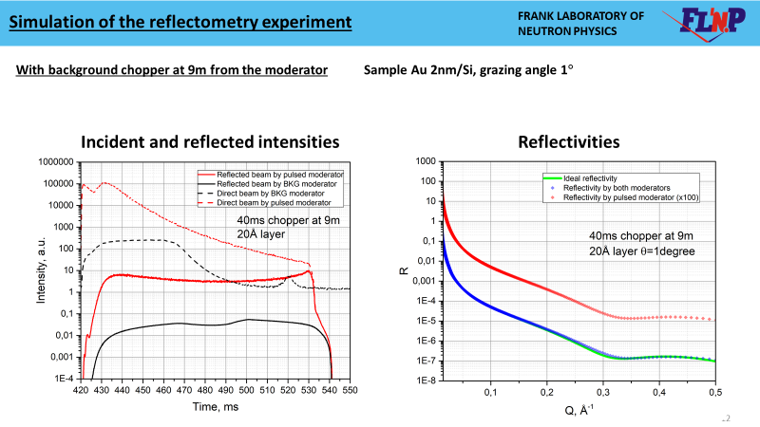

Slide 29
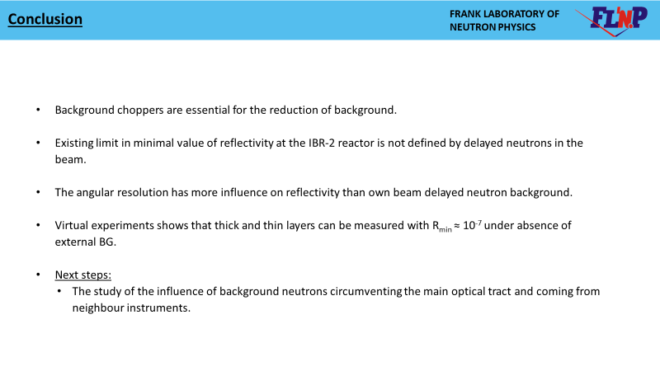

Slide 30
JINR actions to the implementation of the decisions of the joint meeting of the Scientific and Technical Council of ROSATOM and JINR Directorate from Dec. 11, 2019
Several visits of Rosatom representatives to the JINR in 2020;
At present dedicated working groups are under formation;

Slide 31
Conclusion

Slide 32
Current status of the IBR-3 project development
Reactor design, including FE, FA, fuel composition is not fixed yet;
R&D on fuel with participation of the VNIINM was started;
We’re considering the pulsed stability of the IBR-3 as the key point;
So, tightener with NIKIET we’re going forward in studying IBR-2 and more detailed simulations of the IBR-3 dynamics;
The seed of the future IBR-3 department is prepared for planting;
The investigations of the backgrounds at the pulsed neutron sources with fissile targets are continuing;
On behalf of the FLNP directorate and IBR-3 team wish you stay well!
THANK YOU!

