Slide 1

Vacuum system of NICA project
A.Smirnov, A.Galimov, A.Svidetelev, A.Tikhomirov
JINR, Dubna, Russia
Alushta, Crimea
05/09/2017

Slide 2
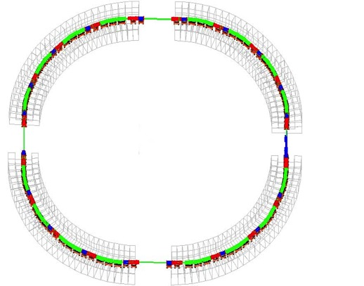
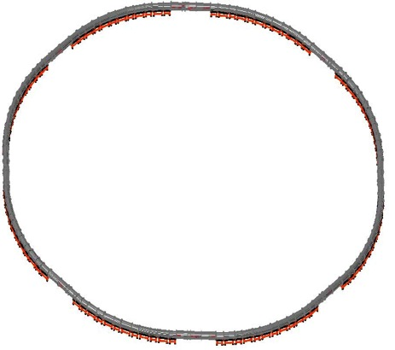
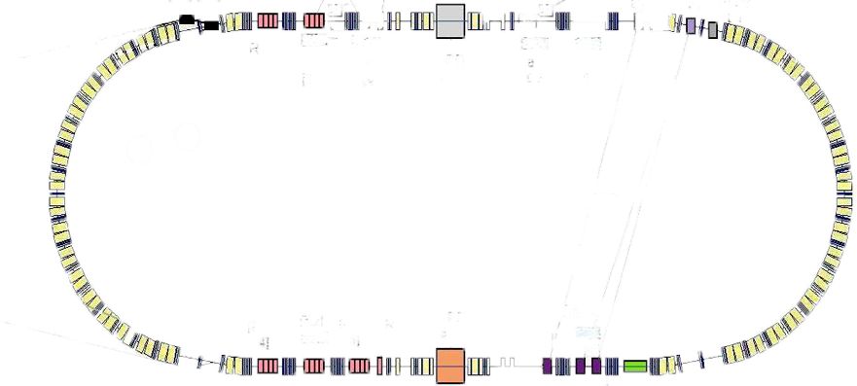
NICA: Structure and Operation Regimes
Linac HILac
KRION HIS
Booster (25 Tm)
1(2-3) single-turn injection,
storage of (2 ÷ 4)×10⁹ ions,
acceleration up to 100 MeV/u,
electron cooling, acceleration
up to 600 MeV/u
Linac LU-20
Ion sources
Fixed Target Area
BM@N
Stripping
Nuclotron (45 Tm)
injection of one bunch
of ≤ 2×10⁹ ions,
acceleration up to
1 - 4.5 GeV/u max.
Two SC
collider rings
~ 22 bunches per ring

Slide 3
Vacuum systems of particle accelerators
Accelerator | Length, m | Pressure, Pa | Pump types | Status
LU-20 | 20 | 10⁻⁴ | Turbo pumps + cryopump | Upgraded
HILAC | 11,5 | 10⁻⁵ | Turbo pumps + ion pumps | Assembled
Nuclotron | 251,5 | 10⁻⁷ | Turbo pumps + ion pumps | Upgraded
Booster | 211 | 10⁻⁹ | Ion pumps + getters | Start version (turbopump)
Collider | 503 | 10⁻⁹ | Ion pumps + getters | Under design

Slide 4
Booster vacuum systems
Name | Status | Chamber manufacturer | Pumping system *
Electron cooling system | Assembling at JINR | BINP, Novosibirsk | Ion pump, TSP, NEG
Injection septum Cold kicker | Design is finished Prototype | 1) BINP, Novosibirsk 2) Cryosystems, Moscow Bulgaria | Ion pump + TSP + CT, NEG
RF-station Pumping post | Testing at JINR Production | BINP, Novosibirsk MILLAB, Moscow | Ion pump + TSP + CT, NEG
Extraction system | Production | BINP, Novosibirsk | Ion pump + TSP + CT
Cold arcs Pick-up stations | Production Prototype | FRAKOTERM, Poland Bulgaria | 1) Turbo pump 2) Ion pump + NEG 3) + TSP @ LN
* TSP – titanium sublimation pump, LN – temperature of liquid nitrogen
CT – cryogenic trap, NEG – non evaporated getter

Slide 5
Beam lifetime due to recombination on rest gas at booster
P = 10⁻⁹ Pa, T = 293 K, k = 1.38 10⁻²³ J/K, β = 0.083 (3.2 MeV/u)
τ = P σ β c / T k – beam lifetime
t_life = 1000 s, σ = 1.63 10⁻²² m² (Au³¹⁺, H₂ rest gas)
t_life = 25 s, σ = 68.6 10⁻²² m² (Au³¹⁺, N₂ rest gas)

Slide 6
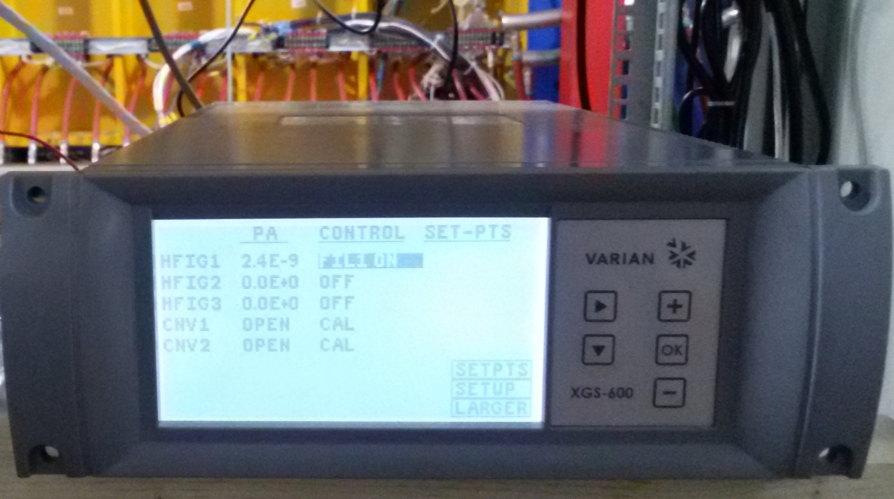
Vacuum chamber of electron cooling system (BINP)
1. Gun, 2. Collector, 3. Sublimation pump TSP-IKG «VACOM», 4. Bent chamber,
5. Toroid section, 6. Pick-up station, 7. Cooling section, 8. Dipole section, 9. Bellows,
10. NEG position, 11. Vacuum valve, 12. Bellows, 13. Ion pump, 14. Connector.

Slide 7
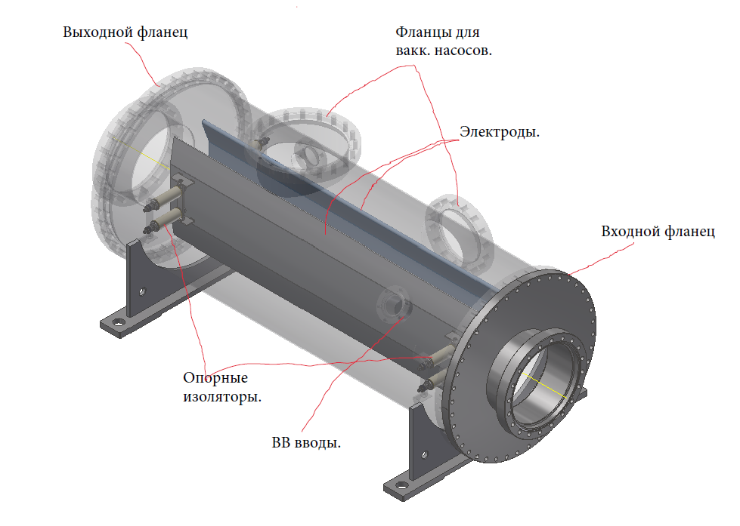
Vacuum system of injection section (Cryosystems)
IK3
IK2
IES
IK1
Ion pump
Ion pump + NEG
IES
IK2

Slide 8
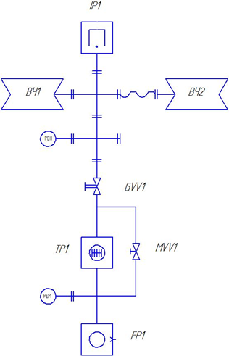
Pump station (MILLAB) with RF-station (BINP)

Slide 9
Extraction system of booster (BINP)

Slide 10
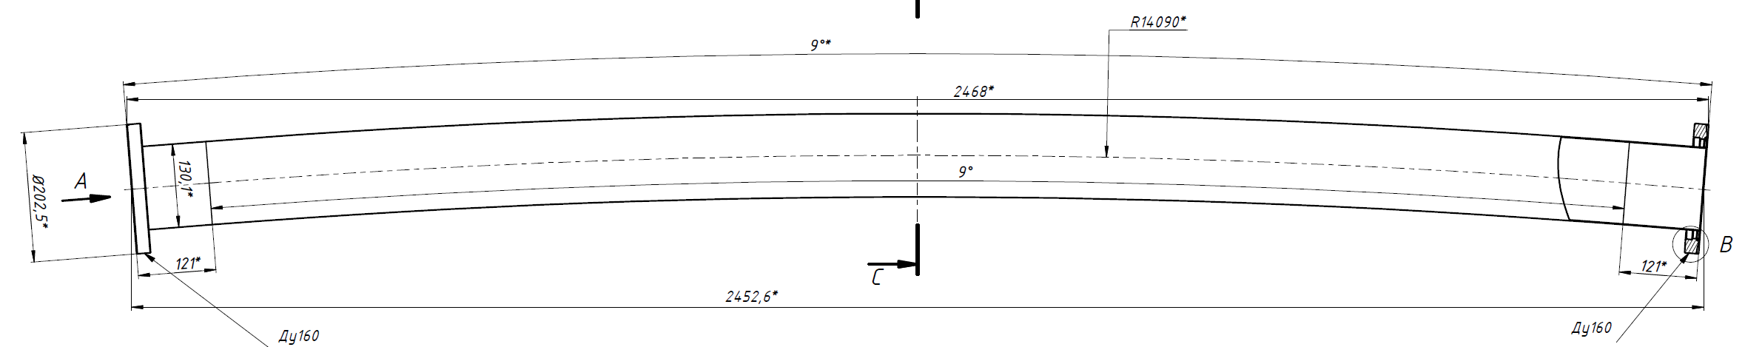
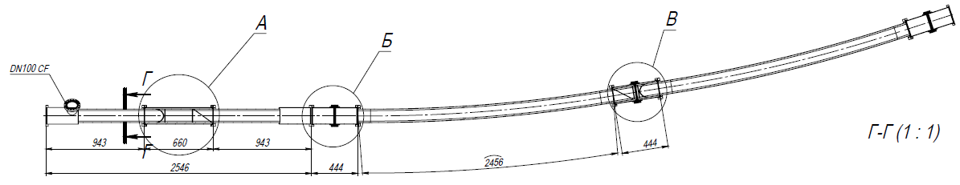
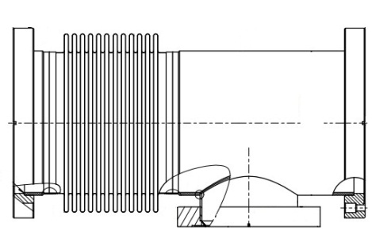
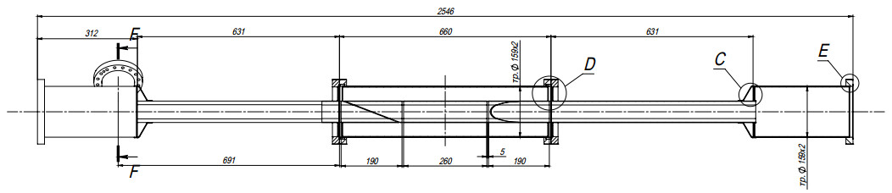
Booster vacuum chambers of cold arcs (FRAKOTERM)
Dipole chamber
Pump station @ RT
Pick-up
Quadrupole & pick-up chamber
TSP @ LN

Slide 11
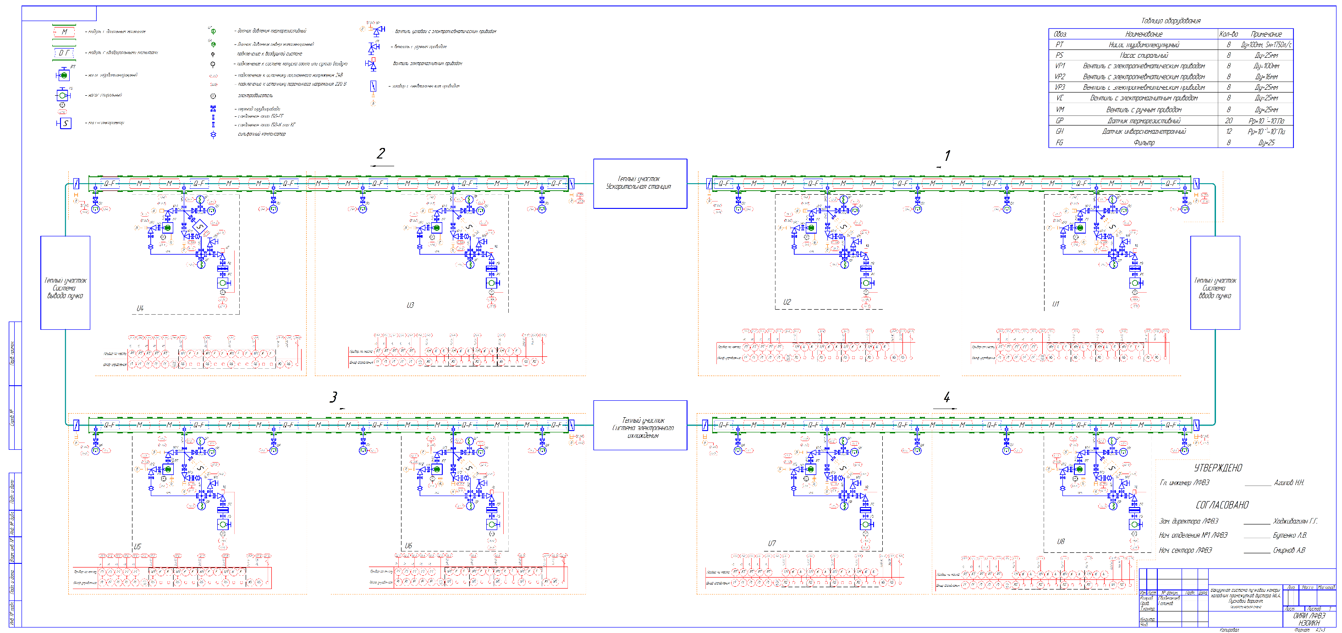
1) Startup version of vacuum scheme for booster cold arcs is included turbopumps only

Slide 12
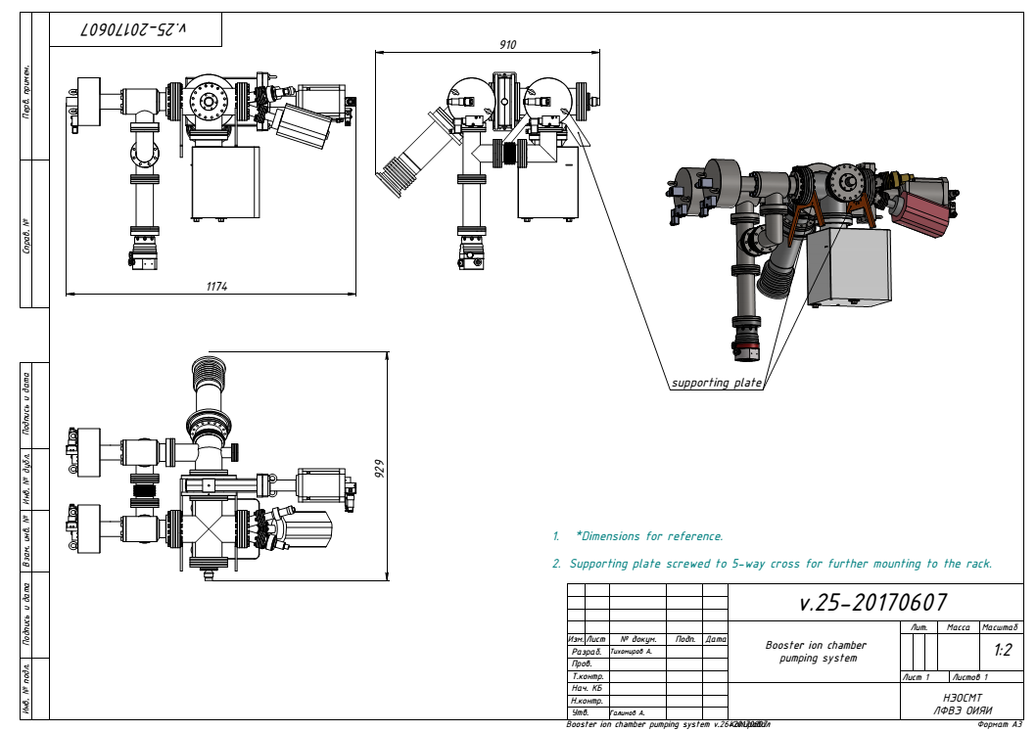
Prototype of vacuum stand (Vakuum Praha)
24
23
22
21
100/40
40x4
12
13
1
15
100
2
16
16
3
40/16
63
40
16x3
4
14
17
63
100
19
16
5
63x3
20
16x3
9
100/63
S
18
100x5
6
10
11
8
7

Slide 13
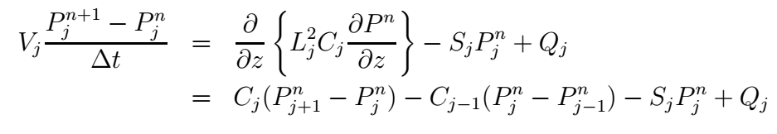

Evolution of vacuum distribution
In accordance with V.Ziemann for same temperatures:
where V – chamber volume, P – pressure, Δt – time step, L – distance,
C – conductance, S – pump speed, Q – outgassing, j – point number.
For different temperatures terms
are replaced on:
$C_{j}\left(P_{j+1}^{n}\sqrt{T_{j}/T_{j+1}}−P_{j}^{n}\right)$ $−$ $C_{j−1}\left({P_{j}^{n}−P}_{j−1}^{n}\sqrt{T_{j}/T_{j−1}}\right)$

Slide 14
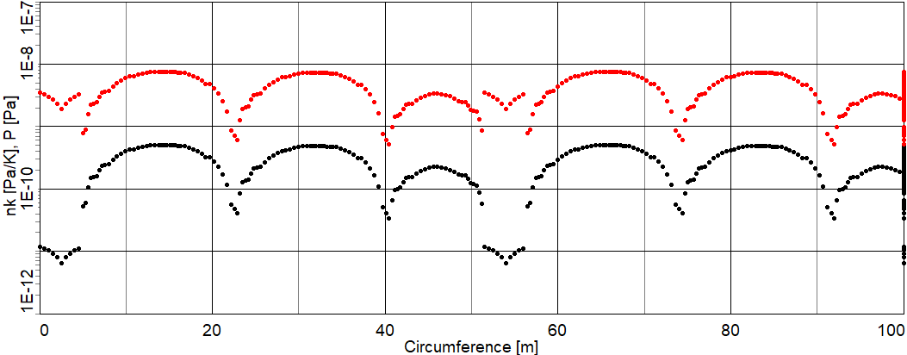

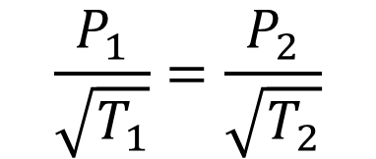

Real distribution of pressure and density
Warm sections @ room temp
Cold sections @ cryogenic temp
$$\frac{P_{1}}{\sqrt{T_{1}}}=\frac{P_{2}}{\sqrt{T_{2}}}$$
$$P=nkT$$
, k = 1.38 10⁻²³ J/K ,
$$n_{1}\sqrt{T_{1}}=n_{2}\sqrt{T_{2}} ,$$

Slide 15
Input File for BetaVacuum Code (MAD format)
var : T_0 = 15
var : T_1 = 293
pump : pump0 = 0.5
pump : pump1 = 0
pump : pump2 = 0
pump : pump3 = 2
leak : leak0 = 0
//tube: name = length, temp, square, conduct, outgas, pump
tube : tube1 = 0.304, T_0, 0.02, 0.426, 2.51e-11, 0
tube : quad = 0.639, T_0, 0.0065, 0.071, 1.56e-11, 0
tube : tube2 = 0.660, T_0, 0.02, 0.426, 2.51e-11, 0
line : duplet0 = tube1, pump0, quad, tube2, quad, tube1
line : duplet1 = tube1, pump1, quad, tube2, quad, tube1

Slide 16
tube : tube3 = 0.444, T_0, 0.02, 0.426, 2.51e-11, 0
tube : dipole = 2.456, T_0, 0.0065, 0.071, 1.56e-11, 0
line : dipole2 = tube3, dipole, pump2, tube3, dipole, tube3
line : super0 = pump2, dipole2, duplet0
line : super1 = pump2, dipole2, duplet1
line : super5 = super1, super0, super1, super0, super1
tube : warm = 2.5, T_1, 0.2, 2, 5e-10, 0
line : booster4 = warm, pump3, warm, duplet1, super5
line : booster = booster4, booster4, booster4, booster4
ini : booster = 2e-8, 293, 0.1 ; pressure, temperature, length step
run : pump = 5, 0.5, 0.082, 1e9 ; pump time, time step, beta, Nion
pump : pump1 = 0.5
run : pump = 5, 0.5, 0.082, 1e9
pump : pump2 = 0.5
run : pump = 5, 0.5, 0.082, 1e9
end

Slide 17
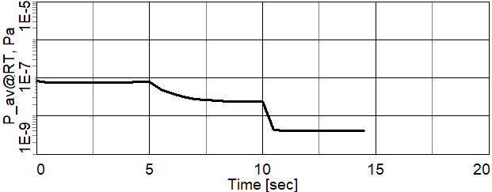
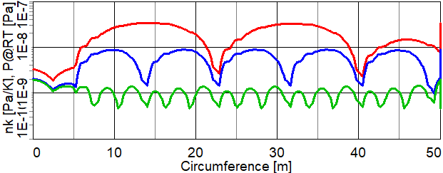
Simulation of dynamics vacuum and pressure distribution
(all gauges at room temperature)
1) Red line – startup vacuum scheme,
2) Blue line – normal vacuum scheme
3) Green line - with additional TSP@LN
between magnets

Slide 18
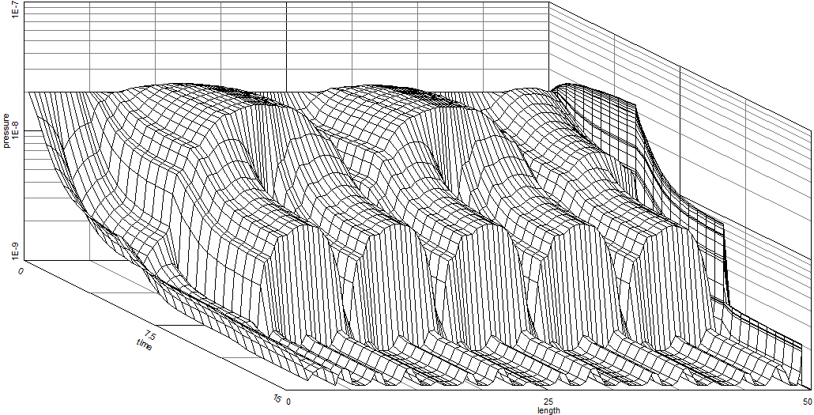
3D Vacuum Evolution
Pressure [Pa]
Time [s]
Circumference [m]

Slide 19
Collider vacuum chamber sizes
Elliptical chamber

Slide 20
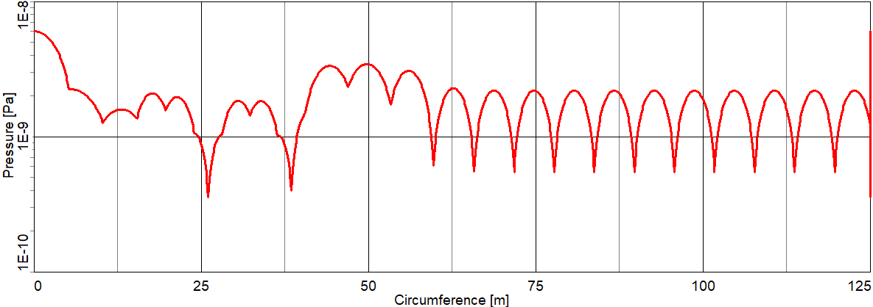
Simulation of pressure distribution (1/4 of collider)
τ = 4×10⁻⁷ s⁻¹ for σ = 68.5 10⁻²⁸ m² (1 GeV/u Au⁷⁹⁺, N₂ rest gas)

Slide 21
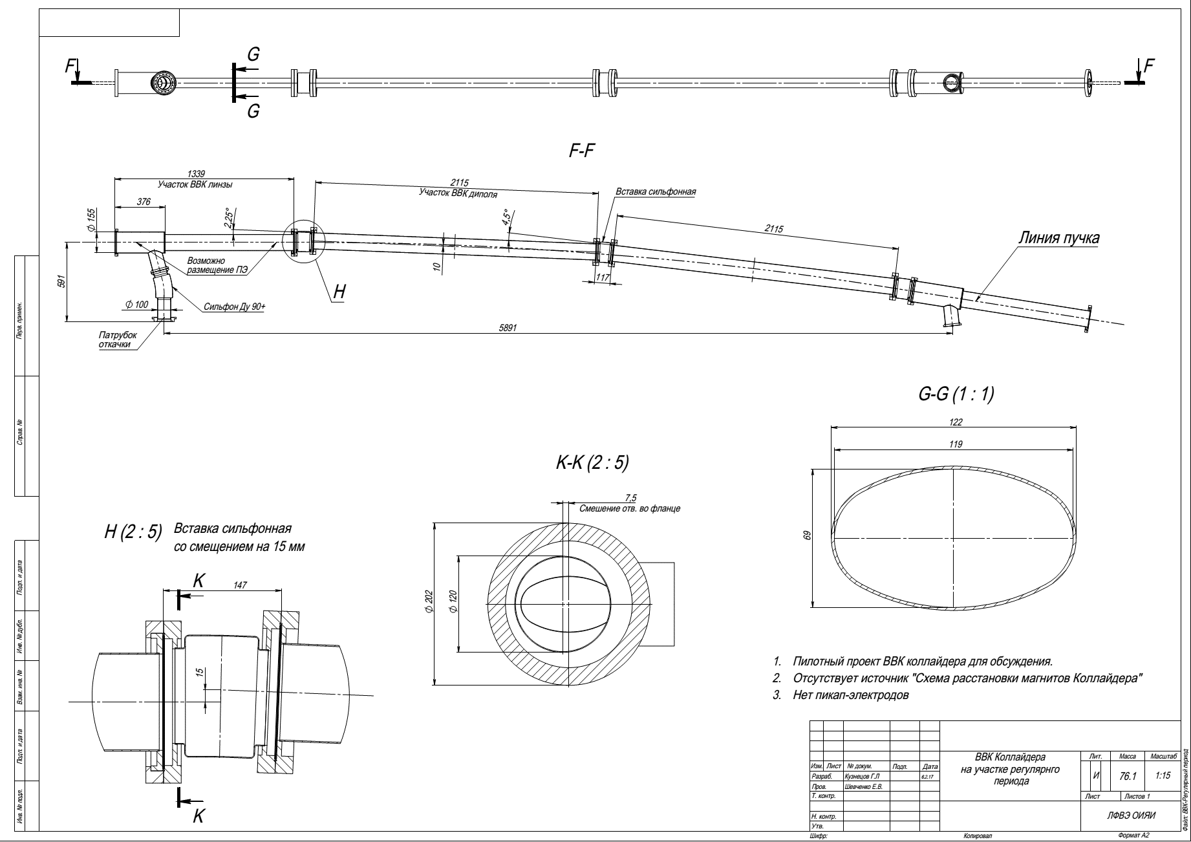
Vacuum chambers for collider cold arcs (FRAKOTERM)

Slide 22
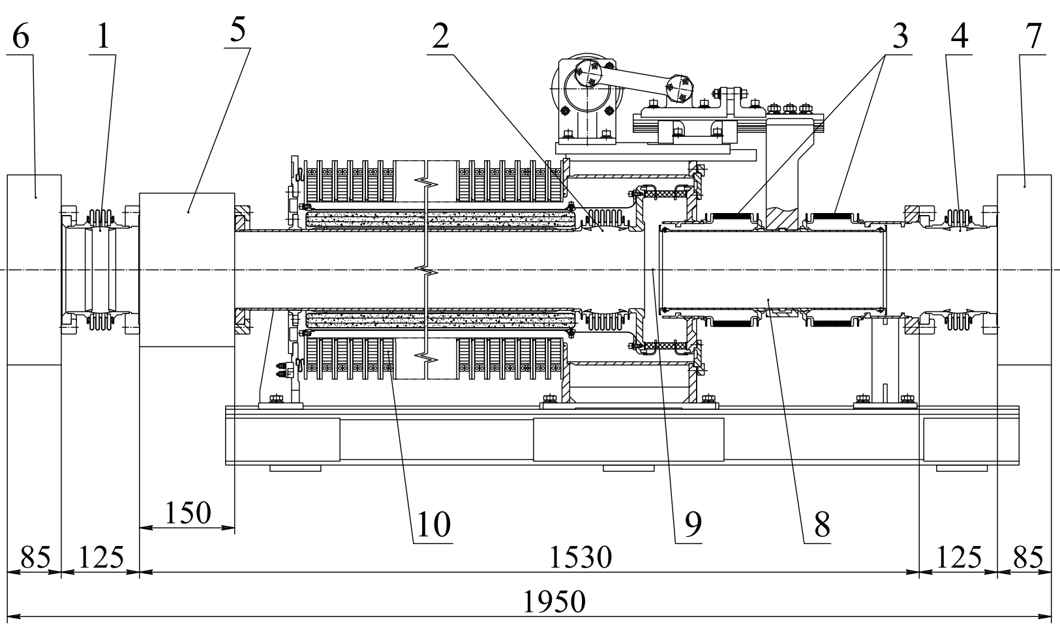
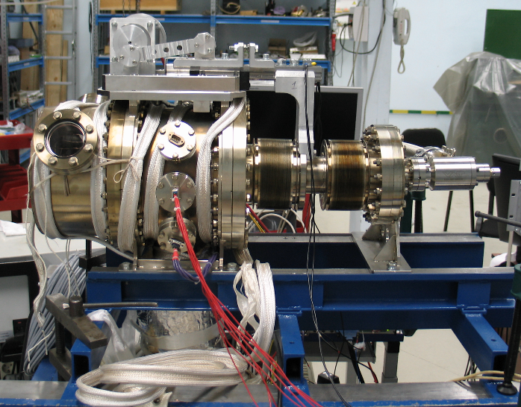
Collider RF-stations (BINP)

Slide 23
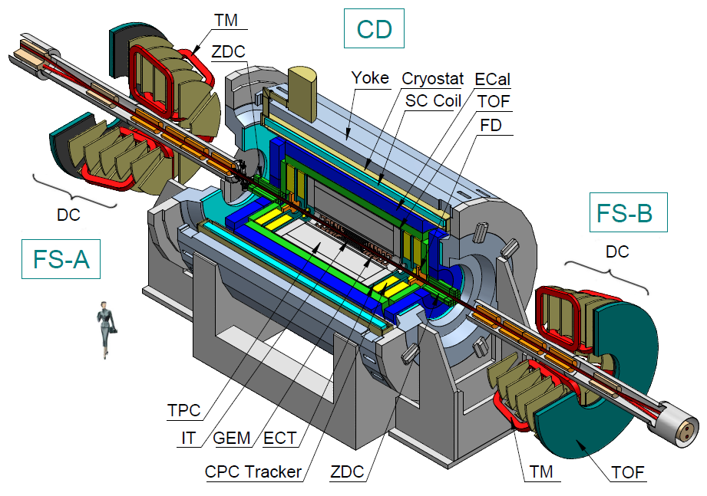
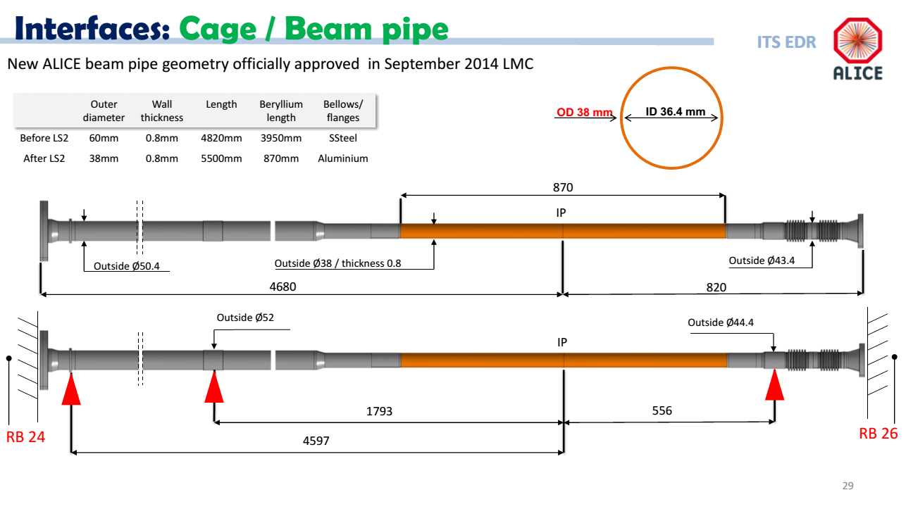
Multi Purpose Detector

