Slide 1
Status of the GEM tracking system at the BM@N experiment
Andrei Galavanov on behalf of the BM@N Collaboration

Slide 2
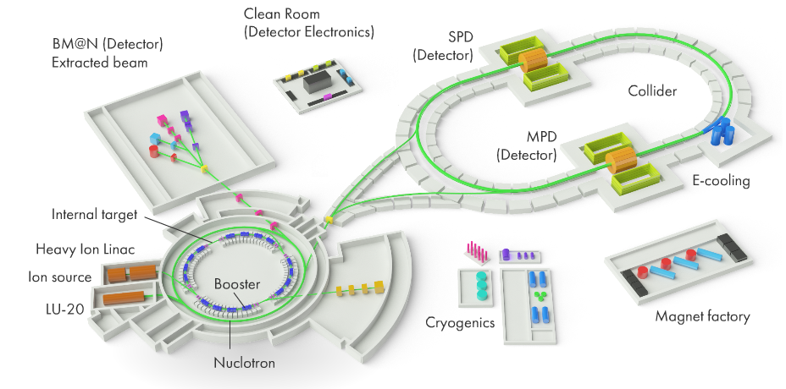
NICA complex
Linear accelerators, 3 MeV/u
Nuclotron,
0.6 – 4.5 GeV/u
Collider,
√S = 4 – 11 GeV/u
Booster, 3 – 660 MeV/u

Slide 3
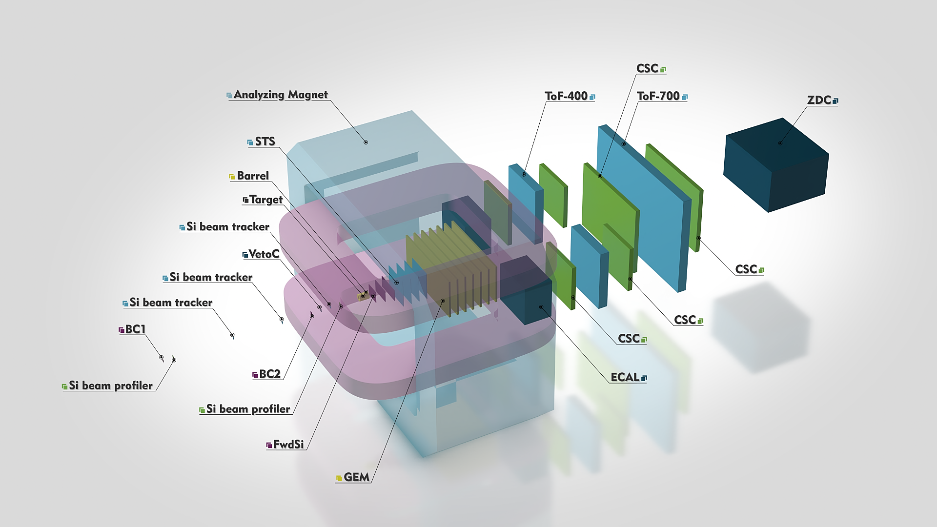
BM@N experiment
BM@N provides a unique opportunity to study strange mesons and multi-strange hyperons close to the kinematic threshold. One of the main goals is to measure yields of light hyper-nuclei, which are expected to be produced in coalescence of Λ-hyperons with nucleons.
GEM tracking system
Experimental setup for high intensity heavy ion beams

Slide 4
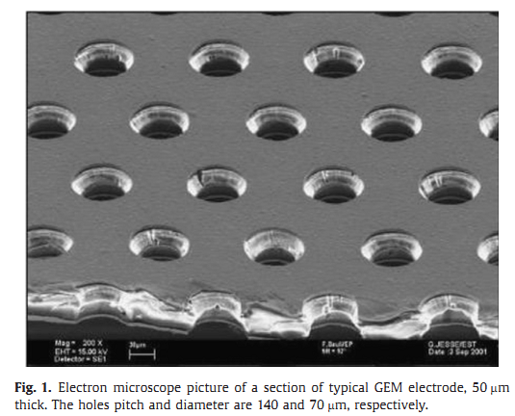
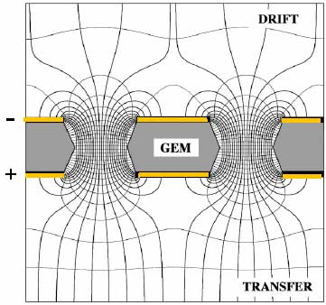
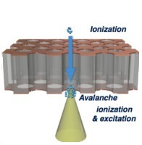
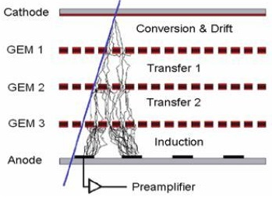
The gas electron multiplier (GEM)
Particle
DRIFT
Electron microscope picture of a section of typical GEM foil: 50 μm thick capton foil, metalized on each side by 5 μm thick copper electrodes . The holes pitch and diameter are 140 and 70 μm, respectively.
Electric field in the region of the holes in a GEM foil.
Electron avalanche in GEM holes.
Typical scheme of a triple GEM detector.

Slide 5
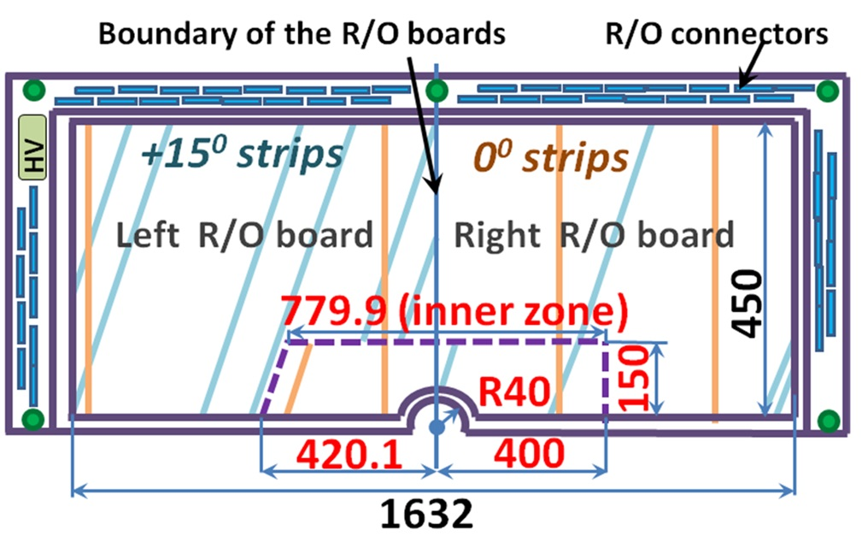
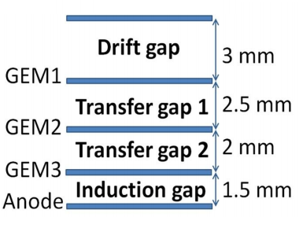
BM@N GEM detectors
Now we have:
7 detectors 1632 × 450 mm²
7 detectors 1632 × 390 mm²
2 spare detectors will be produced in 2021
0.16
0.8
0.8
0.68
Schematic cross section of the BM@N triple GEM detector

Slide 6
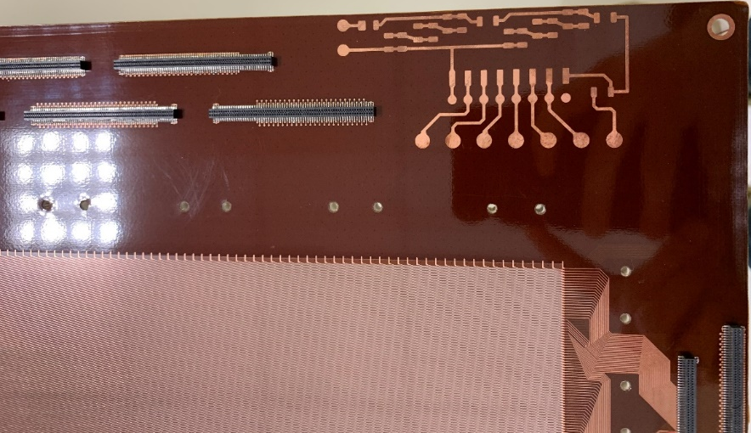
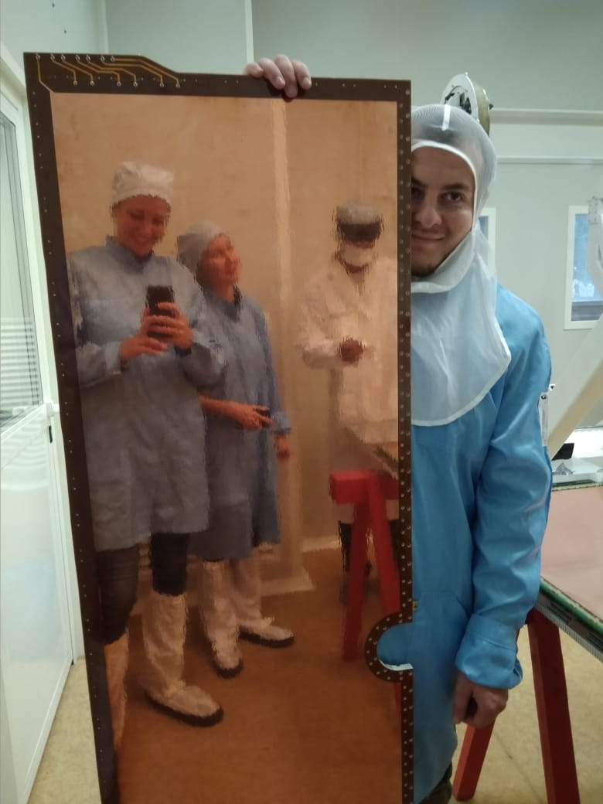
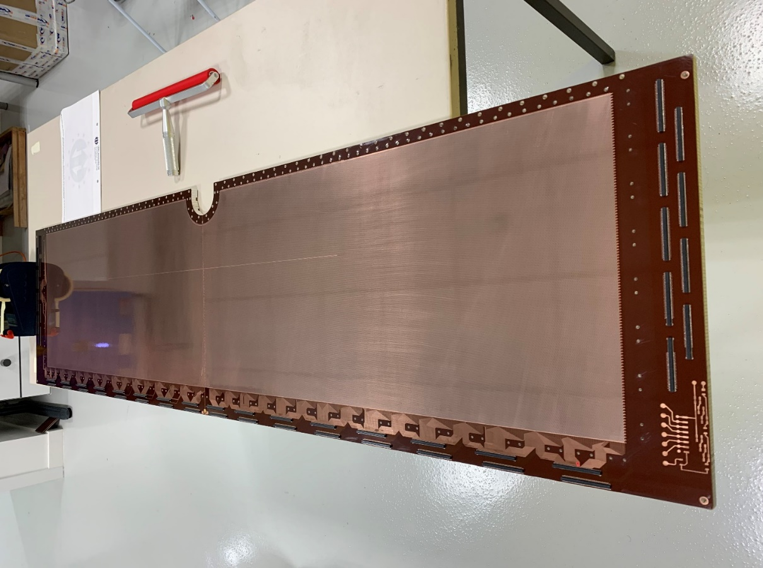
BM@N GEM detectors
Cathode plane
Readout board

Slide 7
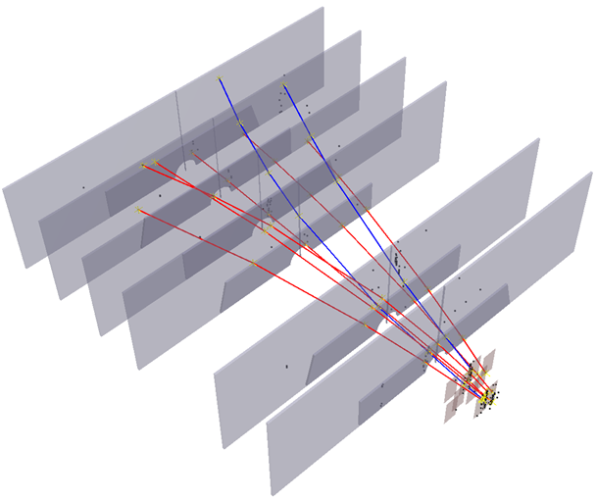
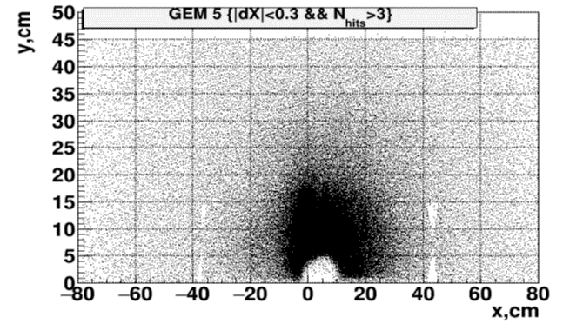
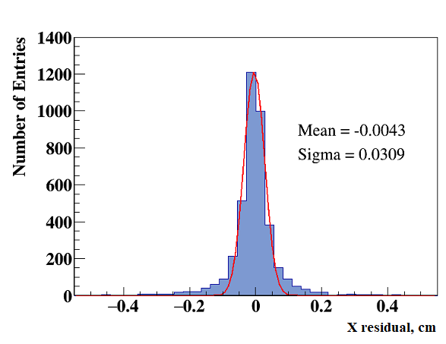
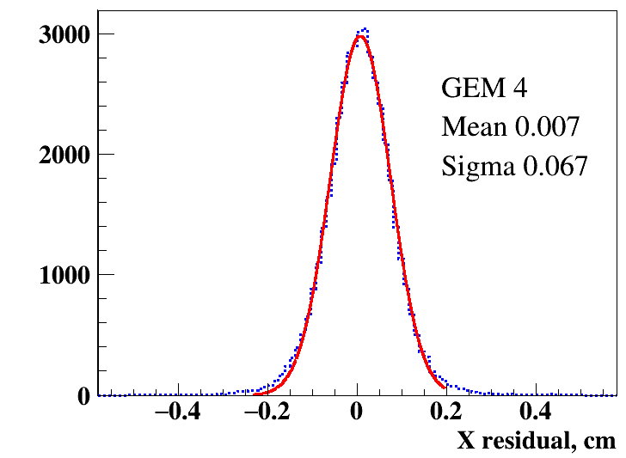
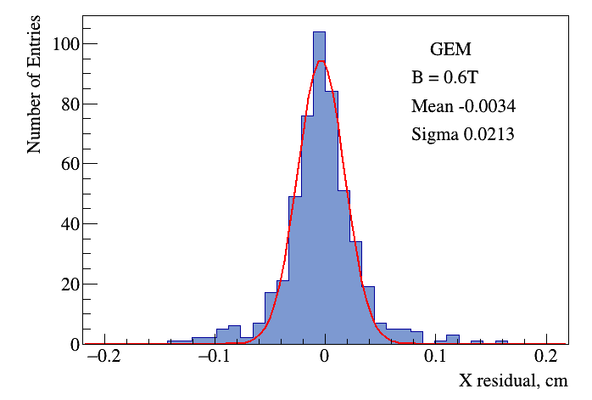
GEM tests on Nuclotron beams
Example of the event reconstruction
Fragments of Ar beam in detector
2016
2017
2018
Magnetic field 0.6 T,
Ar(70)/CO2(30),
C beam, E_{drift} = 1.2 kV/cm
σ = 309 µm
Magnetic field 0.6 T, Ar(90)/Isobutane(10),
d beam, E_{drift} = 0.8 kV/cm
σ = 670 µm
Magnetic field 0.6 T, Ar(80)/Isobutane(20),
Ar beam, E_{drift} = 1.5 kV/cm
σ = 213 µm
In Ar and Kr runs, the value of electric field in drift gaps of GEM detectors was increased. The gas mixture was changed to Ar(80)/Isobutane(20). The Lorentz shift of electrons avalanche was decreased.

Slide 8
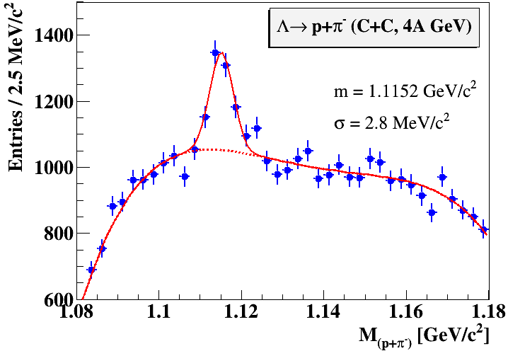
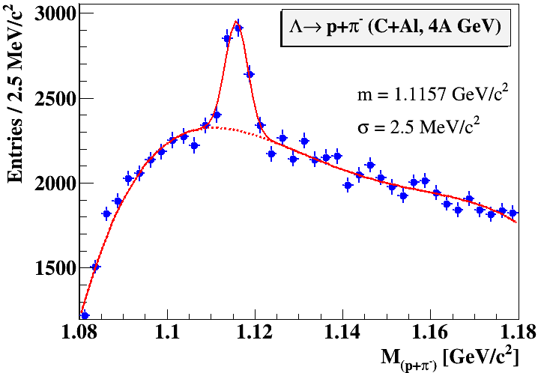
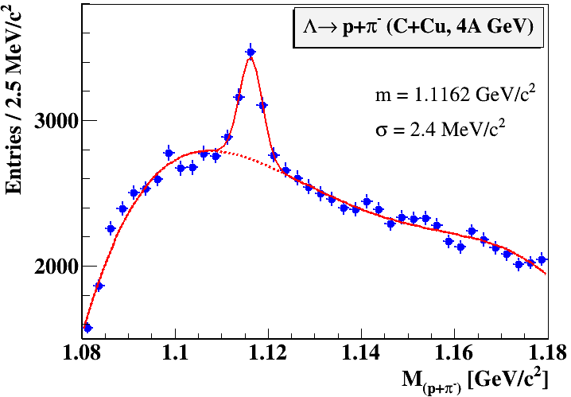
Λ-hyperon signals
Carbon beam, 4 GeV/n
C + C, Al, Cu → Λ + X minimum bias
Λ signal width 2.4 – 3 MeV
C+C: 4.6M triggers
C+Al: 5.3M triggers
C+Cu: 5.3M triggers
2.5 days of data taking

Slide 9
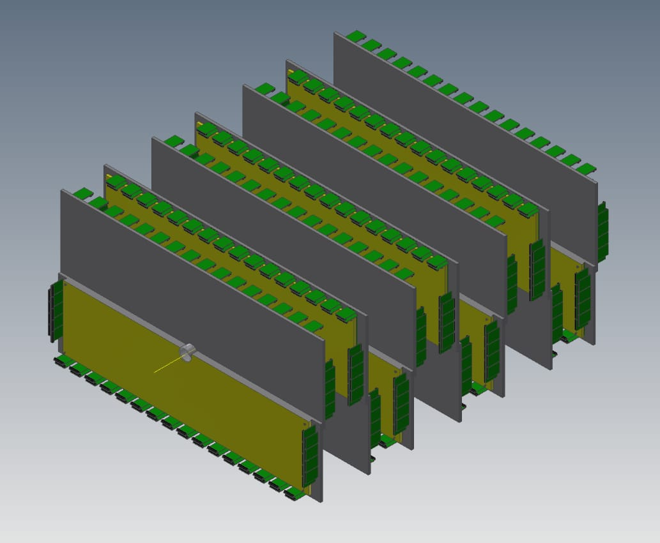
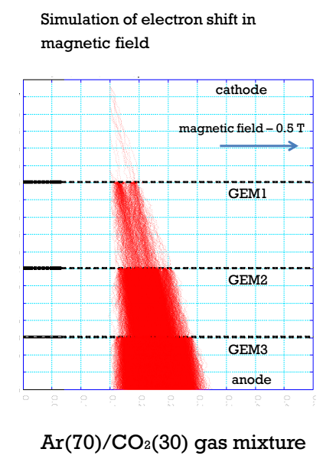
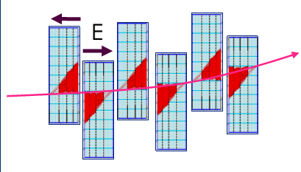
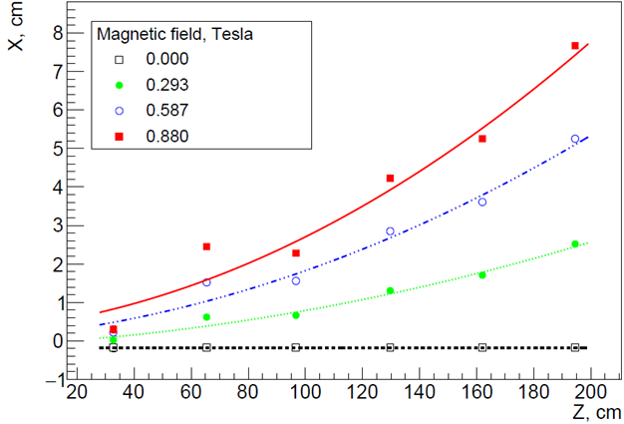
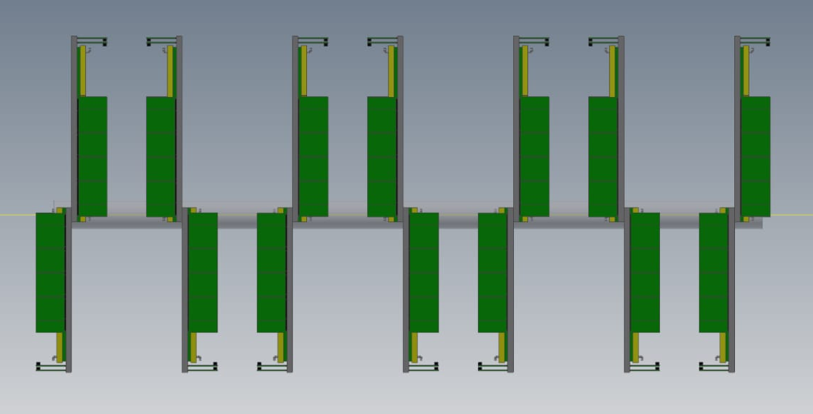
Scheme of the GEM full planes configuration
top
bottom
Lorentz shifts of an electron avalanche in GEM planes
On top - 7 detectors with active area 1632×450 mm²
On bottom - 7 detectors with active area 1632×390 mm²

Slide 10
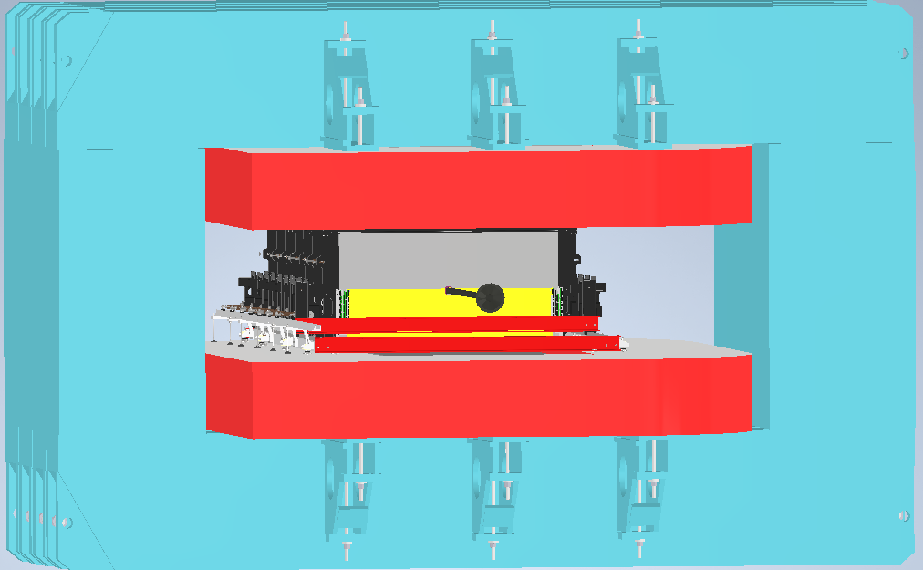
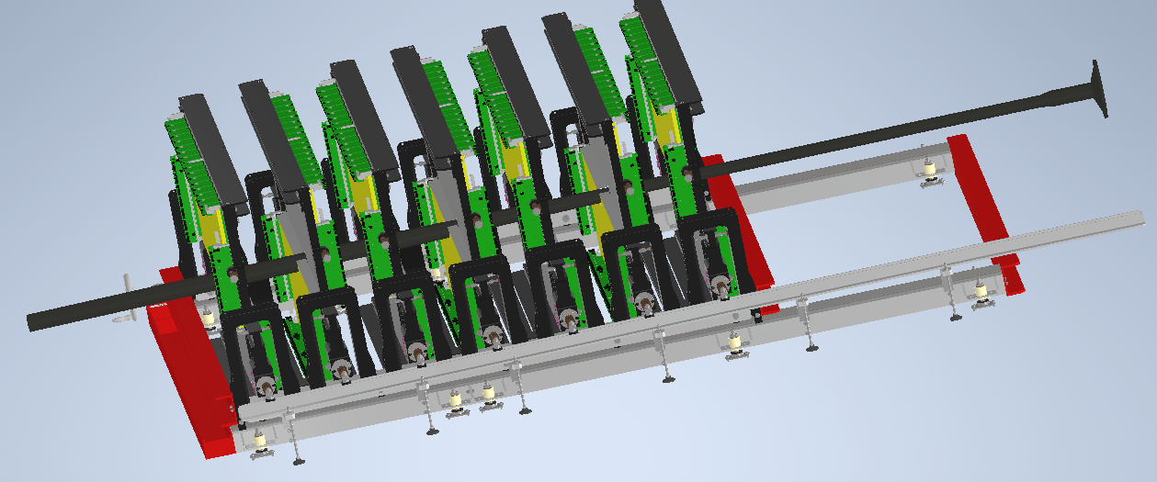
Full planes configuration inside the SP-41 magnet
Active area of the GEM tracking system is around 9.5 m²
Space for the installation and alignment
is limited by the aperture of our magnet
10.2020 – development
of the mechanics design for GEM planes inside the magnet.
2021 – mechanics production, installation of the GEM planes.

Slide 11
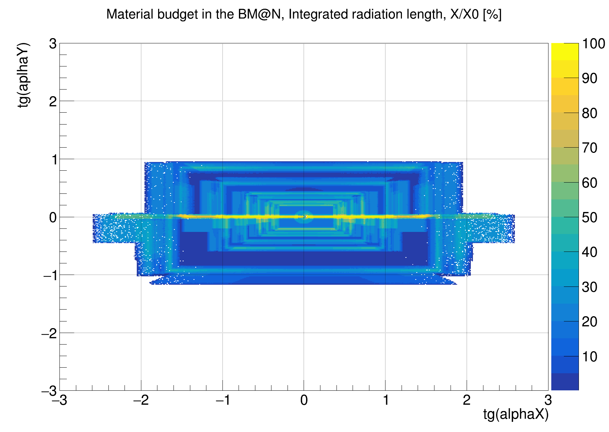
Material budget of the GEM central tracking system
full configuration
D. Baranov

Slide 12
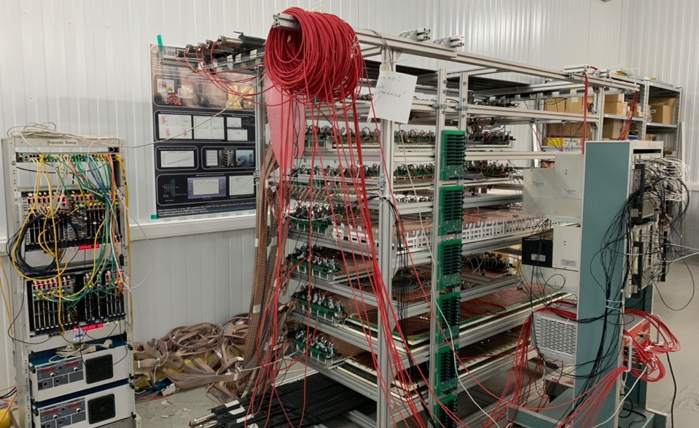
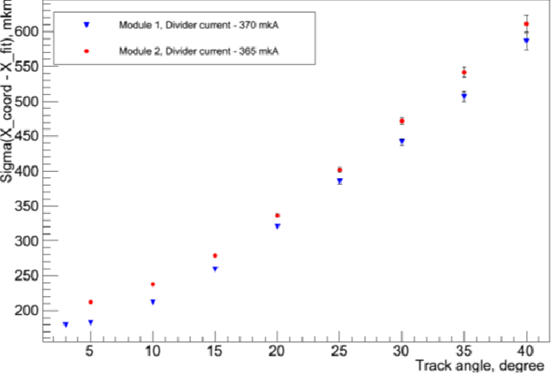
Assembly of the stand for long-term GEM tests
First stage – tests of 1632*390 mm² detectors, in progress
Second stage – tests of 1632*450 mm² detectors
Trigger and HV system
GEM detectors
DAQ system
Scintillation detectors
Main goals: to study geometrical efficiency and spatial resolution

Slide 13
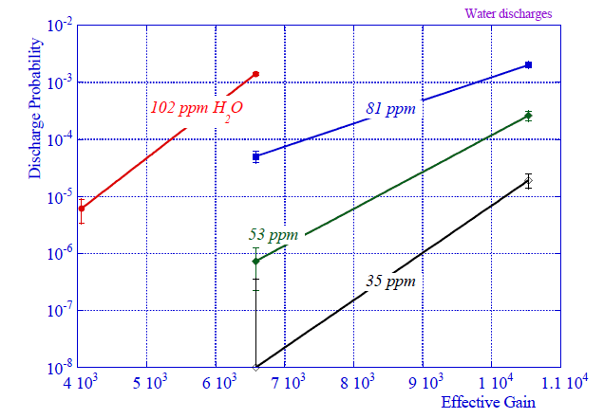
Gas system
Gas system requirements :
stable flow and mixture parameters;
7 independent channels to each GEM-plane;
reducing and control oxygen and moisture impurities in gas mixture;
Gas cylinders
Multichannel gas mixer
H₂0 and 0₂ filter
H₂0 and 0₂ analyzer
Distribution panel
GEM plane
H₂0 and 0₂ analyzer
Oil gate
For one channel
Oxygen analyze - GE oxy.IQ
Moisture analyze - GE dew.IQ+ GE IQ.probe
Discharge probability on alphas as a function of moisture level in the gas. COMPASS

Slide 14
Conclusions
7 detectors 1632×450 mm² and 7 detector 1632×390 mm² are produced;
7 detectors 1632×450 mm² was tested at d, C, Ar, Kr ion beams;
2 spare detectors are waiting for the assembly at CERN;
High Voltage and Low Voltage systems are ready;
Gas system is under upgrade;
Mechanics for GEM-planes inside the magnet has been developed;
Assembling the stand for testing the GEM-detectors with cosmic rays has been finished;
Tests of 1632*390 mm² detectors with cosmic rays are in progress.
Deadline – autumn 2021

Slide 15
Back up slides

Slide 17
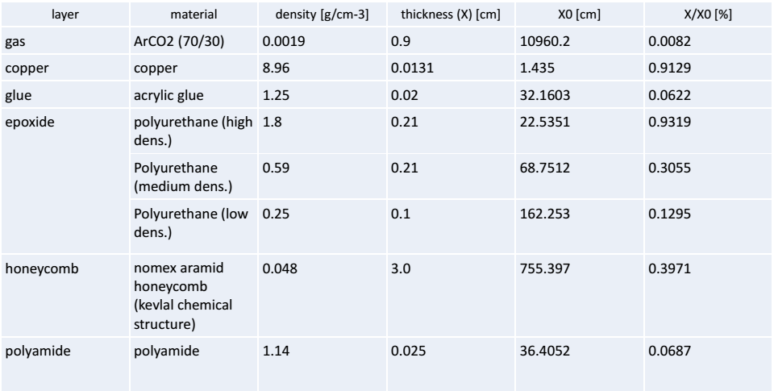
Material budget of one Gem detector

Slide 18
GEM HV divider scheme
50 kΩ
1.05 MΩ
820 kΩ
1.3 MΩ
780 kΩ
1.5 MΩ
740 kΩ
1.28 MΩ
HV
2000 pF
490 mkA – working point for Ar (70) + CO₂ (30) gas mixture
370 mkA – working point for Ar (90) + Isobutane (10) gas mixture
430 mkA – working point for Ar (80) + Isobutane (20) gas mixture
Mixture | I, mkA | DR, kV/cm | Gem 1, V | TR1, kV/cm | Gem 2, V | TR2, kV/cm | Gem 3, V | IND, kV/cm
Ar (70) + CO₂ (30) | 490 | 1.17 | 402 | 2.58 | 382 | 3.68 | 363 | 4.18
Ar (90) + C₄H₁₀ (10) | 370 | 0.88 | 303.4 | 1.92 | 288.6 | 2.78 | 273.8 | 3.16
Ar (80) + C₄H₁₀ (20) | 430 | 1.5 | 352.6 | 2.24 | 335.4 | 3.23 | 318.2 | 3.67

Slide 19
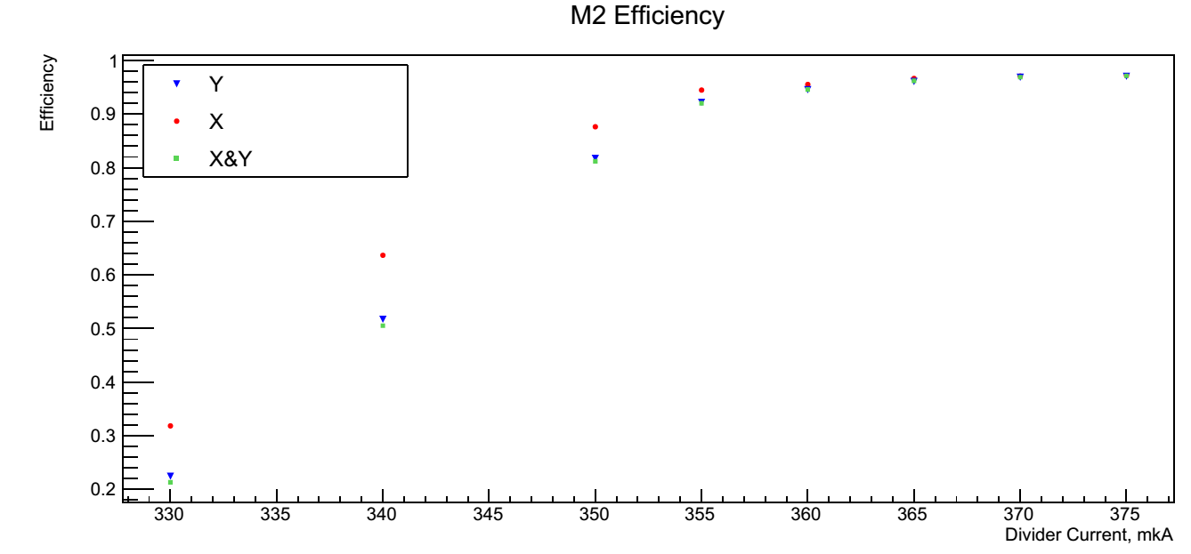
GEM efficiency (cosmic tests)
GEM Efficiency

Slide 20
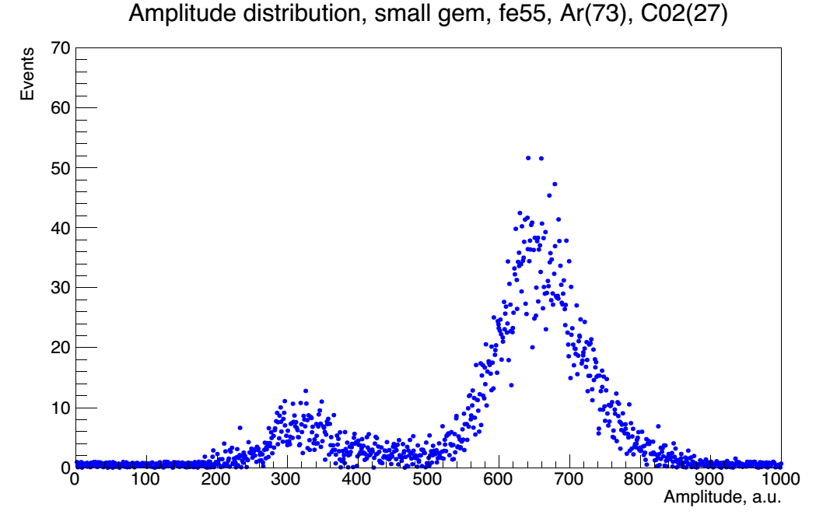
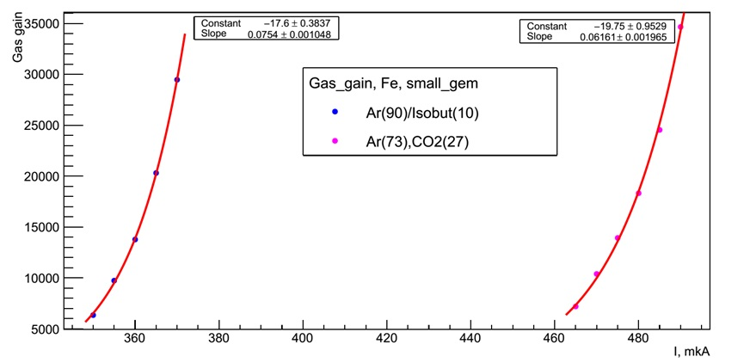
GEM gas gain measurements
Fe⁵⁵
Experimental
scheme
cathode
Gem1
Gem2
Gem3
Discr.
Trigger
anode
ADC
Amplitude distribution, Ar(70)/CO2(30), Fe⁵⁵
GEM gas gain for Ar(70)/CO2(30) and Ar(90)/Isobutane(10) gas mixtures

