Slide 1

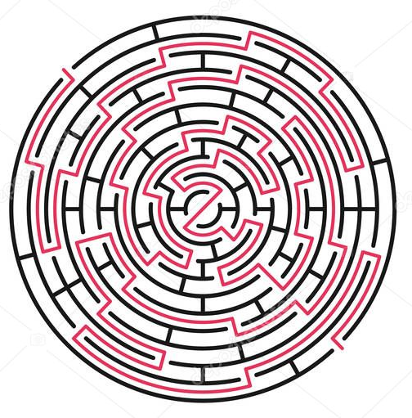

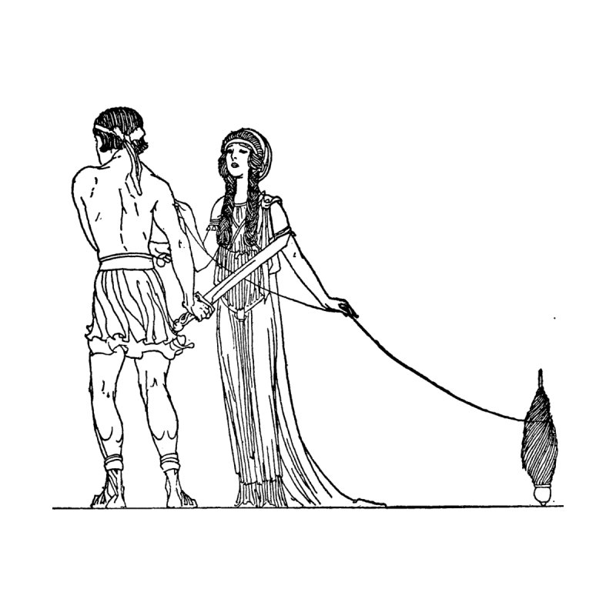
Ariadne: PyTorch Library for Particle Track Reconstruction Using Deep Learning
The reported study was funded by RFBR according to the research project № 18-02-40101
ARIADNE
Pavel Goncharov, Egor Schavelev, Anastasia Nikolskaya, Gennady Ososkov
Joint Institute for Nuclear Research, Saint Petersburg State University

Slide 2
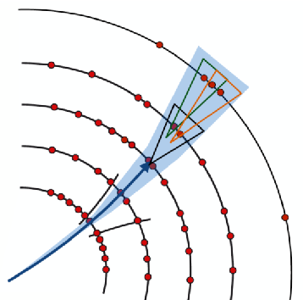
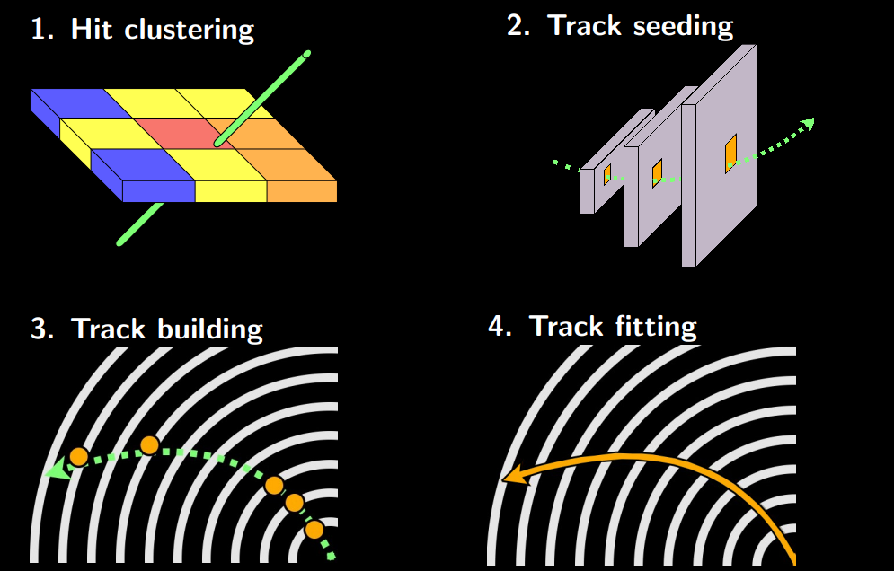
Tracking is our main focus
Tracking or track finding is a process of reconstruction the particle’s trajectories in high-energy physics detector by connecting the points – hits – that each particle leaves passing through detector’s planes.
Tracking includes track seeding and track building phases.
2
15.12.2020
P.Goncharov et al., Ariadne, AYSS-2020

Slide 3
Dream team of tracking
Data Science team
Team is growing!
Gennady Ososkov
Pavel Goncharov
Egor Schavelev
Anastasia Nikolskaya
Ekaterina Rezvaya
NEC-2017
JINR student practice
Physicists kernel
BES-III experiment
Nowadays
JINR Summer school
Dmitry Baranov
Aleksey Zhemchugov
Igor Denisenko
Yuri Nefedov
Olga Bakina
NEC-2019
CHEP-2018
Grants management
Andrey Nechaevskiy
3
15.12.2020
P.Goncharov et al., Ariadne, AYSS-2020

Slide 4
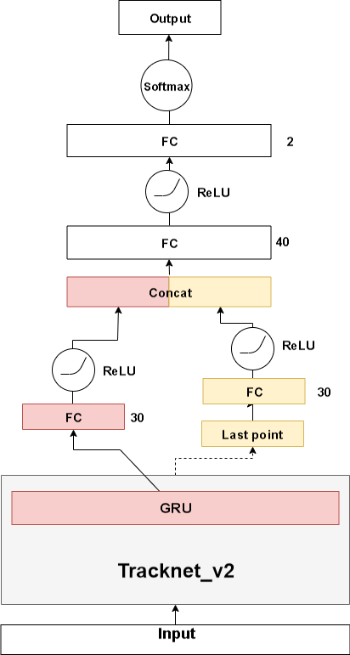
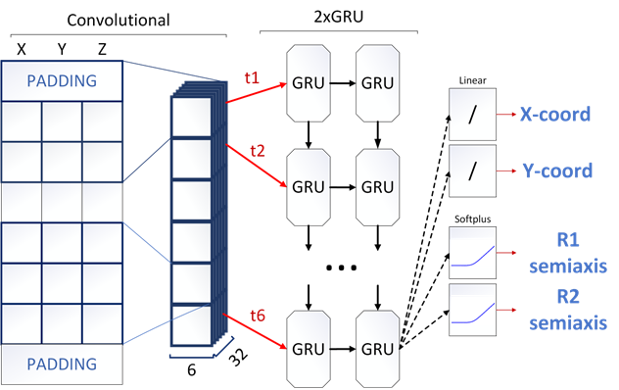
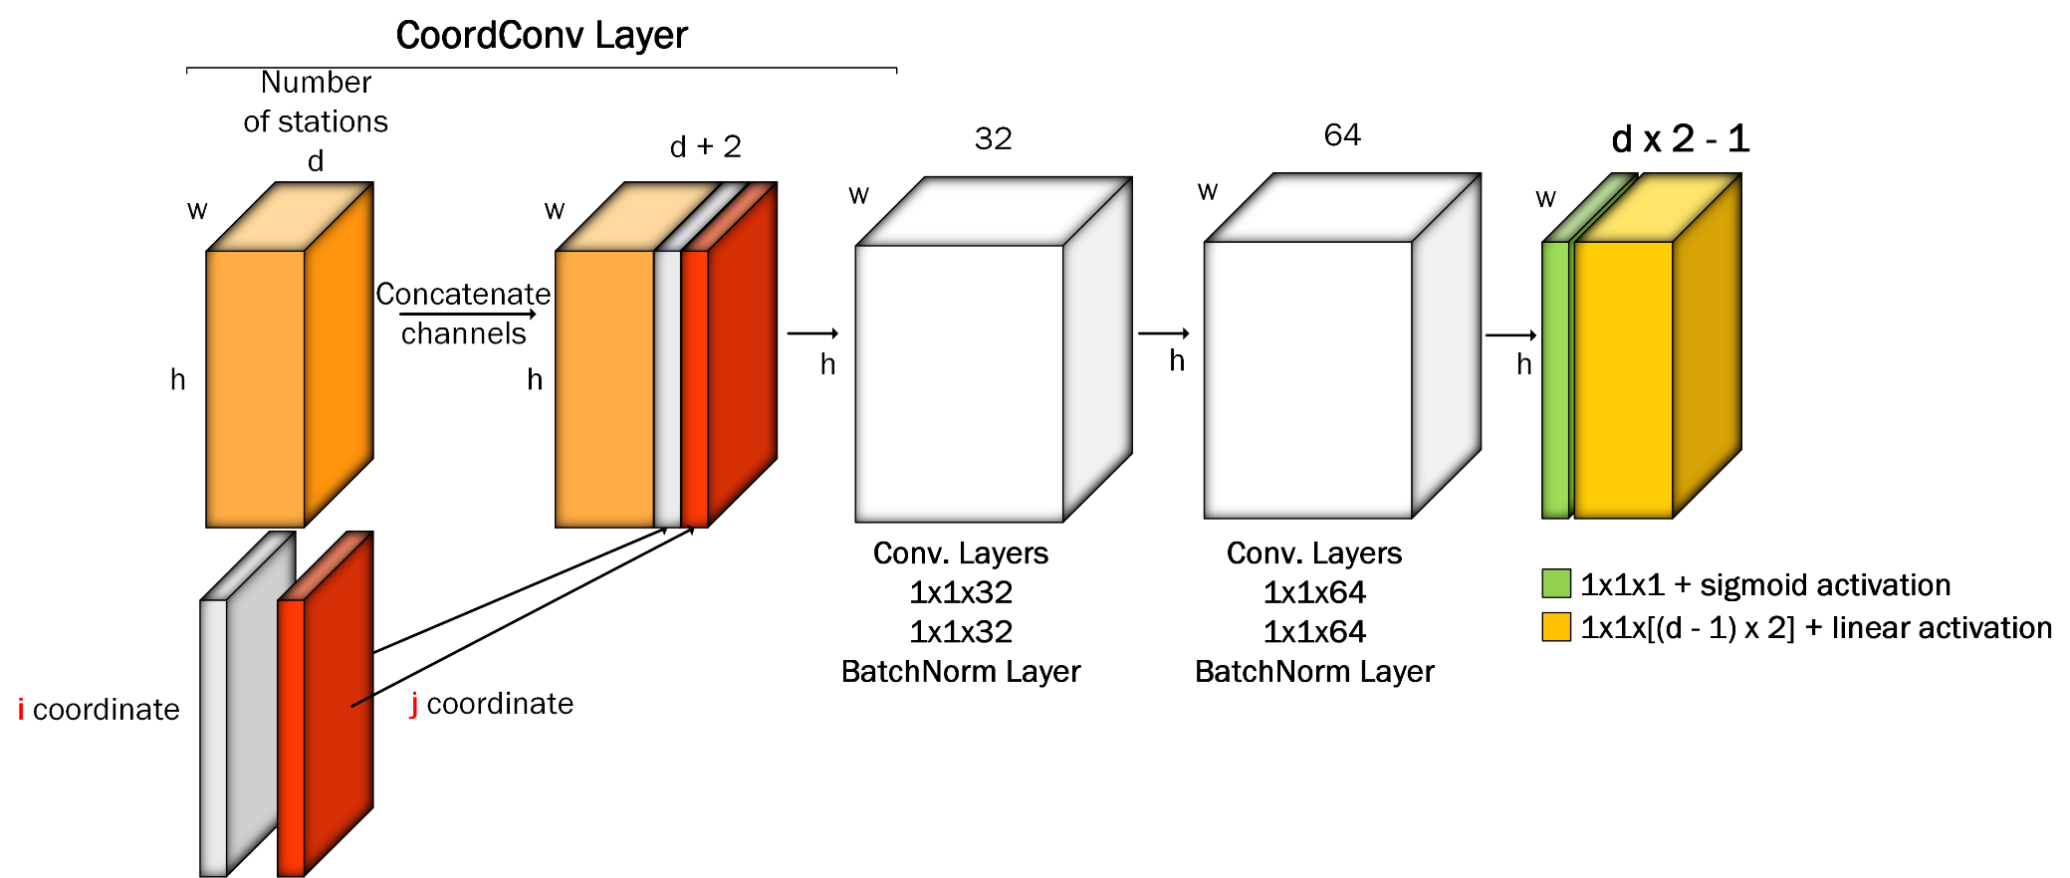
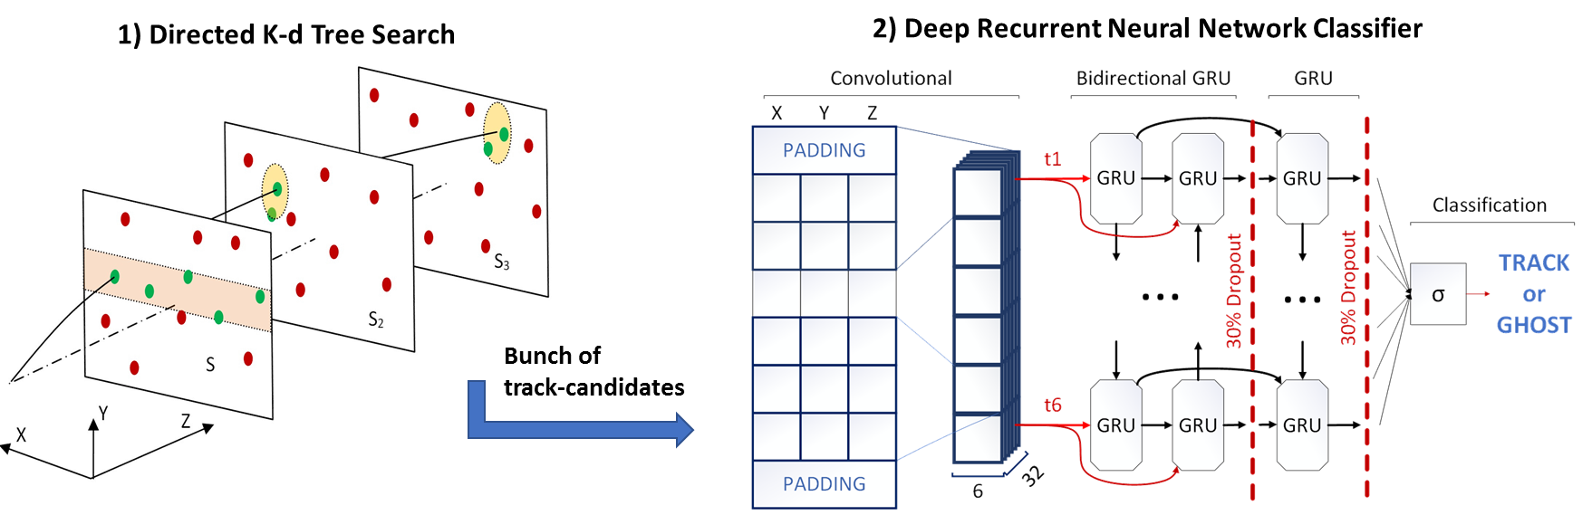
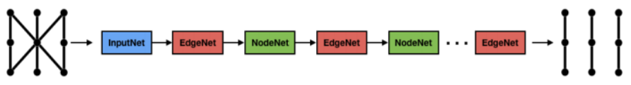
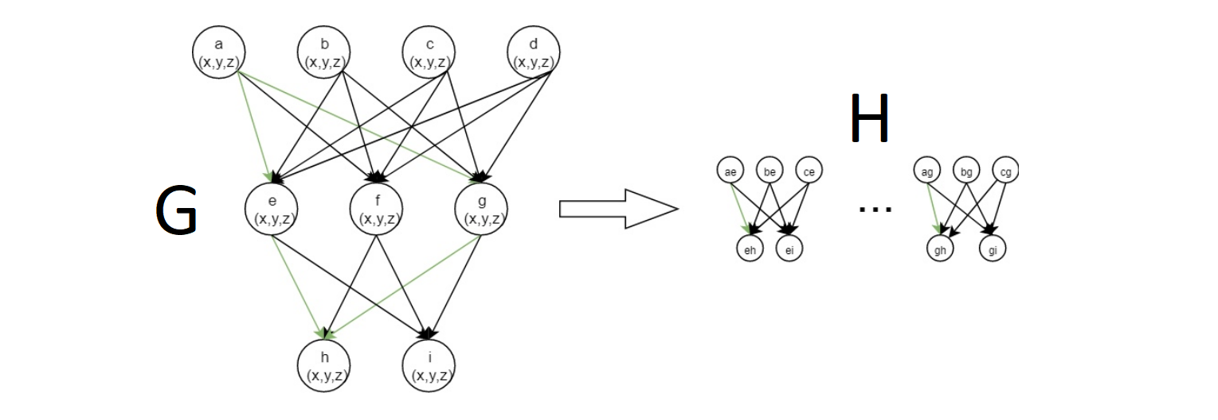
More and more models each time
4
15.12.2020
P.Goncharov et al., Ariadne, AYSS-2020

Slide 5
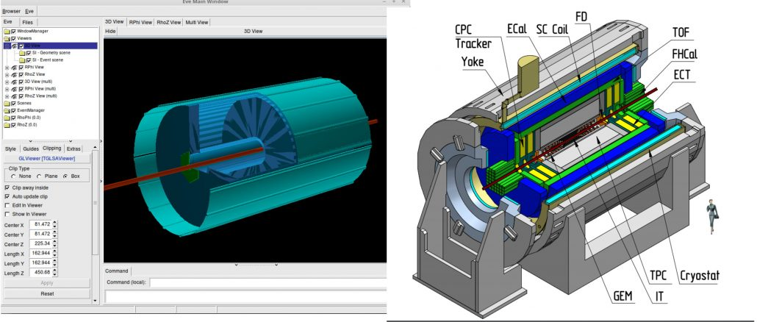
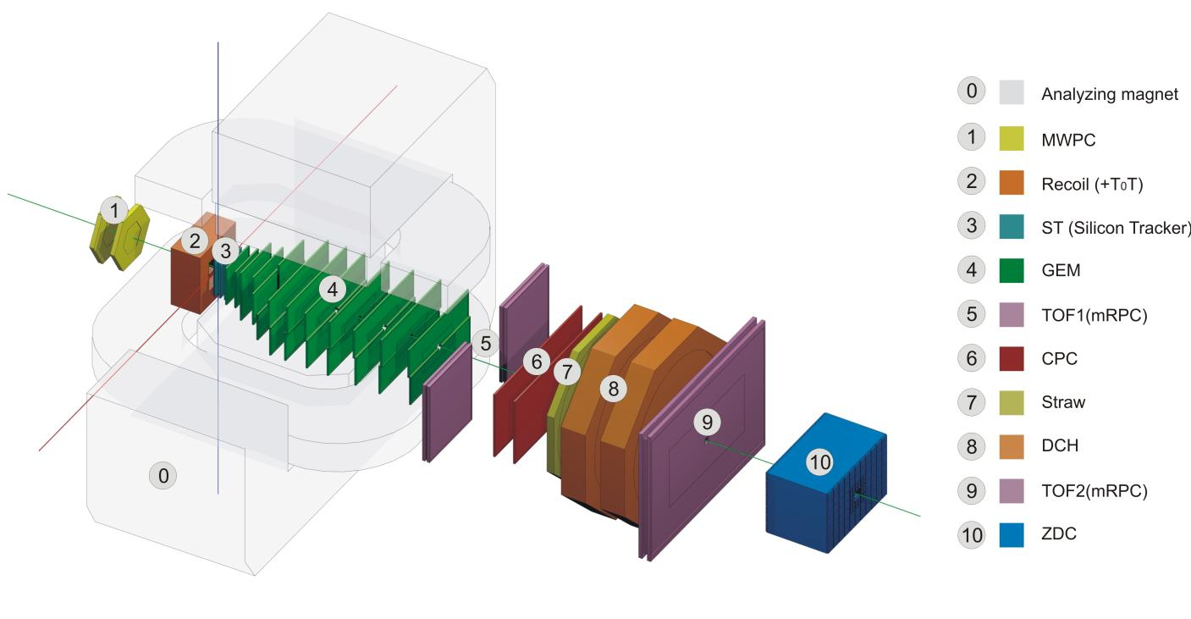
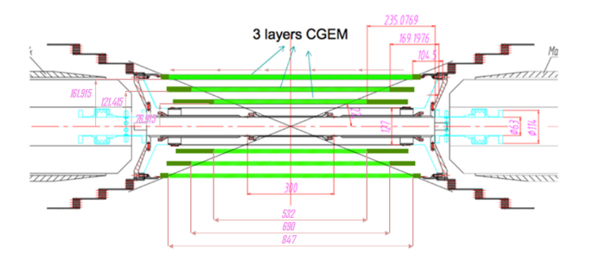
Same for experiments
MPD in the end ???
Baryonic Matter at Nuclotron (BM@N)
BESIII
5
15.12.2020
P.Goncharov et al., Ariadne, AYSS-2020

Slide 6
How to become the master of chaos
The problem is that all these models have:
  data preprocessing
  training skeleton
  metrics
Moreover, they are:
Separated in different github repositories
with different freshness code (two-step approach became legacy almost a hundred years ago)
Even with different deep learning backends (Old TensorFlow vs Keras vs TF 2.0 vs PyTorch)
Therefore, it is very difficult to keep all the repositories fresh and compare methods for equal criteria.
Besides, it seems almost impossible that any physicist will understand how to apply the proposed methods to his problem and data.
SAME
6
15.12.2020
P.Goncharov et al., Ariadne, AYSS-2020

Slide 7
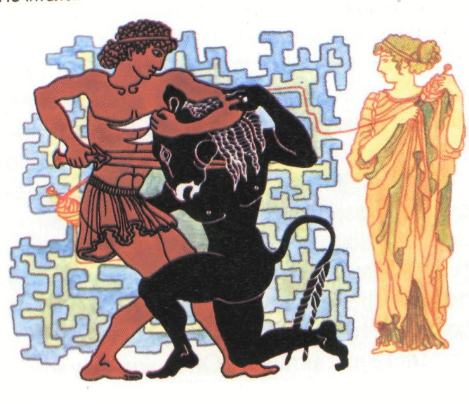
Here Ariadne appears on the stage
Our goal is to create the first open-source library for particle tracking based on deep learning methods.
We named it Ariadne in fame of Ariadne's thread which means the path leading to the goal in difficult conditions as in the tracking process.
Library should
provide a simple interface that allows one to prepare his data
implement all our best models with ability to train them on an arbitrary tracking task
have a modular structure and abstract classes simplifying the process of developing custom model and data processing pipeline
include the system of configuration files for fast reproducing of the experiments with 100% reproducibility
be open-sourced to facilitate academic research in the field of particle tracking based on deep learning
Also, our wish list includes many other small points:
multi-GPU training
hyperparameters optimization
metrics logging
multiprocessing for data preparation
etc.
ARIADNE
7
15.12.2020
P.Goncharov et al., Ariadne, AYSS-2020

Slide 8

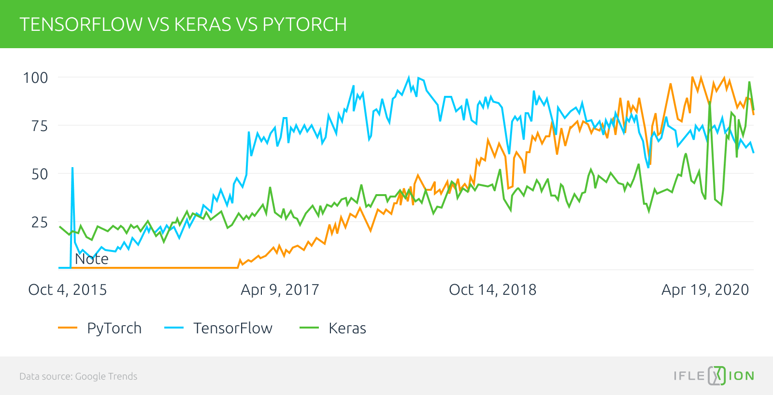
Ariadne is PyTorch-based
We have chosen PyTorch as a base deep learning framework for our library because
until recently (TF 2.3) tensorflow didn’t have full reproducibility on GPUs
pytorch Datasets much more convenient and flexible in our opinion than tf.data.Dataset
at this time researches prefer pytorch, so most of the novel models appear in pytorch at first
8
15.12.2020
P.Goncharov et al., Ariadne, AYSS-2020

Slide 9

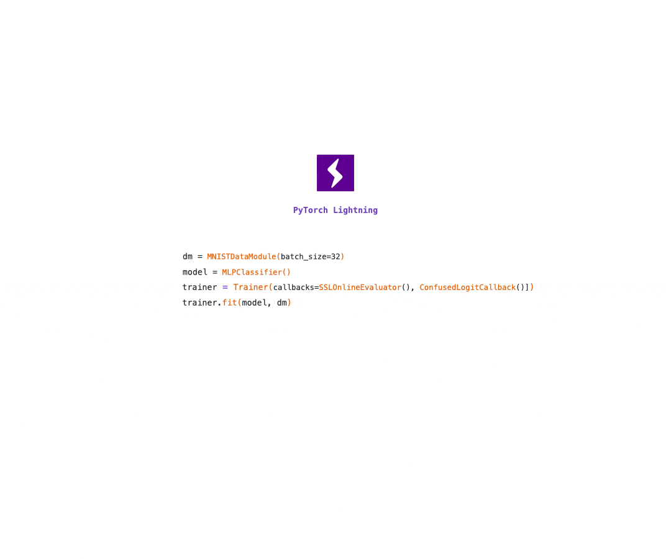

PyTorch Lightning as a core of training
PyTorch Lightning is a lightweight PyTorch wrapper for high-performance AI research as stated on its github.
Lightning helps you to disentangle code to make it more readable, flexible and suitable for testing.
We created a special class TrainModel which is actually a Lightning module to extend the functionality of simple pytorch code with Lightning features:
full reproducibility
checkpoining
callbacks
metrics logging
multi-GPU training
TPU training
learning rate schedulers
batch size optimization
etc.
11
15.12.2020
P.Goncharov et al., Ariadne, AYSS-2020

Slide 10
Data Preparation
For the data preparation step we introduce transformations that allow us to:
translate coordinates into another system, e.g. cartesian to cylindrical
filter out inapplicable tracks or events
normalize and rescale features to be in an unit variance
At the moment, we have a plenty of transformations:
StandardScale
MinMaxScale
Normalize
ConstraintsNormalize
DropShort
DropSpinningTracks
DropFakes
ToCylindrical
ToCartesian
ToBuckets
Also we can compose multiple transformations in one block for convenience
self.transformer = Compose([
DropFakes(),
DropSpinningTracks(),
DropShort(),
ToCylindrical(),
ConstraintsNormalize(
use_global_constraints=False,
constraints=radial_stations_constraints,
columns=('r', 'phi', 'z')
),
])
10
15.12.2020
P.Goncharov et al., Ariadne, AYSS-2020

Slide 11
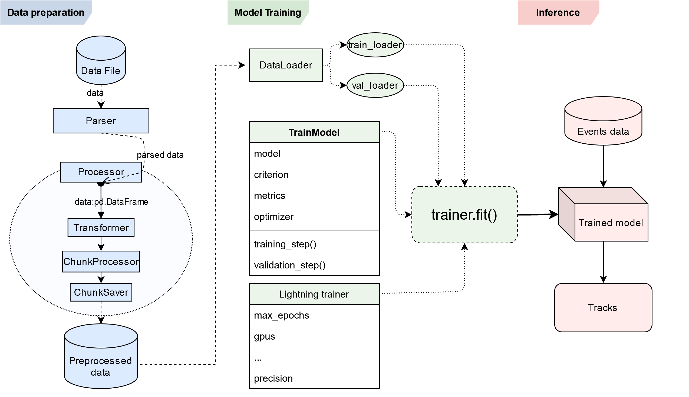
Ariadne’s components
9
15.12.2020
P.Goncharov et al., Ariadne, AYSS-2020

Slide 12

System of configuration files
Example
To allow the users to reproduce our experiments and setup their own easily we introduce a structure of configuration files, consisting of:
train configs
data preparation configs
inference/evaluation configs
Standard Python ArgumentParser is not very flexible so we decided to utilize gin-configs.
Gin-config opens an opportunity to specify the whole classes with their arguments inside a configuration file, so in future all the users of our library will be able to “program” any training from scratch using Ariadne modules and such approach requires no knowledge of Python.
### experiment setup ###
experiment.model = @TrackNETv2
experiment.criterion = @TrackNetLoss
experiment.metrics = [@ellipse_area, @efficiency]
experiment.optimizer = @Adam
experiment.data_loader = @TrackNetV2DataLoader
experiment.epochs = 20
experiment.fp16_training = False
experiment.random_seed = 42
### model ###
TrackNETv2.input_features = 3
TrackNETv2.conv_features = 32
TrackNETv2.rnn_type = 'gru'
TrackNETv2.batch_first = True
### data ###
TrackNetV2DataLoader.batch_size = 16
TrackNetV2DataLoader.dataset = @TrackNetV2Dataset
TrackNetV2DataLoader.max_size = 10000
TrackNetV2DataLoader.valid_size = 0.3
TrackNETv2 is a class inherited from pytorch.Module
12
15.12.2020
P.Goncharov et al., Ariadne, AYSS-2020

Slide 13
Run training in the HybriLIT
As we are working on the base of Laboratory of Information Technologies we want to be able to run all our scripts in the HybriLIT’s environment and especially on the GOVORUN supercomputer.
We added several scripts in the ‘scripts/hydra’ path for that purpose. So now you don’t need to build an environment, download dependencies and manage conflicts between libraries versions. We created two configurations of conda environments – for gpu and cpu usage.
For example, to execute training script on the GPU queue of hydra cluster:
Verify that the miniconda has installed in the ~/miniconda3 or manually change the path in the script you want to execute. Run with source ~/miniconda3/etc/profile.d/conda.sh command
Run scripts/hydra/hydra_gpu.sh script:
The slurm-jobid.out file with stdout will appear in the root directory.
For more details see the README in the https://github.com/t3hseus/ariadne repository.
13
15.12.2020
P.Goncharov et al., Ariadne, AYSS-2020

Slide 14

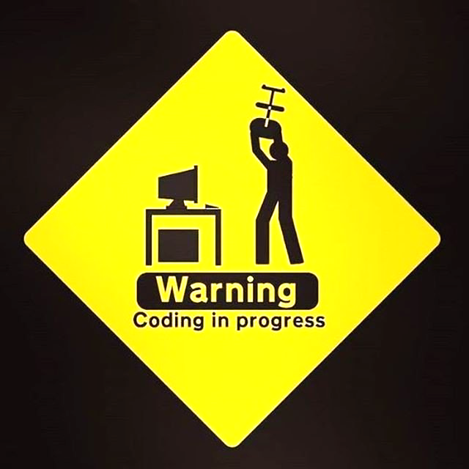
Inference
14
15.12.2020
P.Goncharov et al., Ariadne, AYSS-2020

Slide 15
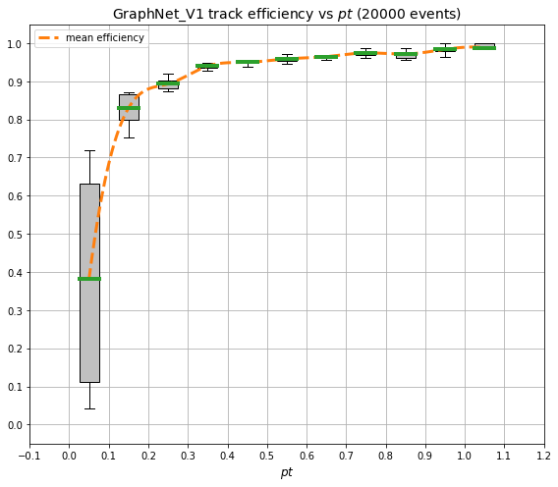
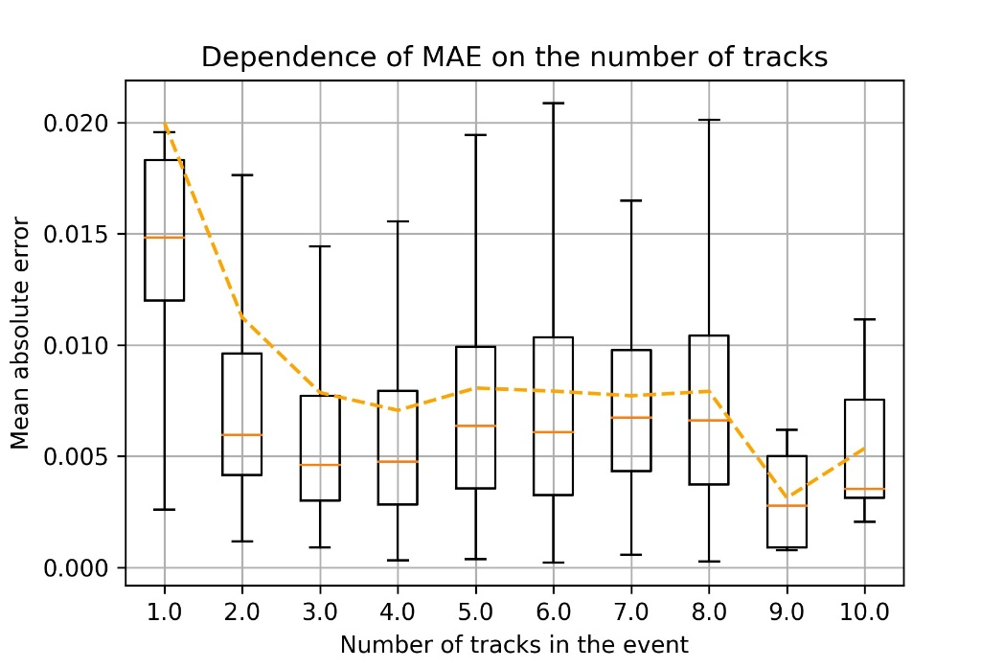
Intermediate results
This is not the last chapter of our Ariadne's history, but we have already achieved some results:
most of the code for training is completed, however it requires a refactoring
data preparation pipeline for the TrackNETv2, GraphNet and LOOT models on the BESIII data was made
three models – TrackNETv2, GraphNet, and LOOT for vertex finding have already been trained using Ariadne
models were trained using HybriLIT cluster
GraphNet track reconstruction
Primary vertex recognition with LOOT
15
15.12.2020
P.Goncharov et al., Ariadne, AYSS-2020

Slide 16

Ariadne: PyTorch Library for Particle Track Reconstruction Using Deep Learning
The reported study was funded by RFBR according to the research project № 18-02-40101
ARIADNE
Ariadne Github:
Pavel Goncharov, Egor Schavelev, Anastasia Nikolskaya, Gennady Ososkov
Joint Institute for Nuclear Research, Saint Petersburg State University

