Slide 1
Detection of clustered DNA Damage in Mammalian Cells Induced by Ionizing Radiation with Different Physical Characteristics
Laboratory of radiation biology JINR
Dubna State University
Regina Kozhina, V.N. Chausov, E.V. Ilyina, E.A. Kuzmina, S.I. Tiounchik
Scientific supervisor: D.Sc. A.V. Boreyko
XXIII International Scientific Conference of Young Scientists and Specialists (AYSS-2020)

Slide 2
DNA Damage in Neuronal Cells
Genomic instability
Genetic alterations
Carcinogenesis
Chronic inflammation
Immune response
Functional disorders
Neurodegeneration
Cell injury
Cell death

Slide 3
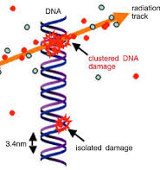
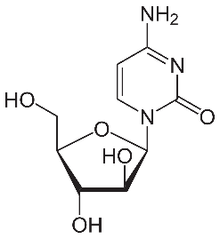
Aim & Goals
The main aim:
study ionizing radiation effects on the neuronal mammalian cells
Comprehensively study the radiation-induced DNA damage complexity
Research the effect of DNA synthesis inhibitor (AraC) on DNA damage formation and repair processes
Provide a comparative analysis of biological effectiveness of ionizing radiation with different physical characteristics (low- and high- LET radiation)
Compare the DNA damage yield after exposure to ionizing radiation in vivo & in vitro
AraC

Slide 4
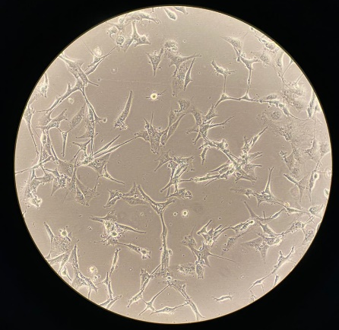
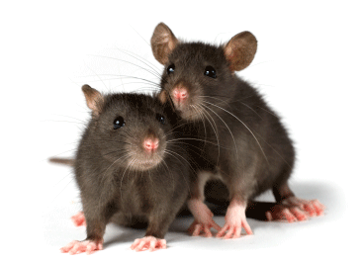
Research Objects
accelerated ¹⁵N ions (LET = 85 keV/µm)
in vitro
⁶⁰Co γ-rays
in vivo
Human U87 glioblastoma cells
Mice hippocampal cells (C57Bl)
hippocampus
Rat hippocampal neuronal cell culture (Sprague Dawley)
Rat hippocampal cells (Sprague Dawley)
Notes:
Glioblastoma is an aggressive cancer that can occur in the brain or spinal cord. Glioblastoma forms from cells called astrocytes, which support nerve cells.

Slide 5
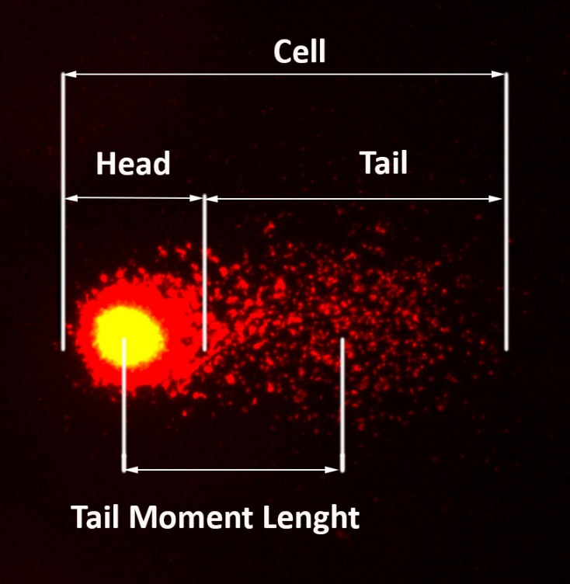
Comet Assay

Slide 6
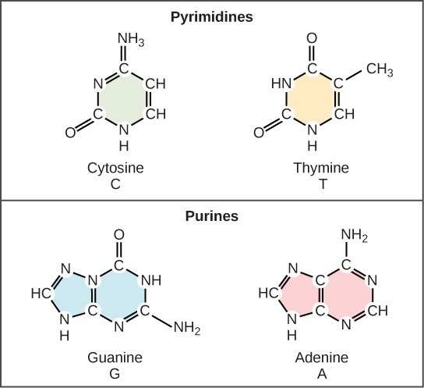
Enzyme Treatment
Endo III recognizes oxidized pyrimidines
Fpg is specific for oxidized purines and otherring-opened purines

Slide 7
Induction of DNA Damage in Hippocampal Cells of Mice After Exposure to γ-rays ⁶⁰Co in vivo
$k=18.$0
$$k=16. 2$$
$$k=14. 6$$
$$k=4. 7$$
$$k=4. 1$$
$$k=1. 3$$
$$\frac{SSB+Endo III}{SSB}=1.1$$
$$\frac{DSB +Endo III}{DSB}=3.2$$
$$\frac{DSB+Fpg}{DSB}=3.6$$
$$\frac{SSB+Fpg}{SSB}=1.2$$
Notes:
Сказать про недостоверное отличие

Slide 8
Induction of DNA Damage in Hippocampal Rat Culture After Exposure to Accelerated ¹⁵N Ions
$$k=18. 6$$
$$k=15. 8$$
$$k=13. 1$$
$$k=10. 8$$
$$k=9. 2$$
$$k=4. 4$$
$$\frac{SSB+Fpg}{SSB}=2.0$$
$$\frac{DSB+Fpg}{DSB}=3.0$$
$$\frac{SSB+Endo III}{SSB}=1.7$$
$$\frac{DSB+Endo III}{DSB}=2.5$$

Slide 9
Repair of DNA Damage in Hippocampal Rat Culture After Exposure to Accelerated ¹⁵N Ions

Slide 10
Induction of DNA Damage in U87 Cells After Exposure to Accelerated ¹⁵N Ions
$k=10.$5
$$k=9. 5$$
$$k=7. 9$$
$$k=6. 3$$
$$k=5. 7$$
$$k=1. 8$$
$$\frac{SSB+Fpg}{SSB}=1.3$$
$$\frac{DSB+Fpg}{DSB}=3.5$$
$$\frac{SSB+Endo III}{SSB}=1.2$$
$$\frac{DSB+Endo III}{DSB}=3.2$$

Slide 11
Repair of DNA Damage in U87 Cells After Exposure to Accelerated ¹⁵N Ions

Slide 12
Induction and Repair of DNA Damage in Hippocampal Cells of Rats After Exposure to ⁶⁰Co γ-rays
3 Gy
3 Gy
Mechanism of action of AraC

Slide 13
Conclusions
Dose-related increases in DNA SSB and DSB after enzymatic treatment (Endo III and Fpg) demonstrates that modified bases make an important contribution to clustered DNA damage formation after exposure to ⁶⁰Co γ-rays in vivo and accelerated ¹⁵N ions (LET = 85 keV/μm) in vitro;
Repair kinetics of clustered DNA damage have exponential character both in rat hippocampal cell culture and human U87 glioblastoma cells after exposure to accelerated ¹⁵N ions (LET = 85 keV/μm);
The number of DNA SSB and DSB in rat hippocampal neurons after Endo III and Fpg treatment dramatically outnumber the control level up until 24 h of post-radiation incubation;
The amount of DNA enzymatic lesions in human U87 glioblastoma cells comes close to control level after 24 h post-radiation incubation;
The level of unrepaired lesions even after 24 h remains almost 2-times higher than under normal conditions;
The significant contribution of enzymatic DNA damage is observed under the action of synthesis inhibitor that expands the total number of DNA damage in rat hippocampal cells after exposure to ⁶⁰Co γ-rays.

Slide 14
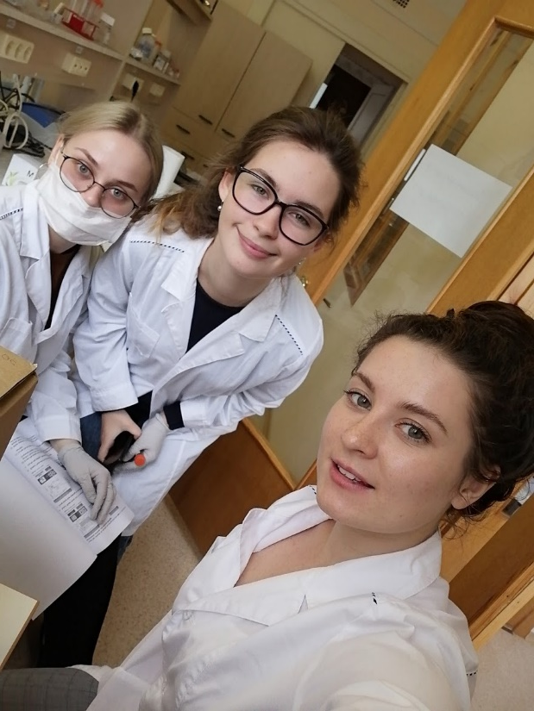
Thank you for your attention!
This work was supported by Moscow Region Governor's grant

Slide 15
Modifying effect of AraC in melanoma B16 cells after exposure to protons (10 Gy)
2 days after irradiation
10 days after irradiation

