Slide 1
Study of magnetic core-shell type nanoparticles for drug delivery system in cancer treatment
Supervisor from JINR - Chudoba D.M.
Supervisor from ENU - Kozlovskiy A.L.
Junior researcher in FLNP, JINR (Russia),
2nd year PhD-student at Eurasian National University (Kazakhstan)
Assel Nazarova

Slide 2
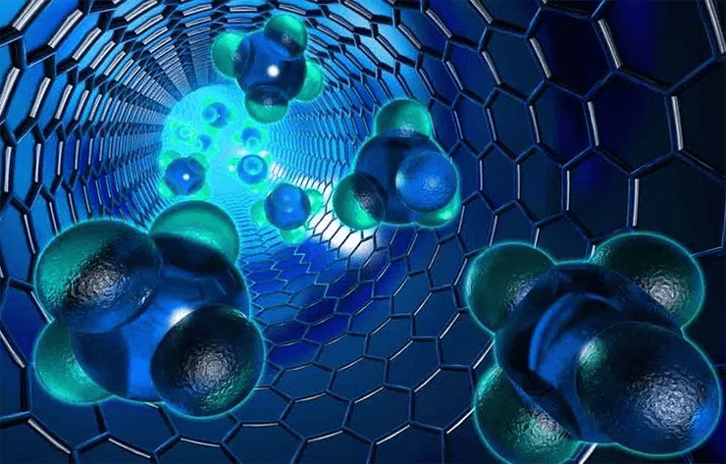
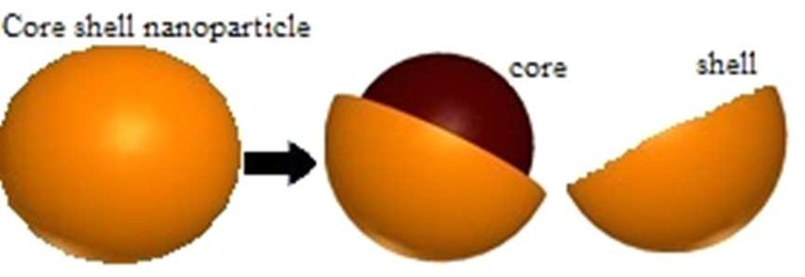
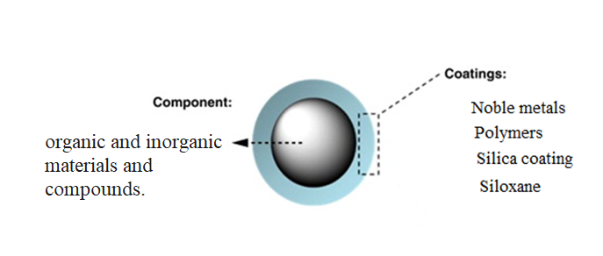
NANOparticles rushing to the rescue

Slide 3
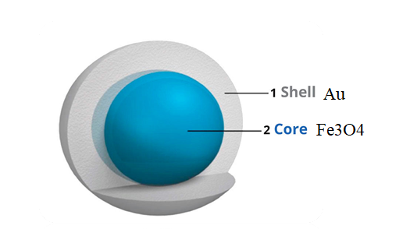
Fe₃O₄@Au core–shell nanoparticles
Iron oxide:
Superparamagnetism
high magnetic susceptibility
low Curie temperature
no coercivity value
Gold:
Biocompatibility
chemical stability
low cytotoxicity
Combining several different properties into a single material is a key feature of multicomponent materials. Unlike single component material, multicomponent materials including two or more different materials inherit respective properties from their individual component, and they have unique multifunctional characteristics.

Slide 4
The purpose of the work:
The main aim of the current study is to carry out synthesis and modification of magnetic nanostructures of the “core-shell” type based on Fe₃O₄ @Au in drug delivery system for bio-application.
The main tasks of the work:
• Study of the synthesis and characterization of "core-shell" type nanoparticles;
• Study of the physical/chemical properties and cytotoxicity of the synthesized nanoparticles;
• Study of structural transformations as a result of external influences.

Slide 5
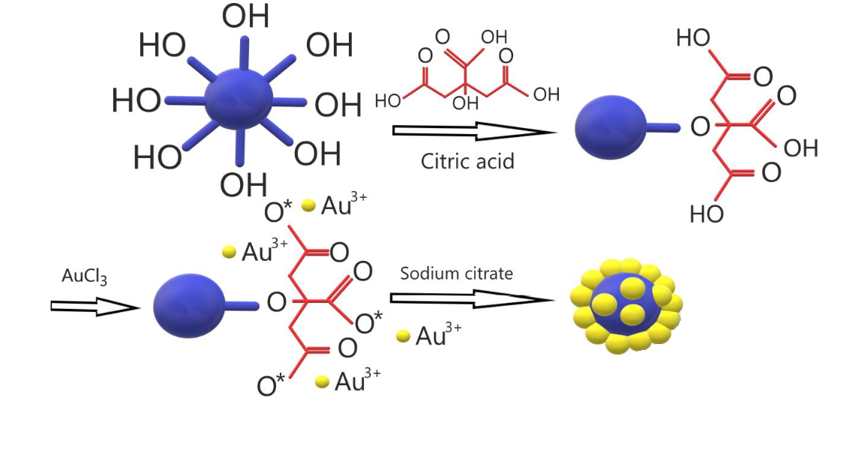
Synthesis of Fe₃O₄ nanoparticles
FeCl₂ + 2FeCl₃ + 8NH₃ H₂O → Fe₃O₄ + 8NH₄Cl + 4H₂O
Synthesis of “core-shell”nanoparticles:

Slide 6
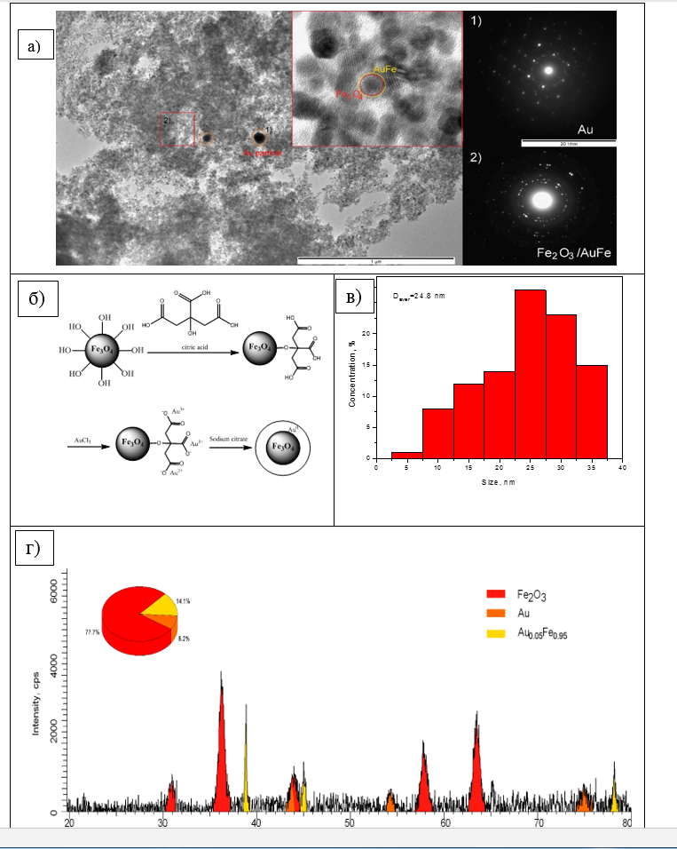
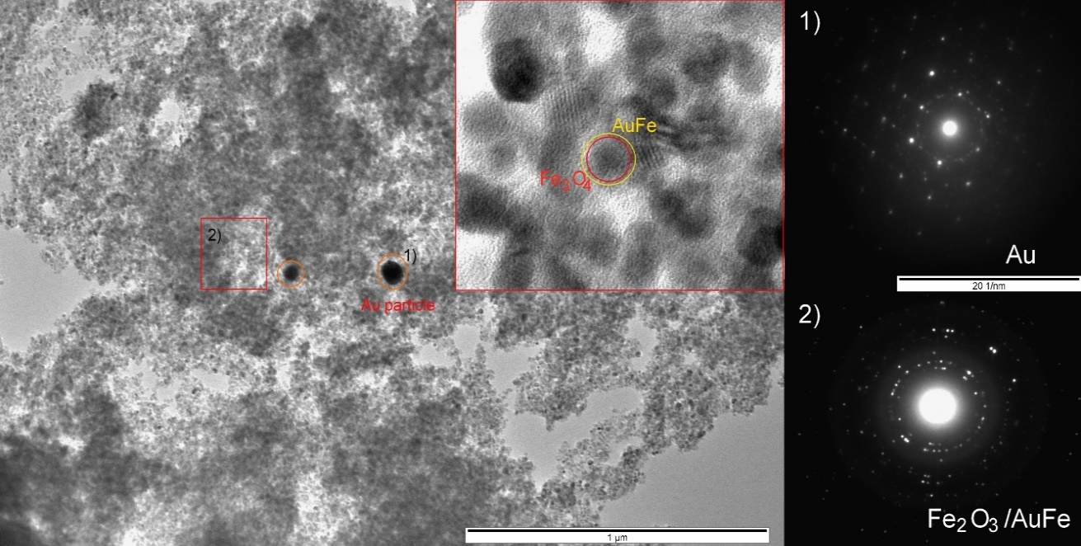
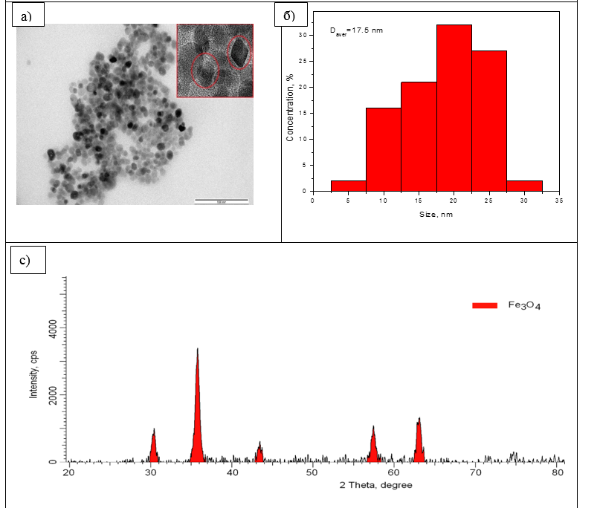
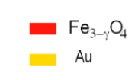
TEM, SEM, XRD
Cubic structure
Crystal lattice parameters
8.2188 Å
The average size of the crystallites 17.9±1.5 nm
Crystal lattice parameters
Au =5 Å
The average size of the crystallites 20-40 nm
Crystal lattice parameters
8.2188 Å
a) TEM images of the studied initial nanoparticles; b) nanoparticle size chart based on TEM data; c)X-ray diffraction pattern of nanoparticles
a)TEM images of the studied core-shell nanoparticles; b) Synthesis of “core-shell”nanoparticles; c) nanoparticle size chart based on TEM data; d)X-ray diffraction pattern of core-shell nanoparticles

Slide 7
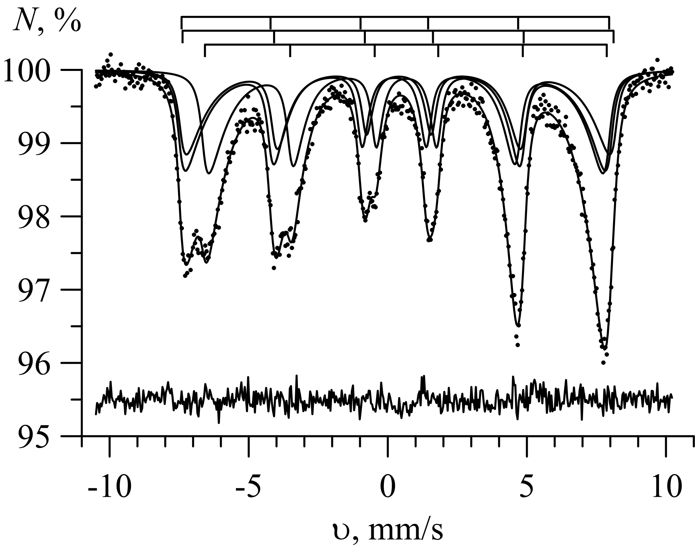
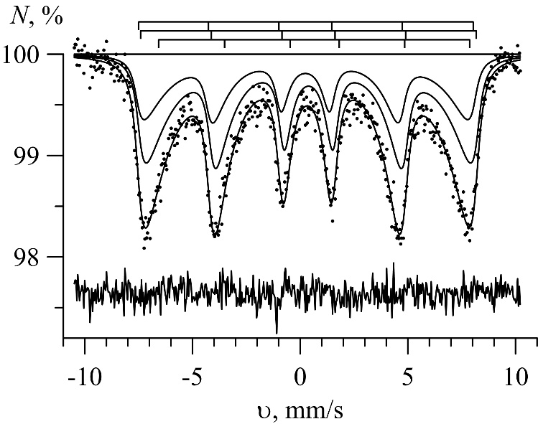
The result of Mössbauer spectrum
The result of fittingthe Mössbauer spectrum of 57Fe nuclei in oxide nanoparticles
The result of fitting the Mössbauer spectrum of 57Fe nuclei in gold coated oxide nanoparticles

Slide 8
Cytotoxicity of magnetite-based nanoparticles
Cytotoxic effect of Fe₃O₄ nanoparticles using different cells:
а) HeLa test; b) PC-3 test

Slide 9
Publications
2019 | Study of phase transformations, structural, corrosion properties and cytotoxicity of magnetite-based nanoparticles | A.L. Kozlovskiy, A.E. Ermekova, I.V. Korolkov, D. Chudoba, M. Jazdzewska, K. Ludzik, A. Nazarova, B. Marciniak, R. Kontek, A.E. Shumskaya, M.V.Zdorovets | VACUUM, ISSN:0042-207X, Изд:Elsevier B.V.. volume 163. 236-247.
2020 | Carboranes immobilization on Fe3O4 nanocomposites for targeted delivery | V.Korolkov, K.Ludzikc, A.L.Kozlovskiy, M.S.Fadeev, A.E.Shumskaya, Ye.G.Gorin, B.Marciniak, M.Jazdzewska. D.Chudoba, R.Kontek, A.Nazarova, V.S.Rusakov, M.V.Zdorovets | MATERIALS TODAY COMMUNICATIONS, ISSN:ISSN: 2352-4928, изд:elsevier. 101247. Volume 24
2020 | Stability and cytotoxicity study of NiFe2O4 nanocomposites synthesized by co-precipitation and subsequent thermal annealing | K.Egizbek, A.L.Kozlovskiy, K.Ludzik, M.V.Zdorovets, I.V.Korolkov, A.Nazarova, B.Marciniak, Jazdzewska M, D.Chudoba,, R.Kontek | CERAMICS INTERNATIONAL, ISSN:0272-8842, eISSN:1873-3956, Изд:Elsevier Science Limited. Volume 46. 16548-16555
2020 | Application of Fe 2 O 3 /CeO 2 nanocomposites for the purification of aqueous media | K. Egizbek, A. L. Kozlovskiy, K. Ludzik, M. V. Zdorovets, M. A. Ibragimova, D. Chudoba, A. Nazarova, B. Marciniak, M. Jazdzewska, R. Kontek | SPRINGER PROCEEDINGS IN PHYSICS, ISSN:0930-8989, Изд:Springer International Publishing. Volume 10.1007/s00339-020-03665-5. 477
2020 | Iron oxide @ gold nanoparticles: Synthesis, properties and potential use as anode materials for lithium-ion batteries | Maxim Fadeeva, Artem Kozlovskiy, Ilya Korolkov, Kamila Egizbek, Dorota Chudoba, Assel Nazarova, Vyacheslav Rusakov, Maxim Zdorovets | COLLOIDS AND SURFACES A: Physicochemical and Engineering Aspects, ISSN:0927-7757, eISSN:1873-4359, Изд:Elsevier Science Limited. Volume 603

Slide 10
Tasks for 2021
-Investigation of structural transformations of Fe₃O₄ with gold with various temperature influences
Conducting neutron diffraction experiments on the High Resolution Fourier Diffractometer (HRFD) at the IBR-2 reactor
-It is planned to publish the results of this research work in Journals with Impact Factor

