Slide 1
MiniSPD Stand
RT-relations calculation progress

Slide 2
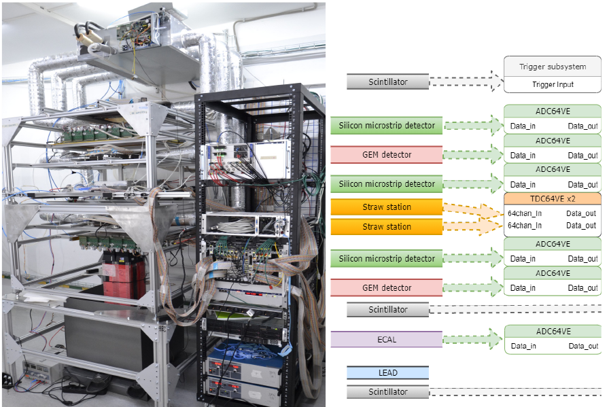
MiniSPD Stand

Slide 3
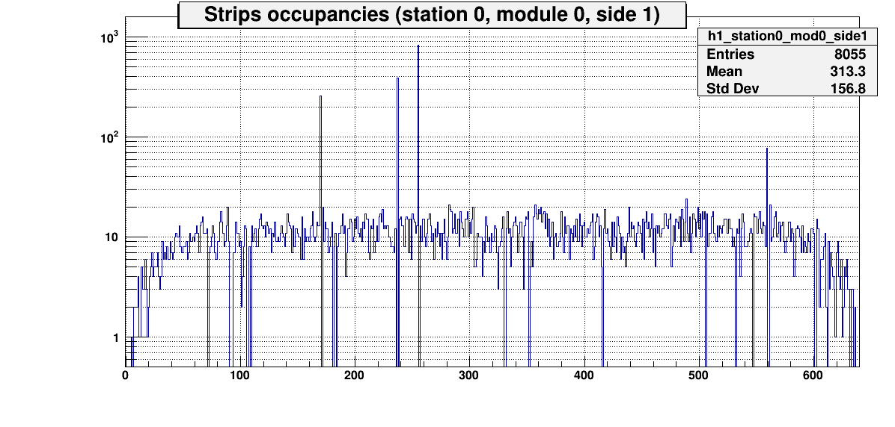
Silicon channels occupancy
Noisy channels excluded from histogram and dead channels
Noisy strips
Short strips

Slide 4
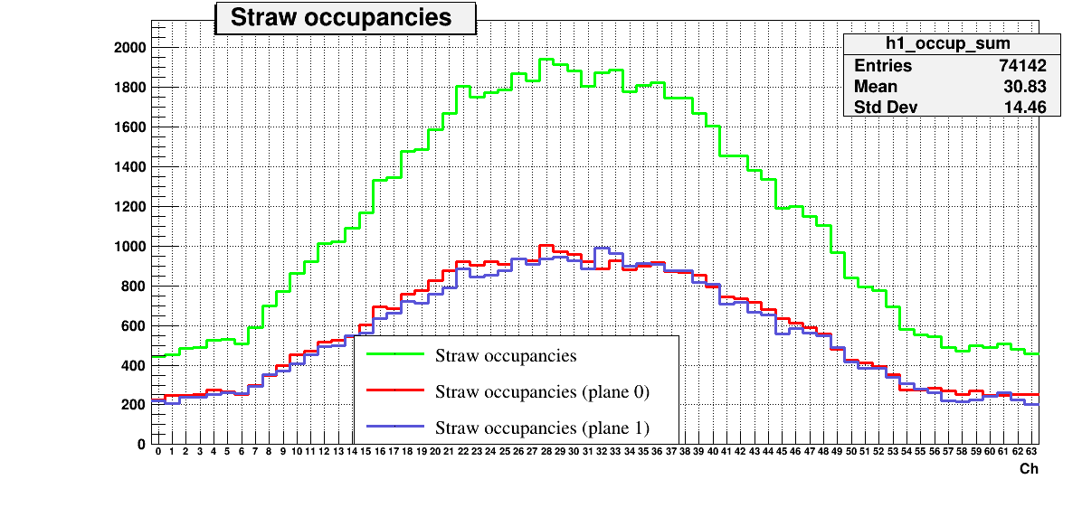
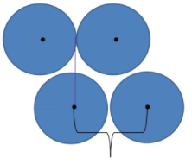
Straw stations occupancy
6 mm

Slide 5
Number of straw signals in event

Slide 6
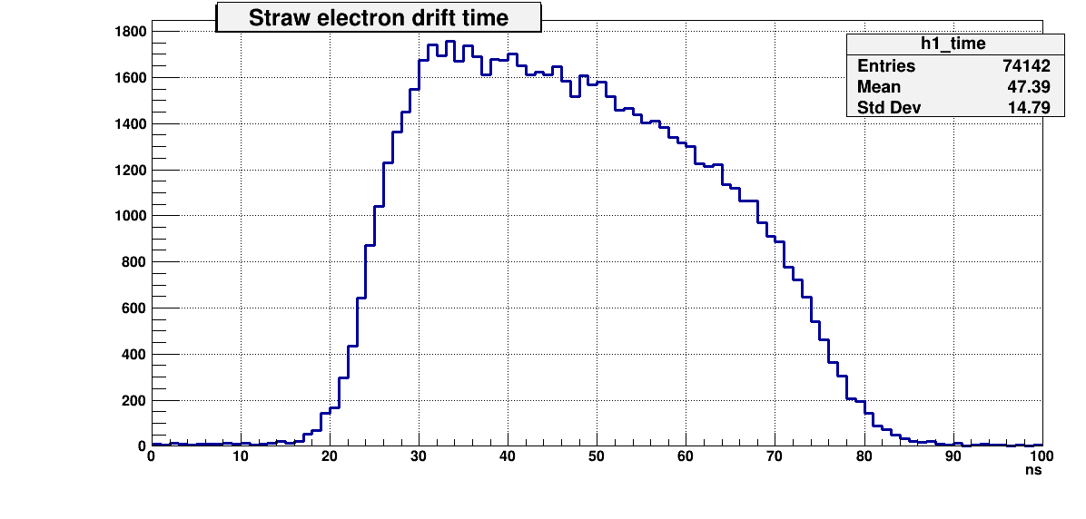
Electron Drift time
Drift time = StrawSignal – (Trigger1Time + Trigger2Time)/2 – TQDCLattency – StrawPedestal
60 ns

Slide 7
Stages
Raw data decoding
Digits mapping
Clustering
Hit reconstruction
Alignment
Track reconstruction
RT-relations calculation

Slide 8
Thanks!

Slide 9
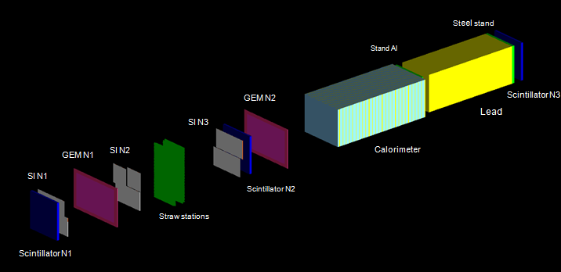
MiniSPD geometry
Geant4 model

Slide 10
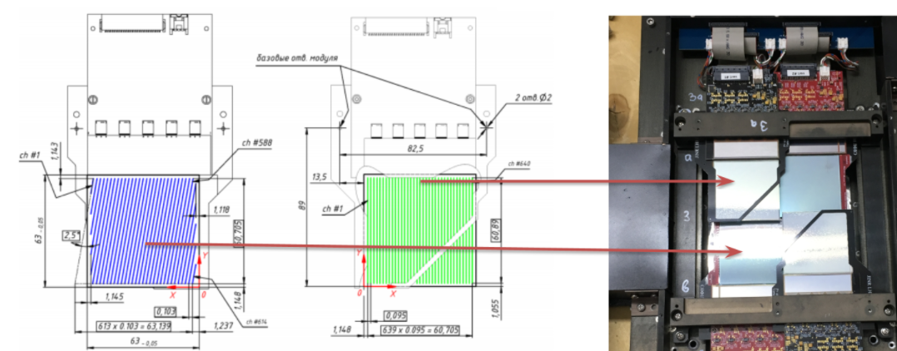
DSSD

