Slide 1
Some drift time pictures

Slide 2
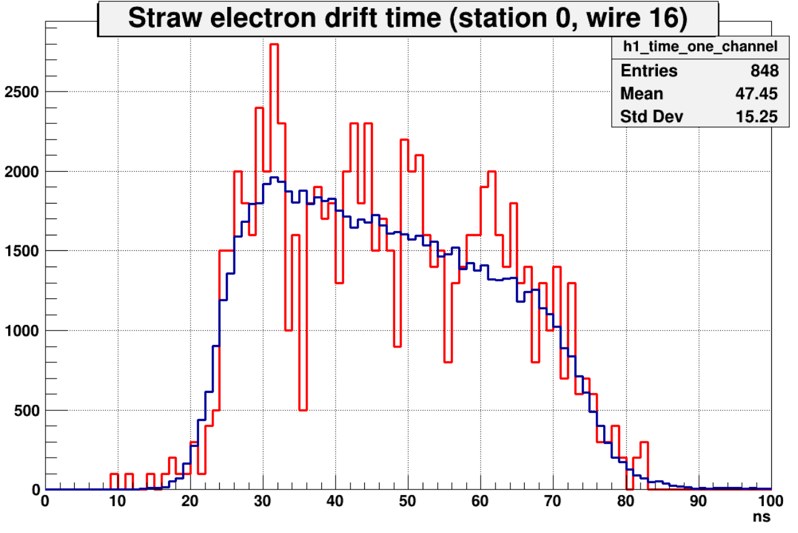
Signal from one wire compared to Integral signal
––– signal from wire 16 (station 0) SCALED;
––– Integral signal
Delay
Signal from single wire mostly align with integral one;
Delay is common for all wires.

Slide 3
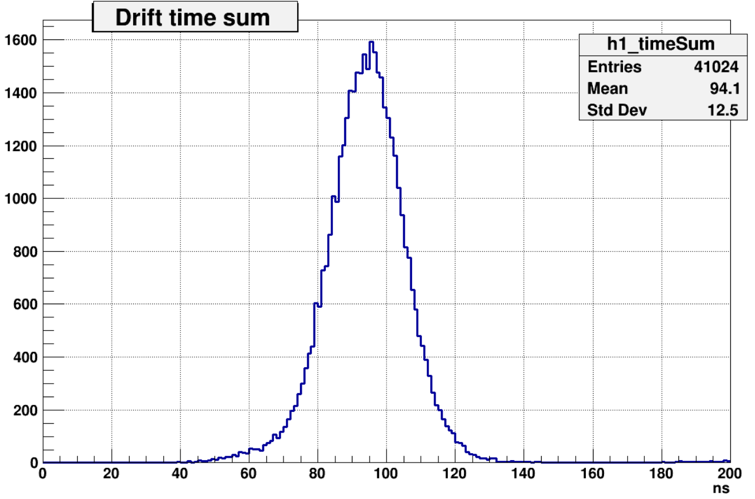
Drift time sum
μ
a
r
b
Mean ≈ 60ns + 2∙Delay
a + b = r
ta + tb ≈ tr ≈ 60 ns
True only for tracks normal to station plane!

Slide 4
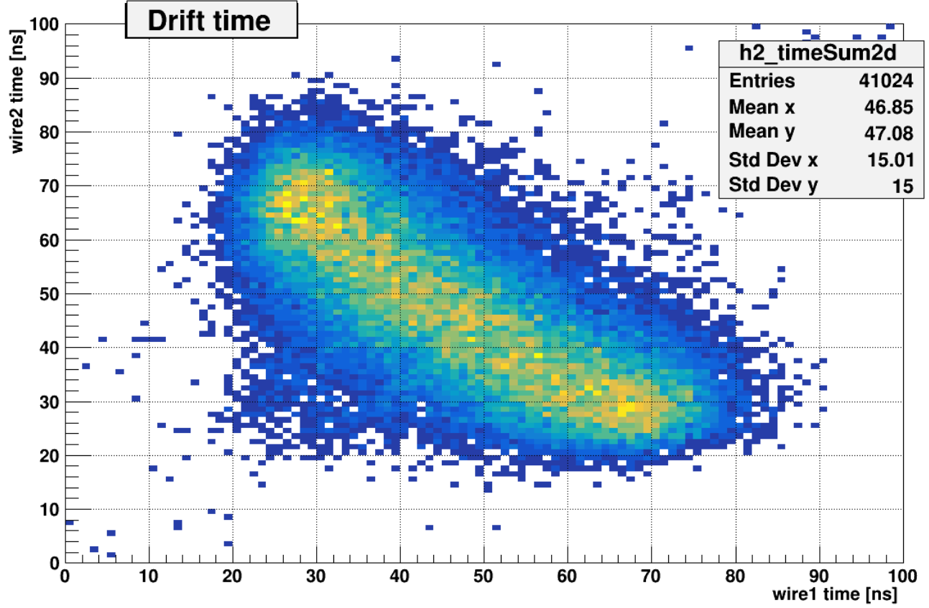
Drift time correlation (Events with two hits per station)

