Slide 1






















129th session of the
JINR Scientific Council
(18-19 February 2021)
Director’s Report
Grigory Trubnikov

Slide 2
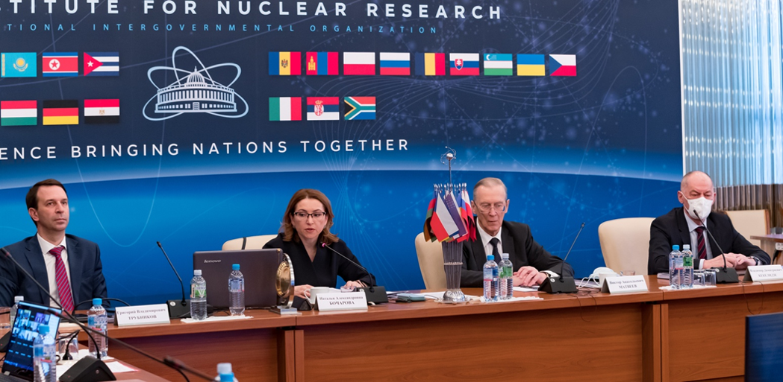
Information on the Decisions
of the JINR Committee of Plenipotentiaries
(November 2020)
A regular session of the Committee of Plenipotentiaries of the Governments of the JINR Member States was held on 23 November 2020 via videoconference.
AGENDA
JINR Director’s report (V. Matveev)
Election of the Director of JINR (N. Bocharova)
On the Scientific Leader of JINR (N. Bocharova)
Progress of implementation of the Seven-Year Plan for the Development of JINR for 2017−2023 and proposals for updates to the Plan (A. Sorin)
Draft budget of JINR for the year 2021, provisional contributions of the Member States for the years 2022, 2023, and 2024 (M. Vasilyev)
Results of the meeting of the JINR Finance Committee held on 19 November 2020 (A. Khvedelidze)
Resumption of the full membership of the Republic of Uzbekistan in JINR (B. Yuldashev)
Results of the audit of JINR’s financial activities of 2019 (D. Korsakov)
It was chaired by the representative of the Russian Federation − Natalya Bocharova, Deputy Minister of Science and Higher
Education of the Russian Federation.

Slide 3

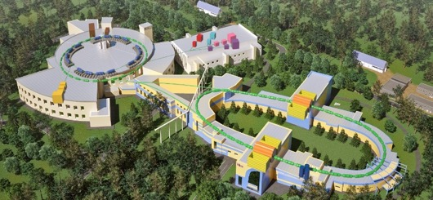
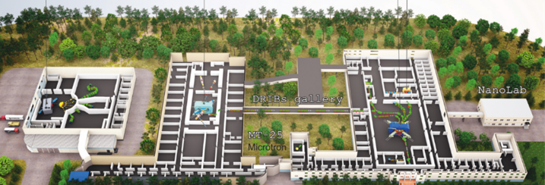
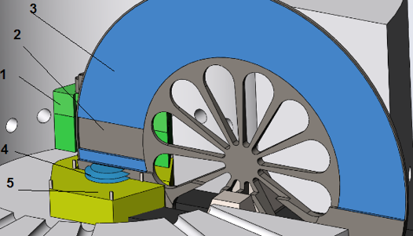
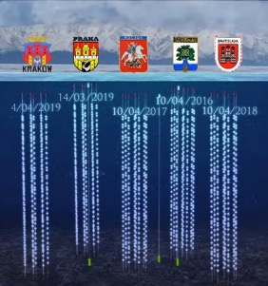
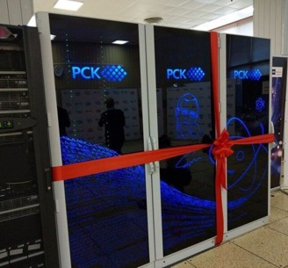
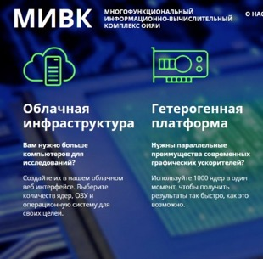




Committee of Plenipotentiaries
DECISIONS
Progress of implementation of the Seven-Year Plan for the Development of JINR for 2017−2023 and proposals for updates to the Plan
Having heard and discussed the report “Progress of implementation of the Seven-Year Plan for the Development of JINR for 2017−2023 and proposals for updates to the Plan” presented by Alexander Sorin, Chief Scientific Secretary of JINR, the Committee of Plenipotentiaries:
Joint institute for nuclear research
Brief progress report
on the implementation of
the current Seven-Year Plan for the Development of JINR for 2017–2020
and
suggested amendments to the Plan
for 2021–2023
appreciated the prepared Brief Report on the Progress of the current Seven-Year Plan for the Development of JINR over 2017–2020 and proposals for updates to the Plan for 2021–2023.
endorsed in general the directions proposed by the Directorate for updating the Seven-Year Plan for the Development of JINR in terms of implementing the JINR major projects and requested the final version of the updated Seven-Year Plan to be presented at the CP session in March 2021.
Dubna 2020
JINR
CENTRE

Slide 4
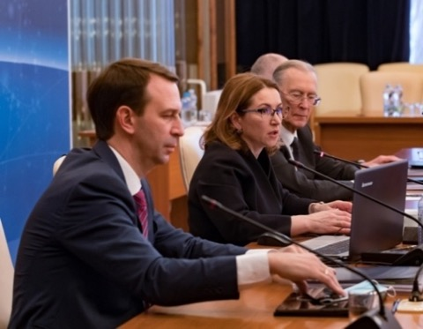
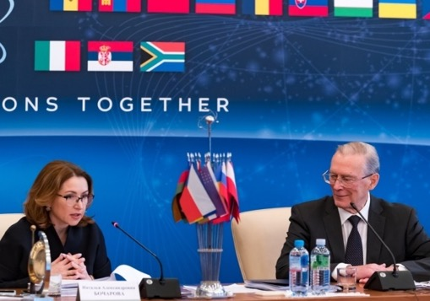
Committee of Plenipotentiaries
DECISIONS
Election of the Director of JINR
The Committee of Plenipotentiaries resolved:
The Scientific Leader of JINR
The Committee of Plenipotentiaries resolved:
to elect Grigory Trubnikov as Director of JINR for a term of 5 years taking office on 1 January 2021;
to endorse the Strategic programme and plans of implementation presented by Grigory Trubnikov;
to express profound gratitude to Victor Matveev for his successful work as Director of JINR;
to consider it expedient to introduce the position of JINR Scientific Leader for Victor Matveev and recommend that the newly elected Director of JINR carry out the respective appointment;
to define the rank and the powers of JINR Scientific
Leader, to recommend that the newly elected Director of JINR use the draft of the respective regulations prepared by the JINR Directorate as commissioned by the CP;
to adopt the terms of office of the Vice-Directors of JINR, the Chief Scientific Secretary of JINR, and the JINR Engineer until 1 January 2021 and to recommend that the newly elected Director appoint acting members of the JINR Directorate from 1 January 2021;
to commission the Director to propose the candidatures of JINR Vice-Directors, Chief Scientific Secretary, and Chief Engineer for approval at the CP session in March 2021.
to approve electing Victor Matveev as a member of the JINR Scientific Council as from 1 January 2021 for the term of the current membership of the Scientific Council consequently increasing it up to 51 members.

Slide 5
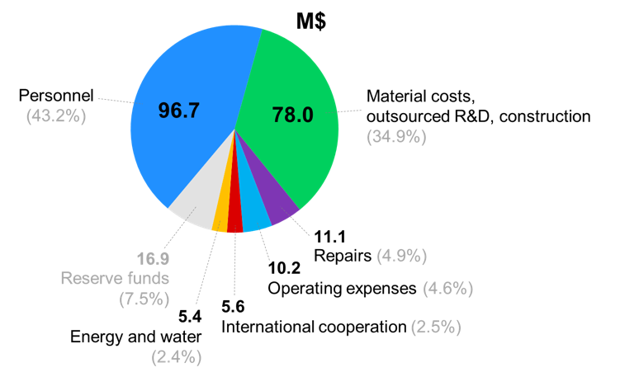
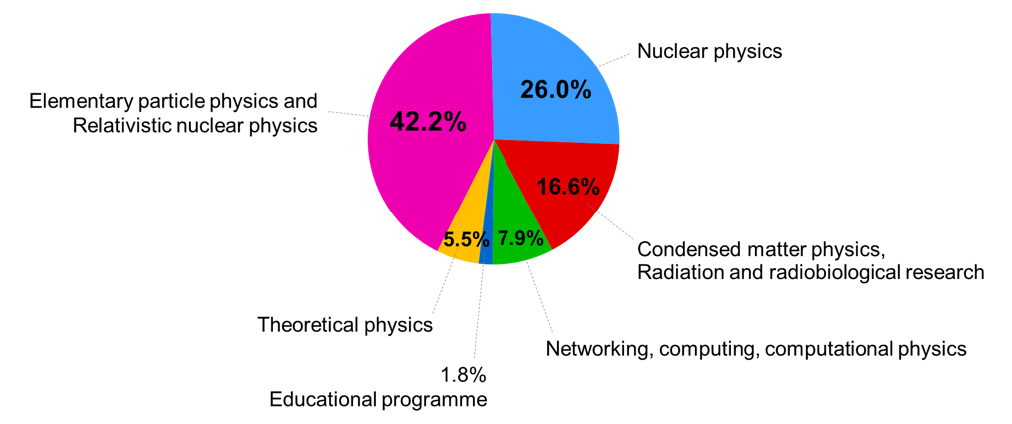
JINR budget issues
Priorities of the JINR budget for 2021
JINR budget (M$)
• Financing of the research projects and experiments in accordance with the Seven-Year Plan for the Development of JINR
• Ensuring a competitive level of remuneration for the employees of JINR
• Development of the JINR's engineering infrastructure to support the operation of newly commissioned and modernized experimental facilities
• Improving the working and living conditions of the JINR employees and guests
Carry-forward from 2020
223.8
217.4
222.8
228.4
Provisional
Breakdown of expenditure by consolidated items for 2021
Breakdown of expenditure by the fields of research for 2021

Slide 6
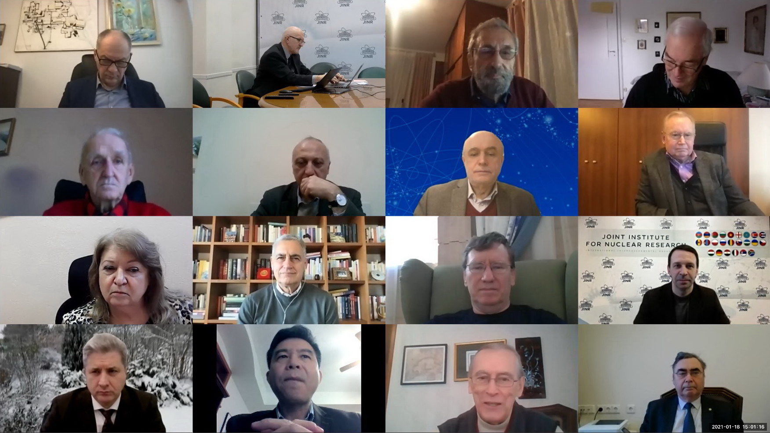
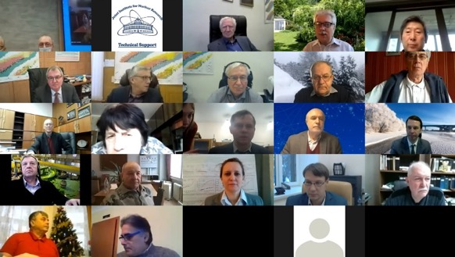
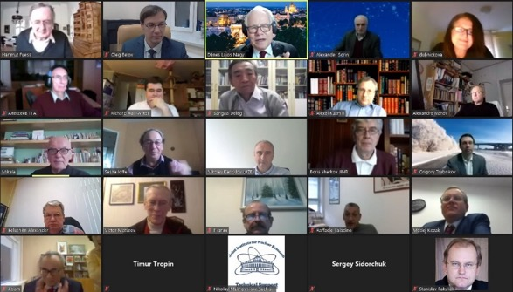


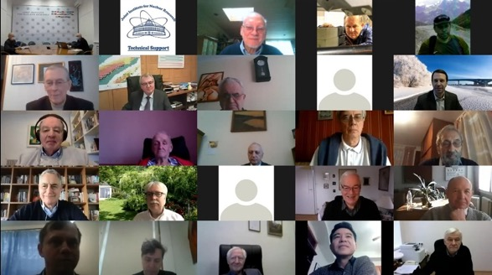
Meetings of the Programme Advisory Committees
PAC for Particle Physics,
18 January 2021,
chaired by Itzhak Tserruya
PAC for Nuclear Physics,
22 January 2021, chaired by
Marek Lewitowicz
PAC for Condensed Matter Physics,
25 January 2021,
chaired by Dénes Lajos Nagy
Joint meeting of the PAC for Particle Physics and PAC for Nuclear Physics, 21 January 2021, chaired by Itzhak Tserruya and Marek Lewitowicz
The joint session of two PACs was held in order to consolidate the JINR Neutrino Programme and to consider simultaneously all the JINR's neutrino projects.
The result of the joint work of two PACs was the classification of the projects of the Neutrino Programme into three categories A, B, C on the basis of their scientific significance and the effectiveness of the JINR group participation in the project.
In addition to the neutrino program, it seems important to extend a similar approach to JINR projects in other areas of research. This January, the PAC for Condensed Matter Physics also expressed an intention to prioritize the projects an themes within the field expertise of this PAC.
The JINR Directorate expresses its grateful thanks to the Chairs of all three PACs for their contribution to formulation of a well-balanced scientific policy of JINR.

Slide 7
Meetings of the Programme Advisory Committees
The JINR Directorate highly values the non-trivial and detailed work of the PACs on prioritization of the JINR projects. This work is extremely important for the realization of the JINR Long-Range Development Strategic Plan up to 2030 and Beyond.
We shall follow the PACs’ recommendations, meanwhile remain guided by the scientific merit of the projects and avoid compromising the existing international obligations. Acting together with the leaders of the JINR laboratories, we will try to apply these recommendations where possible for consolidation of the available intellectual and material resources.
We assume the following routine should be organized:
Recommendations of PAC are delivered by JINR Directorate to laboratories for analysis and feed-back. Each Laboratory should have a kind of arbitrage.
If a laboratory would like to argues the PAC’s recommendation, all explicit and fact-based reasoning, statistics, and evaluation must be submitted.
The Directorate should carefully discuss with the laboratory all related international obligations and assess risks before submitting the project for and the re-submitting to the PAC.
The Scientific Council is mandated to support the JINR Directorate in the careful analysis of all projects and themes planned for evaluation by the PACs, taking them into account as integral part not only of the JINR Topical Plan but also of the JINR Long-Range Development Strategic Plan up to 2030 and Beyond.

Slide 8
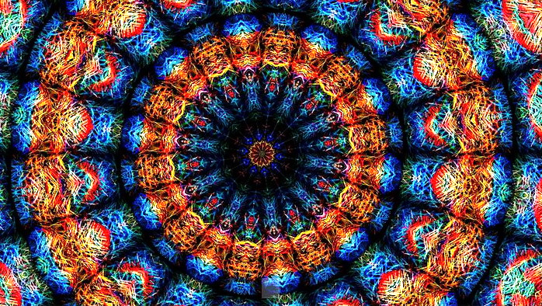
Selected Results
and Achievements

Slide 9

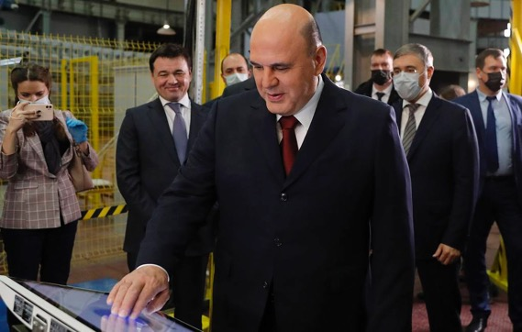
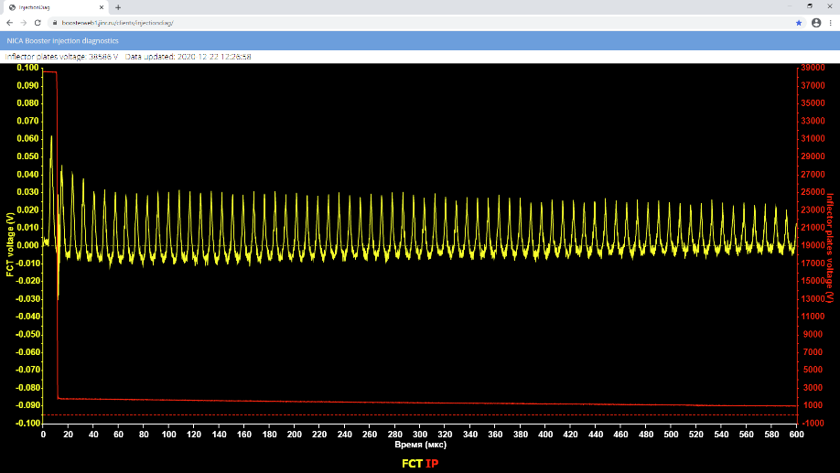

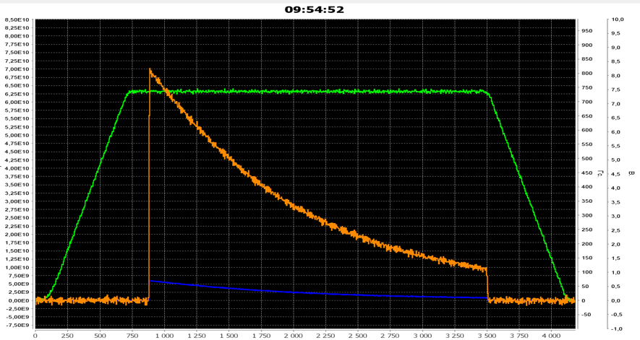
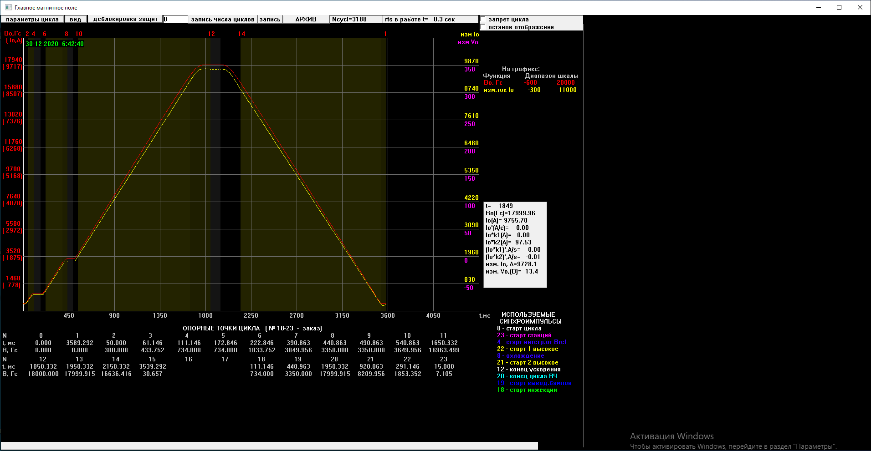
NICA: Booster commissioning. The first run
3.2 MeV/u beam
Nov. 20th – start of technological run. Russian Prime-minister M.Mishustin
December 19th – first beam circulation @ Booster
7·10¹⁰ of circulating He⁺¹ ions
B = 1.8 T
Energy_eqv = 600 Mev/u
Cycle 4 s
Beam intensity
Designed magnetic field achieved

Slide 10
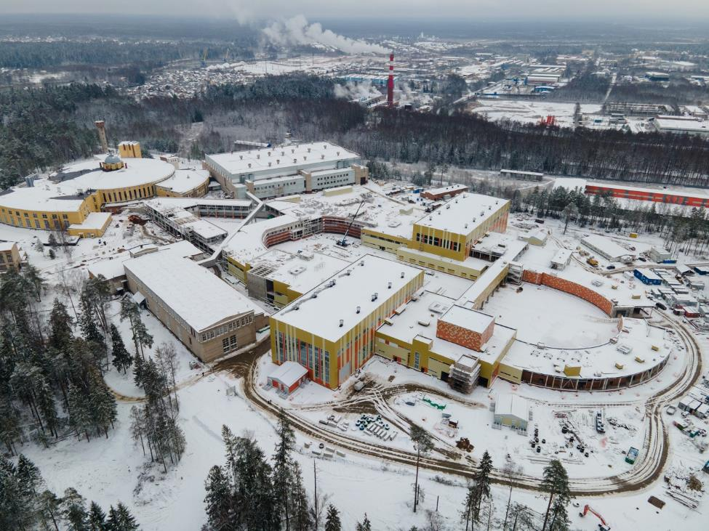
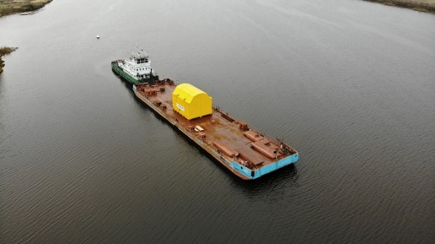
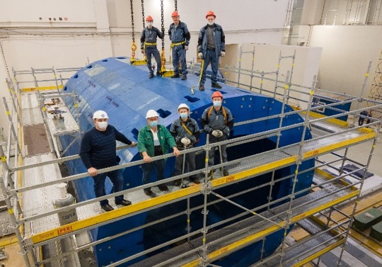
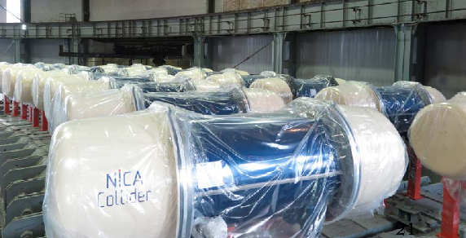
NICA complex Construction: Collider and MPD
Solenoid magnet has been delivered to MPD Hall from Italy. Magnet yoke has been assembled with very high accuracy.
Formation of the MPD collaboration: over 500 specialists from 39 institutes and 11 countries, is completed. Progress in all areas:
TPC - 21 out of 24 readout chambers are produced and tested;
TOF - 40% of mRPCs have already been produced;
FHCal - modules and readout electronics are ready for operation;
ECal - 300 modules have been produced.
In general, 70% of works accomplished towards design configuration of NICA complex
80% of dipoles, 10% of quadrupoles ready
MPD Stages of assembly | Deadline
Magnetic field measurements | October-November 2021
Installation of TOF, TPC, electronics platform, cabling | January-June 2022
Installation of a beam tube, FHCal, cosmic ray test system | July 2022
Commissioning / Beam operation | Dec 2022 / March 2023

Slide 11

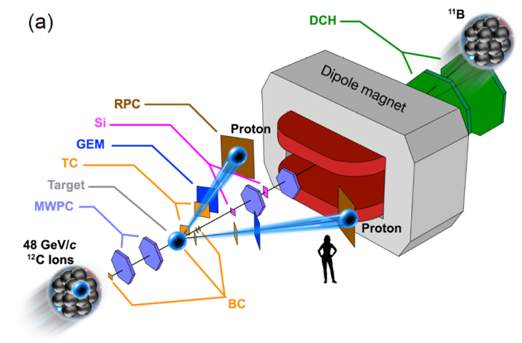
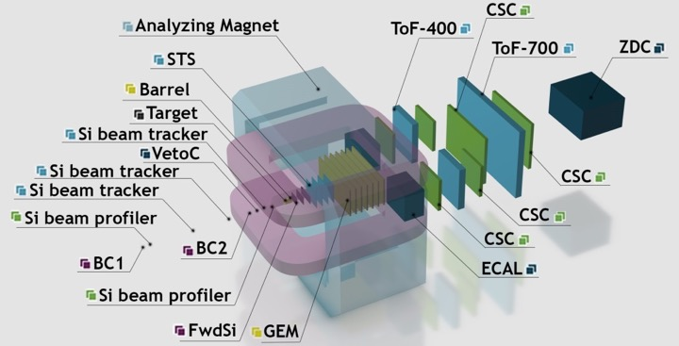
BM@N heavy ion program and studies of short range correlations
Next BM@N Kr (Xe) run in planned for End of 2021:
►Multi-strange hyperons: promising observables for the Equation
of State of symmetric matter at Nuclotron beam energies
► Excitation function of Ξ⁻ production at 2-3 beam energies → search for the onset of thermal equilibration of Ξ⁻ hyperons
► Search for light hyper-nuclei (³H_{Λ})
¹²C + p → 2p + ¹⁰B / ¹⁰Be + (n / p)
• First BM@N SRC paper:
“The Transparent Nucleus: unperturbed inverse kinematics nucleon knockout measurements with a 48 GeV/c carbon beam” accepted by Nature Physics
• Plans for SRC studies in interactions of carbon beam on proton in Fall 2021
BM@N: 35 publications, 95 conference talks
► Incr. statistics of exclusive SRC process by 10
► Full evaluation of SRC process cross section
Publications
 | papers | conference reports
Accelerator systems | 173 | 252
BM@N | 35 | 95
MPD | 44 | 92
BM@N experiment
More details in the talk by Vladimir Kekelidze

Slide 12

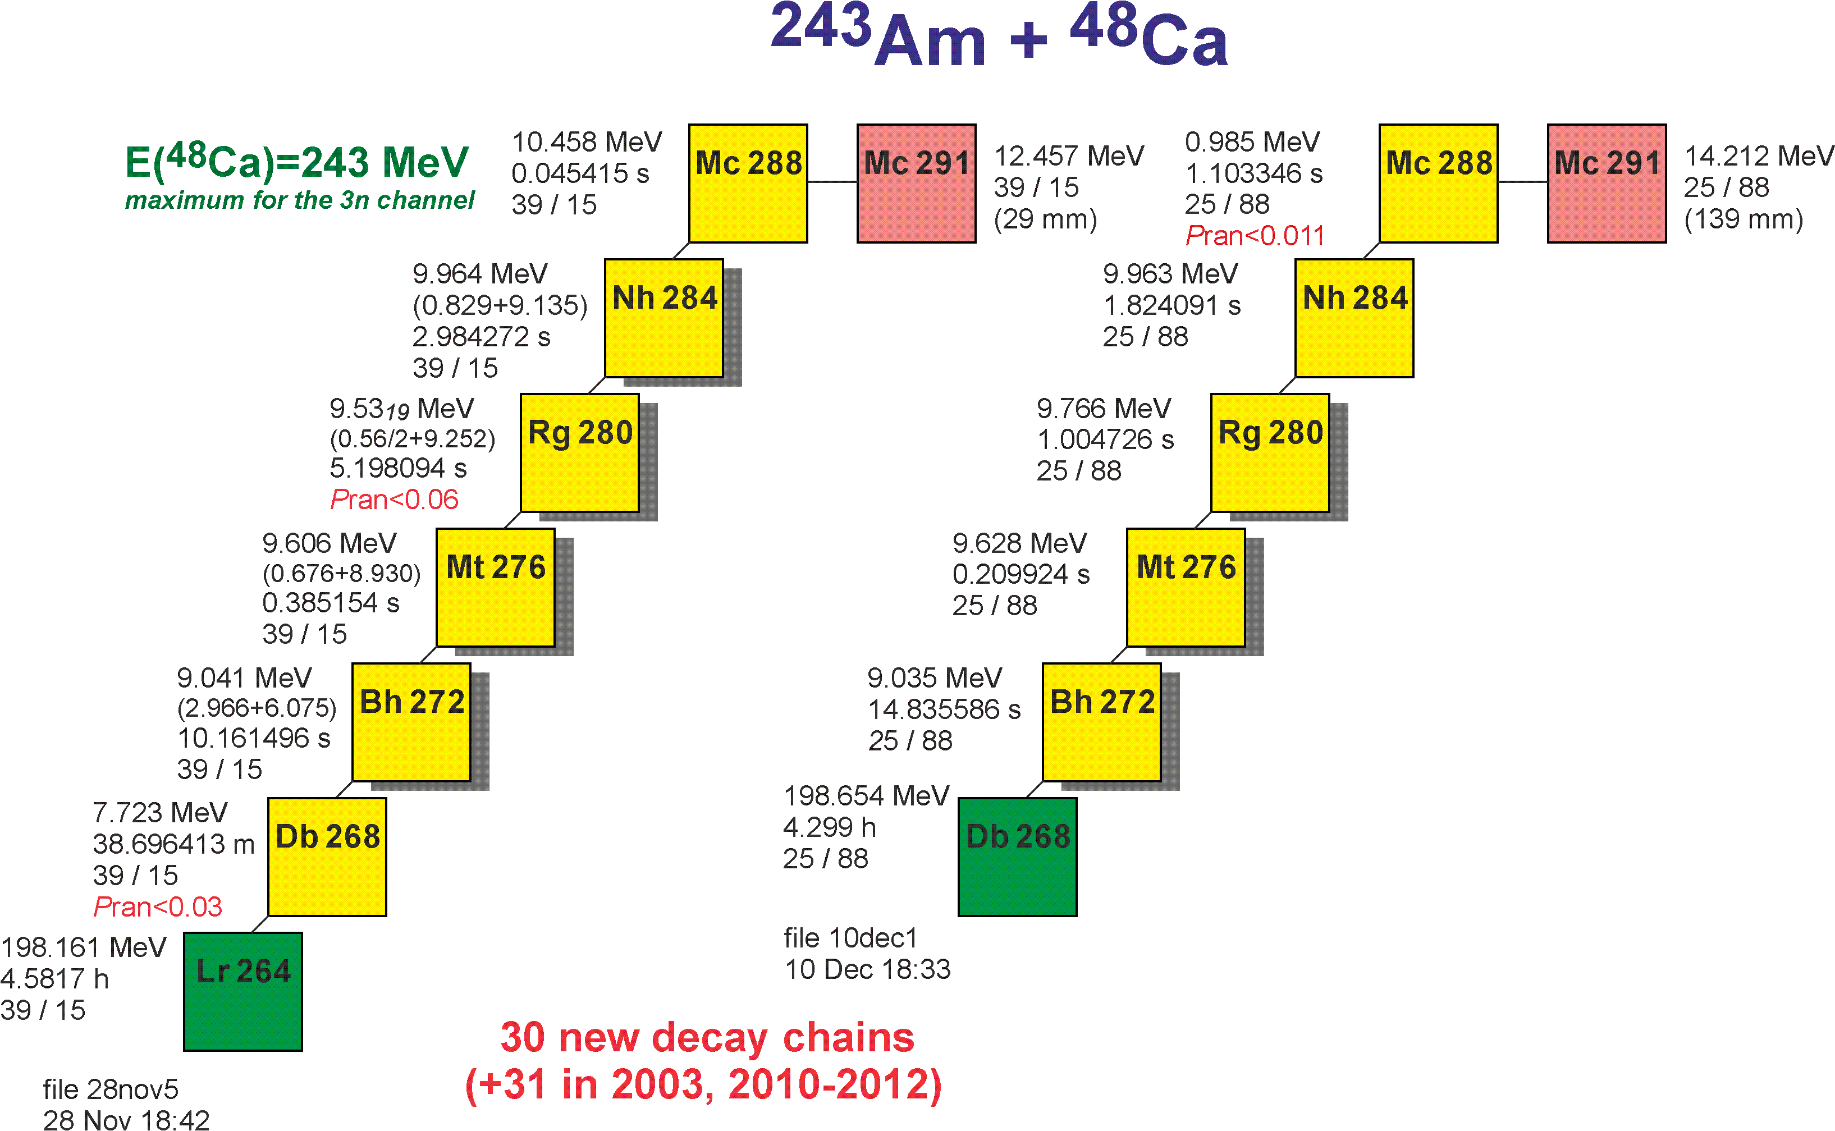
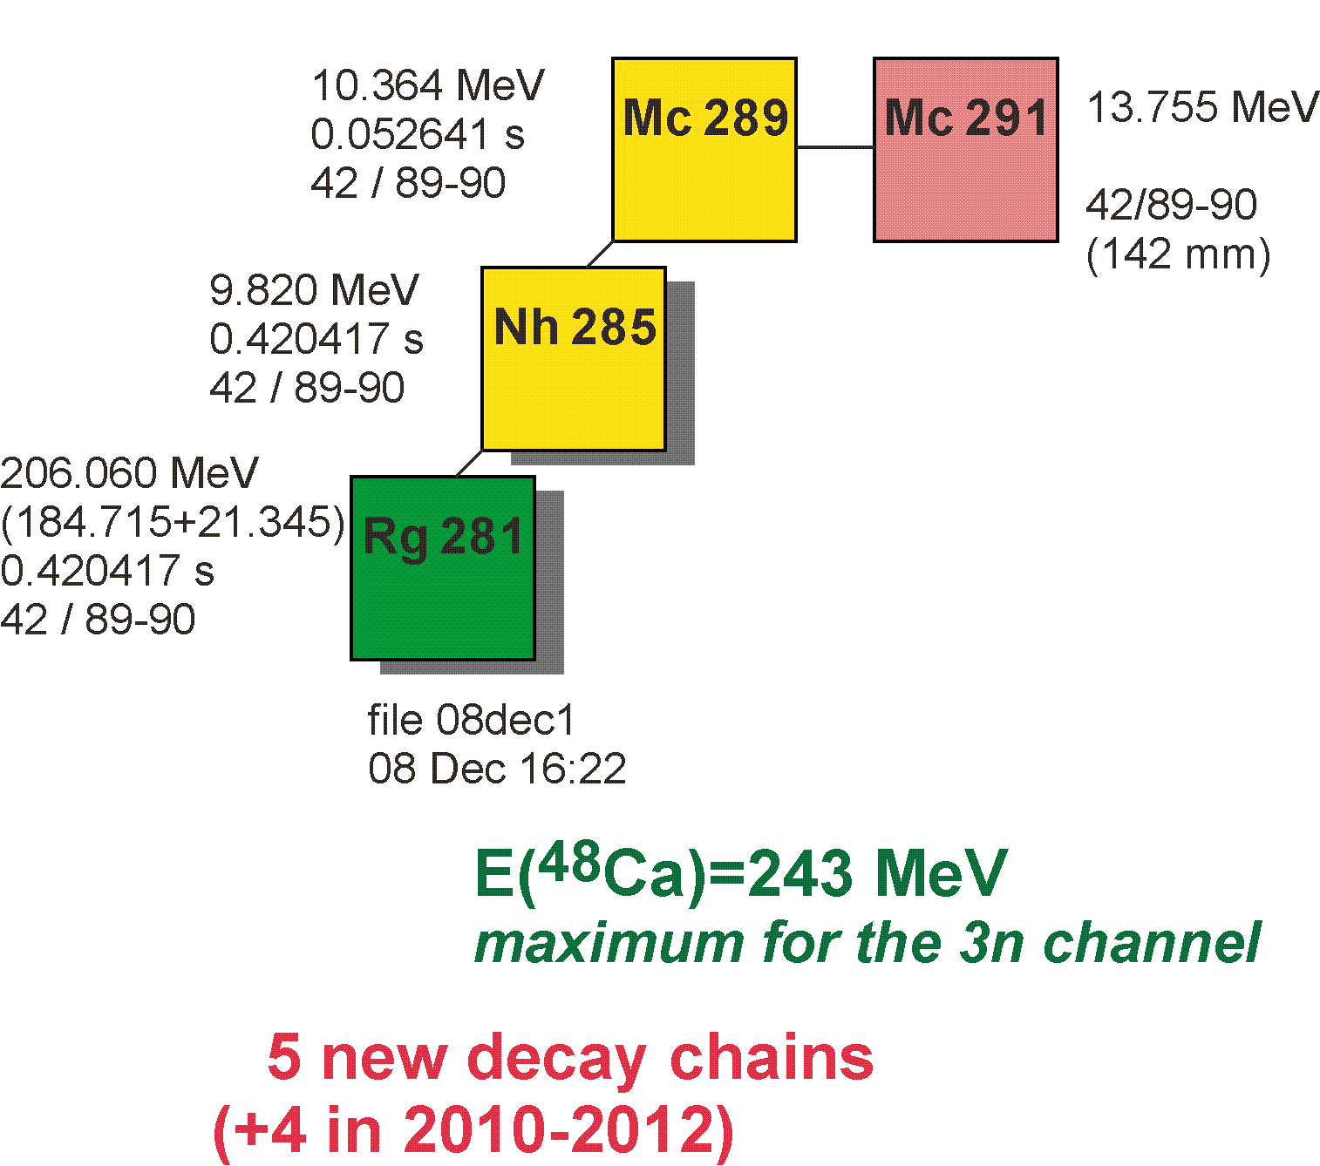
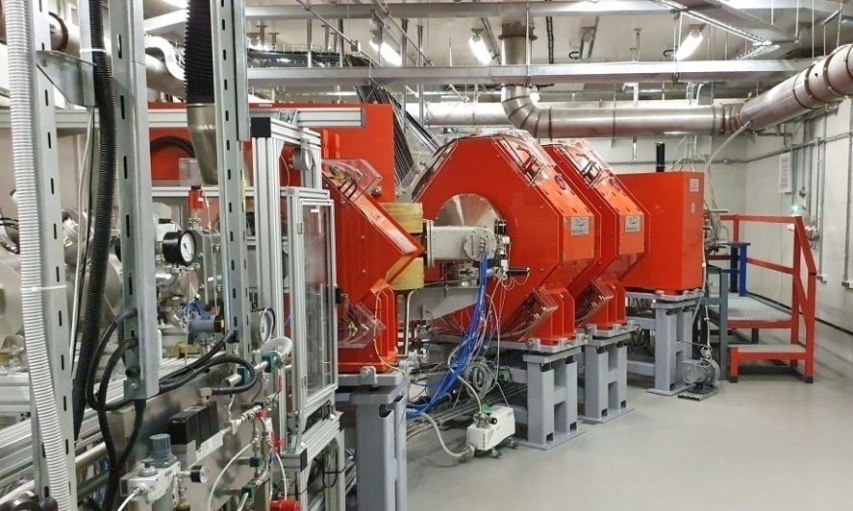
First experiment @ SHE Factory
24 days in Nov.-Dec. 2020 & 16 days in Jan.-Feb. 2021;
55 decay chains of ²⁸⁸Mc
6 decay chains of ²⁸⁹Mc
Alpha-decay of ²⁶⁸Db and fission of the new isotope ²⁶⁴Lr have been registered for the first time (preliminary).
DGFRS-2 separator, ⁴⁸Са + ²⁴³Am
More details in the talk by Yuri Oganessian

Slide 13
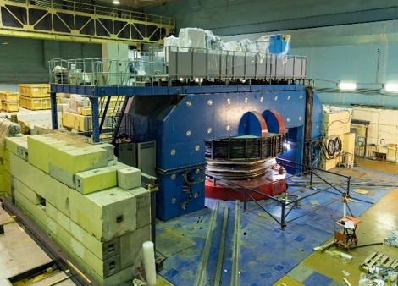
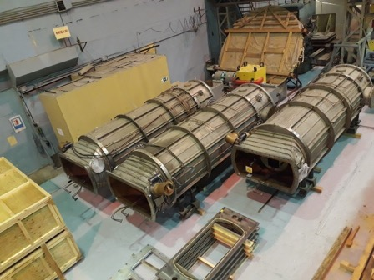
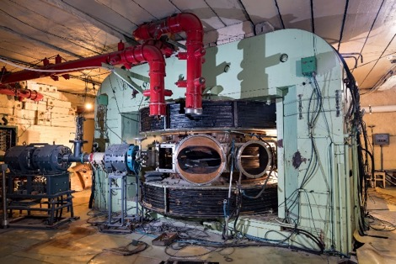
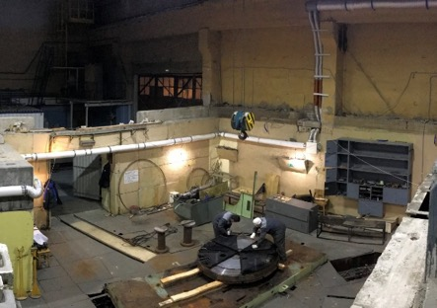
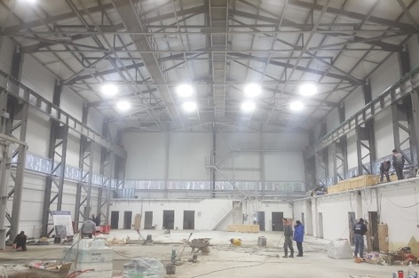
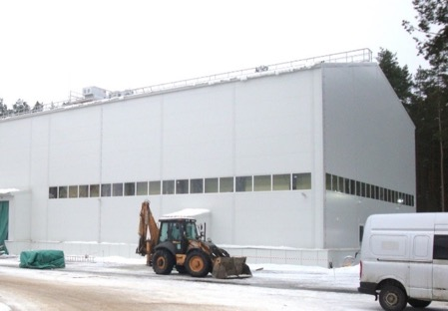
DRIBs-3 development
U400M
Modernization is in progress:
Started in July 2020;
Planned duration ~2 years;
Disassembling is about to be completed;
Proceeds on schedule.
U200 → DC140
Development of a new facility for applied research:
Electronic component testing, track pore membrane research and production, etc.;
DC140 will replace the U200 cyclotron;
The systems of the old facility are dismounted;
The DC140 facility is intended to be commissioned by the end of 2023.
Assembly workshop
End of construction and beginning of use:
Important in particular for the U400M and future U400→U400R modernizations as well as for development of a new accelerator facility DC140.
More details in the talk by Yuri Oganessian

Slide 14

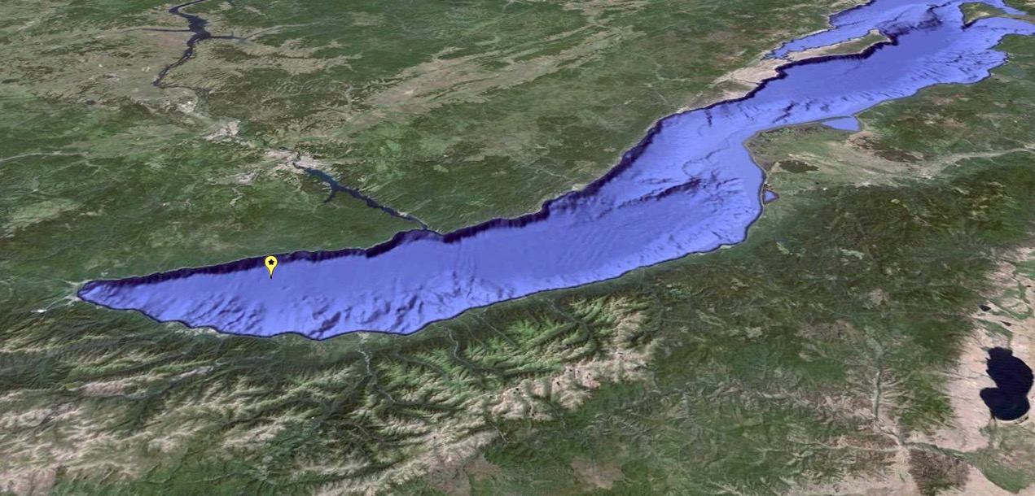
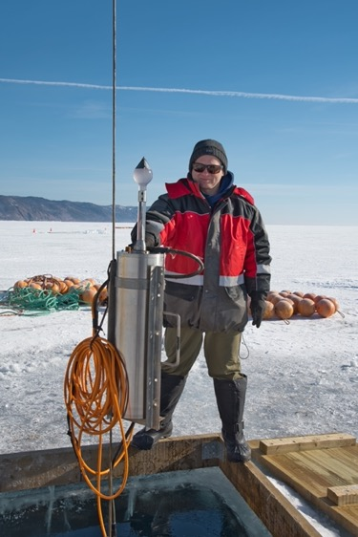
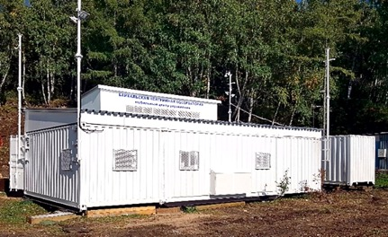
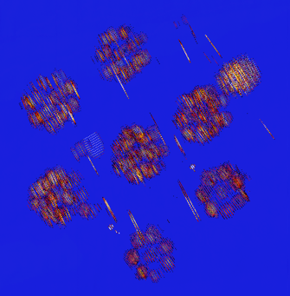
Baikal-GVD Project
Shore station
10 institutes from Russia and Europe
~ 65 physicists and engineers
Two new clusters were installed on April 2020. The telescope of seven clusters with 2016 optical modules takes data at the moment. The effective volume of the deep underwater GVD detector with 7 clusters for neutrino cascade events of energy above 100 TeV reaches 0.35 km³.
Twelve cascade events with energy above 100 TeV was selected as candidates for astrophysical neutrino events from data taking period 2018-2020.
Baikal-GVD participates in multi-messenger program as a follow-upper.
~ 700 m
Sonar surveys of the detector (June 2020)

Slide 15
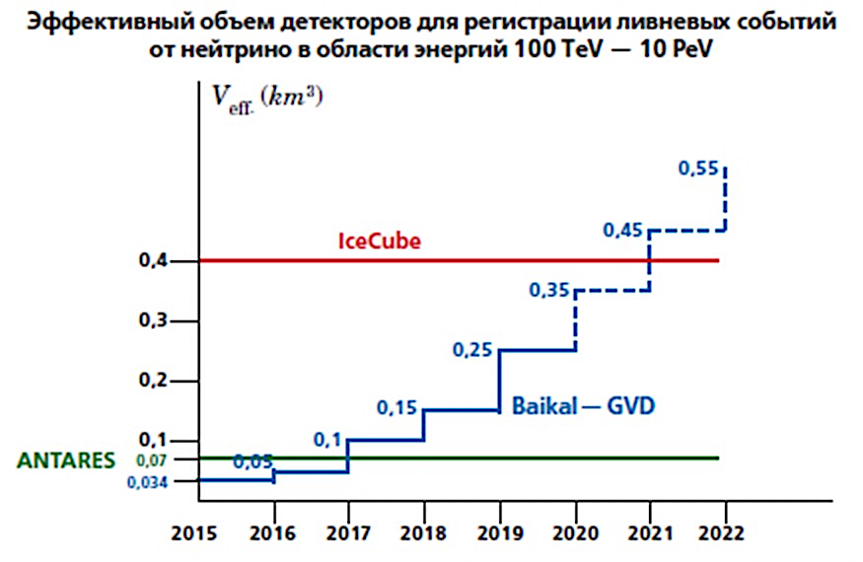
GVD-1 timeline
(according to the 7-Year Plan of JINR)
Year | 2016 | 2017 | 2018 | 2019 | 2020 | 2021
Nb. of clusters Nb. of OMs | 1 288 | 2 576 | 3 864 | 5 1440 | 7 2016 | 9 2592
Effective volume of the Baikal-GVD detector for the cascade-like neutrino events in energy region of 100 TeV- 10 PeV
The collaboration is planning to install 2 new clusters in case of good external conditions (weather and ice).
Additional facilities for long-term tests of electronics are planned to be prepared by summer 2021.

Slide 16

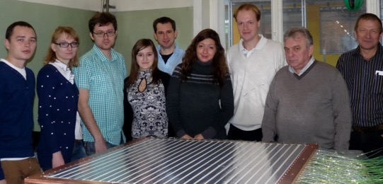
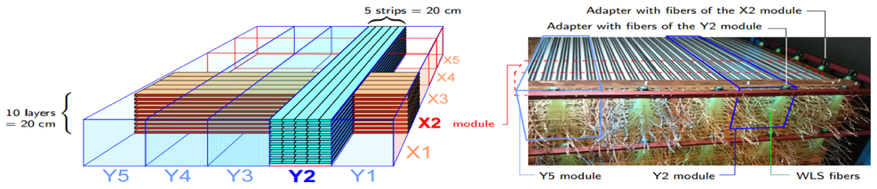
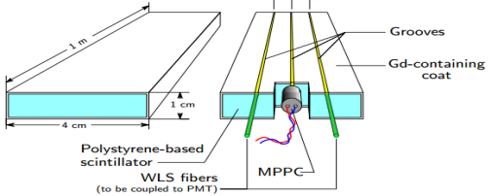
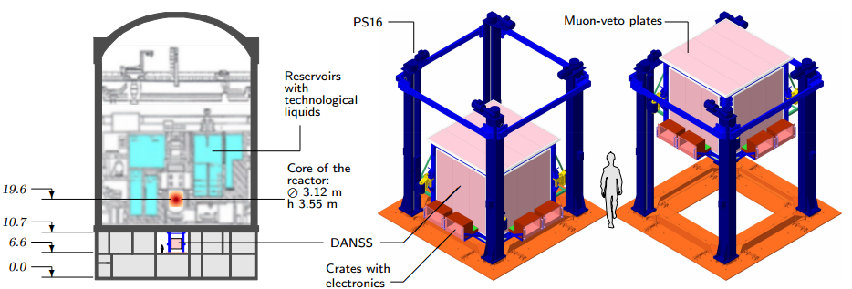
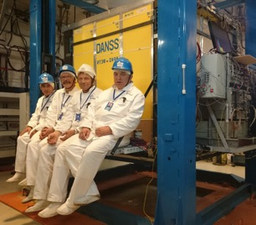
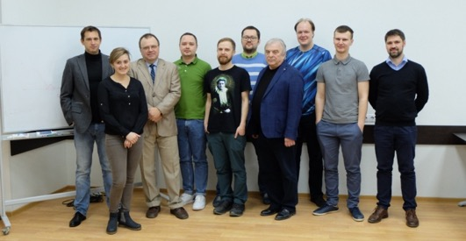
The DANSS
The DANSS collaboration has built a compact 1 m³ (t) neutrino spectrometer, which is able to work safely close to an industrial nuclear power reactor (NPR). It is used to monitor the NPR (applied task) as well as to probe short baseline neutrino oscillations to the sterile state (fundamental researches)
JINR DANSS team with the trial “Zero” section
Victor Brudanin, who led DANSS and many other important projects at JINR, passed away in Dubna on 28 December 2020, aged 70. He was incredibly effective leader, recognized figure within the neutrino-physics community and played a key role in shaping JINR neutrino physics and astrophysics program (BAIKAL-GVD, GEMMA, νGeN, DANSS, NEMO, EDELWEISS, GERDA, MONUMENT, AnCor, and many other experiments and activities).
The basic element – scintillator strip
One of the five sections is consisted of 5 by 5 inter-crossed modules
DANSS at Kalinin NPP
JINR colleagues and friends will sadly miss Victor for his human qualities, and as a physicist.
The fully assembled detector
at the top & bottom positions
The movable platform with the DANSS under the reactor WWER-1000, KNPP, Russia
Measurements are at 3 distances: 10, 11, 12 m, ratios of spectra are analyzed: relative measurements
In 2020 first JINR Prize for “Experimental Research Work” was awarded to the DANSS Group

Slide 17


FLNP User Programme
Cycle | Date | Working hours for physical experiment [h] | FLNP User Program
1 | 16.01. ÷ 29.01. | 312 | With users
2 | 10.02. ÷ 19.02. | 207 | With users
3 | 18.03. ÷ 30.03. | 267 | Partially with users
4 | 13.04. ÷ 24.04. | cancelled
5 | 14.05. ÷ 25.05. | cancelled
6 | 09.09. ÷ 23.09. | 337 | Partially with users
7 | 01.10. ÷ 12.10. | 242 | Partially with users
8 | 19.10. ÷ 31.10. | 289 | Partially with users
9 | 09.11. ÷ 20.11. | 257 | Whitout users
10 | 07.12 ÷ 21.12. | 312 | Whitout users
 |  | Total 2223
New website – a modern platform from September 2020
14 instruments. REGATA is a new one within the User Programme

Slide 18
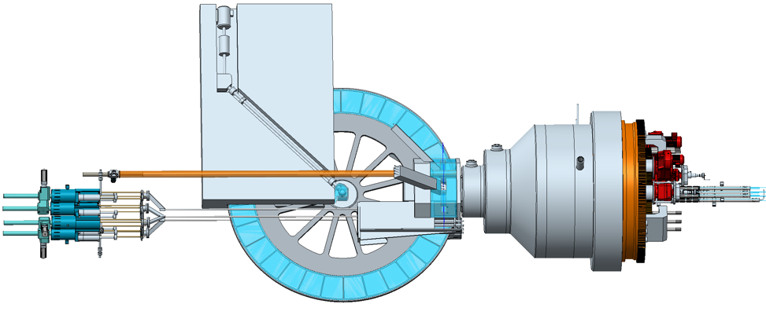
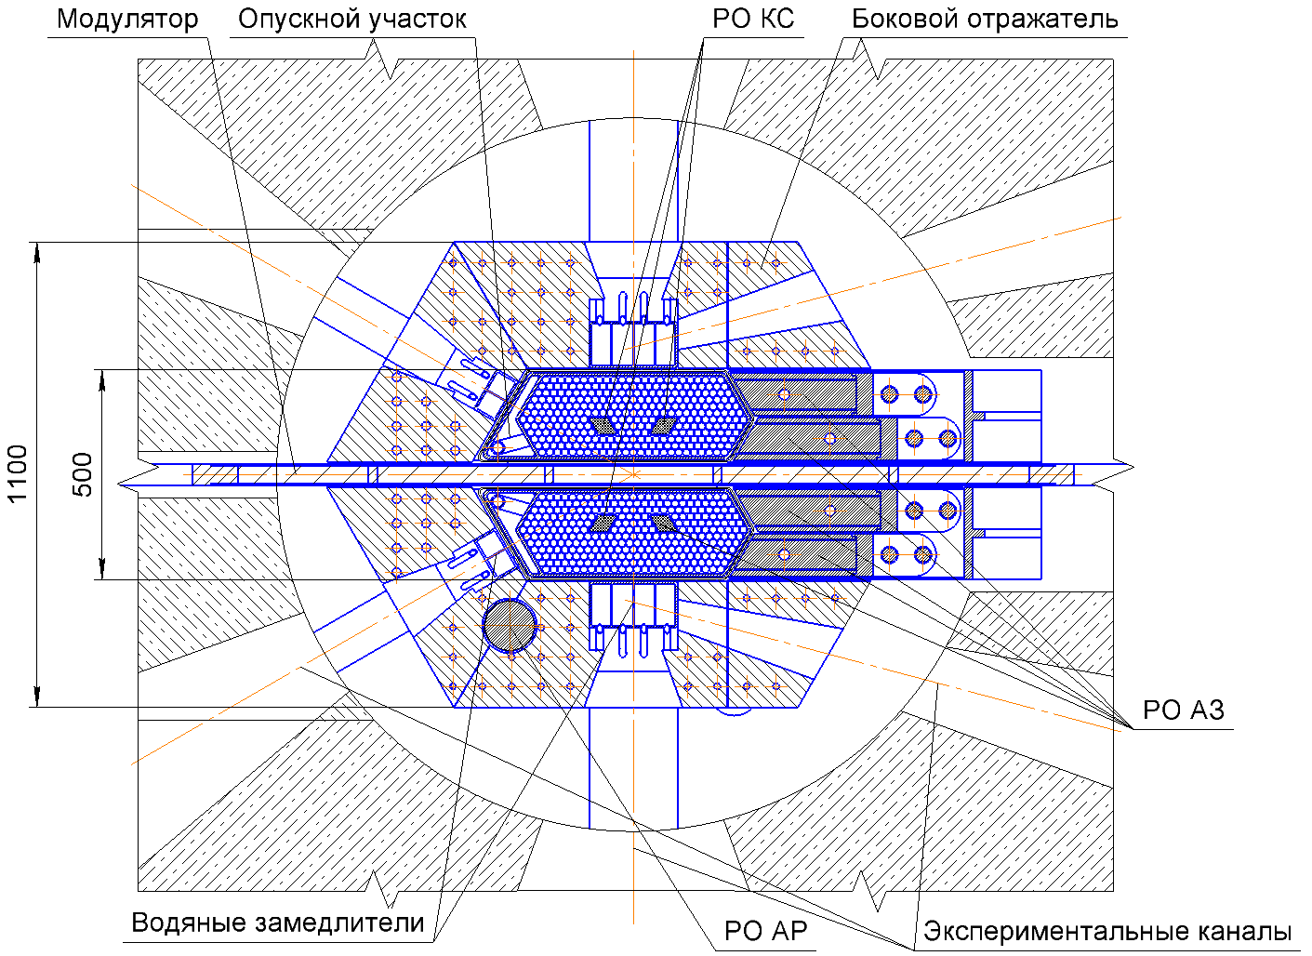
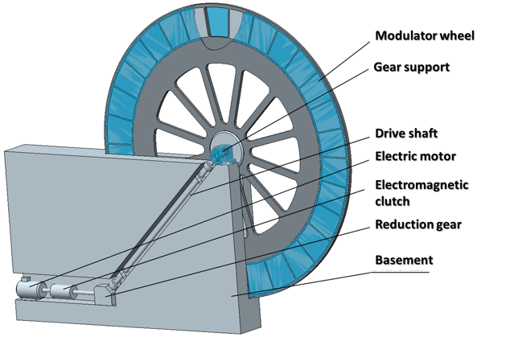
Development of the concept for a new neutron source of JINR
Current status of the IBR-3 project development
R&D on fuel with participation of the VNIINM was started;
The pulsed stability of the IBR-3 is being considered as the key point;
Together with NIKIET, studying IBR-2 and more detailed simulations of the IBR-3 dynamics are going forward;
The seed of the future IBR-3 department is prepared for planting;
Investigations of the backgrounds at pulsed neutron sources with fissile targets are continuing
Core central section
Reactivity modulator
In 2020, a special research theme opened at JINR in order to facilitate the development of a conceptual design of a new neutron source
Reactivity modulator
Downward section
COR CR
Side reflector
CPS CR
Water premoderators
ARC CR
Axes of the experimental channels

Slide 19
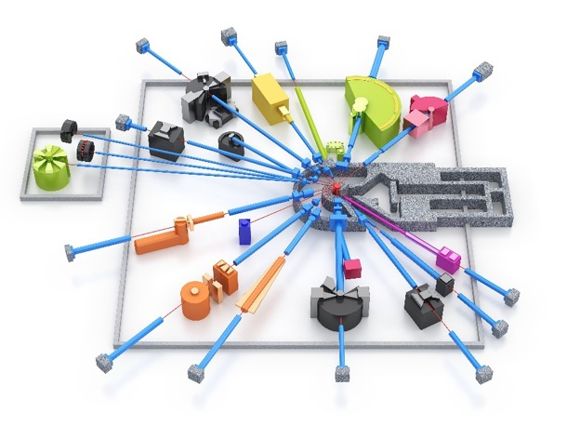





Technical developments at FLNP
Neutron spectra and gain factor of intensity of cold neutrons of the second cryogenic moderator of the IBR-2 reactor for neutron beams № 4, 5, 6 and 9 (2020)
Diffractometers
5
4
6
№6 DN-6
№5 HRFD
9
Reflectometer
Small Neutron Scattering Facility
№9 REFLEX
№4 YuMO

Slide 20






JINR Tier1
Data transfers (>100TB) to/from JINR dCache for
Tier1 in 2020 by WLCG sites
Contribution of the world Tier1 centers to CMS experimental data processing in 2020
Statistics on the use of the JINR Tier1 center by CMS
by different types of data stream processing in 2020
Statistics of data exchange of JINR CMS Tier1 with other grid centers with a volume of >100 TB for the outgoing traffic
192 WLCG data processing centers for the LHC experiments downloaded 26,154.5 TB from the Tier1 storage system, 130 of which transferred 10,655.7 TB of data for writing.

Slide 21















“GOVORUN” SUPERCOMPUTER for JINR TASKS
For the high-speed data storage system developed and implemented for the JINR “Govorun” supercomputer, RSC Group received the prestigious Russian DC Award 2020 in “The Best IT Solution for Data Centers” nomination at the awarding ceremony held on 10 December 2020 in Moscow.
Distribution of the resources by user groups
The resources of the “Govorun” supercomputer are used by scientific groups from all the Laboratories of the Institute within 25 themes of the JINR Topical Plan for solving a wide range of tasks in the field of theoretical physics, as well as for the modeling and processing of experimental data.
Research results obtained in 2020 with the use of supercomputer resources are presented in 65 publications, 6 of them in Q1, 7 in Q2.

Slide 22




TELEPORTATION OF THE BELL STATES ON IBM Q COMPUTERS
UNDER THEIR HARDWARE ERRORS
In the framework of the project “Superheavy nuclei and atoms: the limits of the masses of nuclei and the boundaries of D.V. Mendeleev’s Periodic Table” (grant of the Russian Ministry of Science and Higher Education No. 075-10-2020-117), an algorithm for quantum teleportation of the Bell states on different IBM five-qubit processors was implemented.
To reduce arising errors, several modifications of the original teleportation protocol were proposed.
Quantum scheme of teleportation on IBM Q Rome and Santiago
Input Bell state
Output of IBM Q Yorktown with “noisy” gates
Measurements
The comparison of the dynamics of the teleportation results using the example of the IBM Q Yorktown processor over the past year and a half demonstrates significant progress in improving the characteristics of IBM’s quantum hardware.
Gerdt V.P., Kotkova E.A. // Communications in Computer and Information Science, vol 1337, pp 129-143, 2021

Slide 23





Theoretical Physics
Theoretical physics on the basis of advanced mathematics, cross-disciplinary research, support of the JINR experimental program, interplay of research and education
Scientific staff:
235 researchers
100 – with Ph.D. degree
105 – with 2nd degree
70 – international staff
1/3 – young (under 35 y.o.)
Participation in the JINR flagship projects:
Theory of hot and dense nuclear matter for NICA
Analysis of production and properties of SHN
Theory of neutrino physics
Theory for material study with neutron beams
Lattice QCD calculations with Supercomputer "GOVORUN"
2020 scientific activity:
470 journal articles and conference proceedings, 1 monograph
>110 reports at >60 conferences and workshops, including online
Fedor Šimkovic: ESET Science Award for 2020 - Outstanding individual contributor to Slovak science
Eugeny Mardyban: Scholarship of the President of the Russian Federation for young scientists and graduate students
Horia Pasca: “Ștefan Procopiu” Prize for Physical Sciences from the Romanian Academy

Slide 24




Selected Results in Theoretical Physics
Theory of hadronic matter under extreme conditions
Since 2016 @ BLTP. Advisors: E-J. Aichelin, M. Ilgenfritz, V. Matveev, V. Toneev, G. Zinoviev. Conveners (present time): D. Blaschke, V. Braguta, E. Kolomeitsev, S. Nedelko
Theory of hadron matter with emphasis at NICA physics: dynamics of relativistic heavy ion collisions, vacuum structure and critical phenomena in QCD, phase transformations in dense and/or hot strongly interacting matter under the influence of strong electromagnetic fields and rotation, astrophysics of compact stars.
Support unit - sector 6, Department of fundamental interactions BLTP
Synthesis of complete range of theoretical methods: statistical, hydro and hybrid models of HIC, Lattice QCD, QCD motivated phenomenological models, functional methods of QCD, non-extensive statistics, theory of critical phenomena.
7 countries are represented
(2020)
Collaboration: VBLHEP and LIT at JINR, 30+ universities and research organizations from
Germany, Poland, Italy, Czech Republic, Slovakia, Japan, India, Ukraine, etc (17 countries)
Together with LIT – initiation of installing the supercomputer Govorun at JINR.
Scientific results at the frontier of hadron matter physics, to give few examples:
- evolution and the role of electromagnetic fields in relativistic heavy-ion collisions: deconfinement catalysis by strong electromagnetic field; asymmetry of conductivity in QGP – evidence for both the chiral magnetic effect and the magnetoresistance phenomenon in QGP;
- global polarization in heavy-ion collisions based on axial vortical effect: observable effects of Λ-polarization at NICA energies;
- the influence of the rotation on the confinement/deconfinement phase transition in SU(3)-gluodynamics – the critical temperature of the confinement/deconfinement phase transition increases with a growth in the angular velocity;
- a new observable signature of quark matter in neutron star mergers identified from hybrid EOSs with hadron-quark phase transition, which have direct applications in gravitational wave searches, kilonova interpretations, and multimessenger constraints on neutron star properties;

Slide 25







Selected Results in Theoretical Physics
Properties of rotating quark-gluon matter within lattice simulations Braguta et al., Pisma ZhETF 112, 1 (2020)
Relativistic rotation of quark-gluon matter modifies its properties and gives rise to new physical phenomena. Influence of rotation to properties of quark-gluon matter can be studied within lattice simulation based on the first principles.
Lattice study using the “Govorun” supercomputer shows that rotation increases critical temperature of confinement/de-confinement transition.
Non-linear Breit–Wheeler process with linearly polarized beams Titov, Kampfer, EPJ D 74, 218 (2020)
For the first time asymmetry in electron-positron pair production in interaction of high-energy photon with polarized laser pulse is analyzed in essentially multi-photon regime, where incoming photon interacts simultaneously with n-photon in a pulse.
-a minimal number of laser photons involved into the process
- reduced intensity of laser field
N -number of cycles in the pulse

Slide 26

Fundamentally new method to increase the biological efficiency
of medical proton beams
Initial tumor volume = 56 mm³
Initial tumor volume = 390 mm³
Protons 10 Gy
irradiation
Tumor size, mm³
AraC + protons 10 Gy
Time after transplantation of tumor cells, day
In 2019 LRB JINR invented and patented a fundamentally new method to increase the biological efficiency of photon and proton beams.
In 2020 the influence of initial melanoma tumor size on efficiency of irradiation with medical proton beam with preliminary treatment of AraC drug has been studied.
It is found that the method effectively works even on large melanoma tumors in mice.

Slide 27














COVID-19-related research @ JINR
Effect of cell membrane composition on coronavirus invasion
SARS-CoV-2 – apoferritin chimeric nanoparticle
FLNR products, existing & potential, which can help during COVID-19 pandemic
Folding@Home
for COVID-19 research
Investigation of changes in the structure
and dynamics of cell membrane upon the pathogenic invasion:
  Cell membrane of the increasing complexity comprised of its native proteins;
  Impact of the addition of SARS-CoV-2 extracted proteins;
  Effect of cholesterol and melatonin concentrations on SARS-CoV-2 invasion.
Experimental methods:
  Small angle neutron scattering (IBR-2);
  Fourier Transform Infrared Spectroscopy and MD simulations (Taras Shevchenko National University of Kyiv).
The study of chimeric protein constructs apoferritin-receptor binding domain (RBD) of the S-protein SARS-Cov-2 by small-angle X-ray scattering (SAXS).
Application of track membranes.
Development of a cascade plasma apheresis processes based on track-etched membranes: (1) Separation of pathogenic components from plasma;
(2) Use of the plasma from cured COVID-19 patients to immunize healthy people.
The JINR Tier1 and Tier2 grid clusters, which are part of WLCG, as well as cloud resources of the Member States’ organizations, combined into the distributed information and computing environment, are involved in the Folding@Home COVID-19 project, which uses distributed computing for computer modelling of protein molecule coagulation. JINR joined the coronavirus 2019-nCoV study in March last year.
4 × RBD
F@H
3.12 MHS06*h
Baikal-GVD
3.1 MHS06*h
Pair-distance function P(R)
CPU used
Universal sensor for viruses and specific proteins, including COVID-19 (Coope-ration with MISIS (Moscow) and Imperial College London).
F@H and Baikal-GVD currently consume roughly the same amount of computing resources.
Microcapillary DNA probes with aptamers
JINR cloud and Member States’ Participation [1]
Specific signal
Samples
[1]https://stats.foldingathome.org/team/265602
100-1000 samples chip

Slide 28



JINR LONG-TERM DEVELOPMENT STRATEGIC PLAN UP TO 2030 AND BEYOND
Architecture of the Strategic Plan
Elements of the “JINR 2030+” environment
IIO 2030+
Science organization activity
Staff policy
RESEARCH PROGRAMME
Social environment
Administrative management
PR, Outreach, Communications
Using the indicator matrix for monitoring and evaluating the Strategic Plan implementation
Do Science@Dubna

Slide 29



DIGITAL JINR: step by step
Analyze the current Digitalization Index of the JINR. Availability of Digital Services.
Develop an information system for monitoring metrics of the JINR development strategy
Create a model of the Digital Research Organization on basis of JINR. This is not about digitalization of processes, but about Instrument to evaluate Research Capacity and Efficiency.

Slide 30








JINR and BMBF launch new cooperation programme in 2021
At the previous meeting the
“Neutron programme” was established
with its own steering committee
JINR-BMBF Coordination Committee
30 October 2020, videoconference, 27th session
New cooperation structure finalized
  Heisenberg-Landau cooperation programme
  Neutron programme
  Young scientists programme
Two-year transition period to the new format
New projects will be considered
Human capacity building activities
Selected projects shall be funded from the beginning of 2021
Agreement between JINR and FAIR/GSI
on the establishment of a series
of Dubna-Darmstadt
joint international schools
D²
Paolo Giubellino, FAIR/GSI Science Director
Boris Sharkov, JINR Vice-Director
The topics discussed at the Schools will cover the full range of FAIR/GSI and JINR related science, in experiment and theory, covering ,in particular, Hadron and Nuclear Physics, Atomic Physics, Plasma Physics, Materials Research, Biophysics and Radiation Medicine, Accelerator Physics, Detector R&D, Micro/Nano-electronics, Information Technology and High-Performance Computing , etc. Thus, young scientists will learn about the entire scientific and technological scope of research programmes pursued at FAIR/GSI and JINR.

Slide 31

JINR directorate and researchers meet representatives of Chilean science
Delegation from Chile: 29 participants from 8 Chilean research organizations representing the academia and the Chile Nuclear Energy Commission, headed by Ariel Orellana, Vice-Rector of Andrés Bello National University
28 January 2021. Videoconference meeting
Main purpose:
Search for possible ways to enhance access of Chilean research organizations and universities to JINR research infrastructure
Programme of the meeting:
Brief information on JINR basic research facilities and their research programmes, as well as JINR UC activities;
Talks by B. Sharkov, N. Kučerka and S. Pakulyak;
JINR international cooperation and proposals for Chile.
Talk by Dr. D. Kamanin;
Discussion.
Key output:
Chilean side expressed interest in establishing a bilateral council on cooperation;
Parties are to nominate members to the proposed council and specify contact points;
The discussion is expected to continue in March 2021.
JINR participants
Boris Sharkov, Vice-Director | Alexander Bugay, LRB Director
Alexander Sorin, Chief Scientific Secretary | Grzegorz Kaminski, FLNR Deputy Director
Stanislav Pakuliak, UC Director | Norbert Kučerka, FLNP Deputy Director
Dmitry Kamanin, ICD Head | Tatiana Strizh, LIT Deputy Director Mikhail Hnatič, BLTP Deputy Director

Slide 32


European Physical Society and JINR to strengthen cooperation
20 January 2021. Online meeting of JINR director with EPS President elect Luc Berge
Highlights of the discussion:
Possibilities to increase JINR representation in relevant EPS departments and groups;
Representation of EPS in JINR Scientific Council at the highest level;
JINR to cooperate with EPS on organization of the Summer School for Physics;
JINR to organize EPS Young Minds Section in Dubna.
JINR team:
Grigory Trubnikov, Director
Alexander Sorin, Chief Scientific Secretary
Stanislav Pakulyak, UC Director
Dmitry Kamanin, ICD Head
EPS team:
Luc Berge, President-elect
Gertrud Zwicknagl, EPS Point of Contact to the Russian Federation
Radu Constantinescu, Coordinator for European Projects
Eliezer Rabinovici, member of the EPS Executive Committee and JINR Scientific Council
Meeting results
Letter of Intent covering all discussed issues has been initiated
Contact points in JINR for Summer school on physics (UC director)
and EPS Young Mind section (AYSS chairman) appointed;
Next meeting for discussion of practical arrangements preliminarily scheduled for April 2021.

Slide 33





JINR Information Centre opened in Cairo
23 December 2020
Symbolic passing of the key from NOSU to ASRT
Rector of the North Ossetian
State University (NOSU)
Alan Ogoev
ASRT, Cairo, Egypt
Minister of Higher Education and
Scientific Research of Egypt
Khalid Abdul Ghaffar
and ASRT President
Mahmoud Sakr
Acad. Victor Matveev:
“Information Centres are becoming important elements of the JINR development strategy…”
Videoconference meeting
Representatives of the
ARE Government,
Leaders of JINR, ASRT, NOSU,
Honorary guests from the Member States and partner countries
Director General
of the Arab Atomic Energy Agency (AAEA),
Salem Hamdi:
“AAEA sees the opening of IC at ASRT an important asset for Egypt and all Arab countries to strengthen their scientific capabilities…”

Slide 34


2 Waves of the Programme are finished
50 students from 15 countries (Belarus, Brazil, China, Cuba, Czech Republic, Egypt, France, India, Mexico, Poland, Romania, Russia, UK, Ukraine, Uzbekistan) participated
INTEREST – online Student programme
Wave 1 05 October - 13 November, 2020
Wave 2 02 November - 11 December, 2020
Wave 3 08 February - 19 March, 2021
(in progress, 15 projects available)
New project supervisors and students are welcome
interest.jinr.ru

Slide 35




30 years of attracting youth to Science
1991 – JINR UC is founded.
1991-93 – Material and technical base of the UC is created.
1994 – Dubna University is established.
1995 – Opening of postgraduate studies at JINR in 6 physical specialties.
1998 – Training of physics students at the JINR-based departments of MIREA in Dubna starts.
2003 – Training at the physics departments of Dubna University is opened.
2004 – Start of regular International Student Practices (ISP).
2009 & 2010 – Start of scientific schools for physics teachers at CERN and JINR.
2014 – Start of the Summer Student Programme.
2017 – Opening of the JINR-based departments at K(P)FU and St. Petersburg State University.
2020 – Start of INTEREST – the online programme for students.
Alexei Sissakian
Svetlana Ivanova
Vladimir Kadyshevsky

Slide 36



30 years of attracting youth to Science
Since 1991 – more than 4000 students had practice and were trained at JINR from 19 countries
1995-2016 – 331 postgraduate students at JINR, 119 defended PhD thesis
Since 2015 – 48 PhD seekers in addition to PhD students at JINR laboratories
Since 2003 – more than 1000 students graduated at the physics departments of Dubna University
Since 2004 – more than 2000 participants in International Student Practice from 12 Member States
Since 2009 – 408 physics teachers from 8 Member States participated in schools at CERN and JINR
Since 2014 – 248 participants of the Summer Student Programme from 25 countries
Since October 2020 – 96 participants of the NEW online training program at JINR “INTEREST”
from 20 countries all over the World

Slide 37





Dubna Lyceum
named after V.G. Kadyshevsky
JINR University Centre supports the Lyceum n.a. V. Kadyshevsky assisting in the development of a start webpage on which news are posted. Currently, applications from future students, teachers and partners are being collected.

Slide 38


Awarding ceremony for JINR diplomas
on conferring academic degrees
On 20 January 2021, an awarding ceremony of diplomas on conferring academic degrees took place in the hall of the JINR Scientists’ Club.
Awarding the first “Doctor of Science” diploma of JINR to Sergey Kozhevnikov
Four scientists received diplomas: Sergey Kozhevnikov (FLNP, JINR, Dubna), Huben Ganev (BLTP, JINR, Dubna), Dmitry Nikiforov (VBLHEP, JINR, Dubna) and Ekaterina Yashina (PNPI, St. Petersburg).
JINR Scientific Leader, Chairman of the Qualification Committee of the Institute Victor Matveev, JINR Chief Scientific Secretary, Deputy Chairman of the Qualification Committee Alexander Sorin, Scientific Secretary of the Qualification Committee Oleg Belov, as well as secretaries of the dissertation councils Tatiana Ivankina, Yuri Bystritskiy and Olga Lepkina took part in the ceremony.

Slide 39




Permanent exhibition dedicated to the 65th anniversary of JINR
“NICA/MPD” ‒
design of the exhibit.
“JINR Timeline” ‒
history of international cooperation and discoveries.
General view of the exhibition at the “MIR“ Cultural Centre, Dubna
EXHIBITS
VBLHEP ‒ “NICA/MPD”
FLNR ‒ “SHE FACTORY”
FLNP “IBR-2”
DLNP ‒ “Project BAIKAL-GVD”
LIT ‒ “Central Information and Computer Complex”
“JINR Timeline”
“Nuclear Physics and Life Sciences”
“JINR – International Intergovernmental Organization”
Life Sciences:
Astrobiology,
Nuclear Planetology,
Nuclear Medicine,
Radiobiology.

Slide 40



2021: the Year
of Bulgaria in JINR
The president of the Republic of Bulgaria, Rumen Radev, supported the initiative of Bulgarian researchers to proclaim 2021 the Year of Bulgaria in JINR to involve a maximum number of science and research organizations in joint activities
The JINR Committee of Plenipotentiaries welcomed the initiative presented by the Plenipotentiary of the Government of the Republic of Bulgaria, Latchesar Kostov, to declare 2021 as the Year of Bulgaria in JINR
Dedicated page @ JINR web site
http://www.jinr.ru/about-en/celebration-of-the-65th-anniversary-of-jinr/

Slide 41






2021: the Year of Science
and Technology in Russia
2022: the International Year of Basic Sciences for Development
JINR plays active role in the list of Year Events: among 30 key initiatives, at least 3 are connected to JINR: Baikal-GVD, NICA, Scientific Games
Initiative of IUPAP
These organizations lead IYBSSD 2022
The Year of Science and Technology was officially started on 8 February 2021 on the Day of Russian Science
2020 Approval by the UN General Assembly

Slide 42

Thank you
for your attention!
Looking forward to seeing you at JINR,
our common home on the Volga

Slide 43
EXTRA SLIDES

Slide 44

NICA related events
August 26 - opening ceremony of the Years of Russian-Chinese Cooperation in Science, Technology, and Innovation (2020-2021) and Agreement on the participation of China in the construction and operation of the NICA accelerator complex.
October 20-23 - international conference "RFBR grants for NICA", where the grant holders reported on the results of their studies during the first two years of their work on grants + review lectures by leading theorists, presentations by NICA project leaders, by MPD, BM@N and SPD experiment leaders and reports from experiments at the FAIR, LHC and RICH accelerators.
October 26-27 - VIth Meeting of the BM@N Collaboration: above 40 reports (25 by the young scientists)
October 28 – VIth Meeting of the MPD Collaboration: up to 140 simultaneous users on the ZOOM platform;
40 speakers at the conference
September 15-16, January 15 – 2nd and 3rd meetings of the NICA Cost
and Schedule Review Committee (CSRC). The Committee noted
the outstanding progress of the NICA Project commissioning.
Special attention was paid to the project implementation plans
and milestones, to the use of financial and human resources and
the managerial plans of dealing with the existing gaps in the
implementation of individual elements and the project as a whole.

Slide 45




The DANSS results & plans
Exclusion plot
The DANSS is taking data since 2016 and has the best world statistics & results (the best exclusion plot) among reactor experiments on sterile neutrino oscillations not observed so far.
Best fit of Reactor Anomaly excluded with >5σ.
Technique of relative measurements is independent from shape of neutrino spectrum and detector efficiency systematics and influence of other systematic sources is also small.
The ability to monitor reactor power at 1.5% accuracy and sensitivity to fuel composition have been demonstrated.
DANSS continues to take data. Update of the results based on the latest data is expected soon (this summer).
Upgraded DANSS (in plan) will cover bigger phase space and will check the positive claim of Neutrino-4 experiment.
Measured ratio of spectra
Reactor monitoring

Slide 46

On the possibility of separating coherent and incoherent (anti)neutrino - nucleus scattering
CEvNS: cross section enhancement N² dependence
BUT! The coherence effect is not “pure” but “mixed” with a noticeable incoherent contribution!
For ¹³³Cs and neutrino energies of 30–50 MeV the incoherent cross section is about 10%–20% of the coherent contribution if experimental detection threshold is accounted for.
V.A.Bednyakov, D.V.Naumov, Phys.Rev. D 98, 053004, 2018
V.A.Bednyakov, D.V.Naumov, I.V.Titkova, ЯФ 84, 3, 2021
COHERENT: observation of CEvNS http://science.sciencemag.org/content/early/2017/08/02/science.aao09902017
New approach
Measurement of the coherent and incoherent (anti)neutrino–nucleus scattering cross section is possible not only in accelerator-based experiments but also in reactor experiments
Quantitatively controls the “smooth transition” of the (anti)neutrino–nucleus scattering cross section from the coherent (elastic) to the incoherent (inelastic) regime.
3) Observation of a certain number of photons with a rather high energy deexciting the nucleus after inelastic interaction with an (anti)neutrino is proposed to be used as a signal of this inelastic process.

Slide 47



ATLAS: SM precision measurements
Z + ≥1 or ≥2 b-jets @ 13 TeV (35.6 fb⁻¹)
The 5-flavour number scheme predictions at NLO accuracy agree better with data than 4-flavour number scheme ones. The 4-flavour number scheme predictions underestimate data in events with at least one b-jet (JHEP 07 (2020) 44)

Slide 48





JINR participation in the ATLAS Upgrade
JINR participation in the ATLAS Upgrade
Main commitments in Phase-I – ATLAS Muon Spectrometer:
all Large Micromegas modules production (LM2) for
New Small Wheels (A & B)
A special workshop was built at DLNP for MM production and assembly
MM production has started at the end of 2017
24 out of 32 quadruplets are already delivered to CERN!
Remaining production will be finished by March 2021
The team will move to CERN to participate in the wheel’s assembly
and NSW commissioning
NSW side A at bld. 191 CERN
(early December 2020)
Dubna + Tsessaloniki
German cluster
INFN cluster
CAE Saclay

Slide 49

Astrobiology (BNO):Life on the verge – from deep underground to biology of exoplanets
DLNP JINR Sector of Molecular Genetics of the Cell

Slide 50

The highlight of science
Structural and Magnetic Phase Transitions in van der Waals Material FePS₃ under Variation of Thermodynamic Parameters
Neutron diffraction patterns of FePS₃, measured at selected pressures and temperatures
Antiferromagnetic orders of FePS₃ at ambient (left) and high (right) pressures
M.J.Coak, …, D.P.Kozlenko, S.E.Kichanov, B.N.Savenko et al., Phys. Rev. X (2021)

Slide 51






The highlight of science
TANGRA project
ING-27 + 18 BGO detectors
ING-27 + 2 high purity Ge detectors
Two experimental setups are constructed
Partial gamma-ray emission cross sections are measured for 19 elements
Gamma-ray angular distributions are measured for 13 elements
1763keV
1991keV
For the first time
angular distributions of gamma-rays for strong gamma-transitions are measured for chlorine
2127keV
2646 keV
D. Grozdanov et al, Physics of Atomic Nuclei, 83, 2020, 384-390
N. Fedorov et al., Bulletin of the RAS: Physics, 84, 2020, 367-372

Slide 52


Discovery of Surface-Enhanced Raman Scattering (SERS) followed by evolution of optical systems and nanoengineering approaches has paved a way to detection of essential organic molecules on solid SERS-active substrates from solutions at concentrations attributed to single molecule ones, i.e. below 10⁻¹⁵ M
The highlight of science
Single-molecule imaging by Surface-Enhanced Raman Spectroscopy
Highly sensitive level of Raman spectrum registration and SERS-imaging of single nitrobenzoic acid molecule (TNB) from the attomolar-concentrated solution of DTNB has been achieved.
Dendritic silver nanostructures, onto which analyte molecules of various concentrations were adsorbed, were used as SERS-active substrates.
SERS spectra (top row) and corresponding SERS maps (bottom row) for DTNB concentrations: (A) 10⁻¹² M, (B) 10⁻¹⁴ M, (C) 10⁻¹⁶ M, (D) 10⁻¹⁸
Hanna Bandarenka, Nadzeya Khinevich, Kahramon Mamatkulov, Grigory Arzumanyan, ChemNanoMat, 2020, DOI: 10.1002/cnma.202000521

Slide 53


THEORETICAL PHYSICS
Hybrid Magnetorheological Composites for Electric and Magnetic Field Sensors and Transducers
Bica, Anitas, Chirigiu, Nanomaterials 2020, 10(10), 2060
Hybrid magnetorheological elastomers (hMCs) based on cotton fibers soaked with silicone oil, carbonyl iron and various concentrations of iron oxide microfibers (Fig. 1a) are fabricated. The obtained hMCs are used as dielectric materials for fabrication of electrical devices in the form of plane capacitors.
А theoretical model based on the dipolar approximation is developed to explain its properties. The results show that, in the presence of a magnetic field, the electrical conductivity is sensibly influenced by the magnetic flux density and the concentration of iron oxide microfibers.
(a) (b) (c)
(a) SEM of iron oxide microfibers;
(b) Plane capacitor with hybrid magnetorheological composites (hMCs); 1 – textolite plate, 2 – electrical conductors;
(c) Electrical conductivity as a function of magnetic flux density for various concentrations of iron oxide microfibers).
The possibility to control the electrical properties by fine tuning a magnetic field or the concenration of iron oxide microfibers, makes the obtained hMCs good candidates for fabrication of magneto-active fabrics useful for electric and magnetic field sensors and transducers.

Slide 54











PREDICTION OF AIR POLLUTION BY POTENTIALLY TOXIC ELEMENTS BY COMBINING SATELLITE IMAGERY, MOSS BIOMONITORING DATA AND MACHINE LEARNING
The project is being performed in collaboration between LIT and FLNP using data from the Data Management System (moss.jinr.ru) of the UNECE ICP Vegetation program. A combination of satellite data, biomonitoring measurements, and different machine and deep learning technologies was used to predict potentially toxic elements.
Results:
- Remote sensing and deep learning can expand the ability to monitor environmental pollution.
- Modeling can predict unavailable data between scarce monitoring sites and thus can help in creating air pollution maps.
- Studies on air pollution modeling in the future can partly automate the process of environmental pollution monitoring.
DCNN
The studies are carried out using the capabilities of the HybriLIT platform.
A. Uzhinskiy, M. Aničić Urošević, M. Frontasyeva. Prediction of air pollution by potentially toxic elements over urban area by combining satellite imagery, Moss Biomonitoring Data and Machine Learning. Ciencia e Tecnica Vitivinicola Journal, in press

Slide 55


DEFENSE OF PhD THESES
On 23 December 2020, a successful defense of young LIT specialists for an academic degree of PhD in Physics and Mathematics, specialty 05.13.18 “Mathematical Modeling, Numerical Methods and Program Complexes”, took place at a meeting of the Dissertation Council for Information Technologies and Computational Physics:
Andrey A. Sapozhnikov
Alexander S. Ayriyan
“Magnetic system modeling by the method of volume integral equations with a piecewise-linear approximation of the field within a ferromagnetic”
“Numerical modeling of thermal processes in the cells for supplying molecules to the ion source”

Slide 56


In 1966, M.G. Meshcheryakov headed the work on organizing at JINR a new Laboratory of Computing Techniques and Automation (LCTA) designed to equip scientific research in the field of nuclear and elementary particle physics with modern computing facilities.
From 1966 to 1988 M.G. Meshcheryakov was the Director of the Laboratory, and from 1988 to 1994 he was its Honorary Director. New technical means developed at LCTA (now the Laboratory of Information Technologies) significantly expanded the possibilities of experimental and theoretical research at JINR.
The LIT Directorate and its staff apply to the members of the Scientific Council with a request to name the Laboratory of Information Technologies after M.G. Meshcheryakov.

Slide 57














Formation and repair of clustered DNA double strand breaks with modified bases in human cells under the action of ionizing radiation of different quality
Immunocytochemical staining
For the first time, an analysis of formation, repair, and structure of clustered DNA double strand-breaks with modified bases in human cells irradiated by protons, nitrogen ions and γ-rays has been carried out.
It was found that the repair systems eliminate clustered damage as a single complex rather than repairing different types of damage separately.
Clustered DNA damage includes visualized double strand breaks (53BP1 foci) and base modification (OGG1 foci):
Primary antibodies
Secondary antibodies with fluorescent label
OGG1
53BP1
modified DNA base
DNA double strand break (DSB)
clustered DNA DSB
¹⁵N ions
13 MeV/u
protons 170 MeV
γ-rays ⁶⁰Co
53BP1/OGG1 cluster
53BP1
OGG1
Kinetics of OGG1 and 53BP1 foci formation and repair in normal human skin fibroblasts
OGG1 and 53BP1 foci per cell
Time after irradiation

Slide 58

To ensure the effective use of JINR facilities and expertise
Student programmes
BS and MS theses at JINR
INTEREST – new online programme
International Student Practices
Summer Student Programme
Conferences for young scientists
and specialists
The main fields
of activity are:
Science popularisation
Scientific Schools for physics teachers
at JINR and CERN
Visits to the JINR labs for students
Open resource edu.jinr.ru
Science festivals and more
Skill improvement
Advanced practices
Attachment of degree-seekers
Engineering training
Professional course
Foreign language course
To train highly qualified
scientists and engineers
from the Member States
To bring up-to-date scientific knowledge to the general public and to highlight recent scientific achievements of JINR

Slide 59



Social communications group
“NAUKA 0+" Samara central regional site. Online week "Nuclear Physics"
(September 21-26);
Festival “NAUKA 0+” Central site at ​​Moscow, Expocentre (October 10-11), Online lectures, MSU Fundamental Library (October 10-11 and 17-18);
MIPT Career Day (October 30 - November 2);
Open Days at Dubna University (November 7, 8);
Forum "Start of a Career: Autumn" for students of NRNU MEPhI (November 9-13).
Development of content for outdoor video screen, Joliot-Curie square.
20-minute video was produced for rotation during the New Year's holidays.

