Slide 1

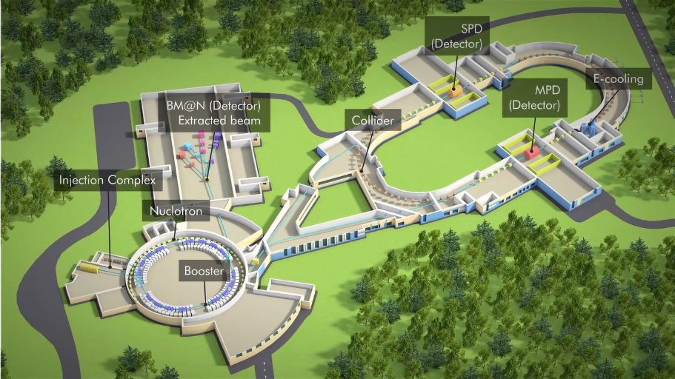
NICA complex research infrastructure:
1st stage:
Injection complex: ion sources & linear accelerators;
Booster, Nuclotron &Collider rings;
BM@N & MPD detectors.
2^{d} stage:
SPD, applied research area, computer center
Requirements: intensive beams of relativistic ions from p to Au & polarized p and d with energy up to √S_{NN}= 11 GeV(Au⁷⁹⁺) and 27 GeV(p)
Main targets of the NICA complex:
study of hot and dense baryonic matter properties;
investigation of nucleon spin nature & polarization phenomena

Slide 2
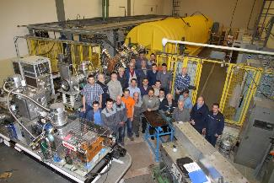
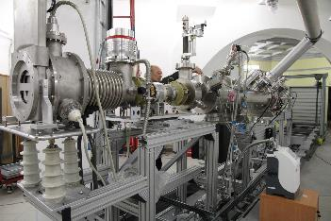
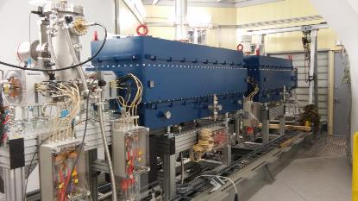
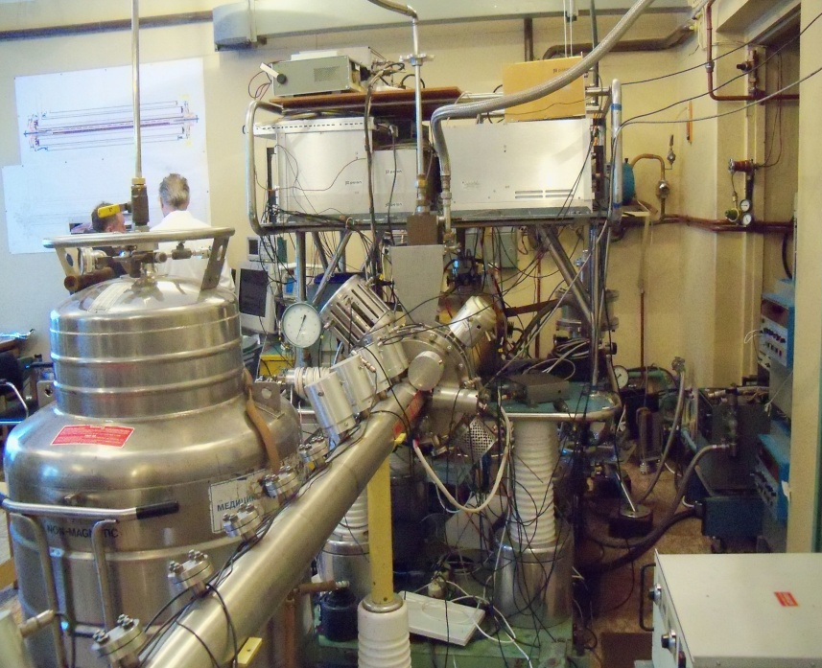
Injection complex
Parameters of Particle Sources of NICA Injection Facility
Source | KRION-6T | Laser source | Duoplasmotron | SPI*)
Particles | Au ³¹⁺ | Light ions up to Mg¹⁰⁺ | H⁺, D⁺, He²⁺ | ↑H⁺, ↑D⁺
Particles per cycle | ~ 2.5⋅10⁹ | ~ 10¹¹ | Н⁺, D⁺ ~ 5⋅10¹² Не ²⁺ ~ 10¹¹ | 5⋅10¹¹
Repetition, Hz | 10 (3 pulses for 5 sec) | 0.5 | 1 | 0.2
Includes 4 ion sources and 2 linear accelerators:
LU20 put in operation – 1974
modernization (2011-2017)
HILac put in operation – 2016
Available researches: nanotechnology
*) SPI = Source of Polarized Ions
Parameters of Linear Accelerator of NICA Injection Facility
Linac | LU-20 | HILAC
Acceleration structure (section number) | RFQ + Alvarez type | RFQ (1) + IH DTL (2)
Mass to charge ratio A/Z | 1-3 | 1-6
Injection energy, keV/amu | 150 for A/Z 1-3 | 17
Extraction energy, MeV/amu | 5 (A/Z 1-3) | 3.24 (A/Z = 6)
Input current, mA | up to 20 | up to 10
Length, m | 22 | 11
SPI: new source of polarised particles & linear accelerator LU-20
Krion-6T: SC ESIS type heavy ion source
HILac: new unique linear accelerator of heavy ions for injecting particles into the Booster

Slide 3
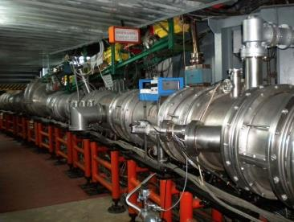
Booster & Nuclotron
Nuclotron - SC synchrotron for acceleration of light and heavy ions, allows to study of relativisric nuclear collisions at A=1-197;
put in operation - 1993, (modernized in 2010-2015)
Available researches:
internal target - polarization phenomena, study of few-body system, search for eta-mesic nuclei;
extracted beam area – search and investigation of phase transitions and critical phenomena of nuclear matter under extremely high baryonic density; search of hypernuclei, strangeness of nuclear matter; study of spin effects and polarization phenomena.
Nuclotron
Parameter | Booster | Nuclotron
Type | SC synchrotron | SC synchrotron
Particles | ions A/Z≤3 | p↑, d↑, nuclei
Injection energy, MeV/u | 3.2 | p↑, d↑ - 5 gold nuclei – 570÷685
Maximum energy, GeV/u | 0.6 | p↑ - 12.07 d↑ - 5.62 gold nuclei – 4.38
Magnetic rigidity, T·m | 1.6 ÷ 25.0 | 25 ÷ 43.25
Circumference, m | 210.96 | 251.52
Cycle duration for collider mode, s | 4.02 (active); 5 (total) | 1.5 ÷ 4.2 (active); 5 (total)
Vacuum, Torr | 10⁻¹¹ | 10⁻⁹
Au Beam intensity, ions/ pulse | 1.5⋅10⁹ | 1⋅10⁹
Transition energy, GeV/u | 3.25 | 7.0
RF range, MHz | 0.5 – 2.53 | 0.6÷ 6.9 (p↑, d↑) 0.947÷1.147 (nuclei)
Spill duration of slow extraction, s | up to 10 | up to 10
3D model of the Booster
Booster- SC synchrotron for acceleration of
Light and heavy ions; is under construction;
start operation in 2019.
Available researches: applied researches in medicine, radiobiology, microelectronic damages, materials science

Slide 4
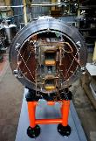
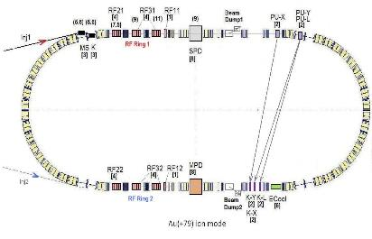
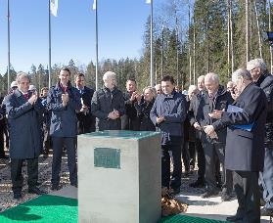
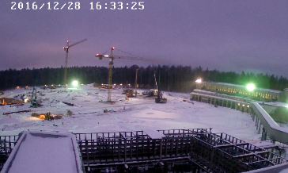
Collider
Is under construction, start operation in 2020;
General responsibility – Strabag(Austria).
Ring circumference, m | 503,04
Number of bunches | 22
r.m.s. bunch length, m | 0,6
β, m | 0,35
max. int. Energy, Gev/u | 11,0
r.m.s. Δp/p, 10⁻³ | 1,6
IBS growth time, s | 1800
Luminosity, cm⁻² s⁻¹ | 1·10²⁷
Available researches:
study of the hot and dense baryonic matter under an
extreme conditions, search for the phase transition
and critical point;
study of the nucleon spin nature and polarized phenomena.
The agreement between the Government of the RF and JINR on the establishment and operation of the Complex of Superconducting Rings for Heavy Ion Colliding Beams NICA was signed on the 27th of April 2016.
Collider structure and main parameters:
magnetic field 45 T m; energy 4.5 GeV/u for Au⁷⁹⁺

Slide 5
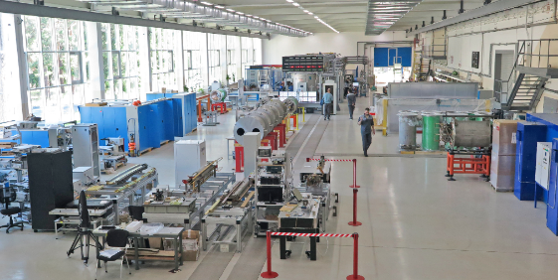
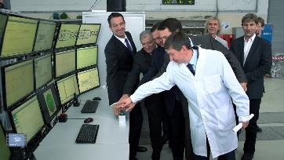
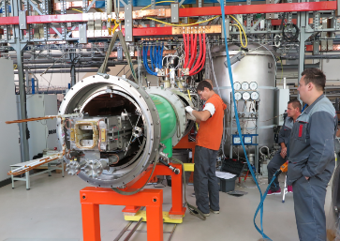
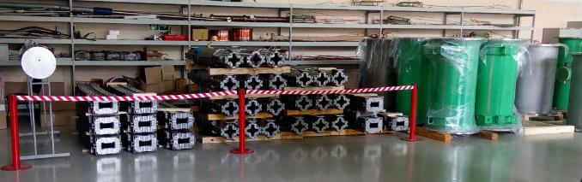
Workshop for SC magnet fabrication& certification
Special area for fabrication, tests and certification of SC magnets for NICA Booster, Collider and for the FAIR accelerator SIS 100 is in operation.
Full number of SC magnets (dipoles, quadruples, correctors) to be produced: for NICA – 360 units, for SIS100 – 310 units.
The workshop productivity – 3 units per week
Workshop areas:
fabrication of SC coils;
mechanical assembly;
magnetic measurements;
vacuum tests;
cryogenic tests
Serial fabrication of the
Booster magnets started
28.11.2016

Slide 6
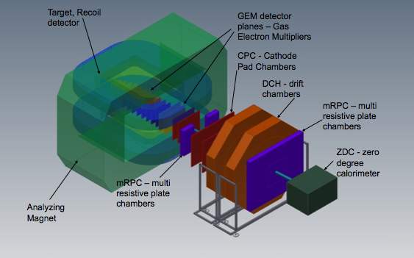
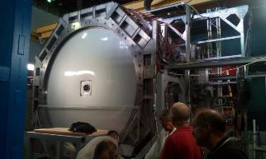
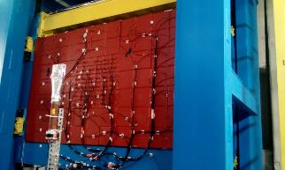
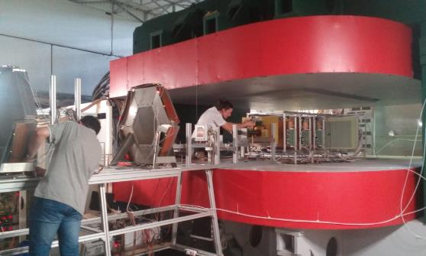
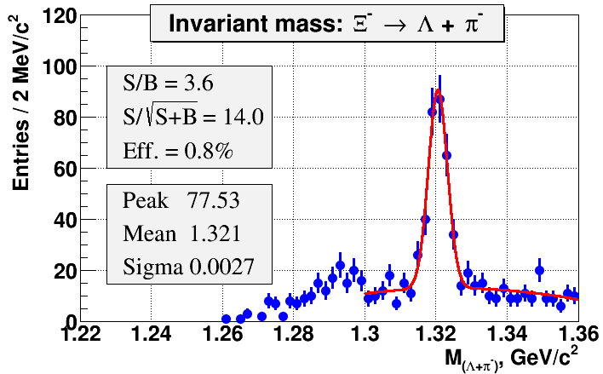
BM@N
Fixed target experiment, 1st stage of the NICA; experiment operates.
Scientific program: study of hyperon & hypernuclei production, hadron femtoscopy, in-medium effects for strange & vector mesons, electromagnetic probes (optional)

Slide 7
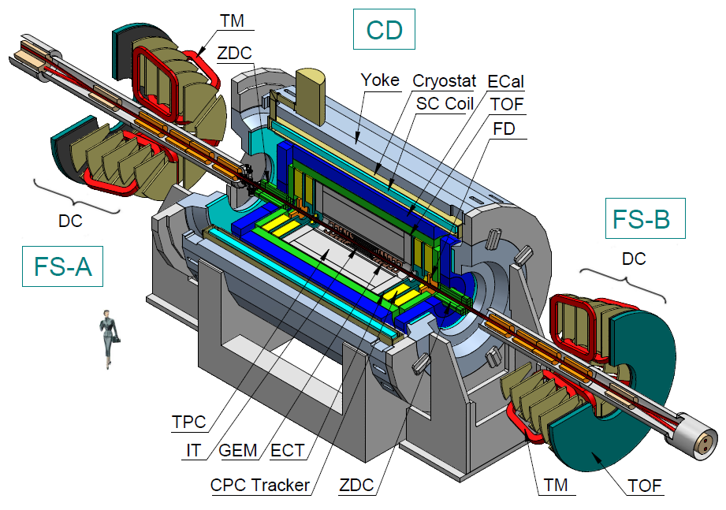
MPD
Main parameters:
9 m length, 6 m in diameter;
Magnet: 0.66 T, SC solenoid;
Tracking: TPC, IT, ECT;
ParticleID: TOF, ECAL, TPC;
T0, Triggering: FFD;
Centrality, Event plane: ZDC
MPD first stage program:
- search for phase transitions (observables – particle yields and spectra) including partial restoration of chiral symmetry (observables – yields of di- leptons);
- search for the critical end-point (observables – event by event fluctuations, particle correlations)

Slide 8
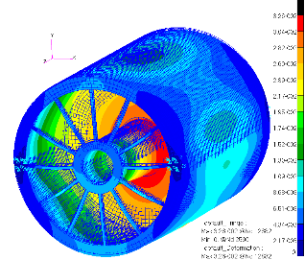
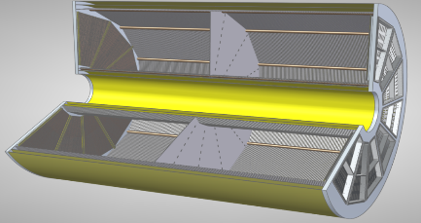
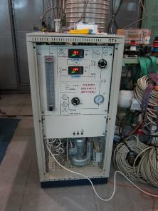
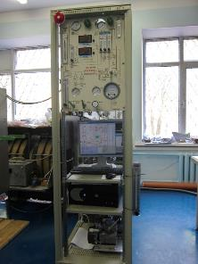
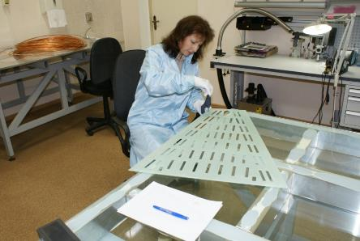
MPD TPC workshop
Main tracking & PID detector; works are going in accordance with the schedule
Sketch of TPC
HV-electrode
~ 28 kV
TPC deformation:
max = 32 µm
3400
Ø2800
12 Readout
chamber
E
E
beam
beam
~ 110 000 readout channels
gas system: delivery to JINR in I 2017
RoC chambers preparation

Slide 9
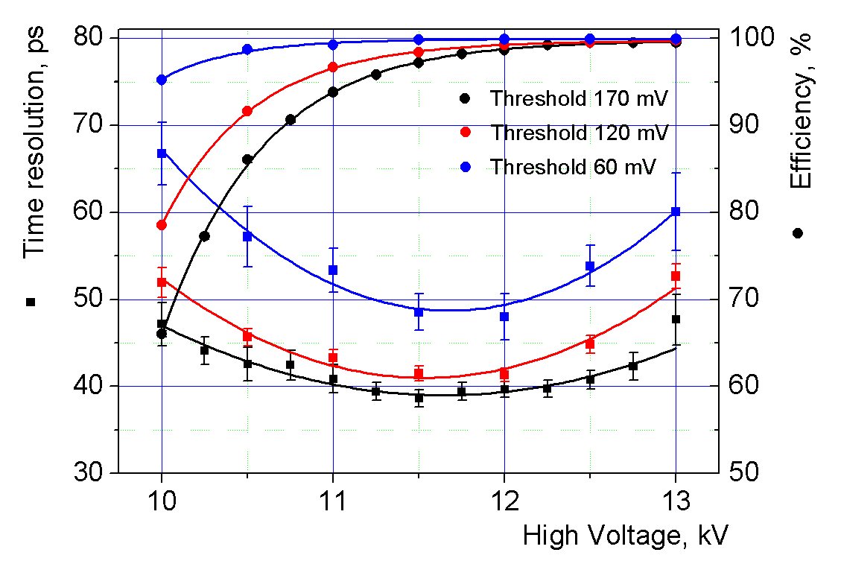
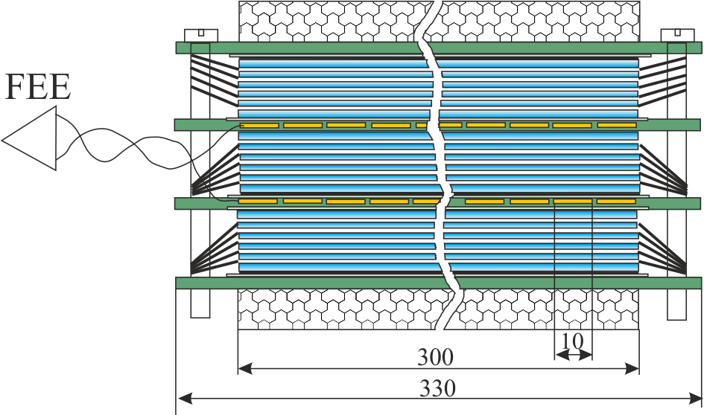
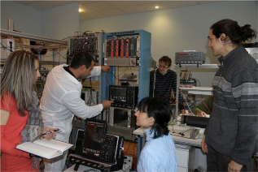
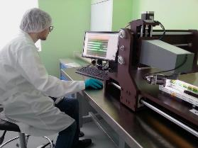
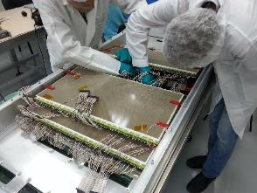
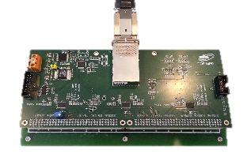
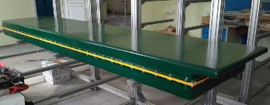
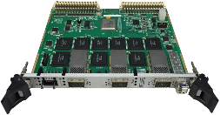
MPD TOF workshop
ARTMASH (Minsk, Belarus)
Provides PID; Active area of TOF barrel ~56 m²
Number of channels 13 824
MRPC
Workshop for the TOF mass-production
Notes:
The TOF module housing was developed in close collaboration with NC PHEP BSU and “Artmash” (Minsk, Belarus). It consists of two volumes: the volume for detectors filled with the gas mixture and the volume for electronics and cables. One prototype of the module housing is available now. Total 28 boxes planned to produce to the end of the year.

Slide 10
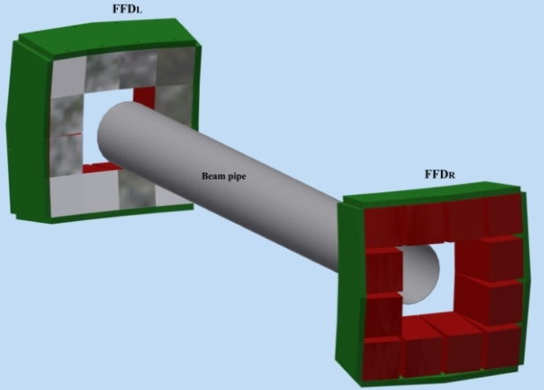
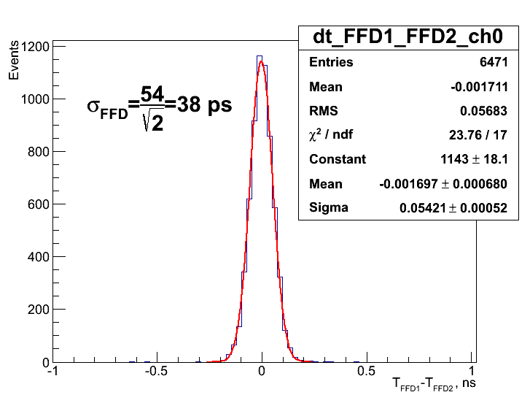
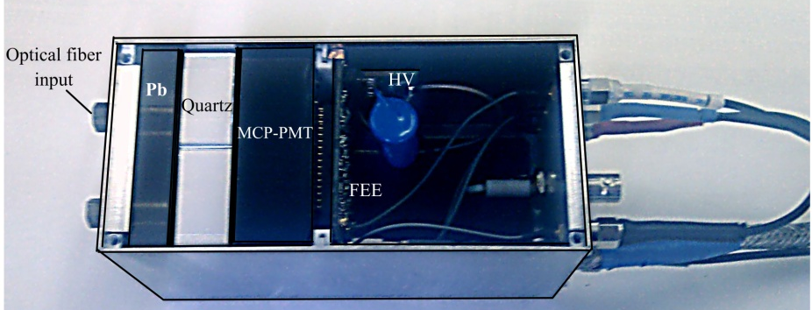
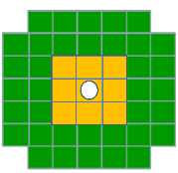
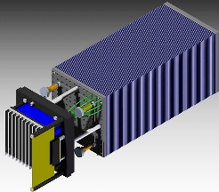
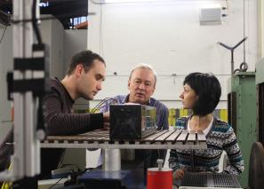
MPD FFD
Provides: T₀ for TOF, beam adjustment & collision L0-trigger
the achieved time resolution fits the requirement
FFD prototype module
Status: production in accordance with the schedule.
MPD FHCAL
MPD ECAL
PID; L ~ 14 X₀, Pb+Scint. read-out: WLS fibers + MAPD
E_{out}
E_{in}
Provides centrality
definition
Status: production

Slide 11
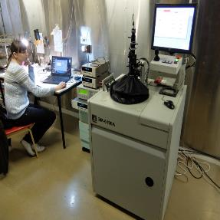
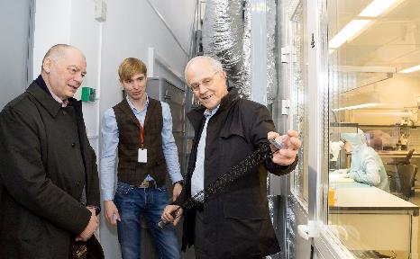
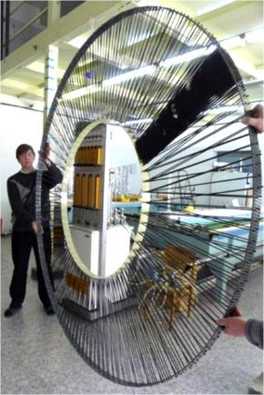
MPD Silicon inner tracker workshop
Provides tracking; CBM-MPD consortium for R&D and production of inner tracker (IT) modules
CERN & JINR have signed MoU for manufacturing the STS carbon fiber space frames for NICA (BM@N & MPD) and FAIR.
the clean room workshop
has started operation in 2015.
Straw Tube Tracker workshop
Provides tracking in the MPD endcap;
unique technology of material-less large
area drift tube detectors was developed at JINR.
Used at COMPASS,ATLAS, CBM, BM@N, MPD and other
Experiments.
prototype (wheel) of the detector

Slide 12
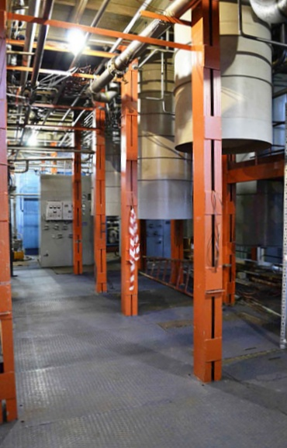
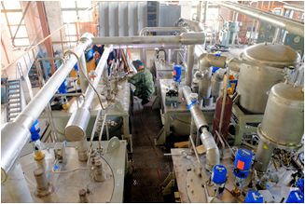
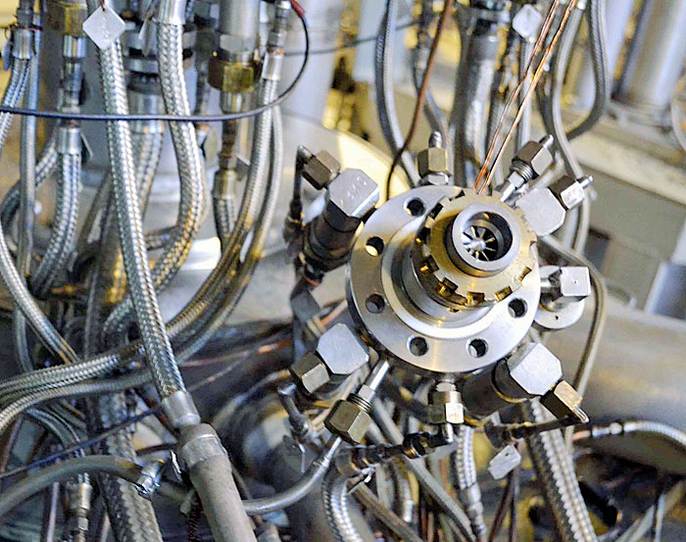
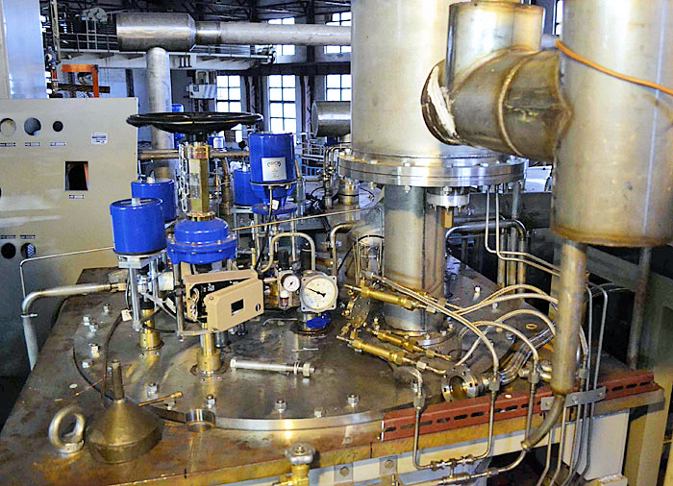
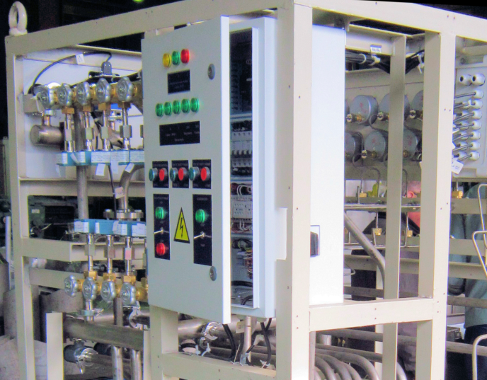
Cryogenic complex
Nuclotron cryogenic system represents a rather enterprising project involving a large number of technical ideas and solutions never used before:
- Fast cycling superconducting magnets
- Refrigeration by two-phase helium flow
- Unusually short cool down time to liquid helium temperature
- Parallel connection of about 150 cooling channels
- Using jet pumps for circulating of liquid helium
- «Wet» turbo expanders
- Screw helium compressors with a pressure rise of more than 25
It has allowed the creation of not only a very efficient and reliable system, but also one, which is unusually inexpensive.
Complex cooling power:
Current - 4kW at 4,5K
Expected in 2020 - 8kW at 4,5K
In 2016 new helium liquefier, most
powerful in RF, with productivity
1100 l/h was put in operation.

Slide 13
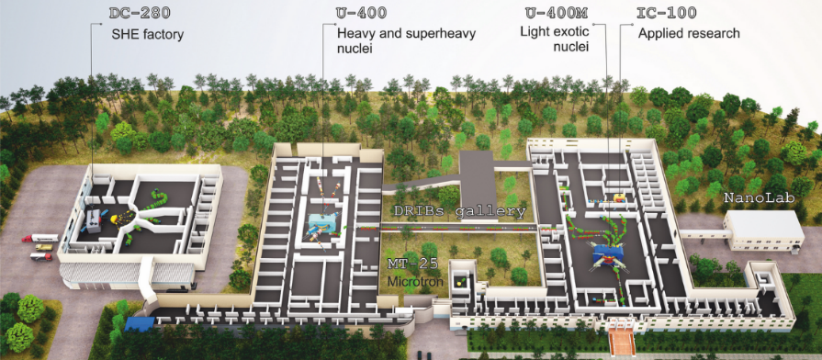
DRIBS-III ACCELERATOR COMPLEX
Flerov Laboratory of Nuclear Reactions basic directions of research:
Heavy and superheavy nuclei
Light exotic nuclei
Radiation effects and physical groundwork of nanotechnology
Accelerator technologies
Notes:
13

Slide 14
U-400 ACCELERATOR COMPLEX
NUCLEAR SPECTROSCOPY AND REACTION MECHANISMS
Main parameters
Energy range | 3÷21 MeV/A
K factor max. | 650
Pole diameter | 4 m
Magnet weight | 2100 t
Magnet power | 850 kW
Vacuum | 10⁻⁷ Torr
Ion | Ion energies [MeV/A] | Output intensity [pps]
¹⁶O²⁺ | 5.7; 7.9 | 3×10¹³
¹⁸O³⁺ | 7.8; 10.5; 15.8 | 2.6×10¹³
⁴⁰Ar⁴⁺ | 3.8; 5.1 | 1×10¹³
⁴⁸Ca⁵⁺ | 3.7; 5.3 | 7.2×10¹²
⁴⁸Ca⁹⁺ | 8.9; 11; 17.7 | 6×10¹²
⁵⁰Ti⁵⁺ | 3.6; 5.1 | 2.4×10¹²
⁵⁸Fe⁶⁺ | 3.8; 5.4 | 4.2×10¹²
⁸⁴Kr⁸⁺ | 3.1; 4.4 | 1.8×10¹²
¹³⁶Xe¹⁴⁺ | 3.3; 4.6; 6.9 | 4.8×10¹¹
¹⁶⁰Gd¹⁹⁺ | 5.5 | 6×10¹⁰
²⁰⁹Bi¹⁹⁺ | 3.4 | 6×10¹⁰
Commissioned: 1978
Modernized: 1996
Reconstruction: 2020-2023 (plan)
Tasks:
Stand-alone mode:
Synthesis of superheavy elements (SHE)
Chemistry of SHE
Nuclear & laser spectroscopy
Nuclear reactions: fusion, fusion-fission &
quasi-fission, multi-nucleon transfer reactions
Applied research
Post-accelerator mode:
Reactions with exotic nuclei
Structure of light exotic nuclei
Experimental setups:
Gas-Filled Recoil Separator (DGFRS-I)
Separator for Heavy Elements Spectroscopy (SHELS)
Radio-chemical setups
Double-arm time-of-flight spectrometer (CORSET)
Magnetic Analyzer of High Resolution (MAVR)
Notes:
14

Slide 15
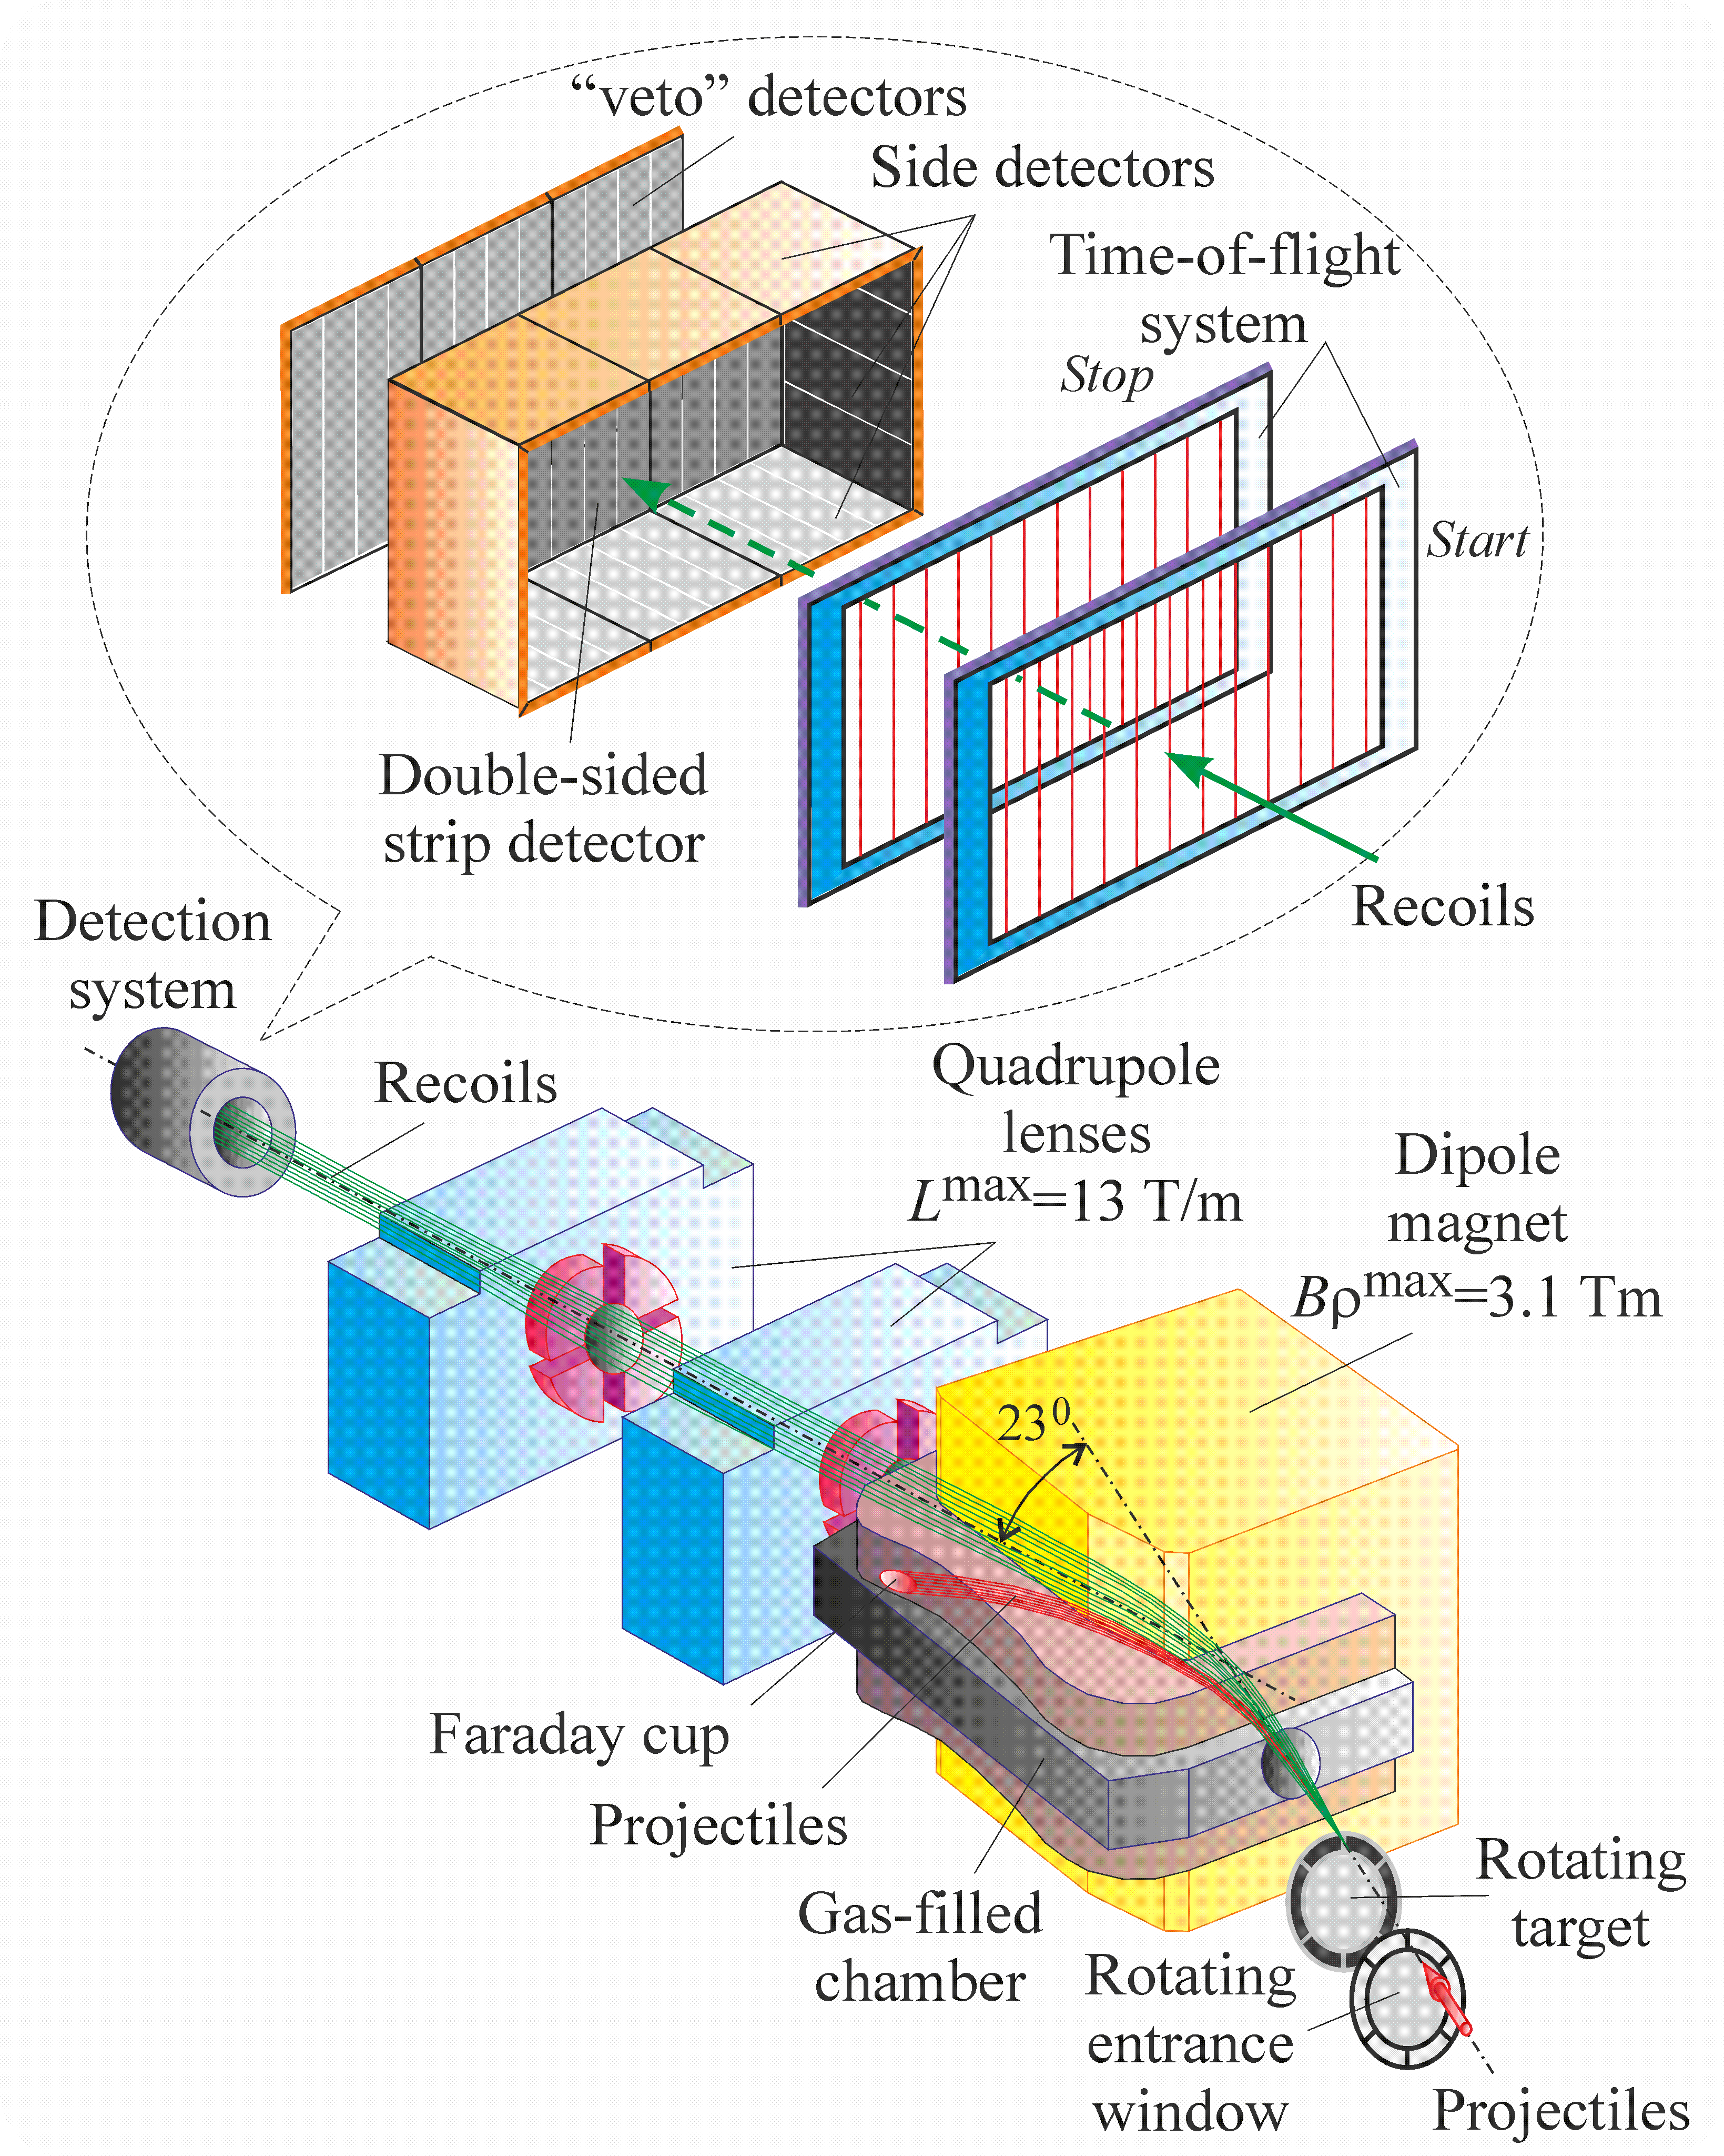
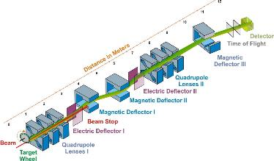
GAS-FILLED RECOIL SEPARATOR (DGFRS-I)
Technical parameters
Bending radius | 1.8 m
Max. magnetic rigidity Bρ | 3.1 T m
Bending angle | 23º
Dispersion | 7.5 mm/1%Bρ
Total length | 4.2 m
Horizontal acceptance | ±3º
Vertical acceptance | ±2º
Transmission efficiency
Reaction | CN | ε (%)
²³⁸U + ¹⁸O | ²⁵⁶Fm | 3
²³⁵U + ²²Ne | ²⁵⁷No | 6
²⁴⁴Pu + ²²Ne | ²⁶⁶Rf | 6
²³⁸U + ²⁶Mg | ²⁶⁴Rf | 10
²⁰⁷Pb + ³⁴S | ²⁴¹Cf | 35
²⁰⁷Pb + ⁴⁰Ar | ²⁴⁷Fm | 45
²³⁸U-²⁴⁹Cf + ⁴⁸Ca | ²⁸⁶Cn - ²⁹⁷Og | 35 - 40
Si DSSD detector,
48x128 1-mm strips
Digital electronics
Synthesis and decay properties of SHE
SEPARATOR FOR HEAVY ELEMENTS SPECTROSCOPY (SHELS)
E_{gamma} (keV) | Detection eff.
100 | 34 %
200 | 26 %
300 | 22 %
400 | 17 %
500 | 14 %
Reaction | Transmission efficiency
²²Ne(¹⁹⁷Au,5n)²¹⁴Ac | 0.1
⁴⁰Ar(²⁰⁸Pb,3n)²⁴⁵Fm | 0.3
⁴⁸Ca(²⁰⁸Pb,2n)²⁵⁴No | 0.35
⁵⁰Ti(²⁰⁸Pb,2n)²⁵⁶Rf | 0.4
Si DSSD detector,
100x100 mm^{2,} 128 x 128 strips,
High resolution electronics
4 Ge single crystal detectors,
1 Clover Ge detector
Study of nuclear reaction mechanisms and
α−,β−,γ−,n− spectroscopy of heavy and SH nuclei
Notes:
15

Slide 16

U-400M
EXPERIMENTS WITH RADIOACTIVE ION BEAMS
Beams (examples)
Ion | Ion energies [MeV/A] | Output intensity [pps]
⁷Li | 35 | 6×10¹³
⁴⁰Ar | 40 | 1×10¹²
⁸⁴Kr | 27 | 2×10¹⁰
¹³²Xe | 25 | 1×10⁹
⁴⁸Ca | 4.5-9 | 3×10¹²
⁸⁴Kr | 4.5-9 | 1×10¹¹
¹³²Xe | 4.5-9 | 1×10¹⁰
²⁰⁹Bi | 4.5-9 | 1×10¹⁰
Main parameters
Energy range | 5÷10 & 25÷55 MeV/A
K factor max. | 550
Pole diameter | 4 m
Magnet weight | 2300 t
Magnet power | 1000 kW
Vacuum | 10⁻⁷ Torr
Commissioned: 1991
Modernized: 1996
Reconstruction: 2019 (plan)
Tasks:
Stand-alone mode:
Properties and structure of light exotic nuclei
Reactions with exotic nuclei
Decay properties of nuclei at drip lines
Mass & laser spectroscopy of heavy nuclei
Applied research
Driving accelerator mode:
Production of beams of radioactive nuclei
Experimental setups (high-energy mode):
ACCULINNA-1 fragment separator
ACCULINNA-2 fragment separator
COMBAS fragment separator
Experimental setups (low-energy mode):
Mass Analyzer of SuperHeavy Atoms (MASHA)
Gas-cell based Laser ionization Setup (GaLS)
Correlation setup for the reaction products registration (CORSAR)
Notes:
16
Beam intensity of Ca-48 up to 2.5 mkA
Ion energy variation on the target with factor 5
Cyclotron average magnetic field from 1.8 up to 0.8 T

Slide 17




FRAGMENT SEPARATORS ACCULINNA-I, II
DOUBLE-ARM TIME-OF-FLIGHT
SPECTROMETER (CORSET)
RIB* | Intensity, pps (at 1 pμA) | Energy, MeV/A
⁶He | 4x10⁷ | 22
⁶He | 1x10⁷ | 13
⁸He | 8x10⁴ | 23
¹¹Li | 7x10³ | 33
¹⁴Be | 2x10³ | 35
¹⁵B | 4x10⁵ | 32
¹⁶C | 2x10⁷ | 29
¹⁸C | 1x10⁴ | 25
²⁴O | 2x10³ | 23
⁸B | 2x10⁶ | 16
¹³O | 1x10⁶ | 24
¹⁷Ne | 2x10⁶ | 30
²⁴Si | 7x10³ | 12
²⁸S | 1x10³ | 38
Time resolution | 150-180 ps
ToF base | 10-30 cm
ToF arm rotation range | 15°-165°
Solid angle | 100 -200 msr
Angular resolution | 0.3°
Mass resolution | 2-4 u
Energy resolution | 1%
* - expected RIB’s characteristics at ACCULINNA-2; RIB’s intensities for ACCULINNA-1 are lower by factor of ~20
http://aculina.jinr.ru/acc-2.php
Study of the mechanisms of heavy-ion-induced reactions (fusion-fission, quasifission and deep inelastic processes)
Experiments with radioactive beams with Z≤36

Slide 18

DC-280
SUPERHEAVY ELEMENTS FACTORY
Main parameters
Range of energies | 4÷8 MeV/A
K factor max. | 280
Pole diameter | 4 m
Magnet weight | 1000 t
Magnet power | 300 kW
Vacuum | 10⁻⁷ Torr
Beams (examples)
Ion | Ion energy [MeV/A] | Estimated output intensity [pps]
⁷Li | 4 | 1×10¹⁴
¹⁸O | 8 | 1×10¹⁴
⁴⁰Ar | 6 | 6×10¹³
⁴⁸Ca | 6 | 6×10¹³
⁵⁴Cr | 6 | 2×10¹³
⁵⁸Fe | 6 | 1×10¹³
¹²⁴Sn | 6 | 2×10¹²
¹³⁶Xe | 6 | 1×10¹⁴
²³⁸U | 7 | 5×10¹⁰
Commissioning: 2017 (plan)
Tasks:
Experiments at the extremely low (σ<100 fb) cross sections:
Synthesis of new SHE in reactions with ⁵⁰Ti, ⁵⁴Cr ...;
Synthesis of new isotopes of SHE;
Study of decay properties of SHE;
Study of excitation functions.
Experiments requiring high statistics:
Nuclear spectroscopy of SHE;
Precise mass measurements;
Study of chemical properties of SHE.
Main setups:
Gas-filled recoil separator (DGFRS-II);
Preseparator for chemical investigations;
Separator for Heavy Element Spectroscopy: velocity filter SHELS – from U-400;
Mass Analyzer of SuperHeavy Atoms (MASHA) – from U-400M
Channels reserved for external users
Notes:
18

Slide 19



GAS-FILLED RECOIL SEPARATOR (DGFRS-II)
Synthesis and study of superheavy nuclei
Simulated yields of Fl isotopes as functions of the PuO₂ target thickness for the DGFRS-I, II
Technical parameters
Magnetic configuration | Q_{v}D_{h}Q_{v}Q_{h}D
Bending radius D₁ | 1.8 m
Max. magnetic rigidity D₁ | 3.2 T m
Bending angle D₁ | 30º
Bending radius D₂ | 1.8 m
Max. magnetic rigidity D₂ | 3.2 T m
Bending angle D₂ | 10º
Total length | 7.1 m
Q₁
D₁
DGFRS-II
Q₂
Q₃
D₂
DGFRS-I
Si DSSD detector,
48 x 128 1-mm strips
Digital electronics
SEPARATOR MASHA
for Mass Analysis
of SuperHeavy Atoms
SUPERCONDUCTING PRE-SEPARATOR
FOR SHE CHEMISTRY
1 – target box with hot catcher;
2 – ion source;
3 – mass analyzer;
4 – focal plane detector
interface for transport of nuclear reaction products to radiochemical setups for study of the properties of SHE in elementary state and investigations of the behavior of their chemical compounds.
under design
Main parameters
Mass resolution | ~3000
Ion source efficiency for noble gas | ~84 %
Separation efficiency for short-lived mercury isotopes | ~7 %
Separation time | 1.8 sec
Notes:
19

Slide 20















IBR-2 pulsed fast reactor of periodic operation
High flux neutron source
Some spectrometers
DN-6
diffractometer
NRT
spectrometer
Technical parameters
Power, MW Mean value Burst maximum | 2 1850
Fuel | PuO2
Pulse repetiton rate, Hz | 5
Pulse half-width, µs fast neutrons thermal neutrons | 240 340
Termal neutron flux density from the surface of the moderator Time average Burst maximum | ~10¹³ n/cm² s ~10¹⁶ n/cm² s
Novel type of the charge ordering state in iron oxide Fe₄O₅ involving competing dimer and trimer formation
Neutron tomography reconstructed model with “hidden” gilding pattern
microsamples under extreme conditions (P ≤ 0.5 Mbar)
radiography tomography
Open access facility
http://ibr-2.jinr.ru/
HRFD
Fourier diffractometer
YuMO
SANS setup
Technique | Nr. of instruments
Diffraction | 7
SANS | 1
Reflectometry | 3
Inelastic scattering | 2
Neutron imaging | 1
NAA setup | 1
Irradiation and test facility | 1
Nuclear physics | 2
Fullerenes complexation with antitumor drugs
A structural study of the Fe-Al phase diagram
structural parameters of crystalline materials
structural of polymers, lipid membranes, proteins, solvents, etc.
Irradiation facility
NAA facility
Radiation damage of electronic boards
Retrospective pollution study of the deep sea sediments
investigation of material radiation hardness at high fluence
multi-elemental analysis
in life and material sciences

Slide 21


IREN Facility
source of resonance neutrons
Multifunctional “CARS” microscope
Main research areas:
Raman, SERS and CARS spectroscopy and microscopy of biological objects: sensitive probes of lipids, lipids bilayers, proteins, thin and small objects; fast dynamic scanning and contrast chemical imaging;
Exploration of structural and spectral characteris-tics of phosphors active-ted with various rare-earth elements;
Plasmon enhanced photo- and upconversion lumines-cence studies.
Technical parameters
Peak current, A | 3
Repetition rate, Hz | 50
Electron pulse duration, ns | 100
Electron energy, MeV | 30
Beam power, kW | 0.4
Multiplication | 1
Neutron intensity, n/s | 10¹¹
Technical parameters
Main operating options | Raman, F-CARS, E-CARS, P-CARS, SERS, SECARS, luminescence, including upconversion
Detection options | Five channels for high-speed measurements: Raman, CARS, reflected, transmitted, luminescent
Spectral detectable range | CARS signals: 990 – 5000 cm⁻¹ ; Raman signals: 75 – 6000 cm⁻¹
Spectral resolution | CARS signals: 7-8 cm⁻¹; Raman signals: 1.8 cm⁻¹ (grating 600 g/mm)
Spatial resolution | CARS signals: < 0.7 μm; Raman signals: XY: < 300 nm, Z: ~ 700 nm
Scanning range (fast mode, 60x lens) | XY: 225 х 225 μm; Z: 80 μm
Spectral measurements and imaging | Monochromator/spectrograph MS5004i Digital CCD camera, Proscan, HS 101H
Main research areas:
FUNDAMENTAL NUCLEAR PHYSICS
search for violation of time invariance with polarized resonance neutrons and polarized target;
study of parity violation in neutron induced reactions (fission, (n,α), (n,p), (n,γ));
electromagnetic structure of the neutron;
quantum aspects of neutron induced fission;
phase transitions in excited nucleus - chaos and order in quantum systems.
APPLIED NUCLEAR PHYSICS
nuclear data for astrophysics;
nuclear data for technology;
isotope analysis with resonance neutrons.

Slide 22



Van-de-Graaff Electrostatic accelerator EG-5
Technical parameters
Energy region, MeV | 0.9-3.2
Accelerated particles | H+, D+, ³He+, ⁴He*
Beam intensity for 𝐻+ and D+, μA | ≤30
Beam intensity for ³𝐻𝑒+ and ⁴He*, μA | ≤10
Energy spread, eV | ≤ 500
Number of beam lines | 6
Experimental chamber
Results on ERDA experiment
Scientific directions
Analytical studies using Rutherford backscattering techniques, methods and techniques of nuclear reactions recoil.
The study of nuclear reactions with neutrons excited by beams of protons and deuterons.
Applied research based on the methodology of tagged neutrons
Notes:
Если информацию оставим, схему ускорителя перерисовывать. Она из интернета.

Slide 23





BAIKAL-GVD project
~2300 OM (2020)
8 clusters
Since April 2016
taking data
300 m
April 2017
Dubna (2015)
Physics Goals:
Neutrino astrophysics above 1 TeV
Dark matter – indirect search
Exotic particles – monopoles, Q-balls, nuclearites, …
~600 m
104º25’ E; 51º46’ N
~1 km
120 m
Notes:
На рисунке представлен планируемый к 2020 г. детектор, состоящий из 8 полномасштабных кластеров подобных тому, который был установлен в 2016 г. В 2017 г. планируется поставить за зимнюю экспедицию еще одну такую же установку.

Slide 24

Neutrino experiments at Kalinin NPP
(Tver region, 285 km NW from Dubna)
Pressurised water reactor;
Termal power 3 100 MW;
Neutrino flux ~ 6 10²⁰ ν_{e}
GEMMA
(Neutrino Magnetic Moment)
νGeN
(Coherent ν-Ge scattering)
DANSS
(reactor monitoring and search for sterile neutrino oscillations)
Notes:
Общая (вводная) картинка к экспериментам DANSS, NuGEN и GEMMA

Slide 25




DANSS
Detector of AntiNeutrino based on Solid state Scintillator
Reactor monitoring and search for short-range neutrino oscillations
Segmented "XY" plastic scintillator (1 m³ =1.1 tn) close to the core of the Kalinin NPP reactor №4
Overburden 50 m w.e. (reactor cauldron, cooling pond, concrete)
3D-information about each event
IBD count rate / day; Signal / BG ≥ 100
Lifting platform => distance variable on-line (L ≈ 10.7-12.7 m)
Status: data taking
Reactor core
DANSS
Notes:
Для нейтринной диагностики промышленных ядерных реакторов, а также для поиска короткопробежных осцилляций нейтрино в стерильное состояние нами совместно с ИТЭФ создан детектор реакторных антинейтрино – DANSS.
Отличительная особенность нашего нейтринного детектора – это то, что он представляет собой не традиционно используемый кубометр жидкого сцинтиллятора (едкая токсичная жидкость вроде керосина, которую из соображений безопасности просто нельзя располагать близко от реактора), а твердый сцинтиллятор на основе полистирола. Это позволило установить детектор в непосредственной близи от мощного промышленного реактора (на рисунке позиция детектора под котлом ВВЭР-1000 Калининской АЭС показана цветным квадратиком) и исследовать экстремально большие нейтринные потоки, что делает наш детектор на порядок более чувствительным по сравнению с другими (существующими или проектируемыми) аналогичными детекторами – даже грубый предварительный анализ данных показывает, что мы надежно регистрируем несколько тысяч ОБР-событий в сутки.
Близкое к реактору расположение детектора не только дает аномально высокий нейтринный поток, но и обеспечивает хорошую защиту от космического фона. Действительно, над нашим детектором расположена огромная масса самого реактора с 70 тоннами урана, толстый слой бетонной защиты и, главное – многометровый слой воды в бассейне выдержки отработанного топлива! Все это надежно прикрывает сверху наш детектор, полностью убирая быстрые нейтроны от космики, которые являются основным источником фона для такого рода детекторов. Все наши конкуренты лишены такой защиты.
Высокая сегментация детектора (он состоит из 2500 независимых элементов в виде перекрещенных X- и Y-полос) обеспечивает трехмерную картину каждого события ОБР, что позволяет значительно ужесточить условия отбора событий и тем самым дополнительно подавить фон, который в итоге не превышает нескольких процентов.
Подъемный механизм позволяет за 5 минут переместить детектор на 2 метра по вертикали, не выключая его. Таким образом, можно измерять эволюцию нейтринного потока с расстоянием, максимально исключив возможные систематические ошибки, присущие подобным экспериментам в иной постановке (с неподвижными детекторами).
Слайд и описание составил В.Егоров (egorov@jinr.ru)

Slide 26



Neutrino laboratory under KNPP power generation units №2 & 3
Low energy semiconductor neutrino detectors
Main feature: maximal available electron antineutrino flux at 5.4х10¹³ cm⁻² sec⁻¹
Infrastructure:
Passive and active shields;
Modern data acquisition systems;
Supplementary neutron-, γ-, μ- detectors for monitoring of ambient backgrounds;
The platform allowing 2.5 m vertical lifting detectors with shields. These changes in distance between the neutrino source (reactor) and detectors is crucial for discrimination of neutrino signals from background.
In the present time there are two experiments:
νGeN: first ever detection of coherent neutrino - nucleus elastic scattering
GEMMA: measurement of electron antineutrino magnetic moment with sensitivity level µ_{ν}~ 10⁻¹¹µ_{B}

Slide 27
Multifunctional Information and Computing Complex at JINR
JINR grid sites of WLCG/EGI: Tier-1 for CMS
Tier-2 for ALICE, ATLAS, CMS, STAR, LHCb,
BES, biomed, fermilab
Cloud infrastructure
Heterogeneous(CPU + GPU)
computing cluster HybriLIT
Off-line cluster and storage system for BM@N, MPD,
SPD Storage and computing facilities for local users
Network infrastructure
Engineering infrastructure
The Multifunctional Information and Computing Complex (MICC) is a basic facility of JINR. It provides a 24×7 implementation of a vast range of competitive research conducted at JINR at a global level.
The core of the entire computing infrastructure of the Institute is JINR Central Informational Computing Complex with powerful high-performance computing facilities integrated into the world’s information and computing resources via high-speed communication channels.

Slide 28






Network and telecommunication channels
JINR Local Area Network
Comprises 7946 computers & nodes
Users – 4298, IP – 13056
Remote VPN users – 370
E-library- 1501, mail.jinr.ru-2355
LAN high-speed transport -10 Gb/s)
Tier-1 & 2 JINR participation in Worldwide Computing Grid (WLCG)
Grid Tier-1 is one of the 7 centres in the world intended for large-scale processing of experimental and event-modeling data coming from the centres of Tier-0 (CERN), for the CMS experiment.
This cluster also provides carrying out computations, including the parallel ones, outside the grid-environment. They are asked both by the experiments NoVA, PANDA, BES, NICA/MPD, etc.

Slide 29


HybriLIT
Heterogeneous computing cluster “HybriLIT” is intended for carrying out calculations using parallel programming technologies. The heterogeneous structure of the computing nodes in the cluster can significantly speed up mathematical calculations by selecting the optimal parallelization technology that takes into account both the specifics of the problem being solved, and the features of computational accelerators – Nvidia graphic processors and Intel Xeon Phi co-processors.
JINR Cloud
One of the most important trends in the cloud technologies is the development of method of integrating various cloud infrastructures.
In order to join the cloud resources of partner organizations from JINR Member State for solving common tasks as well as to distribute a peak load across them, a cloud bursting driver has been designed by the JINR cloud team. It allows one to integrate the JINR cloud with the partner clouds either OpenNebula-based one or any other cloud platform which supports Open Cloud Computing Interface (OCCI).

Slide 30





Monitoring system
The monitoring system of the JINR Computing Complex has been developed and put into exploitation.
System allows one, in a real time mode, to observe the whole computing complex state and send the system alerts to users via e-mail, sms, etc.
690 elements are under observation
3497 checks in real time
Engineering infrastructure
To get meaningful and secure MICC work able to provide fault tolerance in accordance with the ANSI/TIA EIA 942 standard, it is necessary to supply the hall where MICC is located with special conditions on microclimate, special requirements for its power supply.
The close-coupled, chilled water cooling InRow hot and cold air containment system and MGE Galaxy 7000 – 2x300 kW energy efficient solutions 3Ph power protection with high adaptability were put into operation.

Slide 31









Laboratory of Radiation Biology
Equipment:
For work with cell cultures
Sterile laboratory rooms, laminar boxes, exhaust hoods, CO₂ thermostats, cell analyzers
For cytogenetic research
Direct and inverted microscopes, flow cytofluorimeters, shakers, vibration mixers, centrifuges
For molecular research
Fluorescent microscopes, Synergy™ H1 is a flexible monochromator-based multi-mode microplate reader, PCR amplifiers, gel documenting systems, ultrahigh-speed centrifuges

Slide 32


Laboratory of Radiation Biology
Equipment:
For astrobiological research
Scanning electron microscopy:
Search for microfossils (fossil prokaryotes and protists) in early Pre-Cambrian terrestrial rocks and meteorites
Studying the morphology of microfossils and fossil microbe communities
Analysis of sample chemical composition based on X-ray energy dispersive microanalysis
Cosmic dust research
For tests and calibration of nuclear planetary science instruments
DAN experimental stand
DAN (dynamic albedo of neutrons) is an experimental stand for testing nuclear planetary science instruments equipped with fast neutron generators. The housing provides a low scattered neutron background and allows testing instruments with different planetary soil models. The planetary regolith model is based on a silicate glass pack with a total weight of up to 35 tons, which is a model of an absolutely dry soil. The presence of water in the soil is modeled by polyethylene layers at different depths. For the closest possible approximation to the chemical composition of the Martian regolith concerning Fe, Al, and Cl, thin layers of steel, aluminum, and polyvinyl chloride have been included in the glass pack.

Slide 33



Bogoliubov Laboratory of Theoretical Physics
The Bogoliubov Laboratory of Theoretical Physics (BLTP) is a unique center of the organization and co-ordination of international collaboration in the field of theoretical physics. As one of the largest centers, the BLTP acts as a “generator” of multi- and interdisciplinary studies, thus determining the global scientific agenda of both theoretical and experimental researches. The Laboratory hosts the world’s leading experts in the following lines of investigation: quantum field theory and particle physics, theory of atomic nucleus, condensed matter, and modern mathematical physics. The Laboratory’s scientific and organizational structure is aimed at the development of interdisciplinary and international collaboration. More than 60 foreign researchers (30% of the scientific staff) from JINR Member
States, BRICS countries, EU and other countries work at the BLTP permanently; young specialists are employed on a contract basis. Around 12-15 conferences on urgent problems of modern physics are annually organized at the BLTP at the highest international level.
As the largest organization in the field of modern theoretical physics, the BLTP is the center for training highly qualified scientists for many countries. Young theoreticians have a possibility to attend lectures by the Laboratory’s leading and invited researchers, to participate in seminars on recent scientific achievements, to gain first-hand knowledge of present-day issues and scientific challenges, to be directly involved in advanced investigations and international scientific projects. The Dubna International Advanced School on Theoretical
Physics (DIAS-TH), functioning at the BLTP, organizes and coordinates scientific and educational activities, taking into account the present-day tendencies of the science development. Under the auspices of DIAS-TH, 3-4 intensive topical scientific schools and schools-conferences are organized for young scientists and students from JINR Member States and other countries with attraction of the best lecturers on the subjects of the schools. The traditions and fundamentals of scientific schools established in the Laboratory proved to be efficient in training highly qualified theoretical physicists.
Notes:
The Bogoliubov Laboratory of Theoretical Physics carried out research in several fundamental areas of theoretical physics: quantum field theory and elementary particle physics, theory of atomic nuclei, condensed matter physics and methods of mathematical physics.
Distinctive features of research at BLTP are the interdisciplinary character of investigations, their direct integration into international projects in cooperation with scientists from the world leading research centres, c lose coordination of theoretical investigations with experimental programs of JINR.
The Laboratory played also the role of the training centre for young scientists and students from many countries. In particular young scientists from Armenia, Belarus, Bulgaria, China, Czechia, Egypt, France, Germany, Greece,, Khazakhstan, Moldova, Poland, Portugal, Romania, Russia, Slovakia, South Africa, Ukraine participated in the DIAS-TH schools and seminars. The number of the scientists from different countries working at BLTP on the basis of the longterm contracts has increased, including young scientists from Egypt, Korea, Serbia. Recently concluded framework agreement between BLTP and IOP VAST (Institute of Physics VAST, Vietnam) has boosted scientific contacts of BLTP and Vietnamese scientists.
Traditionally, the rate and quality of BLTP publications during the last several months were at high level.

Slide 34



University Centre. Infrastructure
Current in bunch – 15 μA
Bunch width – 2 μs
Bunch frequency – 10-250 Hz
Focal spot ~ 1 mm can be defocused
up to 20 mm
‘Training' beam – 22 MeV
Linac-200
Basics of nuclear physics
Radiation protection and safety
Particle detectors
Vacuum technology
RF technology
Magnets
Electronics and automation

Slide 35

Proton accelerator of the DLNP JINR (Phasotron)
Basic parameters of the phasotron
Energy of accelerated protons | Тр = (659 ± 6) MeV
Energy dispersion | ΔЕ = (3,1 ± 0,8) MeV
Frequency of proton acceleration cycles (modulation frequency) | 250 Hz
Emittance on boundary of scattered magnetic field of phasotron: horizontal vertical | eх = (5,1 ± 2,3) сm*mрад ey = (3.4 ± 1.4) сm*mрад
Ejected proton beam intensity in "fast" ejection mode (pulse duration is 30 µs) | (2-2,5) µА
Ejected proton beam intensity in "slow" ejection mode (Time-stretched beam within 85% of modulation period duration (~ 4 ms) | (1,6-2,0) µА
The ejected proton beam has a micro-structure: particle bunches of 10 ns duration follow each other with an interval about 70 ns.
Physics research on proton beams:
medico-biological research, mu-catalysis
investigations, nuclear spectroscopy, study of
rare particle decays, µSR study of condensed
matter properties, transmutation investigations.

Slide 36





Proton therapy (Phasotron)
Treatment in JINR uses mostly beams under
200 MeV energy
Proton therapy (SC202)
The SC202 cyclotron is under development by JINR and ASIPP (China). SC202 will provide acceleration of protons up to 200 MeV in 2018. We are planning to replace Phasotron in JINR Medico-technical complex.
Medical cabins
Computer model SС202

Slide 37




Fundamental and Applied research at LEPTA
(Low Energy Particle Toroidal Accumulator)
Positron Annihilation Spectroscopy at the LEPTA Facility
Fundamental Research at the LEPTA Facility
Positron annihilation spectroscopy (PAS) is a sensitive method for detection of open-volume defects such as vacancies, vacancy clusters, dislocations, etc.
1
4
2
1 – Positron trap
2 – Transport channel
3 – LEPTA ring
4 – PAS station
Continuous slow positron beam witrh intensity of 10⁶ e⁺/s and energy range of implanted positrons from 50 eV up to 36 keV.
3
Doppler spectrometer with energy resolution equal to 1.2 keV for 511 keV.
Digital lifetime spectrometer with time resolution 170 ps.
Directions of studies:
damage distributions in different materials exposed to various treatment processes
existence of „long range effect”
impact of doses on radiation-induced defects
thin layers produced in diffrent ways
Programs can be done on LEPTA facility
Research of the particle dynamics in positron trap
Research of the circulating particle dynamic in LEPTA ring
Research of electron cooling process of positrons
Using PAS on study of solid state physics

Slide 38





The GreenLab
Scanning station for 20” PMT
In the black room
32-ch Avalanche photodiode and
Remote Operational Center of NOvA
Small 9-MAPD readout block
& ECAL0@COMPASS
The sophisticated lab is built for photodetector testing. Photodetectors are different types and sizes - from small silicon photodiodes (COMPASS@CERN, NOvA@FermiLab) to huge 20 inches PMTs (JUNO@IHEP, China). The Lab is filly equipped with facilities (black room), electronics and even allows remote shifting (ROC-NOvA).

Slide 39




IC-100 CYCLOTRON
MICROTRON MT-25
APPLIED RESEARCH
parameters
Accelerated ions | ²²Ne⁺⁴ ⁴⁰Ar⁺⁷ ⁵⁶Fe⁺¹⁰ ⁸⁶Kr⁺¹⁵ ¹²⁷I⁺²² ¹³²Xe⁺²³ ¹³²Xe⁺²⁴ ¹⁸²W⁺³² ¹⁸⁴W⁺³¹ ¹⁸⁴W⁺³²
A/Z ratio | 5.5 – 5.95
Ion energy | 0.9-1.2 MeV/A
Pole diameter | 1 m
Vacuum | 5·10⁻⁸ Torr
⁸⁶Kr¹⁵⁺ beam intensity | 1.4·10¹² pps
¹³²Xe²³⁺ beam intensity | ∼ 10¹² pps
parameters
Energy range | 5 to 25 MeV
Pulsed beam current | 20 mA
γ-ray flux | 10¹⁴ pps
Thermal neutron flux | 10⁹ pps cm⁻²
Fast neutron flux | 10¹² pps
Applications:
γ-activation analysis
neutron activation analysis
isotope production for analytical purposes
study of nuclear reaction induced by γ-quanta
Commissioned: 1985
Reconstructed: 2002
Setups:
polymer film irradiation unit with uniform implantation over a 600x200 mm target
box for material science research
Notes:
39

Slide 40







NANOLAB
Scanning electron microscopy
Multi-functional chemical laboratory
(studies of heavy ion irradiation effects, modification of materials, polymers, membranes)
FESEM Hitachi SU8020
Resolution of 1 nm at 15 kV
X-ray element microanalysis (EDS)
Deceleration mode (500 eV)
SEM Hitachi S3400N
Resolution of 1 nm at 15 kV
EDS, WDS
Electron backscattering diffraction
NTEGRA Spectra – Atomic force microscopy (AFM)/ Confocal Raman & Fluorescence
X-ray photoelectron spectroscopy K-Alpha
Capillary porometer
Porolux
KRUESS DSA100
system
Chemical analysis of thin layers and surfaces
Studies of nanostructures induced by single ion impact on the surface of solids; depth-resolved Raman and photoluminescence spectra
Precise characterization of ultra- and microfiltration membranes
Investigations of static and dynamic wetting phenomena
Notes:
40

