Slide 1
Ion beam pipe for BM@N experiment current status and schedule
LLC “Vacuum systems and technologies”
A. Kubankin at all.
January 2021

Slide 2
Vacuum ion beam pipe characteristics
vacuum better than 1 mTorr;
internal diameter of the pipe about of 200 mm (ISO-K 200 flanges);
total length about of 140 m;
four focal spots of the ion beam.

Slide 3
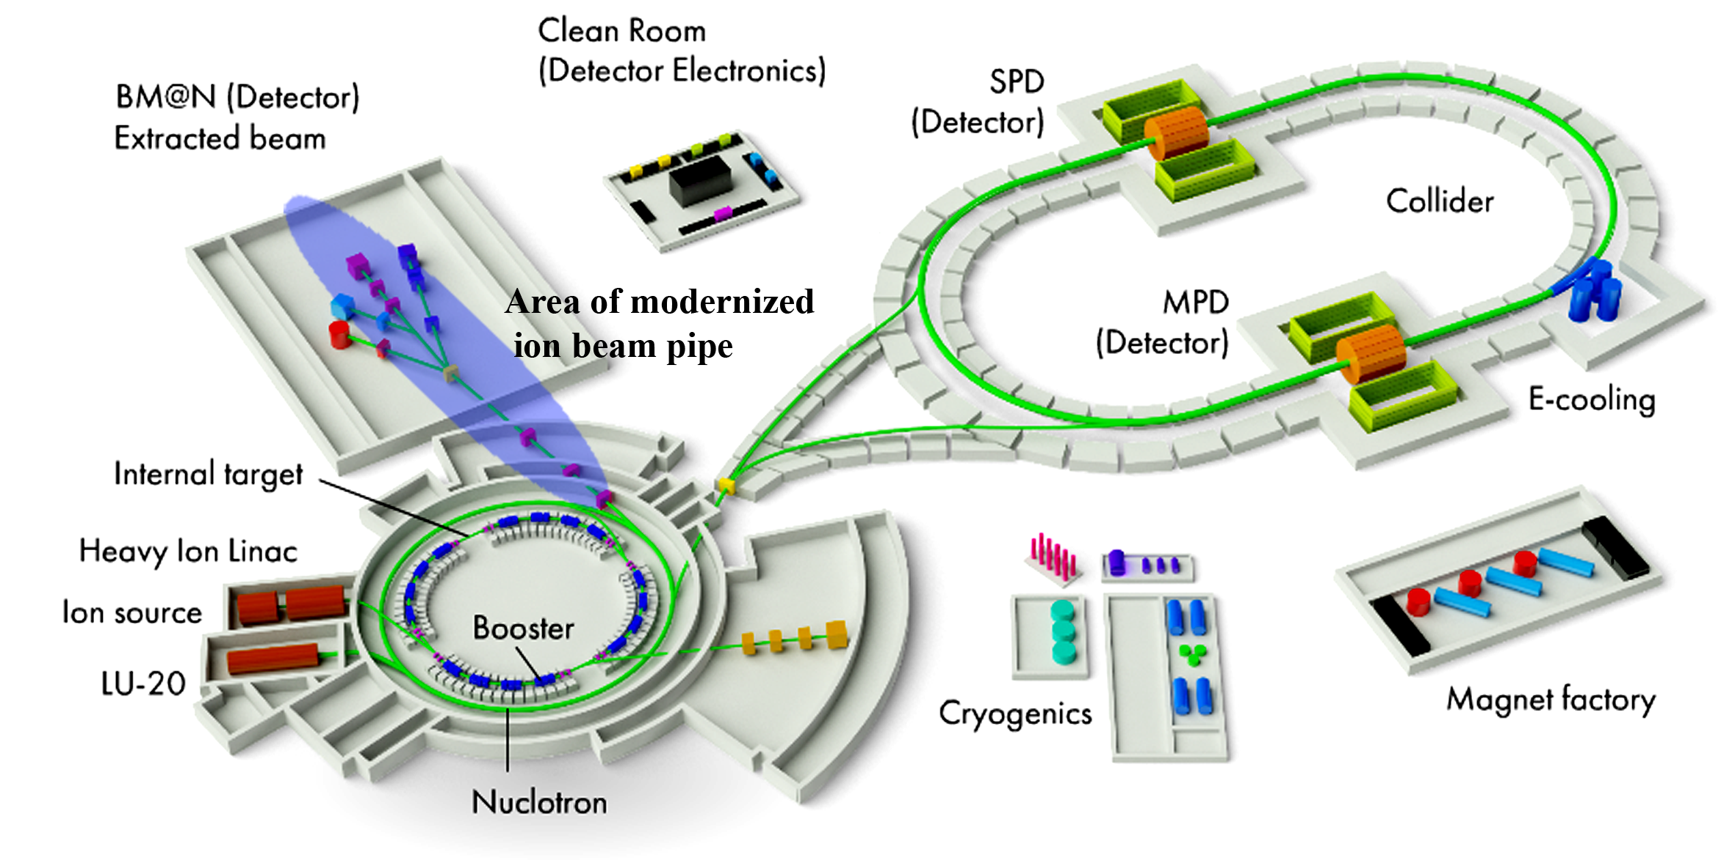
The plan of NICA area

Slide 4
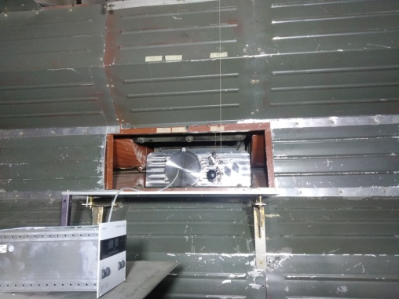
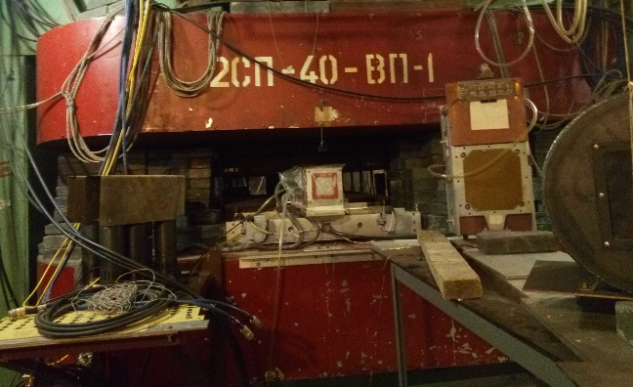
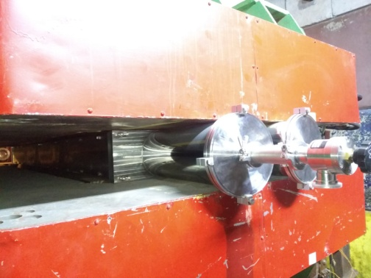
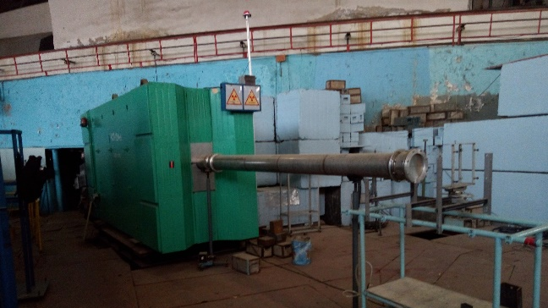
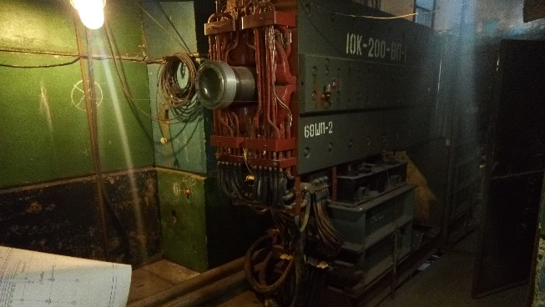
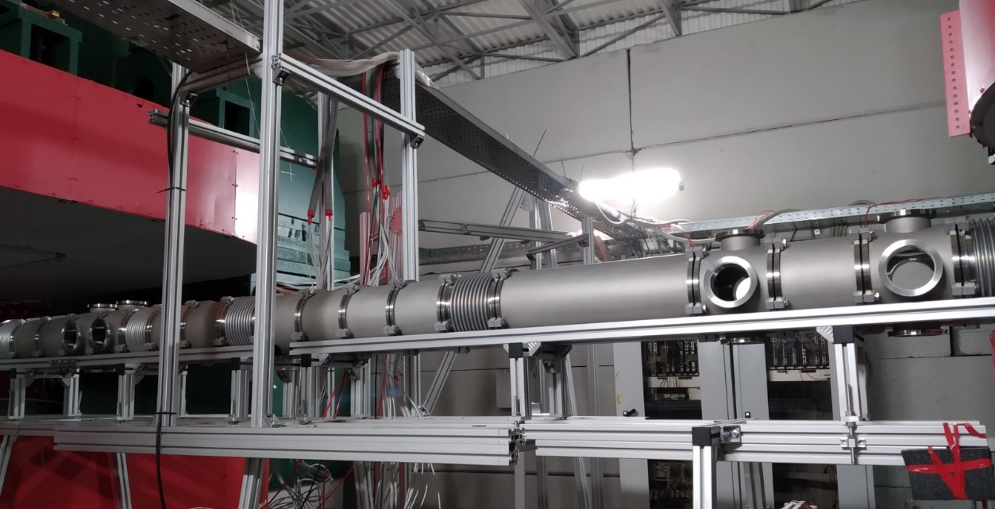
The modernized area 7 quadruple lenses; 6 magnets; 9 beam profilometers

Slide 5
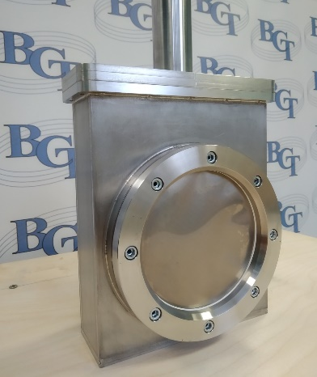
The prototype of vacuum box for the beam profilometers with sensitive area 200x200 mm
Vacuum box for the beam profilometers
Vacuum body with thin titanium
window for gas multiwire profilometers

Slide 6
The schedule
Technical design: March 2021
Production of vacuum beam pipe: from March to August 2021
Installation and testing of vacuum beam pipe: from June to September 2021

Slide 7
Thank you so much for the attention!

