Slide 1
Superconducting cyclotron SC202
Karamysheva Galina

Slide 2
Main cyclotron design characteristics:
• Compact design
• Fixed energy, fixed field and fixed RF frequency
• Bending limit W=200 MeV
• Accelerated particles: protons
• Superconducting coils enclosed in cryostat, all other parts are warm
• Injection by PIG ion source
• Extraction with an electrostatic deflector and passive magnetic channels
Notes:
2

Slide 3
Main characteristics of the magnet:
Four-fold symmetry and spiral sectors
Deep-valley concept - valley depth = 27 cm with 2 RF cavities placed in the opposite valleys
Small sectors gap near beam extraction
  Accelerate ~5-7 mm from pole edge ⇒ facilitate extraction
Vertical focusing in the center (from R = 4 to 8 cm) is provided by bump of magnetic field
Pole radius = 61 cm
Outer diameter = 250 cm
Height = 170 cm
Hill field = 4.75 Tesla, valley field = 3 Tesla
Weight about 55 tons
Notes:
3

Slide 4
The next goals were achieved:
Isochronous field in whole accelerating range
Proper vertical focusing in the whole range
Avoid dangerous resonances
Keep last orbit close to pole edge 5-7 mm
Keep the stray field at an acceptable level
Notes:
4

Slide 5
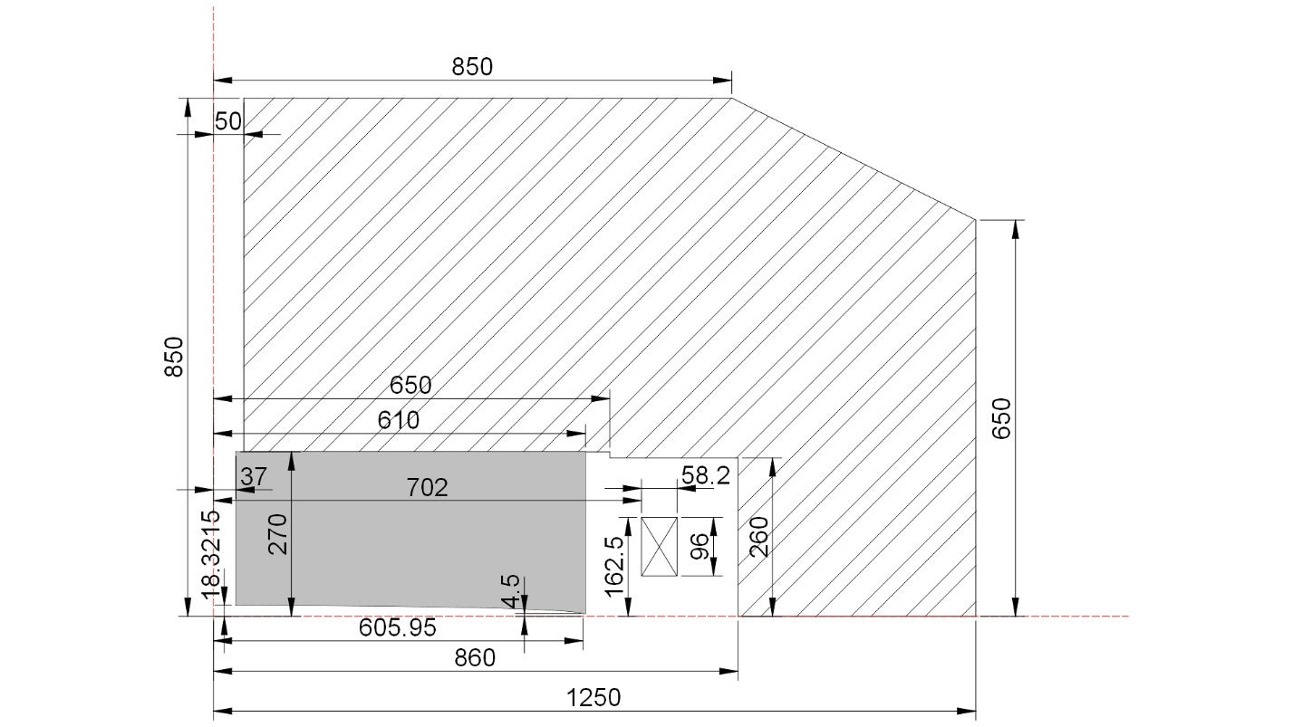
SC202 magnet yoke and SC coil basic sizes

Slide 6
Main parameters SC202 magnetic system
Outer diameter (m) | 2.5
Height (m) | 1.7
Total iron weight (t) | 55
Pole radius (m) | 0.61
Valley depth (m) | 0.54
Sectors gap (m) | 0.038/0.009
Sector angular width (deg) | 22-33
Bending limit | K=200
Hill field (T) | 4.75
Valley field (T) | 3
А*turn (1 coil) | 718 000

Slide 7

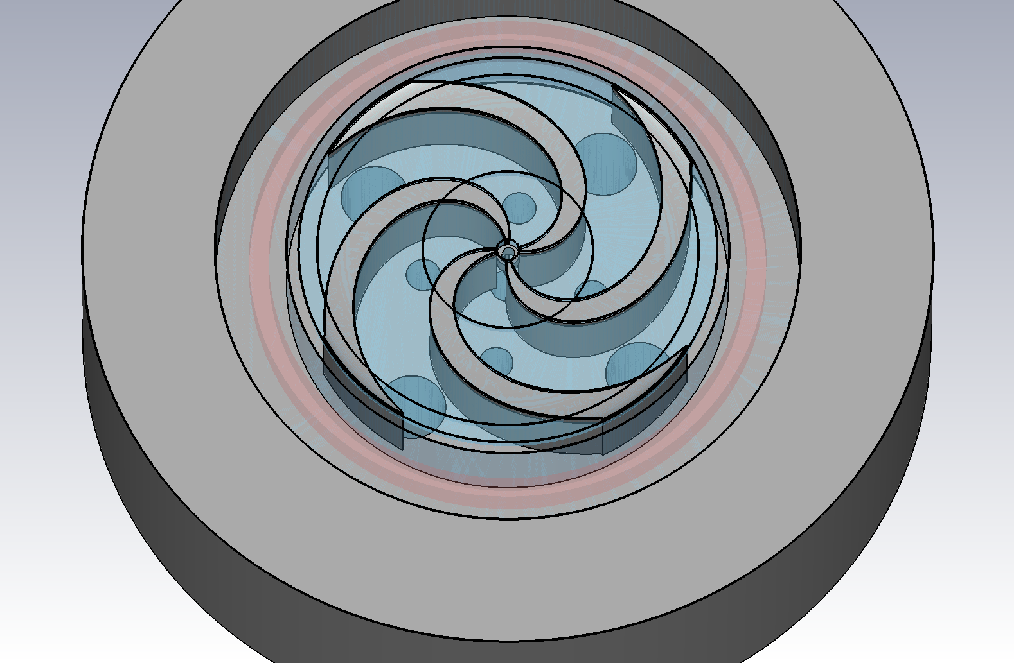
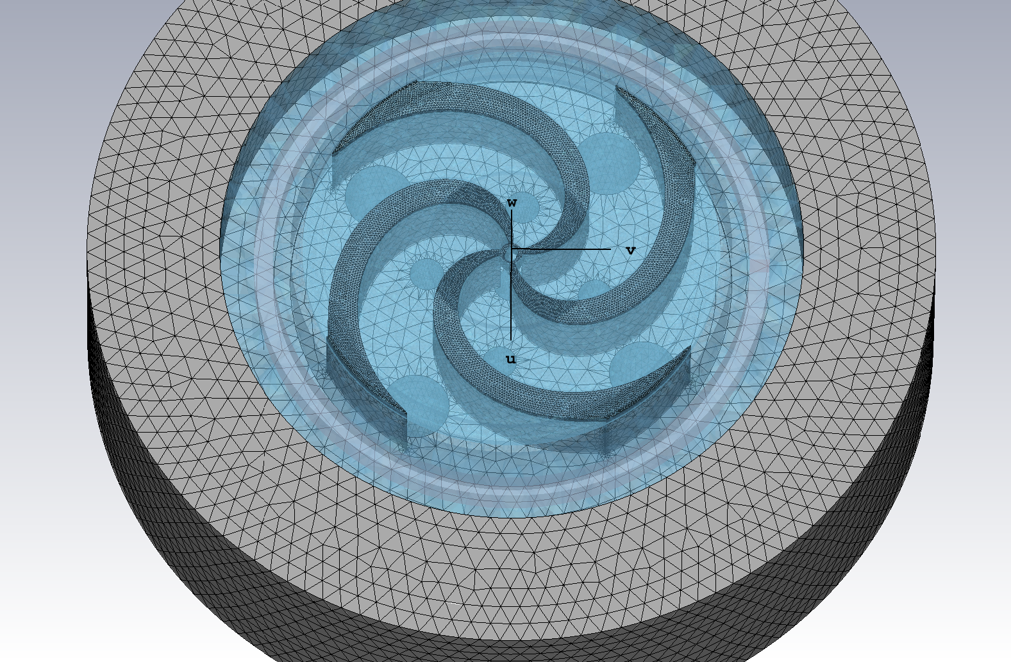
Computer model of SC202 cyclotron magnet
Notes:
7

Slide 8
Spiral sectors
Notes:
8

Slide 9
Spiral sectors
Spiral angle of the middle line of the sector
Central line dϕ/dr of sector
Notes:
9

Slide 10
Sectors axial profile
Notes:
10

Slide 11
Magnetic field in the center.
Notes:
11

Slide 12
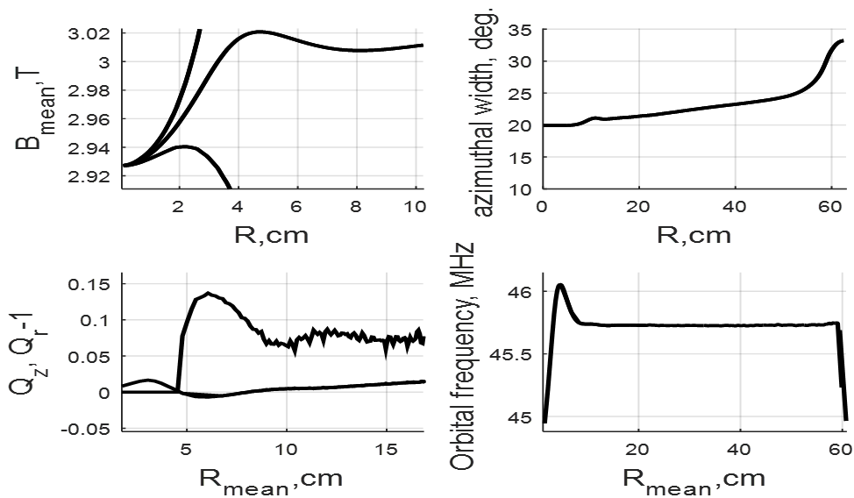
Main characteristics of the calculated model of the magnet
Notes:
12

Slide 13
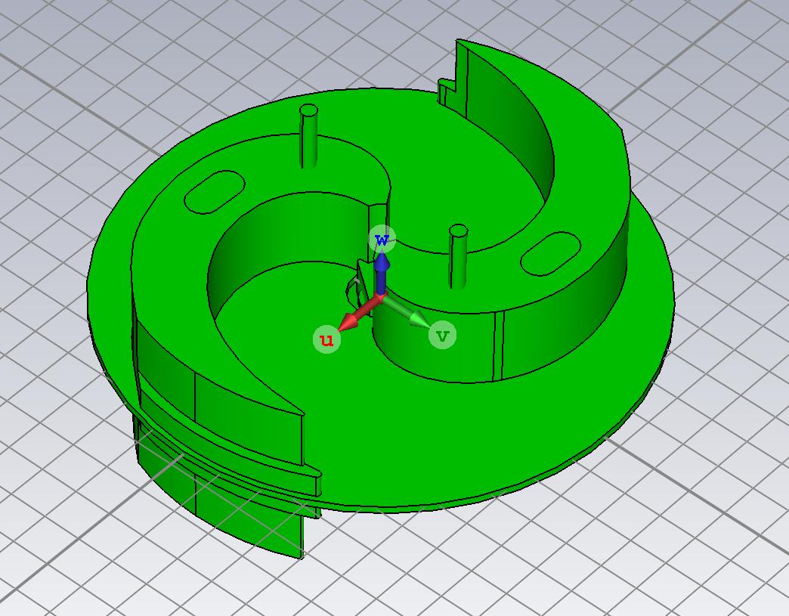
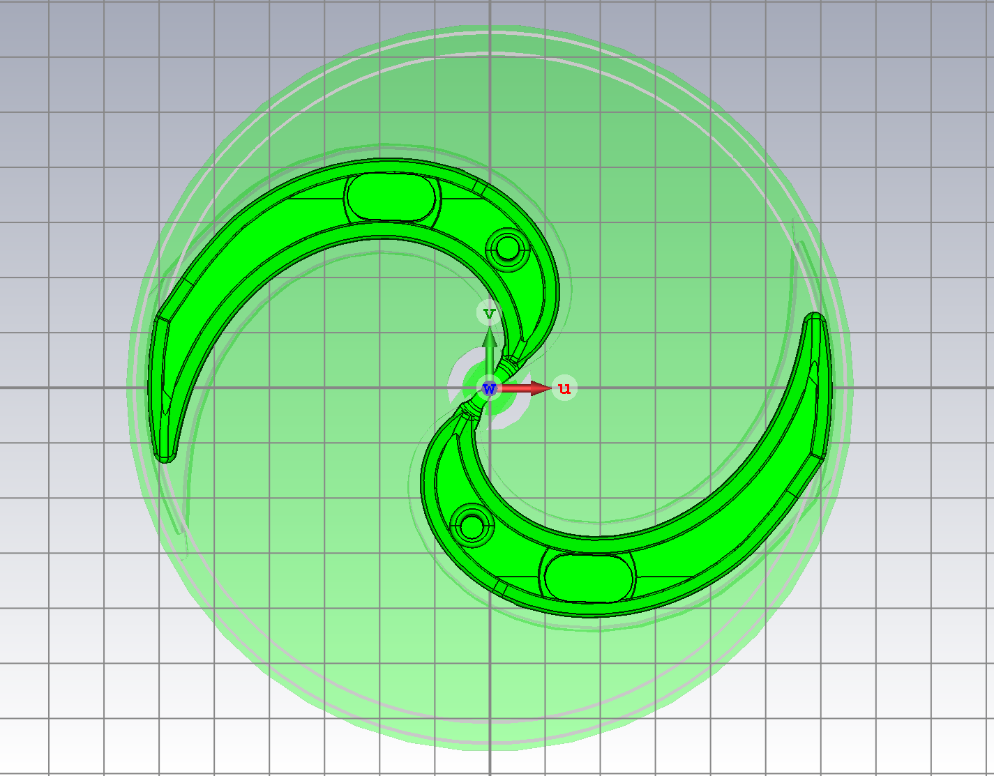
RF cavity design
Notes:
13

Slide 14
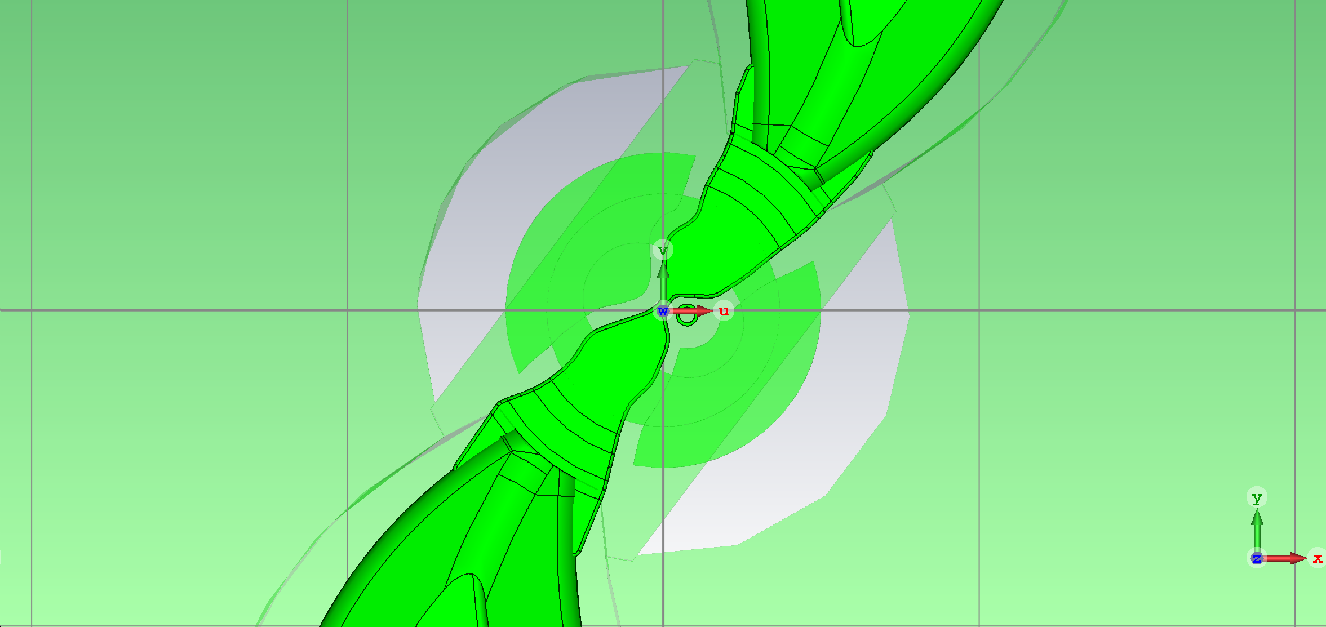
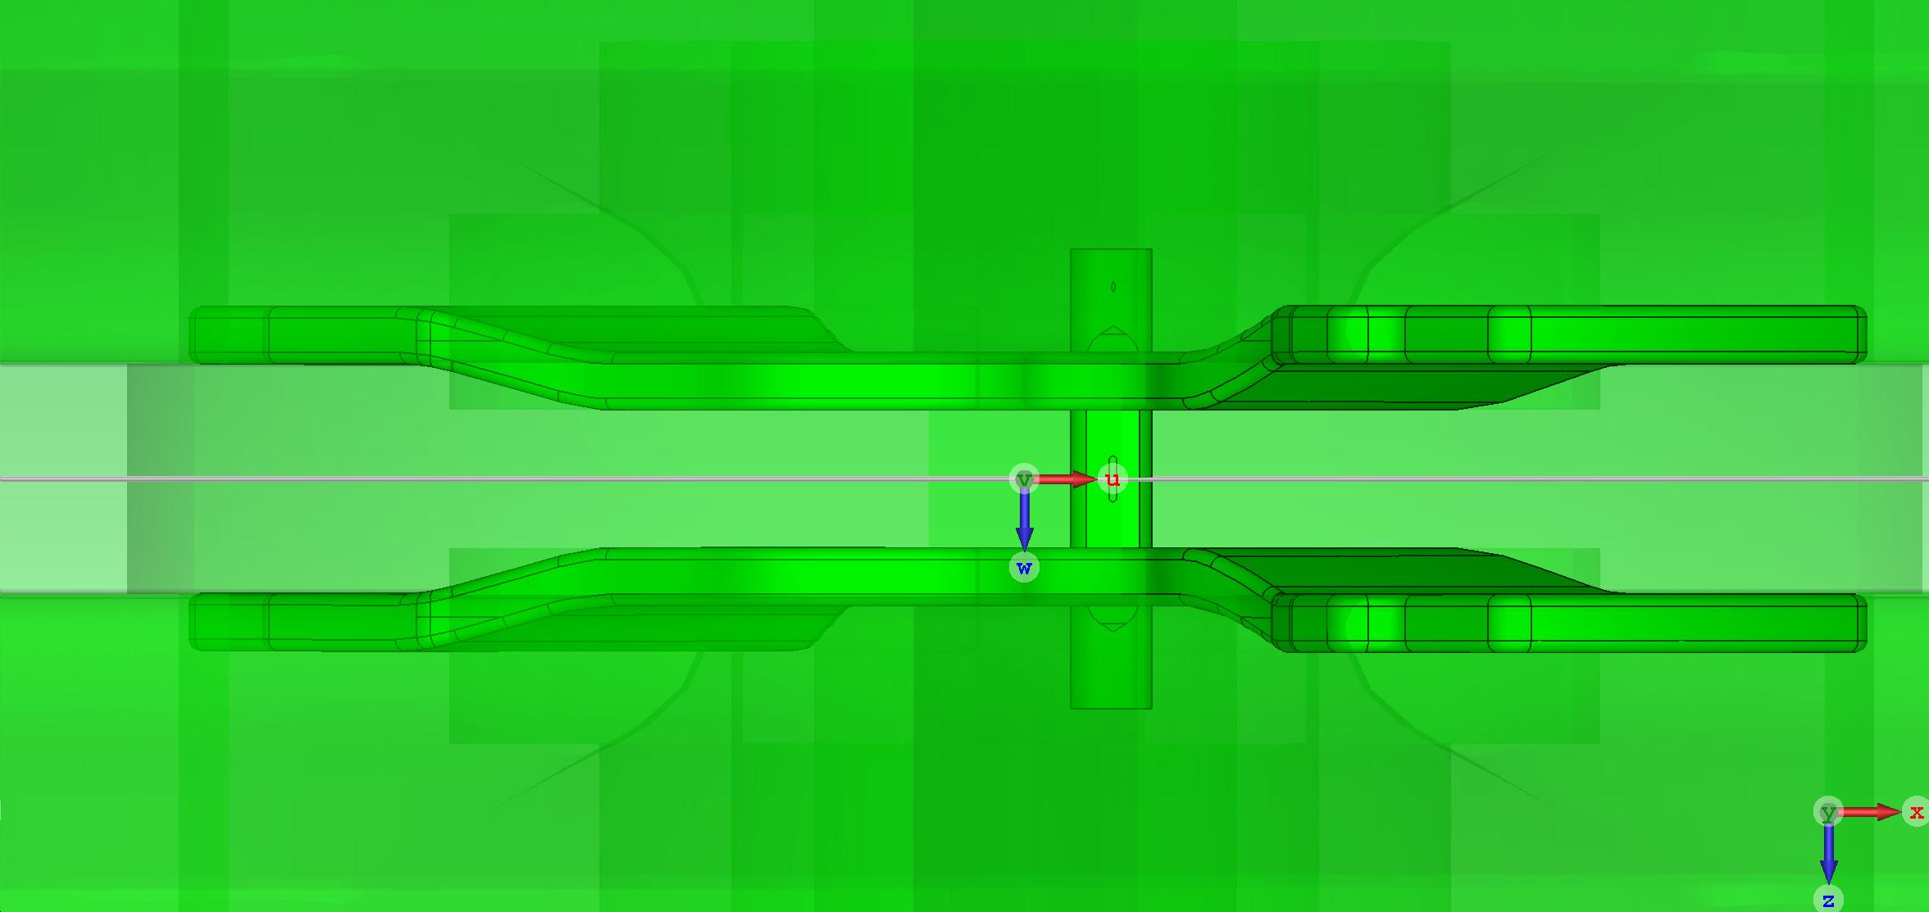
Center region
Notes:
14

Slide 15
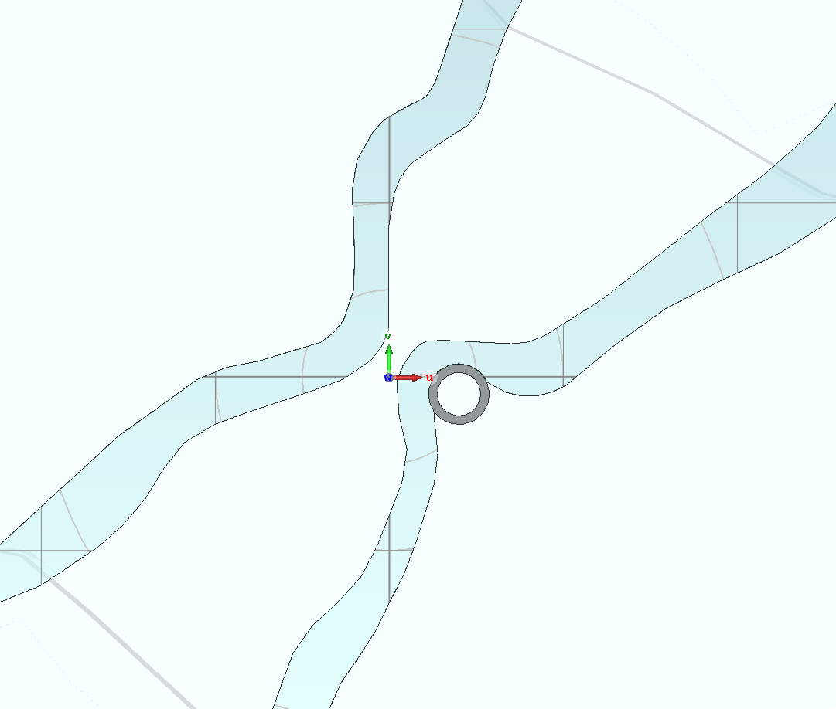
10 RF deg Dee tips
Vertical aperture 12mm, thickness of dee tips 6 mm.
Width of gaps can be 5-7 mm.
Voltage in the center is about 60 kV corresponds stored energy1 Joule in both cavities.
Notes:
15

Slide 16
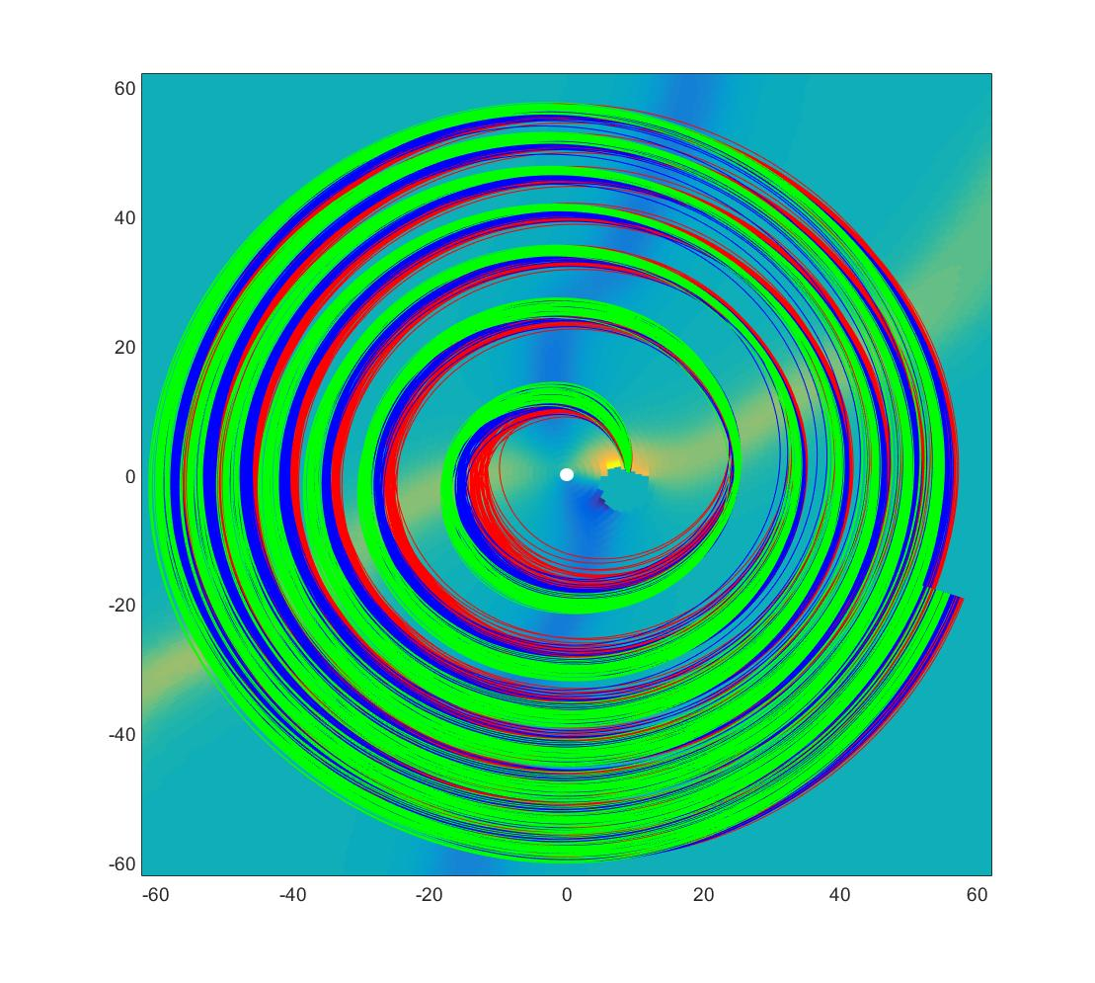
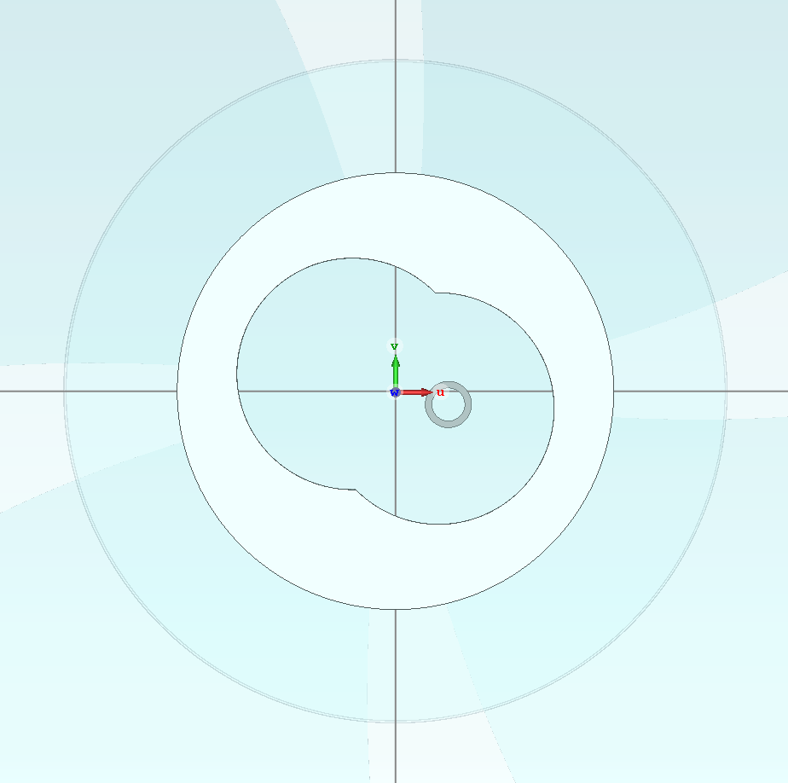
40 RF deg Plug
Radius=33 L=50 height= 38
shd=35 sdr=7 sha=-22
Notes:
16

Slide 17
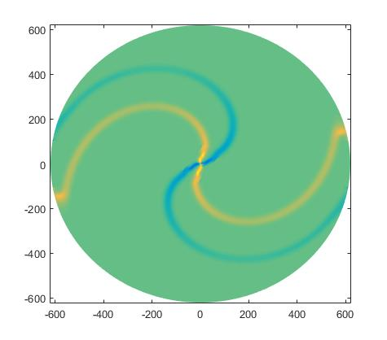
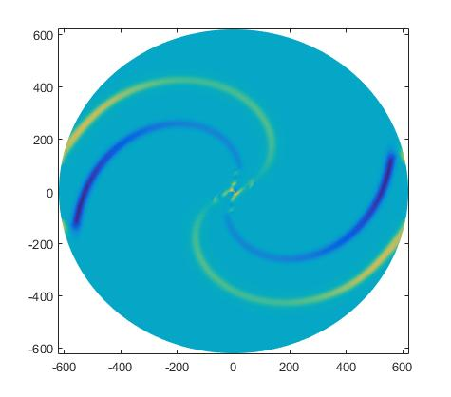
Electric field components in median plane
Radial component
Azimuthal component
Notes:
17

Slide 18
Power consumption and voltage distribution
Voltage in the center is about 55 kV corresponds stored energy1 Joule in both cavities
Results of the RF cavity simulation:
Frequency 91.7672084 MHz
Energy 1 Joule
Power losses for two RF cavities:
92.859 kW Quality factor 6 231.6
Notes:
18

Slide 19
Results of beam dynamic simulations.
For all beam dynamics simulations (including center region) 3D electric field maps from RF cavity simulations were used and 3D magnet field maps from magnet simulations.
3D Fieldmaps used in simulations:
Ez (Phi,R,Z) ; Ephi(Phi,R,Z); Er(Phi,R,Z)
Bz (Phi,R,Z) ; Bphi(Phi,R,Z); Br(Phi,R,Z)
Phi=0.5:0.5:360 degrees; R=1:1:626 mm; Z=-10:1:10 mm
Notes:
19

Slide 20
Energy against turn number
Notes:
20

Slide 21
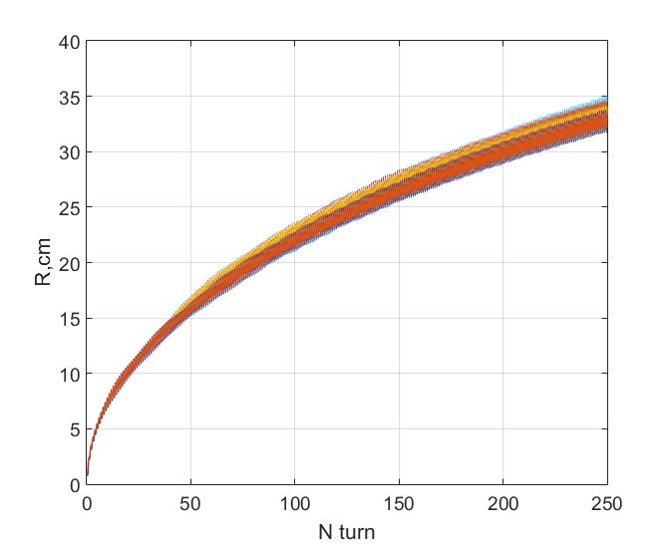
Radius of particles against turn number
Notes:
21

Slide 22
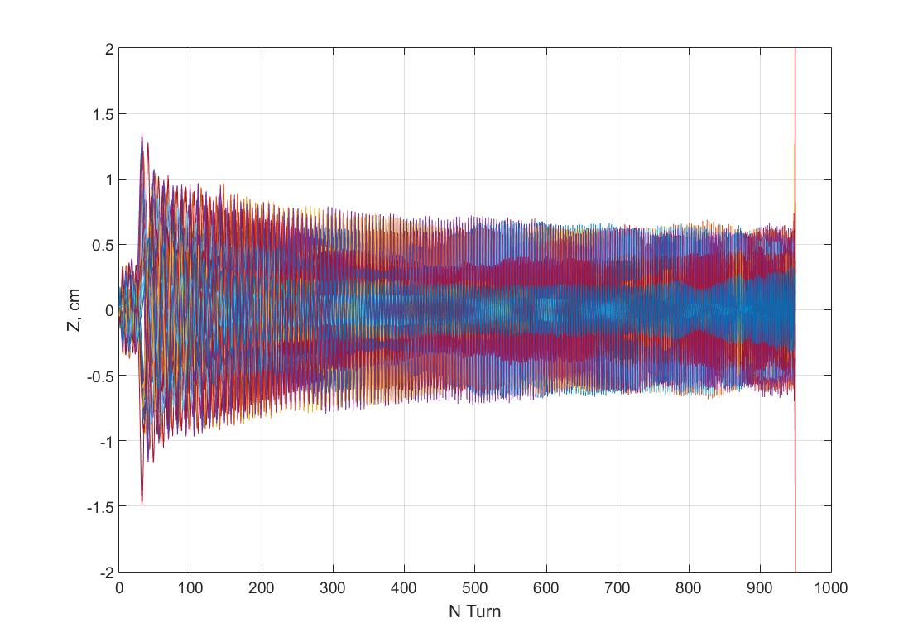
Vertical motion from ion source to 201 MeV
Bad mesh (lack of time)
No resonances even for big amplitudes
of betatron oscillations
Notes:
22

Slide 23
Beam dynamics in SC202 close to extraction region
Mean radius against turn number
Radial amplitudes
Axial motion
Beam energy

Slide 24
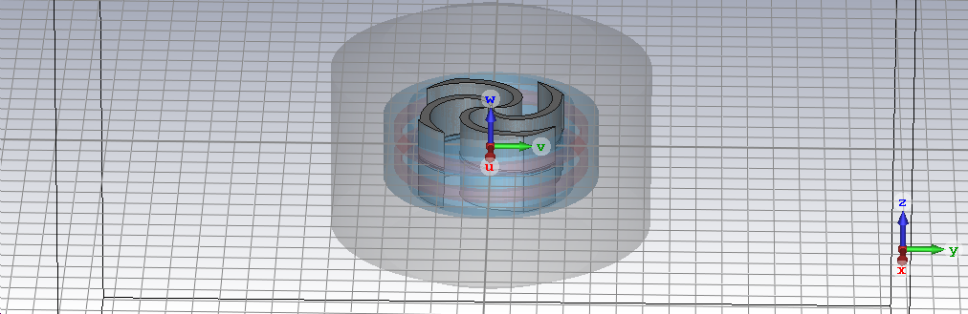
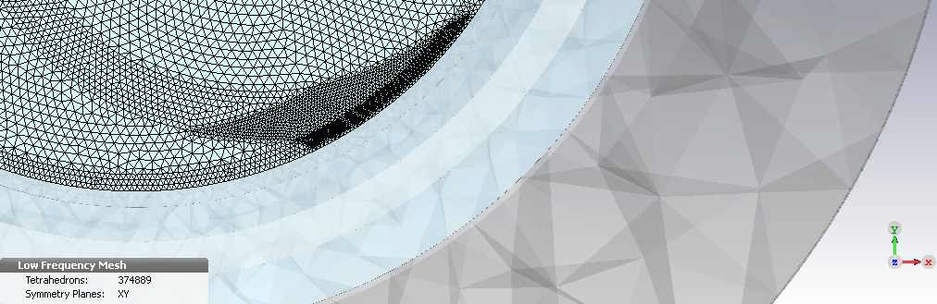
Particle motion
E-Field
B-Field
Up to 30 GB

Slide 25
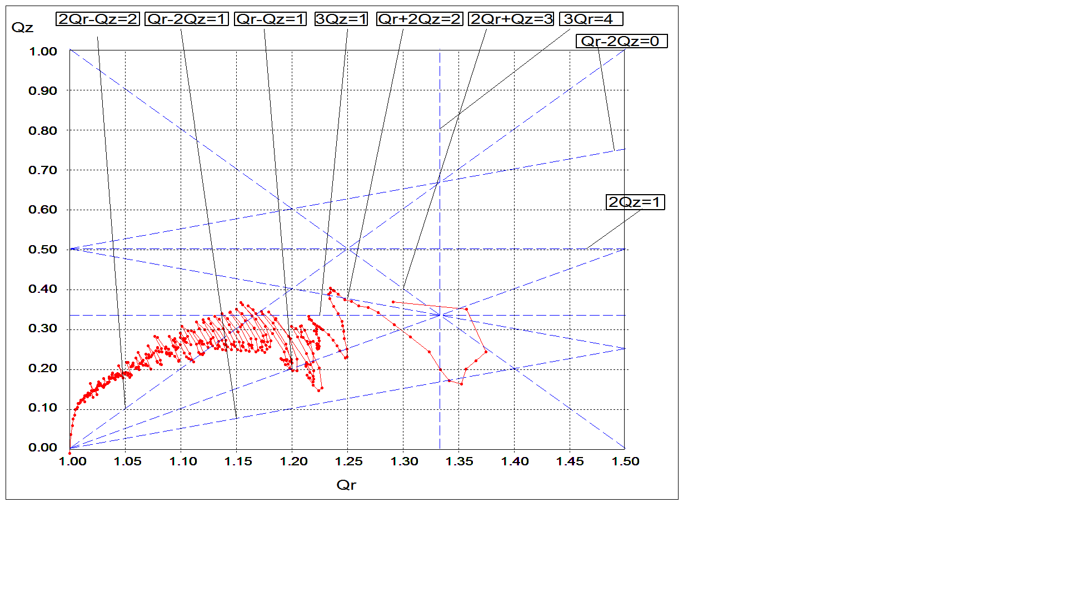
About accuracy
Notes:
25

Slide 26
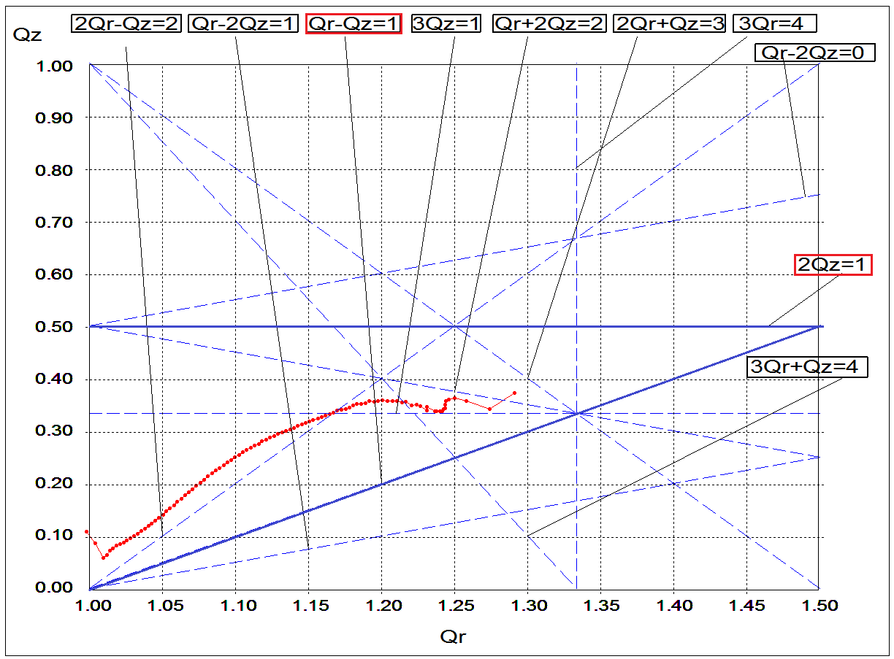
Working diagram

Slide 27
The most accurate result 2 mln meshcells, 15 hours

Slide 28
Black lines- delta Bz from Bz mean (in minimums), green lines – delta Bz from Bz mean im sectors секторах (in maximums).

Slide 29
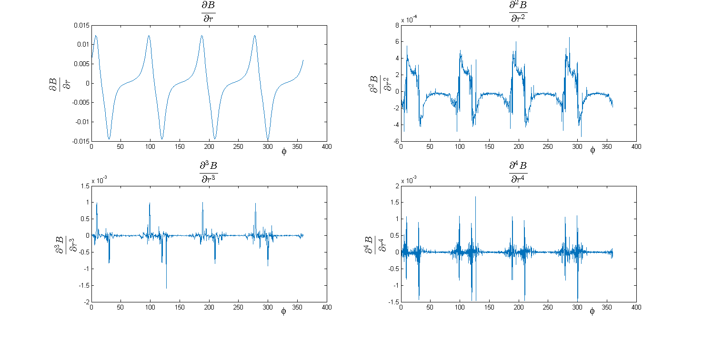
Derivatives

Slide 30
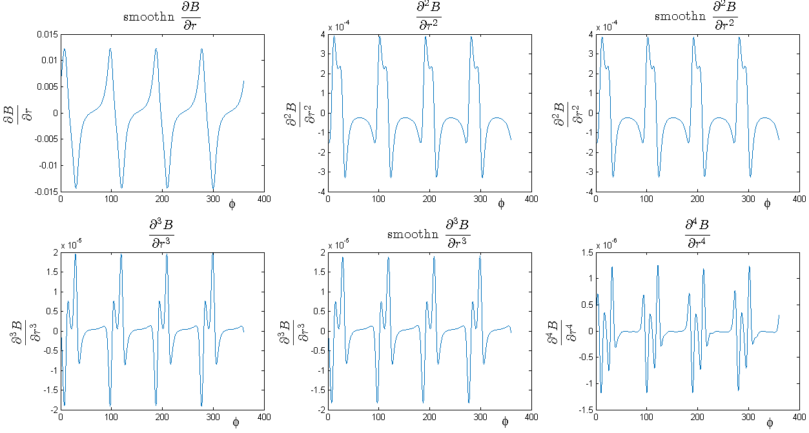
Derivatives

Slide 31
Betatron frequencies in simulations with 2D map and 3D maps
Notes:
31

Slide 32
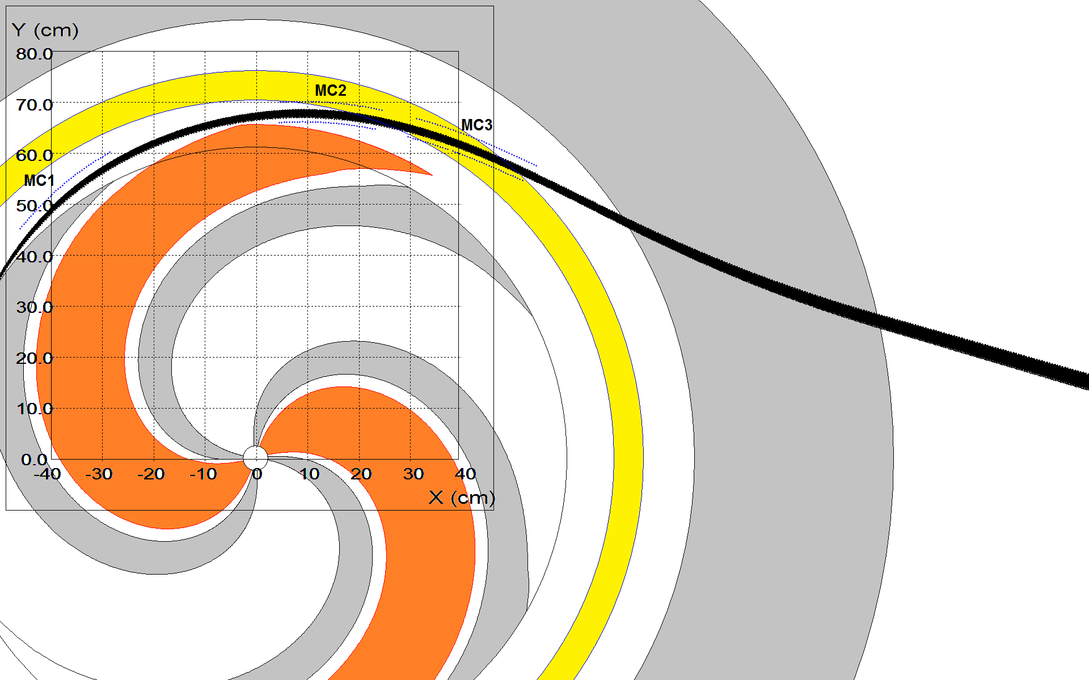
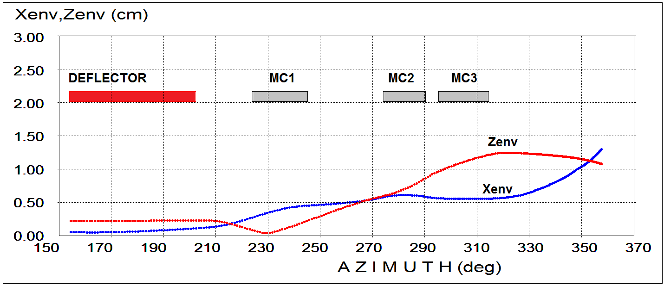
Extraction
Beam envelopes in extraction system
Notes:
32

Slide 33
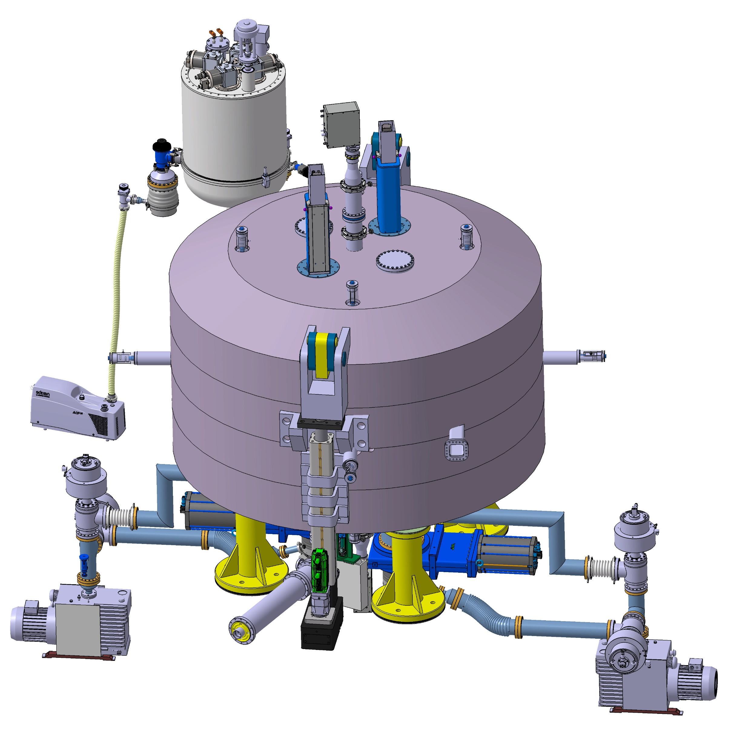
Overview of the SC202/SC200

Slide 34
New medial plane
MC3
MC2
MC1

Slide 35
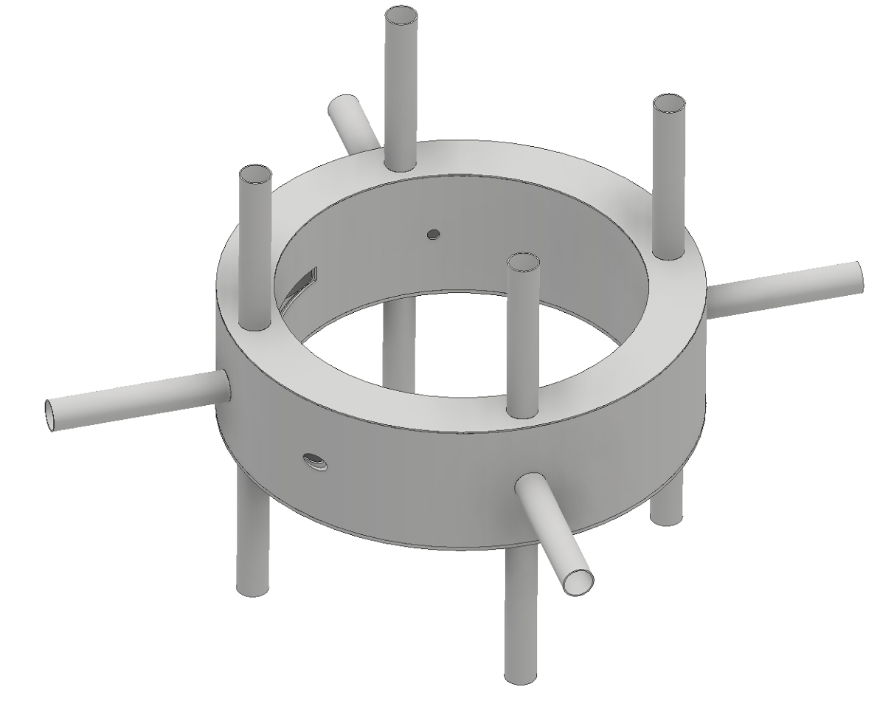
Cryostat
Case already manufactured.

Slide 36
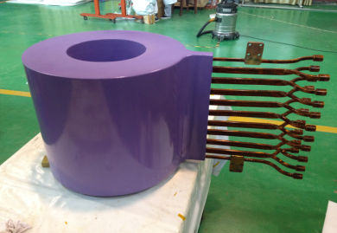
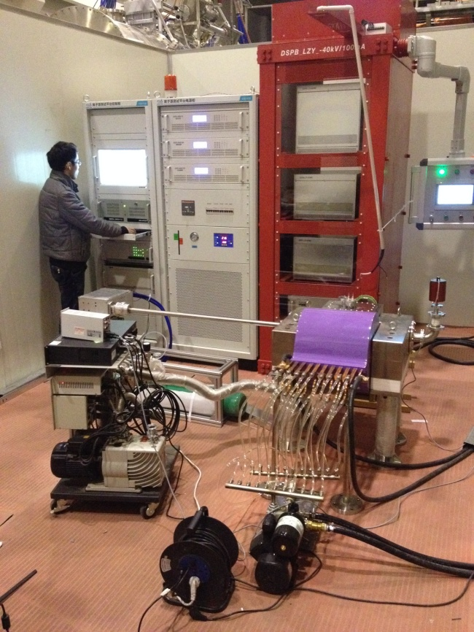
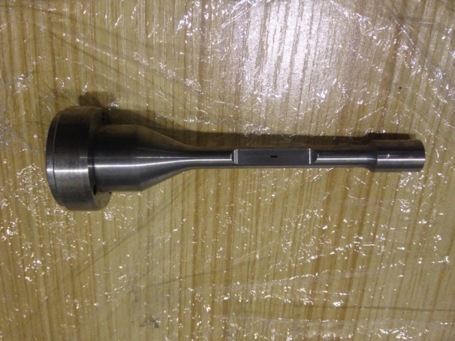
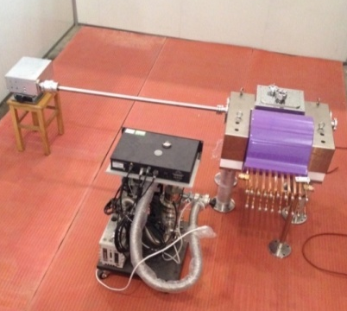
Test stand for ion source is manufactured in china.
PIG source design is finished.
Coil for test system

Slide 37
D cavity cold test
1:1 scale D cavity Cold Test can be realized with stainsteel plates covered with a thin copper sheet, the center region of the Dees hasn’t been finished design, we replace it with a simple bridge. The purpose of this model should be checking resonance frequency, quality factor, accelerating voltage, tuning and coupling.
The model will be tested in 30th, March,2017

Slide 38
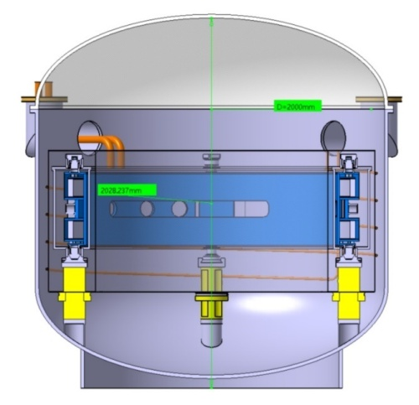
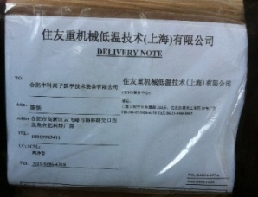
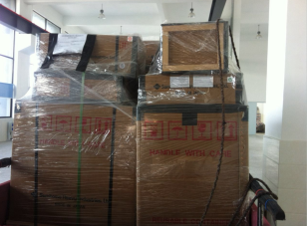
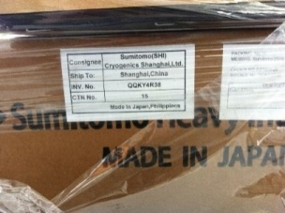
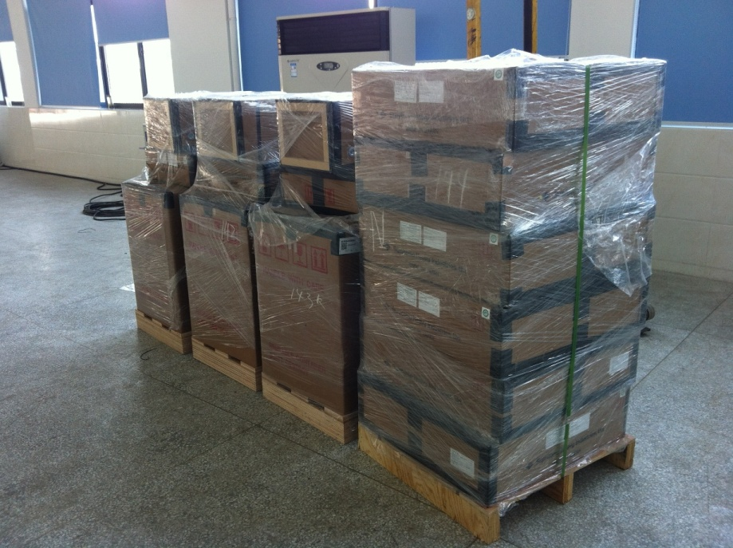
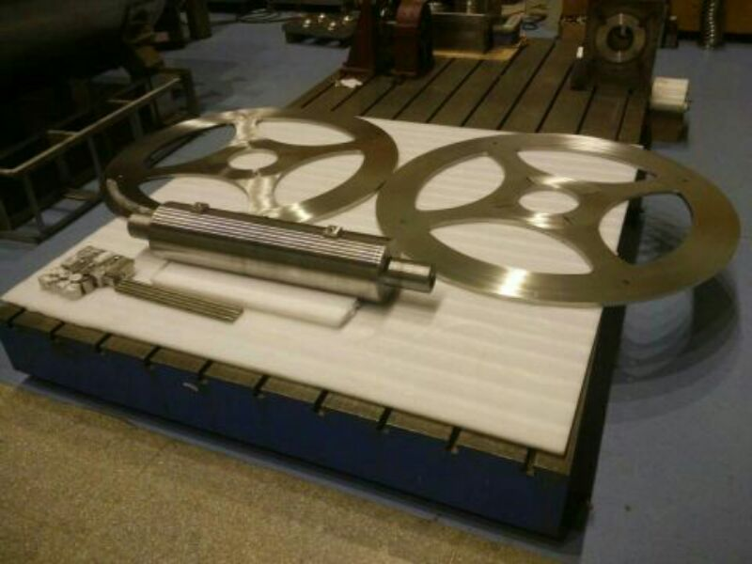
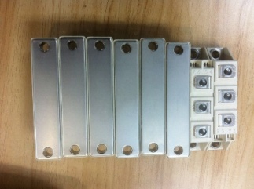
Cryogenic components
Test tank
Current leads
GM cooler
Winding tooling
Dipole

Slide 39
Conclusion
We obtain proper model of magnet.
We obtain proper model of plug dimensions and dee tips geometry in the center.
We test accelerating field distribution.
Beam dynamics shows sufficient quality of the center region and in acceleration zone.
No resonances were observed in the whole accelerating region in beam dynamics simulations.
We can extract beam with accuracy upto 70 %. Optimization of extraction is under way.
Notes:
39

Slide 40
Thank you for your attention!
Notes:
40

Slide 41
Beam dynamics with cut sector
Notes:
41

