Slide 1
NICA Complex construction plan – new control system – 1C
NICA Complex construction plan
– new software tool combined with– 1C (accounting system)
Project Structure
NICA Project
Full FTE
IT infrastructure
26,96
On-line NICA cluster
Off-line cluster jf the NICA Center
LIT off-line cluster
NICA computer network

Slide 2
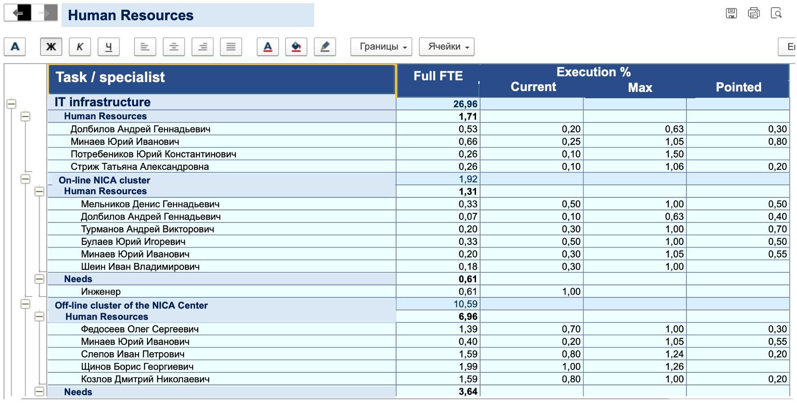
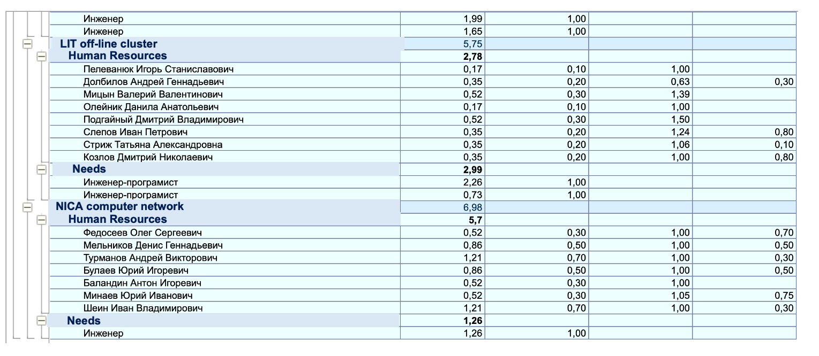
1C Report on Human Resources

