Slide 1
Search for new physics in experiments with the Fermilab high-intensity muon beams
The report and the proposal to extend
Проект: Поиск новой физики в экспериментах на интенсивных пучках мюонов Фермилаб
Artikov A.M., Atanov N.V., Atanova O.S., Azaryan N.S., Baranov V.A, Baranov V.Yu., Batusov Yu.A., Budagov J.A., Chokheli D., Davydov Yu.I., Demin D.L., Duginov V.N., Galoyan A., Glagolev V.V., Gritsaj K.I., Ivanov V.V., Kazakov D.I., Kharzheev Yu.N., Khomutov N.V., Kozlov G.A., Kolomoets V.I., Kolomoets S.M., Kulchitsky Y.A., Kravchuk N.P., Krylov V.A., Kuchinsky N.A., Lyablin M.V., Mamedov T.N., Movchan S.A., Romanov V.M., Rudenko A.I., Sazonova A.V., Shalyugin A.N., Simonenko A.V., Studenov S.N., Suslov I.A., Tarasov O.V., Tereschenko V.V., Tereschenko S.V., Titkova I.V., Usubov Z.U., Uzhinsky V.V., Vasilyev I., Volnykh V.P.
Joint Institute for Nuclear Research, Dubna, Russia
Djilkibaev R.M., Matushko V.L.
Institute for Nuclear Research, Moscow, Russia
Baturitsky M.A., Chehovsky V.A., I.F. Emeliantchik
BGU national scientific-educational center of particle and high energy physics, Minsk, Belarus
Korjik M.V., Lobko A.,S., Misevich O.V., Fedorov A.A.
BGU Institute of Nuclear Problems, Minsk, Belarus
Boyarintsev A.Yu., Gektin A.V., Grinev B.V., Sidletskiy O.Ts.
Institute for Scintillation Materials NAS of Ukraine, Kharkov, Ukraine
Dubnicka S., Bartos E., Adamuscin C., Liptaj A.
Institute of Physics Slovak Academy of Sciences, Bratislava, Slovak republic
Dubnickova A.Z.
Comenius University, FMFI , Bratislava, Slovak Republic
Chizhov M.V.
The St. Clement of Ohrid University of Sofia, Bulgaria

Slide 2
Problems of the Standard Model
Dark Matter: There is a particle that exists and is floating around making up 80% of the mass of our Universe and galaxy.
Inflation: There needs to be an inflationary field that reheats the Standard Model.
Baryon Asymmetry: We don't understand why there is more matter than anti-matter in the Universe. We know that the Standard Model inside Inflationary Big Bang Cosmology doesn't produce anywhere near enough of an excess.
Origin of Masses: The problem is complicated because mass is strongly connected to gravitational interaction, and no theory of gravitational interaction reconciles with the SM.
Strong CP problem According to quantum chromodynamics there could be a violation of CP symmetry in the strong interactions. However, there is no experimentally known violation of the CP-symmetry in strong interactions.
Neutrino oscillation : observation of the phenomenon implies that the neutrino has a non-zero mass, which was not included as part of the original SM.
2

Slide 3
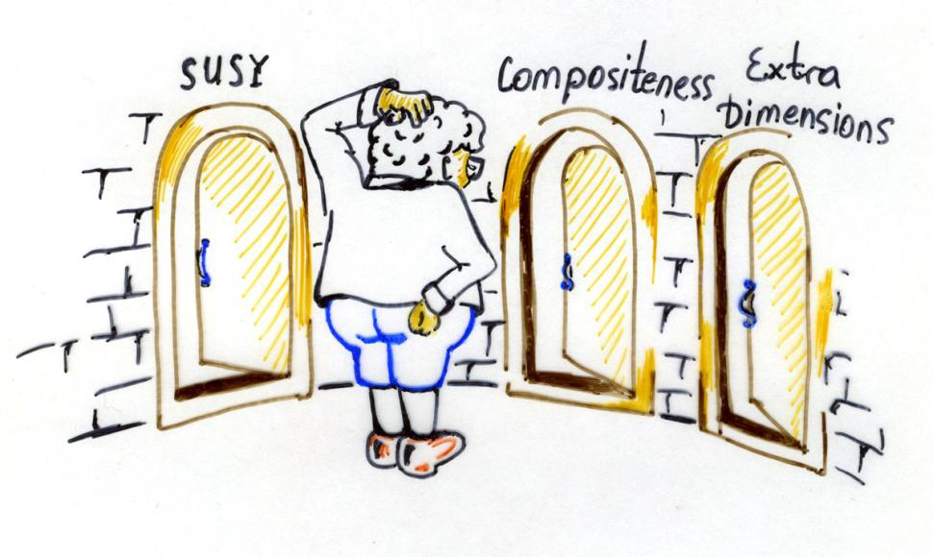
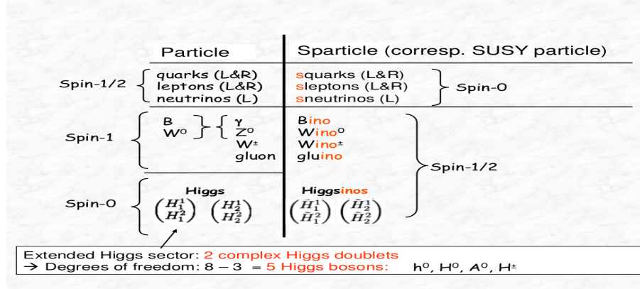
BSM models
Supersymmetry. It is one of the best motivated extension of the SM. The theory proposes a new symmetry between bosons (integer spin) and fermions (half integer spin).
Grand Unified Theories. Attempt at unifying the electroweak and strong interactions at high energy. They are based on larger symmetry groups, like SU(5), SO(10), E6. The full symmetry is restored at very high energies. Typical scales of 10¹⁶ GeV emerge from the different running (meeting point) of the strong, weak and electromagnetic couplings.
Additional spatial dimension(s). An option to attack the hierarchy problem, i.e. the huge difference in scale between the gravitational interaction (M_{Pl}=1.2×10¹⁹ GeV) and the other fundamental interactions (M_{ewk}≈100 GeV), relies on modifying the space-time structure of our universe.
Dynamical symmetry breaking. (technicolor, compositeness, Little Higgs…) Another class of theories introduce a new strong interaction that breaks the gauge symmetry of the SM. The scalar particles are bound states of fermions charged under the strong interaction, similar to pions in QCD.

Slide 4
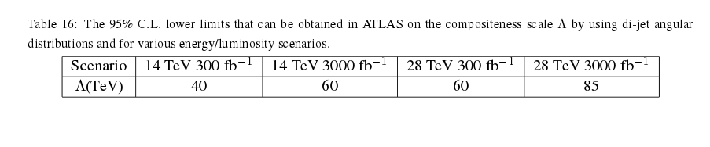
Sensitivity to High Mass Scales
High energy experiments
Of course, the high-energy frontier is not the only option to look for BSM physics. Rather than manifesting itself through new particles as external states, BSM can modify processes with only SM external particles through virtual effects.
BSM particles can act in a similar way and modify couplings and cross sections of SM particles. The size of these deviations from the SM depends crucially on the mass scale of the BSM particles and their coupling to SM particles.

Slide 5
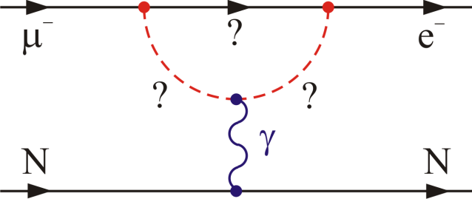
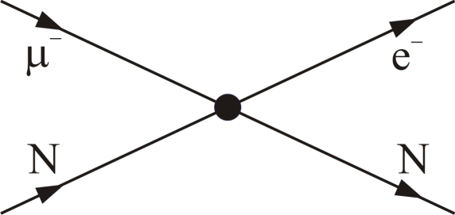
Precision muon experiments :
Sensitivity to High Mass Scales
Loops dominate for κ << 1
Contact terms dominate for κ >> 1
Λ (TeV)
Mu2e PIP II: 5σ
Mu2e: 5σ
μ→eγ
MEG upgrade
μ→eγ
MEG goal
μN→eN
μN→eN
μ→eee
μ→eee
κ

Slide 6
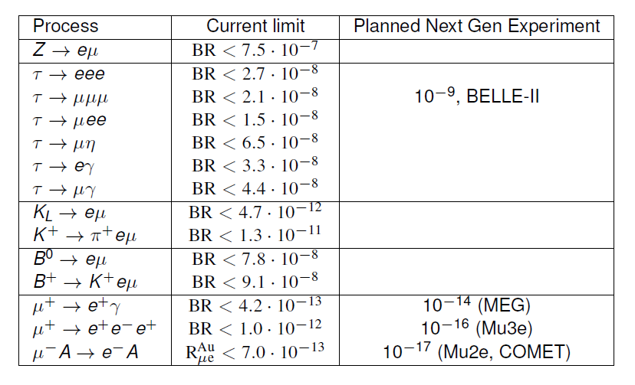
Search for flavor violation in processes
with charged leptons

Slide 7
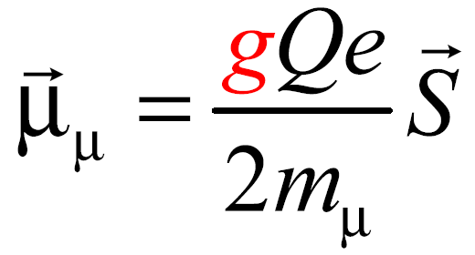
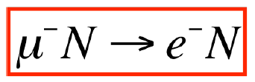

Muon g-2 Mu2e
Search for
neutrinoless conversion of a muon into an electron in the field of a nucleus
Muon magnetic dipole momentum precise measurement
Charged Lepton Flavor Violation

Slide 8

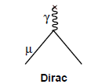
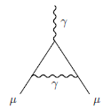
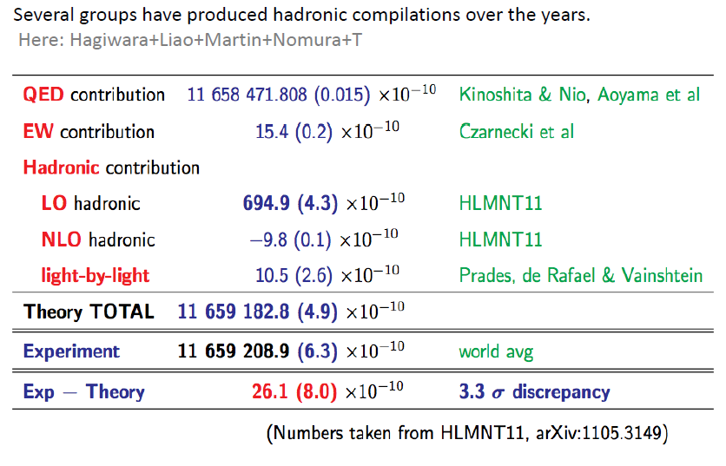
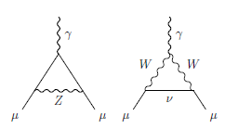
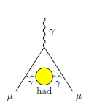
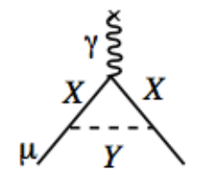
muon g-2: SM prediction and New Physics
Schwinger

Slide 9
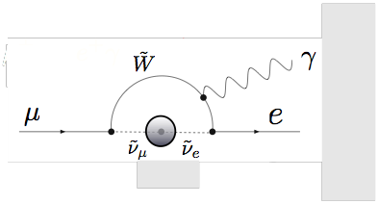
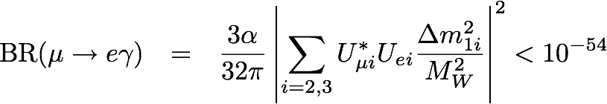
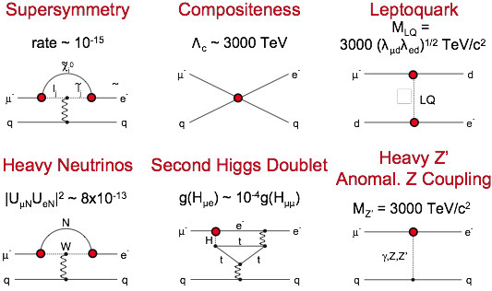
The BR of CLFV processes in the Standard Model
Mu2e : SM prediction and New Physics
Mu2e sensitivity
is 6*10⁻¹⁷
NP
Sensitive to mass scales up to O(10,000 TeV)
Flavour Physics of Leptons and Dipole Moments, Eur.Phys.J.C57:13-182,2008

Slide 10
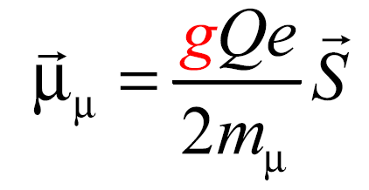
Muon g-2 Experiment Goal
Goal:
Measurement of the value of muon anomalous magnetic moment, a_{μ}, to an uncertainty of 16×10⁻¹¹ (0.14 ppm) where,
Present Situation:
Physics beyond the standard model

Slide 11
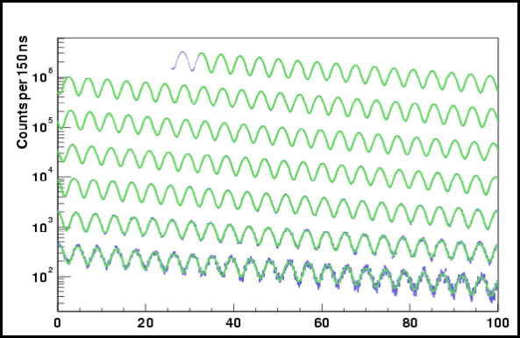
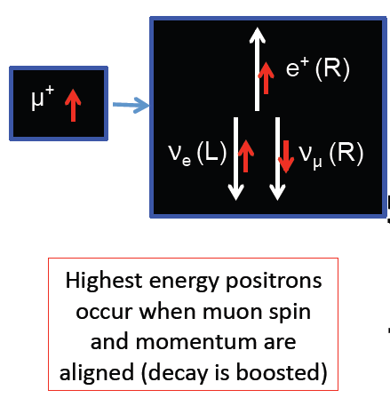
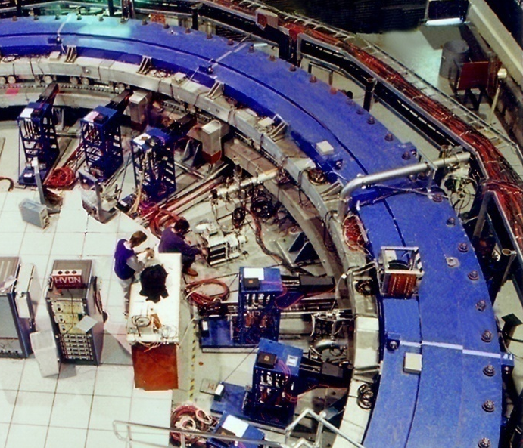
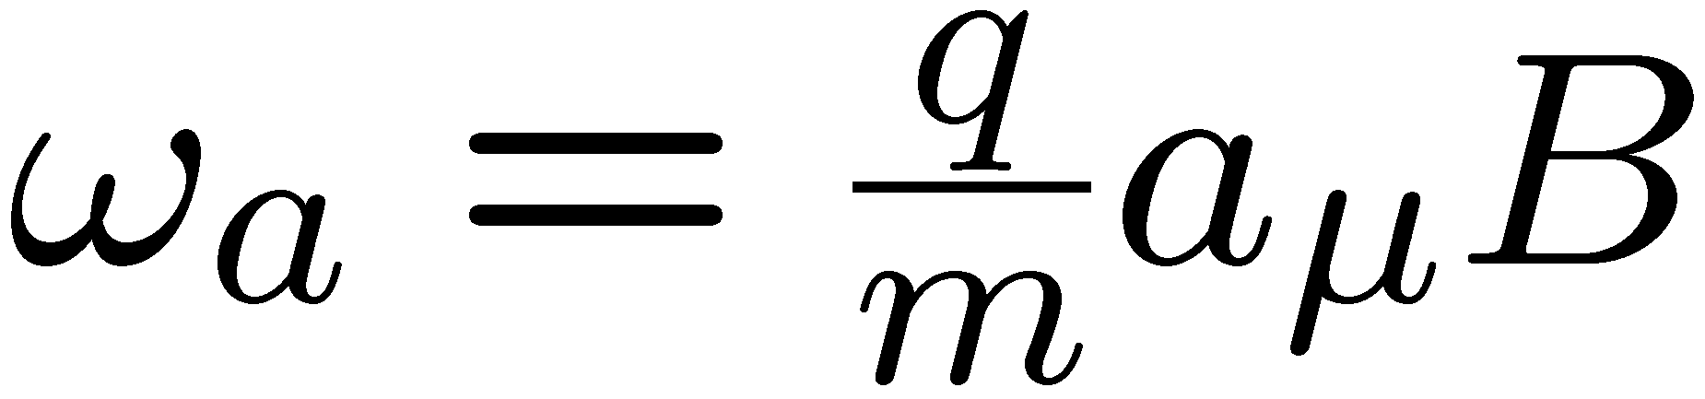
g-2 Experimental Technique
Capture 3.094 GeV/c muons in a uniform magnetic field
Measure the precession frequency of the muon spin
The precession frequency, under special circumstances, is proportional to a_{μ}
muon storage ring
e
Momentum
Spin
Positron direction follows muon spin

Slide 12
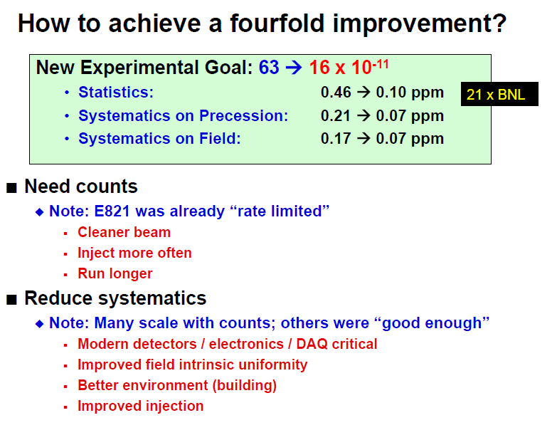
How to achieve a fourfold improvement ?

Slide 13
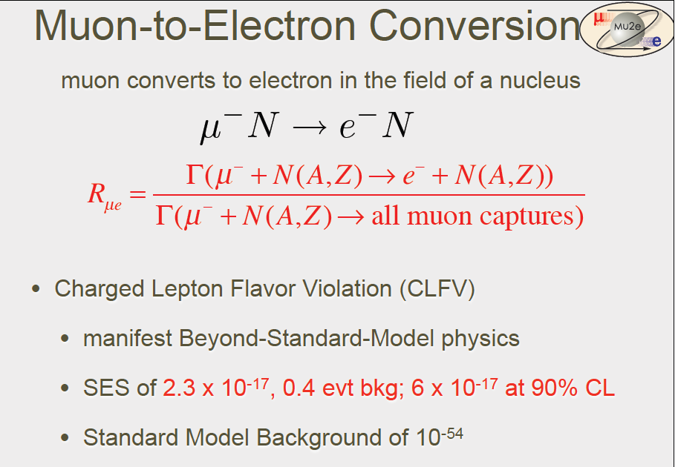
Mu2e Muon-to Electron Conversion
Mu2e will measure the ratio of the coherent neutrinoless muon-to-electron conversion rate to muon capture rate

Slide 14
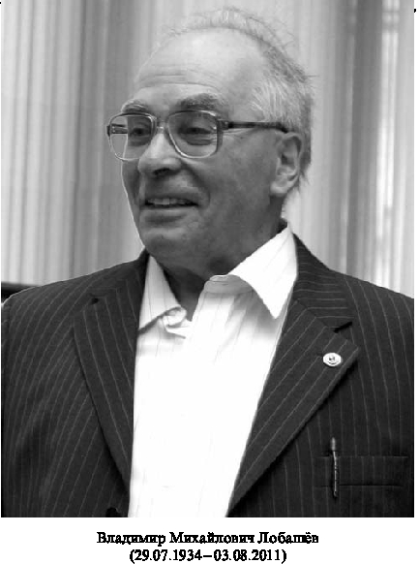
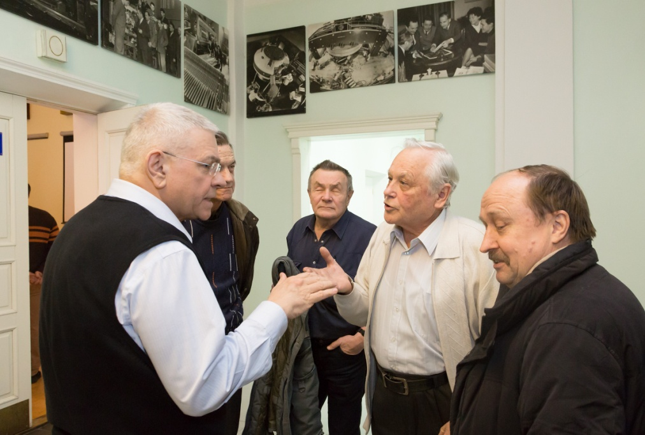
The great-grandparents of the Mu2e
( MELC, 1992; MECO, 1997)
are INR scientists
V.M. Lobashev and R.M. Djilkibaev

Slide 15
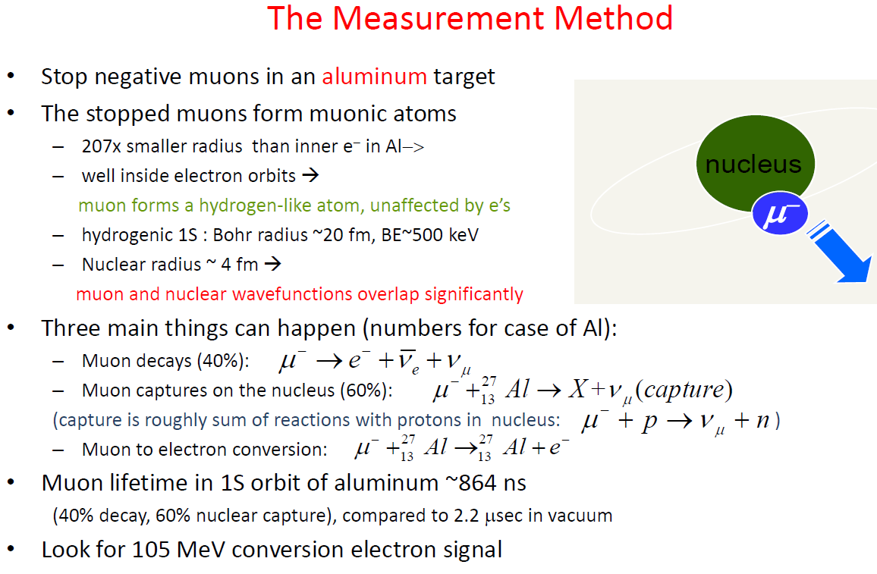
The Measurement Method
E_{e} = m_{μ} - E_{recoil} - E_{1S-B.E.}
E_{e}=104.96 MeV

Slide 16
Backgrounds
Stopped Muon induced
  Muon decay in orbit (DIO)
Out of time protons or long transit-time secondaries
  Radiative pion capture; Muon decay in flight
  Pion decay in flight; Beam electrons
  Anti-protons
Secondaries from cosmic rays
Mitigation:
  Excellent momentum resolution
  Excellent extinction plus delayed measurement window
  Thin window at center of TS absorbs anti-protons
  Shielding and veto

Slide 17
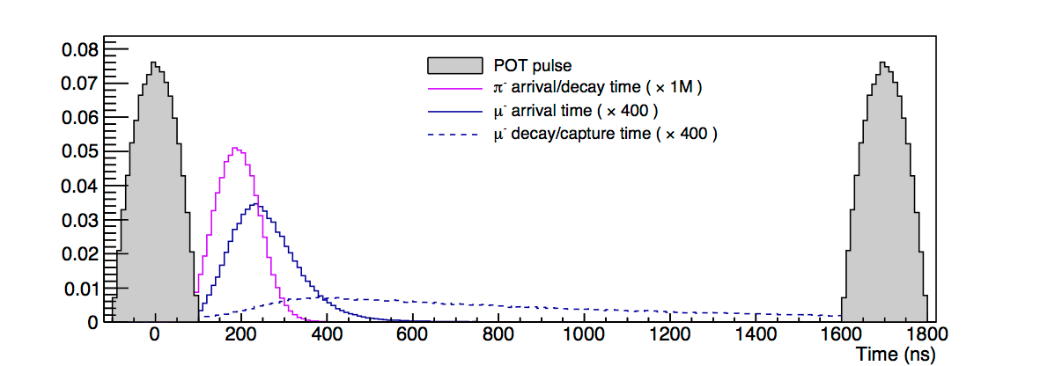
Prompt Background Suppression
  Prompt background
    Happens around the time, when
    the beam arrives at the target.
    Sources
      beam electrons,
      muon decay in flight,
      pion decay in flight,
      radiative pion capture
    May creaste electrons with
    energies in the signal region
    Prompt background can be
    suppressed by not taking data
    during the first
    670 ns after the
    peak of the
    proton pulse.
However, this prompt background cannot be eliminated entirely, since some of the protons arrive “out of time”.
  A ratio of 10⁻¹⁰ is required for the beam between pulses vs. the beam contained in a pulse.
Live Window
The lifetime of a muon in an Al orbit is 864 ns

Slide 18
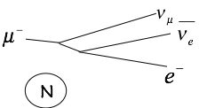
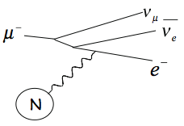
Decay–in-Orbit: Dominant Background
DIO: Decay in orbit
Free muon decay
M_{μ}
DIO tail
M_{μ} / 2
M_{μ}
DIO shape
Reconstructed Momentum (MeV)

Slide 19
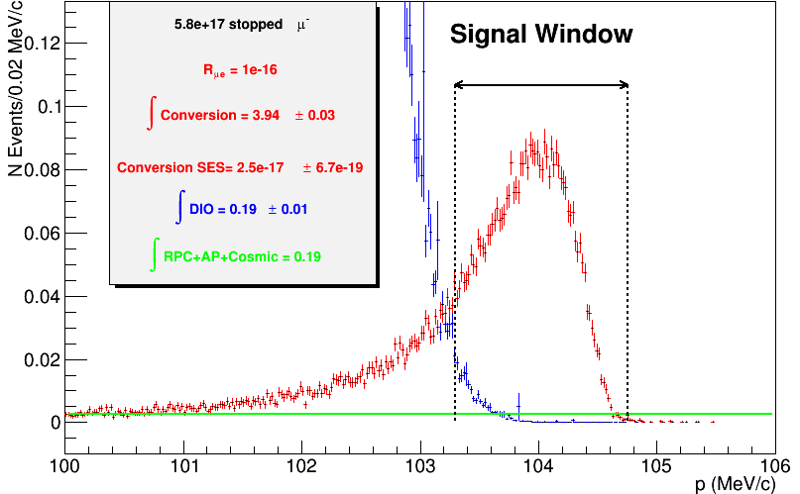
Signal Sensitivity for 3 Year Run
~4x10²⁰ protons on target
(3 year run @ 8 KW)
Stopped μ: 10¹⁸
N_{μe} = 3.94 ± 0.03 For R = 10⁻¹⁶
N_{DIO} = 0.20 ± 0.06
N_{Other} = 0.2
SES = (2.5 ± 0.1) × 10⁻¹⁷
Errors are stat only
Reconstructed e⁻ Momentum

Slide 20
Backgrounds for 3 Year Run
Category | Background process | Estimated yield (events)
Intrinsic | Muon decay-in-orbit (DIO) | 0.199 ± 0.092
 | Muon capture (RMC) | 0.000
Late Arriving* | Pion capture (RPC) | 0.023 ± 0.006
 | Muon decay-in-flight (m-DIF) | <0.003
 | Pion decay-in-flight (p-DIF) | 0.001 ± <0.001
 | Beam electrons | 0.003 ± 0.001
Miscellaneous | Antiproton induced | 0.047 ± 0.024
 | Cosmic ray induced | 0.082 ± 0.018
 | Total | 0.36 ± 0.10
All values preliminary
* scales with extinction: values in table assume extinction = 10⁻¹⁰

Slide 21
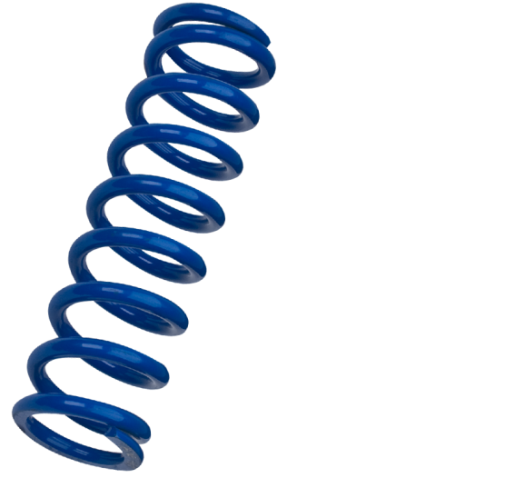
Baseline Mu2e Apparatus
8-GeV protons from
delivery ring
Particles produced
from tungsten target
Muons stop on Al target,
which emits an electron isotropically
2.0 T
2.5 T
1.0 T
4.6 T
Detector Region:
Uniform Field 1T
Graded B for most of length
S-shaped solenoid:
transports particles to detector area, and
allows remaining pions to decay to muons
collimator selects negatively-charged particles
Tracker/calorimeter detect
electron signature

Slide 22
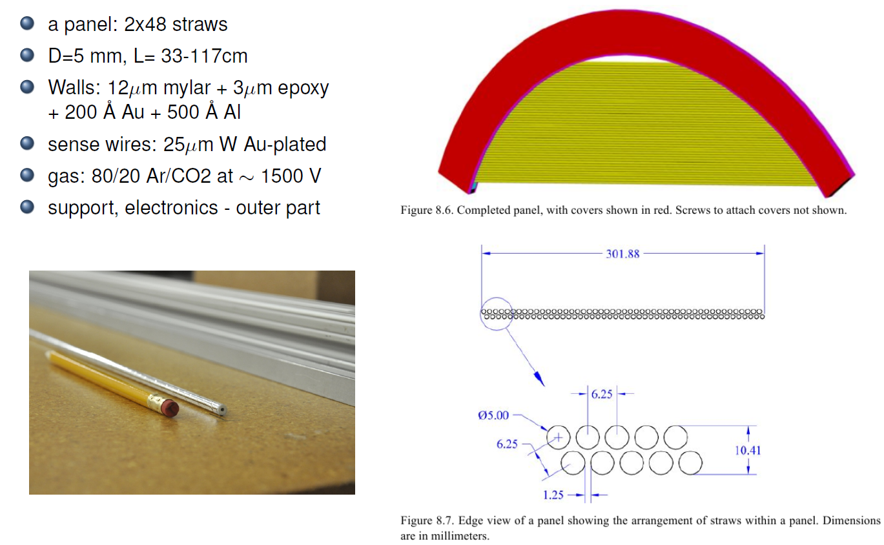
Straw Tracker
18 stations over 3.2 meters, Rout = 70 cm ; station consists of two planes; 6 panels in the plane
plane
station

Slide 23
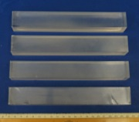
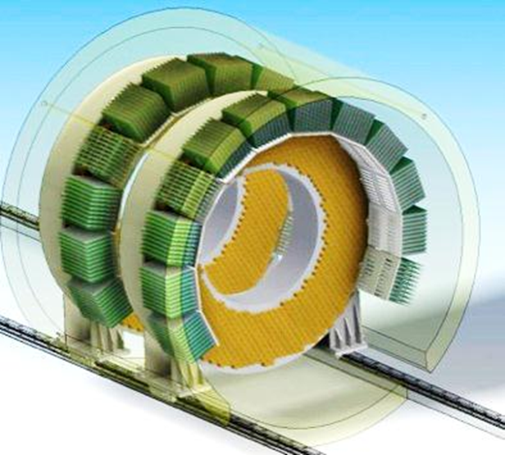
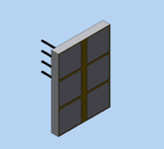
Mu2e Calorimeter
The requirements :
Provide energy resolution σ_{E}/E of O(5 %)
Provide timing resolution σ(t) < 500 ps
Provide position resolution < 1 cm
Provide almost full acceptance for
Conversion Electron @ 100 MeV
Redundancy in FEE and photo-sensors
The calorimeter should be able to operate in an environment where a dose up to 100 krad and a neutron fluency of 10¹² n/cm² are expected. It must also works in a 1 T magnetic field and 10⁻⁴ Torr vacuum.
Each disk has an internal (external) radius of 374 mm (660 mm) and is filled with ~700 34×34×200 mm³ CsI crystals.
Each crystal is readout by two large area
UV extended SiPM’s (14x20 mm²)

Slide 24
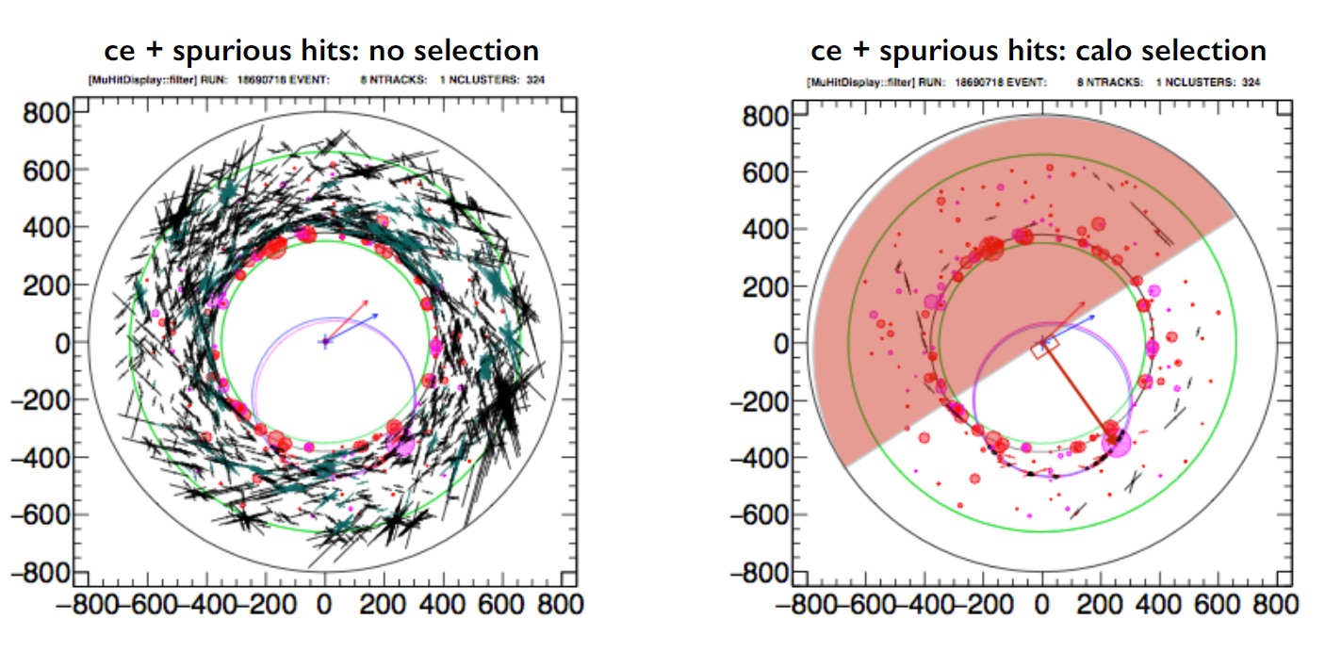
Mu2e Pattern Recognition
Example of a full simulated conversion electron (CE) event in overlap with all hits from the environmental background: (left) without any requirement on the calorimeter system and (right) with a calorimeter based selection. Black points are hits from the tracker. Red points are from calorimeter clusters. By requiring the track hits to be in time with the most energetic cluster of the event, in a time window of 50 ns, the quantity of background hits is strongly reduced

Slide 25
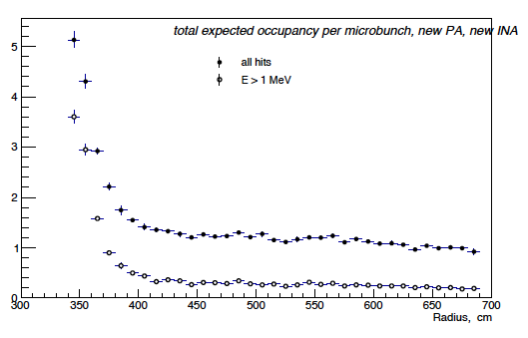
Calorimeter trigger and calibration
on-spill, when the proton beam is
directed to Mu2e
off-spill, when the proton beam is directed to Nova or is off
  cosmic trigger
  calibration source
  laser calibration
  electronics pulses
Occupancy (hit crystals/microbunch)
Mu2e has adopted an approach formerly devised for the BABAR electromagnetic calorimeter .
In this system, a 6.13 MeV photon line is obtained from a short-lived ¹⁶O transition that can be switched on and off as desired. The fluorine, a component of Fluorinert™ coolant liquid, is activated with a fast neutron source, producing the ¹⁶N isotope.
¹⁹F + n →¹⁶N +α
¹⁶N →¹⁶O* + β (τ_{1/ 2} = 7 s)
¹⁶O* →¹⁶O+γ (6.13MeV)

Slide 26
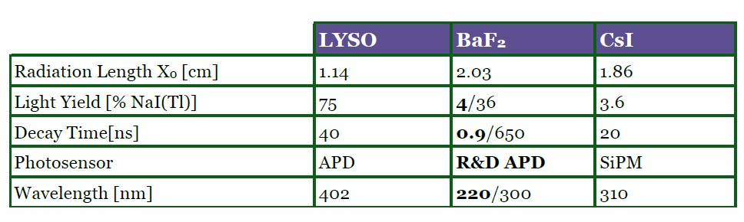
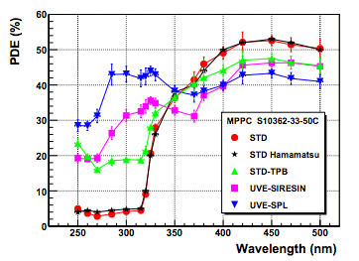
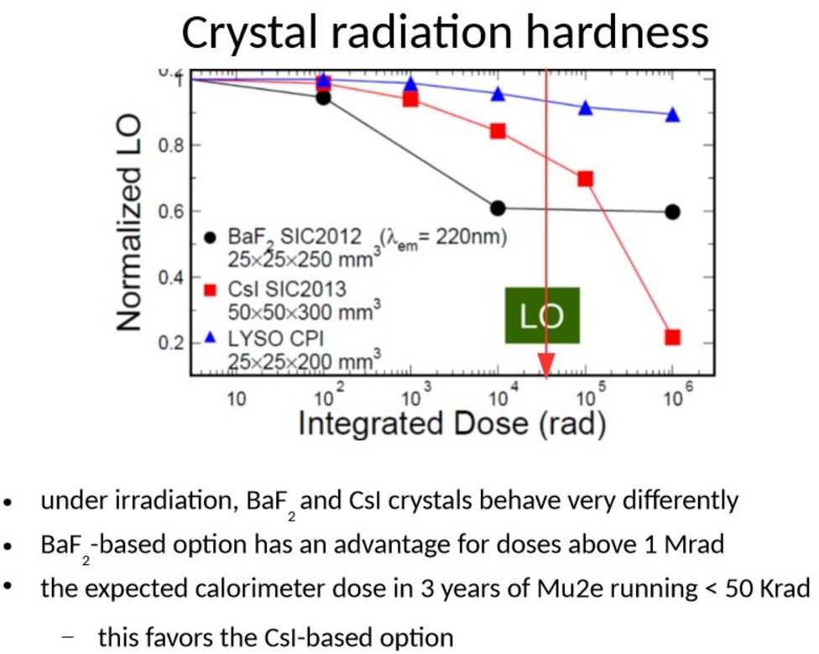
Crystals choice
Undoped CsI
Adequate radiation hardness
Slightly hygroscopic
30 ns emission time, small slow component.
Emits @ 310 nm.
Comparable LY of fast component of BaF₂.
Lower cost (6-8 $/cc)
Well know crystal.

Slide 27
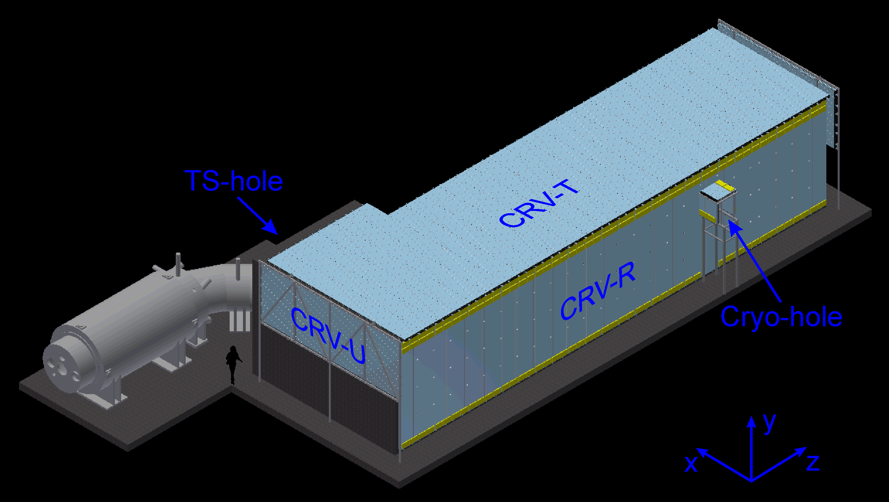
Mu2e Cosmic-Ray Veto
Veto system covers entire DS and half TS

Slide 28
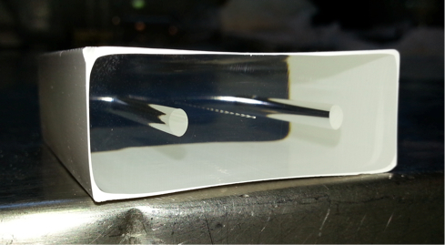
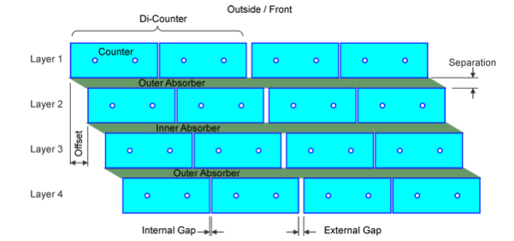
Mu2e Cosmic-Ray Veto
Will use 4 overlapping layers of scintillator
  Each bar is 5 x 2 x (450 – 660) cm³
  2 WLS fibers / bar
  Read-out both ends of each fiber with SiPM
  Have achieved ε > 99.4% (per layer) in test beam

Slide 29
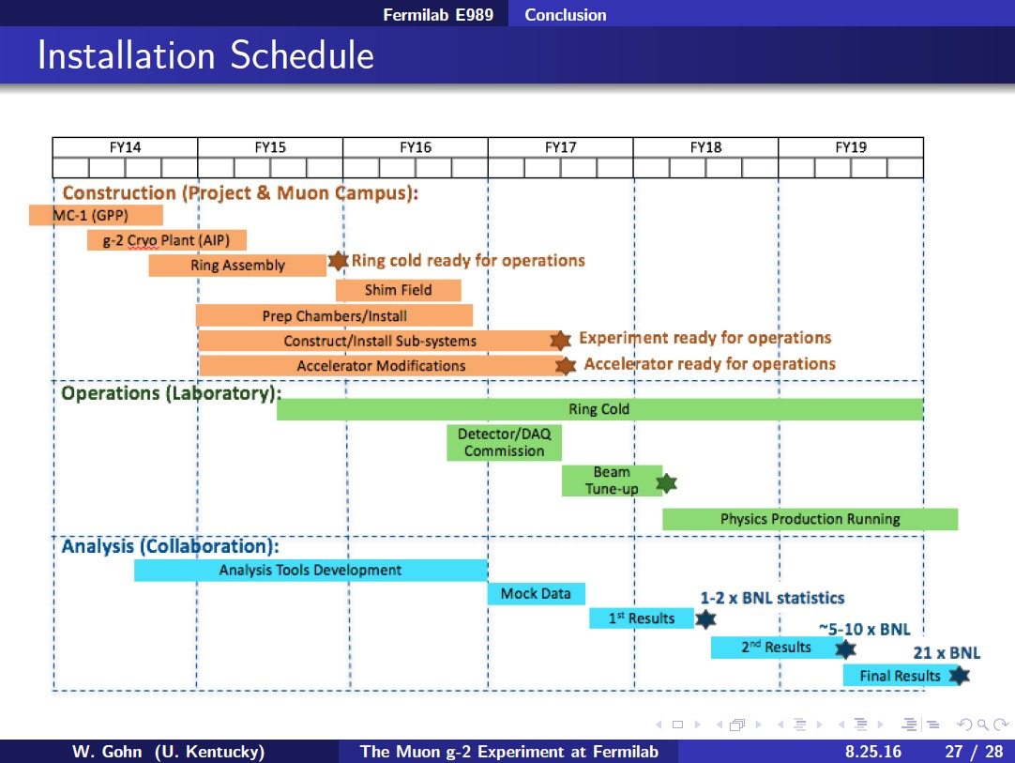
Muon g-2 installation schedule

Slide 30
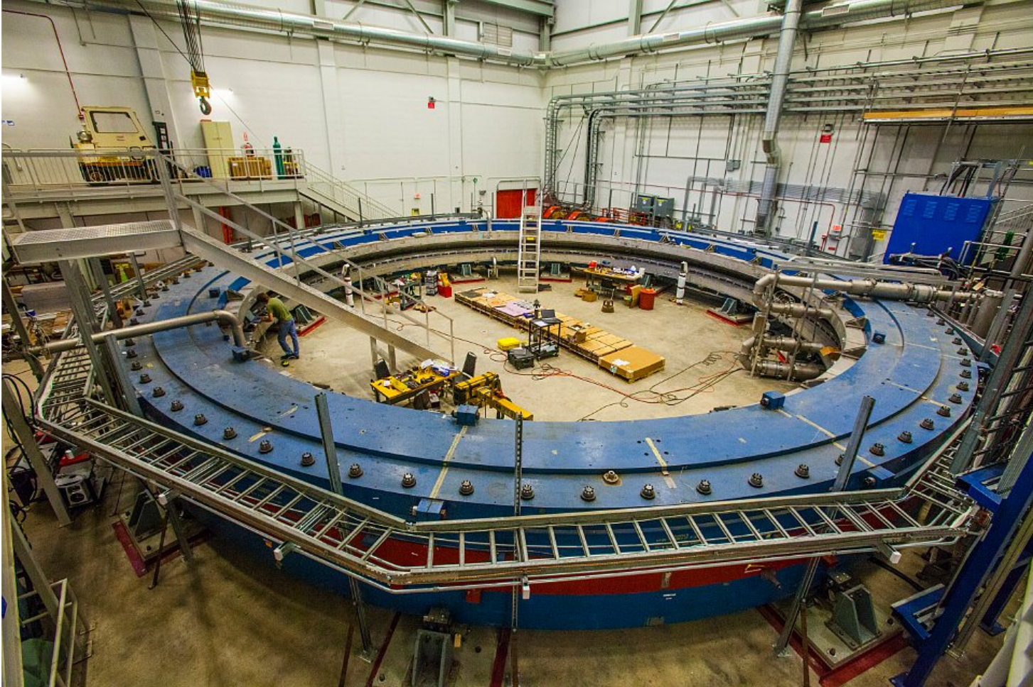
Storage ring in the experimental hall

Slide 31
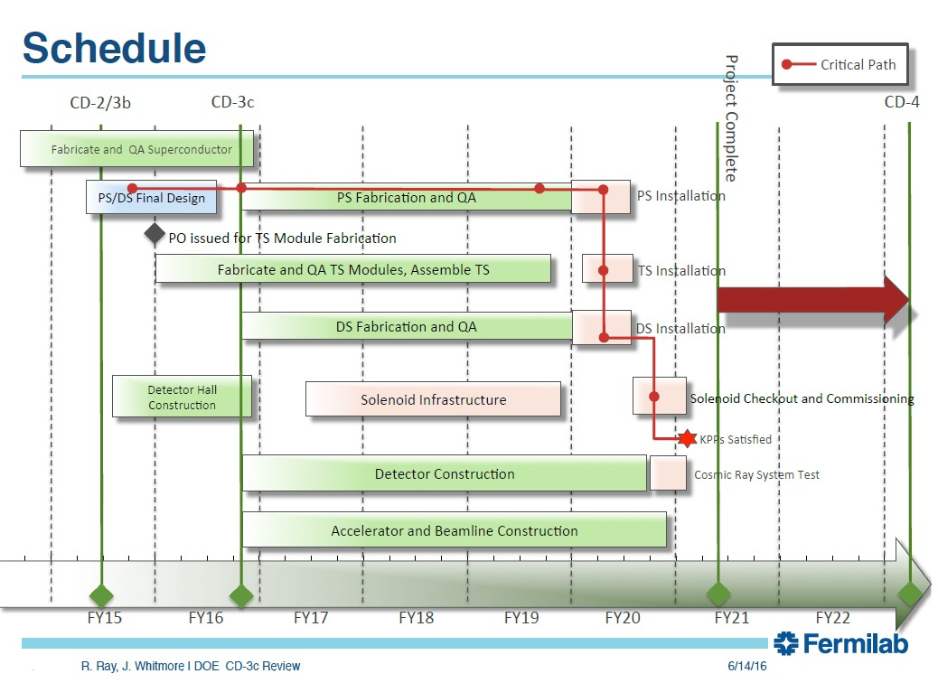
Mu2e installation schedule

Slide 32
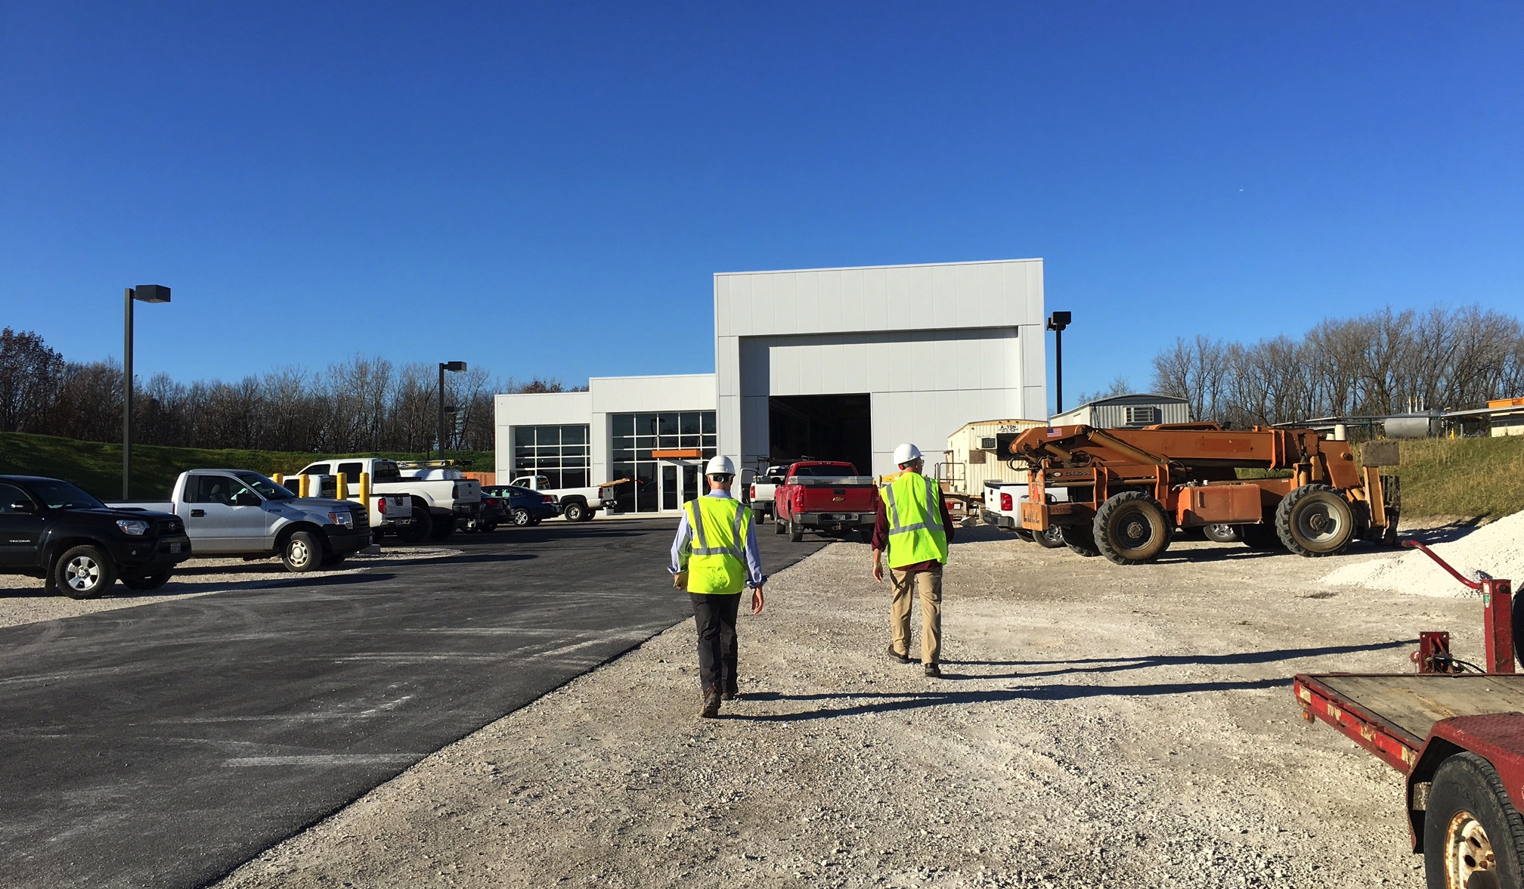
Mu2e building is ready

Slide 33
JINR contribution
E.m. calorimeter simulation
We are developing the new calibration method for the calorimeter in Mu2e experiment using electrons from muon decays-in-orbit (DIO). To provide uniform coverage and high statistics, the magnetic field will be reduced from 1 T to 0.5 T.
Fig.shows the most probable values of E/P distributions vs the initial electron momentum P_{gun} in different magnetic fields. The points for cases when P is measured in the front and back of the tracker are presented on the plot. Estimating <E/P> variations from the plot one can conclude that the calibration with accuracy of ~1.5% is possible. The accuracy can be increased after understanding of behavior of <E/P> vs the magnetic field and momentum.
We have investigated scintillation light distribution in BaF₂ and pure CsI crystals with dimensions 3x3x20 cm³ using the Geant4 toolkit. The diffuse wrapping material is selected as coating for the crystals. The simulated cosmic muons and 105 MeV electrons are used as beam particles.

Slide 34
JINR contribution
Test of LYSO crystal matrix at MAMI and Frascati accelerators
JINR colleagues strongly participated in the LYSO matrix tests. A LYSO matrix prototype was built in March 2014 with an overall transverse dimension corresponding to a ~ 3.6 Moli`ere Radius (RM) and a longitudinal dimension corresponding to ~ 11.2 radiation lengths (X0). The prototype consisted of 25 LYSO crystals (30 × 30 × 130 mm³) . Each crystal was wrapped with a 60 μm thick layer of super-reflective ESR-3M and read out by a Hamamatsu S8664-1010 APD. The APDs were optically connected to the crystals by means of Saint-Gobain BC-630 optical grease.
energy resolution as a function of the deposited energy
Time resolution as a function of the energy deposited in the matrix
Energy distribution for 92.5 MeV photons

Slide 35
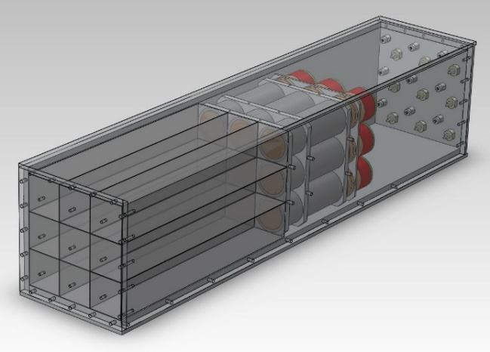
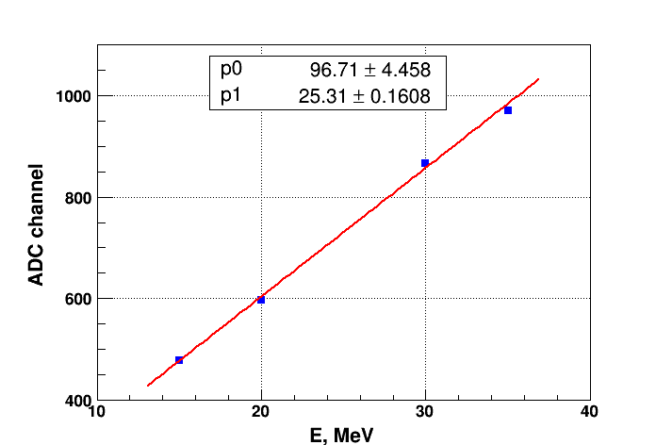

JINR contribution
Test of CsI crystal matrix at Yerevan electron accelerator
DLNP and Erevan Physics Institute (A.Alikhanyan National Laboratory) groups established a cooperation in 2015 to carry out beam tests of the e.m. calorimeter prototype on the Erevan Linac LUE-75. Calorimeter beam test requires single electron events, i.e. it is required to suppress the beam intensity by 10-11 orders of magnitude. Accelerator staff successfully got a steady LUE-75 operation mode with extremely low beam intensity (10-20 electrons/s) . Several Runs DLNP physics performed at LUE-75 with CsI crystal matrix.
Tested 3x3 matrix of pure CsI crystals 30x30x200 mm³ each with PMT readout
Matrix demonstrates good linearity of energy response
Energy resolution is about σ_{E}/E ≈ 6.4% at 35 MeV

Slide 36
JINR contribution
Test of CsI crystal matrix at Frascati electron accelerator
JINR colleagues participated in the beam test of CsI matrix which was done during April 2015 at the Beam Test Facility in Frascati (Italy) . Time and energy measurements have been performed using a low energy electron beam, in the energy range [70,120] MeV.
The calorimeter prototype consisted of nine 3 x 3 x 20 cm³ undoped CsI crystals wrapped into 150 μm of Tyvek®, and arranged into a 3x3 matrix. Out of the nine crystals, two were produced by Filar OptoMaterials, while the remaining 7 came from ISMA (Kharkov).
Figure : Energy resolution obtained from the data (black) compared with the Monte Carlo (red).
The time resolution for 100 MeV electrons is ϭt ~ 200 ps.

Slide 37


JINR contribution
JINR electron linear accelerator
DLNP in cooperation University Centre are interested in the soonest start of the linear electron accelerator (LINAC-800) in the building No. 118 sites LNP and its further use. In this regard, aiming to create an experimental base for carrying out scientific-methodical works using a beam of electrons in the energy range 5-240 MeV accelerator stand.
We investigating the possibility to obtain of a low-intensity (1…3 electron) beam of elections at the linear accelerator LINAC-800. Low-intensity beam of electrons with 1…3 electrons on each spill will allow us to study the characteristics of CsI and other type crystals.

Slide 38

JINR contribution
Radioactive Sources test
A study of scintillation properties of undoped CsI crystals. Undoped CsI sample 30x30x200 mm³ from Institute for Scintillation Materials ( Kharkiv, Ukraine) was tested at DLNP lab. Tested undoped CsI crystal shows a good light yield ~100 p. e./MeV (gate 200ns). Longitudinal response uniformity not worse 7% at 100-200 ns gates. Measured ratio of fast/total scintillation components is 0.83.
Longitudinal response uniformity and ratio fast to total scintillation component

Slide 39


JINR contribution
RnD with BaF2 crystals and solar blind photodetectors.
In the second stage of the Mu2e with two order high luminosity suppose to reassemble calorimeter on BaF2 crystals which have propriate radiation hardness. We ordered and obtaind 2 BaF2 crystals from Incrom ( Saint-Pitersburg). They were tested at Dubna and Frasctai and showed acceptable quality.
There are no commercially available UV photodetectors able to work in magnetic field 1 T. We carried out research on photodetectors for BaF2 crystals. Developing a photodetector sensitive to the fast component of the spectrum of the crystal in the range up to 260 nm and insensitive to the slow component peaking at 310 nm. As UV photodetectors, suitable for isolation only fast emission components of BaF₂ crystals, applied photocathode with upper p-emitter layer AlGaN:Mg. AlGaN photocathode with a mass fraction of Al x=0.3 was combined into one device with a microchannel plate. Our testing with Co⁶⁰ shows FWHM~10% .

Slide 40

JINR contribution
Increasing the light yield from scintillation strips (CRV system)
One of efficient methods of increasing light collection from a plastic scintillator by WLS fiber is filling a space between them with optical glue or some other filler with refractive index of wich close to that of the scintillator. In case of using high viscosity optical transparent filler the special technique we developed for injecting it into the strip hole.
Figure. Setup to pump the high viscosity filler into the co-extruded hole of the scintillation strip (not in scale): (1) dry type compressor; (2) SL101N digital Liquid Dispenser; (3) manometer; (4) special vessel with filler; (5) filler; (6) polyvinylchloride tube; (7) inlet for filling; (8) strip; (9) WLS fiber; (10) sealing; (11) exhaust outlet for extracting air.
The light yield of the strip filled with optical resin SKTN-MED(E) in average is 1.5-1,8 times higher than that of the “dry” strip

Slide 41


JINR contribution
Radiation hardness tests of the scintillator strips and filler samples
We have carried out the investigations on radiation hardness of scintillation strips and SKTN-MED(D) and Bicron-600 (for comparision) in the neutrons flux (E>1MeV) from fast neutron reactor IBR-2 of JINR. Fillers and strips with length 15 cm with WLS fiber in the its hole with/without filler were irradiated on neutron integral flux up to 1.6x10¹⁵neutrons/cm².
Transmission spectra of glue SKTN-MED(D) (a), BC-600 (b) measured on neutron integral flux (1.6x10¹⁵, 3.8x10¹⁴ , 1.2x10¹⁴) neutrons/cm²

Slide 42

JINR contribution
Test beam of the CRV counter prototypes
Tests of the CRV counter prototypes were performed at Fermilab 120 GeV proton beam.
According to the performed tests for the CRV modules were choosen :
• 2 mm X 2 mm SiPM Hamamatsu (small cross-current, low-noise);
• 1.4 mm fiber;
The paper is under preparation.

Slide 43


JINR contribution
Technology of the CRV 4-layers module assembly
In the 2015,2016 a group of JINR colleagues was sent to the University of Virginia, USA to establish a mass-production process of scintillation modules CRV. They successfully develop a procedure of module assemble and created two pilot CRV modules with a length of 90 cm and prepared scintillation strip components for 4.5 meter length module.

Slide 44
JINR plans (according to Statement of work for participation in the Mu2e Experiment at Fermilab)
VII.2.1 QA for crystals:
The JINR will test the crystals supplied by JINR as specified by the L2 manager of the calorimeter sub-system. This may involve using an electron accelerator beam from JINR or INFN, and/or radioactive sources, and/or cosmic rays collected via a test stand setup as will be determined by the preparation of experiment. JINR will determine the optical parameters of the crystals as well.
VII.2.2 Calorimeter FEE
JINR will be available to participate in the design and testing of the calorimeter Front-end Electronics (FEE) boards and waveform digitizers.
VII.2.3 Calorimeter commissioning
This activity, scheduled in 2020, will be described in a future addendum to this SOW.
VII.2.4 CRV module production
JINR will contribute to the development of a method for mass production of the CRV modules.
VII.2.5 Radiation tests of optical silicone
JINR will perform radiation hardness tests of the optical silicon and prototypes of CRV counters at the JINR neutron reactor.

Slide 45
JINR plans (according to Statement of work for participation in the Mu2e Experiment at Fermilab)
VII.2.6 Quality Assurance test stand for CRV modules
JINR will create the test stand for the Quality Assurance (QA) testing of assembled CRV modules.
VII.2.7 Filling fiber holes in long CRV modules
If the Mu2e project chooses to pursue the option of using optical silicone to increase light yield, JINR will fill the fiber holes of the 9 CRV extra-long ( 6.6.m) modules.
VII.2.8 CRV test beams
JINR will participate in test beams for CRV prototypes and modules.
VII.2.9 CRV commissioning
This activity, scheduled in 2020, will be described in a future addendum to this SOW.
VII.2.10 Simulations
JINR will participate in the Mu2e calorimeter and CRV simulation focusing on the developed of a calibration method for the calorimeter using electrons from muon decays-in-orbit.
VII.2.11 Photosensor R&D
JINR will participate in the R&D with solar blind Aluminium gallium nitride (AlGaN) photodetectors for BaF2 crystal calorimeter for Mu2e-II.

Slide 46
Agreements
Memorandum of Understanding JINR-FNAL
  Mu2e, muon (g-2)
  2013-2018
Implementation Agreement JINR-FNAL
  Mu2e
  2013-2016
NON-PROPRIETARY USER’S AGREEMENT BETWEEN JOINT INSTITUTE OF NUCLEAR RESEARCH, DUBNA, AND FERMI RESEARCH ALLIANCE, LLC DATED August 18, 2015
Statement of work For participation in the Mu2e Experiment at Fermilab, February 2017

Slide 47
Our publications connected to this Project
J. Budagov et al., “The calorimeter project for the Mu2e experiment”, Nucl. Instr.&Meth. A718(2013) 56-59.
O. Sidletskiy et al., “Evaluation of LGSO:Ce scintillator for high energy physics experiments”, Nucl. Instr.&Meth. A735(2014) 620-623.
K. Afanaciev et al., “Response of LYSO:Ce scintillation crystals to low Energy gamma-rays”, Part. Nucl. Lett. (2015), Vol. 12 (193), p.476
Z. Usubov, “Electromagnetic calorimeter simulation for future µ→e conversion experiments”, arXiv:1212.4322 (2012).
Z. Usubov, “Light output simulation of LYSO single crystal”, arXiv:1305.3010 (2013).
N. Atanov et al., “Measurement of time resolution of the Mu2e LYSO calorimeter prototype”, Nucl. Inst. Meth. A 812 (2016), 104.
N. Atanov et al., “Design and status of the Mu2e electromagnetic Calorimeter”, Nucl. Inst. Meth. A 824 (2016), 695.
Z.Usubov, “Scintillation light simulation in big-sized BaF₂ and pure CsI crystals” http://arxiv.org/abs/1604.00827
N.Atanov et al., “Characterization of a prototype for the electromagnetic calorimeter of the Mu2e experiment” IL NUOVO CIMENTO 39 C (2016) 267
N. Atanov et al, “Energy and time resolution of a LYSO matrix prototype for the Mu2e experiment” NIM A824, 11 July 2016, Page 684
N. Atanovet al, “Characterization of a 5 × 5 LYSO Matrix Calorimeter Prototype” IEEE TRANSACTIONS ON NUCLEAR SCIENCE, VOL. 63, NO. 2, APRIL 2016, p.596
M.Angelucci et al., “Longitudinal uniformity, time performances and irradiation test of pure CsI crystals” Nucl.Instrum.Meth. A824 (2016) 678
A. Artikov et al. “Optimization of light yield by injecting an optical filler into the co-extruded hole of the plastic scintillation bar.” JINST 11 (2016), T05003.
A. Simonenko et al., “ The increase of the light collection from scintillation strip with hole for WLS fiber using various types of fillers” , submitted to Part. Nucl. Lett. (2016), in Russian, arXiv:1604.02286.

Slide 48
Conference reports
Baranov V.Y., JINR, “Research of properties undoped crystals CsI” Fifth International Conference ISMART 2016 “Engineering of Scintillation Materials and Radiation Technologies” , 26 - 30 September 2016
Atanov N.V., Ivanov S.V., Jmeric V.N., Nechaev D.V., Tereshchenko V.V. “Solar-blind photodetectors with AlGaN photocathodes for light registration in UVC range” conference NTIHEP-2016, Montenegro, Budva
Kharzheev Yu.N., “New trends in using Scintillation counters in modern high energy experiments” THE 6th INTERNATIONAL CONFERENCE ON CONTEMPORARY PHYSICS, June 7-10, 2016, Ulaanbaatar Mongolia
Vasilyev I.I., JINR, « The light yield of a long scintillation strip with WLS fiber embedded into the co-extruded hole » Fifth International Conference ISMART 2016 “Engineering of Scintillation Materials and Radiation Technologies” , 26 - 30 September 2016
A.Simonenko et al, «INCREASING THE LIGHT YIELD FOR SCINTILLATION STRIPS WITH WLS FIBER EMBEDDED INTO THE CO-EXTRUDED HOLE» New Trends in High Energy Physics, 2016, Montenegro, Budva
Kharzheev Yu.N., “Scintillation Detectors in modern High Energy Physics Experiments and Prospect of their use in Future Experiments”, International Conference on Astrophysics and Particle Physics, December 8-10, 2016, Dallas, USA
N. V. Khomutov, “Using the cathode surface of straw tube for measuring the track coordinate along the wire and increasing rate capability”, New Trends in High-Energy Physics. Budva, Becici, Montenegro, 02 October - 08 October, 2016.
N. P. Kravchuk, “Tracker prototype on a base of cathode straw”, Fifth International Conference ISMART 2016 “Engineering of Scintillation Materials and Radiation Technologies”, September 26-30, 2016, Minsk, Belarus.

Slide 49
FTE
# | Name | Lab | Task | FTE(%)
1 | Artikov A.M. | DLNP | CRV, calorimeter | 80
2 | Atanov N.V. | DLNP | calorimeter, CRV | 80
3 | Atanova O.S. | DLNP | calorimeter | 30
4 | Baranov V.A. | DLNP | Muon g-2 | 50
5 | Baranov V.Yu. | DLNP | calorimeter, CRV | 80
6 | Budagov J.A | DLNP | calorimeter, CRV | 50
7 | Chokheli D. | DLNP | calorimeter, CRV | 100
8 | Davydov Yu.I. | DLNP | calorimeter, CRV | 80
9 | Demin D.L. | DLNP | calorimeter | 20
10 | Duginov V.N | DLNP | calorimeter | 30
 | Duginov V.N | DLNP | Muon g-2 | 20
11 | Glagolev V.V. | DLNP | calorimeter, CRV | 70
12 | Gritsaj K.I. | DLNP | Muon g-2 | 20
13 | Kharzheev Yu.N. | DLNP | CRV, calorimeter | 100
14 | Khomutov N.V. | DLNP | Muon g-2 | 80
15 | Kolomoets V.I. | DLNP | CRV, calorimeter | 100
16 | Kolomoets S.M. | DLNP | CRV, calorimeter | 30
17 | Kravchuk N.P. | DLNP | Muon g-2 | 30
 | Kravchuk N.P. | DLNP | Mu2e | 20
18 | Krylov V.A. | LRB | Muon g-2 | 50
19 | Kuchinsky N.A. | DLNP | Muon g-2 | 70
20 | Mamedov T.N. | DLNP | Muon g-2 | 30
21 | Sazonova A.V. | DLNP | CRV | 30
22 | Shalyugin A.N. | DLNP | CRV, calorimeter | 80
23 | Simonenko A.V. | DLNP | CRV, calorimeter | 80
24 | Suslov I.A. | DLNP | Calorimeter simul. | 70
25 | Tereschenko V.V. | DLNP | CRV, calorimeter | 50
26 | Tereschenko S.V. | DLNP | CRV, calorimeter | 50
27 | Titkova I.V. | DLNP | CRV, calorimeter | 10
28 | Usubov Z. | DLNP | CRV, calorimeter sim. | 100
29 | Vasilyev I.I. | DLNP | CRV, calorimeter | 80
30 | Volnykh V.P. | DLNP | Muon g-2 | 50
 |  |  | Mu2e | 1420
 |  |  | Muon g-2 | 400

Slide 50
What next?
Mu2e Signal?
A next-generation Mu2e experiment makes sense in all scenarios
  Push sensitivity or
  Study underlying new physics
  Will need more protons → upgrade accelerator
Yes
No
Precision Measurement if necessary
Higher Sensitivity search
Measure conversion rate as a function of Z
Accelerator
Upgrade

Slide 51
Summary
Precise muon experiments :
Improve sensitivity by a factor of 10⁴
Provide discovery capability over wide range of New Physics models
Are complementary to LHC, heavy-flavor, and neutrino experiments

Slide 52

Planned Future : PIP-II project at Fermilab

