Slide 1
Activities and Perspectives at Armenian Grid site
ATLAS Team, A. Alikanian National Laboratory (YERPHI)
H. Oganezov
The 6th International Conference "Distributed Computing and Grid-technologies in Science and Education"

Slide 2
Overview
E-Infrastructures in Armenia
International Projects
AANL grid site
Network topology
Bandwidth allocation
Site overview
ATLAS VO support
ALICE VO support
Monitoring and job statistics
Network diagnostic with perfSonar
perfSONAR deployment at AANL
Issues and Perspectives

Slide 3
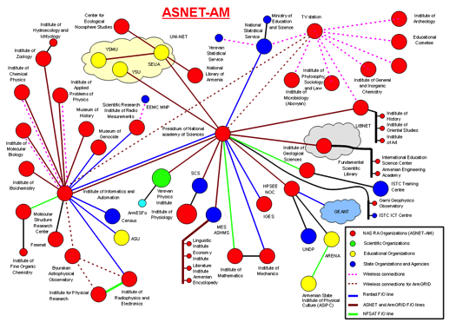
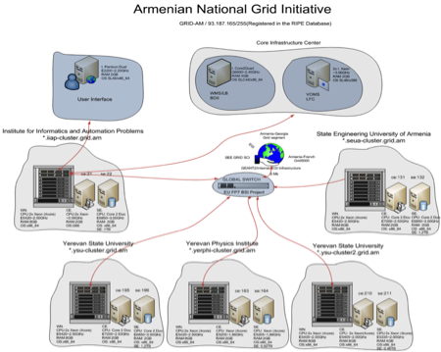
E-Infrastructures in Armenia
Armenian e-infrastructure is a complex national IT infrastructure consists of both communication and distributed computing infrastructures. The infrastructure is operated by the Institute for Informatics and Automation Problems (IIAP), which is the leading ICT research and technology development institute of the National Academy of Sciences of the Republic of Armenia (NAS RA).

Slide 4
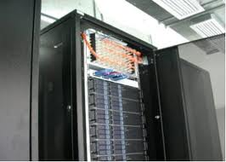
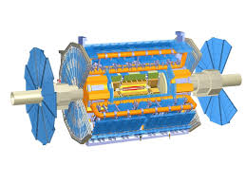
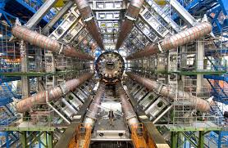
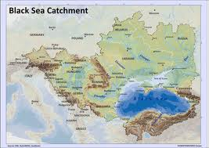
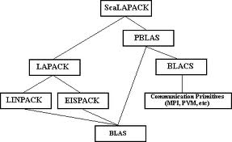
E-Infrastructure Components
Types of Infrastructure
Middlewares
Collaboration
Software tools
ATHENA

Slide 5
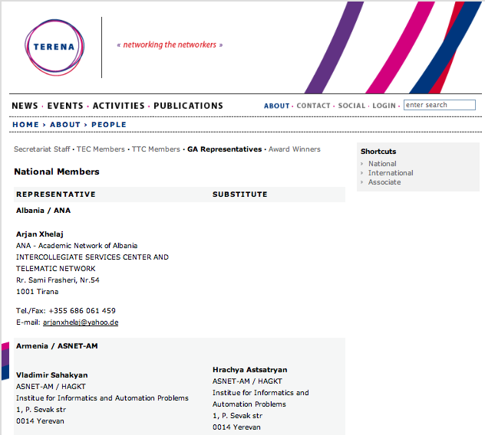
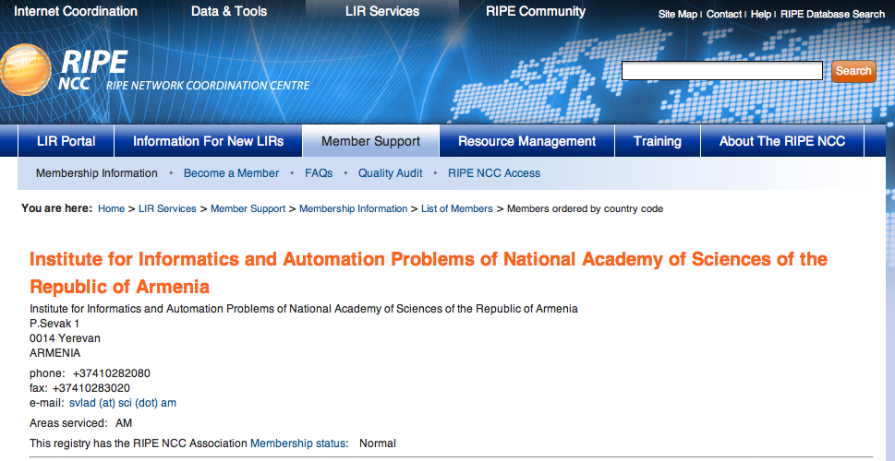
E-Infrastructures: Collaboration
Réseaux IP Européens Network
Coordination Centre
Trans-European Research and Education Networking Association

Slide 6
International Projects in E-Infrastructures
FP7
STATE
State Target Project entitled Deployment of Armenian National Grid Infrastructure (2010-2012)
Deploying ARmenian distributed Processing capacities for Environmental GEOspatial data (2011-2013)
European Grid Initiative: Integrated Sustainable Pan-European Infrastructure for Researchers in Europe (2010-2014)
High-Performance Computing Infrastructure for South East Europe’s Research Communities (14 countries) (2010-2013)
Integrating Armenia into ERA: information and Communication Technologies (AM, FR, HU, BEL) (2013-2015)
SNF
GN3+ (Multi-gigabit European research and education network and associated services) (2013-2015)
BSEC
Experimental Deployment of an Integrated Grid and Cloud Enabled Environment in BSEC Countries on the Base of g-Eclipse (2013-2014)

Slide 7
Overview
E-Infrastructures in Armenia
International Projects
AANL grid site
Network topology
Bandwidth allocation
Site overview
ATLAS VO support
ALICE VO support
Monitoring and job statistics
Network diagnostic with perfSonar
perfSONAR deployment at AANL
Issues and Perspectives

Slide 8
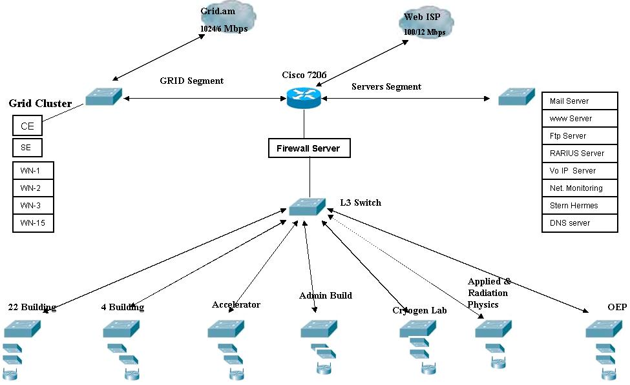
AANL network topology
LAN includes 10 buildings at Yerphi and Aragats ,Nor-Hamberd Stations
computer network consists of over 400 workstations.,

Slide 9
AANL GRID bandwidth allocation
36 Mbps 45 Mbps 100 Mbps
2009-2011 2012-2013 2014
Network is provided by GEANT and by the channel rented from the local telecom companies (Arminco, ADC).
IP Group "Grid" members and policies:
GRID Cluster
Grid oriented servers and services
ALICE,ATLAS Collaboration Workstations
Access to ASNET and Educational Network 1000 Mbps Access to Outside Armenia 6 Mbps No session Limits

Slide 10
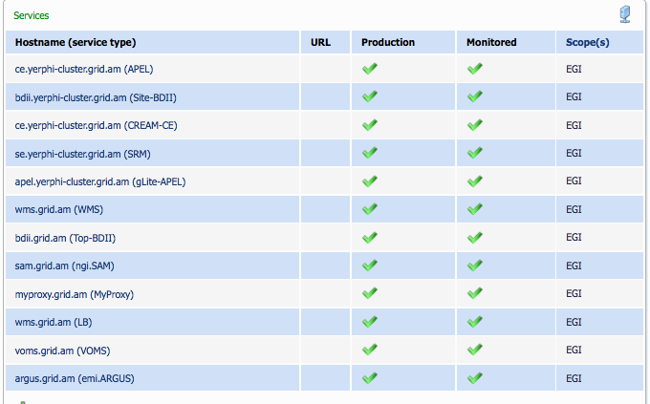
Site overview: services

Slide 11
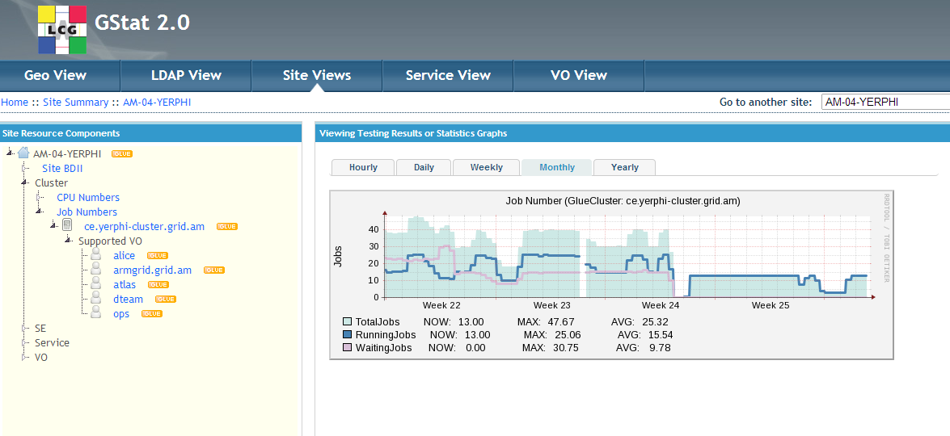
Site overview: Gstat monitoring

Slide 12
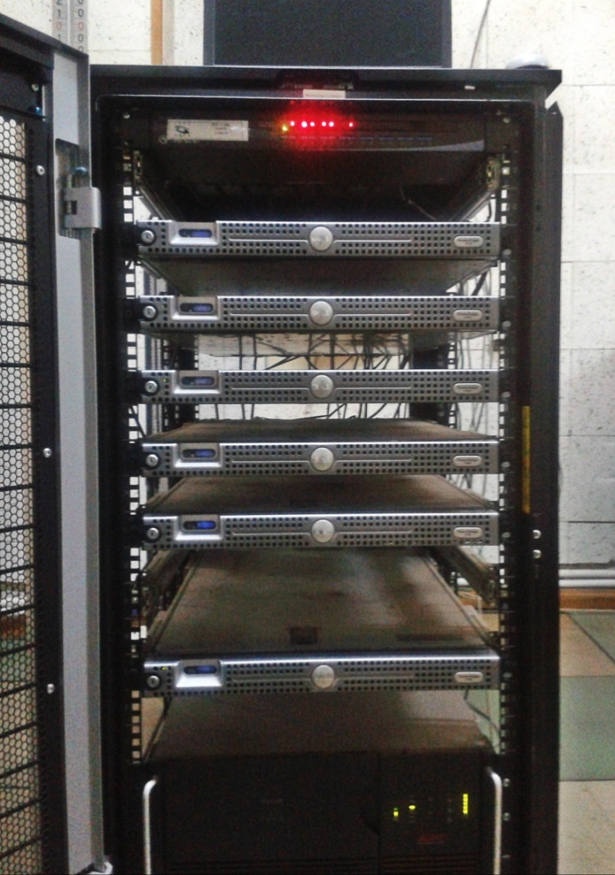
LCG – Armenia T3 contribution
2007: the AM-04-YERPHI site has been certified as “production site” of WLCG
Computational resources
CPU: 6 nodes x 2 cpus
per node X 4 cors per cpus= 48 cors
HDD:160 GB
RAM: 8 GB
Storage Capacity
50TB
Supported VOs:
ATLAS
ALICE

Slide 13
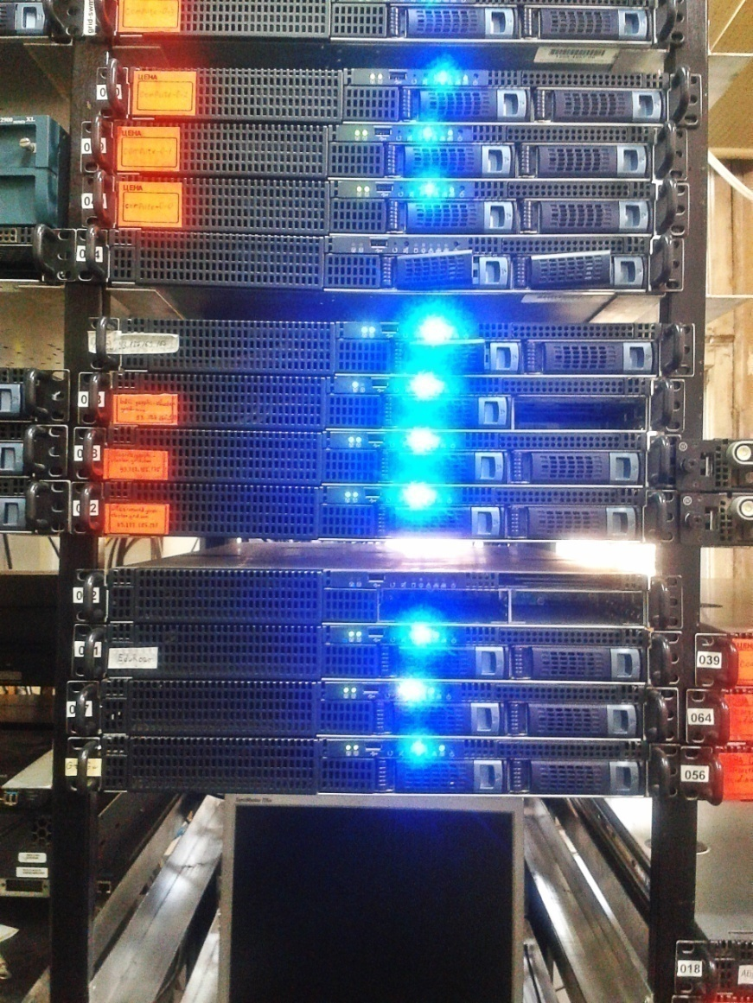
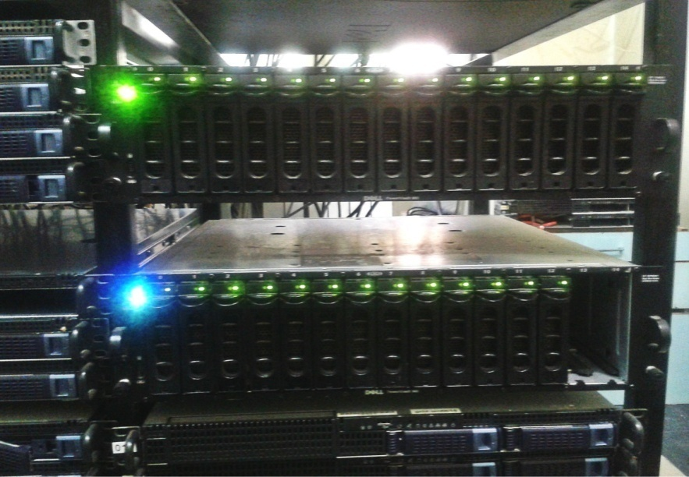
ATLAS VO Support
Clusters
October 20-th 2011 : Site status as ATLAS GRID site was approved by ICB
Allocated Storage 10TB (nfs)
ATLASSCRATCHDISK 2T
ATLASLOCALGROUPDISK 7.00T
ATLASPRODDISK 1024.00G
Frontier/ Squid cluster
perfSONAR node
xrootd cluster

Slide 14
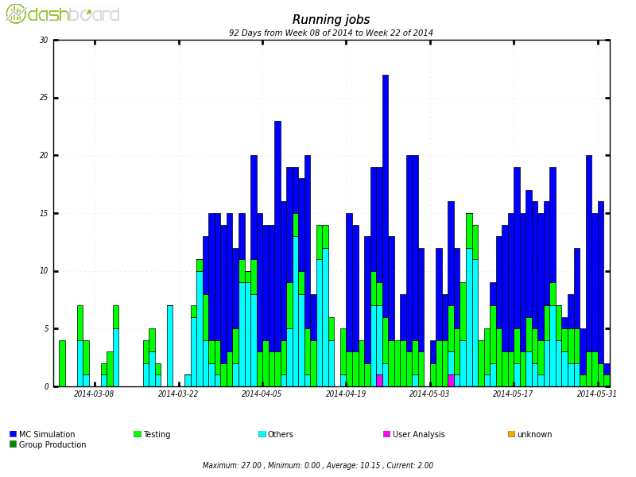
ATLAS VO Support
Monitoring and job statistics
Security hole issue

Slide 15
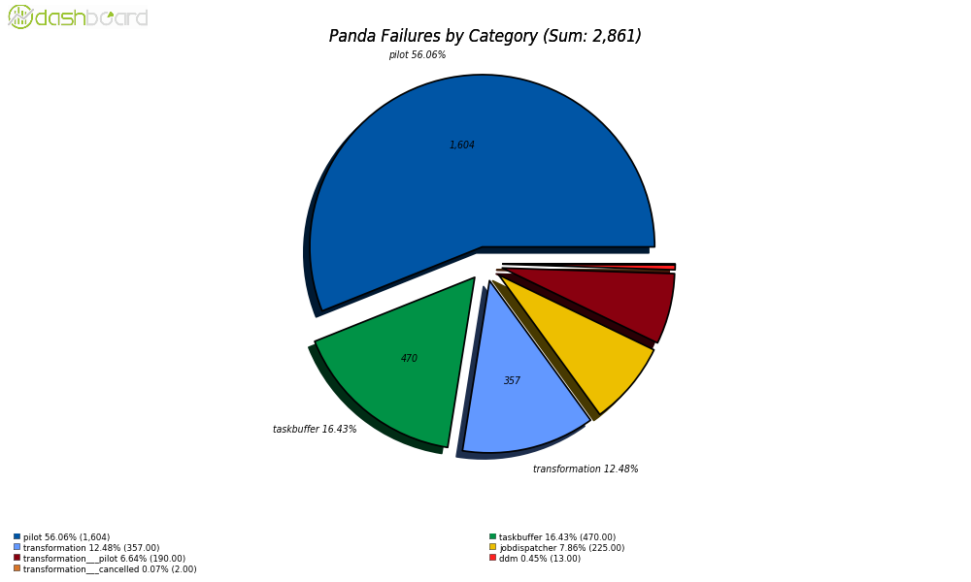
Job Failure by Category and Exit Code
ATLAS VO Support
Maui scheduler job problems : optimization needed
Probably communications and acl problems
Pilot error

Slide 16
ATLAS VO Support
Wall Clock Efficiency
Good efficiency of testing and MC production jobs

Slide 17
Alice VO support
Monitoring and job statistics

Slide 18
Alice VO support
Monitoring and job statistics

Slide 19
Overview
E-Infrastructures in Armenia
International Projects
AANL grid site
Network topology
Bandwidth allocation
Site overview
ATLAS VO support
ALICE VO support
Monitoring and job statistics
Network diagnostic with perfSonar
perfSONAR deployment at AANL
Issues and Perspectives

Slide 20
Network diagnostic with perfSonar
perfSONAR stands for PERformance Service Oriented Network monitoring Architecture
perfSONAR is designed to be:
Decentralised and Scalable
Large number of networks and services, large volume of data
Each domain can set its own security policy
Secure
Will not put participating networks at risk of attack or congest them
Main purpose
aiding network problem diagnosis and speeding repairs
identifying structural bottlenecks in need of remediation
providing a standard measurement of various network performance related metrics over time as well as “on-demand” tests.

Slide 21
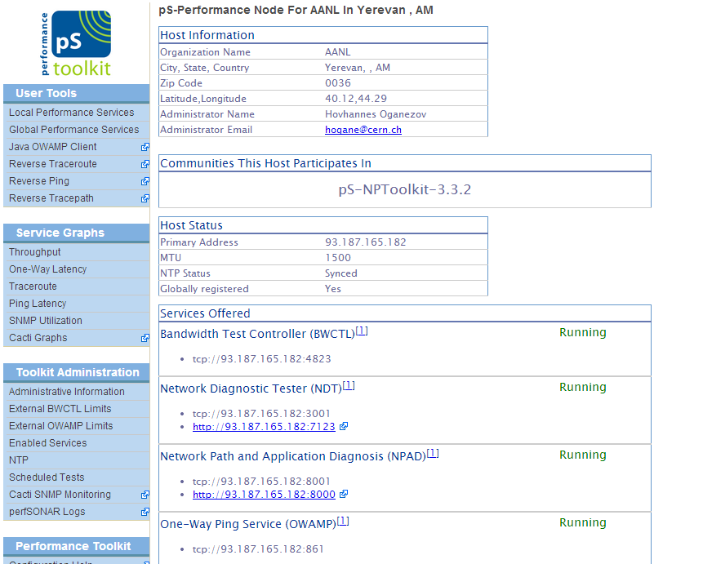
perfSONAR deployment at AANL
Current network problem:
issue with big file transferring(~10 Gb) - connection timeouts and connectivity problem (packet loss)
perfSonar diagnostic will use to better optimize decisions in workflow and data management – tune timeout value, number of streams, etc
optimize data distribution (DDM) based upon a better understanding of the network between sites
Current status:
installed and configured
waiting for DNS alias for perfSonar
node

Slide 22
Overview
E-Infrastructures in Armenia
International Projects
AANL grid site
Network topology
Bandwidth allocation
Site overview
ATLAS VO support
ALICE VO support
Monitoring and job statistics
Network diagnostic with perfSonar
perfSONAR deployment at AANL
Issues and Perspectives

Slide 23
Issues and Perspectives
We are facing problems
Each problem
is particularly tricky and time consuming
better communication needed with VO supporters
with service experts
A reliable network is critical
it is necessary for stable operations of the Grid and other high network activities
perfSONAR deployment could help
to monitor network conditions in a full-mesh topology(i.e. between any combination of 2 sites)
to monitor network performance
CERN experts’ help could make it easier to solve end-to-end problems
perfSonar diagnostic will use to better optimize FTS transferring: timeout and stream numbers still need to be revised

Slide 24
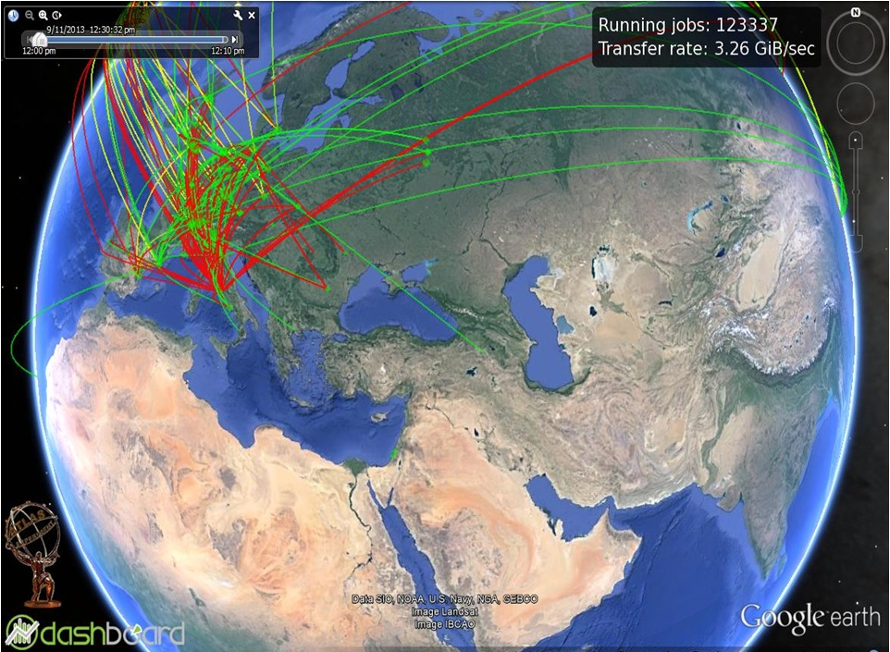
Thank you
AM-04-YERPHI

