Slide 1



Slide 3
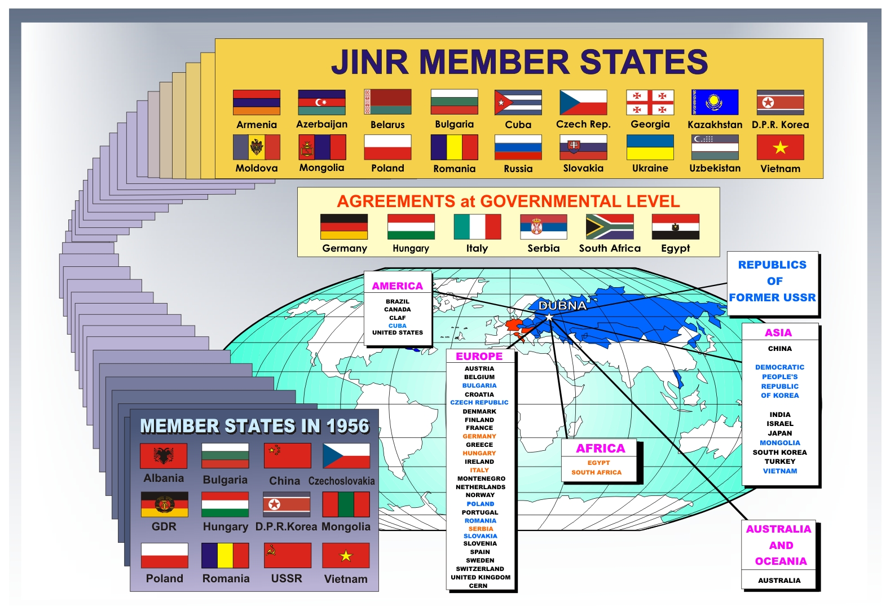
JINR’s partners are about 700 institutions located in 60 countries, including about 300 institutions and universities
from the JINR Member States

Slide 4
JINR’s staff members ~ 4500
Researchers ~ 1200
including from the Member States ~ 500
Doctors and PhD ~ 1000
> 60 Conferences/Workshops yearly

Slide 5
JINR Governing Bodies & Structure
Committee of Plenipotentiaries
Scientific Council
Directorate
Finance Committee
PAC for Particle Physics
Scientific-Technical Council
PAC for Nuclear Physics
7 Scientific Laboratories
PAC for Condensed Matter
Physics
University Center
Administrative Departments

Slide 6
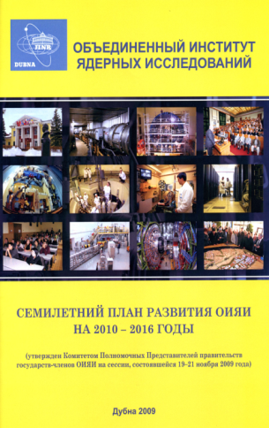
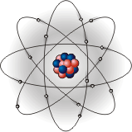
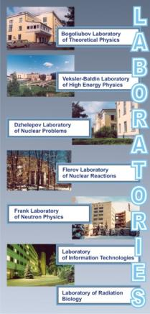
JINR’s Science Policy
7-Year Program: ‘2010 – 2016’
Basic Scientific Directions
High Energy Physics
Nuclear Physics
Condensed Matter Physics
Fundamental
Science
Innovative
activities
Education
programme
Special Economic Zone “Dubna”
Public-Private-Partnership
UC, DIAS-TH
International Univ. “Dubna”

Slide 7
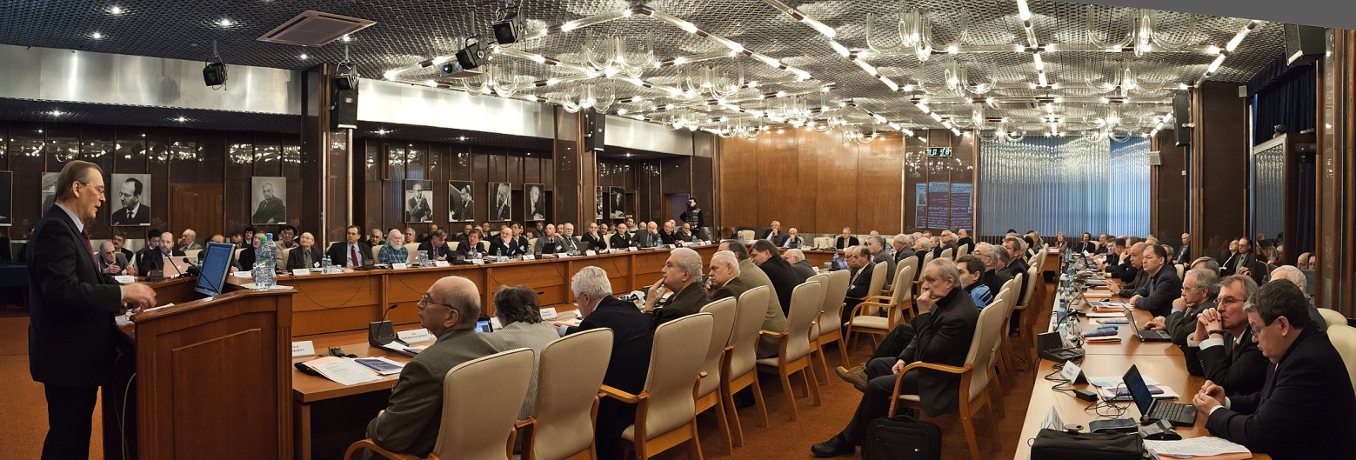
The research policy of JINR is determined by the Scientific Council, which consists of eminent scientists from the Member States, as well as famous researchers from China, France, Germany, Greece, Hungary, India, Italy, and CERN
111th session of the Scientific Council , February 2012

Slide 8
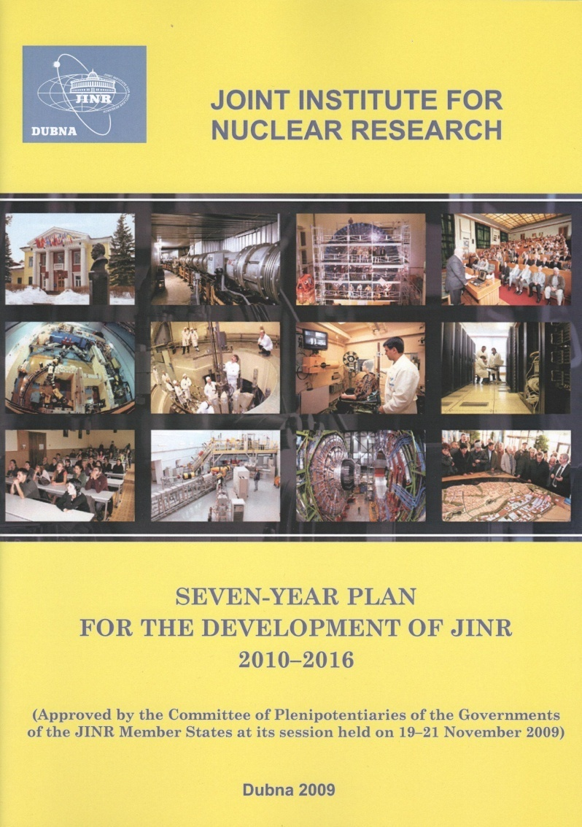
JINR – strategic development
Planned JINR budget М$ (7-years plan)
Actual JINR budget, М$

Slide 9
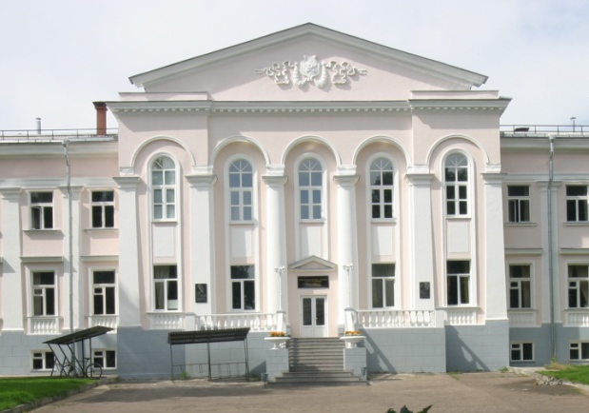
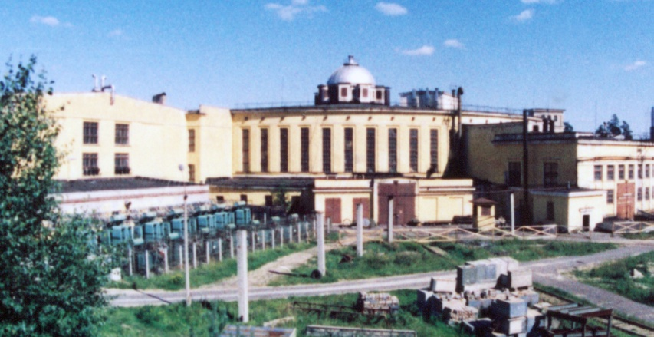
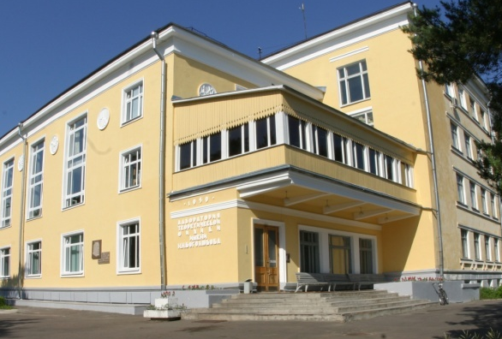
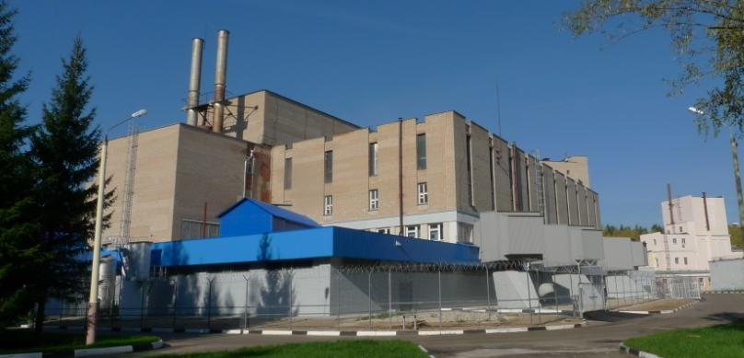
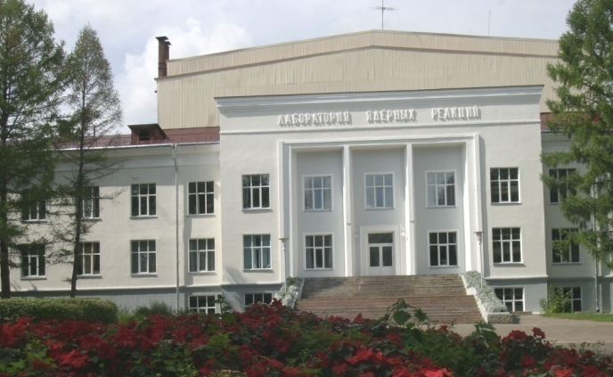
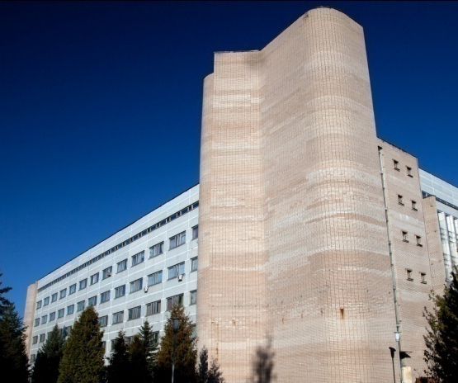
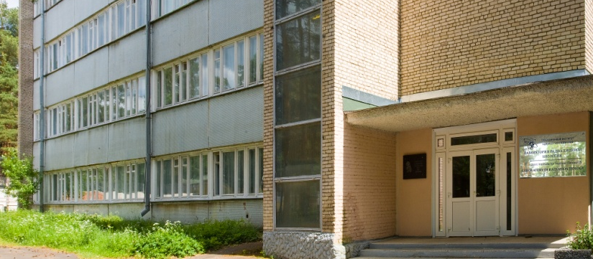
JINR comprises 7 Laboratories, each being comparable with a large institute in the scale and scope of investigations performed
Veksler and Baldin
Laboratory of High Energy Physics
Dzhelepov
Laboratory of Nuclear Problems
Bogoliubov
Laboratory of Theoretical Physics
Frank Laboratory of Neutron Physics
Laboratory of
Information Technologies
Flerov
Laboratory of Nuclear Reactions
Laboratory of Radiation Biology

Slide 10

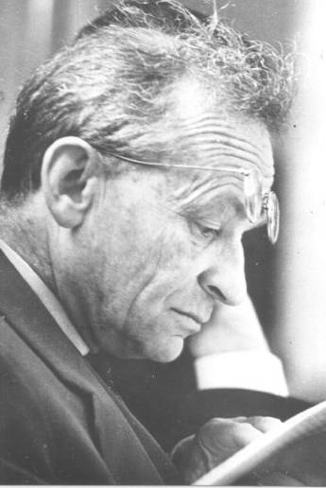
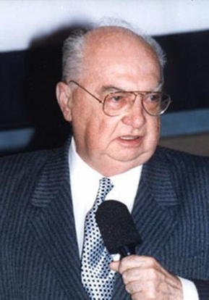
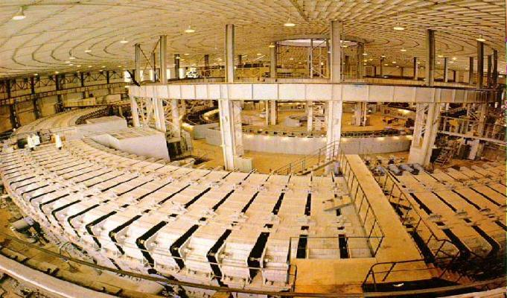
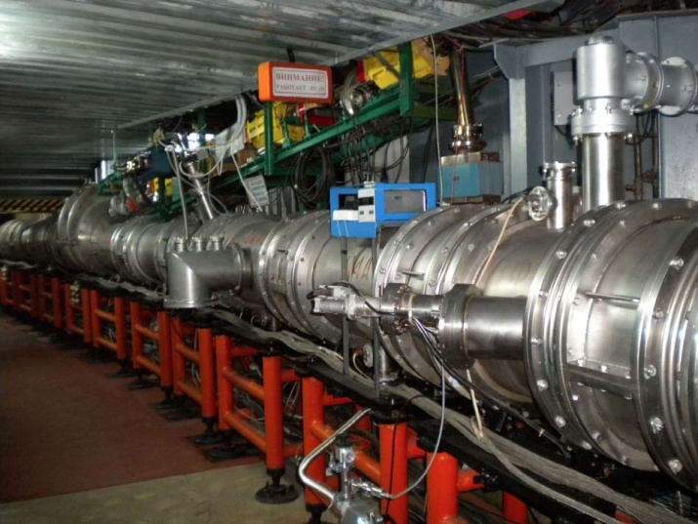
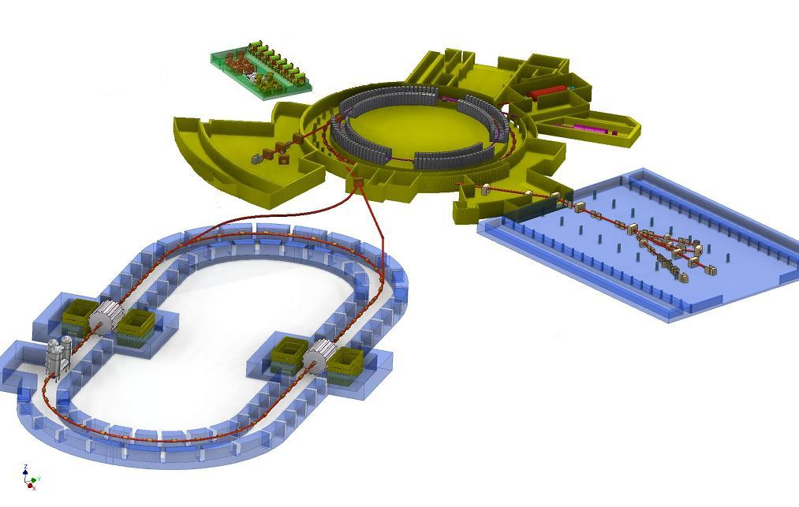
From the First Synchrotron to High-Energy
Heavy-Ion Physics
1957 Synchrophasotron
1993
Nuclotron
2017
NICA
10 GeV Aaccelerator of protons – world leader
in energy
Beginning
of the era of
high-energy
physics
First in the world
Superconducting synchrotron of
heavy ions
Superconducting collider of heavy ions
V. Veksler - discovery
of the phase stability
principle
A. Baldin - beginning
of relativistic nuclear physics
Study of nuclear
matter at maximum density
Notes:
As one of the world leading centres in physics and technology of charged particle accelerators, JINR has greatly contributed to the development of high energy physics. From the first in the world accelerator with the record at that time energy of 10 GeV – the synchrophasotron, developed on the basis of the phase-stability principle introduced by V.Veksler and launched in 1957, to the first in the world superconducting accelerator of heavy ions – the Nuclotron launched in 1993, the project of an accelerator complex of superconducting rings with heavy ion colliding beams NICA will be able to maintain the leading position of JINR, and, therefore, Russia, in high energy physics for the coming 20-25 years.
Herewith, the Nuclotron itself and the unique magnet of the synchrophasotron will be not only historic symbols of the greatness of our science, like the first manned flight to space, but will serve as a preaccelerator and equipped working premises for the booster of the superconducting collider NICA which is intended for the studies of fundamental properties and behaviour of nuclear matter in the maximum attainable conditions in accelerator experiments of energy densities and temperatures that existed in the first microseconds of the Universe evolution after the Big Bang and which possibly still exist deep in neutron stars.
NICA will offer a unique chance to reconstruct the associated conditions in laboratory and allow the all-round studies of new sates of the nuclear matter on a profound and accurate level unattainable in other accelerator centres of the world. It is exactly due to these reasons that the NICA project has obtained significant support of international experts.

Slide 11


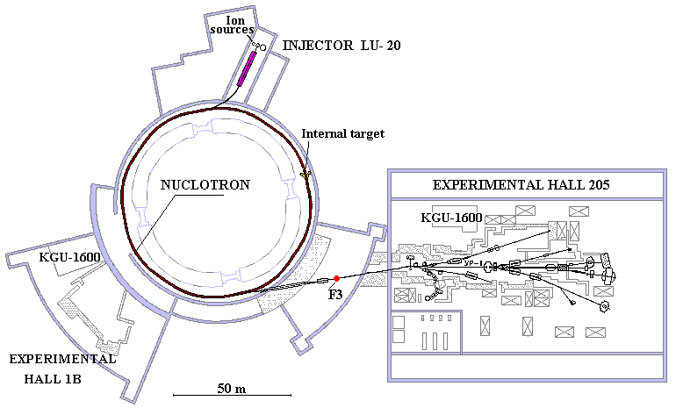
NICA: Nuclotron based Ion Collider fAcility
Routine
beam extraction at 5.2 GeV/u
Ions: from p to Xe
Acceleration up to 5.8 GeV/u (C6+)

Slide 13
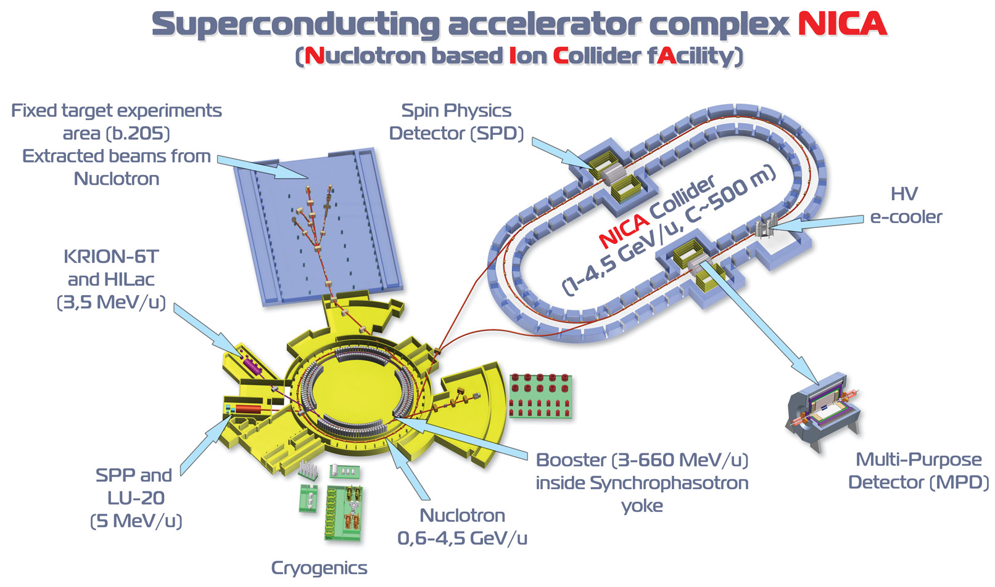
NICA parameters:
Energy range: √s_{NN} = 4 - 11 GeV
Beams: from p to Au
Luminosity: L~10²⁷ (Au), 10³² (p)
Detectors: MPD (ions), SPD (spin physics)
Notes:
13

Slide 14
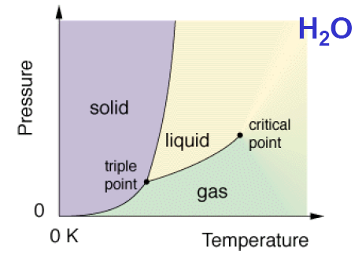
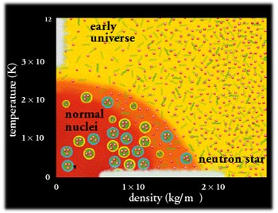
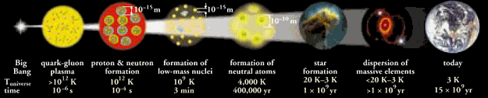
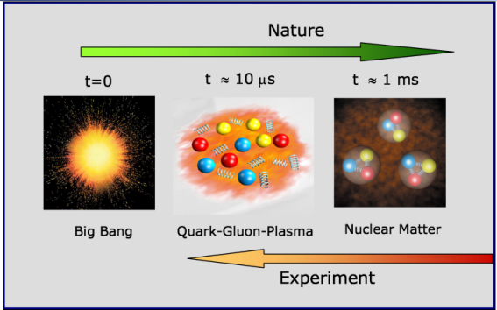
14
Notes:
14

Slide 15
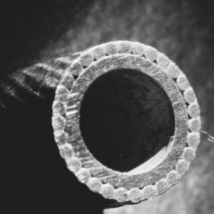
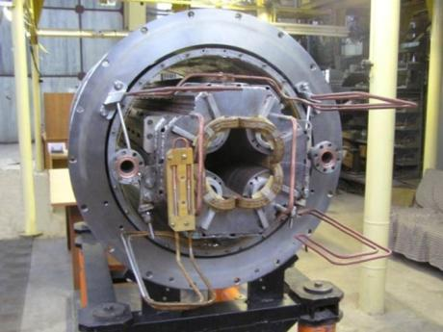
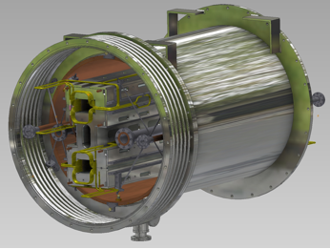
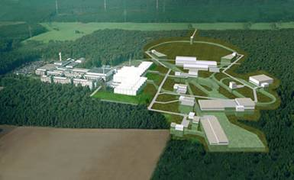
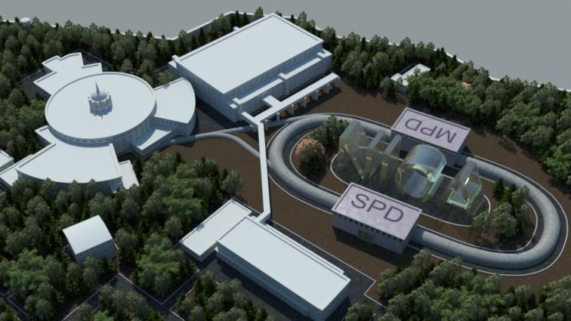
Unique Dubna technologies of fast-cycling superconducting magnets tested during several tens of Nuclotron runs and chosen as basic for accelerator complexes NICA and FAIR
Common European Research infrastructure for Heavy Ion High Energy Physics: NICA + FAIR
Notes:
15

Slide 16

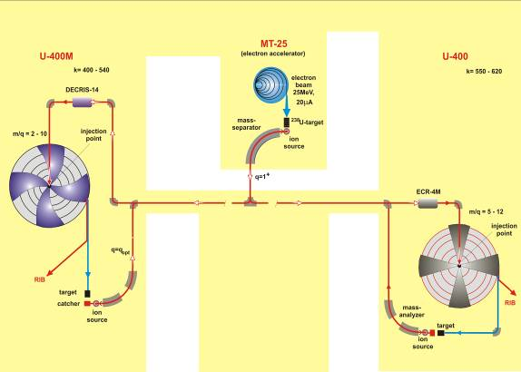
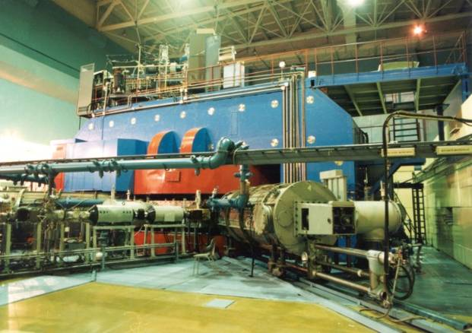
U400 and U400M isochronous cyclotrons
U-400: energy factor K 305÷650
mass-to-charge ratio range 5÷12
U-400M: accelerated ion mass 4÷238
energy 20÷120 MeV/n; mass-to-charge ratio 2÷5
DRIBs (I,II,III) –
Dubna Radioactive
Ion Beams
U400 and U400M isochronous cyclotrons are combined into accelerator complex – the project DRIBs – which deals with production of beams of exotic light neutron-deficient and neutron-rich nuclei in reactions with light ions.
16

Slide 17
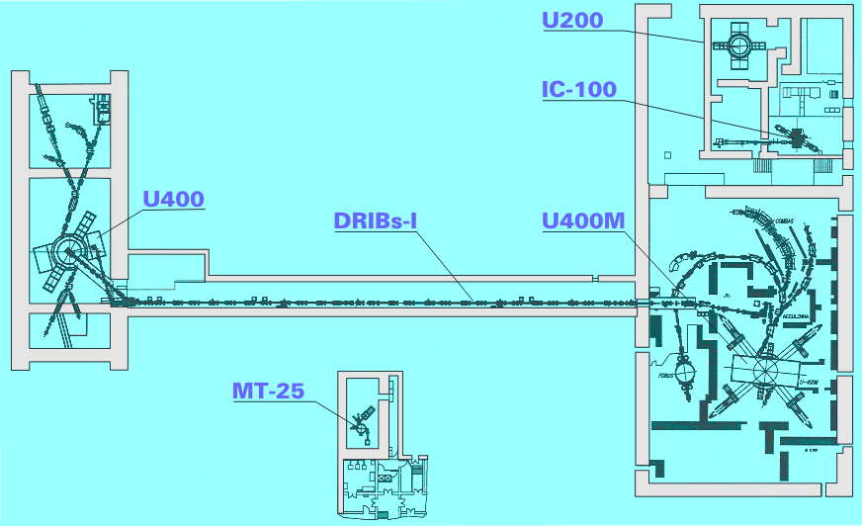
DRIBS
 | Unique beams of heavy ions: ⁴⁸Са - ⁵⁸Fe, ⁶He, ⁸He Beam on target time up to 12,000 hours/year Unique actinide targets ²³⁷Np – ²⁴⁹Cf Cryogenic D-T- target Advanced experimental set-ups
Broad international cooperation: JINR Member States, Germany, the USA, Finland, France, Italy, Japan, Switzerland, etc.
17

Slide 18
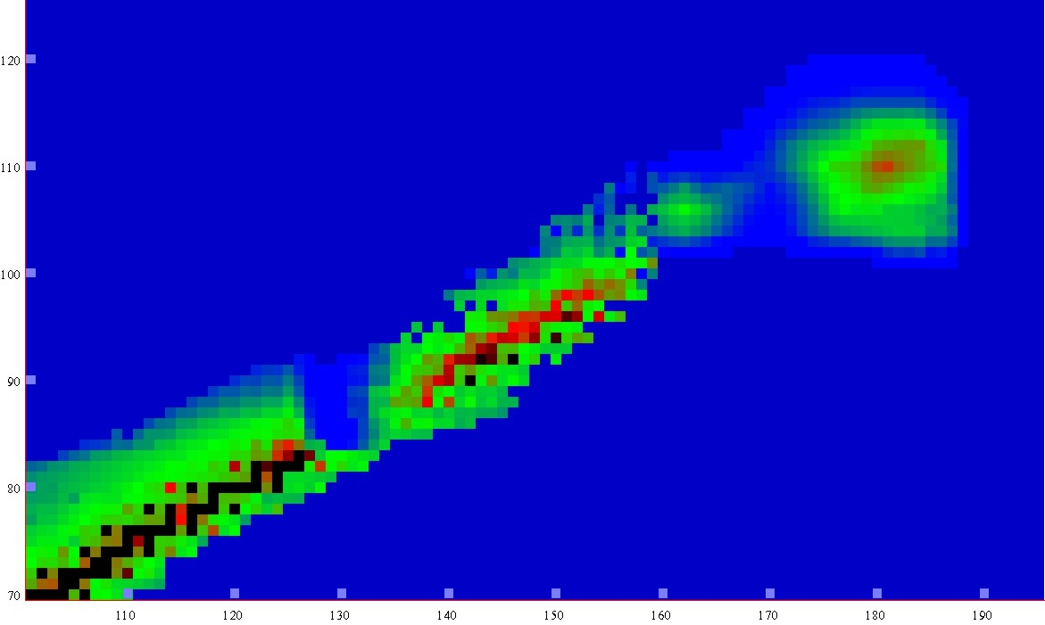
New lands
New lands
New lands
New lands
-5
0
5
10
15
LogT_{1/2} s
1µs
1s
1h
1y
1My
Island of
Stability
Island of
Stability
120
r
e
b
shoal
m
shoal
u
110
n
n
o
t
peninsula
o
peninsula
r
P
100
continent
90
continent
Sea of Instability
80
70
100
110
120
130
140
150
160
170
180
190
Neutron number

Slide 19
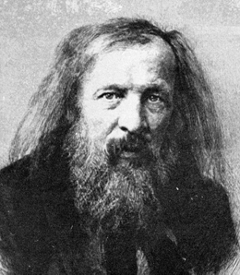
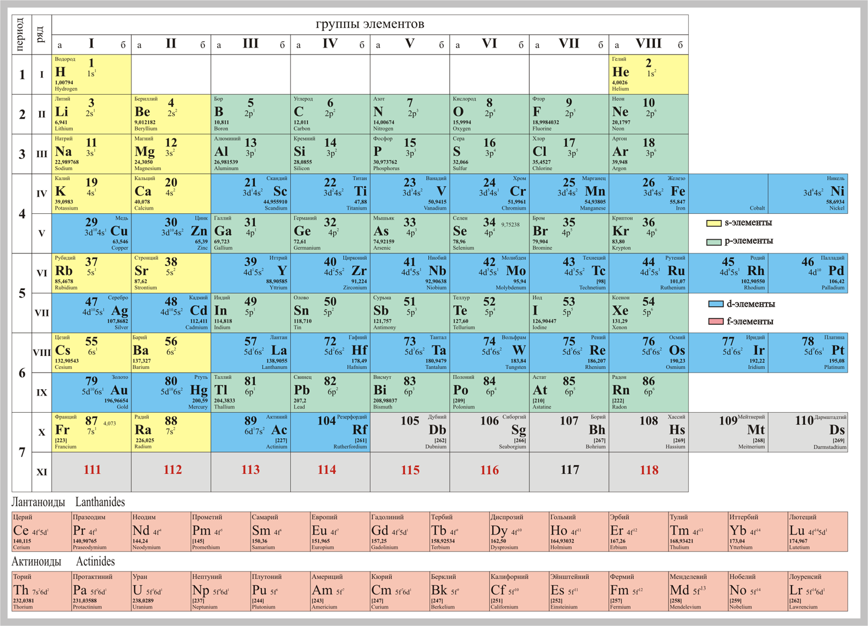
D.I. Mendeleev
1834 - 1907
113
114
115
116
117
118
Discovered
at JINR in 2003
Discovered
at JINR in 1999
Discovered
at JINR in 2003
Discovered
at JINR in 2000
Discovered
at JINR in 2009
Discovered
at JINR in 2001

Slide 20
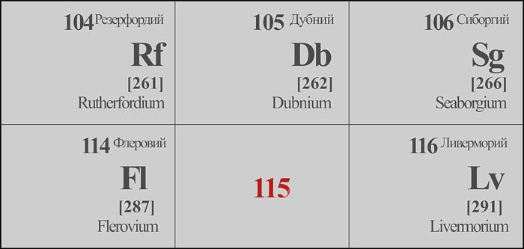
Dubnium and Flerovium
As recognition of the outstanding contribution of JINR scientists to the research in the modern physics and chemistry, the International Union of Pure and Applied Chemistry named element 105 of the D.Mendeleev Periodic system of chemical elements "Dubnium".
Very recently IUPAC has officially approved the name Flerovium, with symbol Fl, for the element of atomic number 114 and the name Livermorium, with symbol Lv, for the element of atomic number 116. Priority for the discovery of these elements was assigned to the collaboration between the JINR (Dubna, Russia) and the Lawrence Livermore National Laboratory (Livermore, California, USA).

Slide 21
PROSPECTS
Superheavy elements (SHE) | Project «DRIBs-III» experimental base
Nuclear structure and properties of SHE Chemical properties of SHE Electron structure of SH atoms Search for new nuclear shells Search for SHE in nature | Upgrade of the running accelerators U400 and U400M Construction of the new experimental hall (≈ 2600 м²) Development and construction of the next-generation set-ups Development of high current heavy ion accelerator
21

Slide 22
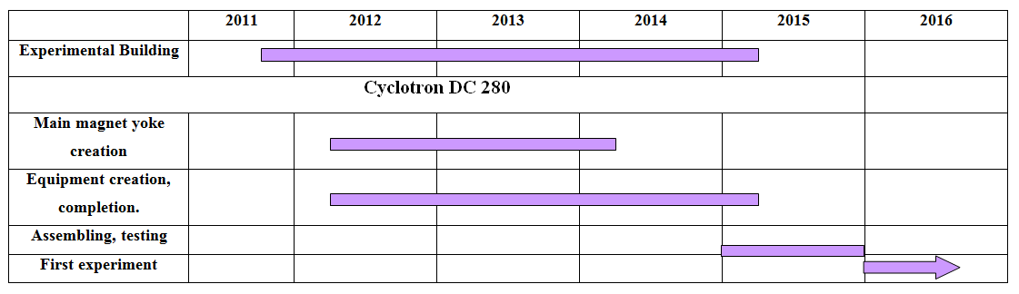
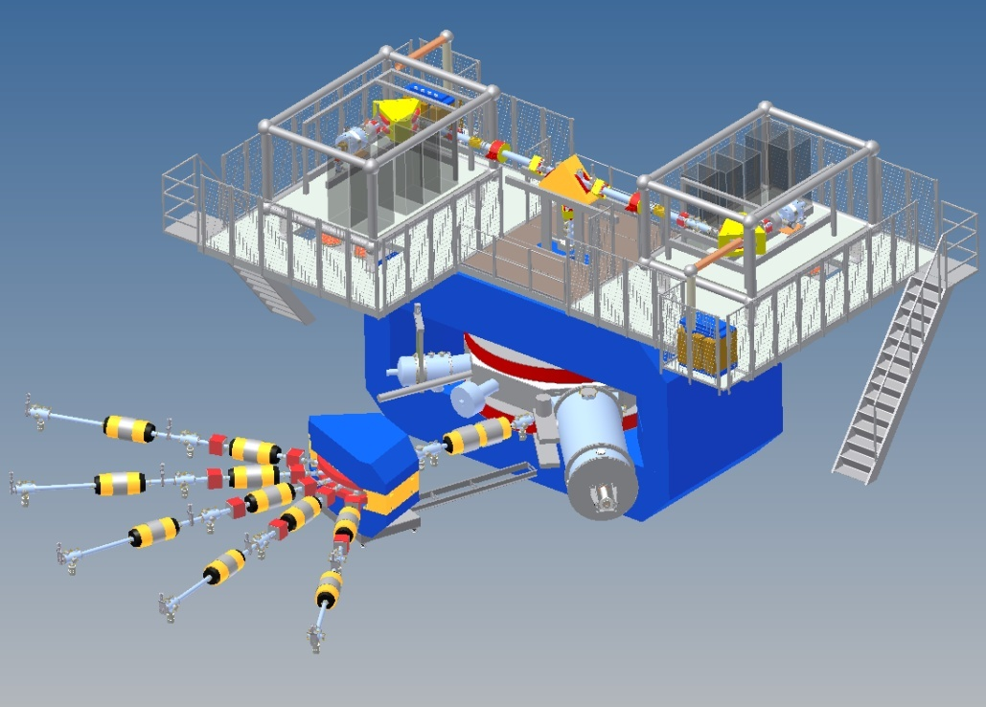
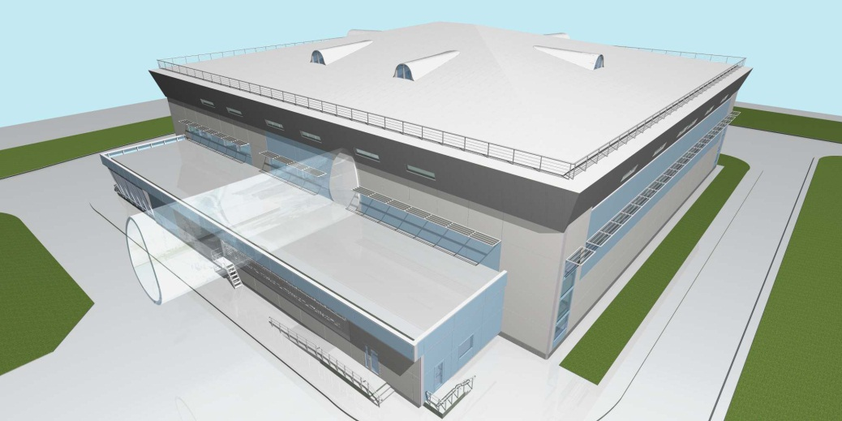
Schedule of the SHE factory

Slide 23
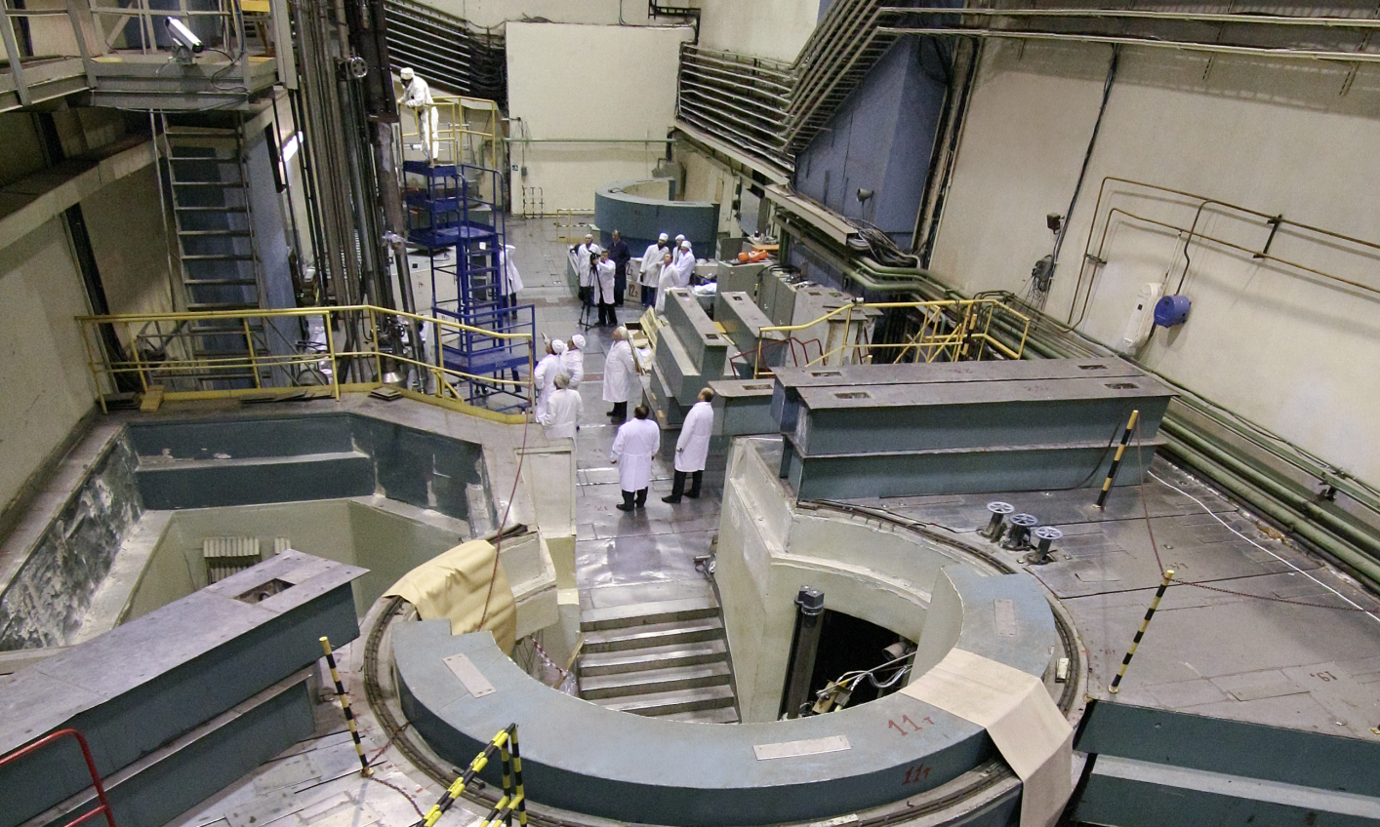
IBR-2: Pulsed reactor with fast neutrons
mean power 2 MW
pulse frequency 5 Hz
pulse width for fast neutrons 200 μs
thermal neutrons flux density on the moderator surface: 10¹³n/cm² /s
maximum in pulse: 10¹⁶ n/cm² /s

Slide 24
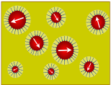
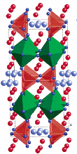
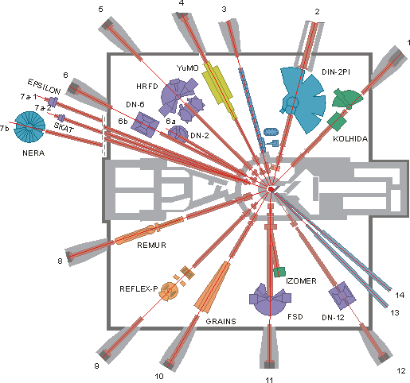

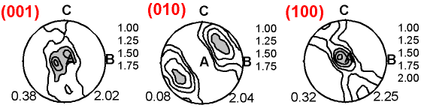
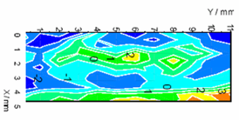
Upgrade and development of the IBR-2 spectrometer complex
Complex Liquids and Polymers
Physics of Nanosystems
2013
2012
Structure and Dynamics of Functional Materials
Molecular Biology and Pharmacology
Structure of rocks and minerals
Engineering Diagnostics
2011
24
Notes:
Спектрометрический комплекс реактора ИБР-2 достаточно развит и ориентирован на широкий круг научных исследований. По большинству параметров многие спектрометры не уступают лучшим мировым аналогам.
Дальнейшая модернизация спектрометрической инфраструктуры реактора выполняется при непосредственном участие стран участниц и ассоциированных стран ОИЯИ (в частности, Германия, Венгрия, Польше, Румыния и др.) с целю продолжить и развивать исследования в области физики наносистем, функциональных материалов, структурной биологии, геологии и инженерии.
Хотелось бы особо отметить, что программа научных снована на реализации пользовательской политики и развития собственной экспериментальной и теоретической программы. Для международных организаций, каковой является и ОИЯИ, пользовательская политика играет исключительно важную роль, поскольку обеспечивает прозрачный, ясный и гарантированный механизм реализации приоритетных научных программ стран-участниц на экспериментальной базе Института.
Вместе с тем, собственная научная программа также имеет важнейшее значение, поскольку определяет лицо ОИЯИ перед мировым нейтронным сообществом. Такая программа разработана и ожидаемые результаты на ближайшую перспективу сформулированы.

Slide 25
Particle Physics at External Facilities
(few examples)
25

Slide 26
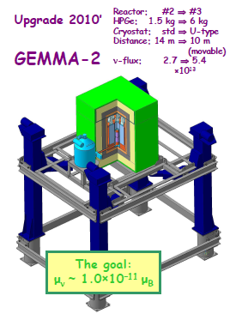
Neutrinos at Kalinin Power Plant
Search for Neutrino Magnetic moment measurement with JINR detector GEMMA
TEXONO (2006):
μ_{ν}< 7.4 × 10 ^{–11} μ_{B}
GEMMA I (2006):
μ_{ν}< 5.8 × 10 ^{–11} μ_{B}
BOREXINO (2008)
μ_{ν}< 5.4 × 10 ^{–11} μ_{B}
GEMMA I+II (2009):
μ_{ν}< 3.2 × 10 ^{–11} μ_{B} The Best limit!

Slide 27
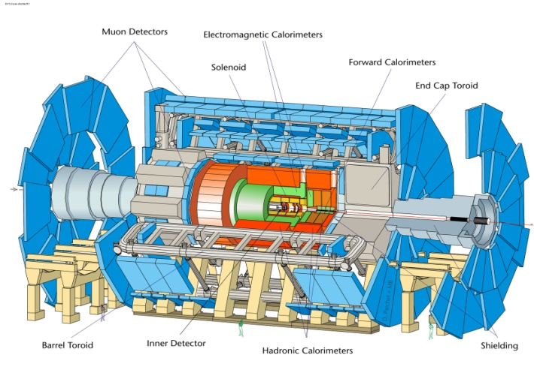
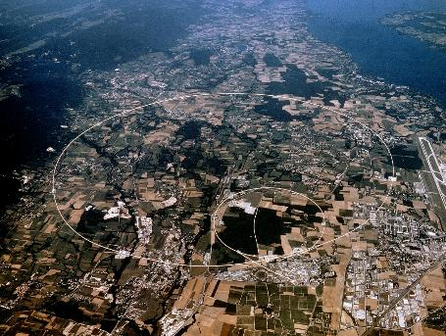
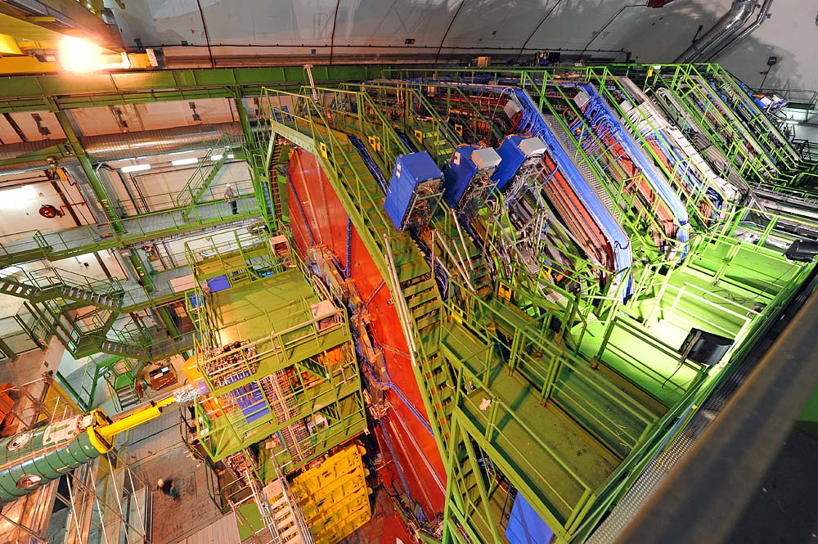
Experiments at LHC: ATLAS, CMS, ALICE
JINR participates in:
Higgs Physics
QCD and SM Physics
Top quark Physics
SUSY Physics
Exotics Physics
Heavy Ions Physics
ATLAS
CMS
ALICE
Notes:
JINR physicists are involved into the 3 main experiments at LHC: ATLAS, CMS and ALICE.
During the past years the JINR groups have successfully completed their obligations in the construction of the detectors and are now ready to exploit excellent physics capabilities which will be offered by the LHC data.
The goal of the ATLAS project is to study proton-proton interactions using to the maximum extent the resources and capabilities of the LHC collider in order to investigate various physics processes for the purpose of verifying predictions of the Standard Model and search for phenomena beyond its scope. A team of JINR staff is responsible for maintaining and possibly modernizing separate subsystems of the experimental facility. The main physics topics with JINR participation are:
Higgs Boson Physics, SUSY Physics, Exotics Physics,Top Quark Physics and Heavy Ions Physics.

Slide 28
Information Technologies
28
Notes:
28

Slide 30
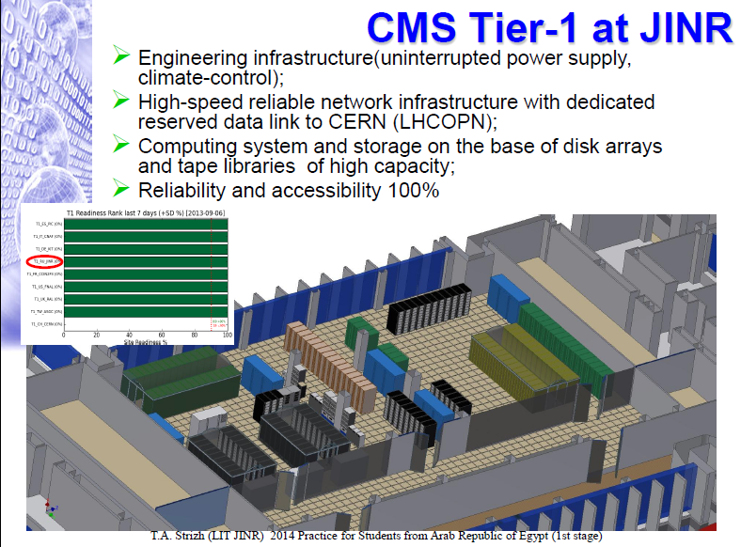


Slide 31
Education and Outreach
31

Slide 32





EDUCATION AT JINR addresses a vitally important task of attracting of young people from all the JINR Member States to science
More than 400 students from different JINR MS Universities annually
JINR-based chairs of top Russian technical universities (MSU, MPTI, MIPI, MIREA)
Dubna University accept students from JINR MS to early start of scientific career
INTERNATIONAL STUDENT PRACTICE (ISP)
More than 150 students annually
Practice is organized in several stages
Each stage consists of 3 weeks activity
Coming HEP Data Analysis Practices
INTERNATIONAL SCHOOLS
More than 30 schools annually at different JINR Labs

Slide 33





Outreach Activity at JINR
TEACHERS PROGRAMS
3 programs at CERN
2 programs at JINR
136 teachers visited CERN
94 teachers visited JINR together with best pupils
VIDEO-CONFERENCES CERN-JINR-RUSSIAN SCHOOLS
More than 20 video-conferences with middle schools from
different regions of Russia
VIRTUAL TRIPT TO JINR BASIC FACILITIES
at http://uc.jinr.ru/
EXCURSIONS TO JINR LABS

Slide 34

Innovations & Technology Transfer
JINR is an active participant of the innovation programme of the Special Economic Zone “Dubna”.
34

Slide 35








Innovations based on Accelerator technologies
Transmutaion of nuclear fuel waste
Radiobiology
and medicine
Irradiation treatment of space craft elements
and electronics
Study of molecular mechanisms
of genetic influence on human
& mammal
Obtaining the basic data for design of set-ups for nuclear waste processing
Design and Development of accelerator and detector
Safety systems
Ion tracking technologies:
technologies
for medicine

Slide 36

Proton therapy and medical accelerators
Proton Therapy at JINR’s Phasotron
  Unique in Russia experience of application of
  conformal 3D therapy method
  About 100 patients per year since 2000
  Development of the project of PT Center
C400 SC Cyclotron Project for p & C Therapy (together with IBA)
Notes:
36

Slide 37
Conclusions
Integration into the world research infrastructure is fully consistent with the mission of JINR as International Research Center. This initiative is strongly supported by JINR’s governing body (CP) and Scientific Council.
Besides of a set of unique facilities being used for a long time by physicists from different countries, JINR owns infrastructure providing relevant access to these facilities.
Currently, upgrades of major facilities of the JINR (reactor IBR-2M, DRIBS-III and NICA-MPD) are well guaranteed by increasing budget of the Institute, as a result of clear support from JINR’s member countries and especially from Russian Federation.

Slide 38
Conclusions
Being a world leader in some domains of Nuclear Physics (e.g., synthesis of superheavy elements) and visible partner in major world projects (Tevatron, RHIC, LHC, ILC, FAIR, XFEL and others) JINR now proposes its home facilities and services to become available for wider scientific community.
Information Technologies at JINR are in active development with wide international collaboration and State support (grants, international responsibilities, etc): GRID, Cloud technologies, Supercomputers, Automatization of administrative tools, web, etc.

Slide 39




Welcome to Dubna!

Slide 40








