Slide 1
Brief news form the Physics Council meeting
G.Feofilov
MPD/NICA PWG1 meeting 11/02/2021
https://indico.jinr.ru/event/1927/

Slide 2
Layout
Discussion on the beam energy and number of events in the first run with Bi+Bi collisons at NICA
Strategy for simulations and physics analysis codes
Conferences

Slide 3
Brief news form the Physics Council meeting
Bi+Bi collisions: beam energy and number of events in the first run with Bi+Bi collisons at NICA
Report at the last MPD Physics Seminar 04.02.2021: Grigory Nigmatkulov (MEPhI)
“ Energy for the first collisions in MPD at NICA” (See : https://indico.jinr.ru/event/1907/)
From the report by Grigory Nigmatkulov :
“Only √sNN=9.2 GeV has already been measured at RHIC in the COLLIDER mode in the year 2008 (low statistics)
•Theoretically motivated (peak in trace anomaly) K.A. Bugaev et al. PEPAN 15, 210 (2018)
•STAR took data at √sNN=9.2 GeV in the year 2020 (~160M events)
•In case first heavy-ion collisions at NICA will be at √sNN=9.2 GeV it will:
•Allow to test the collider capabilities
•Be a compelling and timely measurement”
Physics Council discussion:
Bi+Bi collisions: √sNN=9.2 GeV and 7.7 GeV
<100 mln events at the first Run with Bi+Bi collisions
Beam energy scan program – after the first results

Slide 4
Brief news form the Physics Council meeting
2) Strategy for simulations and physics analysis codes
The proposal is to continue MC simulations with the given values
Bi+Bi collisions: √sNN=9.2 GeV and 7.7 GeV
<100 mln events at the first Run with Bi+Bi collisions
Beam energy scan program – more undesratbding from the theoretical point of view is needed
The critical issues for the PWG1:
Centrality classes codes (the first exercise to be available soon for the collabortion as an example)
Event-plane determination codes
Finding people?

Slide 5
Conferences
SQM2021 online through BNL on the dates originally foreseen, May 17-22, 2021.
An Indico page for the virtual conference has been setup.
https://indico.cern.ch/event/985652/

Slide 6
BACK-UP SLIDES
.

Slide 7
Development of the MPD common software: some proposals to move further.
G.Feofilov
MPD/NICA Physics Council27/01/2021

Slide 8
One slide from the report by G.Feofilov, A.Ivashkin: “Tentative plans and tasks of the MPD/PWG1 for the year 2021 https://indico.jinr.ru/event/1840/ What we are missing:
Coordination of MC simulations:
MC simulations for various observables vs. centrality, (Theoretical predictions are important for these observables vs. centrality estimator class)
Physics requirements and requests for MC production:
task from various PWGs →MC simulations →Analysis
We need to define the experts/representative(s) of the PWG1 to work on the MC simulations in contact with the JINR software representatives
Task No1: Centrality class codes should be implemented in the MPDRoot
….as well as as other codes in the future

Slide 9
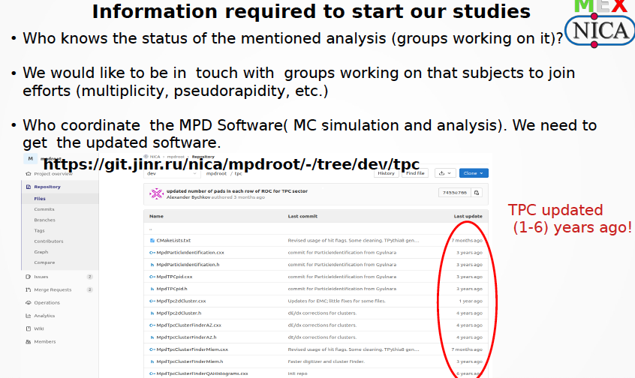
.
One slide from the report by Eleazar Cuautle: “MexNICA Plans for 2021” https://indico.jinr.ru/event/1840/
.

Slide 10
Some proposals to move further:
Coordination of the MC simulations software by the PWG:
The 1st step: to define the wish-list of participants, for example for the PWG1:
Topic | Groups and people interested/contacts | Experts and code developers/contacts
Centrality determination and different estimators | SPbSU, INR RAS, MePHI…. 1)GF – e-mail: grigory-feofilov@yandex.ru 2)AI---e-mail: … 3) AS ---e-mail:… 4) NN----e-mail: … etc | e-mail:…
Event plane reconstruction | … | e-mail:
Multiplicity and pseudorapidity distribution measurements | MexNICA… | e-mail:
Total cross-section measurement | … | …e-mail:
…etc | … | …e-mail:

Slide 11
Some proposals to move further:
Coordination of the MC simulations software by the PWG:
The 2nd step: to define Codes, location, responsibility
Topic | Code name and location in MPDRoot | Experts and code developers/contacts
Centrality determination and different estimators | Multiplicity classes in standard procedure:…… Centrality classes by the calorimeter:………. | Name….e-mail:… Name….e-mail:…
Event plane reconstruction | Event plane reconstruction code | Name….e-mail:…
Multiplicity and pseudorapidity distribution measurements | … | Name….e-mail:…
Total cross-section measurement | … | Name….e-mail:…
…etc | … | Name….e-mail:…

