Slide 1

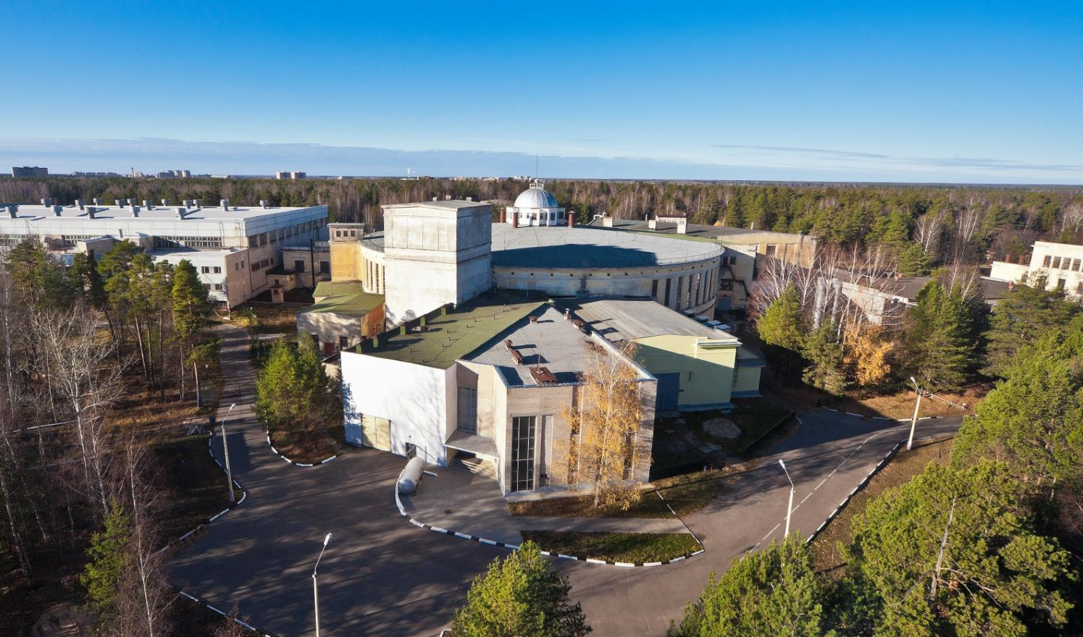


The NICA complex
Injection facility
A.Butenko on behalf of the team
RuPAC 2021, Crimea, Alushta, 27 of September 2021

Slide 2

Introduction
Two LINACs & ion sources
  SPI & LU-20/LILAc (light & pol. ions)
  HILAC (heavy ions)
The Booster ring
Beam transfer line
The Nuclotron ring
RuPAC 2021, Crimea, Alushta, 27 of September 2021

Slide 3

Injection complex
Two linacs:
HILAC & LILAC
Nuclotron
Two Linear Injectors
& sources
Booster
Booster & beam line
Nuclotron ring
RuPAC 2021, Crimea, Alushta, 27 of September 2021

Slide 4
Structure of the Injection complex
Transfer to the collider rings
Slow extraction
& transfer to BM@N
Nuclotron
2×10⁹ Au⁷⁹⁺, 3.9 GeV/u
or
light ions, 5 GeV/u
LILAc
SPP
RFQ
LU-20
LIS
p↑, d↑, ions z/A>0.3, 5 MeV/u
Stripping Au³¹⁺=>Au⁷⁹⁺
Booster
HILAc
(2÷4)×10⁹ ions Au³¹⁺ 570 MeV/u
ESIS
RFQ
IH1
IH2
Au³¹⁺ 3.2 MeV/u
RuPAC 2021, Crimea, Alushta, 27 of September 2021

Slide 5
Introduction
Two LINACs & ion sources
  SPI & LU-20/LILAc (light & pol. ions)
  HILAC (heavy ions)
The Booster ring
Beam transfer line
The Nuclotron ring
RuPAC 2021, Crimea, Alushta, 27 of September 2021

Slide 6
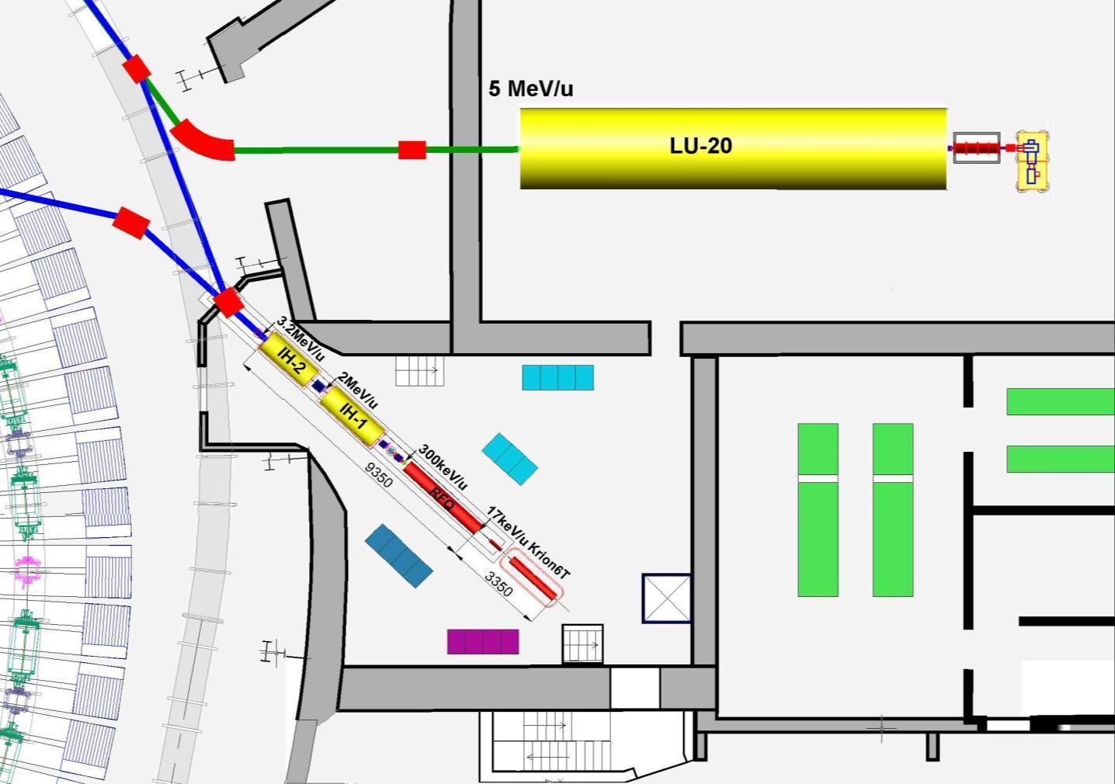
Layout of the linear Injectors
p↑, d↑, ions Z/A>0,3
Booster
Injection
channel
Ions Z/A>0,3
LIS
RFQ
SPI
p↑,d↑
10mA
LU-20 building
HILAc
HILAc building
^{Booster}
Nuclotron
RF amplifier for LU-20
RuPAC 2021, Crimea, Alushta, 27 of September 2021

Slide 7

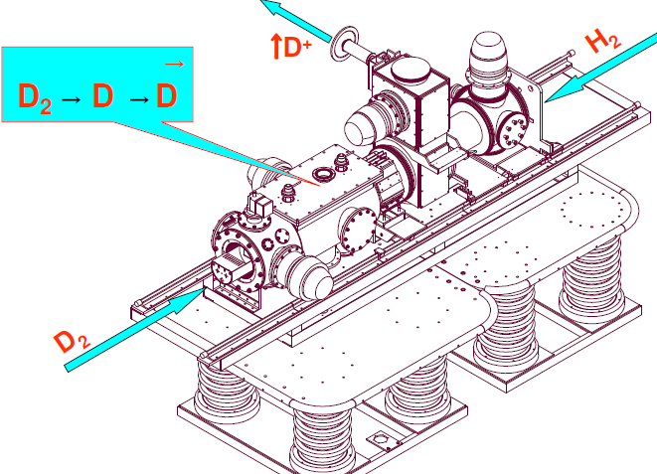
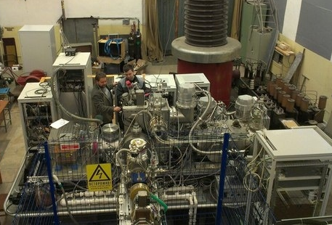
SPI, polarized beams of d & p
SPI “source of polarized ions” was transported, installed on the HV terminal and commissioned with the new fore-injector & LU-20
in spring 2016
The SPI-project was started more then 10 year ago.
Main purpose is to provide the intensity of the accelerated polarized beams (D+,H+) up to 10¹⁰ p/pulse
Commissioned in 2016
two Nuclotron beam RUNs
was provided
The SPI provided by polarized d & p Nuclotron complex during two beam RUNs in 2016-17.
RuPAC 2021, Crimea, Alushta, 27 of September 2021

Slide 8
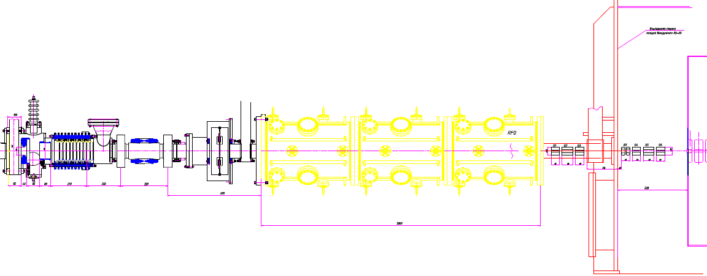
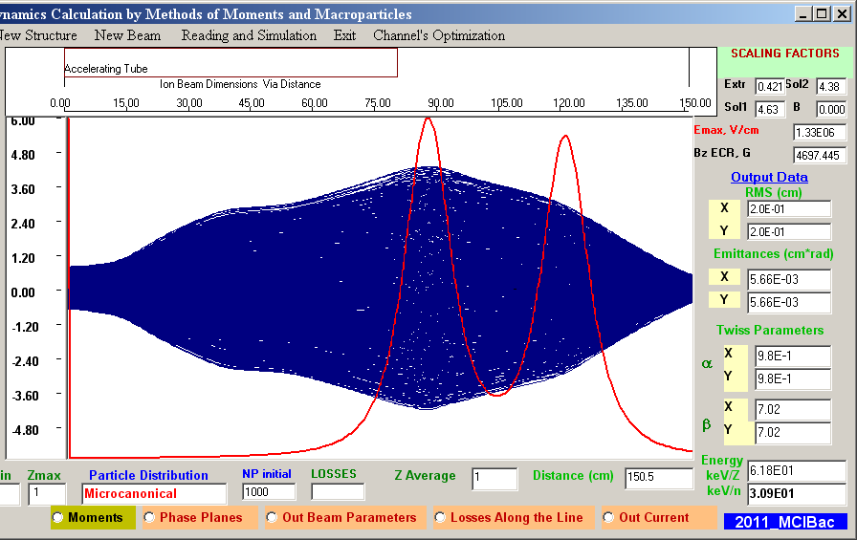
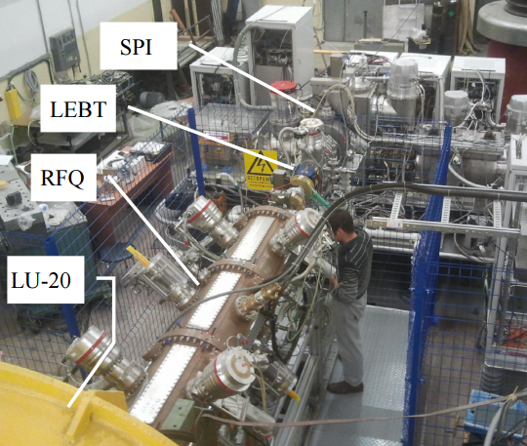
New fore-injector for LU-20
Designe has been started in 2012 In collaboration with ITEPH, MEPHI, Snezhinsk.
LEBT + Buncher
4 wane RFQ
(3 sections)
MEBT LU-20
QT + Bu +QT
Commissioned in 2016
4 Nuclotron beam RUNs
was provided
source
RuPAC 2021, Crimea, Alushta, 27 of September 2021

Slide 9
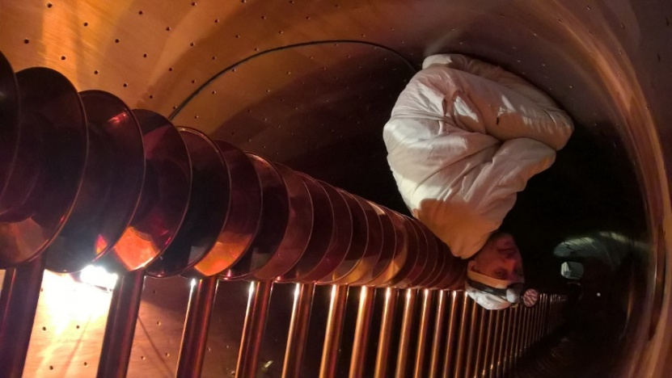
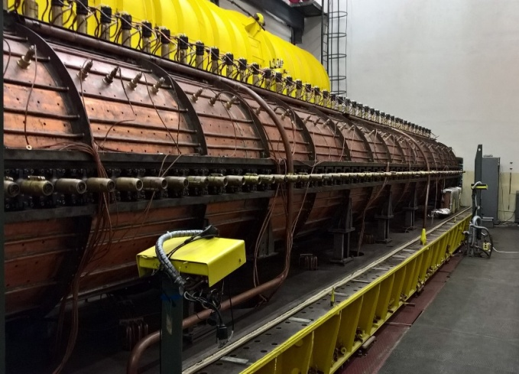
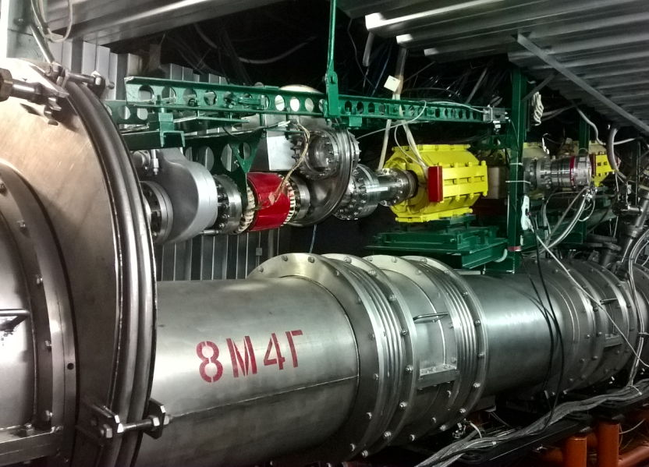
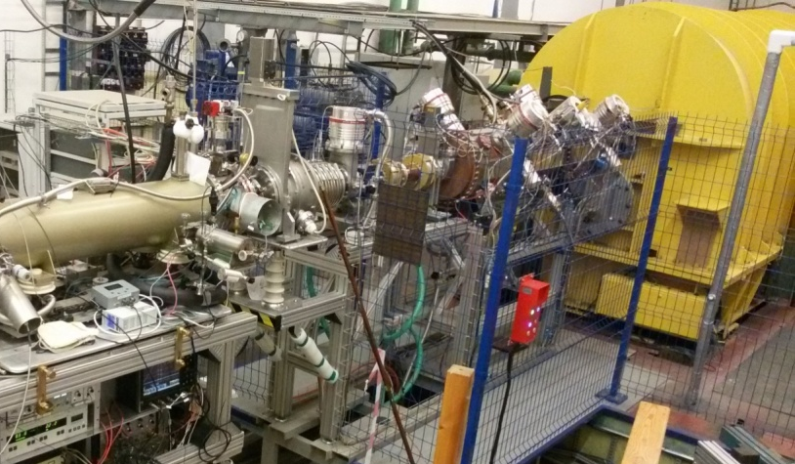
Deep modernization of LU-20
The Drift-tube linac (DTL)
Output energy = 5 MeV/u, A/q<3
During 2009 - 2018 years
Completely modernized all of the main systems of the Linac:
RF power amplifiers (5MW/pulse)
Drift tubes PS
Beam diagnostics
HV terminal
Foreinjector
LLRF system
Synchronization
Vacuum system
PS system of the inj. line
RuPAC 2021, Crimea, Alushta, 27 of September 2021

Slide 10
Layout of the linear Injectors
K. Levterov
p↑, d↑, ions Z/A>0,3
Booster
Injection
channel
Ions Z/A>0,3
LIS
RFQ
SPI
p↑,d↑
10mA
LU-20 building
HILAc
HILAc building
^{Booster}
Nuclotron
RF amplifier for LU-20
RuPAC 2021, Crimea, Alushta, 27 of September 2021

Slide 11
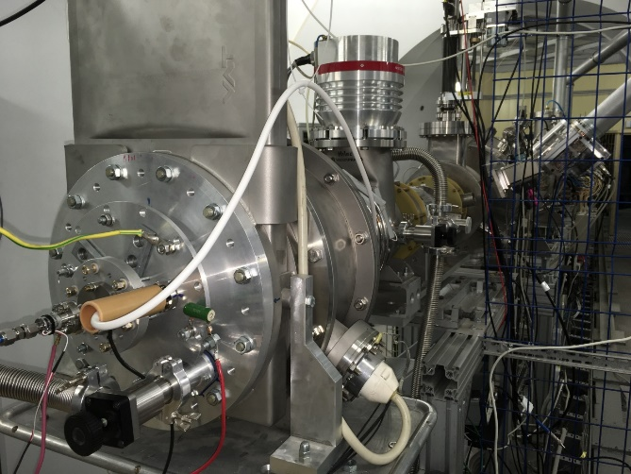
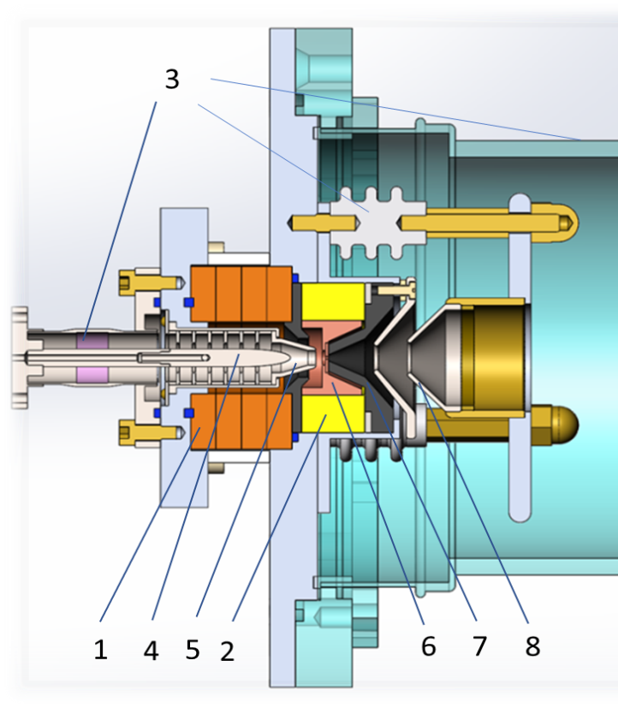
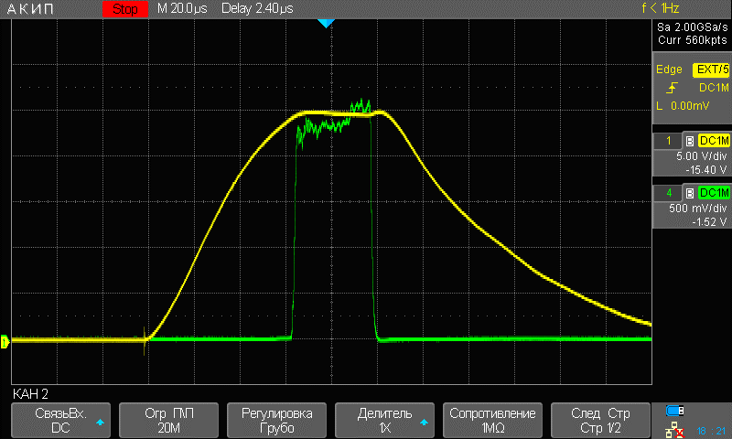
Ion source for beam commissioning
Ion source with a cold magnetron cathode and magnetic plasma compression.
For the Booster commissioning
the He¹⁺ ion beam was used.
Why do we use He¹⁺ ions?
“Mono” beam after the
linear injector (no other species)
99% of He¹⁺
A/q = 4 more closer to the project beam for
the linac and Booster ring (compare to
other possible ions). Magnetic rigidity.
Good beam for measuring of integral
vacuum conditions in the ring beam pipe.
Very stable in time, high current, simple
source in operation.
Beam at the entrance of the Linac
RuPAC 2021, Crimea, Alushta, 27 of September 2021

Slide 12
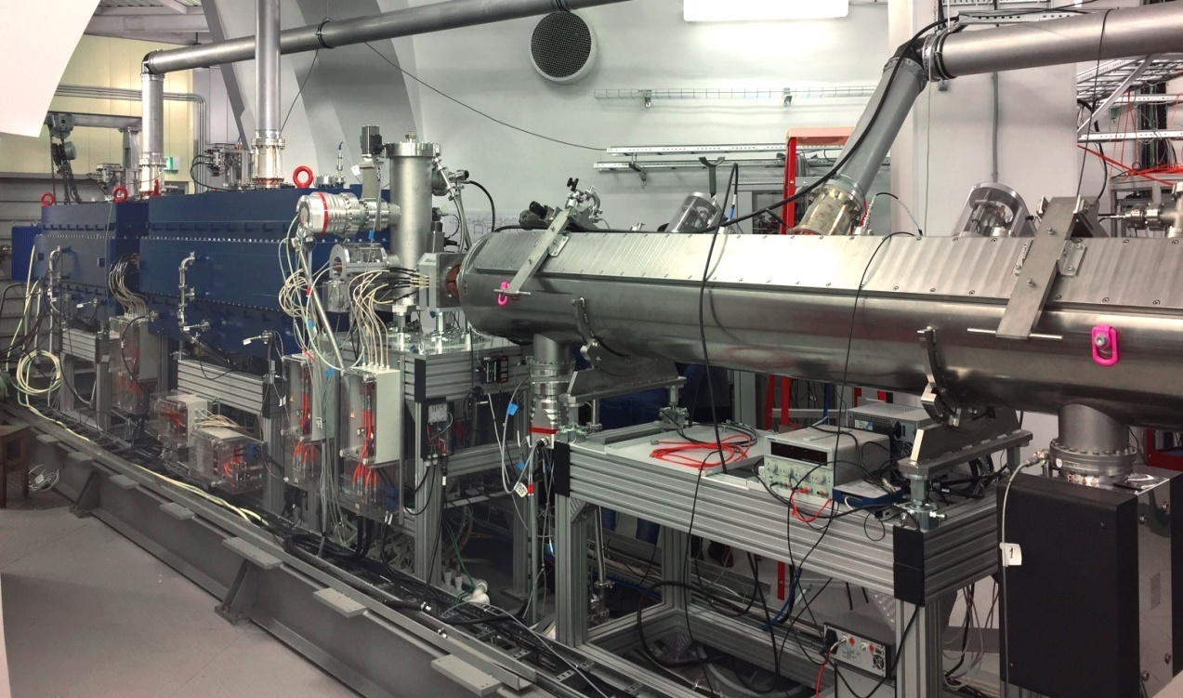
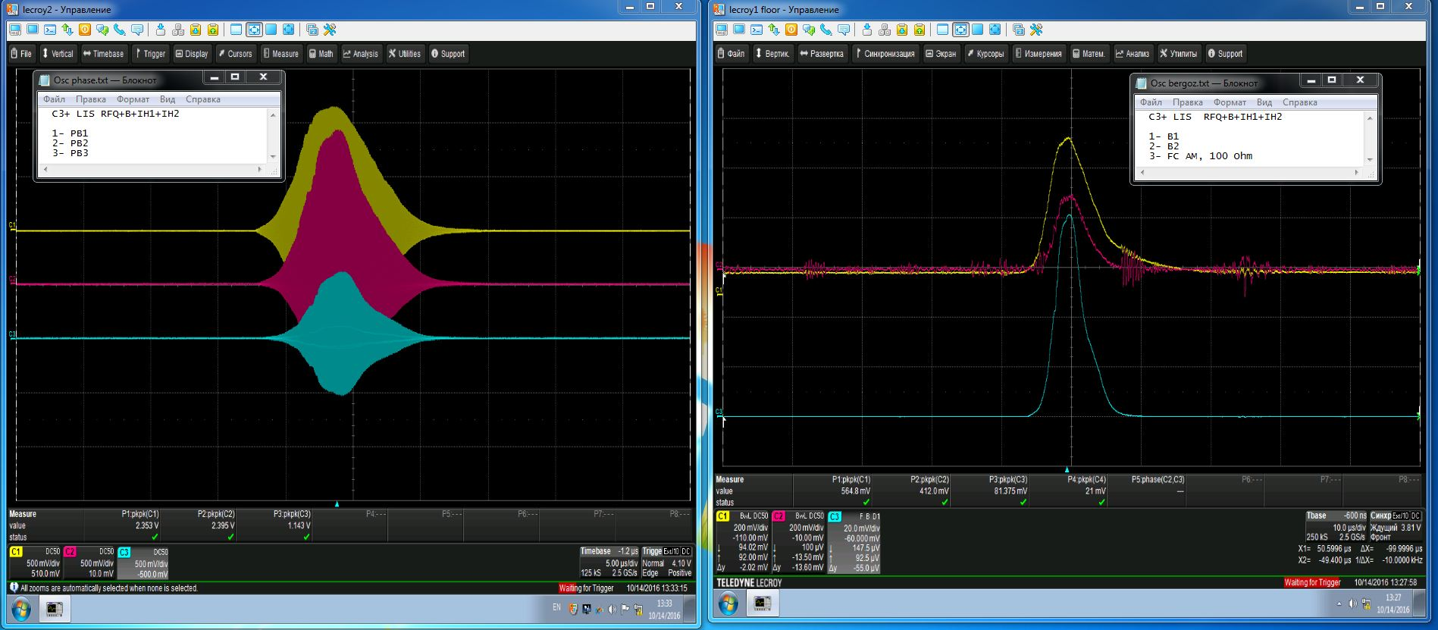
HILac status
HILAc status
Stable and safe operation during Booster commissioning with He¹⁺ and Fe ¹⁴⁺ beams
Transmission of carbon ions about 70% from RFQ to the exit of linac,
3.2 MeV/u
Phase probe’s signals
RFQ (red), IH1 (yellow), IH2 (blue)
Commissioned in 2018
A/q (Target Ion Au³¹⁺) | 6.25
Beam current | < 10 emA
Repetition rate | < 10 Hz
Output energy | 3.2 MeV/u
RuPAC 2021, Crimea, Alushta, 27 of September 2021

Slide 13
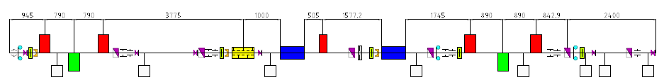
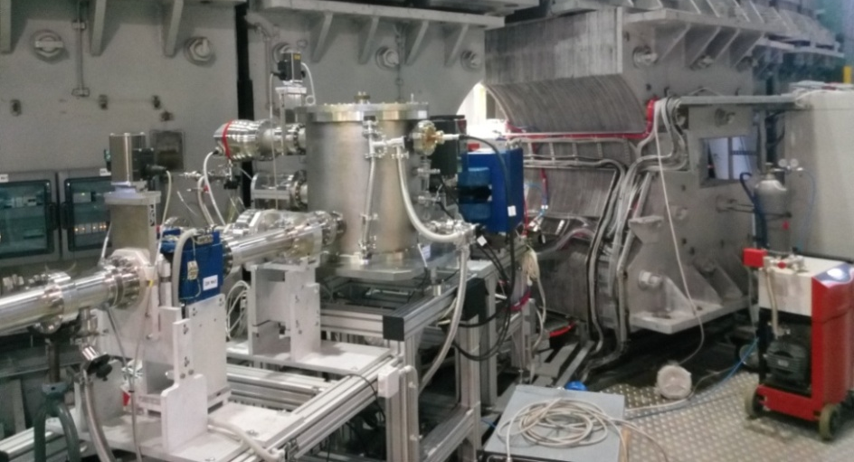
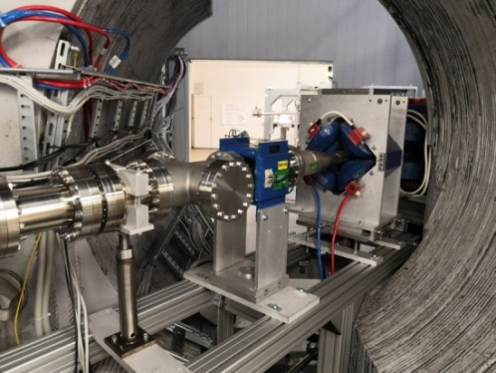
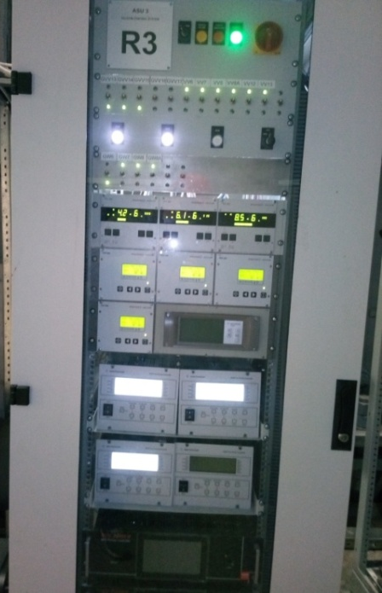
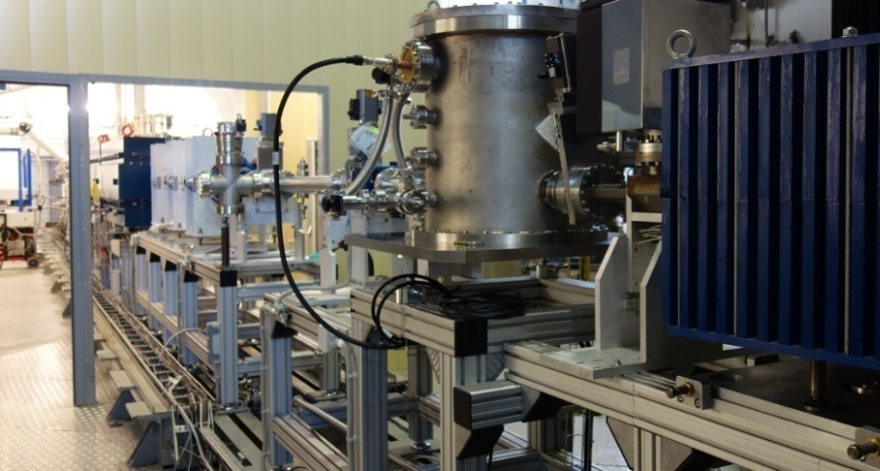
Booster injection beam line
Commissioned
beam transmission ~75%
Debunching
Matching
Separation and adsorption of neighbor charge states of ions.
Provide different schemes of the beam injection into the Booster.
RuPAC 2021, Crimea, Alushta, 27 of September 2021

Slide 14
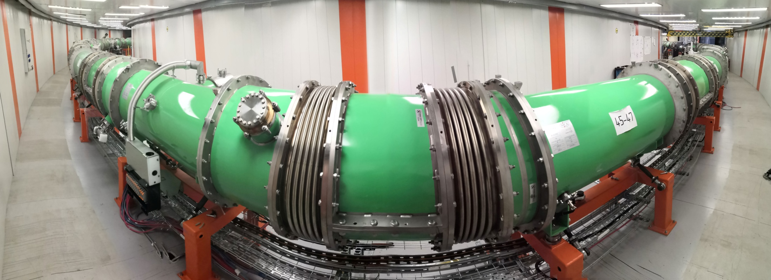
Introduction
Two LINACs & ion sources
  SPI & LU-20/LILAc (light & pol. ions)
  HILAC (heavy ions)
The Booster ring
Beam transfer line
The Nuclotron ring
RuPAC 2021, Crimea, Alushta, 27 of September 2021

Slide 15
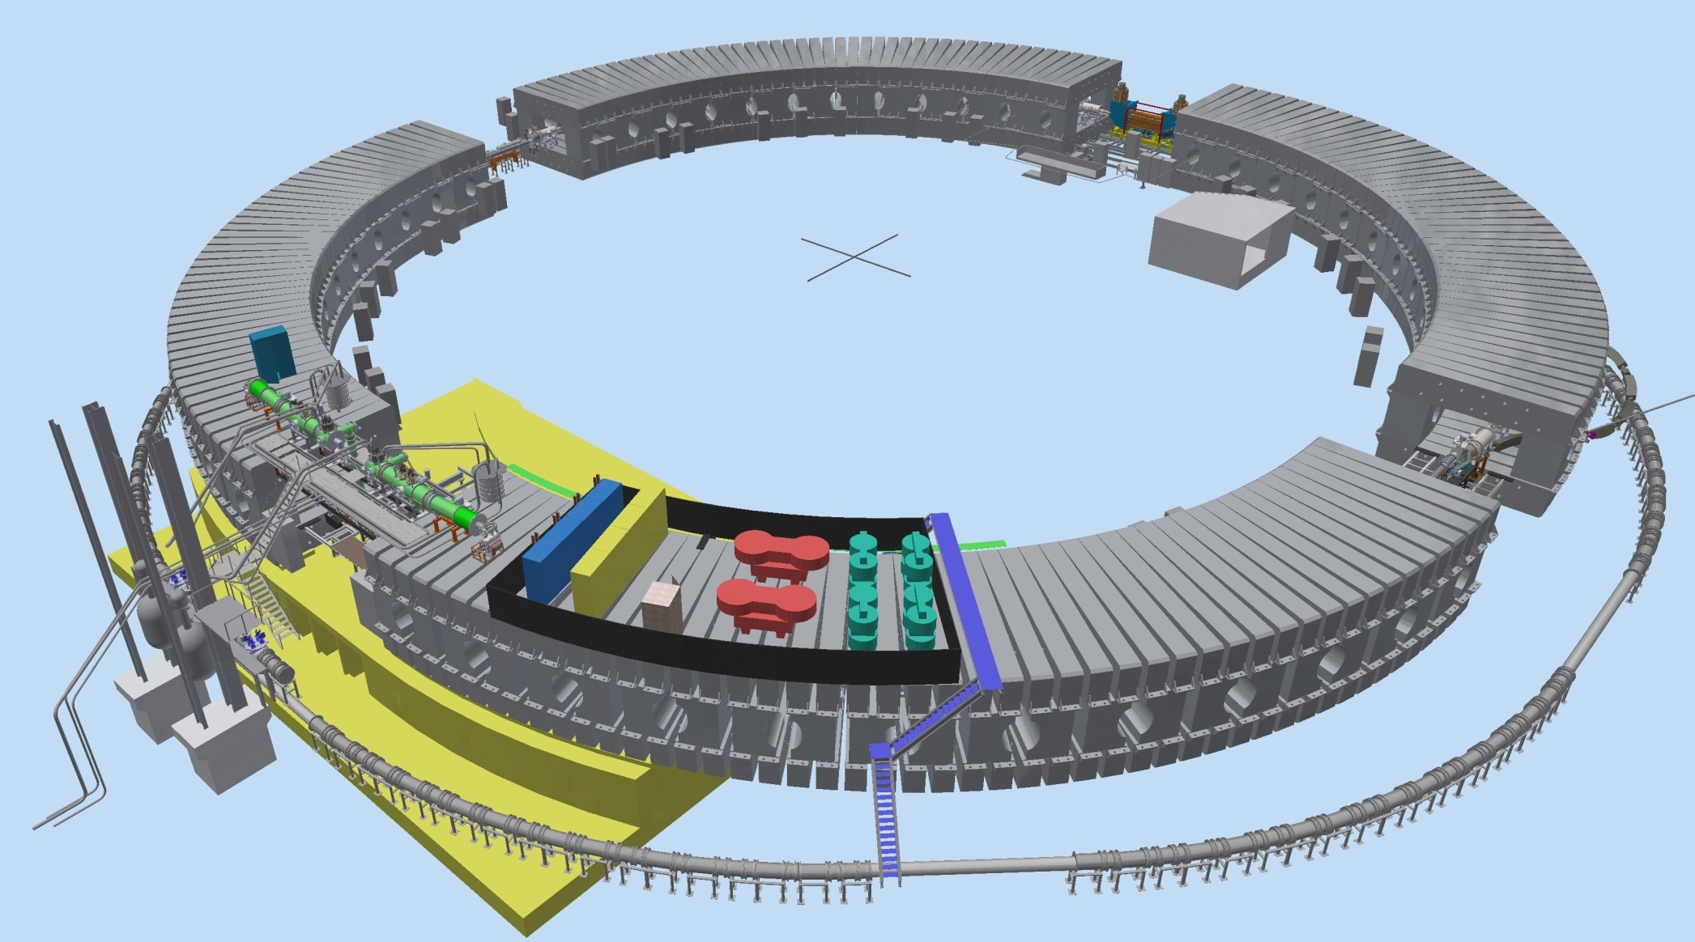

Booster ring layout
Injection system
E-cooling system
Synchrophasotron iron yoke
Parameter | Value
Circumference, m | 210.96
Lattice type | DFO
Injection energy, MeV/u | 3.2
Maximum energy, MeV/u | 578
Magnetic rigidity at injection, Т∙m | 1.6
Maximum magnetic rigidity, Т∙m | 25.0
Ions species (project) | ¹⁹⁷Au³¹⁺
Fast Extraction system
RF system
Reference magnets section
Power supply & energy evacuation
Nuclotron ring
RuPAC 2021, Crimea, Alushta, 27 of September 2021

Slide 16
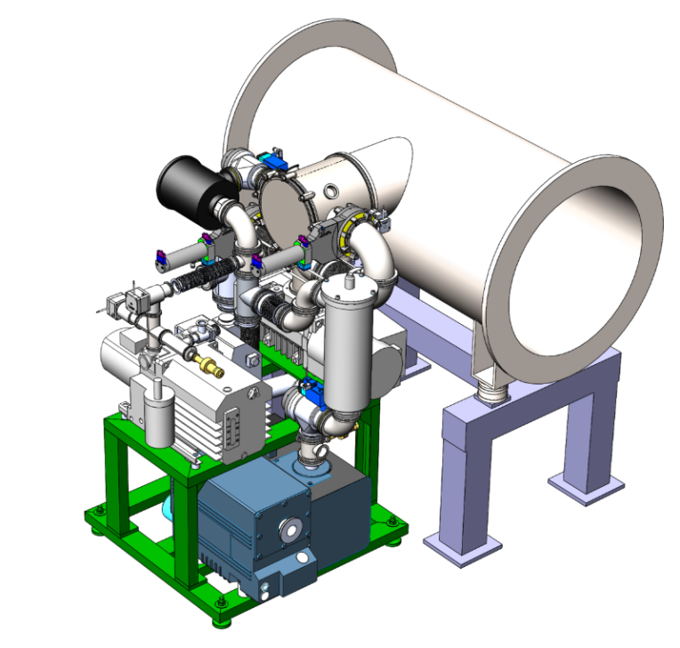
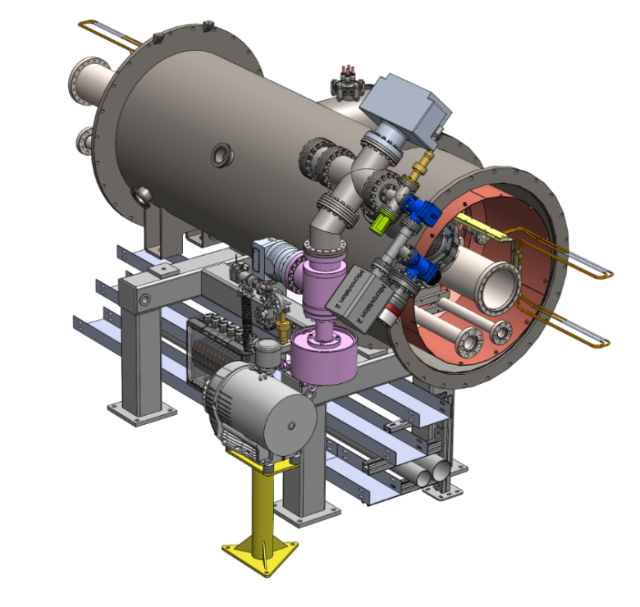
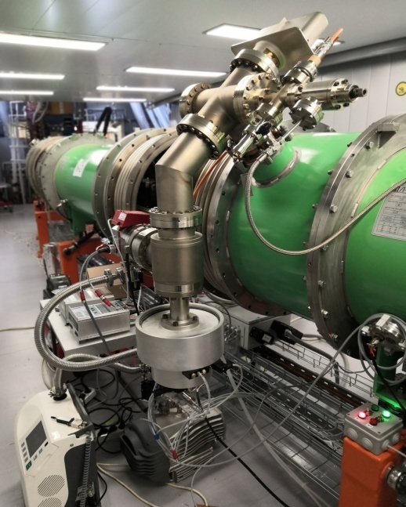
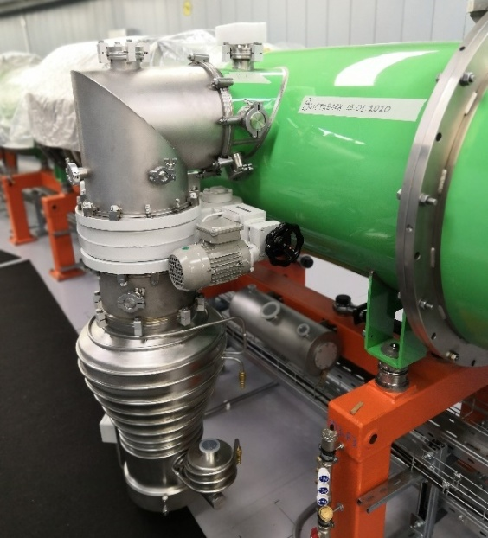
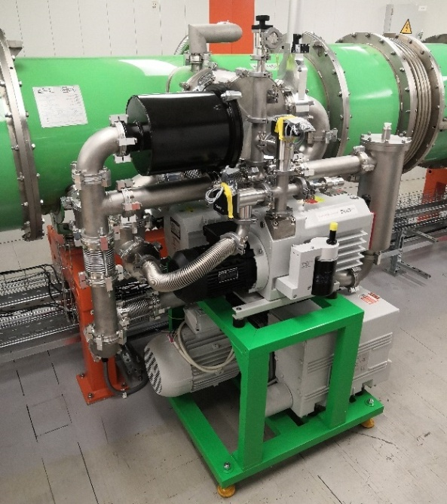
Vacuum system
A. Galimov
Pump stations of “cold” beam pipe
Pump stations of insulation volumes
Beam pipe pressure
< 10 ⁻⁸ Pa
^{for the 1st stage of project}
RuPAC 2021, Crimea, Alushta, 27 of September 2021

Slide 17
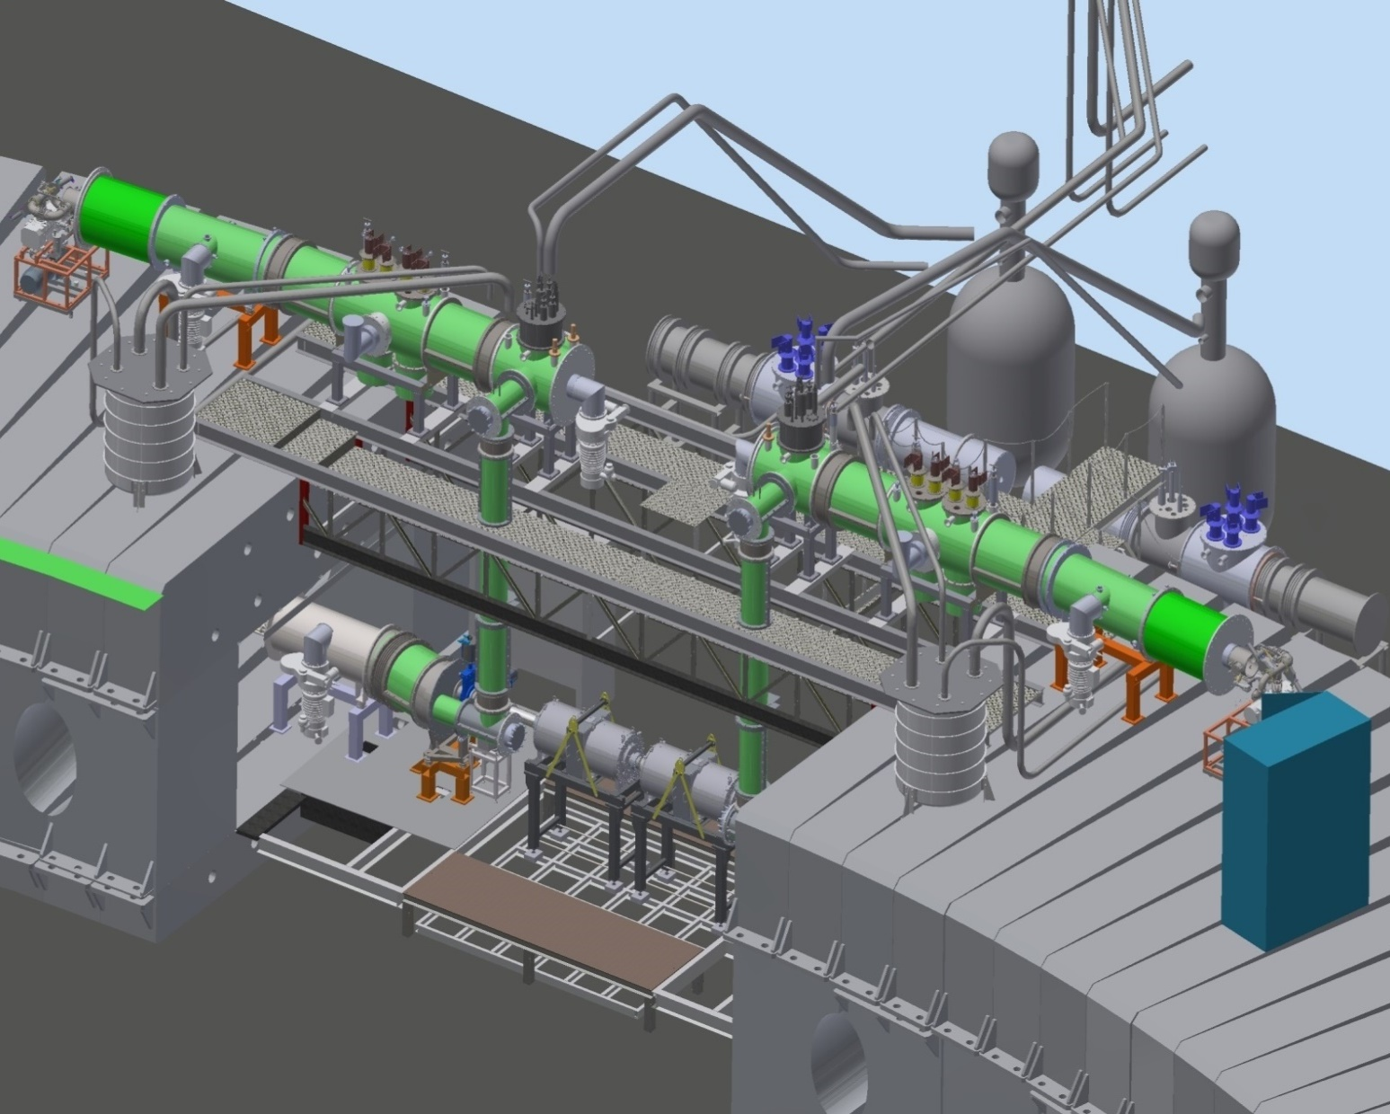
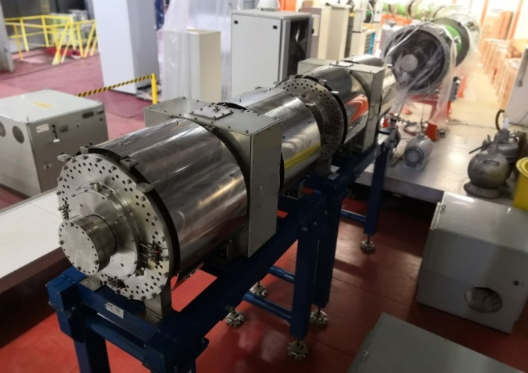
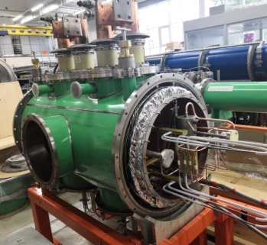
Reference section & RF
A. Grebentsov
2-nd str. Sect.
RF system
from BINP
Reference magnets
Current lead-in
Two cryogenic feedboxes
Reference magnet
Current Lead-Ins
Temporary cryo lines
Feedboxes
Cryogenic feeders
Feedboxes
Reference quads
Left half-ring
Right half-ring
Current Lead-Ins
Two RF stations
17
RuPAC 2021, Crimea, Alushta, 27 of September 2021

Slide 18
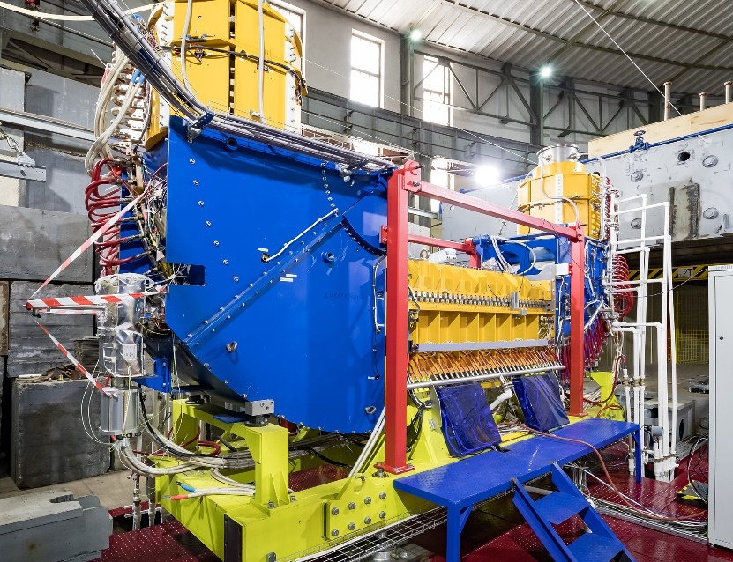
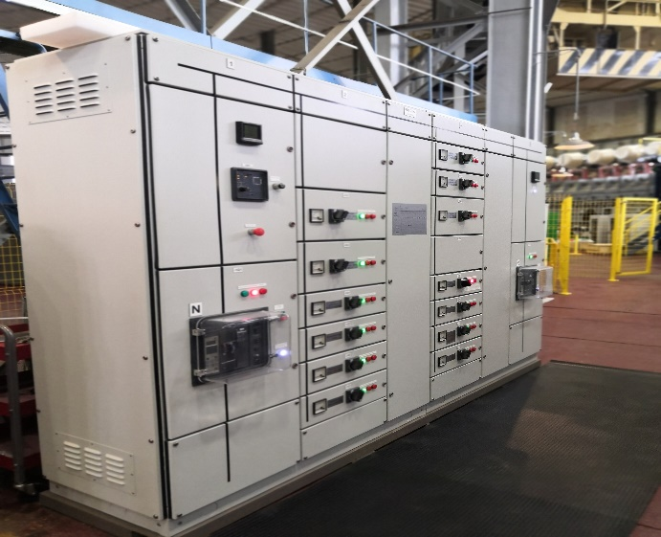
Electron cooling section
S. Melnikov
Contract with BINP
4-th str. sect.
Achieved parameters | Value
Electron energy, keV | 30
Electron current, mA | 170
Magnetic field, kGs | 1
Filed homogeneity | 2×10⁻⁵
Vacuum pressure, Pa | 3×10⁻⁹
Commissioned
RuPAC 2021, Crimea, Alushta, 27 of September 2021

Slide 19
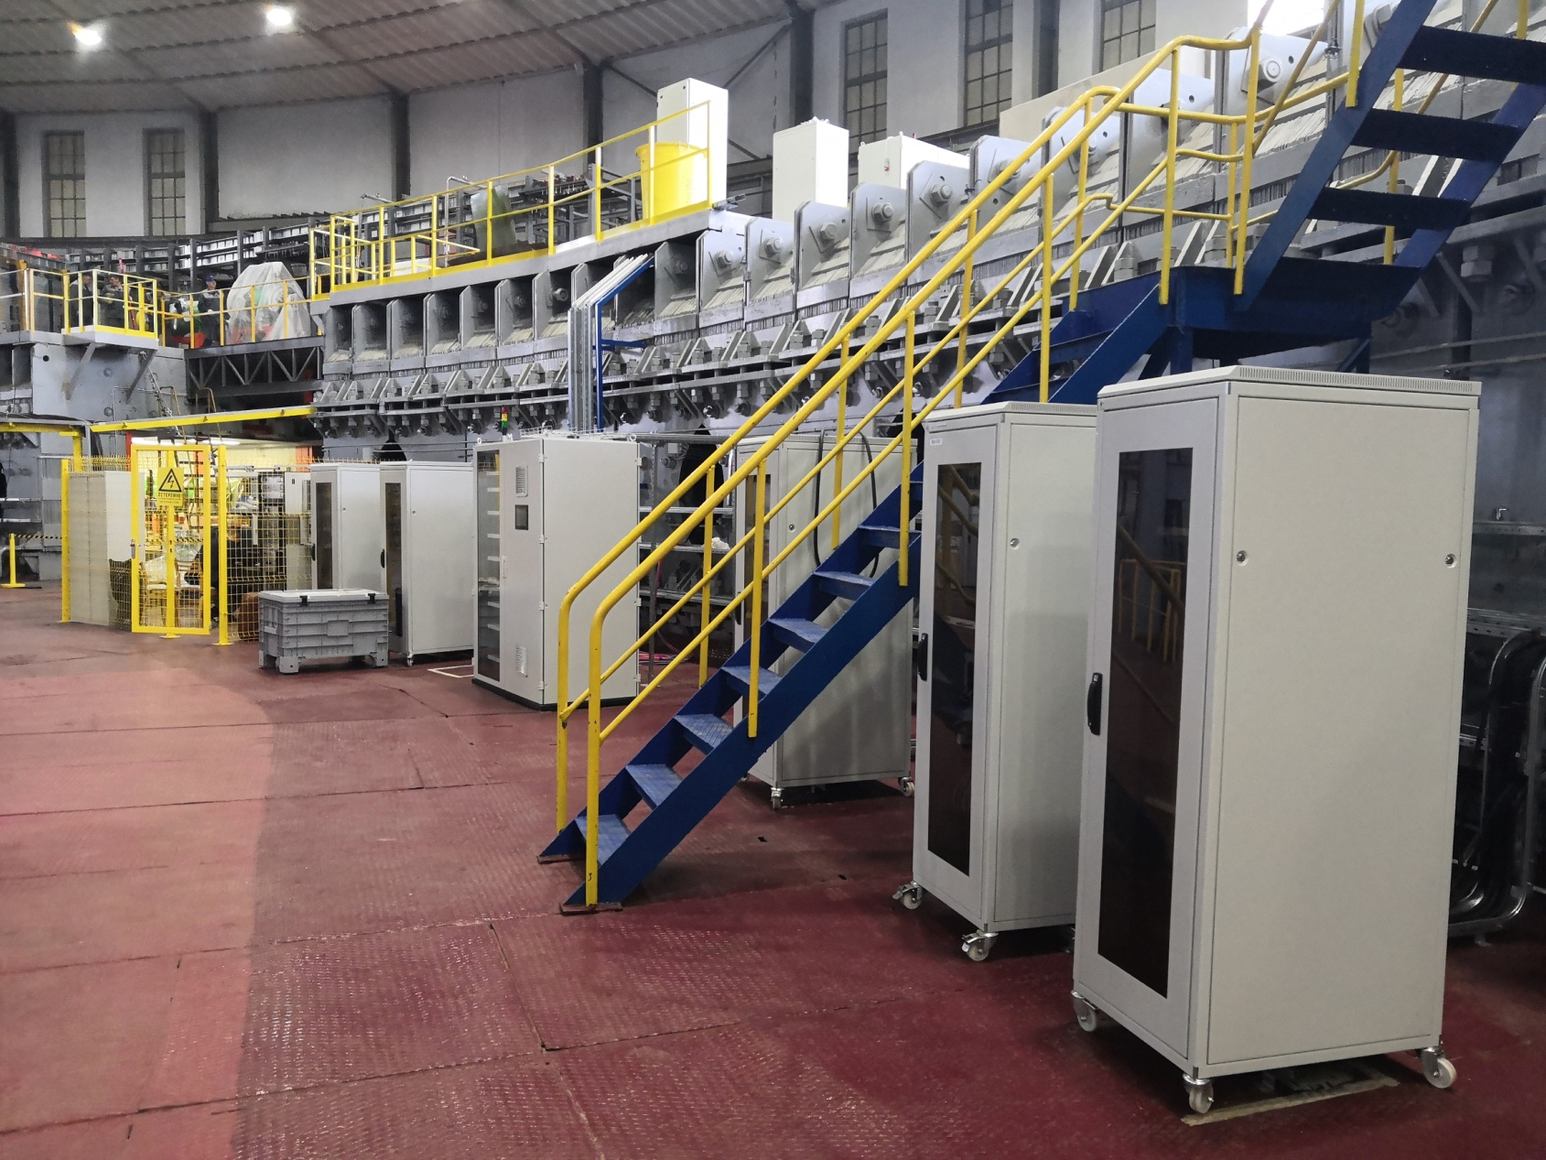
Control, diagnostics & orbit correction
E. Gorbachev
Beam diagnostics
tested
Main Control system
“1st gen”
tested
Vacuum system control (1 stage)
tested
RF racks
Control rack of vacuum system
Rack of BPM and thermometry
Racks of correctors PS
RuPAC 2021, Crimea, Alushta, 27 of September 2021

Slide 20
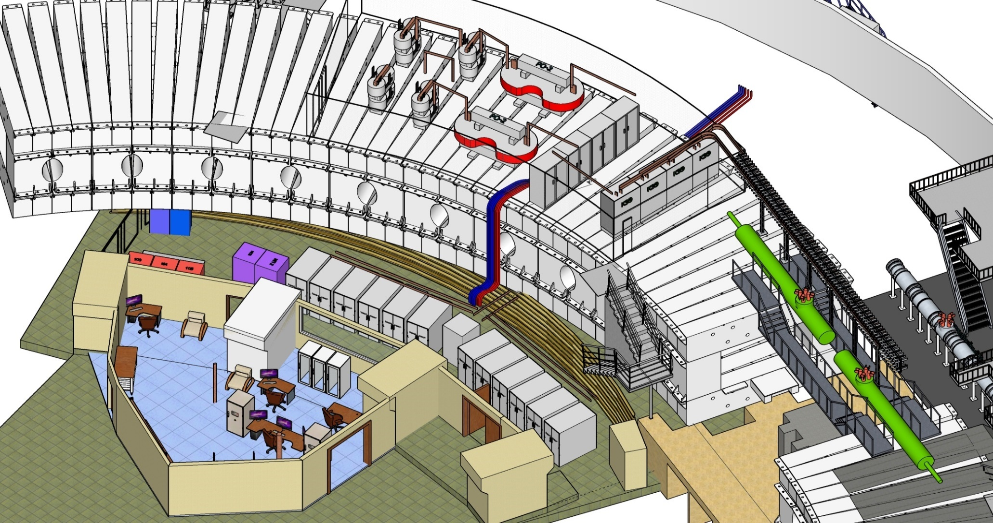
Power supply & machine safety
V. Karpinsky
Evacuation energy keys
Switchboards
Current lines
Equivalent load
Power supplies
Control room
RuPAC 2021, Crimea, Alushta, 27 of September 2021

Slide 21
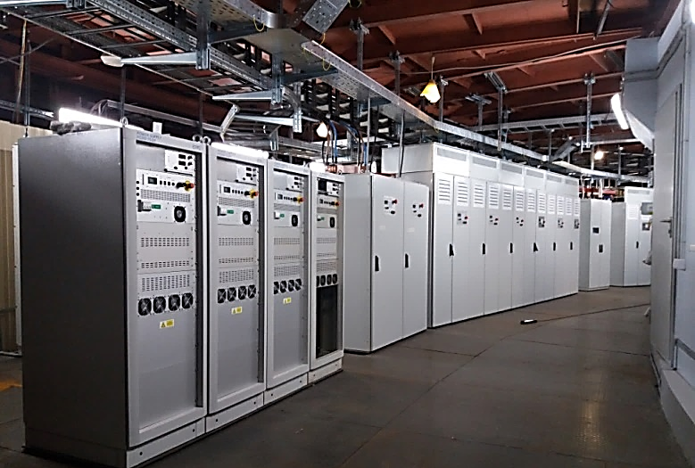
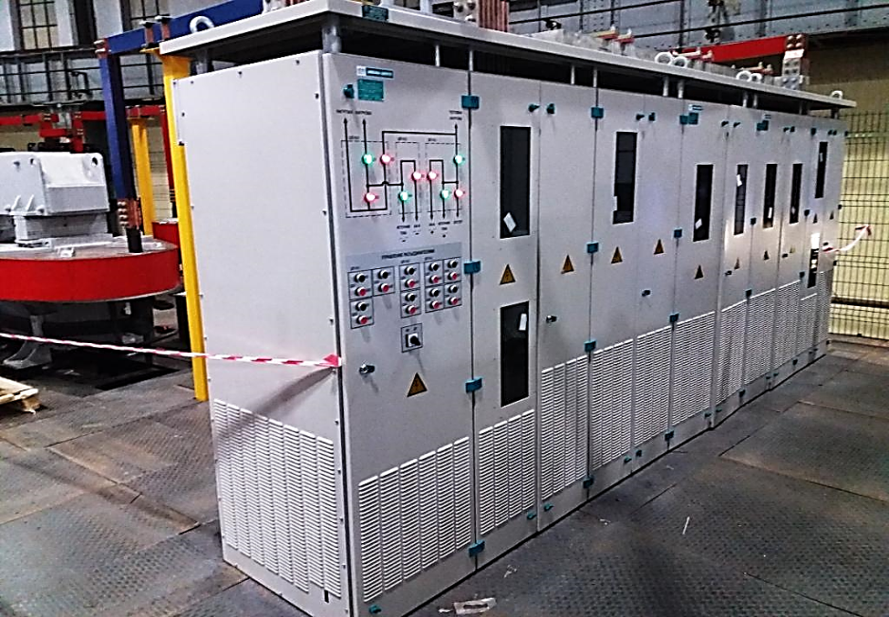
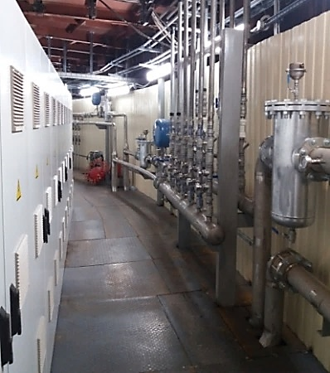
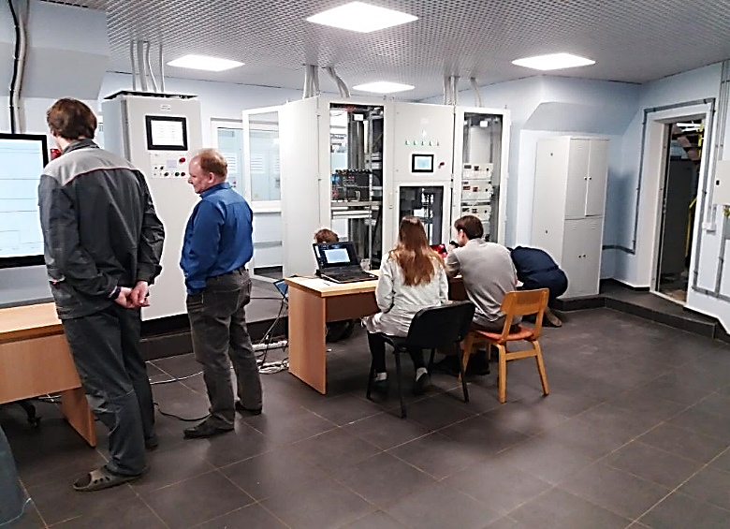
Main Power supply
Main Power supply
Commissioned !
Project parameters achieved
power switches
water cooling subsystem
Local control room
RuPAC 2021, Crimea, Alushta, 27 of September 2021
21

Slide 22
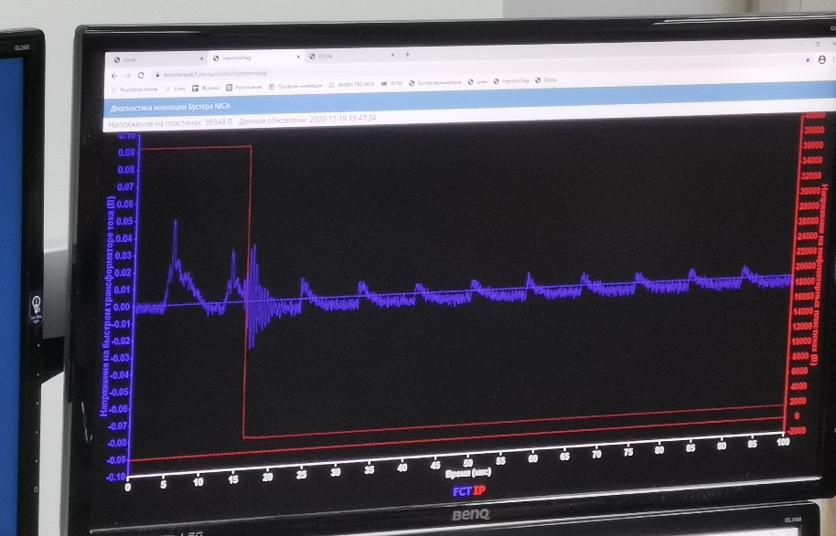
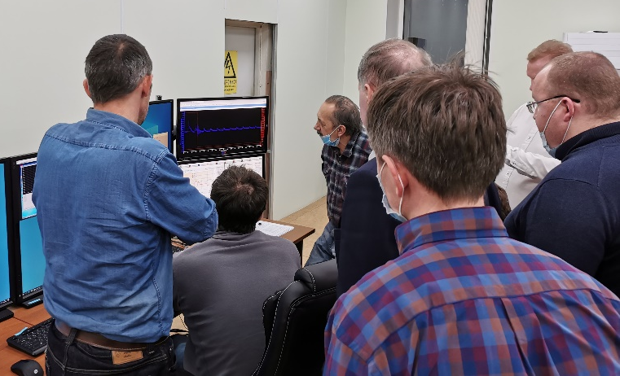
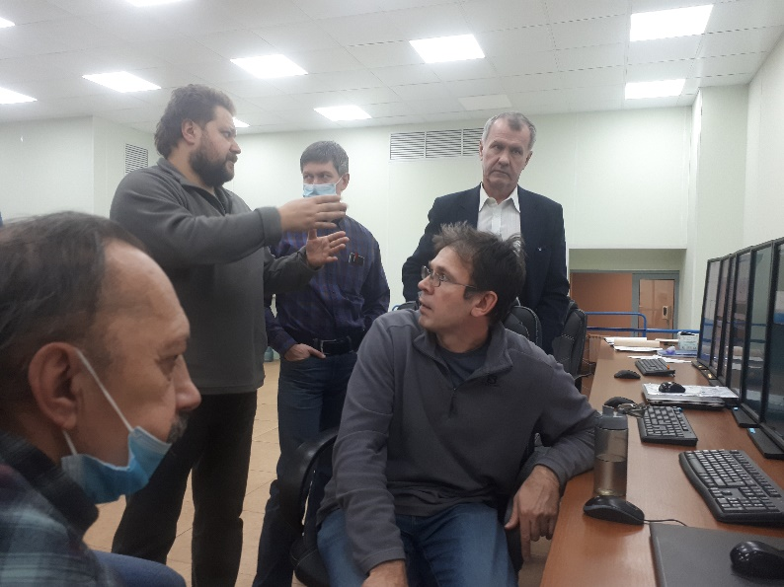
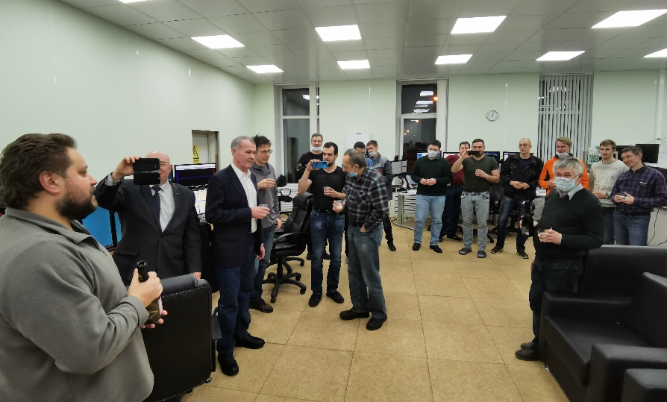
Booster ring commissioning
19.12.2020, 19:56 Moscow time. First beam in the ring.
Start of beam commissioning of the Booster ring, first cycle
First beam in the ring.
RuPAC 2021, Crimea, Alushta, 27 of September 2021

Slide 23
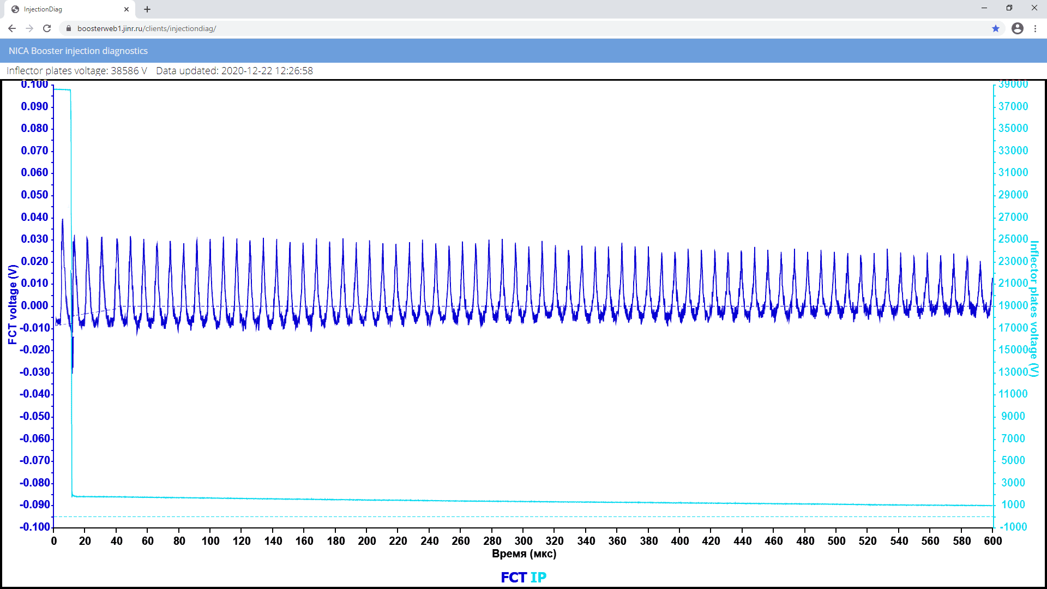
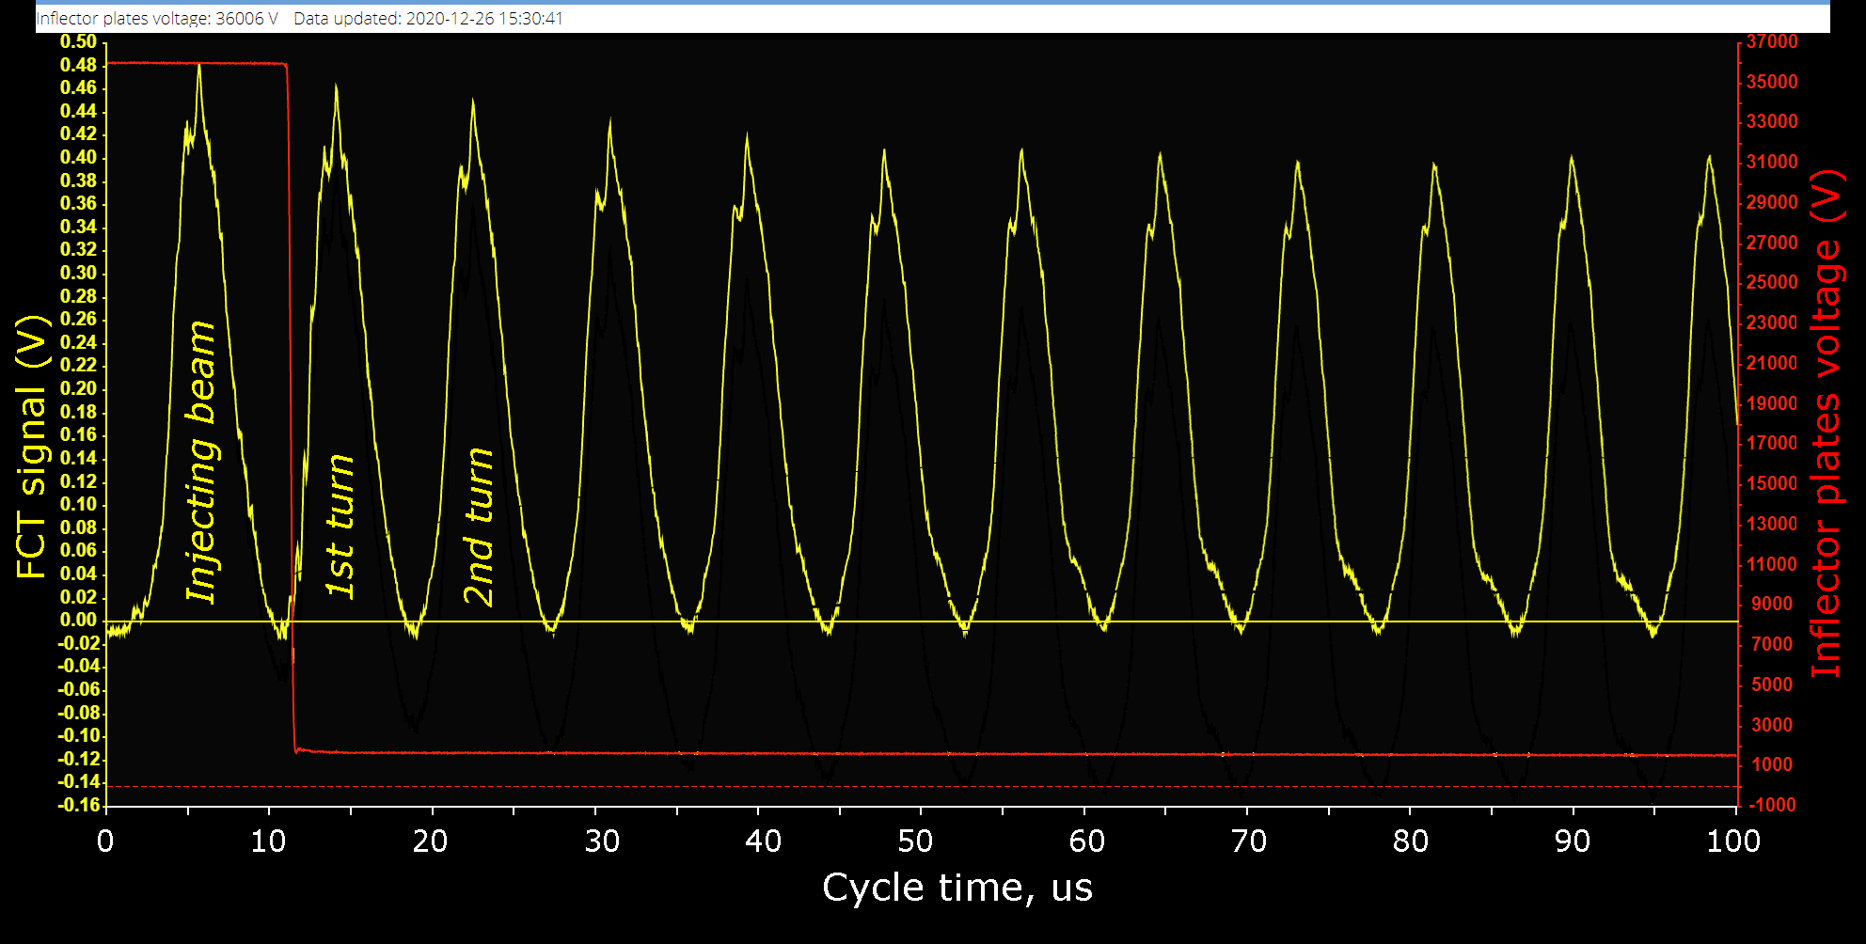
Beam injection & circulation
Fast Current Transformer (FCT)
22.12.2020
Circulating beam
at the injection energy 3.2 MeV/u
600 ms circulation
26.12.2020
Beam losses < 10%
just on the first 5 turns.
RuPAC 2021, Crimea, Alushta, 27 of September 2021

Slide 24
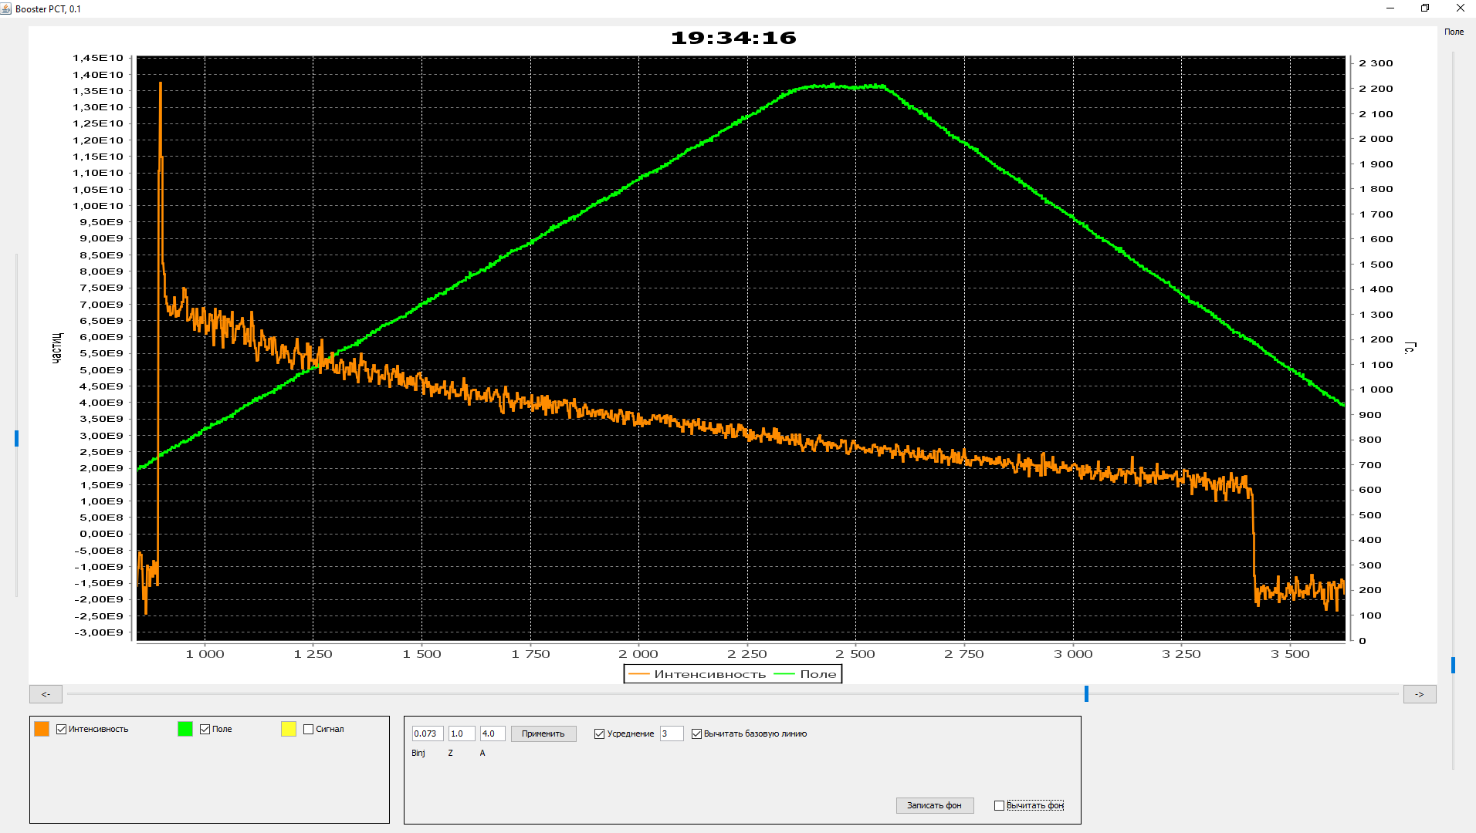
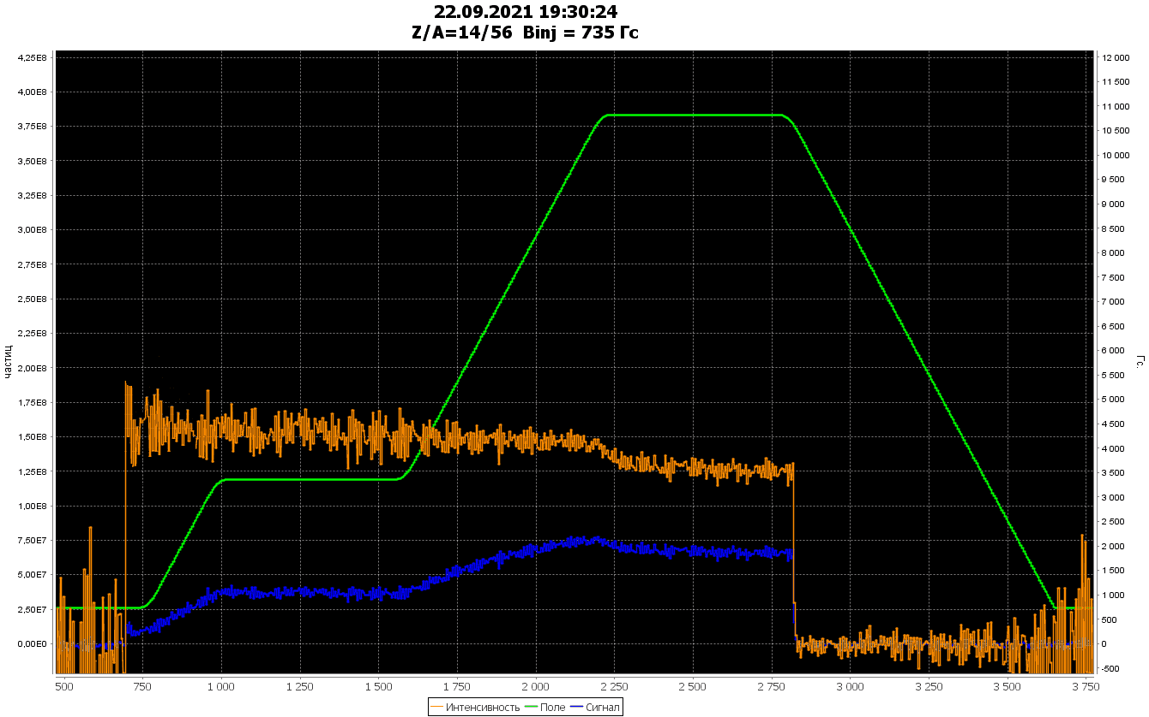
Beam acceleration
Parametric beam current transformer signal (DC mode)
Cycle-1 of commissioning
20 of December 2020 He¹⁺
Injection
Circulation
100 MeV/u
Magnetic field
Beam Intensity
PCT signal when beam injecting into rising field, capturing (~60%), accelerating & decelerating:
no transient losses on the MF table & after.
Acceleration
He¹⁺
Deceleration
Magnetic field
RF off
1000 1500 2000 2500 3000 3500
Cycle time, ms
Cycle 2 of commissioning
14-23 of September 2021 Fe¹⁴⁺
RF capturing 5 harm.
Acceleration
Re-capturing 1 harm.
Fe¹⁴⁺
Injection
Circulation
65 MeV/u
Acceleration
Circulation
578 MeV/u
Beam injection with adiabatic capturing 5 harmonic (>95%),
accelerating up to 65 MeV/u,
recapturing 1 harmonic (close to 100%)
acceleration up to 578 Mev/u
with dB/dt = 1.2 T/s
Magnetic field 1,2 T/s
500 1000 1500 2000 2500 3000 3500
Cycle time, ms
RuPAC 2021, Crimea, Alushta, 27 of September 2021

Slide 25
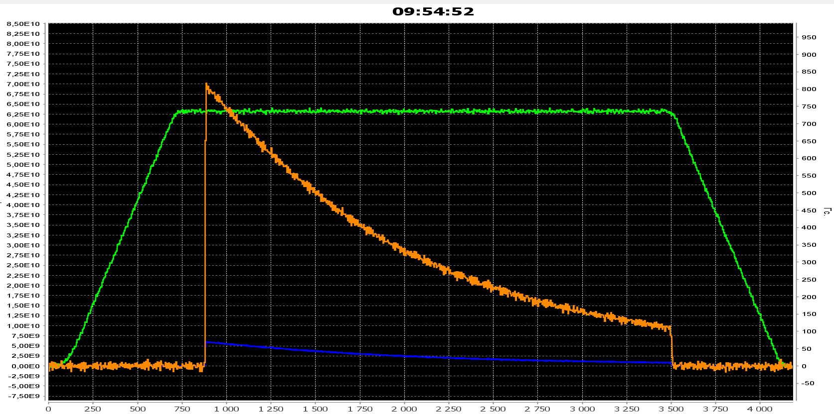
Beam current & vacuum conditions
26.12.20: Orbit correction, Injection optimization – design current of circulating beam,
Measurements of integral vacuum conditions by intensity decrement of circulating He¹⁺
Parametric beam current transformer signal (DC mode)
7⋅10¹⁰
Beam intensity
Circulation of 3.2 MeV/u
1.3 s He¹⁺ beam lifetime
Magnetic field plateau
Beam Intensity
Magnetic field
PCT signal
t, ms
0 500 1000 1500 2000 2500 3000 3500 4000
23 December 2019
7⋅10¹⁰ elementary charges ~ 2⋅10⁹ of Au³¹⁺ (design intensity)
Life-time is about 1.3 s, equivalent pressure of residual gas is 3÷4⋅10⁻⁸ Pa
RuPAC 2021, Crimea, Alushta, 27 of September 2021

Slide 26
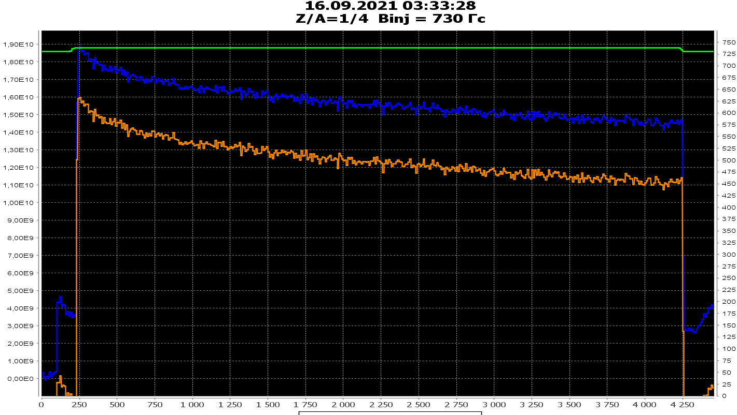
Beam current & vacuum conditions
16.09.2021: Measurements of integral vacuum conditions by intensity decrement of circulating He¹⁺
Parametric beam current transformer signal (DC mode)
PCT signal
Beam Intensity, PPC
Circulation of 3.2 MeV/u He¹⁺
~10 s beam lifetime
Beam intensity
Magnetic field, Gs
16 September 2021
t, ms
0 500 1000 1500 2000 2500 3000 3500 4000
Life-time up to 10 s (3x more), equivalent pressure of residual gas
              is about 8÷9⋅10⁻⁹ Pa
RuPAC 2021, Crimea, Alushta, 27 of September 2021

Slide 27
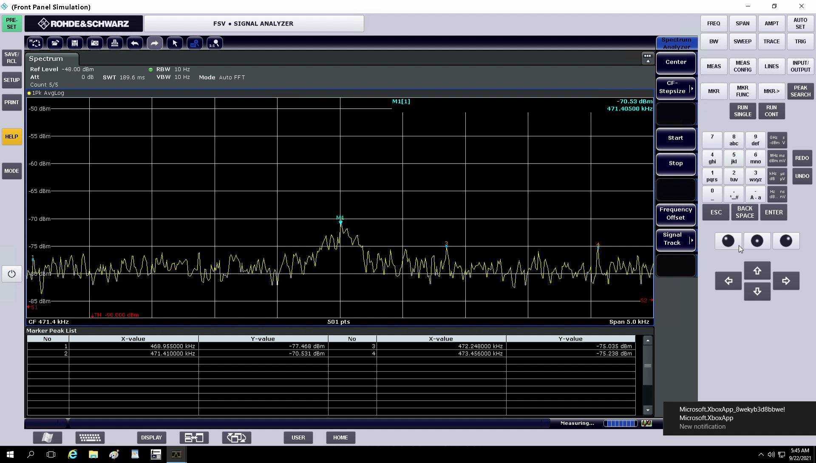
Electron cooling section
Electron cooling of Fe¹⁴⁺ at 3.2 MeV/u during 2 s
I.Meshkov
Schottky spectrum at 4-th harmonics
RuPAC 2021, Crimea, Alushta, 27 of September 2021

Slide 28

Electron cooling section
Electron cooling of Fe¹⁴⁺ at 3.2 MeV/u during 2 s
I.Meshkov
Schottky spectrum at 4-th harmonics
RuPAC 2021, Crimea, Alushta, 27 of September 2021

Slide 29

Electron cooling section
Electron cooling of Fe¹⁴⁺ at 3.2 MeV/u during 2 s
I.Meshkov
Schottky spectrum at 4-th harmonics
RuPAC 2021, Crimea, Alushta, 27 of September 2021

Slide 30

Electron cooling section
Electron cooling of Fe¹⁴⁺ at 3.2 MeV/u during 2 s
I.Meshkov
Schottky spectrum at 4-th harmonics
RuPAC 2021, Crimea, Alushta, 27 of September 2021

Slide 31

Design magnetic field amplitude & ramping rate
30.12.20: design magnetic field cycle
Maximum 1.8 T
dB/dt = 1.2 T/s
17999.96Gs
Electron cooling plateau
Injection plateau
3.6 s
RuPAC 2021, Crimea, Alushta, 27 of September 2021

Slide 32
Introduction
Two LINACs & ion sources
  SPI & LU-20/LILAc (light & pol. ions)
  HILAC (heavy ions)
The Booster ring
Beam transfer line
The Nuclotron ring
RuPAC 2021, Crimea, Alushta, 27 of September 2021

Slide 33

Beam extraction & transfer line
A. Tuzikov
3-rd str. sect.
Contract with BINP
Beam dynamic optimization
Fast extraction elements
Magnets & PS
Beam pipe & vacuum system
Beam diagnostics
RuPAC 2021, Crimea, Alushta, 27 of September 2021

Slide 34


Beam extraction & transfer line
A. Tuzikov
3-rd str. sect.
Contract with BINP
Beam fast extraction section
Циркулирующий пучок
В Нуклотрон
3D model of the transfer line
RuPAC 2021, Crimea, Alushta, 27 of September 2021

Slide 35



Beam extraction & transfer line
Contract with BINP
3-rd str. sect.
RuPAC 2021, Crimea, Alushta, 27 of September 2021

Slide 36


Beam extraction & transfer line
3-rd str. sect.
BINP team during beam line commissioning
RuPAC 2021, Crimea, Alushta, 27 of September 2021

Slide 37

Beam extraction & transfer line
3-rd str. sect.
⁵⁶Fe beam portrait at the exit of the transfer line Booster- Nuclotron
RuPAC 2021, Crimea, Alushta, 27 of September 2021

Slide 38




Beam injection system (Nuclotron)
Lambertson magnet
10.2021
4-rod kicker
10.2021
Testing & mounting
Nov.2021
38
RuPAC 2021, Crimea, Alushta, 27 of September 2021

Slide 39
Introduction
Two LINACs & ion sources
  SPI & LU-20/LILAc (light & pol. ions)
  HILAC (heavy ions)
The Booster ring
Beam transfer line
The Nuclotron ring
RuPAC 2021, Crimea, Alushta, 27 of September 2021

Slide 40

Nuclotron status
Circumference ~251m, Br<43 Tm
The project approved
in 1986 year
Commissioning &
fist beam
March 1993 year
Slow extraction
2000 year
The last RUN #55
Feb. - April 2018
Accelerated:
Ions from p to Xe (C, Mg, Fe, Ar, Kr)
Polarized p & d beams
Proton energy max 12 GeV
Light ions max 6 GeV/u
Heavy ions max 4.5 GeV/u
RuPAC 2021, Crimea, Alushta, 27 of September 2021

Slide 41
Deep modernization
Nuclotron-N
modernization of the ring for NICA project
Development of the
KRION ESIS
+
Injector modernization
Energy evacuation system
Heavy ions
Quench protection system
Energy 6 Gev/n
(for Z/A = 1/2)
Field ~ 2T,
B’< 0,8 T/s
Slow extraction at HE
Nuclotron-N
Vacuum improvement
Intensity >10^7 ppc
(with KRION-2)
Control, diagnostics, RF
Cryogenics modernization
Stable, safe,
long operation
Power supply system modernization
Radiation safety
RuPAC 2021, Crimea, Alushta, 27 of September 2021

Slide 42


Nuclotron beam RUNs
Run #53, 1450 h, Oct-Dec 2016
Cooling, 7.3%
Polarized, unpolarized deuterons,
maximum energy of extracted beam
4.6 GeV/u
Tuning, 8.7%
Repairs, 4%
Unexpected
Losses 2,5%
77.6%
Experiments
Run #55, 1020 h, Feb-Apr 2018
Cooling, 9.9%
Accelerating and slow extraction of heavy Ion beams:
C, Ar, Kr
Tuning, 25.6%
Experiments 60%
Repairs, 4.2%
Unexpected losses, 1.1%
RuPAC 2021, Crimea, Alushta, 27 of September 2021

Slide 43


Heavy ion beams acceleration
⁷⁸Kr⁺²⁶ beam extraction (2,8 Gev/u) RUN #55
⁷⁸Kr 2*10⁵ T_{spill} = 10s, k_{dc}= 99,3%
RuPAC 2021, Crimea, Alushta, 27 of September 2021

Slide 44
Nuclotron status table
Parameter | Project | Status (2020)
Max. magn. field, T | 2 | 2 (1.7 T routine)
B-field ramp, T/s | 1 | 0.8 (0.7 routine)
Accelerated particles | p–U, d↑ | p↑, d↑, p – Xe
Max. energy, GeV/u | 12 (p), 5.8 (d) 4.5( ¹⁹⁷Au⁷⁹⁺) | 5.6 (d, ¹²C), 3.6 (⁴⁰Ar¹⁶⁺)
Intensity, ions/cycle | 1E11(p,d), 2E9 (A > 100) | d 4*10¹⁰ (2*10¹⁰ routine), ⁷Li³⁺ 3*10⁹ ¹²C⁶⁺ 2*10⁹ ⁴⁰Ar¹⁶⁺ 1*10⁶ ⁷⁸Kr²⁶⁺ 2*10⁵ ¹²⁴Xe⁴²⁺ 1*10⁴
RuPAC 2021, Crimea, Alushta, 27 of September 2021
44

Slide 45
Summary
During last beam runs of the injection complex elements was demonstrated:
Stable operation;
Low beam losses at all stages of acceleration;
Real possibility for efficient acceleration of different ions:
    polarized protons and deuterons;
    light ions (d+, Li, C et. set.);
    heavy ions (Ar, Fe, Kr, earlier Xe…).
High quality of the slowly extracted beam form the NUCLOTRON -
emittances, profiles, excellent spill structure;
For operation of the NICA injection complex for collider,
♦ new current lead-ins (high temp. SC) for the Nuclotron,
♦ beam injection from the Booster
♦ fast extraction from the Nuclotron
♦ new global synchronization
systems are needed.
RuPAC 2021, Crimea, Alushta, 27 of September 2021

Slide 46

Thank you for attention
RuPAC 2021, Crimea, Alushta, 27 of September 2021

