Slide 1
Status of the Novosibirsk Fourth-Generation Light Source SKIF

Slide 2
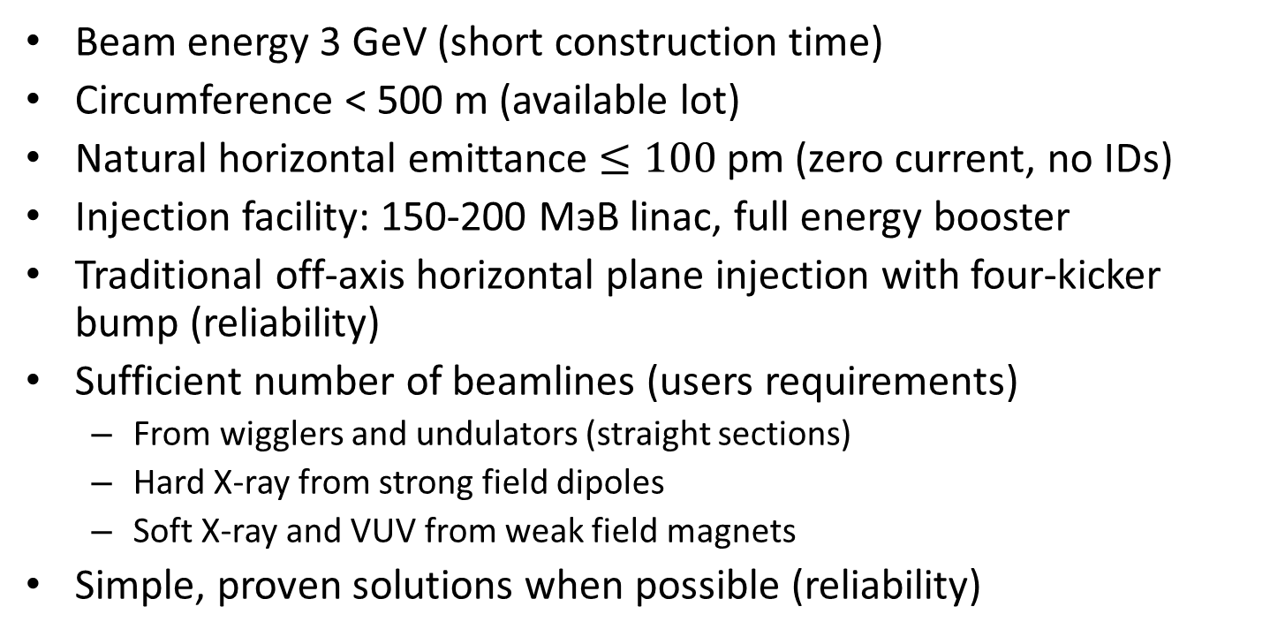
Description
Beam energy 3 GeV (short construction time)
Circumference < 500 m (available lot)
Natural horizontal emittance $≤100$ pm (zero current, no IDs)
Injection facility: 150-200 МэВ linac, full energy booster
Traditional off-axis horizontal plane injection with four-kicker bump (reliability)
Sufficient number of beamlines (users requirements)
  From wigglers and undulators (straight sections)
  Hard X-ray from strong field dipoles
  Soft X-ray and VUV from weak field magnets
Simple, proven solutions when possible (reliability)

Slide 3
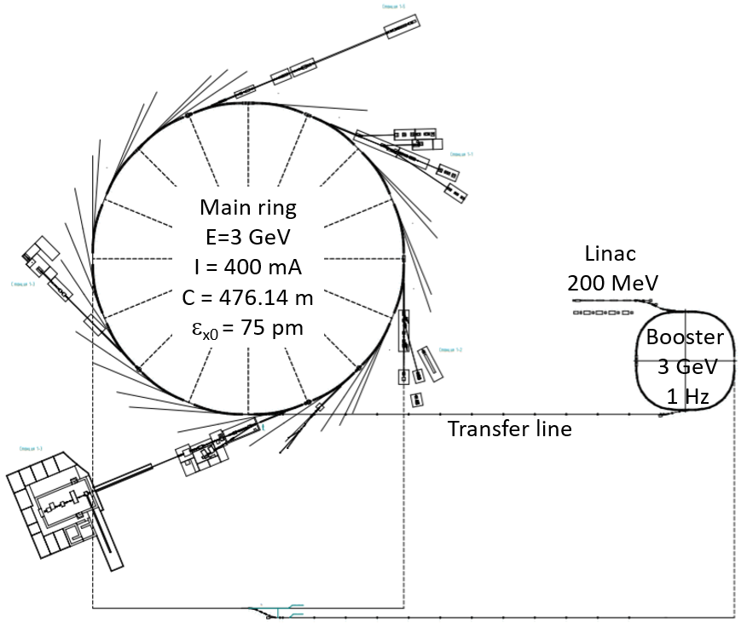
Configuration
To complete construction and to start operation before the main building and ring, the injection facility is in separate building.
Linear accelerator with maximum energy of 200 MeV
Booster synchrotron with maximum energy of 3 GeV and orbit length of 158.7 m
Electron storage ring 16-fold symmetry with 3 GeV energy and 476 m circumference

Slide 4
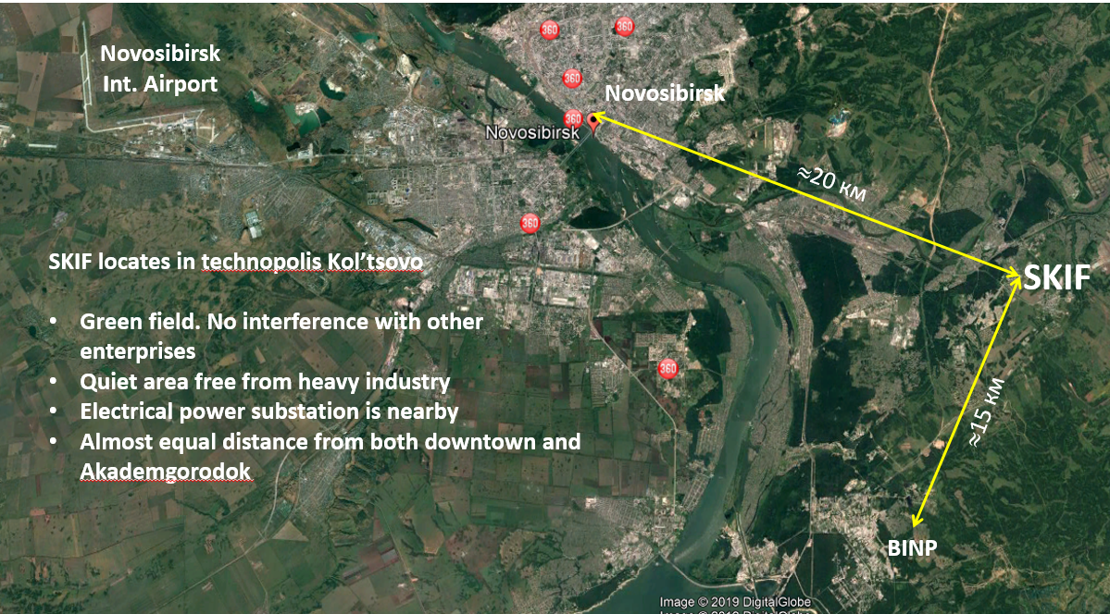
Location: Kol’tsovo Science Town

Slide 5
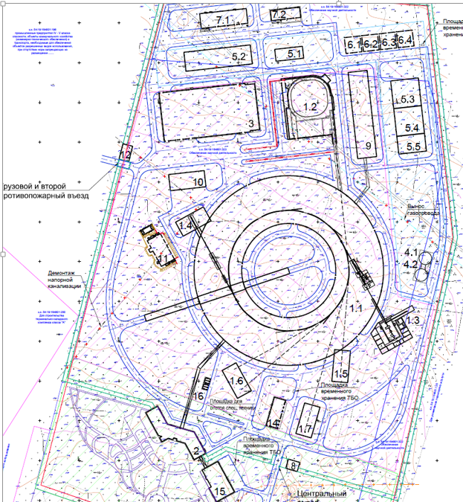
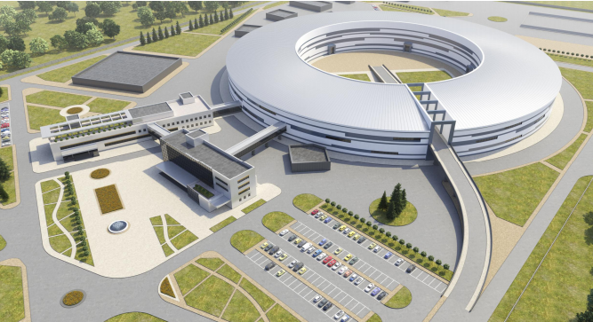
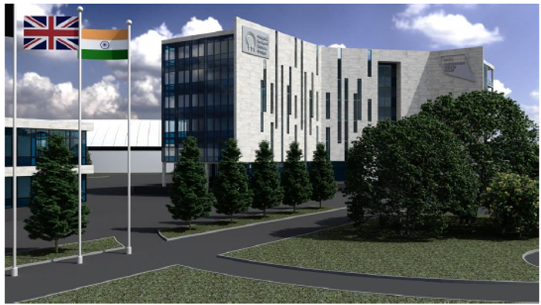
Architecture

Slide 6
Government contracts
Manufacturing, assembling, delivering and commissioning of “SKIF” equipment
Government order 12.10.2020 № 2630-р:
BINP is the sole contractor for manufacturing, assembling, delivering and commissioning of “SKIF” accelerator facility (ЦКП «СКИФ») equipment
Government contract with BINP (16.11.2020) in the frame of WP (12.10.2020 № 2630-р) for injecting facility:
  3.62 billion rubles (the first tranche – 30 % in 2020 and 2021);
  term – 01.10.2022 (commissioning of injector in separate building)
Government contract with BINP (28.05.2021) tender for storage ring
  8.93 billion rubles (the first tranche – 50 % in 2021 and 2022)
  term – 31.12.2023 (commissioning of accelerator facility SKIF)

Slide 7
Injection facility (200 MeV linac; 3 GeV, 158 m booster)
Signed ~70% of contracts for materials, equipment and parts.
BINP workshop received design documentation for 141 orders for more than 120,000 working hours.
Contract signed with ООО «НПП Триада ТВ» (Novosibirsk) for manufacturing of amplifier with 700 kW pulsed power at 178 MHz for RF gun and amplifier with 10 kW pulsed power at 534 MHz for linac.
Contract signed with АО «БЭМЗ» (Berdsk) for manufacturing 20 Amp, 50 V power supplies.
Contract signed with Marubeni corporation (Japan) for 50 MWt, 2856 MHz klystron delivery. Preparation of the contract for two more klystrons.
Contract signed with АО «НПО НИИИП-НЗиК» (Novosibirsk) for manufacturing modulator parts of klystrons being produced in BINP.

Slide 8
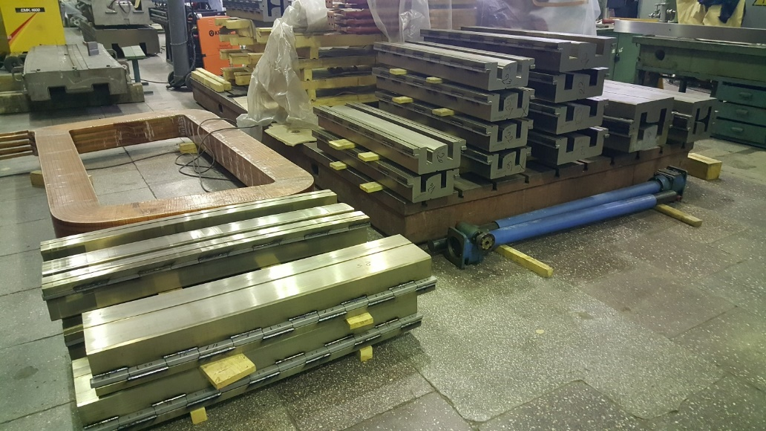
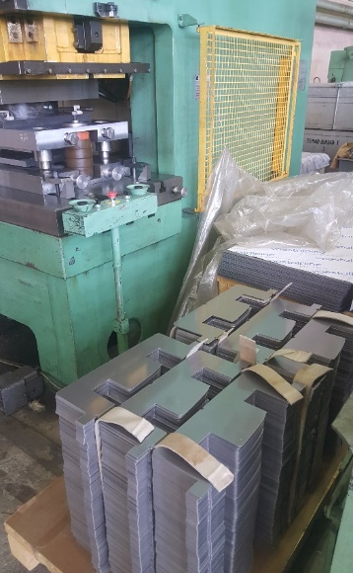
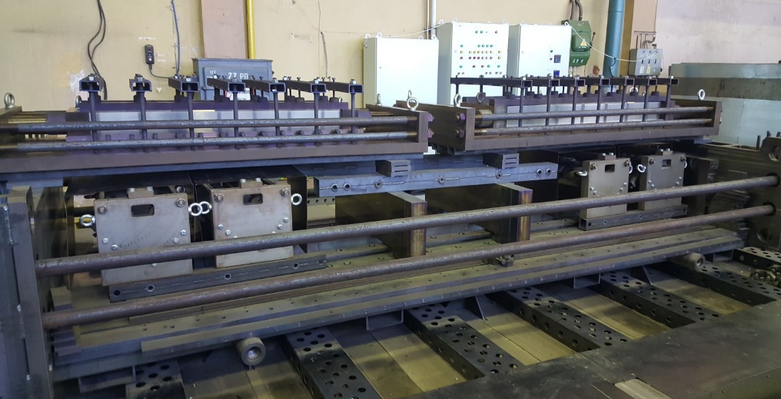
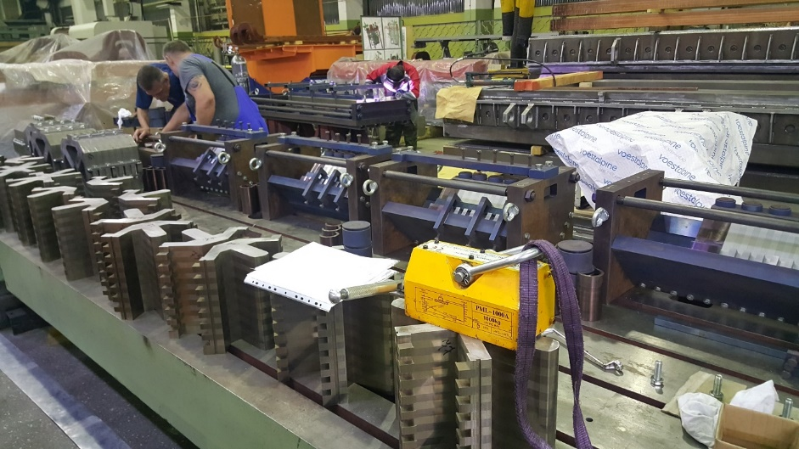
Booster (Energy 3 GeV, circumference 158 m)
Received 120 tons of steel with glue layer for booster magnets.
Almost finished cutting out all laminations.
Baked 50% yoke segments for dipoles and 100% for quadrupoles.

Slide 9
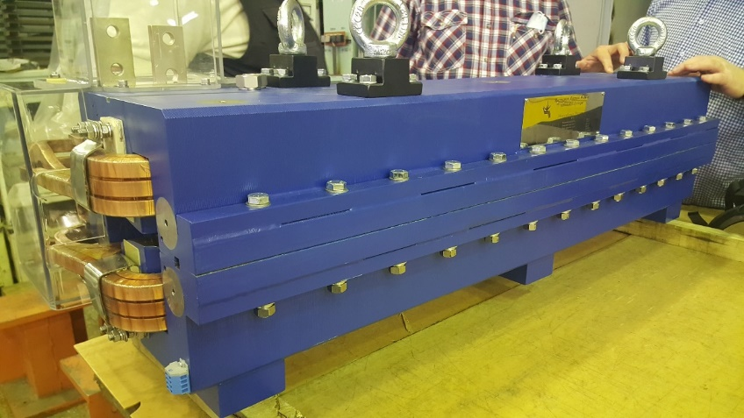
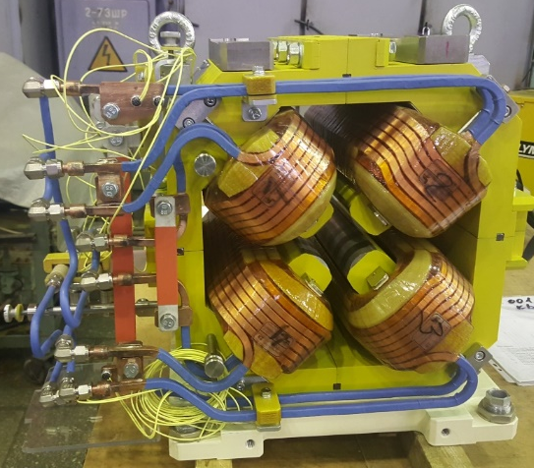
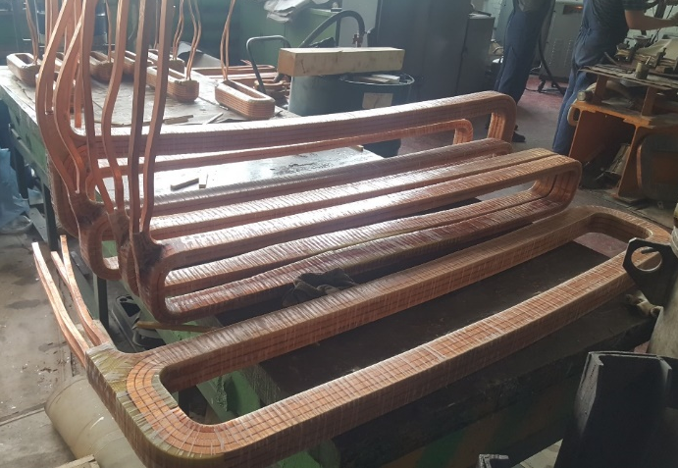
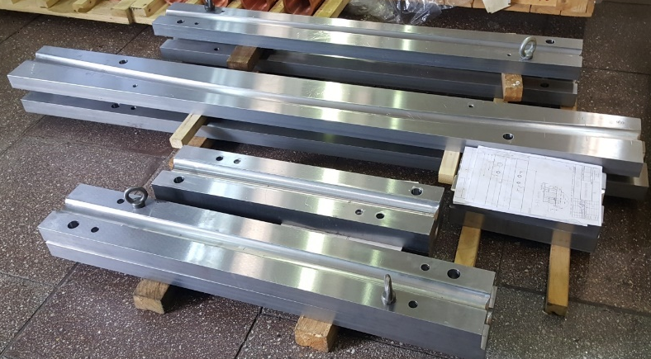
Booster
Manufactured 70% of dipole magnet coils and 100% of quadrupoles coils.
In June the first dipoles and quadrupoles were manufactured.
Manufactured stamps for booster vacuum chambers.
Waiting for delivery of nonmagnetic pipes for vacuum chambers.
Signed contract with Danfysic A/S (Denmark) for booster dipole power supplies. The other power supplies are manufactured in BINP.
Signed contract with ООО «НПП Триада ТВ» (Novosibirsk) for manufacturing three amplifiers with 80 kW of continuous power at 357 MHz for booster RF cavities.
Preparation of contract with АО «Воткинский Завод» (Votkinsk) for manufacturing of 41 booster girders.

Slide 10
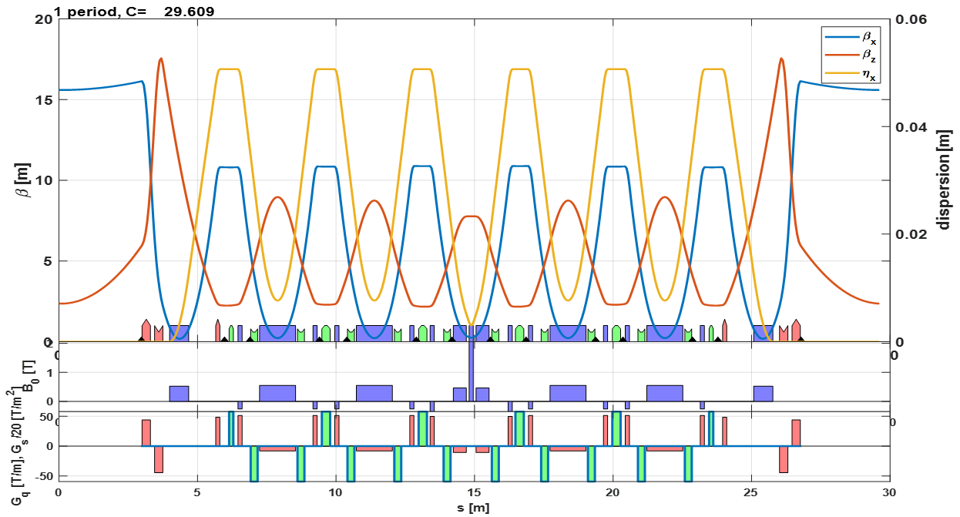
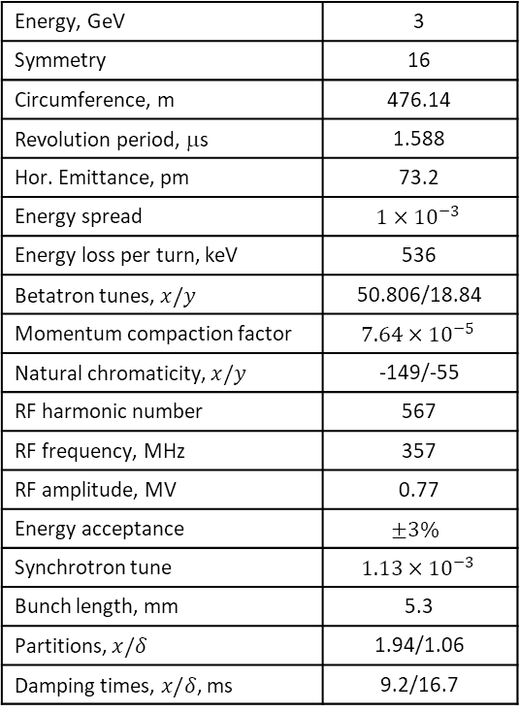
Super-period optics and parameters
Energy, GeV | 3
Symmetry | 16
Circumference, m | 476.14
Revolution period, μs | 1.588
Hor. Emittance, pm | 73.2
Energy spread | $$1×{10}^{−3}$$
Energy loss per turn, keV | 536
Betatron tunes, $x/y$ | 50.806/18.84
Momentum compaction factor | $$7.64×{10}^{−5}$$
Natural chromaticity, $x/y$ | -149/-55
RF harmonic number | 567
RF frequency, MHz | 357
RF amplitude, MV | 0.77
Energy acceptance | $$±3\%$$
Synchrotron tune | $$1.13×{10}^{−3}$$
Bunch length, mm | 5.3
Partitions, $x/δ$ | 1.94/1.06
Damping times, $x/δ$, ms | 9.2/16.7

Slide 11
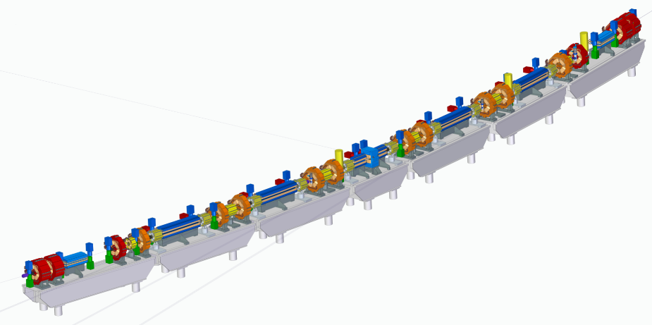
Super-period layout

Slide 12
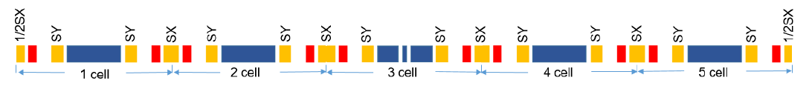
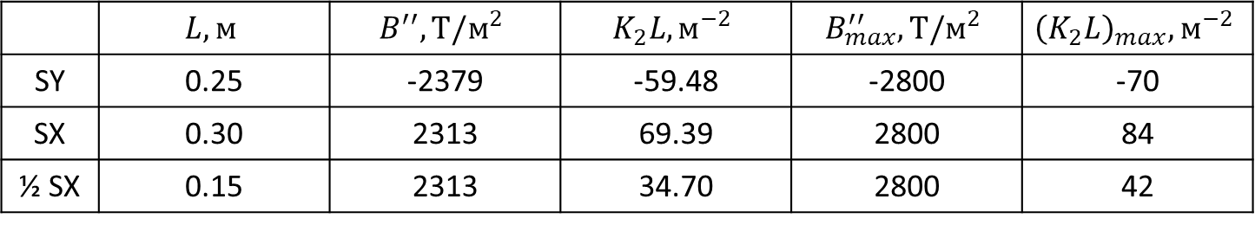
Chromaticity correction
Two sextupole families $ξ_{x}/ξ_{y}=−149/−55$
 | $$L, м$$ | $$B^{′′}, Т/м^{2}$$ | $$K_{2}L, м^{−2}$$ | $$B_{max}^{′′}, Т/м^{2}$$ | $${\left(K_{2}L\right)}_{max}, м^{−2}$$
SY | 0.25 | -2379 | -59.48 | -2800 | -70
SX | 0.30 | 2313 | 69.39 | 2800 | 84
½ SX | 0.15 | 2313 | 34.70 | 2800 | 42

Slide 13
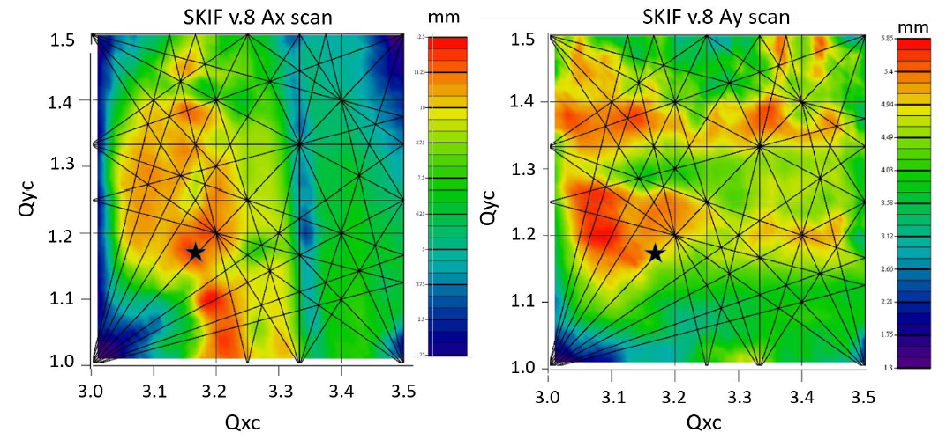
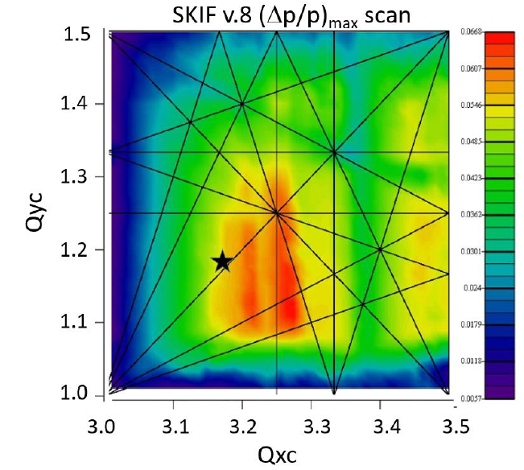
Dynamic aperture scan for one super-period
Betatron tunes, phase advances between chromatic sextupoles, and their strength were carefully adjusted to maximize dynamic aperture and momentum acceptance.

Slide 14
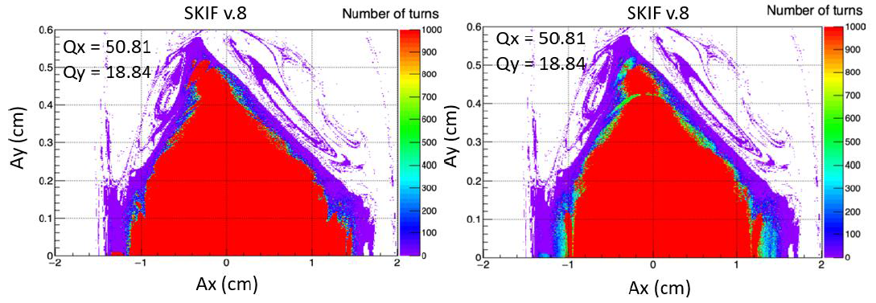
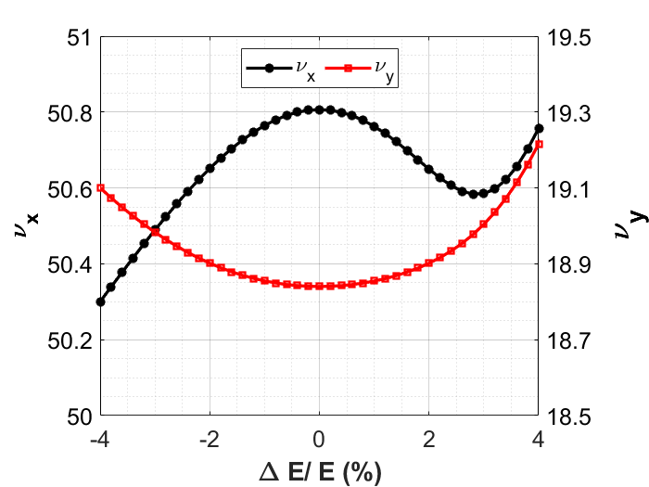
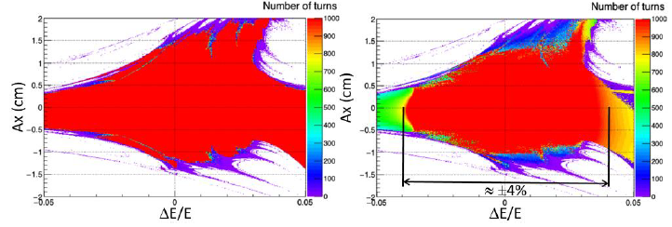
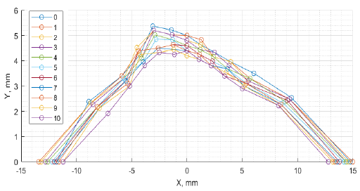

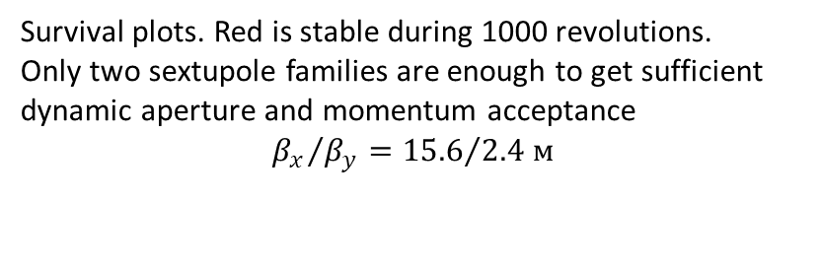
Dynamic aperture and momentum acceptance
$$ξ_{x,y}=\left[0,10\right]$$
Survival plots. Red is stable during 1000 revolutions.
Only two sextupole families are enough to get sufficient dynamic aperture and momentum acceptance
$${β_{x}}/{β_{y}}={15.6}/{2.4 м}$$

Slide 15
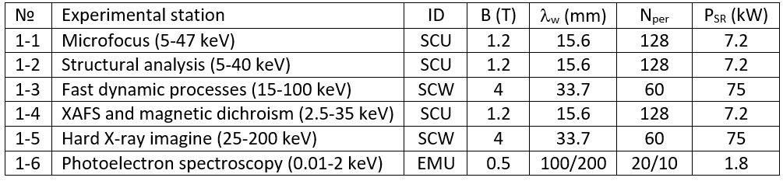
Insertion devices
To extend the spectrum in the hard X-ray region,
we plan to use superconducting IDs.

Slide 16
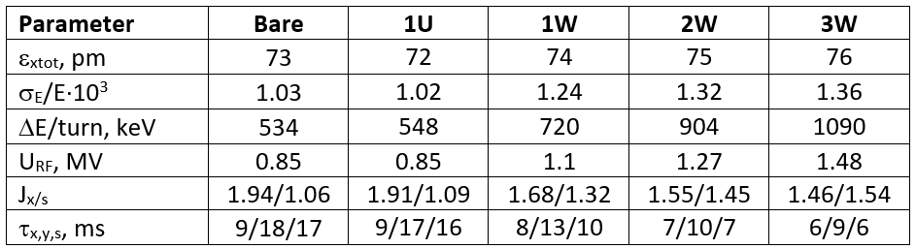
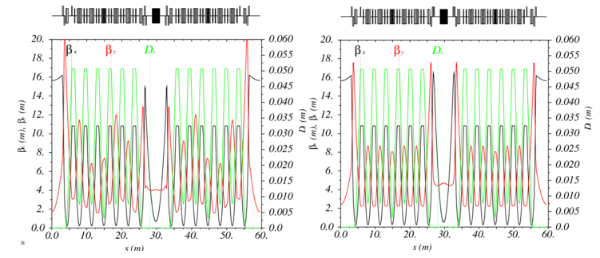
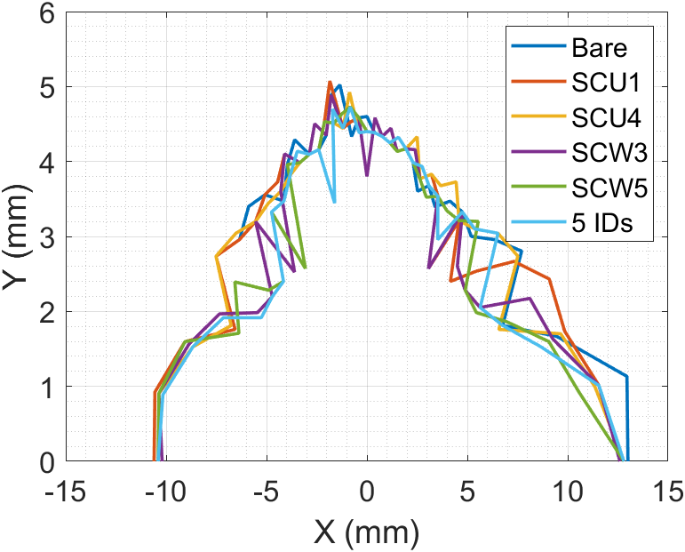
Insertion devices base optics
To extend the spectrum in the hard X-ray region, we plan to use superconducting IDs.
For baseline lattice,
emittance does
not depend on IDs.
Before correction
After correction
Optics with 1 SCW

Slide 17
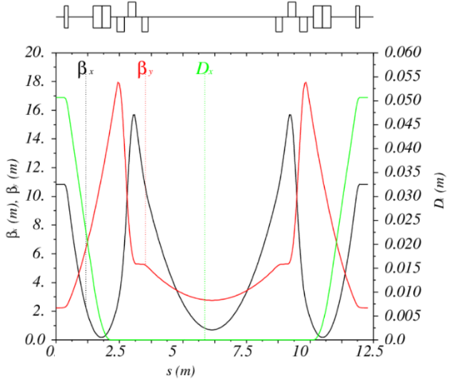
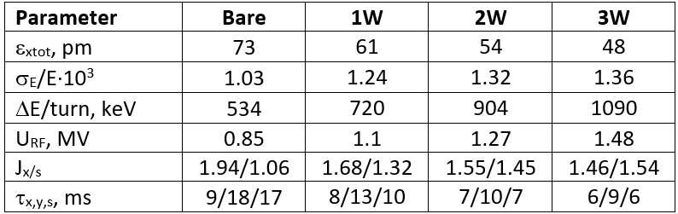
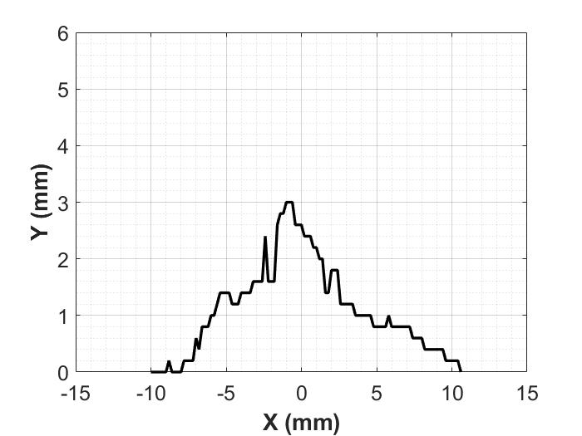
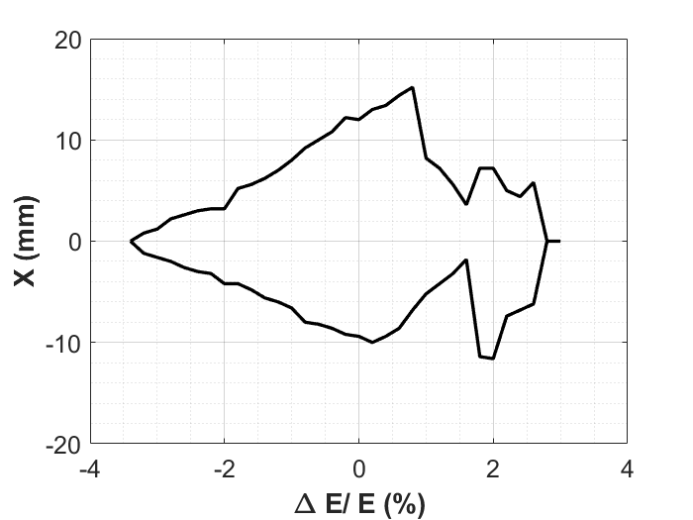
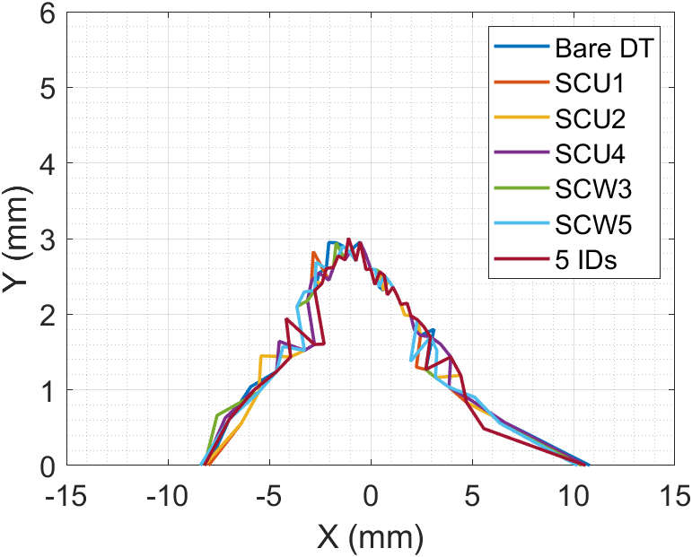
Insertion devices alternative optics
Reduction of $β_{x}$ for higher brightness requires triplets

Slide 18
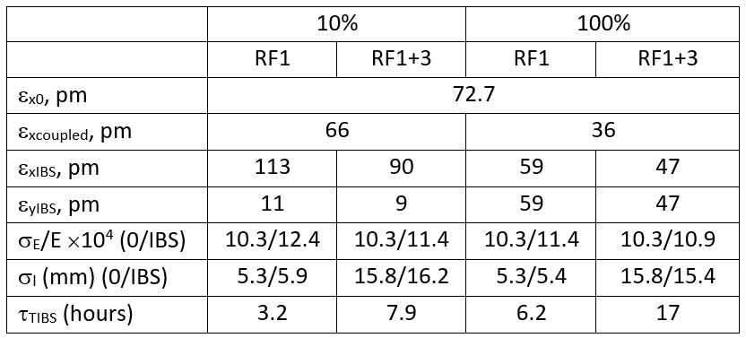
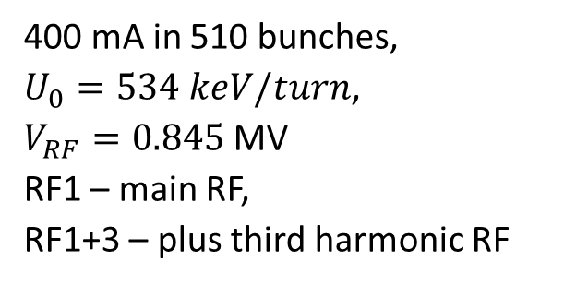
IBS base lattice
400 mA in 510 bunches,
$U_{0}=534 keV/turn$,
$V_{RF}=0.845$ MV
RF1 – main RF,
RF1+3 – plus third harmonic RF

Slide 19

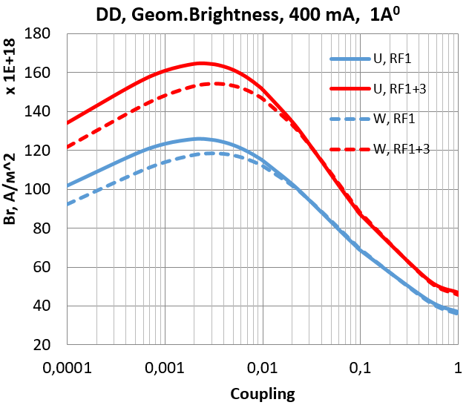

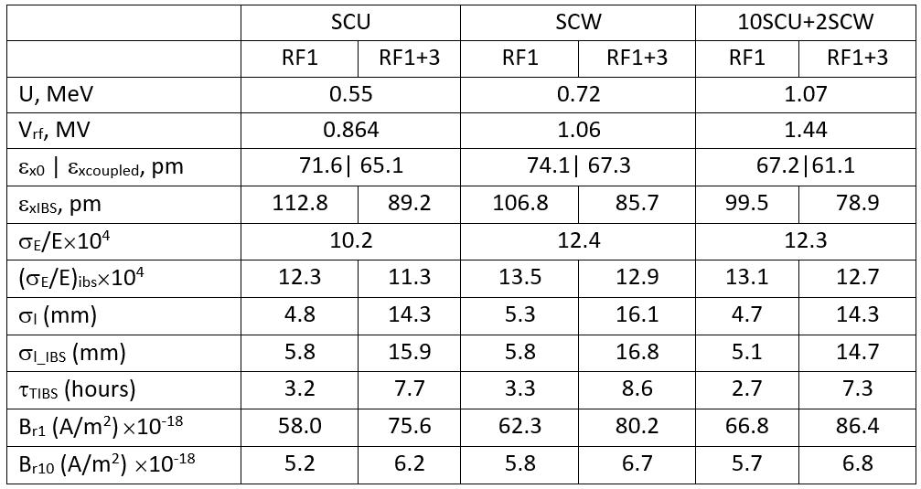
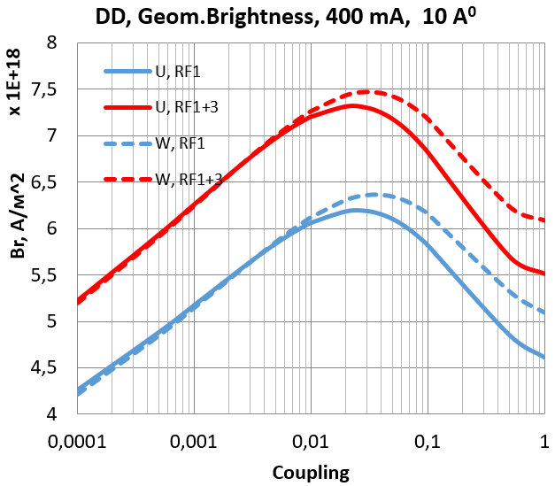
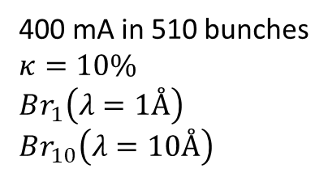
IBS with IDs
Geometrical brightness depends on electron beam parameters
400 mA in 510 bunches
$κ=10\%$
$Br_{1}\left(λ=1Å\right)$
$Br_{10}\left(λ=10Å\right)$

Slide 20
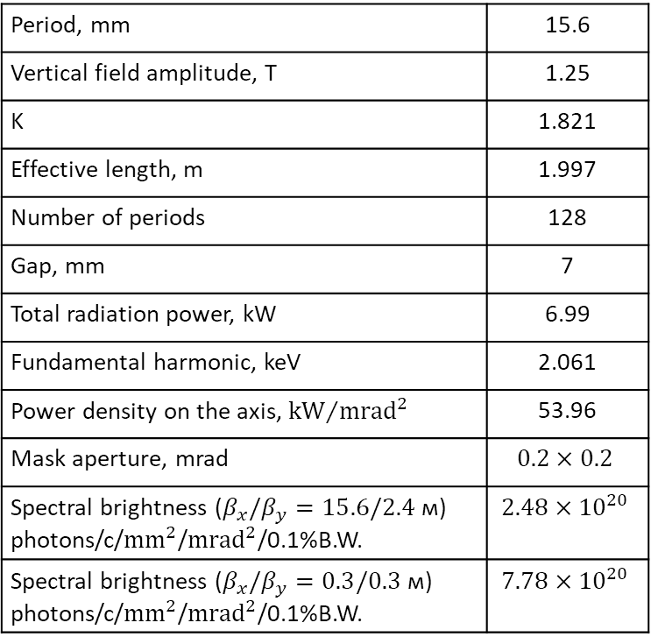
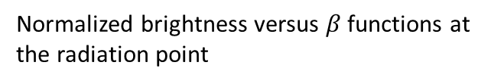
Brightness of superconductive undulator
Period, mm | 15.6
Vertical field amplitude, T | 1.25
K | 1.821
Effective length, m | 1.997
Number of periods | 128
Gap, mm | 7
Total radiation power, kW | 6.99
Fundamental harmonic, keV | 2.061
Power density on the axis, ${\text{kW}}/{{\text{mrad}}^{2}}$ | 53.96
Mask aperture, mrad | $$0.2×0.2$$
Spectral brightness ($β_{x}/β_{y}=15.6/2.4$ м) photons/c/${\text{mm}}^{2}$/${\text{mrad}}^{2}$/0.1%B.W. | $$2.48×{10}^{20}$$
Spectral brightness ($β_{x}/β_{y}=0.3/0.3$ м) photons/c/${\text{mm}}^{2}$/${\text{mrad}}^{2}$/0.1%B.W. | $$7.78×{10}^{20}$$
Optimized 1
Base
Optimized 2
Normalized brightness versus $β$ functions at the radiation point

Slide 21
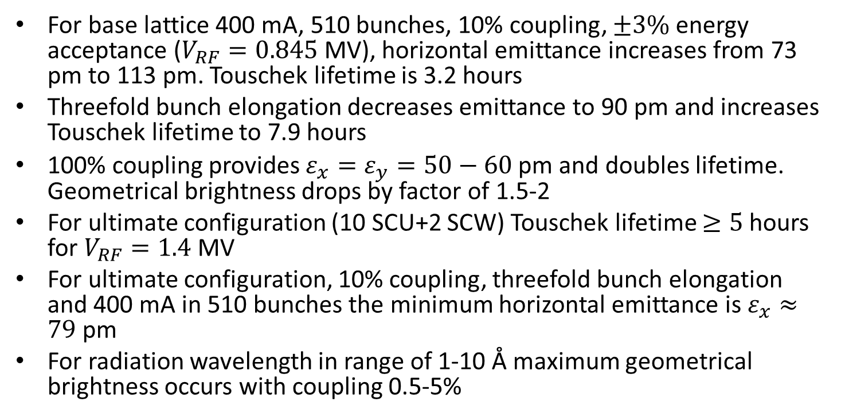
Emittance and lifetime with IBS
For base lattice 400 mA, 510 bunches, 10% coupling, $±3\%$ energy acceptance ($V_{RF}=0.845$ MV), horizontal emittance increases from 73 pm to 113 pm. Touschek lifetime is 3.2 hours
Threefold bunch elongation decreases emittance to 90 pm and increases Touschek lifetime to 7.9 hours
100% coupling provides $ε_{x}=ε_{y}=50−60$ pm and doubles lifetime. Geometrical brightness drops by factor of 1.5-2
For ultimate configuration (10 SCU+2 SCW) Touschek lifetime $≥5$ hours for $V_{RF}=1.4$ MV
For ultimate configuration, 10% coupling, threefold bunch elongation and 400 mA in 510 bunches the minimum horizontal emittance is $ε_{x}≈79$ pm
For radiation wavelength in range of 1-10 Å maximum geometrical brightness occurs with coupling 0.5-5%

Slide 22
Alignment errors correction
Closed orbit distortions in strong sextupoles reduce dynamic aperture.
Studying and correction algorithm:
Errors distributions in all elements
Orbit correction at 224 BPM, by 256+64 correctors
Optics and coupling correction by 256 gradient correctors in sextupoles
 | σ_{x,} μm | σ_{y,} μm | σ_{s,} μm | σ_{ψ,} μrad
Girders | 80 | 80 | 150 | 200
Elements on girders | 30 | 30 | 150 | 200

Slide 23
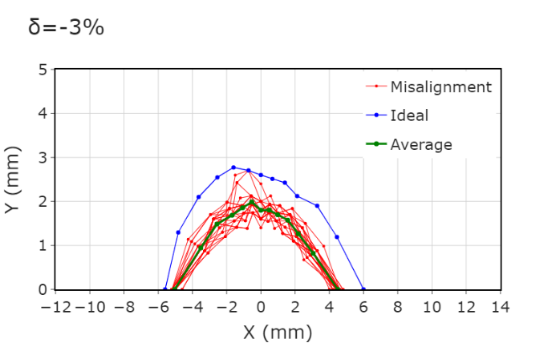
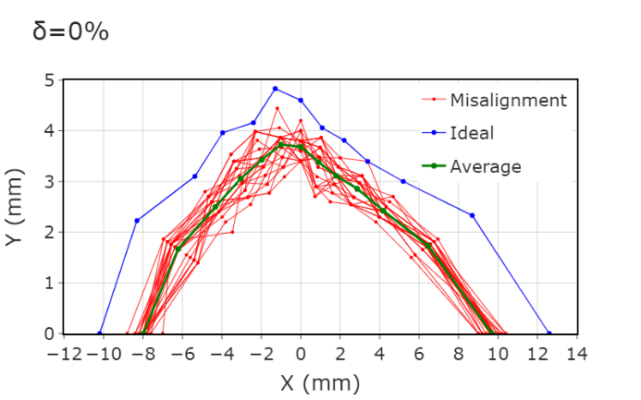
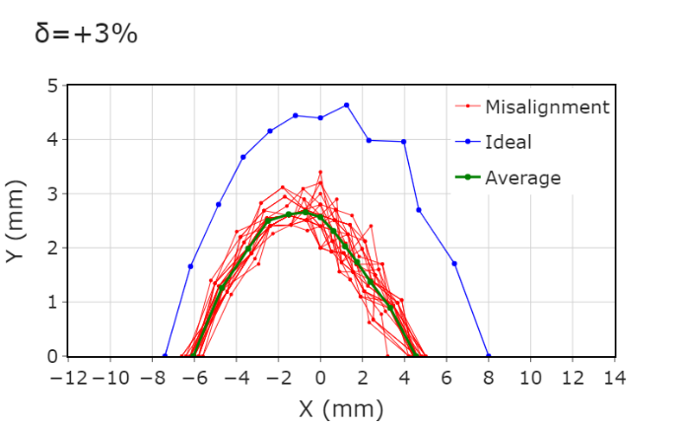
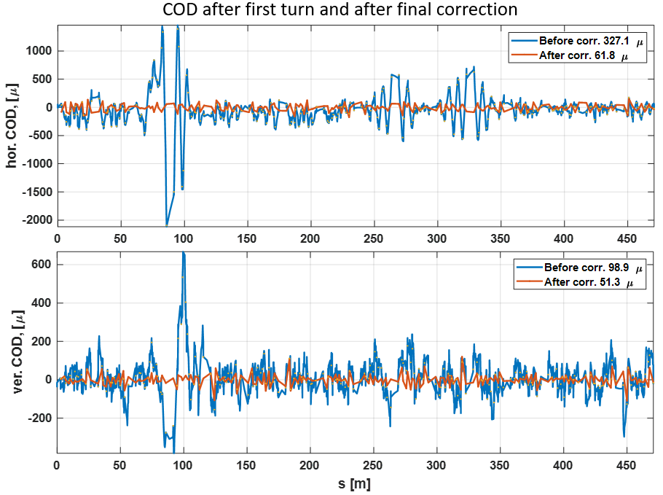
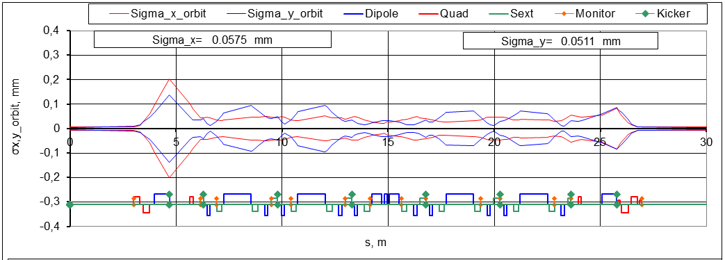
Alignment errors correction

Slide 24
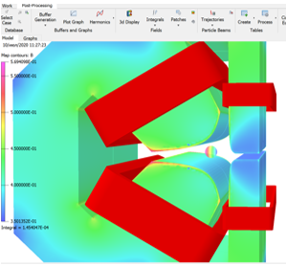






Magnets
Dipoles
Quadrupoles
Sextupoles

Slide 25







RF system
HM spectrum
Threshold for $I_{beam}=0.4$ A
Single cavity fundamental data
$f_{0}$, MHz | 357
$R/Q$, Ohm | 150
$Q_{0}$ | 17000
$\frac{R}{Q}Q_{0}$, MOhm | 2.55
$V_{acc 1}$, kV | 400
$P_{Cu}$, kW | 31.4
$$P_{S max}, \text{W}\text{/}\text{c}{\text{m}}^{\text{2}}$$ | 15.7
Main ring single cavity 357 MHz/160 kW CW SSPA
Booster cavity SSPA: ¼ of the main ring SSPA

Slide 26

Vacuum system
Vacuum lifetime >10 hours ($P\left(CO\right)≤2.5nTorr$)
Absorbs 200 kW of SR
Low impedance design
Pipe material: aluminum alloy 6063
Connections like in SuperKEKB, compensators like in PEPII type, BPMs like in MAX4/SIRIUS/Diamond
Cryo-pump or distributed NEG coating in the narrow aperture straight sections
Lumped compact combined pumps in the arcs. Expected conditioning time 3-6 months. Advantages over the NEG coating are unbaked system, less sensitive to micro-leaks, low wall impedance

Slide 27




Vacuum system design
Requirements
Status:
All profiles are defined. BINP is ready to order.
Beam pipes are defined by BPMs and e-ph beams branching points positioning.
Universal port and flange connections are designed.
Design of smooth flange connection for prototyping is completed.
Bellow units is based on the PEP-II design.
Parameters of crotch-absorbers are defined. Design follows the ESRF absorbers.
Beam pipe gate valves (32 pieces) with RF contacts will be designed by BINP.
Inner diameter of beam pipe, d [mm] | 27
Average distance between pumps, L [m] | 1
Total number of lumped pumps per arc | 24
Pumping speed of one pump for CO [l/s] | 120
Average photon flux [ph/s/m] at I=0.4A, E=3 GeV | $$2×{10}^{18}$$
Initial/final desorp.coeff. [mol./ph] for CO | $1×{10}^{−2}$ $$0.8×{10}^{−6}$$
Average photon dose for conditioning [ph/m] | $$1.4×{10}^{25}$$ $$(777 Ач)$$
Lifetime at I=0.4 A during conditioning [h] | 3
Calculated conditioning duration [s] (worst case) | 3 months

Slide 28

Conclusion
25.08.2021 SKIF construction opening ceremony

