Slide 1

Beam dynamics challenge in Novosibirsk Super C-Tau Factory
A. Bogomyagkov
RuPAC-2021

Slide 2
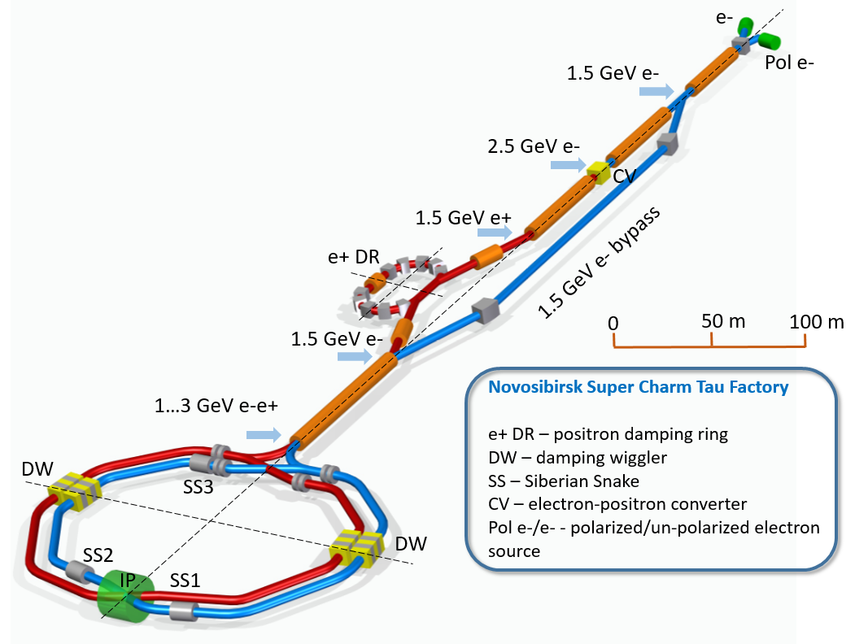
Facility overview
1.5 – 3.5 GeV e-e+

Slide 3
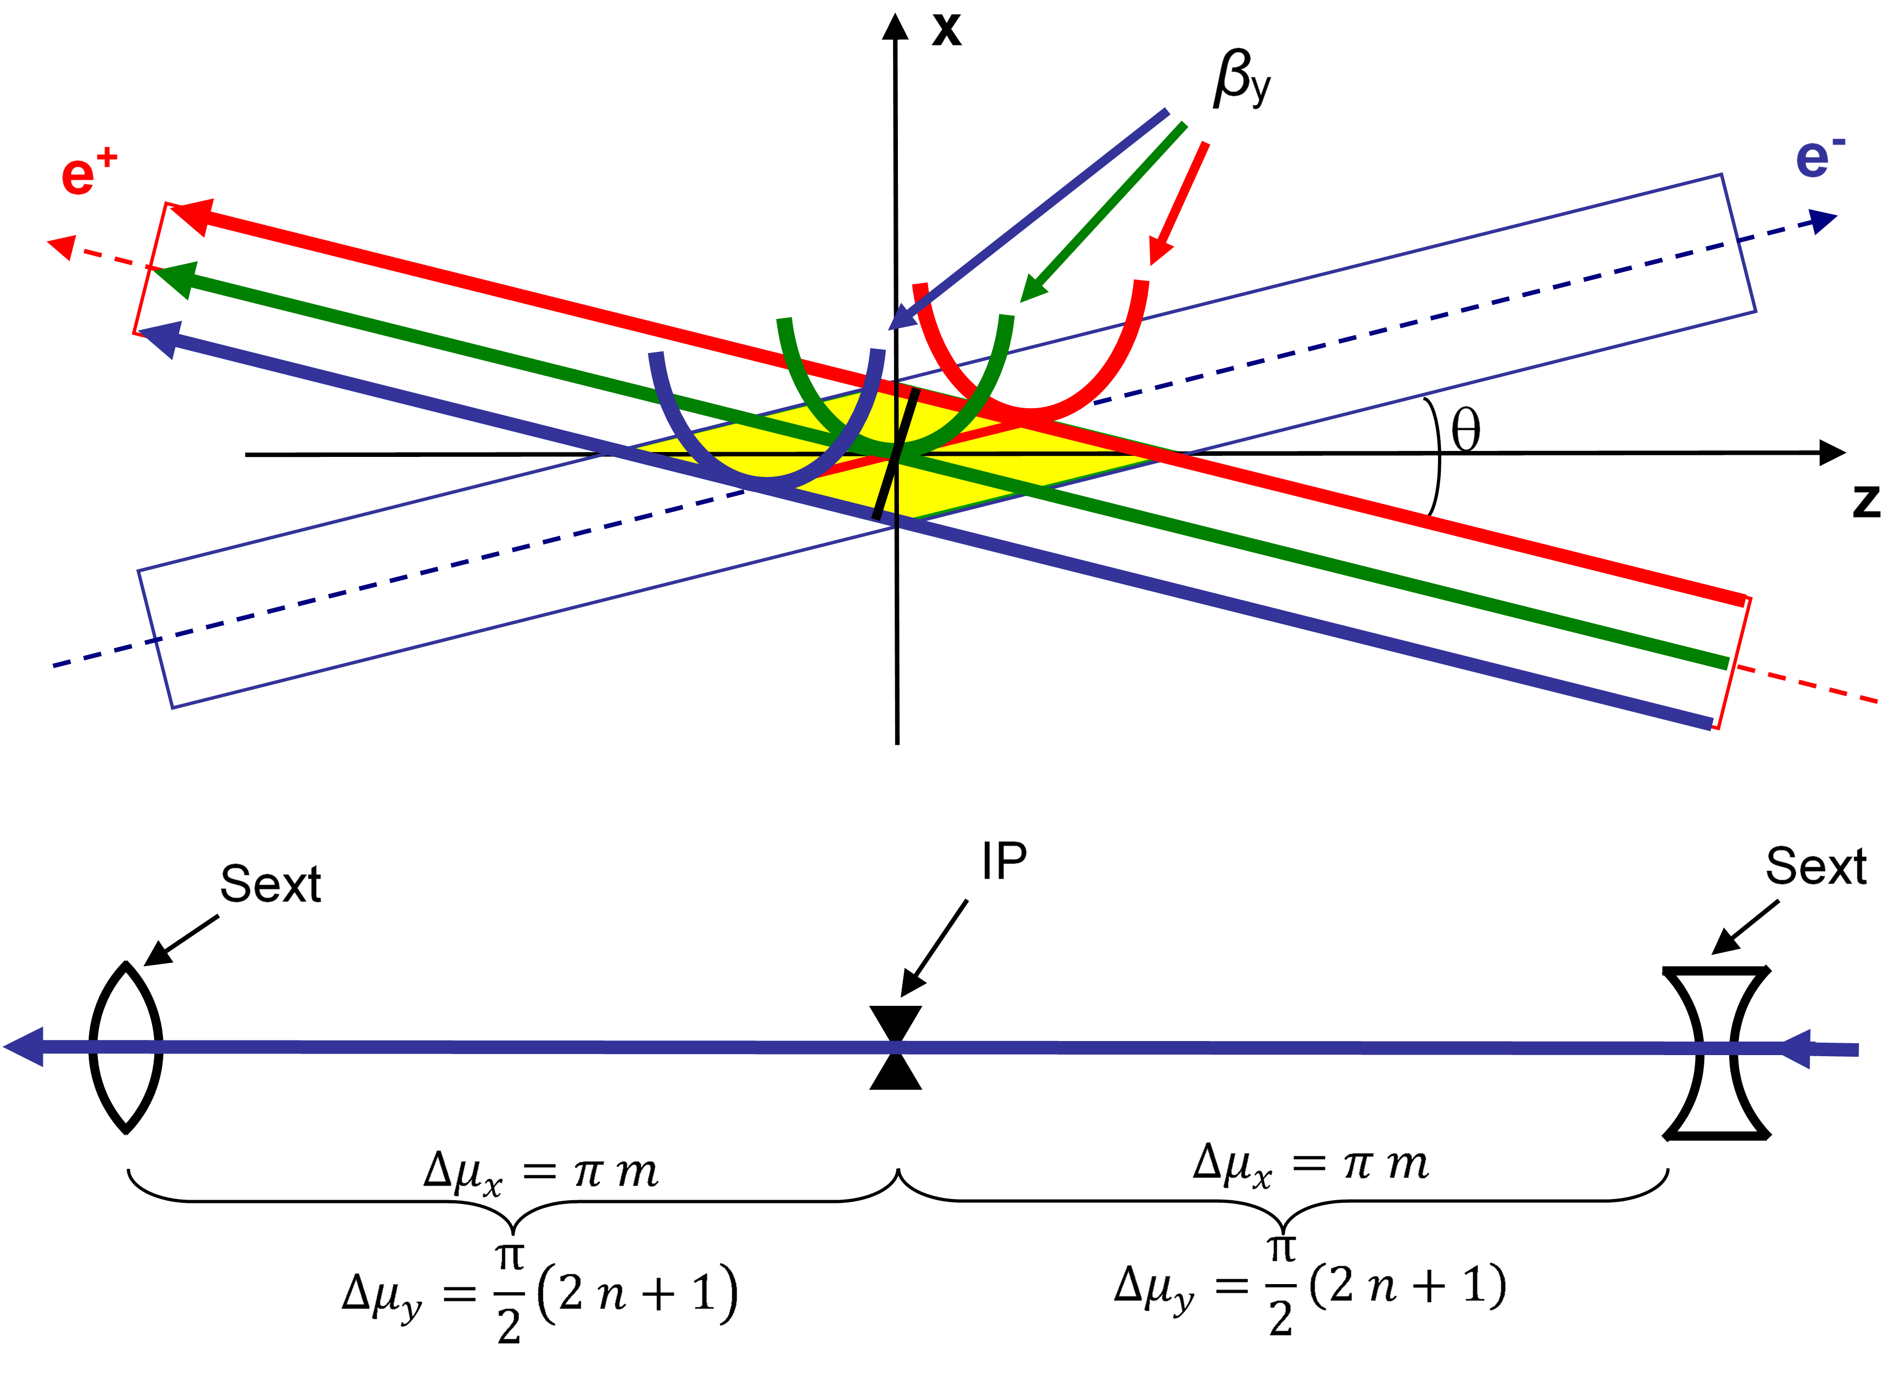
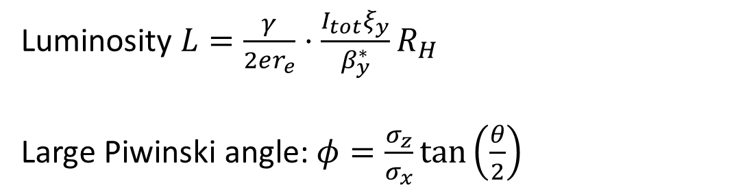
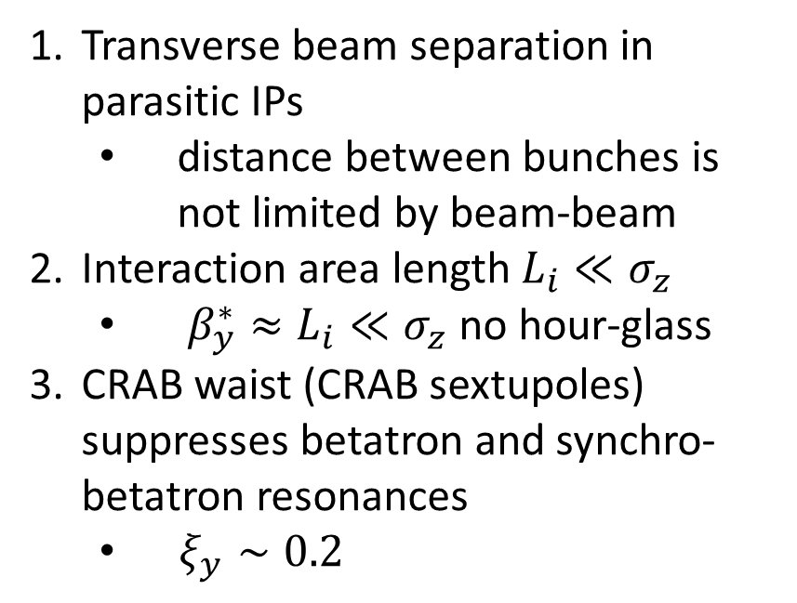
Crab waist (P.Raimondi 2006)
Luminosity $L=\frac{γ}{2er_{e}}⋅\frac{I_{tot}ξ_{y}}{β_{y}^{∗}}R_{H}$
Large Piwinski angle: $φ=\frac{σ_{z}}{σ_{x}}\tan\left(\frac{θ}{2}\right)$
Transverse beam separation in parasitic IPs
  distance between bunches is not limited by beam-beam
Interaction area length $L_{i}≪σ_{z}$
  $β_{y}^{∗}≈L_{i}≪σ_{z}$ no hour-glass
CRAB waist (CRAB sextupoles) suppresses betatron and synchro-betatron resonances
  $ξ_{y}∼0.2$
x
+
-
e
L_{i}
e
θ
φ ∙σ_{x}
z
2σ_{z}
2σ_{x}
Notes:
mux=3pi*2, muy=2.5pi*2

Slide 4
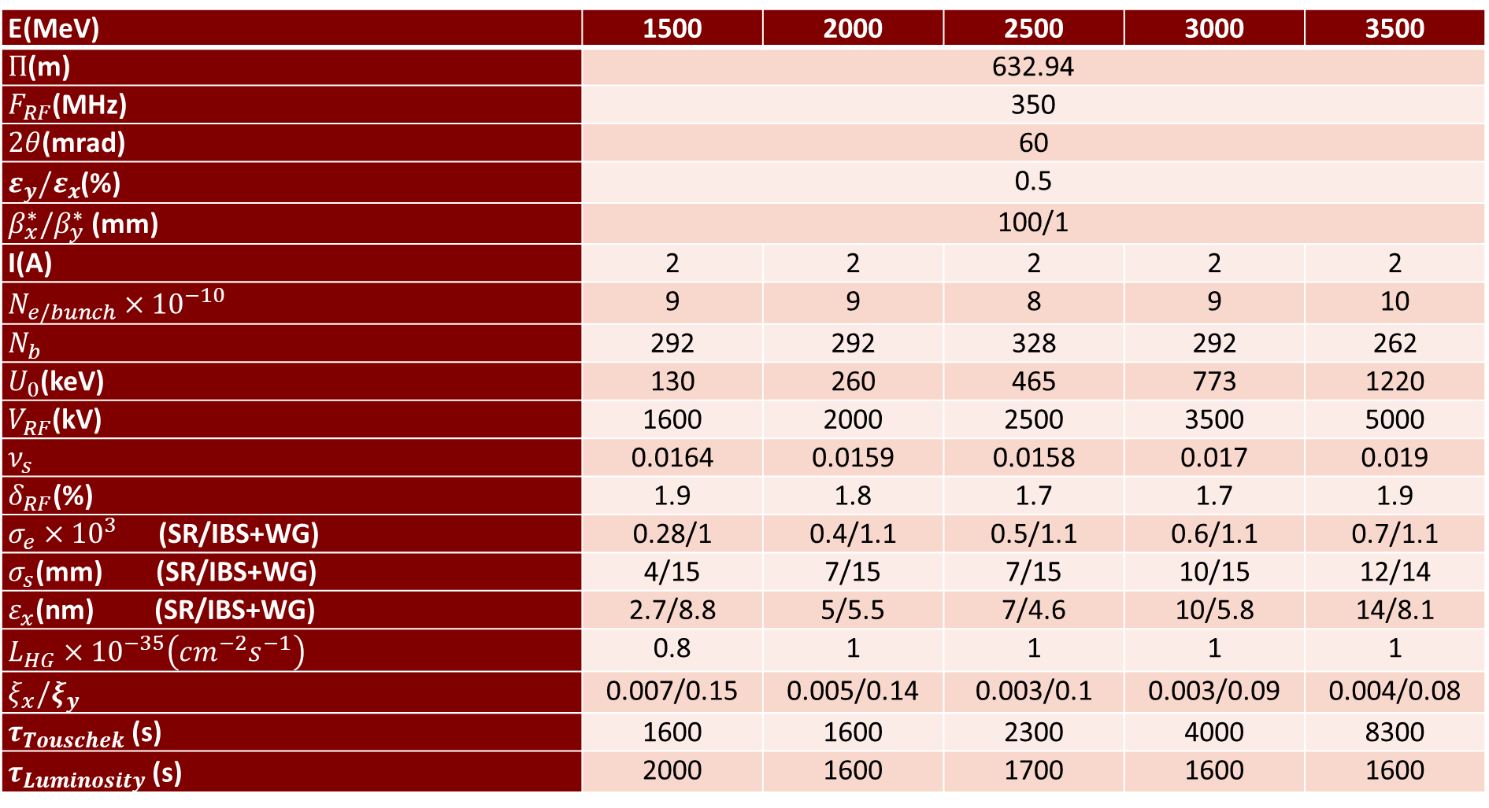


Design parameters
E(MeV) | 1500 | 2000 | 2500 | 3000 | 3500
$Π$(m) | 632.94
$F_{RF}$(MHz) | 350
$2θ$(mrad) | 60
$ε_{y}/ε_{x}$(%) | 0.5
$β_{x}^{∗}/β_{y}^{∗}$ (mm) | 100/1
I(A) | 2 | 2 | 2 | 2 | 2
$N_{e/bunch}×{10}^{−10}$ | 9 | 9 | 8 | 9 | 10
$N_{b}$ | 292 | 292 | 328 | 292 | 262
$U_{0}$(keV) | 130 | 260 | 465 | 773 | 1220
$V_{RF}$(kV) | 1600 | 2000 | 2500 | 3500 | 5000
$ν_{s}$ | 0.0164 | 0.0159 | 0.0158 | 0.017 | 0.019
$δ_{RF}$(%) | 1.9 | 1.8 | 1.7 | 1.7 | 1.9
$σ_{e}×{10}^{3}$ (SR/IBS+WG) | 0.28/1 | 0.4/1.1 | 0.5/1.1 | 0.6/1.1 | 0.7/1.1
$σ_{s}$(mm) (SR/IBS+WG) | 4/15 | 7/15 | 7/15 | 10/15 | 12/14
$ε_{x}$(nm) (SR/IBS+WG) | 2.7/8.8 | 5/5.5 | 7/4.6 | 10/5.8 | 14/8.1
$L_{HG}×{10}^{−35}\left(cm^{−2}s^{−1}\right)$ | 0.8 | 1 | 1 | 1 | 1
$ξ_{x}/ξ_{y}$ | 0.007/0.15 | 0.005/0.14 | 0.003/0.1 | 0.003/0.09 | 0.004/0.08
$τ_{Touschek}$ (s) | 1600 | 1600 | 2300 | 4000 | 8300
$τ_{Luminosity}$ (s) | 2000 | 1600 | 1700 | 1600 | 1600
SuperKEKB 03.12.2019 $β_{y}^{∗}=1 mm$
PEPII: I(e+)=3.2 A PEPII
DAFNE : I(e-)=2.45A
SuperKEKB: $L=3.1×{10}^{34}$
Notes:
54_1, q=740, I(e+)=3.2 A PEPII, I(e-)=2.45A DAFNE, L=2.1e34 KEKB

Slide 5
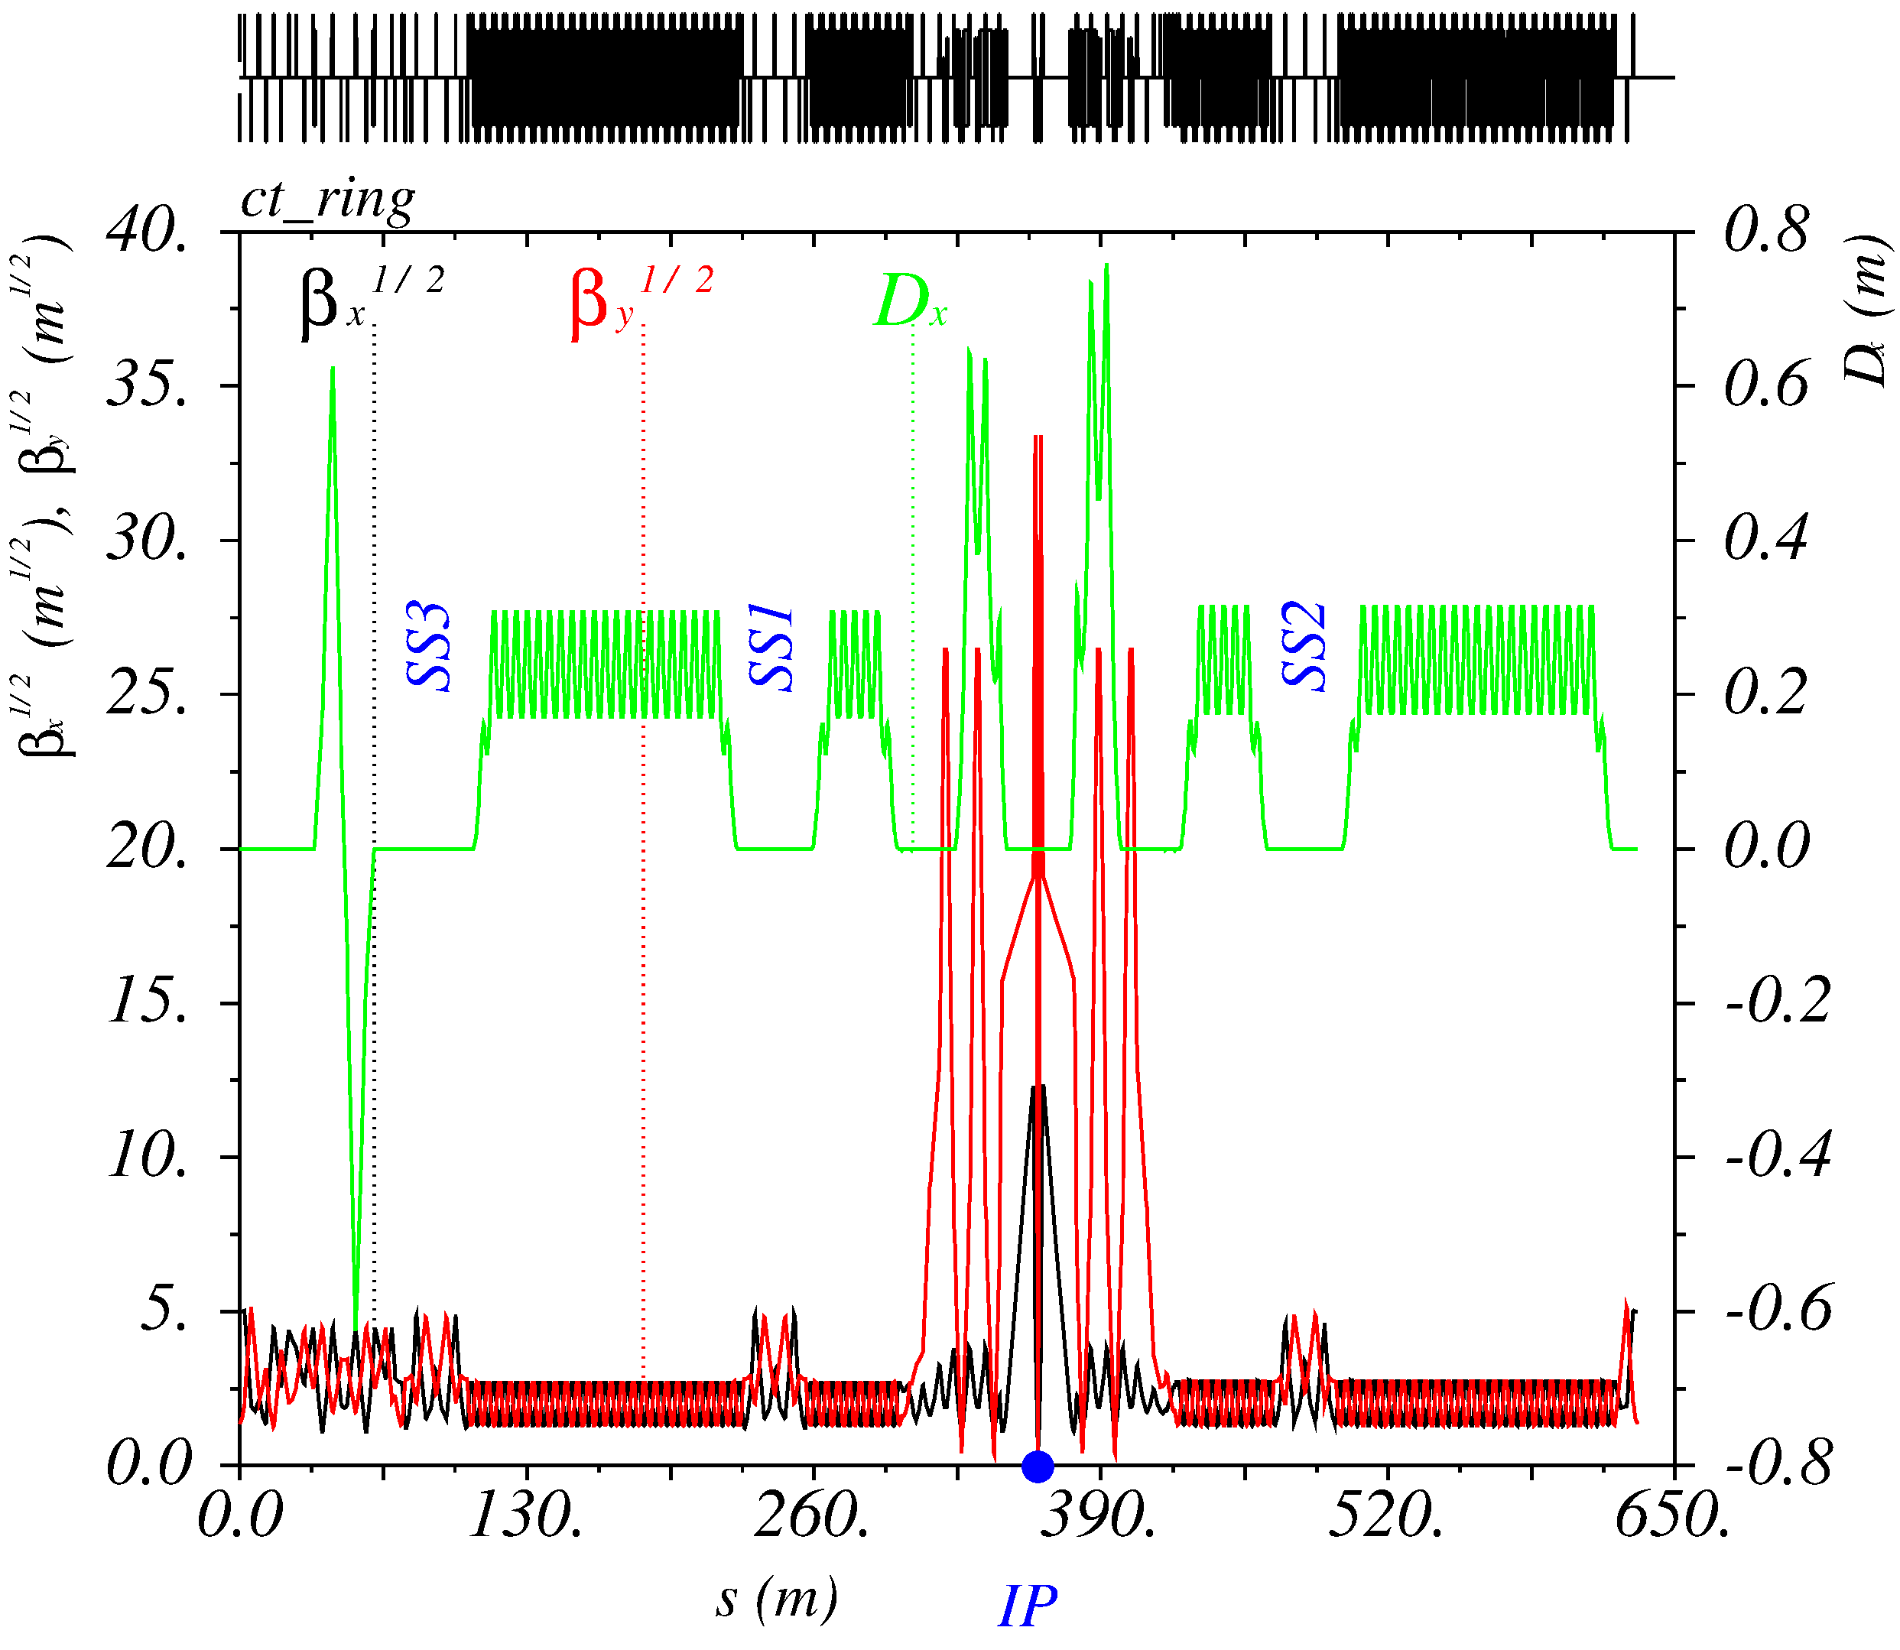
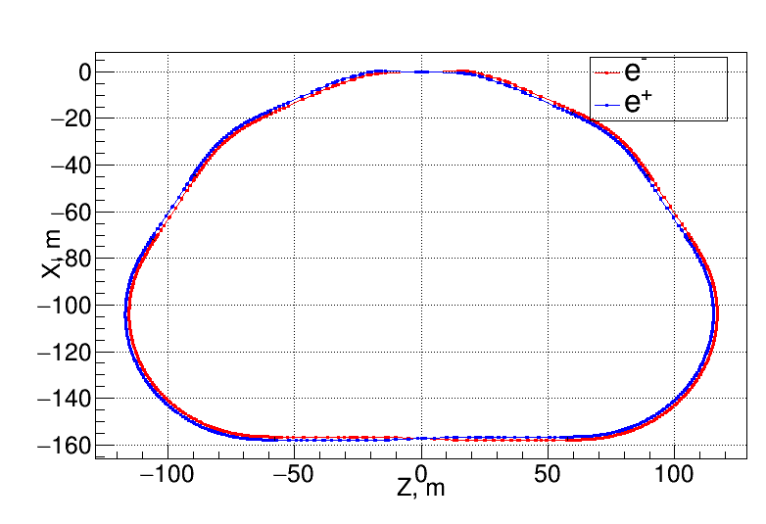
Lattice and layout 2021
IP
Interaction Region
SS
SS
SS
Inj
Xing
Notes:
54_1

Slide 6
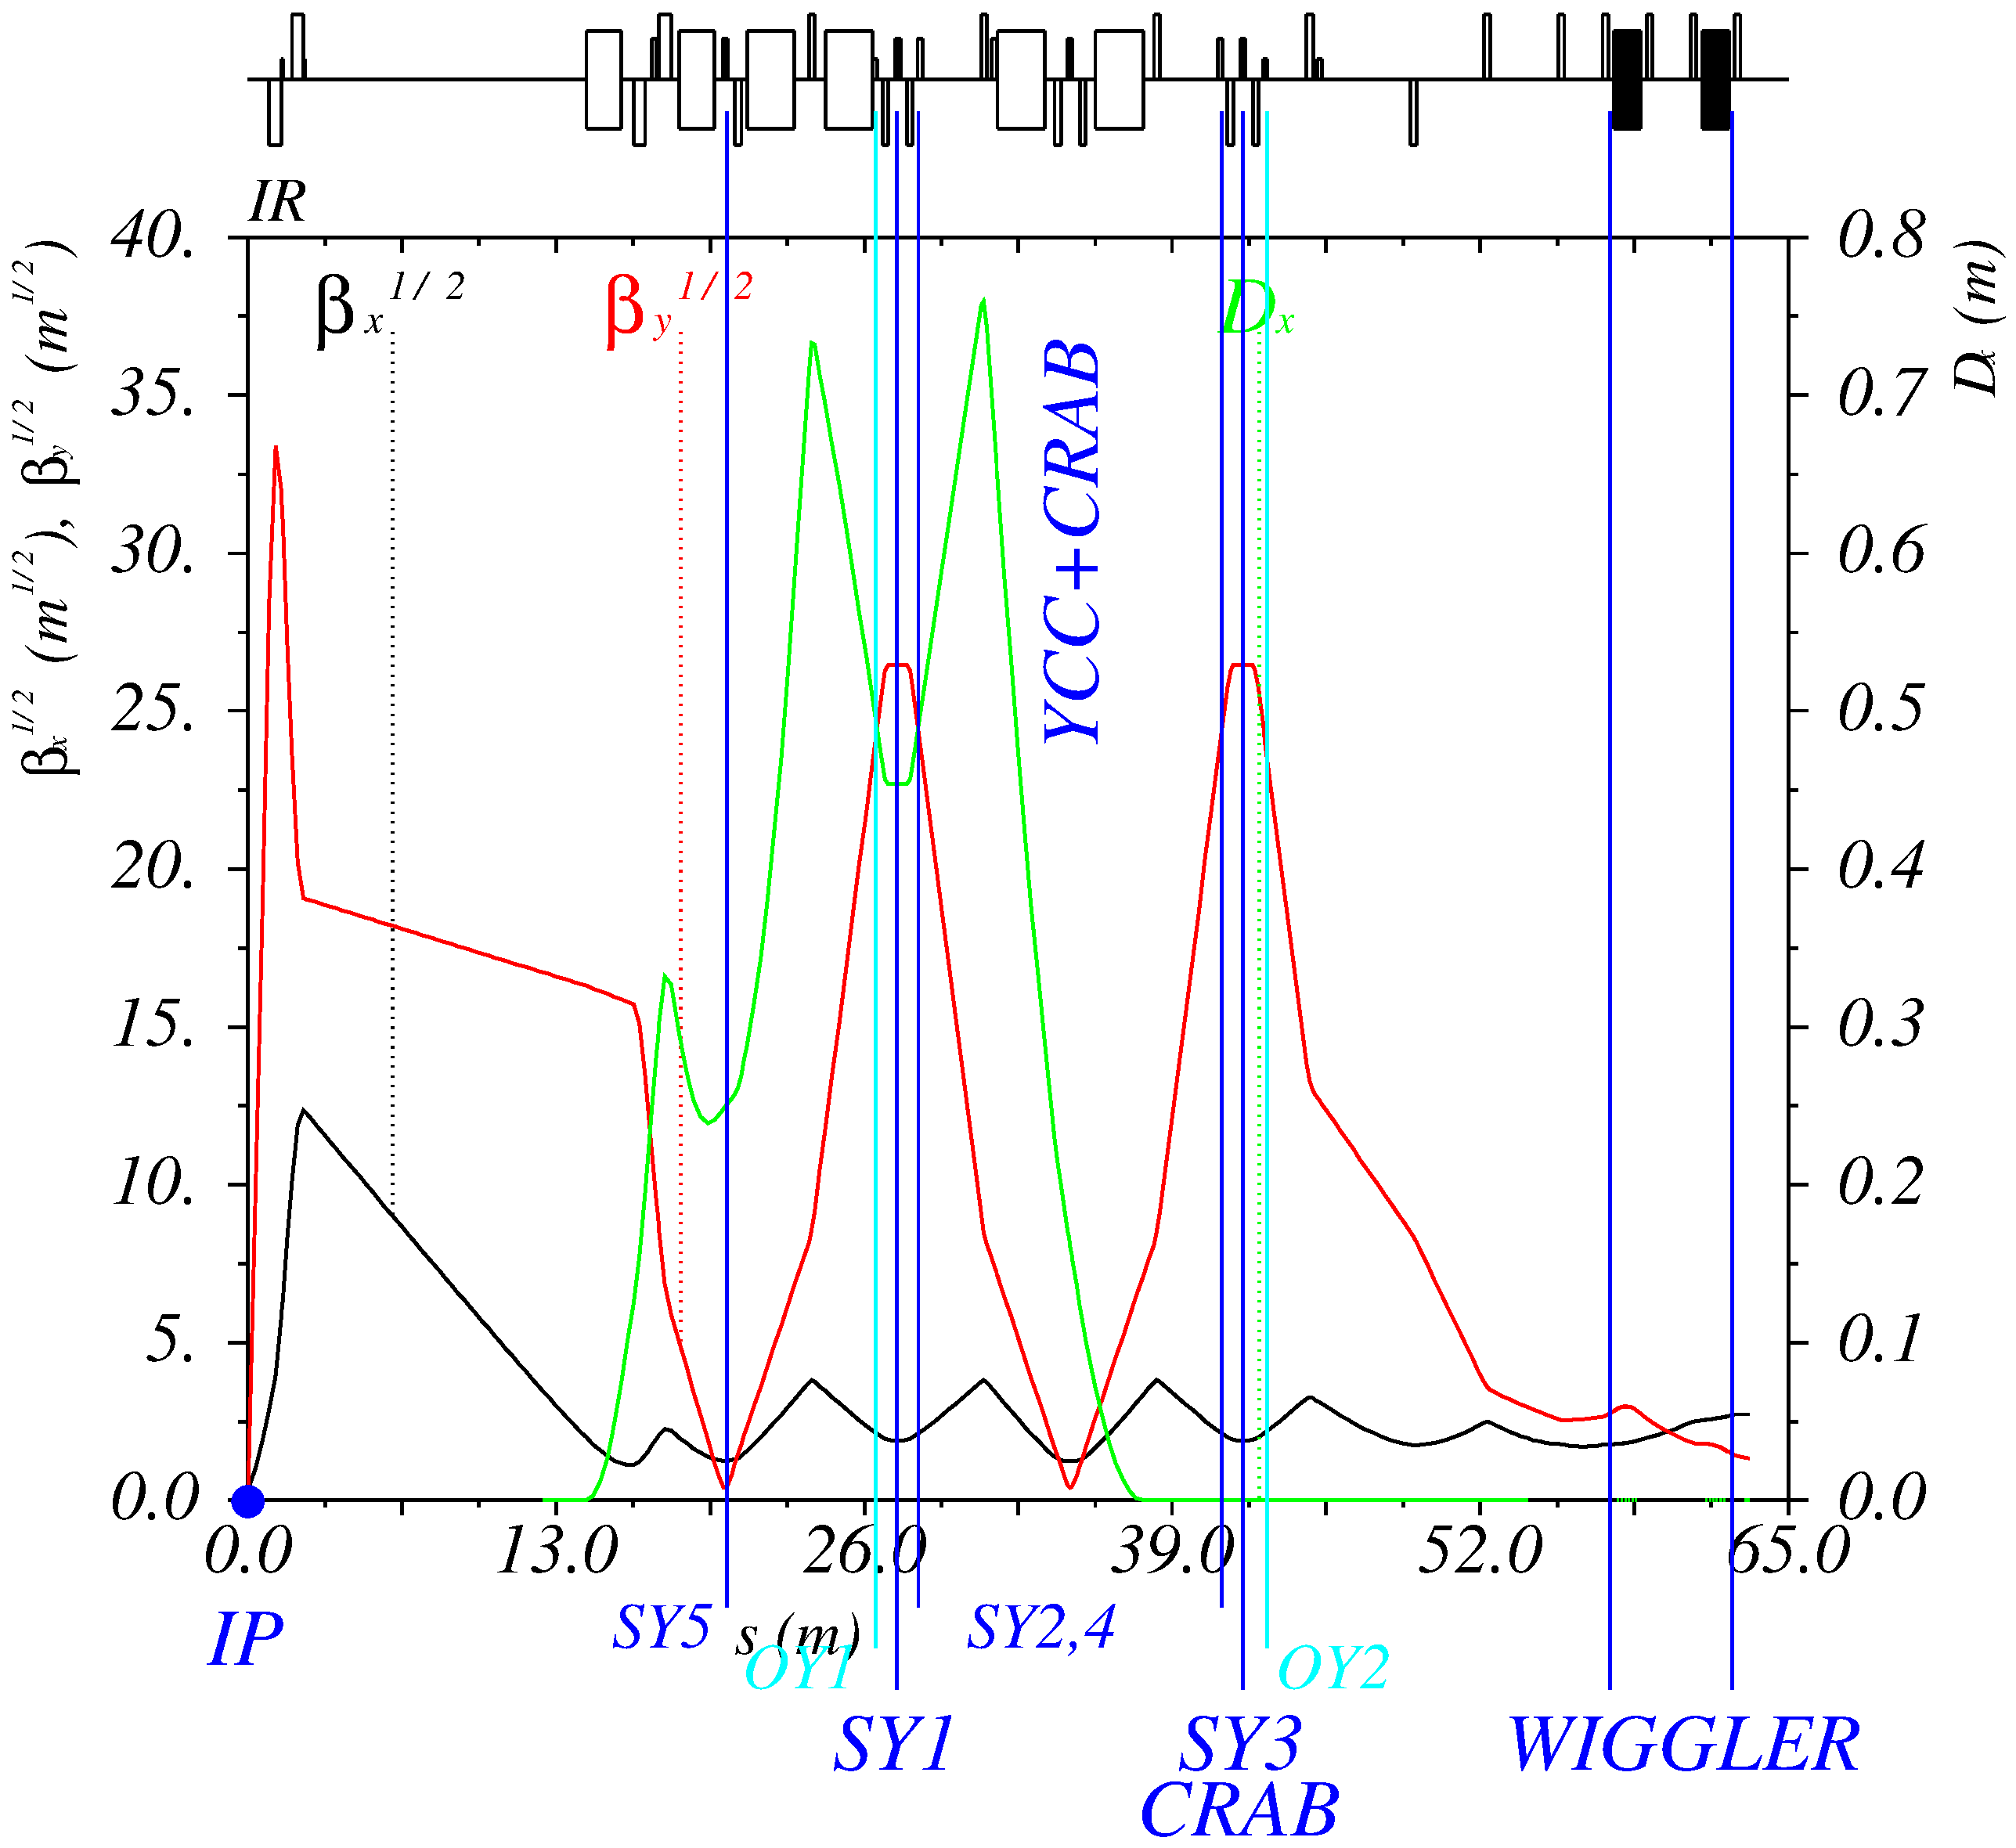
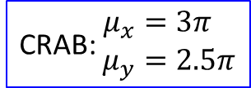
Interaction region
CRAB: $\begin{aligned}μ_{x}&=3π \\ μ_{y}&=2.5π\end{aligned}$
Notes:
mux=3pi*2, muy=2.5pi*2

Slide 7
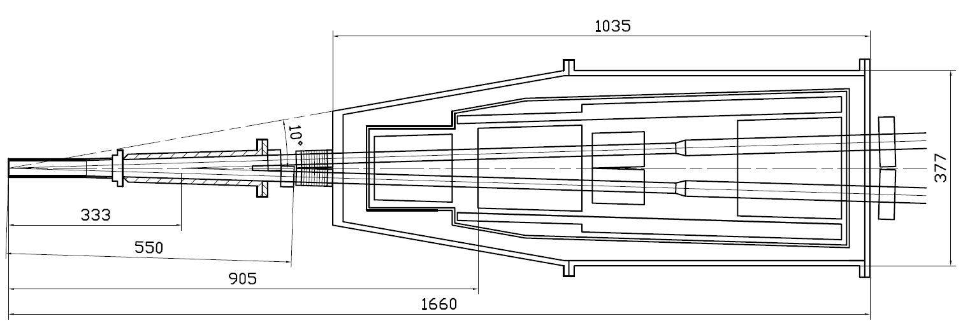
Machine-detector interface
Compensating solenoid
Gradients for 3 GeV
Be-tube ±150 mm,
∅30 mm, cooled
QD0, 200 mm
–100 Т/m
QF1, 200 mm
70 Т/m
Corr. coils
Screening solenoid
BPMs
Y-chamber,
cooled
BPMs
e+
IP
∅ 417
e-
L* =
FF vacuum chamber
Cryostate with FF magnets

Slide 8
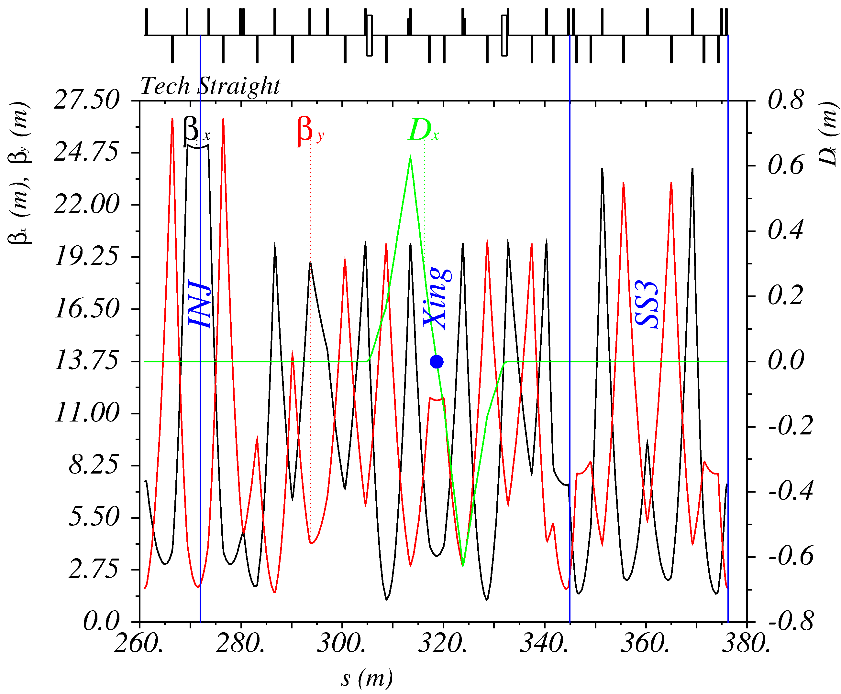
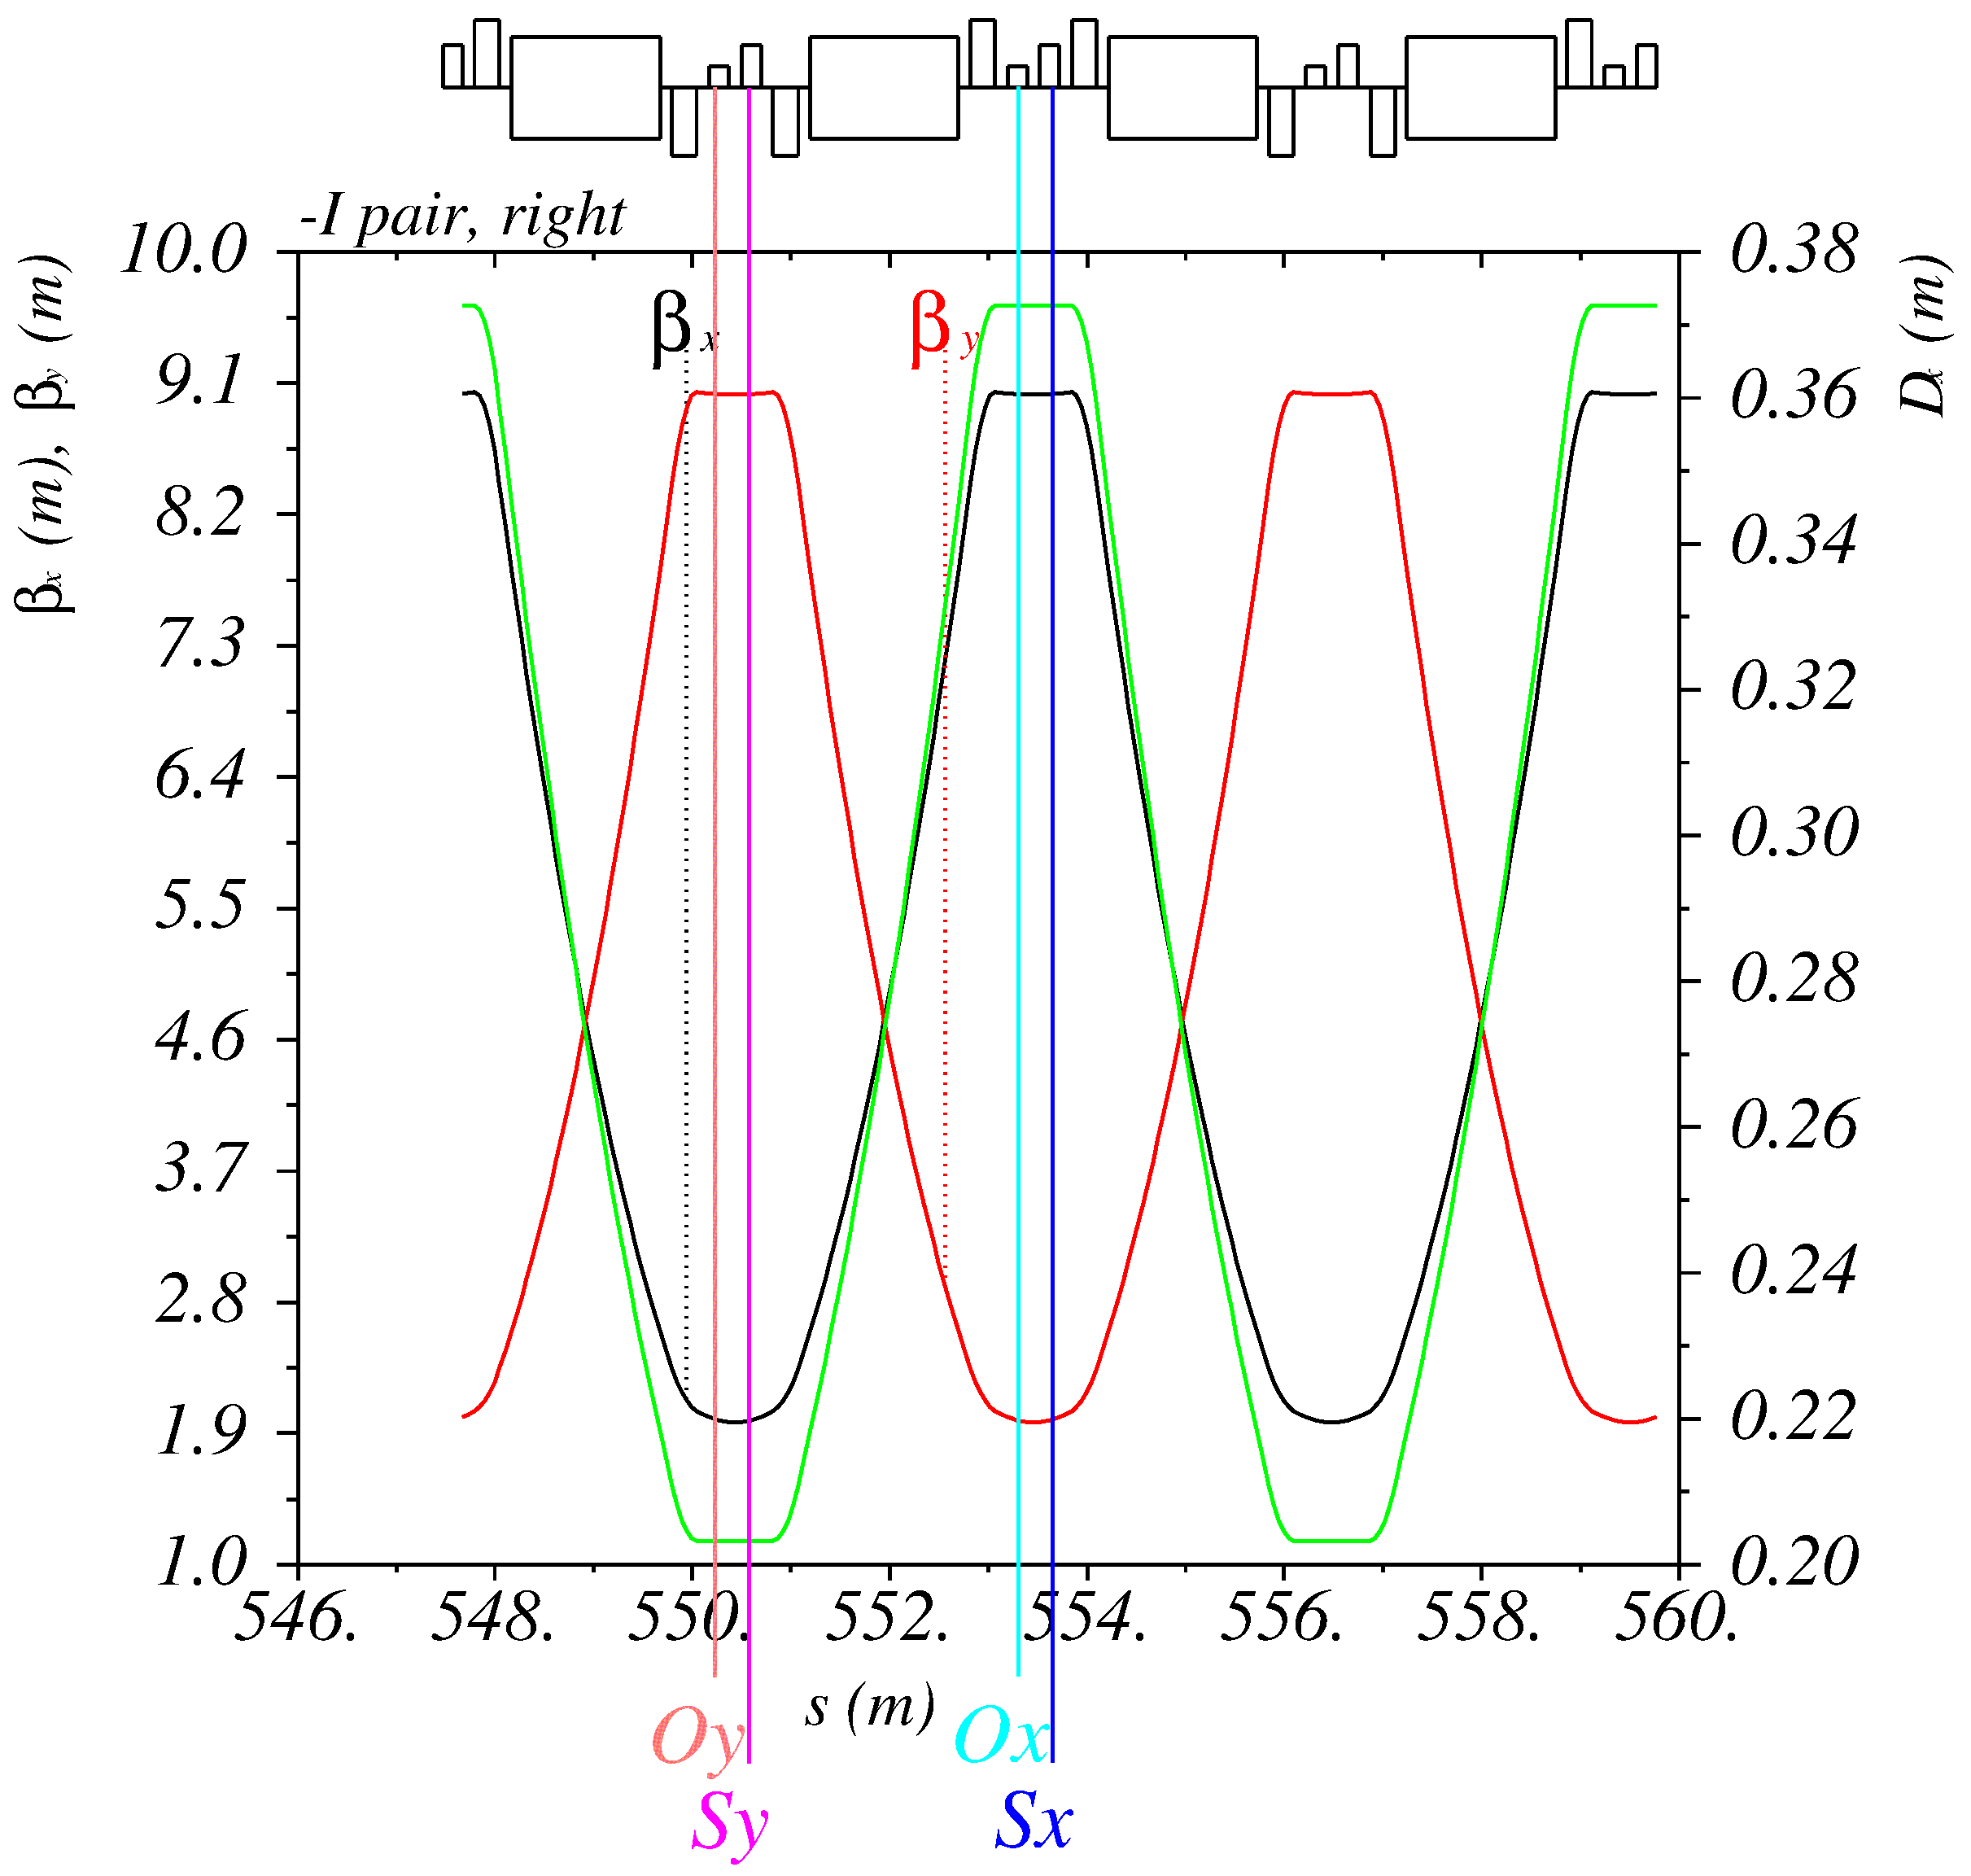
Straight and Arc sections
Straight
Arc: FODO 90° cells

Slide 9
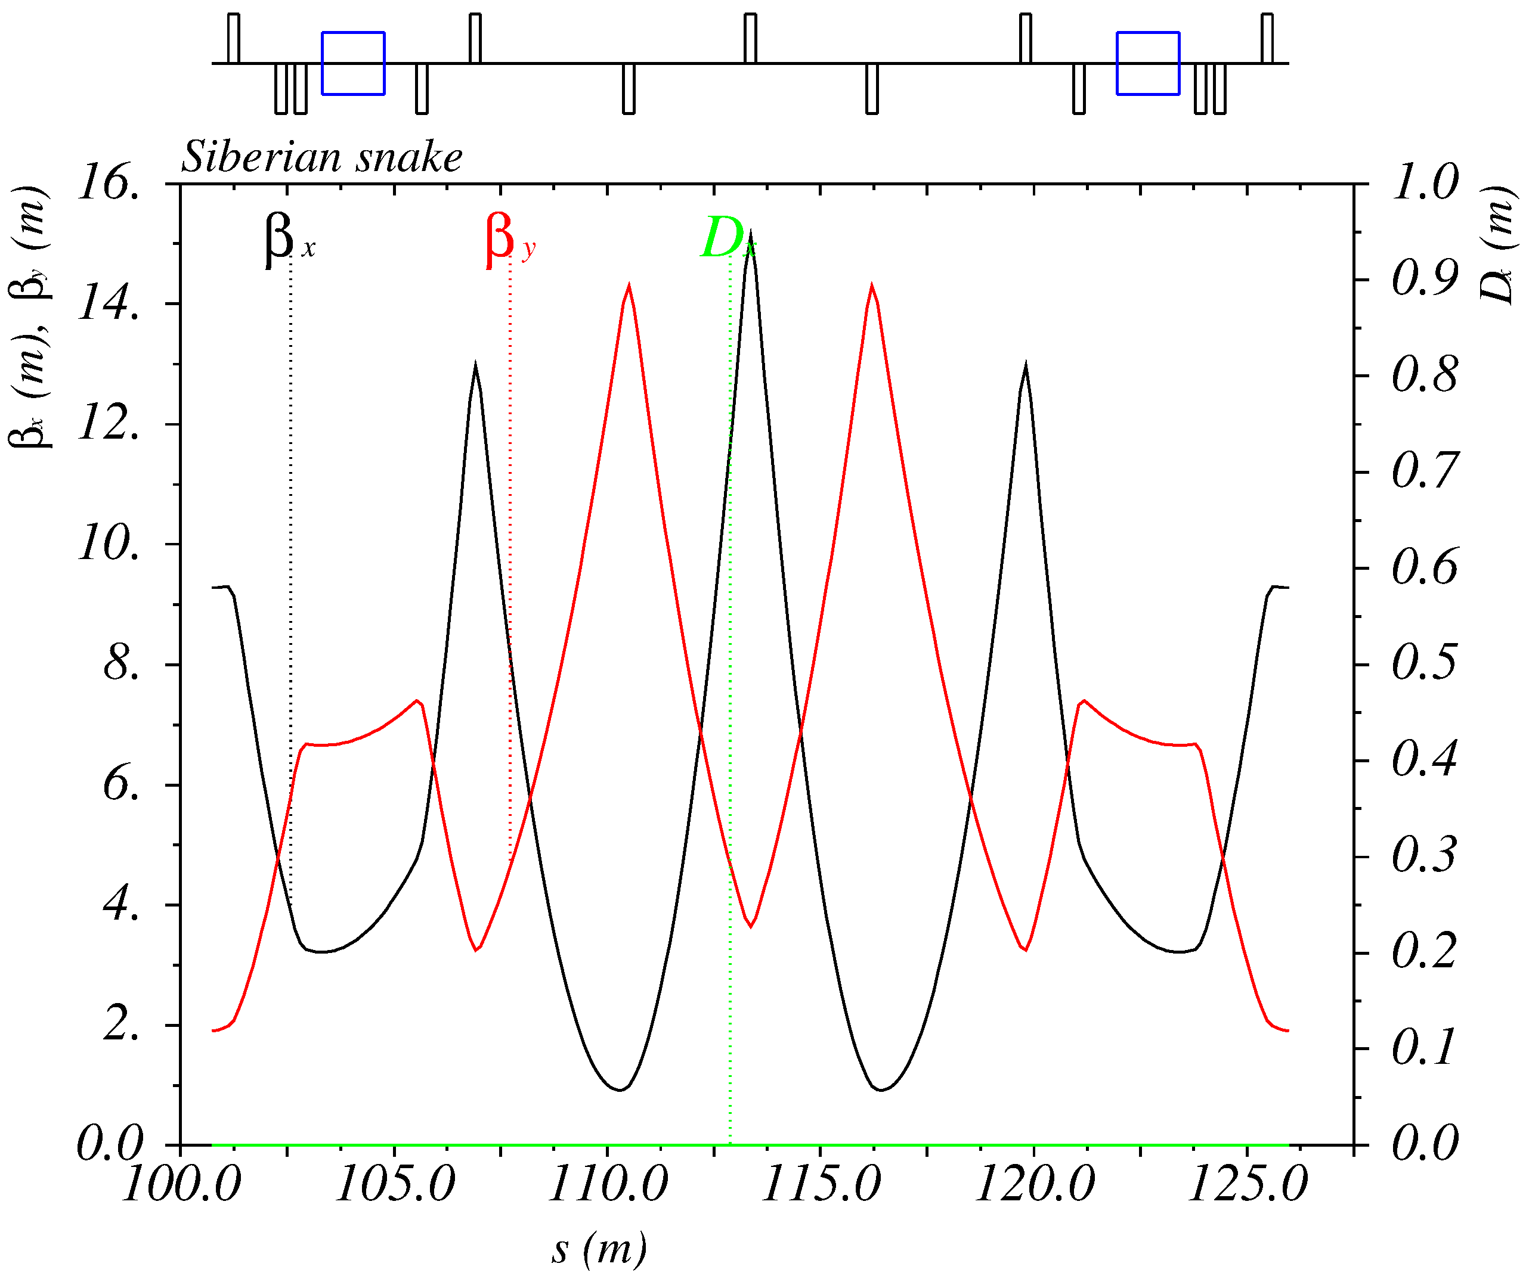
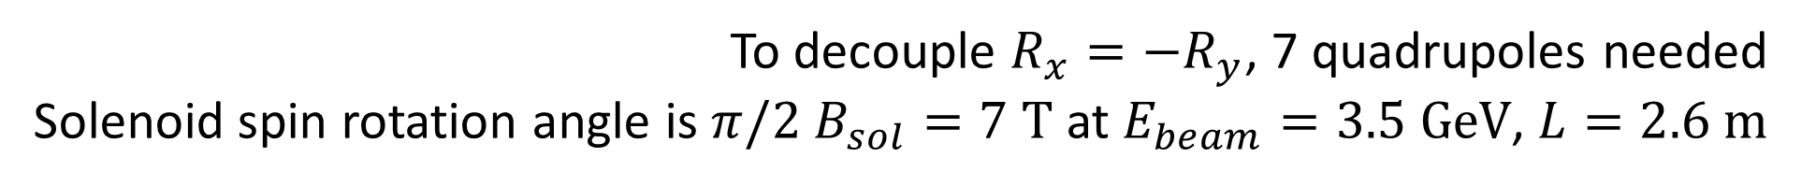
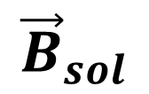
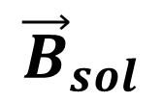
Siberian Snake
The goal is to provide longitudinal polarization at IP
$${\vec{B}}_{sol}$$
$${\vec{B}}_{sol}$$
120°
IP
SS2
SS1
120°
120°
SS3
To decouple $R_{x}=−R_{y}$, 7 quadrupoles needed
Solenoid spin rotation angle is $π/2$ $B_{sol}=7 \text{T}$ at $E_{beam}=3.5 \text{GeV}$, $L=2.6 \text{m}$

Slide 10
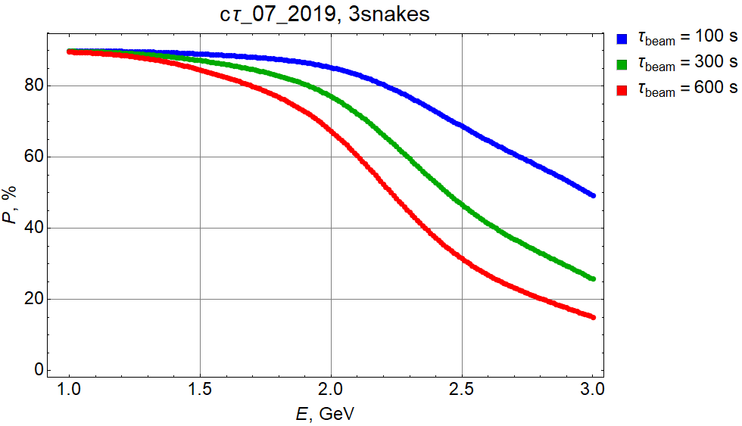
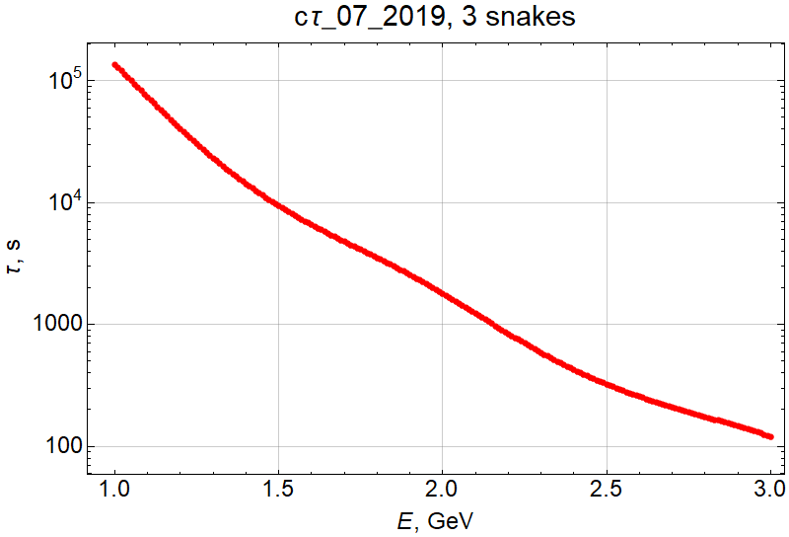
Longitudinal Polarization (number of snakes)
Particle replenishing time

Slide 11
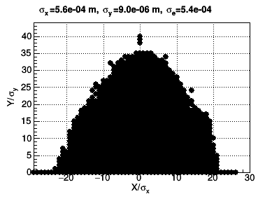
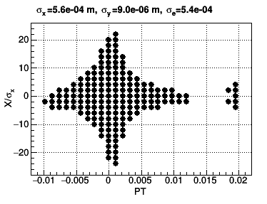
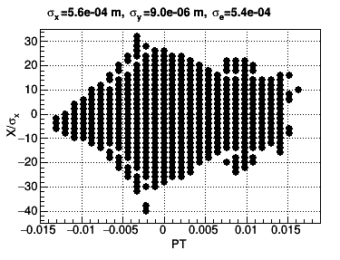
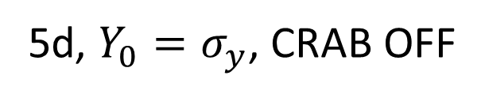
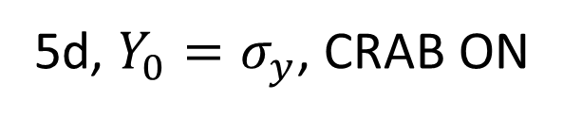
Nonlinear dynamics
4d, on momentum
5d, ${Y_{0}=σ}_{y}$, CRAB ON
5d, ${Y_{0}=σ}_{y}$, CRAB OFF
Notes:
2020.10.11-22.59.05_sextupole_chrom-5.str

Slide 12
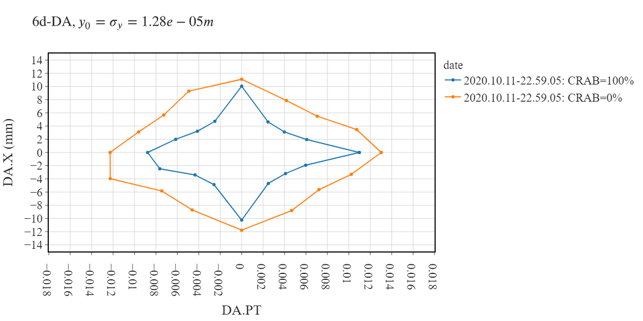
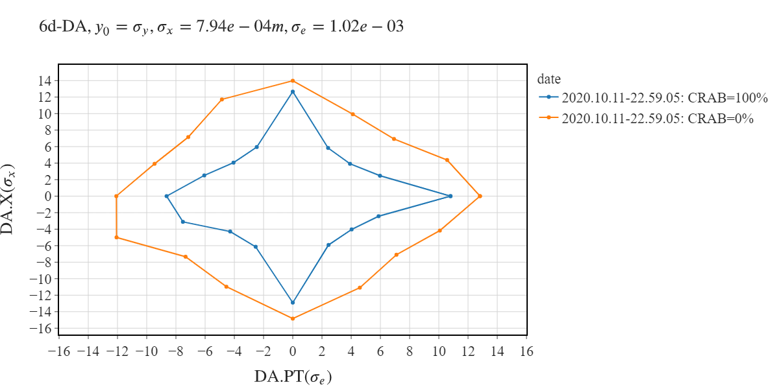
CRAB sextupole influence: 6d-DA

Slide 13
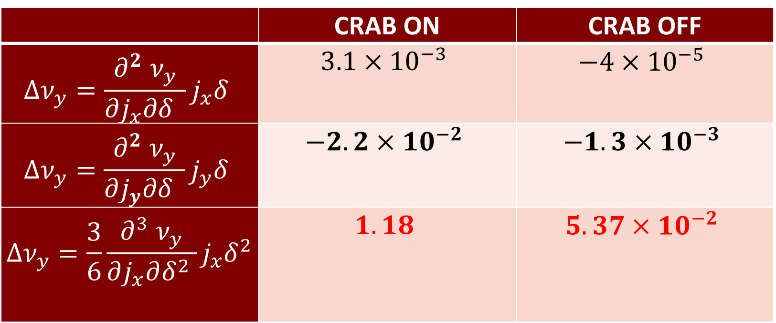

CRAB sextupole influence
 | CRAB ON | CRAB OFF
$$Δν_{y}=\frac{∂^{2} ν_{y}}{∂j_{x}∂δ }j_{x}δ$$ | $$3.1×{10}^{−3}$$ | $$−4×{10}^{−5}$$
$$Δν_{y}=\frac{∂^{2} ν_{y}}{∂j_{y}∂δ }j_{y}δ$$ | $$−2.2×{10}^{−2}$$ | $$−1.3×{10}^{−3}$$
$$Δν_{y}=\frac{3}{6}\frac{∂^{3} ν_{y}}{∂j_{x}∂δ^{2} }j_{x}δ^{2}$$ | $$1.18$$ | $$5.37×{10}^{−2}$$
$$x_{0}=10σ_{x}, y_{0}=15σ_{y}, δ=1.5\%$$
Notes:
49_5, call,file="../2020.10.11-22.59.05_sextupole_chrom-5.str";

Slide 14
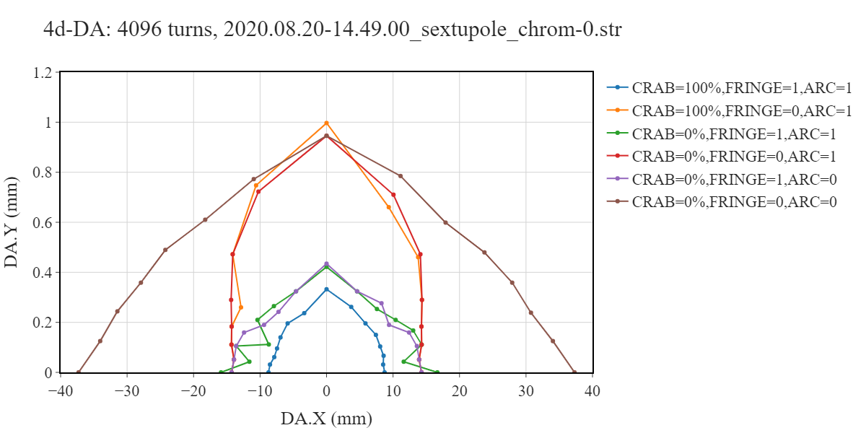
4d-DA study
CRAB sextupole interference with FF quadrupole edges and kinematic term limits dynamic aperture
4d DA is limited by CRAB sextupole and fringe fields interference
Notes:
49_6 (49_5), k2_lcrab = 24.2061222750197

Slide 15
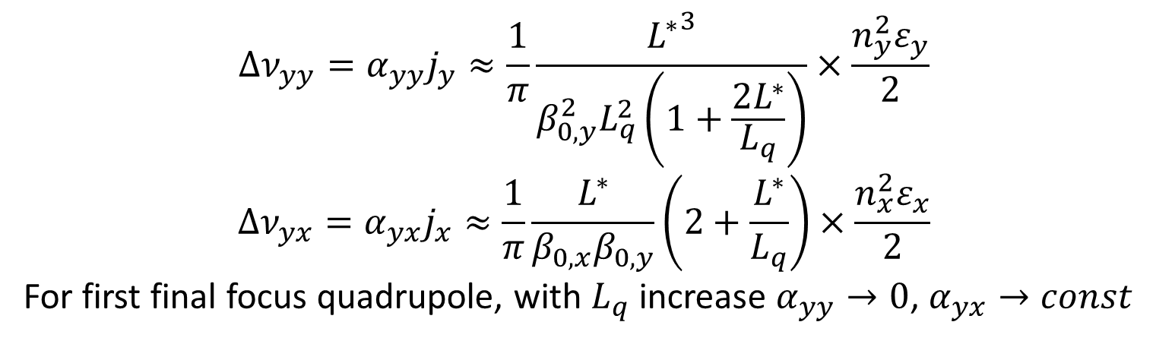
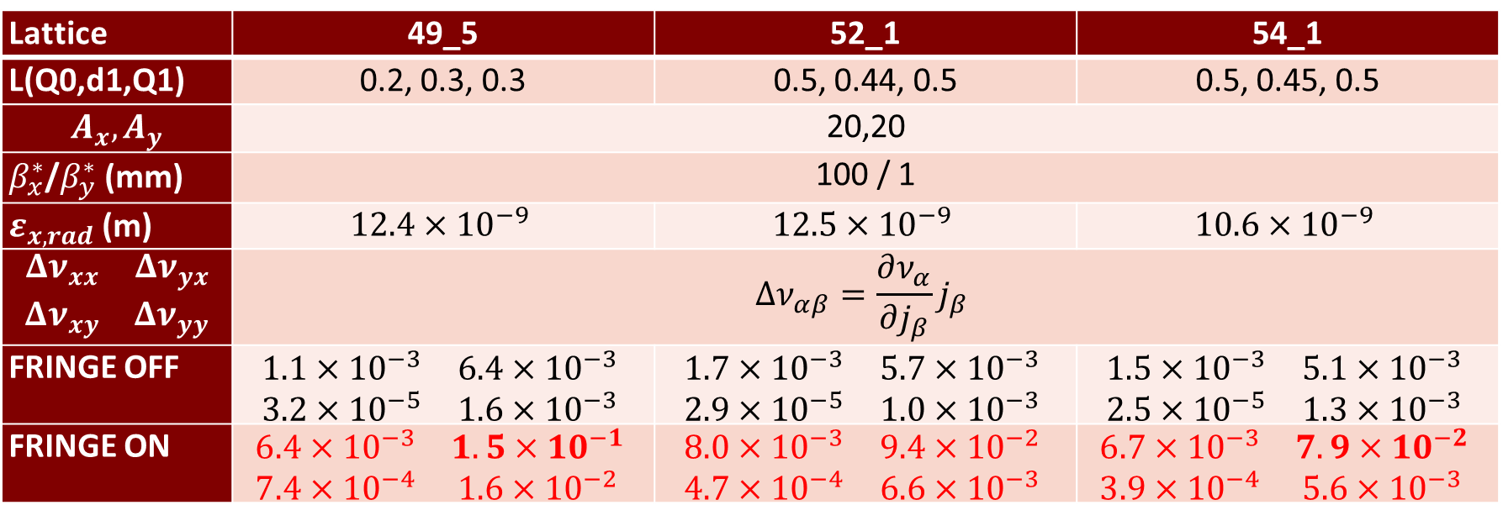
Optimization of the final doublet
$$Δν_{yy}=α_{yy}j_{y}≈\frac{1}{π}\frac{{L^{∗}}^{3}}{{β_{0,y}^{2}L}_{q}^{2}\left(1+\frac{2L^{∗}}{L_{q}}\right)}×\frac{n_{y}^{2}ε_{y}}{2}$$
$$Δν_{yx}=α_{yx}j_{x}≈\frac{1}{π}\frac{L^{∗}}{β_{0,x}β_{0,y}}\left(2+\frac{L^{∗}}{L_{q}}\right)×\frac{n_{x}^{2}ε_{x}}{2}$$
For first final focus quadrupole, with $L_{q}$ increase $α_{yy}→0$, $α_{yx}→const$
IP
L*
d1
Q0
Q1
Lattice | 49_5 | 52_1 | 54_1
L(Q0,d1,Q1) | 0.2, 0.3, 0.3 | 0.5, 0.44, 0.5 | 0.5, 0.45, 0.5
$$A_{x}, A_{y}$$ | 20,20
$β_{x}^{∗}$/$β_{y}^{∗}$(mm) | 100 / 1
$ε_{x, rad}$(m) | $$12.4×{10}^{−9}$$ | $$12.5×{10}^{−9}$$ | $$10.6×{10}^{−9}$$
$$\begin{matrix}Δν_{xx} & Δν_{yx} \\ Δν_{xy} & Δν_{yy}\end{matrix}$$ | $$Δν_{αβ}=\frac{∂ν_{α}}{∂j_{β}}j_{β}$$
FRINGE OFF | $$\begin{matrix}1.1×{10}^{−3} & 6.4×{10}^{−3} \\ 3.2×{10}^{−5} & 1.6×{10}^{−3}\end{matrix}$$ | $$\begin{matrix}1.7×{10}^{−3} & 5.7×{10}^{−3} \\ 2.9×{10}^{−5} & 1.0×{10}^{−3}\end{matrix}$$ | $$\begin{matrix}1.5×{10}^{−3} & 5.1×{10}^{−3} \\ 2.5×{10}^{−5} & 1.3×{10}^{−3}\end{matrix}$$
FRINGE ON | $$\begin{matrix}6.4×{10}^{−3} & 1.5×{10}^{−1} \\ 7.4×{10}^{−4} & 1.6×{10}^{−2}\end{matrix}$$ | $$\begin{matrix}8.0×{10}^{−3} & 9.4×{10}^{−2} \\ 4.7×{10}^{−4} & 6.6×{10}^{−3}\end{matrix}$$ | $$\begin{matrix}6.7×{10}^{−3} & 7.9×{10}^{−2} \\ 3.9×{10}^{−4} & 5.6×{10}^{−3}\end{matrix}$$
Notes:
call,file="../2020.10.11-22.59.05_sextupole_chrom-5.str";

Slide 16
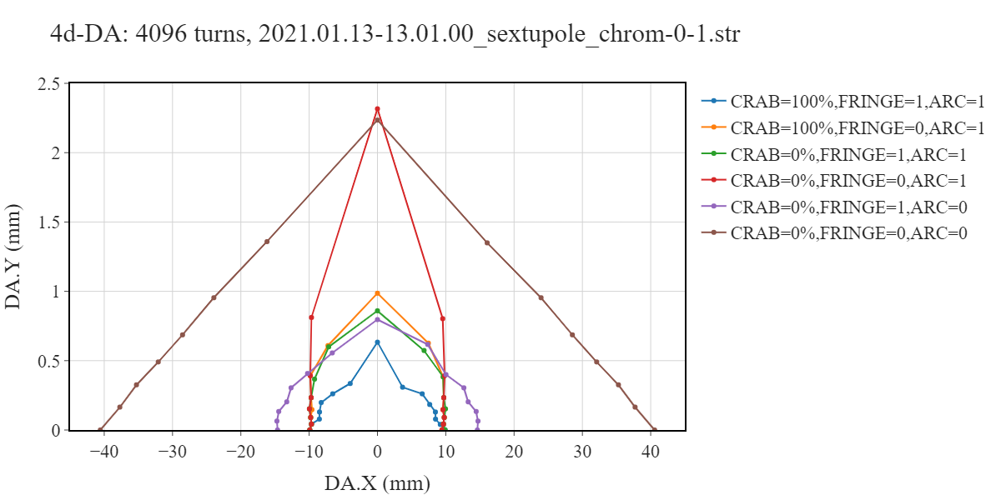
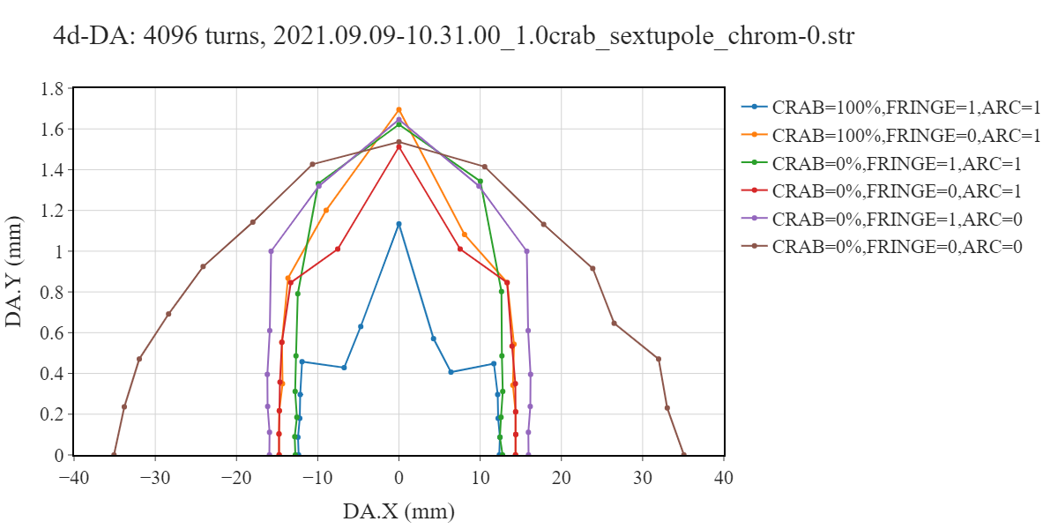
4d-DA: optimization
49_5
52_1
54_1
Notes:
49_6, k2_lcrab = 24.2061222750197; 54_1, k2_lcrab = 19.7885218159168; 55_1, k2_lcrab = 15.6466891406201

Slide 17
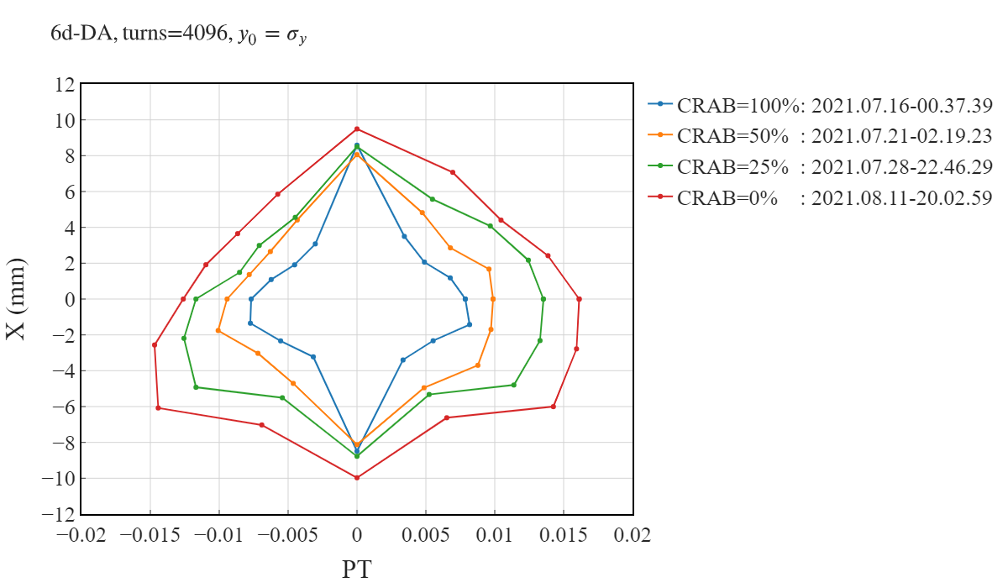
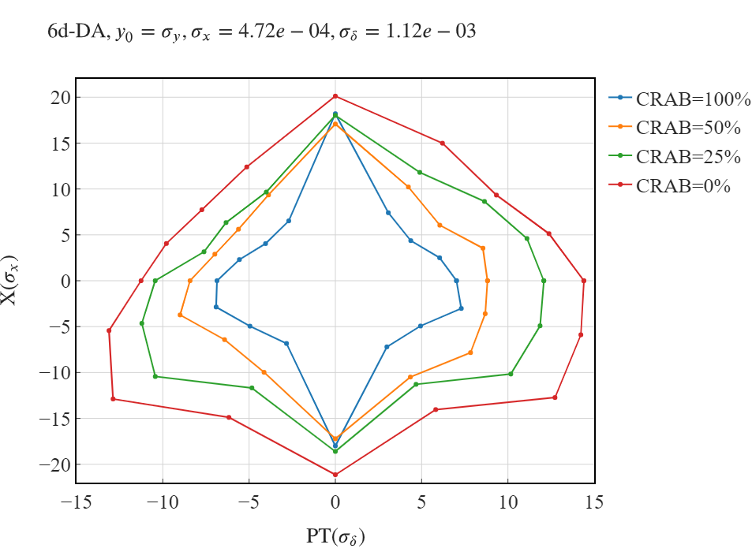
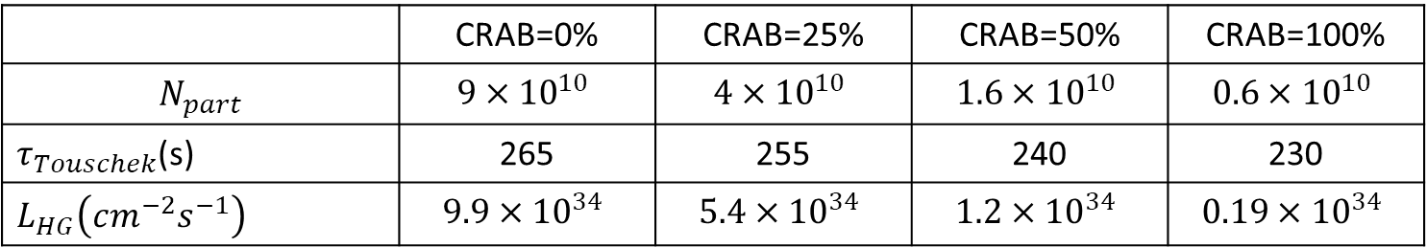
CRAB sextupole influence on 6d DA, E=1.5 ГэВ
 | CRAB=0% | CRAB=25% | CRAB=50% | CRAB=100%
$$N_{part}$$ | $$9×{10}^{10}$$ | $$4×{10}^{10}$$ | $$1.6×{10}^{10}$$ | $$0.6×{10}^{10}$$
$τ_{Touschek}$(s) | 265 | 255 | 240 | 230
$L_{HG}\left(cm^{−2}s^{−1}\right)$ | $$9.9×{10}^{34}$$ | $$5.4×{10}^{34}$$ | $$1.2×{10}^{34}$$ | $$0.19×{10}^{34}$$
Notes:
54_1

Slide 18
Challenges of the ambitious project
Energy range makes Touschek scattering scattering significant at low energy and insignificant at high energy
High luminosity requires high current, high bunch population and intensifies Touschek scattering
High luminosity requires small beta function, which raises chromaticity and demands stronger sextupoles
Stronger sextupoles reduce dynamic aperture and diminish beam lifetime due to Touschek effect
Ambitious project with interesting accelerator physics effects in multi-particle dynamics (Touschek, beam-beam, impedance etc.) and single particle effects (nonlinear 6d dynamics)

Slide 19
Conclusion
The linear lattice and parameters provide desired luminosity and polarization
Realistic injection facility for 200 s of beam life time
Siberian snakes sections provide sufficient longitudinal polarization
On momentum dynamic aperture is sufficient for injection and beam-beam effects
Off momentum dynamic aperture with CRAB ON is insufficient at 1.5-2.5 GeV to provide necessary Touschek lifetime
We continue optimization of the OFF momentum dynamic aperture

Slide 20
Extra slides

Slide 21

Explanation: detuning from quad fringe
Starting from IP
$$\begin{aligned}α_{yx}\left(Q0\right)&≈\frac{K_{1}}{8π}\left(α_{1,y}β_{1,x}−α_{1,x}β_{1,y}−\left(α_{2,y}β_{2,x}−α_{2,x}β_{2,y}\right)\right) \\ &= 11 − \left(−9487\right) \\ α_{yx}\left(Q1\right)&≈\frac{K_{1}}{8π}\left(α_{1,y}β_{1,x}−α_{1,x}β_{1,y}−\left(α_{2,y}β_{2,x}−α_{2,x}β_{2,y}\right)\right) \\ &= 6966 − \left(−235\right)\end{aligned}$$
First edge
from IP
Second edge from IP
Notes:
54_1

Slide 22
Notes
E=1.5 GeV, $ε_{x}=8.9×{10}^{−9}$m, at injection $β_{x}=25$ m
$σ_{x}=$0.000471795648970455 m
$σ_{y}=\text{9.048223769469}\text{18}×{10}^{−6}$ m
$σ_{δ}=\text{0.000935078971902656}$
$σ_{px}=\text{1.88718259588336}×{10}^{−5}$
$σ_{py}=\text{4.92010675374118}×{10}^{−6}$
$σ_{z}=\text{0.012328686694371}$ m
Notes:
54_1 wiggler

Slide 23
2021: Final Focus trajectories

