Slide 1


Status of U70
Report MOB01
NATIONAL RESEARCH CENTRE «KURCHATOV INSTITUTE»
Institute for High Energy Physics
of National Research Centre «Kurchatov Institute»
Vladimir Kalinin
on behalf of the U70 staff

Slide 2
Outlook
Generalities
Runs
Upgrades
Acceleration of light ions
Conclusion
Accelerator Complex U-70 & synchrotron U-70 per se
“Register of unique nuclear physics facilities …”approved by the RF Government order issued on December 30, 2009, No. 2125-р

Slide 3
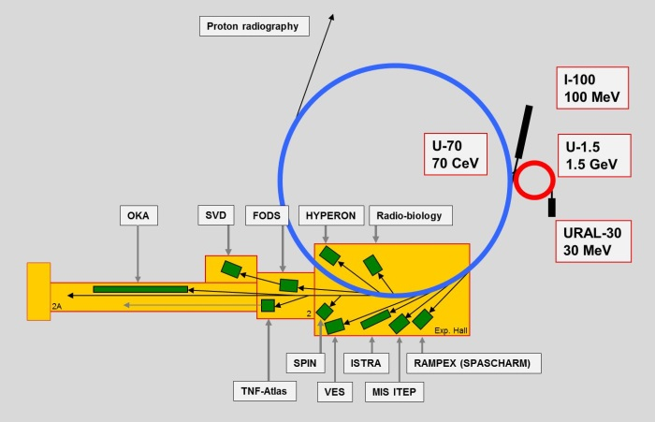
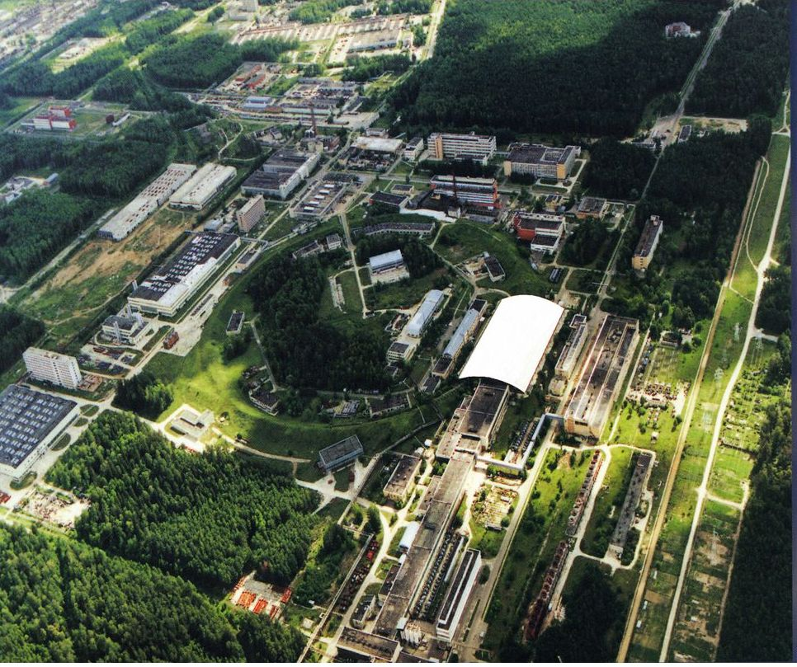
Layout, AC U-70 vs the U-70 proper
4 machines (since October 2007):
2 linacs
2 synchrotrons
Experimental Hall, 156 х 96 m²
Modes:
p (default, 50-70 GeV) URAL-30/U-1.5/U-70
light-ion (C, complementary) I-100(2 of 3)/U-1.5/U-70
In the SIS-18, SIS-100
name convention:
LIS-233 [T⋅m]
LIS-6.9 [T⋅m]
Light-ion (C nuclei):
(very) high energy 24.1-34.1 GeV/u
intermediate (though high) energy 180-455 MeV/u

Slide 4
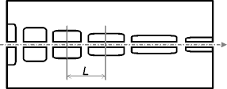
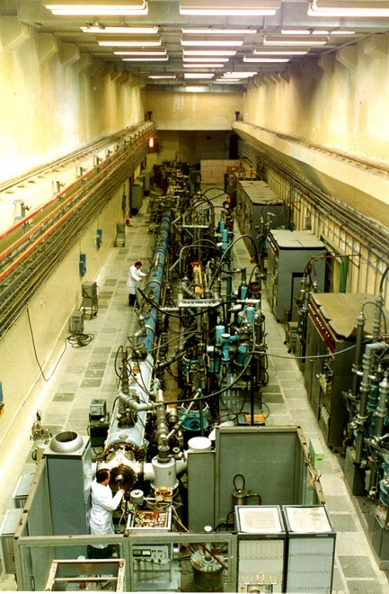
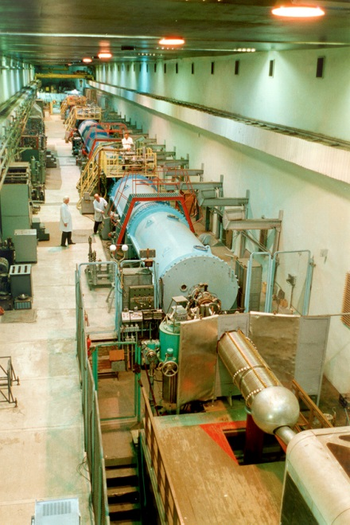
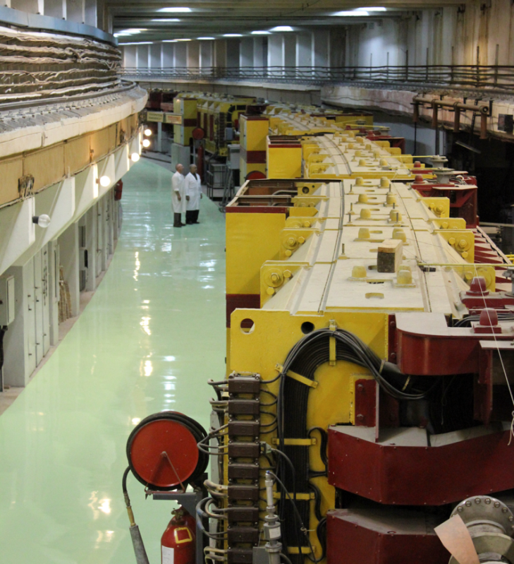
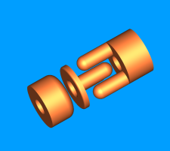
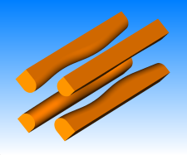
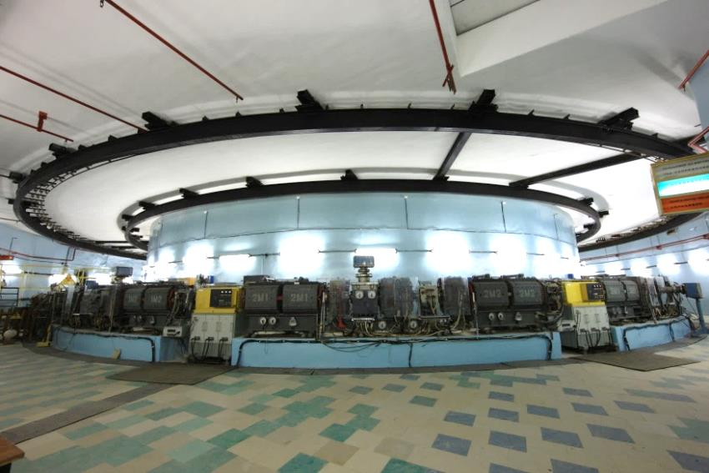
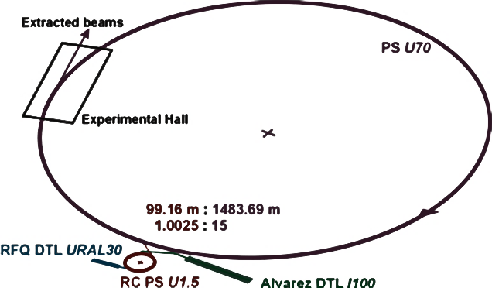
Photo album of the machines
RFQ DTL URAL-30
Alvarez DTL I-100
Main PS U-70
RC PS U-1.5

Slide 5
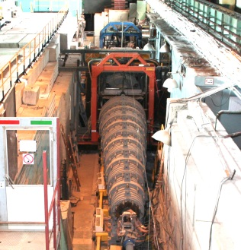
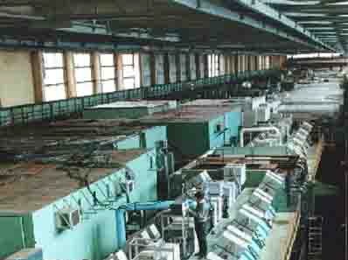
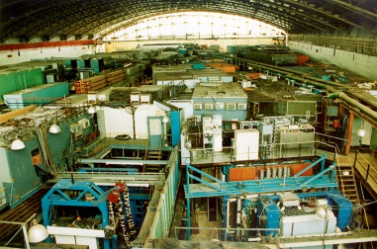
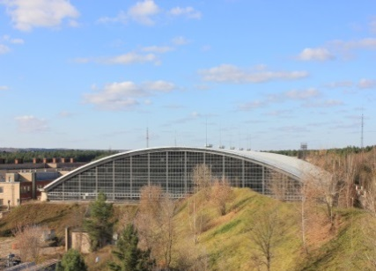
Fixed-target physics and BTL network
Beams of
p, π, K, e, ν, C
Fields of HEP research:
h spectroscopy
spin physics
rare K-decays
h-A interactions
nuclear physics
[ν physics]
Applied research:
p radiography
C radiobiology
…
Collaborators:
IHEP, ITEP, JINR,
INR, St.-PbNPI, SINP MSU, MEPhI, CERN, FNAL,
Collaborators:
IHEP, ITEP, JINR,
INR, St.-Pb NPI, BINP,
SINP MSU, NRNU MEPHI, CERN, …
VNIIEF, MRRC NMRRC ITEB, IMBP, FMBC…
Up to 10 HEP experiments (= No of setups) per a run,
Up to 7 beam users per a cycle

Slide 6
RUNS
Run | 2018-2 | 2019-1 | 2019-2 | 2020-1 | 2021-1
Launching linac URAL30, booster U1.5 and U70 sequentially (I100 in parallel with a delay) | October, 01 | September, 16 | October, 19 | October, 19 | February, 24
Beam in the U70 ring since | November, 06 | October, 07 | November, 24 | November, 21 | March, 24
Fixed-target physics program with extracted top-energy beams (either of protons or of carbon nuclei) | November, 12 –20, 9 days | - | November, 25- December, 2, 8 days | November, 26- December, 15, 20 days | March, 29 – April, 12, 15 day
No. of multiple beam users (of which the 1st priority ones) | 4 (4) | 4(4) | 11(6) | 12(8) | 10(4)
MD sessions and R&D on beam and accelerator physics, days | 19 | 13 | 6 | 18 | 12
Light-ion acceleration program, intermediate energy only | November,21 – December,12, 17½ days | October,07–27, 20½ days | December, 03–12, 9½ days | December, 16–30, 14½ days | April, 13–30, 17½ day

Slide 7
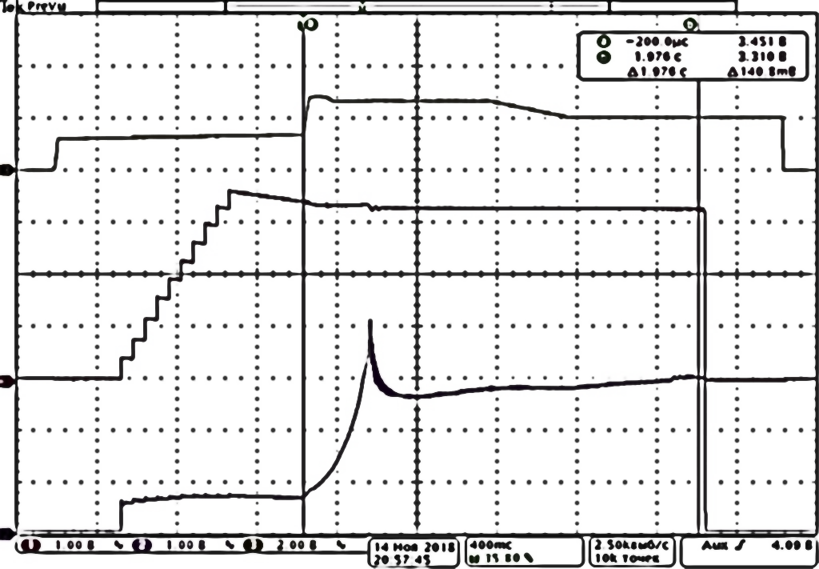
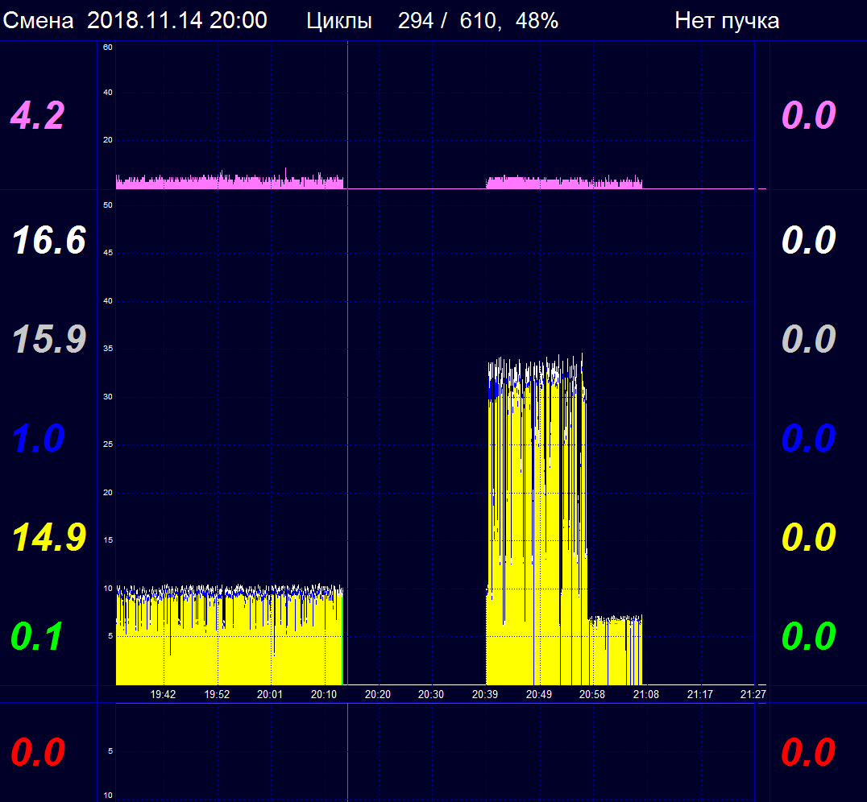
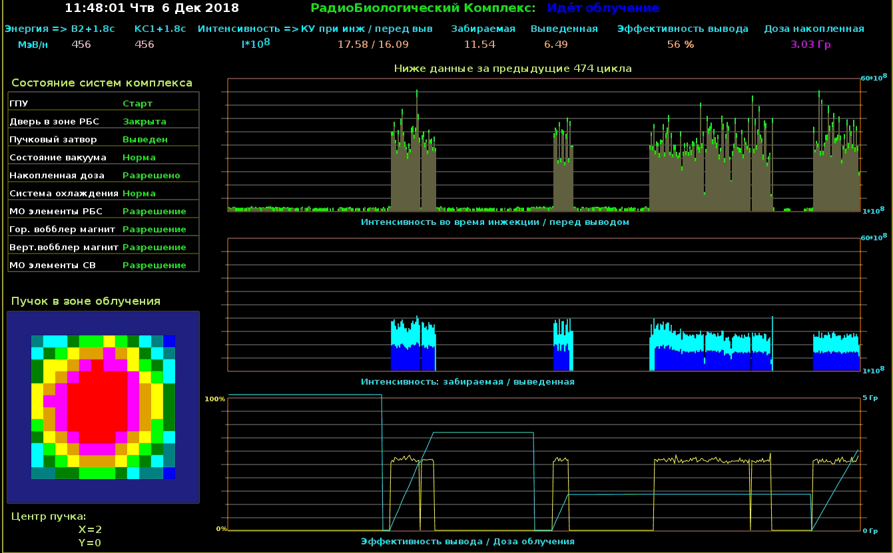
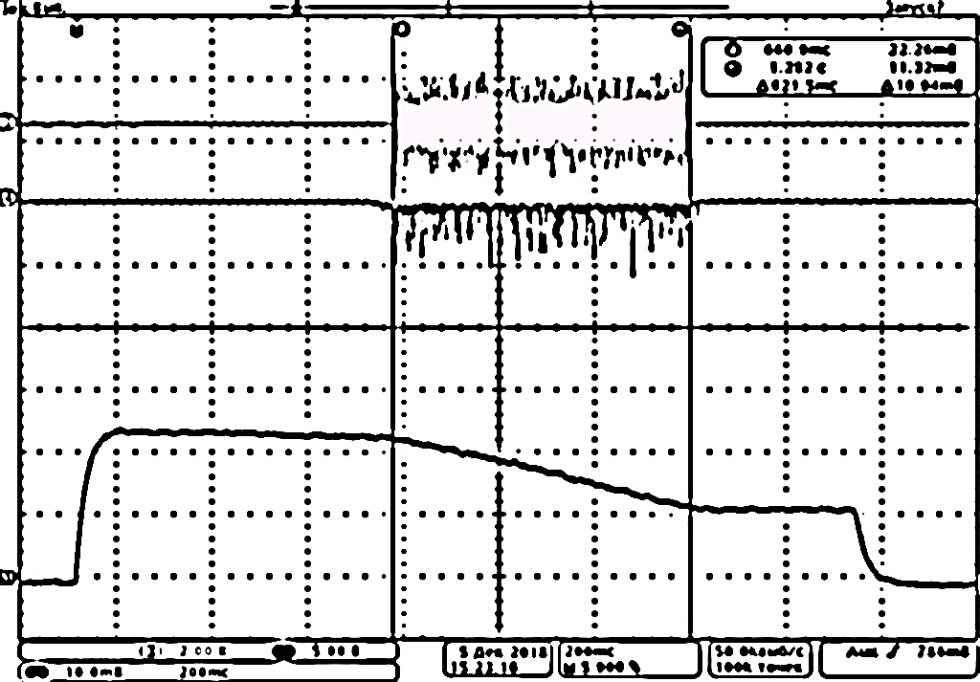
RUN 2018-2
Radiographic facility, p (50 GeV),108 hours
fast-extraction,
1-10 equal bunches 3–4.5⋅10¹¹ ppb
Radiobiological and biophysical research,
C (455 MeV/u) 4.0⋅10⁹ ipp

Slide 8
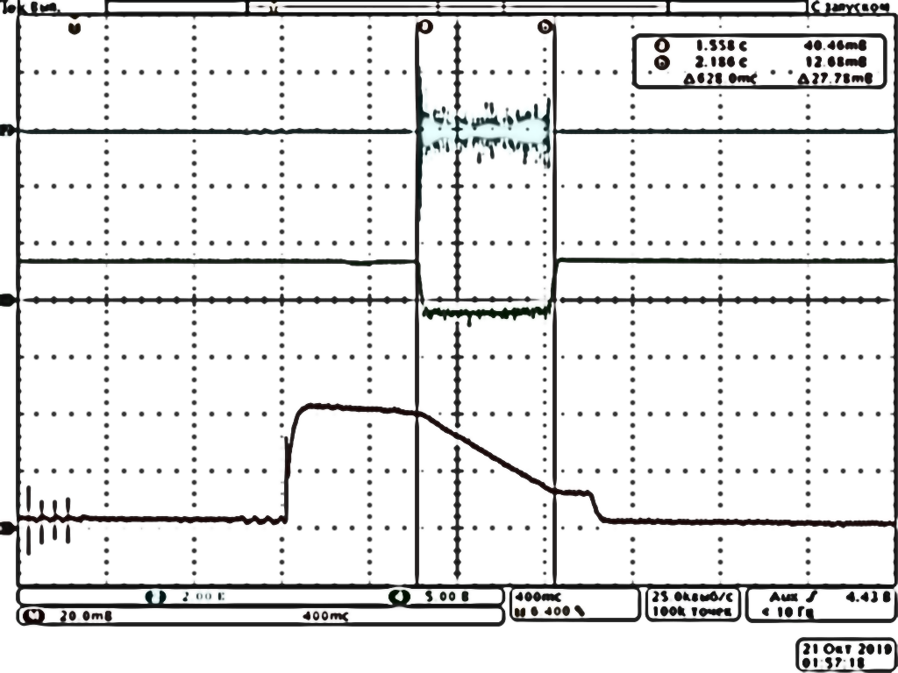
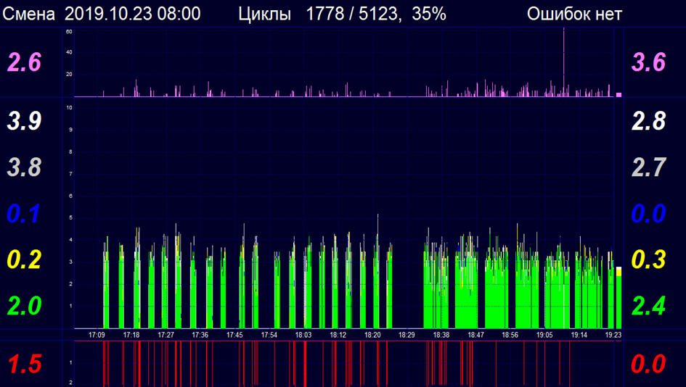
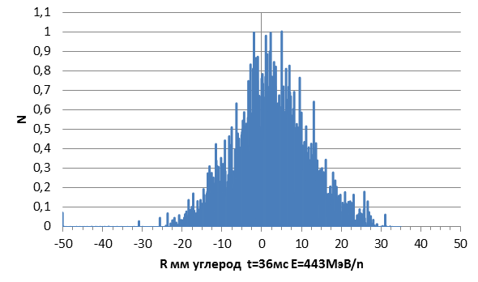
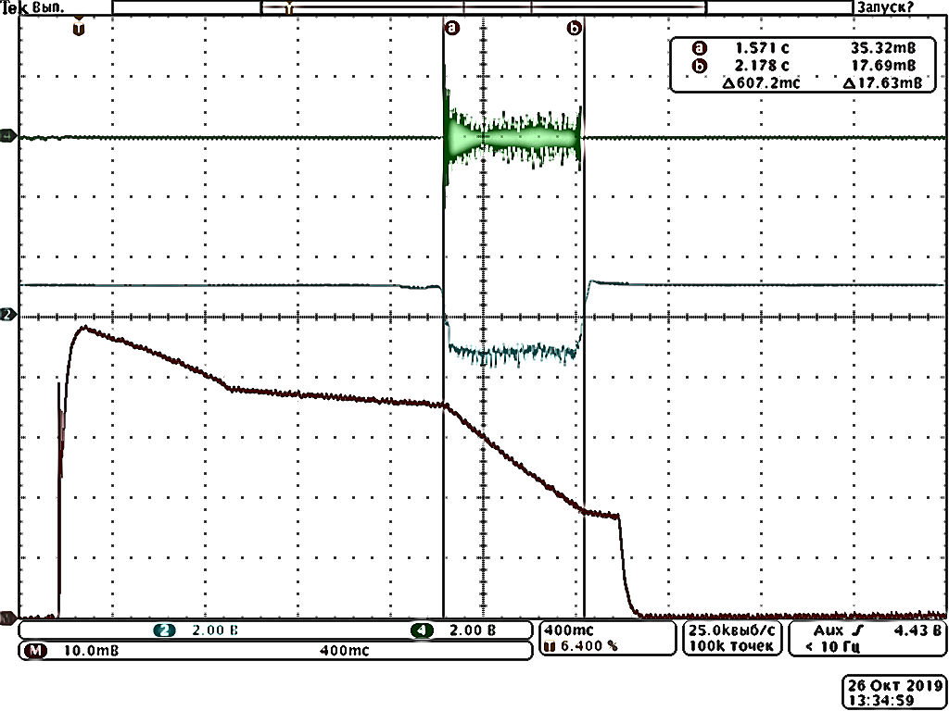
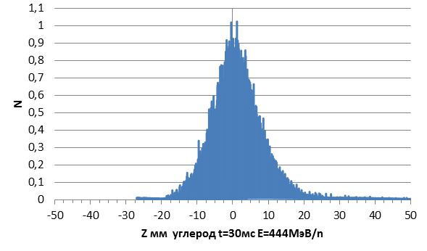
RUN 2019-1
Radiobiological and biophysical research,
C (455 MeV/u, 300 MeV/u ) 4.6⋅10⁹ ipp

Slide 9
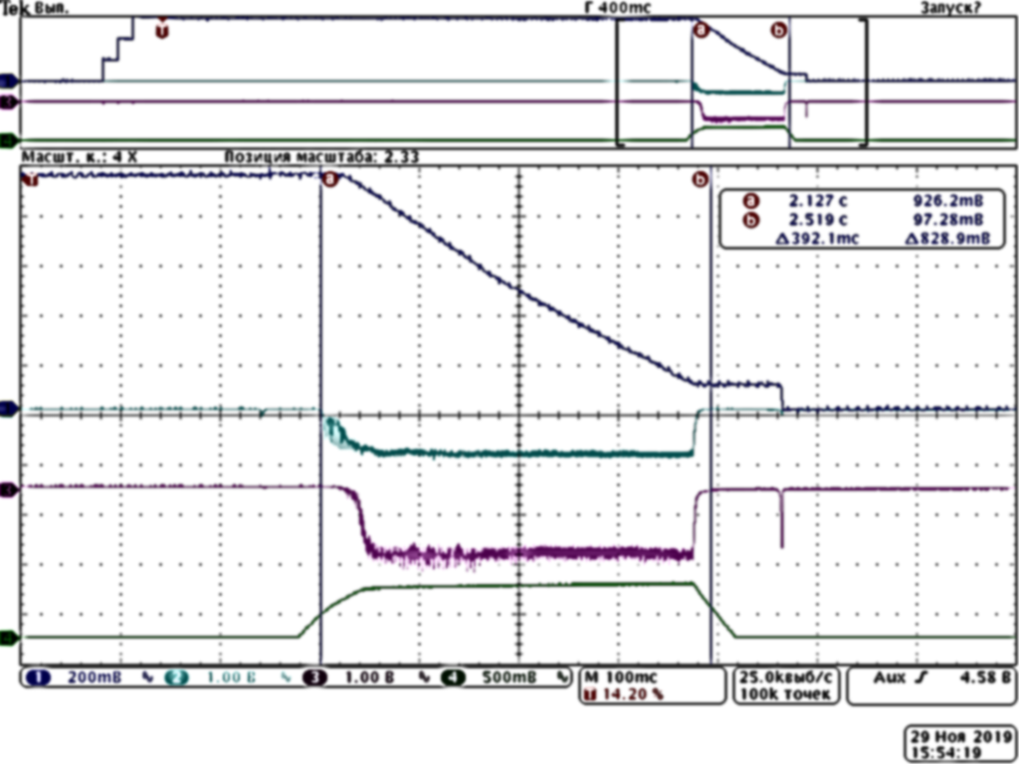
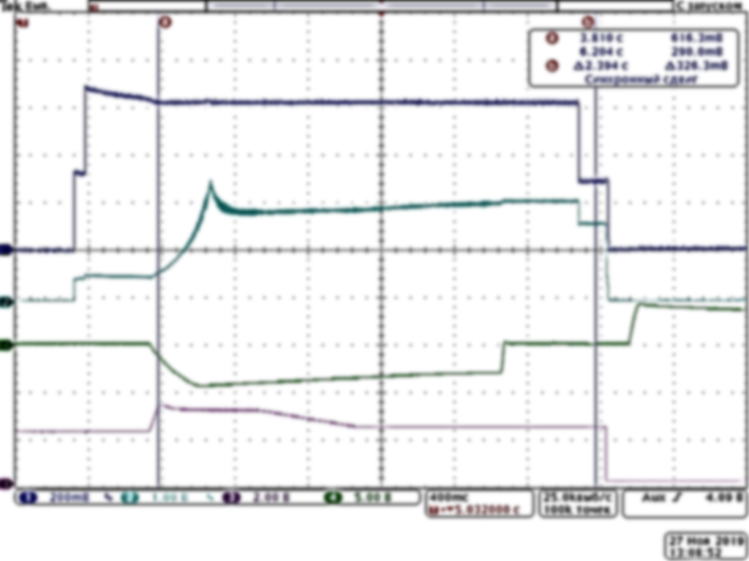
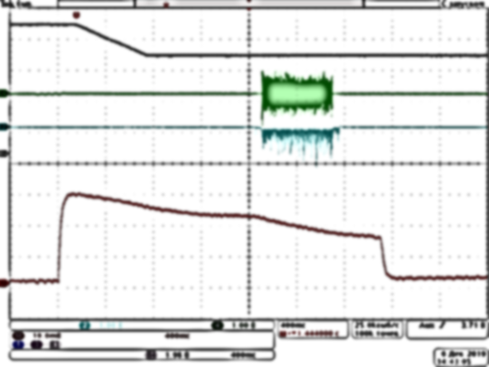
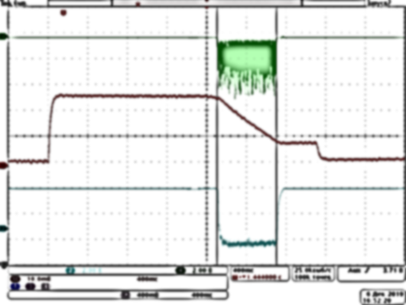
RUN 2019-2
Radiographic facility, NEUTRON,
p (50 GeV), fast-extraction,
1-15 equal bunches 3–4.2⋅10¹¹ ppb
Fundamental physics, p (50 GeV)
lowered priority
Internal-targets(IT)
Crystal Deflector(CD)
VES IT#27
FODS CD#19
SPASCHARM IT#24
SVD CD#19
1.0⋅10¹² ppp
Radiobiological and biophysical research,
C (455 MeV/u, 300 MeV/u ) 2-4.6⋅10⁹ ipp

Slide 10
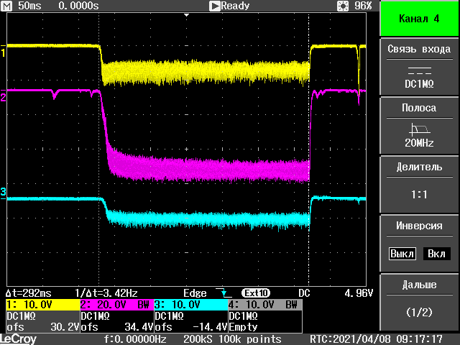
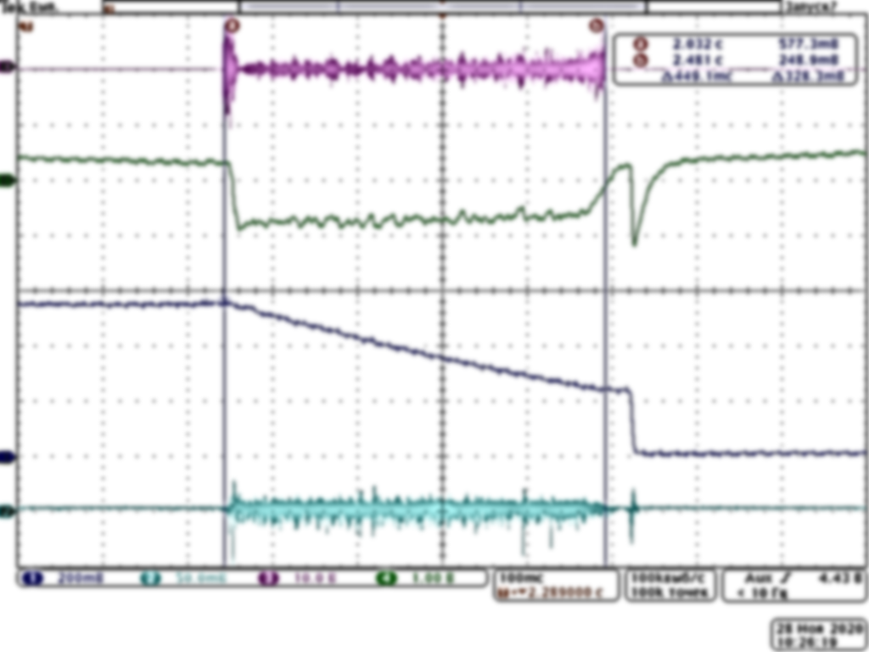
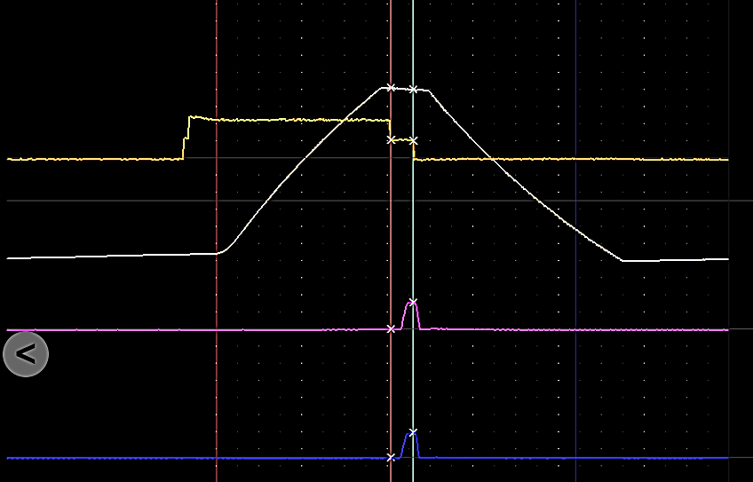
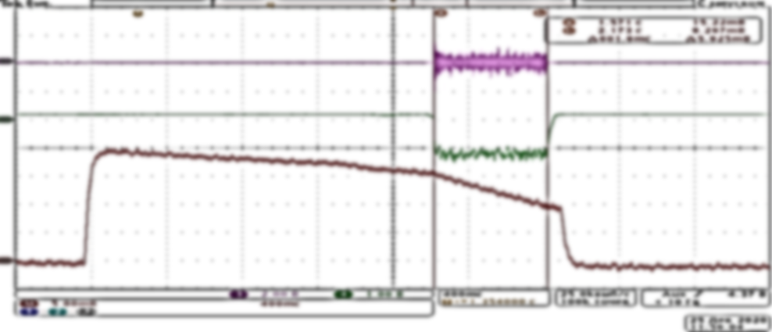
RUN 2020-1
Fundamental physics, p (50 GeV)
Internal-targets(IT)
Crystal Deflector(CD)
VES IT#27
SPASCHARM IT#24
HYPERON IT#35
1.0⋅10¹² ppp
OKA,SPIN Slow stochastic extraction,FODS(CD30)
, up to 3.5⋅10¹¹ ppp
Radiographic facility, NEUTRON,
p (50 GeV), fast-extraction,
1-15 equal bunches 3–4.5⋅10¹¹ ppb
Radiobiological and biophysical research,
C (455 MeV/u, 300 MeV/u ) Slow extraction

Slide 11
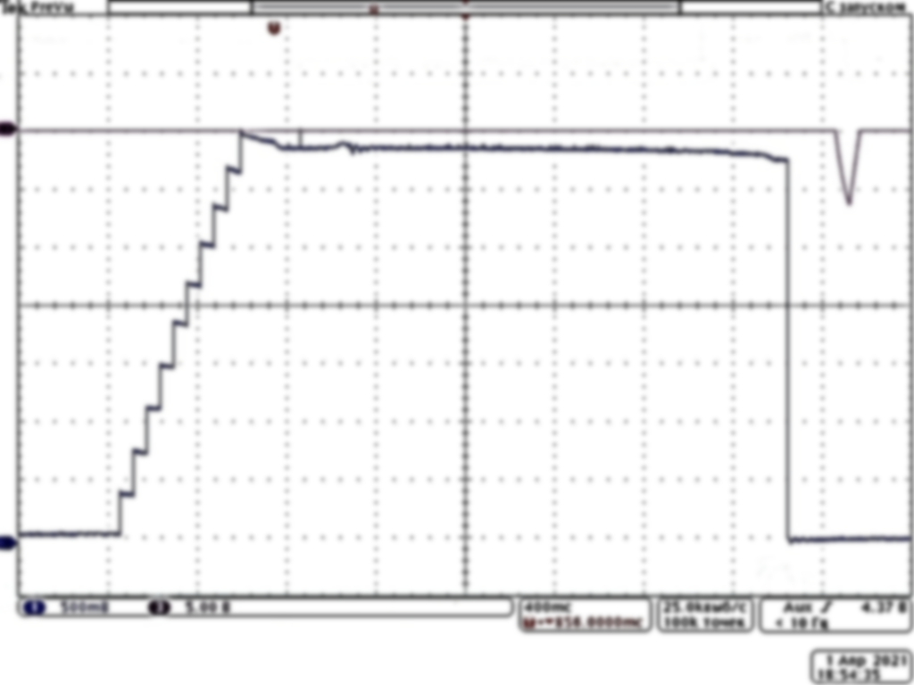
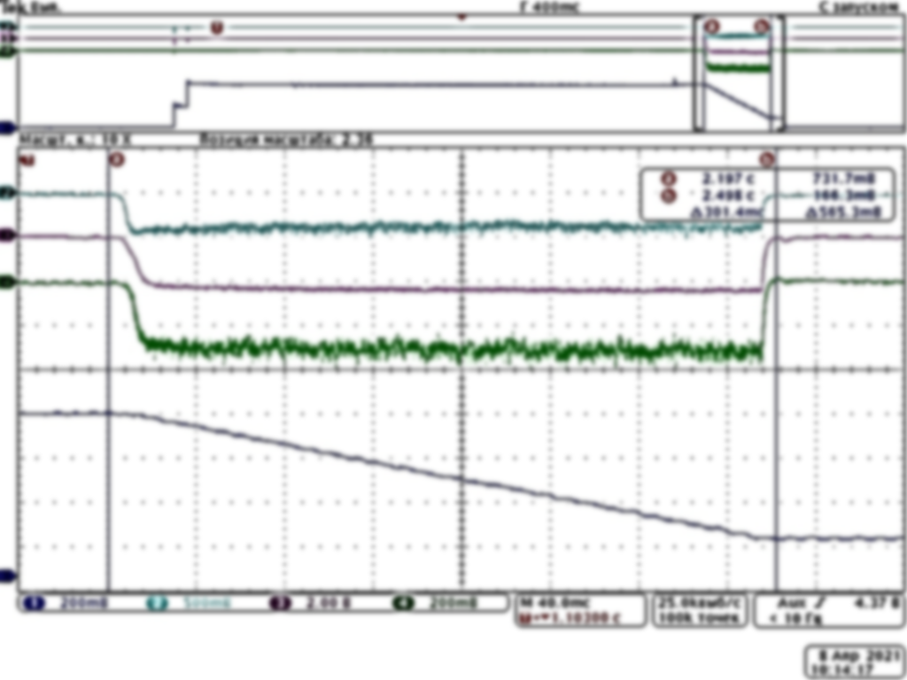
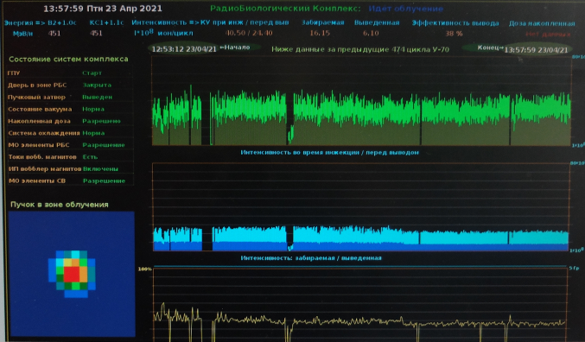
RUN 2021-1
Radiographic facility, NEUTRON, SPIN
p (50 GeV), fast-extraction,
1-15 equal bunches 3–4.5⋅10¹¹ ppb
Fundamental physics, p (50 GeV),
180 hours lowered priority
Internal-targets(IT)
Crystal Deflector(CD)
VES IT#27
SPASCHARM IT#24
HYPERON IT#35
ISTRA CD#27
1.0⋅10¹² ppp
Radiobiological and biophysical research,
C (180-455 MeV/u) 2-2.5⋅10⁹ ipp

Slide 12
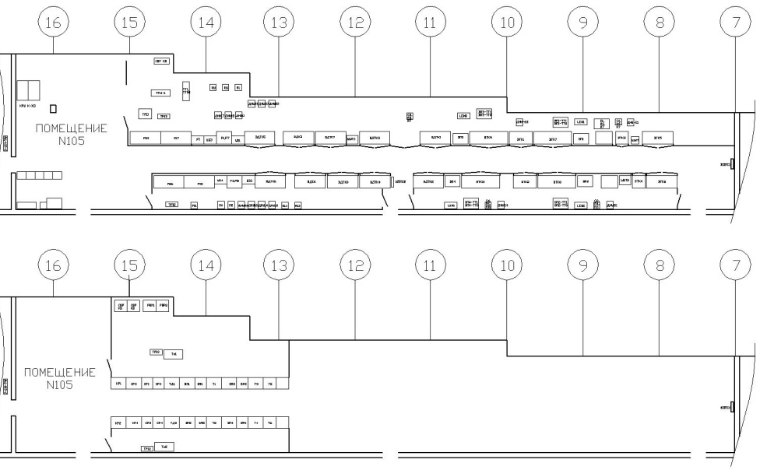
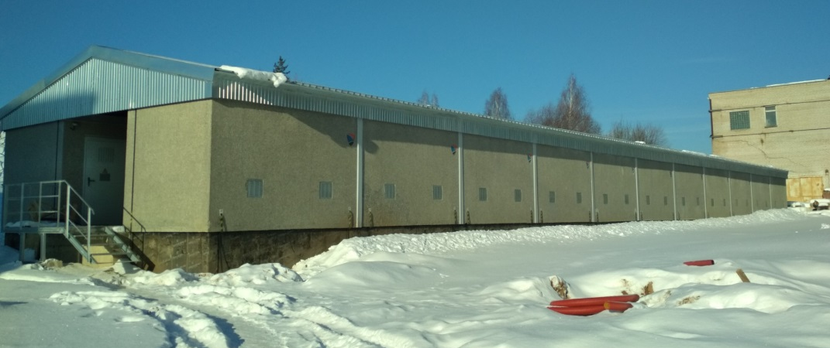
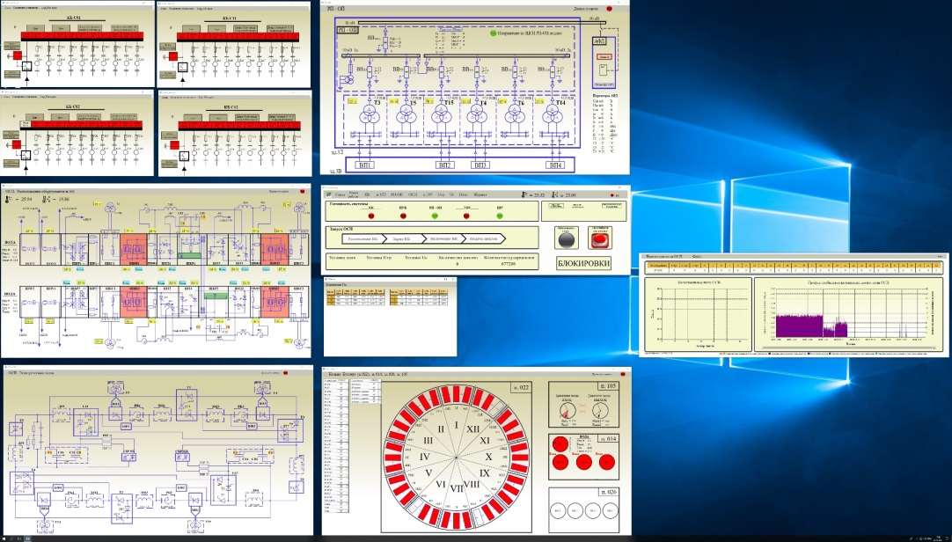
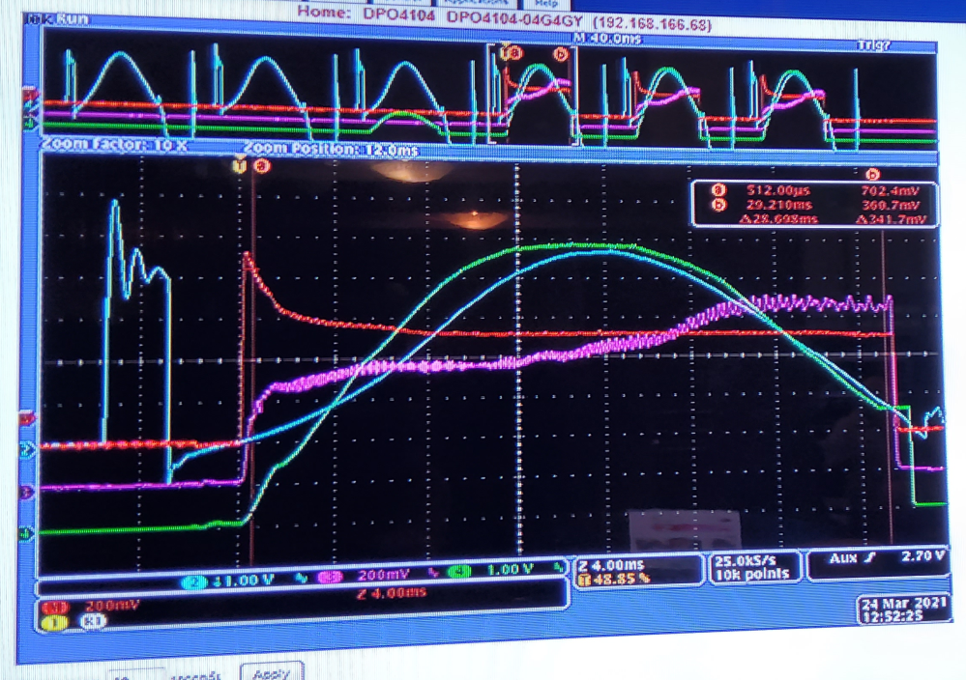
UPGRADES
U1.5 power supply system upgrade.

Slide 13
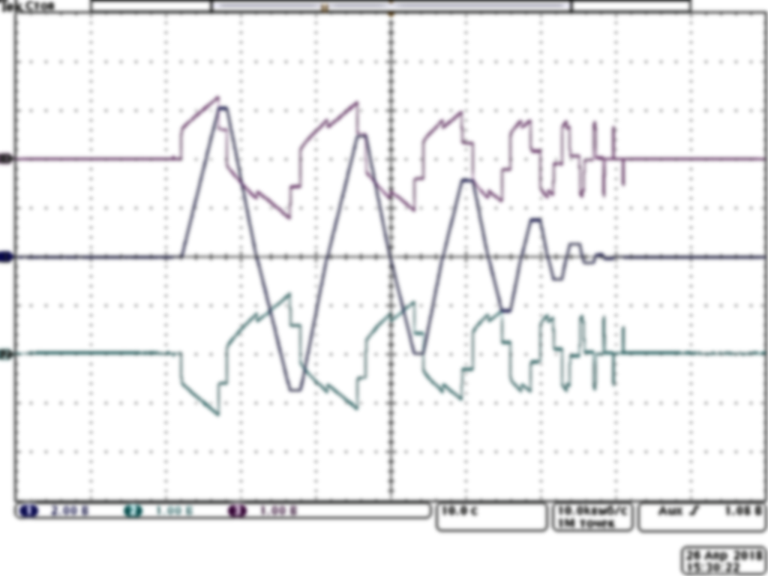
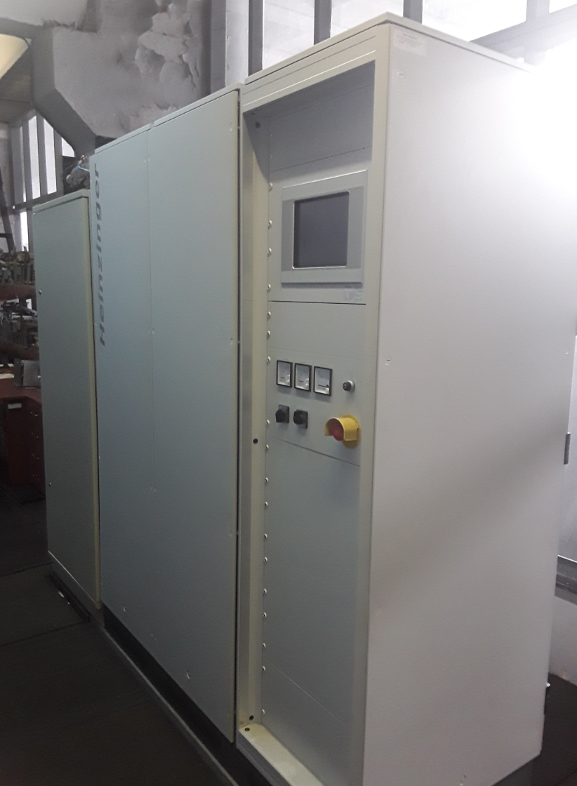
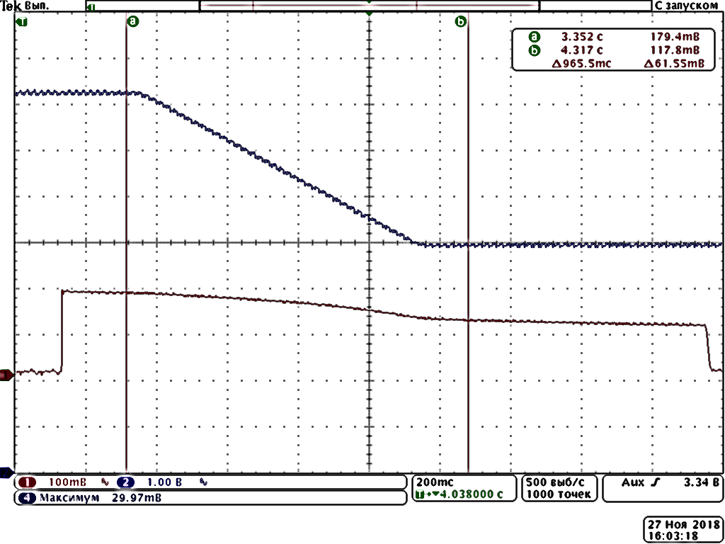
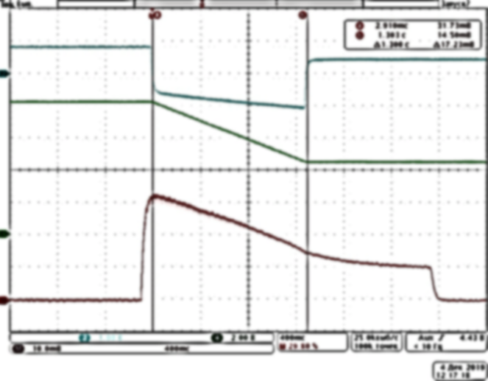
UPGRADES
New power supply (20 kW) for magnet U70 synchrotron
demagnetization
p (0.7-1.3 GeV)
C (180-455 MeV/u)

Slide 14
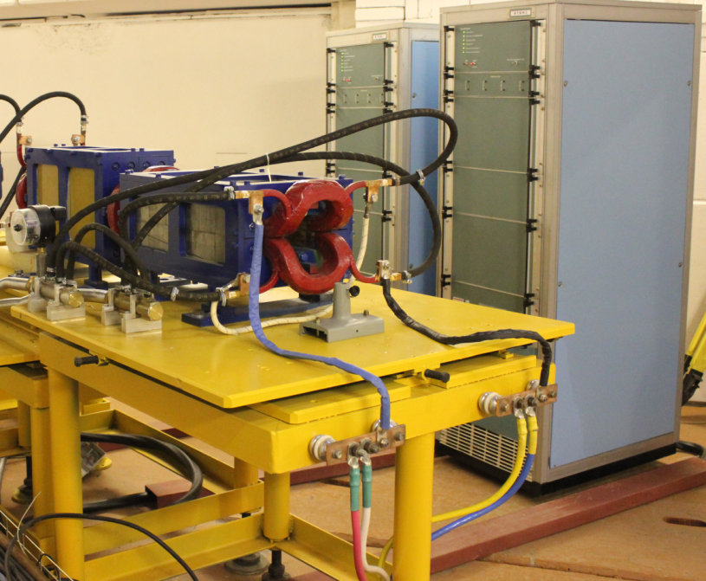
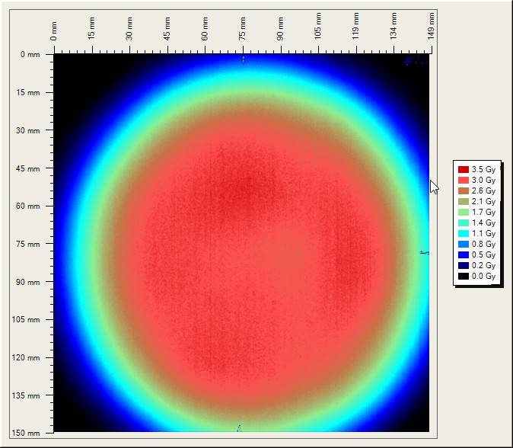
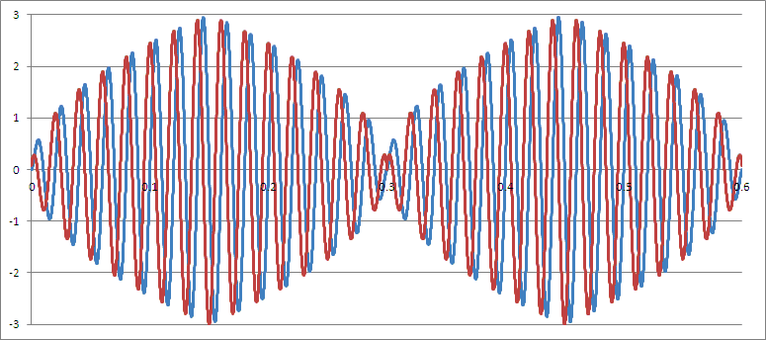
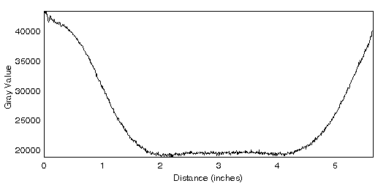
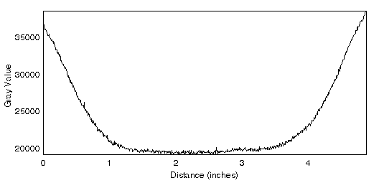
UPGRADES
New irradiation field-forming system
Flat dose field
Wobbler magnet
current
X direction
Y direction

Slide 15
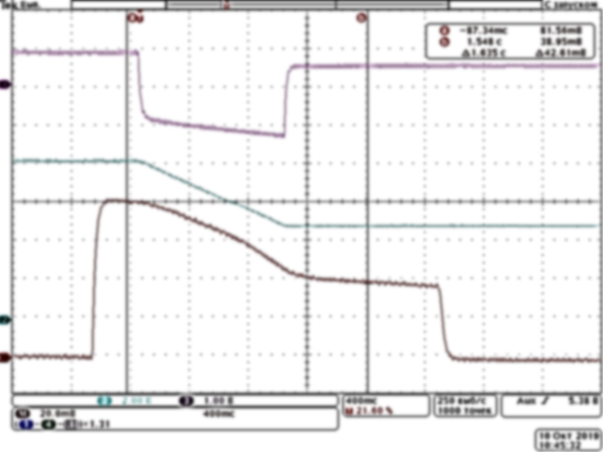
Acceleration of light ions
C (180÷455 MeV/u), 5 RUNS,
504 hours MD sessions and R&D on beam
and accelerator physics
372 hours radiobiological and
biophysical research
C (455 MeV/u) 1.35⋅10¹⁰ ipp
Institution | 2018-2 | 2019-1 | 2019-2 | 2020-1 | 2021-1
MRRC of NMRCR, http://mrrc.nmicr.ru | + | + | + | + | +
ITEB of RAS, web.iteb.psn.ru | + | + | + | + | +
IBMP of RAS, www.imbp.ru | + | + | + | +
FMBC of FMBA, fmbafmbc.ru |  | + | +
JINR, www.jinr.ru |  | + |  |  | +
VNIIFTRI, www.vniiftri.ru |  | + | +
MEPHI, https://mephi.ru/ |  |  |  | +
IMB of BAS, www.bio21.bas.bg | +

Slide 16
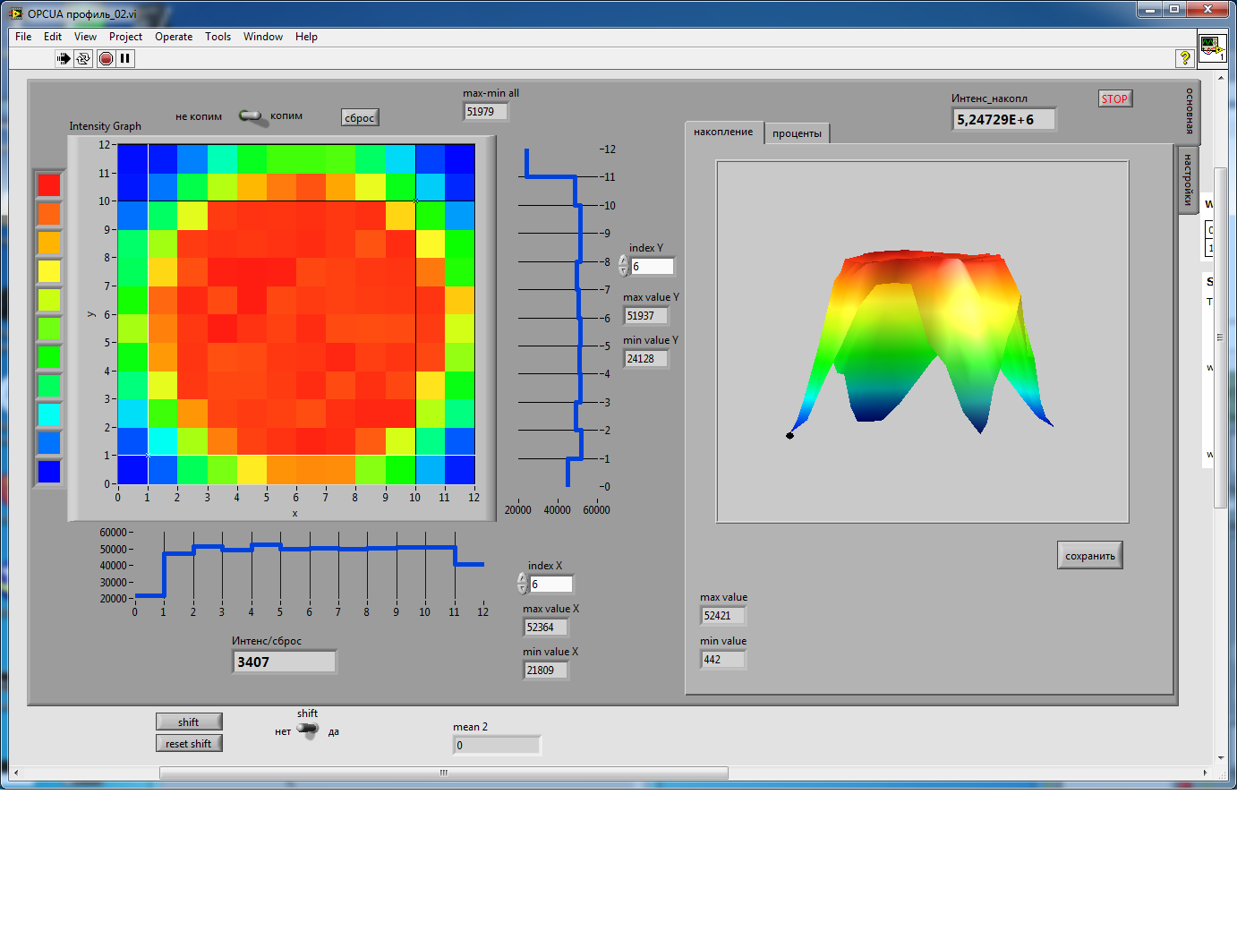
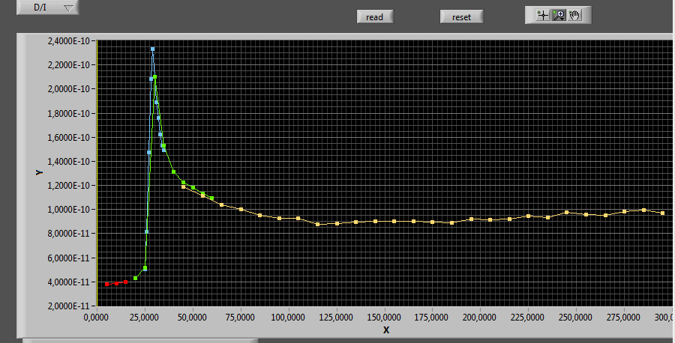



Acceleration of light ions
144-channel mosaic
ionization chambers
Bragg peak in water phantom
C (455 MeV/u) 1.8⋅10⁹ ipp
C (300 MeV/u) 1.5⋅10⁹ ipp
ITEB of RAS, experiments
C (200 MeV/u) 1.5⋅10⁹ ipp

Slide 17
Conclusion
Accelerator Complex U-70 of NRC “Kurchatov Institute” – IHEP (Protvino):
  comprises 4 machines (URAL-30, I-100, U-1.5, and U-70 itself),
  readily ensures running the fixed-target physics program
  is subject to ongoing upgrade program
  has noticeably improved quality of proton beam recently
  now has slow extraction of 200, 250, 300, 350, 400, 455 MeV per nucleon of ¹²C⁶⁺ beam for radiobiology and future prior-to-therapy studies
  U-1.5 and U-70 now belong to PS and (L)IS categories
  is open for a few promising options for future development

Slide 18
Thank you very much

