Slide 1


heavy ion collider
Beam Dynamics

Slide 2


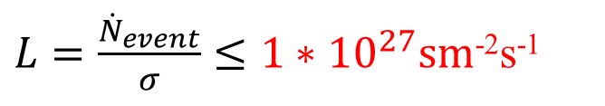

Required luminosity
Main parameters:
beam energy – E
luminosity - L
MPD electronics
$${\dot{N}}_{event}≤7 kHz$$
Event rate
$${\dot{N}}_{event}=L∗σ$$
The cross-section
$$σ≈7⋅10^{−24} cm^{−2}$$
$L=\frac{{\dot{N}}_{event}}{σ}≤1∗{10}^{27}sm$⁻²s⁻¹
typical for RHIC (Au-Au) and LHC (Pb-Pb)
 | NICA | RHIC | LHC
L * 10^27 | 1 | 8.7 | 3.6
E [GeV/n] | 4.5 | 100 | 2510
…however, the ion kinetic energy is below 4.5 GeV/n

Slide 3
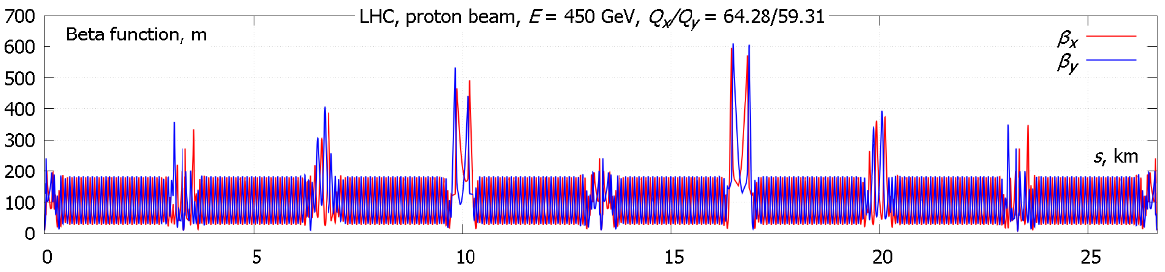
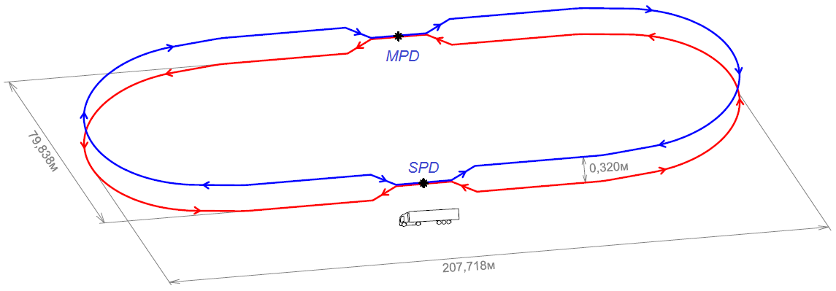
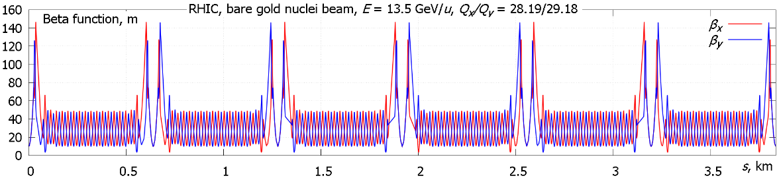
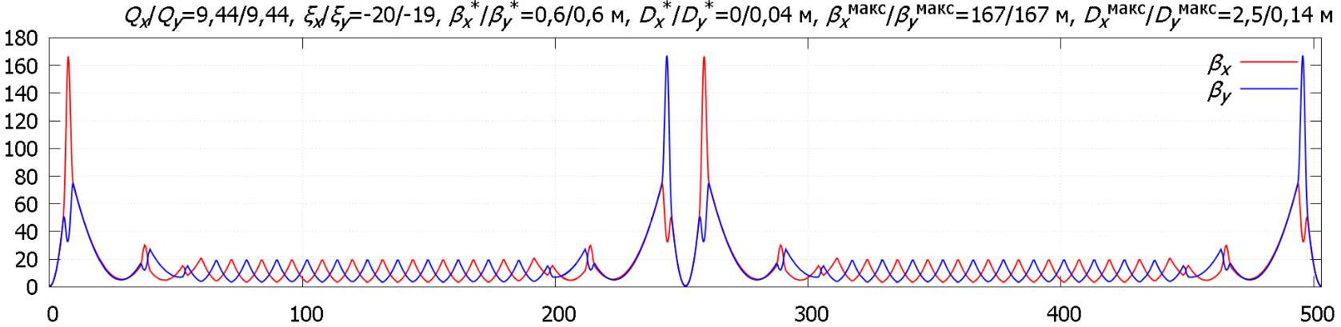
How does NICA collider look like?
LHC
RHIC
NICA

Slide 4
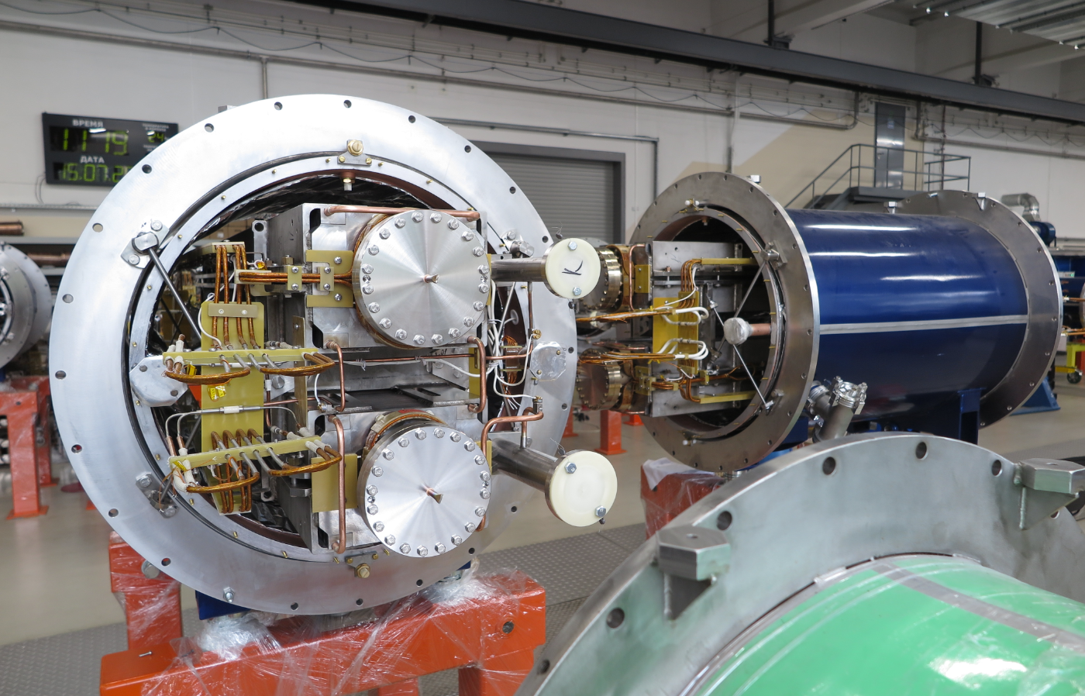
preparation of the collisions
Vertical beam separation
particles detector
use bunched beam

Slide 5
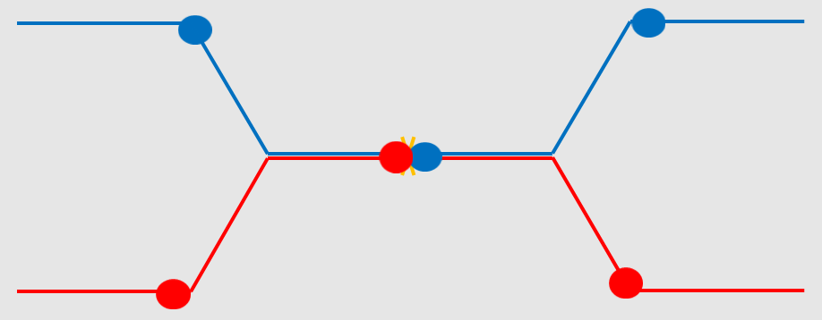
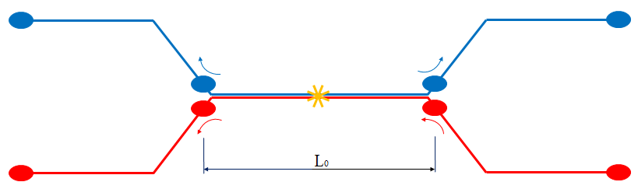
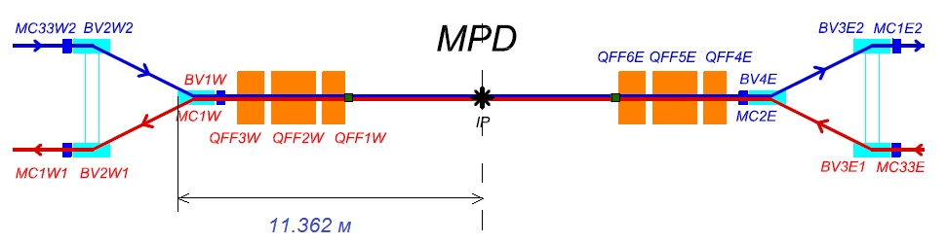
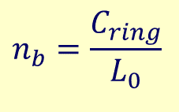
preparation of the collisions
Detector
inter-bunch distance is to be large enough
to avoid parasitic collisions
=>
fixed number of bunches in the ring
$$n_{b}=\frac{C_{ring}}{L_{0}}$$
`

Slide 6
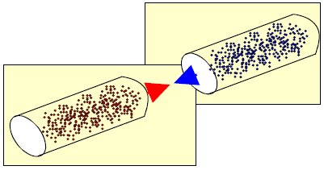
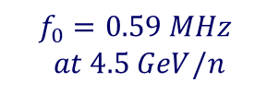
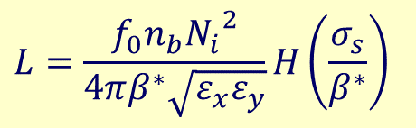


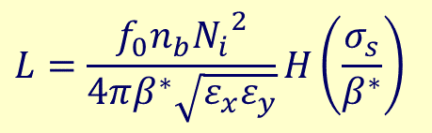
Luminosity
For round beams and head-on collisions
$$L=\frac{f_{0}n_{b}{N_{i}}^{2}}{4πβ^{∗}\sqrt{ε_{x}ε_{y}}}H\left(\frac{σ_{s}}{β^{∗}}\right)$$
Number of bunches n_{b} has to be as large as possible
but the inter-bunch distance is to be large enough
to avoid parasitic collisions
Train of bunches is prepared by injection chain
the bunch intensity N_{b} has to be maximal
the emittance ε growth has to be minimized in all elements of injection chain
beta function in collision point β* has to be as small as possible
but comparable with bunch length σ_{s}
to avoid luminosity reduction due to “hour-glass” factor
$$L=\frac{f_{0}n_{b}{N_{i}}^{2}}{4πβ^{∗}\sqrt{ε_{x}ε_{y}}}H\left(\frac{σ_{s}}{β^{∗}}\right)$$
  Major effects limiting the luminosity
  IBS
  Space charge
  Luminosity lifetime
  Ring optics
  Cooling
  Instabilities
$$n_{b}=\frac{C_{ring}}{L_{0}}$$
$$f_{0}=\frac{с∙β_{0}}{C_{ring}}$$
$$f_{0}=0.59 MHz$$
$$at 4.5 GeV/n$$

Slide 7
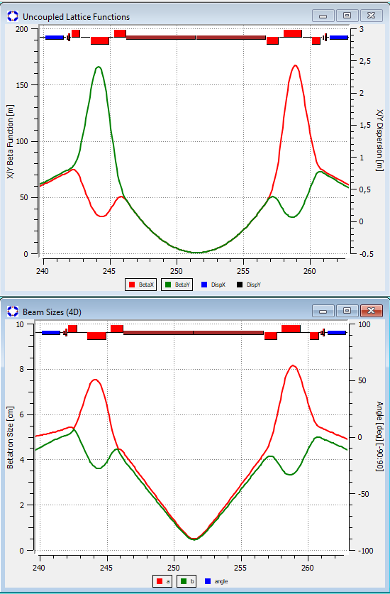
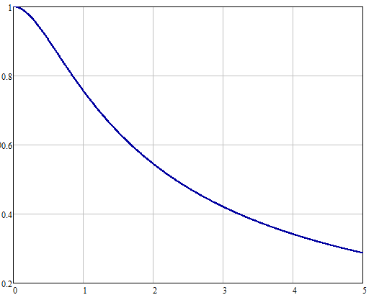
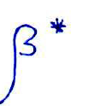
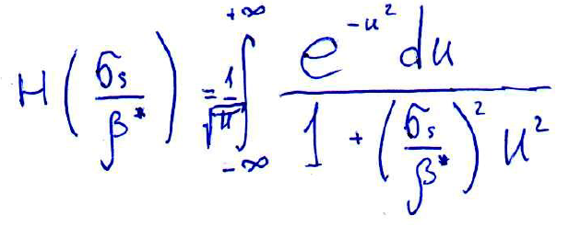

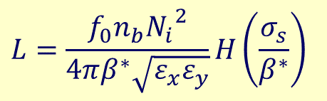
Luminosity reduction due to hour-glass effect
Interaction point
$$L=\frac{f_{0}n_{b}{N_{i}}^{2}}{4πβ^{∗}\sqrt{ε_{x}ε_{y}}}H\left(\frac{σ_{s}}{β^{∗}}\right)$$
0.6m
4.2mm
$$σ_{s}≅β^{∗}$$
6-sigma rms beam-size

Slide 8
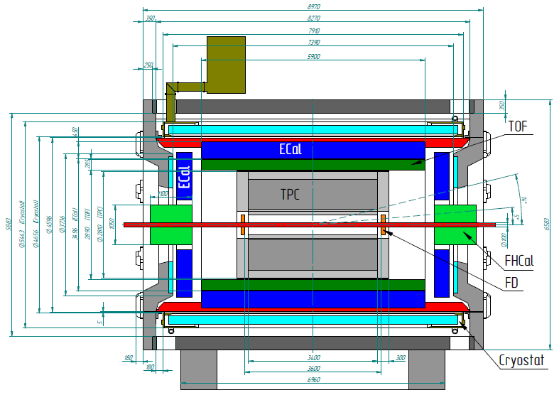
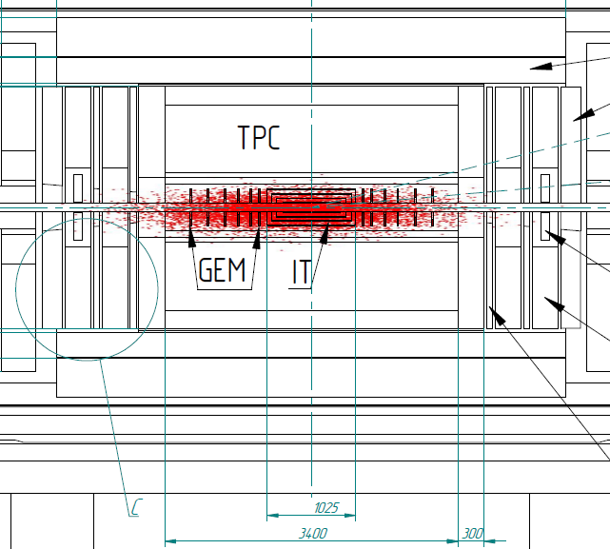
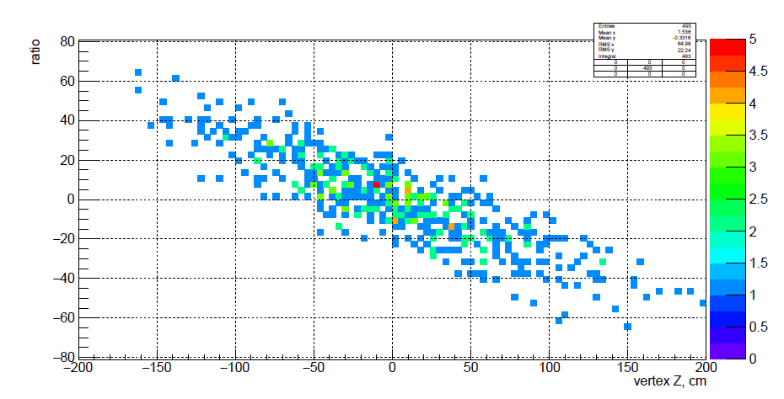


Required bunch long size
Particles Detector
MPD
Asymmetry of energy deposited in the left-right forward Hadron Calorimeters
$$6σ_{s}≅TPC$$
Central events, 11 GeV/n
$$σ_{s},σ_{p}→U_{RF}$$

Slide 9
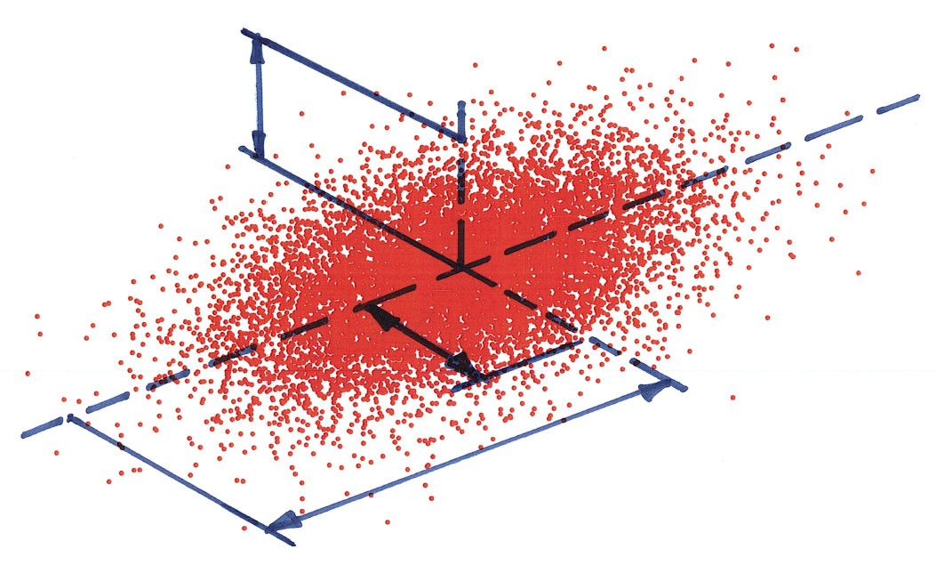
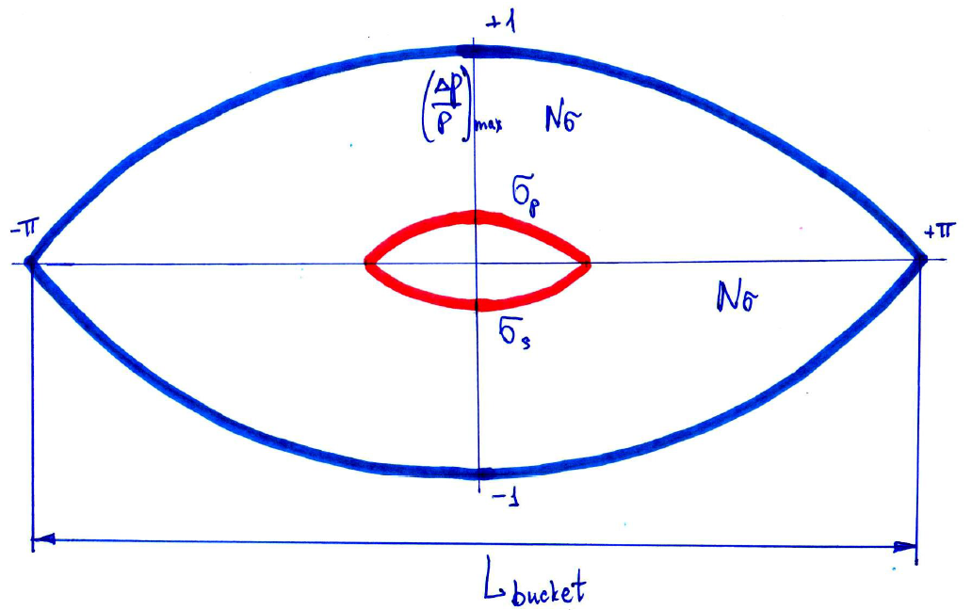
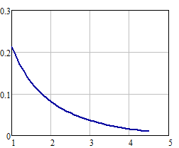
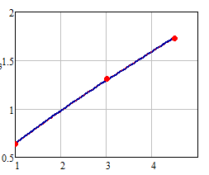
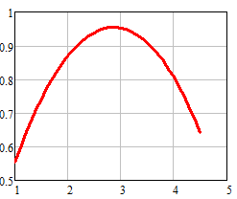
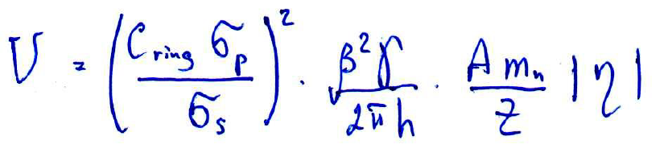
















Required bunch long size 2
$$Nσ_{RF}=4$$
$$6σ_{s}≅TPC$$
$$σ_{y}$$
$$0.6m$$
$L_{bucket−desired}=Nσ_{RF}∙$ $σ_{s}∙π=7.5m$
$$σ_{x}$$
$$σ_{s}$$
$$η=\frac{1}{γ^{2}}−α$$
$$σ_{p}∙{10}^{3}$$
IBS- «thermal» equilibrium
$$n_{b}=22 (=\frac{C_{ring}}{L_{0}})$$
$$h=3∙n_{b}=66$$
$$L_{bucket−RF}=\frac{C_{ring}}{h}=7.6m$$
$$E_{k}[Gev/n]$$
$V_{RF−3}$[MV]
$$E_{k}[Gev/n]$$
$$E_{k}[Gev/n]$$
9

Slide 10
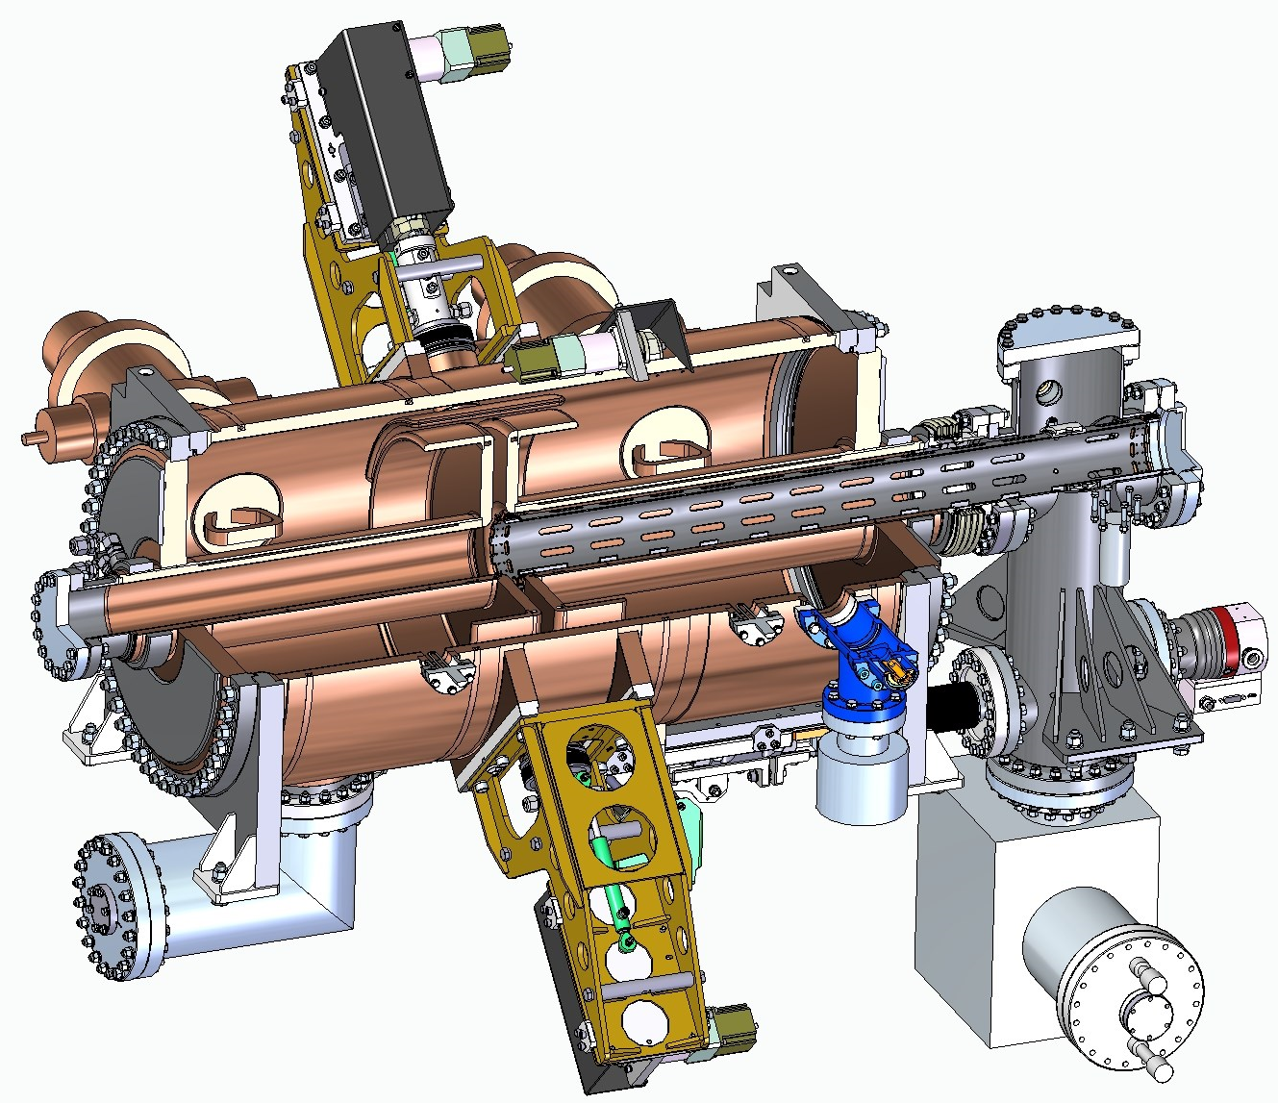
NW
Location of RF cavities in the accelerator tunnel.
RF-3 system
Station prototype – 8 stations/ring
NE
2×RF2
ECool
MPD
1×RF1
5×RF3
W
2×RF2
E
2×RF2
4×RF3
2×RF3
1×RF1
5×RF3
SPD
SW
SE
2×RF2
10
RF systems of the NICA collider
A.Tribendis

Slide 11
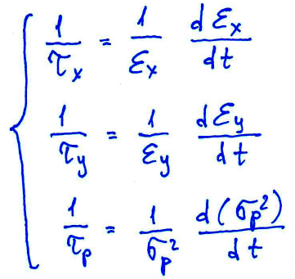
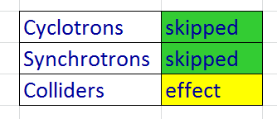
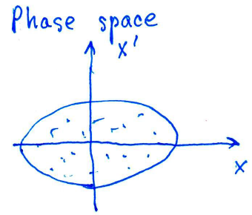
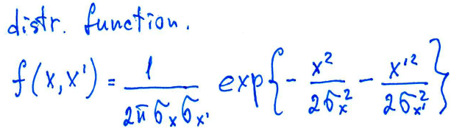
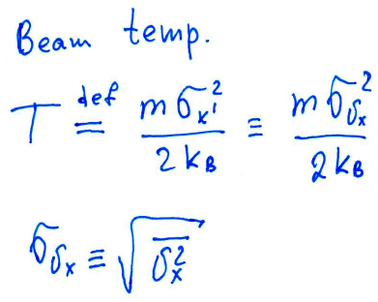
Intra-Beam Scattering
IBS - Coulomb scattering of charged particles in a beam results in an exchange of energy between different degrees of freedom
Causes the beam size to grow up ➔ limits luminosity lifetime
IBS is important constraint for circular machines
Visible effect in 10th to 1000th seconds
IBS leads to
relaxation (equation) between 3 “temperatures” in the beam faster than 6D-emmitance growth rate
infinite beam 6D-phase space volume growth in circular machines

Slide 12
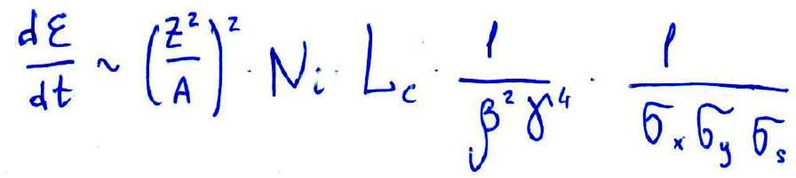
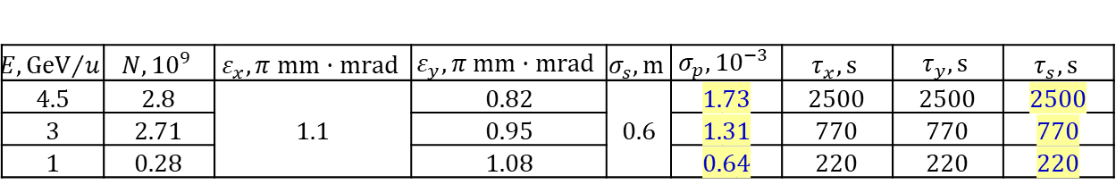

Intra-Beam Scattering
$$U_{RF}$$
$$E, {GeV}/u$$ | $$N, {10}^{9}$$ | $$ε_{x}, π mm·mrad$$ | $$ε_{y}, π mm·mrad$$ | $$σ_{s}, m$$ | $$σ_{p}, {10}^{−3}$$ | $$τ_{x}, s$$ | $$τ_{y}, s$$ | $$τ_{s}, s$$
4.5 | 2.8 | 1.1 | 0.82 | 0.6 | 1.73 | 2500 | 2500 | 2500
3 | 2.71 |  | 0.95 |  | 1.31 | 770 | 770 | 770
1 | 0.28 |  | 1.08 |  | 0.64 | 220 | 220 | 220
operation in vicinity of thermal equilibrium still significantly reduces IBS heating
Fast grows of the beam phase volume due to Intra-Beam Scattering:
RHIC ~ 4 h
LHC >> 10 h
NICA 3 ÷ 30 minutes → Beam cooling during experiment is mandatory
Requirements to cooling systems

Slide 13
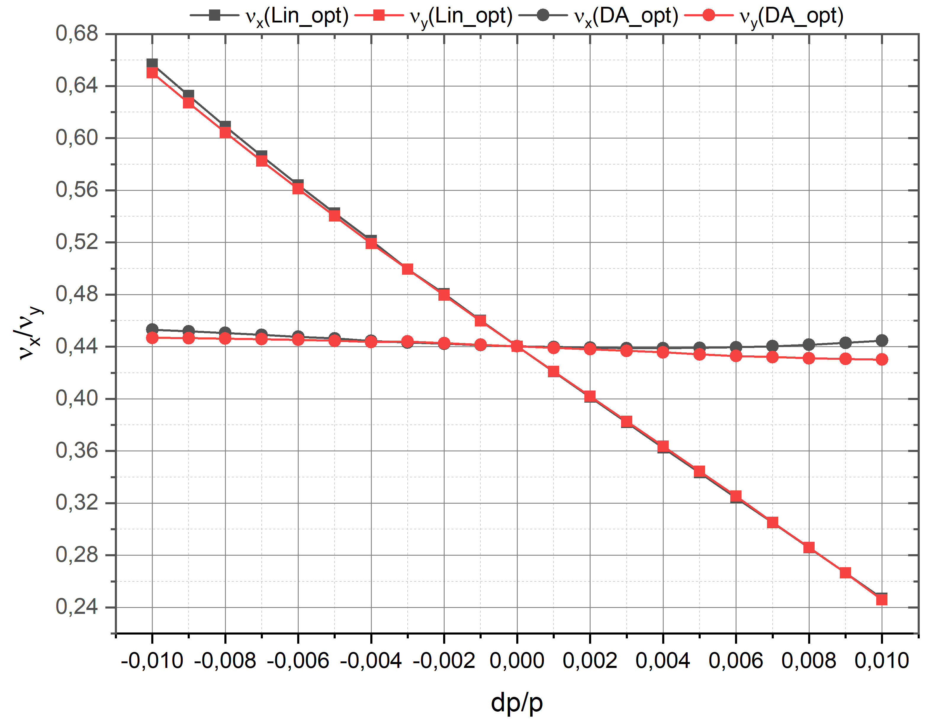
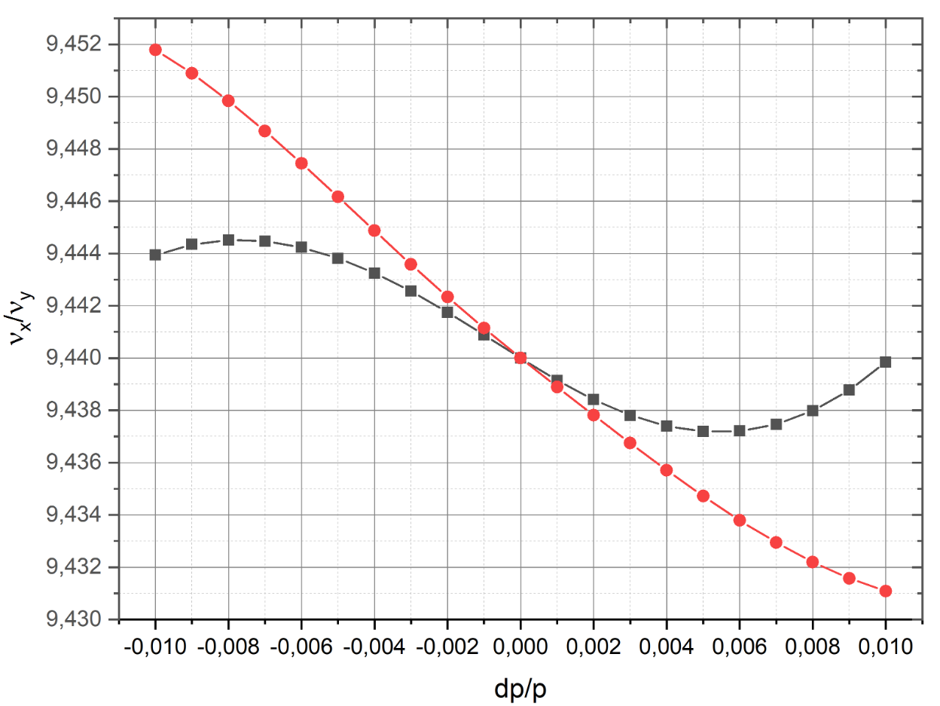
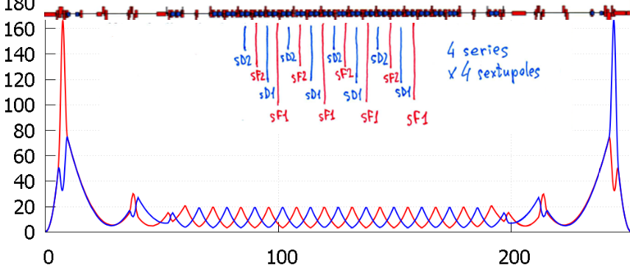


Collider non-linearities 1
$${±4σ}_{p}$$
$${±1σ}_{p}$$
sF1=-47 T/m^2
sD1=11 T/m^2
sF2=-48 T/m^2
sD2=10 T/m^2
DA ??

Slide 14
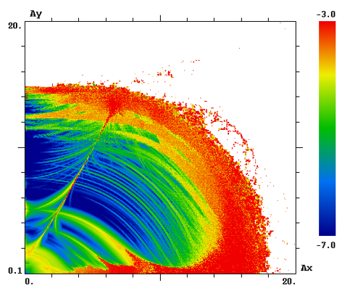
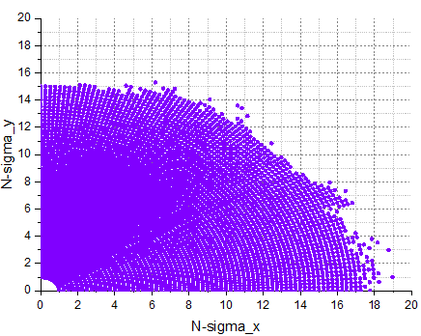

DA
Linear optics
chromaticity correction
Lifetrac
D. Shatilov, BINP
MADX
A. Philippov
$DA ≈16÷18$ $σ$

Slide 15
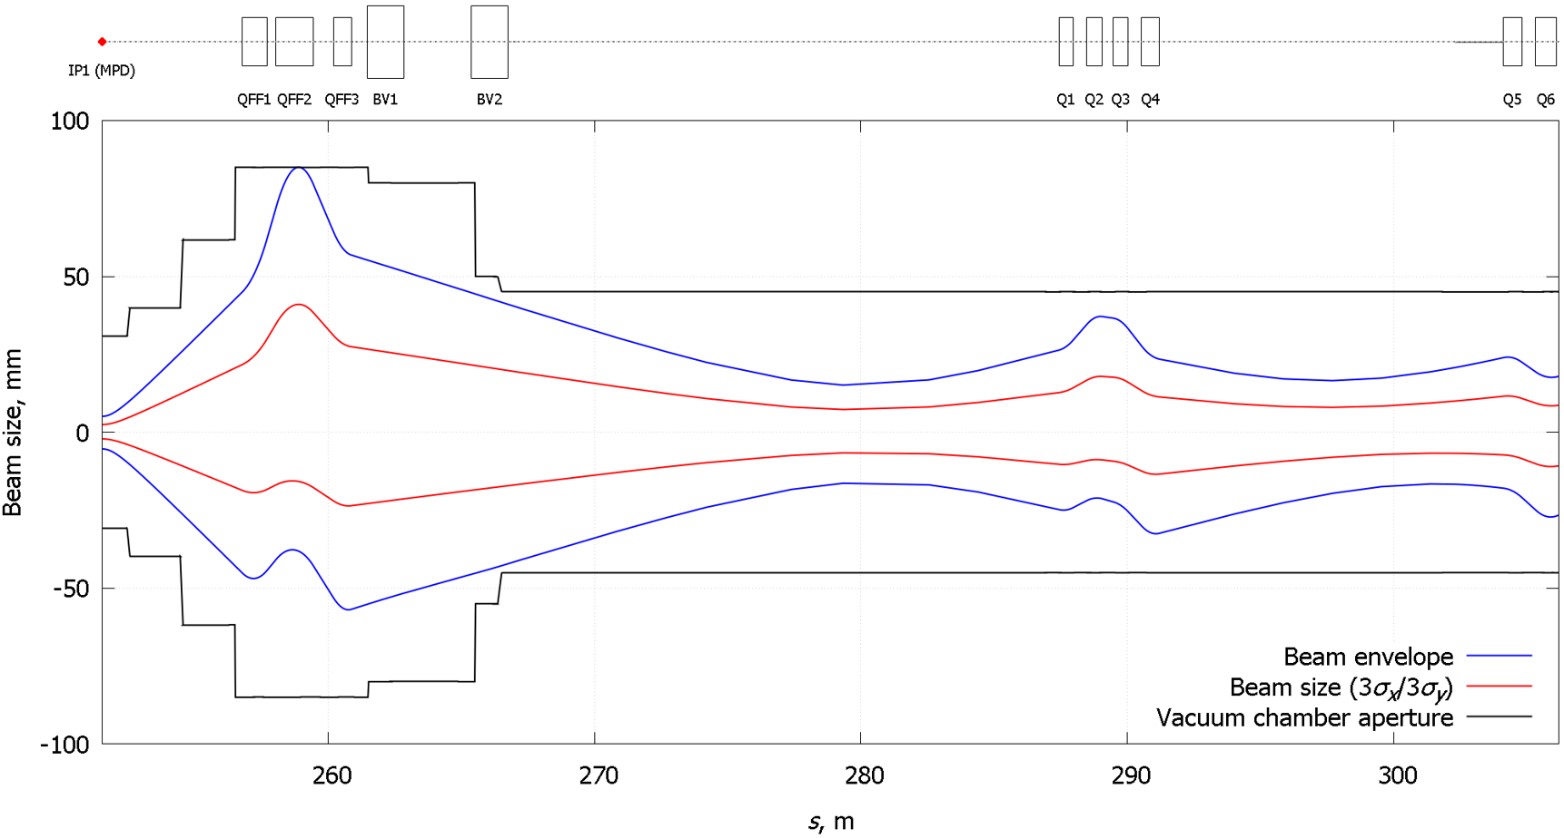
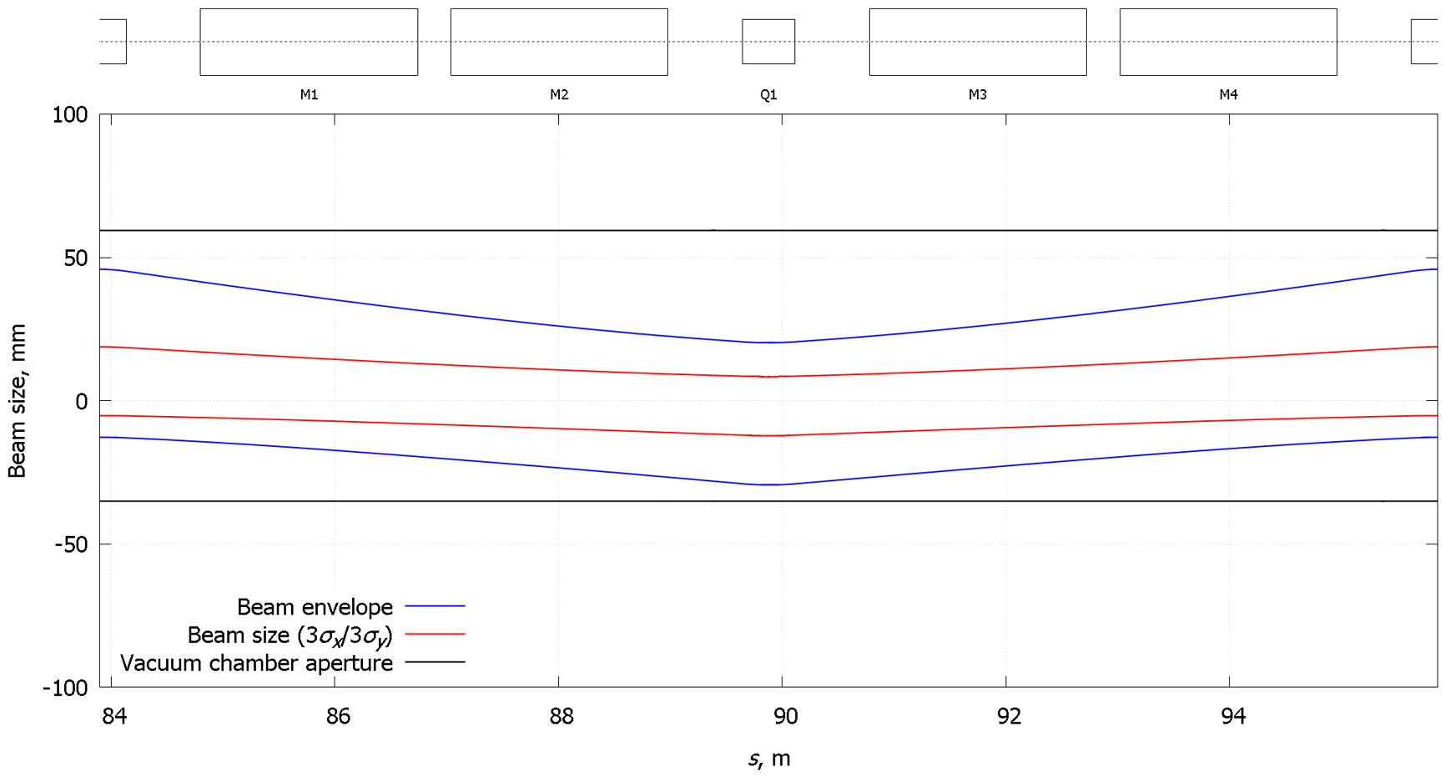
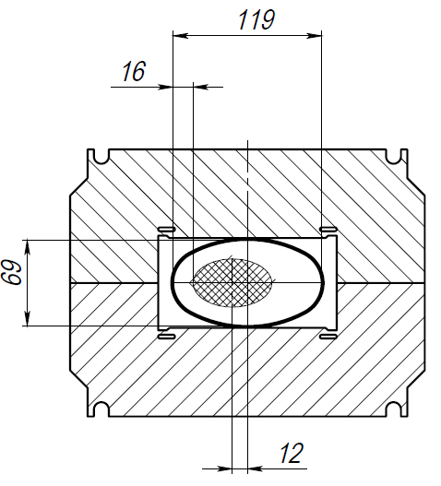
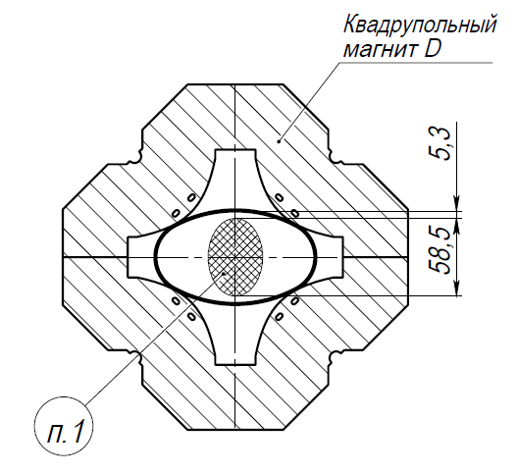
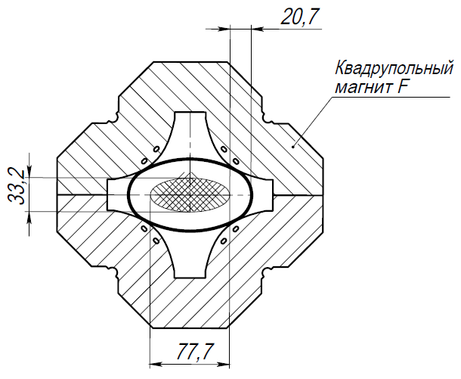
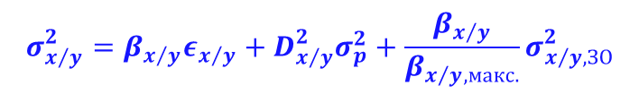
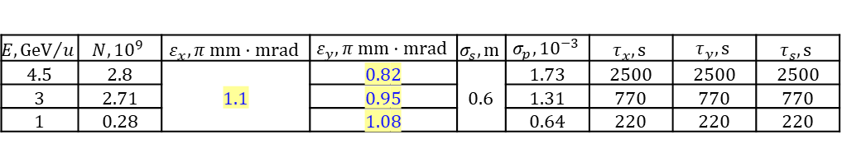
Transverse beam size
$$E, {GeV}/u$$ | $$N, {10}^{9}$$ | $$ε_{x}, π mm·mrad$$ | $$ε_{y}, π mm·mrad$$ | $$σ_{s}, m$$ | $$σ_{p}, {10}^{−3}$$ | $$τ_{x}, s$$ | $$τ_{y}, s$$ | $$τ_{s}, s$$
4.5 | 2.8 | 1.1 | 0.82 | 0.6 | 1.73 | 2500 | 2500 | 2500
3 | 2.71 |  | 0.95 |  | 1.31 | 770 | 770 | 770
1 | 0.28 |  | 1.08 |  | 0.64 | 220 | 220 | 220
Intra-Beam Scattering
Ref. value
$$σ_{x/y}^{2}=β_{x/y}ε_{x/y}+D_{x/y}^{2}σ_{p}^{2}+\frac{β_{x/y}}{β_{x/y,макс.}}σ_{x/y,ЗО}^{2}$$

Slide 16
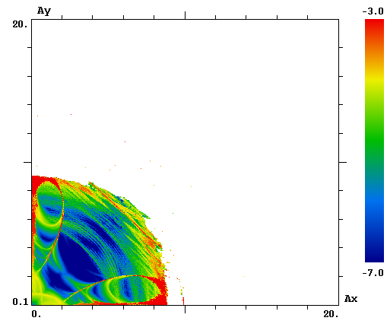


DA
Linear optics
chromaticity correction
fringe fields
Lifetrac
M. Shandov
$DA ≈16÷18$ $σ$
$DA ≈8÷9$ $σ$

Slide 17
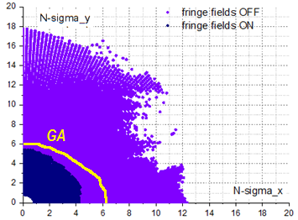







FF-quads fringe fields shrink DA
Initially designed
$$β^{∗}=0.35 m$$
$DA ≈4÷5$ $σ$
$$β^{∗}=0.35 m$$
$$β^{∗}=0.60 m$$
S.A. Glukhov, E.B. Levichev,
RuPAC-2016

Slide 18








Collider non-linearities
FF-quads fringe fields shrink DA
Beta_IP=0.35 m
Beta_IP=0.60 m
25 % luminosity decrease
$$β^{∗}=0.35 m$$
$$β^{∗}=0.60 m$$
fringe field effect need to be corrected

Slide 19






Quadrupoles’ fringe field effect
In NICA effect 2-3 orders stronger due to “lower” energy range

Slide 20




DA
Linear optics
chromaticity correction
fringe fields
Octupole correction of fringe field effect
$DA ≈8÷9$ $σ$
Octupole correction
$DA ≈10÷11$ $σ$

Slide 21




DA
MADX
A. Philippov
$DA ≈8÷9$ $σ$
Octupole correction
$DA ≈10÷11$ $σ$

Slide 22



Ring tune
ideal if
= const for all particles in the beam
$$Q=Q_{0}+δQ_{sc}+δQ_{bb}+ξ_{1}\frac{δp}{p}+ξ_{2}{\left(\frac{δp}{p}\right)}^{2}$$
self space charge effect
beam-beam effect
tunes vs dp/p:

Slide 23







  Space charge
The bunch brightness N_{b}/ε is limited by two main space charge effects:
shift of the betatron tune due to action of beam self space charge field (Laslett tune shift)
$$ΔQ=−\frac{Z^{2}r_{p}}{A}\frac{N_{b}}{4πεβ^{2}γ^{3}}F_{b}$$
(for round beam and smooth focusing)
$$F_{b}=\frac{C}{\sqrt{2π}σ_{s}}$$
- bunching factor
shift of the betatron tune due to action of the colliding bunch field (beam-beam parameter)
$$ξ=\frac{Z^{2}r_{p}}{A}\frac{N_{b}}{4πεβ^{2}γ}\frac{1+β^{2}}{2}$$
For NICA collider parameters
$$δQ_{BB}=δQ_{L}\sqrt{\frac{π}{2}}\frac{σ_{s}}{C}γ^{2}\left(1+β^{2}\right)$$

Slide 24


The beam space charge creates the major luminosity limitation
project value
Space charge
dominated regime
IBS dominated regime

Slide 25


Beam Maintenance in Collider Rings with Cooling Technique
Beam Maintenance in Collider Rings with Cooling Technique
10000
1000
100
10
1
Two modes of the collider operation
E-Cooling
Stochastic cooling
Time, s
τ_{IBS} (3D equilibrium)
τ_{stoch} (D.Möhl)
τ⊥ e-cooling
τ|| e-cooling
IBS dominated regime: Stochastic cooling is used to suppress beam
IBS influence.
Space charge dominated regime: Electron cooling is used to maintain
bunch 3D emittance.
1 1.5 2 2.5 3 3.5 4 4.5 5
E, GeV/u
Space charge dominated mode (ΔQ ≤0.05) | IBS dominated mode
ε and dp/p are optimized independently. The bunch relaxation? is suppressed by cooling. Luminosity is limited by space charge effects | ε and dp/p are “equi-partitioned”, either fast bunch relaxation. Luminosity can be obtained at small ΔQ<0.05
I.Meshkov Three stages of the NICA project COOL’2015 18 September 2015
I.N. Meshkov

Slide 26


DA
Linear optics
chromaticity correction
fringe fields
Octupole correction of fringe field effect
+ magnets’ systematic and random errors
$$?$$
$DA ≈8÷9$ $σ$
need to be checked…

Slide 27





DA
to be solved:
how calculate mitigation scheme for main DA limitation factor ?
  Magnets’ fringe fields
Tracking of path through the IP and fin focus quads
Action of the fringe fields
Distortion of the phase space
Fringe fields + octupoles
…seems better but did not confirmed by
yet…

Slide 28

Thank you

