Slide 1
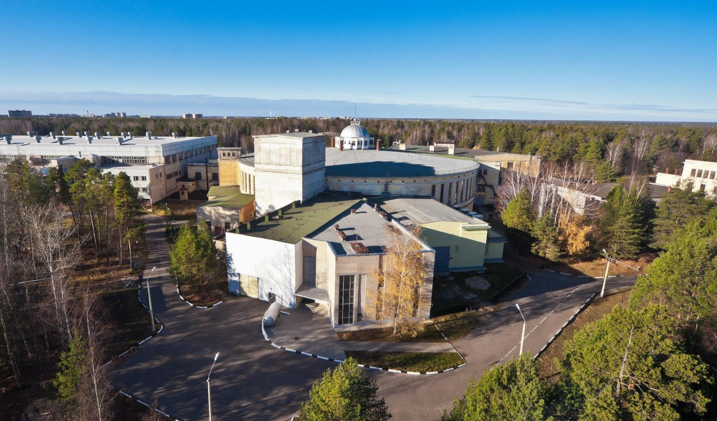
Beams formation for the injection into NICA Booster
Levterov K. on behalf of Acceleration Division
1/25

Slide 2
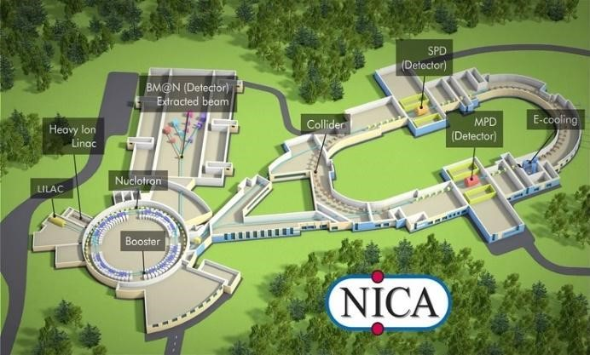
Area layout
2/25

Slide 3
HILAC & LILAC – two injectors for NICA
Into collider
Nuclotron
SPI
RF
IH1
IH2
IH3
LIS
7 MeV/u or 13 MeV for p
p↑, d↑, ions z/A>0.3
600 Me/u
HILАC
Booster
ESIS
RFQ
IH1
IH2
Au³¹⁺ 3.2 MeV/u
Beams of polarized particles p↑ и d↑ and light ions will be accelerated by LILAC (now it is LU-20), then injected into Nuclotron
Heavy ions : HILAC + Booster + Nuclotron
3/25

Slide 4
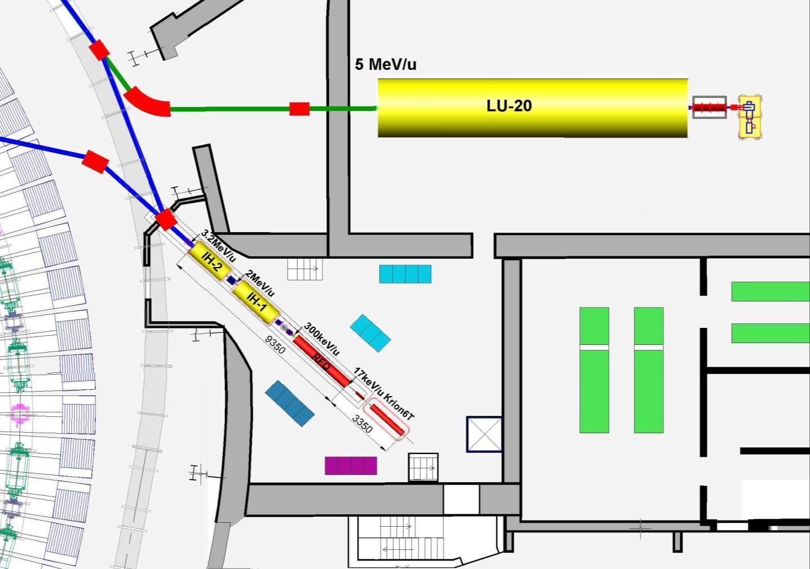
Injection Facility arrangement
p↑, d↑, ions Z/A>0,3
Ions Z/A>0,3
LIS
Transport channel
to Nuclotron
RFQ
Transport channel to booster
SPI
p↑,d↑
10mA
LU-20
(to be replaced with LILAC)
HILАC
ESIS
“KRION”
^{Booster}
^{Nuclotron}
RF amplifier for LU-20
4/25

Slide 5
TOPICS
Alvarez proton linac LU-20 as an ions injector for Nuclotron
Heavy ion injector based on the KONUS IH-DTL accelerating structure
Ion sources of the NICA injection facility
Formation the beams of ions produced with the Laser Ion Source or plasma ion source with the cold hollow cathode for HILAC and Booster commissioning.
RF beam loading and beam output energy vs RF tuning of IH2
Summary.
5/25

Slide 6
Alvarez proton linac LU-20 as an ion injector
1974- LU-20 commissioning, 2-2.5×10¹¹ 20 MeV protons/pulse, 4×10¹² protons/pulse – record achievement
1971- A.M. Baldin paper “Масштабная инвариантность адронных столкновений и возможность получения пучков частиц высоких энергий при релятивистском ускорении многозарядных ионов”
1974 Oct - LU-20 operates in 2ββλ mode as injector of α-particles and deutrons produced by duoplasmotron ion source developed in LHEP
1977 - С⁶⁺, N⁷⁺, O⁸⁺, Ne¹⁰⁺, produced with ESIS “KRION”
1993 – LU-20 reconstruction; proton beam current dropped down from 40 mA to 20 mA, deutron current increased from 10 mA to 14 mA
Main features and limitations of LU-20
Only protons were accelerated in βλ mode up to 20 MeV, the other ones species – in 2βλ up to 5 MeV/u
A/Z≤3 due to the reasons of both maximum RF power limitation and vacuum breakdowns in RF cavity
6/25

Slide 7
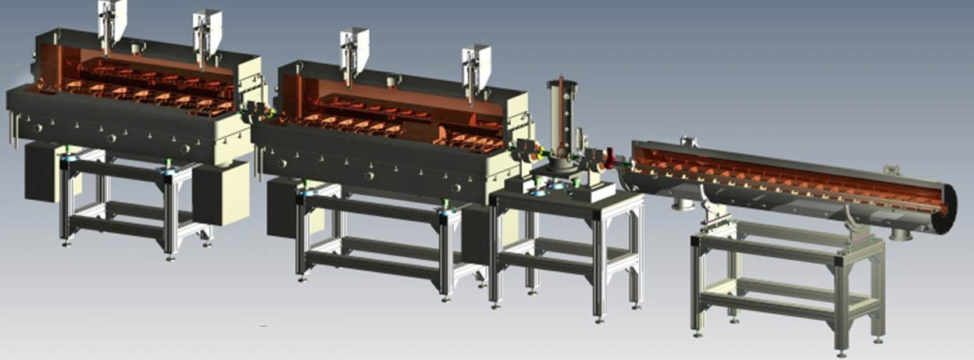
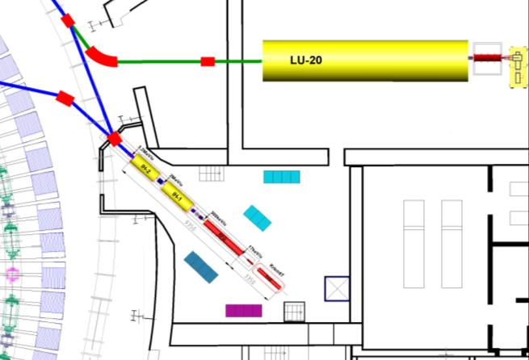
Heavy ion linear Injector based on KONUS DTL structure
HILAC=RFQ + IH1 + IH2
IH-2
IH-1
MEBT
RFQ
A/Z 6.25 | Type | Length | RF power | Output energy
RFQ | 4 - rod | 3.16 m | 120 kW | 0.3 MeV/u
MEBT | Two QD + buncher | 1.4 m | 3 kW (buncher) | 0.3 MeV/u
IH1 | DTL + QT | 2.3 m | 296 kW | 2 MeV/u
IH2 | DTL | 2.1 m | 278 kW | 3.2 MeV/u
7/25

Slide 8
DTL structure IH1 + IH2
Au31+, Ein=300 keV/u Eout=3.2 MeV/u
Accelerating structure «KONUS» (KOmbinierte NUll grad Struktur).
βλ/2 IH-mode, H110.
Main features:
• Main acceleration along a 0° synchronous particle structure with asynchronous beam injection and a surplus in bunch energy compared to the synchronous particle.
• Transverse focusing by a quadrupole triplet or a solenoid lens.
• Longitudinal focusing by a few rebunching gaps operating at φs = -35°
“KONUS” in the world:
• HSI and HLI in GSI FAIR, Eout=1.4 MeV
• LINAC3- CERN, Eout=4.2 MeV
• Injector for Booster of AGS
· HIAF injector
8/25

Slide 9
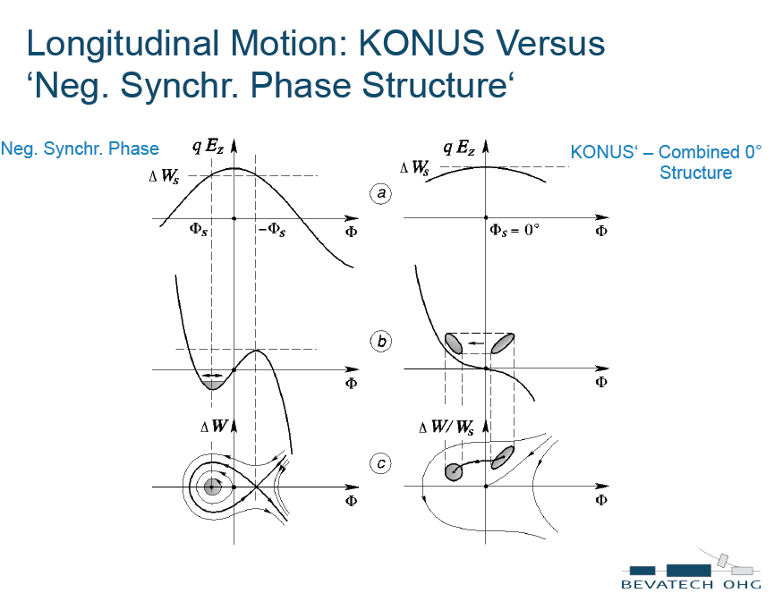
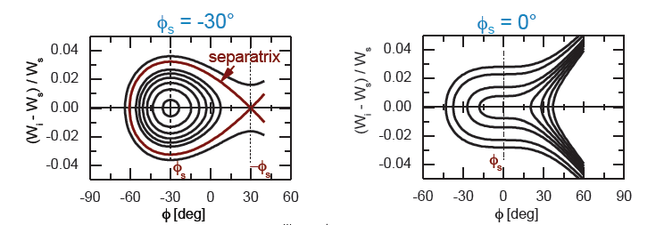
9/25

Slide 10
10/25

Slide 11
11/25

Slide 12
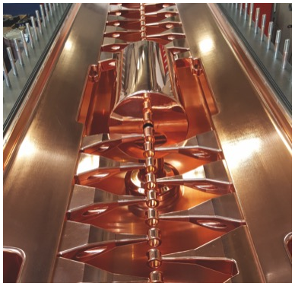
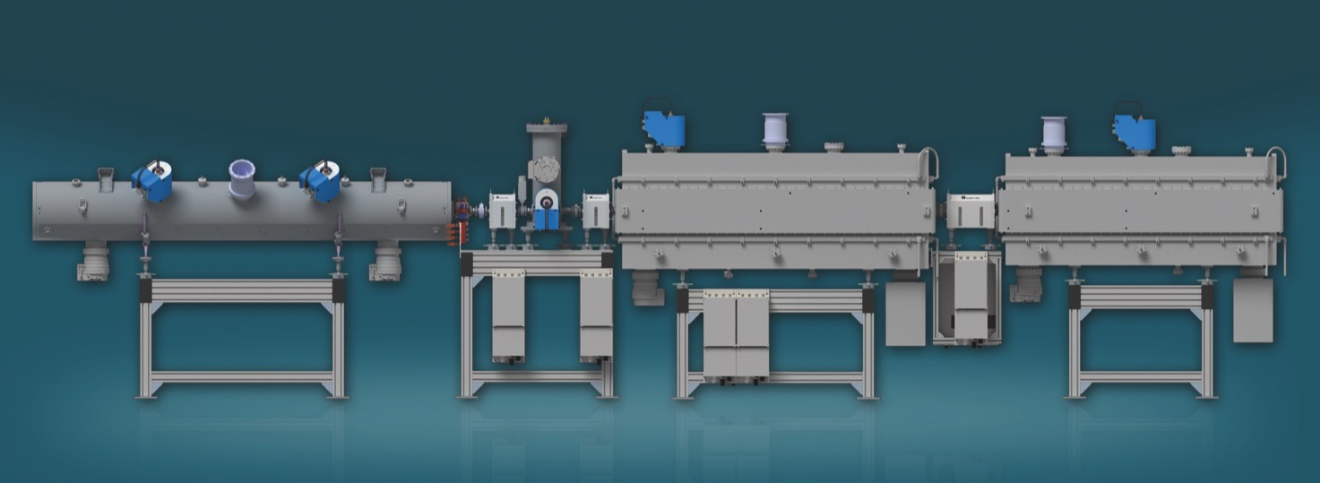
Main parameters and design features of the HILAC
 | HILAC
Species | ₁₉₇Au³¹⁺, ₂₀₇Bi³⁴
Value А/Z | ≤ 6.25
Input energy | 17 keV/u
Output energy | 3.2 MeV/u
Beam current, mA | ≤10
Pulse spread behind debuncher | 10⁻³
Emittance normalized, π мм мрад | 0.6/0.4
Repetition rate | ≤ 10 Hz
Frequency, MHz | 100.625
Transmission, % | 98
IH1 cavity with the
internal triplet inside
12/25

Slide 13
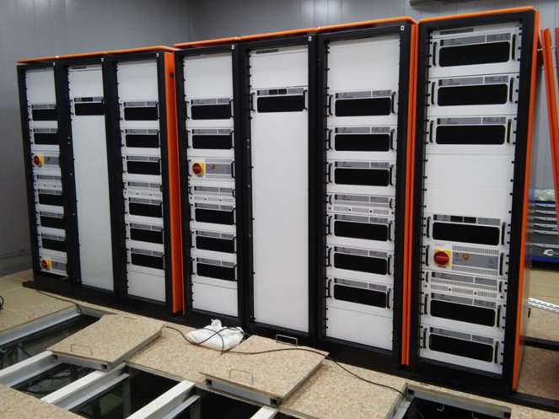
RF power supply system based on the solid state amplifiers
140 kW- RFQ, 340 kW- IH1, 340kW-IH2
4 kW – Buncher, 4 kW - Debuncher
RF pulse duration up to 200 us
13/25

Slide 14
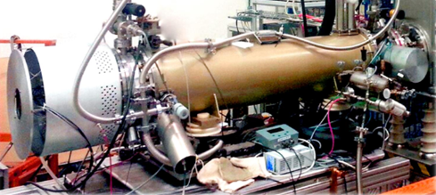
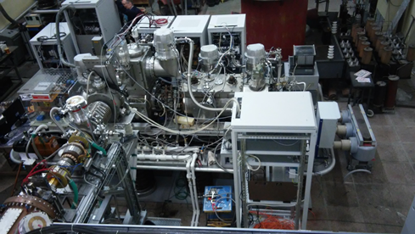
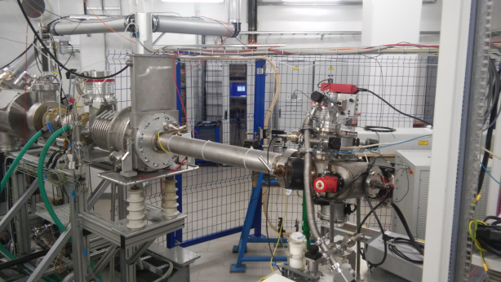
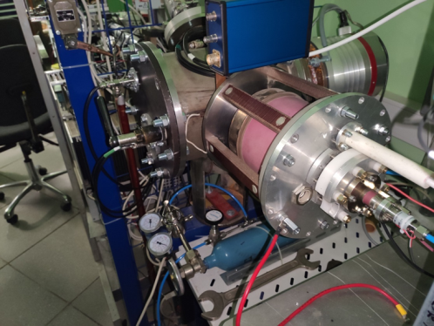
Ion sources of the NICA injection facility
Electron String Ion Source KRION-6T – project ion source for HILAC
heavy ion production Au³¹⁺, Bi^{+Fe33}
Source of Polarized Ions SPI:
project ion source for LILAC
light ion production: p↑, d↑
Laser Ion Source LIS:
wide light ions range:
Traditional species: Li³⁺, ⁷Li³⁺, B⁴⁺, C⁴⁺, N⁵⁺, O⁶⁺, F⁷⁺, Mg⁸⁺, Si¹¹⁺
The new species: Fe
Helium ion source with the cold hollow cathode
He¹⁺ - for commissioning and transmission estimation
14/25

Slide 15

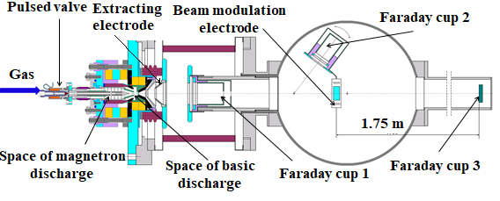
Plasma ion source with a cold magnetron hollow cathode and magnetic plasma compression
Plasma Ion Source is designed to produce the only one species He¹⁺ to estimate HILAC transmission and for the Booster commissioning.
Gas system provides pulsed gas injection into space of magnetron discharge. Pulsed voltage up to 1 kV in the gaps between magnetron anode and magnetron cathode, and between magnetron cathode and anode was provided with the generator of HV pulses. Extraction voltage was supplied with the pulsed transformer and applied to the terminal whereas extraction electrode had a ground potential. Test bench for the TOF studies had three Faraday cups, beam modulation electrode and drift space ~1.8 m (see Fig. 2, 3). The total ion current was estimated with the signal from FC1and the value observed was up to 50 mA. There was the aperture 8 mm diameter in the bottom of the FC1.for the beam passing. About 25 cm behind the extracting electrode Faraday cup 2 and beam modulation electrode mounted together in one assembly could be placed manually on the beam way.
Test bench for plasma ion source
15/25

Slide 16
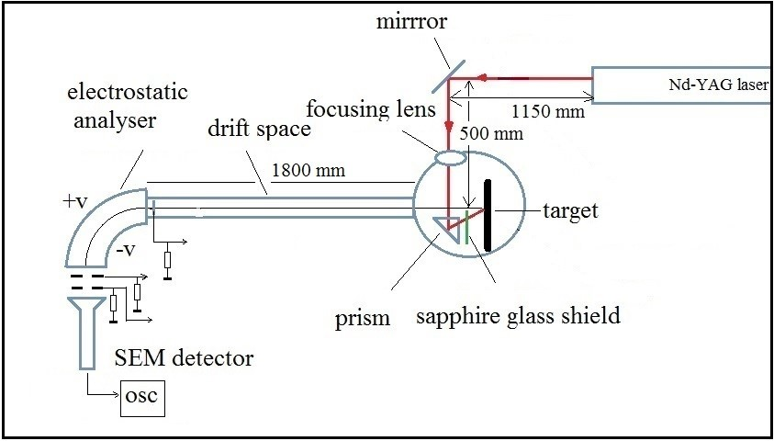
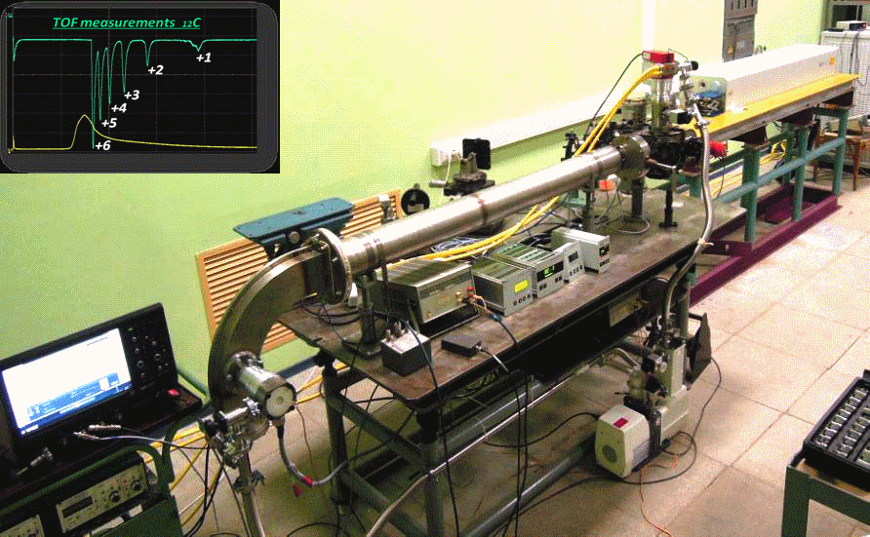
Test bench for laser plasma research
Laser ion source
Light ions with A/Z≤3: ⁶Li³⁺, ⁷Li³⁺, B⁴⁺, C⁴⁺, N⁵⁺, O⁶⁺, F⁷⁺, Mg⁸⁺, Si¹¹⁺. Development of the LIS is focused on the increasing of the radiation flux density on the target for the production of the ions in high charge states to provide as low A/Z ratio as possible. The previous limitation A/Z≤3 was limited by the maximum RF power and RF breakdown in cavity of proton linac LU-20. It seems reasonable to think about new sorts of heavier ions produced with Laser Ion Source that may be accelerated by HILAC in terms of “upgraded” A/Z=6.25.
Note that HILAC was commissioned with the beams of С²⁺ ions from LIS having mass-to-charge ratio A/Z=6 close to the project one A/Z=6.25 that the ions Au³¹⁺ or Bi³³⁺ have.
16/25

Slide 17
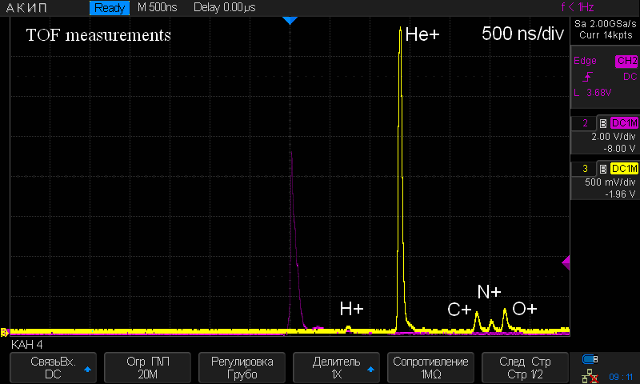
TOF spectra of He¹⁺ ions produced with
Helium Ion Source
Yield of of He¹⁺ ions ̴ 95%
17/25

Slide 18
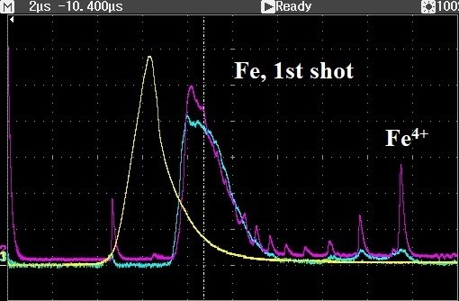
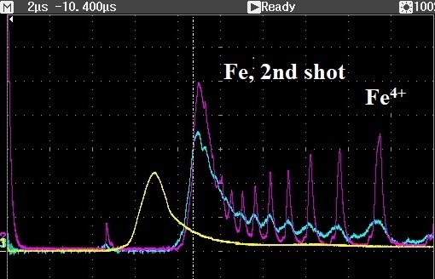
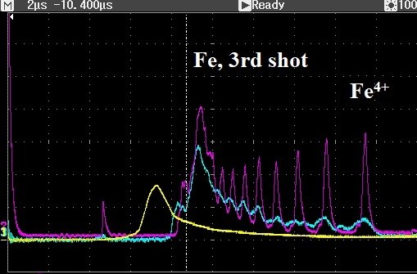
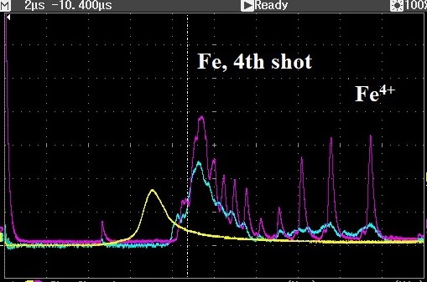
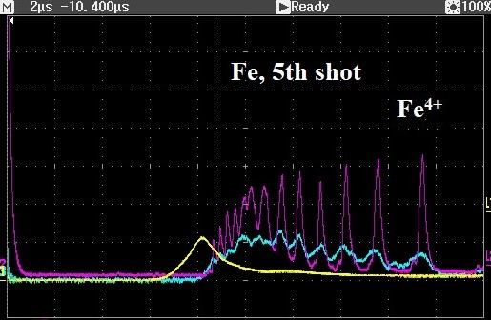
TOF spectra of ferrum ions produced with
Laser Ion Source
Fe ions charge states shot by shot evolution, lilac - SEM detector signals, blue - collected signal at the SEM input, yellow - collected signal at the analyzer input, white vertical line is TOF marker for Fe16+. Ionization energy for Fe¹⁶⁺ -489 eV, Fe¹⁷⁺ -1262 eV.
18/25

Slide 19
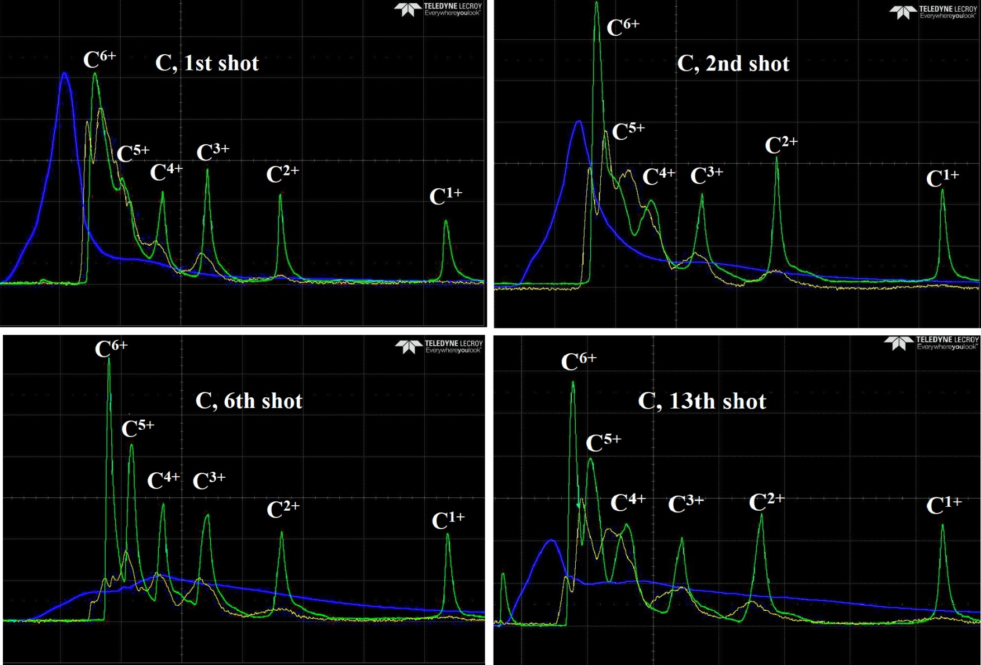
TOF spectra of carbon ions produced with
Laser Ion Source
Carbon ions charge states shot by shot evolution (2us/div), green - SEM detector signals, yellow – collected signal at the SEM input, blue - collected signal at the
analyzer input. Ionization energy for С⁶⁺ 490 eV.
19/56

Slide 20
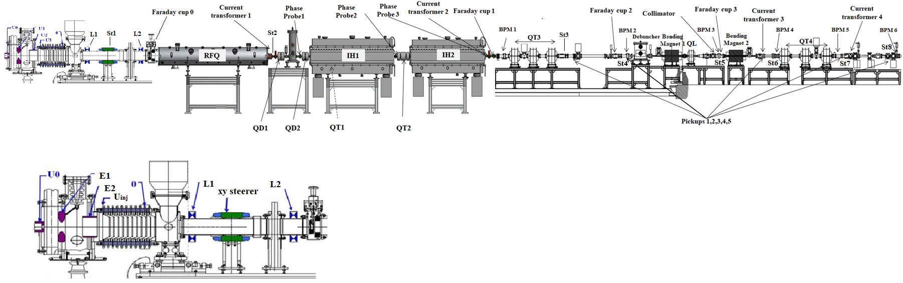
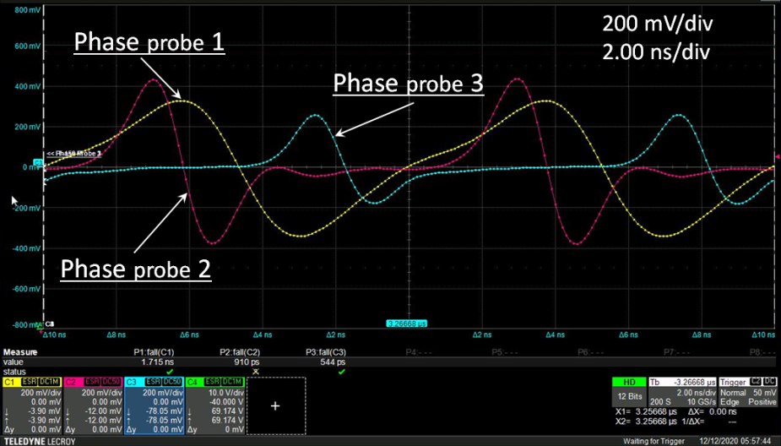
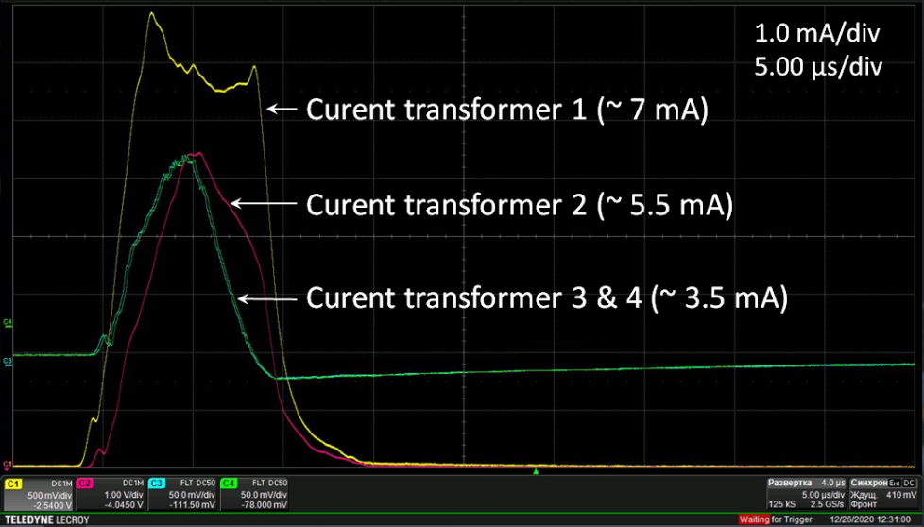
2020-2021 – assembly of the HILAC-Booster channel,
He¹⁺ beams accelerated with HILAC were used in the first run of NICA Booster
Beam diagnostic
MEBT
LEBT
HEBT
Phase probes-3, current transformers-4, shoebox pickups- 5, Faraday cups-4, beam profile monitors - 6
20/25

Slide 21
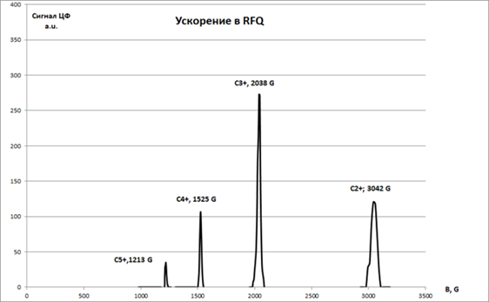
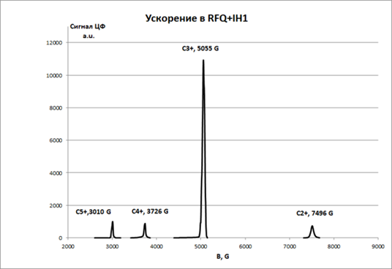
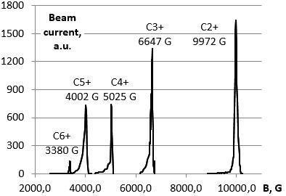
2015-2018 - HILAC assembly and commissioning
The beams of С²⁺ С³⁺ С⁴⁺ С⁵⁺ С⁶⁺ ions with a value A/Z=6 that is closed to the project one 6.25 from Laser Ion Source were accelerated for the HILAC commissioning. The energy of ions accelerated by each cavity step by step was measured.
FC signal,
a.u.
Acceleration in RFQ, E=300 keV/u
FC signal,
a.u.
Acceleration in RFQ+IH1, E=1.84 MeV/u
Acceleration in RFQ+IH1+IH2, E=3.2 keV/u
FC signal,
a.u.
21/25

Slide 22
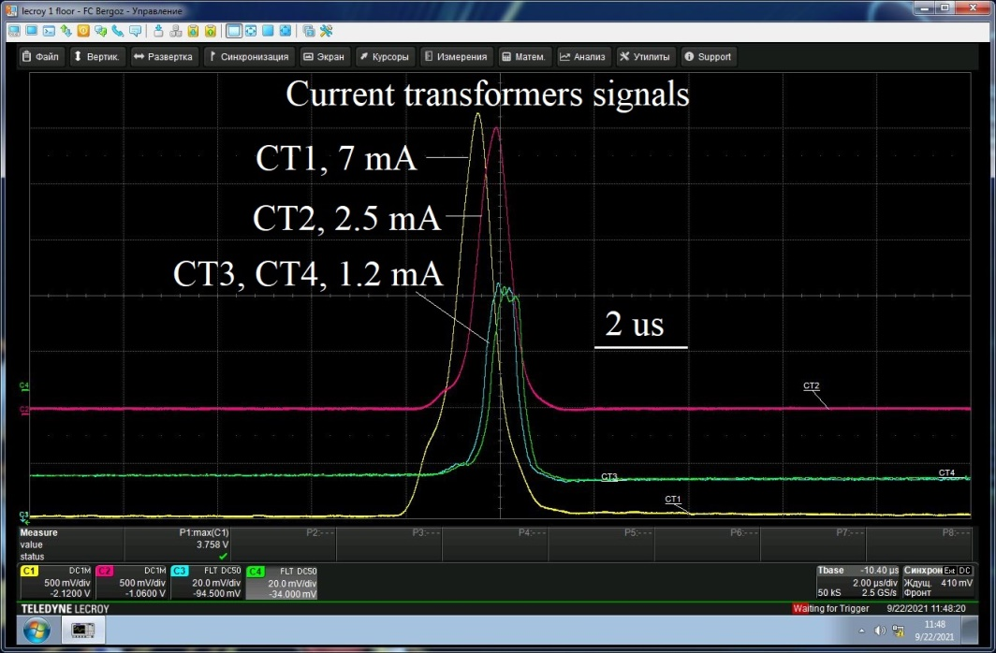
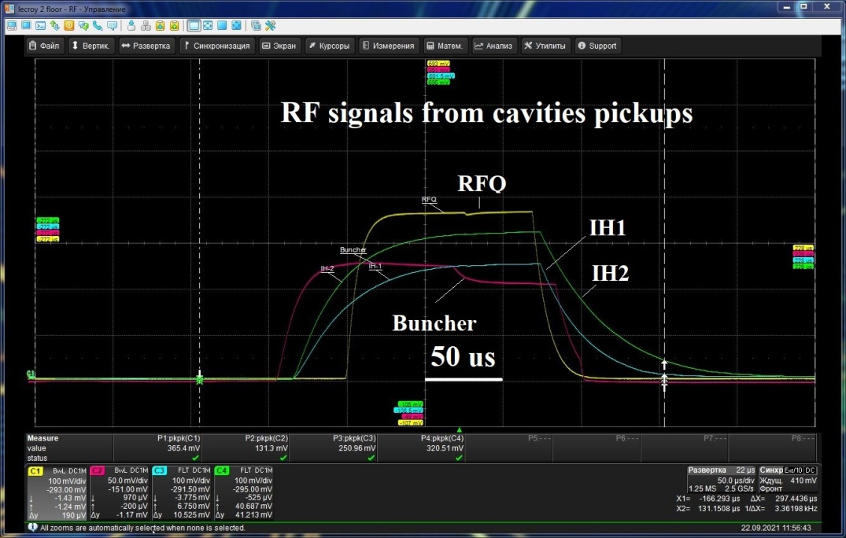
Acceleration of the Fe¹⁴⁺ ions produced with a Laser Ion Source
by HILAC and injection into Booster
Fe¹⁴⁺ ions accelerated in LEBT up to 17 keV/u, ion current duration ~2 us, 7.5 mA behind RFQ, 2.5 mA – behind IH2, 1.2 mA at the injection point.
No RF beam loading was observed
22/56

Slide 23
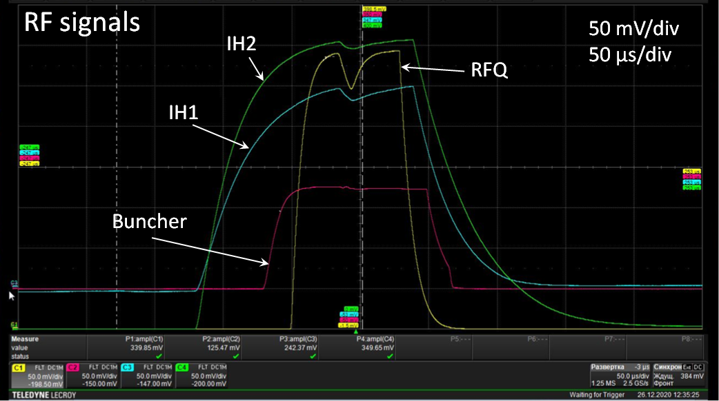
RF beam loading
Level of RF power inside each cavity was controlled by the pickups signals monitoring. The detected signals of RFQ, IH1 and IH2 pickups were observed synchronously to the beam currents presented. One can see how the part of stored field energy was eaten by the beam passing through. One can also see the reaction of the amplifier – pushing back the cavity to equilibrium level after the extra requirement of beam acceleration has gone.
RF compensation is needed evidently.
RF signals from pickups under beam loading
23/25

Slide 24
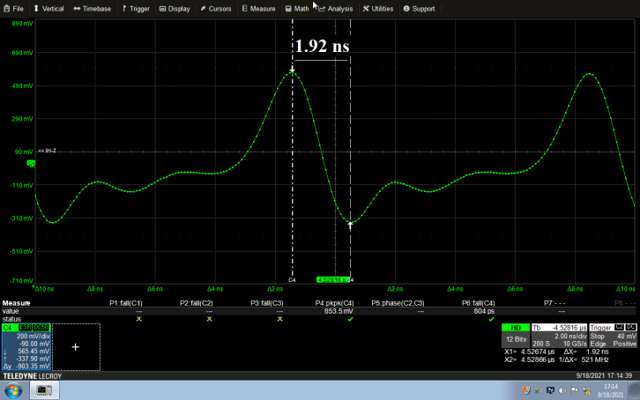
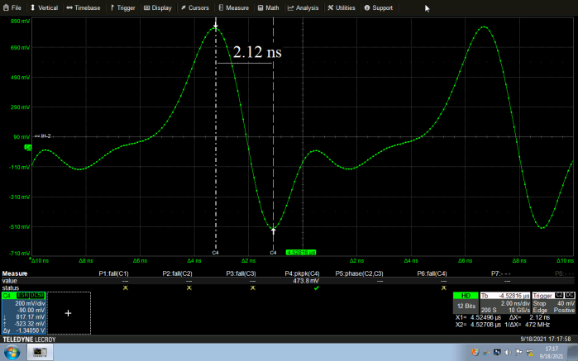
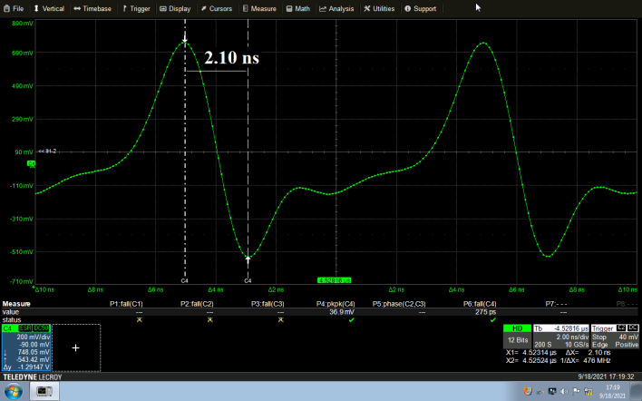
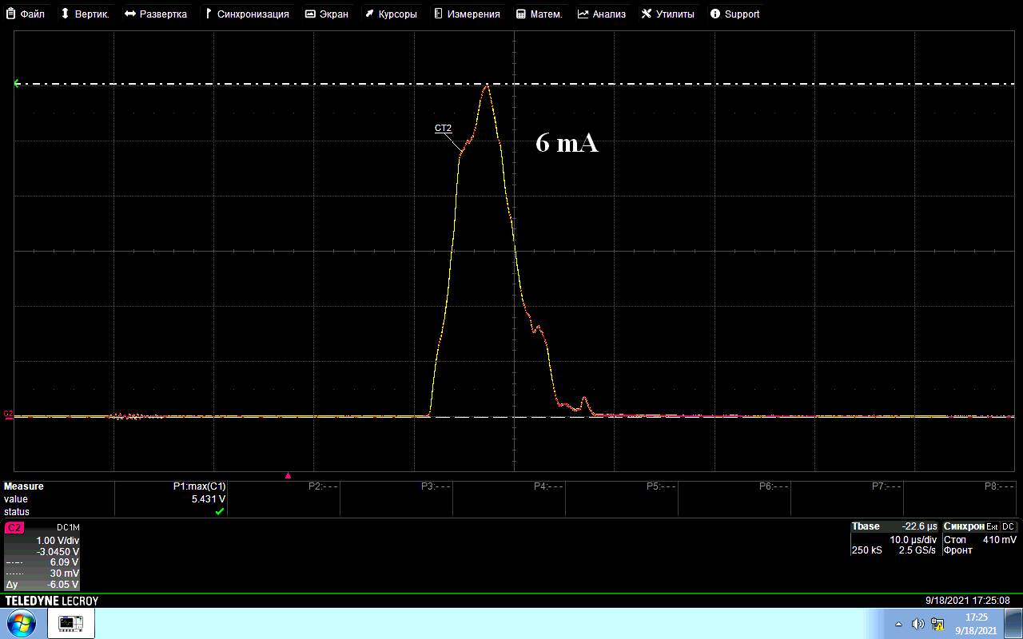
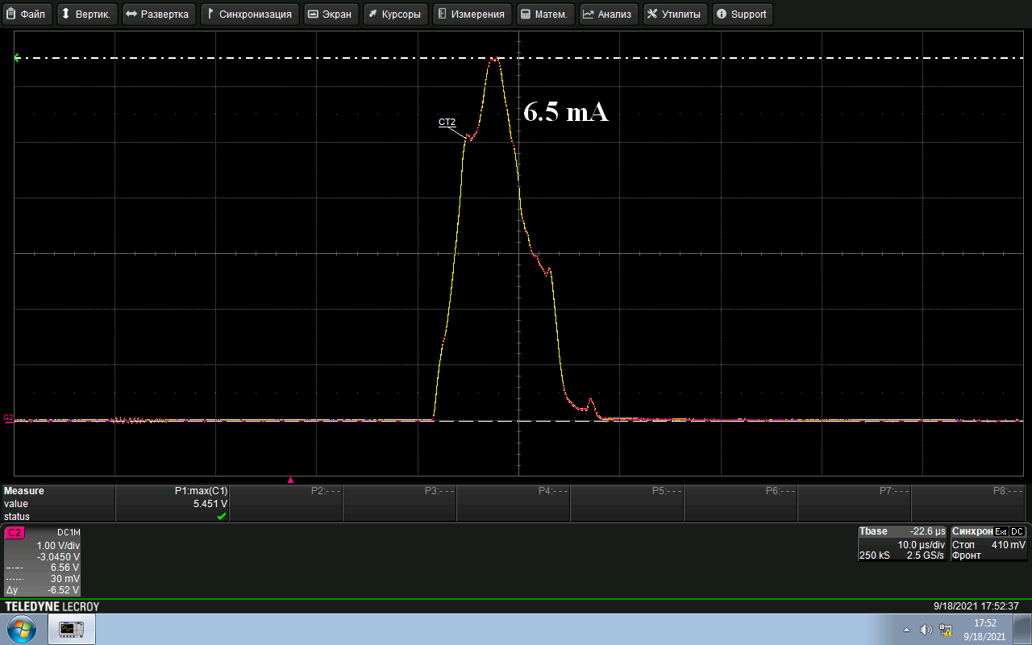

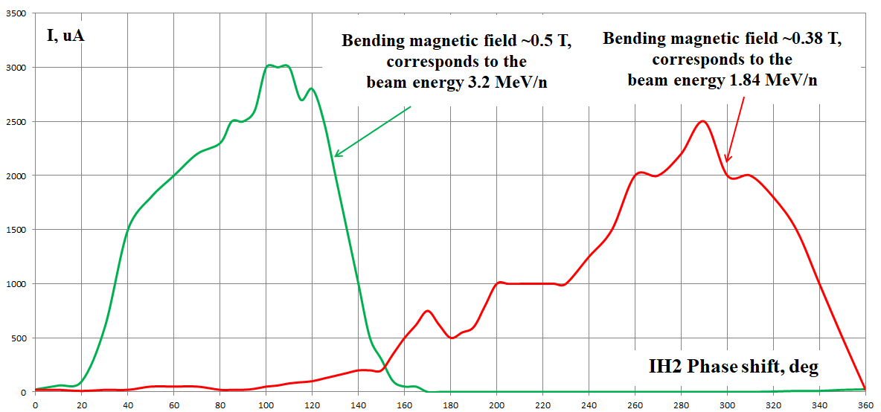
Two energy beams at the output depending on the RF phase in IH2,
phase probe behind IH1 and Faraday cup behind first bending magnet signals
3.2 MeV/u, bunch 1.92 ns, 6mA
IH1 ON
1.84 MeV/u, bunch 2.12 ns, 6.5mA
IH1 OFF
1.84 MeV/u, bunch 2.10 ns, 5/2mA
IH1 ON
FC1 signal
a.u.
Micro bunch duration
3.2 MeV/u ~ 1.9 ns
1.82 MeV/u ~ 2.1 ns
24/25

Slide 25
Summary
The linear heavy ion injector based on HILAC has been commissioned with the beams of C²⁺ ions having A/Z ratio close to the project one 6.25
The beams of He¹⁺ and Fe¹⁴⁺ have been accelerated and injected into Booster in its two first runs
Injector should be tuned for the maximum beam transmission
The RF system should upgraded to compensate beam RF loading
Two beam injection energies are available
Range of accelerated ions provided by new injector may be extended due to upgraded LIS based on Nd-YAG laser and “upgraded” ratio A/Z=6.25 available for HILAC.
Thanks
25/25

