Slide 1


First Experience of Production and Testing the Superconducting Quadrupole and Corrector Magnets for the SIS100 Heavy Ion Accelerator of FAIR
E. Fischer, Y. Bespalov, V. Borisov, H. Khodzhibagiyan, D. Khramov, D. Nikiforov,
T. Parfylo, M. Petrov, A. Shemchuk, D. Zolotykh
JINR, Dubna, Russia
A. Waldt, A. Bleile, GSI, Darmstadt, Germany

Slide 2
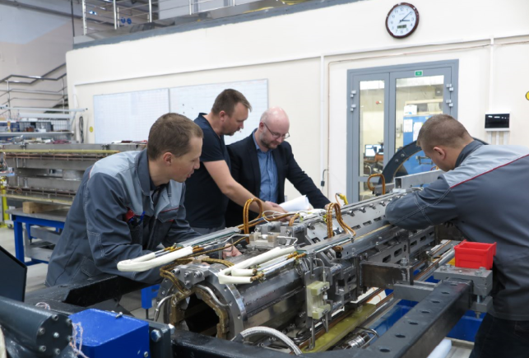
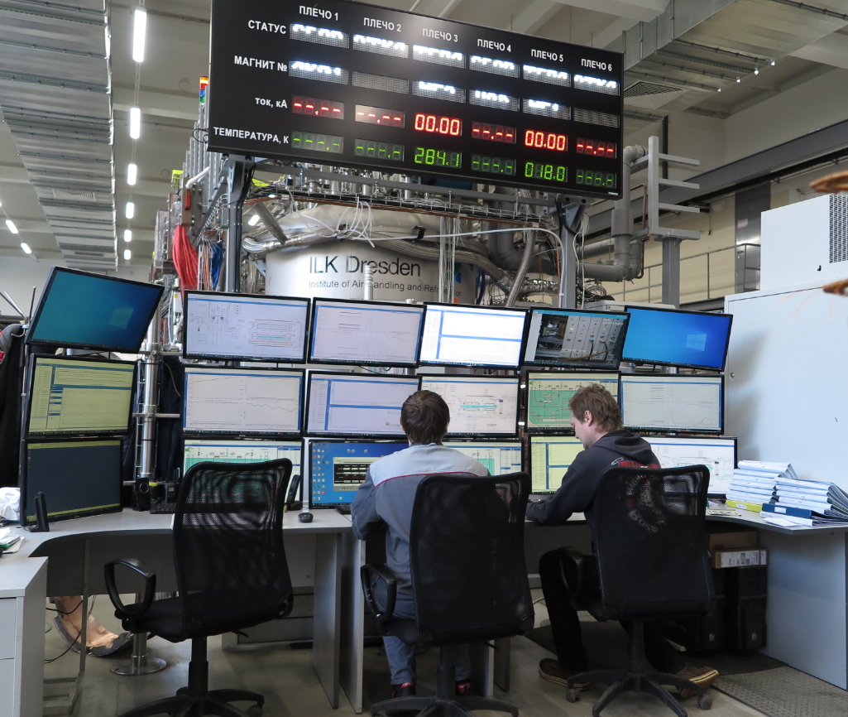
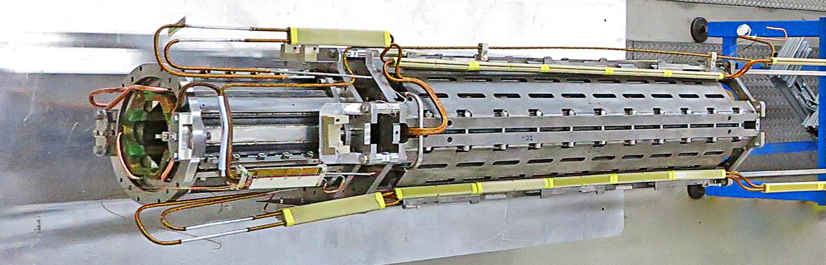

Outline
The SIS100 Lattice Structure
  Doublet Modules
  Quadrupole Units
2. Main Quadrupoles and Correctors
  Design of the Superconducting Magnets
  Status of Series Production
  Test Results and Reproducibility
3. Summary
Notes:
2
2

Slide 3
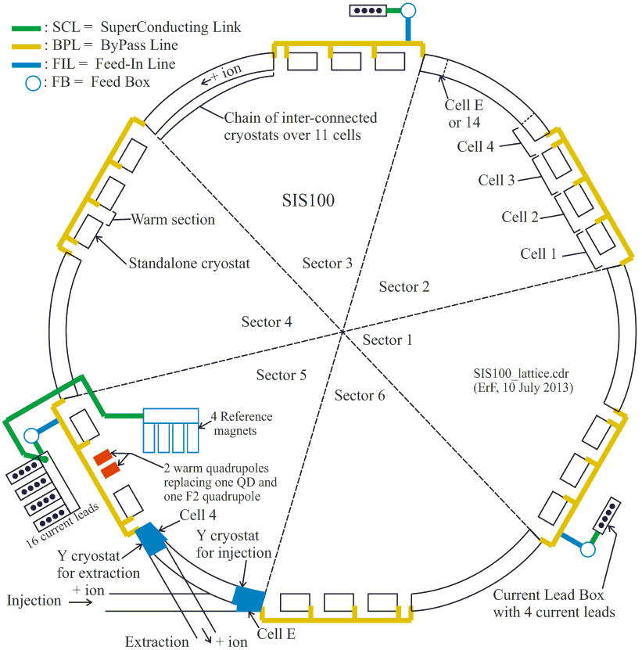
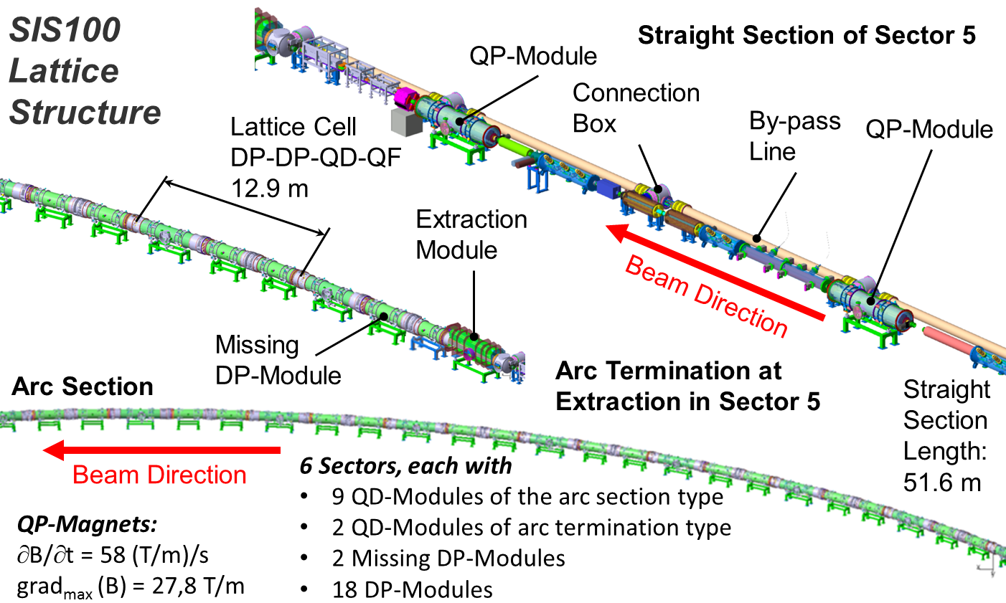
SIS100 Lattice Structure
◄ The six sections of the synchrotron ring
with its Bypass Lines, the cryogenic and
electrical supply systems.
Cryomagnetic components in sector 5 ►

Slide 4
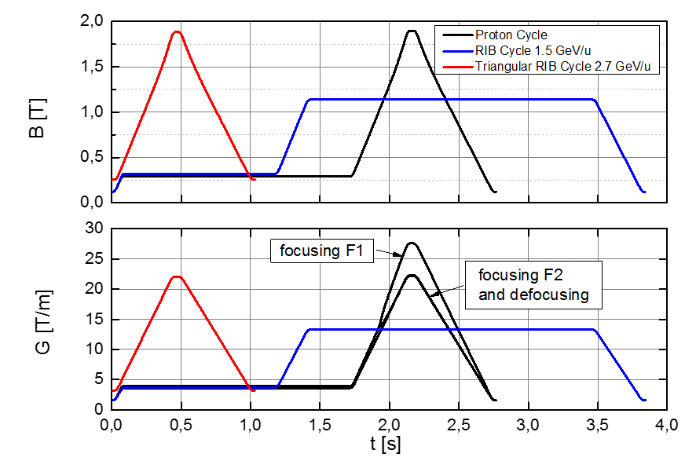
Examples of the SIS100 Operation Cycles
main dipoles
three families of quadrupole magnets
F1, F2, QD
See also E. Fischer et al.
Start of the Series Production for the Cryogenic Magnet Corrector Modules of FAIR
https://jacow.org/ipac2019/papers/THPTS010.pdf

Slide 5
SIS100 Lattice Structure
Quadrupole Units and Doublet Modules
Abbreviations
QD | Defocusing quadrupole
F1 | Focusing quad. 1
F2 | Focusing quad. 2
B | Beam position monitor
V | Vertical chrom. sextupole
H | Horizontal chrom. sextupole
S | Steering magnet
M | Multipole corrector magnet
C | Cryo-ion-catcher (collimator)
T | Drift tube
b | modified busbars
i | injection Y cryostat
x | extraction Y cryostat
s | Star shape chamber
P | Cryo-sorption-pump
R | Roughing pump with CWT
Unit Configuration |  |  | Doublet Configuration
Upstream | Centre | Downstream | Joined Name | Short Name | Quantity
QDB | -TRP- | SF2 | QDB-TRP-SF2 | 2.123 | 15
QDBs | -TRP- | SF2s | QDBs-TRP-SF2s | 2.13s | 2
QDBb | -T- | SF2Mb | QDBb-T-SF2Mb | 2.4 | 5
QDBx | -T- | SF2Mx | QDBx-T-SF2Mx | 2.4x | 1
VQD | -CR- | SF2B | VQD-CR-SF2B | 2.5 | 6
BQD | -C- | SF1H | BQD-C-SF1H | 1.6A | 12
VQD | -CR- | SF1B | VQD-CR-SF1B | 1.7B | 12
BQD | -C- | SF2H | BQD-C-SF2H | 2.8C | 12
BQD | -CR- | SF2J | BQD-CR-SF2J | 2.9D | 12
MQDb | -C- | SF1Bb | MQDb-C-SF1Bb | 1.E | 5
MQDi | -C- | SF1Bi | MQDi-C-SF1Bi | 1.Ei | 1
 |  |  | Total |  | 83
Example: Type 2.5
Unit (type SF2B)
Integrated QDM
Doublet (cold mass)

Slide 6
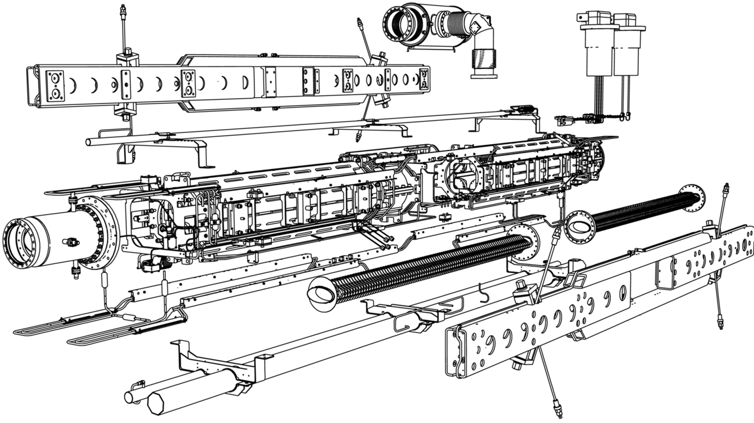
QP Units and Doublet Modules
Focusing QP-Magnet (within unit)
Steering Magnet
Cryo Catcher
Roughing CWT
Local Current Leads
Common Girder and Suspension
Defocusing
QP-Magnet
(within Unit)
Sextupole Magnet
Bus Bar System
Beam Vacuum Chamber, Defocusing
Beam Position Monitor
Common Girder and Suspension
Voltag Breaker
He-Supply and Return, Magnet cooling
Beam Vacuum Chamber, Focusing
Bus Bar System

Slide 7
Main Quadrupoles and Correctors
All SIS100 lattice quadrupole and corrector magnets have to be made in JINR, Dubna. The Nuclotron-type design, based on a cold, window-frame iron yoke and a winding of the hollow superconductor, was chosen for the SIS100 magnets.
Characteristics of the magnets
Characteristic | Lattice Quadrupole | Corrector magnet
 |  | Multipole (Q/S/O) | Steerer | Chrom. Sextupole
Number of magnets | 166 | 12 | 84 | 42
Max. field strength, T/m^{n-1} | 27.77 | 0.75/25/333,3 | 0.37 | 232
Effective magnetic length, m | 1.264 | 0.75 | 0.403/0.41 | 0.383
Aperture diameter, mm | 100 | 150 | 135 | 120
Operation current | 10512 | 250/246/240 | 245/241 | 252
Magnet weight, kg | 850 | 200 | 120 | 145

Slide 8
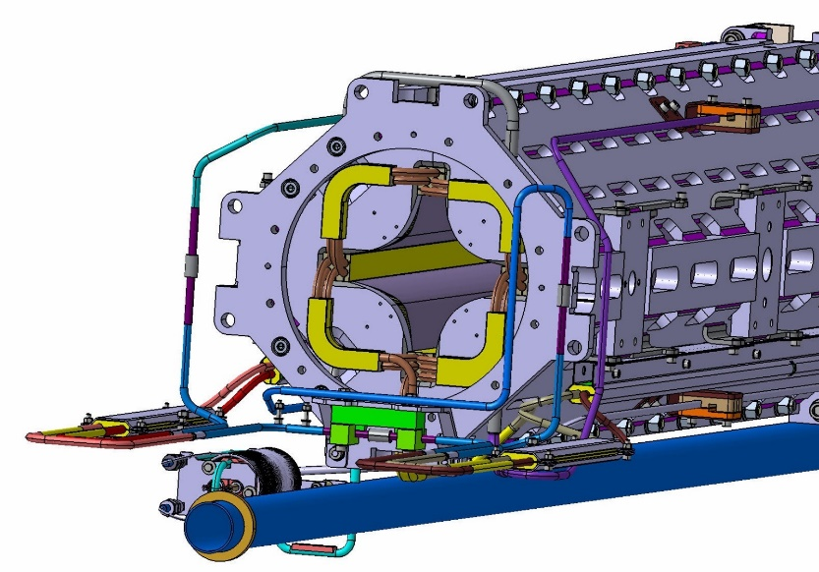
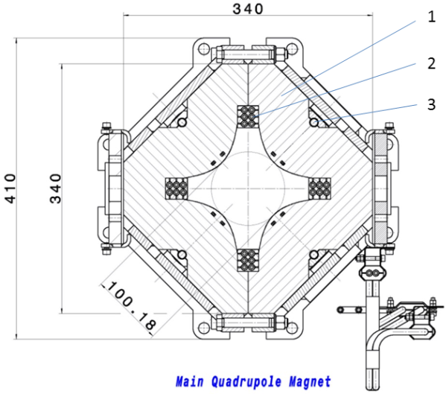
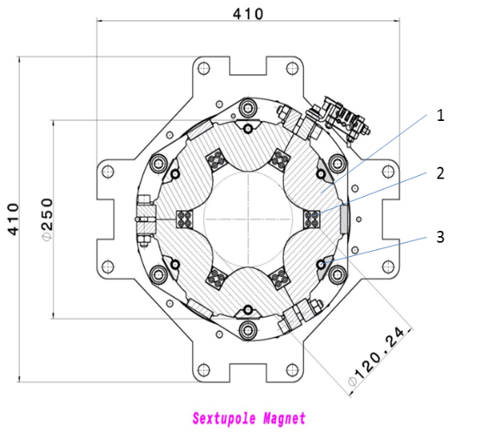
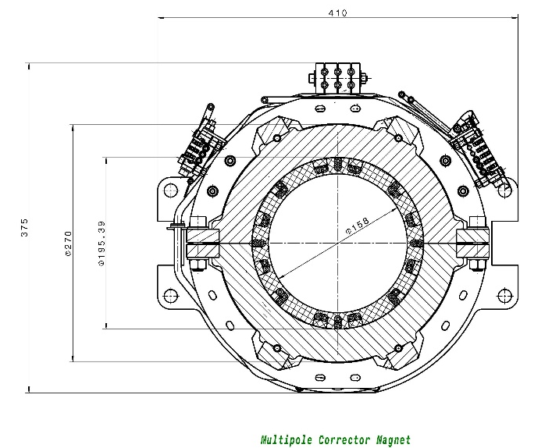
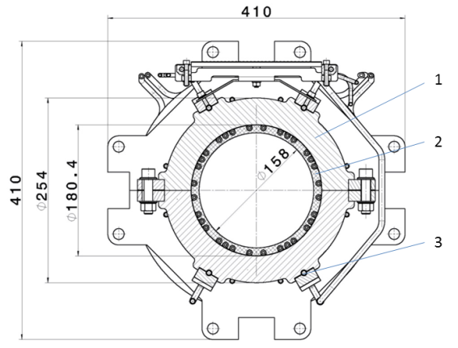
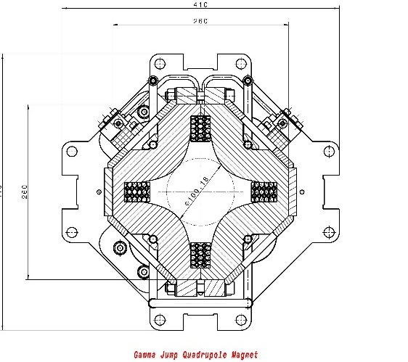
Design of the superconducting Magnets
Main Quadrupole
Sextupole
Steerer
Multipole Corrector
Gamma Jump Quadrupole

Slide 9
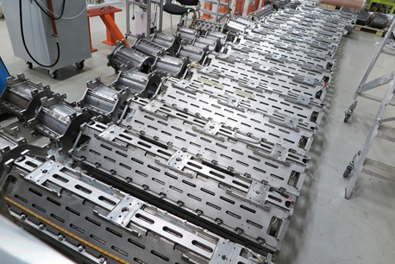
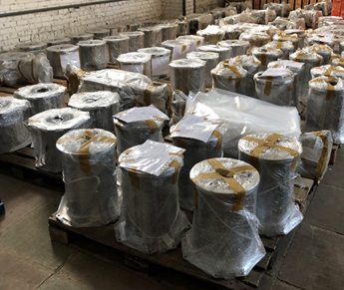
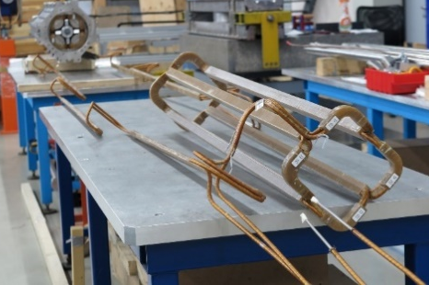
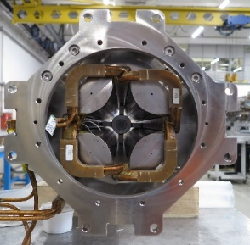
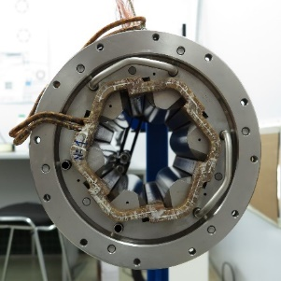
Status of Series Production
Magnet yokes
Magnet type | at JINR | Completion % | Incoming inspection pass
Quadrupole | 173 | 100 | 173
Sextupole | 85 | 100 | 85
Steerer | 44 | 100 | 44
Superconducting coils
Magnet type | Produced at JINR | Completion % | Incoming inspection pass
Quadrupole | 34 | 20 | 34
Sextupole | 21 | 25 | 21
Steerer | 22 | 50 | 22
Magnet and Unit assembling
Units | Assembled and delivered | Completion %
Series 2.5 | 12 | 100
Series 1.7B | 8 | 33
Total | 20 | 12

Slide 10
Test Results and Reproducibility
For details of cryogenic procedures and magnetic measurement systems see, e.g.:
V. Borisov et al.
Magnetic Field Performance of the First Serial Quadrupole Units for the SIS100 Synchrotron of FAIR https://jacow.org/ipac2021/papers/tupab383.pdf
D. Nikiforov et al.
SC Magnets for Project of NICA
RuPAC 2021, WEB01
A. Shemchuk et al.
Magnetic Field Measurements for the Collider Magnets and FAIR Quadrupole Units
RuPAC 2021, WEB02
T. Parfylo et al.
Vibrating Wire System for Fiducialization NICA Booster Superconducting Quadrupole Magnets
RuPAC 2021, WEPSC17

Slide 11
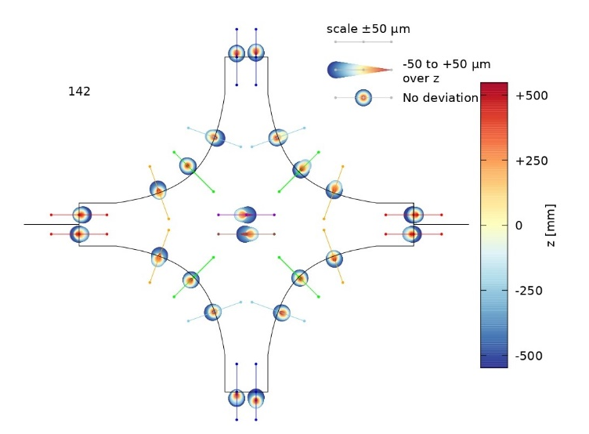
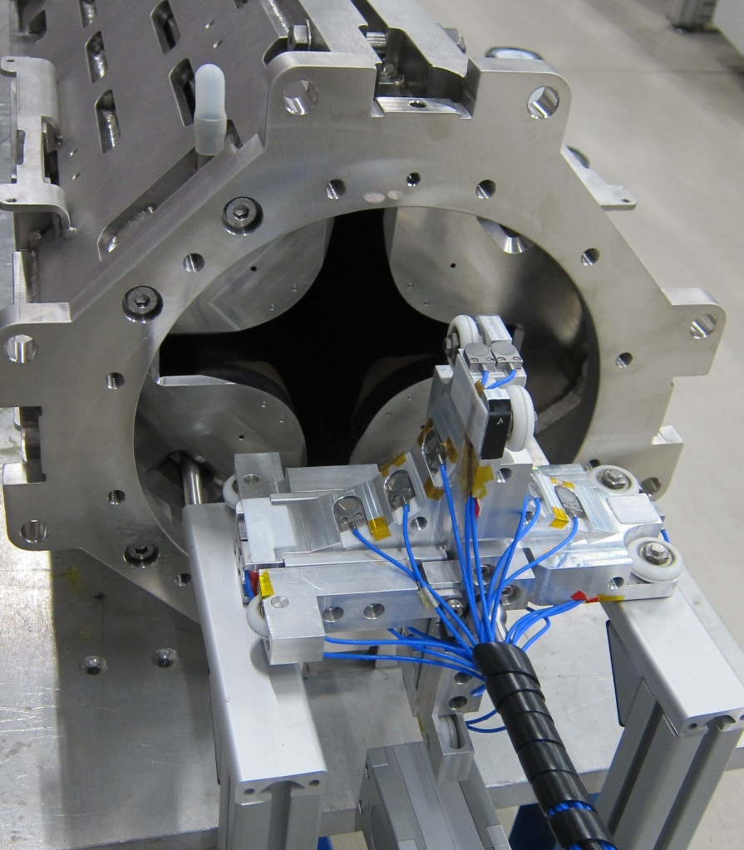
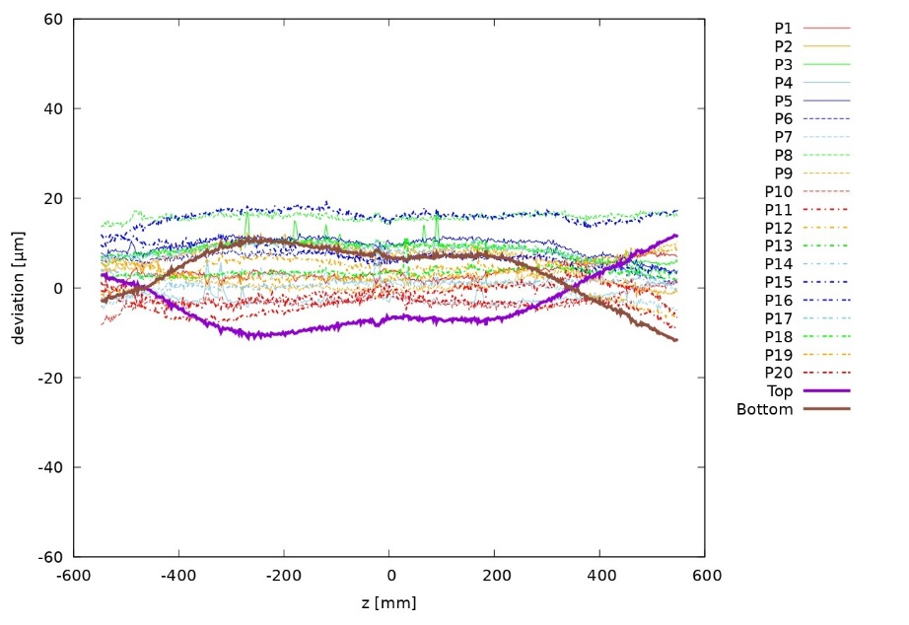
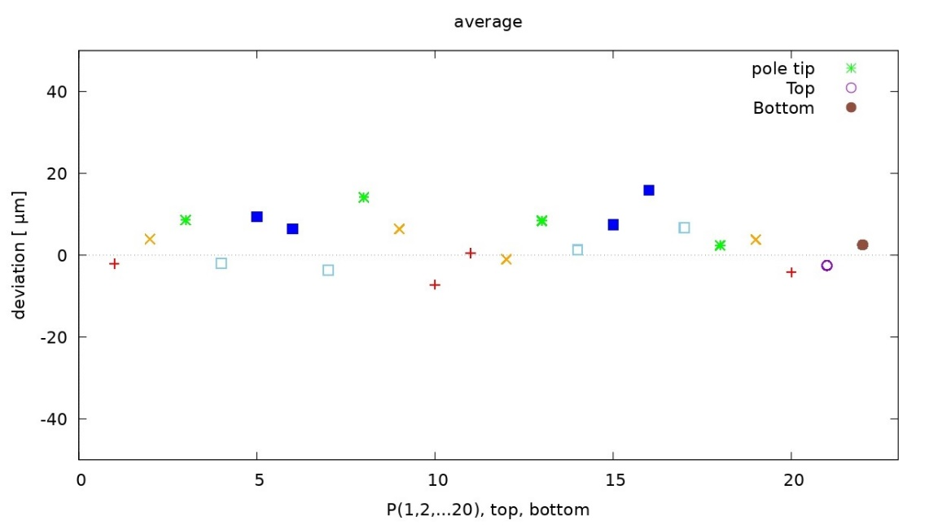
Typical example for geometrical proof of QP aperture
All quadrupole apertures are within the specification

Slide 12
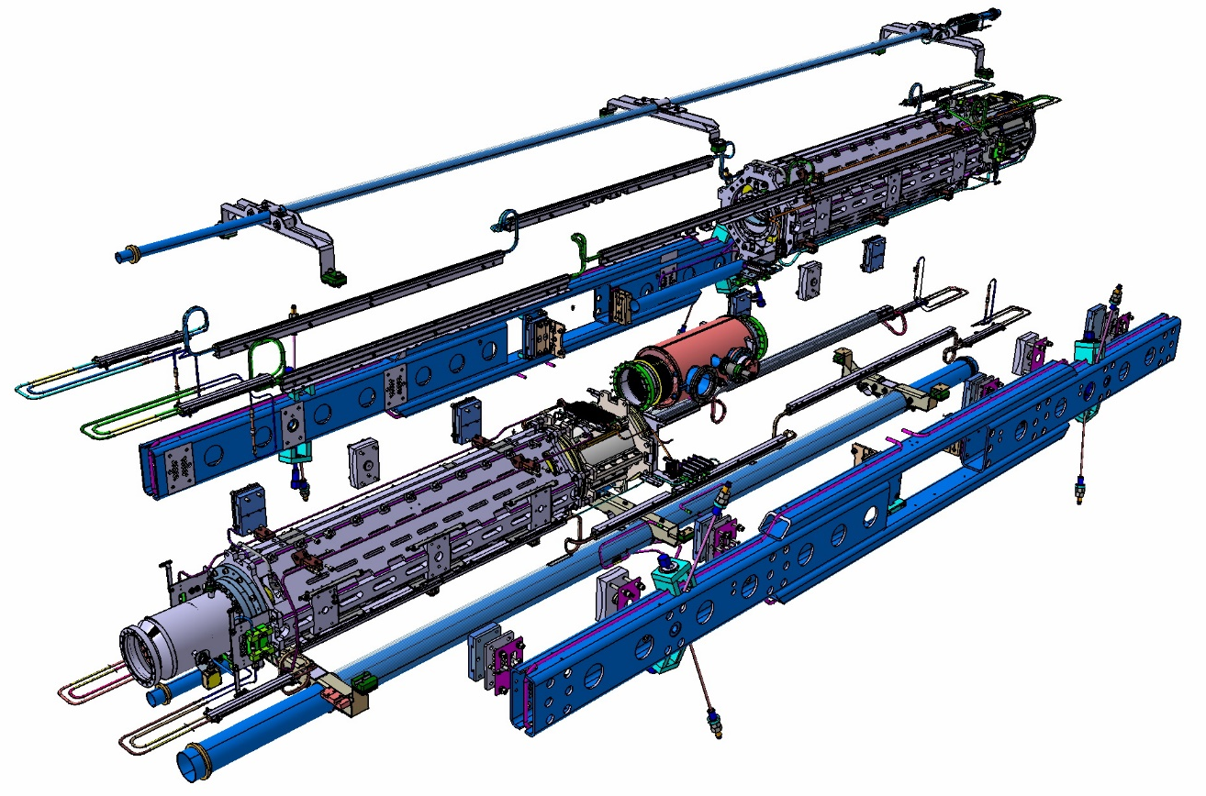
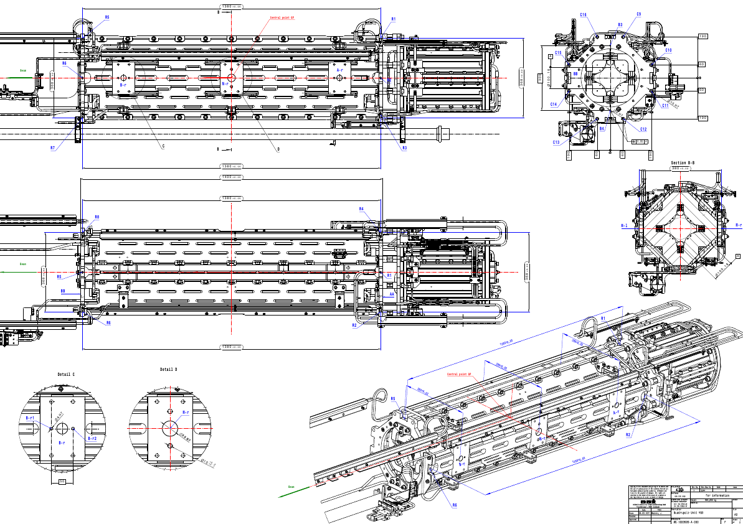
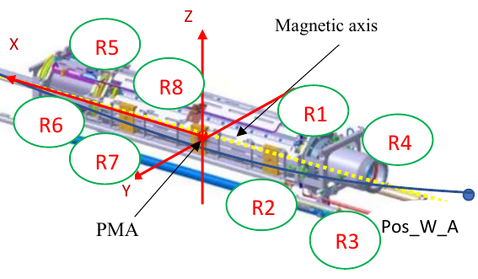
Adjustment of Units in the Doublet
Description | Drawing size, mm | Real size, mm | Δ, mm
AA-BB | 1400±0,05 | 1400.03 | 0.03
R1-R5 | 1380±0,05 | 1380.05 | 0.05
R2-R6 |  | 1380.05 | 0.05
R3-R7 |  | 1380.04 | 0.04
R4-R8 |  | 1380.05 | 0.05
R1-R3 | 368 ±0,02 | 368.02 | 0.02
R2-R4 |  | 368.02 | 0.02
R5-R7 |  | 368.02 | 0.01
R6-R8 |  | 368.02 | 0.02
A-l – A-r | 380 ±0,02 | 379.99 | -0.01
A-l – A-r |  | 0.02 | 0.00
M-l – M-r |  | 379.99 | -0.01
M-l – M-r |  | 0.02 | 0.00
B-l – B-r |  | 379.99 | 0.02
B-l – B-r |  | 0.02 | 0.00
Geometrical measurements to the reference points of the MM

Slide 13
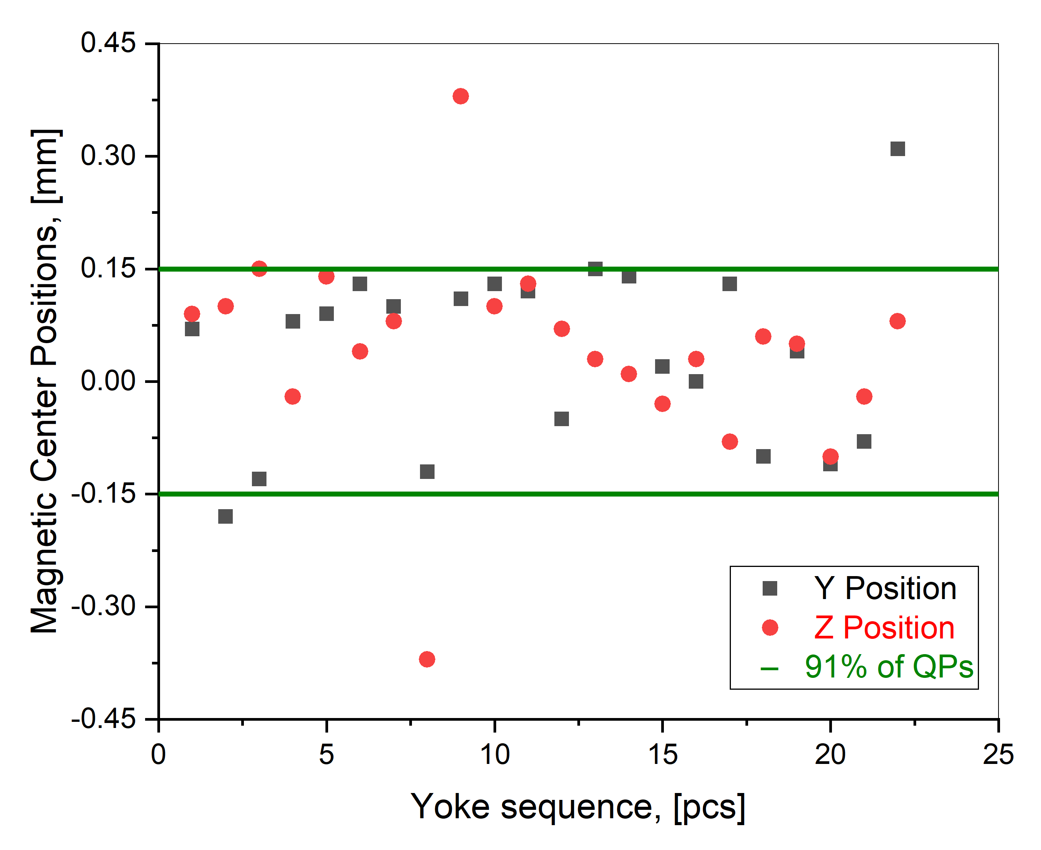
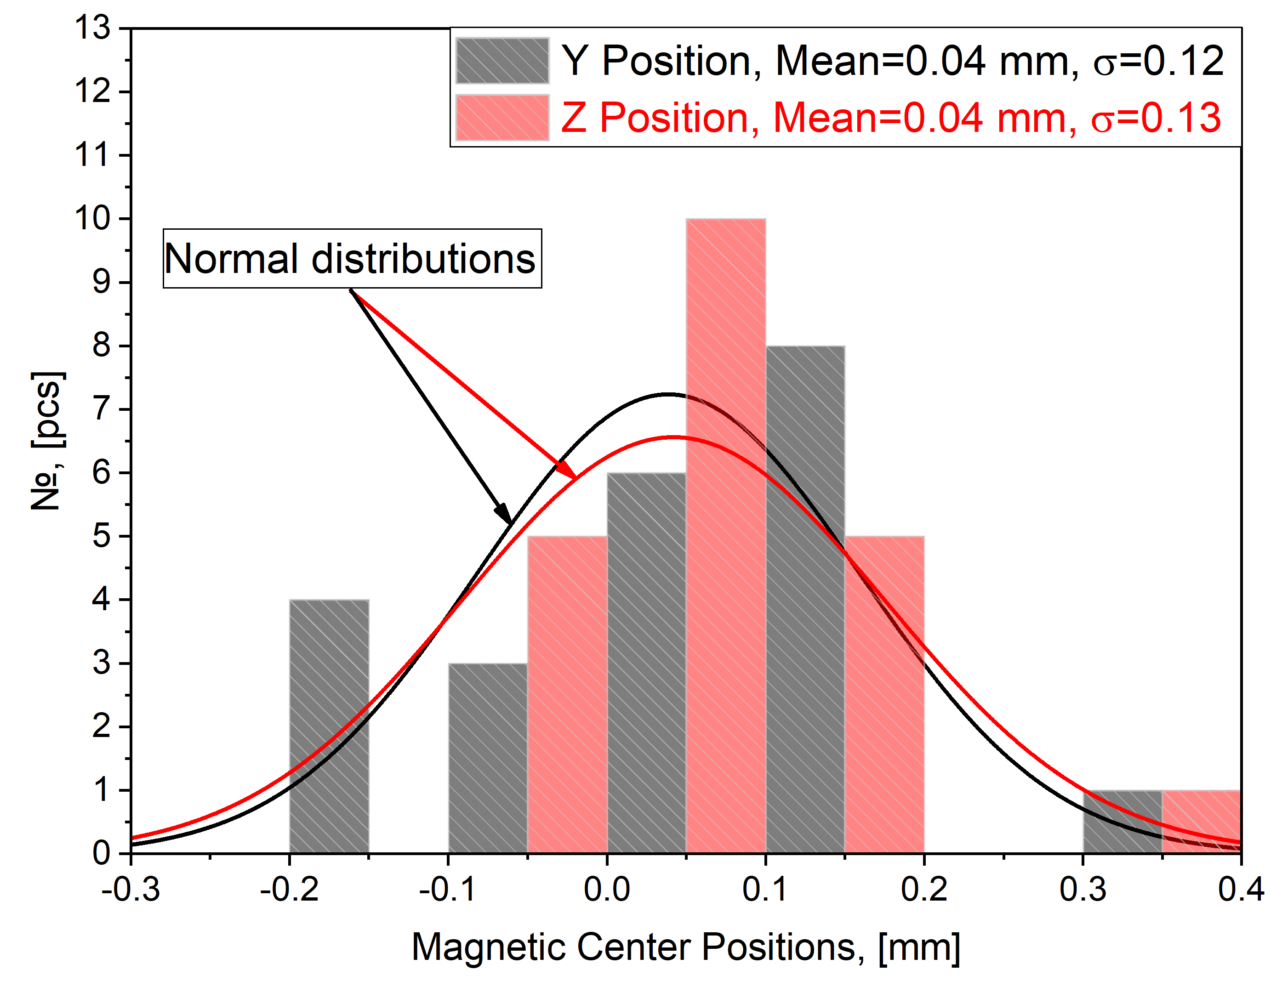
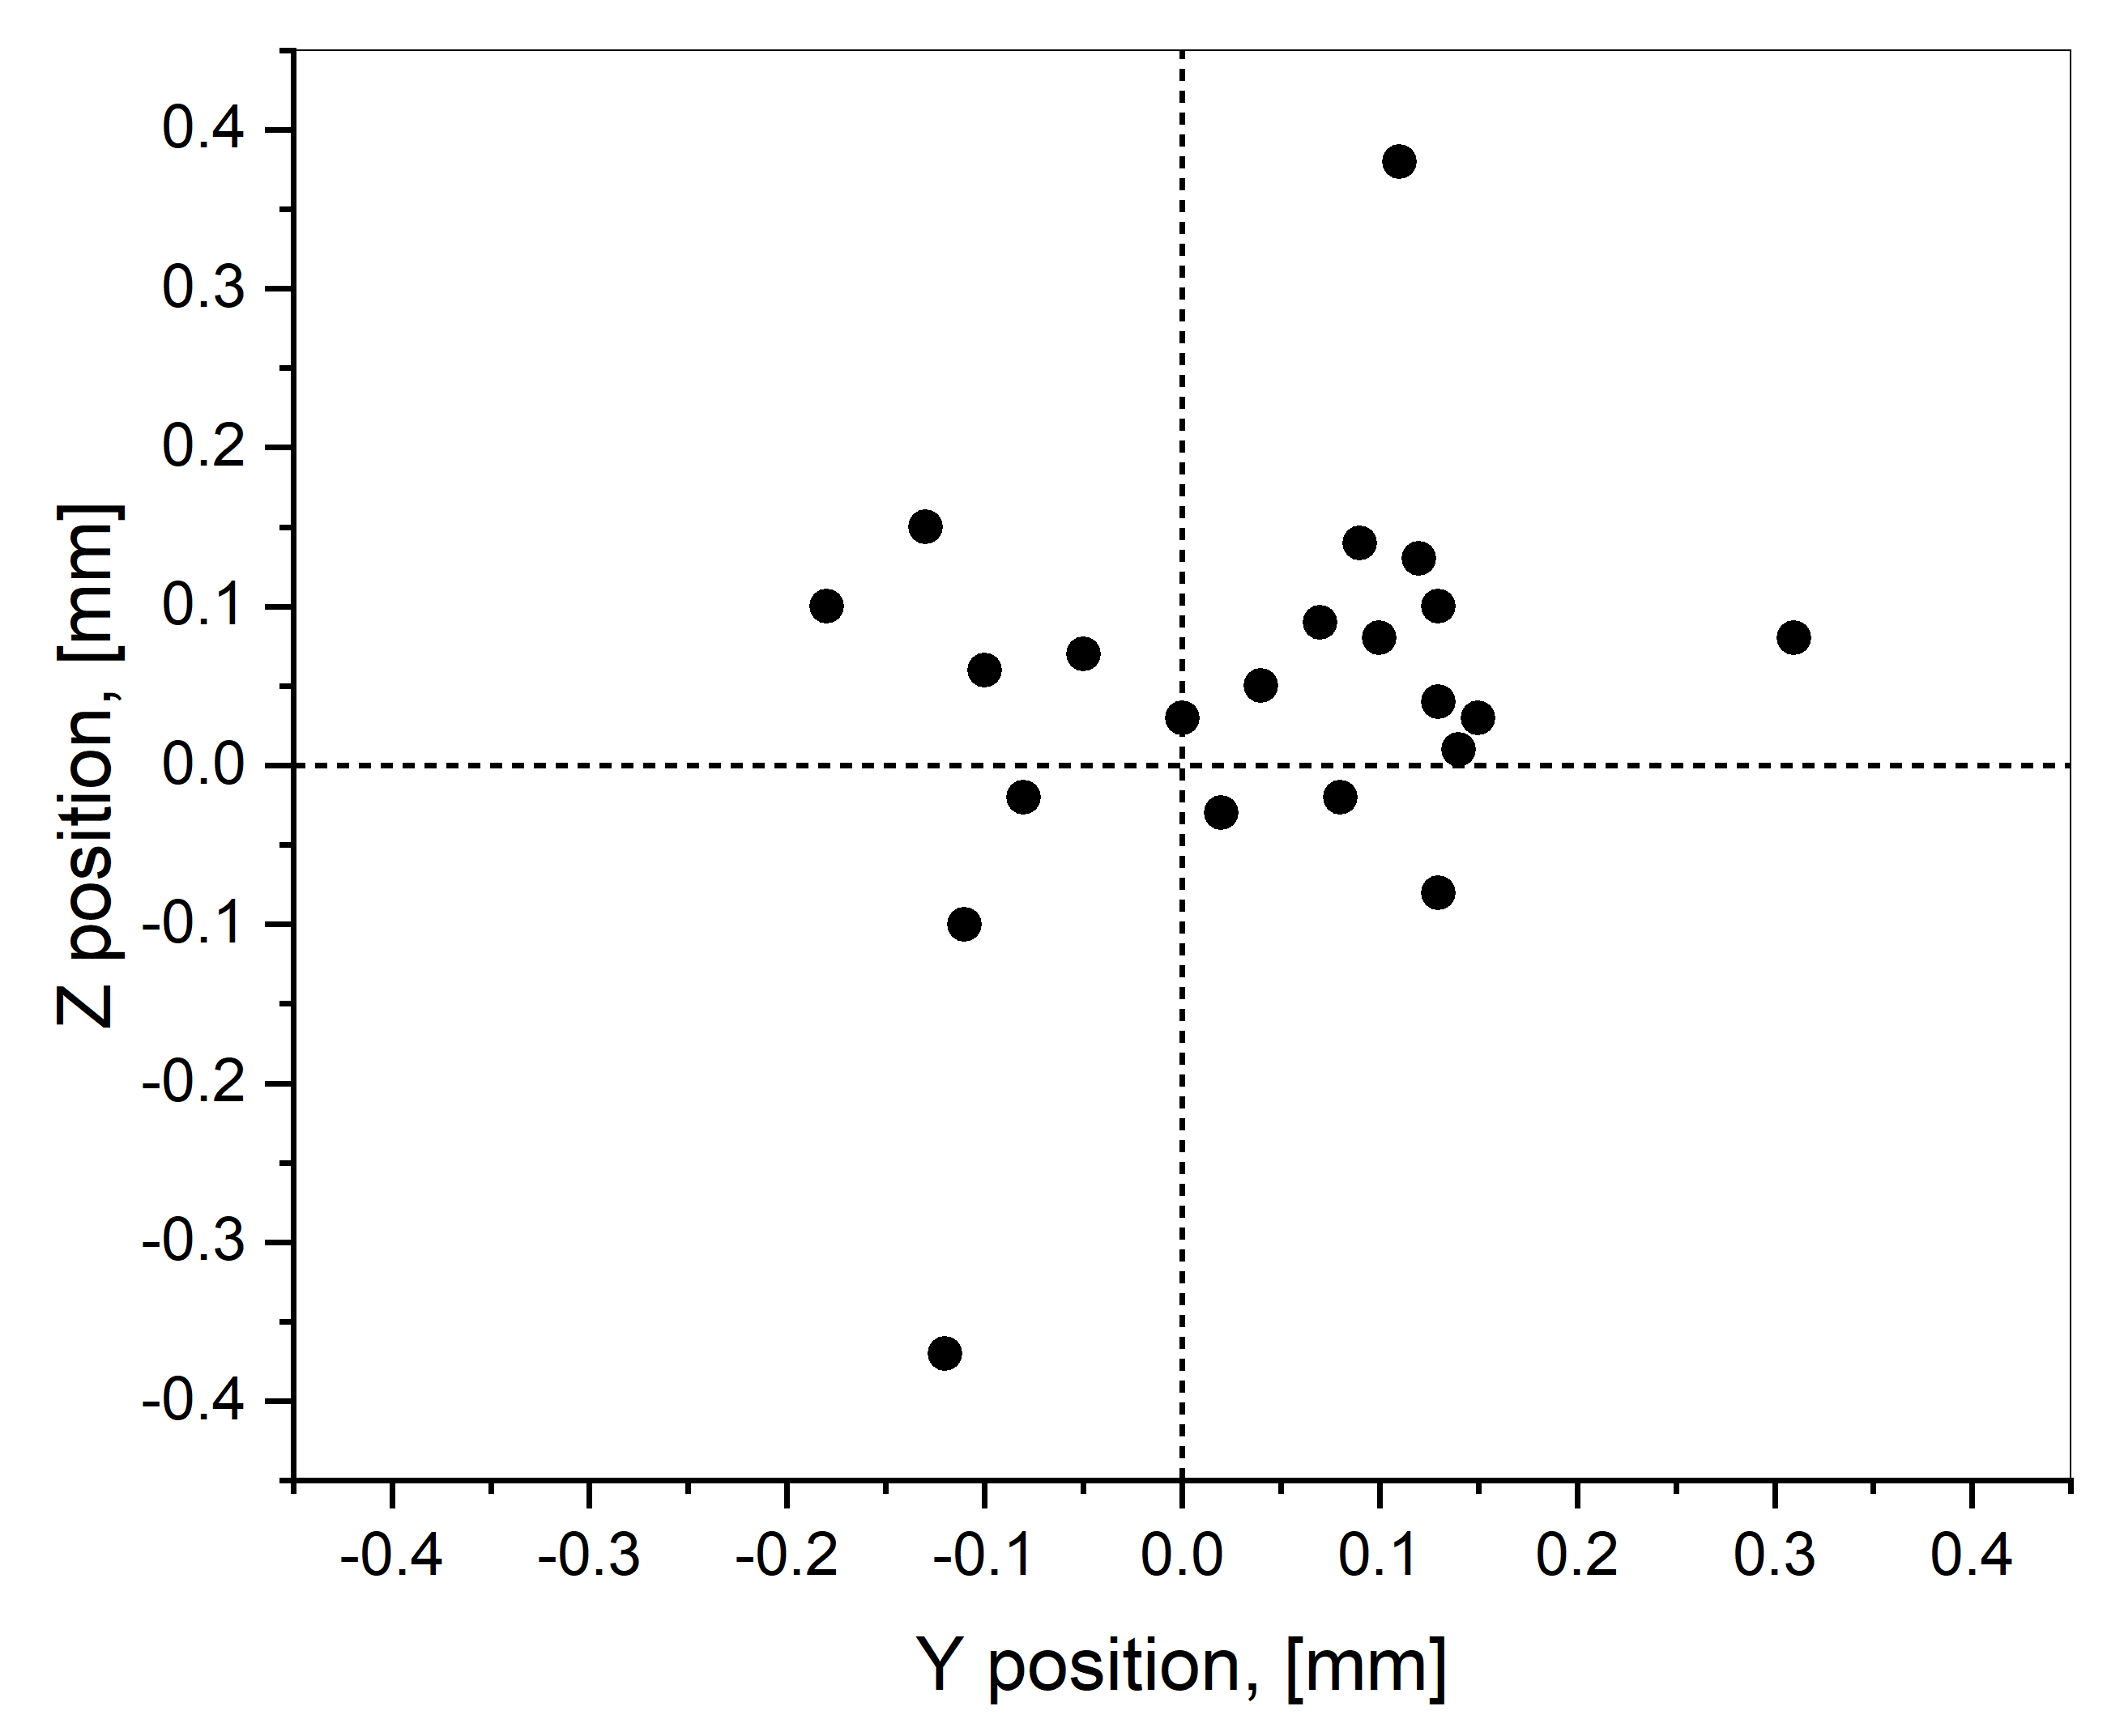
Magnetic Axis Measurements @ RT using vibrating wire technique

Slide 14
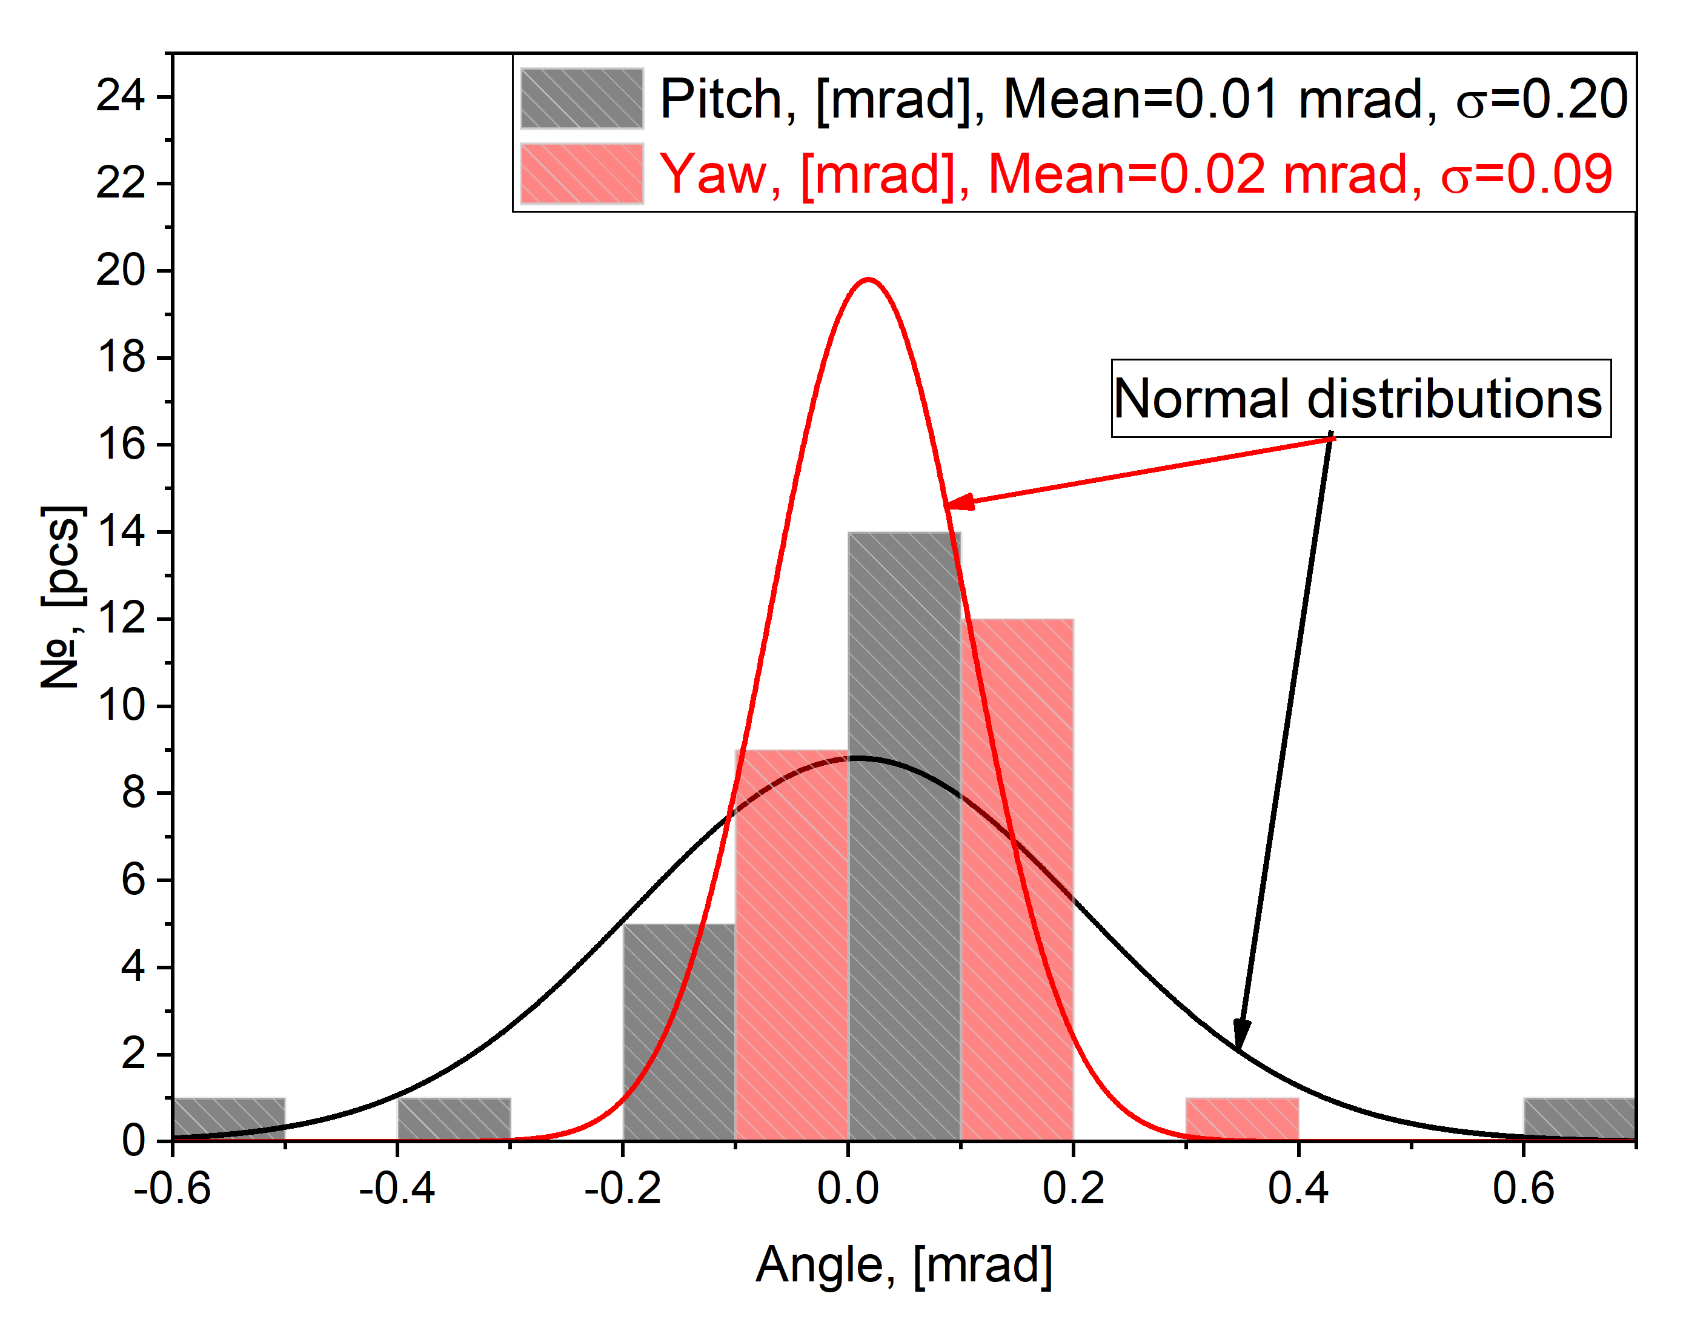
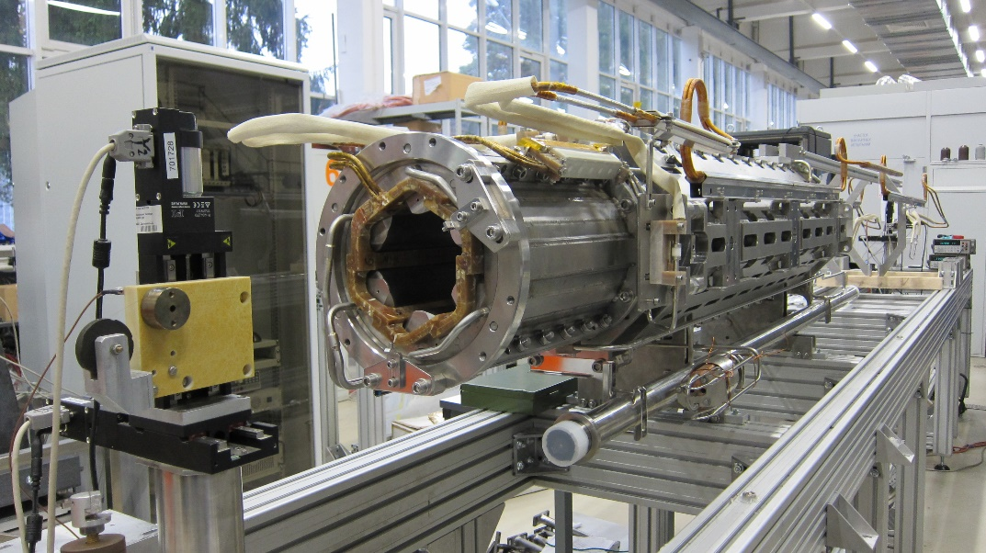
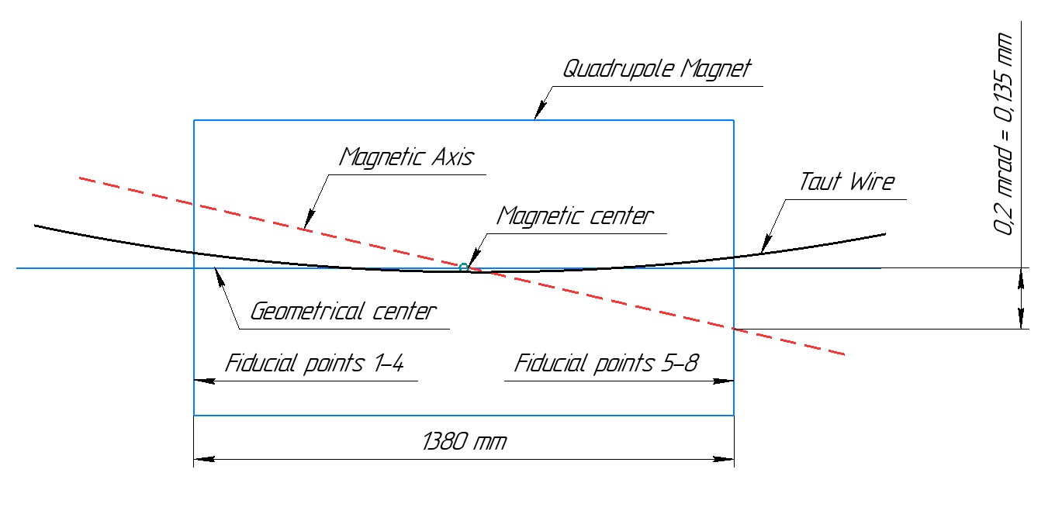
Angle of the QPs Magnetic Axis

Slide 15
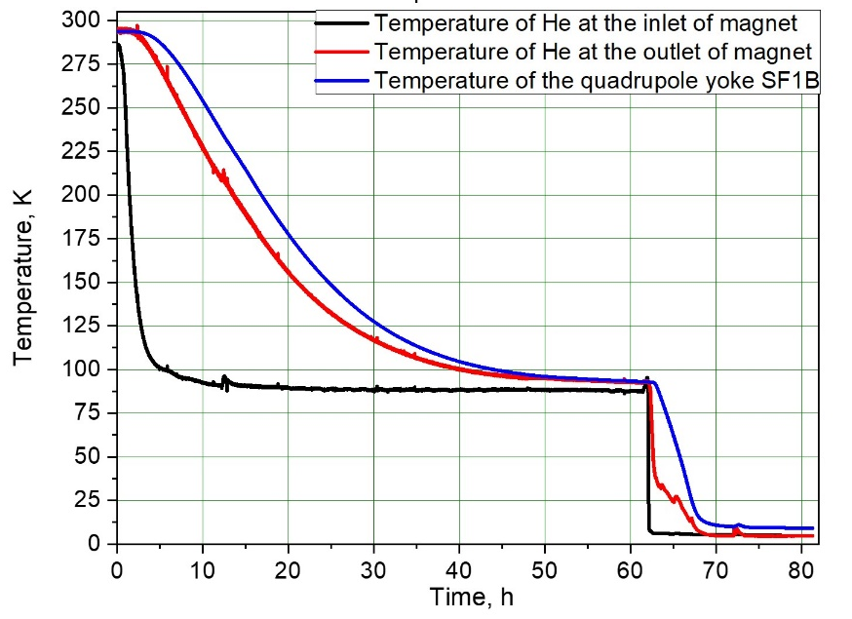
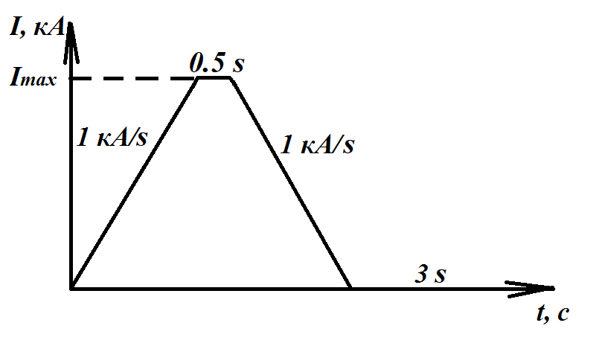
Cold Tests
Training of the sextupole magnets
Typical cooldown scenario for QPUs
Operation current 250 A
Training current 300 A
Training Statistics of the Series Quadrupoles
Training current = 12.6 kA
Operation current = 10.5 kA
RMS distribution quenches of training current = 6..7
RMS distribution quenches of operating current = 2..3
Current cycle for magnet training

Slide 16
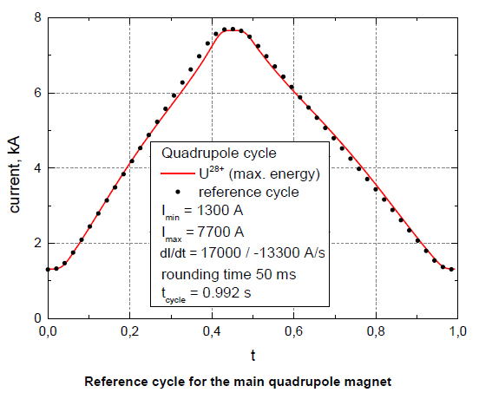


Cold Tests
Dynamic heat releases of quadrupole magnets
Reference cycle
Quadrupole magnet
Tolerance value (2.0 W)
Median (17.7 W)
Series Number of Magnet

Slide 17




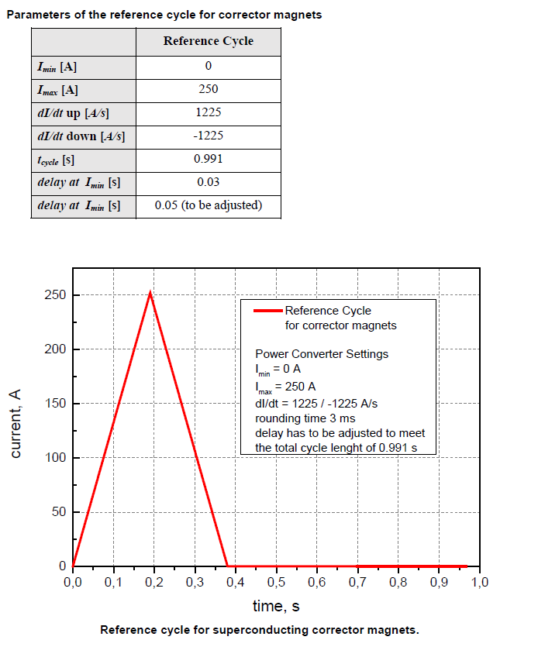
Cold Tests
Dynamic heat releases of the corrector magnets
Steering magnets
Heat release matrix of the quadrupole
Median (9.41 W)
Sextupole magnets
Median (2.77 W)
Frequency, Hz

Slide 18
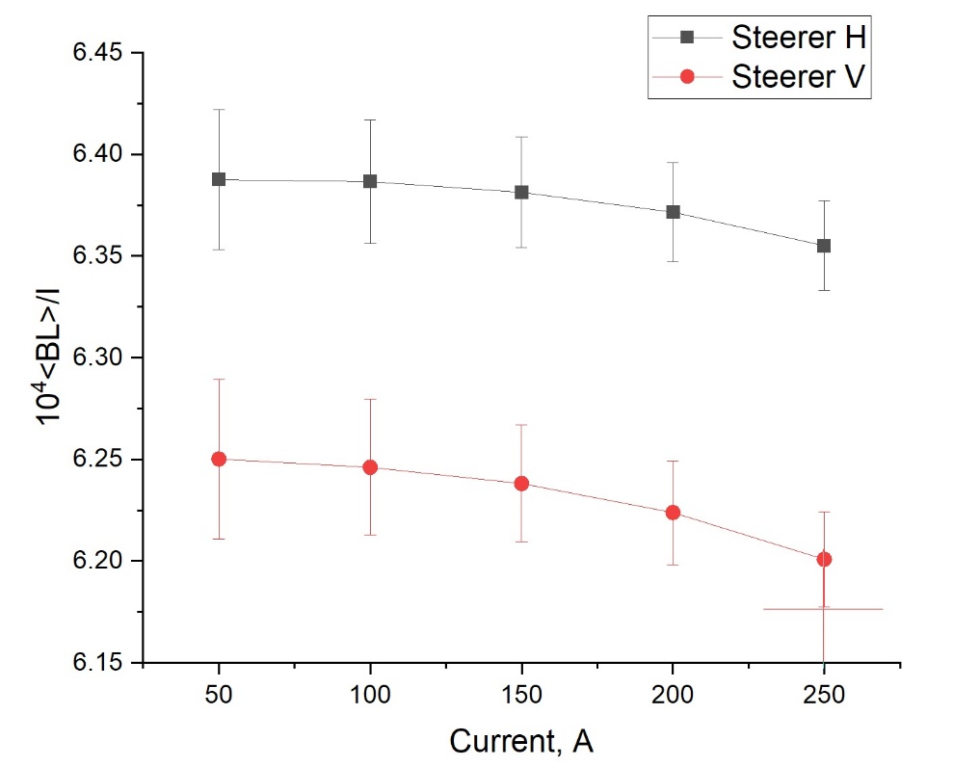
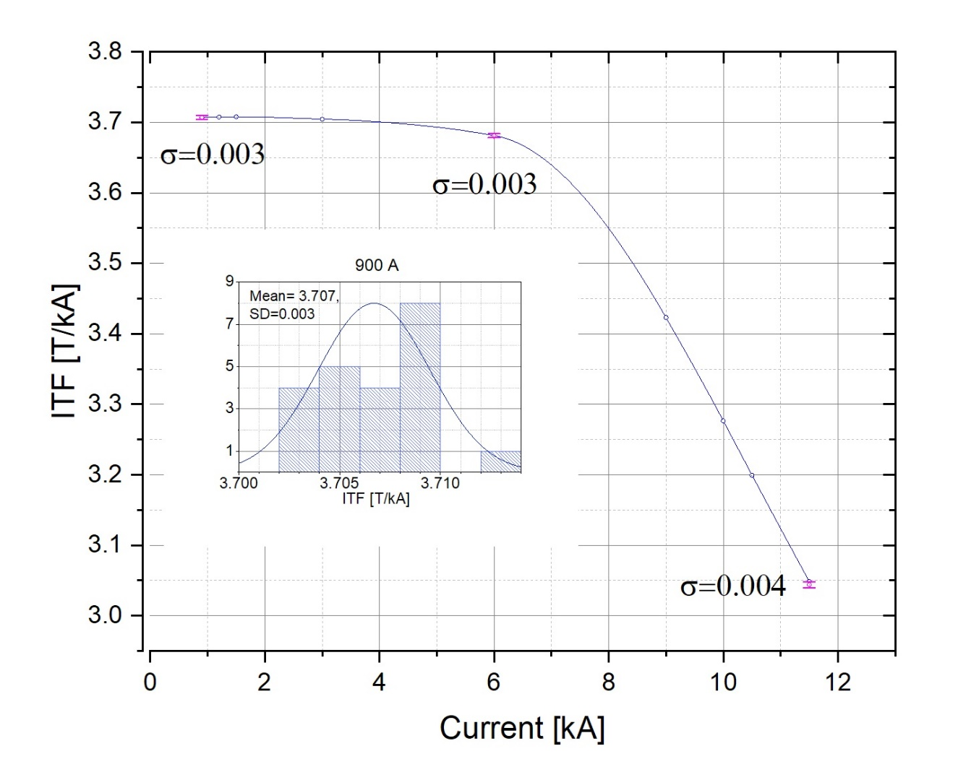
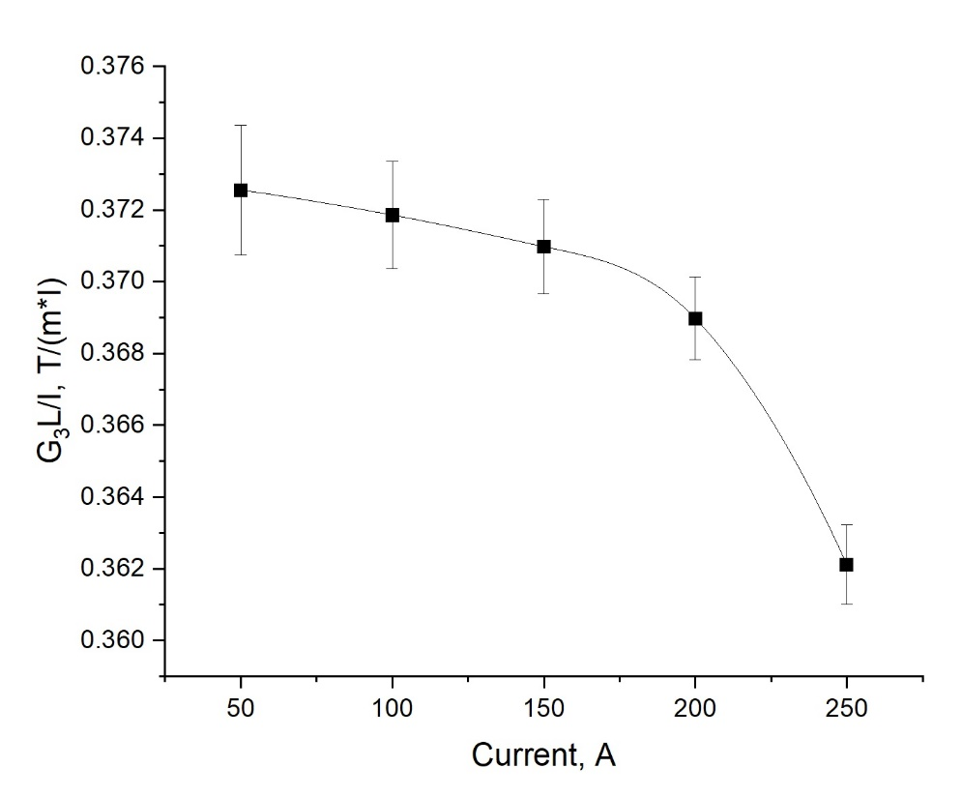
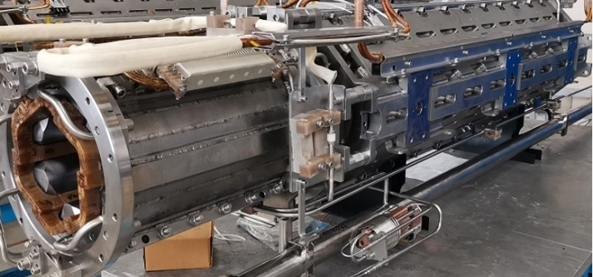
Typical current dependance of Integral transfer functions. Inset graph: distribution of ITF of 22 series magnets « 900 A.
sextupole

Slide 19
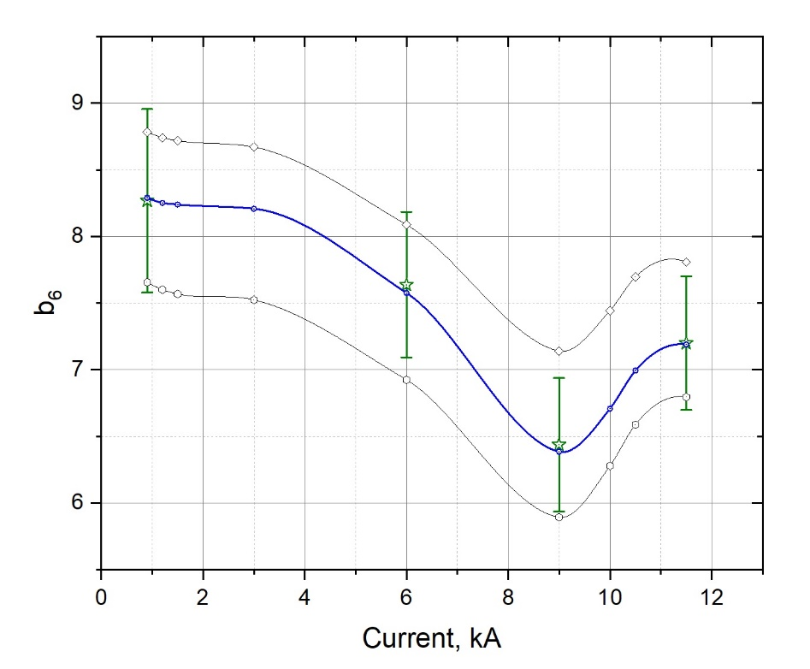
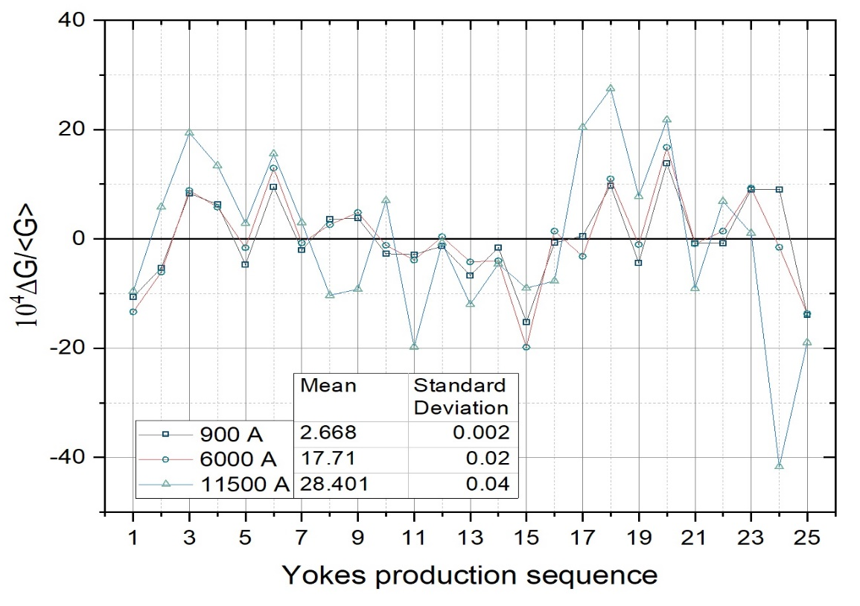
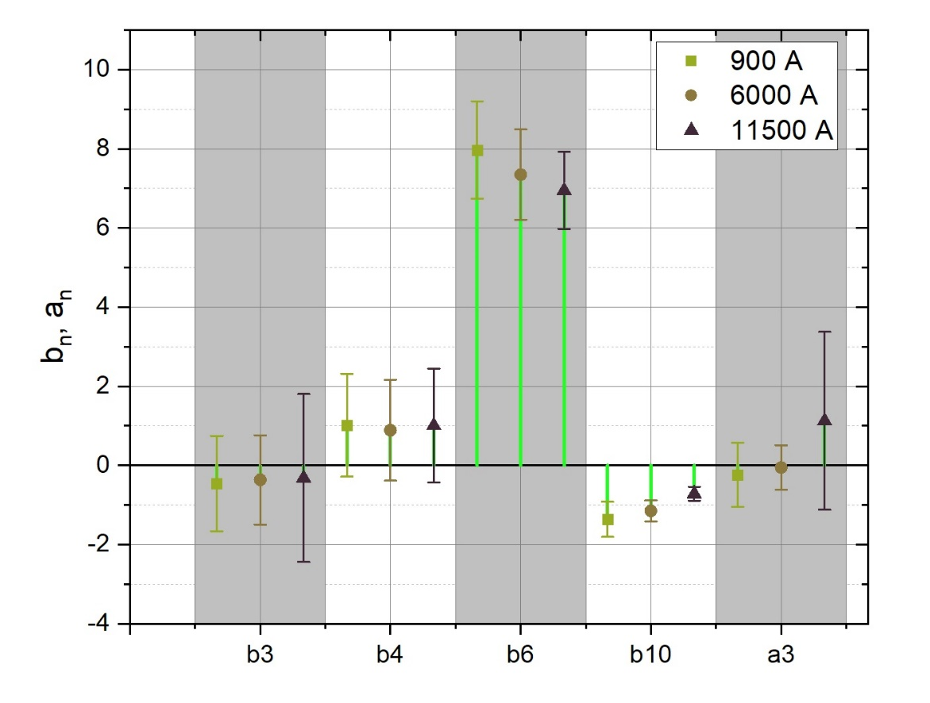
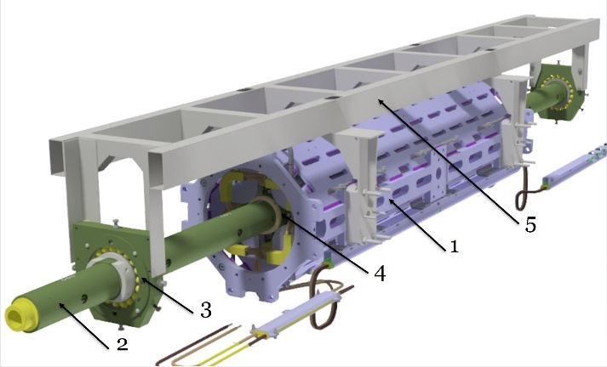

Relative variations of gradient at the center of quadrupole magnets vs. yokes production sequence
Typical current dependances of b₆ . Points with error bars are averaged values and standard deviation for series of 25 magnets
Measuring probe inside the magnet:
1 - quadrupole
2 - probe
3 - ball bearings
and adjustable
housings
4 - inside precision
ceramic ball
bearing
5 - frame
Integral Multipoles of the Quadrupole Magnets .

Slide 20
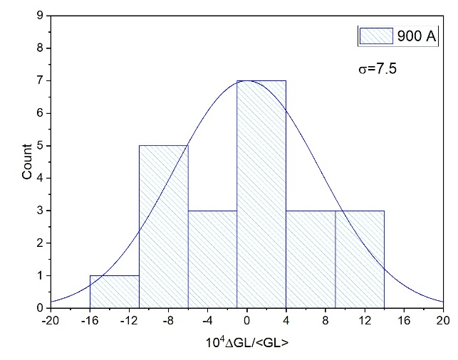
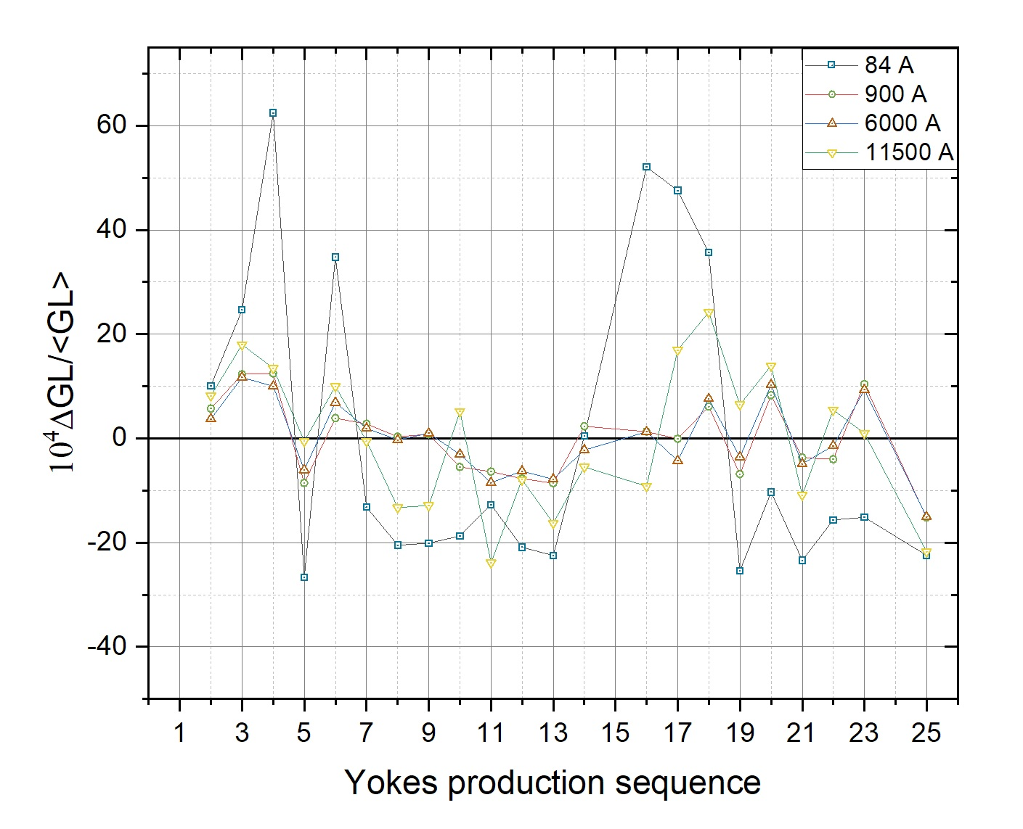
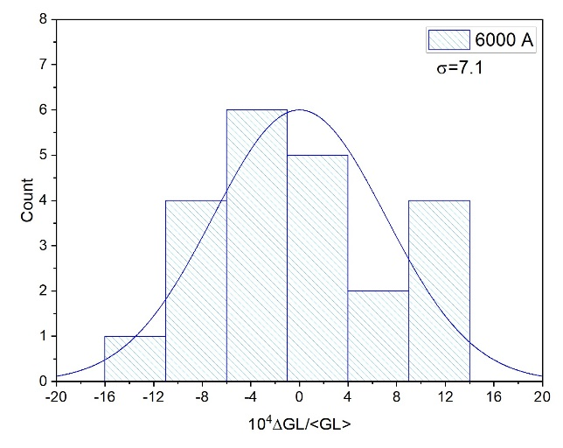
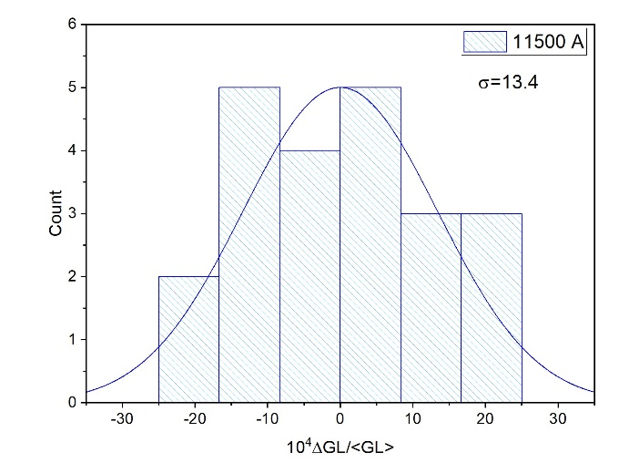
Relative variations of the integral gradient vs.
production sequence of the quadrupole yokes
Distribution of relative variations of the integral gradient

Slide 21
Summary
100 % of all yokes for QP-unit magnets were already delivered to JINR
20 QP-units are assembled, successfully tested at JINR and were delivered to FAIR
Next 8 Units are under preparation for shipment in October 2021
The first Unit series 2.5 was completed in March this year, the second series 1.7B will follow in October.
JINR had established an effective and stable production and testing scenario for the Quadrupole Units
The optimisation of the production technology and detailed methodological adjustment of the measurement techniques resulted in the proven and continuously high quality of the series magnets.

Slide 22
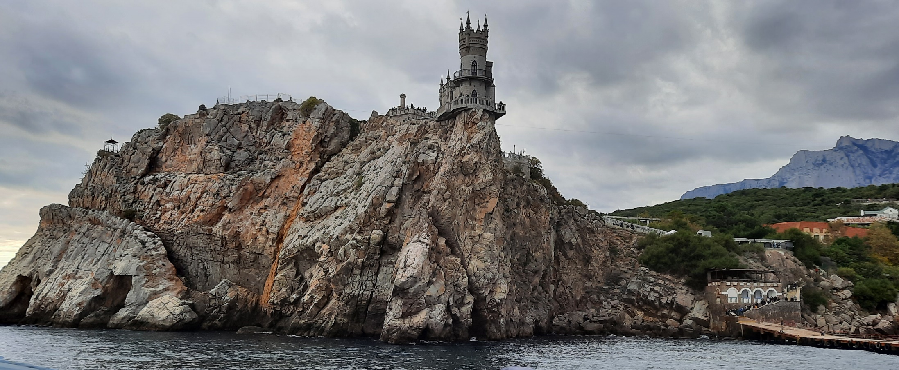
Thank you for your attention !

