Slide 1
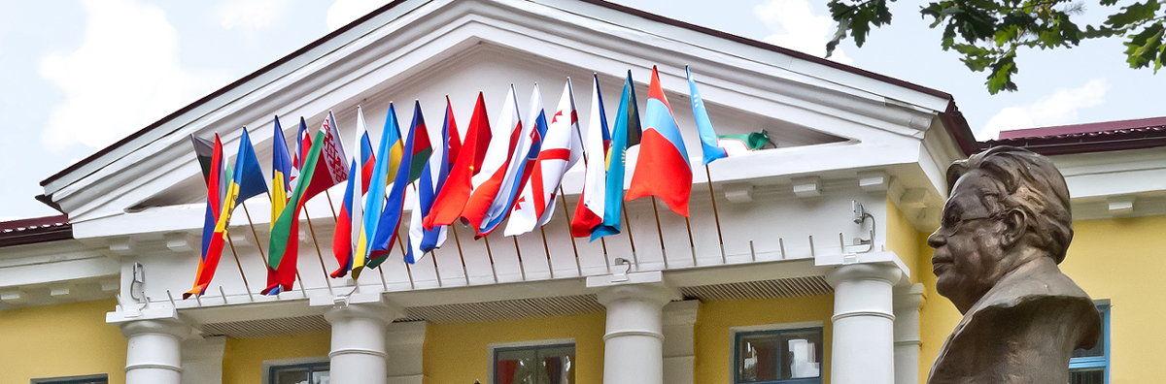
Joint Institute for Nuclear Research:
International Intergovernmental Research Organization
Dr. Dmitry Kamanin, Director,
Department of International Cooperation
Notes:
Как Вы, уважаемые коллеги, знаете, ОИЯИ – международная межправительственная организация, основанная в 1956 году, расположена на берегу великой русской Волги в Подмосковной Дубне.
Миссия ОИЯИ опирается на пять важнейших столпов:
Международное сотрудничество, Фундаментальные исследования на границах знаний, Инновационные решения, Подготовка научной молодежи, Пропаганда науки.
По Уставу, результаты исследований, проводимых в Институте, могут быть использованы исключительно в мирных целях на благо всего человечества.

Slide 2
Joint Institute for Nuclear Research in Glance
Notes:
Как Вы, уважаемые коллеги, знаете, ОИЯИ – международная межправительственная организация, основанная в 1956 году, расположена на берегу великой русской Волги в Подмосковной Дубне.
Миссия ОИЯИ опирается на пять важнейших столпов:
Международное сотрудничество, Фундаментальные исследования на границах знаний, Инновационные решения, Подготовка научной молодежи, Пропаганда науки.
По Уставу, результаты исследований, проводимых в Институте, могут быть использованы исключительно в мирных целях на благо всего человечества.

Slide 3
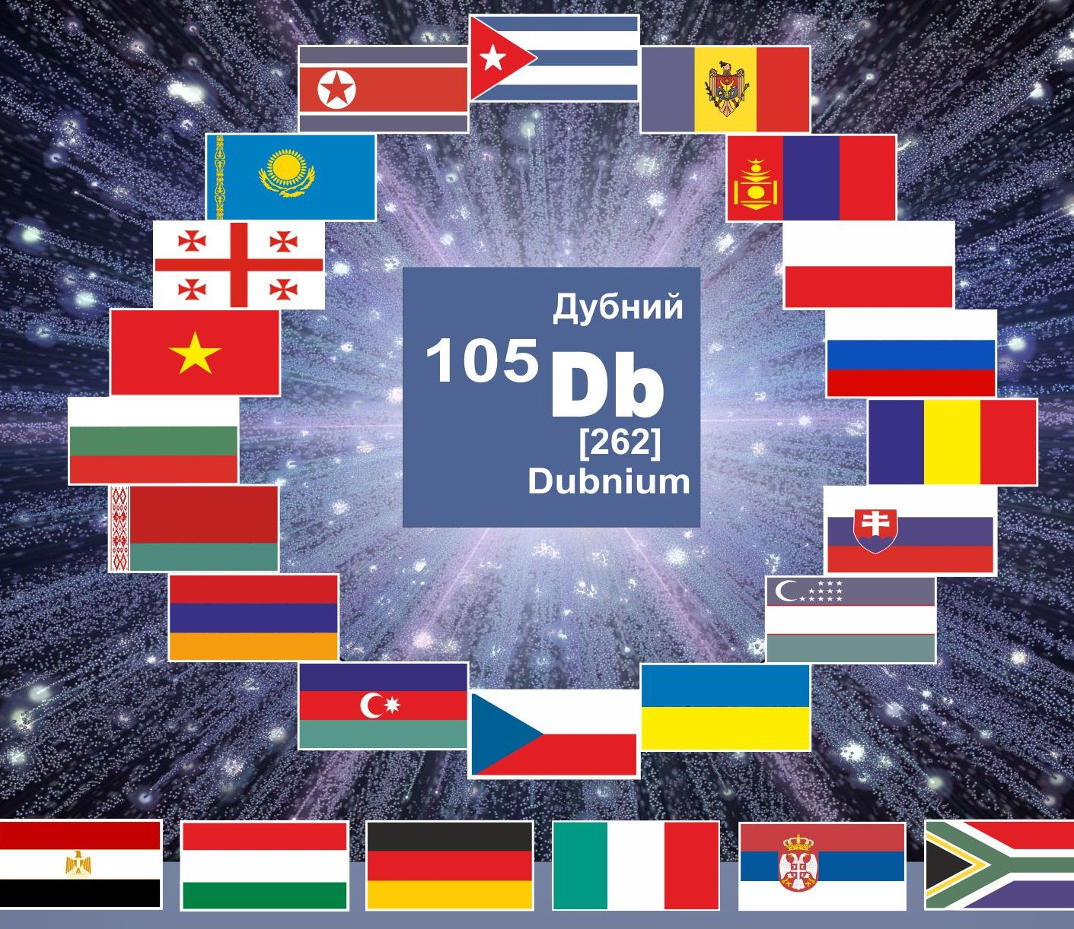
JINR Member States and Partner Network
Collaborating organizations from JINR Topical Plan 2020
Russia (host) 192
1. USA 74
2. Germany 66
France 40
Romania 39
5. Italy 37
6. Poland 33
7. Japan 27
Ukraine 24
Czech Republic 22
10. India 21
Bulgaria 20
Belarus 19
Great Britain 19
China 18
Spain 16
....
European Union 346
New agreements 37
International JINR staff
1200 Researchers
from 33 countries
> 450 Expats
> 150 from EU
Member States
Armenia
Azerbaijan
Belarus
Bulgaria
Cuba
Czech Republic
Georgia
Kazakhstan
DPRK (suspended)
Moldova
Mongolia
Poland
Romania
Russian Federation
Slovakia
Ukraine
Uzbekistan
Vietnam
Participation of Egypt, Germany, Hungary, Italy, the Republic of South Africa and Serbia
is based on bilateral agreements signed at governmental level (associated countries).
Partner network – over 900 destinations in more than 60 countries
Notes:
Сегодня в ОИЯИ – это 18 стран-участниц, 9 из которых расположены на пространстве бывшего СССР и 5 – члены Евросоюза. С шестью странами Институт работает на основе соглашений правительственного уровня.
ОИЯИ связан научными контактами с 800 научными организациями и университетами более чем в 60 странах мира. Почти четверть этих контактов приходится на страну местопребывания Института, в числе лидеров по количеству научных связей Института – ведущие научные державы Мира.
Более 130 партнерских организаций ОИЯИ находятся в
странах МААН, и четверть их них приходятся на Беларусь.

Slide 4




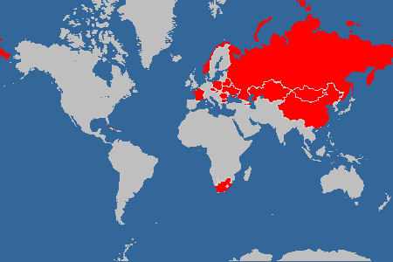
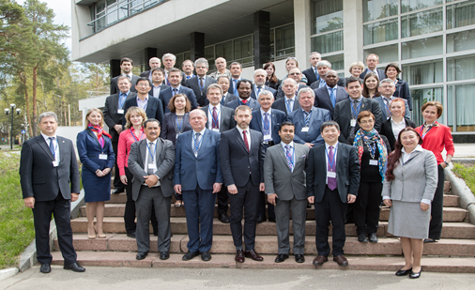
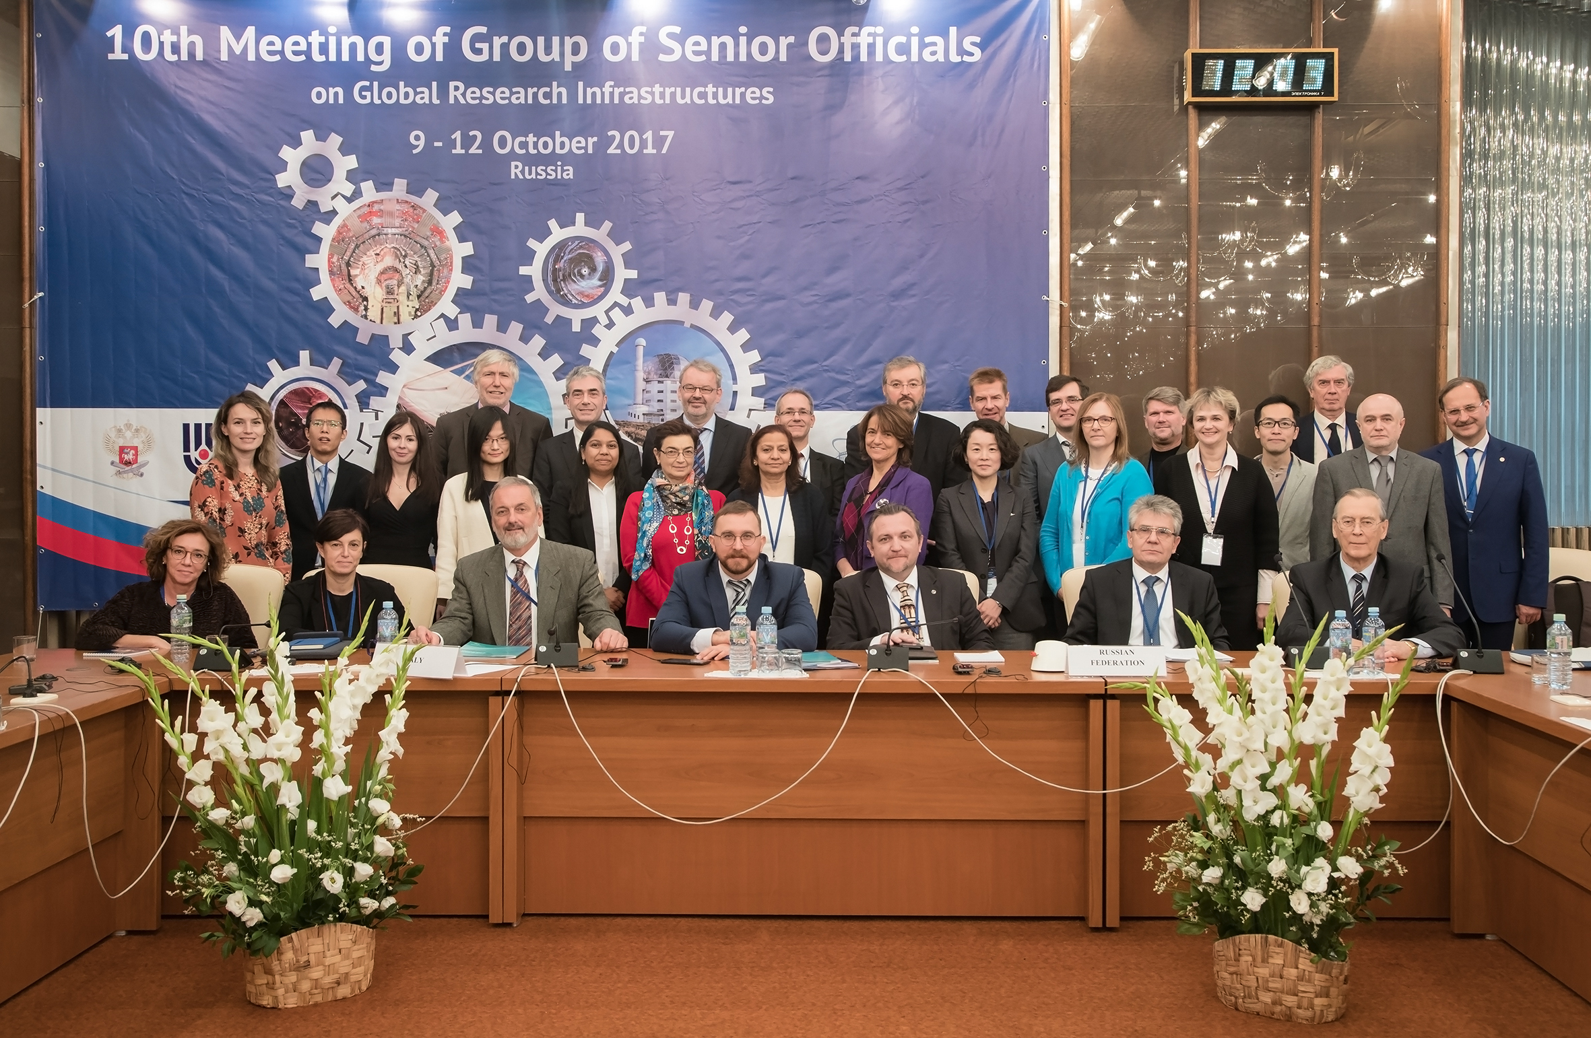
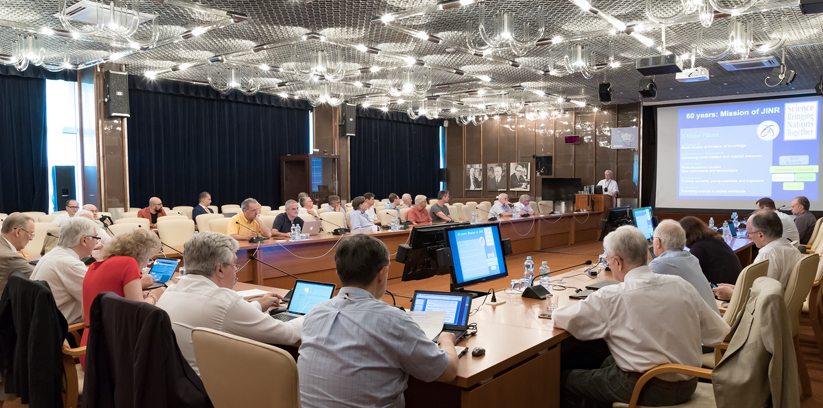
JINR is a part of global research coordination network
Major IGO partners of JINR
New strategic partnership
>100 international meetings/year
JINR works closely with ESFRI, ILL, ESS, XFEL, ApРEC, ICFA, ECFA and many others
BRICS
GSO
NuPECC
21-22 June 2019
The 95th meeting of the Nuclear Physics European Collaboration Committee (NuPECC). Meeting was devoted to implementation of the European Long Range Plan for nuclear physics and coordination of activities of nuclear physics centres in Europe
15-16 May 2017
Two-day meeting of the BRICS Working Group on Research Infrastructure and Mega-Science projects. Meeting was focused on cooperation within BRICS based on Research Infrastructures and Mega-Science Projects.
9-12 October 2017
The 10th Meeting of the Group of Senior Officials on Global Research Infrastructures. Main meeting task - the formulation of strategies and specifying the directions of RI development.
Notes:
Благодаря широкой международной экспертизе, определяющей работу Института и его вовлеченность в работу важнейших международных организаций и форматов, ОИЯИ является важным узлом глобального координации научных исследований, образуя вместе с ЦЕРН своего рода диполь в геополитическом и научно-тематическом пространстве.
ОИЯИ сам организует и проводит, а также принимает на своей площадке научные мероприятия мирового масштаба, привлекая большое количество участников из разных стран мира. Так, в 2017 в Дубне впервые на территории СНГ прошло заседание Группы Старших Должностных Лиц по Исследовательской Инфраструктуре. В прошлом году ОИЯИ принял у себя очередную сессию NuPecc, регулярно проходят сессии Совета РАН по физике тяжелых ионов.

Slide 5
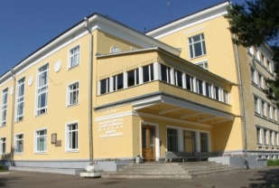
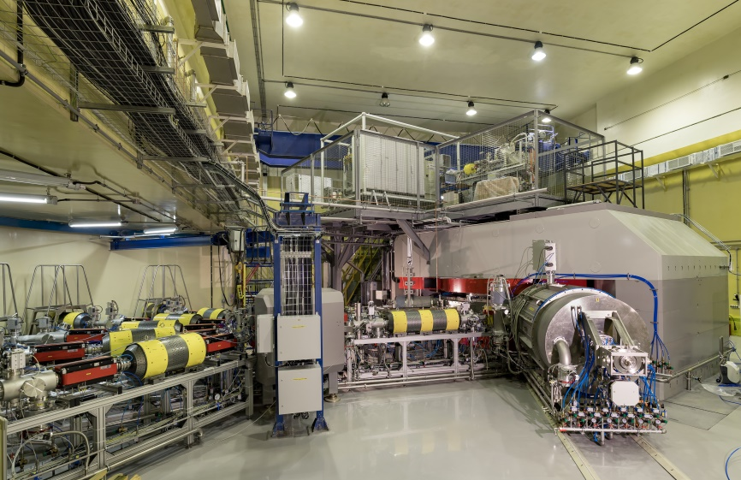
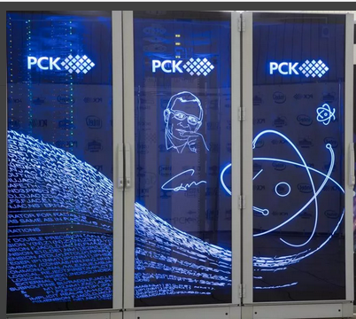
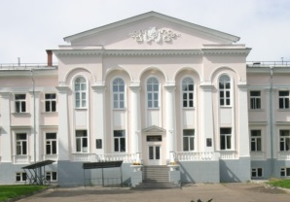
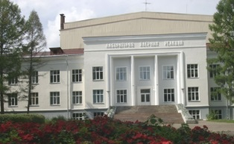
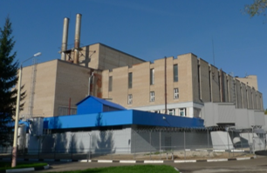
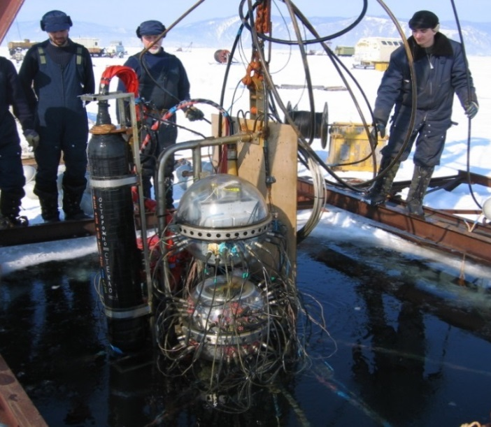
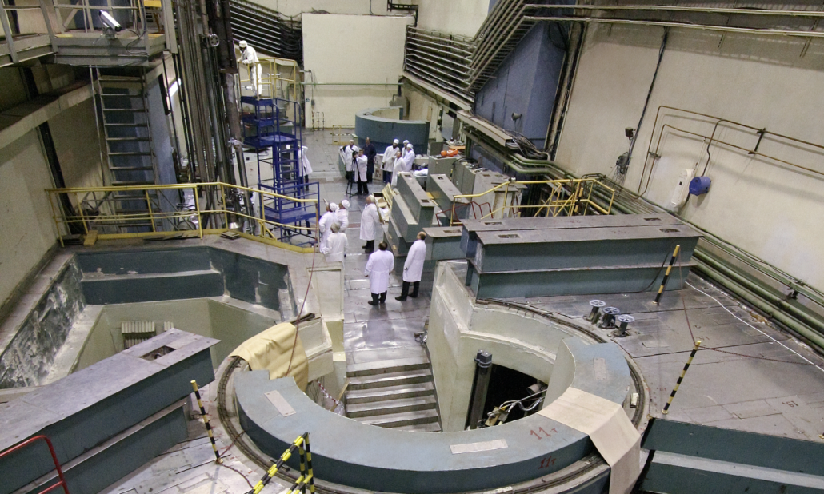
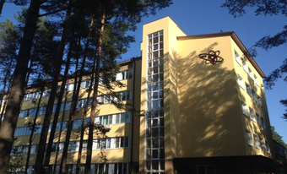
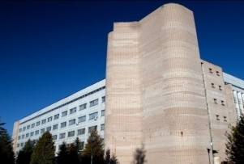
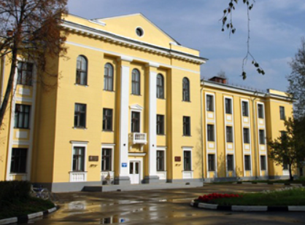
JINR laboratories and research infrastructure
5 cyclotrons in FLNR
Together with Tier-1 for CMS
and cloud computing
Bogoliubov Laboratory
of Theoretical Physics
Dzhelepov Laboratory
of Nuclear Problems
Flerov Laboratory
of Nuclear Reactions
First full scale experiment 2021
Launched in 2018
Frank Laboratory
of Neutron Physics
Cyclotron DC-280 / Superheavy Elements Factory
Supercomputer “Govorun”
15 instruments,
user-programme
Laboratory
of Radiation Biology
Laboratory of
Information Technologies
Veksler and Baldin
Laboratory
of High Energy Physics
Full power in 2012
Reached 0.4 km³ in 2021
Baikal Neutrino Telescope in Irkutsk
IBR-2 Pulsed Research Reactor
Notes:
ОИЯИ сегодня – это 7 научных Лабораторий со своей научной повесткой и уникальным набором базовых установок и научных инструментов, объединенных общей научной политикой и руководством.
В последнее десятилетие Институт пополнился новым циклотроном DC-280 и фабрикой сверхтяжелых элементов, суперкомпьютером «Говорун». Совместно с ИЯИ РАН запущен и продолжает строиться глубоководный Байкальский нейтринный телескоп. После глубокой модернизации заработал фактически новый импульсный реактор на быстрых нейтронах ИБР-2
В Институте работают более 5000 сотрудников, в том числе 1200 ученых, из которых 450 – нероссийских граждан, представляющих 33 страны. Годовой бюджет Института составляет 200 миллионов долларов США.

Slide 6
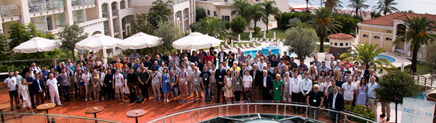
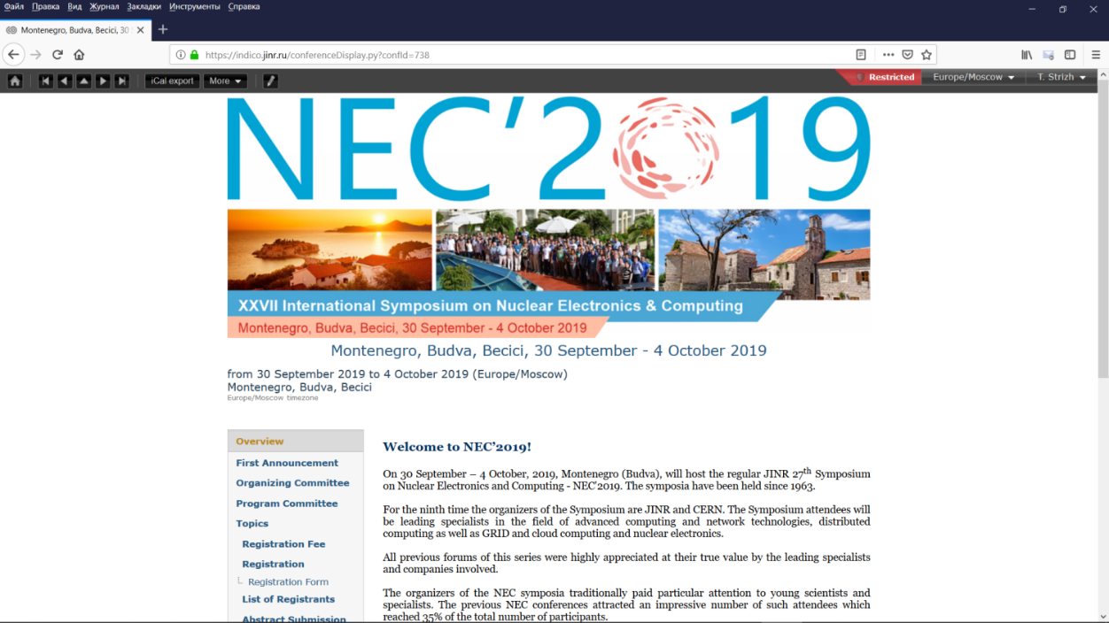




Examples of JINR «brand» conferences
EXON - International Symposium on EXOtic Nuclei
Jointly organized by:
JINR (Dubna), RIKEN (Wako-shi), GSI (Darmstadt), GANIL (Caen), NSCL (Michigan), …
held bi/tri-annually in the most exotic places of Russia.
1991 - Faros (Crimea), 2001 - Baikal, 2004 - Peterhof,
2006 - Hanty Mansiisk, 2009 - Sochi, 2012 - Vladivostok,
2014 - Kaliningrad, 2016 - Kazan 2018 - Petrozavodsk
The largest number of participants was registered in 2004 in Peterhof- over 230.
The main goal of the Symposium is to discuss the latest results on the production and study of the properties of the lightest to heaviest nuclei, as well as the plans for future joint investigations in the field of exotic nuclei.
NEC - Symposium on Nuclear Electronics and Computing
held biannually, with over 100 participants
Last conferences were organized jointly with CERN
The symposium aims to stimulate the development and acceleration of researches, the improvement of their quality and visibility of results, to promote cooperation and exchange of ideas in the area of nuclear electronics and computing and related domains for the purposes of physical research and the more close cooperation between JINR and CERN.
I | 1963 | Budapest
II | 1964 | Dubna
III | 1965 | Dresden
IV | 1966 | Prague
V | 1968 | Alushta
VI | 1971 | Warsaw
VII | 1973 | Budapest
VIII | 1975 | Dubna
IX | 1977 | Varna
X | 1980 | Dresden
XI | 1983 | Bratislava
XII | 1985 | Dubna
XIII | 1988 | Varna
XIV | 1990 | Warsaw
XV | 1992 | Warsaw
XVI | 1994 | Varna
XVII | 1997 | Varna
XVIII | 2001 | Varna
XIX | 2003 | Varna
XX | 2005 | Varna
XXI | 2007 | Varna
XXII | 2009 | Varna
XXIII | 2011 | Varna
XXIV | 2013 | Varna
XXV | 2015 | Budva
XXVI | 2017 | Budva

Slide 7


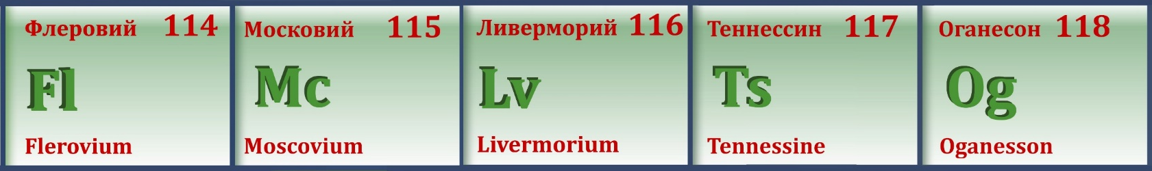
May 2012:
Official approval of the name Flerovium for element 114
and the name Livermorium for element 116
30th December 2015:
Approval of the discovery of new elements 113, 115, 117, and 118
International Union of Pure
and Applied Chemistry
element 113: RIKEN (Japan)
elements 115 and 117: JINR (Dubna) - LLNL (USA) – ORNL (USA) collaboration
element 118: JINR (Dubna) – LLNL collaboration.
28th November 2016:
IUPAC formally approved names and symbols of new elements:
  Nihonium (Nh) for element 113,
  Moscovium (Mc) for element 115,
  Tennessine (Ts) for element 117, and
  Oganesson (Og) for element 118.
All these elements were synthesized for the first time at the U-400
accelerator complex of the Flerov Laboratory of Nuclear Reactions of JINR.

Slide 8



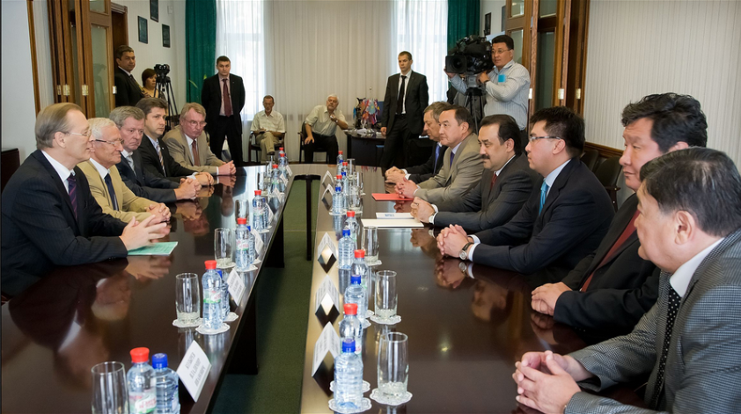
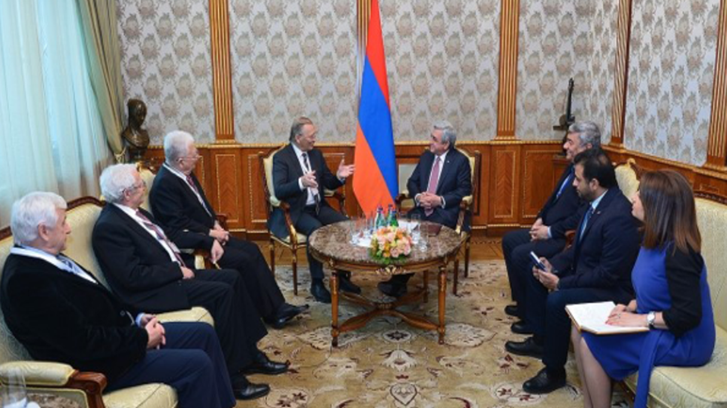
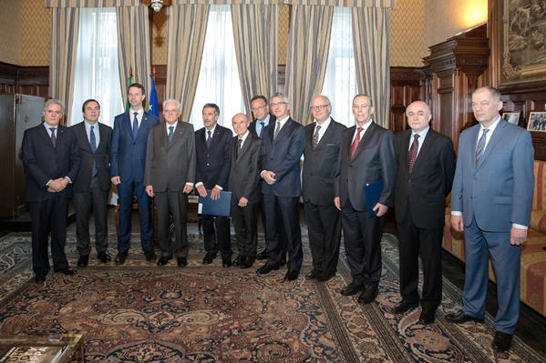
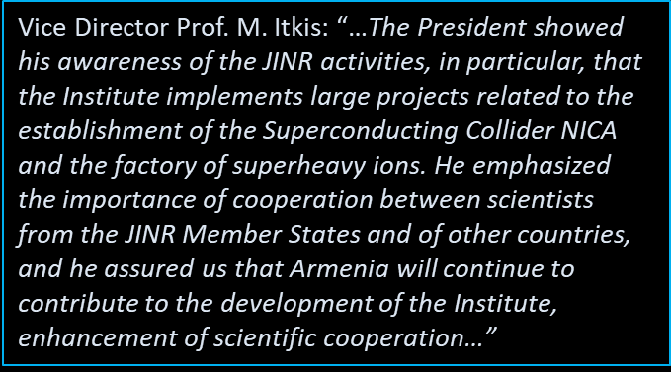
Contacts with the high level officials from the Member States and Associate Members
July 11, 2011, Dubna
Visit of the Prime Minister of the Republic of Kazakhstan Karim Massimov
October 19, 2016, Yerevan
Meeting President of Armenia Serzh Sargsyan
during Days of JINR in Armenia
April 12, 2017, Moscow
Italian Embassy in Moscow
The Government of Kazakhstan intends to continue the cooperation with JINR in the fields of development of educational programmes.
The 5th anniversary of the project DC-60 (Astana) and development of cooperation between scientific centers of the Republic of Kazakhstan and JINR
JINR Director V.A. Matveev and INFN President F. Ferroni signed the new Agreement on INFN–JINR cooperation
in the presence of President of the Italian Republic Signor S. Mattarella.
The new agreement is concluded for a period of 6 years and marks a qualitatively new stage in the development of cooperation between JINR and Italy

Slide 9
Roots of JINR International Cooperation
Notes:
Как Вы, уважаемые коллеги, знаете, ОИЯИ – международная межправительственная организация, основанная в 1956 году, расположена на берегу великой русской Волги в Подмосковной Дубне.
Миссия ОИЯИ опирается на пять важнейших столпов:
Международное сотрудничество, Фундаментальные исследования на границах знаний, Инновационные решения, Подготовка научной молодежи, Пропаганда науки.
По Уставу, результаты исследований, проводимых в Институте, могут быть использованы исключительно в мирных целях на благо всего человечества.

Slide 10
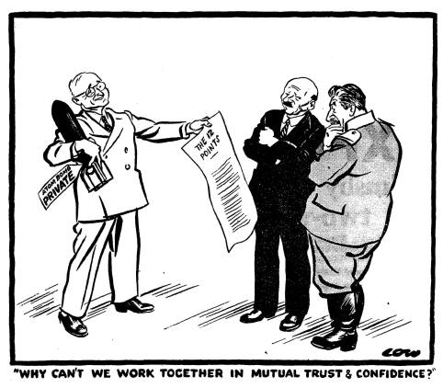
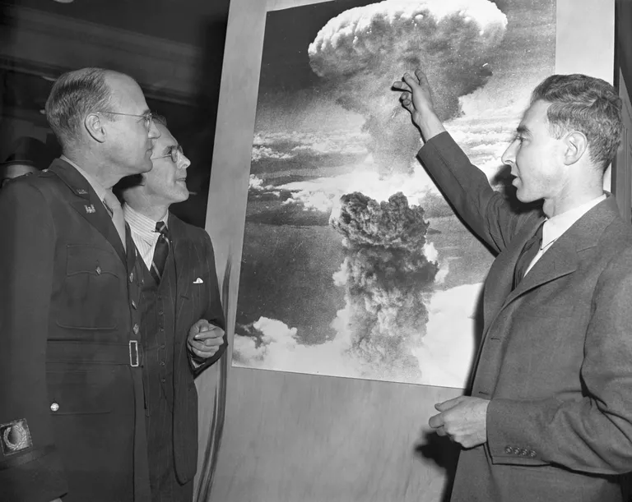

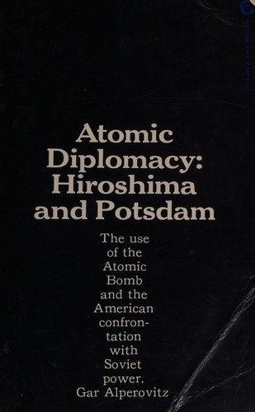
Atomic diplomacy
“Atomic diplomacy” refers to attempts to use the threat of nuclear warfare to achieve diplomatic goals. After the first successful test of the atomic bomb in 1945, U.S. officials immediately considered the potential non-military benefits that could be derived from the American nuclear monopoly.
The factor of monopoly ownership of atomic weapons was especially evident during the Berlin (Potsdam) conference in 1945 and after the atomic bombings of the Japanese cities of Hiroshima and Nagasaki on August 6 and 9, 1945.
Atomic weapons were seen as an effective means of "containing" and "rejecting" communism. In particular, The “Dropshot” plan developed in 1949 implied nuclear strikes on the territory of the USSR.
Thanks to the implementation of the atomic project, the USSR managed to eliminate the US nuclear monopoly. After the tests of the atomic bomb in the Soviet Union (1949) and the launch of an artificial Earth satellite (Sputnik) (1957), it became obvious that the United States was losing its primacy in creating both nuclear weapons and their means of delivery.

Slide 11
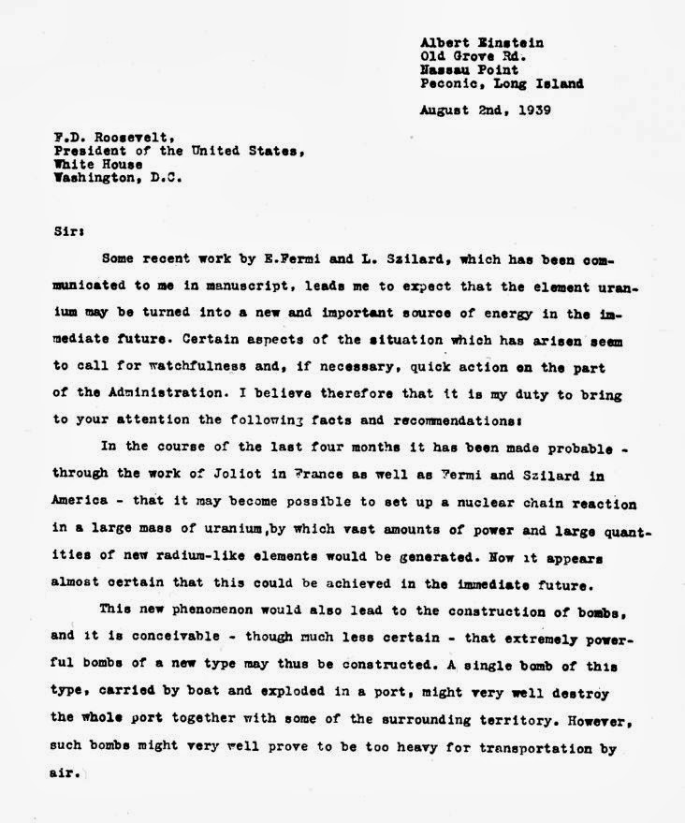
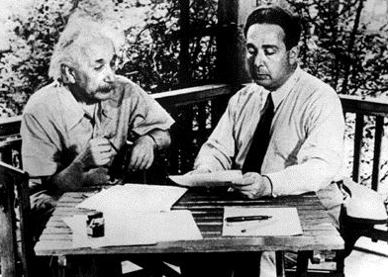
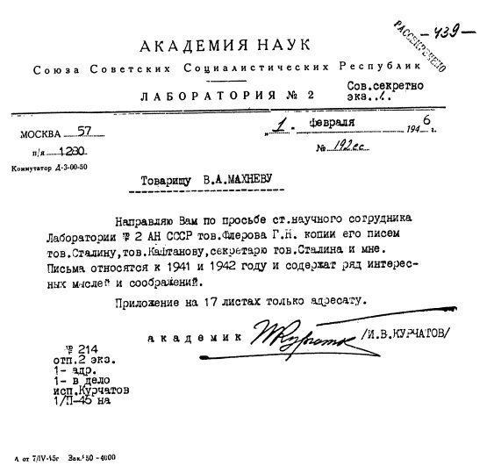
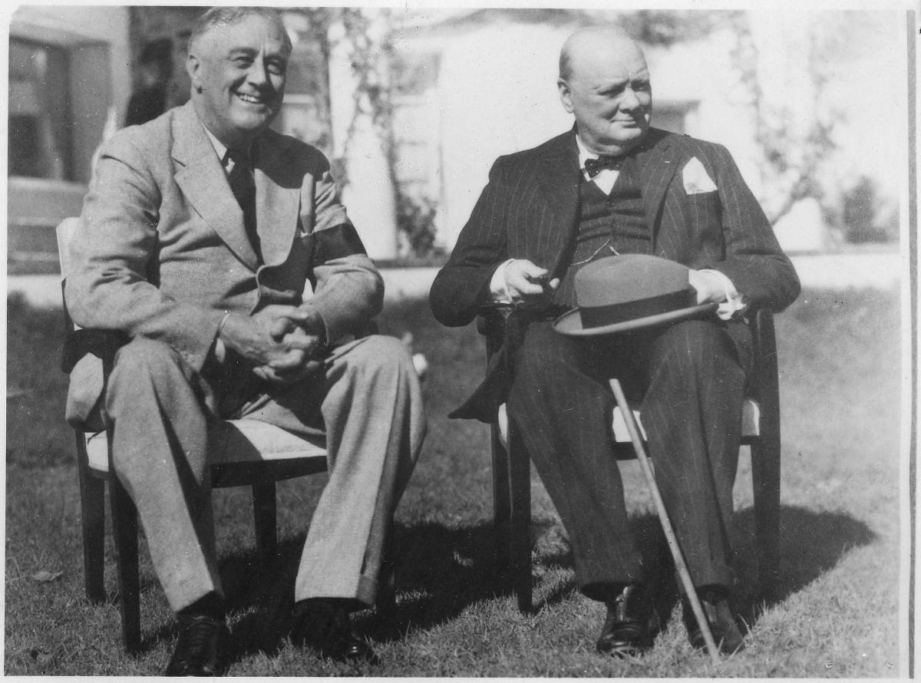
From atomic to science diplomacy
"Science diplomacy" is one of the diplomatic tools for building both multilateral and bilateral relations between countries, based on the interaction of the scientific communities of these countries.
First examples of scientific diplomacy:
August 2, 1939 - A letter from physicists A. Einstein, L. Szilard, E. Wigner and E. Teller to F. D. Roosevelt warning that Germany might develop atomic bombs and suggesting that the United States should start its own nuclear program;
April 1942 - a letter from G. N. Flerov to J. V. Stalin calling for the beginning of the nuclear program in the USSR;
July 3, 1944 - Niels Bohr's Memorandum addressed to F. D. Roosevelt with a request not to hide from the USSR the work being done in the United States to create an atomic bomb, since the USSR is an ally of the United States, great Britain and France in the war against Germany. Roosevelt reacted to this favorably, however, W. Churchill categorically prevented the issue from being resolved having said that “this should not be done in any case and the author of this idea deserves to be put in prison”

Slide 12
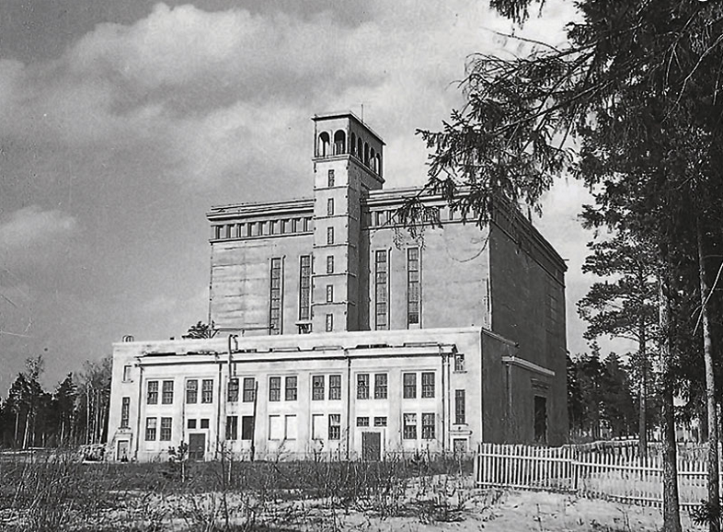
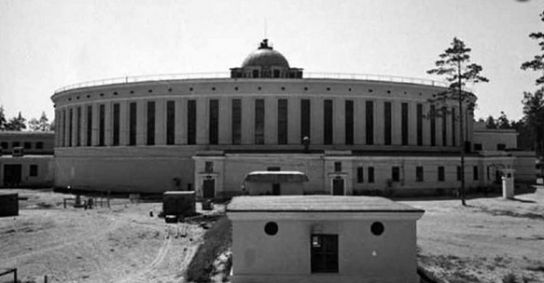
JINR founding: International background
1949 – foundation of the Council of Europe
to promote human rights, democracy and rule of law in Europe
1951 – foundation of the European Coal and Steel community. The goal -
to regulate industrial production under a common authority.
European integration launched which led to the European Union
1954, 29 September – the European Organization for Nuclear Research (CERN) was founded in response to the interest of many European countries and as a counterbalance to American superiority in the field of nuclear research
1955, April – Bandung Conference (Indonesia), Non-Aligned Movement milestone
1955, August - International Conference on the Peaceful Uses of Atomic Energy in Geneva
1954 – the principle of peaceful coexistence is introduced as one of the basics in international relations
(5 postulate, China-India Agreement),
1956, February – 20th Congress of the CPSU: the principle of peaceful coexistence becomes the basis for foreign policy of the Soviet Union, JINR hosting country
1956, 26 March JINR was founded
1957, 29 July - IAEA was created in response to the deep fears
and expectations generated by the discoveries and diverse uses
of nuclear technology
1957, July – Pugwash Conference(Canada) united scientists from East
and West to discuss jointly global issues.

Slide 13
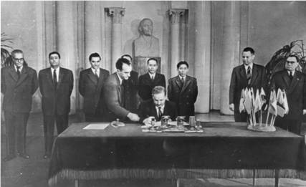
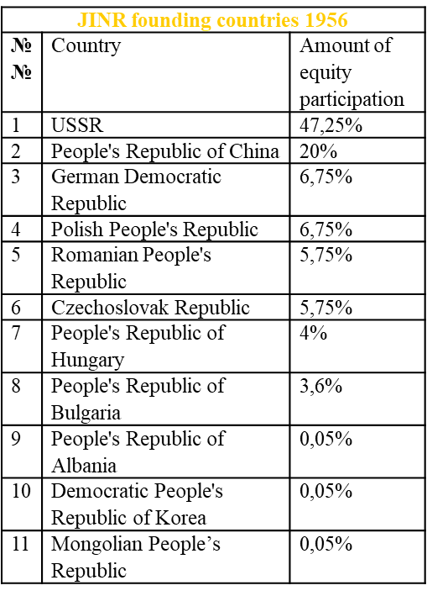
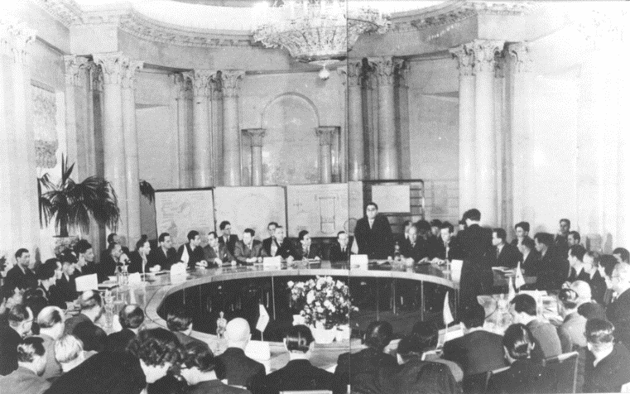

Establishment of the Joint Institute for Nuclear Research
The Joint Institute for Nuclear Research (JINR)
is an international intergovernmental scientific research organization established under the Convention signed on 26 March 1956 in Moscow to unite scientific and material potential of its Member States in order to study fundamental properties of matter
Albania
Bulgaria
China
Czechoslovakia
GDR
Hungary
D.P.R.Korea
Mongolia
Poland
Romania
USSR
Vietnam
The results of research carried out at the Institute can be used solely for peaceful purposes for the benefit of mankind.

Slide 14
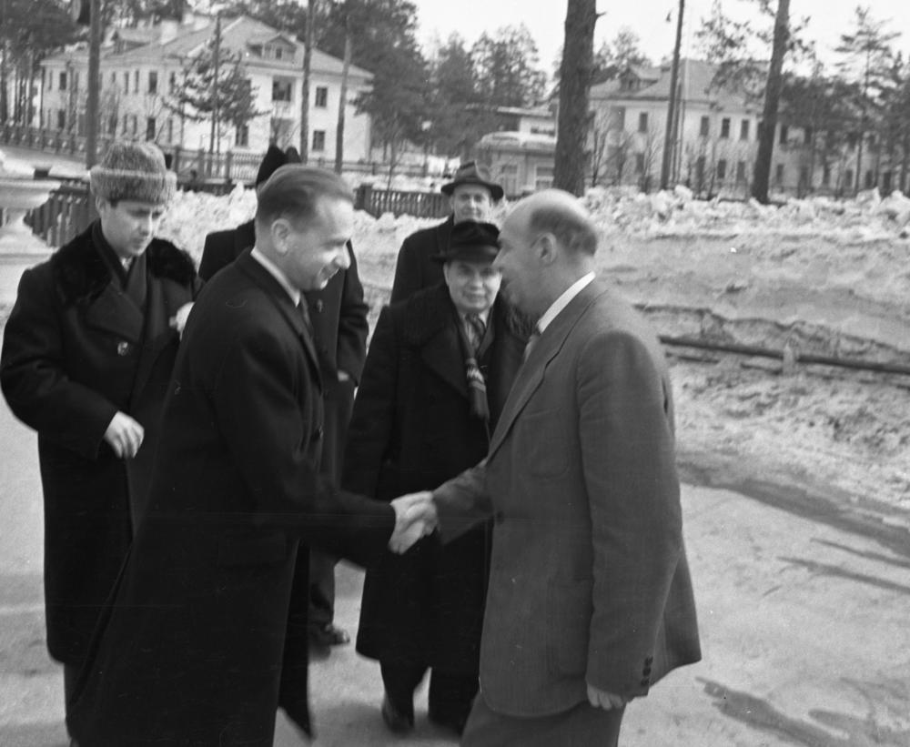
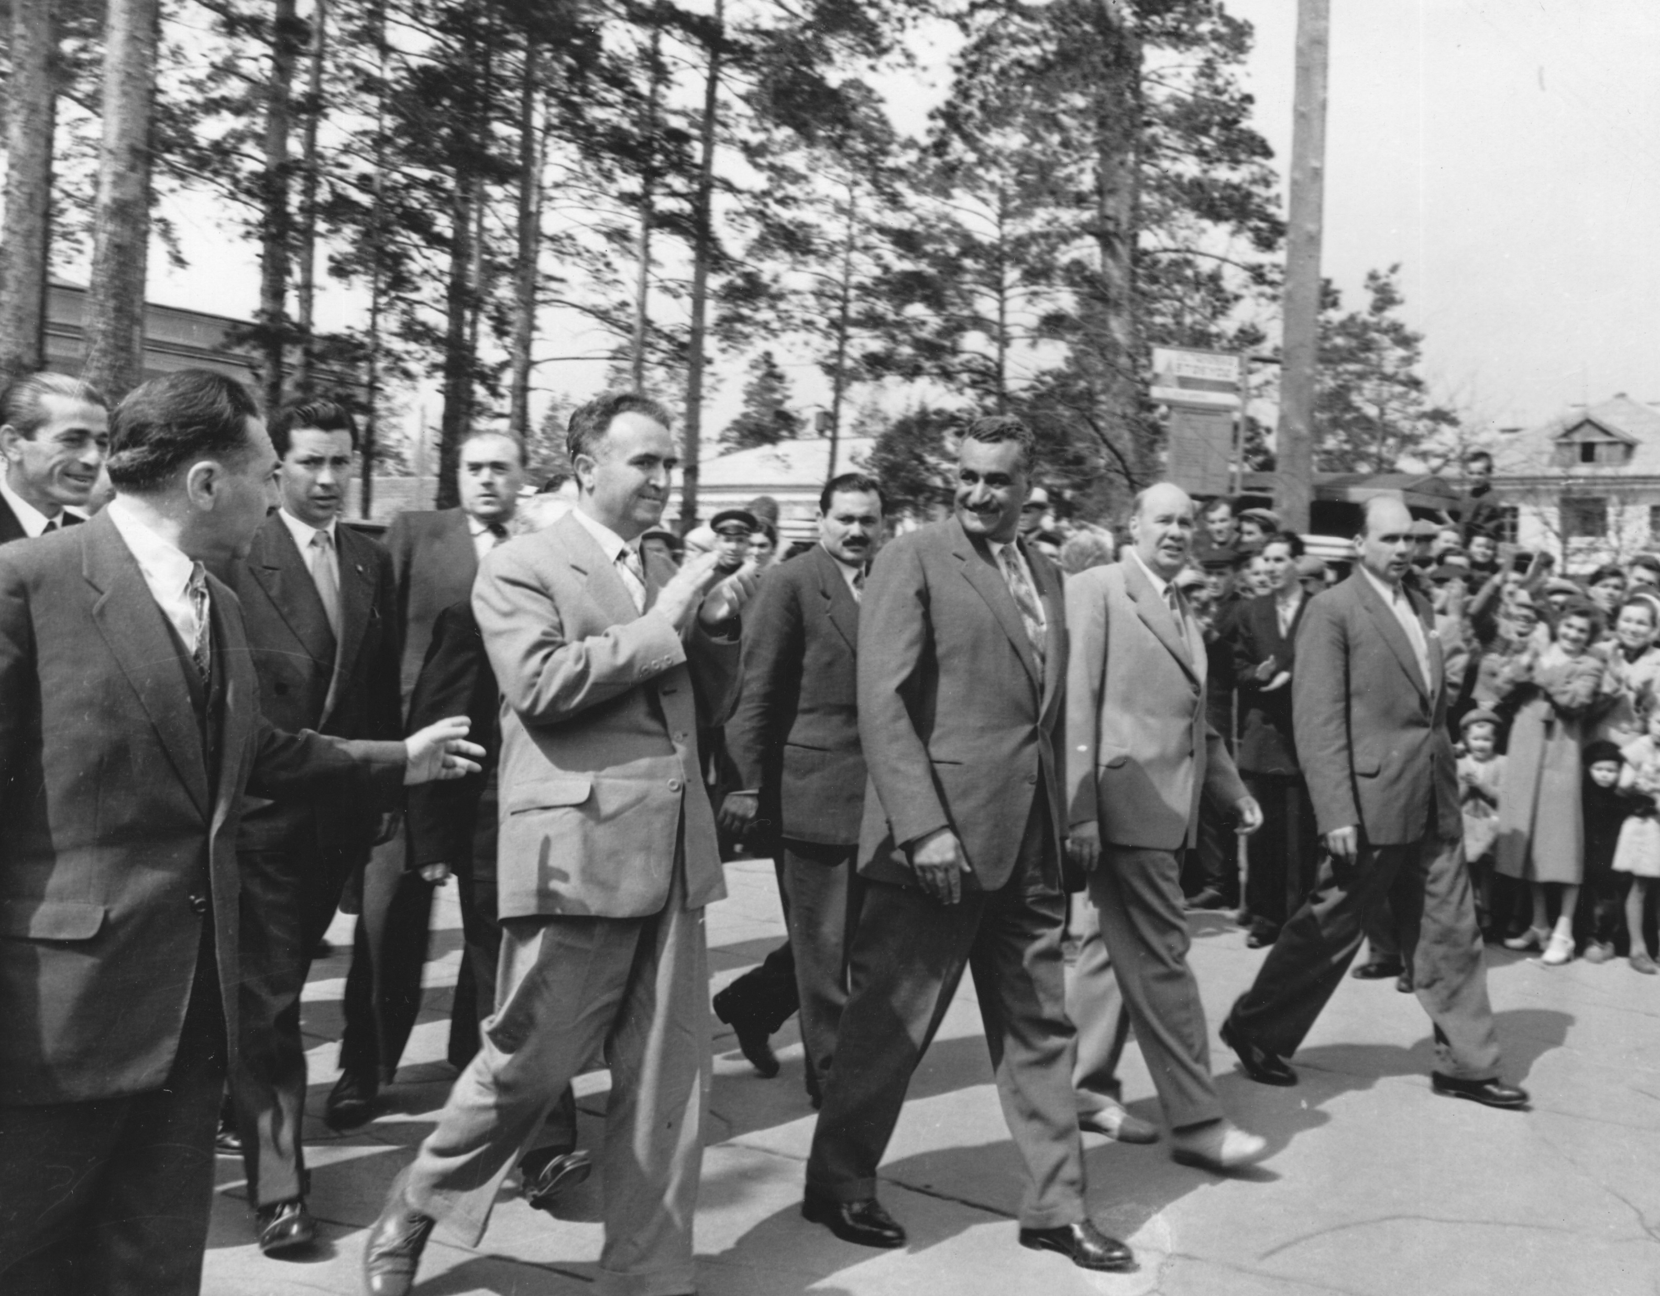
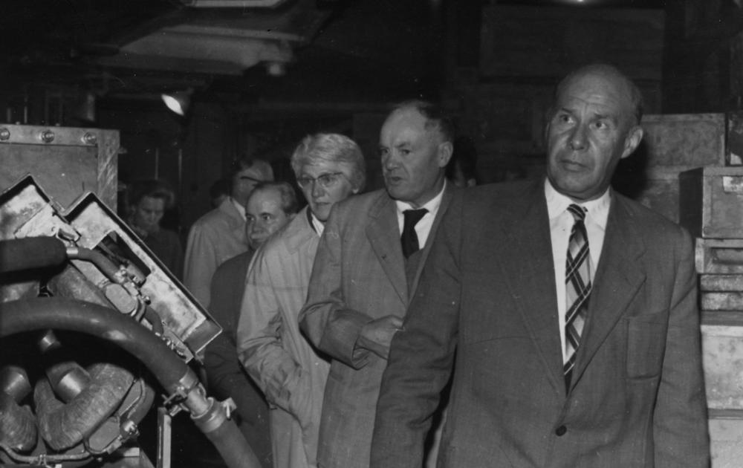
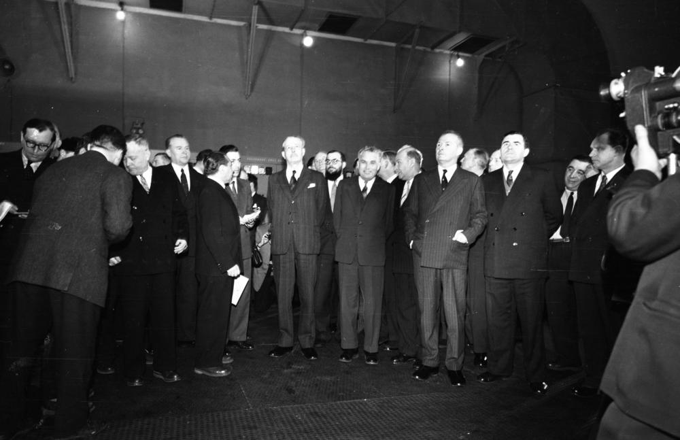
JINR as an exhibition of Soviet science achievements in 1950es
Dag Hammarskjöld,
3rd Secretary-General of the United Nations, 1958
President of Egypt Gamal Abdel Nasser,
1958
Maurice Thorez, leader of the French Communist Party, 1959
Prime Minister of the United Kingdom Maurice Harold Macmillan
and Soviet Minister of Foreign Affairs Andrey Gromyko, 1959

Slide 15
Nobel laureates - guests of JINR
№ | Name | Country | Date of NP receipt | Date of the visit to JINR
1 | Jean Frédéric Joliot-Curie | France | 1935 | 1956
2 | Paul Adrien Maurice Dirac | Great Britain | 1933 | 1958
3 | John Douglas Cockcroft | Great Britain | 1951 | 1958
4 | Isidor Isaac Rabi | USA | 1944 | 1959
5 | Patrick Maynard Stuart Blackett | Great Britain | 1948 | 1959
6 | Cecil Frank Powell | Great Britain | 1950 | 1959
7 | Owen Chamberlain | USA | 1959 | 1960
8 | Emilio Gino Segrè | USA | 1959 | 1960
9 | Niels Bohr | Denmark | 1922 | 1961
10 | Glenn Theodore Seaborg | USA | 1951 | 1963
11 | Edwin Mattison McMillan | USA | 1951 | 1963
12 | Yang Zhenning | China, USA | 1957 | 1970
13 | Burton Richter | USA | 1976 | 1986
14 | Karl Alexander Müller | Switzerland | 1987 | 1989
15 | Melvin Schwartz | USA | 1988 | 1993
16 | Ilya Prigogine | Belgium | 1977 | 1999
17 | James Watson Cronin | USA | 1980 | 2006
Paul Adrien Maurice Dirac
Burton Richter
Isidor Isaac Rabi
Owen Chamberlain
Karl Alexander Müller
John Douglas Cockcroft
Emilio Gino Segrè
Cecil Frank Powell
Melvin Schwartz

Slide 16
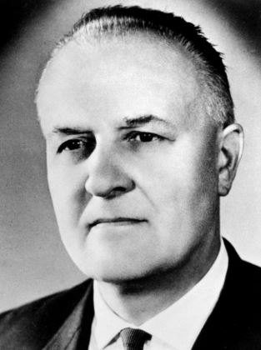
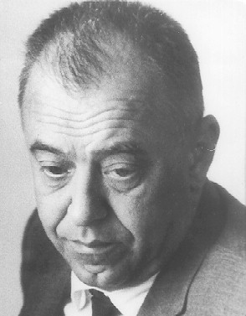
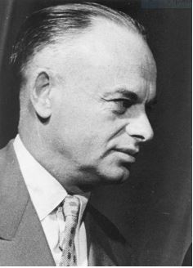
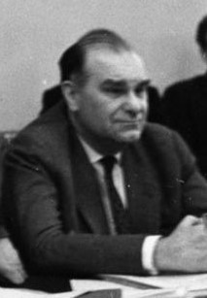

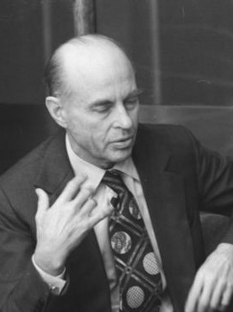
JINR Vice-Directors from member states from beginning
Václav Votruba
Czech Technical University in Prague
1956-1958
Marian Danysz
The University of Warsaw
1956-1958
Wang Ganchang
Chinese Academy of Science
1959-1960
Emil Stefanov Dshakov
The University of Sofia
1959-1960
Heinz Barwich
Dresden University of Technology
1961-1963
Tudor A. Tănăsescu
Romanian Academy of science
1961
Șerban Țițeica
Bucharest University
1962-1963
Ervin J. Fenyves
University of Budapest,
University Texas, Dallas
1964-1966
Ivan Ulehla
Czechoslovakian Academy
of Sciences
1964-1966
Andrzej Hrynkiewicz
Institute of Nuclear Physics
of the Polish Academy
of Sciences
1967
Namsarain Sodnom
Mongolian Academy
of Science
1967 – 1972
Hristo Yankov Hristov
Sofia University
1968-1969

Slide 17
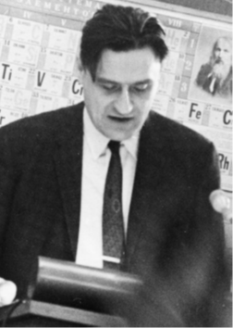
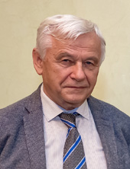
JINR Vice-Directors from member states from late 60es
Alexandru Mihul
Bucharest University
1968-1969
Karl Lanius
Institute of High Energy Physics, (GDR)
CERN
1973-1975
Chestmir Shimane
Nuclear Physics Institute,
Czechoslovakia
1973-1976
Dezse Kis
Hungarian Academy of Sciences
CERN
Vice-Director –1973-1976
Director – 1989-1991
Mieczyslaw Sowinski
Poland Atomic Energy Office
Institute of Nuclear Physics, Orsay
1977-1978
Aureliu Sandulescu
Romanian Academy of Sciences
1983-1985
Erias Entralgo
Cuban Academy of Sciences
University of Havana
1983-1988
Marián Gmitro
Charles University of Prague
1986-1988
Dietmar Ebert
Institute of Physics, Humboldt University, Germany
1989-1991
Tsvetan Vylov
JINR Bulgarian Stuff
1992-2006
Richard Lednický
Institute of Physics of the Czech
Academy of Sciences
2006-2021

Slide 18
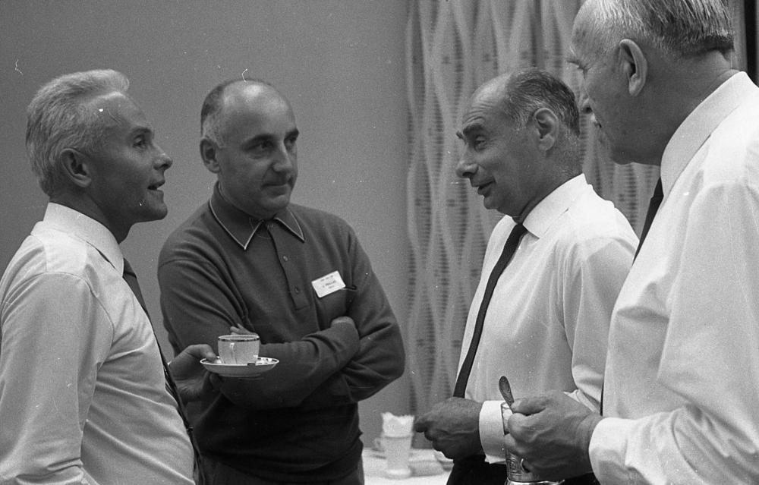
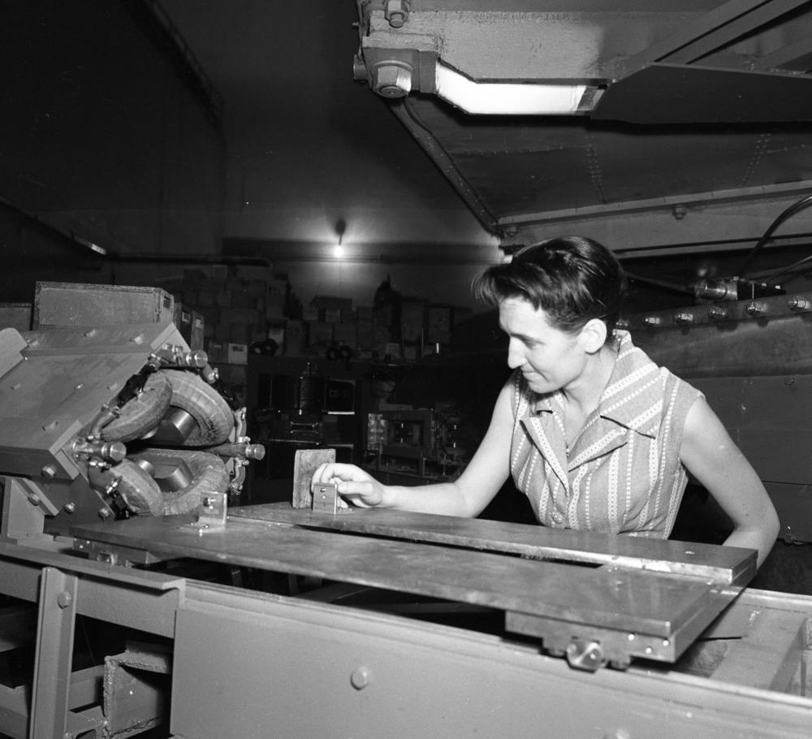
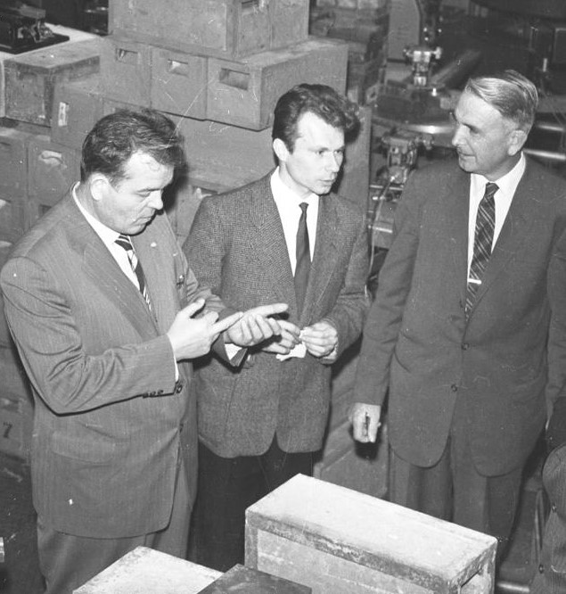



Interaction with non-member states
1964
France
1957 – first French scientists in JINR
1958 – visit of Nobel prize winner Frederic Joliot-Curie
1972 – the first official cooperation agreement was signed between JINR and the National Institute of Nuclear and Particle Physics (IN2P3), initiated by Director of the Institute N. N. Bogolyubov and Jean Teillac, a follower of Frederic Joliot-Curie, Director of the Radium Institute and the Institute of Nuclear Physics of Orsay.
1970s – signing of cooperation protocols with the Laue-Langevin Institute in Grenoble and with the Nuclear Research Center in Strasbourg.
1992 – signing of the General agreement on cooperation with IN2P3
Andrzej
Hrynkiewicz
Jean Teillac
Georgy
Flerov
Genrich
Nevodnichanski
Jeanne Laberrigue – one of the first French specialists in JINR, 1958
The United States of America
The end of the 1950s - on the basis of individual scientific contacts between
JINR physicists and its American colleagues close ties with
national centers of the USA began to develop
1958 – visit of the famous American writer and popularizer of physics Mitchell Wilson
1959 – visit of the American professor Albert Ghiorso by the invitation of G. N. Flerov: independently of each other, they received the 102nd element.
1963 - a new stage in the development of cooperation - a visit of
Glenn Seaborg, who was at that time the chairman of the
United States Atomic Energy Commission.
Albert Ghiorso and L.I. Lapidus, 1959
M.G. Mechsheryakov
and
Mitchell Wilson, 1958
Frederic Joliot-Curie and
Venedict Dzhelepov, 1956
Glenn SeaborgG. N. Flerov and Yu. Ts. Oganesyan, 1963

Slide 19
Changes in JINR member states 1956 - 1991
Historical and political background
Albania's withdrawal – 1962
Soviet-Albanian split as a result of political conflict in 1955-1961 between the USSR and the People's Republic of Albania
Ground for conflict:
Soviet leader N. Khrushchev's rapprochement with Yugoslav President Josip Broz Tito;
USSR policy of de-Stalinization, which began after the XX Congress of the CPSU in 1956
Result: the complete breakdown of relations between the two countries in December 1961, which led to the withdrawal of Albania from the Warsaw treaty organization in 1961 and from the COMECON (Council for Mutual Economic Assistance) in 1962.
Vietnam's entry – 1956
1945 - the formation of the Democratic Republic of Vietnam
1954 - the Geneva conference on Indochina
Results of the conference:
end of first Indochina war;
temporary division of Vietnam into two parts;
planning for free elections to reunify the country in July 1956.
26 March 1956 - an invitation from the founders to join the members of JINR
28 April 1956 - the last French soldier leaves South Vietnam
Summer 1956 - failure of the Geneva agreement, proclamation of the DRV with its capital in Hanoi and the Republic of Vietnam with its capital in Saigon
September 1956 - the emergence of Vietnam as a JINR member state
Cuba's entry – 1976
1959 - proclaiming the victory of the revolution on Cuba and straining its relations with the United States. Washington's economic sanctions
April 1960 - President Kennedy's speech on Cuba: “Cuba should not be given to the Communists and we're not going to do that. If the countries of our hemisphere do not fulfill their obligations to fight against Communist infiltration from outside, our government will not hesitate to fulfill its primary duties”.
1961 - The Bay of Pigs invasion failed American landing operation and overthrow the Castro regime
1962 - Installation of Soviet medium-range ballistic missiles in Cuba to protect the island from American invasion. Caribbean crisis.
1962-1970s -formation of a socialist state in Cuba, active rapprochement with the USSR
28 January – 3 February 1974 - Brezhnev's visit to Cuba, integration of Cuba into the socialist bloc, expansion of Soviet-Cuban contacts in the economic and scientific spheres. Cuba’s entry into COMECON - Cuba’s entry into JINR
People's Republic of China's withdrawal – 1965
The Sino-Soviet split as diplomatic conflict between the PRC and the USSR that began in the late 1950s.
Ground for conflict:
Chinese Communist party leader Mao Zedong's disagreement with the policy of de-Stalinization;
different interpretations and practical applications of Marxism–Leninism;
China's rejection of the new course of the USSR, which declared peaceful coexistence and competition between two systems as well as the variety of forms of transition of different countries to socialism.
Result: break in relations between China and the USSR, mass departure of Chinese specialists, students and scientists from the USSR.

Slide 20



The most important milestones in the history of JINR
Formation, 0+
New Era, 35+
Today, 50+
New associate members:
Republic of South Africa(2005),
Republic of Serbia (2007),
Arab Republic of Egypt (2009)
Towards full membership
Moscow, 26th March 1956
Session of the Committee of Plenipotentiaries, Dubna, 17th March, 1993
12 countries - founders:
Albamia, Bulgaria, China, Czechoslovakia, DPRK, German Democratic Republic Hungary, Mongolia, Poland, Romania, USSR, Vietnam
International legal framework: Intergovernmental Agreement on the Organization of JINR of 1956, The Convention on the Legal Status, Privileges and Immunities of Interstate Economic Organizations of December 5, 1980, the Charter of JINR, etc. regulatory and legal documents; Privileges and immunities of the Ministry of Defense, the highest governing body: the international governing Council-CPT, the priority of the decisions of the CPT over the legislation of the country of residence
New member states:
Belarus, Russia, Ukraine (December 1991)
Armenia, Azerbaijan, Georgia, Kazakhstan, Moldova (March 1992)
Uzbekistan (July 1992)
Czech and Slovak Republics (March 1993)
Associate members:
Germany (July 1991), Hungary (February 1993), Italy (December 1996)
15th December, 2018, ASRT, Cairo
Signing of the JINR-ARE road map
17th October, 2019, Dubna
Signing of the JINR-Serbia road map
Agreement between the Government of the Russian Federation and JINR on the Location and Terms of Operation of JINR in the Russian Federation
Ratified by the Federal Law of the Russian Federation January 2, 2000 N 39-FZ

Slide 21
Joint Institute for Not Only Nuclear Research
Notes:
Как Вы, уважаемые коллеги, знаете, ОИЯИ – международная межправительственная организация, основанная в 1956 году, расположена на берегу великой русской Волги в Подмосковной Дубне.
Миссия ОИЯИ опирается на пять важнейших столпов:
Международное сотрудничество, Фундаментальные исследования на границах знаний, Инновационные решения, Подготовка научной молодежи, Пропаганда науки.
По Уставу, результаты исследований, проводимых в Институте, могут быть использованы исключительно в мирных целях на благо всего человечества.

Slide 22
Web of Science
200 M$
JINR budget
40 M$
23 M$

Slide 23
Joint publications with JINR authors and authors from different countries (2018) from SC 02.2019
JINR Member States | Number of Publications
ARMENIA | 313
AZERBAIJAN | 169
BELARUS | 321
BULGARIA | 251
CUBA | 33
CZECH REPUBLIC | 398
GEORGIA | 265
KAZAKHSTAN | 36
MOLDOVA | 17
MONGOLIA | 55
POLAND | 446
ROMANIA | 233
SLOVAKIA | 219
UKRAINE | 254
UZBEKISTAN | 32
VIETNAM | 19
Other States | Number of Publications
USA | 486
FRANCE | 418
CHINA | 407
SWITZERLAND | 364
ENGLAND | 347
TURKEY | 328
BRAZIL | 324
SPAIN | 314
GREECE | 303
AUSTRIA | 297
TAIWAN | 291
PORTUGAL | 286
SOUTH KOREA | 264
COLOMBIA | 262
INDIA | 253
JAPAN | 238
MALAYSIA | 234
SWEDEN | 216
PAKISTAN | 212
AUSTRALIA | 210
MEXICO | 198
CROATIA | 197
NETHERLANDS | 196
FINLAND | 195
BELGIUM | 179
THAILAND | 178
CYPRUS | 162
NORWAY | 156
IRAN | 153
IRELAND | 152
CANADA | 150
ECUADOR | 149
DENMARK | 147
LITHUANIA | 147
NEW ZEALAND | 147
ESTONIA | 145
LATVIA | 145
QATAR | 142
SCOTLAND | 140
CHILE | 136
ISRAEL | 133
SRI LANKA | 118
ARGENTINA | 115
SLOVENIA | 114
MOROCCO | 110
SAUDI ARABIA | 83
PALESTINE | 56
UAE | 42
INDONESIA | 31
PERU | 31
TAJIKISTAN | 7
JORDAN | 5
ALGERIA | 3
WALES | 3
ALBANIA | 2
BOTSWANA | 2
MACEDONIA | 2
MONTENEGRO | 2
COSTA RICA | 1
LUXEMBOURG | 1
NIGERIA | 1
UGANDA | 1
URUGUAY | 1
VENEZUELA | 1
JINR Associate Members | Number of Publications
EGYPT | 162
GERMANY | 584
HUNGARY | 295
ITALY | 447
SERBIA | 271
SOUTH AFRICA | 160
Notes:
It is important to note a significant number of papers published in co-authorship with scientists from JINR Member States and Associate Members as well as from other countries.

Slide 24

User policy: excellent example of IBR-2
https://ibr-2.jinr.ru/user-policy
Scientists from any country of the world can apply for beam time
Scientists affiliated to laboratories in JINR member states get financial support for the accommodation expenses and the per diem (20 USD/day) for a limited period
IBR-2 beam time is distributed between internal users (FLNP) and general science community (GSC) in the ratio of 35 % (internal proposals) : 55 % (external regular proposals) : 10 % (external urgent beam time requests).
The proposals are peer-reviewed and rated
and beam time for experiments is allocated
on the basis of scientific merit of the proposal.
All accepted proposals get free of charge beam time.
Currently following Selection Committees are established:
  Atomic and Magnetic Structure;
  Lattice and Molecular Dynamics;
  Nanosystems and Soft Matter;
  Neutron Activation Analysis.
Notes:
During 12-14.12.18. JINR was glad to welcome representatives of the Republic of Korea. The Korean delegation included Prof. Seung-Woo Hong, Department of Physics, Sungkyunkwan University, Prof. Chang-Bum Moon, Faculty of Science, Hoseo University, Dr. Lee Hyo Hee, Director, ISBB Promotion Office, Ministry of Science and ICT, and Dr. Seog Hyung Kim, Senior Researcher, ISBB Promotion Office, Ministry of Science and ICT.
The meetings and discussions that took place during the visit focused on subject areas and opportunities for enhancing cooperation between Korean research community and JINR. In particular, JINR Flerov Laboratory and the Laboratory of High Energy Physics were ready with definite proposals on cooperation, to name a few:
- joint investigations with radioactive beams at ACCULINNA-2 fragment separator,
- joint work on a new JINR project “Conceptual design of high-current cw-LINAC for RIB research”,
- participation in NICA project, in particular, BM@N, MPD and SPD collaborations
and others
Material sciences, bio-medical sciences, rare isotopes, nuclear data, training and education programmes were indicated as subject areas with definite collaborative potential and further contacts and discussions between JINR and Korean researchers shall be continued.

Slide 25











Research focus of the Laboratory of Radiation Biology
Molecular Radiobiology
Clinical Radiobiology
Radiation Neuroscience
Radiation Genetics
Radiation Physiology
Mathematical Modeling
Since 2005 : LRB
Leading centre for accelerator-based radiation biology in former Soviet Union and Eastern Europe
Development of innovations in radiation medicine and space research
Radiation Cytogenetics
Radiation Protection
Astrobiology
Notes:
The Laboratory of Radiation Biology (LRB) was organized in 2005 on the basis of the JINR Division of Radiation and Radiobiological Research. The laboratory structure includes the departments of radiobiology and radiation research and a sector of astrobiology.
For over 20 years LRB’s education programs in Dubna university and JINR Univesity centre contribute to training of young specialists.
Owing to a wide range of radiation sources at JINR, LRB can rightly be regarded as a leader among other scientific organizations of Russia and JINR Member States in the field of radiation biology.
An international research programme is implemented at the laboratory. It includes studies of the action of heavy charged particles on the molecular, cell, tissue, organ and organism levels of biological organization (see research focus).
Modern applied research trends include:
radiation neuroscience and evaluation of space radiation risks
development of innovative methods for radiation medicine
A new trend of fundamental research is developed at the laboratory – astrobiology which studies origin and distribution of life in the universe using nuclear physics methods.

Slide 26




DLNP JINR Sector of Molecular Genetics of the Cell
Varioskan LUX multimode microplate reader
SeqStudio Genetic Analyzer
Affymetrix GeneChip system
Zeiss AxioVert microscope
with microinjection/micromanipulation system

Slide 27







QC Milestones South Africa – JINR
1993 First contact with Johannesburg University
1994 First cooperation agreement signed
2000 Coordination of 4 joint projects
2005 MoU between DST SA and JINR signed
2007 Fist SA-JINR Student Practice (23 students)
2012 First Student Session at SA-JINR symposium
2013 Big international conference jointly organized (IASEN-2013)
2015 Week of South Africa in JINR
2016 “10 Years review Forum”
2018 First official discussion of the Road Map
2019 Concept of “strategic projects”
2020 First joined workshop on Theory
1st International African Symposium on Exotic Nuclei 2013
Review Forum “RSA-JINR: 10 Years Together” 28 November – 3 December 2016, Pretoria-CapeTown, South Arfica
WoS Publications Year | JINR, SA with others | JINR, SA without CERN
2007 | 2 | 2
2008 | 3 | 1
2009 | 3 | 3
2010 | 24 | 10
2011 | 76 | 14
2012 | 157 | 17
2013 | 116 | 17
2014 | 116 | 14
2015 | 135 | 13
2016 | 182 | 28
2017 | 151 | 26
2018 | 166 | 19
2019 | 219 | 30
Member of SC since 2018
Faïçal Azaiez
Director
iThemba LABS, SA
9-10 October 2019 Dubna. 18th meeting of JCC
Key words: Strategic projects, Theory Workshop, Road Map
RSA in JINR today: 16 Joint Research Projects / 900 kUSD per Annum

Slide 28


















Nuclear newcomers’ visits at governmental level in 2016-2019
03/2016 Ethiopia 02/2017 Zambia
06/2016 Botswana 04/2017 Paraguay
01/2017 Bolivia 09/2017 Shri Lanka 06/2018 Rwanda 02/2019 Uganda
The visits were aimed at studying opportunities for use of JINR experience in developing national expertise in nuclear sciences and applications, participation in JINR education programmes and providing access to modern scientific infrastructure for young talented researches.
Round table within the framework of «ATOMEXPO-2017» in JINR / June 2017
90+ experts from 20 countries discussed key issues related to
JINR experience in efficient operation of Research Infrastructure and User Policy
Notes:
В последние годы сильно активизировался интерес к ОИЯИ со стороны стран-новичков в области ядерных наук. Так, недавно в Институт приезжали профильные министры и Чрезвычайные и Полномочные Послы из Боливии, Ботсваны, Замбии, Парагвая, Шри-Ланки, Эфиопии.
Высокие гости изучали возможности кооперации с ОИЯИ в деле развития национальной ядерной экспертизы, образовательные программы, обеспечение доступа молодых ученых к современной исследовательской инфраструктуре. Часть этих визитов явилась результатом нашей тесной кооперации с ГК «Росатом».
В июне прошлого года наш Институт с честью принял выездной круглый стол в рамках Атомэкспо-2017, который собрал в Дубне около ста государственных руководителей и высокопоставленных экспертов из 20 стран, приехавших обсудить вопросы организации эффективного использования исследовательских инфраструктур и пользовательской политики.

Slide 29
Novel instruments of IC development
Notes:
Как Вы, уважаемые коллеги, знаете, ОИЯИ – международная межправительственная организация, основанная в 1956 году, расположена на берегу великой русской Волги в Подмосковной Дубне.
Миссия ОИЯИ опирается на пять важнейших столпов:
Международное сотрудничество, Фундаментальные исследования на границах знаний, Инновационные решения, Подготовка научной молодежи, Пропаганда науки.
По Уставу, результаты исследований, проводимых в Институте, могут быть использованы исключительно в мирных целях на благо всего человечества.

Slide 30

Stimulating role of NICA detector collaborations
MPD Collaboration
12 countries
44 Institutes/Universities
>500 participants (485 authors)
5 Physics working groups:
Global observables
Light flavour & hypernuclei
Correlations & fluctuations
Electromagnetic probes
Heavy flavour
BM@N Collaboration
10 countries
19 Institutes/Universities
255 participants
Extended physics programme of the ongoing
experiment:
Short-range correlations
Hyperons & hypernuclei
Heavy ion physics, etc.
SPD Collaboration
10 countries
23 Institutes/Universities
~300 authors + individuals
Physics goals:
Gluon content in p and d
Charmonia
Open charm
Prompt photons
MPD fosters unique high technology industry, e.g.
Magnet Yoke - Vitkovice HM / Czech
Cryostat/SC coils - ASG Genova / Italy
MPD promotes creating intellectual clusters in Universities, e.g.
ECAL subsystem - University consortium in China
BD scintillator array - University consortium in Mexico
MPD demands development of local production, e.g.
Clean room labs for advanced semiconductor detectors
December 25, 2020
Notes:
Флагманский проект Институт NICA – это новый сверхпроводящий ускорительный комплекс, который создаётся с целью изучения свойств плотной барионной материи. Дополнительно к бюджету Института, проект поддержан специальным мега-грантом Российской Федерации.
После того, как коллайдер NICA будет запущен, учёные ОИЯИ смогут воссоздать в лабораторных условиях особое состояние вещества, в котором пребывала наша Вселенная первые мгновения после Большого Взрыва, — кварк-глюонную плазму.
Часть проекта – тяжело-ионный синхротрон и установка BM@N уже в строю. Но в ближайшем будущем заработают коллайдер и первый большой детекторный комплекс MPD. Это откроет огромные возможности и в передовой науке и в подготовке кадров.

Slide 31



Research Infrastructure as a magnet for young talents
Summer Student Programme
International Student Practice
247 participants in 2014-2019
1716 participants since 2004

Slide 32


United Scientific and Educational Center “Dubna” in Kazakhstan established in 2016/2017
Impact of DC-60 cyclotron complex on Kazakhstan participation in JINR
Research scope today
Solid state physic
Nanotechnology
Nuclear physic
Chemistry – all fields
Catalysis
Polymer chemistry
Biology
Pharmacology
Medicine
Theoretical physics
Main Goals
Coordination of cooperation of enterprises and universities of Kazakhstan with JINR;
Dissemination of information about the possibilities of cooperation with JINR;
Selection of students from universities of the Republic of Kazakhstan for specialized training in JINR;
Dynamics in the number of employees by year
(to March 2020)
USEC “Dubna” is established in 2017

Slide 33




JINR Information Center in the South of Russia
October 2018
Opening ceremony in Vladikavkaz in North Ossetian State University (NOSU)
The first JINR information center and the JINR Cloud
December 2017
The idea is to use access to the modern research infrastructure as driver for raising interest in natural sciences
February 2020
Cloud Cluster launched in NOSU
April 2021
School Conference and the workshop “Distributed Computing and Data Science” in NOSU
NOSU will join JINR international IT-School “Analytics of BIG Data”
Distributed information and computing environment
based on the resources of JINR and its Member States’ organizations
Main achievements of IC
2018 number of physics students doubled
2019 competition rate rose to 2.5
2020 full course of 1st year physics students despite pandemic
Groundwork for cooperation
in NICA, ecology, material research, IT, modern education, …
Notes:
В 2021 году Объединенный Институт будет отмечать свое 65-летие. Одной из вех грядущего года станет принятие Долгосрочного стратегического плана развития ОИЯИ до 2030 года. Одна из важных глав этого плана – дальнейшее развитие международного сотрудничества.
Укрепление связей МААН и ОИЯИ, участниками которого мы с Вами сегодня являемся, несомненно внесет вклад в интеграционные процессы на пространстве СНГ и за его пределами.
Наука сближает народы – это лозунг нашего Института с 20-летней историей. Ровно 20 лет назад ОИЯИ принимал у себя десятое заседание Совета МААН, и мы рассчитываем, что один из ближайших Советов также пройдет в Дубне.
Спасибо за внимание!

Slide 34


Prospects of JINR Information Centers around the world
Staring point Current Experience Under Preparation Decisions Made Under Consideration Possible Future
IFA
Bucharest
Romania
IC
in the South
of Russia
NOSU
FEFU
Vladivostok
Russia
2021
University of Novi Sad
Novi Sad
Serbia
2022
Chisinau
Moldova
Minsk
Belarus
Vladikavkaz,
Russia, 2019
Krakow
Poland
VBSU
Petropavlovsk
-Kamchatsky
Russia
2021
TPU
Tomsk
Russia
Erevan
Armenia
ISU
Irkutsk
Russia
Hanoi
Vietnam
Gauteng
South Africa
JINR
Visit
Center
ASRT
Cairo
Egypt
2020
AAEA
Tunis
Tunisia
2022
SFU
Rostov-na-Donu
Russia
BIUST
Botswana
PSU
Petrozavodsk
Russia
Dubna, 2016
Sofia
University,
Bulgaria
2021
Ulanbator
Mongolia
SEC
“Dubna”
Nur-Sultan
INP
iThemba Labs
Western Cape
South Africa
Slovak
Republic
Library of Alexandria
Egypt
Kazakhstan, 2017
Santiago
Chile
Readiness

Slide 35


JINR Expertise for Member States and Partner Countries
* 15 training programs for science administration implemented during April 2017 - February 2020
* 183 participants from 30 countries and one IGO
Universities | Rectors and Vice-Rectors | 6
 | Deans and directors of research units | 19
 | Local contact points | 45
Research organizations | Directors and vice-directors | 17
 | Heads of departments | 51
 | Local contact points/experts | 30
Governments and IGO | Minister, DG, CEO/ deputies | 3
 | Governmental & IGO officers | 8
 | JINR Board members | 4
3 years
15 JEMS
hosting country JEMS TOP5 sum over region emerging directions
Notes:
JEMS started in 2017 and during 3 years 183 participants from 30 countries and one international organization, namely the Arab Atomic Energy Agency, have taken part in this program. JEMS hosted representatives of 45 universities, 35 research organizations and more than 10 government level units from different countries and continents. JEMS has become a multi-purpose vehicle to work with new partners from different parts of the world, including the hosting country of JINR. So far, representatives of 13 Russian universities have participated in JEMS.

Slide 36









Expanding the partner network through a regional approach
Latin American region - an interesting idea
South Africa - search for a base organization
Initiative: Cuba
4th of March 2014. JINR
Ambassadors of 11 Latin American countries visited JINR
The result:
- Intensification of official contacts with the government of Brazil
Unsolved issue:
Basic structure
26th February, 2016, Gaborone, Botswana
Visit to the headquarters of the Southern African Development Community (SADC) with the support of the Russian Embassy in Botswana and the Botswana International University of Science and Technology
Results:
Interest of the Government of Botswana in official participation in JINR
South Africa's interest in joint programs with JINR for Africa - iThemba LABS will take on the role of the basic structure
Southeast Asia - the first step has been taken
Arab League-regular work
Initiative: Vietnam
Initiative: Egypt
Basic structure: AAEA
December 15, 2016, the JINR-AAEA Agreement was signed
April 19-22, 2017, the leadership of AAEA passed the JEMS training programme at JINR December 17, 2018 2nd JINR-AAEA Coordination Meeting
27 — 28 November 2019,
Hanoi, Vietnam
Conference
JINR-VANT_UNESCO
“Challenges and opportunities for international cooperation in Natural Sciences” with the participation of scientists from Vietnam, the Republic of Korea, Malaysia, Thailand, the Philippines, and Japan.
  Results:
  Familiarization contacts with representatives of the governments of a number of Arab countries;
  AAEA plans to open a JINR Information Center at AAEA headquarters in Tunisia;
  Interns in JINR under the AAAE line are discussed on a competitive basis
Objective: to strengthen Vietnam's regional leadership in science
In the future: creation of a joint laboratory on the basis of the reactor under construction in Ho Chi Minh City (Rosatom)
Notes:
В последние годы сильно активизировался интерес к ОИЯИ со стороны стран-новичков в области ядерных наук. Так, недавно в Институт приезжали профильные министры и Чрезвычайные и Полномочные Послы из Боливии, Ботсваны, Замбии, Парагвая, Шри-Ланки, Эфиопии.
Высокие гости изучали возможности кооперации с ОИЯИ в деле развития национальной ядерной экспертизы, образовательные программы, обеспечение доступа молодых ученых к современной исследовательской инфраструктуре. Часть этих визитов явилась результатом нашей тесной кооперации с ГК «Росатом».
В июне прошлого года наш Институт с честью принял выездной круглый стол в рамках Атомэкспо-2017, который собрал в Дубне около ста государственных руководителей и высокопоставленных экспертов из 20 стран, приехавших обсудить вопросы организации эффективного использования исследовательских инфраструктур и пользовательской политики.

Slide 37
Future of JINR International Cooperation
Notes:
Как Вы, уважаемые коллеги, знаете, ОИЯИ – международная межправительственная организация, основанная в 1956 году, расположена на берегу великой русской Волги в Подмосковной Дубне.
Миссия ОИЯИ опирается на пять важнейших столпов:
Международное сотрудничество, Фундаментальные исследования на границах знаний, Инновационные решения, Подготовка научной молодежи, Пропаганда науки.
По Уставу, результаты исследований, проводимых в Институте, могут быть использованы исключительно в мирных целях на благо всего человечества.

Slide 38


Visit of the Ambassadors of the Republic of Poland, the Slovak Republic and the Czech Republic to JINR - 24 September 2021
Several significant events were timed to coincide with the visit of the ambassadors:
Opening of a photo exhibition decorated with photos of notable places in the Czech Republic provided by the Czech Tourism Development Agency;
Opening of a commemorative plaque on the completion of the renovation of the hotel for the 65th anniversary of JINR by the general contractor LLC ASARKO (Czech Republic);
Ambassador of the Republic of Poland Krzysztof Krajewski, Ambassador of the Slovak Republic Lubomir Regak, Ambassador of the Czech Republic Vitezslav Pivonka visited JINR as part of the celebration of the 65th JINR anniversary.
Highlights of the visit:
meeting with the JINR Directorate in the round table format;
participation in the 130th session of the JINR Academic Council;
visiting the main objects of the JINR scientific infrastructure;
communication of heads of diplomatic missions with national groups of Slovakia, Poland and the Czech Republic at JINR.
Outcome of the visit:
the ambassadors stressed the importance of the JINR for the interaction of the member states’ scientific communities;
the parties agreed to assist in strengthening and developing further cooperation within the framework of joint projects and collaborations
Notes:
On September 24, as part of the celebration of the 65th anniversary of JINR, the Ambassadors Extraordinary and Plenipotentiary of the Republic of Poland, the Slovak Republic and the Czech Republic to the Russian Federation arrived in Dubna. Within the framework of the visit, they participated in the meeting with the JINR Directorate in the format of a round table with a discussion of the prospects for the development of scientific cooperation between their countries and the Institute. The ambassadors also took part in the 130th session of the JINR Academic Council. As part of the program, the guests visited an interactive exhibition dedicated to the 65th anniversary of JINR, the MPD experimental hall and the factory of superconducting magnets in the Laboratory of High Energy Physics. An important component of the visit was the communication of the heads of diplomatic missions with the national groups of Slovakia, Poland and the Czech Republic in JINR. The guests also took part in the opening of a photo exhibition decorated with photographs of notable places in the Czech Republic provided by the Czech tourism development Agency.

Slide 39



ARE-JINR: TODAY and TOMORROW: FULL MEMBERSHIP FOR EGYPT
13 September 2021/ The plenary session “Strategic Opportunities for Advancing Global Collaborative Perspectives Towards Achieving 2030 Main Research Goals” and topical parallel sessions of the workshop
14 September 2021/ Ceremonial opening of the JINR
Information Centre at the headquarter of ASRT
Participants:
JINR delegation headed by Acad. G. Trubnikov;
Directorate of ASRT, headed by Prof. M. Sakr;
Arab Atomic Energy Agency’s Head of Scientific Affairs Directorate Daw Saad Mosbah;
Egyptian leading scientists
Honorable speakers:
the Ambassador of the Russian Federation to Egypt H. E. Georgiy Borisenko;
the Ambassador of Romania to Egypt H. E. Mihai Stuparu;
the Ambassador of Bulgaria in Egypt H. E. Deyan Angelov;
The participants of the ceremonial opening of the event:
JINR Director Academician Grigory Trubnikov;
Chairman of the Egyptian Atomic Energy Agency (EAEA) Prof. Amr El-Hag Ali;
President of ASRT Prof. Mahmoud Sakr;
Minister of Higher Education and Scientific Research of Egypt H. E. Khaled Abdel-Ghaffar.
Topic parallel sessions “Towards Advancing ARE-JINR Scientific Collaborative Opportunities”:
Main highlights:
discussion of the prospects for the development of the information center and its role in the development of scientific communication in both Egypt and the MENA region;
demonstration of educational films prepared by the UC as one of the training tools for the potential audience of the Information Center.
Radiobiology, Genetics, and Radiation Therapy
Nuclear analytical techniques, neutron radiography
Archaeology and Cultural Heritage
High energy physics, NICA, SPD, and MPD
Nanotechnology Applications
Theoretical Physics and Advanced Mathematics
Analysis of Big Data, Computation
Notes:
On September 13 the scientific workshop “Egypt – JINR: Today and Tomorrow” started in Cairo. The participants of the ceremonial opening of the event were welcomed by the Chairman of the Egyptian Atomic Energy Agency (EAEA) Prof. Amr El-Hag Ali, the President of ASRT Prof. Mahmoud Sakr, and the Minister of Higher Education and Scientific Research of Egypt H. E. Khaled Abdel-Ghaffar. The welcome addresses on behalf of the JINR Member States were delivered by: the Ambassador of the Russian Federation H. E. Georgiy Borisenko , the Ambassador of Romania H. E. Mihai Stuparu and the Ambassador of Bulgaria H. E. Deyan Angelov. JINR delegation was presented by the members of Directorate, Chief Scientific secretary, UC Director, ICD Director, the directors and deputy directors of laboratories. A number of the leading specialists of JINR laboratories and Egyptian research centers took part in the topical parallel sessions of the workshop. The agenda of the event included the meetings of the JINR’s leadership with the leaders of ASRT, the Ministry of Higher Education and the administration of the higher educational institutions and research institutes of the Egypt.
On September 14 a ceremonial opening of the JINR Information Centre took place at the headquarters of the Egyptian Academy of Scientific Research and Technology. The ceremony was attended by the directorate of JINR, ASRT, Head of Scientific affairs Directorate of Arab Atomic Energy Authority Daw Mesbah and leading scientific researches of Egypt.

Slide 40






QC Milestones JINR – Serbia
1994 Multilateral agreement JINR-“Vinča” institute
1996 Construction of “Vinča cyclotron complex started
2001 Ministerial visit to JINR
2007 Cooperation Agreement with Serbian government
2009 Funding from Serbia started
2010 Bilateral coordination meeting FAMA-FLNR on material science with ion beams
2014 International coordination meeting (Belgrade)
2017 Days of JINR in Serbia (Belgrade, Novi Sad)
2017 Endorsement of the Road Map, increased contribution
2019 Road Map of the cooperation is signed, readiness to full member in 2024
2020 Open Days of JINR in Belgrade
2021 Action Plan for fast track on the Road Map (expected)
Main cyclotron of the TESLA Acceleration Installation complex aiming to deliver 70 MeV protons for the proton therapy, experimental production of radiopharmaceuticals and the analysis of materials.
First ECR ion source of TESLA project
JINR Directorate visit
to “Vinča” Institute, 2009
WoS Publications Year | JINR, Serbia with others | JINR, Serbia without CERN | CERN, Serbia without JINR
2004 | 1 | 1 | 2
2005 | - | - | 1
2006 | 4 | 1 | 1
2007 | 13 | 3 | -
2008 | 15 | 6 | 2
2009 | 21 | 6 | -
2010 | 69 | 6 | 1
2011 | 146 | 4 | 1
2012 | 263 | 11 | -
2013 | 196 | 10 | 1
2014 | 189 | 8 | -
2015 | 226 | 9 | 1
2016 | 246 | 17 | 4
2017 | 222 | 12 | 3
2018 | 277 | 15 | -
FAMA: Facility for modification and analysis of materials with ion beams
Member of SC since 2018
Member of the NC of Science
Secretary General
of the World Academy
of Art and Science
Serbia in JINR in 2020:
12 Joint Research Projects
Annual contribution
150 kUSD in 2019
C2 channel: modification of materials with heavy ions (various metal, semiconductor, carbon, polymer and ceramic targets).
C1 channel: irradiation of polycrystalline and monocrystalline targets.

Slide 41

Highest-level meeting in Sofia
09 September 2021/ Sofia, Bulgaria
JINR Vice-Director Latchesar Kostov met with the President of Bulgaria Rumen Radev in his residence in Sofia
Proposal to CoP meeting in Sofia
SOFIA DECLARATION
On the value of developing international integration in science and technology
Value of the format of an international, intergovernmental research organization, … JINR cooperation model and securing a high level and competitiveness of research results and alignment with world science,
Undertake accorded, proactive efforts in the interests of the Member States to involve new countries… in conformity with the principles of openness and inclusivity,
Strengthen the role of JINR as a unique integrating site for development of modern instruments applied by the Member States and partner countries in science diplomacy, promotion of science and intercultural exchange.
Notes:
JINR Vice-Director Latchesar Kostov met with the head of the country in his residence in Sofia at the 9th of September 2021. The parties discussed the prospects for the development of the partnership between Bulgaria and JINR in the fields of fundamental and applied scientific research. Participants of the meeting noted a considerable contribution made by Bulgaria to scientific studies of the Institute throughout the JINR history. At the meeting, Rumen Radev accepted the invitation extended by Latchesar Kostov to become an official guest at the festive session of the Committee of Plenipotentiary Representatives of JINR dedicated to the 65th JINR anniversary.

Slide 42




Prospects for formalizing relations with non member states
Status at the level of government structures or authorized departments
- there is an official partnership
- a specific agreement was discussed
- progress made in negotiations
- interest was expressed
Circle area – the number of partner organizations, figure – the number of employees in JINR
15th February 2018 Day of JINR in France
Letter of intent of the Government of France and JINR to conclude a Memorandum of Understanding.
Turkey
France
Botswana
Bangladesh
Brazil
1
1
12th October, 2019, Mexico
Memorandum of Understanding between JINR and the community of research institutes of Mexico on joint participation in the implementation of the NICA project
Chile
Mexico
1
1
Greece
Montenegro
Republic of Korea
China
Israel
India
1
Tajikistan
1
5
9
The multidisciplinary forums JINR-India (2014) and JINR-Brazil (2015) were held with a high level of participation.
Draft Agreements with JINR at the associate membership level were sent to Brazil (CNEN) and India (DAE) in 2015.
26th August, 2020, Russia China scientific and technical cooperation year opening, video conferenceя
Agreement between the Ministry of Science and Technology of China and JINR on the construction and operation of the NICA project
2010 2015 2020

Slide 43


Member states
JINR global reach – strategic perspective
Sustainable development of the partner network: positive experience
Expansion of the JINR Universe 2030+
Individual
organizations
Countries establishing contacts with JINR
Countries and IO
Regional clusters
Non-member states with developed contacts with JINR
Member states
Other countries
International organizations
Partner organizations
Associated members
Member states
Research infrastructure,
Headquarter
New initiatives:
Joint Laboratories;
Information centers network;
Ministerial conferences;
“Alumni” Club
Expected result 2030
Partners network 1000+
Countries in network 80+
Member states 18+
Intergovernmental agreement on International Intergovernmental organization

Slide 44


The first JINR director about JINR foundation
«We go to a completely new area and do not yet know what will come of it, but history teaches that when physicists go to a new area they never come out empty-handed»
Dmitry Ivanovich Blokhintsev
Thank you
for attention!

