Slide 1

Improving Scientific Presentations
Holly K. Bogomyagkova
Advance English - Physics Faculty
Novosibirsk State University
h.bogomyagkova@g.nsu.ru

Slide 2
As a scientist you are…
…a professional writer and speaker,
…in a second language.
Notes:
Ask the first question and wait for response.

Slide 3
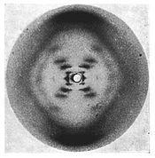
Who mapped DNA?
Rosalind Franklin, 1951
In 1953, two scientists were officially able to announce their discovery of the chemical structure of DNA. James D. Watson and Frances H.C. Crick

Slide 4
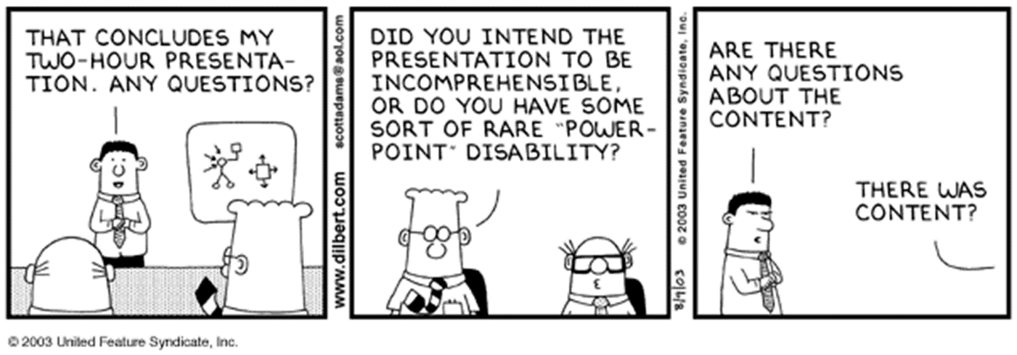
Scientific Presentations
"Tell'em what you are going to tell'em.
Tell'em.
Then tell'em what you told'em."

Slide 5
Presentation purpose
Inform – what you are doing
Persuade – this research is important
Inspire – see what others are doing
Make decisions, instruct, get money

Slide 6
The advantages and disadvantages of scientific presentations
Advantages | Disadvantages
Speaker receives and answers questions Opportunity to revise on the spot Speaker emphasizes important points Presentations incorporate many types of visual aids Speaker interacts with audience | One chance to speak – one chance to hear Audience may not know background information Audience restricted to pace of speaker Success dependent on speaker’s ability to deliver Academic English Smaller vocabulary

Slide 7
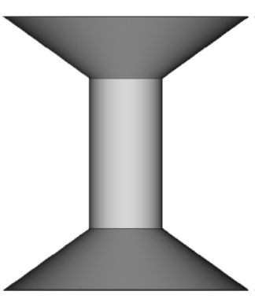
Structure similar to scientific articles
←Introduction - What is out there?
← What is not out there?
← How the research answers this need
← Hypothesis - research meeting the need
← Methods -“the how” to reach this need
← Results – what was obtained to fill the need
← Discussion- How the results answer the need
← How the results fit into what is missing
← How the results fit into the big picture
The speaker begins with the big picture, focuses on the work
In the middle, and comes back to big picture in the ending.

Slide 8
Talk to the Audience
Eye contact – look at your audience
Confidence – believe in what you have to say
Enunciation – use some expression
Pointer – do not go crazy with it
Movement – speaker’s triangle, gestures
Road signs – tell the audience where you are in the talk

Slide 9
Targeting the audience: start shallow, dive deep and then resurface

Slide 10
Make the slides readable and appealing to the audience
Typography – use Arial/boldfaced, consistent sizing (at least 18 point) and AVOID ALL CAPITALS
Color – better light background dark lettering, avoid red/green combinations (colour blindness)
Layout – use a complete thought title, keep lists minimal and parallel (do not punctuate)
Style – include an image on every slide, one idea per slide, 45 seconds – minute per slide

Slide 11
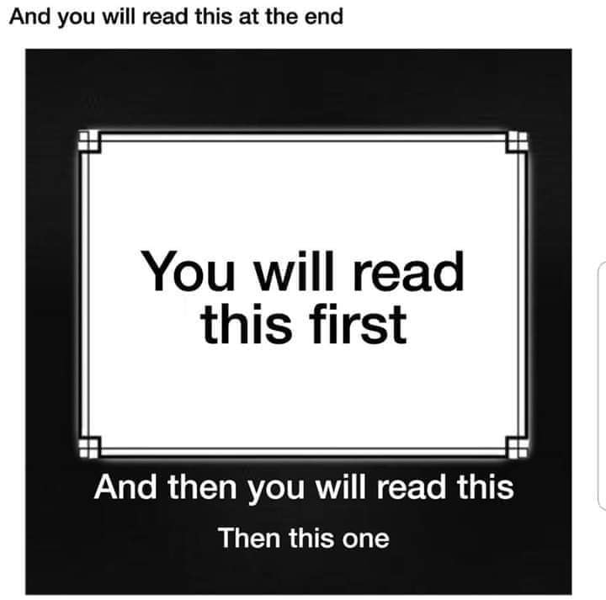

Slide 12
Crafting the beginning
Strong beginning and get to the point
Anticipate the questions of the audience:
What exactly is the subject?
Why is this subject important?
What background is needed to understand the subject? (review)
In what order will the subject be presented?

Slide 13
The idea of mapping the talk verses the outline

Slide 14
An example of a weak slide from presentation to NASA

Slide 15
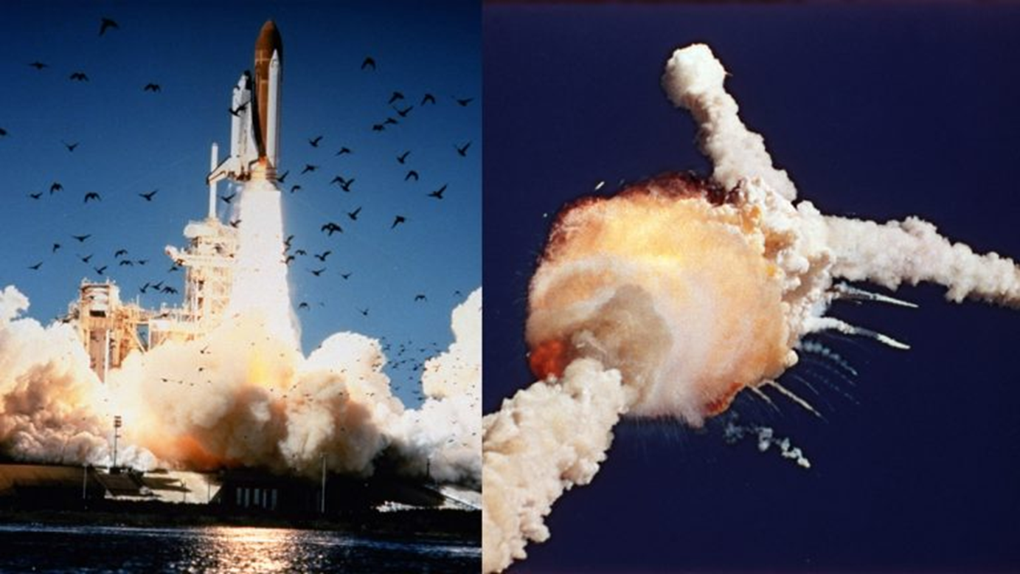
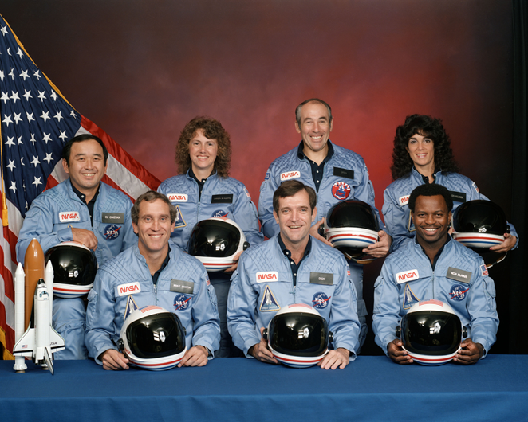
Challenger Explosion 1986

Slide 16
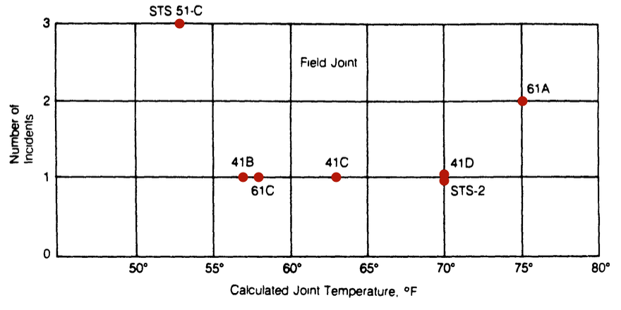
Visit to Precision Rubber Products Corporation and Parker Seal Company
Source: Report of the Presidential Commission on the Space Shuttle Challenger Accident, 6 June 1986, Volume 1, Page 145, Color added.
Notes:
What can you get from this figure? This is one of the figures explaining the risk of the o-rings. Notice the color was added.

Slide 17
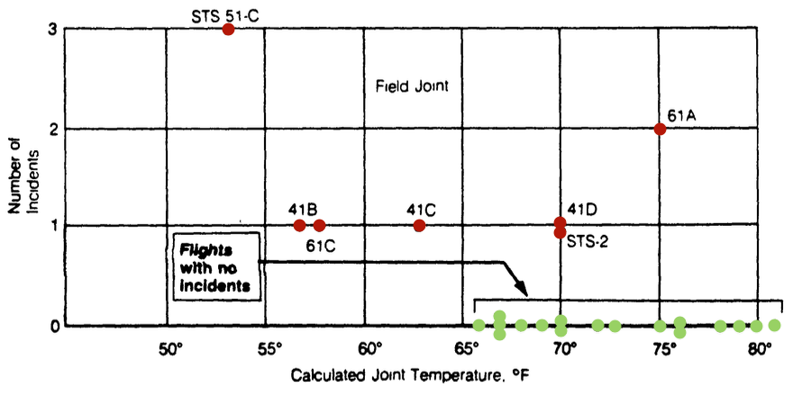
Showing the full information
Full Information
Source: Report of the Presidential Commission on the Space Shuttle Challenger Accident, 6 June 1986, Volume 1, Page 145, (link) Color added.
Notes:
This is the graph with the full information, still any clearer? This was presented in written and by phone conference.

Slide 18
Wanting to put everything on the slides

Slide 19
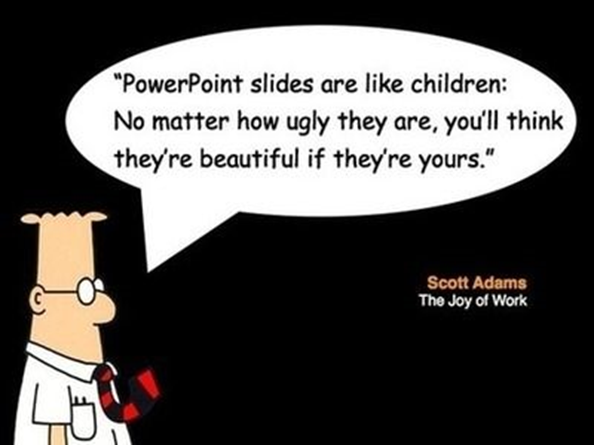

Slide 20
Strong slide in which the presenter has limited number of details

Slide 21
Slide shows the key image for the presentation

Slide 22
No extra line but only the essential information on the figures

Slide 23
Important points to remember
Arrive early – expect the worst
Make a conscious effort to improve – uhm’s
Know the audience – they are usually nice
Use movement, hand gestures if comfortable
Avoid annoying habits
Fake it ‘til you make it
Conclude – restate the take home message
Eye contact!

Slide 24
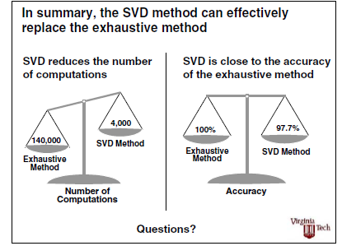
Instead of “thanks for the attention” have an image to summarize results

Slide 25
Conclusion
Tell your story to the targeted audience - remember they have low information capacity
Keep your slides uncluttered - Nothing should be extraneous
Make sure the audience knows your main point, do not be afraid to repeat it
Keep in your allotted time
Summarize by stating your main point

Slide 26
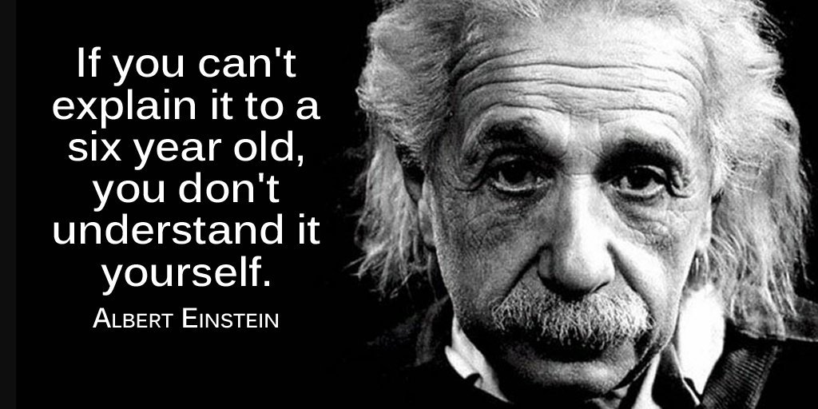

Slide 27
Make Vocabulary learning count
the 6-7%
Top 10 words 22%
Top 50 words 37%
Top 100 words 44%
Top 1,000 words families 71%
Top 2,000 word families 76%
570 academic word families 86%
After 86% vocabulary grows exponentially, especially after 89%

Slide 28
Vocabulary Lists
General Service List (GSL) - West (1953)
New-General Service List (new-GSL) – (Brezina & Gablasova 2015)
Essential Word lists (EWL) (Dang & Webb 2016)
Academic Word List (AWL) (Coxhead, 2000)
Academic Vocabulary List (AVL) (Gardner & Davies, 2014)
New Academic Word List (AWL) (Browne et al. n.d.)

Slide 29
Learning Academic Vocabulary
Collocations - Academic Collocation List (ACL)
Academic phrase bank (www.phrasebank.Manchester.ac.uk)
Prefixes, suffixes and roots
  Complete –deplete, implement, compliment, plus, replenish, replete, surplus, accomplish, plenty
Read – extensive reading of graded readers

Slide 30
Pronunciation
English is a syllabic language – intonation and rhythm
Content Words are stressed – nouns, active verbs, adjectives, adverbs (except frequency) negatives
Function words are unstressed – determiners (articles), auxiliary verbs, prepositions, modal verbs, conjunctions, pronouns
Shadow reading

Slide 31

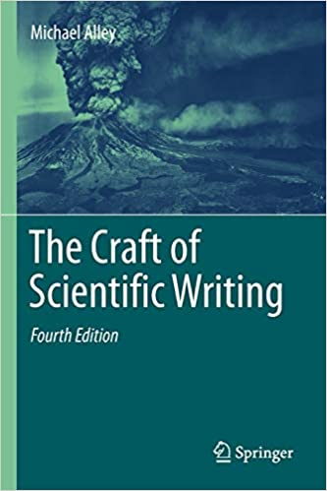
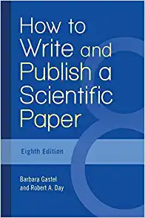
Useful sites/resources
www.eapfoundation.com (academic word lists)
www.wgtn.ac.ns/lals/resources/paul-nations-resources/vocabulary-lists (Vocabulary lists)
www.esl-bits.net (Shadow reading)
Alley, Michael. (2013) The Craft of Scientific Presentations, (2nd ed.). Springer
Alley, Michael. (2018)The Craft of Scientific Writing, (4th ed.). Springer
Gastel, B. & Day, R.A (2016). How to write and publish a scientific paper, (8th ed.) Greenwood.

