Slide 1
Status of the SC HWR cavities production for NICA project
THA01
A. Butenko, E. Syresin, G. Trubnikov, D. Nikiforov,
Joint Institute for Nuclear Research, Dubna, Russia
M. Gusarova¹, M. Lalayan¹, S. Matsievskiy¹, R. Nemchenko, S. Polozov, N. Sobenin, V. Shatokhin¹,
National Research Nuclear University MEPhI, Moscow, Russia
¹also at Joint Institute for Nuclear Research, Dubna, Russia
D. Bychanok², A. Sukhotski, S. Huseu, S. Maksimenko²,
Research Institute for Nuclear Problems of Belarusian State University, Minsk, Belarus
²also at Tomsk State University, Tomsk, Russia
A. Shvedov, S. Yurevich, V. Petrakovsky, A. Pokrovsky, I. Pobol, V. Zaleski,
Physical-Technical Institute, Minsk, Belarus
XXVII Russian Particle Accelerator Conference RuPAC’21, 27 September –1 October 2021, Alushta, Crimea THA01

Slide 2
New injector linac for Nuclotron-NICA
0001
Light Ion Linac
Nuclotron-NICA
LILac consists of Source of Polarized Ions (SPI) and of 5 cavities: RFQ, re-buncher, two Interdigital H-mode Drift-Tube-Linacs (IH-1 and IH-2) and a de-buncher. The operating frequency is 162.5 MHz and the final energy at the IH-2 exit is 7 MeV/u. After IH-2 beam is transported towards the Nuclotron (bending magnets shown in blue).
In future the extension of LILac with normal-conductive cavities up to 13 MeV/u (marked green) and followed by SC HWR 1 cavities (light blue) up to 20 MeV for protons and to 7.5 MeV/u light ions and by SC HWR 2 cavities up to 50 MeV for protons. The operating frequency of SC sections is 325 MHz.

Slide 3
Russian - Belarusian collaboration
The development of the SRF technologies is the key task of the new Russian - Belarusian collaboration launched in March 2015.

Slide 4
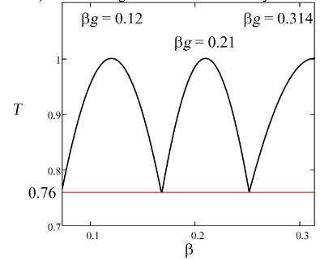
Beam dynamics of proton and deuterium ions beam
Cavity group | 0 * | 1** | 2** | 0 * | 1** | 2**
 | Proton beam |  |  | Deuterium beam
β_{g} | 0.12 |  | 0.21 | 0.12 |  | 0.21
F, MHz | 162.5 |  | 325 | 162.5 |  | 325
T, % | 24.0 |  | 24.0 | 24.0 |  | 24.0
N_{gap} | 2 |  | 2х2** | 2 |  | 2х2***
L_{res}, m | 0.222 |  | 0.39 | 0.222 |  | 0.39
L_{sol}, m | 0.2 |  | 0.2 | 0.2 |  | 0.2
L_{gap}, m | 0.1 |  | 0.1 | 0.1 |  | 0.1
L_{per}, m | 0.622 |  | 0.79 | 0.622 |  | 0.79
N_{per} | 3 | 8 | 8 | 3 | 8 | 8
L, m | 1.87 | 4.98 | 6.32 | 1.87 | 4.98 | 6.32
E_{acc}, MV/m | 4.50 | 5.86 | 6.4 | 4.50 | 5.86 | 6.4
U_{res}, MV | 1.0 | 1.3 | 1.25 | 1.0 | 1.3 | 1.25
Φ, deg | –20 | –20 | –20 | –20 | –20 | -90
B_{sol}, T | 1.35 | 1.3 | 1.9 | 1.8 | 2.0 | 1.0
W_{in}, MeV | 2.5 | 4.9 | 13.47 | 2.5 | 3.65 | 8.3
β_{in} | 0.073 | 0.102 | 0.168 | 0.073 | 0.088 | 0.133
W_{out}, MeV | 4.9 | 13.47 | 31.0 | 3.65 | 8.3 | 8.3
β_{out} | 0.102 | 0.168 | 0.251 | 0.088 | 0.133 | 0.133
K_{T}, % | 100 | 100 | 100 | 100 | 100 | 100
The beam dynamics simulation for superconducting part of the first linac layout was done using BEAMDULAC-SCL code designed at MEPhI.
The sliding factor T for proton and deuterium beams
* cavities in 0th group are normal conducting
** two 2-gap HWR per one period

Slide 5
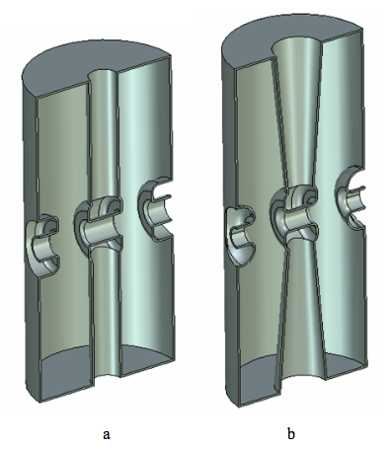
Choice of the cavity types for SC section and RF design
Considerations on the SC cavity types choice and RF design done at MEPhI and JINR.
RF parameters of 325 MHz HWR for βg = 0.21
Parameter | Value
HWR type | Cylindrical |  | Conical
Operating frequency, f, MHz | 325
Geometrical velocity, β_{g} | 0.21
Cavity height, mm | 431 | 474
Cavity radius, mm | 97 | 97
Ratio of the peak electric surface field to the accelerating field, E_{p}/E_{acc} | 6.5 | 5.9
Ratio of the peak surface magnetic field to the accelerating field, B_{p}/E_{acc}, mT/(MV/m) | 10.2 | 9.6
Effective shunt impedance, R_{sh}/Q₀, Ohm | 298 | 306
Geometric factor, G=R_{s}/Q, Ohm | 57 | 57
SRF’2017, Lanzhou, China, July 2017
Selection of the Type of Accelerating Structures for the Second Group of Cavity SC Linac Nuclotron-NICA

Slide 6
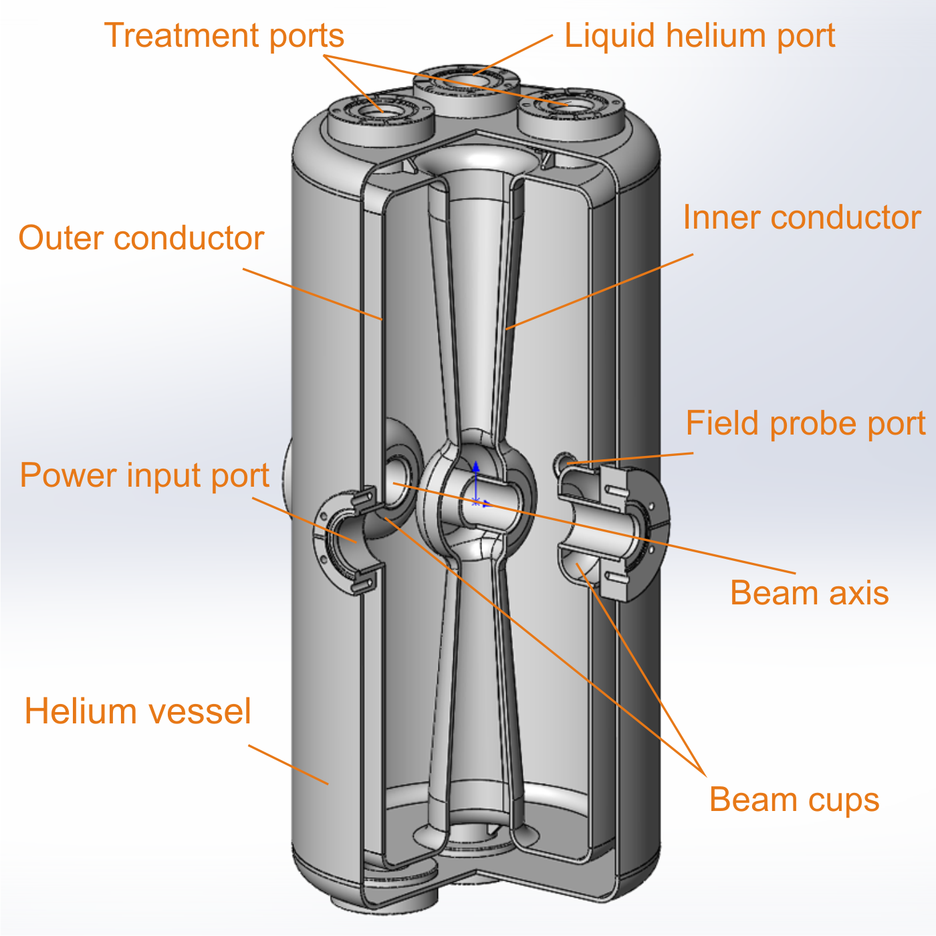
325 MHz SC cavity design
Cavity body design was done by PTI NASB and MEPhI research groups taking into account thermal and mechanical cavity performance considerations during cooldown.
PTI NASB production facility expertise in deep-drawing and EB welding of high purity niobium allowed us to choice in favor of more complicated but yet much more promising design with conical inner conductor.

Slide 7
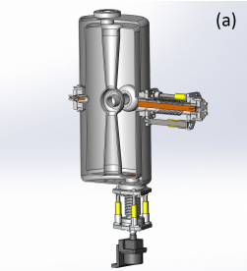
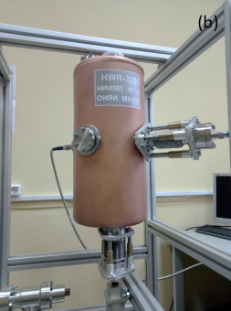
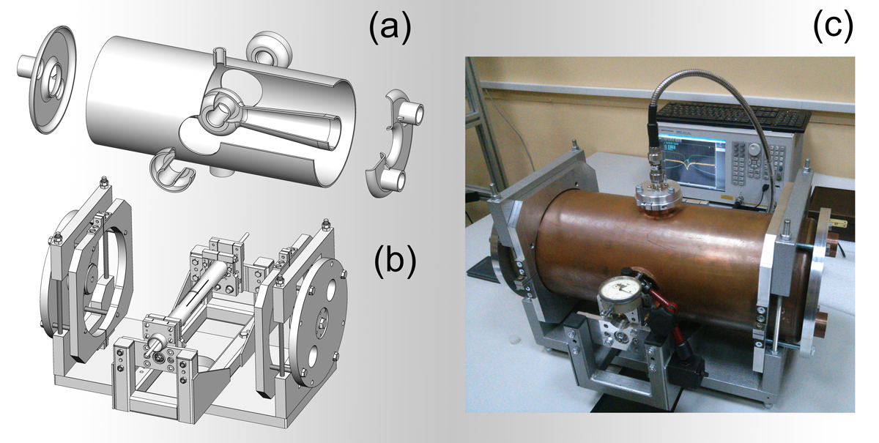
Design study and production of copper prototype cavity
Design study and production of copper prototype cavity were carried out from 2019 to 2020
at PTI NANB and INP BSU.
(a) 3D model of the coaxial half-wave cavity with field probe, power coupler, and plunger-based frequency tuning system;
(b) manufactured copper prototype.
(a) Six parts of the cavity body, (b) assembling frame and (c) complete assembly with fixtures for RF measurements.

Slide 8
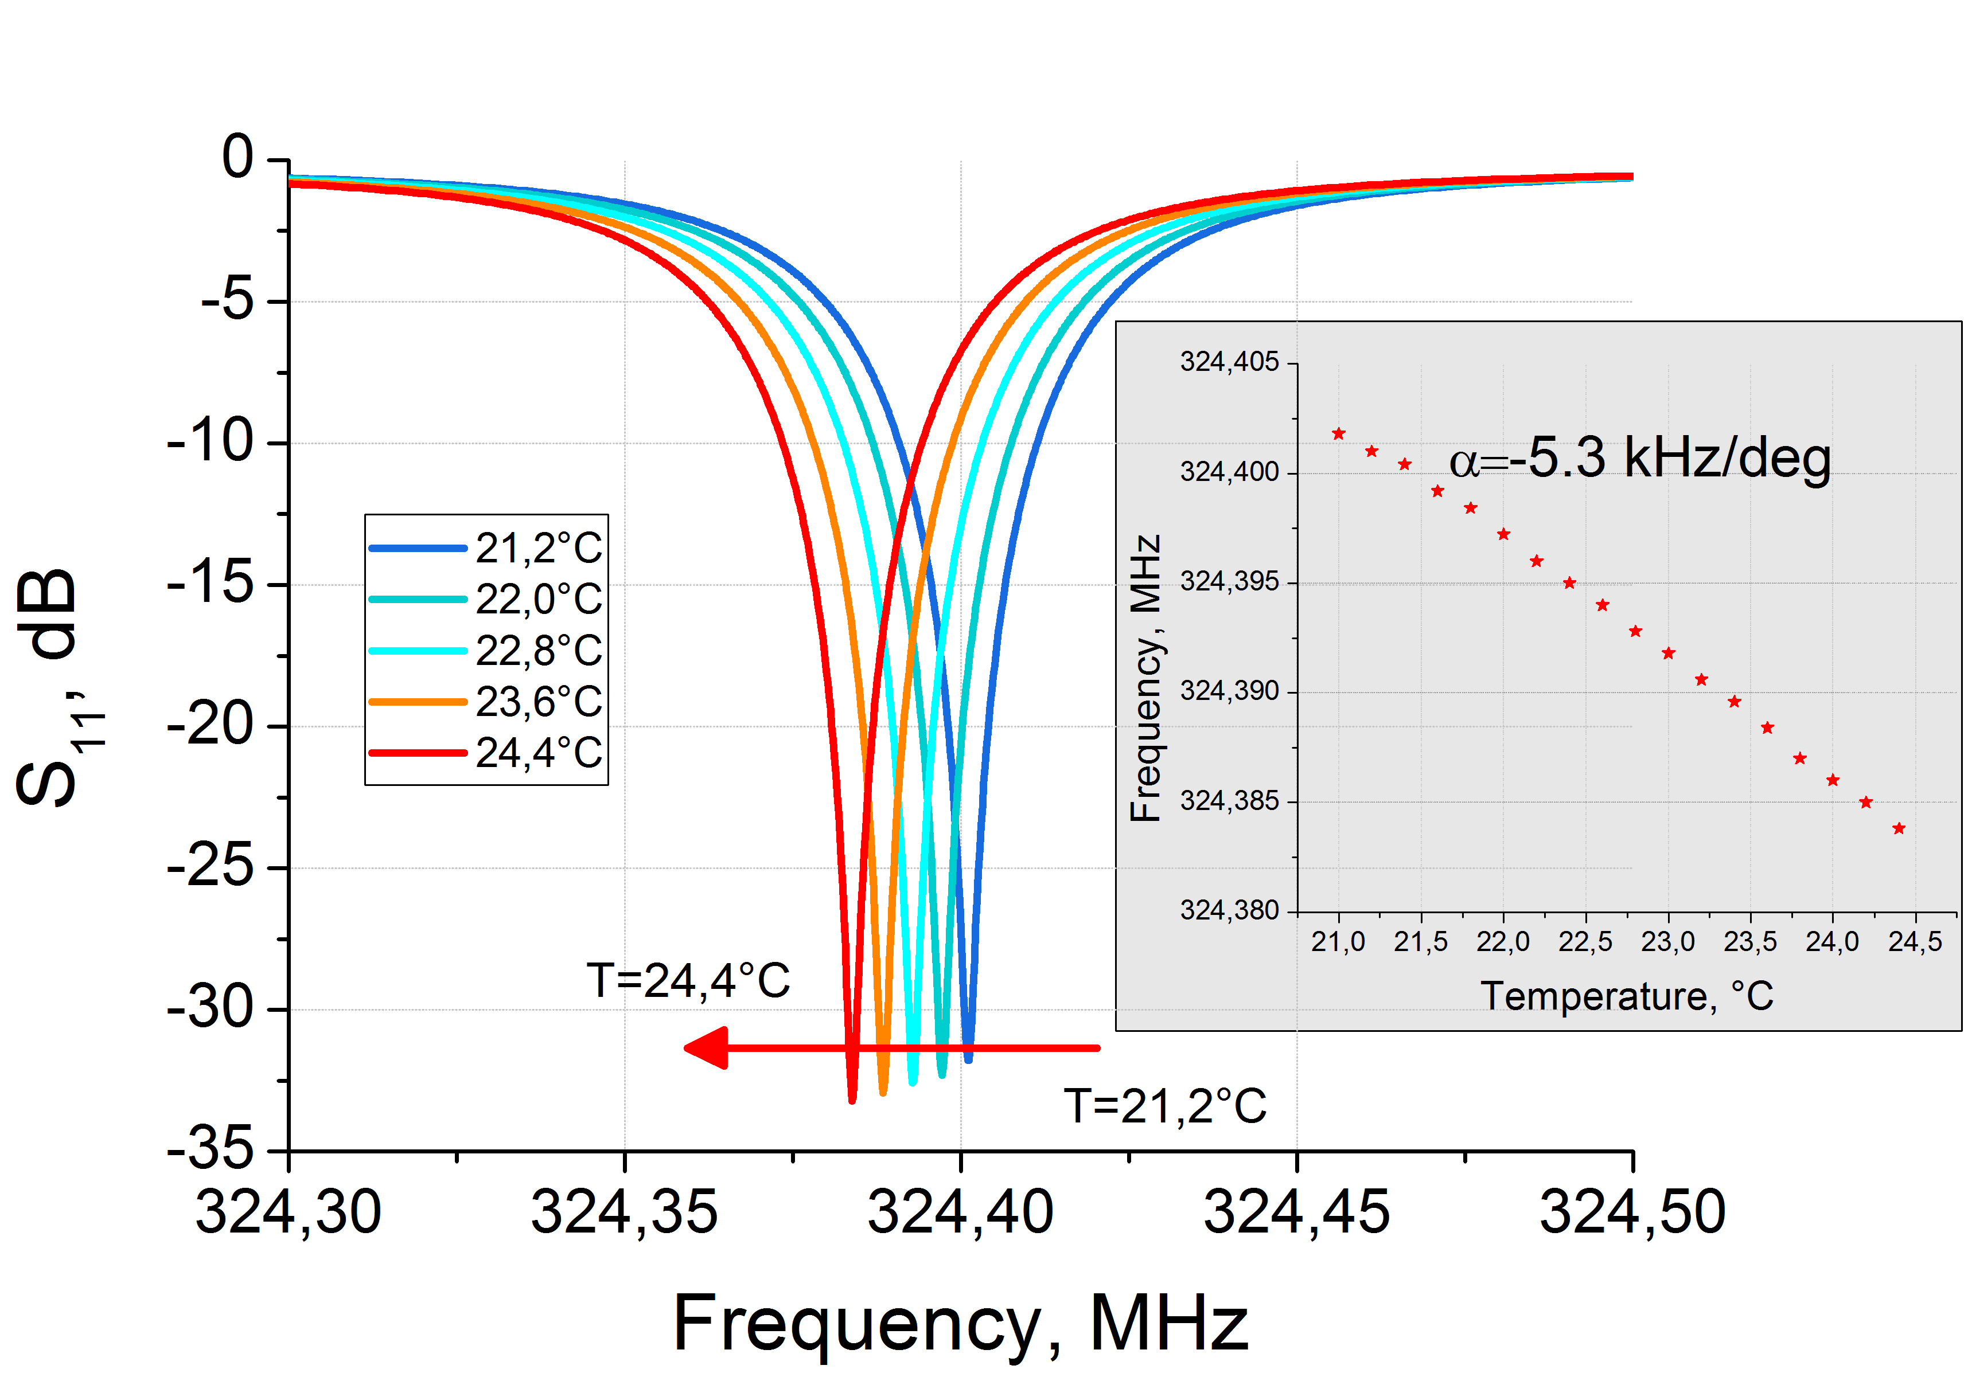
Control of electromagnetic properties during prototyping, fabrication and operation
Resonant frequency measurements and vacuum tests showed cavity desired performance.
Journal of Physics D: Applied Physics, vol. 54, no. 10, p. 255502, Apr. 2021.
D. Bychanok, A. Sukhotski, S. Huseu et al.,
Control of electromagnetic properties during prototyping, fabrication and operation of low-β 325 MHz half-wave resonators
The reflection coefficient S₁₁ for the power coupler in the critical coupling conditions for different ambient temperatures;
(inset) resonant frequency dependence on temperature.

Slide 9
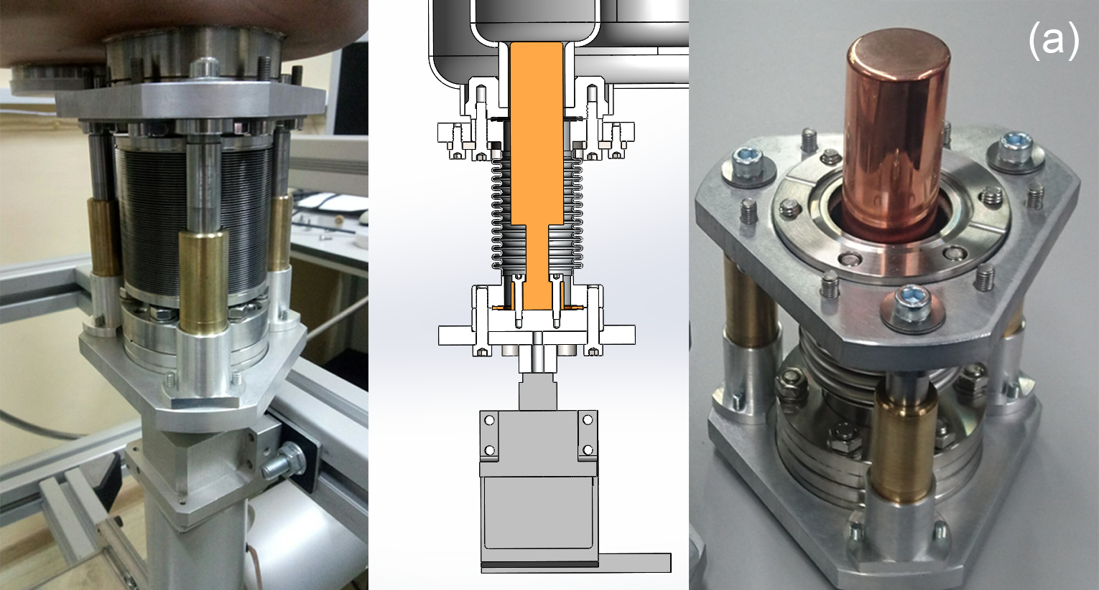
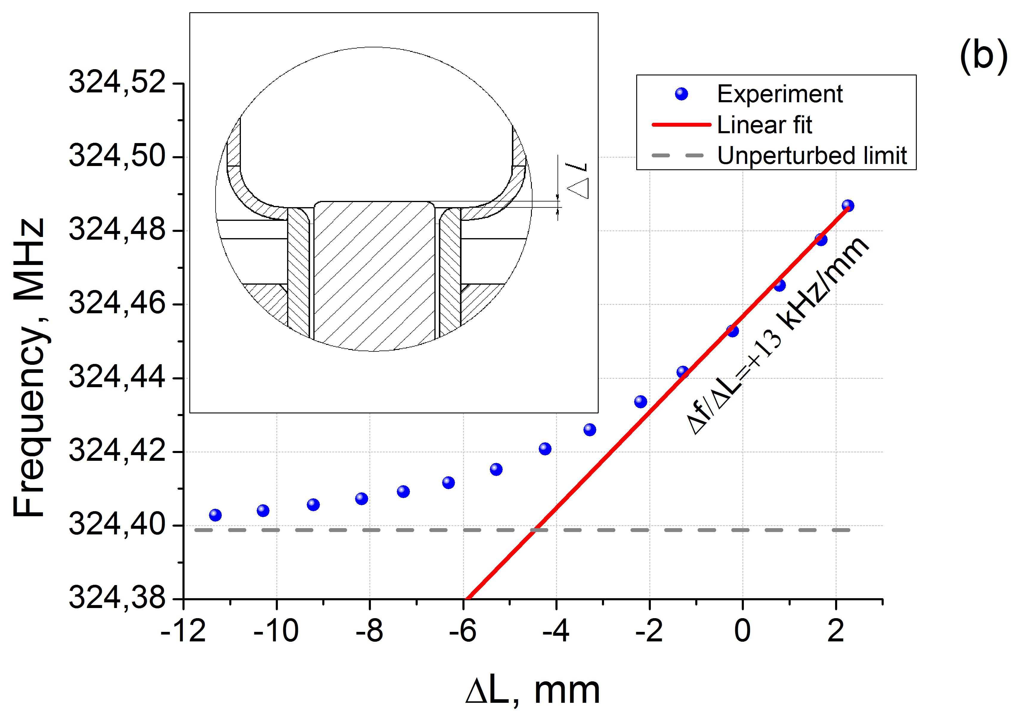
The slow frequency tuning system
Plunger with precise mechanical actuator for slow frequency tune was developed and produced at INP BSU. This tuner was successfully tested on copper cavity and showed to deliver 13 kHz/mm frequency shift.
Experimentally measured
frequency shift ∆f vs plunger penetration depth ∆L

Slide 10
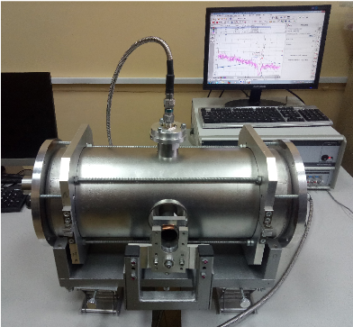
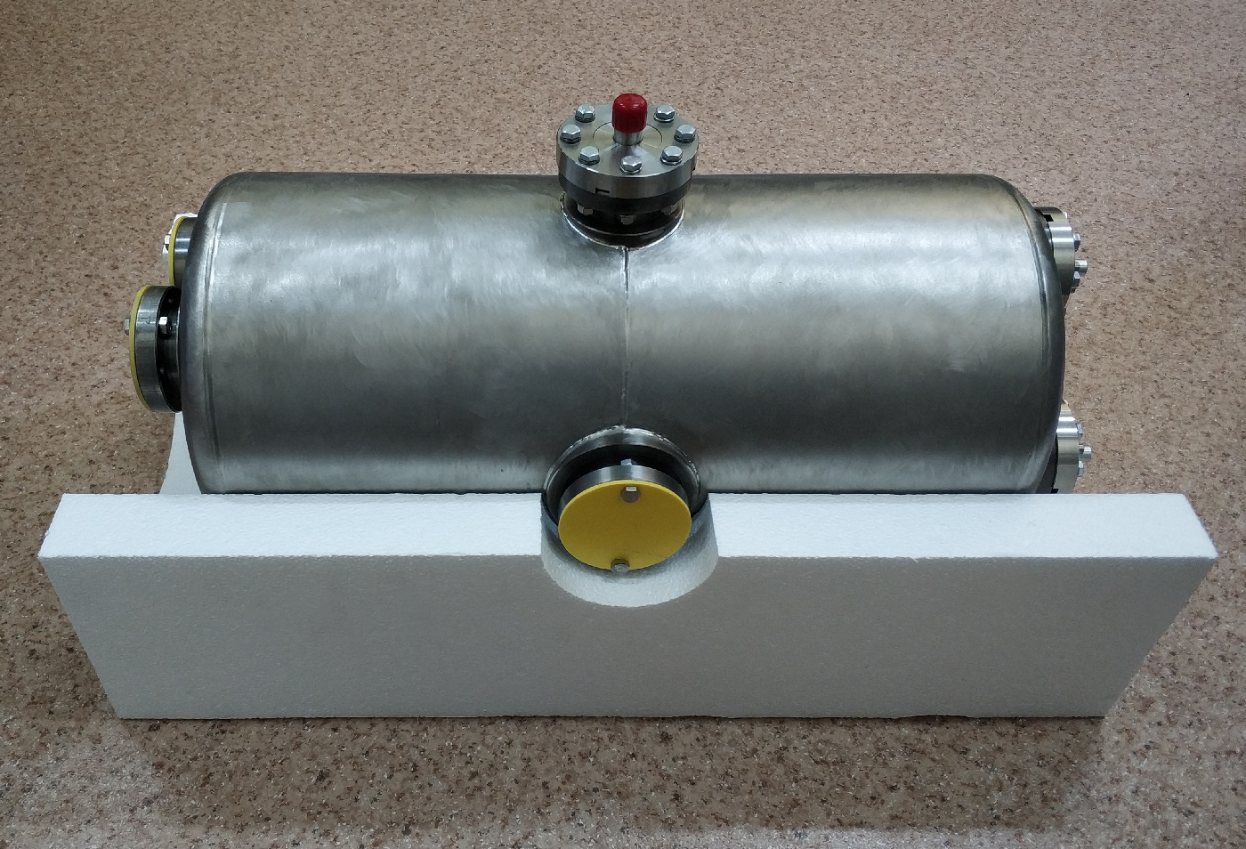
Production of the pilot full performance SC cavity
Pilot full performance SC cavity is being manufactured in 2020-2021.
The cavity is made of high RRR bulk niobium and has titanium cryogenic vessel welded to the cavity.
Technology of niobium sheets deep drawing, hydroforming, electron beam welding at several production facilities at Minsk were developed.
The intermediate frequency measurements and control of niobium cavity were performed based on copper prototype-based experience.
Weld seals leak rate was under 3.8×10⁻⁹ Pa*m³/s.
Cavity low power RF tests at room temperature were carried out and showed the expected results.
Niobium cavity core under intermediate RF test
Cavity Nb core with outer Ti shell assembly

Slide 11
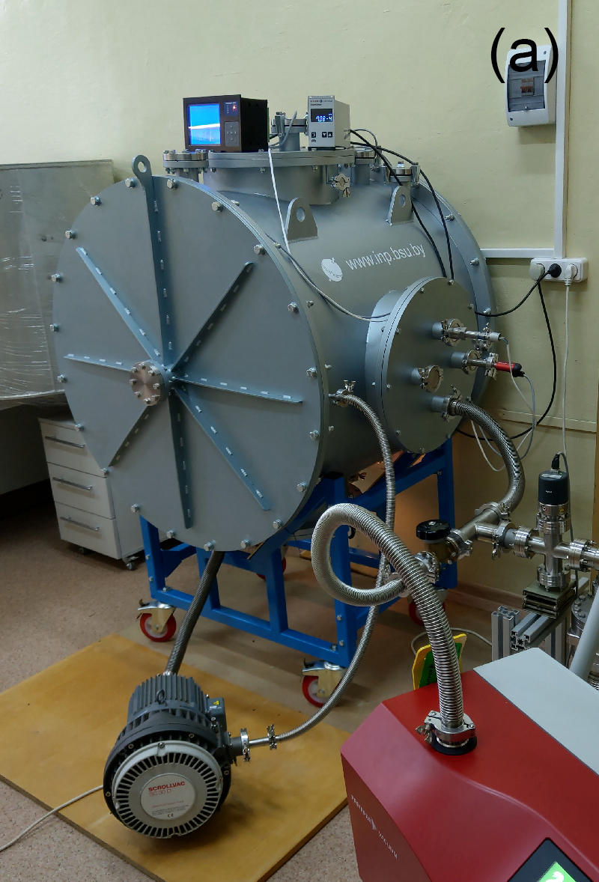
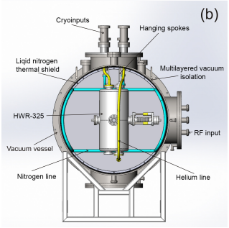
Cryostat for cavity testing
Cryostat for cavity testing was developed in collaboration of JINR and INP BSU
Design and characteristics of cryostat for testing of low-betta 325 MHz Half-Wave resonators
Рresented at this conference: MOPSA16
Fabricated test cryostat
Main parts and subsystems of the cryostat

Slide 12
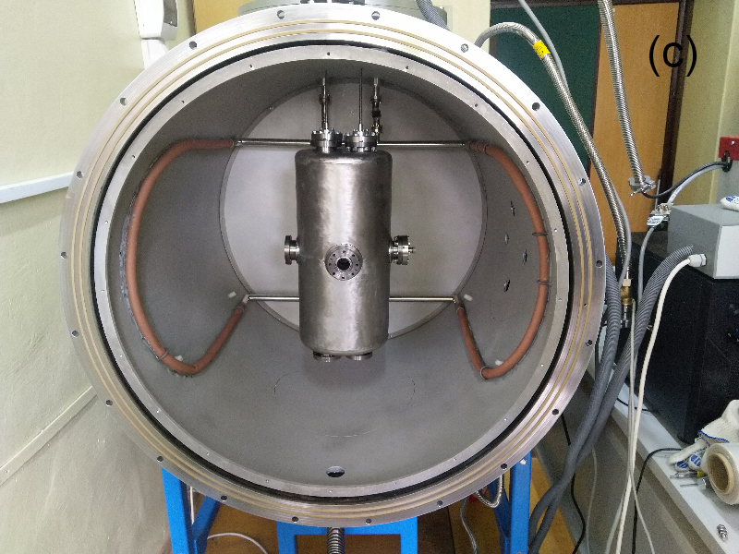
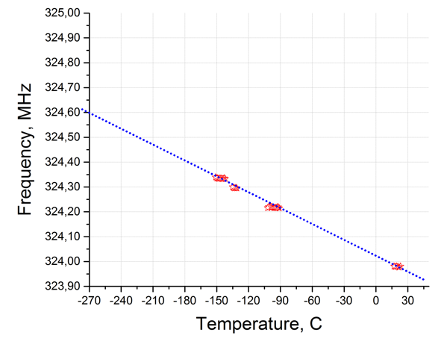
First tests of cavity cooled down to liquid nitrogen temperature
At September 2021
first tests of cavity cooled down to liquid nitrogen temperature were done
Test cryostat with a cavity inside
Resonant frequency vs. temperature dependence measured during cavity cooldown

Slide 13
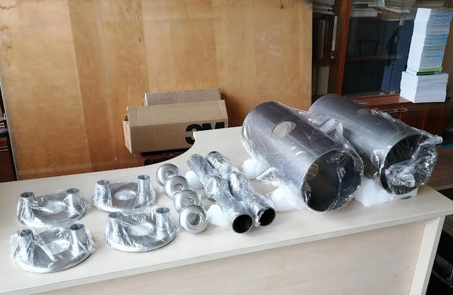
Two SC cavities for test stand Nuclotron-NICA injector
For testing purposes, the test beamline is proposed with two HWR1 cavities installed.
A test cryostat for two cavities HWR 1 is developing now by a joint team of JINR, GSI (Germany) and BEVATECH (Germany).
Cryostat for 4 HWR1 cavities is developing by JINR and IMP (China).
Nb parts for two Nuclotron-NICA SC cavities
XXVII Russian Particle Accelerator Conference RuPAC’21, 27 September –1 October 2021, Alushta, Crimea

Slide 14
Conclusion
HWR SC cavity with frequency tuner for Nuclotron-NICA injector was designed.
Dedicated tooling and technologies were developed and certified for production of high performance SC cavities. Core parts are made of high RRR bulk Nb sheets by deep drawing and hydroforming and then electron beam welded.
Full production line procedures for intermediate measuring, testing and adjustment of cavity parts was developed.
Copper prototype and niobium pilot cavity were manufactured.
Cryostat for cavity tests under L-He temperature was designed and manufactured.
Vacuum and low power RF tests at room temperature and Liquid-N₂ conditions were carried out and showed the cavity expected performance.
Production of two Nb cavities for NICA beamline is launched.
Next steps scheduled to 2021/2022 will be cavity cold tests at 4K and fast frequency tuning system development.

Slide 15
Thanks for attention!

Slide 16
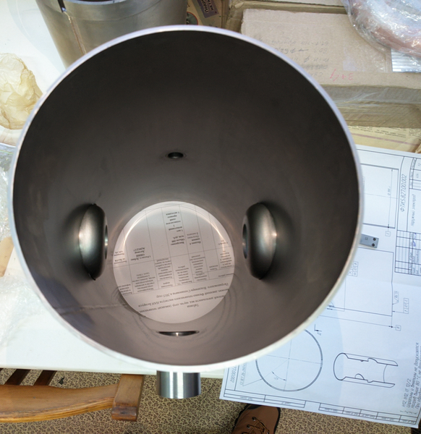
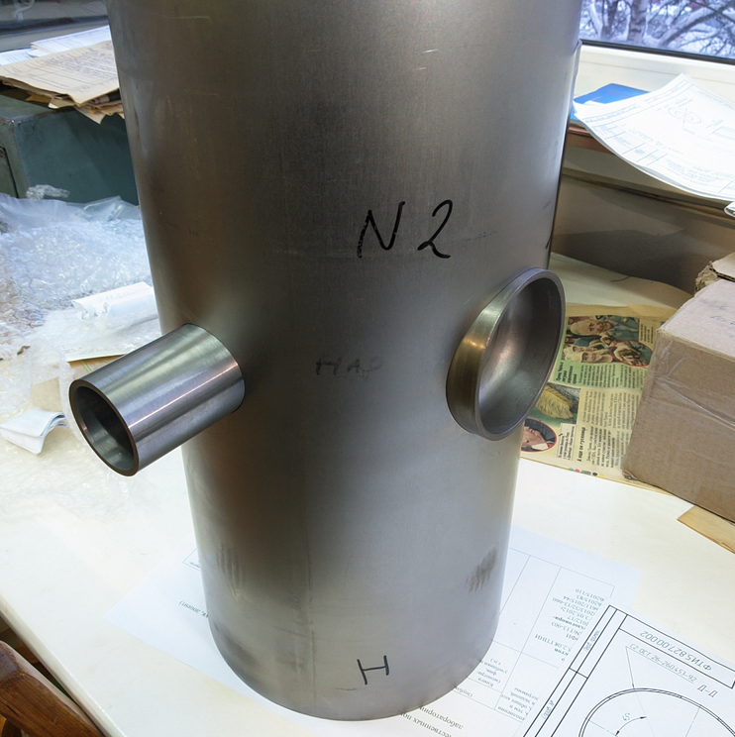

Slide 17
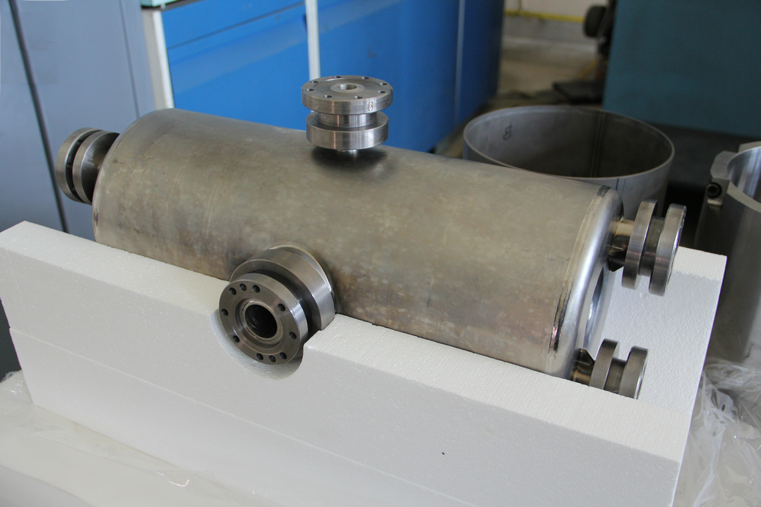
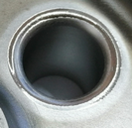
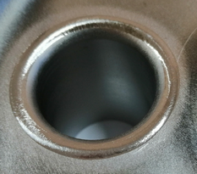

Slide 18
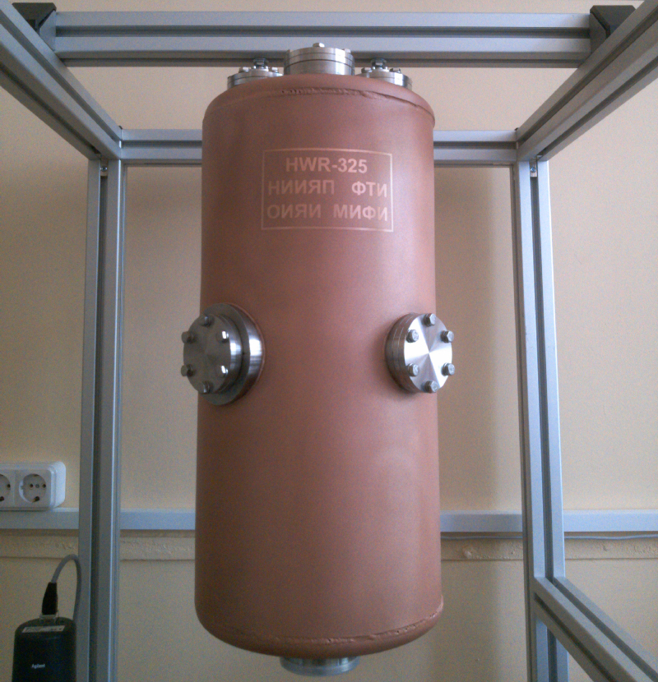
05.06.2020

Slide 19
