Slide 1
Memorial talk for Prof. Evgeny D. Donets
(15.10.1935 – 17.06.2021)
>50 years with EBIS/ESIS
E.E. Donets, LHEP JINR
RUPAC-2021, Alushta, Crimea

Slide 2
Evgeny Denisovich Donets was born on October 15, 1935 in the village of Shkurinskaya in the Krasnodar Territory, Russia as the youngest of five children in the family.
His father, Denis Yemelyanovich, was a teacher of Russian language and literature at high school, his mother, Lydia Andreevna, was a housewife.
In WWII his father was fighting in the army and the mother with five children managed to survive the famine and occupation. They lost their home, but
the father survived the war and became director of a high school.
Evgeny graduated from high school 1953 and entered
the Leningrad Polytechnic Institute, where all his siblings studied.
Evgeny graduated with honors from the Faculty
of Physics and Mechanics in 1959 and was hired
at the Institute of Atomic Energy (Moscow)
in the group of Georgy Flerov,
where he did his doctoral thesis.
3

Slide 3
The early years 1959-1966: towards “stability island”
5
In the same year, 1959, Evgeny moved to Dubna and began working at the Laboratory of Nuclear Reactions of the Joint Institute for Nuclear Research (JINR).
He performed experimental studies of the production of transuranium elements
with Z ≥ 100 in nuclear reactions with multicharged ions, which led to the discovery of elements 102 and 103.
….
14-th February 2020; JINR museum. E.D.Donets “History of 102-nd and 103-d elements (Nobelium) discovery”.
(in a series of lectures From the first-person). Video is available in JINR museum.

Slide 4
1-st attempt to produce 102: Stockholm.
1957 , Fields P. S., Friedman A. M., Milested J. at al.
244, 245, 246, 247
Cm
12
С
Gamma rays
No
102
In further studies, the result was not confirmed and is recognized as completely erroneous
Z of new nuclei 102. Chemical identification.
T1\2 = 10 min. E_alpha= 8,5 MeV
They named it
Nobelium
Fission products

Slide 5
2-nd attempt
1958, LIPAN Moscow: G. Flerov, S. Polikanov, A.S. Karamian
16
241
О
Pu
gamma
257
253
102
102
Fm 249 + alpha
No - Nobelievium
Fission products

Slide 6
3-nd attempt:
1958, Berkely, CA, USA: Gyiorso A., Sikkeland T., Walton J., Seaborg G. T.
12
C
244, 246
Cm
they reported:
discovery of 102
gamma
neutrons
254 102
102
T1/2=3 s
Fm 250 + alpha
Chemical identification
Т1/2 = 30 minutes!, Е_alpha = 7,43 MeV
spontaneous fission 30%
There seemed to be no doubt
Fission products

Slide 7
1963 JINR, Dubna : Evgeny D. Donets, Victor A. Ermakov, Vyacheslav A. Schegolev
238
U
22
Ne
gamma
102
256
102
Fm 252 + alpha, Т1/2 = 25 hours, Е = 7,04 MeV
Fission products

Slide 8
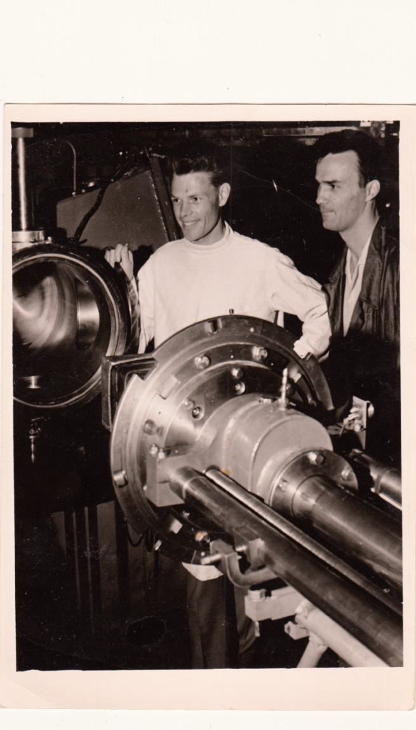

Evegny D. Donets, Victor A. Ermakov, Vyacheslav A. Schegolev
after discovery of the isotope of element 102 (Nobelium) with the Mass=256 and half-life ~8 s in nuclear reaction
22Ne + 238U; Dubna, JINR. April 1963.

Slide 9
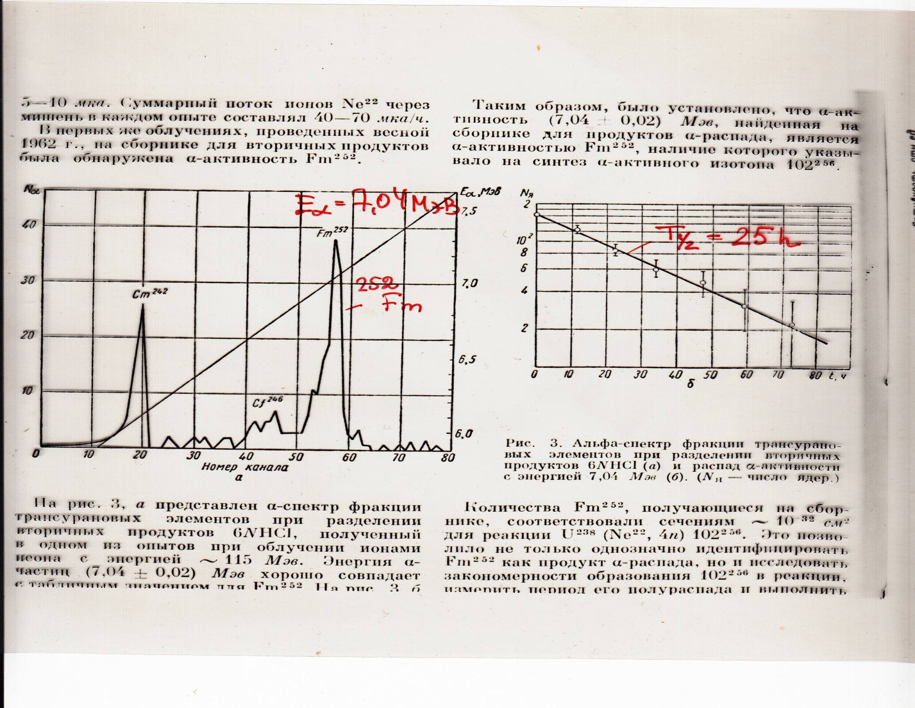

Slide 10
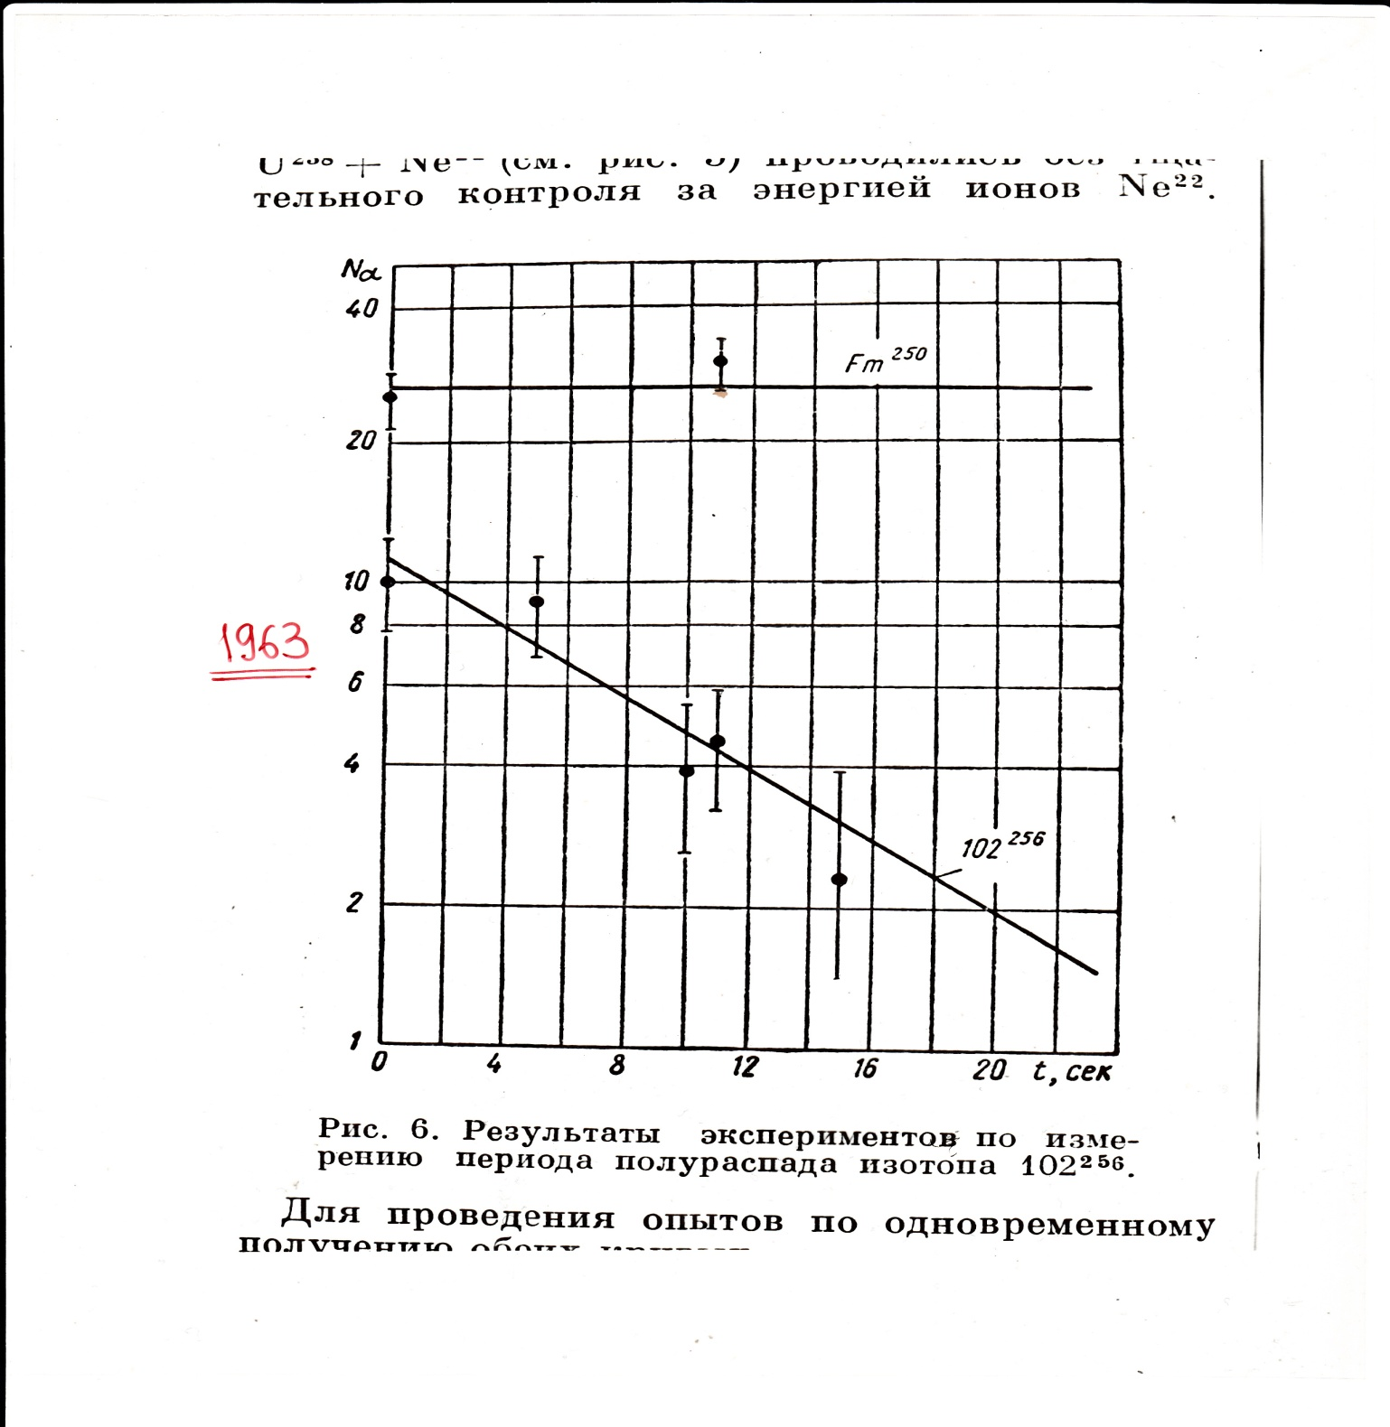

Slide 11
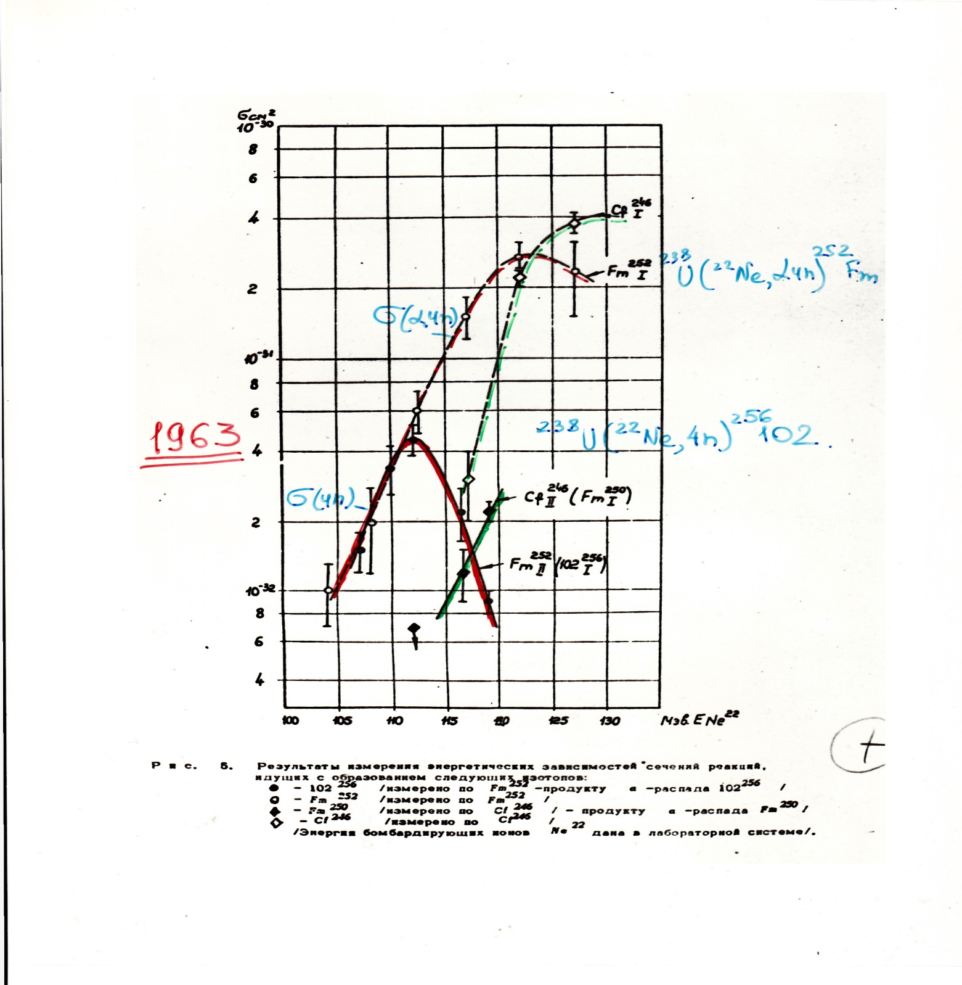

Slide 12
For the next twenty years, there were disputes
about the first discovery of element 102 between
the group from Dubna,
the Swedish group (Nobel institute)
and the group of G. Seaborg (Berkeley, USA).
left to right: Sergey Polikanov, Glenn Seaborg, Georgy Flerov, Vyacheslav Schegolev, Evgeny Donets, Albert Ghiorso in the hall of the U-300 cyclotron, Laboratory of Nuclear Reactions, JINR, Dubna; May 1963.

Slide 13
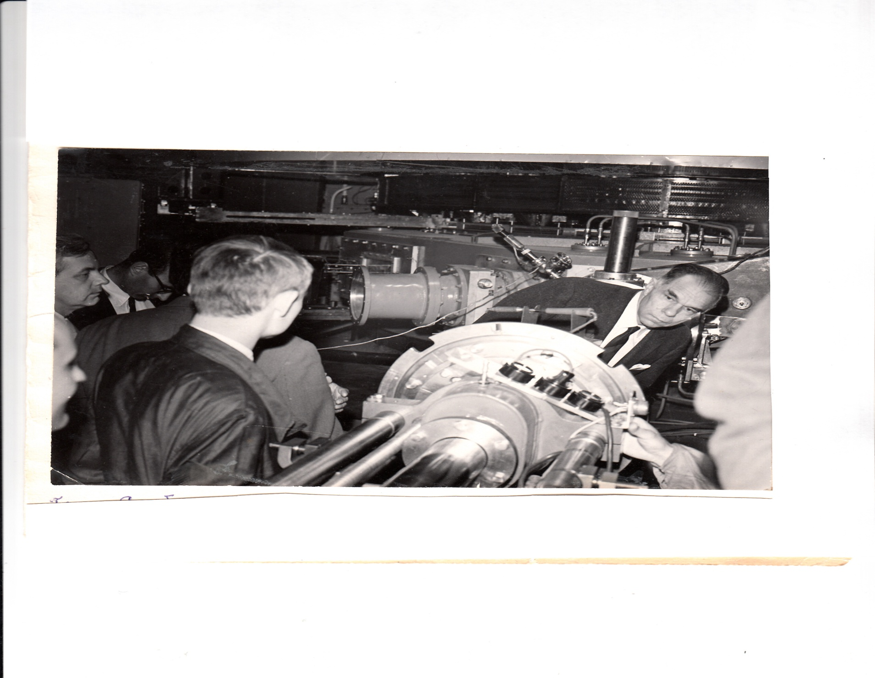
Victor Ermakov, Evgeny D.Donets, April 1963.
G.Seaborg at U-300 cyclotron hall. JINR May 1963

Slide 14
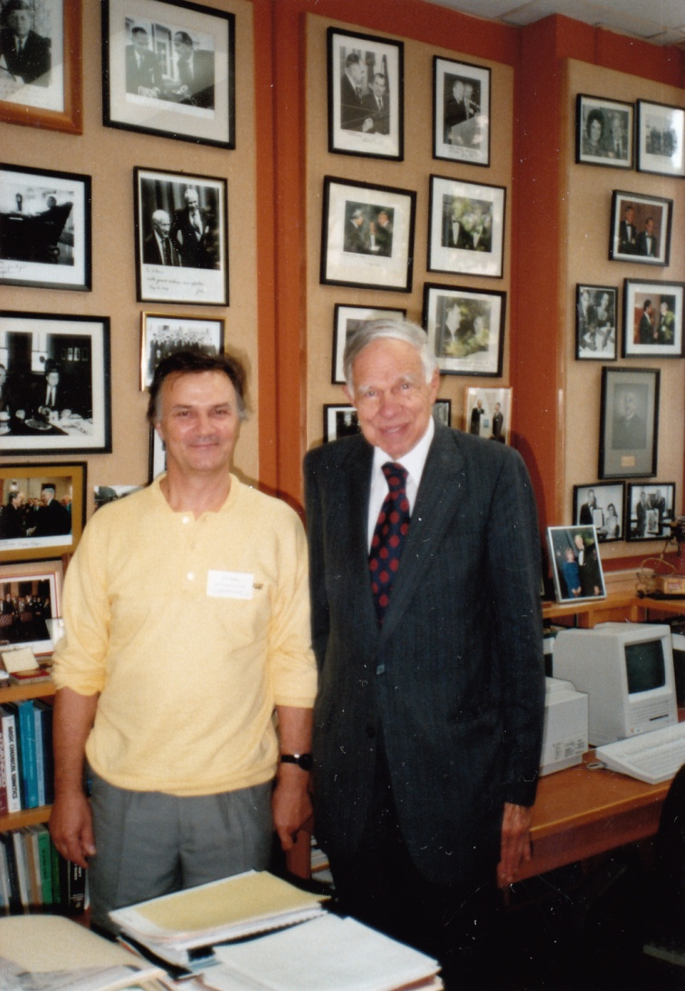
However, in 1992, the IUPAC-IUPAP Transfermium
Working Group (TWG) reassessed the claims
of discovery and concluded that only the Dubna work
(Donets, Ermakov, Schegolev)
correctly detected and assigned decays to nuclei with atomic number 102 at the time.
26 years later… visiting Glenn Seaborg;
Berkely, CA, USA; July 1989.
In 1966, Evgeny D. Donets defended his PhD thesis "Synthesis and study of the regularities of the formation of isotopes of transuranic elements with Z ≥ 100 in nuclear reactions with
multicharged ions".

Slide 15













EBIS history begins…
After 1966, Evgeny became interested in creating sources of highly charged ions, which was initially motivated by the need to accelerate heavier ions for the synthesis of new transuranic elements.
In 1967, Evgeny D. Donets has proposed an electron-beam ionization method and created a prototype in 1968 based on the proposed principles.
A demonstrator (IEL-1, IEL-2) was operational in 1968.
What was the new principle:
anode
solenoid
barrier electrode
electron repeller
The electrons are produced by an electron gun and not as in case of plasma ion sources from a plasma discharge.
Confinement of the ions in axial direction
potential established by ring electrodes in radial direction
space charge potential of the e-beam
The extraction of ions can be done by switching the collector barrier or the electrodes surrounding the ionization region.
electron beam
ion beam
electron collector
drift tubes
U(z)
ionisation
extraction
Z

Slide 16
Krion-1(cryogenic ionizer) – 1st working EBIS
However, after moving to the JINR Laboratory of High Energies in 1971 by invitation of Acad. Alexander M. Baldin
E.D.Donets with colleagues created the first real EBIS, KRION-1, which was ready for tests in 1972.
Sector of sources of multicharged ions has been organized on March 1-st 1971 at LHE JINR. 50 years of sector at 2021.
KRION-1 was the world's first complex device that used superconductivity as an applied technology.
Until that time only Penning-type sources could produce multi- charged ions. But compared to the Penning-type source and EBIS reaches much higher charge state, even bare heavy ions.

Slide 17
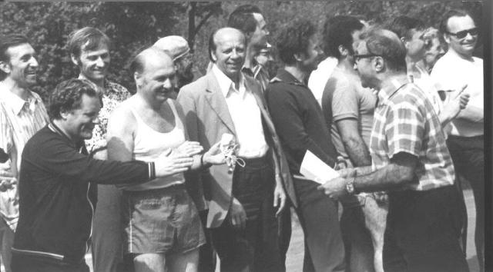
Acad. Alexander M. Baldin, Evgeny D. Donets and other LHE JINR staff on start of
jogging relay race among JINR laboratories, dedicated to 30-th annivesary of Victory
in Great Patriotic War; Dubna, May 8-th, 1975.

Slide 18
Krion-1(cryogenic ionizer) – 1st working EBIS
- B_max=1.2 Tesla; SC solenoid 120 cm long;
- Electron gun: Pierce type at 1/6 B_max,
cathode LaB_6 3 mm diameter; up to 1.2 A e-current;
- Electron beam energy up to E_e=4 KeV;
During 1974 -1982 beams of bare nuclei
C6+ (up to 10^9 ppp) , N7+, O8+ and Ne10+ were produced and accelerated on LHE JINR Synchrophasatron.
Relativistic nuclear physics (A.M. Baldin) in LHE JINR
as a forerunners of a NICA project
E.D Donets and A.I. Pikin with KRION-1
EBIS on a HV platform of LU-9 injector; 1972

Slide 19
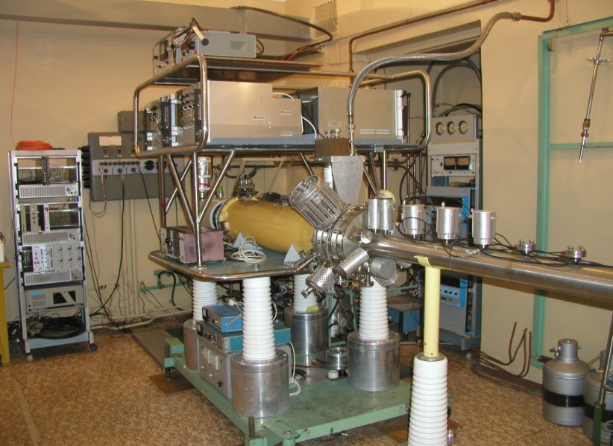
Krion-2 EBIS (1974-1993)
B_max=3.3 Tesla; SC solenoid 120 cm long;
- Vacuum at the ion trap region 10^{-12} Torr; (10^{-10} Krion-1)
Electron beam energy up to E_e=7 KeV at the beginning;
later on, E_e was increased up to 150 KeV:
Krion-2 trap on an insulated HV platform,gun/collector on ground.
K-shell ionization energies (in KeV):
¹²C ²⁰Ne ⁴⁰Ar ⁸⁴Kr ¹³²Xe
0.39, 0.49; 1.19, 1.36; 4.12, 4.43; 17.29, 17.94; 40.27, 41.29;
²³⁸U
129.57, 131.82
Bare nuclei of ²⁰Ne10+, ⁴⁰Ar18+ , ⁸⁴Kr36+, H⁺ like ions of ³²Xe53+ have been produced and studied.
Physics of highly charged ions (HCI) begins…

Slide 20
What we need to get HCI beam of certain mean charge state ?
Electron flux with energy > binding energy;
Required Ionization factor J •τ_{i} ; (J : e-beam current density)
Good enough vacuum (to avoid charge exchange with neutrals);
…possibility to extract HCI beam with reasonable emittance (for the required ~10 µs time for injection to synchrotron);

Slide 21
Calculated values of j•τ_{i} needed to produce some HCI ions for corresponding energies of the bombarding electrons.
LIS------------------- j•τ_{i} [1/cm²]
ECR-----------------------------------
EBIS,ESIS*------------------------------------------------------
21

Slide 22

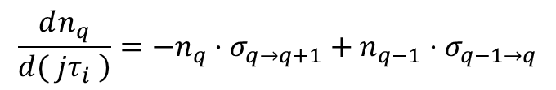
Electron impact ionisation cross-
section measurements
In 1983 the Dubna EBIS group around Evgeny D. Donets used the electron beam ionization method an EBIS provides to measure ionization cross sections.
A well-defined quantity of low charged ions has been injected and then the charge state evolution has been recorded.
The well-known linear rate equations have been used to extract ionization cross section (note that the current density just scaling the time to reach the charge state)
You need to determine the current density well.

Slide 23
Experimental data of charge state evolution

Slide 24
Inverse problem has been solved to extract unknown values of ionization cross-sections from the obtained experimental charge state evolution data using truncated linear system of evolution equations
More cross-sections measurements are needed, especialy for heavy ions (closed shells/subshells)

Slide 25

X-ray spectroscopy with HCI
9
Identifications of bare or hydrogen like ions (Ar¹⁷⁺, Kr^{35,36+},Xe⁵³⁺) produced with KRION-2 were made by means of detection of K-line x-rays, emitted by the ion recombination at a metallic surface.
.
”
_{Z} q+
E.D.Donets et al.,
Supplement to Z. Phys. D - Atoms,
Molecules and Clusters 21, S 337-
339 (1991)
e
_

Slide 26
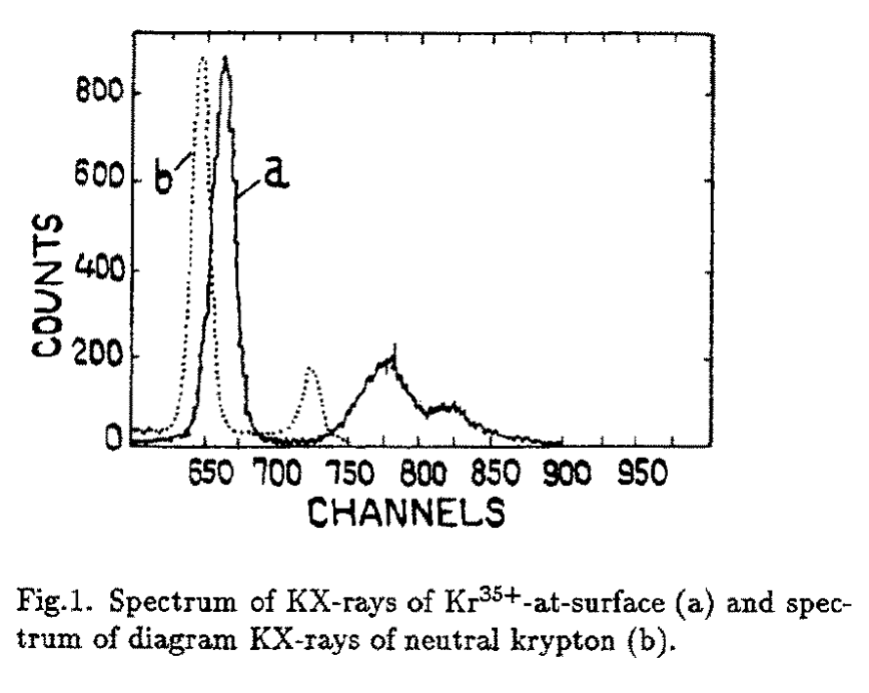
X-ray spectroscopy with HCI
Shift of K-lines of Kr35+ (and other species) with respect to neutral Kr is due to absence of electrons in the L-shell which produce partial screening of nuclear charge in neutral Kr.

Slide 27

Super excited states of ions/atoms
Relative intensities of the obtained K-series (alpha, beta and higher) surface show, that electrons fill first very high levels (near Auger-contimuum and then successive step-by-step and relatively slow (in atomic scale) cascade down to low level states.
Theses were called “super-excited”(A.M. Baldin) states of ions/atoms (“hollow atoms”) -> quasistable Rydberg states.
.
”
9
_{Z} q+
E.D.Donets et al.,
Supplement to Z. Phys. D - Atoms,
Molecules and Clusters 21, S 337-
339 (1991)
e
_

Slide 28
Super excited states of ions/atoms – > ball lightning phenomena?
.
” Interesting idea from Evgeny D. Donets:
If we have two or more super-excited atoms closed enough to each other, the electrons on their higher levels could be common for few or an assembly of super-excited ions Hence, cluster of super-exited ions could exists in metastable state with many common electrons on high excited levels only
→ it could be possible scenario for ball lightning formation in atmosphere
9
_{Z} q+
E.D.Donets et al.,
Supplement to Z. Phys. D - Atoms,
Molecules and Clusters 21, S 337-
339 (1991)
e
_

Slide 29
Ion-Ion cooling.
E.D.Donets, G.D.Shirkov (1984)
10
ION HEATING – ION LOSSES ;
heating of highly charged ions due to elastic collisions with the beam electrons, AND ,
DUE TO TWO-BEAM INSTABILITIES (ELECTRON-ION) :(CONVECTIVE TYPE, j –KEY FACTOR)
Calculations showed the production of ions with q > 50 can hardly be reached because of rapid ion losses in a radial direction caused by the heating!
At the first moment this ionization limit of EBIS looked insufferable, but soon the technique of ion-ion cooling was proposed by
Donets and Shirkov, Avtorskoe svidetelstvo USSRN1225420 from 02.07.1984

Slide 30
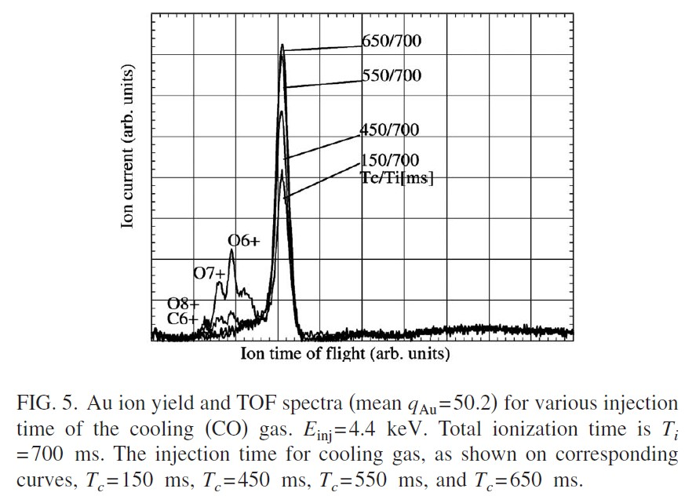
Ion-ion cooling
11
The proposed cooling technique includes a constant or periodic injection of ‘‘cold’’ low charged ions into the trap that cool highly charges ions via ion-ion collisions.
This led to the paper
“The ion cooling in EBIS”, G. Shirkov,
E. Donets, R. Becker, and M. Kleinod, RSI 63 (1992) 2819
D. E. Donets, E. D. Donets, E. E. Donets, V. V. Salnikov, V. B. Shutov et al., Rev. Sci. Instrum. 80 (2009) 063304
and explained why much higher charge states could be produces up to bare uranium in the LLNL Super-EBIT in 1994.

Slide 31
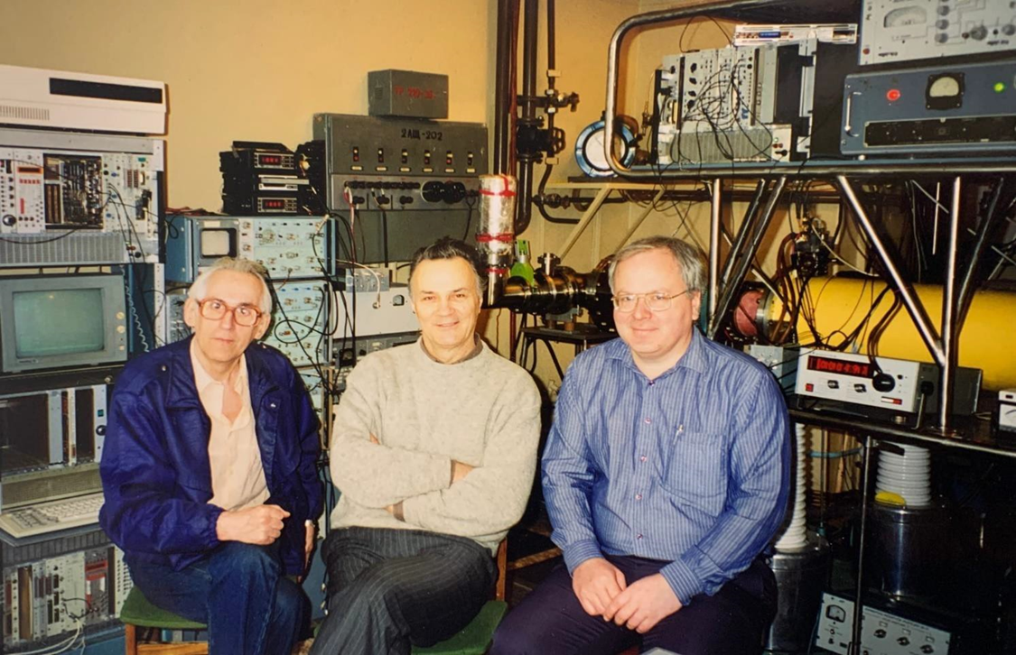
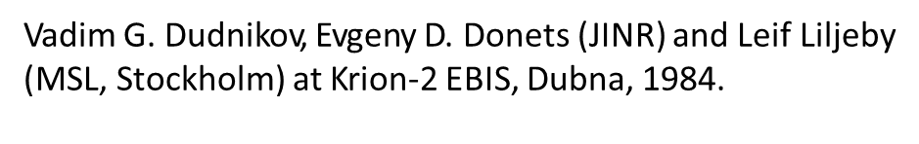
EBIS development around the world:
EBIS as injectors on synchrotrons, EBIS as a charge breeders
International EBIS/T symposium since 1976, next in Vancouver 2022
10
LHE JINR Dubna, Krion-2. E.D.Donets, A.I.Pikin, V.P, Ovsiannikov et al
IAP Frankfurt University EBIS; Reinard Becker
MSL Stockholm CryEBIS; Leif Liljeby
Saclay EBIS ; J. Arianer -> “supercompression”” ???
CERN EBISes ; F. Wenander
RHIC EBIS , BNL Ed Beebe
-----------------------------------------------------------------------------------------------
EBIT(rap) development:
cherge breeders, X-ray spectorscopy, atomic physics
S-EBIT LLNL , R. Schmieder : bare U92+ (1994)
Tokyo EBIT, K.Ohtani, A.Nakamura
Heidelberg EBIT, J. Crespo
Michigan MSU EBIT, A.Lapierre
TRIUMF CANREB EBIT, O. Kester
….

Slide 32
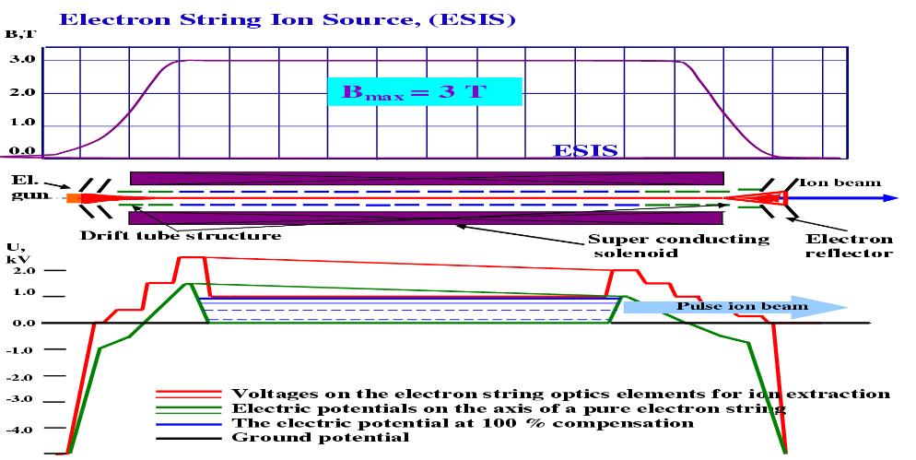
New concept: Electron String Ion Source - ESIS
In 1989 Evgeny got the title Professor Evgeny D. Donets in the field of experimental physics.
Soon after in 1990 he discovered the linear electron string phenomenon - high-temperature single-component electron plasma in a reflex mode EBIS operation!
Until the very end he did experimental research of the electron string physics.
Electron string is formed in nonlinear process via strong instability of trapped electrons and exists as a dynamic
equilibrium of injected and
lost electrons.
Electrons are collected at the
anode → no collector
13

Slide 33
Accumulation of electrons in ESIS
Electron inj. current 5 μА
Electron inj. current 20 μА
Transition to e-string state
Electron inj. current 50 μА
Electron inj. current 300 μА

Slide 34
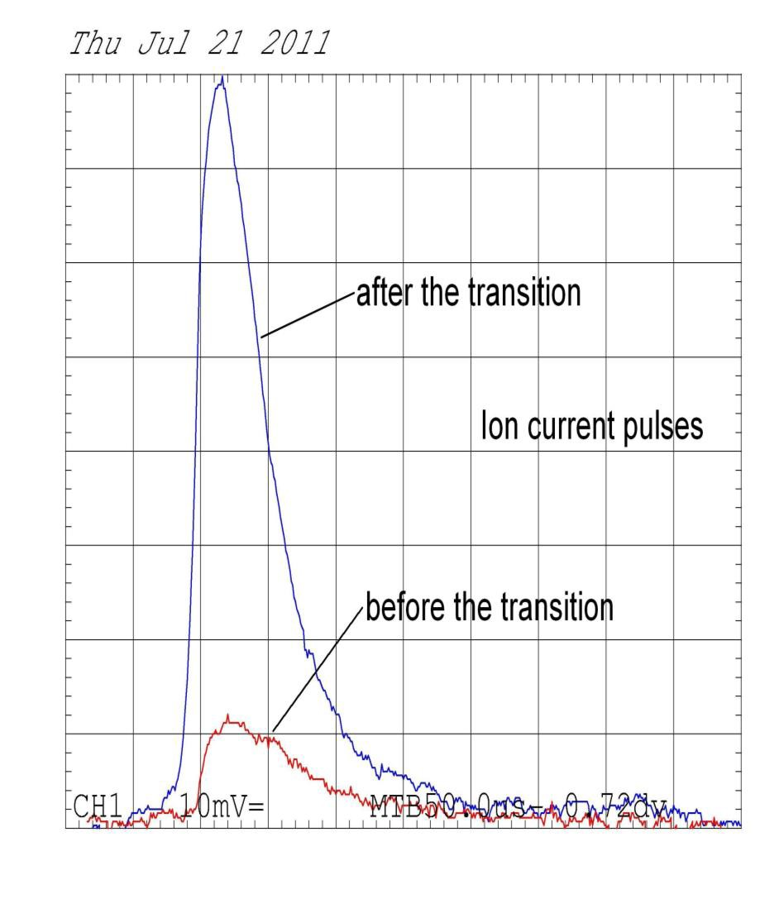
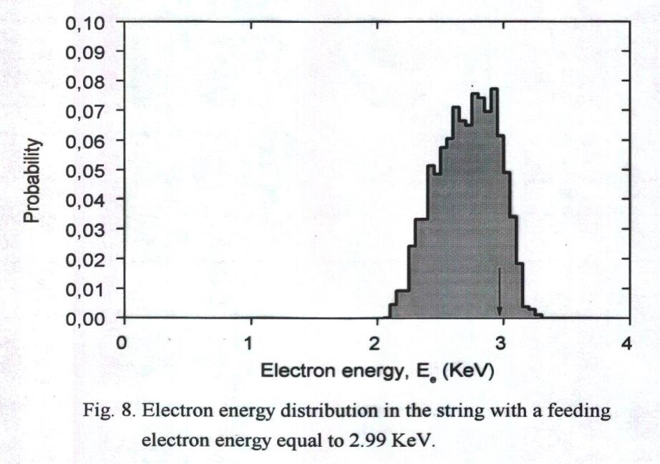
ESIS
14
The transition into the stable string operation can be determined via current in the extraction pulses.
The electron energy distribution is modified due to collisions of the electrons, so electrons can reach higher energies than provided by the gun potential.
The high energy tail of the e-string electrons
→ higher charge states Au54+ with KRION-2M
Key parameter:
Cathode Heating,
e-beam current density,
B-field

Slide 35
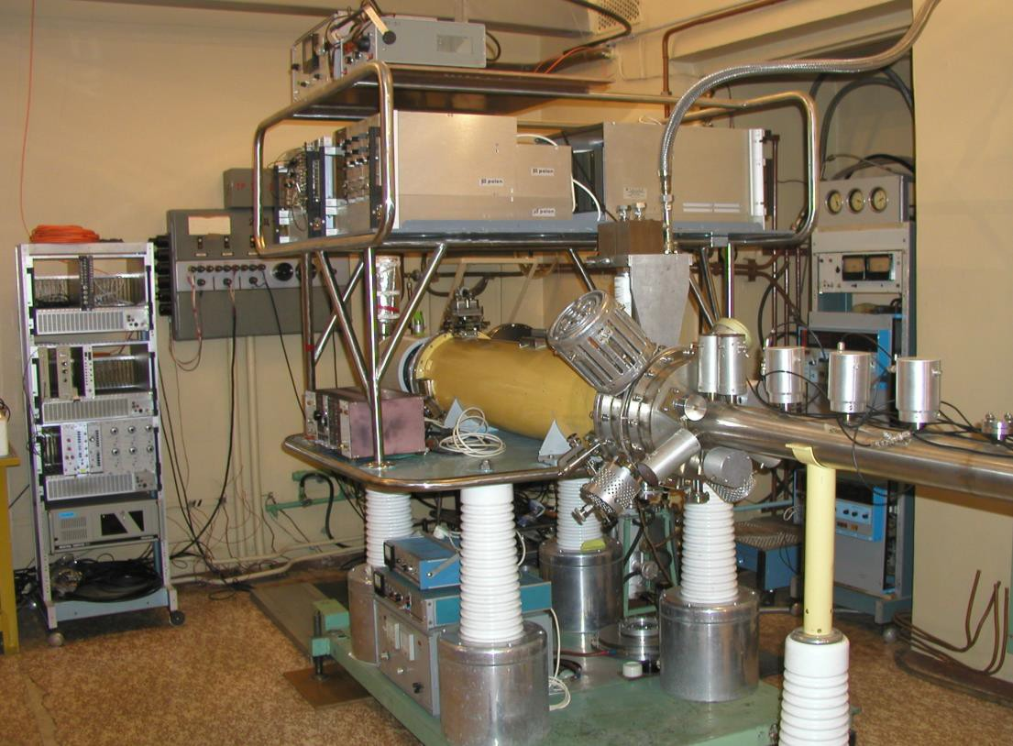
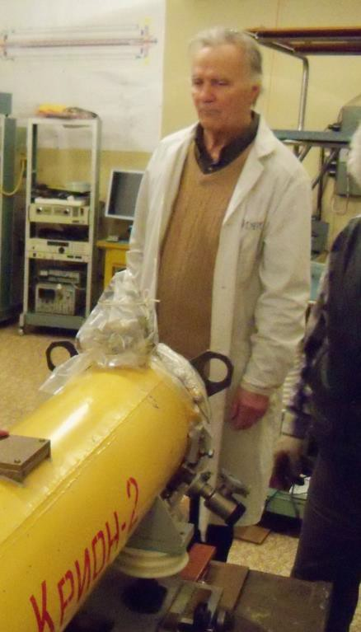
ESIS
15
KRION-2 had been modified to operate as ESIS (KRION-2M) and was used as injector into the NUCLOTRON at JINR in Dubna.

Slide 36
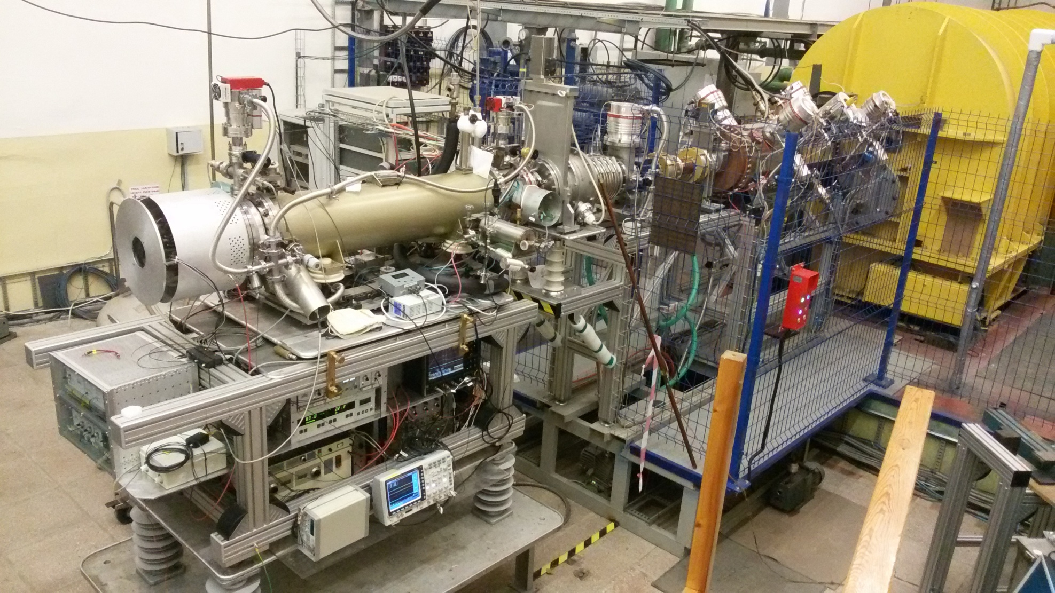
In 2005 at the ICIS in Caen, E.D. Donets with colleagues got the ICIS conference international "Brightness Award", for the "Electron String source of Highly Charged Ions".
16
For the NUCLOTRON the Krion-6T has been developed to increase the injection intensity of highly charged ions, as the stronger magnetic field is beneficial for the string formation.
NICA requirements:
1÷2x10^9 ppp ²⁰⁹Bi35+ (¹⁹⁷Au31+)

Slide 37
B=3.1 T -> B=4.6 T; Ion yield growth 5 (Kr26+, Xe41+),
J_e growth 2.15 - 4.69, different for ions with different A;
Ionization cross sections for A>100 should be measured experimentally!

Slide 38



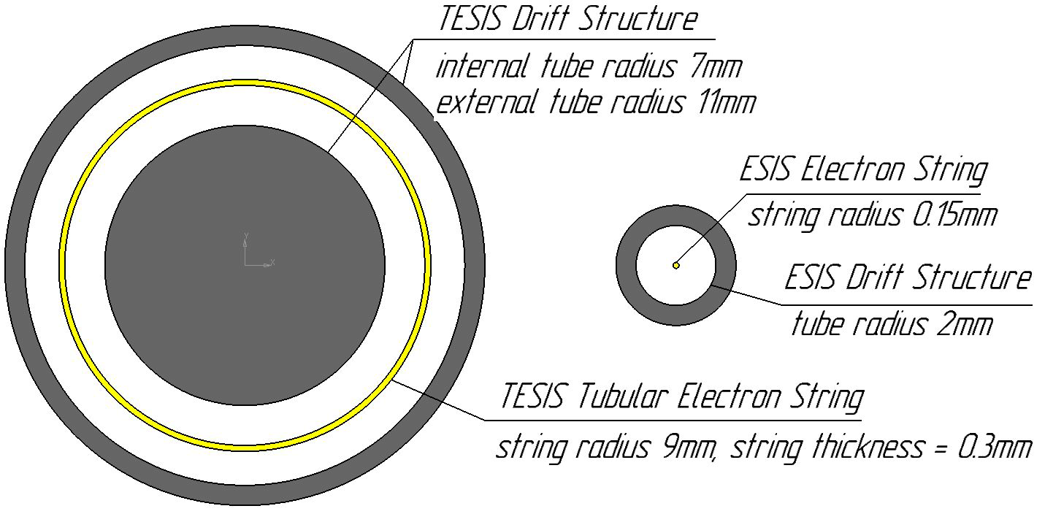
For ultimate intensities a new concept of a
“tubular electron beam/string ion sources (TEBIS/TESIS)
has been proposed by E.D.Donets in 2001
TUBULAR ESIS
Motivation was inspired by nuclear astrophysics problem of cross-sections measurement for fusion reactions between bare nuclei of light elements near Gamov peak;
4
4

Slide 39
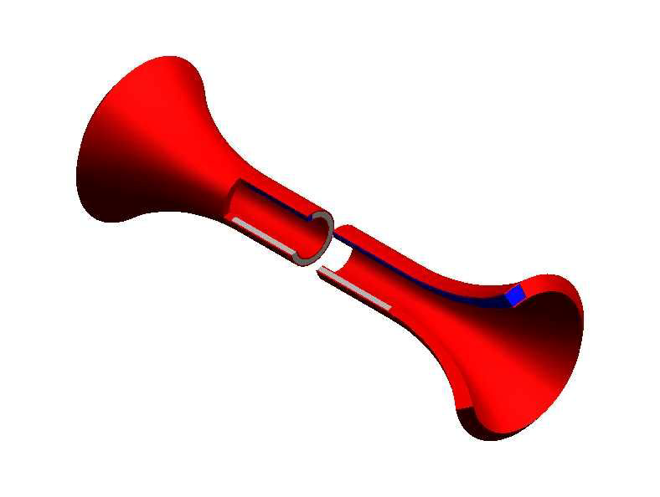
Electron beam volume
Off-axis extraction of ion beam
from TESIS
5

Slide 40
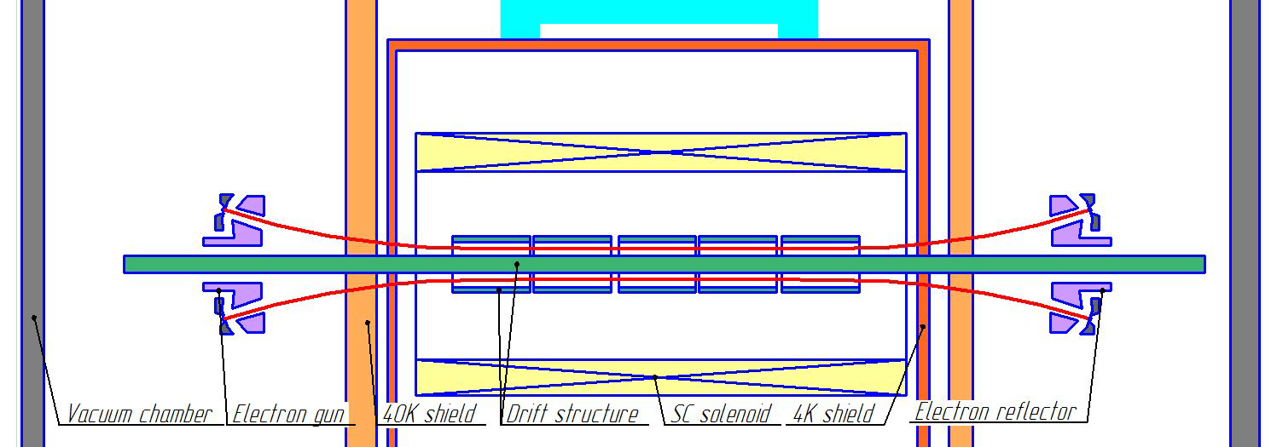
Scheme
6

Slide 41
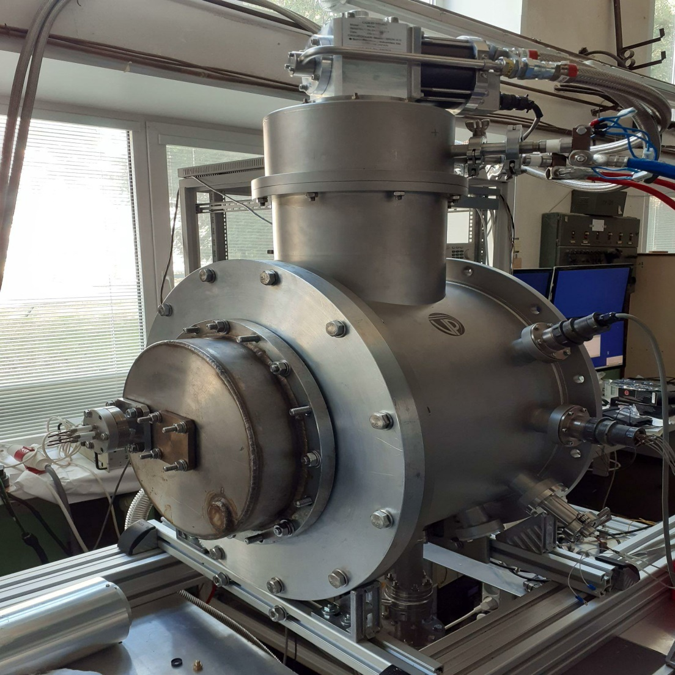

First TESIS Test Facility; LHEP JINR
Operating pressure = 7e-8 mbar
Cryocooler Sumitomo RDK 415 1.5W
Solenoid temperature = 4.2K
HTSC current leads (4mm tape) SuperOx
Pumping and cooling time = 48h
7

Slide 42
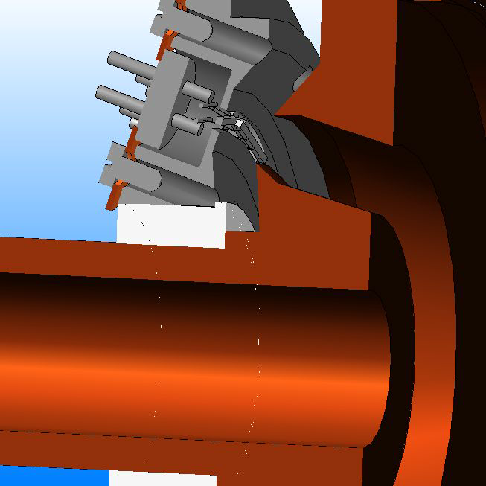
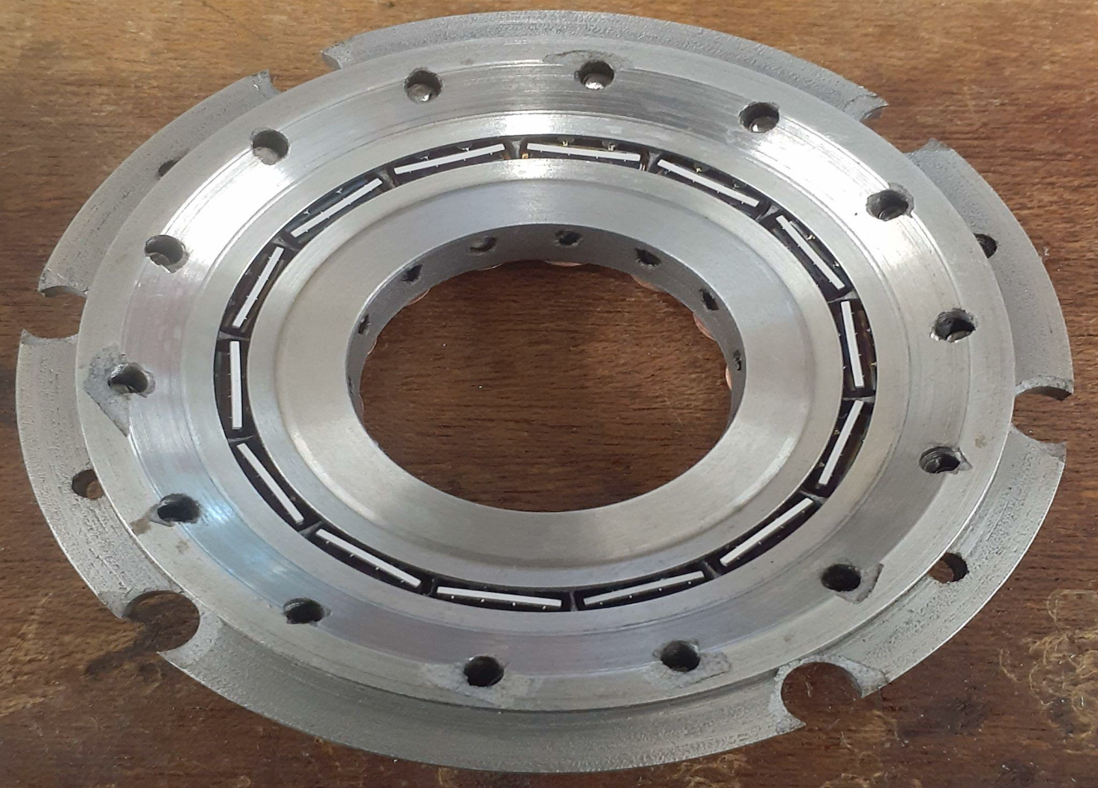
Electron gun
14 IrCe cathodes, ring diameter = 40mm
15

Slide 43
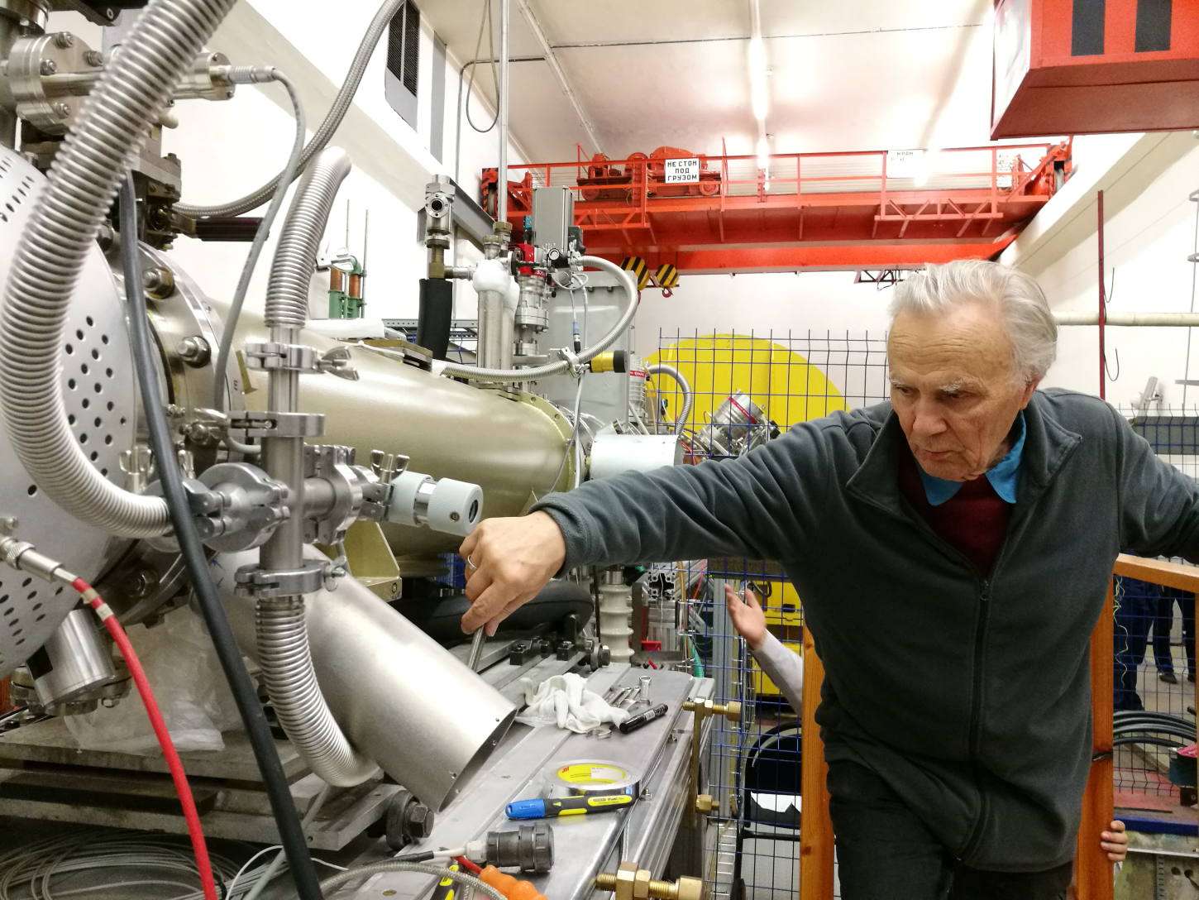
Known in the community
20
E.D.Donets has about 220 scientific publications,
including 1 monography, 10 inventions and
two discoveries.
He was a member of the International
Advisory Committee of the ICIS conference
and the international symposium on
EBIS/T/ for many years
He was still active, cheerful and
full of new plans and ideas up to the very end.
Evgeny D. Donets at Krion-6T

Slide 44

Problems for future :
Comprehensive understanding of
Electron String phenomena: theoretical model, frames of operation, predictability.
2) Creation of Tubular ESIS/ESIS: possible increase of HCI ion yield in 1-2 orders of magnitude, saving all other EBIS/ESIS avantagies. All modern accelerators requirements should be covered.
3) Nuclear physics with slow bare HCI:
Influense of electron shells on alpha-decay
220Rn
4) Cross-section measurements in fusion reactions between bare nuclei of light elements
Near Gamow peak (nuclear astrophysics).
Et cetera….
7

