Slide 1
NICA Collider Magnetic Field Correction System
M. M. Shandov, H. G. Khodzhibagiyan, S. A. Kostromin, O. S. Kozlov,
I. Yu. Nikolaichuk, T. Parfylo, A. V. Phillippov, A. V. Tuzikov
Veksler and Baldin Laboratory of High Energy Physics,
Joint Institute for Nuclear Research, Dubna, Russia

Slide 2
Introduction
Outlines
Magnetic Field Correction System
Magnetic Measurements
Main Goals
Magnets Design
Future Plans
DA Calculation

Slide 3
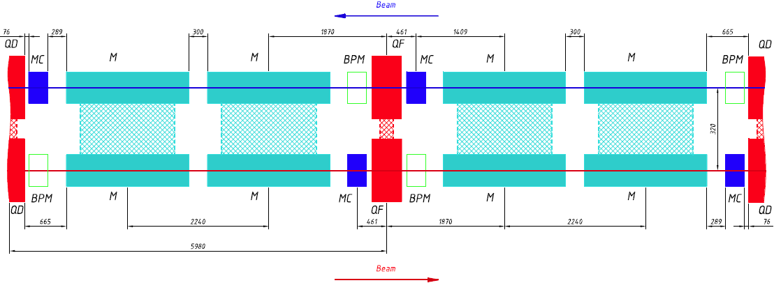
Correctors in the Collider Lattice
FODO-Cell
92 correctors in arcs (46 per each beam)
32 correctors in straight section (16 per each beam)
4 correctors in straight section (combined for 2 beams)
4 dodecapole correctors in central QFF
Total: 132 correctors

Slide 4
Goals of the Correction System
Field Type | Correction goal | Field Strength | Ampere-turns
“Normal” dipole ($b_{0}$) | Horizontal orbit | 0.15 T | 11500
“Skew” dipole ($a_{0}$) | Vertical orbit | 0.15 T | 11500
“Normal” quadrupole ($b_{1}$) | Betatron tune | 3 T/m | 12500
“Skew” quadrupole ($a_{1}$) | Betatron tune coupling | 3 T/m | 12500
“Normal” sextupole ($b_{2}$) | Ring chromaticity | 175 T/m² | 8260*
“Normal” octupole ($b_{3}$) | Fringe field influence | 1300 T/m³ | 4890
“Normal” dodecapole ($b_{5}$) | Fringe field influence | 125000 T/m⁵ | 1000
* – Average value for 3 layers
$$B_{n}=\frac{1}{n!}\frac{{∂B}_{y}^{n}}{{∂x}^{n}},n=0,1,…$$

Slide 5
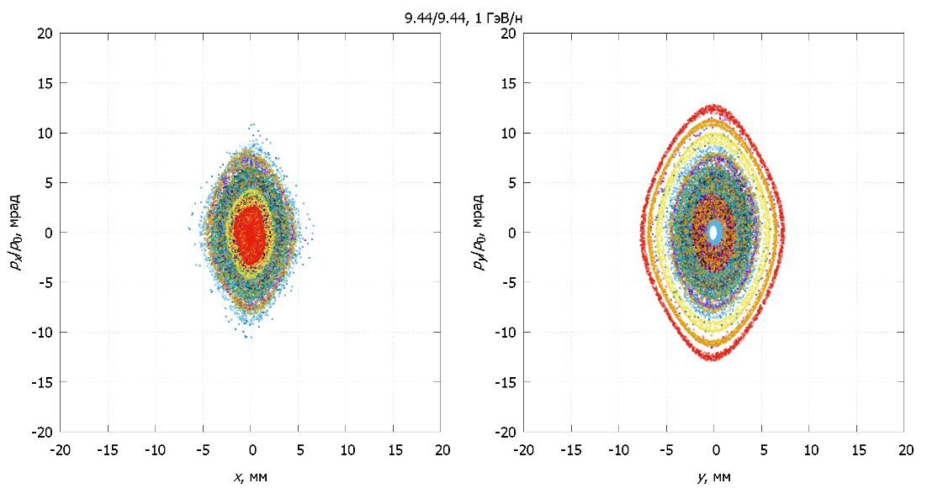
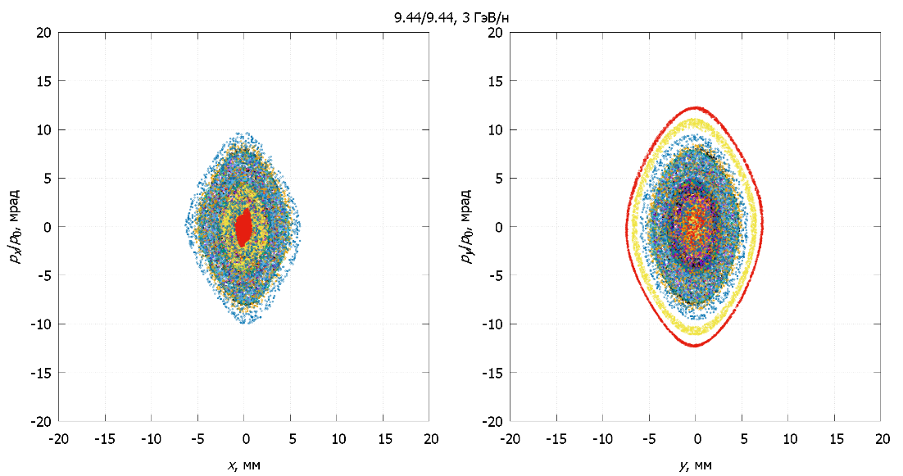
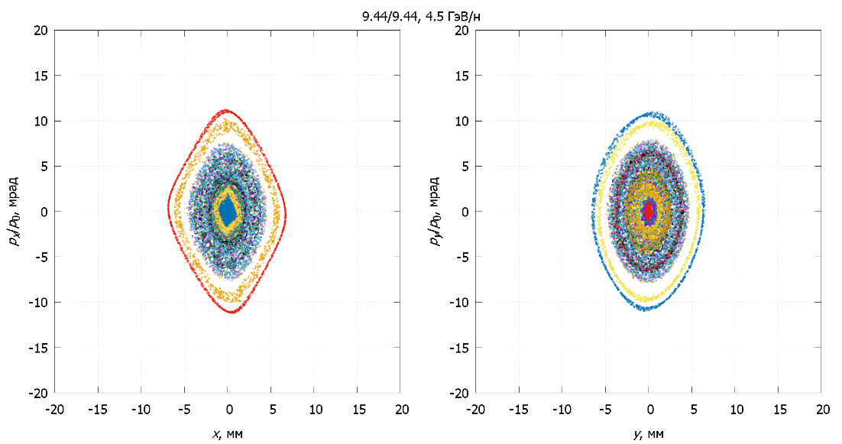
DA Calculation
Optimization of the NICA collider
optics structure
A. V. Philippov et. al., 2019
DA $≈8÷9$ $σ (MAD−X)$

Slide 6
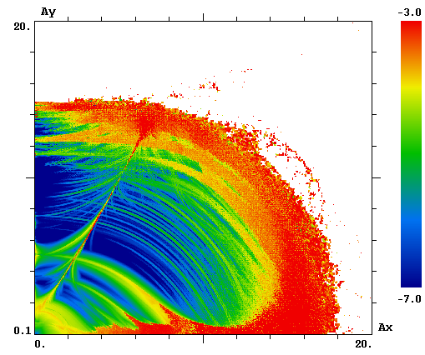
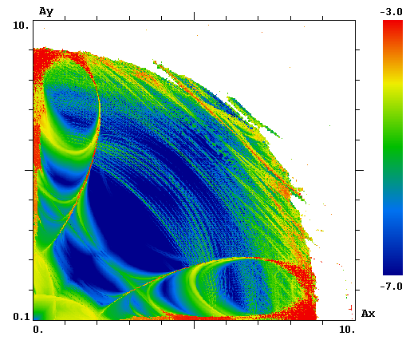
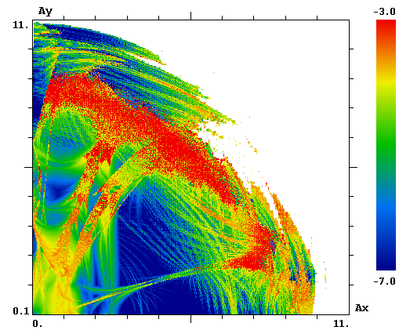
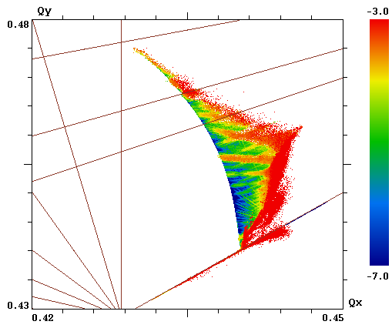
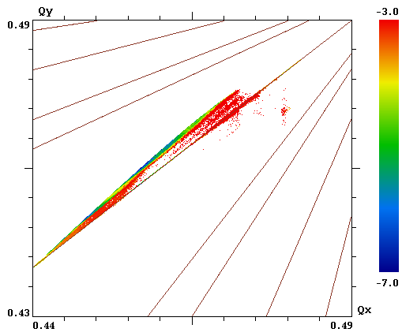
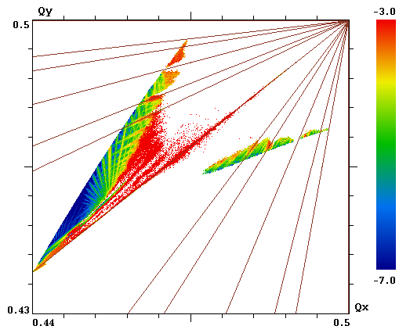
DA Correction. Example
Coupling + Chromaticity
Correction
DA Correction ($b_{3}$)
Qedge On
Ion Beam dynamics
in NICA collider
S. A. Kostromin et. al., TUB01

Slide 7
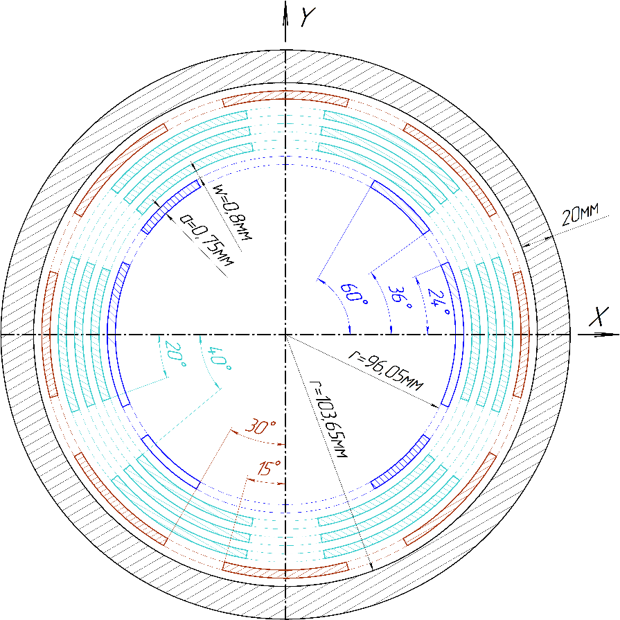
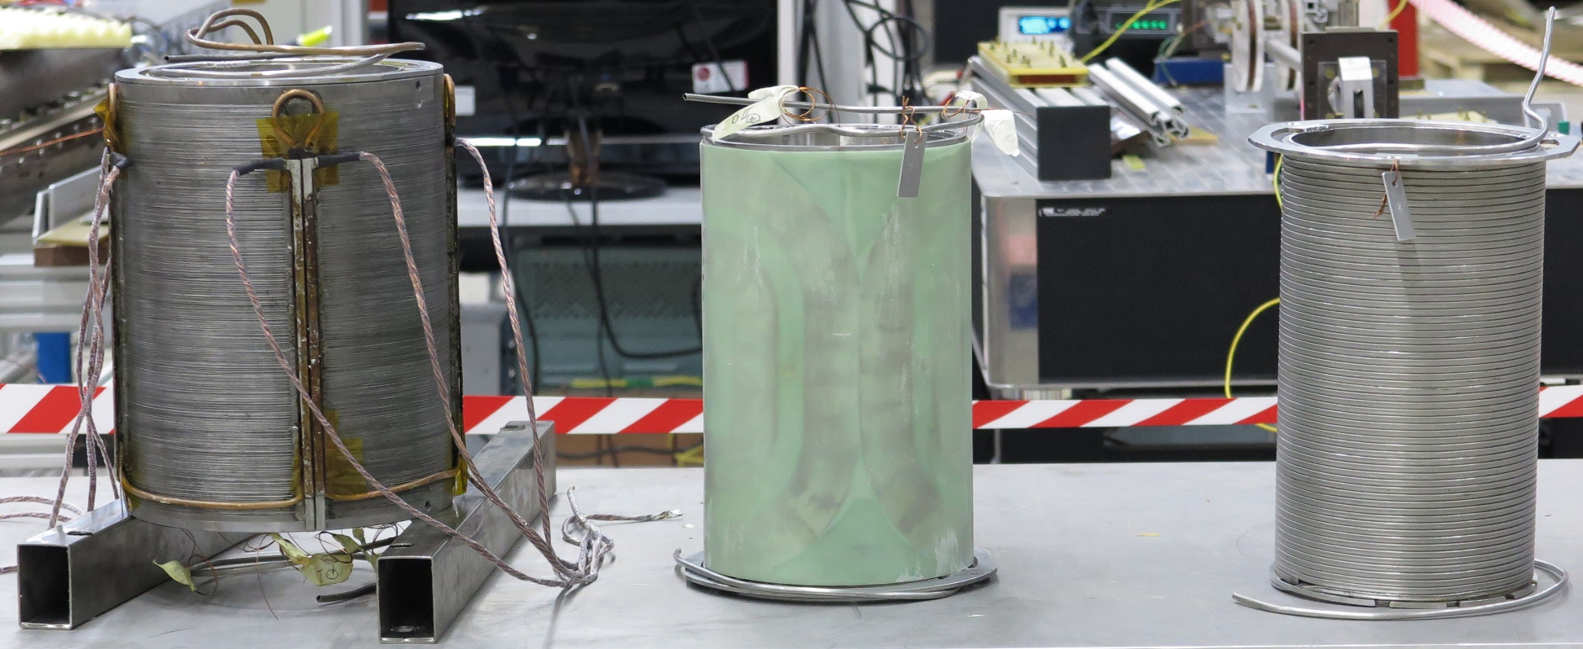
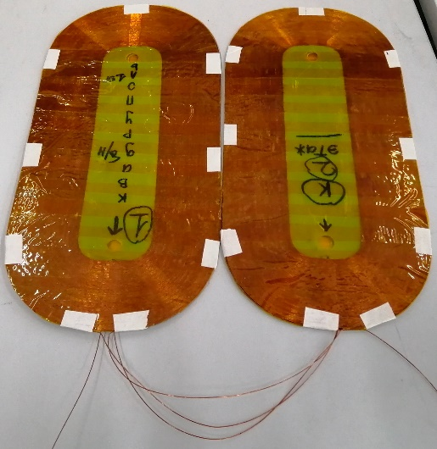
Magnet Design
Correctors’ Magnets for
the NICA Booster and Collider
M. M. Shandov et. al., 2019
Dipole
Sextupole
Octupole
SC Magnets for
Project of NICA
D. N. Nikiforov et. al., WEB01

Slide 8
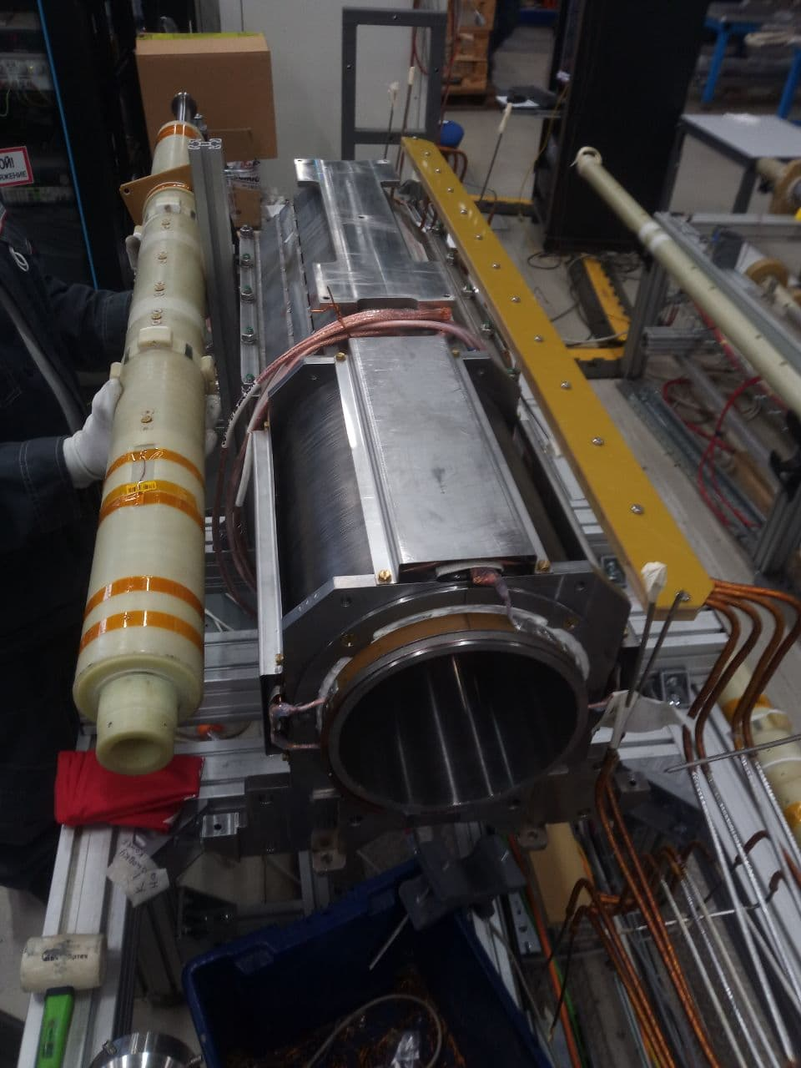
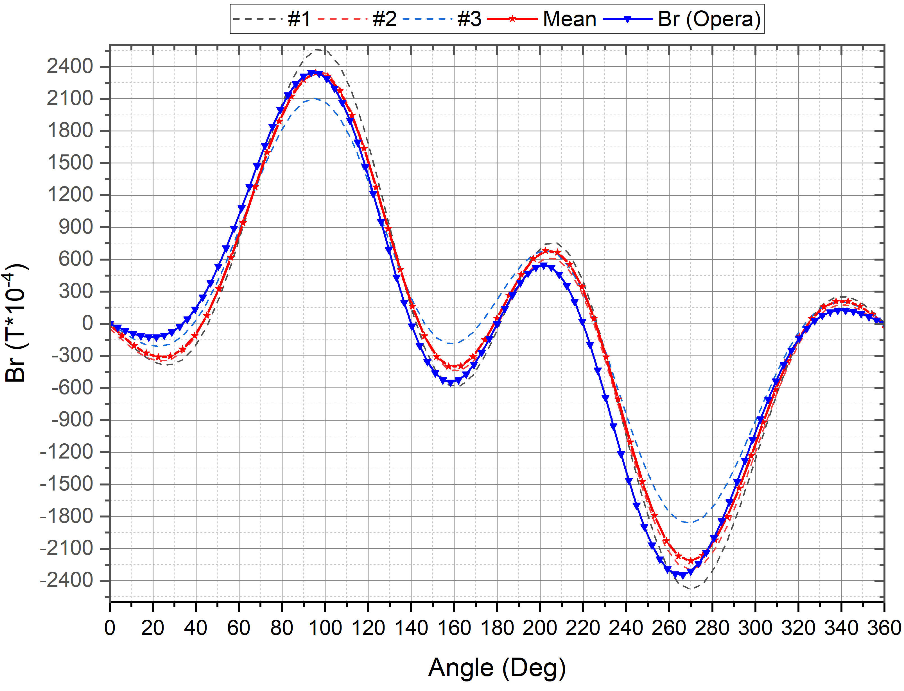
Magnetic Measurement
Field @R=46 mm
Hall Sensor
Field Type | Measurements | FEM 2D
Dipole ($b_{0}$) | 0.127223 | 0.138722389
$$\text{Sextupole}\text{ (}b_{2}\text{)}$$ | 0.0972577 | 0.095743794
Octupole ($b_{3}$) | 0.0189354 | 0.021159588

Slide 9
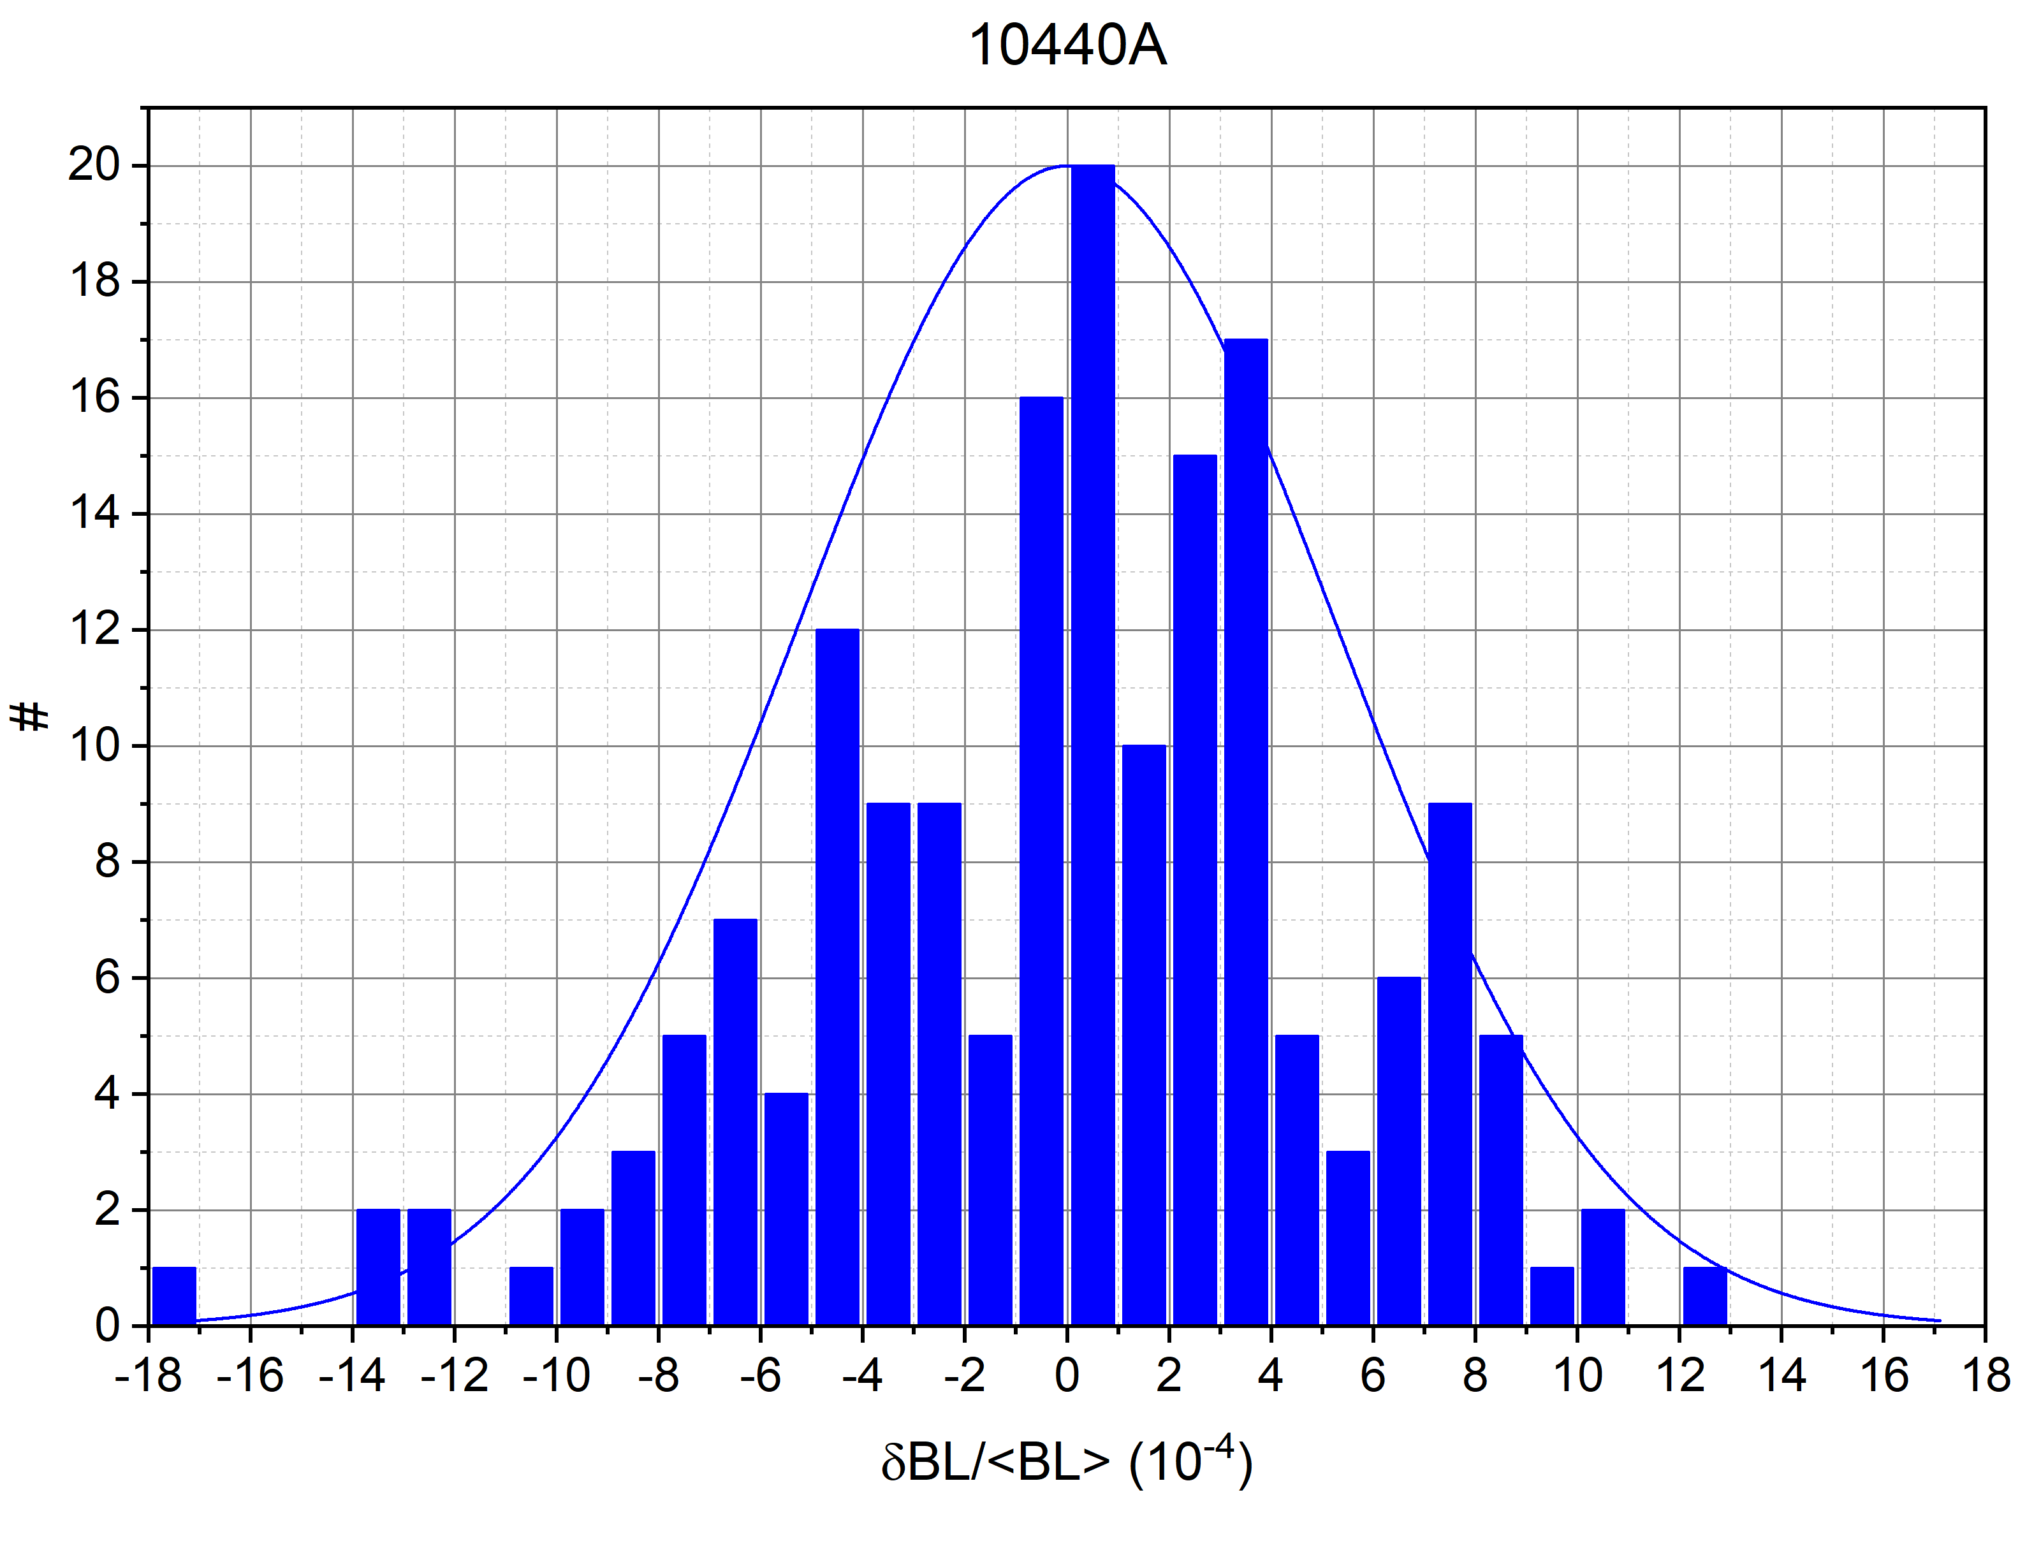
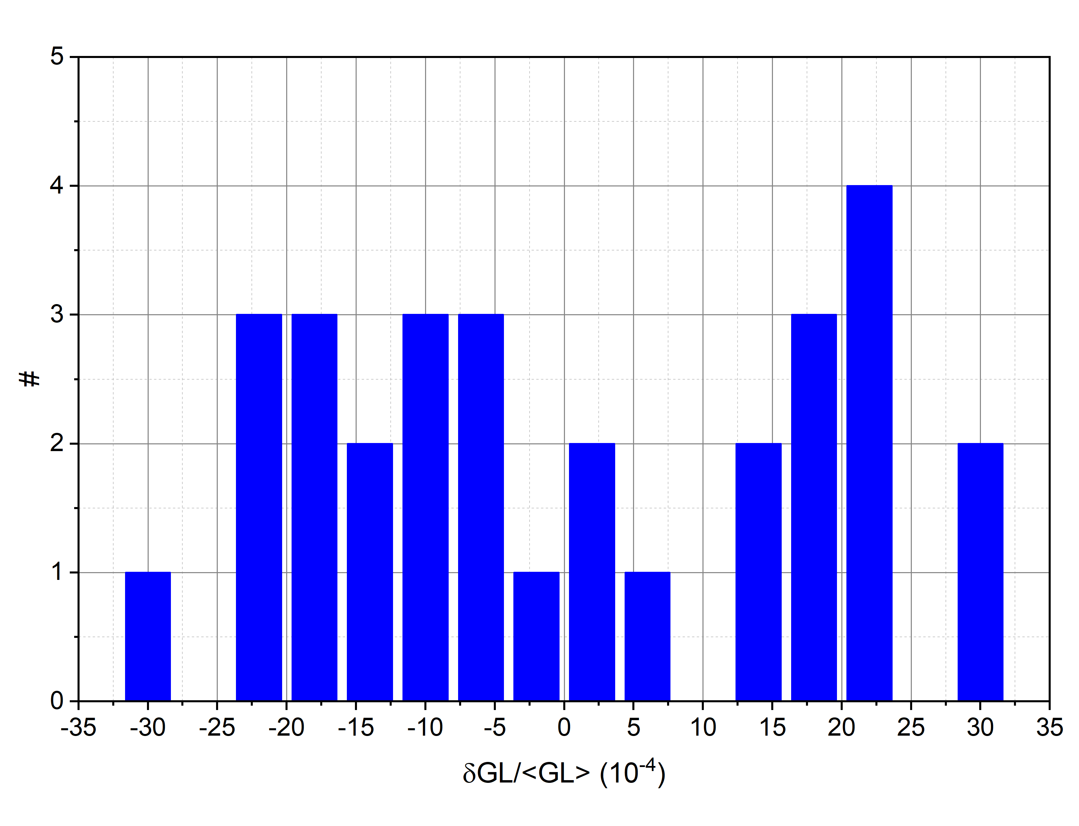
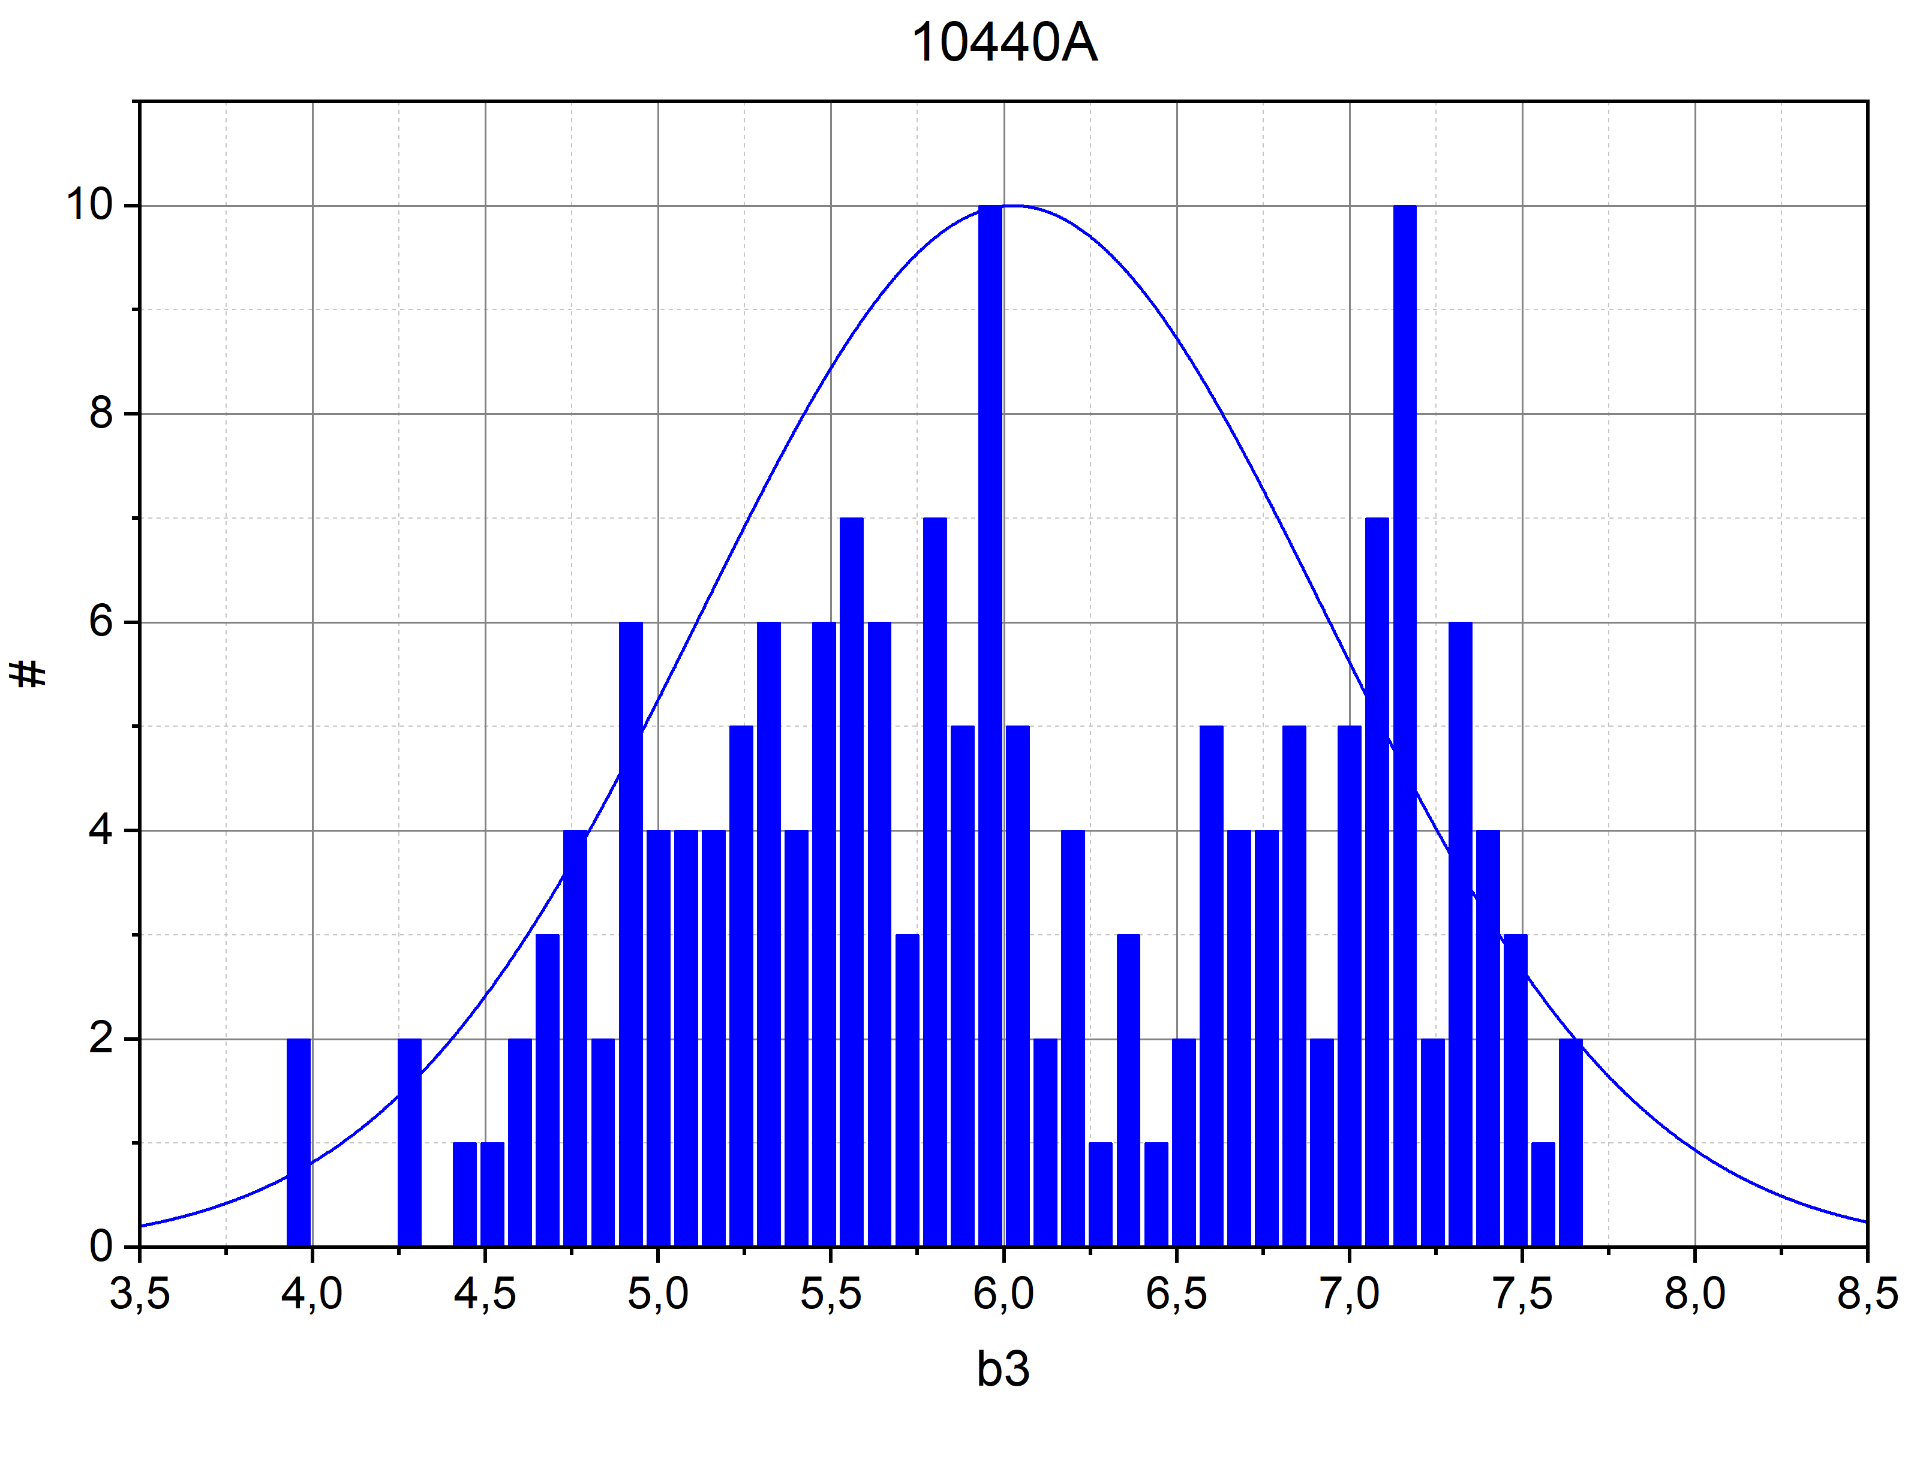
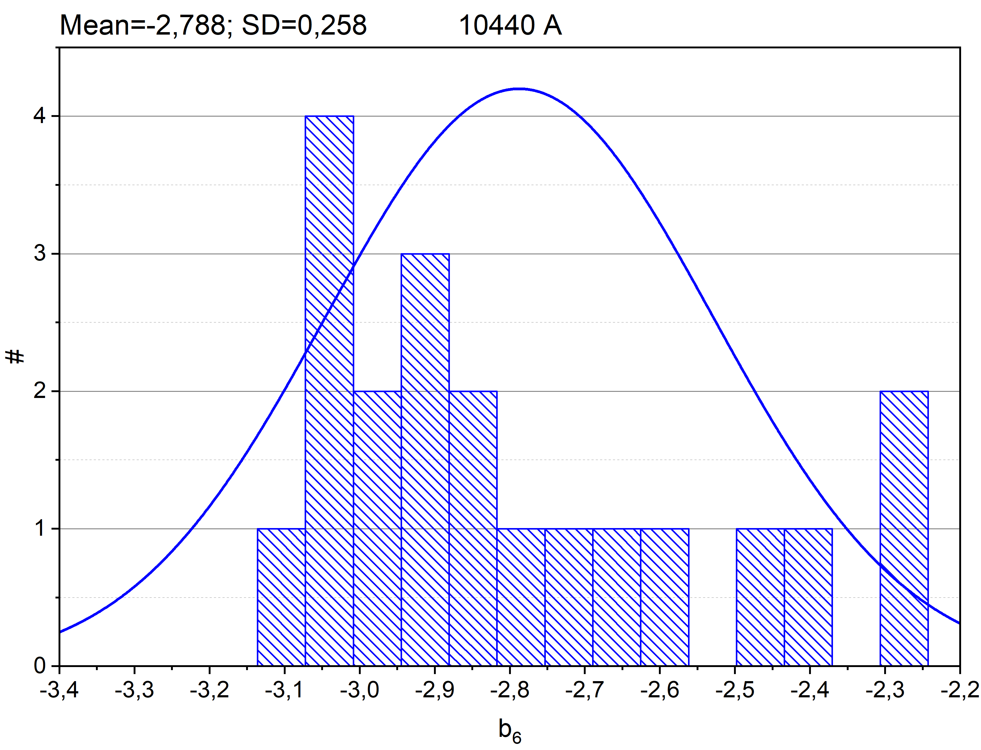
Collider Magnets Measurement
Serial MM of the NICA
Collider Twin-Aperture
Dipoles.
The Main Results
D. Zolotykh et. al., WEPSC18
Quadrupoles 34,8%
Dipoles 100%

Slide 10
Conclusions
Magnetic Field Correction Systemm
Magnetic Measurements
DA Calculation
Magnets Design
Future Plans

Slide 11
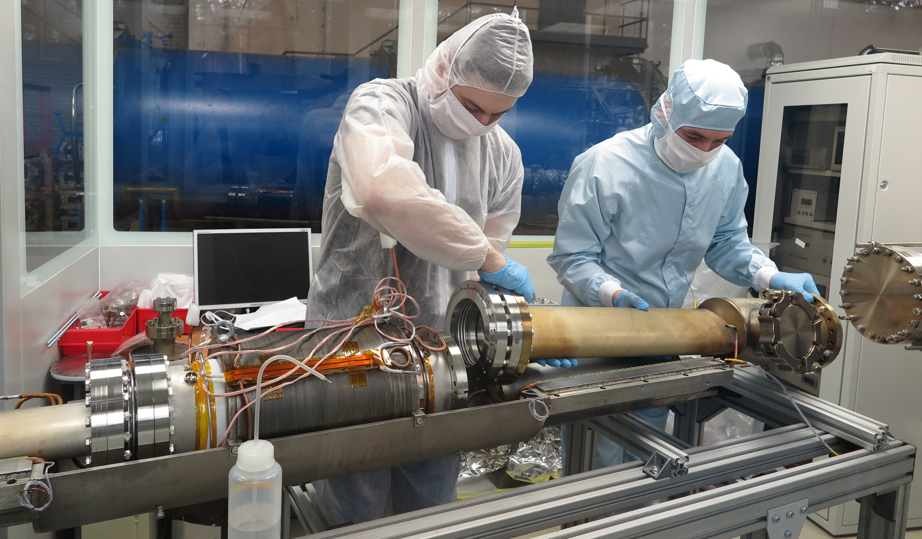
THANK YOU FOR ATTENTION !!!

