Slide 1

Methods and systematic errors for searching for the electric dipole moment of charged particle using a storage ring
Y. Senichev, A. Aksentyev, A. Melnikov
Institute for Nuclear Research of RAS

Slide 2
Introduction
Accelerating complex NICA is the best candidate for searching for dEDM and Axion

Slide 3
The analysis done by the AD Sakharov, showed that this CP-violation is absolutely necessary to explain why on earth and in the visible universe there is a MATTER, but there is practically no ANTIMATTER
First message to search for Electric Dipole Moments(EDM) of fundamental particles: it came to understand the CP violation
Second message for Electric Dipole Moments of fundamental particles: the baryon asymmetry of the Universe that represents the fact of the prevalence of matter over antimatter

Slide 4
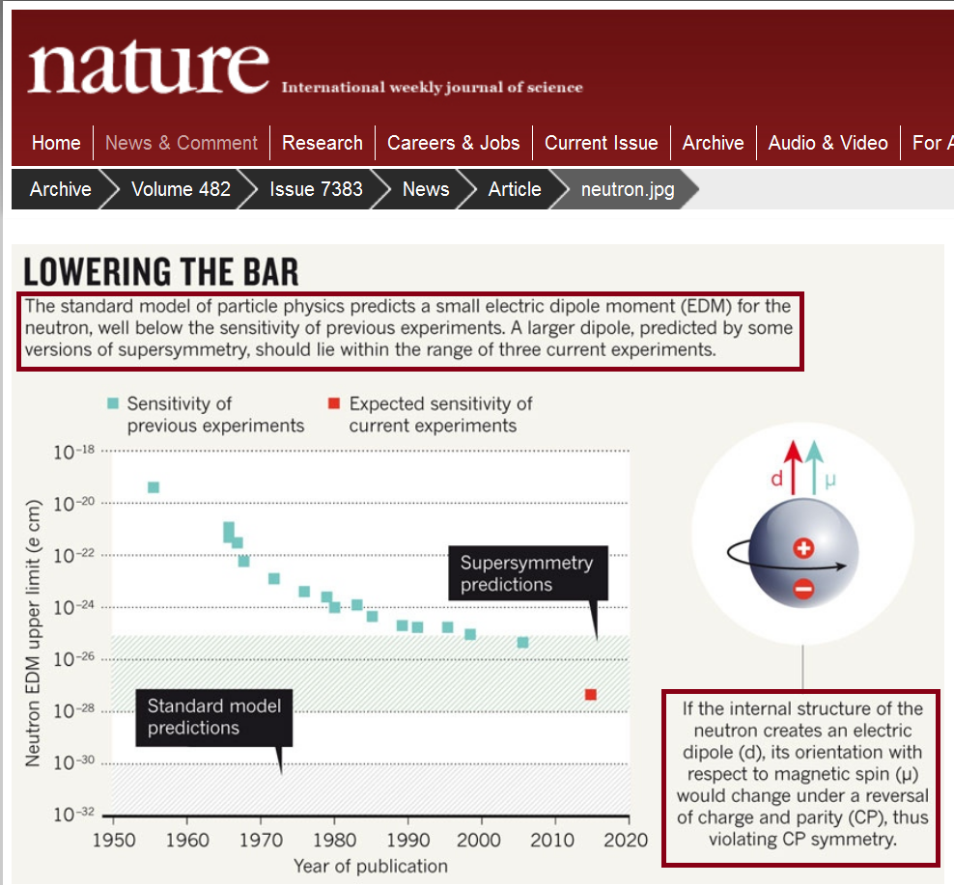
Current results for neutron:

Slide 5
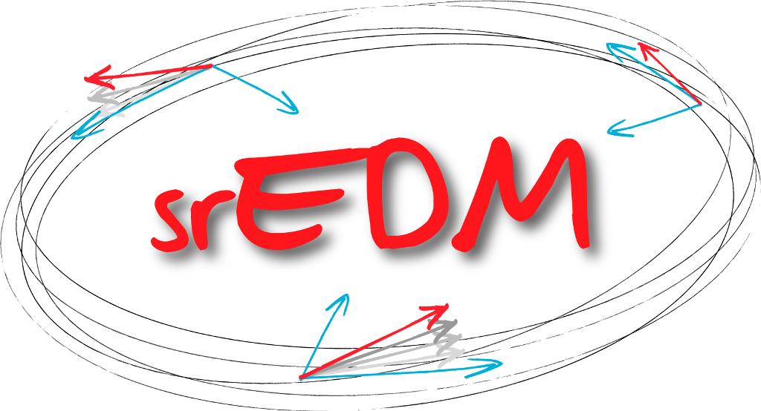
Storage Ring EDM Project
Options:
Electric ring (proton or electron): only E-field
Electro-magnetic field ring (deuteron): E- and B-fields
JEDI
Jülich Electric Dipole Moment Investigations
JEDI includes Russian institutes: JINR, INR, ITP Landau, St-PbSU, BINP, St-PbNPI

Slide 6
Basic principle of EDM measurement in ring comes from “Tomas-Bargmann, Michel,Telegdi” equation with EDM term
The spin is a quantum value, but in the classical physics representation the “spin” means an expectation value of a quantum mechanical spin operator:
EDM

Slide 7
Frozen spin method for purely electrostatic proton ring at “magic” energy
In the method the beam is injected in the electrostatic ring with the spin directed along momentum S║p and S┴E; S={0,0,S_{z}} and E={E_{x},0,0}
at “magic” energy :
MDM spin frequency
EDM spin frequency

Slide 8
Frozen spin method for deuteron:
Frozen spin lattice for deuteron based on the «B+E» elements:
the spin of the reference particle is always oriented along the momentum

Slide 9
Most important problems in the ring for EDM search:
Frozen (or quasi-frozen) spin lattice
Spin decoherence
Systematic errors

Slide 10
Two concepts of lattices for deuteron EDM search have been investigated:
Frozen Spin (FS) method
Quasi-frozen spin (QFS) method

Slide 11
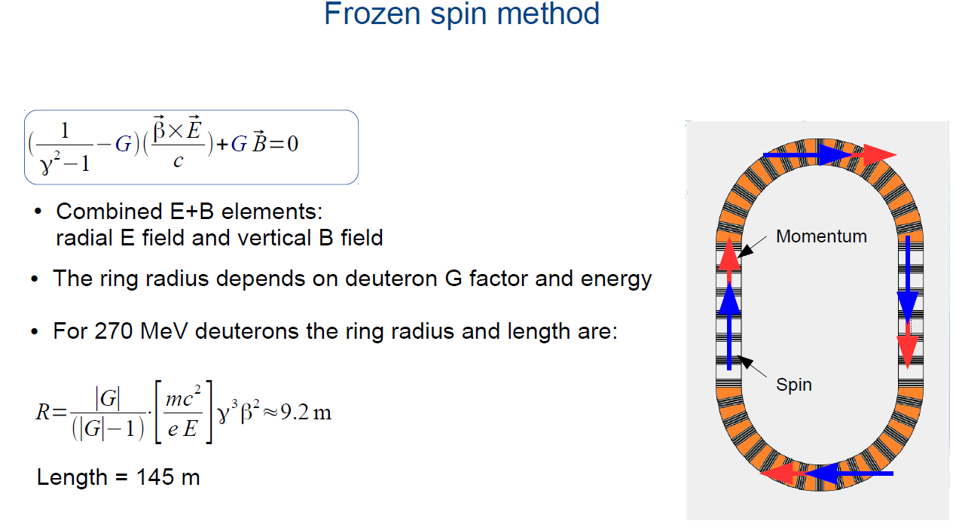

Slide 12
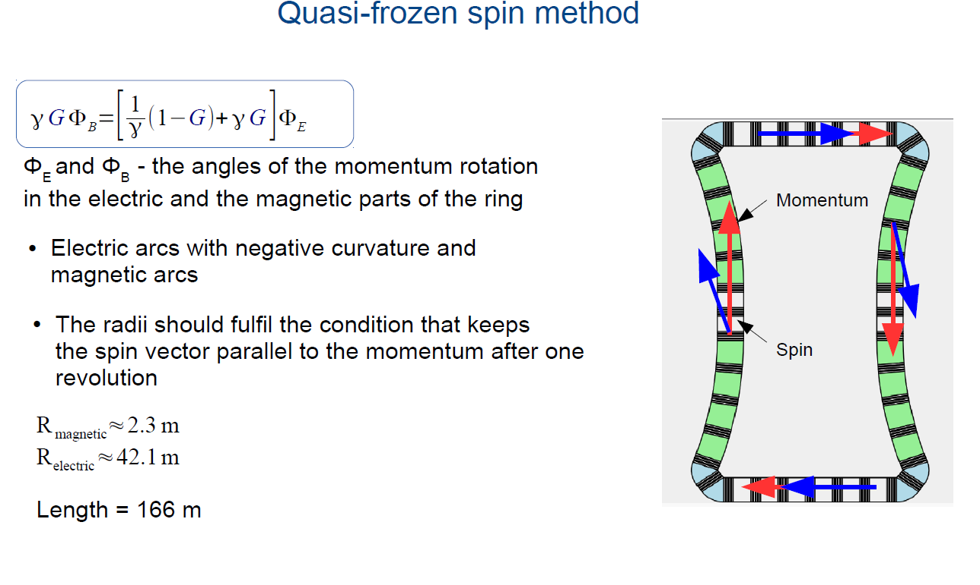

Slide 13
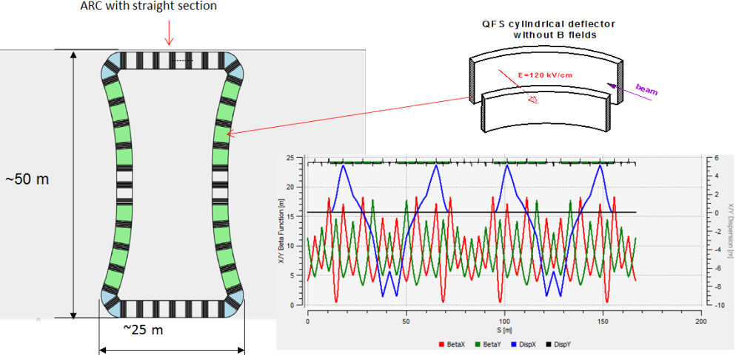
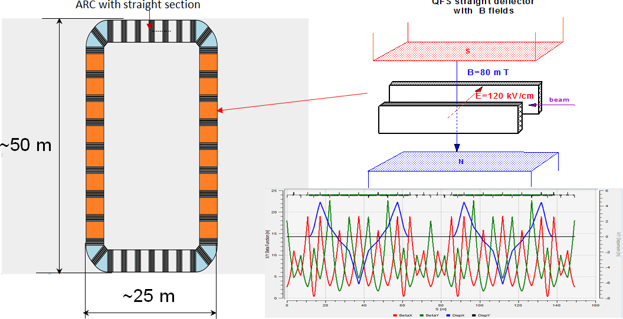
QFS lattice
B~100 mT

Slide 14
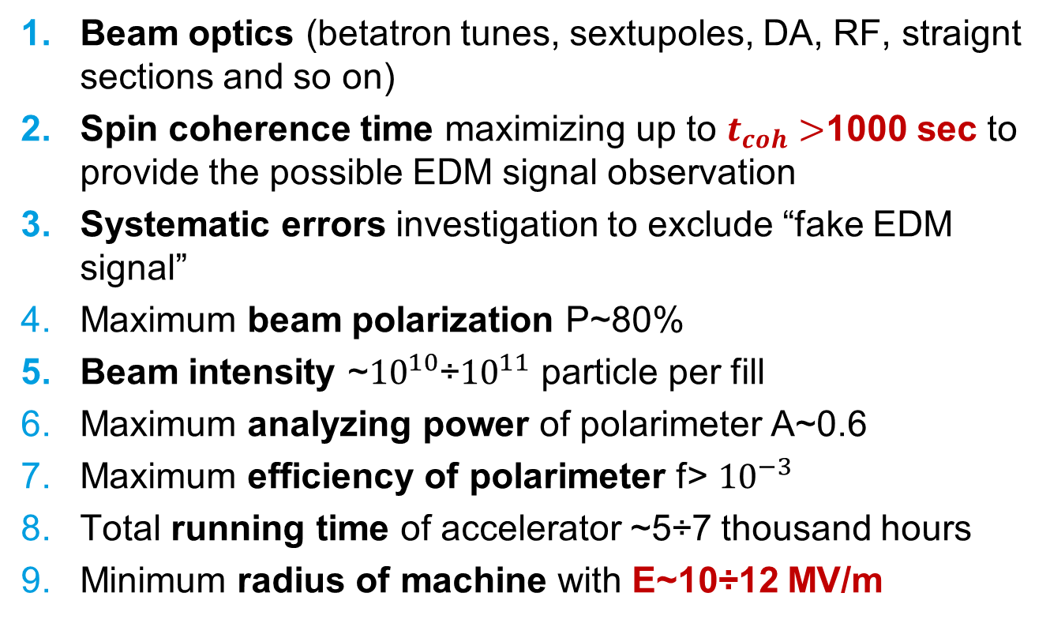
Main requirements to the experiment for search for EDM in the ring:

Slide 15
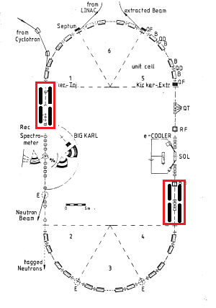
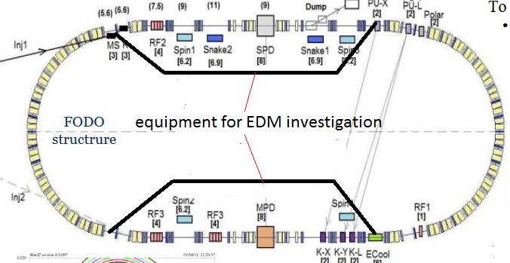
QFS in COSY ring and NICA
.
COSY
NICA

Slide 16
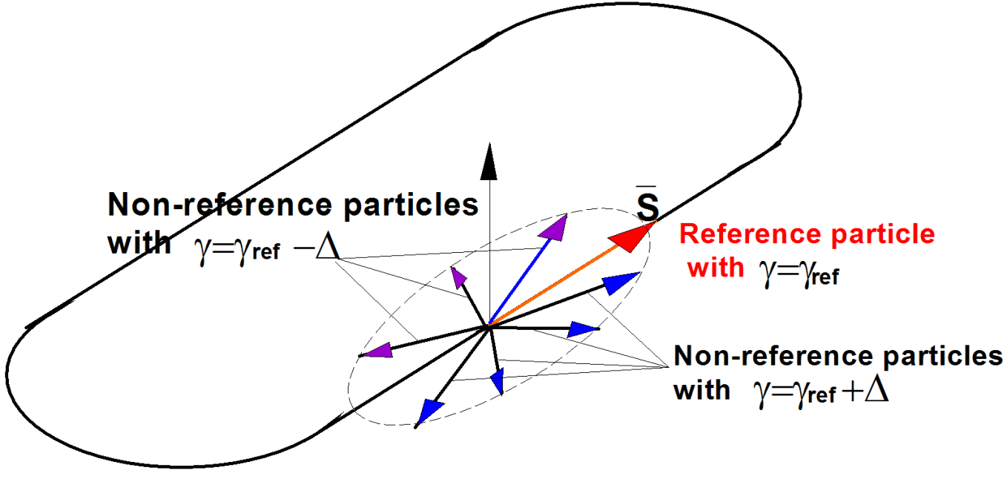
Spin tune decoherence
In magnetic field
In electric field

Slide 17
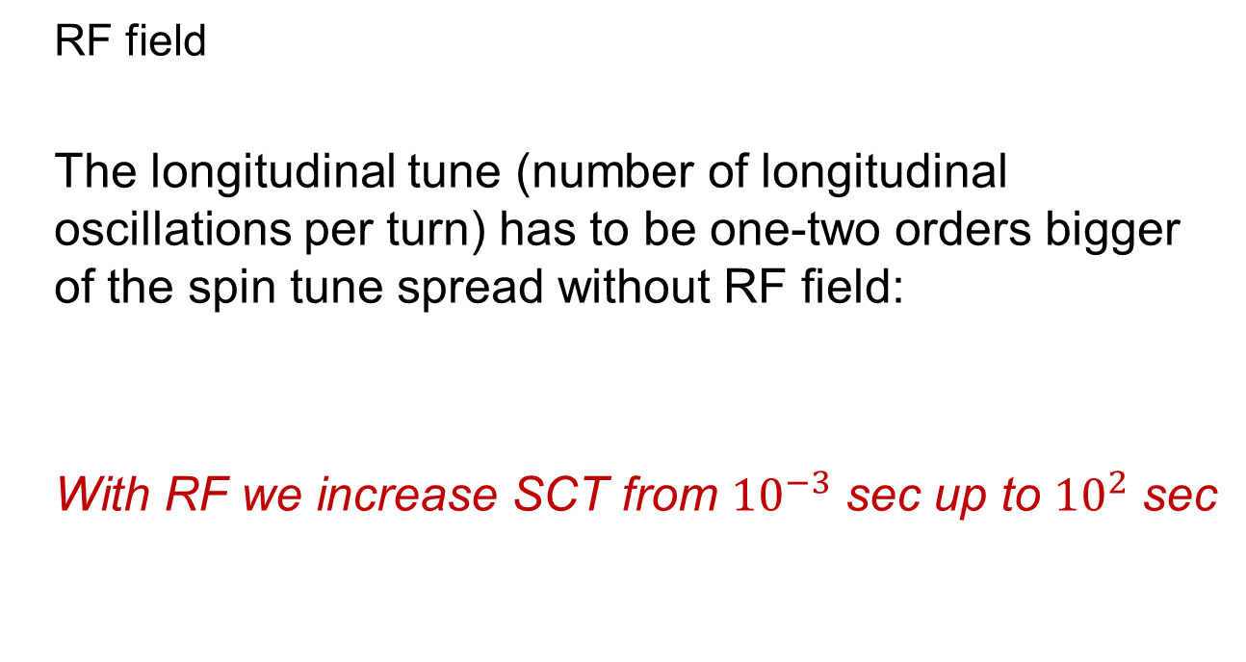
Spin tune coherence :
RF field as a method for mix particles of energy

Slide 18
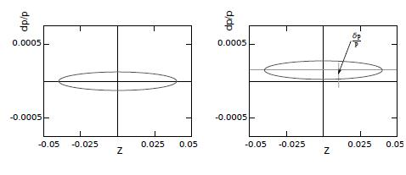
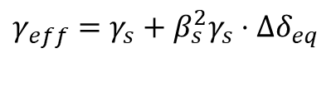
Orbit lengthening effects and effective gamma
Momentum deviation is described by eq:
Thus due to the betatron oscillation, the square term of momentum compaction factor
and the slip factor dependent on the equilibrium level energy is shifted
by the value :
$$γ_{eff}=γ_{s}+β_{s}^{2}γ_{s}⋅Δδ_{eq}$$

Slide 19
Systematic errors: ring with Imperfections
The difference between rings construction do not play an essential role with respect to the spin-orbital motion, so long as the motion of the reference particle in the perfect ring without imperfections is considered

Slide 20
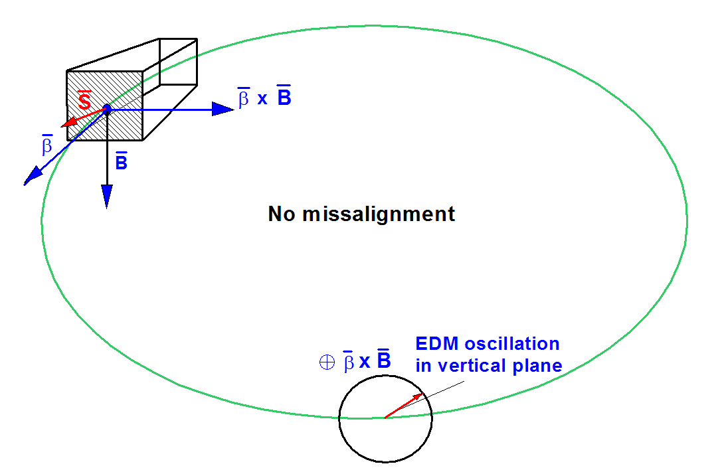
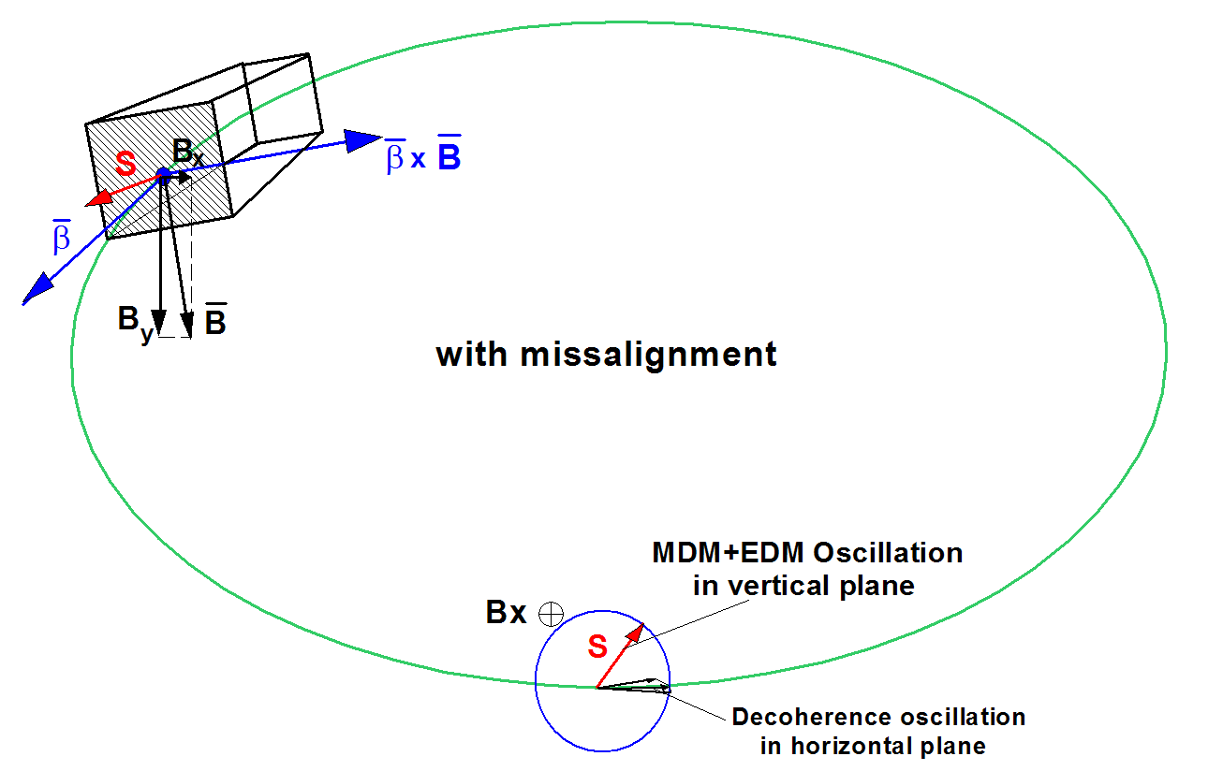

Radial $B_{r}$, vertical $E_{v}$ fields fake EDM signal
The presence of errors in the installation of the elements (imperfections) of the ring leads to the appearance of vertical and radial components of the electric and magnetic fields, respectively.
They both change the spin components in the vertical plane, in which the EDM signal is expected, and create the systematic errors that initiate the “fake EDM” signal.

Slide 21
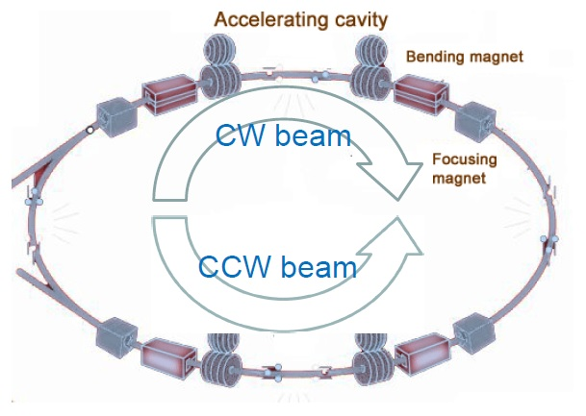
CW and CCW procedures
To solve this problem in the case of a proton beam, it was suggested that the procedure of simultaneously injecting two beams in the ring in two opposite directions, clockwise (CW) and counter clockwise (CCW) [BNL], be used.
Adding the CW and CCW results together, the EDM can be separated from a systematic error arising due to MDM.

Slide 22
Currently four methods for measuring EDM are considered as working:
-BNL method
-Koop Wheel method
-Frequency Domain method
The main tasks to be solved by the methods
under consideration are:
what do we measure;
decoherence suppression mechanism
implementation of the reverse field
at CW and CCW;
systematic errors.

Slide 23
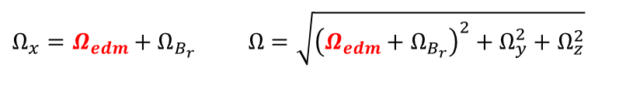
BNL: what does the method measure?
In the frozen spin regime it measures the vertical projection of the spin, that is, the amplitude of the changing part of the signal during a long time ~1000 sec, namely
where are frequencies of spin precession in X,Y and Z planes.
the solution at the initial conditions for zero horizontal, vertical Sx,Sy and for longitudinal components Sz=1 in the general form
$$Ω_{x}=Ω_{edm}+Ω_{B_{r}} Ω=\sqrt{{\left(Ω_{edm}+Ω_{B_{r}}\right)}^{2}+Ω_{y}^{2}+Ω_{z}^{2}}$$

Slide 24

Basic concept of BNL method
Expecting the EDM value at the level of after 1000 sec and assuming that the systematic errors arise due to imperfection it is necessary to correct all misalignments to such a magnitude
This mode will be called the 3-D frozen spin or zero order spin resonance in 3D space, when the direction of the spin is fixed relative to the pulse in all three space directions.
In that case the contribution will be determined only by the EDM signal, that is the total frequency .
$$Ω≈Ω_{\text{edm}}+o(Ω_{edm})$$

Slide 25

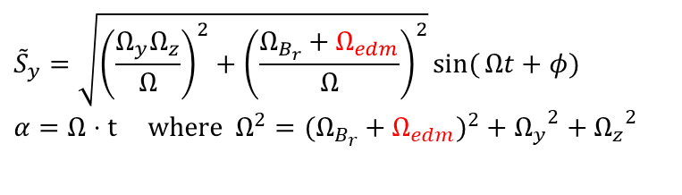
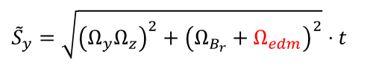
BNL: requirements to imperfections
first, the accuracy of the installation of magnets should be less than 10⁻⁹ meters (super unrealistic !!!);
second, the amplitude of depends on ,
At
and of the same order with we do not
know the value of .
$${\tilde{S}}_{y}=\sqrt{{\left(\frac{Ω_{y}Ω_{z}}{Ω}\right)}^{2}+{\left(\frac{Ω_{B_{r}}+Ω_{edm}}{Ω}\right)}^{2}}\sin{(}Ωt+φ) \\ α=Ω⋅\text{t} \text{where} Ω^{2}=(Ω_{B_{r}}+Ω_{edm})^{2}+{Ω_{y}}^{2}+{Ω_{z}}^{2}$$
$${\tilde{S}}_{y}=\sqrt{{\left(Ω_{y}Ω_{z}\right)}^{2}+{\left(Ω_{B_{r}}+Ω_{edm}\right)}^{2}}⋅t$$
$$Ω_{\text{edm}}$$

Slide 26
BNL: the geometric phase
the GEOMETRIC PHASE occurs when the invariant spin axis changes direction from element to element, and when the total angle of spin rotation in each of the planes
is zero, nevertheless after n-pairs of elements of one turn we have the non-zero MDM deviation:
This is an real fact!!!

Slide 27
BNL: criterion for minimizing the contribution of the geometric phase
Obviously, this contribution should be less than the EDM angle rotation per turn
that is
Thus, at n≈100 elements per one turn we must provide:
This is again super unreal!!!

Slide 28
BNL: how to restore conditions for a polarized beam at passing from CW to CCW
no reasonable ideas

Slide 29
Koop Wheel method: instead CW CCW split average trajectory in vertical plane Δ -Δ
The idea of measuring EDM by introducing a transverse coil and measuring the spin precession in the vertical plane was proposed in the wheel concept by I. Koop [[I A Koop 2015 Phys. Scr.2015 014034].
Ivan Koop proposes to install a transverse magnetic dipole and changing the polarity of the field in the dipole to use the separation of trajectories to calibrate the magnetic field in solenoid and try to measure the EDM.

Slide 30

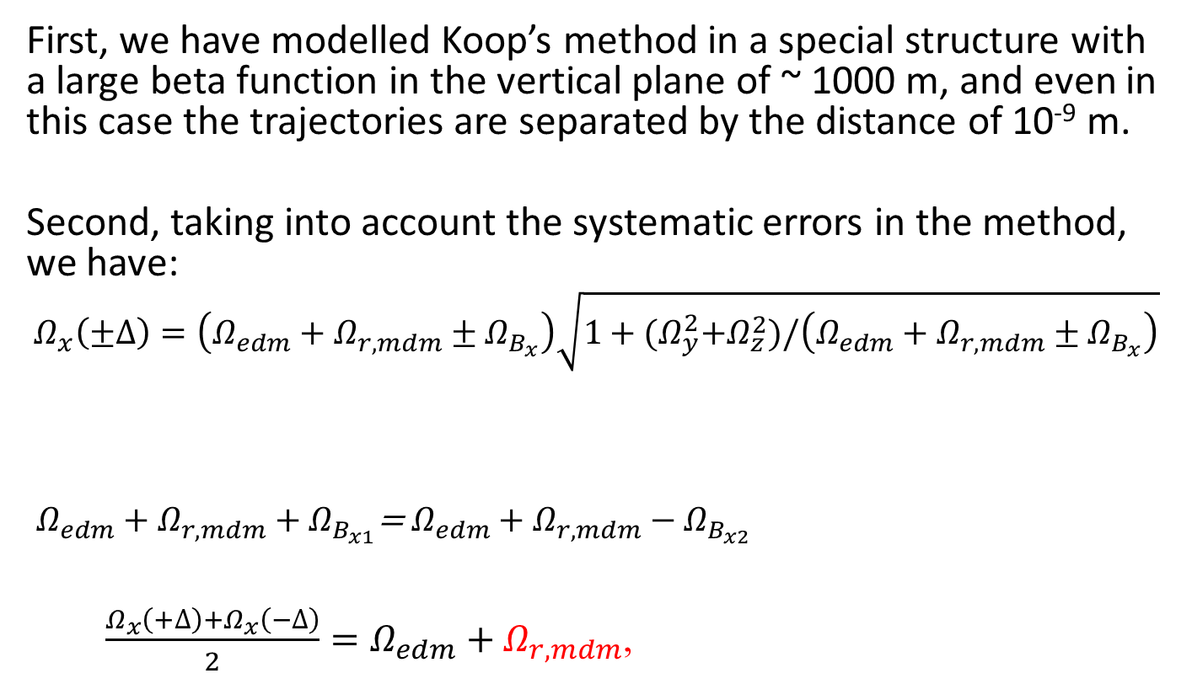
Koop Wheel Method: Systematic errors
First, we have modelled Koop’s method in a special structure with a large beta function in the vertical plane of ~ 1000 m, and even in this case the trajectories are separated by the distance of 10⁻⁹ m.
Second, taking into account the systematic errors in the method, we have:
$$Ω_{x}\left(±∆\right)=\left(Ω_{edm}+Ω_{r,mdm}±Ω_{B_{x}}\right)\sqrt{1+{(Ω}_{y}^{2}+Ω_{z}^{2})/\left(Ω_{edm}+Ω_{r,mdm}±Ω_{B_{x}}\right)}$$
$Ω_{edm}+Ω_{r,mdm}+Ω_{B_{x1}}$= $Ω_{edm}+Ω_{r,mdm}−Ω_{B_{x2}}$
$\frac{Ω_{x}\left(+∆\right)+Ω_{x}\left(−∆\right)}{2}=Ω_{edm}+Ω_{r,mdm}$,
$$Ω_{x}(Δ)=Ω_{x}(−Δ)$$

Slide 31
Koop Wheel Method: spin decoherence
The decoherence in the horizontal plane becomes almost zero, but simultaneously the spin decoherence arises in the vertical plane, where we are going to measure EDM, and it plays the major role.

Slide 32
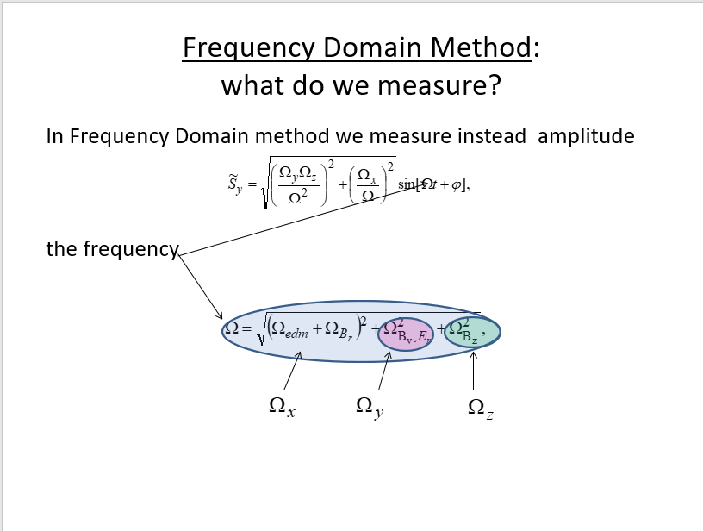

Slide 33
Frequency Domain Method: systematic errors
Let us to consider the case when in
We can not realize relation ,
but we can
we have so called 2D frozen spin option:

Slide 34
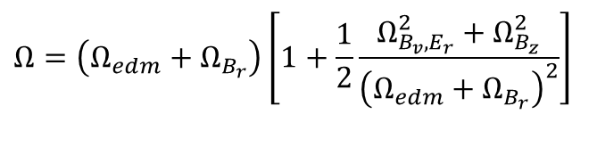


Frequency Domain Method: basic relationships
finally
Main idea:
to make the contribution from EDM frequency into the total frequency $Ω_{edm}+Ω_{B_{r}}$ bigger than from MDM additions
$$Ω=\left(Ω_{edm}+Ω_{B_{r}}\right)\left[1+\frac{1}{2}\frac{Ω_{B_{v},E_{r}}^{2}+Ω_{B_{z}}^{2}}{{\left(Ω_{edm}+Ω_{B_{r}}\right)}^{2}}\right]$$
$$Ω_{edm}>\frac{1}{2}\frac{Ω_{B_{v},E_{r}}^{2}+Ω_{B_{z}}^{2}}{Ω_{edm}+Ω_{B_{r}}}$$

Slide 35
Frequency Domain Method: 2D frozen spin
Thus, we do not require 3D frozen spin when all three
frequencies close to zero:
Now we realize 2D frozen spin with simple condition:
Having the frequency ~50÷100 rad/sec in the vertical plane
and making the frequencies and in other planes
much smaller ~10⁻³ rad/sec we realize conditions, when the
contribution of other frequencies is less than the contribution
of the expected EDM frequency in the vertical frequency.

Slide 36
Frequency Domain Method: geometric phase
Making frequencies and up to the value of ~ 10⁻³ rad/sec
(six orders higher of EDM) it does not mean we need to know
them precisely for both CW and CCW.
In Frequency Domain Method there is no problem of the geometric
phase, since the spin oscillates around the invariant spin axis
under the above condition, and the contribution from frequencies of
other planes is less than the EDM frequency.
During a revolution, the invariant axis does not jump, as in the BNL
variant, but is oriented all the time along the horizontal direction
with a kind of jitter, which on average gives zero contribution.

Slide 37

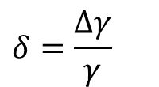
Effective gamma
Equation of Longitudinal motion:
$$\frac{dφ}{dt}=−ω_{rf}\left[\left(α_{0}−\frac{1}{γ^{2}}\right)⋅δ+\left(α_{1}−\frac{α_{0}}{γ^{2}}+\frac{1}{γ^{4}}\right)⋅δ^{2}+{\left(\frac{ΔL}{L}\right)}_{β}\right] \\ \frac{dδ}{dt}=\frac{eV_{rf}ω_{rf}}{2πhβ^{2}E}φ$$
$$δ=\frac{Δγ}{γ}$$
Nonlinear
Z motion
Betatron
motion

Slide 38
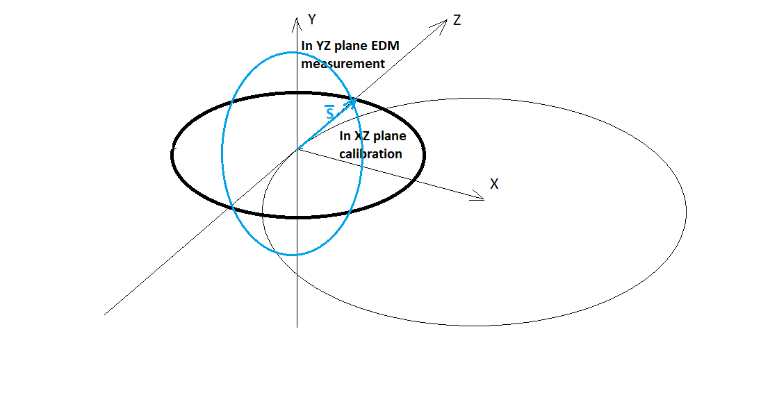
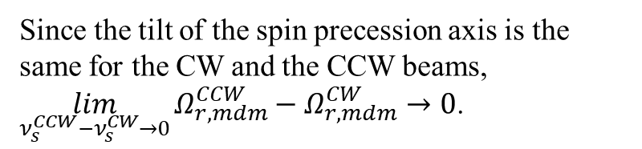
Frequency Domain method: calibration of effective gamma
The second part of FDM strategy is when we calibrate the effective gamma by measuring the spin precession frequency in the horizontal plane, where there is no EDM, and we have the precession frequency of the spin in the horizontal plane much larger than the frequencies in other planes, that is the invariant spin axis coincides with the vertical axis, and we exclude the influence of frequencies in other planes on the calibration in the horizontal plane
Since the tilt of the spin precession axis is the same for the CW and the CCW beams, $\lim_{ν_{s}^{CCW}−ν_{s}^{CW}→0}{Ω_{r,mdm}^{CCW}−Ω_{r,mdm}^{CW}}→0$.

Slide 39
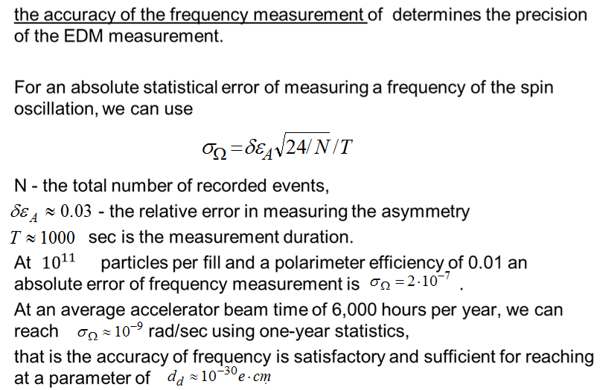
EDM measurement precision

Slide 40
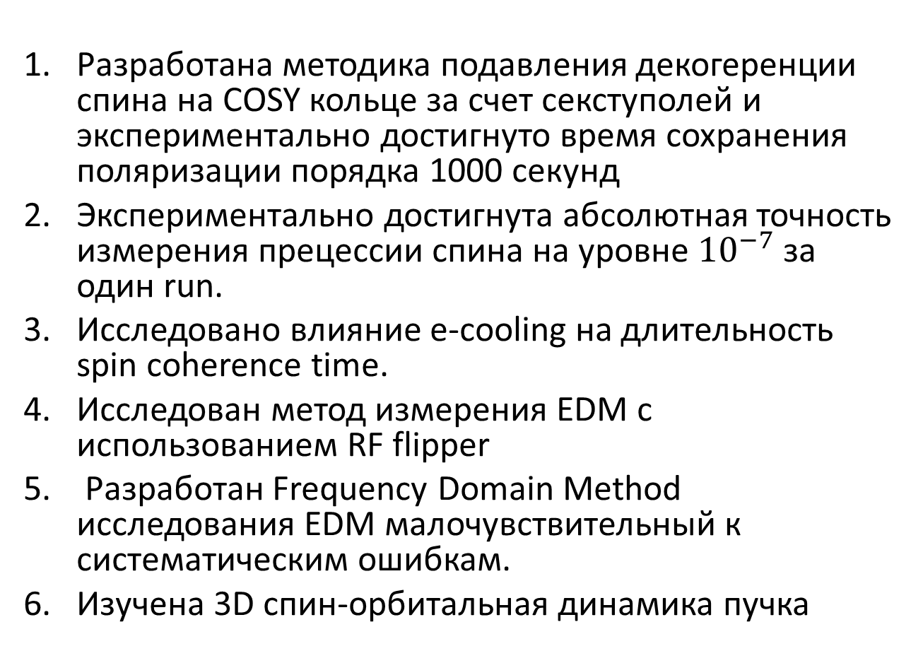
Что уже сделано на данный момент?
Разработана методика подавления декогеренции спина на COSY кольце за счет секступолей и экспериментально достигнуто время сохранения поляризации порядка 1000 секунд
Экспериментально достигнута абсолютная точность измерения прецессии спина на уровне ${10}^{−7}$ за один run.
Исследовано влияние e-cooling на длительность spin coherence time.
Исследован метод измерения EDM с использованием RF flipper
Разработан Frequency Domain Method исследования EDM малочувствительный к систематическим ошибкам.
Изучена 3D спин-орбитальная динамика пучка

Slide 41
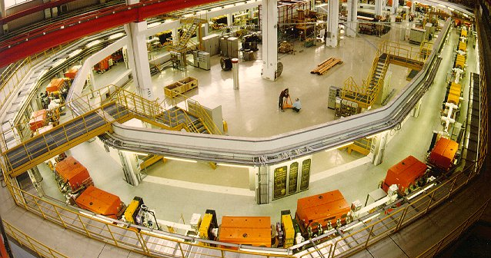
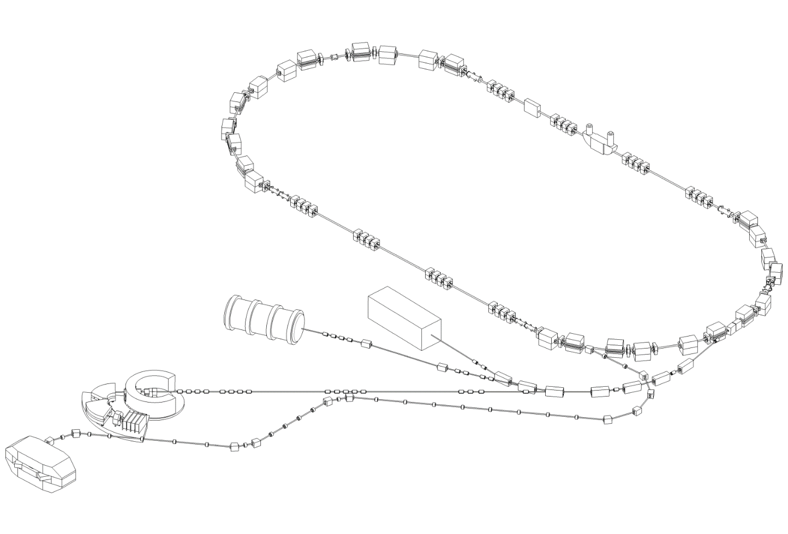
Cooler Synchrotron COSY
in Jülich
RF Devices for
Spin Manipulations
Sextupole magnets
Electron Cooler
EDDA Polarimeter
Momentum up to 3.5 GeV/c
Polarized Protons / Deuterons
Circumference 184 m

Slide 42
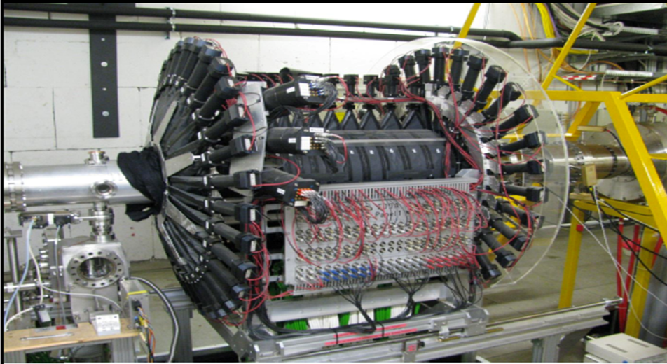
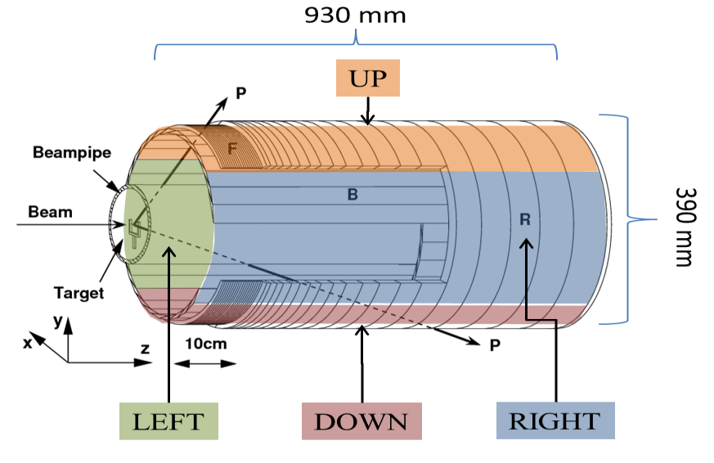
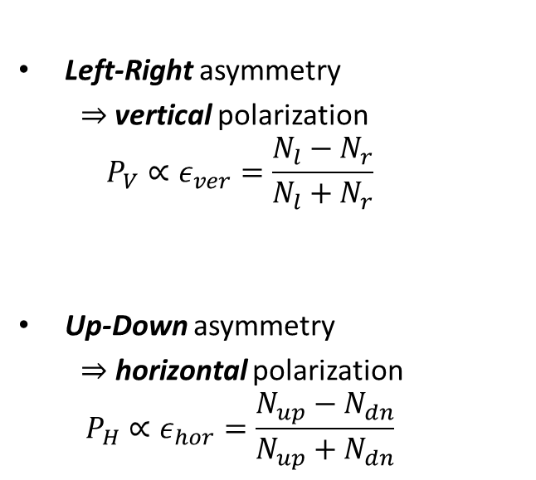
EDDA Polarimeter
Left-Right asymmetry
  $⇒$vertical polarization
  $$P_{V}∝ε_{ver}=\frac{N_{l}−N_{r}}{N_{l}+N_{r}}$$
Up-Down asymmetry
  $⇒$ horizontal polarization
  $$P_{H}∝ε_{hor}=\frac{N_{up}−N_{dn}}{N_{up}+N_{dn}}$$

Slide 43
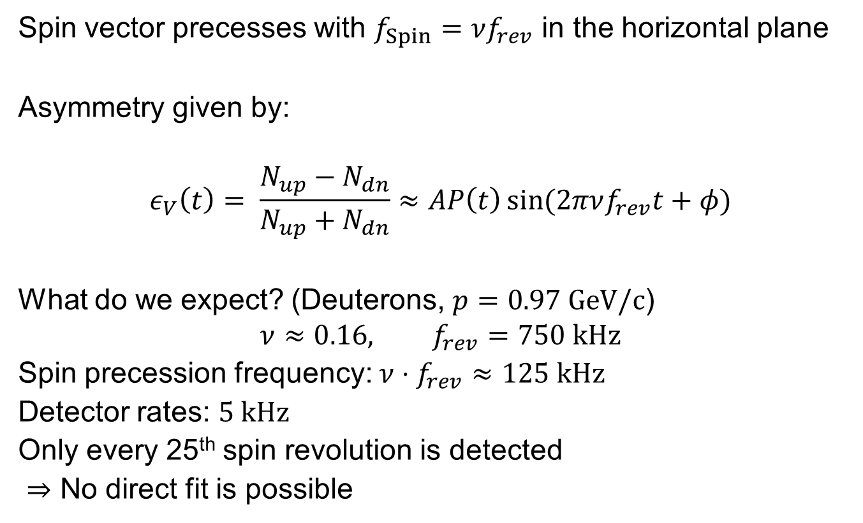
Spin Tune Measurement
Spin vector precesses with $f_{Spin}=νf_{rev}$ in the horizontal plane
Asymmetry given by:
$$ε_{V}\left(t\right)= \frac{N_{up}−N_{dn}}{N_{up}+N_{dn}}≈AP\left(t\right)\sin{(2πνf_{rev}t+φ)}$$
What do we expect? (Deuterons, $p=0.97 \text{GeV}\text{/}\text{c}$)
$$ν≈0.16, f_{rev}=750 kHz$$
Spin precession frequency: $ν⋅f_{rev}≈125 \text{kHz}$
Detector rates: $5 \text{kHz}$
Only every 25th spin revolution is detected
$⇒$ No direct fit is possible

Slide 44
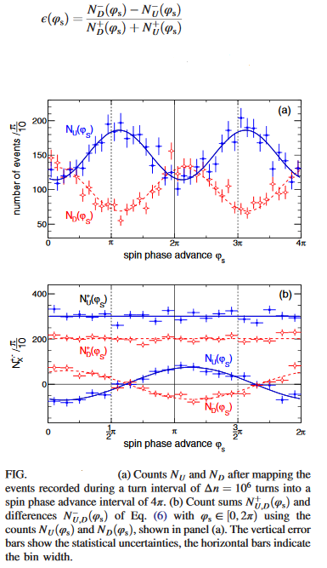
Measurement of polarization asymmetry
An rf solenoid-induced spin resonance was employed to rotate the spin by 90° from the initial vertical direction into the transverse horizontal direction. Subsequently, the beam was slowly extracted onto an internal carbon target using a white noise electric field applied to a stripline unit. Scattered deuterons were detected in scintillation detectors, consisting of rings and bars around the beam pipe[, and their energy deposit was measured by stopping them in the outer scintillator rings. The event arrival times, with respect to the beginning of each cycle and the frequency of the COSY rf cavity, were recorded in one long-range time-to digital converter; i.e.,the same reference clock was used for all signals.

Slide 45
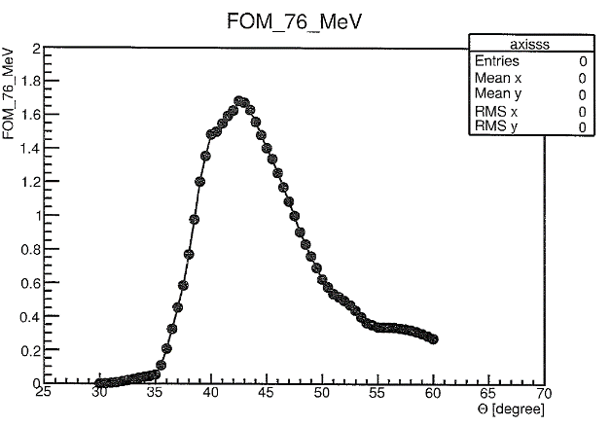
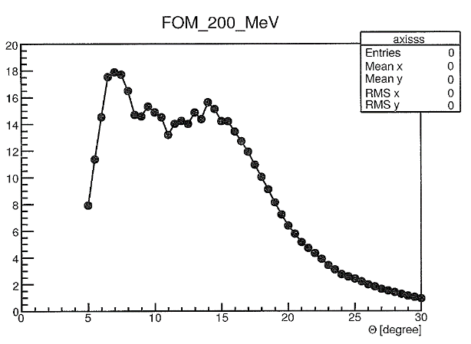
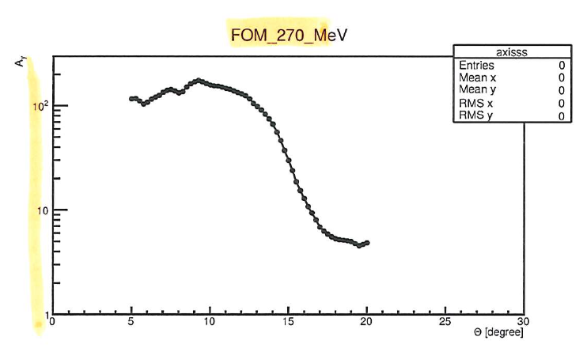
Figure Of Merit vs Energy: choice of energy
76 MeV 200 MeV 270 Mev

Slide 46
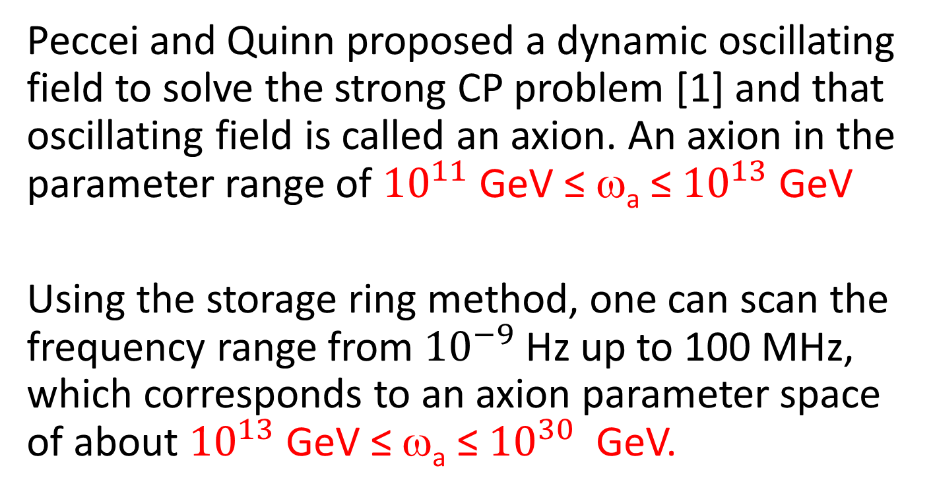
Axion
Peccei and Quinn proposed a dynamic oscillating field to solve the strong CP problem [1] and that oscillating field is called an axion. An axion in the parameter range of ${10}^{11}$ GeV ≤ ω_{a} ≤ ${10}^{13}$ GeV
Using the storage ring method, one can scan the frequency range from ${10}^{−9}$Hz up to 100 MHz, which corresponds to an axion parameter space of about ${10}^{13}$ GeV ≤ ω_{a} ≤ ${10}^{30}$ GeV.

Slide 47
Search for AXION dark matter at NICA (K.Nikolaev ITP Landau)
Peccei-Quinn (pseudogoldstone) axions solve the strong-CP problem
Relic very light axions as a credible candidate for dark matter
Extensive serch for axions in dozen expts worlwide
Galactic axion field generates oscillating EDM and pseudomagnetic oscillating solenoidal field in the storage ring (Silenko 2021)
Axion oscillation frequency ω_{a}=m_{a}c²
Scan spin precession frequency ramping magnetic field in the ring until hitting the axion frequency (with good luck!): the axion signal is a sudden resonance (Froissart-Stora) rotation of vertical polarization towards horizontal one
Detect the buildup of precessing horizontal polarization at SPD by the JEDI time stamp technique via azimuthal asymmetry of elastic scattering in the internal carbon target in SPD
The beam halo is brought into interaction with the target heating the beam
Detuned quasi-frozen spin regime gives access to very small axion masses
No demand for any extra equipment beyond the internal target in SPD and heating the beam: just keep ramping the beam energy as much as possible

Slide 48


