Slide 1
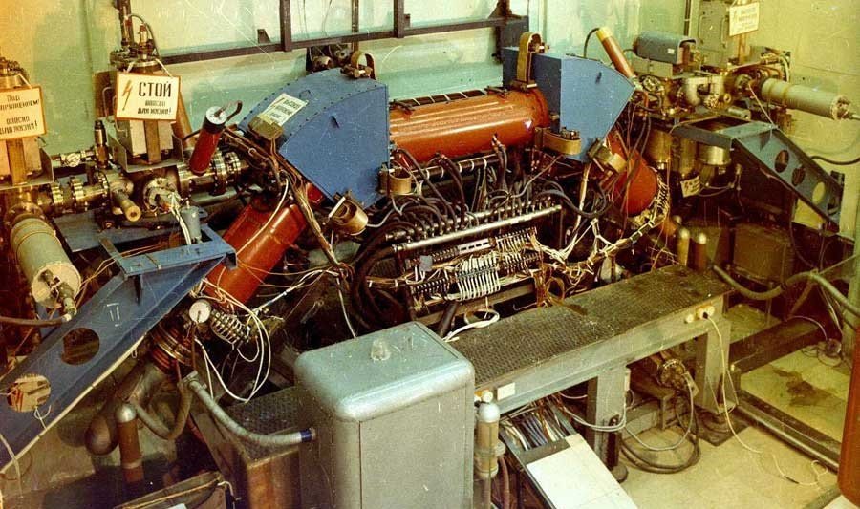
Development of the Electron Cooling System for NICA Collider
Bryzgunov Maxim
on behalf of BINP Electron Cooling team

Slide 2
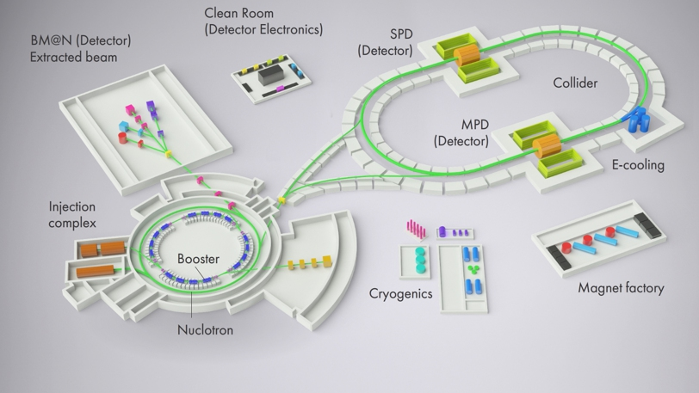
High voltage electron cooling in the NICA collider
HV electron cooler
Electron cooling system for NICA booster
(In September of 2021 first cooling was achieved!)
In the collider two cooling systems (electron and stochastic) will work both during beam accumulation and during experiment.

Slide 3
First electron cooling experience in collider
From: A. Fedotov et al., Operational Electron Cooling in RHIC, IPAC’21, Brazil, May 24-28, 2021
Electron cooler LEReC operated for RHIC physics program using 1.6 MeV kinetic energy electron beam to cool Au ions at 3.85 GeV/nucleon total energy and using 2 MeV electron beam to cool ions at 4.6 GeV/nucleon.

Slide 4
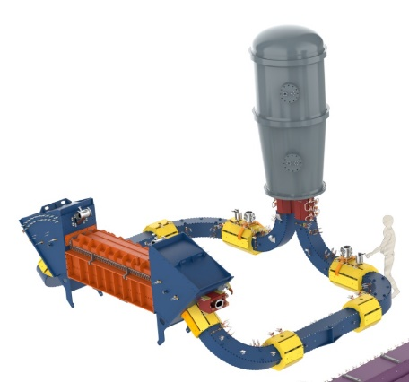
High voltage electron cooling in the NICA collider
The construction is based on HV ECS for COSY (Germany)
The HV ECS for NICA consists of two almost independent coolers. Scheme with one electron beam looks very complicated
COSY HV cooler
Electron energy | 0.2 - 2.5 MeV
Energy stability (ΔU/U) | <10⁻⁴
Electron current | 0.1 - 1 A
Cooling section length | 6 m
Magnetic field in cooling section | 0.5 - 2 kG
Vacuum | 10⁻¹¹ mbar
Main problems:
High energy (up to 2.5 MeV);
Small distance between beams (320 mm);
Limited power consumption of the system (not more then 700 kW).

Slide 5
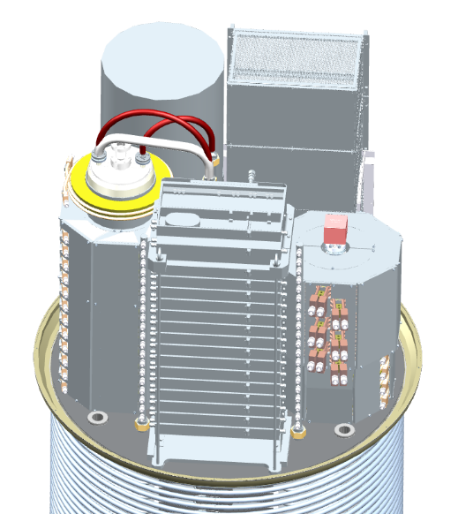
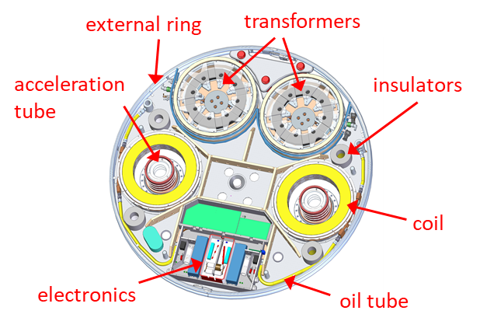
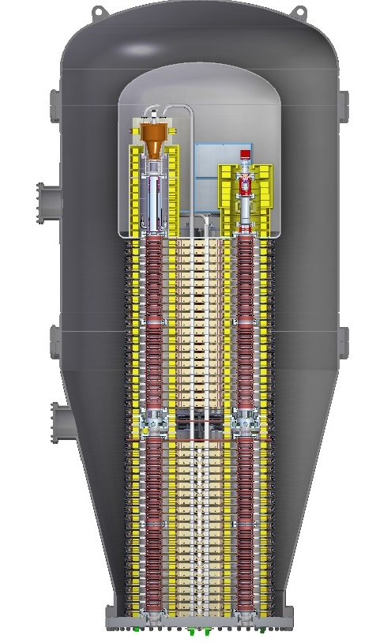
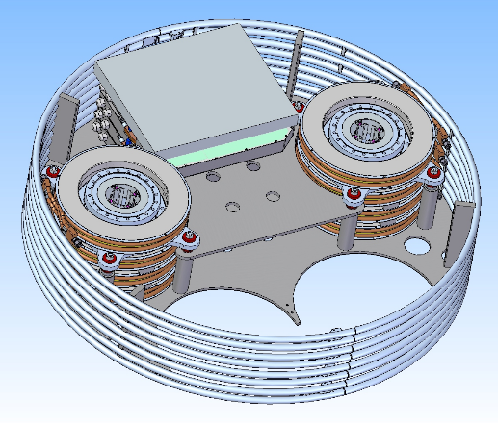
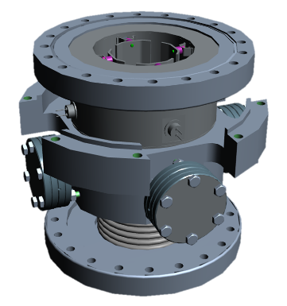
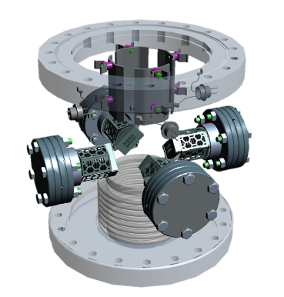
High voltage system
Purpose of the high voltage system is production of electron beam in electron gun and acceleration for working energy in electrostatic tube. After interaction with ion beam electrons flies to high voltage again where they are decelerated in another electrostatic tube and dumped in electron collector.
vessel
collector PS
control electronics
HV terminal
collector
collector
solenoid
gun
gun
solenoid
HV column
magnet PS
middle section
bottom flange

Slide 6
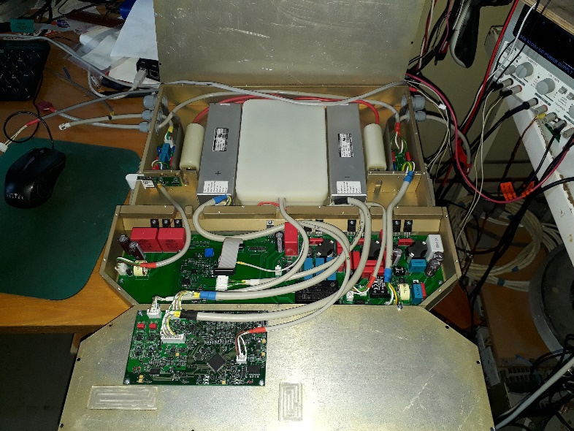
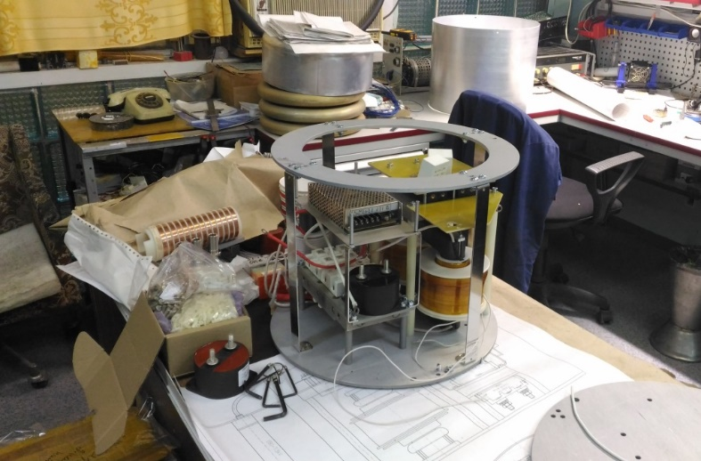
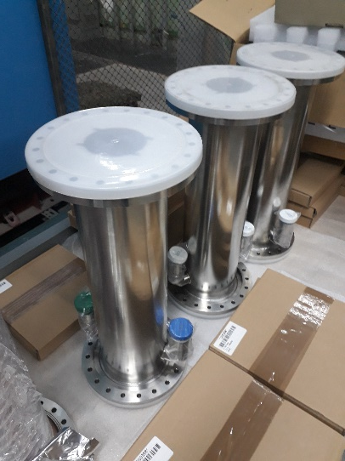
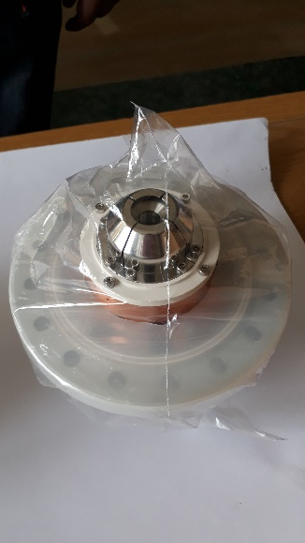
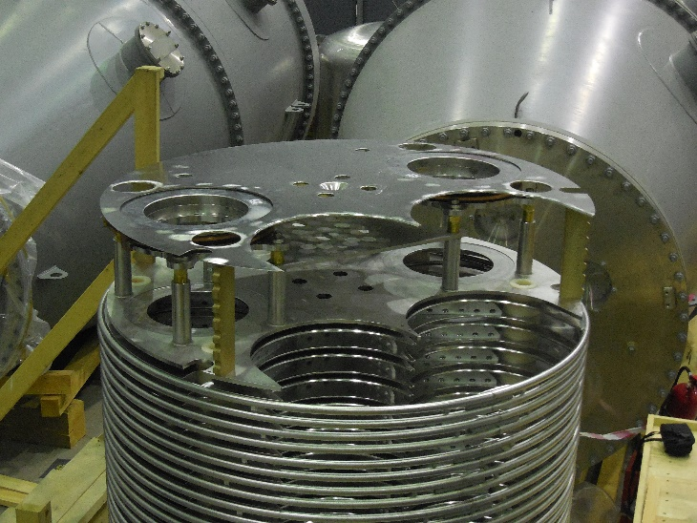
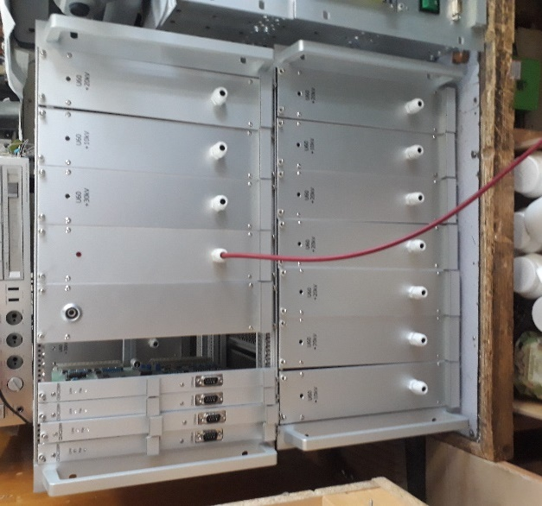
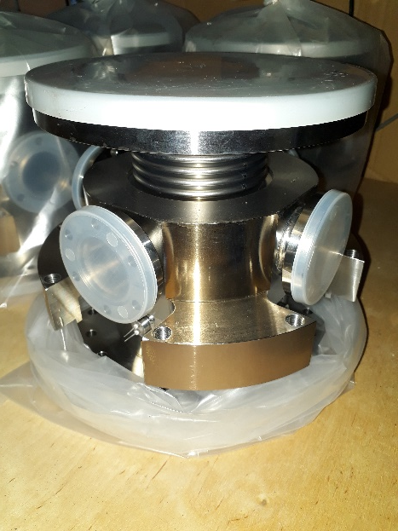
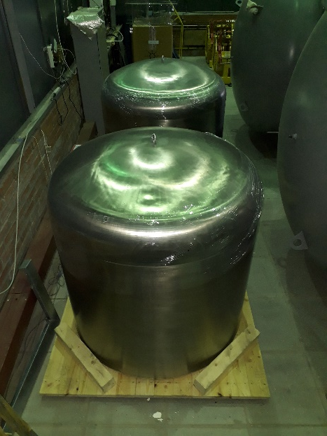
High voltage system production
Collector PS
Electron gun
High voltage section
Wien filters
High voltage column
Middle section
High voltage terminal
Gun-collector control electronics

Slide 7
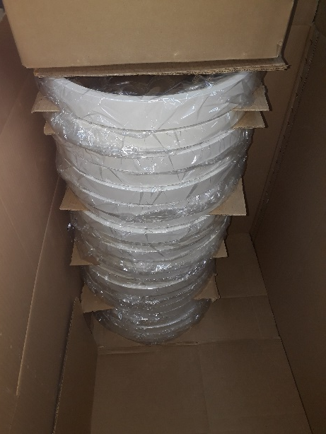
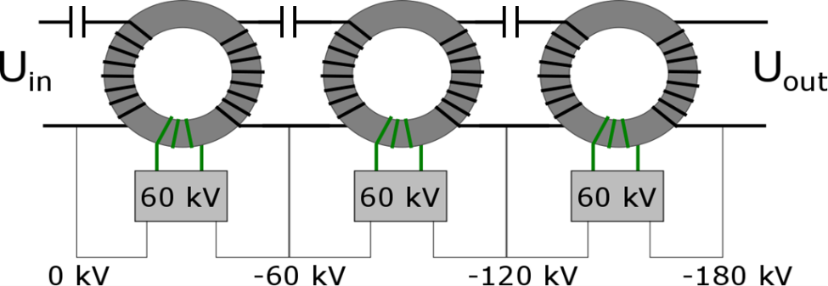
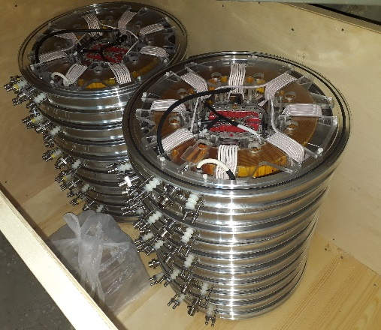
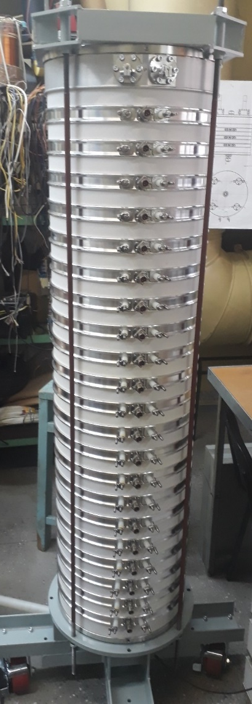
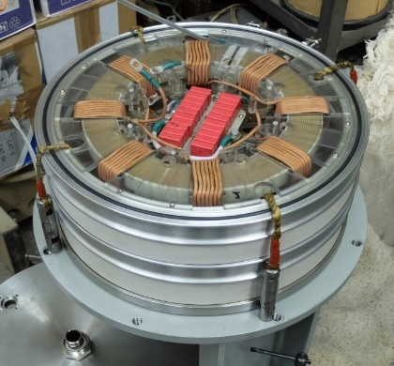
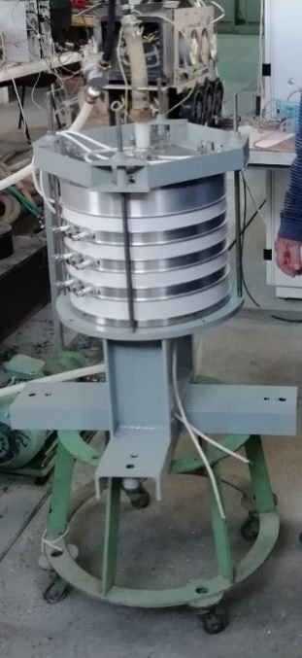
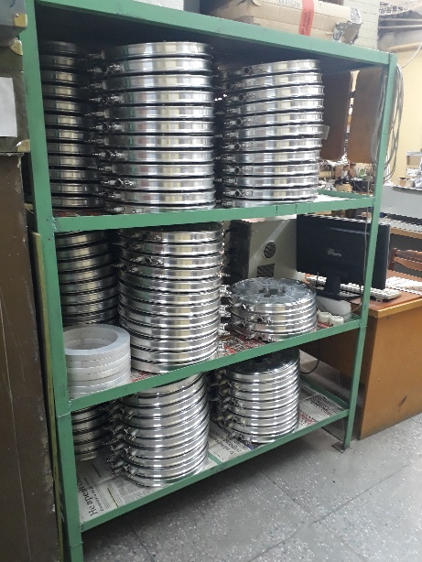
Cascade transformer
Power transfer

Slide 8
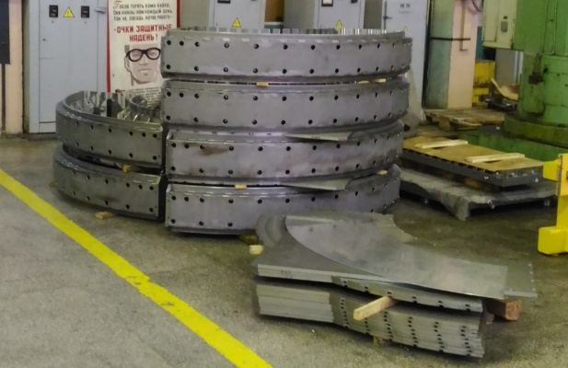
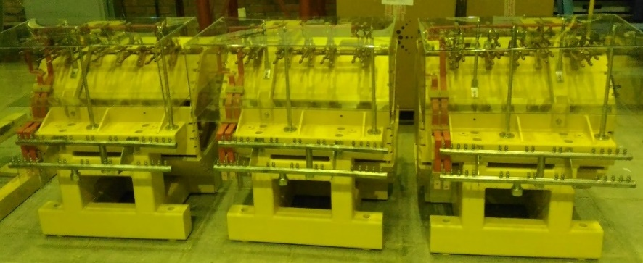
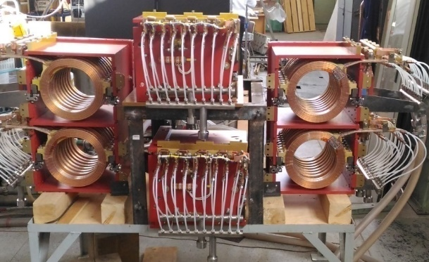
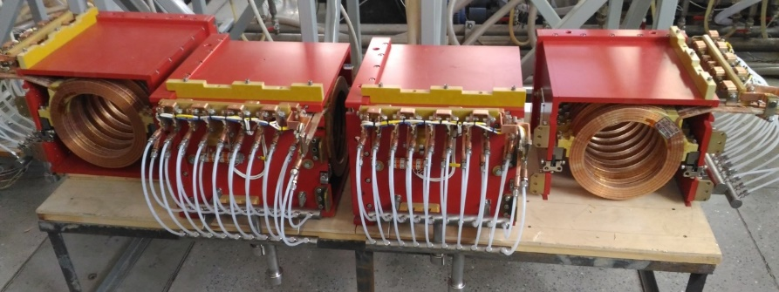
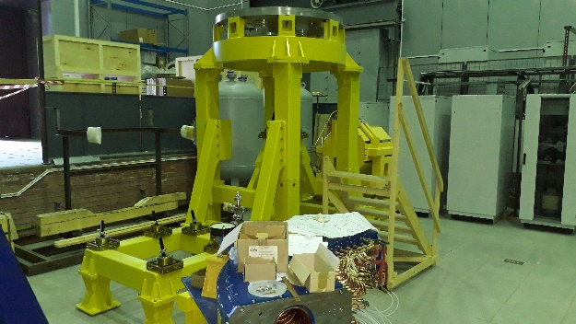
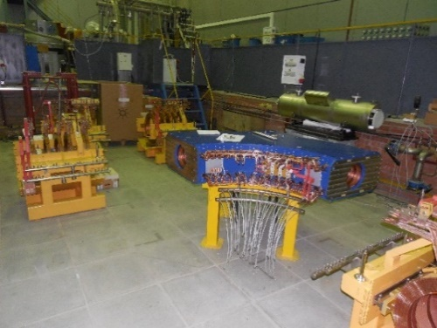
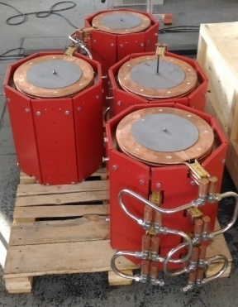
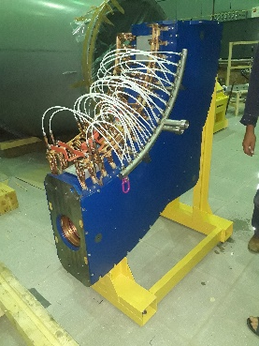
Magnetic system
Electrons move on whole trajectory from gun to collector in longitudinal magnetic field. Transport channels consist of set of straight and bend solenoids.

Slide 9
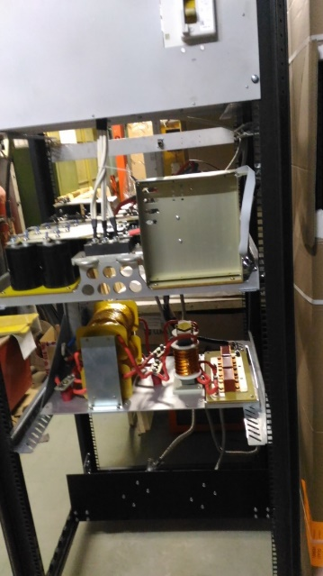
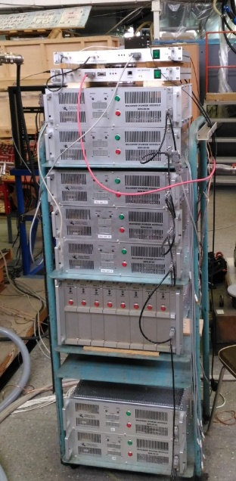
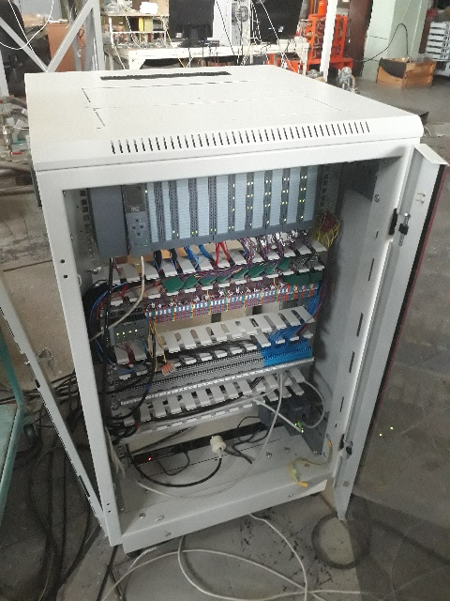
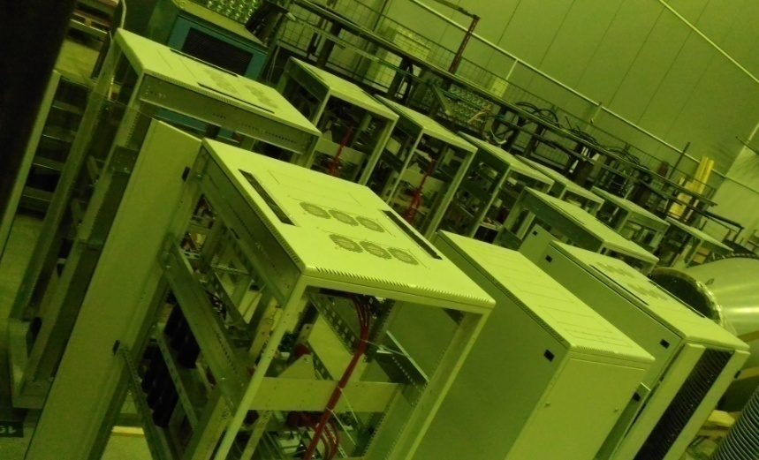
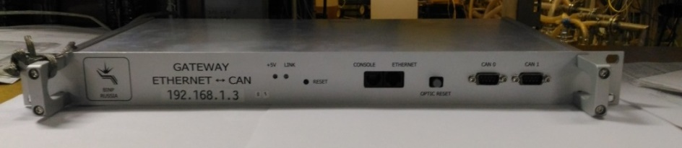
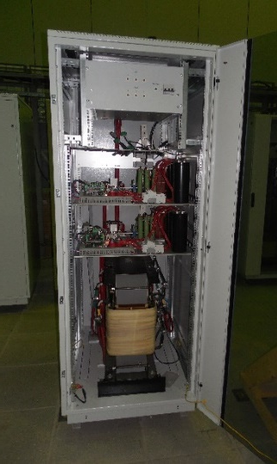
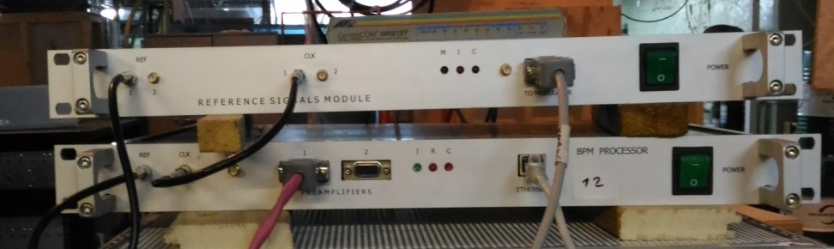
Electronics
The ECS contains several systems:
Interlock system
PS for cascade transformer
Corrector magnet PS (MPS-6 and MPS-20)
High current magnet PS (IST)
Ethernet-CAN gateway
BPM electronics
1
2
3
4
4
5
6

Slide 10
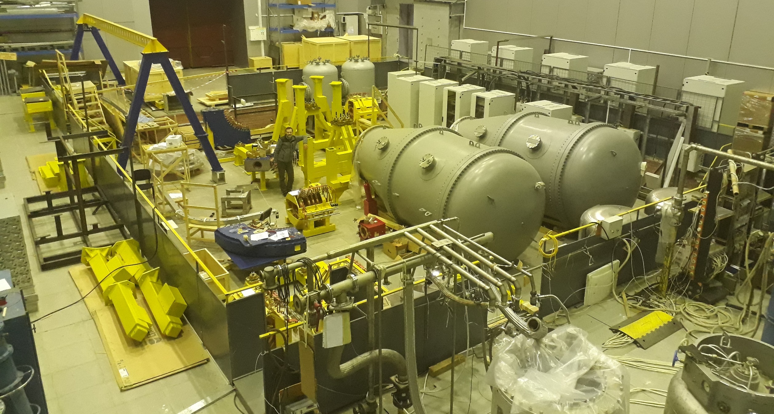
Hall for ECS commissioning in the BINP

Slide 11
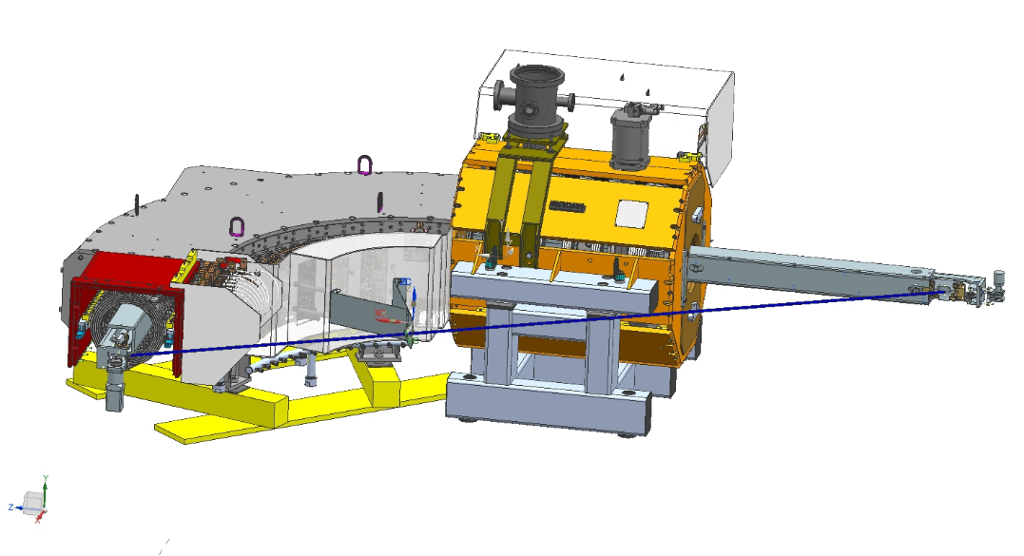
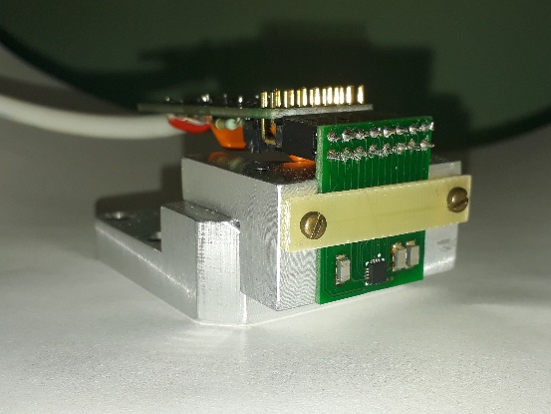
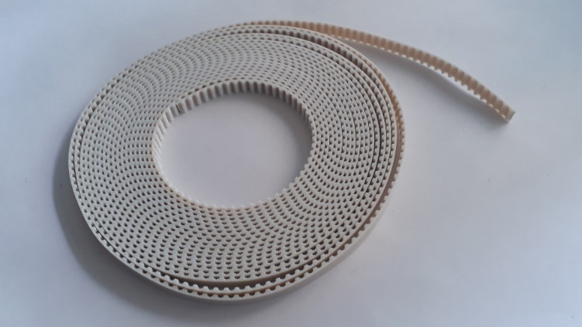
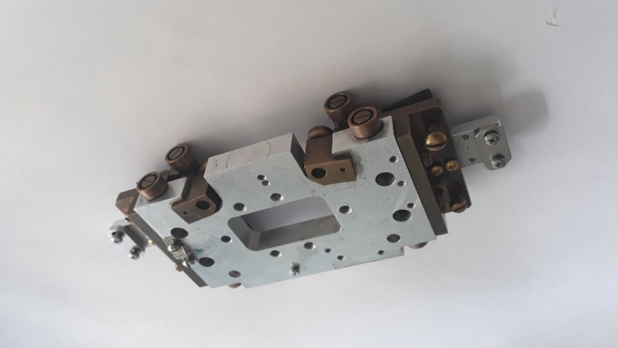
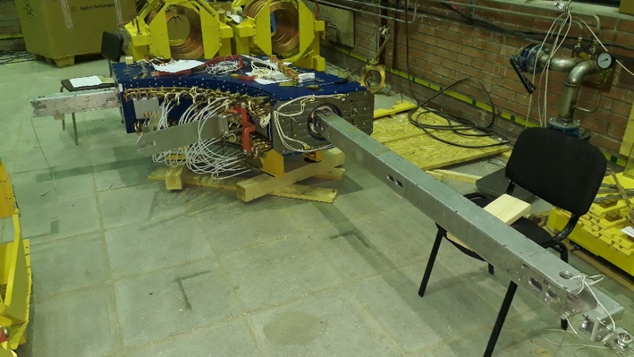
Magnetic measurements (Hall)
Hall probe measurement system contains set of straight and bent rails, which can be assembled n different way in order to measure magnetic filed distribution in different parts of the cooler.
3-D Hall probe
Tape
Carriage for Hall probe
The rail in 90-degree solenoid

Slide 12
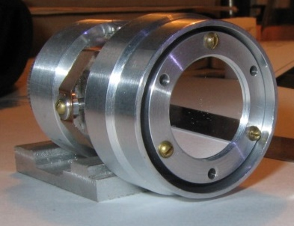
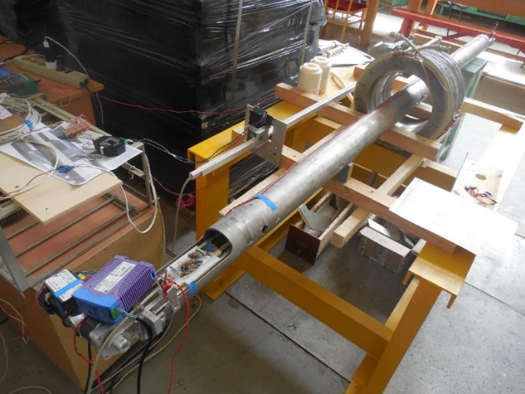
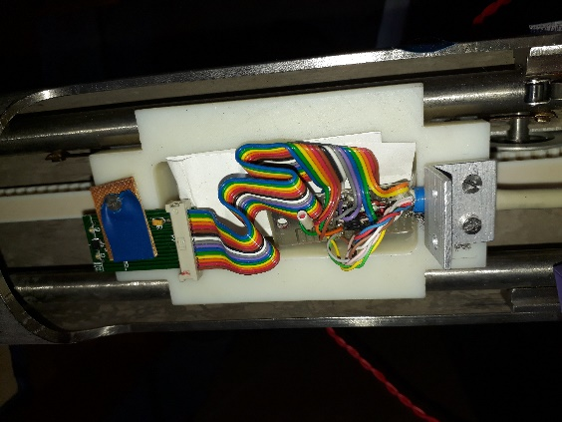
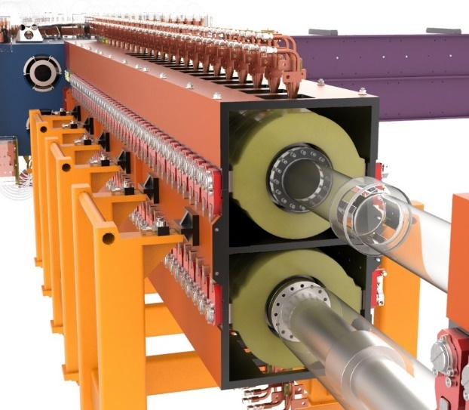
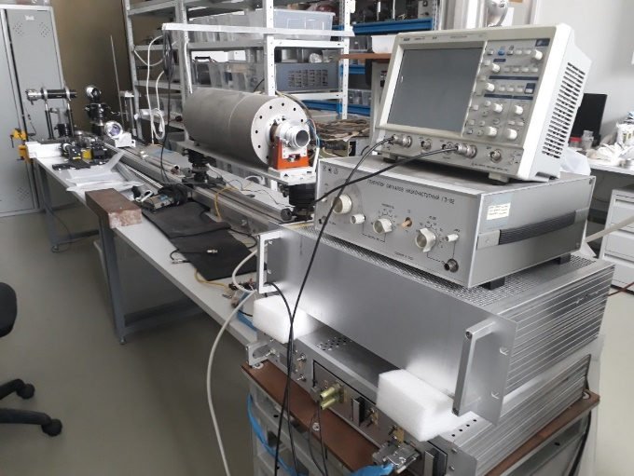
Magnetic measurements (compass)
Compass sensor provides high precision measurements of magnetic line straightness.
Scheme of compass measurements

Slide 13





“Gun-collector” test bench
The test bench is assembled to test new electron gun. Its diagnostic node contains BPM and wire profile monitor and provides measurements both profile and temperature of the electron beam.
With the help of the wire profile monitor one can measure both current from the wire with ADC and wire glow (induced by beam) with CCD camera
diagnostic node
collector
gun
Current measurement
Camera measurement

Slide 14

Thankyou for your attention!

Slide 17


Slide 18








Electron cooling
Electron collector
Electron gun
solenoid
Uncooled
ion beam
Cooled
ion beam
Cooling section
circulating ion beam
“cool” electron beam

Slide 19
High voltage electron cooling in the NICA collider
HV electron cooler
Parameters of the NICA collider
Parameter | Value
Number of bunches | 22
RMS length of a bunch, m | 0.6 m
β-function at the IP, m | 0.6 m
Energy Au⁷⁹⁺, GeV / n | 1.0 | 3.3 | 4.5
Number of ions in the bunch | 2·10⁸ | 2.4·10⁹ | 2.3·10⁹
RMS momentum spread, Δp/p | 0.6·10⁻³ | 1.2·10⁻³ | 1.6·10⁻³
RMS emittance, π·mm·mrad | 1.10/1.1 | 1.10/0.9 | 1.10/0.8
Time of growth due IBS, s | 160 | 530 | 1700
Luminosity, cm⁻² ·с⁻¹ | 0.6·10²⁵ | 1.0·10²⁷ | 1.0·10²⁷
Electron cooling system for NICA booster
(In September of 2021 first cooling was achieved!)
Two cooling systems (electron and stochastic) will work both during beam accumulation and during experiment.

