Slide 1
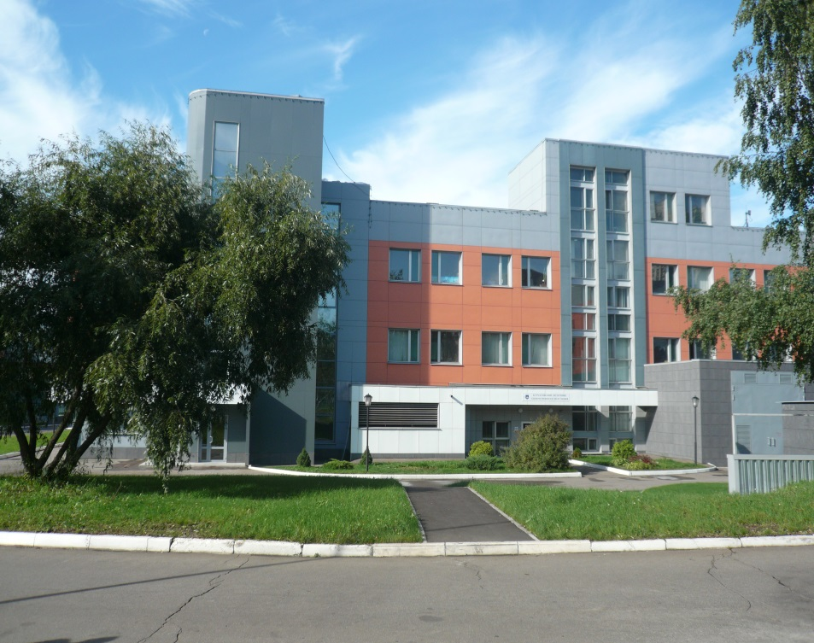
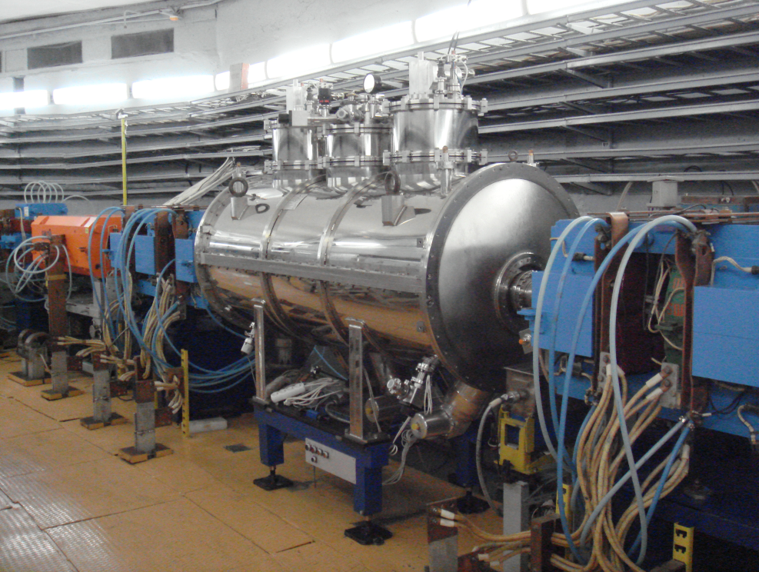
Status of Kurchatov Synchrotron Radiation Source
A.Valentinov, A.Belkov, Y.Fomin, E.Kaportsev, V.Korchuganov, Yu.Krylov, V.Moiseev, K.Moseev, N.Moseiko, D.Odintsov, S. Pesterev, A.Smygacheva, A. Stirin, V. Ushakov
NRC Kurchatov Institute RUPAC-2021, 30 September 2021
Notes:
1

Slide 2
Content:
KSRS operation
2. Federal Program for KSRS modernization (Program1) 2013 – 2022
maintenance of existing accelerators
modernization of its subsystems
3. Federal Program for Scientific Infrastructure Development (Program2) 2020 – 2027
new low-emittance SR source
Notes:
2
2

Slide 3
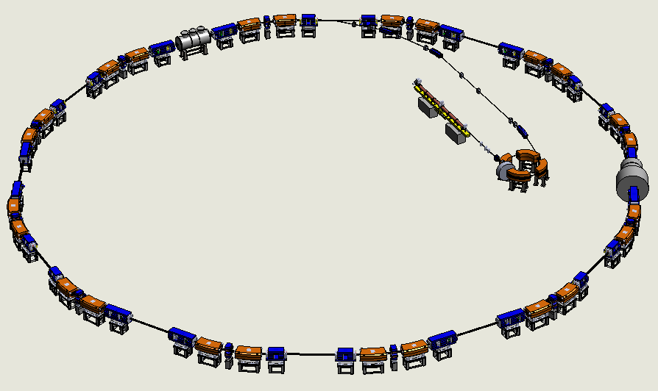
KSRS
3 electron accelerators:
LINAC
80 MeV LINAC
450 MeV storage ring SIBERIA-1
2.5 GeV storage ring SIBERIA-2
SIBERIA-1
SIBERIA-2
14 experimental stations (SIBERIA-2)
Experiments in physics, chemistry, biology, medicine, nanotechnologies and many more…
Notes:
3
3

Slide 4
Accelerator parameters
 | SIBERIA-1 | SIBERIA-2
Energy, GeV | 0.45 | 2.5
Circumference, m | 8.68 | 124.13
Horizontal. emittance, nm·rad | 860 | 98
Energy spread, σE/E | 3.8·10⁻⁴ | 9.54·10⁻⁴
Electron current, mA | up to 200 | up to 150
Lifetime, hours (at 100 mA) | 1.1 | up to 20
SR power, kW (at 100 mA) | 0.36 | 68.5
Time for users per year, hours | - | 2700 – 3000
Consumed electric power at working energy, MW | 0.4 | 2.5
Notes:
4
4

Slide 5
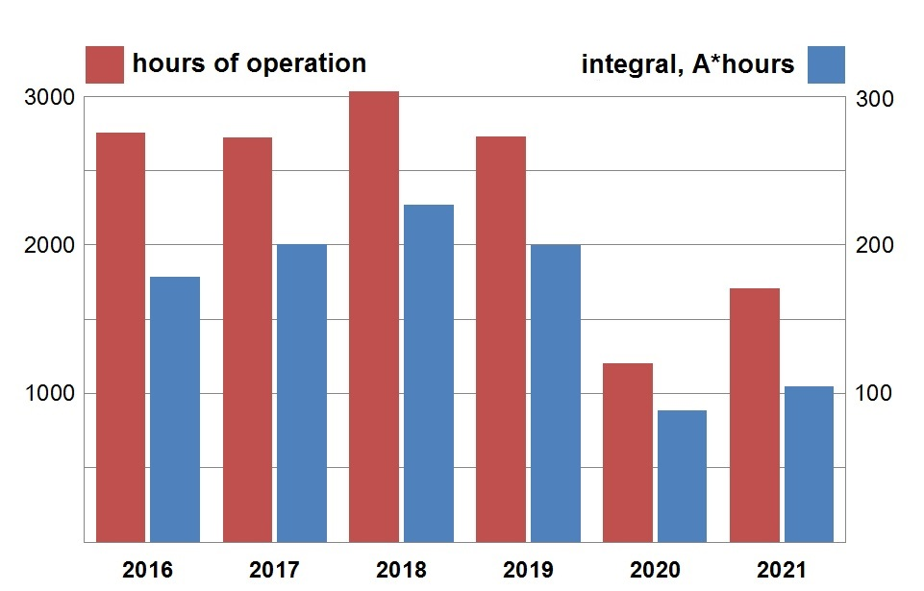
KSRS operation in 2016 - 2021
Sept
Notes:
5
5

Slide 6
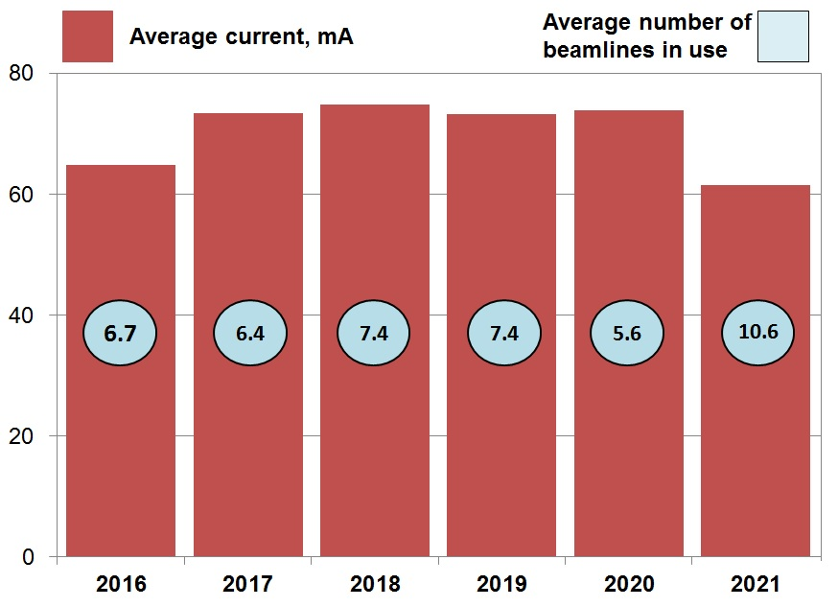
KSRS operation in 2016 - 2021
6.7
6.4
7.4
7.4
5.6
10.6
Notes:
6
6

Slide 7
Federal Program for KSRS modernization
RF system
Vacuum system
3. Superconducting wigglers
4. Control system
General contractor – FINPROMATOM
1 – 3: Budker Institute of Nuclear Physics
1: Triada
2: Intech, BEMZ
4: RTSoft, Marathon, I-Tech
Notes:
7
7

Slide 8
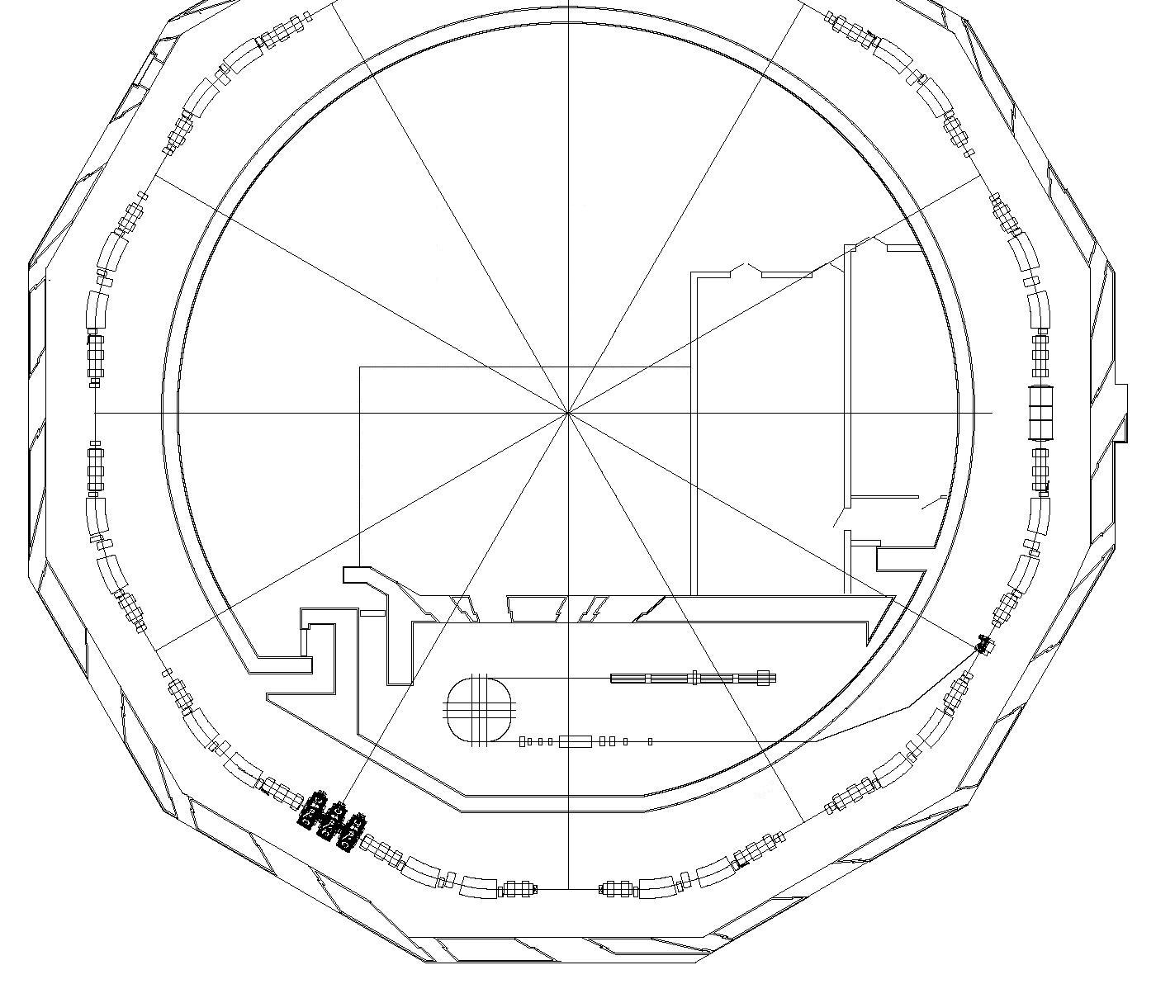
Future scheme of RF system
New RF generator №3
New power supply racks
All new RF equipment were already produced and tested in BINP !
New waveguides
Two existing RF generators
RF cavities
New control racks
Notes:
8
8

Slide 9
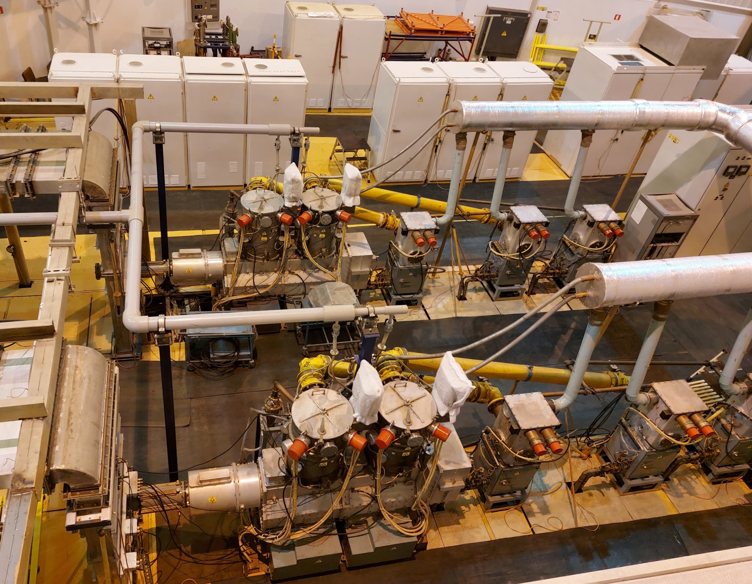
RF system – future 3rd 181 MHz generator
Output amplification cascade
waveguide
Notes:
9
9

Slide 10
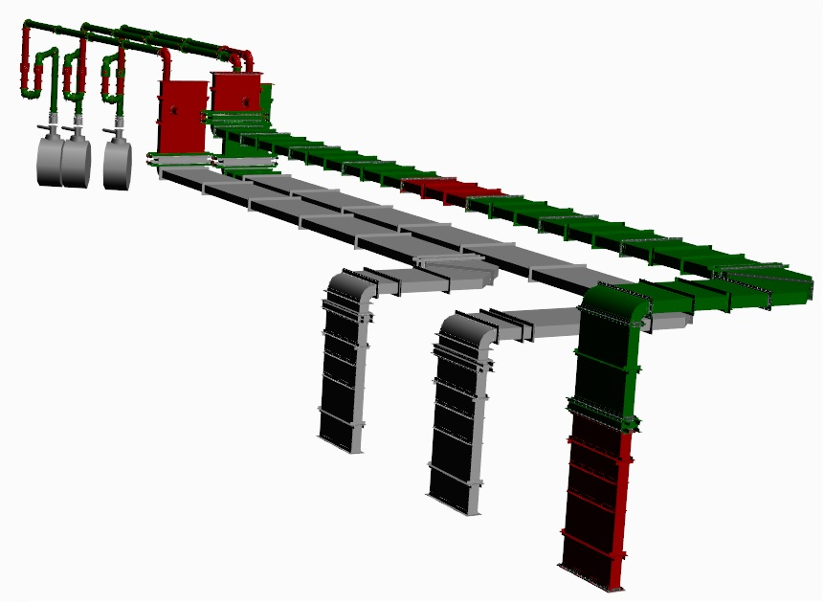
RF system – new waveguides
New waveguides (red & green)
181 MHz cavities
Two old waveguides (grey)

Slide 11
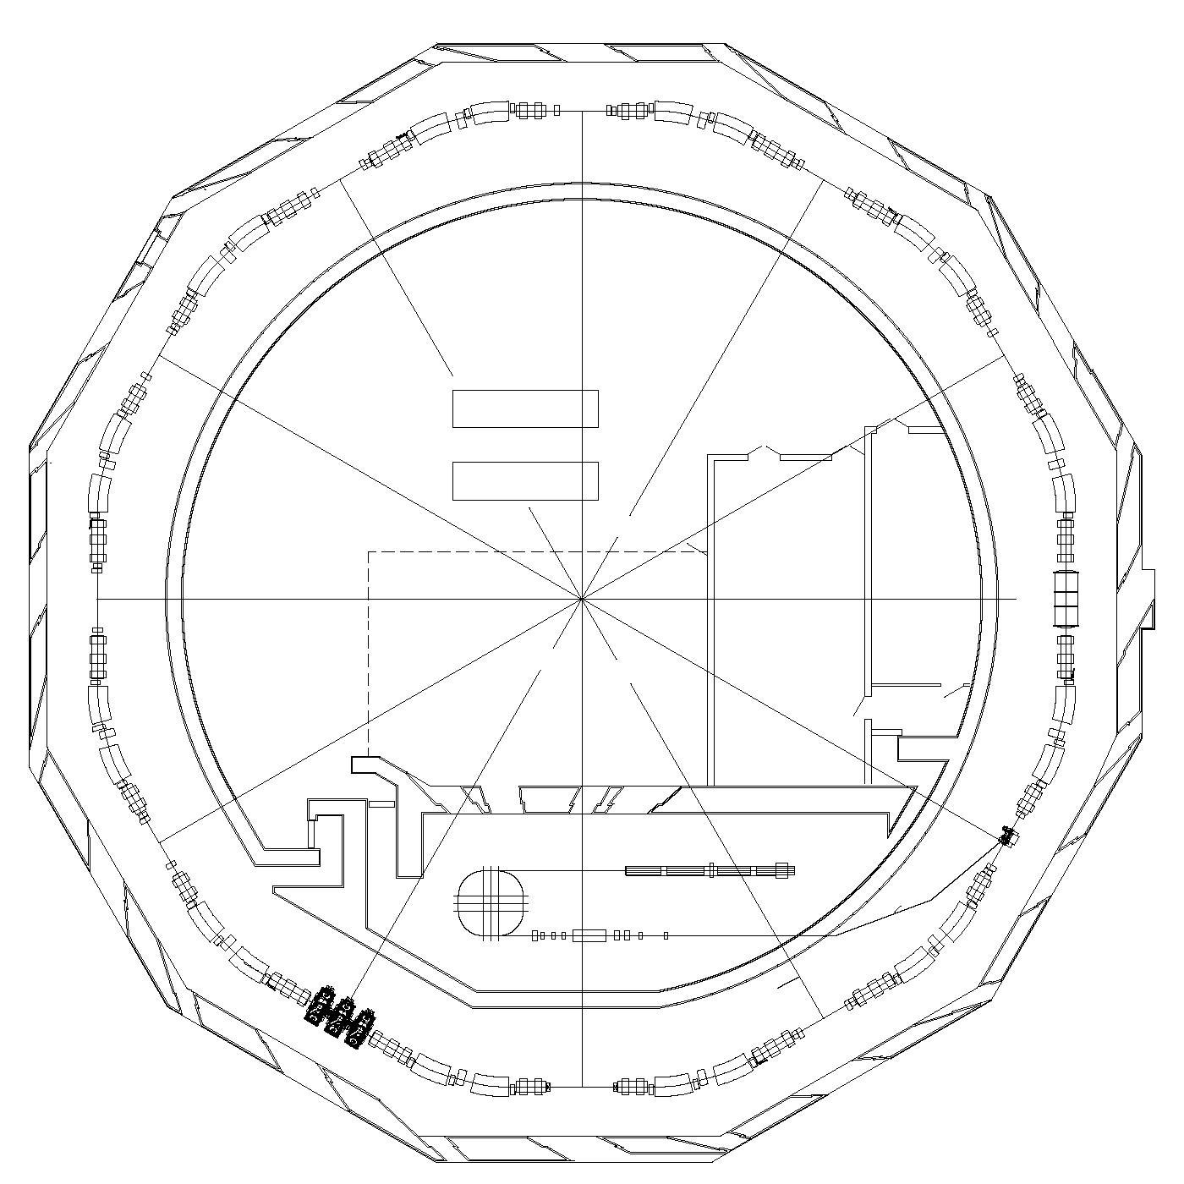
Works on vacuum system in 2019-2020
New 3 T wiggler
SCW3
New 3 T wiggler SCW2
New ion pumps, gages, bells, straight section’s vacuum chambers,
Ti evaporation units.
15 new valves,
21 new BPMs
5 new BPMs, 4 new valves
Notes:
11
11

Slide 12
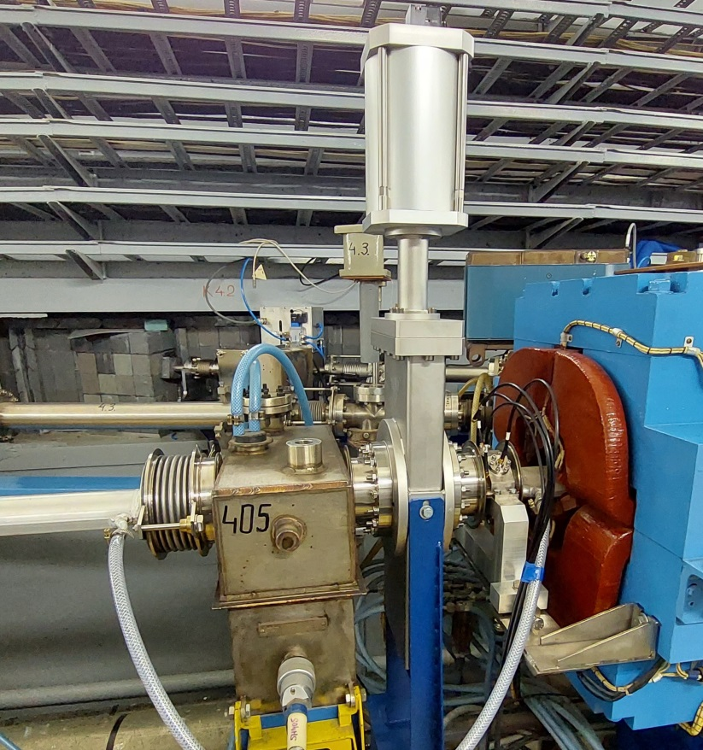
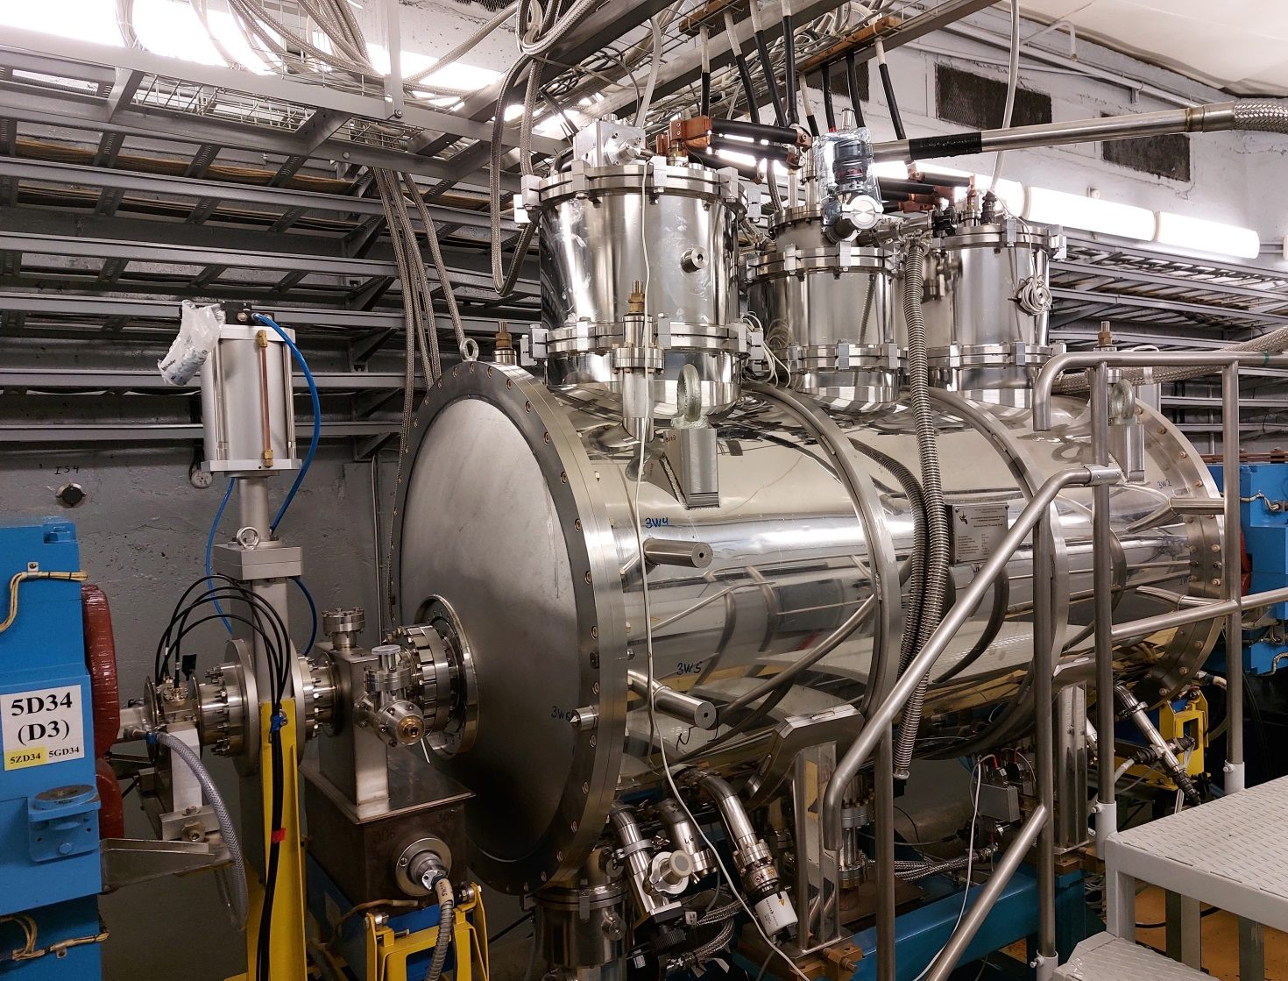
New ion pump, BPM, pneumatic valve, bell
New 3 T wiggler

Slide 13
New 3 T superconducting wigglers (SCW) 2019-2021
SR
New wiggler, elements for junction with ring chamber (valve, photon absorber, bells)
СИ
New wiggler
48 mm period
50+4 poles
Service lines (power supply and diagnostic cables, cryocoolers’ flexlines)
SR
СИ
Technological area for wiggler’s equipment at shielding roof level (compressors for cryocoolers, power supplies, water cooling systems, computer)
Notes:
13
13

Slide 14
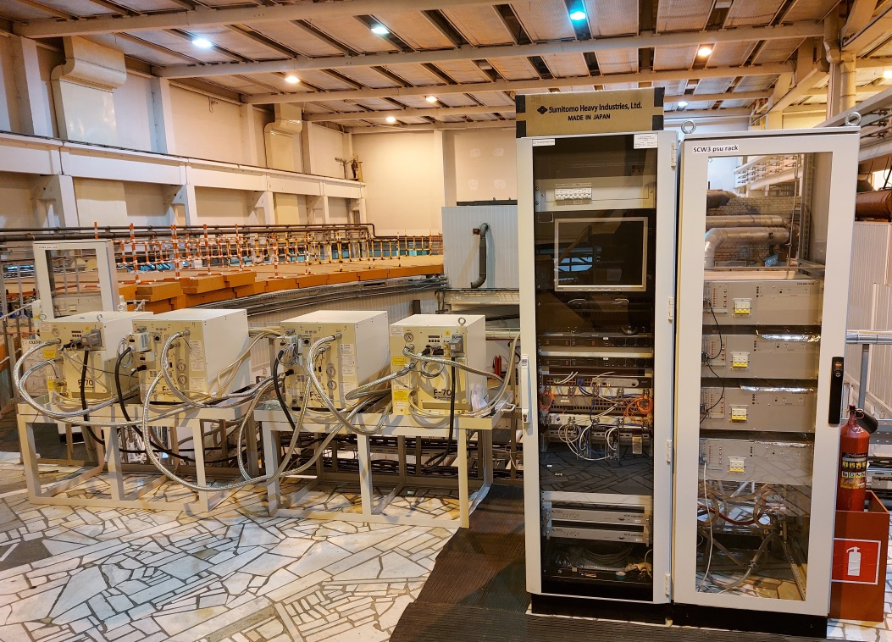
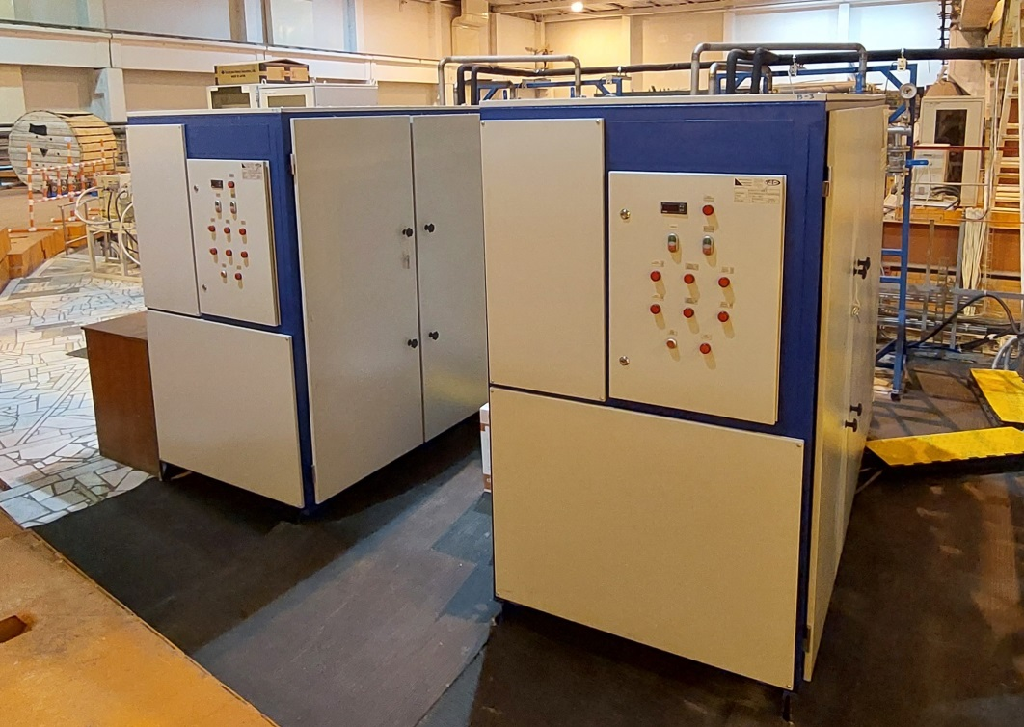
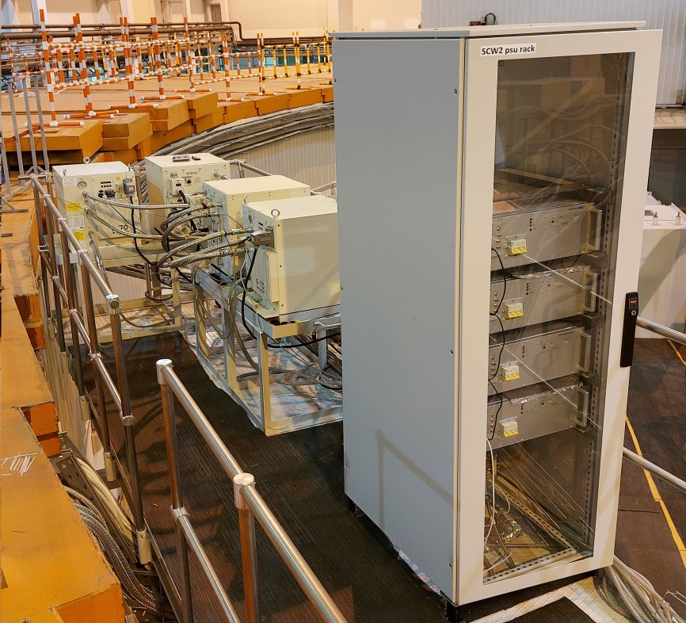
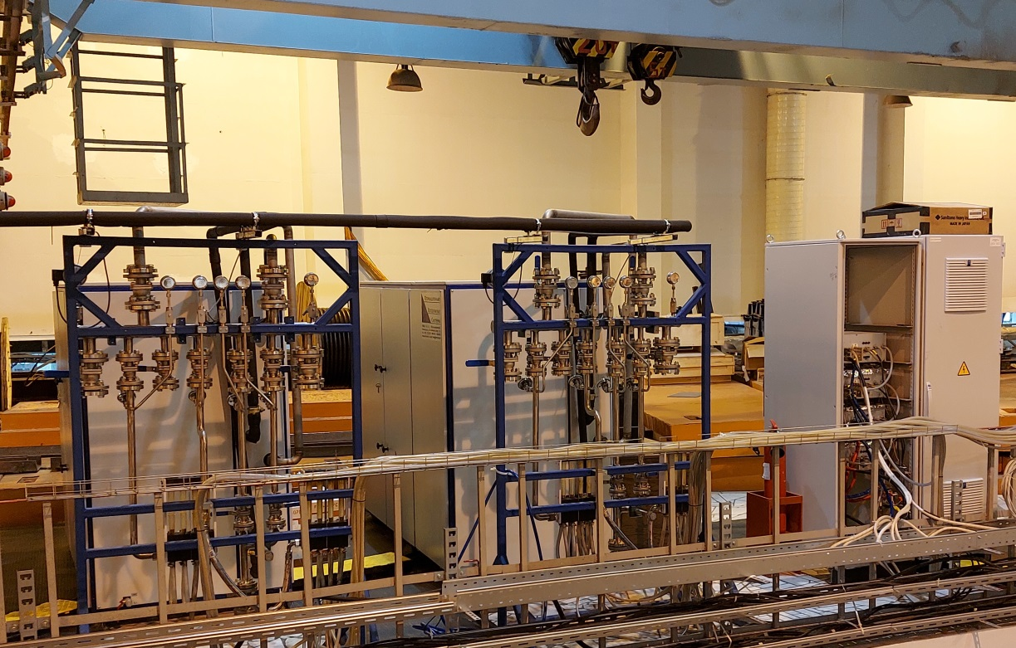
SCW power supplies, control rack & compressors
Autonomous water cooling systems
Notes:
14
14

Slide 15
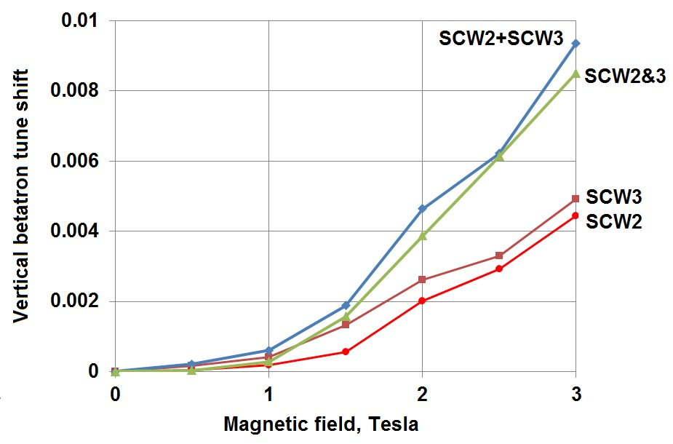
Wigglers influence on beam parameters

Slide 16
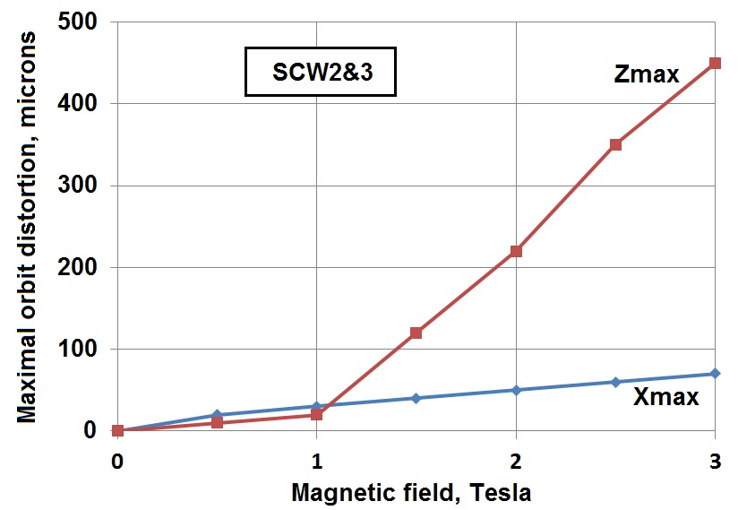
Wigglers influence on beam parameters

Slide 17
KSRS control system 2020 - 2021
Problems:
Complicated structure (CitectSCADA + CANServer + …)
Old modules (including CAMAC)
CAN-bus with low speed
Synchronization problems
Modernization goals:
Unified structure (under new version of CitectSCADA)
New modules (vacuum and magnet systems, BPMs…)
Ethernet
Optic synchronization
New software
Notes:
17
17

Slide 18
KSRS control system 2020 - 2021
Vacuum system: 65 new modules BUP-M for ion pumps control (contractor - MARATHON), 12 new racks in Siberia-2 hall for Ti evaporation units and vacuum valves control.
RF system: new modules for all RF generators control, measurement of RF power in waveguides and temperature of RF cavities.
New pulse synchronization system using optic cables; removal of old CAMAC modules.
Magnet system: 60 new modules BUK-M for high- and low-current power supplies control (contractor - MARATHON).
New thermal stabilizing scheme for linac structure.
6 new modules Libera Brilliance for Siberia-2 closed orbit measurement, 5 new modules Libera Spark for trajectory measurements in electron transport line. 7 new racks for Libera modules in Siberia-2 hall. All these modules are manufactured by Instrumentation Technology (Slovenia).
New server hardware and terminal devices.

Slide 19
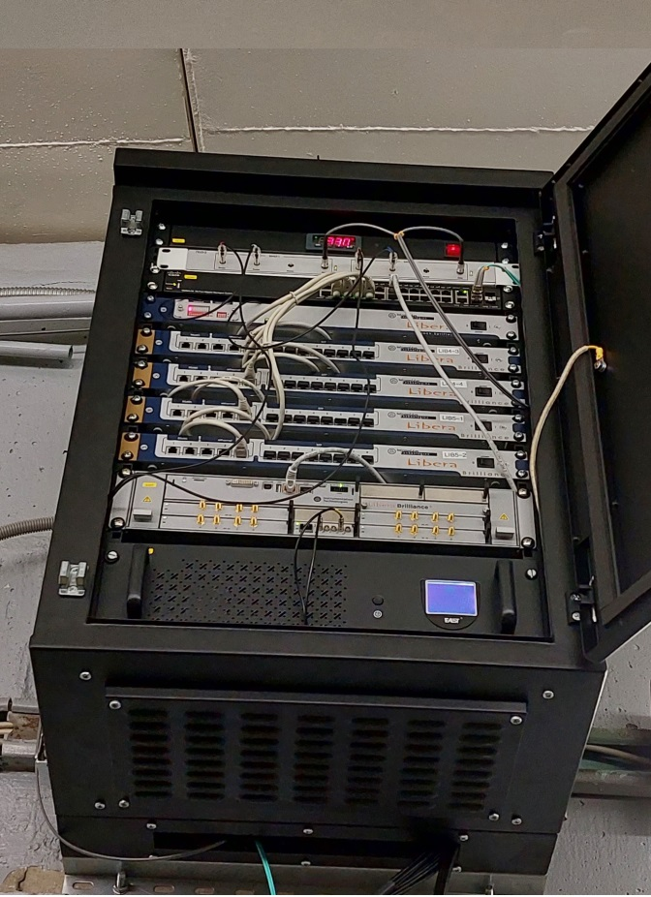
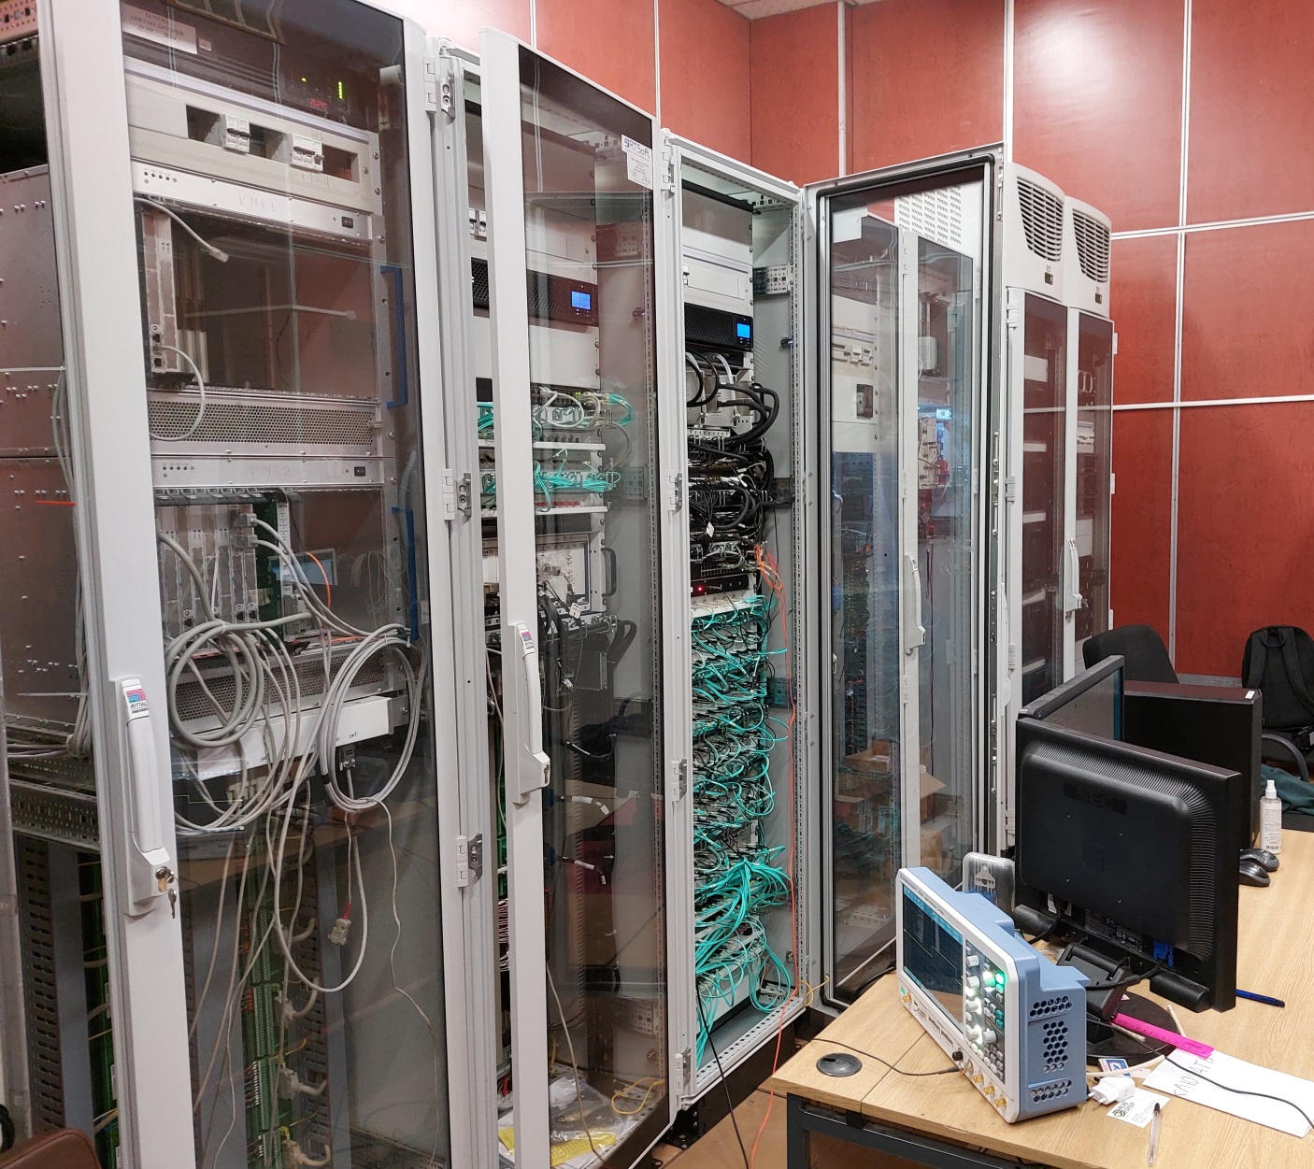
KSRS control system
Libera Brilliance (BPM controlling)
New control system racks
Notes:
19
19

Slide 20
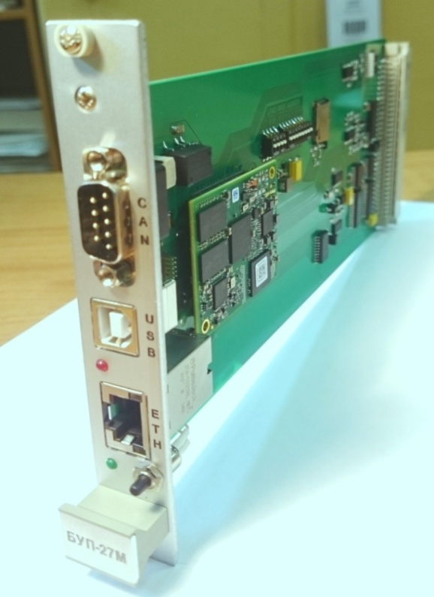
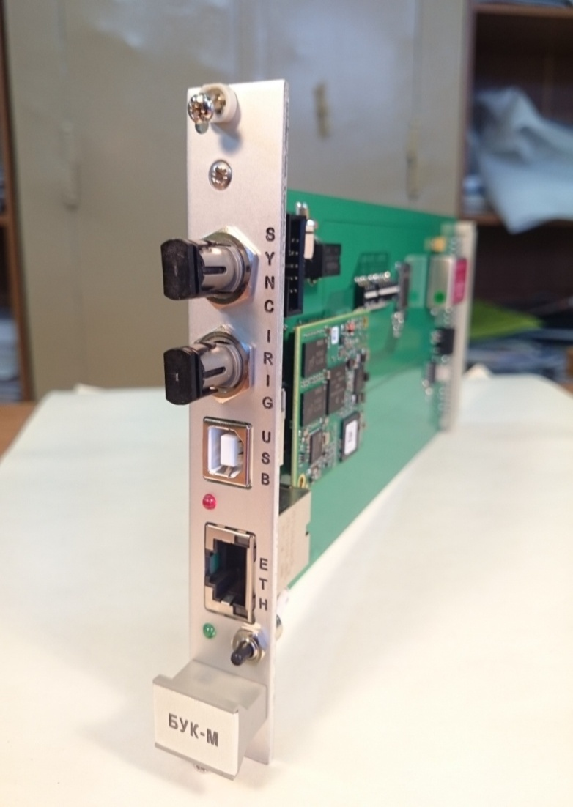
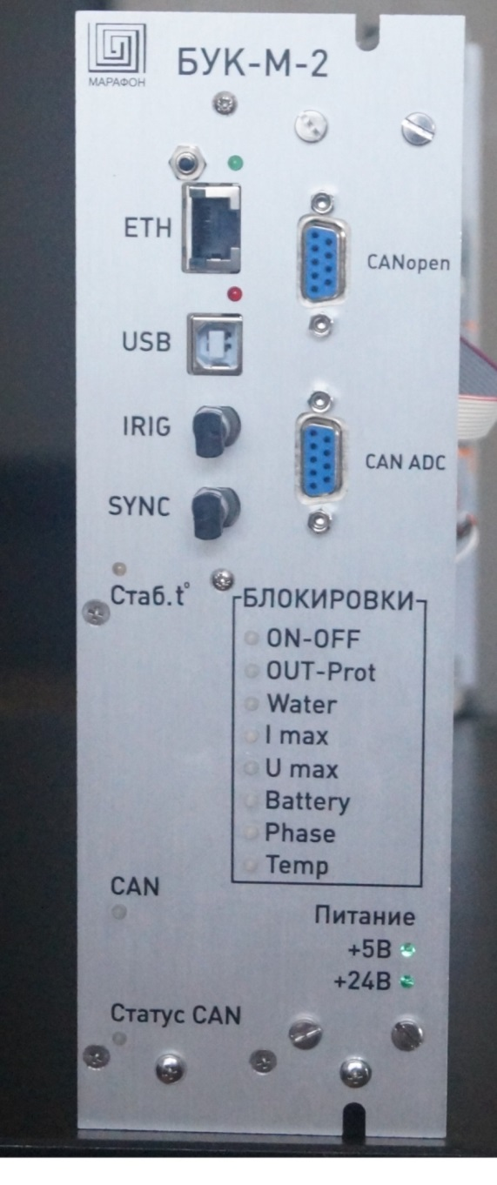
KSRS control system
65
48
BUP-27M (4 ion pumps controlling)
BUK-M1 (8 low-current power supplies controlling)
BUK-M2 (high-current power supply controlling)
12
Notes:
20
20

Slide 21
Federal Program for Scientific Infrastructure Development
Main features for KSRS:
All three KSRS accelerators disassembling
New low-emittance 2.5 GeV storage ring as bright SR source
More information in TUC02 report
Items moved from Program1 to Program2:
Mounting of RF generators, waveguides, supplying and control racks;
Modernization of water and air cooling systems;
Modernization of electric power supplying system.
Items cancelled from Program1:
Modernization of high-current power supplies.
Notes:
21
21

Slide 22
Thank you for your attention!
Notes:
22
22

