Slide 1
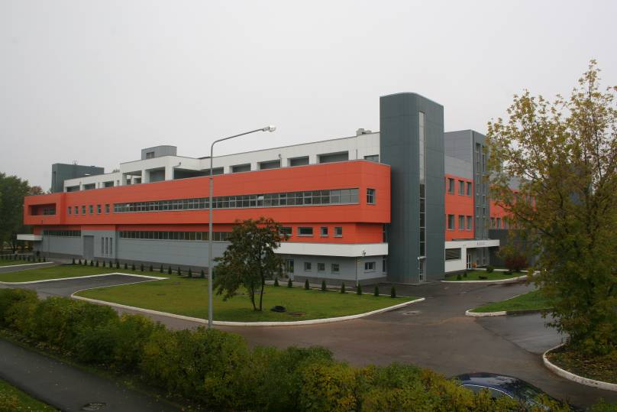
Concept of a New Kurchatov Synchrotron Radiation Source
V. Korchuganov,
NRC KI,
RUPAC 2021 26.09-02.10/2021

Slide 2
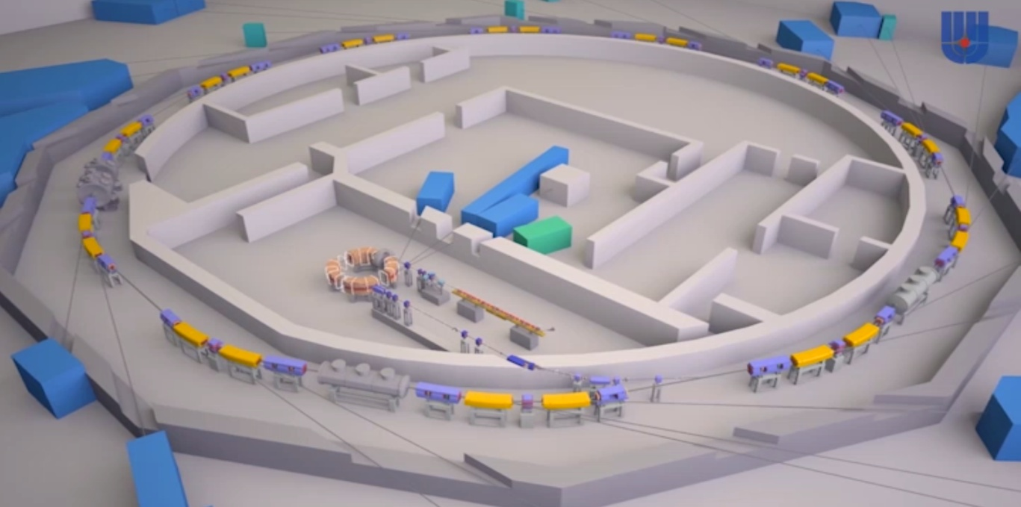
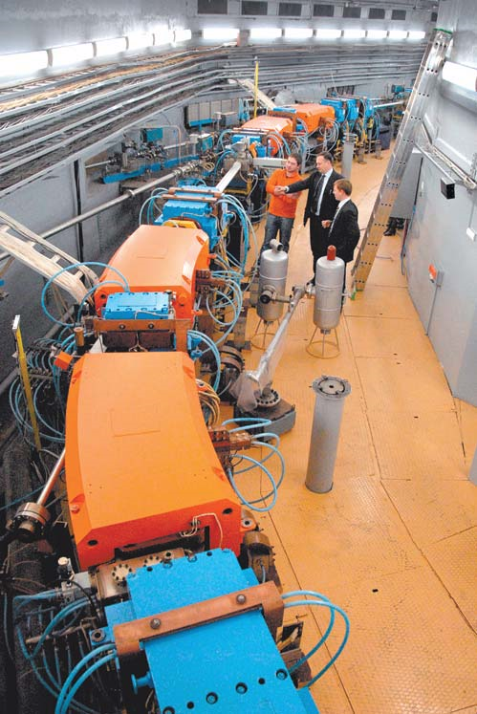
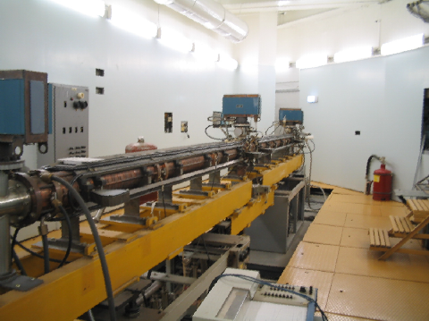
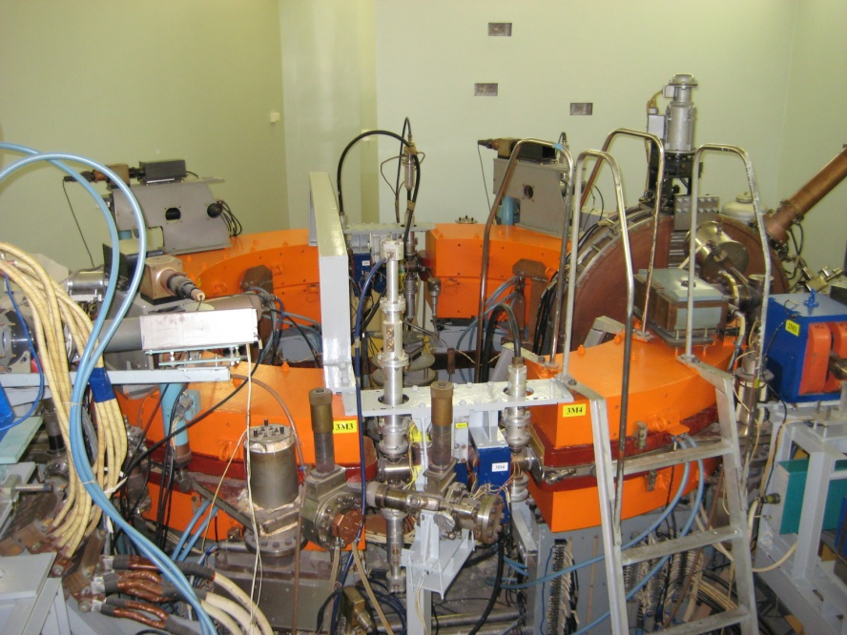
KSRS-1 Overvew

Slide 3
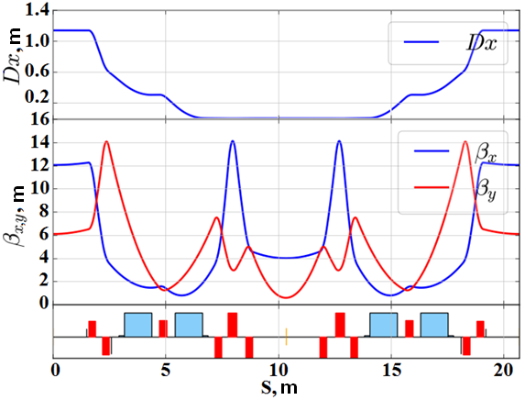
KSRS-1 Status
KSRS-1 main parameters
Twiss`s functions
Energy | 2.5 GeV
Perimeter | 124.130 m
Superperiods | 6
Emittance | 98 nm-rad
Electron current | ~150 mA
Life time | 15-20 hrs
Betatron numbers | 7.775 / 6.695
Chromaticities, x/y | -16.9 / -12.9
Structure - Modified DBA
Earlier studies had shown that with existing magnetic structure of SR Source “Siberia-2” it is possible to achieve:
emittance 55-65 nm ∙ rad when keeping zero dispersion function, but an injection factor was limited due to lower DA and large emittance of “Siberia-1” (800 nm-rad)
emittance 13-18 nm ∙ rad - reinstallation of sextupoles and work with non-zero dispersion function in the straight sections. Limitations: it is impossible to operate with strong field SCW, small DA and large injected emittance.

Slide 4
Content of the KSRS-1 modernization project. Decree of the Russian Federation Government on March 20, 2020
  1. Development and creation of a new injection complex, consisting of:
  1.1. A new booster synchrotron (BS) - an electron injector with an energy of 2.5 GeV for a new SR source;
  1.2. a new 200 MeV linear electron accelerator (LUE) - injector for BS;
  1.3. the electron transport lines (EOK-1, EOK-2)
  2. Creation of a new 2.5 GeV SR source ring with the natural emittance of 2-4 nm-rad:
  to bring closer the SR fluxes and SR brightness to the values ​​typical for SR sources of the 3rd generation;
  to keep the perimeter of the old SR source and the coordinates of the existing SR channels.
  3. Main features for KSRS:
  All three KSRS accelerators disassembling

Slide 5
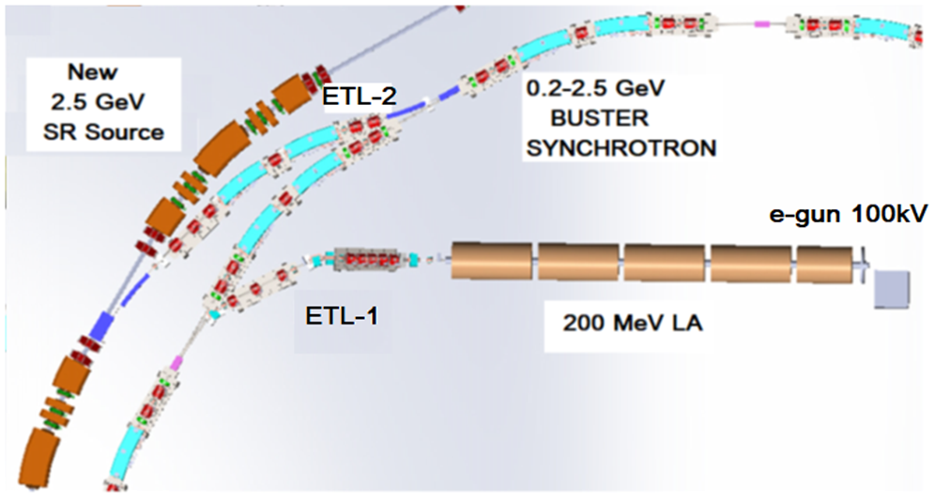
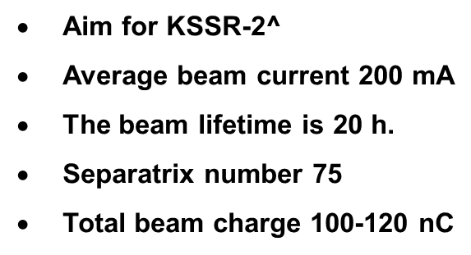
New injection complex of KSRS-2: BS+LA
KSRS-2 injection complex scheme
New electron gun with buncher (max 3 A, 100 keV, ∆t ~ 5 ns)
new linear accelerator (max 2 A, 200 MeV, ∆t ~ 5 ns)
new booster synchrotron (10-15 mA, 0.2-2.5 GeV)
new main storage (200 mA, 2.5 GeV)

Slide 6
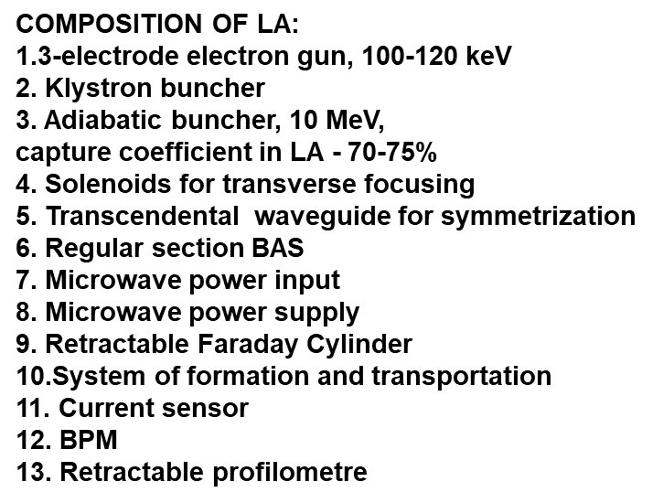
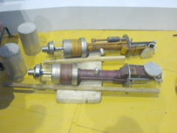

A new pre-injector - 200 MeV, 2797 MHz Linear Accelerator
8
1 2 3
6
6
6
6
7
7
7
7
4
5
9
Schematic diagram of microwave power supply
Biperiod accelerating structure - BAS - standing voltage wave,
4 Klystrons KIU-53A, 18-20 MW, 2797 MHz, section ~ 2.4 m, acceleration rate 25-30 MeV / m

Slide 7
Status LA. The beam dynamics simulation in 200 MeV linac

Slide 8
Linear Accelerator project status
The geometric and electrical parameters of the electron gun, the adiabatic buncher were found;
the geometrical elements for inputting microwave power into the accelerating cells were determined;
mathematical modeling of the dynamics of the electron beam in the LA was carried out, the optimal parameters of the resonant accelerating structure with high impedance were found;
the microwave power supply scheme was determined.
A set of defining geometric parameters (form of accelerating sells) for the start of specific design studies of microwave systems has been found.
SEE: Poster

Slide 9
02-2.5 GeV Booster Synchrotron Project
Planed:
to inject from the BS an electron beam with low emittances (ex ~ 50 nm-rad) at a total energy of 2.5 GeV with high efficiency (low radiation load);
to exclude in the KSSR-2 ring the periodic process of accumulation of electrons at low energy, which interrupts the use of SR beams at X-ray stations, leads to temperature problems of orbit stabilization, transient electronic-magnetic processes when the electron energy rises in the storage ring, when working with SCW and other plug-in devices;
to achieve the effect of "infinite" lifetime of the electron beam;
to work with much higher stability of the spatial position of photon beams;
to improve the reliability of the SR source with the help of new technologies, and more stabilized power supplies.

Slide 10

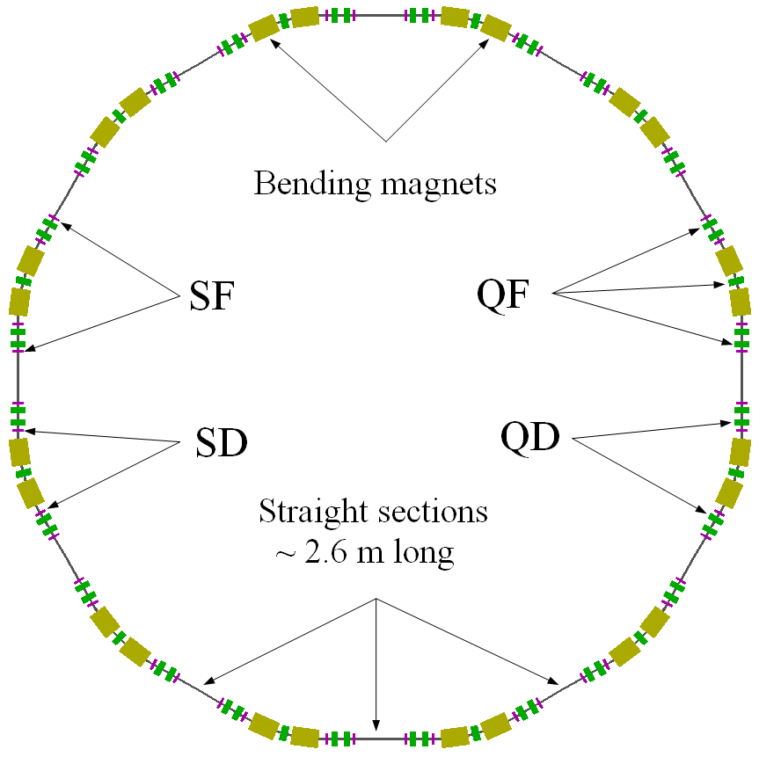
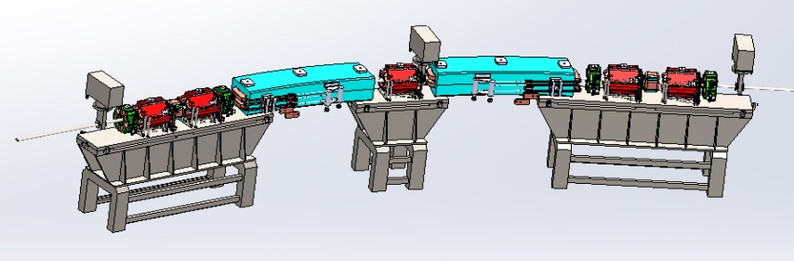
BS Project:: Optical structure of BS - 12-fold symmetry
Energy, GeV | 0.200 | 2.5
Super-periods | 12
Circumference, m | 110.873
Operation cycle, Hz | 1
Electron beam current, mA | 10
Revolution frequency, MHz | 2.704
RF system frequency, MHz | 181.1
RF harmonic number | 67
RF acceptance, ε_{RF}, % | 1.7 | 0.7
Betatron number: Q_{x}/ Q_{y} | 7.178/4.367
Synchrotron numder: Q_{s} | 8·10⁻⁴ | 9·10⁻⁴
Max./Min. lattice functions: β_{xmax}/β_{xmin} , m β_{ymax}/β_{ymin} , m h_{xmax}/h_{xmin} , m | xx 8.472/1.323 10.156/1.528 0.715/0.147
Chromaticity: x/y | –9.0186/−8.5569
Momentum compaction factor, a | 0.00997
Horizontal emittance, e_{x}, nm-rad | 300 (Lin. Acc.) |  | 43.4
Energy spread, s_{E}/E, % | 1.5 (Lin. Acc.) |  | 0.084
Energy loss/turn, U₀ , keV | 0.022 |  | 538.6
Oscillation damping times:: horizontal, t_{x} vertical, t_{y} Longitudinal, t_{s} | 6.9 с 6.7 с 3.3 с |  | 3.53 мс 3.43 мс 1.69 мс
Damping factors: J_{x} J_{y} J_{s} | 0.995 1.000 2.005
12 s / periods, 24 BMs, 60 Qs, 46 Ss,
12 straight sections 2.6 m long

Slide 11
Status of BS Project
3D calculations of magnetic fields in BS laminated magnets were carried out: the relative integral inhomogeneity of the magnetic field in the “good field” region for the dipole component does not exceed 1 ∙ 10-4, for the quadrupole component - 2 ∙ 10-4, for the sextupole component - 5 ∙ 10-4.
Terms of reference for all magnetic elements of the BS have been worked out sufficient to begin the design, taking into account the technology being laid for the production of laminated magnets.
See A. Smygacheva. Posters 06 ID: 2084, Poster 07 ID: 2085

Slide 12
New KSRS-2 Project
Requirements:
saving all experimental stations
minimization of emittance
preservation of the spectral range of SR
preservation of the number, lengths and coordinates of the axes of straight sections with a zero dispersion function
providing the possibility of injection of an electron beam from a booster synchrotron, placed "concentrically" relative to the ring of the SR source in the same tunnel
reaching the lifetime of an electron beam of at least 10 h at a current of up to 200 mA
saving the perimeter of the main storage ring
meeting technological constraints on the part of all systems

Slide 13
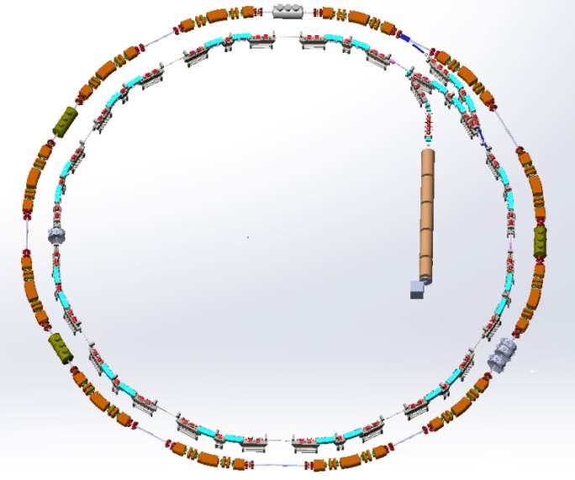
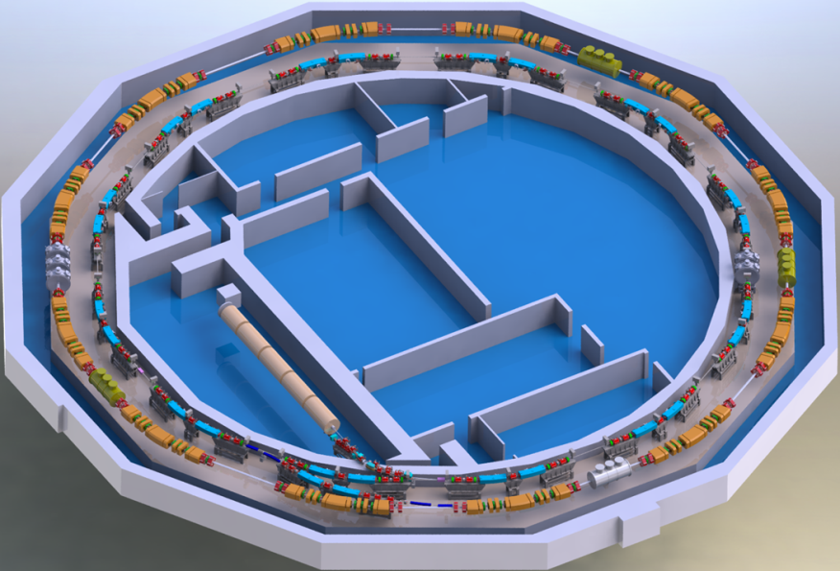
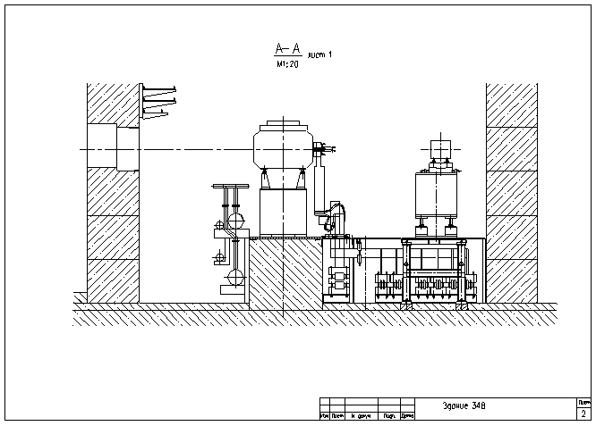
Location of new SR Source and Booster Synchrotron
KSSR-2 complex scheme
New electron gun with buncher (max 3 A, 100 keV, ∆t ~ 5 ns)
new linear accelerator (max 2 A, 200 MeV, ∆t ~ 5 ns)
new booster synchrotron (10-15 mA, 0.2-2.5 GeV)
new main storage (200 mA, 2.5 GeV)
200 MeV Linac
2.5 GeV BS
2.5 GeV KSSR-2
2.5 GeV KSSR-2
2.5 GeV BS

Slide 14

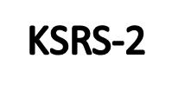
Location of magnets in KSRS and KSRS-2 at one super-period
Notes:
Типы магнитов –> пределы по эмиттансу

Slide 15
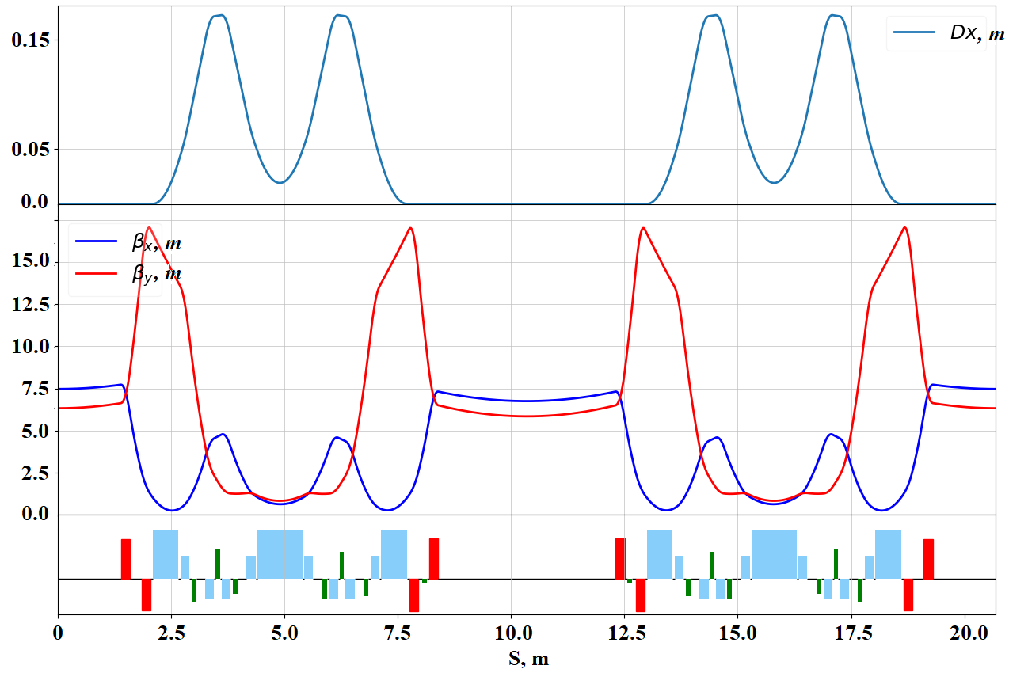
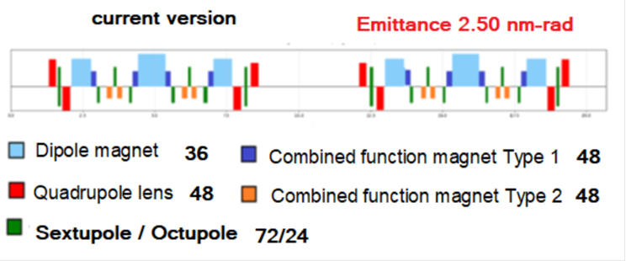
Optical function comparison of KSSR and KSSR-2 latticies
MDBA
KSSR
KSSR-2
Perimeter | 124.130 м |  | 124.174 м
Emittance | 98 нм·рад |  | 2.86 нм·рад
Frequencies | 7.775 / 6.695 |  | 14.852 / 6.759
Chromaticity | -16.9 / -12.9 |  | -29.3 / 27.0
MTBA

Slide 16
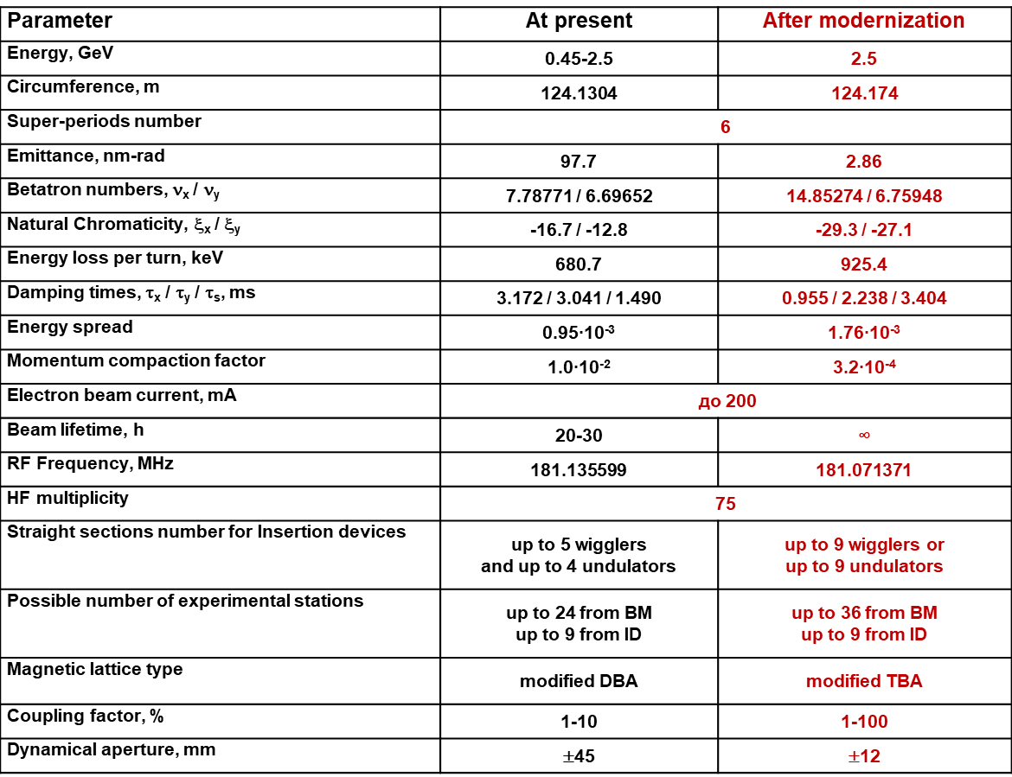
Parameters of the Kurchatov`s SR source before and after modernization

Slide 17
Man Ring – KSSR-2 Project work
During September 2020 - August 2021, optimization of the new brighter magneto-optical structure of the source were continued.
The current magneto-optical structure provides:
natural emittance of the electron beam is 2.5 (2.9) nm ∙ rad while maintaining the dynamic aperture with dimensions HxV=12x8 mm sufficient for injection even in the presence of errors in the position of the magnetic elements at the level of 35-50 microns;
keeping the positions of the beam lines for the SR from the bending magnets with an accuracy of fractions of one millimeter;
the lengths of the straights for setting superconductive wigglers have been increased from 3m to 3.5m;
the length of the straights intended for the injection of the electron beam decreased from 3m to 2.6m.
Such a redistribution of the lengths of straight sections is a payment for a significant decrease of the emittance. Nevertheless, the length of the 2.6 m will be quite enough for the installation of insertion devices, similar to those installed on the main ring at the present time.

Slide 18
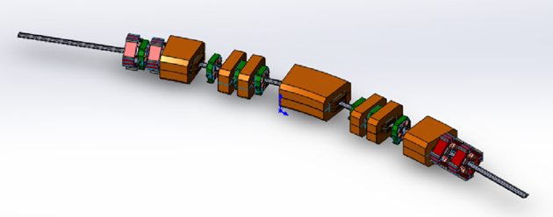
Arrangement of KSSR-2 magnets at half of the super- period
6 super-periods
1/2 superperiod:
3 dipole magnets with a field of 2 T:
4 dipoles - defocusing quadrupoles (DQ, type 1);
4 anti-bend dipoles- focusing quadrupoles (DF, type 2);
4 standard quadrupoles;
6 chromatic sextupoles;
2 harmonic sextupoles and 2 octupoles.
All magnetic elements will be made of non-laminated soft magnetic iron (Armco). The minimum area of ​​good field in all magnets is ± 10 mm horizontally and ± 5 mm vertically accordinally with DA.

Slide 19
SR parameters comparison of old and new structures at 2 .5 GeV, 100 mA
New storage ring: ~3*10^17
Old storage ring: ~1.03*10^16
Note that the transition from modified DBA structure, available in the operating SR source "Siberia-2", to modified TBA structure in the new KSRS , creates an additional advantage, allowing, in principle, to increase the number of SR beam lines from bending magnets by one and a half times. Another new feature (advantage) of the new structure is the "zeroing" of the dispersion function in all long (from 2.5 m) straight sections, which also allows increasing the number of special emitters on the ring.

Slide 20
SR Sourses – world experience
Estimation of the electron beam emittance in the new structure based on scaling:
MAX-IV (3 GeV, 528 m, 7BA) -> 17 nm-rad
ESRF EBS (6 GeV, 844 m, 7BA) -> 8 nm-rad
SLS-2 (2.4 GeV, 290 m, 7BA) -> 2 nm-rad
ANKA (2.5 GeV, 110 m,, 4BA) -> 6 nm-rad

Slide 21
KSRS-2 - challenges
Large number of complex precision magnetic elements
High precision of magnetic elements alignment in narrow tunnel
Dense packing of elements on the rings leads to unwanted interaction of edge magnetic fields of different types of neighboring magnets.
Complex vacuum system – small cross-section of vacuum chamber and its articulation with many and dissimilar devices provided they are tightly packed
Long-term temperature stabilization of the tunnel and main storage ring
Numerous power supplies for magnetic elements and others
Distribution of electrical, water- cooling communications and …

Slide 22
CONCLUSIONS
Main Ring. The calculated magnetic structure of the new SR source at the Kurchatov Institute has a ~ 30 times lower natural emittance, which will ensure the parameters of synchrotron radiation beams (brightness and intensity) at the level of the 3rd generation SR sources. Electromechanical calculations of the KSRS-2 magneto-vacuum system are being carried out. The RF system is being manufactured. The magnets 3D calculations are in progress
BS. The stage of calculations of all magnetic elements of the booster synchrotron has been completed. Terms of reference for all magnetic elements and the RF system of the BS have been developed, sufficient to start work on the development of design documentation, taking into account the technology for the production of BS magnets.
Linear Accelerator. The work carried out on the prototyping and optimization of the parameters of a 200 MeV linear accelerator - pre-injector. A set of defining geometric parameters for the start of specific design studies of microwave systems has been found.

Slide 23
Thank you
for your attention!

