Slide 1
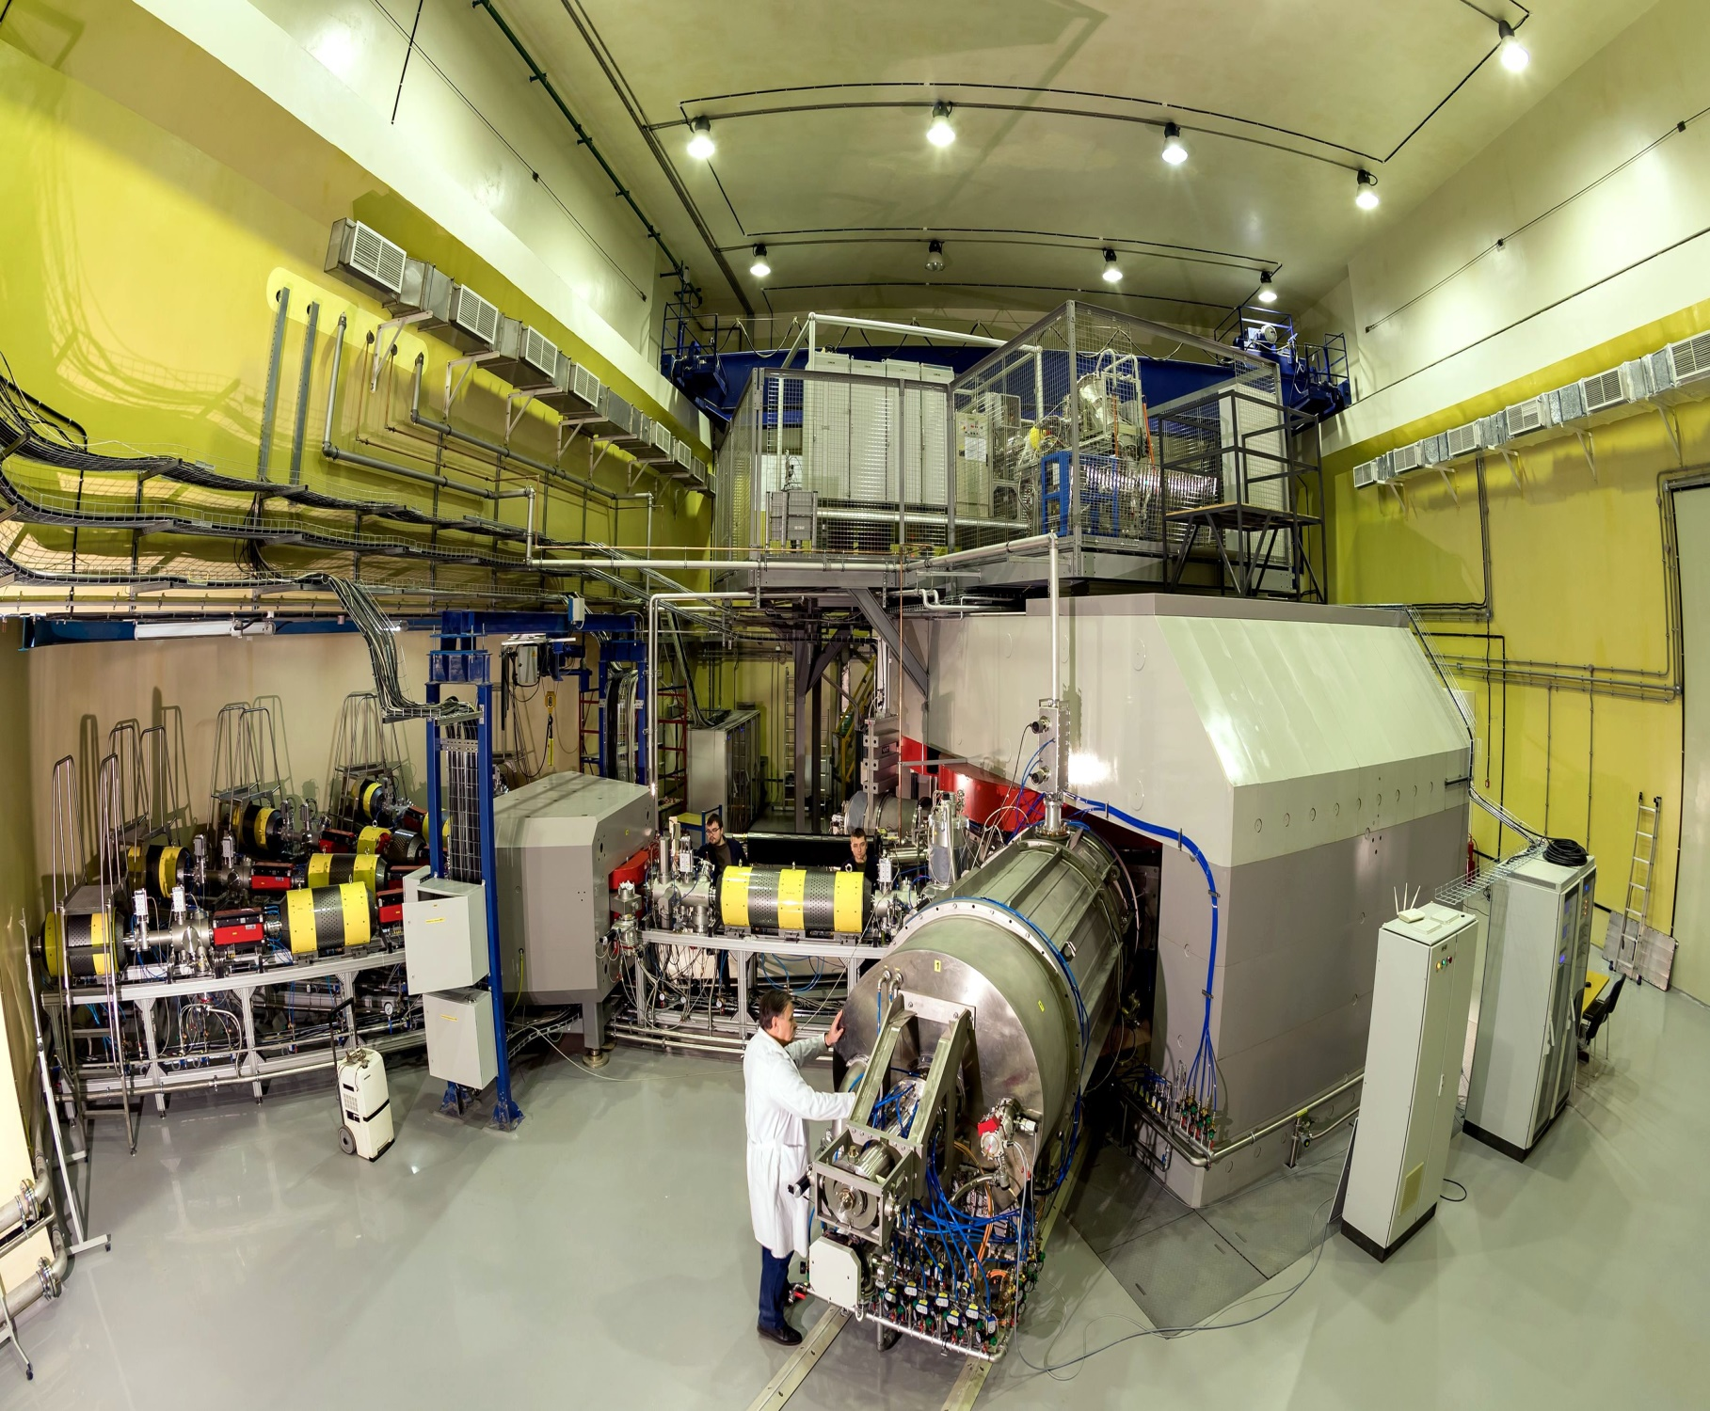
PECULIARITIES OF PRODUCING ⁴⁸CA, ⁴⁸TI, ⁵²CR BEAMS AT THE DC-280 CYCLOTRON
1

Slide 2
Superheavy Elements (SHE) Factory – the Goals .
The first beam of 84Kr14 + ions in the DC-280 cyclotron was obtained on December 26, 2018. and on January 17, 2019, the 84Kr14 + ion beam was extracted from the accelerator
Experiments at the extremely low (σ<100 fb) cross sections:
Synthesis of new SHE in reactions with ⁵⁰Ti, ⁵⁴Cr ...;
Synthesis of new isotopes of SHE;
Study of decay properties of SHE;
Experiments requiring high statistics:
Nuclear spectroscopy of SHE;
Study of chemical properties of SHE.
To carry out the scientific program, the DC-280 has to provide the following parameters of ion beams:
 | DC-280 | U-400
Ion energies (smooth variation) | 4 - 8 MeV/n | 4 – 20 MeV/n
Ion masses | 10 - 238 | 7 - 209
Intensities (A~50) | >10 pµA | 1 pµA
Efficiency of beam transfer from ion source to physical facility | >50% | ~10%
2

Slide 3
3

Slide 4
DC-280
Main Parameters
parameters | design | achieved
Injecting beam energy | Up to 80 keV/Z | 38,04 – 72,89 keV/Z
A/Z | 4÷7.5 | 4,4(⁴⁰Ar⁺⁷) ÷6,9(⁴⁸Ca⁺⁷)
Energy | 4÷8 MeV/n | 4,01 – 7 MeV/n
Ion (for DECRIS-PM) | 4-136 | 12 (¹²C⁺²) – 84 (⁸⁴Kr⁺¹⁴)
Intensity (A~50) | >10 pµA | 10,4 pµA (⁴⁰Ar⁺⁷);
Magnetic field level | 0.6÷1.3 T | 0.8÷1.23 T
K factor | 280
Dee voltage | 2x130 kV | 130 kV
Power of RF generator | 2x30 kW
Accelerator efficiency | >50% | 51,9 % (⁴⁸Ca⁺¹⁰ 5 pµA)
4

Slide 5
DC280. Parameters and Goals
 | DC280 Parameter | Goals
1. | High injecting beam energy (up to 80 kV) | Shift of space charge limits for factor 30
2. | High gap in the center | Space for long spiral inflector
3. | Low magnetic field | Large starting radius. High turns separation. Low deflector voltage
4. | High acceleration rate | High turns separation.
5. | Flat-top system | High capture. Single orbit extraction. Beam quality.

Slide 6
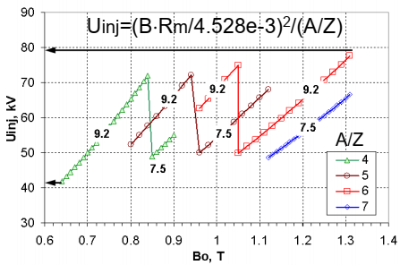
DC-280 description
To ensure optimal injection conditions for all range of accelerated ions, two versions of the inflector type A and type B with two magnetic radii of 7.5 and 9.2 cm are used.
Magnetic field Dependence of injection voltage.
The work diagram of DC-280 cyclotron with marks of tested regimes is presented on Fig.2. The cyclotron has shown reliable and highly effective work.
6

Slide 7
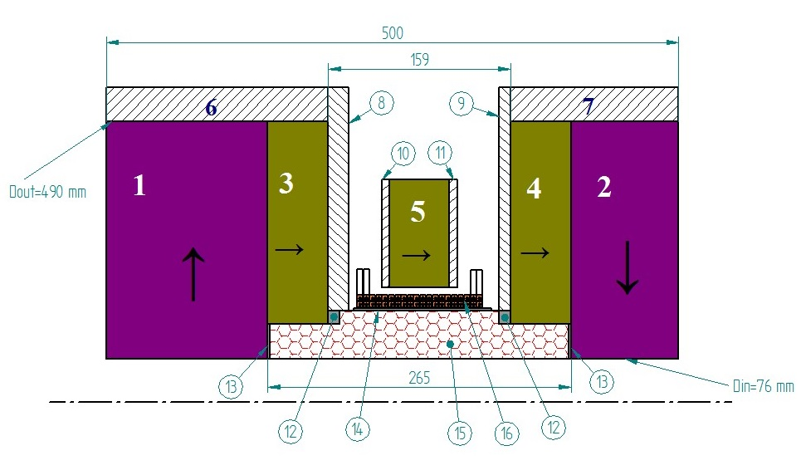
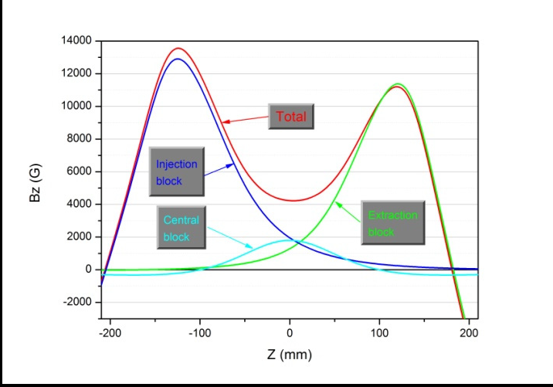
DECRIS-PM
(14 GHz)
Magnetic structure of DERIS-PM.
1÷5 – PM rings; 6. 7 – soft iron rings;
8÷11 – soft iron plates;
12÷14 - auxiliary elements;
15 – hexapole; 16 – coil.
7

Slide 8
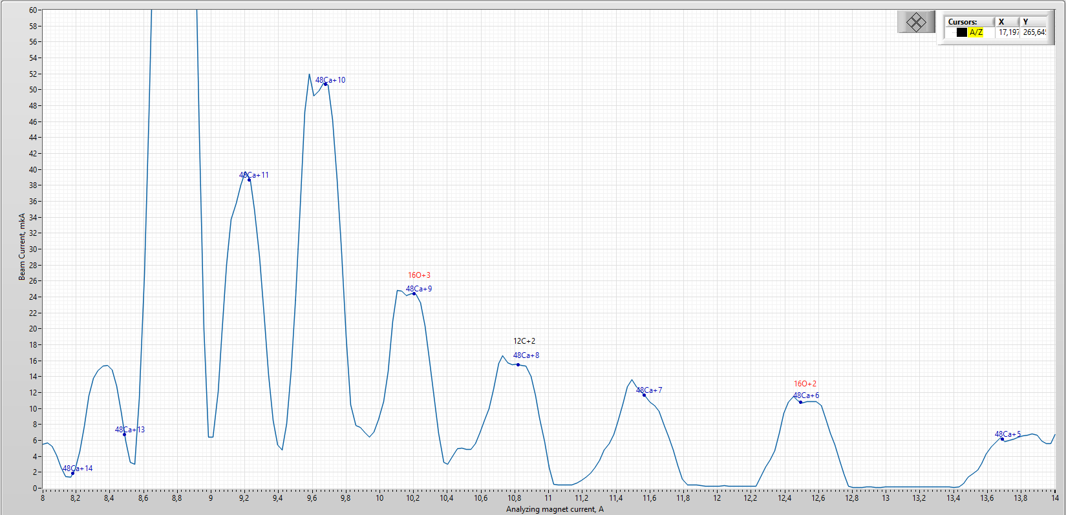
DECRIS PM Producing of ⁴⁸Ca
How we can see from the spectrum obtained from the ECR source, ions with charge +7, +10 don’t have impurities. Due to the lower consumption, ⁴⁸Ca⁺¹⁰ was chosen for experiments on the synthesis of superheavy elements.

Slide 9
Producing of ⁴⁸Ca
I,puA
Beam stability is about 1-3%.
Calcium consumption ~0,2-1,5 mg/h
9

Slide 10
Producing of ⁴⁸Ca
The total efficiency of transporting the ion beam of ⁴⁸Ca¹⁰⁺ from the vertical part of the injection to the transport channel is about 50%.
10

Slide 11
Producing of ⁴⁸Ca
Ion | Energy (MeV) | Intensity (pµA)
 |  | Axial injection |  | cyclotron |  | Transport channel
 |  | after separation | vertical part | R=400 | R=1770
⁴⁸Ca⁺⁷ | 240 | 10,9 | 9,8 | 6,9 | 6,1 | 5,2
⁴⁸Ca⁺¹⁰ | 240 | 9 | 8,1 | 5,58 | 5,1 | 4,7
⁴⁸Ca⁺¹⁰ | 240 | 23 | 19 | 12,8 | 10,6 | 7,1
Ion | Energy (MeV) | Efficiency
 |  | axial injection | capture | cyclotron | extraction | Total
⁴⁸Ca⁺⁷ | 240 | 90% | 71% | 88% | 85% | 48%
⁴⁸Ca⁺¹⁰ | 240 | 90% | 69% | 91% | 91% | 51%
⁴⁸Ca⁺¹⁰ | 240 | 82% | 67% | 83% | 67% | 31%
On the vertical, with an increase in the intensity from the ion source to 240 μA, we observed a deterioration of the beam transmission through the spherical deflector (Bender) from 94.22% at 150 μA to 79% at 240 µA, and the capture in acceleration decreased from 69% to 67%, respectively. This may be due to an increase in the space charge of the beam or the tuning of the accelerator as a whole.
11

Slide 12
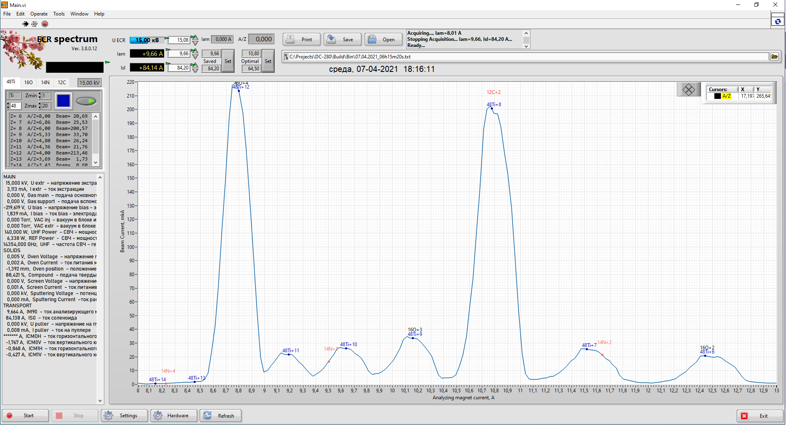
Producing of ⁴⁸Ti
The ions of ⁴⁸Ti with a charge of +7, +10 do not have impurities and we can use them in experiments on the synthesis of SHE.
Compound (CH₃)₅Ti(CH₃)₃.
12

Slide 13
Producing of ⁴⁸Ti
The beam of ⁴⁸Ti⁺¹⁰ from ECR source with intensity is about 2.5 pµA and ⁴⁸Ti⁺⁷ with intensity is about 3.14 pµA were obtained and accelerated with intensity 1,0 pμA and 0,93 pμA respectively. The total efficiency of transporting the ion beam of ⁴⁸Ti^{10+,7+} from the vertical part of the injection to the transport channel is about 40-45%.
13

Slide 14
Producing of ⁵²Cr
The ions of ⁵²Cr with a charge of +7, +8, +10 do not contain impurities, but we cannot accelerate ions with a charge of +7 and +8 to the energy required for the experiment.
C₁₀H₁₀Cr
14

Slide 15
Producing of ⁵²Cr
The beam of ⁵²Cr⁺¹⁰ from ECR source with intensity is about 6,3 pµA and accelerated with intensity 2,6 pμA. We can see, that efficiency of acceleration worsen then we increase power input to ECR source.
The total efficiency of transporting the ion beam of ⁵²Cr¹⁰⁺ from the vertical part of the injection to the transport channel is about 50%.
15

Slide 16
CONCLUSION
The beams of ⁴⁸Ca^{7+,10+},⁴⁸Ti^{+7,+10} and ⁵²Cr¹⁰⁺ were accelerated and extracted from the DC-280 to the beam transport channel.
Maximum intensity of accelerated ⁴⁸Ca ion beam is 10,6 pμA and 7,1 pμA were extracted.
The efficiency of acceleration for ⁴⁸Ca is about 50 %. The beam is given to the GNS-2 experimental setup for a series of test experiments.
The beams of accelerated ⁵²Cr¹⁰⁺ and ⁴⁸Ti^{7+,10+} ions with intensity 2,6 pμA and 1 pμA respectively were extracted from the DC-280 to the beam transport channel.
The efficiency of acceleration for ⁵²Cr¹⁰⁺ and ⁴⁸Ti^{7+,10+} is about 40-50 %.
For the the ion beam of ⁴⁸Ti and ⁵²Cr the intensity is limited by ion current from ECR source. We work to improve of the method of ion production and optimize the ECR source work mode.
16

Slide 17
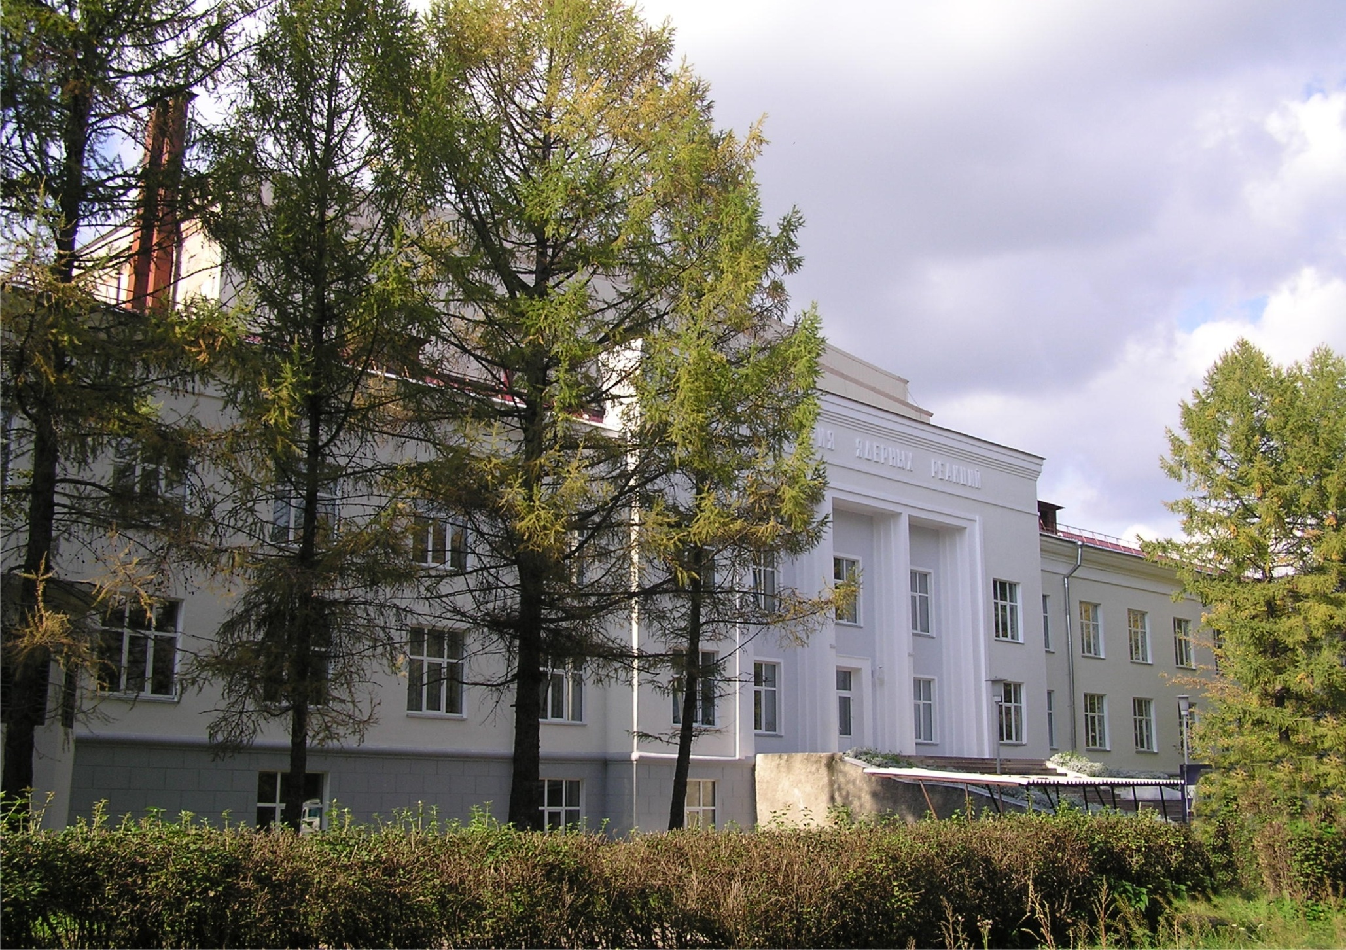
THANKS
FOR YOUR
ATTENTION !
Flerov Laboratory of Nuclear Reactions , JINR

