Slide 1
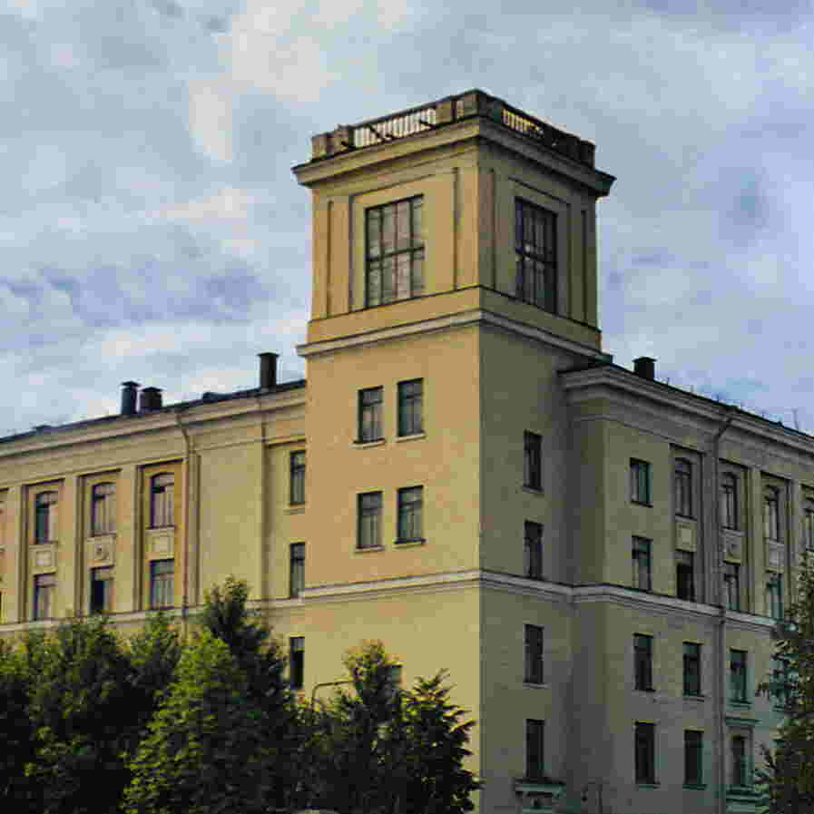
CYCLOTRON OF MULTICHARGED IONS
Yu.K. Osina, A.A. Akimova, Yu.N. Gavrish, A.V. Galchuck, S.V. Grigorenko,
V.I. Grigoriev, M.L. Klopenkov, R.M. Klopenkov, L.E. Korolev, K.A. Kravchuck,
A.N. Kuzhlev, I.I. Mezhov, V.G. Mudrolyubov, K.E. Smirnov, Yu.I. Stogov,
S.S. Tsygankov, M.V. Usanova
JSC «NIIEFA», 196641, St. Petersburg, Russia
XXVII RUSSIAN PARTICLE ACCELERATORS CONFERENCE, RuPAC-2021,
27 September – 2 October 2021, Alushta, Crimea
Speaker: Yu.K. Osina
E-mail: osina@luts.niiefa.spb.su

Slide 2
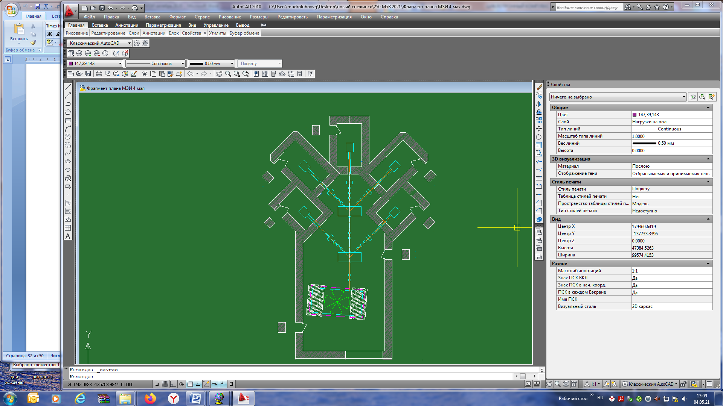
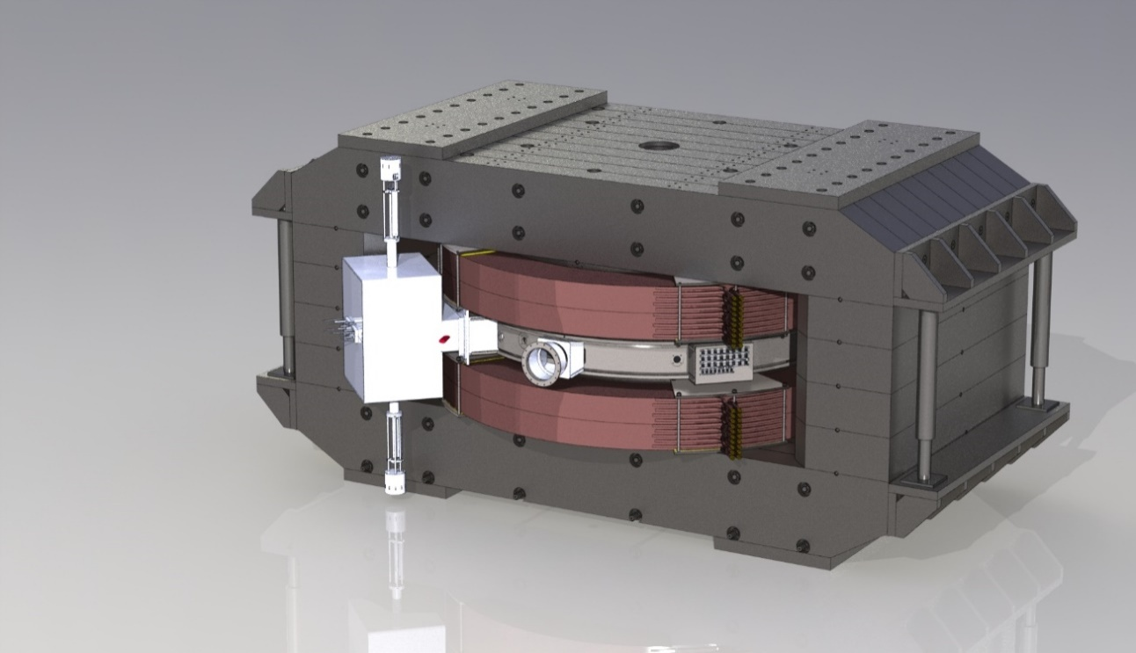
Cyclotron of multicharged ions
The complex of multicharged ions is designed to generate multicharged ions, accelerate them, form and transport beams with specified characteristics to remote vacuum chambers.
Layout of the main equipment cyclotron complex of multicharged ions
3D model of a multicharged ion cyclotron
Commissioning complex of multicharged ions - 4th quarter of 2023.

Slide 3
Technical requirements of the Customer
Parameter | Value
Type of accelerated ions | C, O, Ne, Si, Ar, Fe, Kr, Ag, Xe, Bi
Ion energy, regulated, MeV / nucleon | 7,5-15
The transition time from one type of ion to another, min, no more | 30
The range of ion flow density on the irradiated object, cm⁻²×s⁻¹ | 10² - 10⁵
The size of the irradiation field in each irradiation chamber, mm² | 50×50 150×150
Inhomogeneity of the ion flow density at a fluence of 10⁷ particles/cm² on the samples irradiation area of 50×50 mm², %, no more | 10
Cyclotron operating modes | continuous /pulse-periodic
Number of radiation output channels | at least three

Slide 4
The cyclotron of multicharged ions equipment composition
Electromagnet with upper balk lifting system;
External injection system;
Resonance system;
High-frequency power supply system;
Vacuum chamber equipment (probes, deflector, magnetic channel, etc.);
The system of formation and transportation of accelerated particle beams;
Sample irradiation system;
Power supply system;
Vacuum pumping system;
Water cooling system;
Automated control system.

Slide 5
Ions list for acceleration in the cyclotron of multicharged ions
Ion type | Mass | Charge | A/Z mass-to-charge ratio
Bi | 209 | +43 | 4.86
 |  | +34 | 6.14
Xe | 136 | +28 | 4.85
 |  | +23 | 5.91
Ag | 107 | +22 | 4.86
 |  | +18 | 5.94
Kr | 84 | +17 | 4.94
 |  | +14 | 6
Fe | 56 | +12 | 4.66
 |  | +9 | 6.22
Ar | 40 | +8 | 5
 |  | +6 | 6.66
Si | 28 | +9 | 4.66
 |  | +4 | 7
Ne | 22 | +5 | 4.4
 |  | +4 | 5.5
 | 20 | +4 | 5
 |  | +3 | 6.66
С | 12 | +4 | 3
 | 13 | +4 | 3.25
O | 16 | +5 | 3.2
 | 18 | +4 | 4.5

Slide 6
Requirements for the magnetic structure
The maximum stiffness of the magnetic field in the final orbit R=1.8 m should have the value BR=2.73 T * m;
The mean magnetic field along the azimuth should have a shape that coincides with the isochronous dependencies for ions having a range of mass-to-charge ratio A/Z=3-7. The desired shape is provided by correction coils located in the space between the pole and the sectors;
The formed magnetic field should provide vertical and horizontal focusing;
The frequencies of the betatron oscillations of the beam in the working diagram should not fall into the resonance zone;

Slide 7
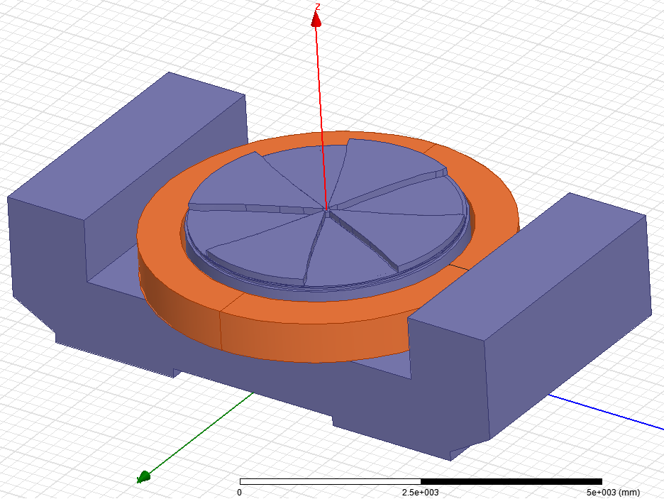
The magnetic system of the cyclotron of multi-charged ions
The cyclotron electromagnet main parameters
Magnet
Magnet type (steel 10) | «H-shaped»
Magnet dimensions, m | 8,1x4x4,3
Pole diameter, m | 4
Number of sectors per pole | 4
The gap "valley / hill" on the iron, mm | 370 / 80
Induction range in the center (for different types of ions), T | 1,29 - 1,6
The final radius of acceleration, m | 1,8
Sector angle, maximum, ⁰ | 51
Maximum induction in the hill, T | 2,15
Mass Fe/Cu, t | 870/72
Power supply capacity, kW | 262
Correction coils | radial, azimuthal
Output system
Output devices | Electrost. deflector + magnetic channel

Slide 8
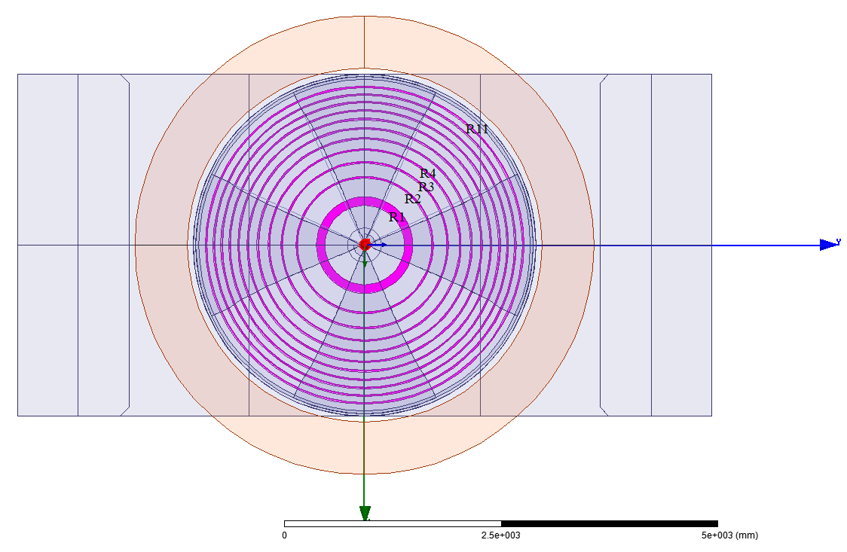
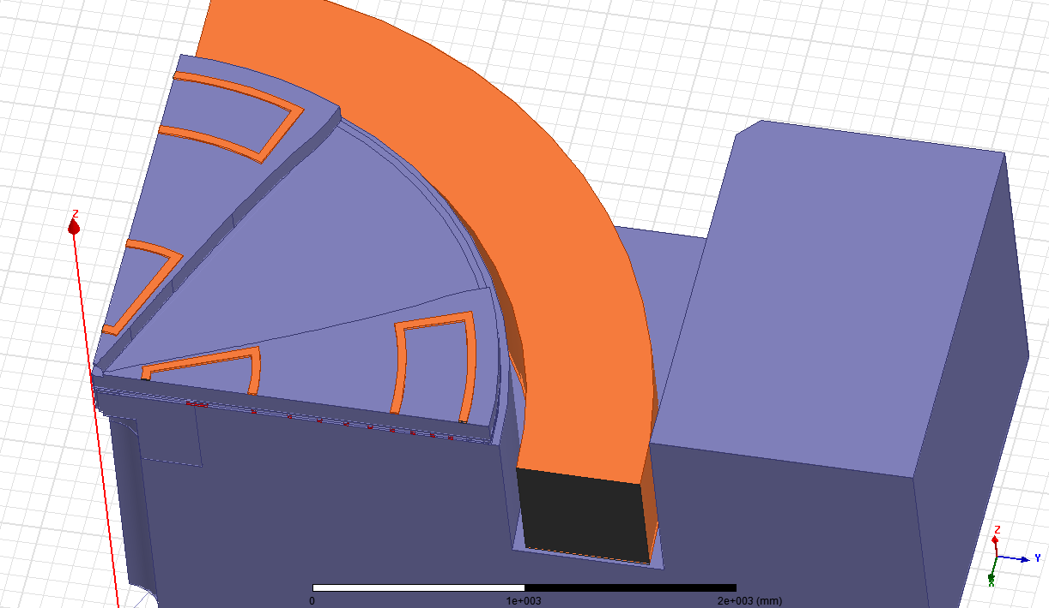
Correcting magnet coils
Number of pairs of radial correction coils | 11
Number of pairs of azimuth correction coils | 8
Power consumption of the correction coils, kW, no more | 20
The location of the radial correction coils in the aluminum base under the sectors
Arrangement of azimuth correction coils

Slide 9
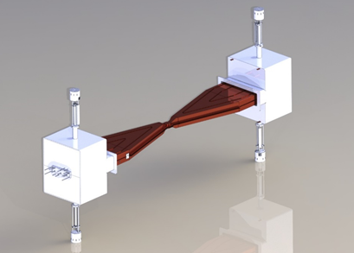
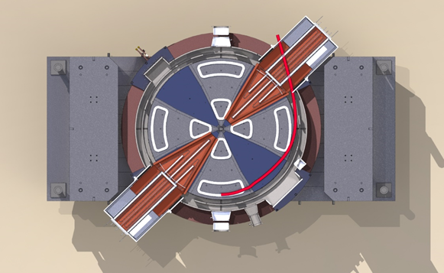
Resonance accelerating system of the cyclotron of multicharged ions
The resonance system main parameters:
The maximum amplitude of the RF voltage is 70 kV,
The operating frequency range is 13-20 MHz.
Operational frequency control is carried out by changing the gaps between the part of the rod and the single-link panels, which are equipped with contact nodes with ball contacts.
3D model of the resonance system
3D model of an electromagnet with a resonance system

Slide 10
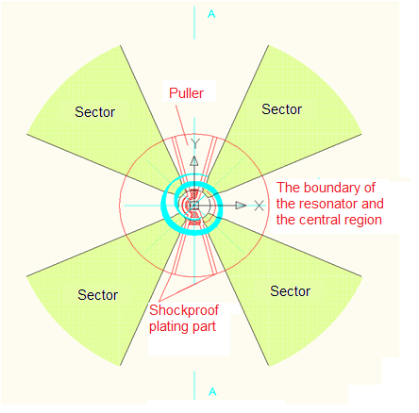
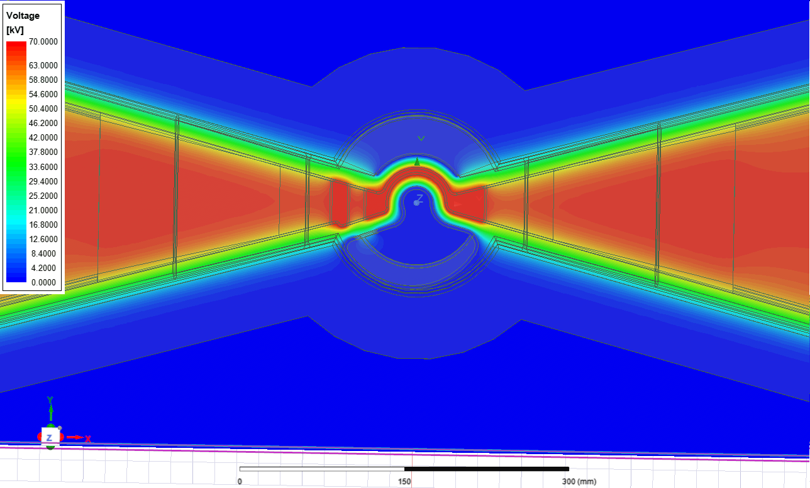
Central region
Potential distribution in the median plane
The beam trajectory in the central acceleration region

Slide 11
High-frequency power supply system
The RF power supply system provides generation of high-frequency power in a given range and stabilization of the high-frequency accelerating field in the resonance system.
The composition of the RF power supply system:
a high-voltage power supply with a set of switching equipment;
module for control and stabilization of parameters;
control, monitoring, protection and measurement system;
RF generator (pre-amplifier, pre-terminal stage, terminal stage);
RF power input device.
A special feature of the system is the placement of the RF generator terminal stage in a separate cabinet next to the resonance system and the use of high-frequency power conduction input. The remaining nodes of the high-frequency power supply system contain radio-electronic components and are placed outside the radiation protection in the room of the power and control systems.
Main characteristics of the RF power supply system
operating frequency, MHz | 13 - 20
frequency stability, | 1×10⁻⁶
output power, kW, not less | 60
stability of the RF voltage amplitude at the duants | 1×10⁻³

Slide 12
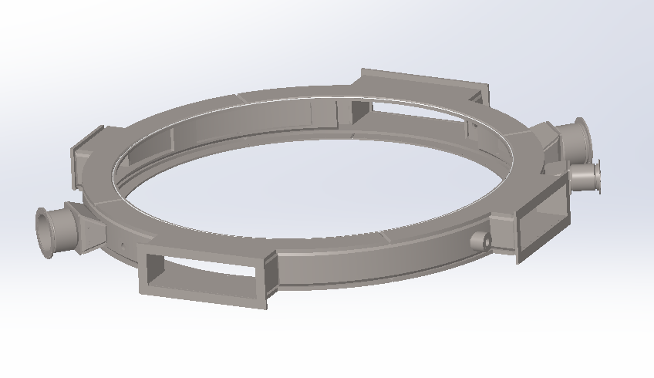
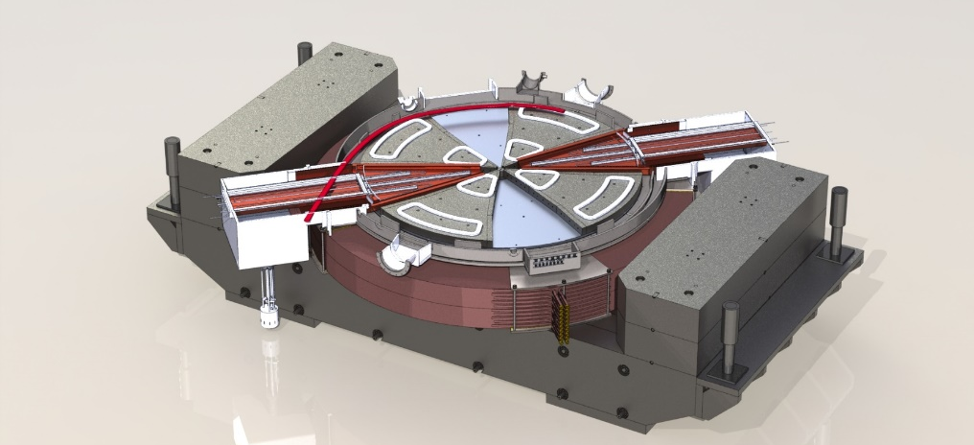
Vacuum chamber
The working vacuum is 10⁻⁷ Torr.
The vacuum chamber consists of a titanium body and two covers, which are used as pole tips of the magnet.
Vacuum chamber housing
3D model of a electromagnetic with a vacuum chamber installed

Slide 13
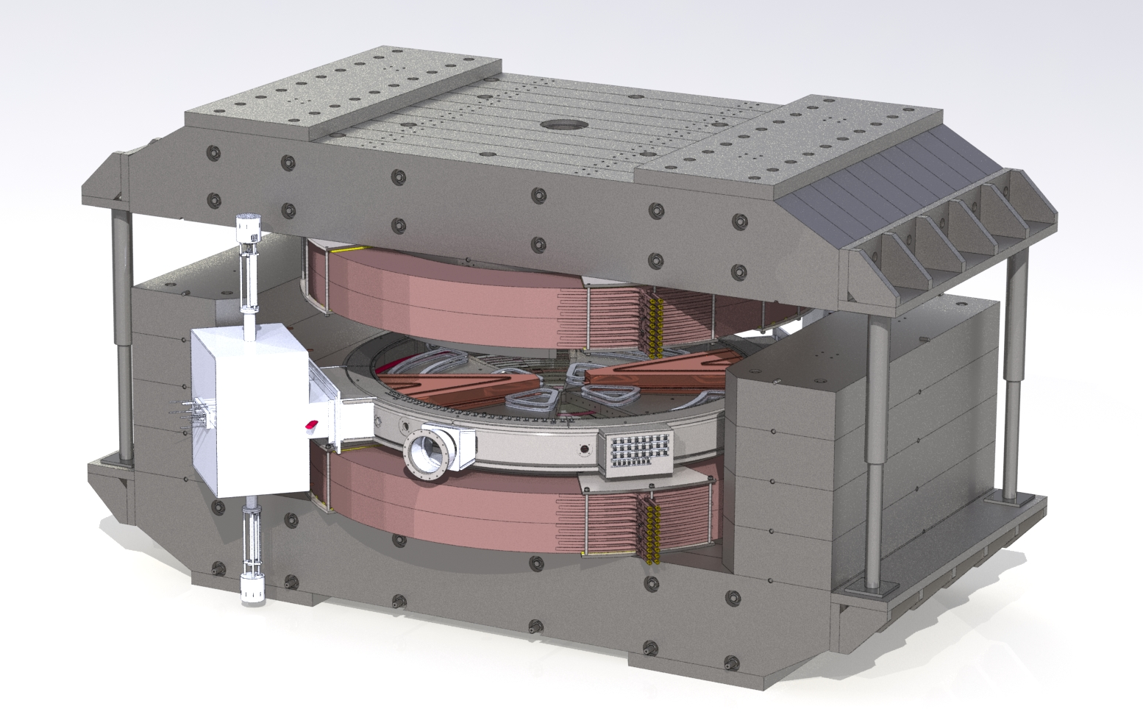
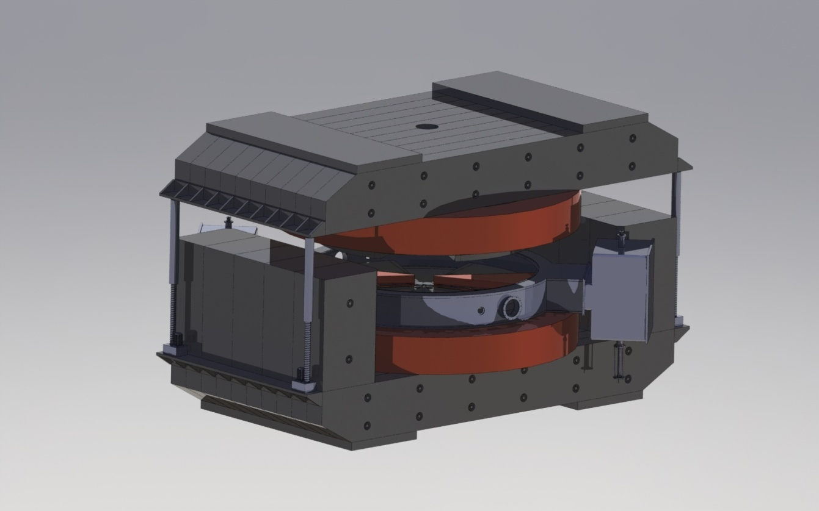
Upper girder lifting system
The electromagnet is equipped with an electromechanical lifting system of the upper half-frame with a load capacity of at least 350 tons. The electric drive of the lifting mechanism must ensure smooth movement of the upper half-frame along four guides to a height of at least 800 mm.

Slide 14
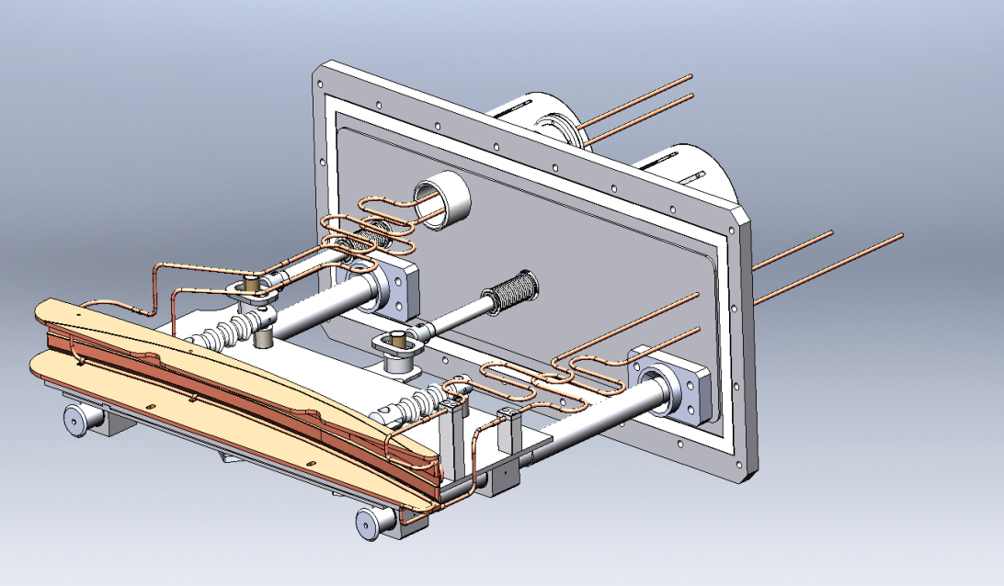
Device for releasing a beam from a cyclotron
3D model of the electrostatic deflector
The main parameters of the deflector
Angle length of the electrostatic deflector | 37⁰
Potential on the high-voltage plate | ~100 kV

Slide 15
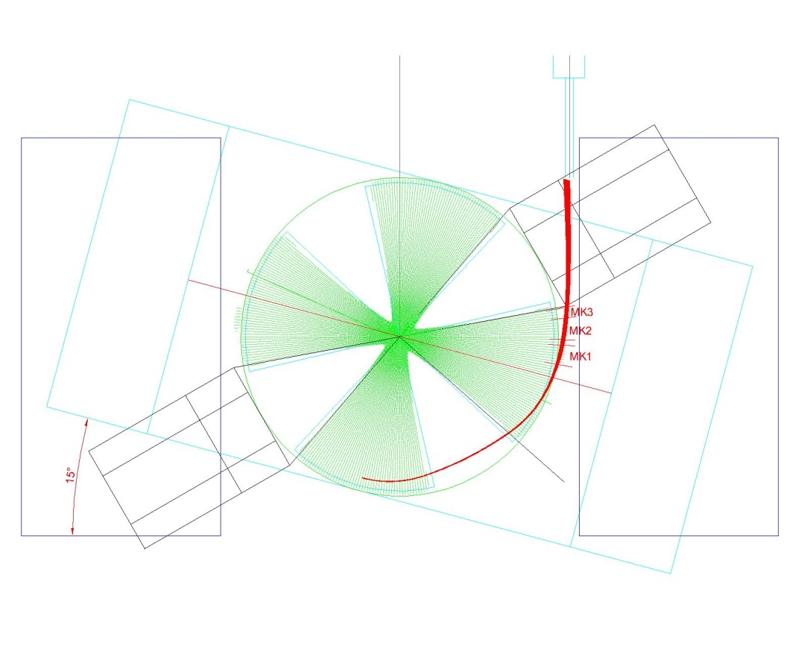
Beam release
As an example, the trajectory of the released ion beam
Xenon-136 (+23) at the entrance to the ion pipeline of the cyclotron beam transportation system in the 330 kA·turn.
MK1 - gradient corrector made of two ferromagnetic plates
MK2 – radially - focusing magnetic channel made of permanent magnets
MK3 – vertically - focusing magnetic channel made of permanent magnets
Parameters of the magnetic channel
Magnetic channel length | 0,3 m
Magnetic channel gradient | 12-16 T/m

Slide 16
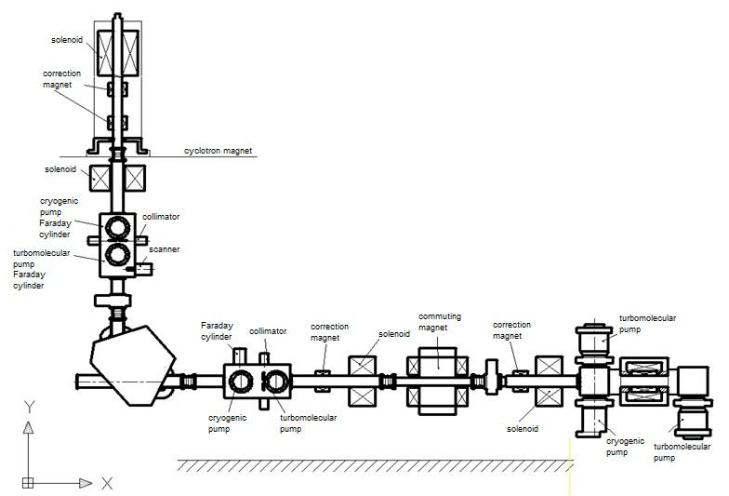
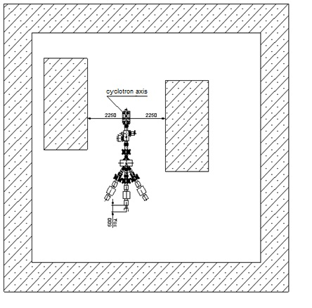
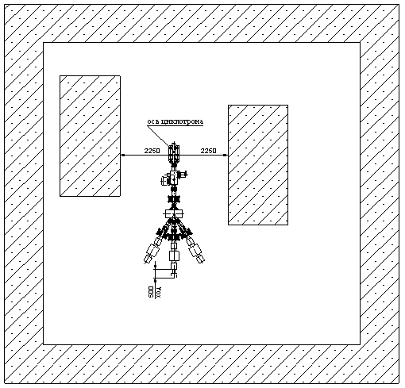
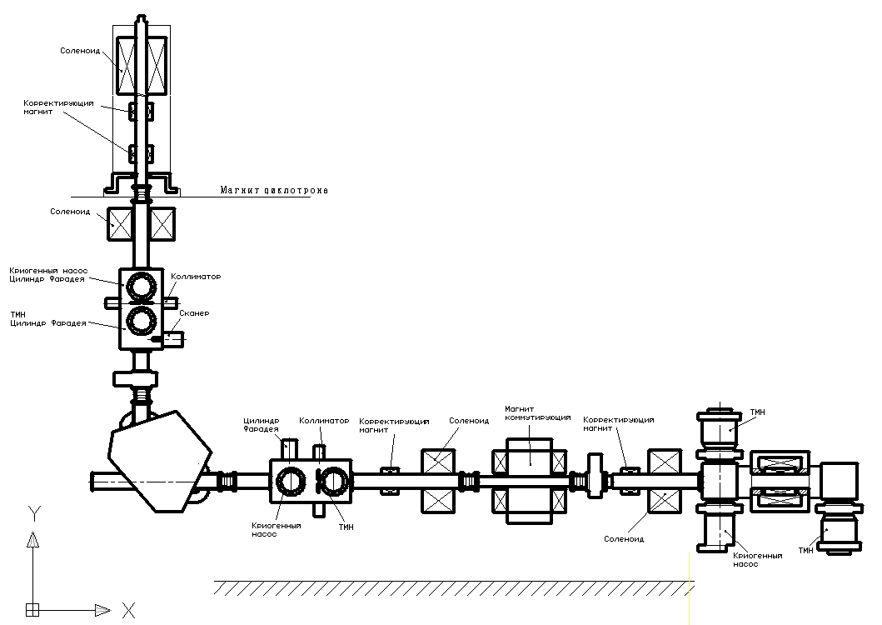
External injection system
The external injection system is designed for obtaining, pre-accelerating, separating and transporting ions to the central area of the cyclotron:
C, O, Ne, Si, Ar, Fe, Kr, Ag, Xe, Bi.
The composition of the external injection system :
- 2 an ECR source with a high-frequency system of 14 GHz;
- 1 electron beam source EBIS.
Location the external injection system multi-charged ions in the basement
Schematic diagram of the external injection system

Slide 17
External injection system
Ion | Charge | A / Z | B₀, Т | RF harmonic | W/A, MeV/nucl. | E_{inj}, keV/charge
Ne₂₀ | 3 | 6,67 | 1,43 | 4 | 7,19 | 13,68
 | 5 | 4 | 1,29 | 4 | 16,5 | 18,5
 | 6 | 3,33 | 1,42 | 2 | 27,9 | 28,1
Si₂₈ | 4 | 7 | 1,5 | 4 | 7,18 | 14,3
 | 6 | 4,67 | 1,5 | 4 | 16,5 | 21,5
 | 9 | 3,11 | 1,42 | 2 | 32,1 | 28,9
Ar₄₀ | 6 | 6,67 | 1,43 | 4 | 7,19 | 13,68
 | 10 | 4 | 1,3 | 4 | 16,5 | 18,5
Fe₅₆ | 9 | 6,22 | 1,35 | 4 | 7,36 | 13,08
 | 14 | 4 | 1,3 | 4 | 16,5 | 18,5
Kr₈₄ | 14 | 6 | 1,29 | 4 | 7,18 | 12,38
 | 18 | 4,66 | 1,5 | 4 | 16,5 | 21,5
Ag₁₀₇ | 18 | 5,94 | 1,29 | 4 | 7,31 | 12,5
 | 22 | 4,86 | 1,6 | 4 | 16,88 | 23,51
Xe₁₃₆ | 23 | 5,91 | 1,29 | 4 | 7,39 | 12,57
 | 28 | 4,86 | 1,6 | 4 | 16,88 | 23,51
Bi₂₀₉ | 35 | 5,97 | 1,29 | 4 | 7,29 | 12,44
 | 43 | 4,86 | 1,6 | 4 | 16,85 | 23,51
C₁₂ | 2 | 6 | 1,29 | 4 | 7,18 | 12,3
 | 3 | 4 | 1,29 | 4 | 16,5 | 18,5
 | 4 | 3 | 1,42 | 2 | 34,4 | 30
O₁₆ | 3 | 5,33 | 1,29 | 4 | 9,08 | 13,9
 | 5 | 3,2 | 1,42 | 2 | 30,1 | 27
O₁₈ | 3 | 6 | 1,32 | 4 | 7,5 | 12,96
 | 4 | 4,5 | 1,43 | 4 | 15,7 | 20,28

Slide 18
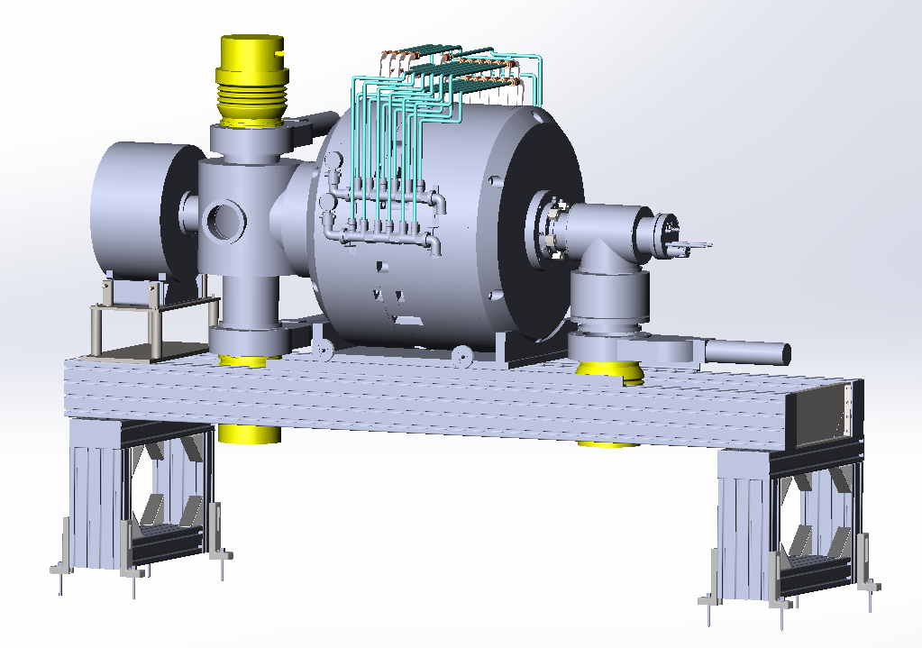
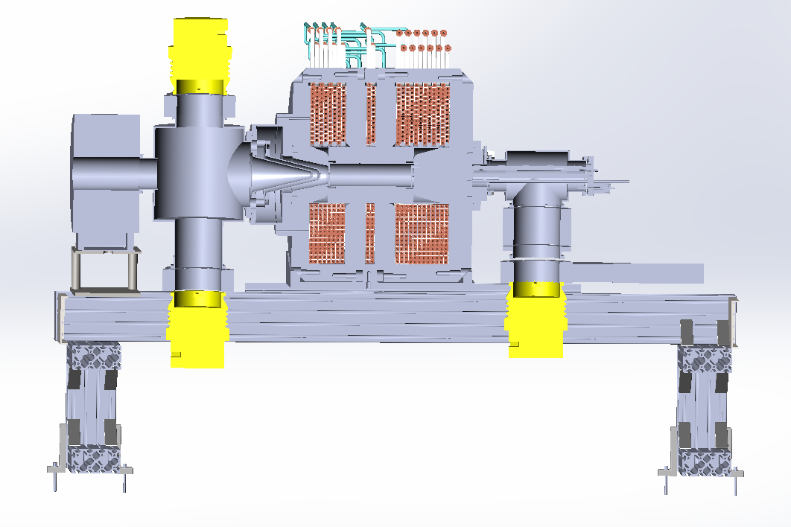
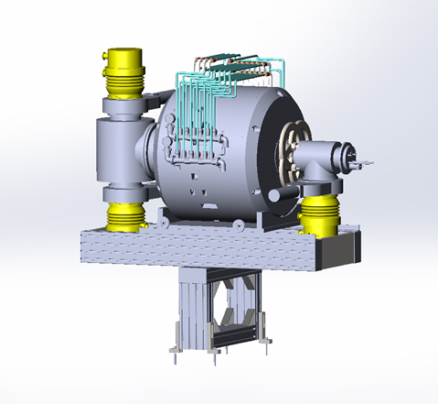
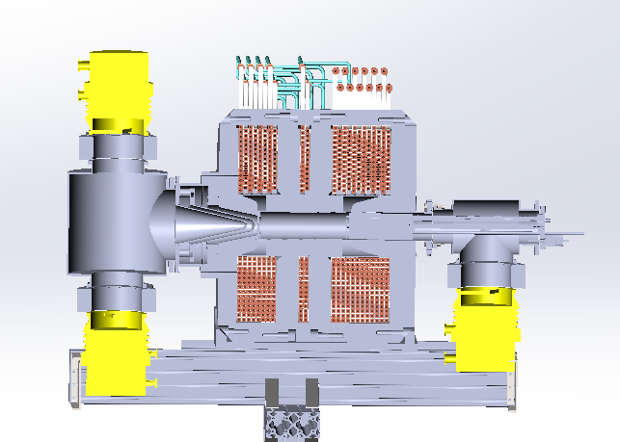
14 GHz ECR source
1
1
6
1
5
2
7
8
2
4
3
1
Section of the ECR source at 14 GHz
(1- turbo molecular pump, 2-vacuum chamber, 3-crio pump, 4-injector unit, 5-electrodes extracting, 6-solenoid windings, 7- hexapole, 8- focusing solenoid)
3D model of a 14 GHz ECR source
In the ion sources and in the ion pipelines of the injector, the vacuum will be maintained at the level of 5×10⁻⁸ Torr.
18

Slide 19
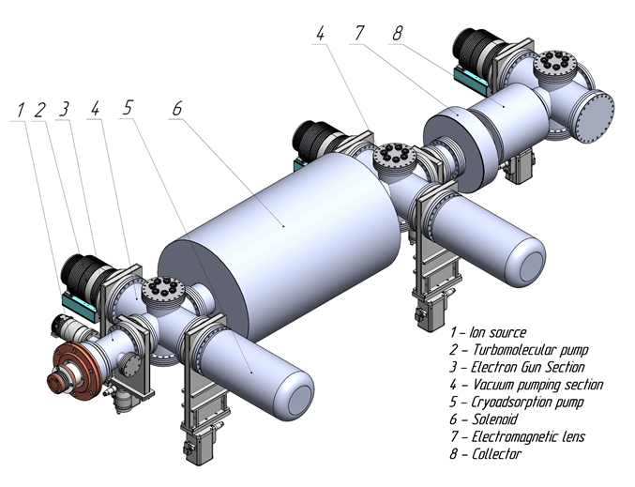
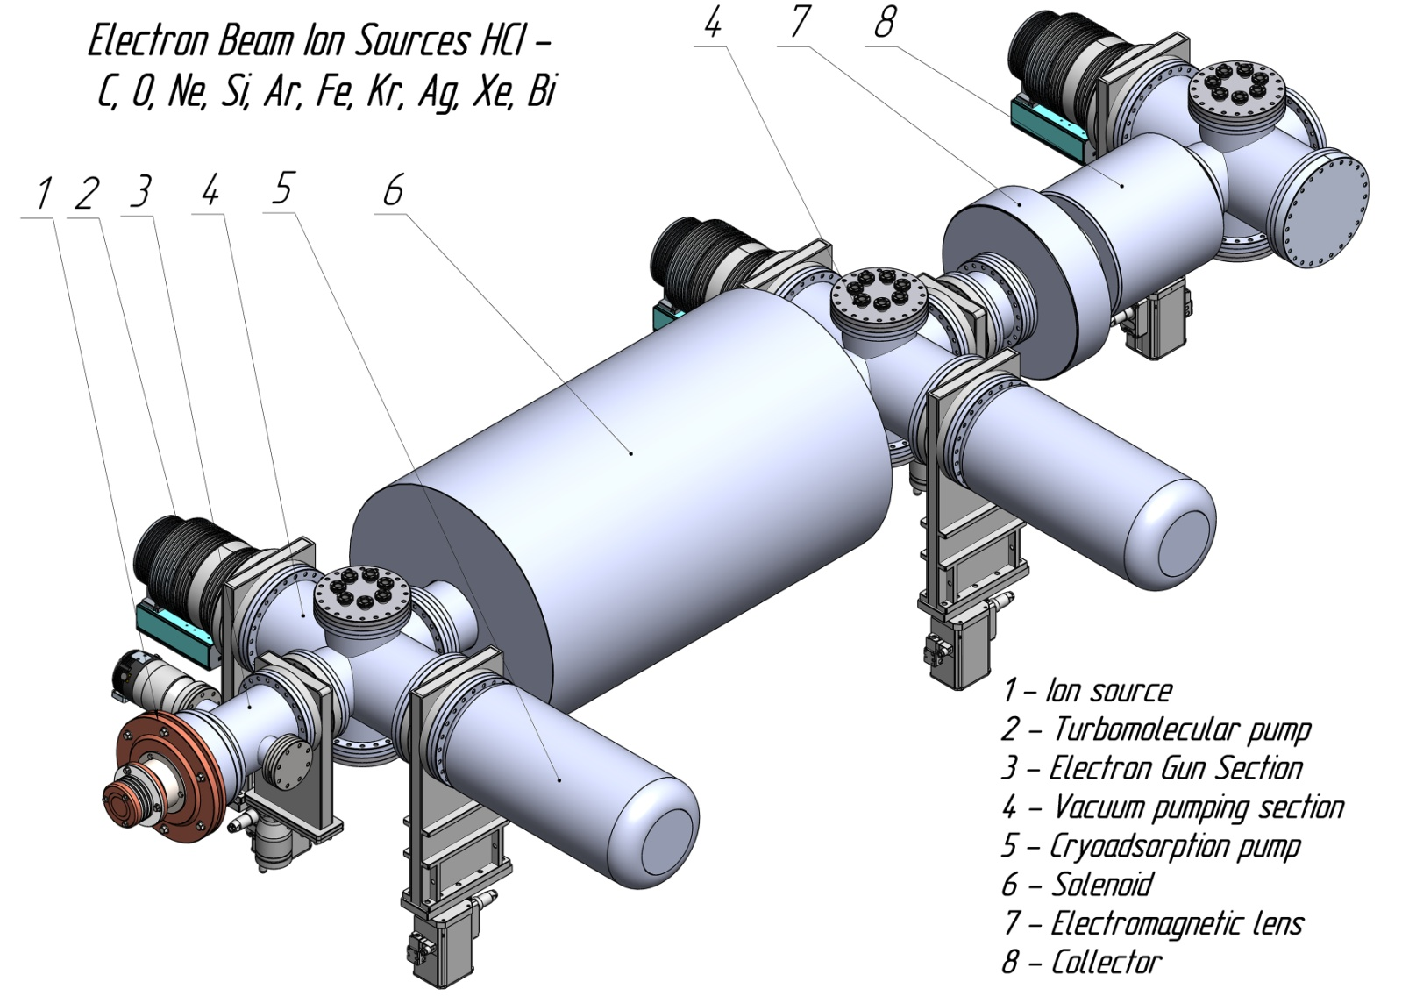
Source EBIS
Composition of the EBIS source
Source of low-charge ions of the Penning type, duaplasmatron;
Electron source with a hollow cathode (electron beam energy-15 keV, current-1 A);
Cryogenic superconducting closed-loop solenoid with a length of 1.12 m (B up to 3 T);
Drift tube system;
Electromagnetic collector lens;
Span electron collector;
Vacuum system;
A set of vacuum valves and pumping means;
Ion source gas supply system;
Power supply system;
Water cooling system for an ion source, an electromagnetic lens and a collector.

Slide 20
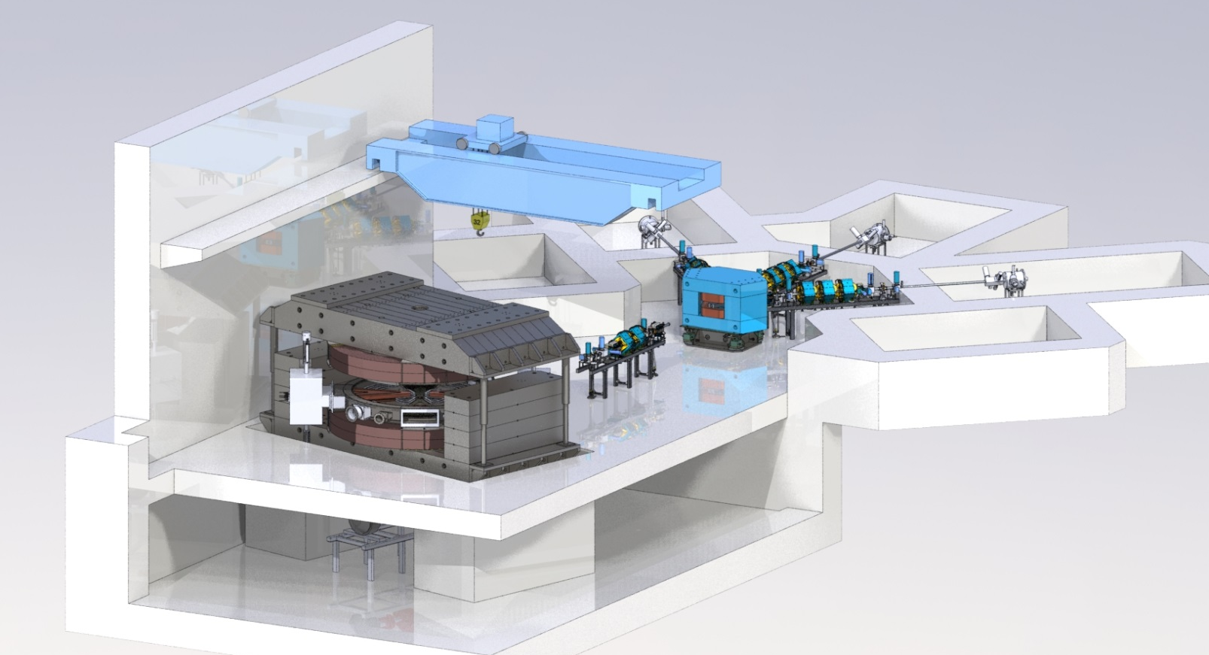
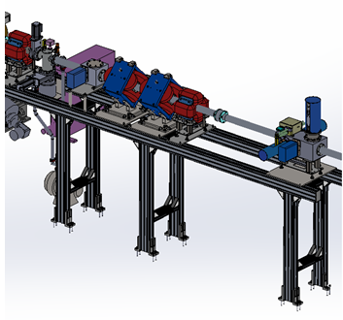
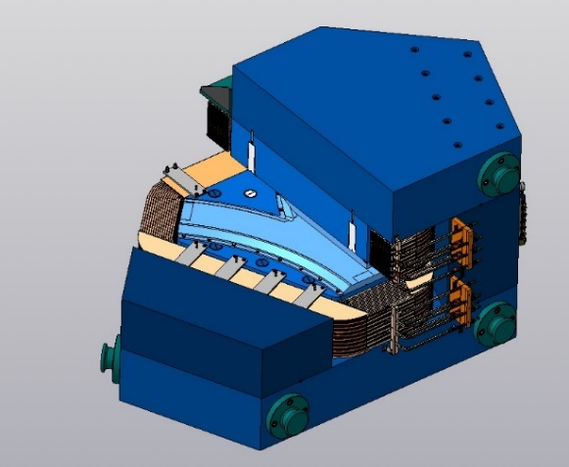
Beam forming and transportation system
The composition of the beam forming and transportation system for 3 end devices:
commutating electromagnet– 1 piece,
quadrupole lenses-11 pieces,
correcting electromagnets – 5 pcs,
a set of collimators and forming diaphragms,
diagnostic blocks with Faraday cylinders and beam density sensors, a set of ion conduits and pumping chambers,
a set of stands.
Main characteristics of the commutating electromagnet
Magnet type | «H-shaped»
maximum effective induction, T | 1,76
the mass of the electromagnet (Fe/Cu), t | 35,3/2,1
power consumption, kW | 23,6
3D model of the multicharged ion cyclotron with a beam transport system
Commutating electromagnet
3 D модель тракта транспортировки пучка

Slide 21
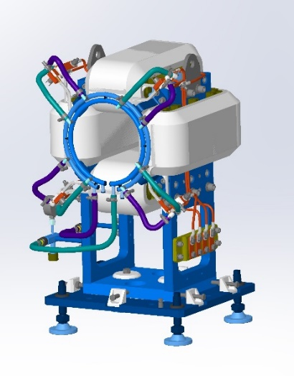
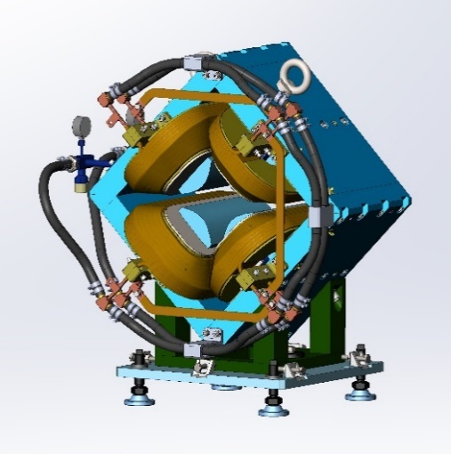
Electromagnetic elements of the beam formation and transportation system
Correcting electromagnet
Quadrupole lens
The main characteristics of the correcting electromagnet
Diameter of the aperture, mm | 115
Induction on the centerline in the center of the electromagnet, T | 0,047
Maximum dissipated power, kW | 0,5
Mass, kg | 127
The main characteristics of the quadrupole lens
Diameter of the aperture, mm | 115
Induction gradient, T/m | 10
Maximum dissipated power, kW | 7
Mass, kg | 541

Slide 22
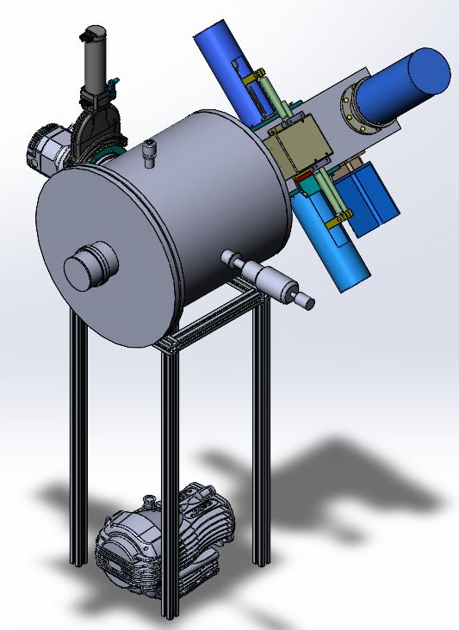
Sample irradiation system
The sample irradiation system consists of three identical sets, including a beam release device, an irradiation chamber, equipment for positioning (test cells) and fixing the irradiated samples, monitoring and monitoring the irradiation conditions (angle of rotation relative to the beam axis), ion beam diagnostics by current, spot size.
A special feature of this project is the need to obtain and measure ion beams with a mass from 12 to 209 au at an ultra-low density, from 10² cm⁻²×s⁻¹ to 10⁵ cm⁻²×s⁻¹ on an irradiation area of at least 50×50 mm².
3D model of the vacuum chamber

Slide 23
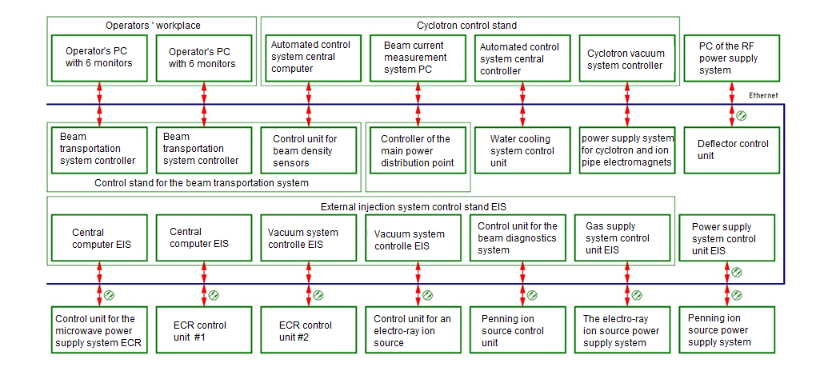
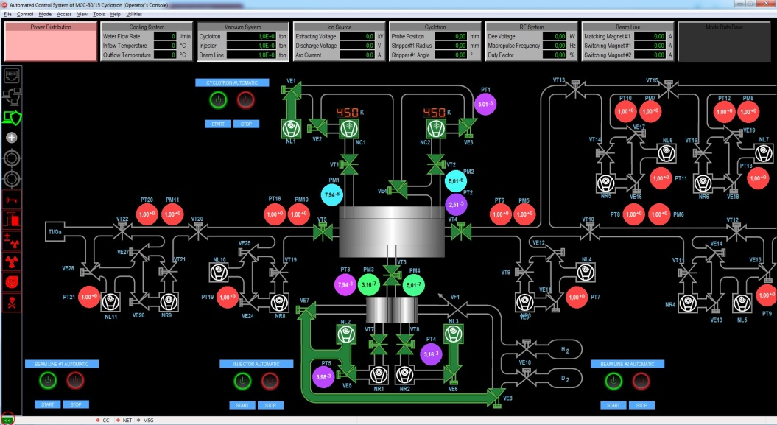
Automated control system of the multicharged ion cyclotron complex
Automated control system it is equipped with an uninterruptible power supply sufficient for the operation of the control system for an hour in the event of a power outage.
Automated control system of the cyclotron CC‑30/15 for TINT
23

Slide 24
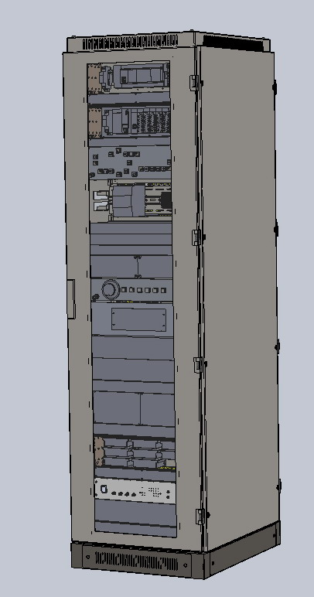
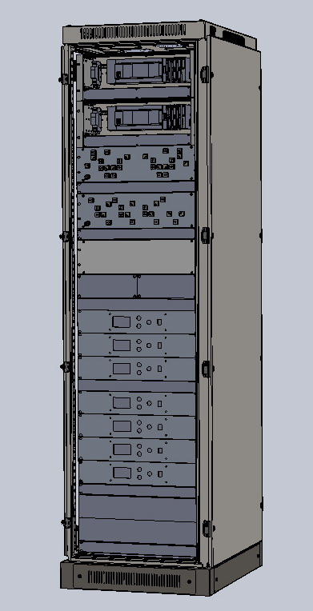
Automated control system
Automated control system provides :
control of all systems of the cyclotron complex with the display of parameters on the automated control system monitors in real time, as well as saving these parameters in the library of "modes" and printing them out if necessary;
creating a library of parameters for each mode of operation of the cyclotron complex (the type of accelerated ions, their energy, intensity, direction of movement along the transport path), which can be used to set previously worked-out modes, as well as expand and adjust it with new parameters for subsequent use in the future;
diagnostics of cyclotron complex systems with their status displayed on the screen, as well as fixing the equipment that has left the normal operation mode or is located in the boundary zone (an emergency situation);
the system of interlocks of the cyclotron complex associated with the operation of independent systems;
emergency shutdown of the cyclotron;
disabling the beam operation mode.
3D model of cyclotron control racks

Slide 25
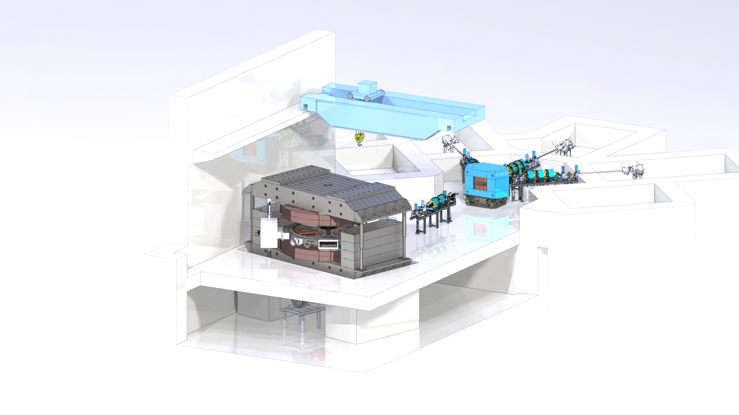
Conclusion
A complex of computational works was performed to determine the characteristics of the main systems of the cyclotron, which made it possible to increase the energy of multicharged ions from 10 MeV per nucleon according to the technical specification to 15 MeV per nucleon;
a technical project for a cyclotron complex of multicharged ions has been developed;
design documentation for the cyclotron was developed;
the technical task for the placement of equipment has been developed;
the production of the main components of the cyclotron of multicharged ions has begun.

Slide 26
Thank you for your attention!

