Slide 1

Simulation and Design of the Permanent Magnet Multipole for DC140 Cyclotron
I. Rodin, A. Firsov, M. Kaparkova, V. Kukhtin, E. Lamzin, M. Larionov, A. Makarov,
A. Nezhentzev, N. Shatil, S. Sytchevsky, JSC “NIIEFA”, St. Petersburg, Russia
G. Gulbekyan, I. Ivanenko, N. Kazarinov, I. Kalagin, N. Osipov,
Flerov Laboratory, JINR, Dubna, Russia
N. Edamenko, D. Ovsyannikov, St.Petersburg State University, St.Petersburg, Russia
XXVII Russian Particle Accelerator Conference RuPAC-2021, Alushta, 26 September – 2 October 2021

Slide 2
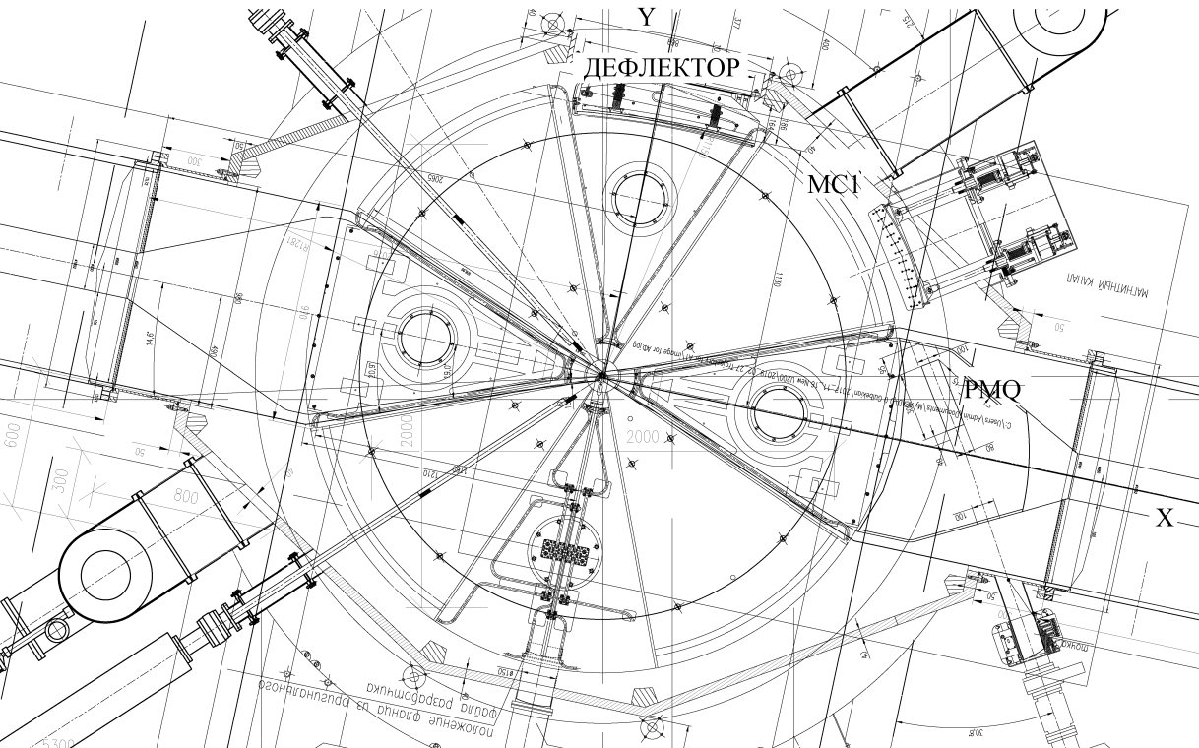
Cyclotron DC140
Working region in DC140
DC140 beam extraction scheme
D – electrostatic deflector
MC1 – passive magnetic channel
PMQ – PM quad
1 – closed orbit
2 – extraction orbit
XXVII Russian Particle Accelerator Conference RuPAC-2021, Alushta, 26 September – 2 October 2021

Slide 3
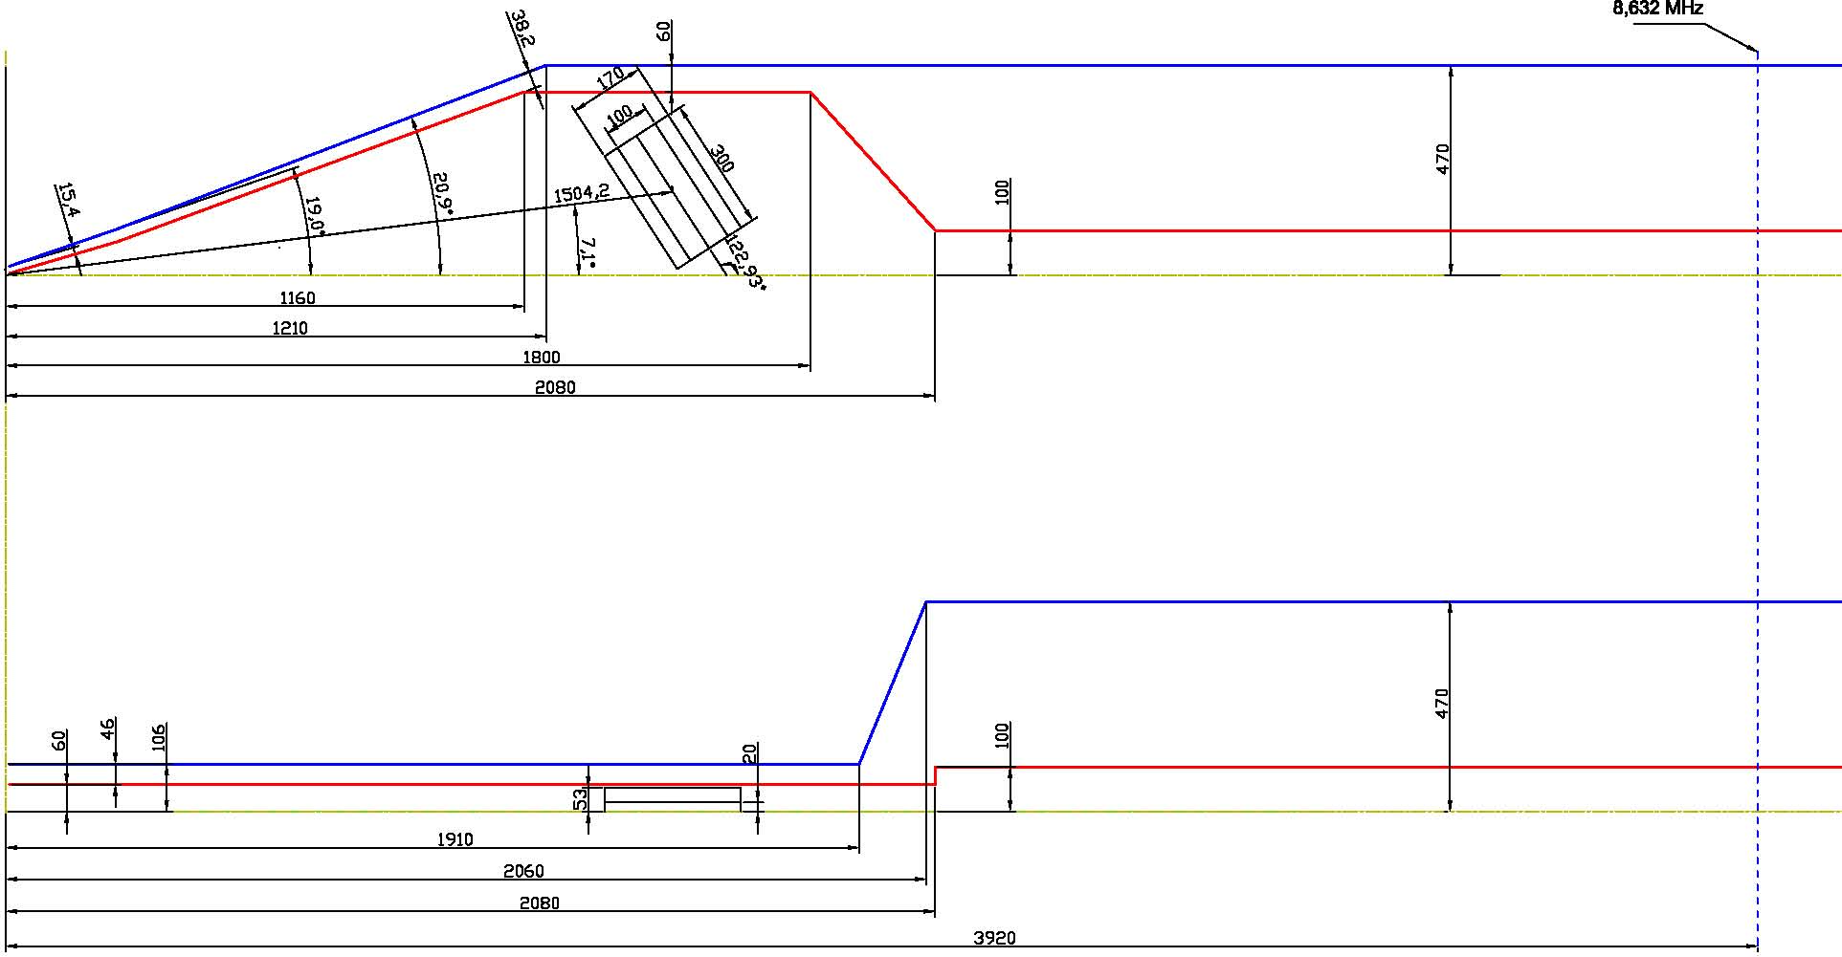
PMQ arrangement with DC140 dees
XXVII Russian Particle Accelerator Conference RuPAC-2021, Alushta, 26 September – 2 October 2021

Slide 4
Required PMQ parameters
Field gradient (G₀) | 8.1 T/m
Working region (hor. × vert.) | 64 mm × 25 mm
Aperture (hor. × vert.) | 80 mm × 32 mm
Overall sizes (hor. × vert.) | 170 mm × 106 mm
Effective lenght* (L_{eff0}) | 299.26 mm
Error in working region** (Δ_{x,y}) | ±1%
**A linear approximation error in the horizontal and vertical directions:
*The effective length:
XXVII Russian Particle Accelerator Conference RuPAC-2021, Alushta, 26 September – 2 October 2021

Slide 5
PMQ operating conditions
External field | 0.35 T
Vacuum | 10⁻⁷ Torr
Operating temperature | 30-40 °C
Temperature range | 20-70 °C
Life time | 10-15 years
XXVII Russian Particle Accelerator Conference RuPAC-2021, Alushta, 26 September – 2 October 2021

Slide 6
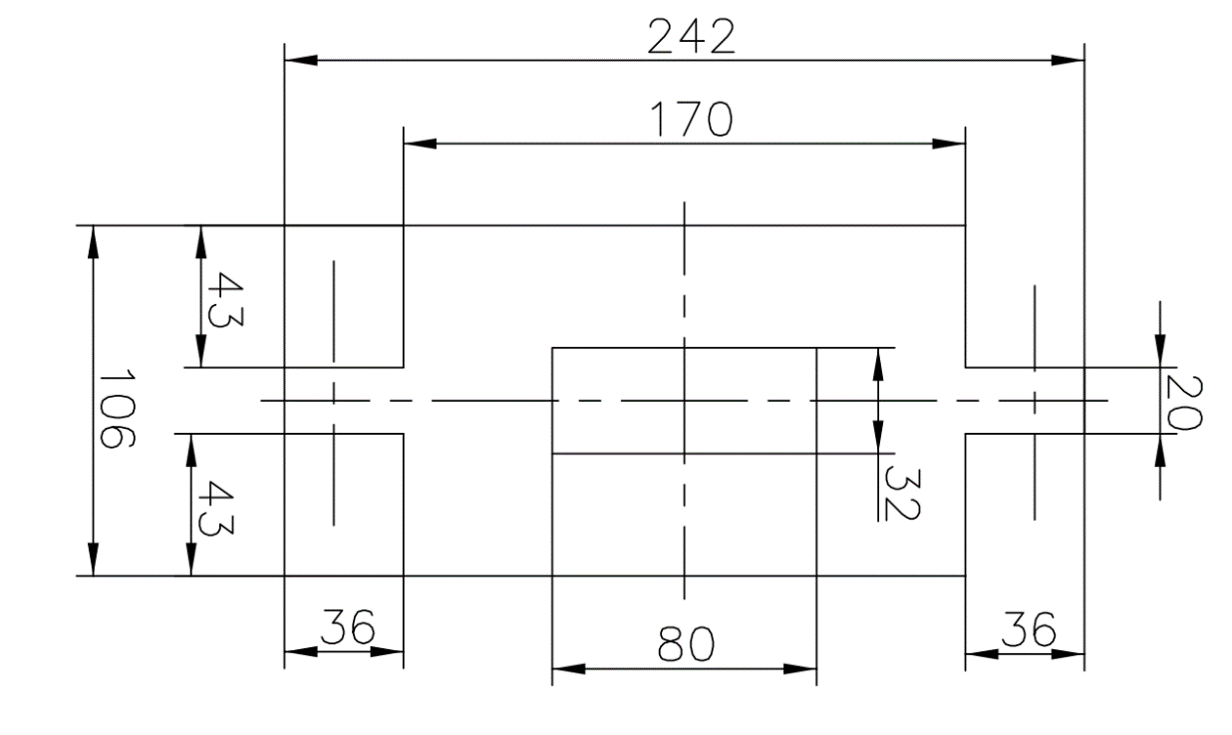
PMQ structure
The DC140 quad will be designed as a set of identical PMs rigidly fixed in a non-magnetic housing encircling the aperture.
Additional aspects of the quad specification
simple PM shape, preferably cuboidal bricks,
minimized number of PM in assembly,
minimized nomenclature,
commercial availability of PM.
XXVII Russian Particle Accelerator Conference RuPAC-2021, Alushta, 26 September – 2 October 2021

Slide 7
Stages of PMQ design
I .
The initial quad design is selected from an analytical study with the use of a simplified 2D model.
At this stage the number and positions of PMs are determined.
II .
Then the chosen configuration is optimized in iterative 2D and 3D parametric simulations with realistic PM shape and magnetic characteristics in mind. Simulated data are used to select candidate magnet materials, number, dimensions, and tolerated mechanical and magnetic errors of PM blocks.
As a result, the quad design is finalized, and an assembly procedure is proposed.
III .
Additional adjustment may be required on the basis of measurements of supplied PM.
The assembled quad is magnetically inspected to make sure the desired field requirements are reached.
XXVII Russian Particle Accelerator Conference RuPAC-2021, Alushta, 26 September – 2 October 2021

Slide 8
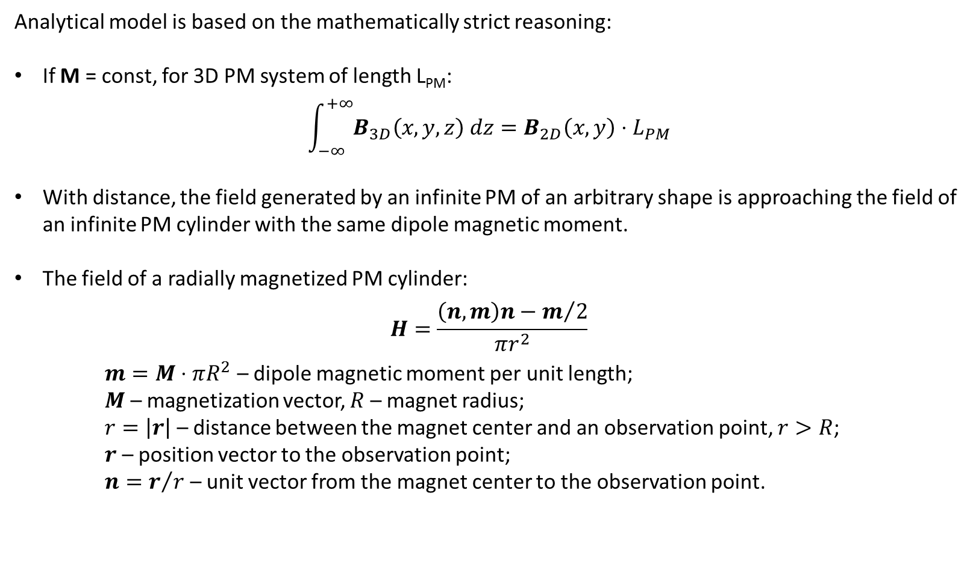
Simplified 2D model of PMQ
Analytical model is based on the mathematically strict reasoning:
If M = const, for 3D PM system of length L_{PM}:
$$\int_{−∞}^{+∞}{B_{3D}\left(x,y,z\right) dz}=B_{2D}\left(x,y\right)⋅L_{PM}$$
With distance, the field generated by an infinite PM of an arbitrary shape is approaching the field of an infinite PM cylinder with the same dipole magnetic moment.
The field of a radially magnetized PM cylinder:
$$H=\frac{\left(n,m\right)n−m/2}{πr^{2}}$$
$m=M⋅πR^{2}$ – dipole magnetic moment per unit length;
$M$ – magnetization vector, $R$ – magnet radius;
$r=\left|r\right|$ – distance between the magnet center and an observation point, $r>R$;
$r$ – position vector to the observation point;
$n=r/r$ – unit vector from the magnet center to the observation point.
XXVII Russian Particle Accelerator Conference RuPAC-2021, Alushta, 26 September – 2 October 2021

Slide 9
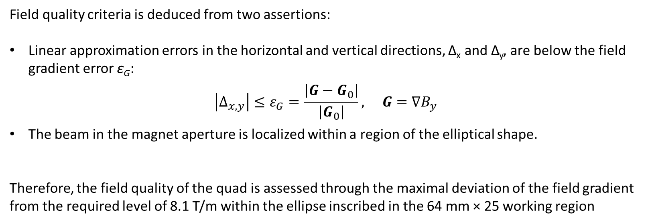
Field quality criteria
Field quality criteria is deduced from two assertions:
Linear approximation errors in the horizontal and vertical directions, Δ_{x} and Δ_{y}, are below the field gradient error ε_{G}:
$$\left|Δ_{x,y}\right|≤ε_{G}=\frac{\left|G−G_{0}\right|}{\left|G_{0}\right|}, G=∇B_{y}$$
The beam in the magnet aperture is localized within a region of the elliptical shape.
Therefore, the field quality of the quad is assessed through the maximal deviation of the field gradient from the required level of 8.1 T/m within the ellipse inscribed in the 64 mm × 25 working region
XXVII Russian Particle Accelerator Conference RuPAC-2021, Alushta, 26 September – 2 October 2021

Slide 10
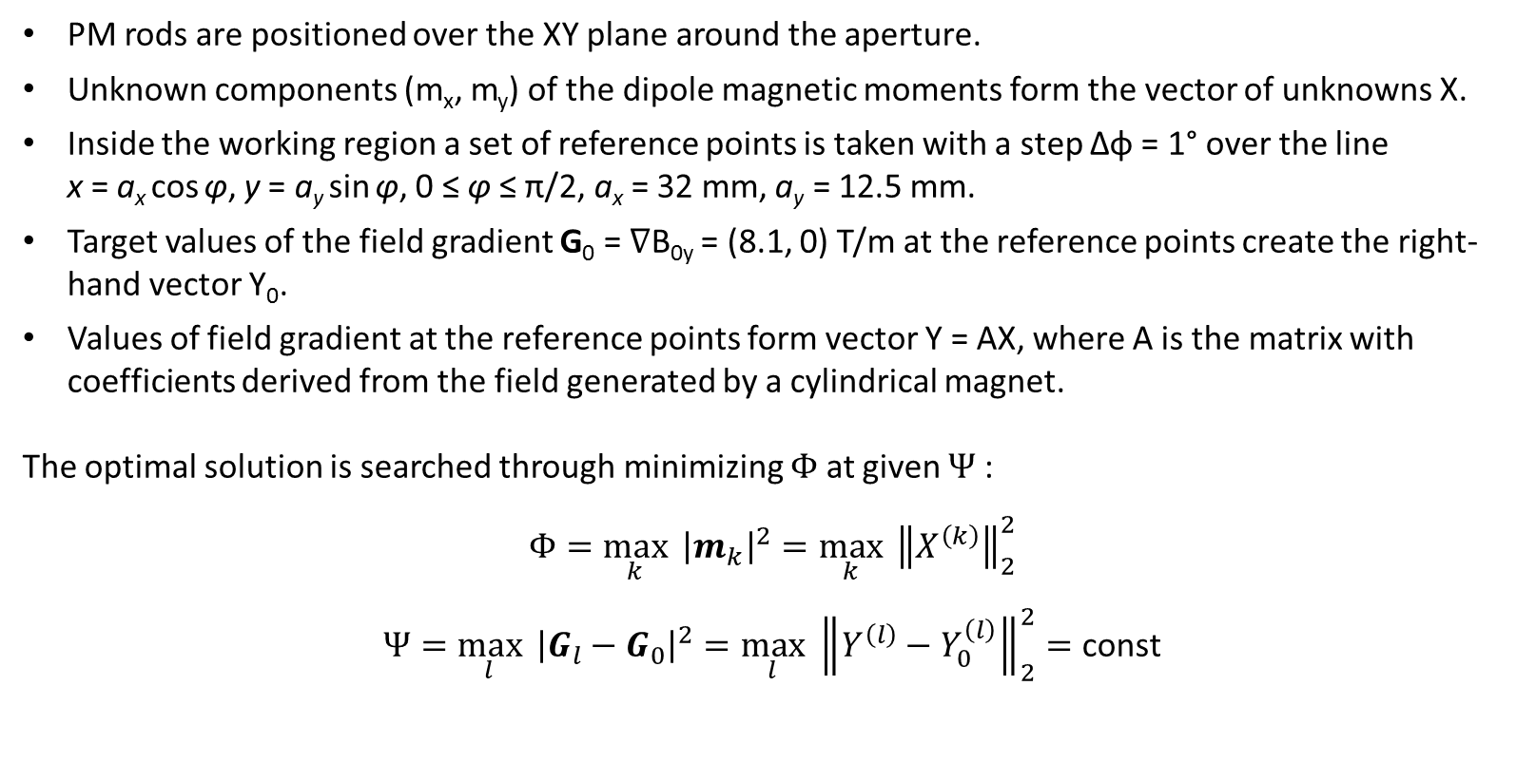
PMQ optimization using simplified 2D model
PM rods are positioned over the XY plane around the aperture.
Unknown components (m_{x}, m_{y}) of the dipole magnetic moments form the vector of unknowns X.
Inside the working region a set of reference points is taken with a step Δφ = 1° over the line x = a_{x} cos φ, y = a_{y} sin φ, 0 ≤ φ ≤ π/2, a_{x} = 32 mm, a_{y} = 12.5 mm.
Target values of the field gradient G₀ = ∇B_{0y} = (8.1, 0) T/m at the reference points create the right-hand vector Y₀.
Values of field gradient at the reference points form vector Y = AX, where A is the matrix with coefficients derived from the field generated by a cylindrical magnet.
The optimal solution is searched through minimizing $Φ$ at given $Ψ$:
$$Φ=\max_{k}{ {\left|m_{k}\right|}^{2}}=\max_{k}{ {\left\|X^{\left(k\right)}\right\|}_{2}^{2}}$$
$$Ψ=\max_{l}{ {\left|G_{l}−G_{0}\right|}^{2}}=\max_{l}{ {\left\|Y^{\left(l\right)}−Y_{0}^{\left(l\right)}\right\|}_{2}^{2}}=\text{const}$$
XXVII Russian Particle Accelerator Conference RuPAC-2021, Alushta, 26 September – 2 October 2021

Slide 11
Optimal solution on simplified 2D model
Quad formed with 26 identical 11 mm ×11 mm PM bricks each magnetized to 1.1402Т.
Arrows indicate PM orientations,
dashed lines bound 64mm × 25mm working region,
solid lines are for 80mm × 32mm aperture and 170mm × 106mm overall sizes.
XXVII Russian Particle Accelerator Conference RuPAC-2021, Alushta, 26 September – 2 October 2021

Slide 12
Relative gradient error in PMQ working region
Relative gradient error: ε_{G} = |δG|/|G₀| (%).
Dashed lines indicate 64mm × 25mm working region with inscribed elliptical region.
Field gradient error in the elliptical region was found to be below 0.07%.
XXVII Russian Particle Accelerator Conference RuPAC-2021, Alushta, 26 September – 2 October 2021

Slide 13
Perturbing factors influence on PMQ field quality
Perturbing factor | max ε_{G}
Unperturbed system | 0.07%
Square PM cross-section | 0.5%
Intrinsic PM degaussing (ϰ=0.1) | 5%
Mutual PM magnetization (ϰ=0.1) | 0.6%
Anisotropy ϰ (ϰ_{||M}=0.1, ϰ_{⊥M}=0) | 0.3%
3D representation (ϰ=0.1) | 0.17%
XXVII Russian Particle Accelerator Conference RuPAC-2021, Alushta, 26 September – 2 October 2021

Slide 14
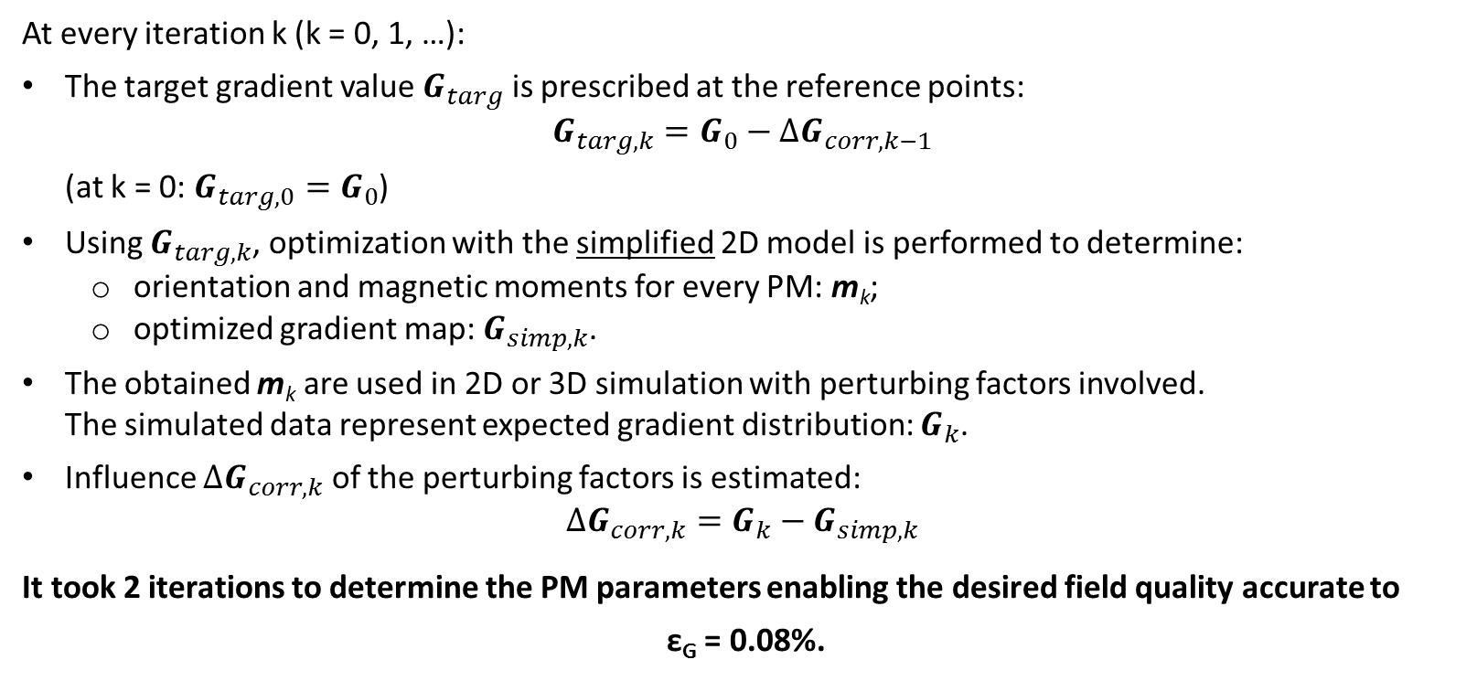
PMQ correction for disturbing factors compensation
At every iteration k (k = 0, 1, …):
The target gradient value $G_{targ}$ is prescribed at the reference points:
$$G_{targ,k}=G_{0}−ΔG_{corr,k−1}$$
(at k = 0: $G_{targ,0}=G_{0}$)
Using $G_{targ,k}$, optimization with the simplified 2D model is performed to determine:
  orientation and magnetic moments for every PM: m_{k};
  optimized gradient map: $G_{simp,k}$.
The obtained m_{k} are used in 2D or 3D simulation with perturbing factors involved.
The simulated data represent expected gradient distribution: $G_{k}$.
Influence $ΔG_{corr,k}$ of the perturbing factors is estimated:
$$ΔG_{corr,k}=G_{k}−G_{simp,k}$$
It took 2 iterations to determine the PM parameters enabling the desired field quality accurate to
ε_{G} = 0.08%.
XXVII Russian Particle Accelerator Conference RuPAC-2021, Alushta, 26 September – 2 October 2021

Slide 15
Optimized PMQ specification
PM parameters at operating temperature
Geometrical and magnetic tolerances
Remanent field B_{r} | 1.1853 T
Magnetic susceptibility ϰ | 0.1
Linear piece of B-H curve | up to 1200 kA/m
Nd-Fe-B grade | N35SH, N35UH
PM cross-section | 11 mm × 11 mm
PM length L_{PM} | 300 mm
Total number of PM | 26
PM dimensions | ± 0.05 mm
Remanent field |B_{r}|:
- average over batch | ± 3%
- single PM | ± 1-1.5%
Magnetization direction in PM | ± 1°
Positioning:
- X, Y, Z coordinates | ± 0.05 mm
- orientation | ± 0.3°
XXVII Russian Particle Accelerator Conference RuPAC-2021, Alushta, 26 September – 2 October 2021

Slide 16
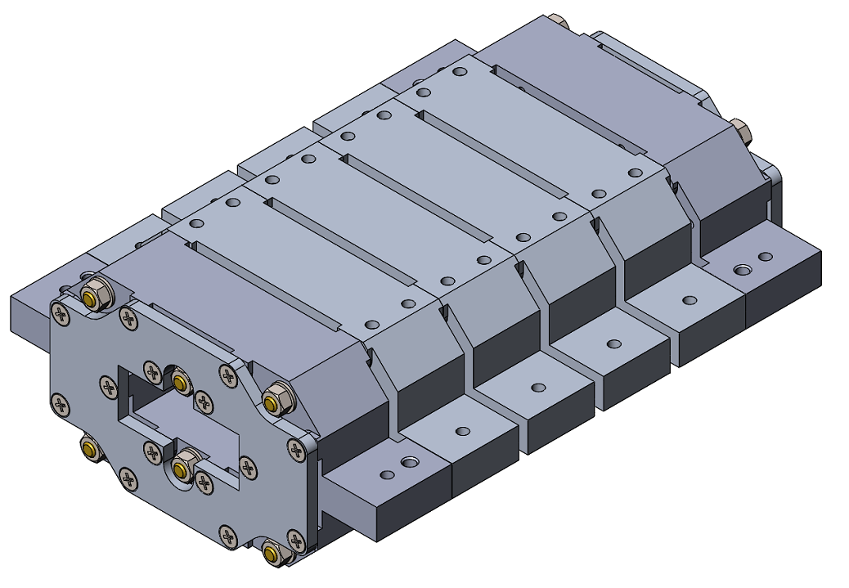
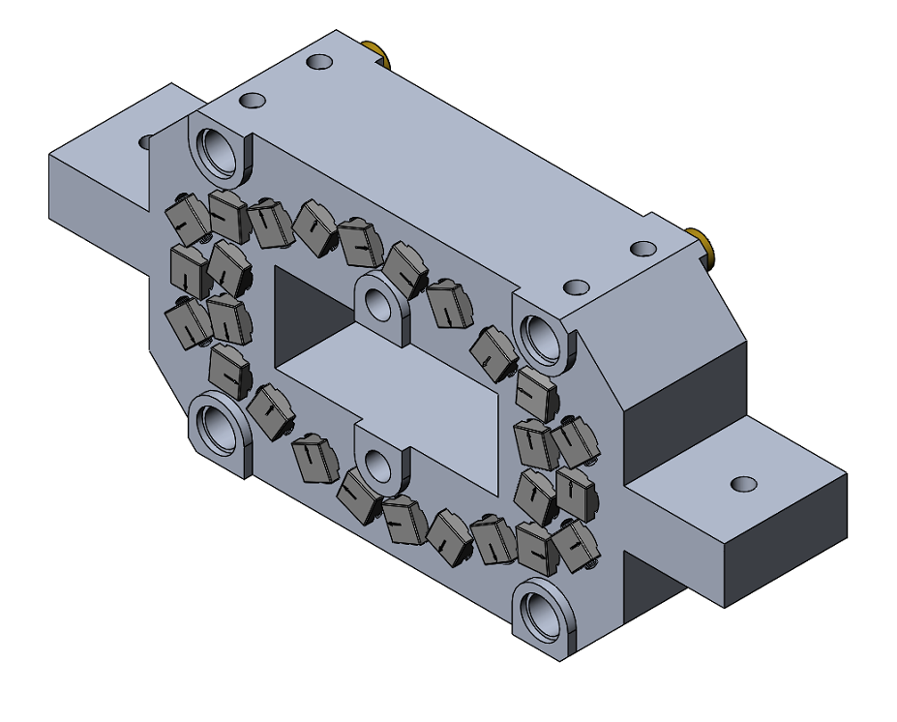
Proposed PM quad design
PMQ segment
PMQ assembly
XXVII Russian Particle Accelerator Conference RuPAC-2021, Alushta, 26 September – 2 October 2021

Slide 17
Thank you!
XXVII Russian Particle Accelerator Conference RuPAC-2021, Alushta, 26 September – 2 October 2021

