Slide 1
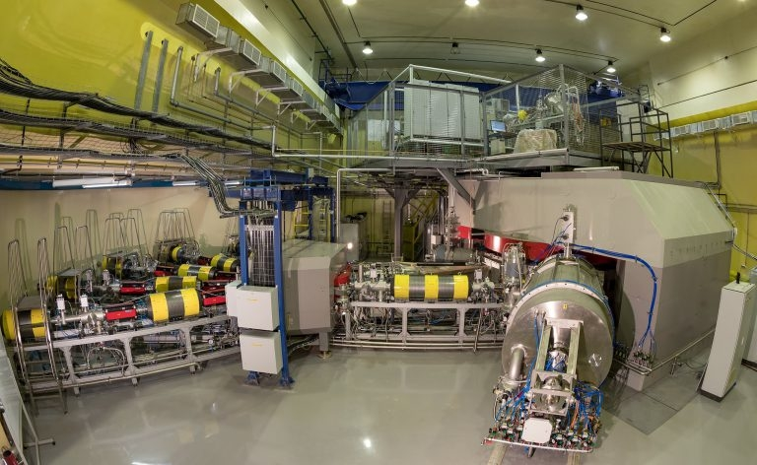


The Experimental Research
of Cyclotron DC-280 Beam Parameters
Vasiliy Semin
Scientific and Technical department of accelerators
FLEROV LABORATORY of NUCLEAR REACTIONS,
Joint Institute for Nuclear Research, Dubna, Russia

Slide 2
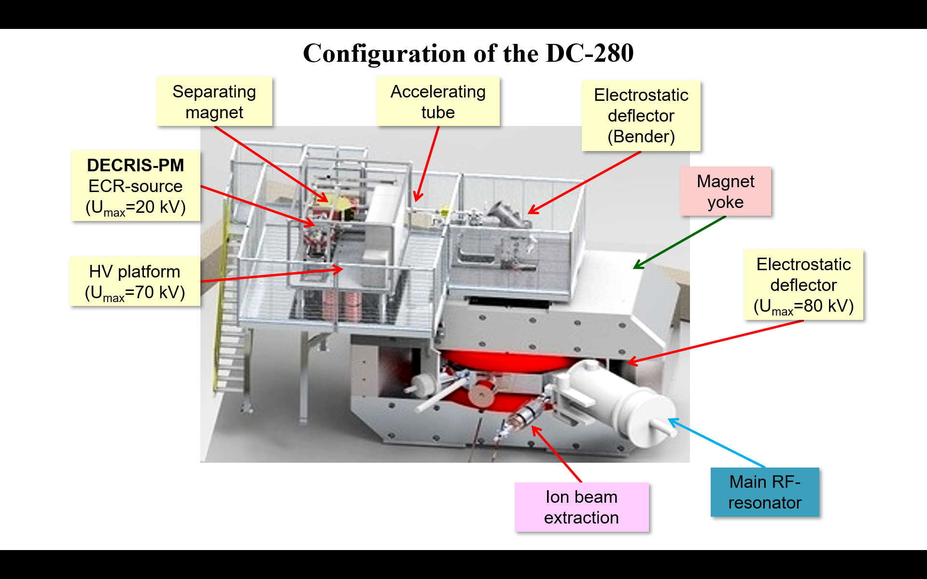
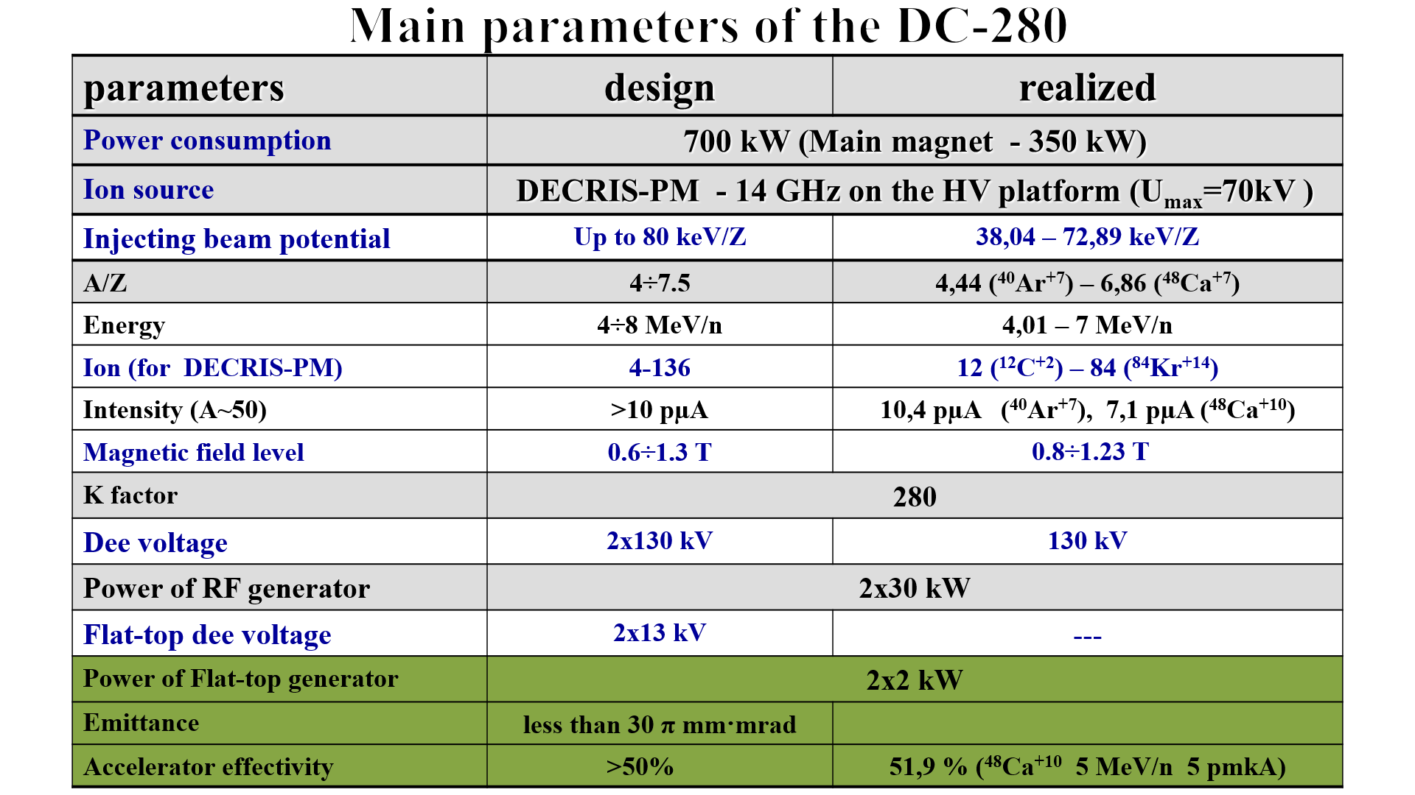
Cyclotron DC-280

Slide 3
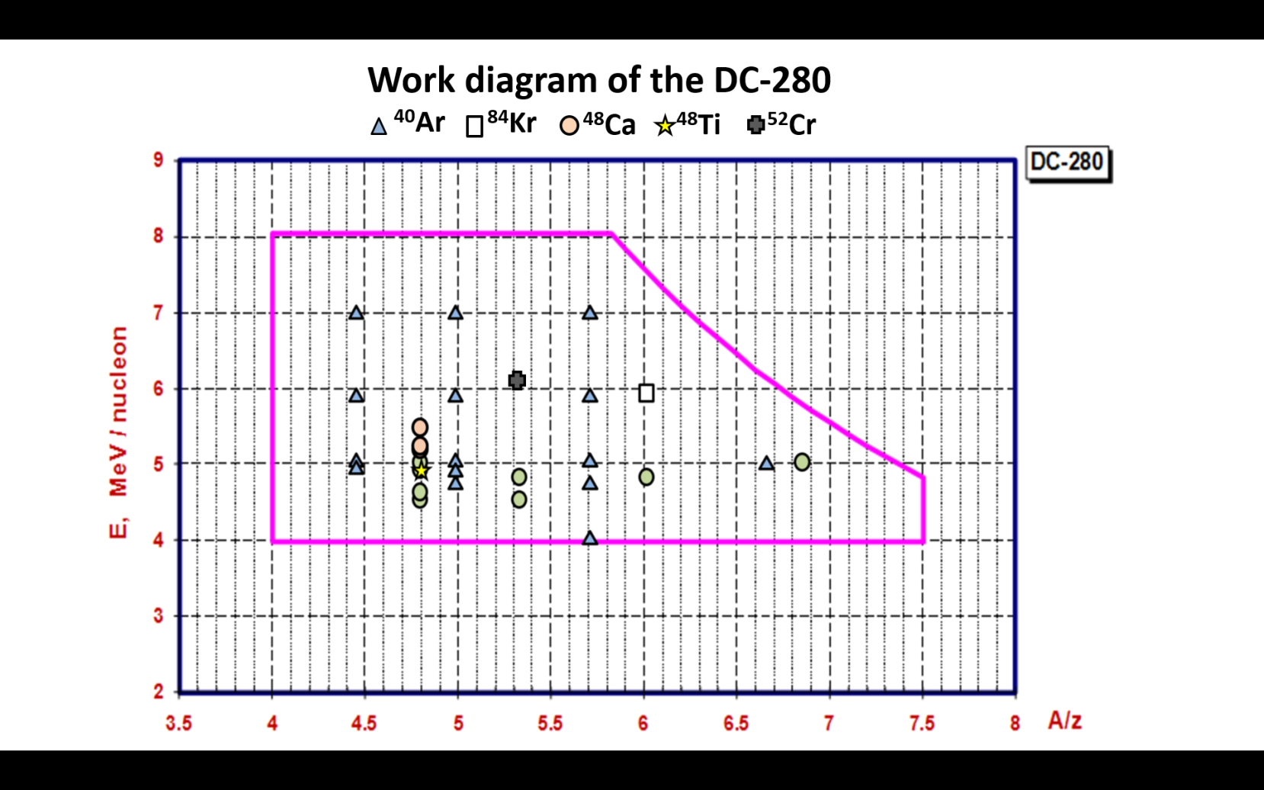
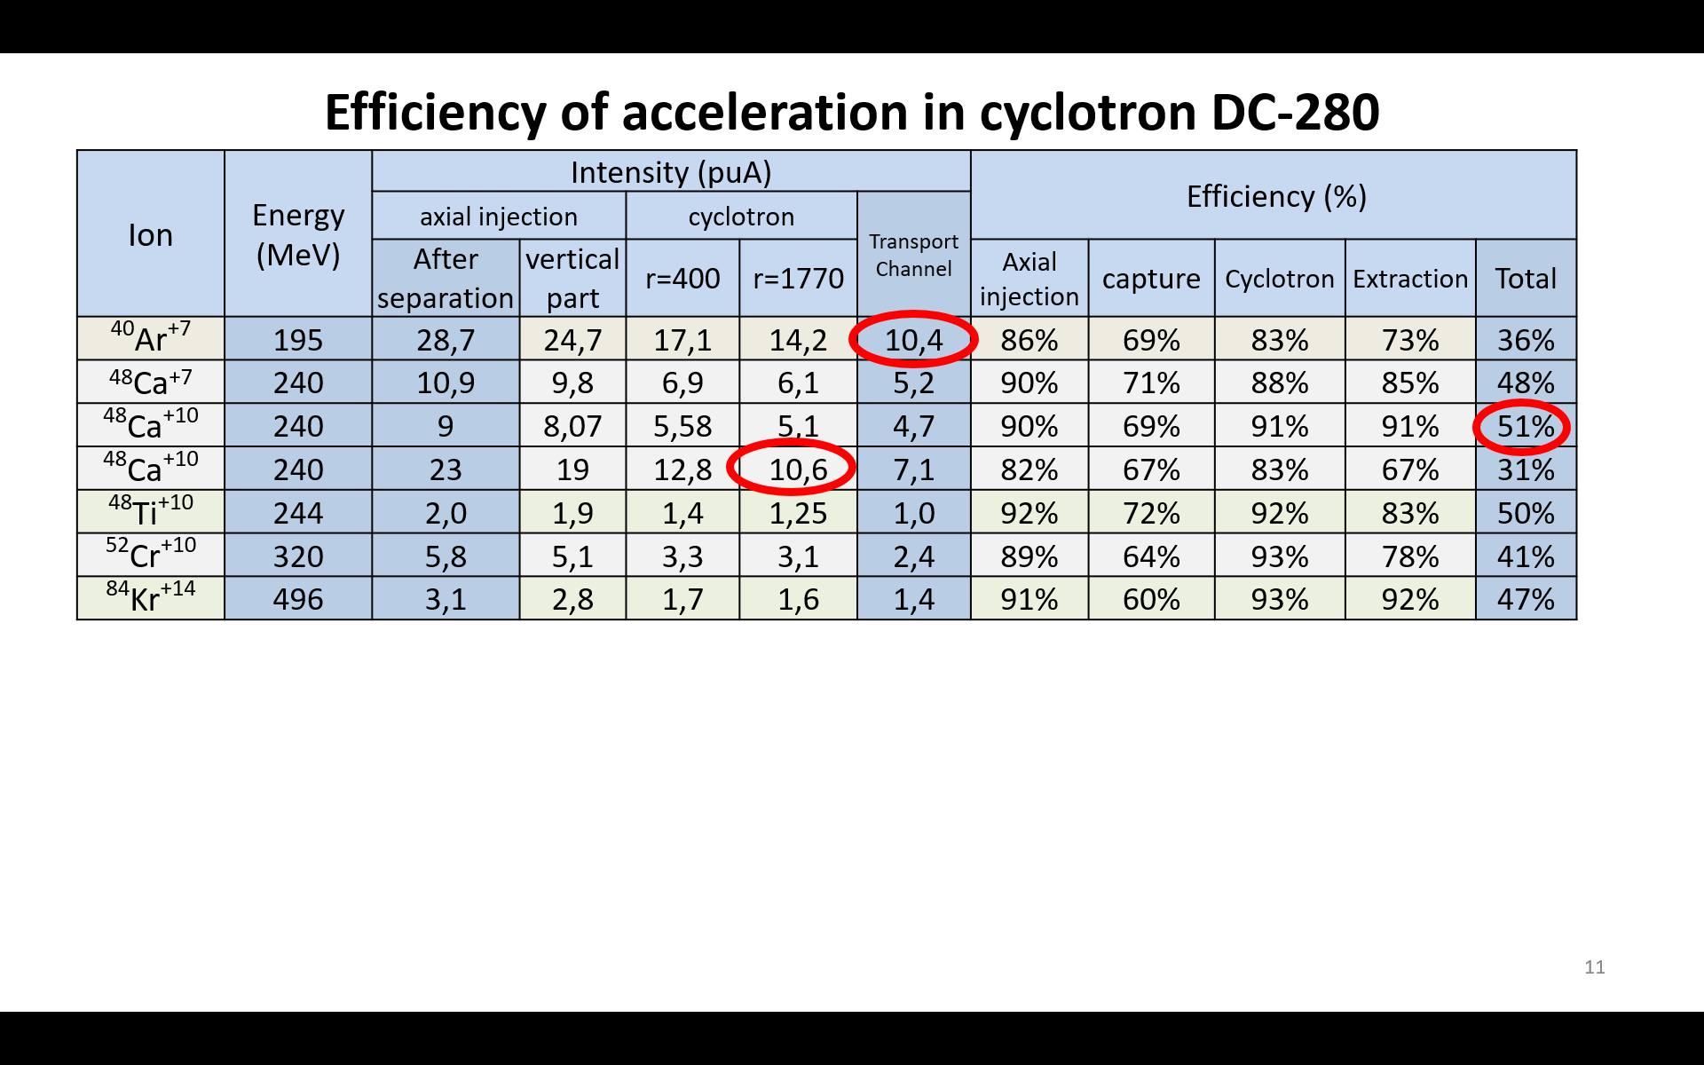
Year | Total work time | Ions
2018 | First Beam | ⁸⁴Kr
2019 | 3377 | ¹²C, ⁴⁰Ar, ⁴⁸ Ca, ⁸⁴Kr
2020 | 3705 | ⁴⁰Ar, ⁴⁸ Ca, ⁴⁸Ti
2021 | 3794 | ⁴⁸ Ca, ⁴⁸Ti , ⁵²Cr

Slide 4


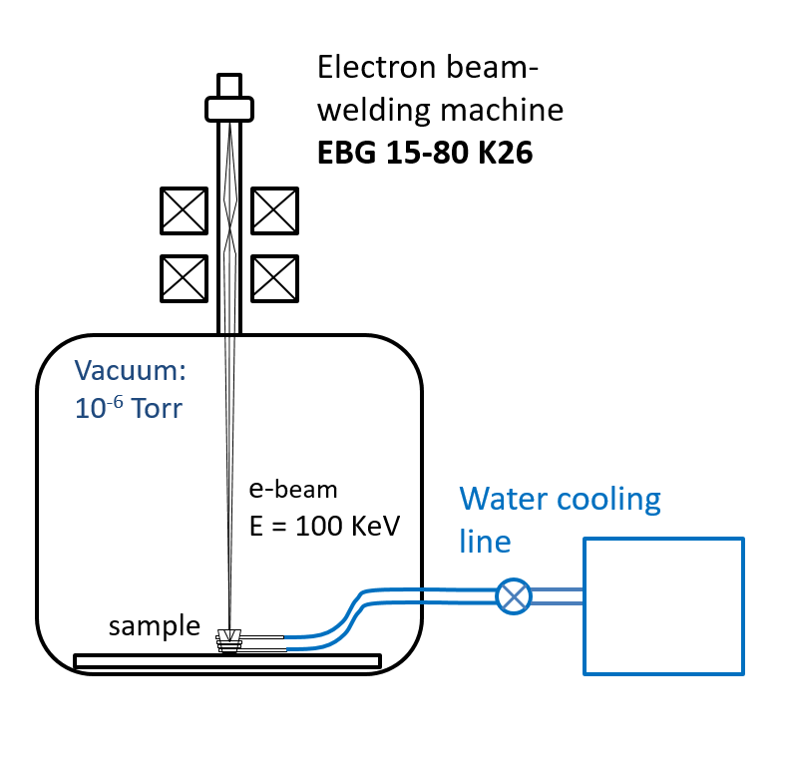
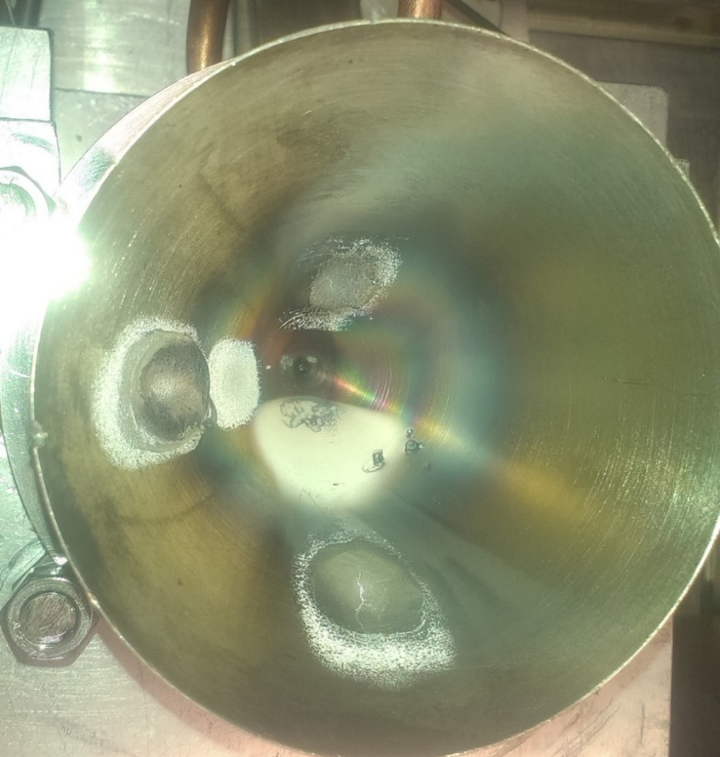
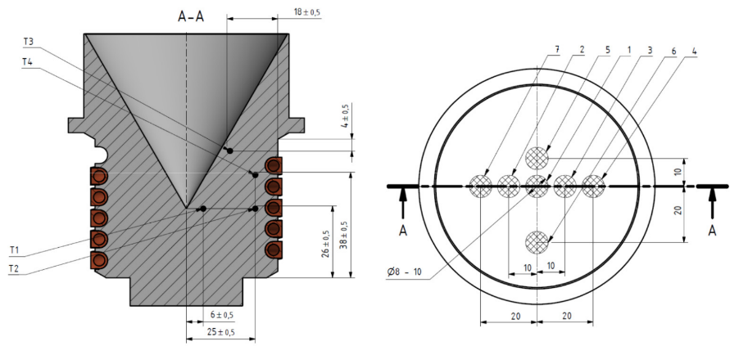
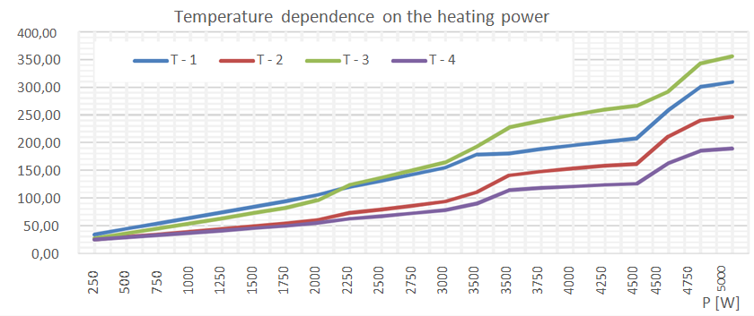
The test of thermal loads resistance
the diagnostic and safety elements of the DC-280.
List of tested elements:
The Faraday cup
The Aperture diaphragm
The Protect window
Accelerated Ion beam power is 3,5 kW
Test of Faraday cup
Scheme of thermo-control placing
scheme of testing bench
Faraday cup after testing

Slide 5
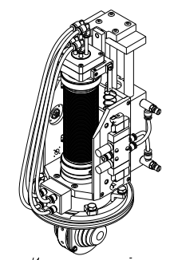
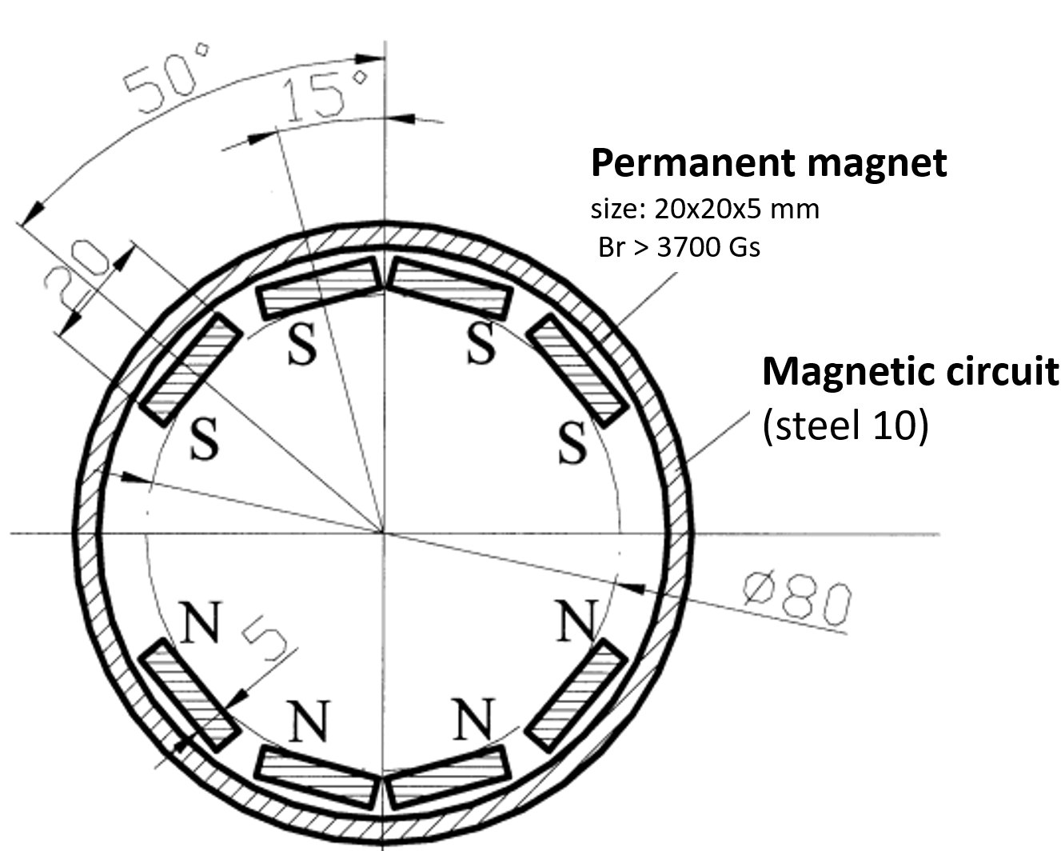
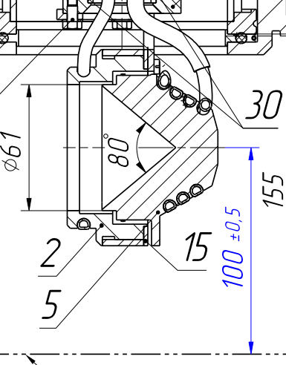
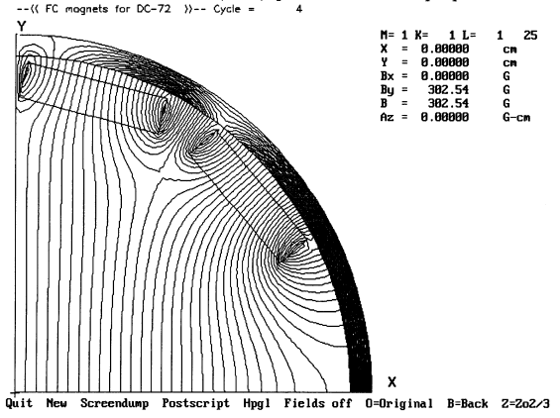
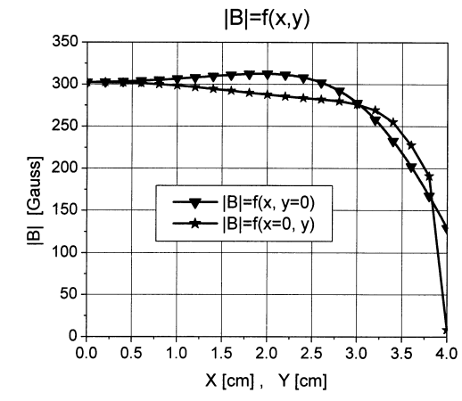
Ion beam current. Faraday Cup
Faraday cup view
Scheme of formation of magnetic field
Schema of Faraday cup head
Map of magnetic field in Faraday cup
Centre of a beam line

Slide 6
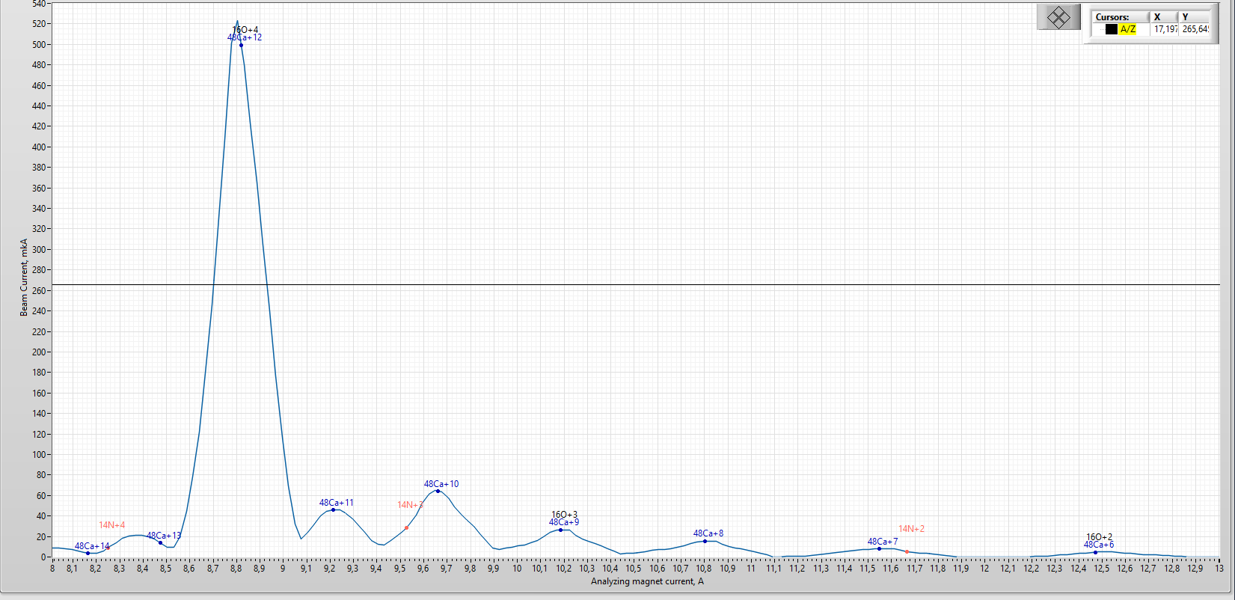
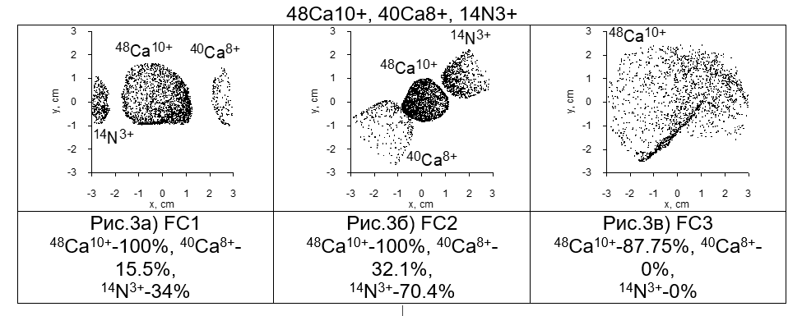
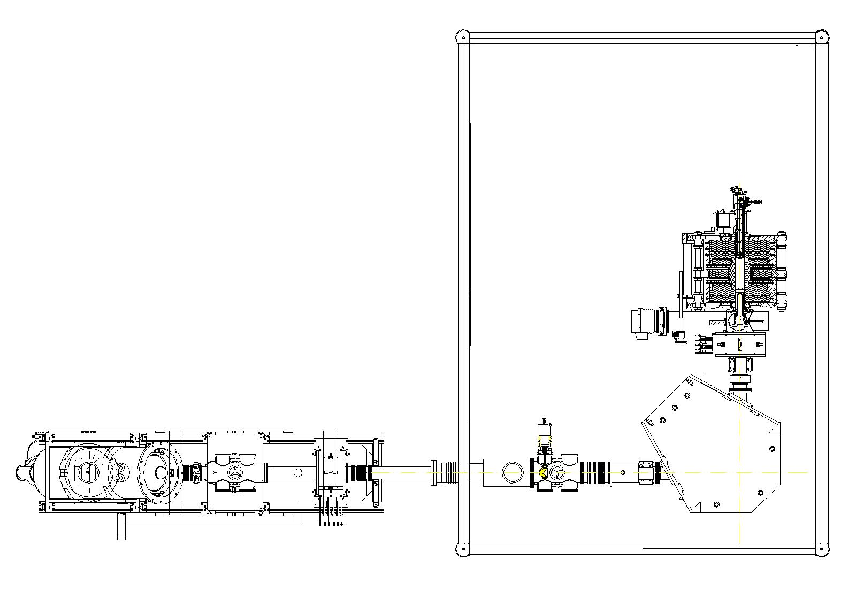
Analysis of production ions beam from ECR source.
Spectrum of Ions from DECRIS-PM (⁴⁸Ca)
⁴⁸Ca⁺¹⁰
IFC-1
IM-90

Slide 7
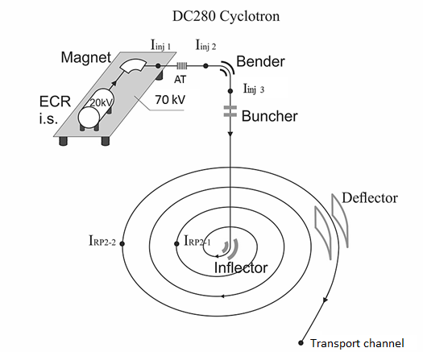
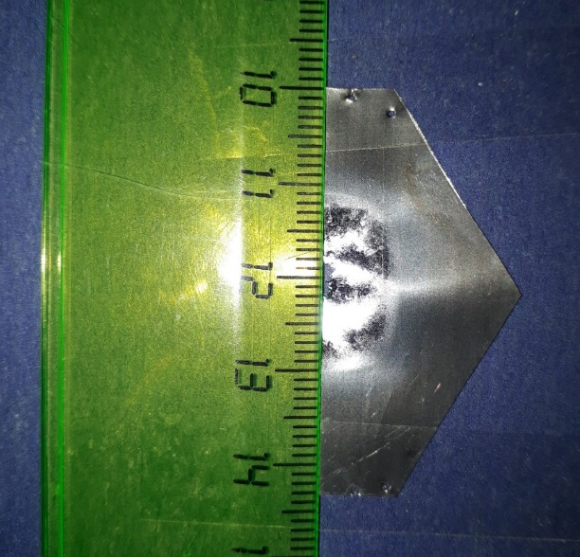
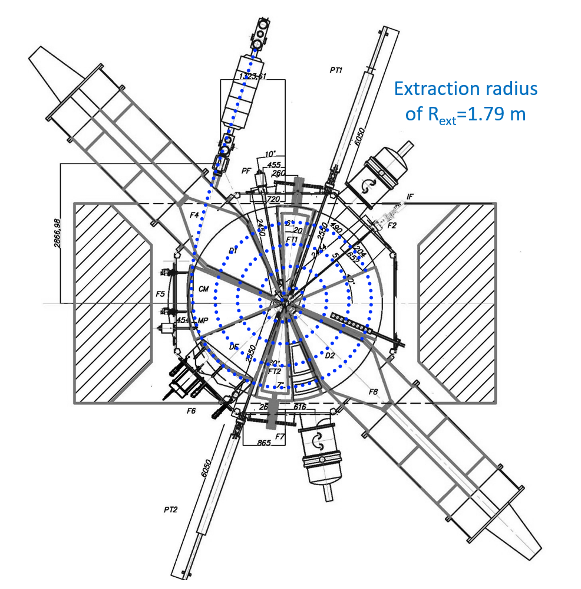
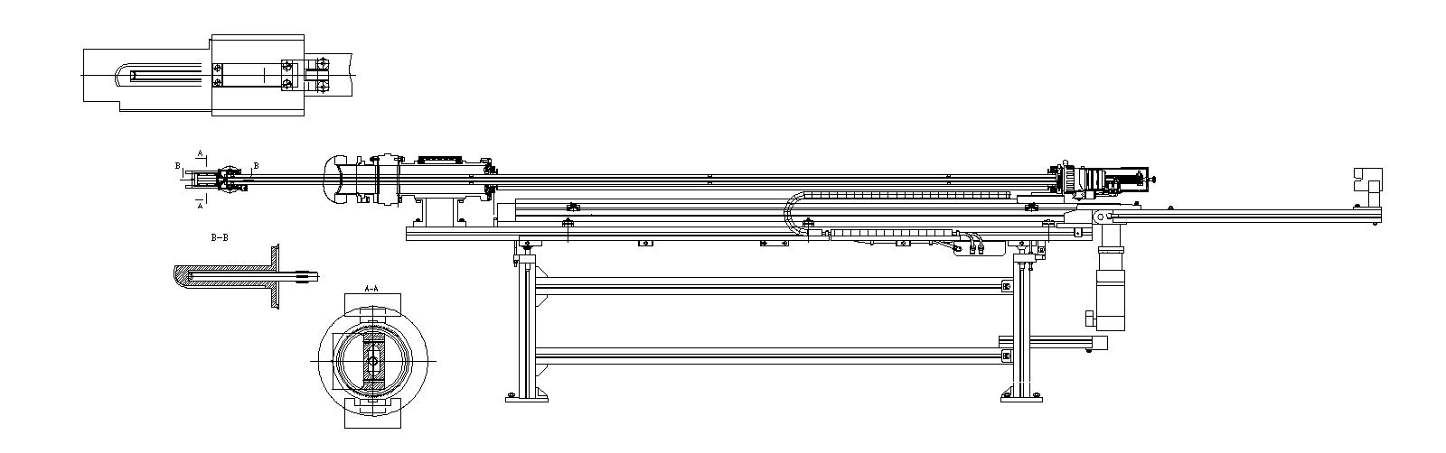
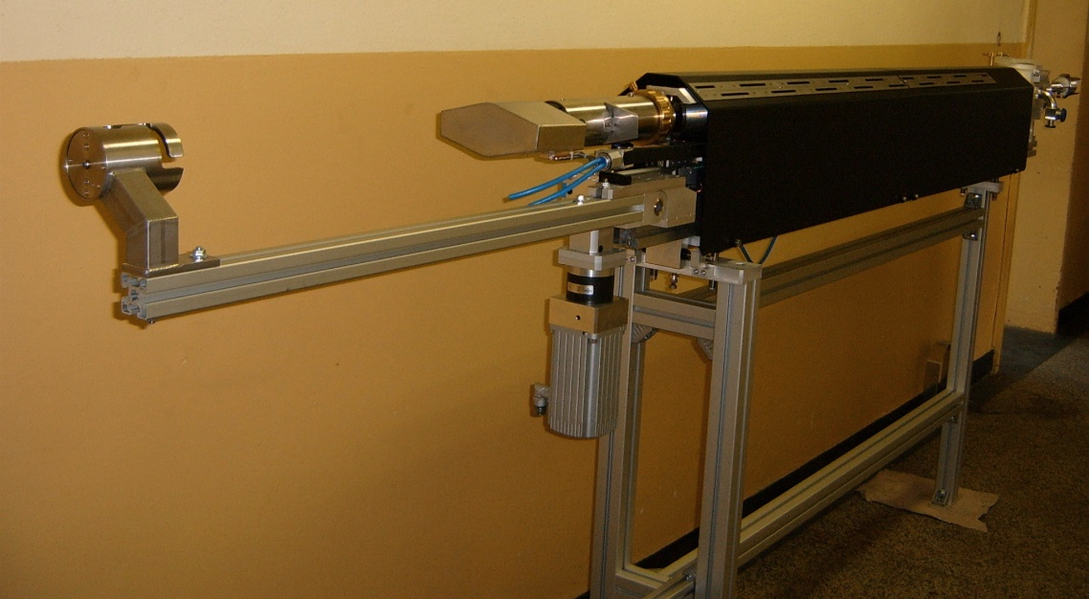
Ion beam current. Inner moving probe.
Mark on Ta foil
from accelerated ions of Kr
Schema of places of diagnostic elements on DC-280
Schema
of head part
of the probe
Schema of inner moving probe

Slide 8
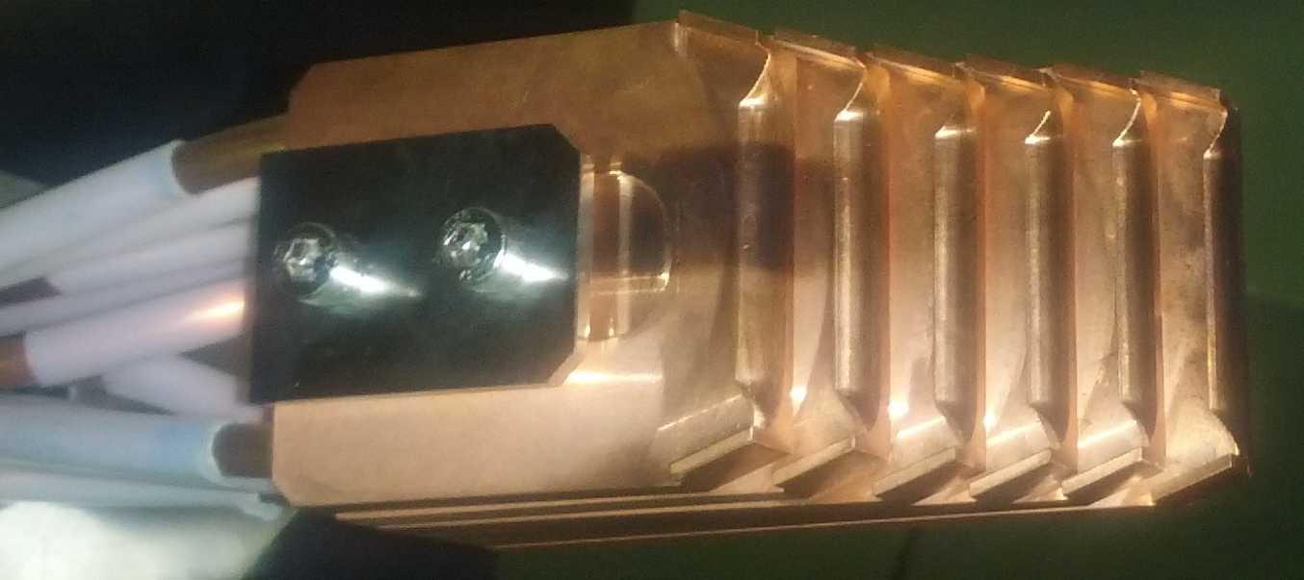
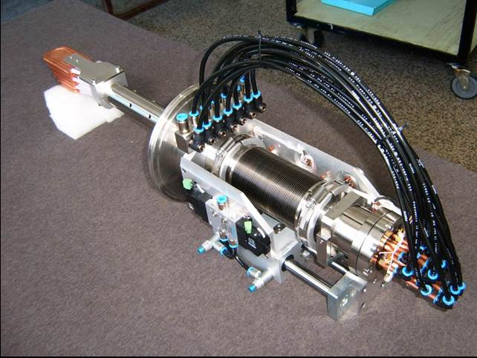
Ion beam current. Inner moving probe.
5 мм
25 мм
Moving
Multi Lamellar probe.

Slide 9
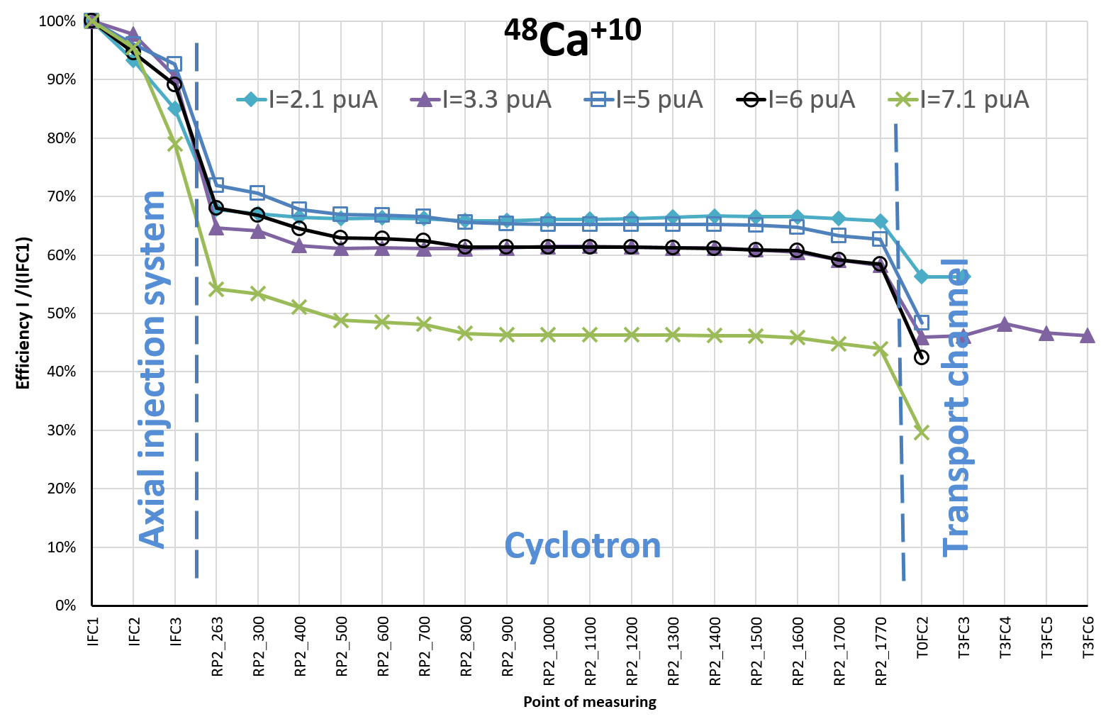
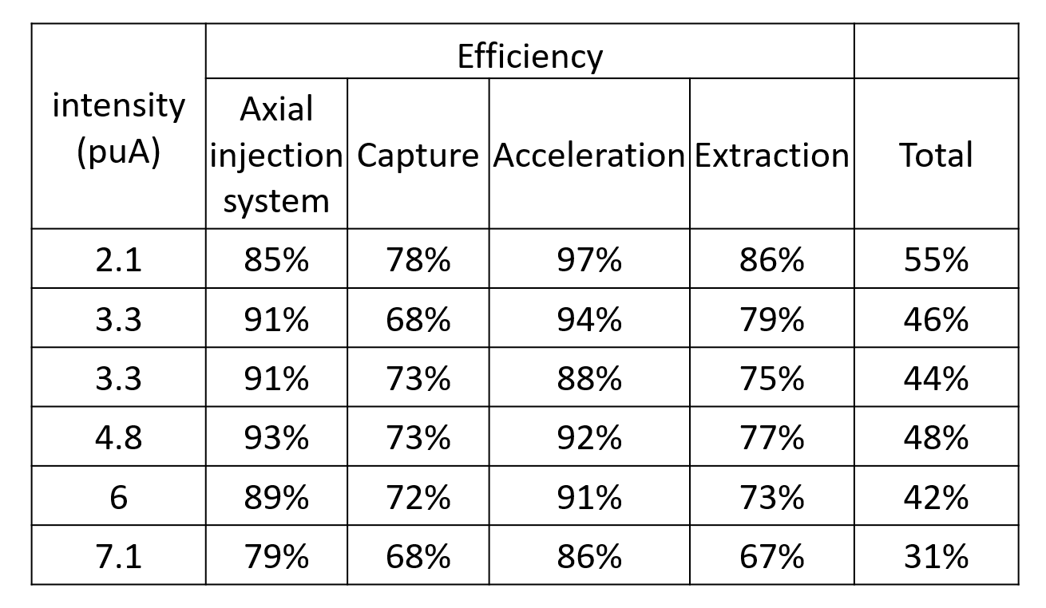

Slide 10
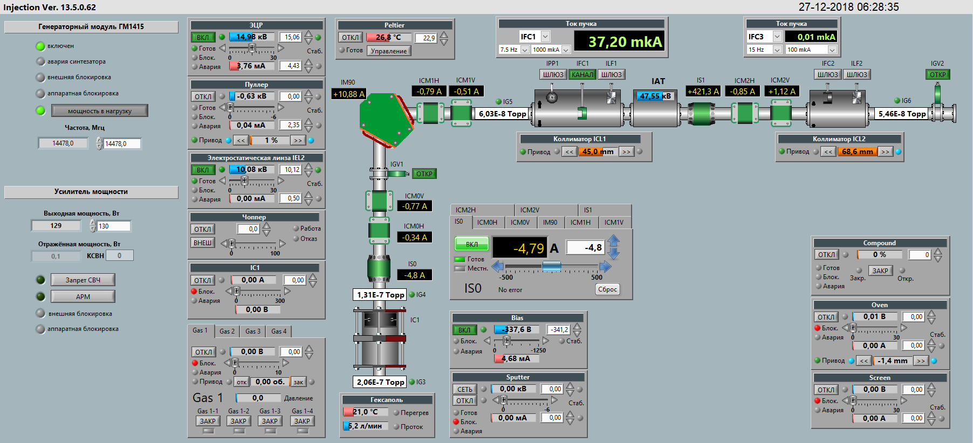
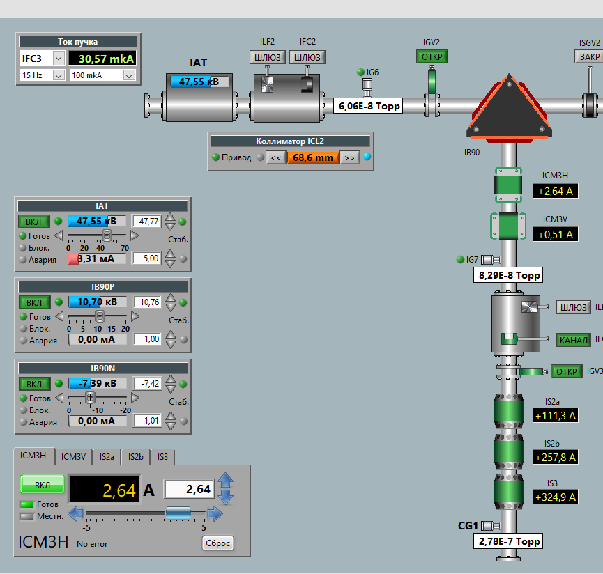
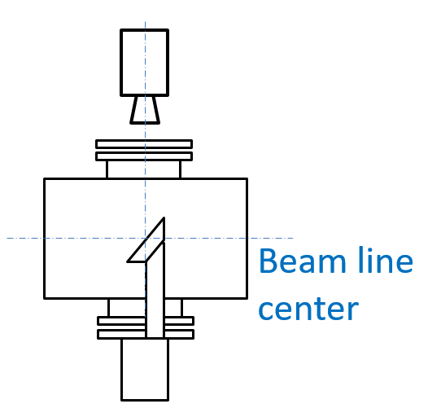
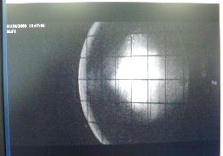
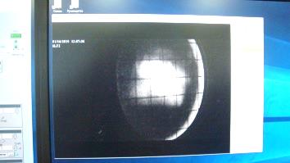
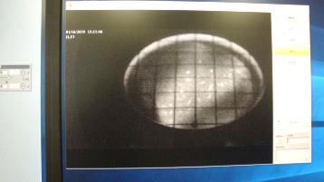
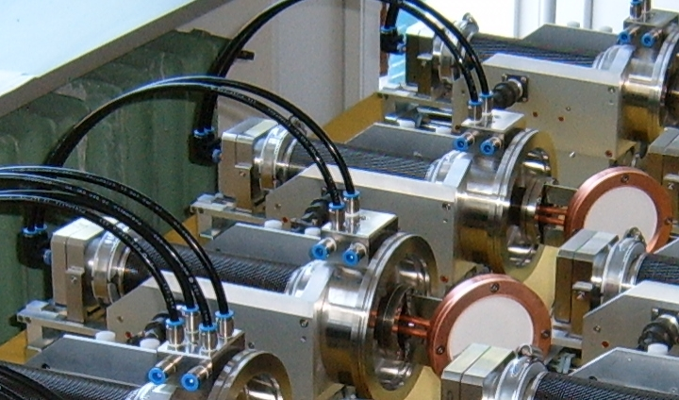

Ion beam profile. Luminafor + Camera
Transport of ₈₄Kr⁺¹⁴ beam through injection system
ILF3
ILF 1
ILF 2
HV
ILF 3
ILF 1
ILF 2
ILF 3
~30
~40
~40
~40
75

Slide 11
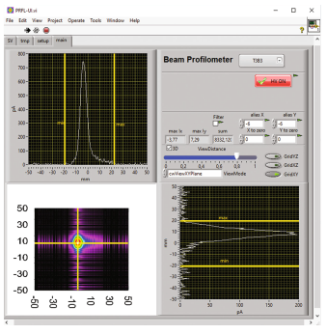
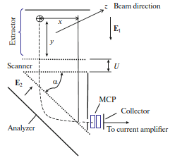
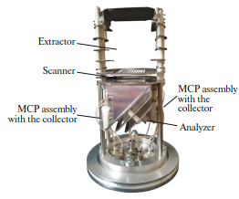
Ion beam profile. The ionization profile monitor
The schema of ionization profile monitor:
Е1, Е2 vectors of the electric field strength between the plates of the extractor and the analyzer, respectively;
U potential difference between the scanner electrodes;
α is the angle at which the analyzer electrodes are rotated with respect to the scanner electrodes;
x, y coordinates of the point of electron−ion pair production on a plane that is perpendicular to the beam axis.

Slide 12
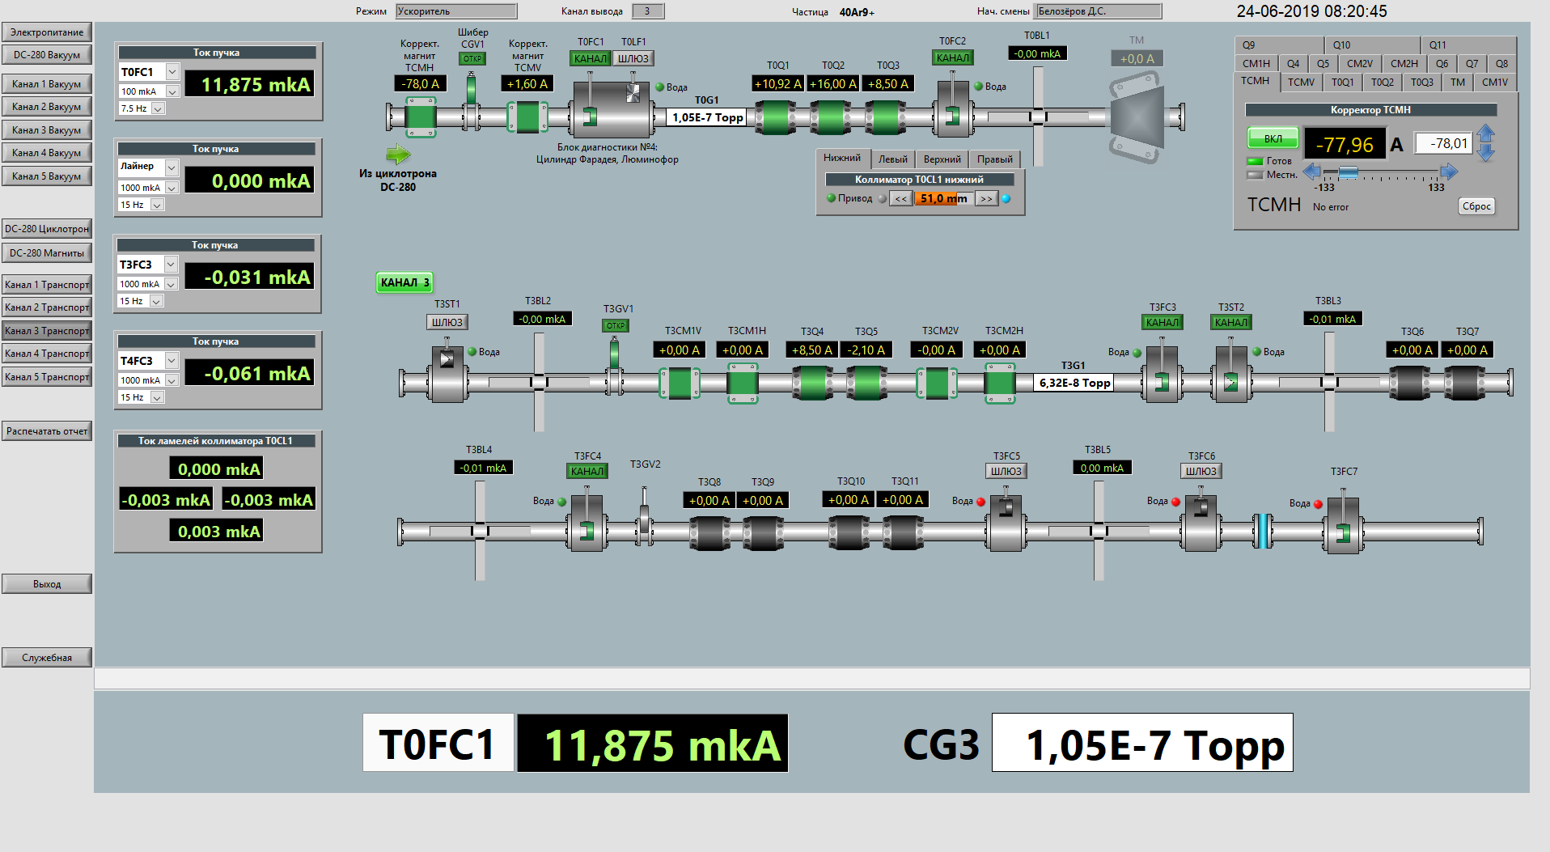
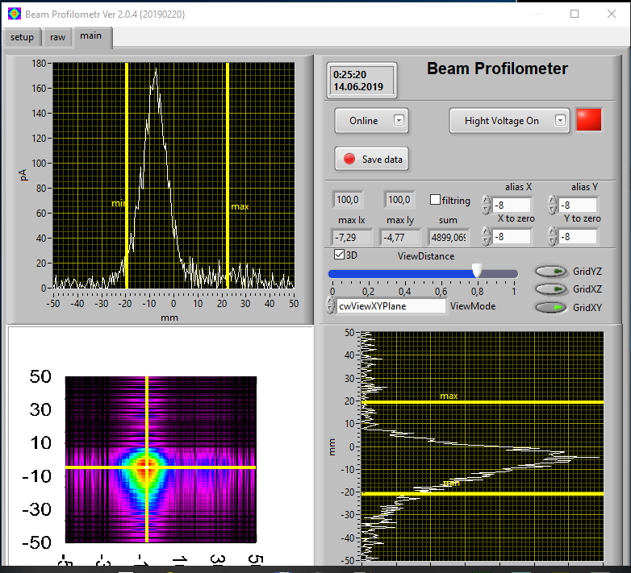
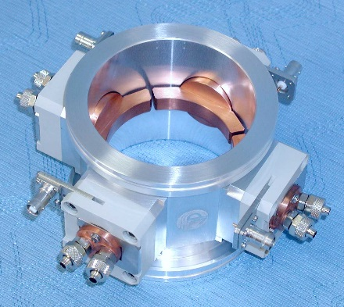
Ion beam profile. The ionization profile monitor
4-section loss monitor
Ø 60 mm

Slide 13
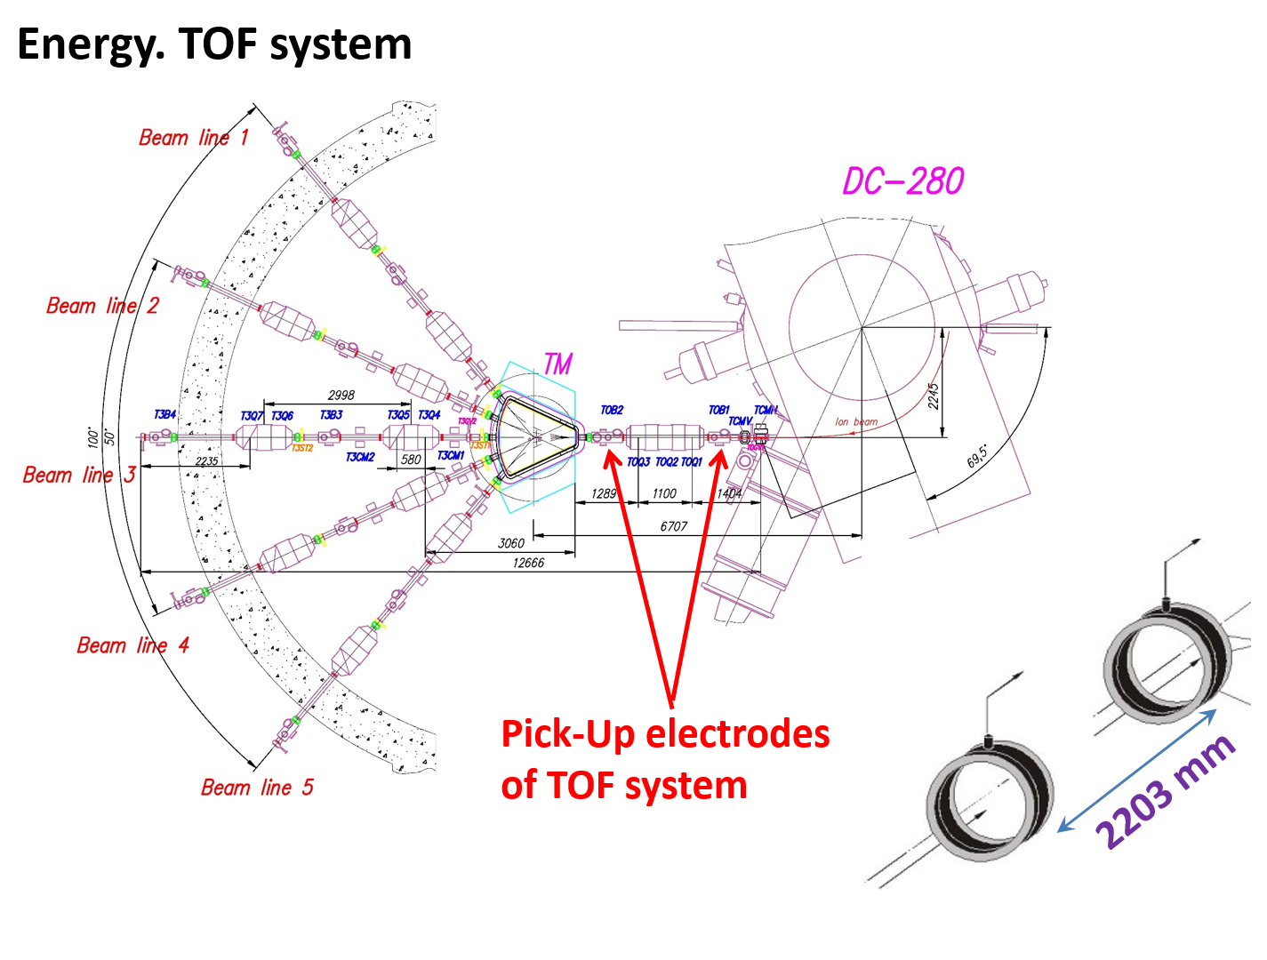
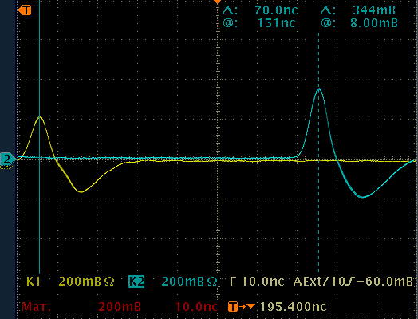
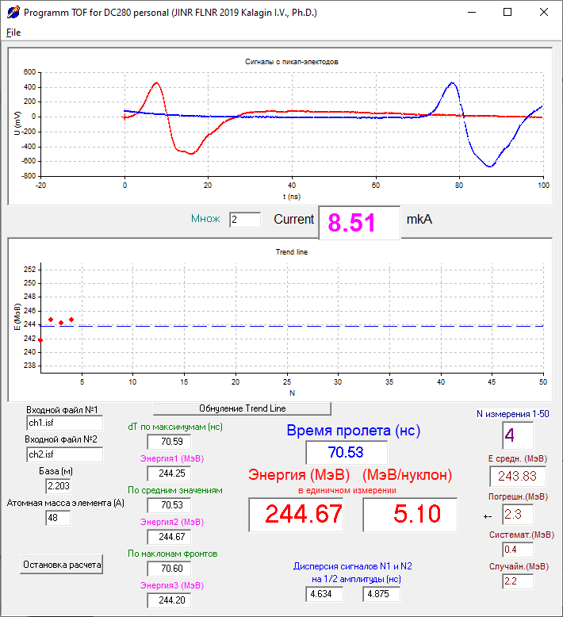
Energy. TOF system
Signal from Pick-Up
after amplifier
Measured energy of ⁴⁸Ti¹⁰⁺

Slide 14
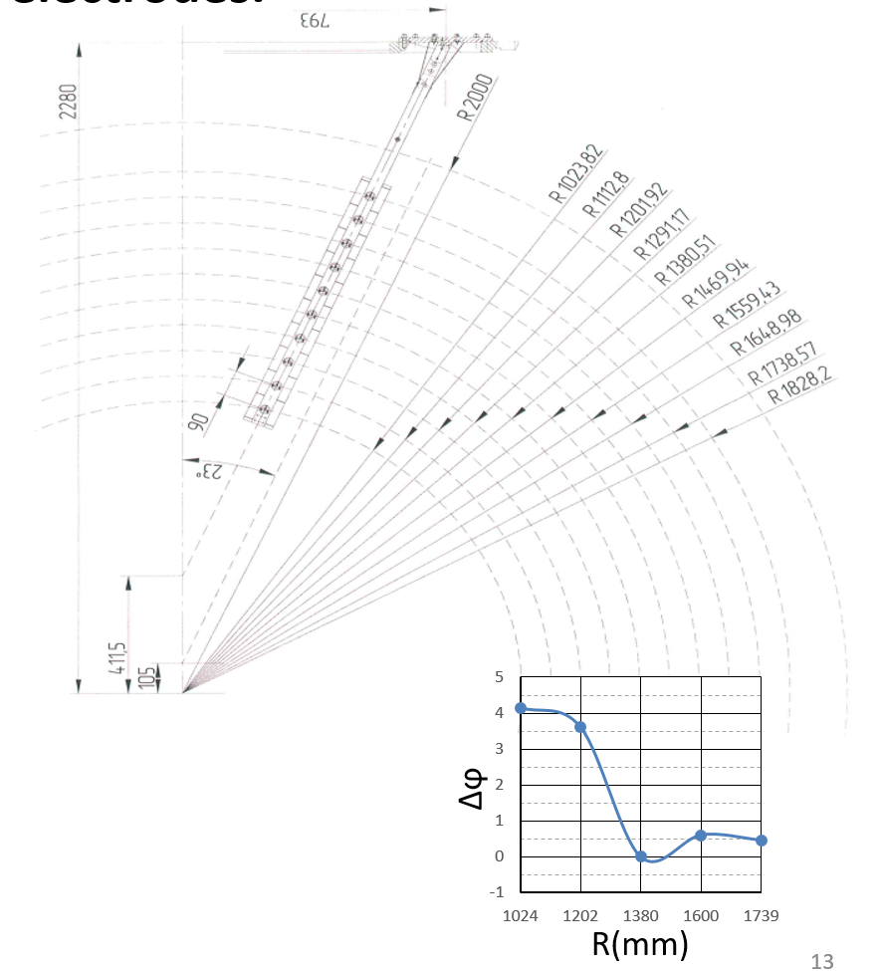
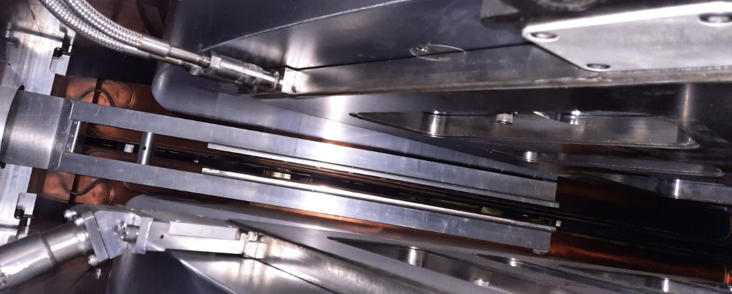
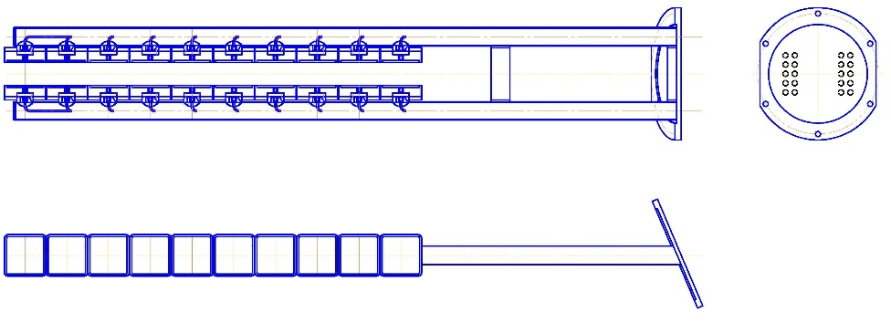
Phase moving in cyclotron. Inner Pick-Up electrodes.
⁴⁰Ar⁺⁷ F=8.51 Hhz;
E=5.2 MeV/n
10 couple of Pick-Up electrodes
Square 70 x 70 mm²
Second harmonic filter

Slide 15
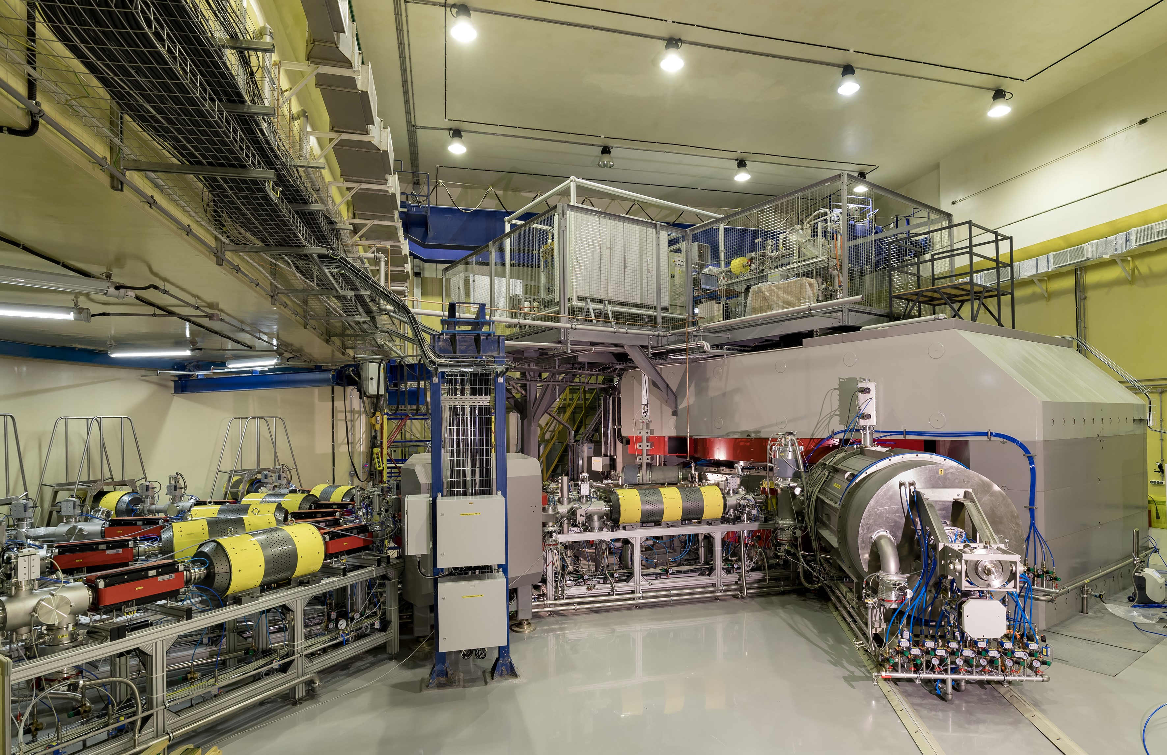
Conclusion and plans to development
Non-destructive control of beam intensity
Commission of phase moving monitor system
evaluation of bunch length
Evaluation of emittance of ion beam

Slide 16
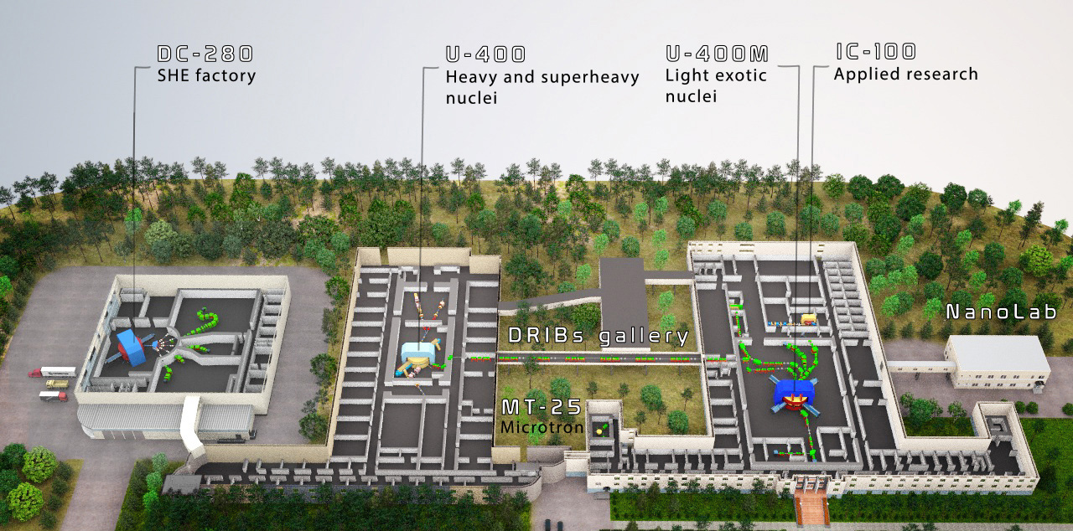
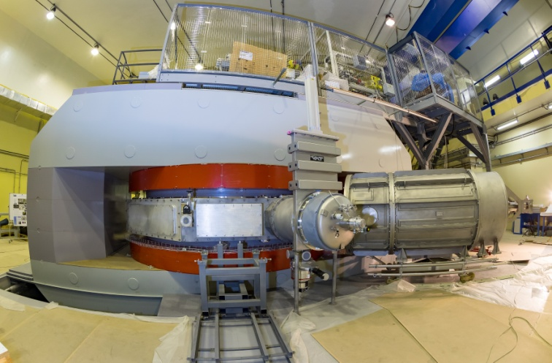

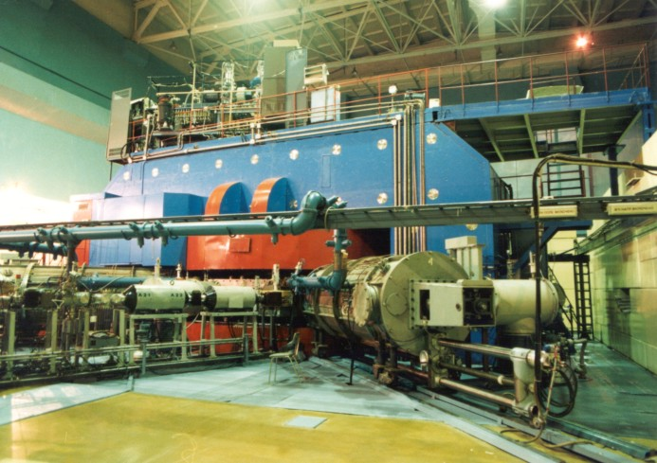
Notes:
New experimental hall is in the stage of building completion

Slide 17


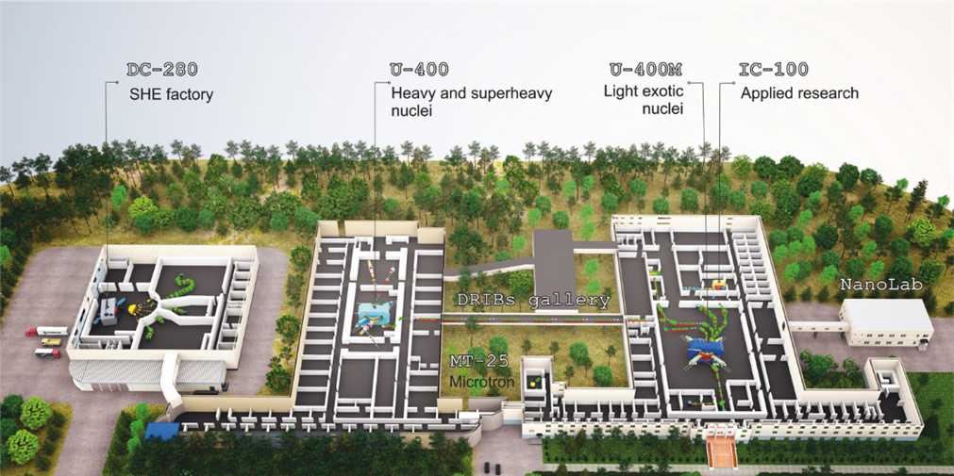


Циклотрон ДЦ-140
В ЛЯР ОИЯИ создается ускорительный комплекс для прикладного использования ионных пучков на базе циклотрона ДЦ-140
3
Технические параметры ДЦ-140:
Магнитное поле в центре 1.377 - 1.554 Тл;
Частота ускорения ионов: 8.452 МГц;
Ускоряемые ионы элементов: O – Bi;
Инжекция ионов от ЭЦР- источника;
Энергии ионов:
2.124 МэВ/нукл. (A/Z=7.35 – 8.25)
4.8 МэВ/нукл. (A/Z=4.9 - 5.5)
1
2
Эскиз комплекса ДЦ-140
Планируемое использование пучков ДЦ-140:
Канал тестирования электронных компонентов ~3000 час/год.
Канал радиационного материаловедения ~1500 час/год;
Канал облучения полимерных пленок ~1500 час/год;
10⁵ ÷ 10¹² ионов/с

