Slide 1
CYCLOTRON SYSTEM C-250
K.E. Smirnov, Yu.N. Gavrish, A.V. Galchuck, S.V. Grigorenko, V.I. Grigoriev, R.M. Klopenkov, L.E. Korolev, K.A. Kravchuck, A.N. Kuzhlev, I.I. Mezhov, V.G. Mudrolyubov, Yu.K. Osina, Yu.I. Stogov, M.V. Usanova JSC «NIIEFA», 196641, St. Petersburg, Russia
XXVII RUSSIAN PARTICLE ACCELERATORS CONFERENCE, RuPAC-2021,
27 September – 2 October 2021, Alushta, Crimea
Speaker – Smirnov Kirill

Slide 2
Basic requirements of the technical task
 | Technical task | Final project
Type of accelerated parts | Protons | Protons and Н⁻
Beam energy, МэВ | 30, 50 MeV – discrete values 70-250 МэВ – smooth regulation | 30-250 МэВ – smooth regulation
Accelerated beam current, uA | 0,05 - 5 | 0,05 - 5
Accelerator operating mode | Pulse and continuous | Pulse and continuous
Number of beams of the transport system | 3 | 3
Lifting system of the upper half yoke | Presence | Presence
Magnetic system | “Warm” | “Warm”

Slide 3
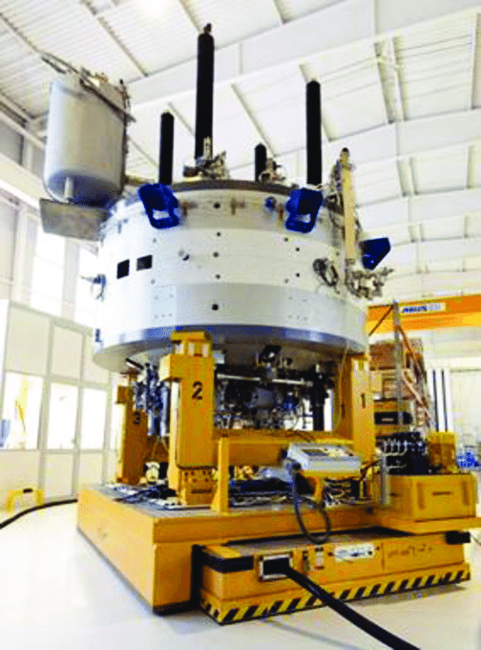
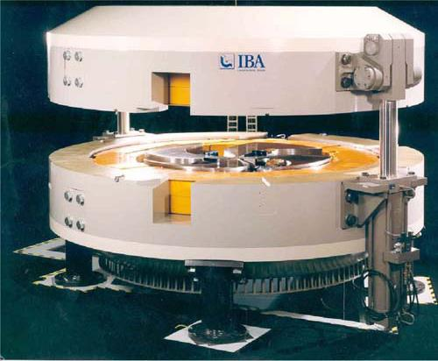
Accelerators for proton therapy
+ small size
+ relative simplicity of design
- low intensity of accelerated current
- no energy regulation
Varian ProBeam | Model | IBA C235
250 | Energy of protons, MeV | 235
4 | Induction, Т | 2,1
90 | Magnet weight, t | 200
3,1 | Magnet diameter, m | 4,3

Slide 4
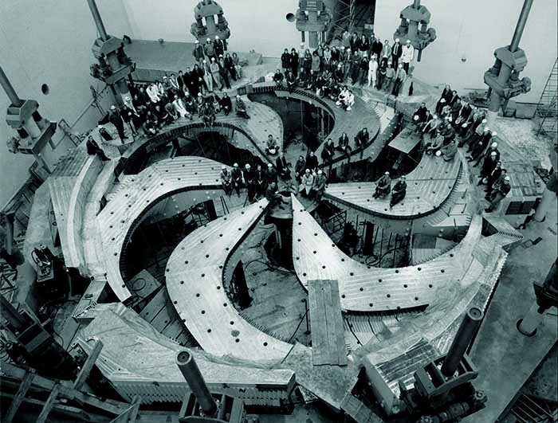
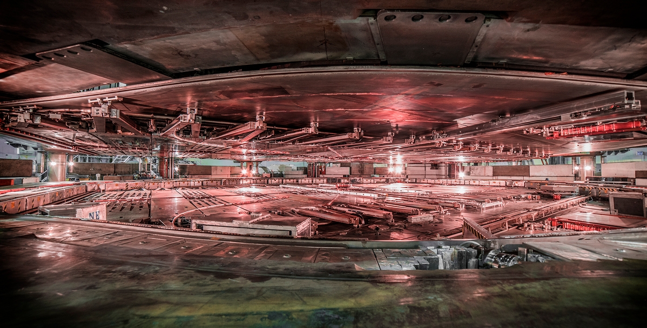
Cyclotron in Triumf laboratory, Vancouer, Canada
pole tip of cyclotron
inside the accelerating chamber
Type of accelerated parts | H⁻
Energy, MeV | 520
Pole diameter, m | 18

Slide 5
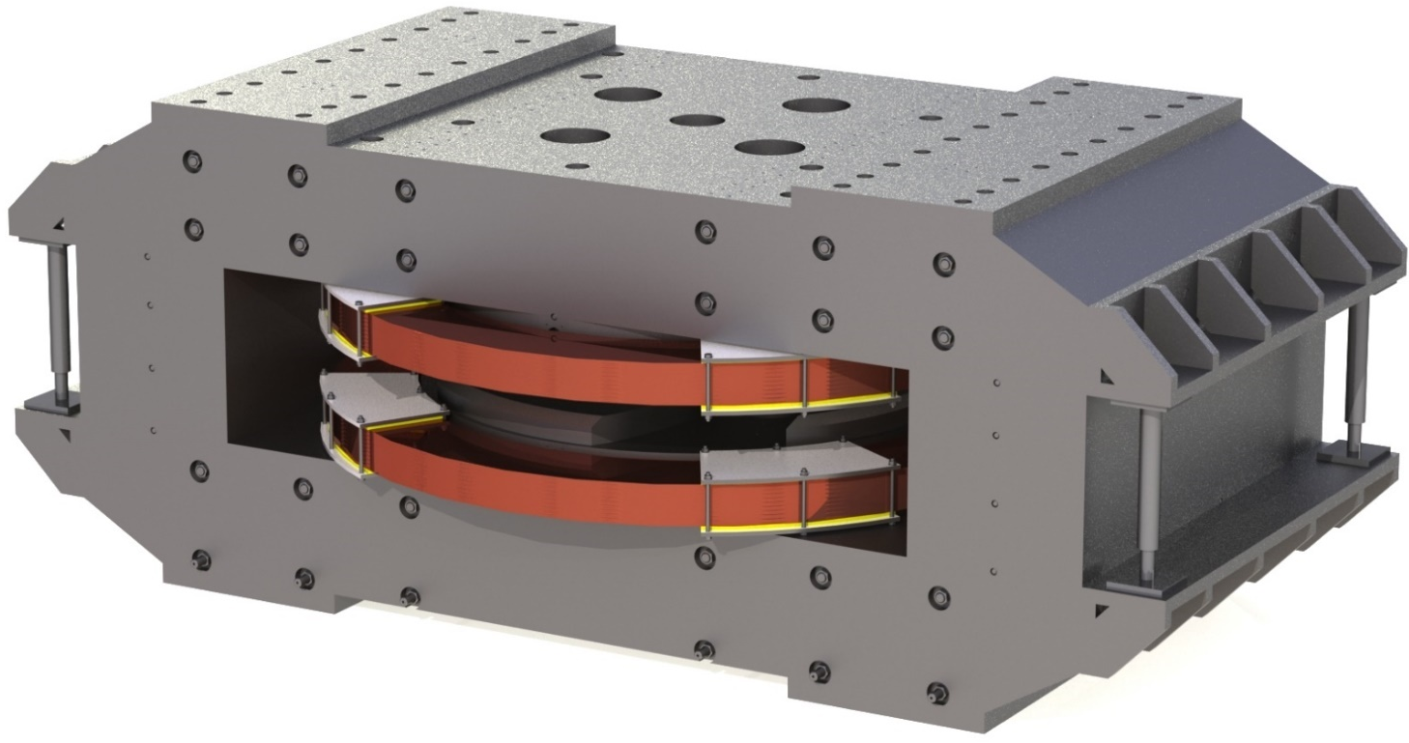
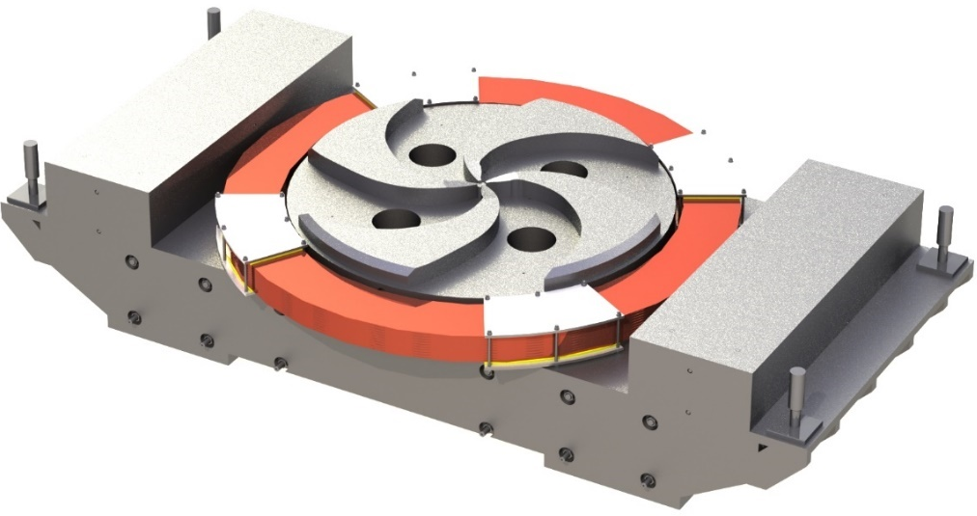
Electromagnet of cyclotron C-250
Magnet dimensions, mm | 8,1х4х3,6
Weight of steel, t | 720
Weight of copper, t | 36
Pole diameter, m | 4
Air gaps, sector/valley, mm | 100/500
Induction in the center, Т | 0,8 - 1,08
Max consumption power, kW | 104
Number of correction coils | 15x8

Slide 6
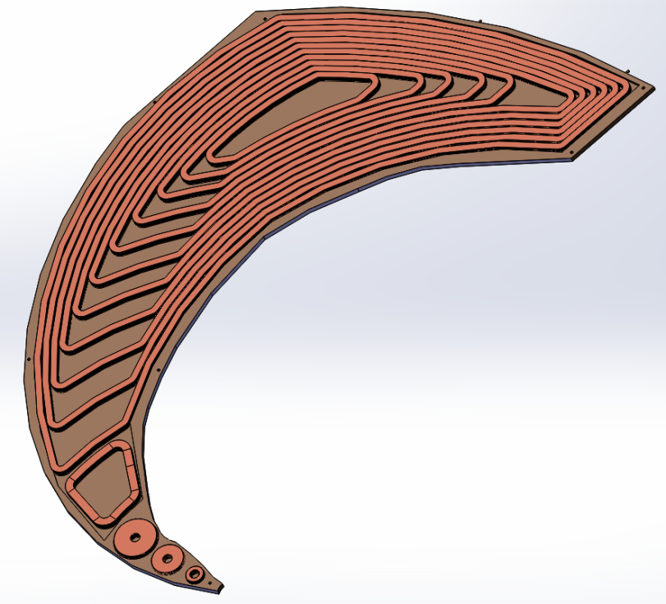
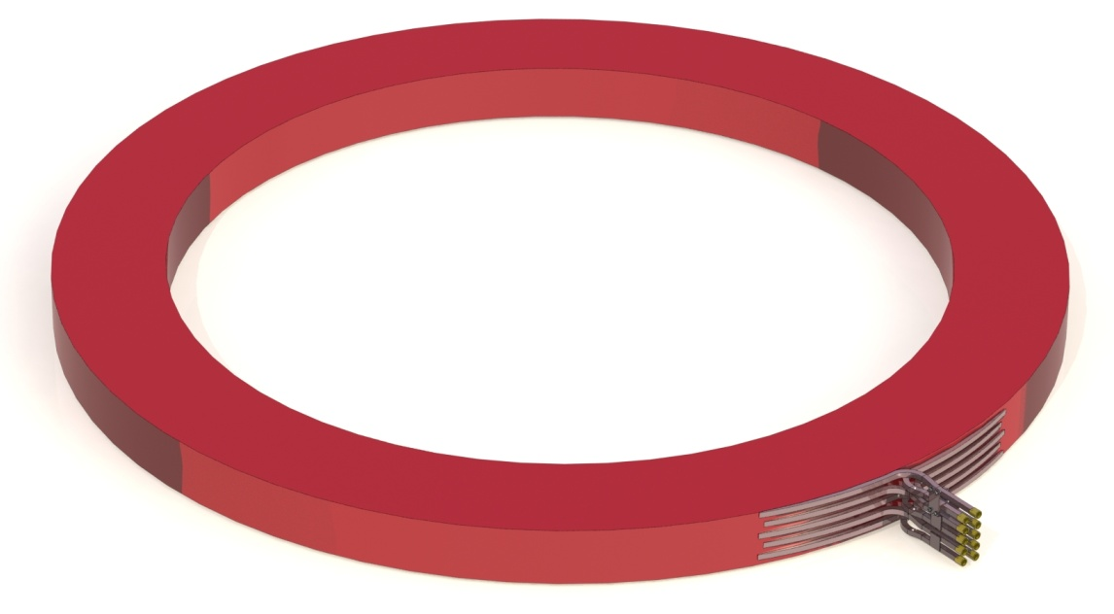
Magnetic coils
Correction coils
Number of correction coils | 15 on each sector, 8 sets
Total consumption power of correction coils, kW | 16
Coils construction | Set of 15 coils for each sector in a common vacuum housing
Cooling type | Water
Main coils
Diameter, mm | 5350
Weight, t | 18

Slide 7
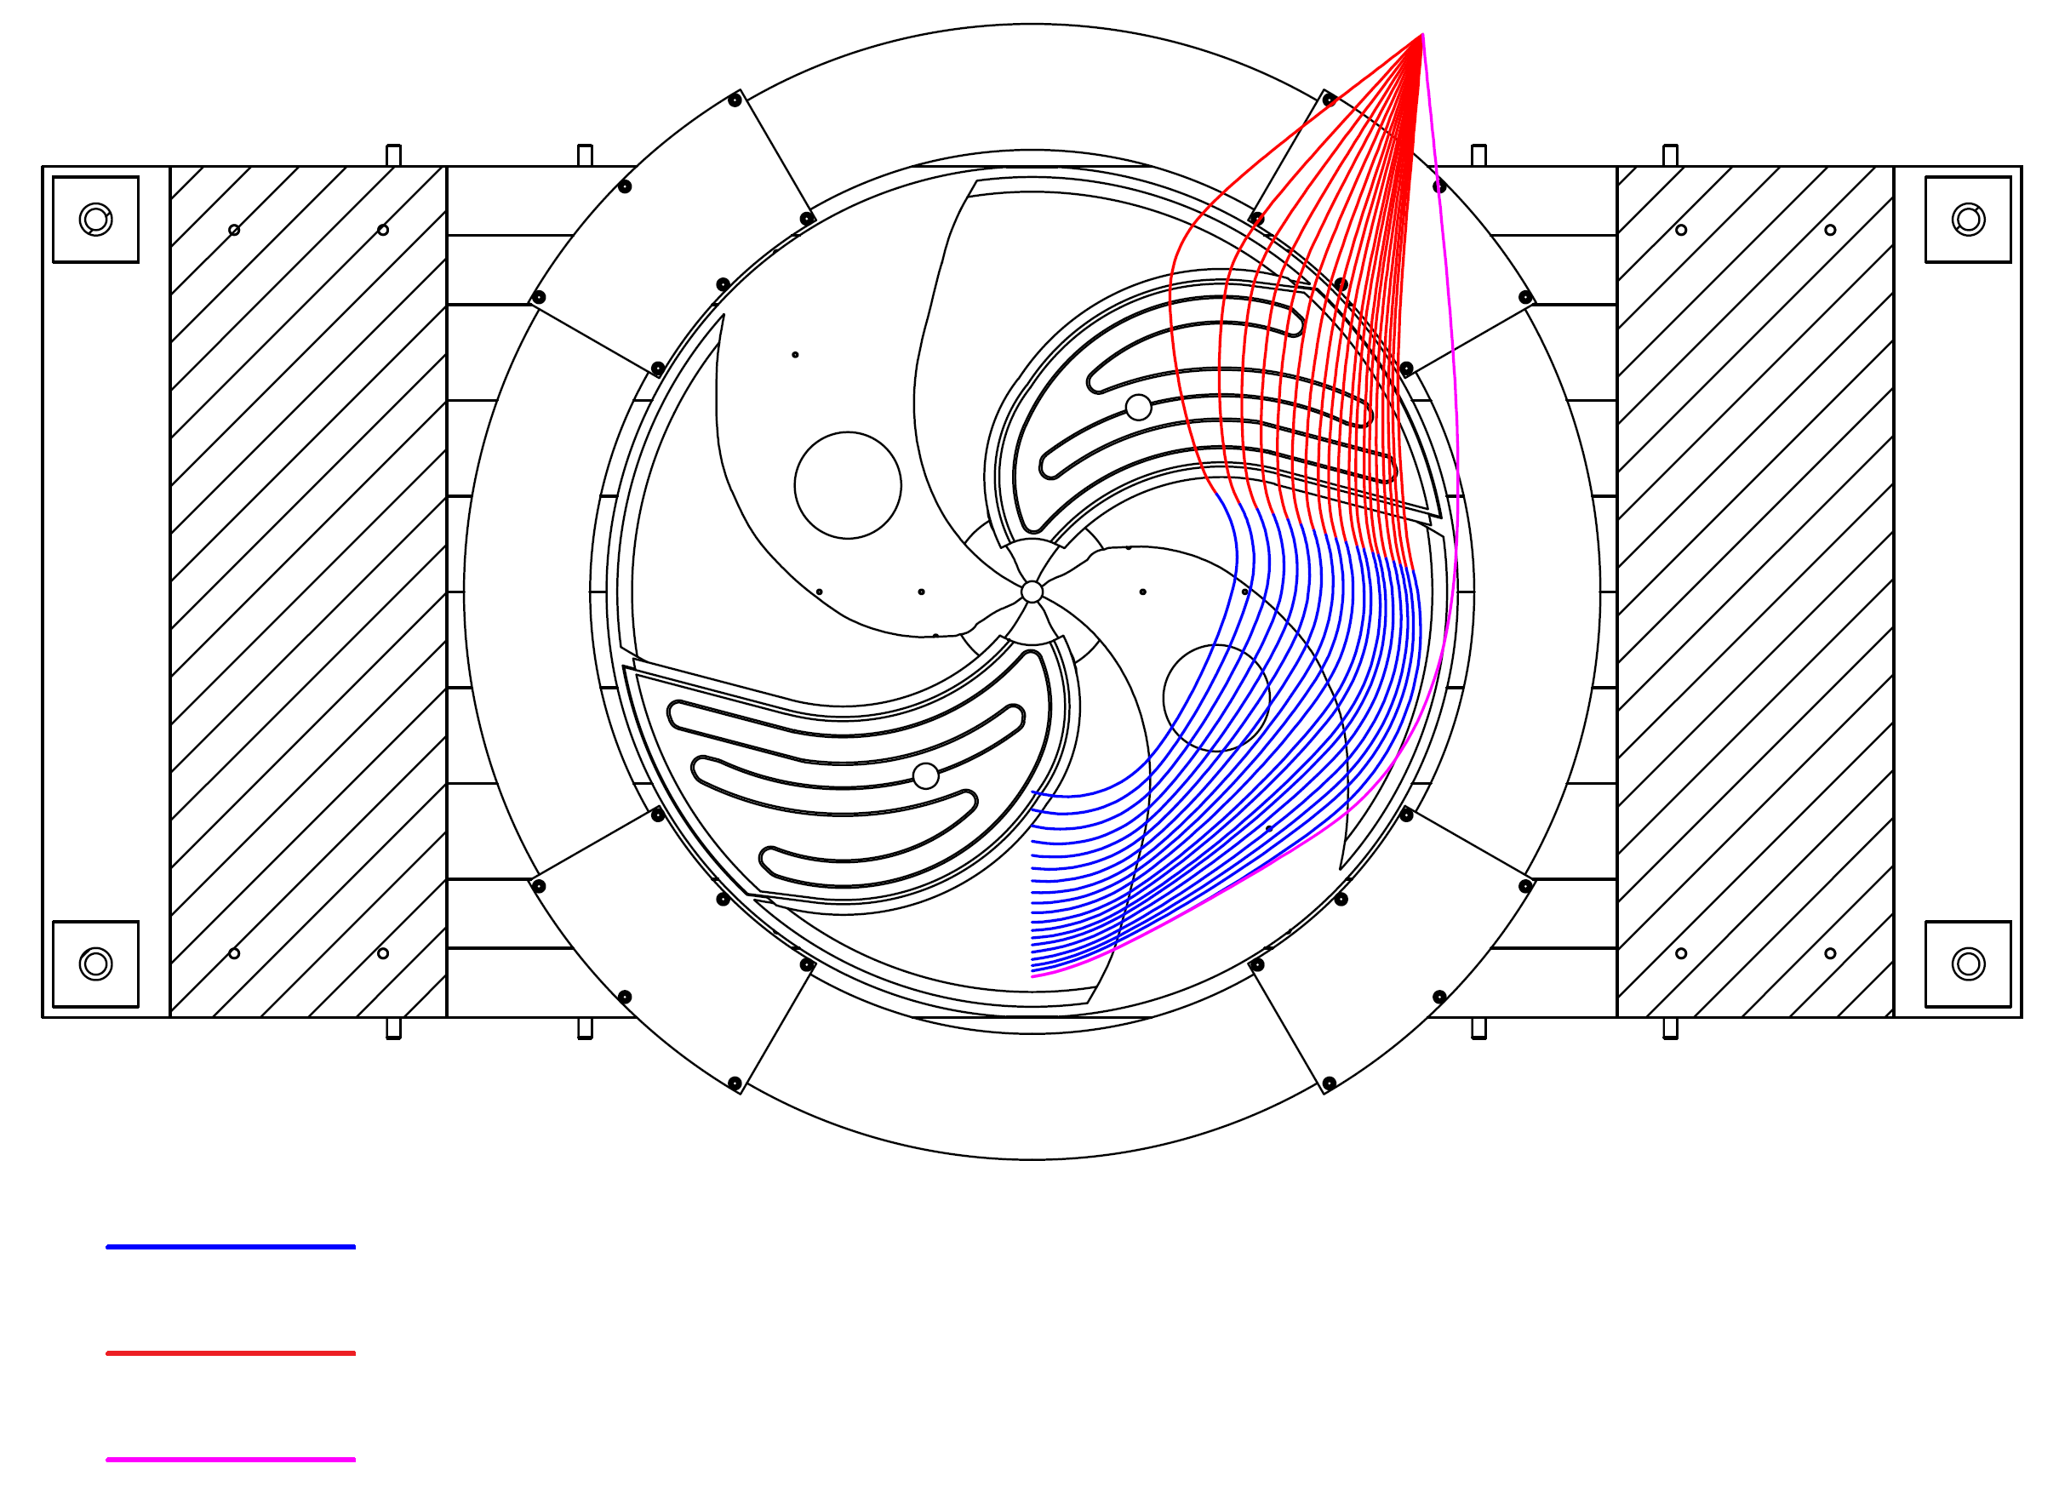
Beam dynamics
Energy, MeV | Up to 120 | 120 - 250
Type of accelerated parts | Н- | Protons
Extraction method | Stripper | Deflector
Type of extracted parts | Protons | Protons
H⁻ ions before stripper
Protons after stripper
Protons ejected by deflector

Slide 8
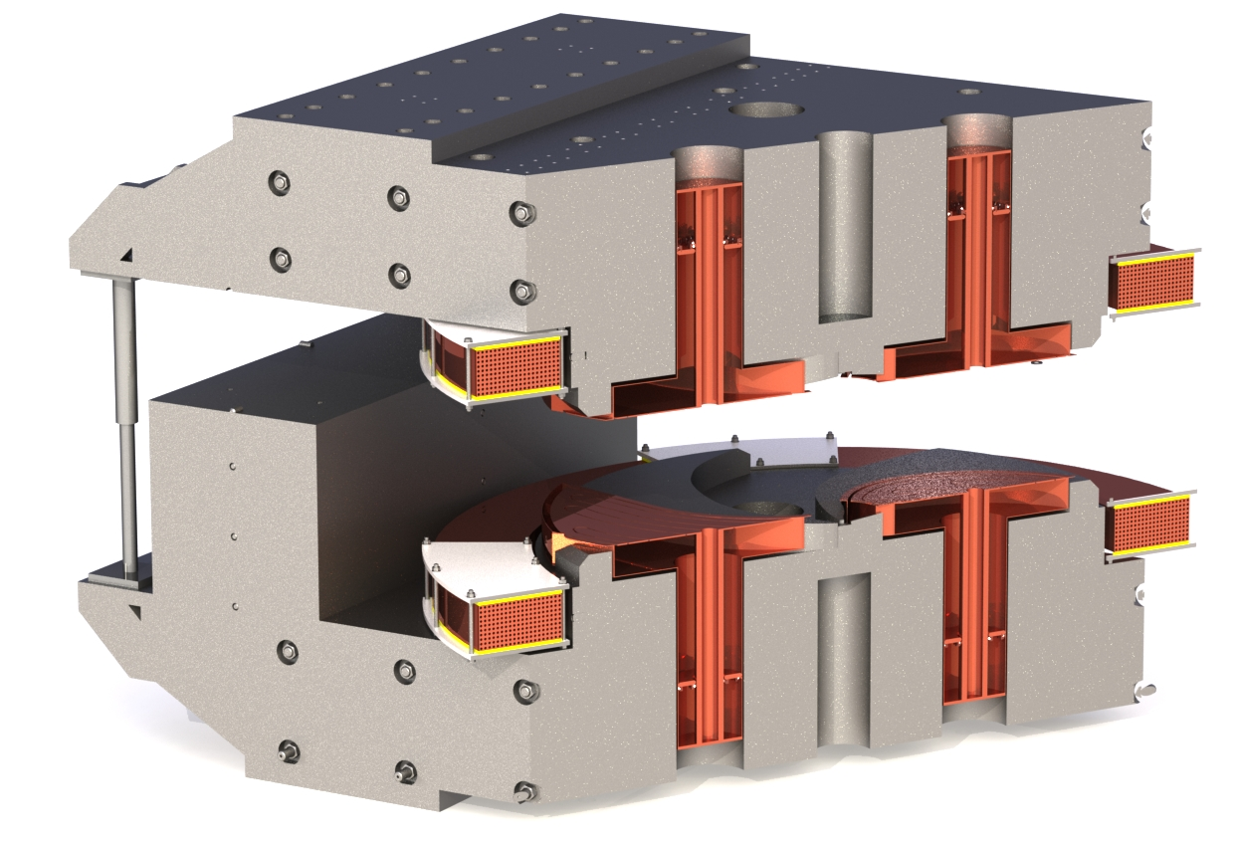
Accelerating system
Number of resonators | 2
Construction of resonators | Vertical dee stems, delta electrodes
Harmonic | 2
Operating frequency range, MHz | 24 – 32,4
Active lose power, kW | 52 – 32
Accelerating voltage, kV | 100
RF system output power, kW | 60

Slide 9
Injection system
As a basis is taken the developed and tested
Sample of the ion source
Ion source type | Internal ion source
Beam current from ion source, uA | 50
Working gas | Hydrogen
Way of ntroducing the ion source in accelerating chamber | Radial
Cooling type | Water

Slide 10
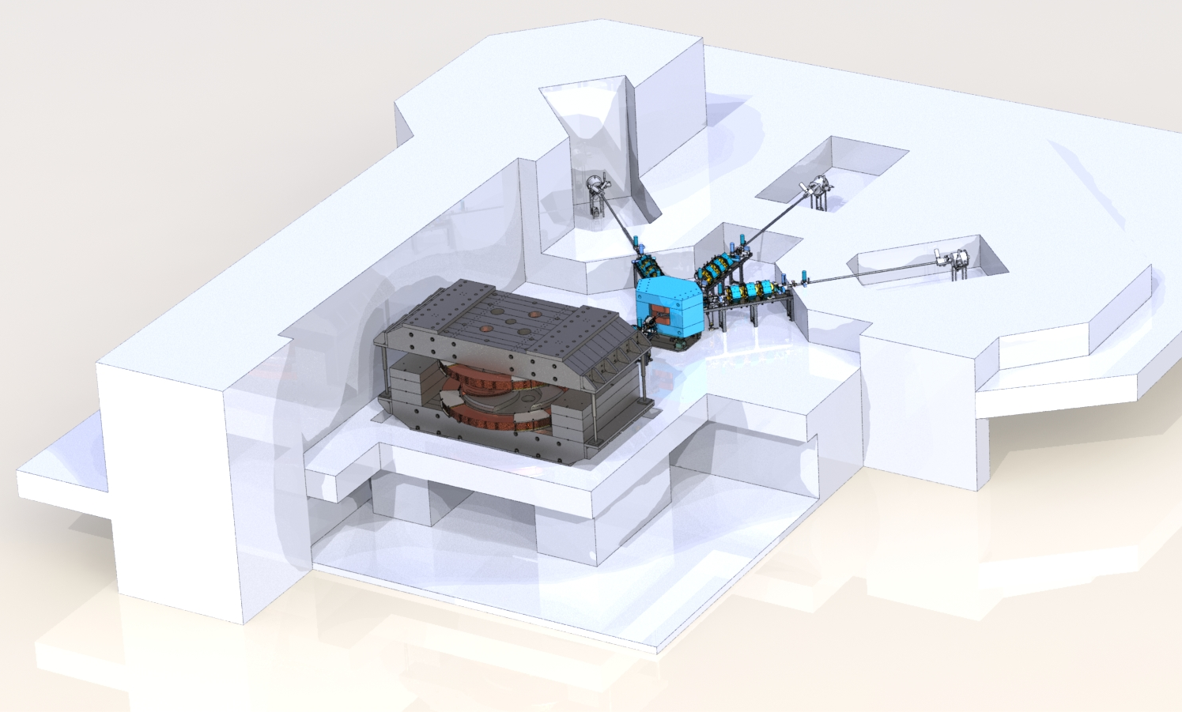
Beam transport system
Number of beam output from the cyclotron | 1
Number of switching electromagnet | 1
Switching magnet weight, t | 39
Switching magnet working angles, ° | ±45
Number of beams of transport system | 3
Number of eletromagnetic lenses | 11
Number of corrector | 4
Internal diameter of the pipes of transport system, mm | 100

Slide 11
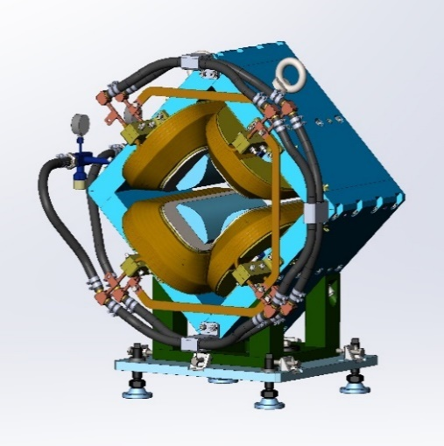
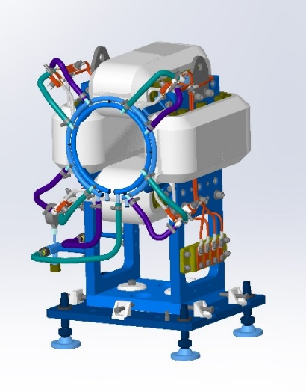
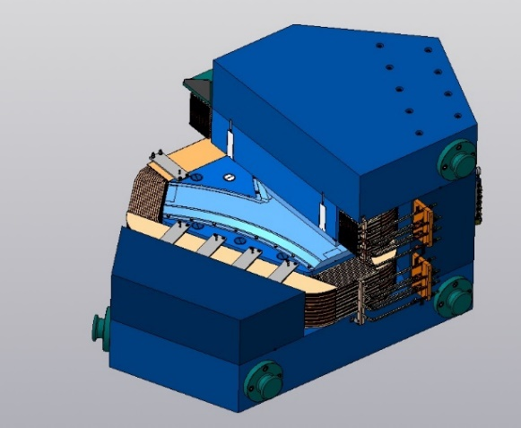
Elements of beam transport system
Electromagnetic lens
Corrector
Switching electromagnet

Slide 12
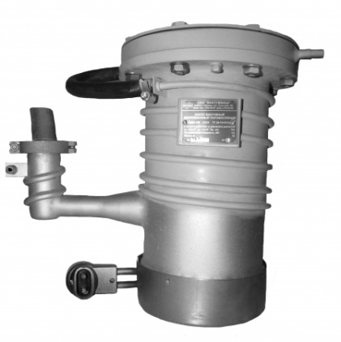
Vacuum system
Cyclotron operating vacuum, torr | 5·10⁻⁷
Beam transport system operating vacuum, torr | 5·10⁻⁶
Forevacuum pumps type | Oil-free scroll
High vacuum cyclotron pumps type | Cryogenic
Cyclotron high vacuum pumping speed (for hydrogen), l/s | 30 000
High vacuum beam transport system pumps type | Diffusion stream-oil with cryogenic trap
Type of vale and gate control | Pneumatic

Slide 13
Water cooling
Number of coolingcircuits | 2
Coolant of external circuit | Water
Coolant of internal circuit | Distillate
Temperature of coolant in internal circuit, ⁰С | 15-20
The amount of heat removed by the cooling system, kW | About 320
Блок водяного охлаждения

Slide 14
Automatic control system
automatic control of all cyclotron systems;
the ability to control the vacuum system and cyclotron devices in manual mode;
system of interlock and alarms;
recording and storage cyclotron operating parameters;
possibility of remote access to the cyclotron control system.
Cyclotron control rack

Slide 15
In conclusion
creation of a facility with such parameters in terms of proton beam intensity and energy regulation in a wide range is being implemented for the first time and will create unique opportunities for research;
it is worth noting the technical solution that implements the acceleration of two types of particles, this will reduce the beam loss during extraction and narrow the range of regulation of the magnetic field and RF system;

Slide 16
Thank you for your attention
Smirnov Kirill
Chief project engineer, JSC “NIIEFA”

