Slide 1
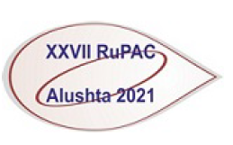
Advances in the development of a Vacuum Insulated Tandem Accelerator and its applications
Budker Institute of Nuclear Physics, Novosibirsk, Russia Novosibirsk State University, Novosibirsk, Russia
Sergey TASKAEV, Alexander IVANOV,
BINP BNCT team: Evgenii BERENDEEV, Marina BIKCHURINA, Timofei BYKOV, Dmitrii KASATOV,
Anna KASATOVA, Iaroslav KOLESNIKOV, Alexey KOSHKAREV, Alexandr MAKAROV, Georgii OSTREINOV, Alexey PONEDELCHENKO, Pavel PONOMAREV, Sergey SAVINOV, Ivan SHCHUDLO, Evgeniia SOKOLOVA, Igor SOROKIN, Tatiana SYCHEVA, Iuliia TASKAEVA, Gleb VERHOVOD

Slide 2
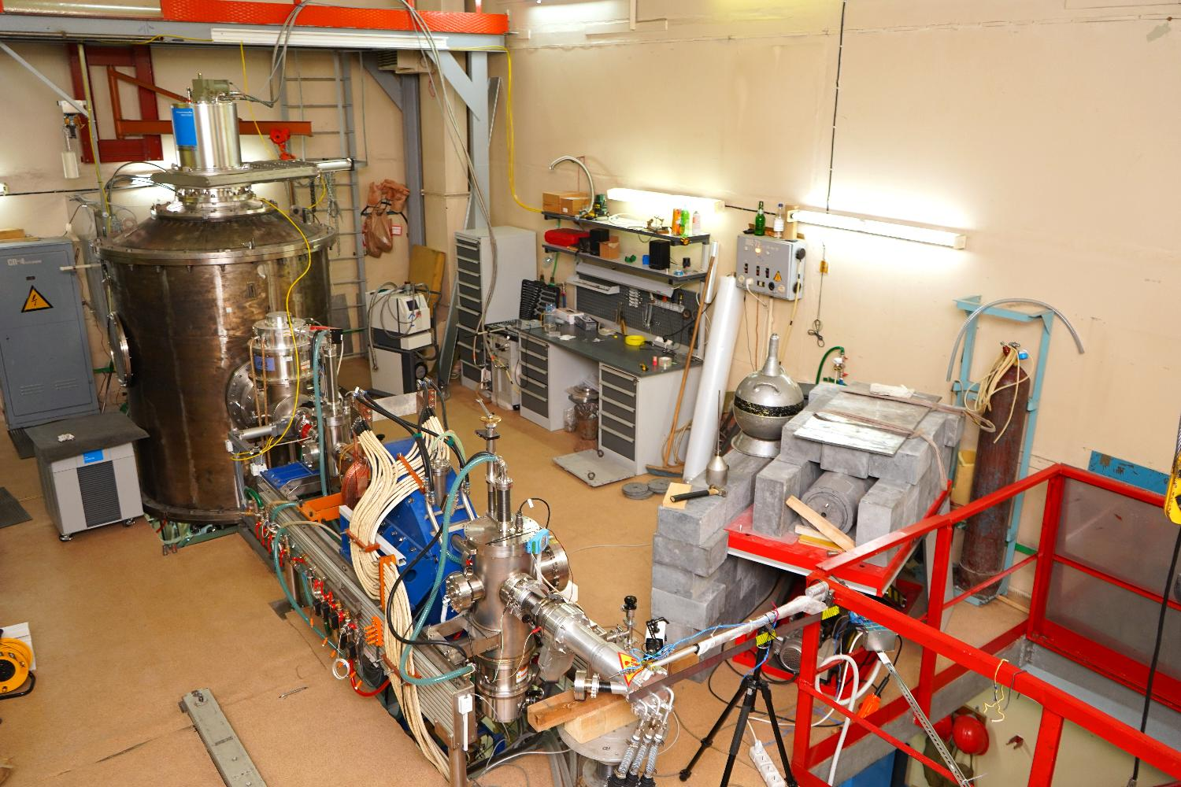
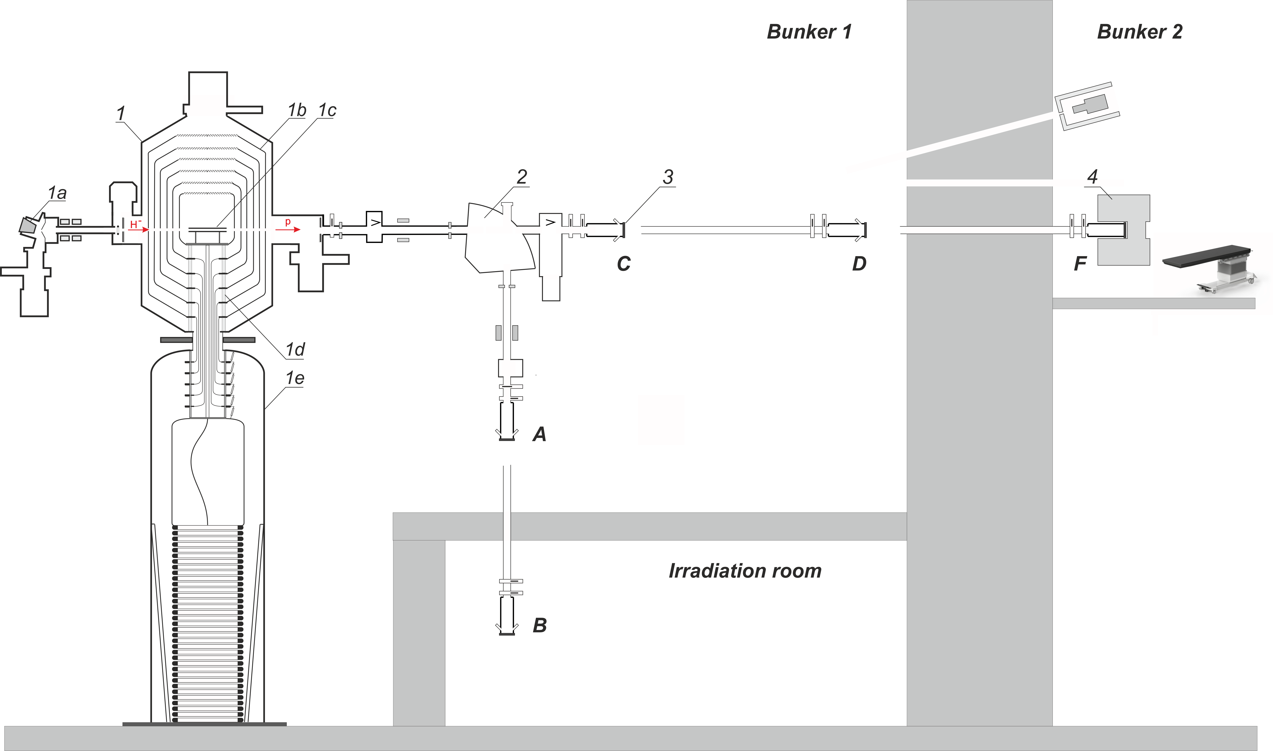
Achievements – significant
Applications – numerous
Facility is a state-of-the-art device comprised
the Vacuum Insulation Tandem Accelerator (VITA)
a solid lithium target
a Beam Shaping Assembly

Slide 3
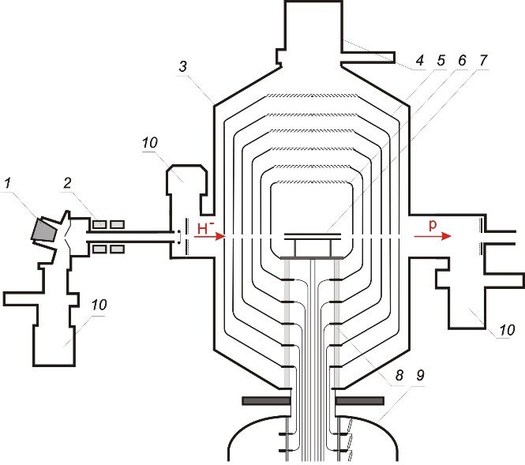

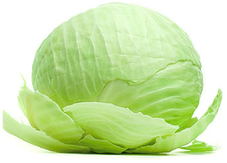
The original design tandem accelerator, which was named as Vacuum-Insulated Tandem Accelerator (VITA), has a specific design that does not involve accelerating tubes, unlike conventional tandem accelerators. Instead of those, the nested intermediate electrodes (5) fixed at single feedthrough insulator (8) is used, as shown in Figure.
The advantage of such an arrangement is moving ceramic parts of the feedthrough insulator far enough from the ion beam, thus increasing the high-voltage strength of the accelerating gaps given high ion beam current.
A consequence of this design was also a fast rate of ion acceleration—up to 25 keV/cm.
VITA: 1 – H– source, 2 – magnetic lenses,
3 – accelerator, 4 – cryogenic pump,
5 – intermediate electrodes, 6 – high-voltage electrode,
7 –gas stripper, 8 – insulator, 9 – high-voltage power supply, 10 – turbomolecular pumps.

Slide 4
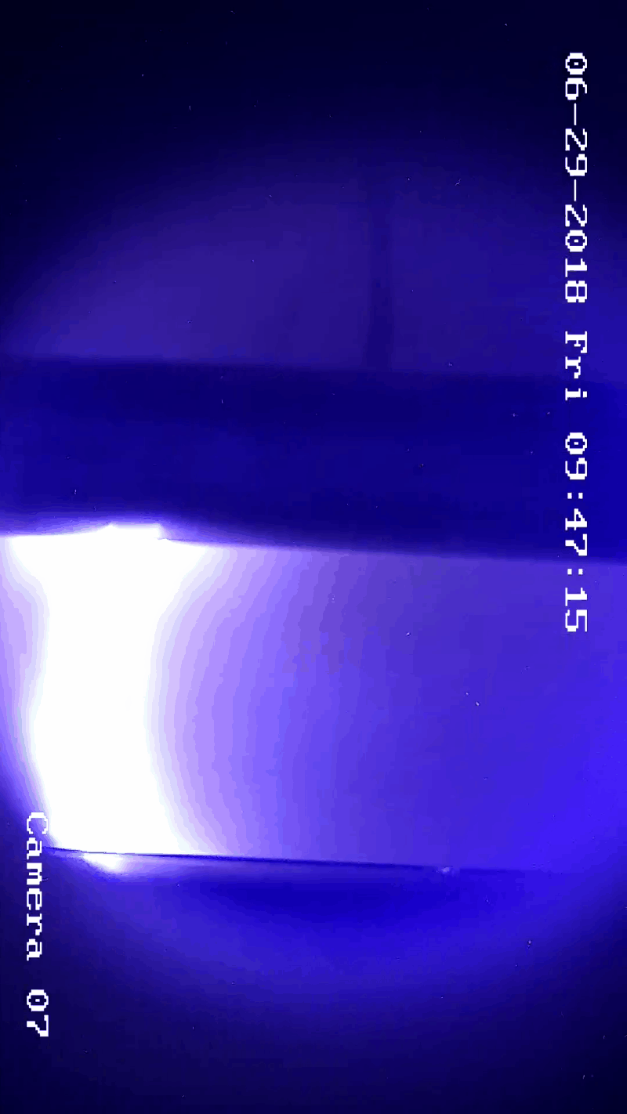
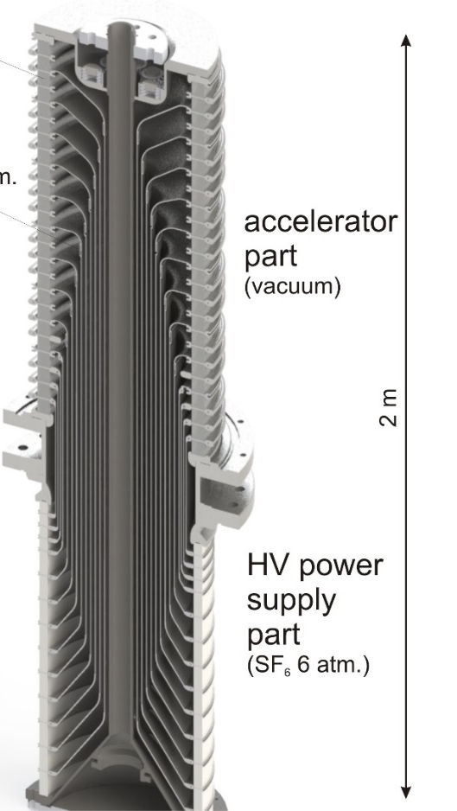
Advance # 1: elimination of high-voltage breakdowns
For the compactness of the accelerator, the average electric field strength on the insulator was chosen to be 14 kV/cm, which is 1.5 times higher than the recommended one.
This led to breakdowns along the surface of smooth ceramic insulators with a height of 73 mm, from which the feedthrough insulator was assembled.
Such breakdowns occurred approximately once every 10–20 min; they did not lead to a decrease in the electric strength of the accelerator, but required 15 s to restore the parameters of the ion beam.
To eliminate breakdowns along the vacuum surface of insulators, smooth ceramic insulators were replaced with corrugated insulators.

Slide 5
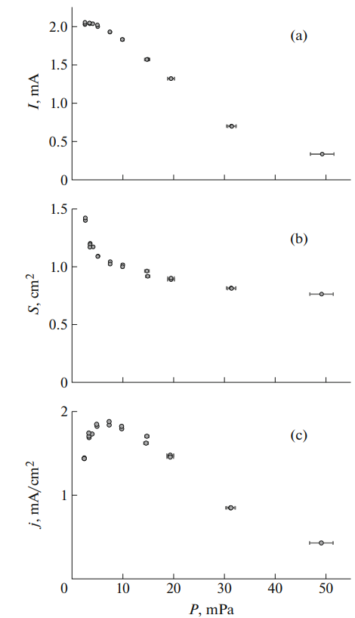
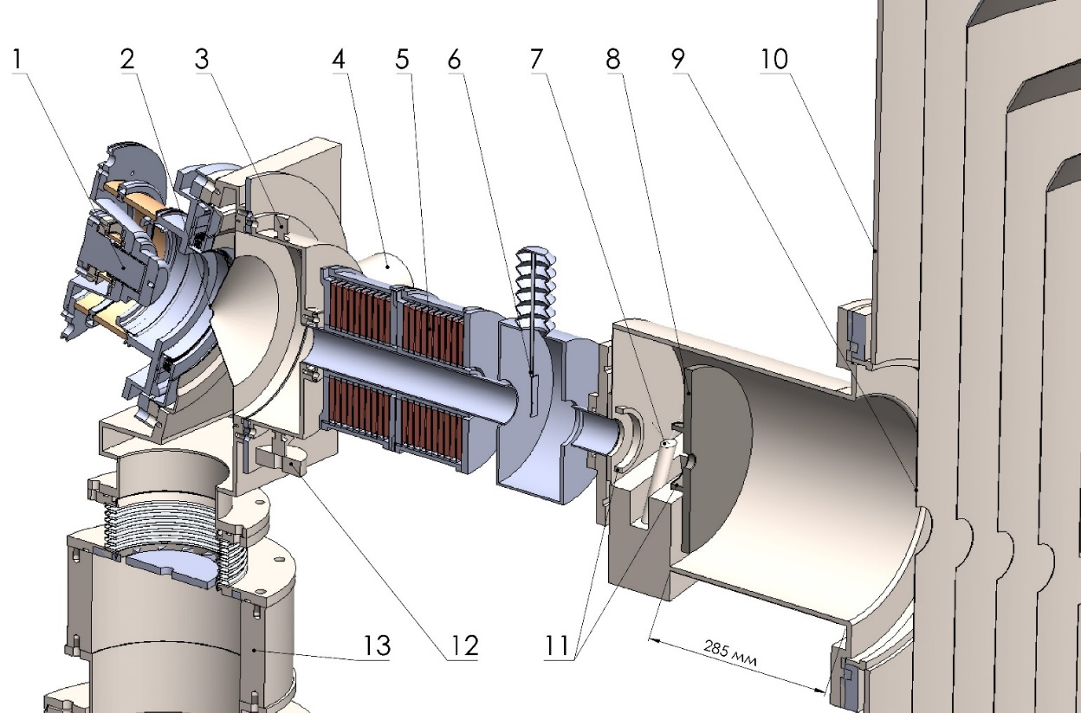
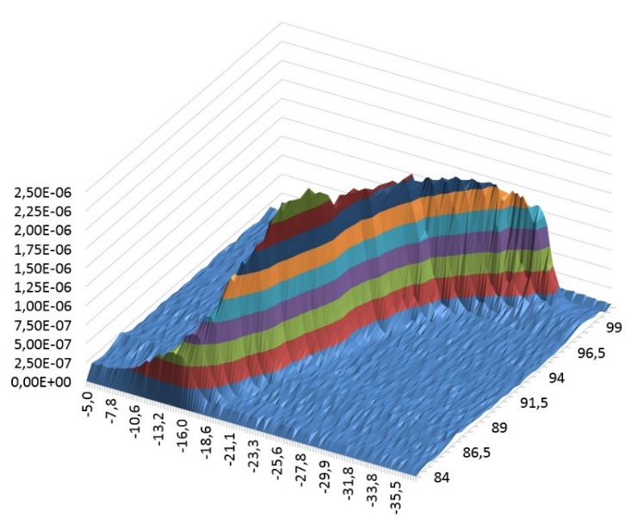
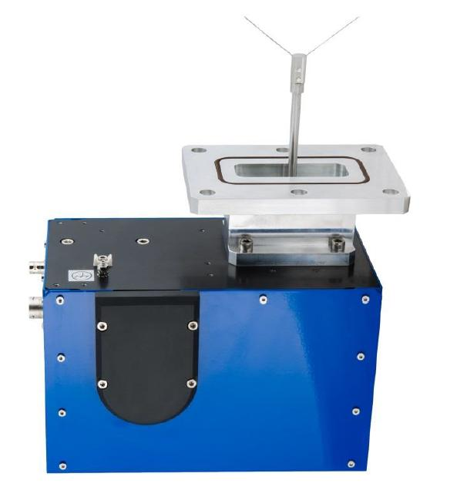
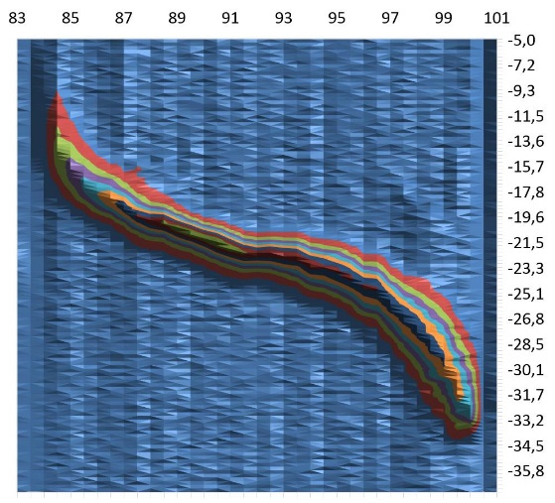
Advance # 2: wire scanner OWS-30 (D-Pace, Canada) is used to control the position and size of the ion beam at the entrance to the accelerator
source of negative hydrogen ions,
cone diaphragm,
vacuum lamp,
turbomolecular pumps,
magnetic lenses,
movable diaphragm,
OWS-30 wire scanner,
cooled diaphragm,
first electrode of the accelerator,
vacuum tank of the accelerator,
metal rings,
leak valve.
The dependences (a) of the current I,
(b) the cross sectional area S, (c) the current density j of the ion beam
on the residual gas pressure P
The phase portrait of the ion beam

Slide 6
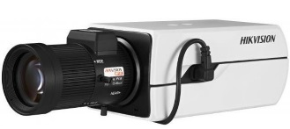
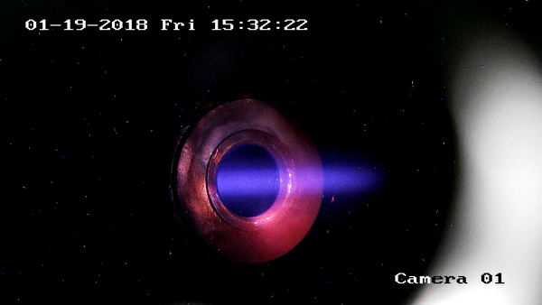
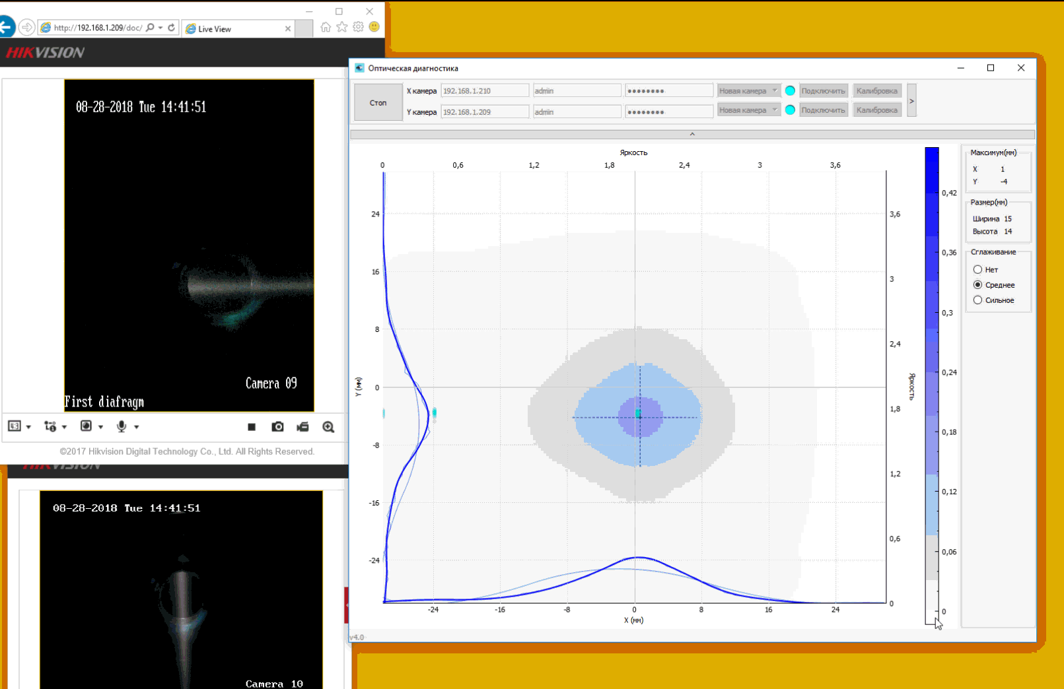
Advance # 3: The position and size of the ion beam in the accelerator are controlled by two pairs of video cameras overseeing the input and output diaphragms of the external accelerating electrode
The presence of a gas stripper in a tandem accelerator is often considered a disadvantage. We managed to neutralize the disadvantages and turn the use of a gas stripper into an advantage. The additional gas flow makes it possible to visualize the beam for diagnostics of its position and size and improves the high-voltage strength of the accelerating gaps.

Slide 7
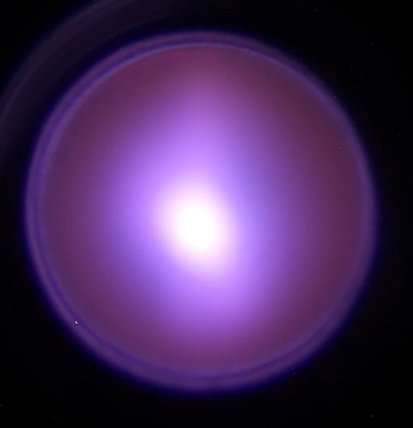
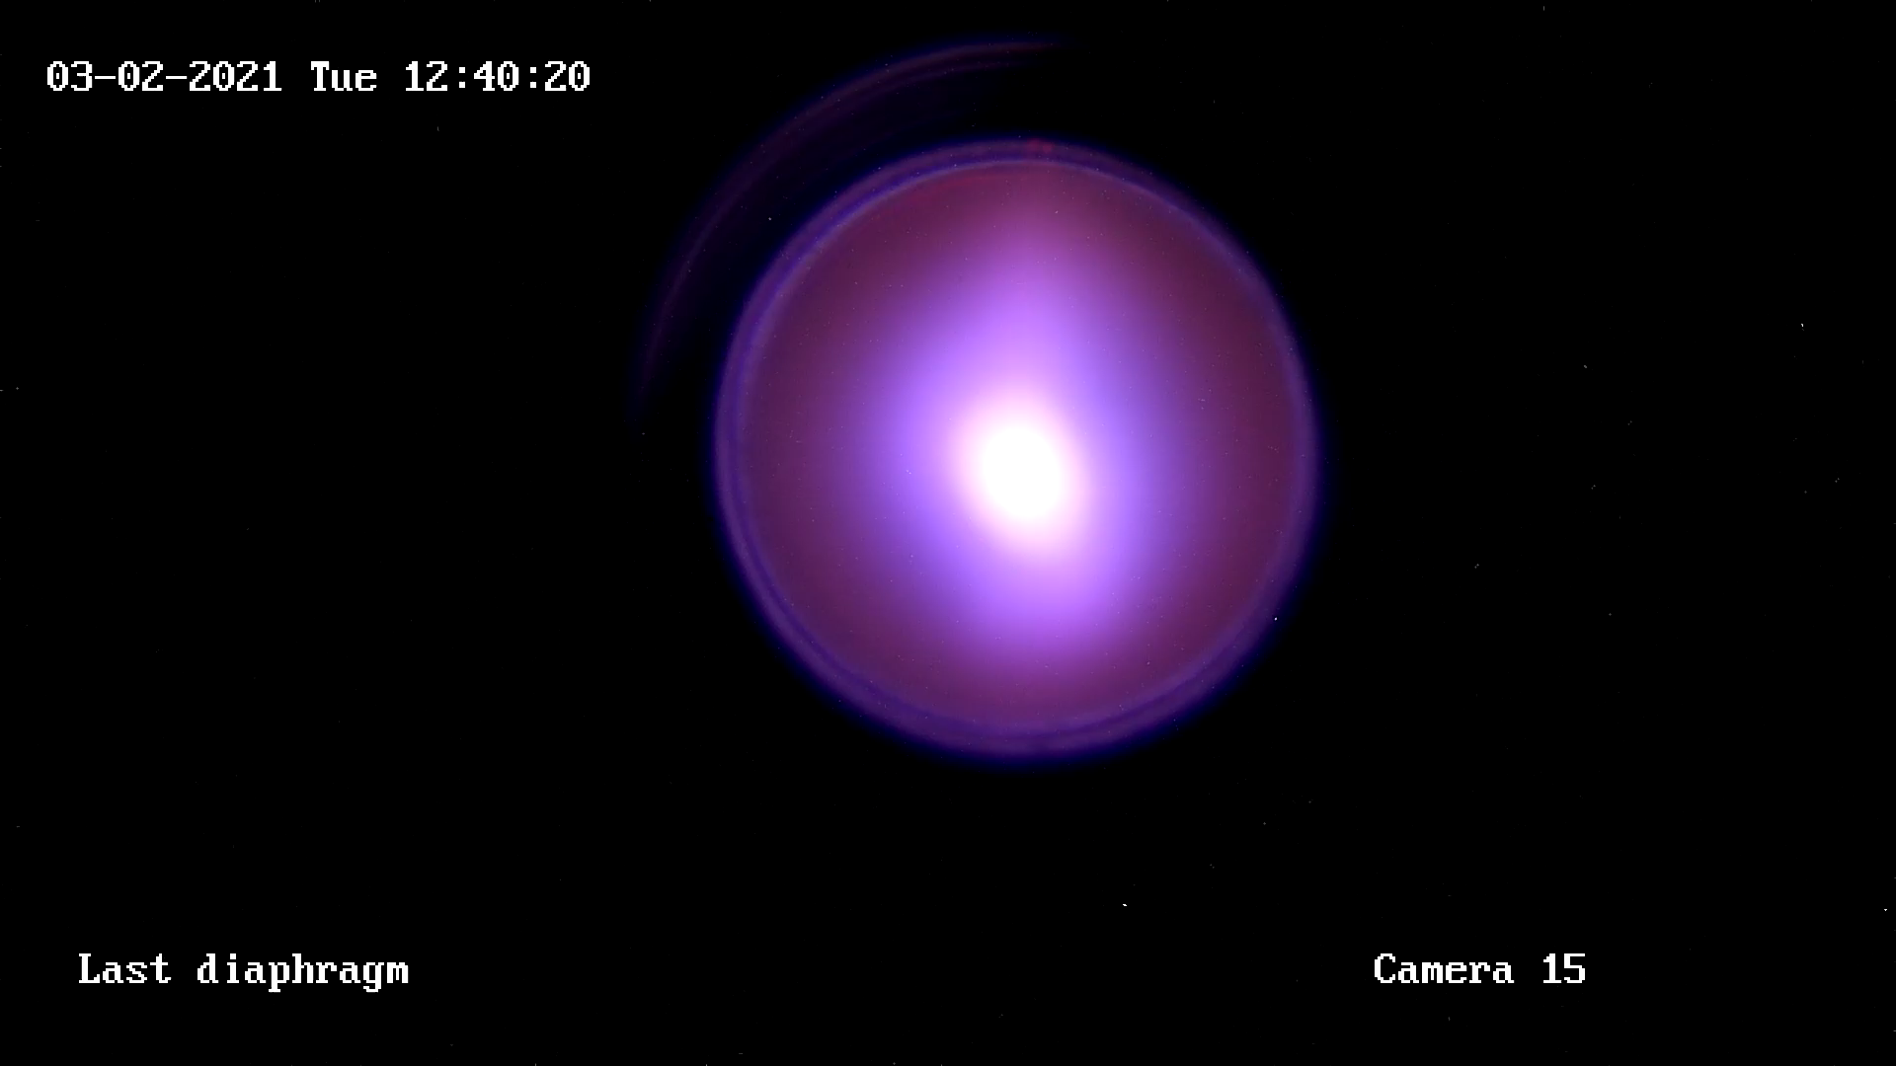
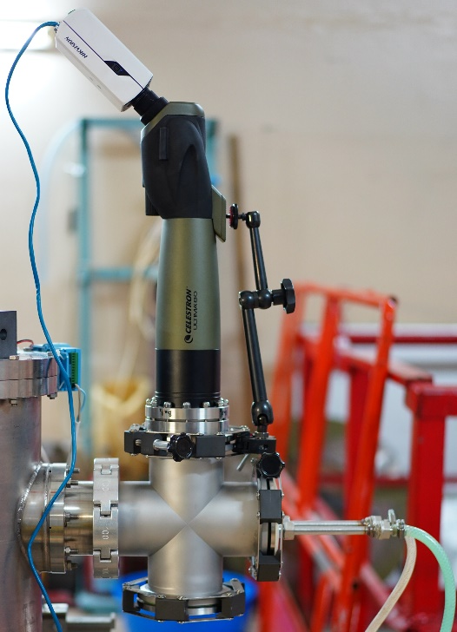
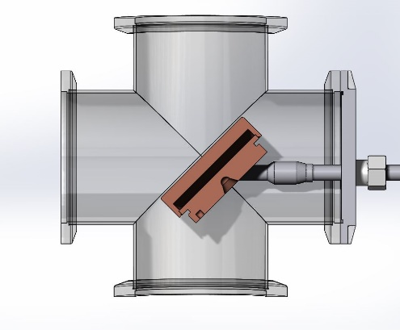
Advance # 4: The position and size of the ion beam inside the gas stripper is monitored with Celestron Ultima 80-45 telescope looking axially through a cooled mirror.

Slide 8
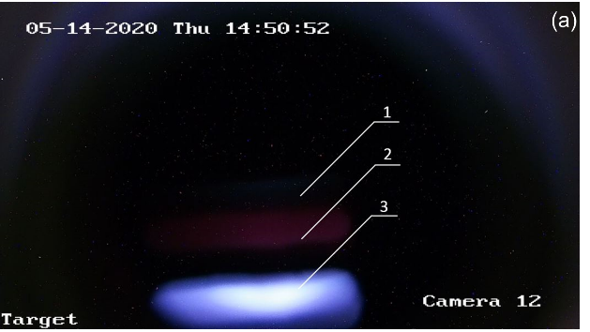
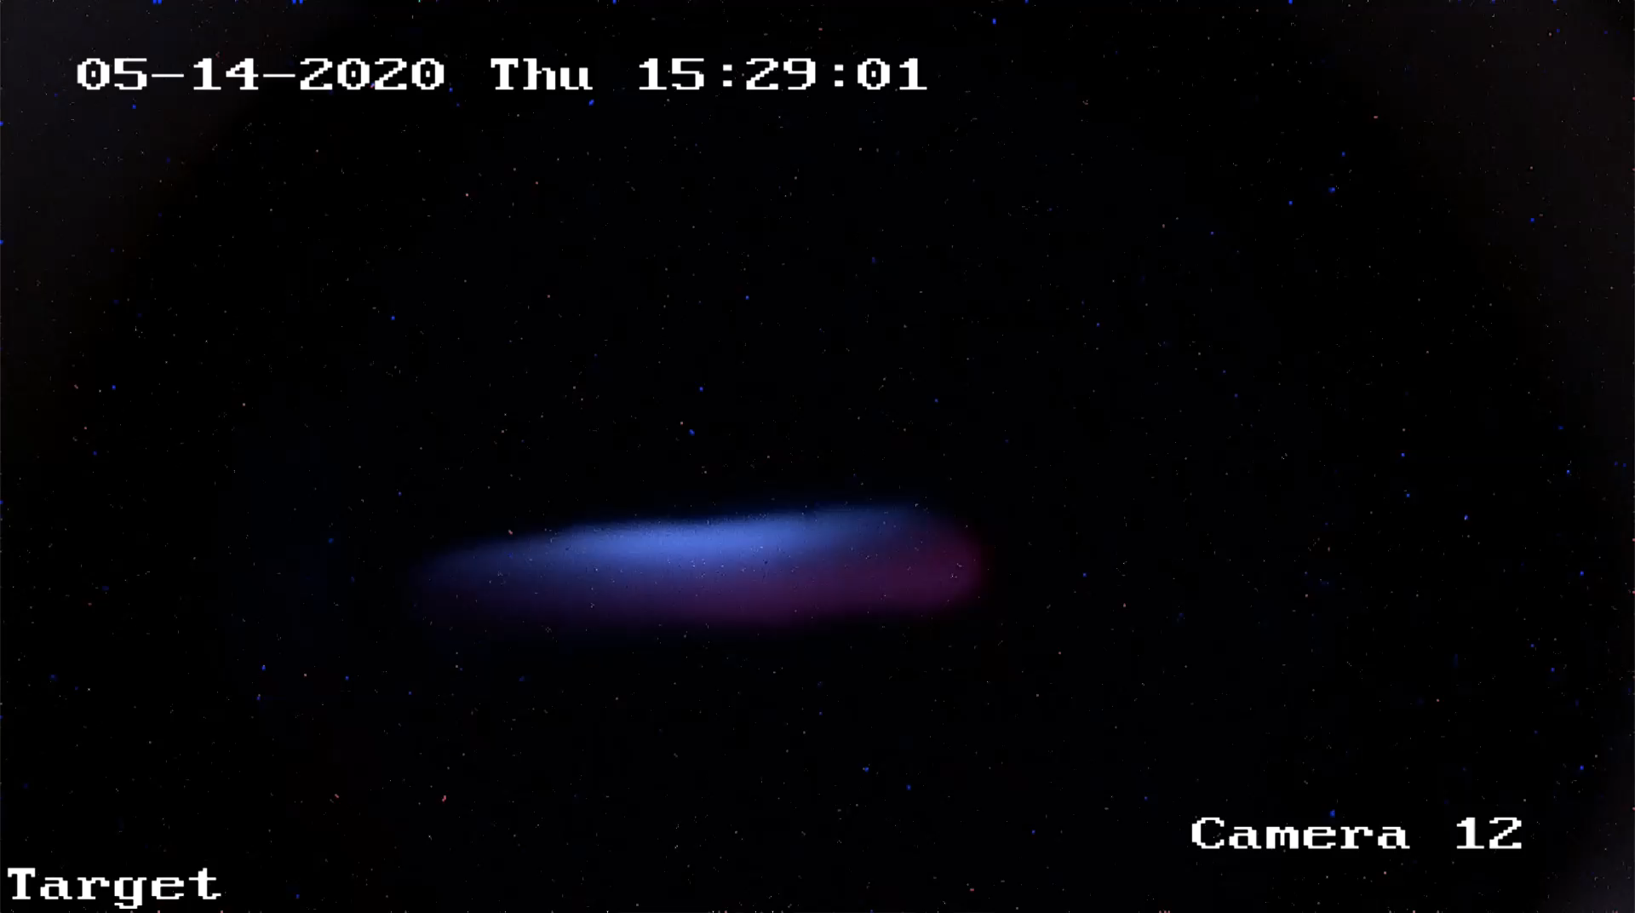
Advance # 5: The magnitude of the argon ion beam current was measured by mass spectroscopy using a bending magnet and a cooled diaphragm; it is 2000 times smaller than the proton beam current.
The reliability of the measurement is provided by visualization of an argon ion beam on the surface of a lithium target, as confirmed by an experiment with increased gas injection and an estimate of the possible contribution of the proton beam.
Such a small value of the current of the argon ion beam poses no danger either as an additional heating of the lithium target or as an additional load of a high-voltage power supply and therefore does not require the previously proposed suppression means.

Slide 9
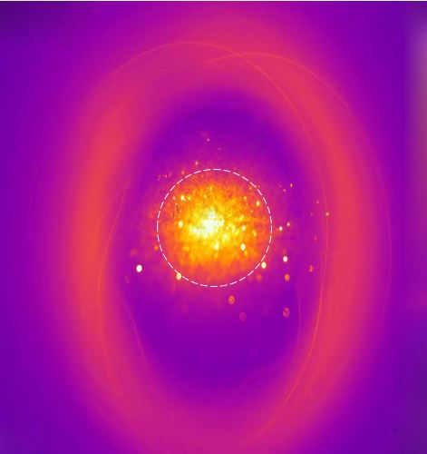
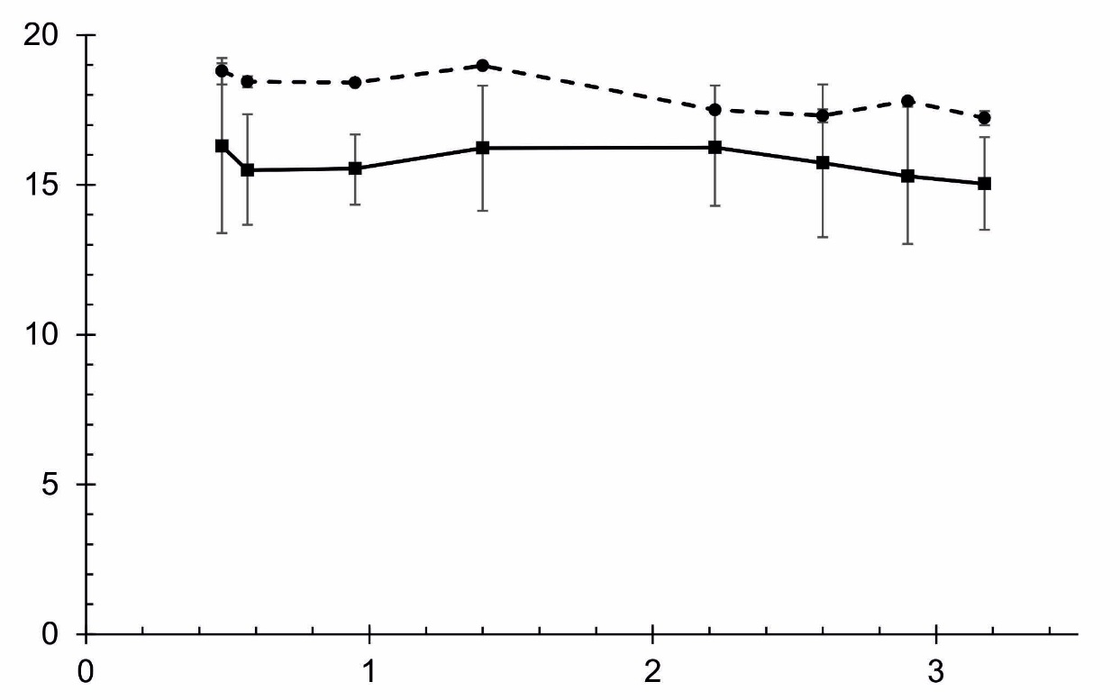
Advance # 6: No appreciable influence of the spatial charge on the proton beam transport.
r, mm
I, mA

Slide 10
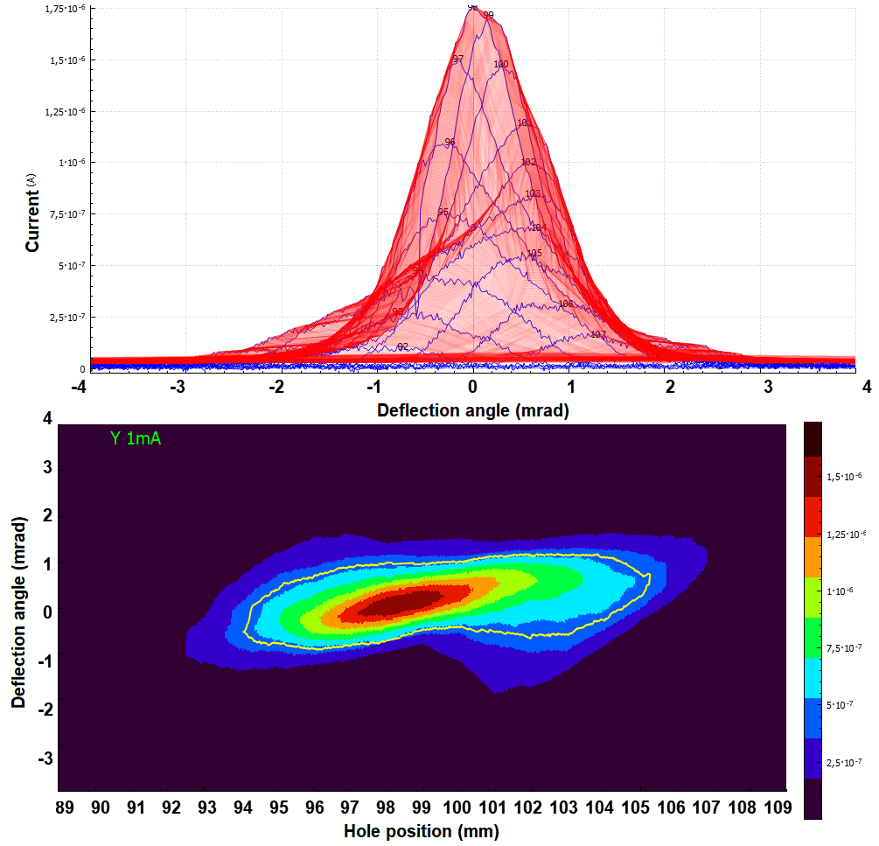
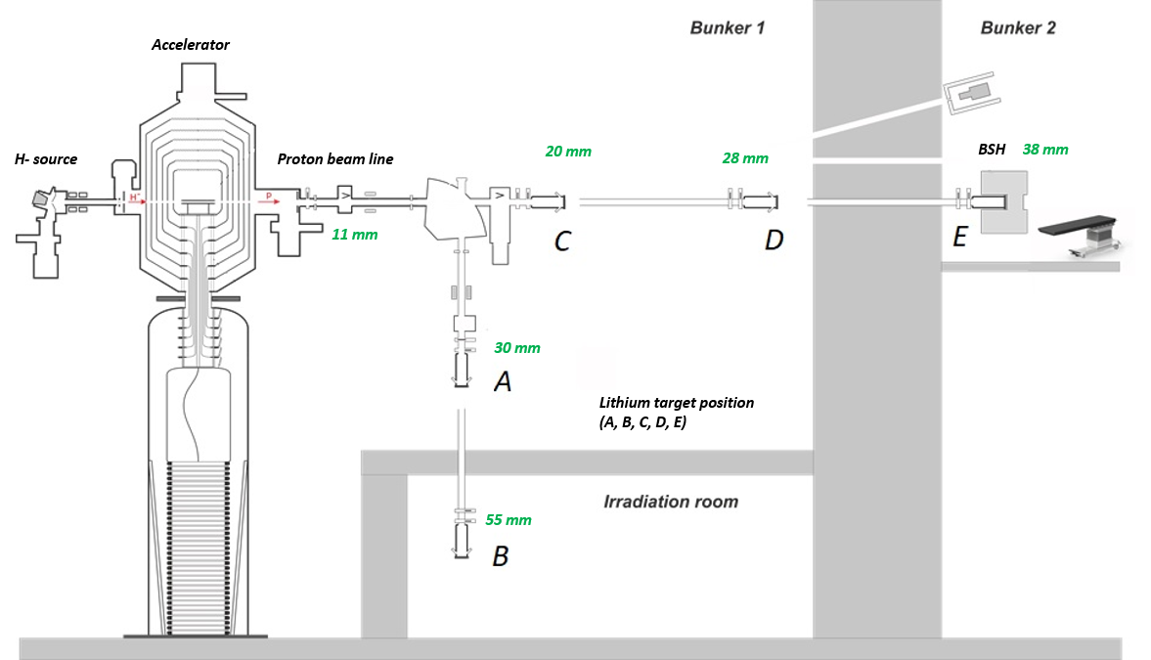
Advance # 7: 9 methods for measuring the proton beam profile implemented.
Phase portrait of a beam of protons and neutrals measured.
The proton beam has a characteristic size of 11 mm,
a divergence of 1.5 mrad,
and a normalized emittance of 0.23 mm mrad.

Slide 11
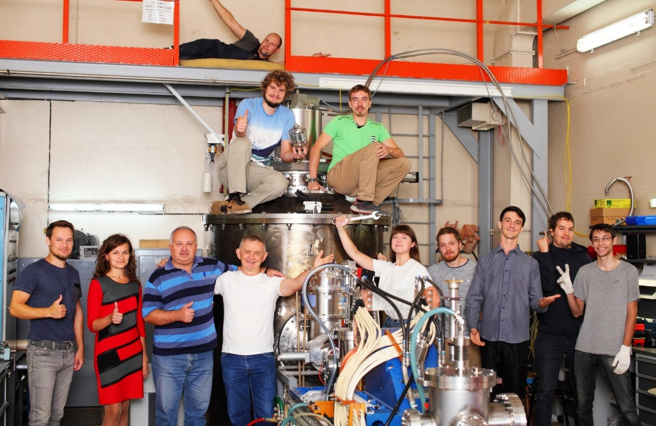
RESULT:
High power DC proton/deuteron beam (20 kW):
Monochromaticity and stability: 0.1%
Energy: ranges from 0.6 MeV to 2.3 MeV
Current: ranges from 1 pA to 10 mA (10 orders!)
High flux neutron beam (2 10¹² s⁻¹):
thermal (D₂O or Plexiglas moderator)
epithermal (MgF₂ moderator)
exclusively epithermal (no fast and thermal)
over-epithermal
monoenergetic (kinematic collimation)
fast
Bright source of photons:
478 keV - ⁷Li(p,p’γ)⁷Li
511 keV – ¹⁹F(p,αe⁺e⁻)¹⁶O
α-particles in ⁷Li(p,α)α and ¹¹B(p,α)αα
positrons in ¹⁹F(p,αe⁺e⁻)¹⁶O

Slide 12



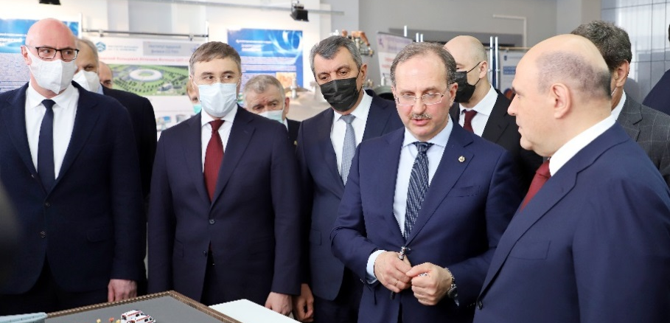

Application # 1: Boron Neutron Capture Therapy
Neutron source VITA meets the requirements of BNCT to the greatest extent
The neutron source VITA commercialized by TAE (CA, USA):
1st source is installed in new BNCT Center at Xiamen Humanity Hospital
in Xiamen, P.R. China in 2020. It is planned to start treatment in early 2022;
2nd source will be made for National Oncological Hadron Therapy Center (CNAO) in Pavia, Italy;
3rd source will be made for National Medical Research Center of Oncology in Moscow, Russia;
- I hope the list will go on
Visit
of the Prime Minister
of the Russian Federation
M. Mishustin to BINP
March 05, 2021

Slide 13

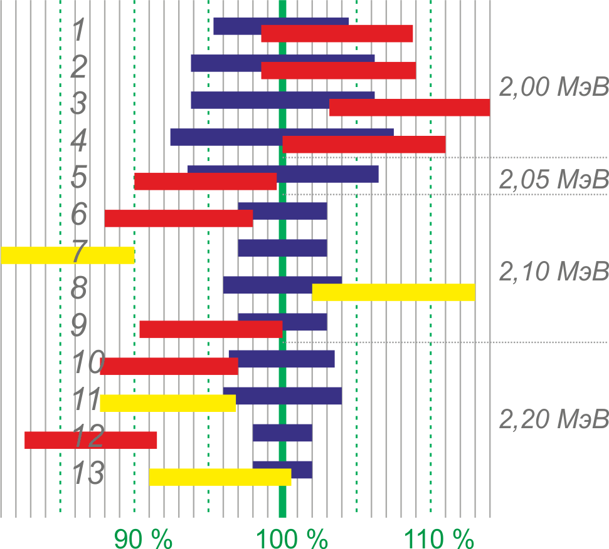
Application # 1: Boron Neutron Capture Therapy
Our new results:
A small-sized detector for measuring boron dose and gamma-ray dose
is developed and used [JINST 16 (2021) P01024];
New method for measuring the sum of the fast neutron dose and the nitrogen dose is proposed and implemented [Radiation Research 196 (2021) 192-196];
New method for in situ measuring the lithium layer thickness is proposed and implemented
[JINST 15 (2020) P10006];
The neutron yield of the ⁷Li(p,n)⁷Be reaction in lithium target was measured [Biology 10 (2021) 824];
A number of new boron delivery drugs have been tested
[Intern. J. Molecular Sciences 22 (2021) 7326; Intern. J. Radiation Oncology, Biology, Physics;
Pharmaceutics 13 (2021) 1490; Chemical Phys. Letters; …]
Our patent on new boron delivery drug, jointly with colleagues from Moscow,
[RU2729458, WO 2020/246913] is recognized as the best Russian invention
of the 21st century.

Slide 14
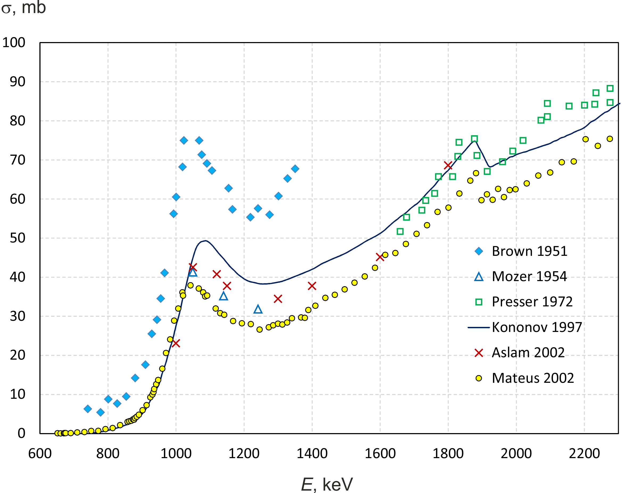
Application # 2: Fundamental knowledge
⁷Li(p,p‘γ)⁷Li reaction cross-section

Slide 15
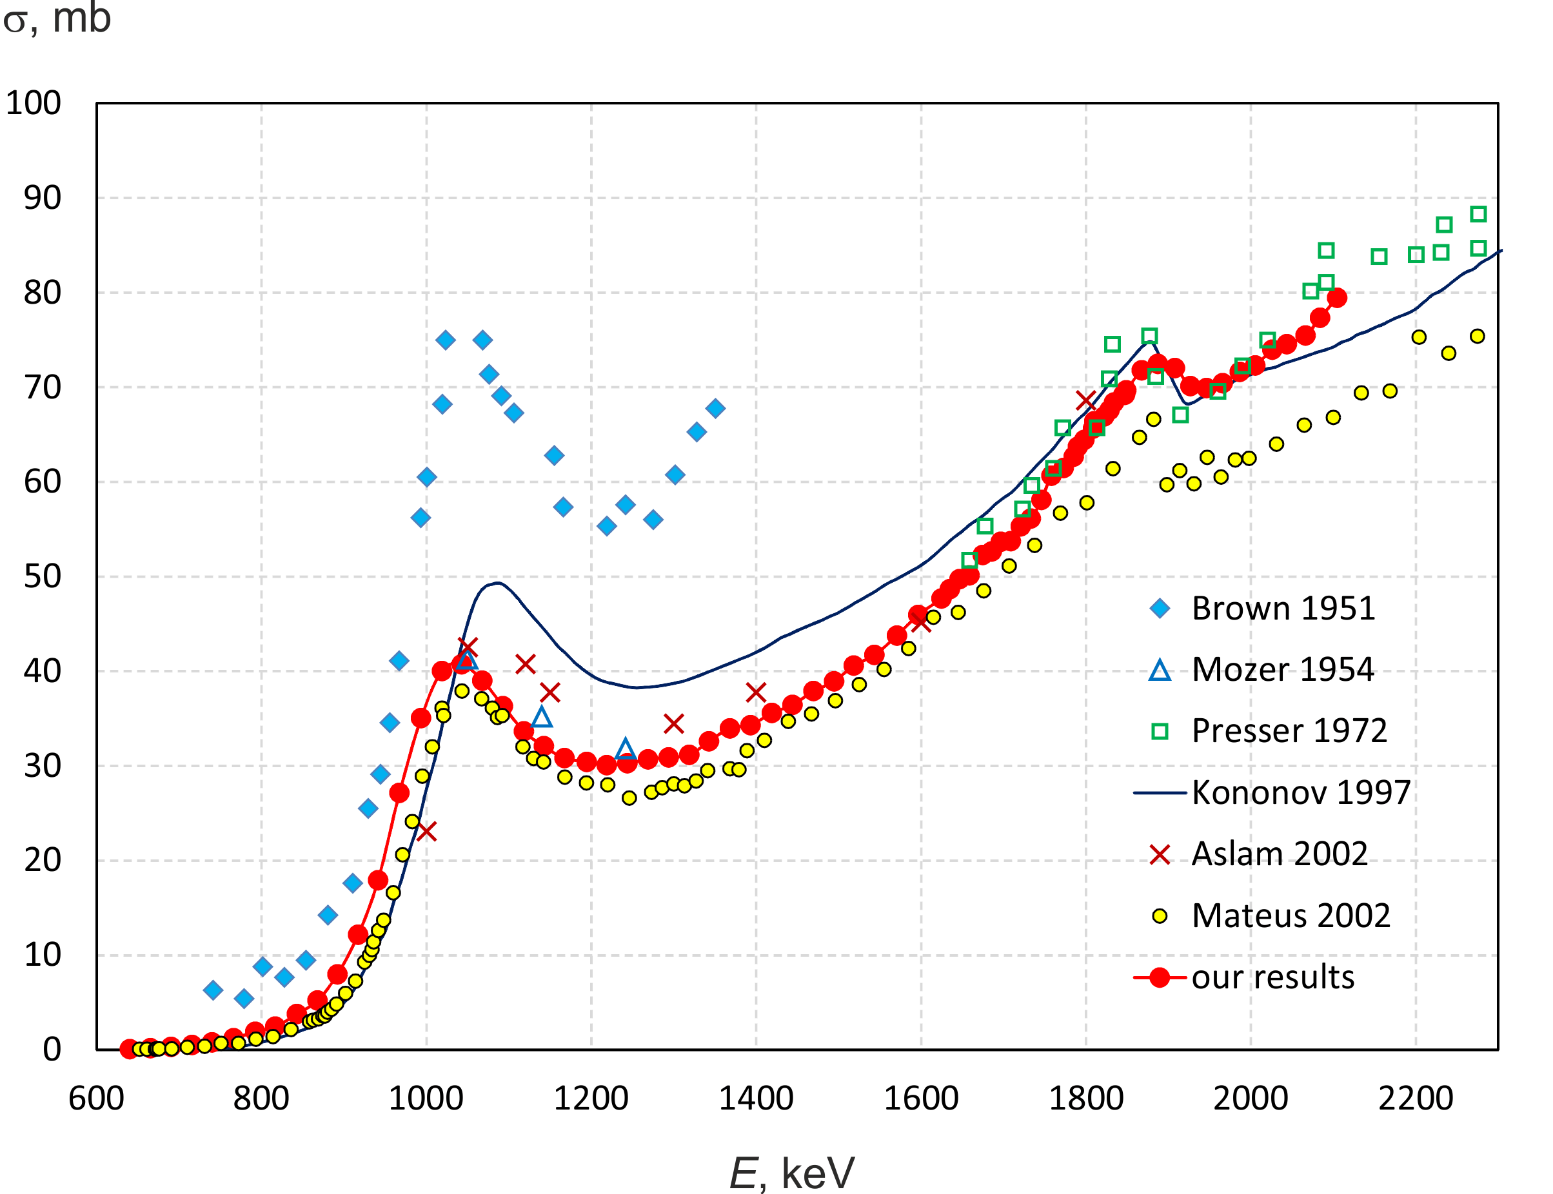
Application # 2: Fundamental knowledge
⁷Li(p,p‘γ)⁷Li reaction cross-section
[Nucl. Instrum. Methods Phys. Res., Sect. B, vol. 502, pp. 85-94, June 2021]

Slide 16
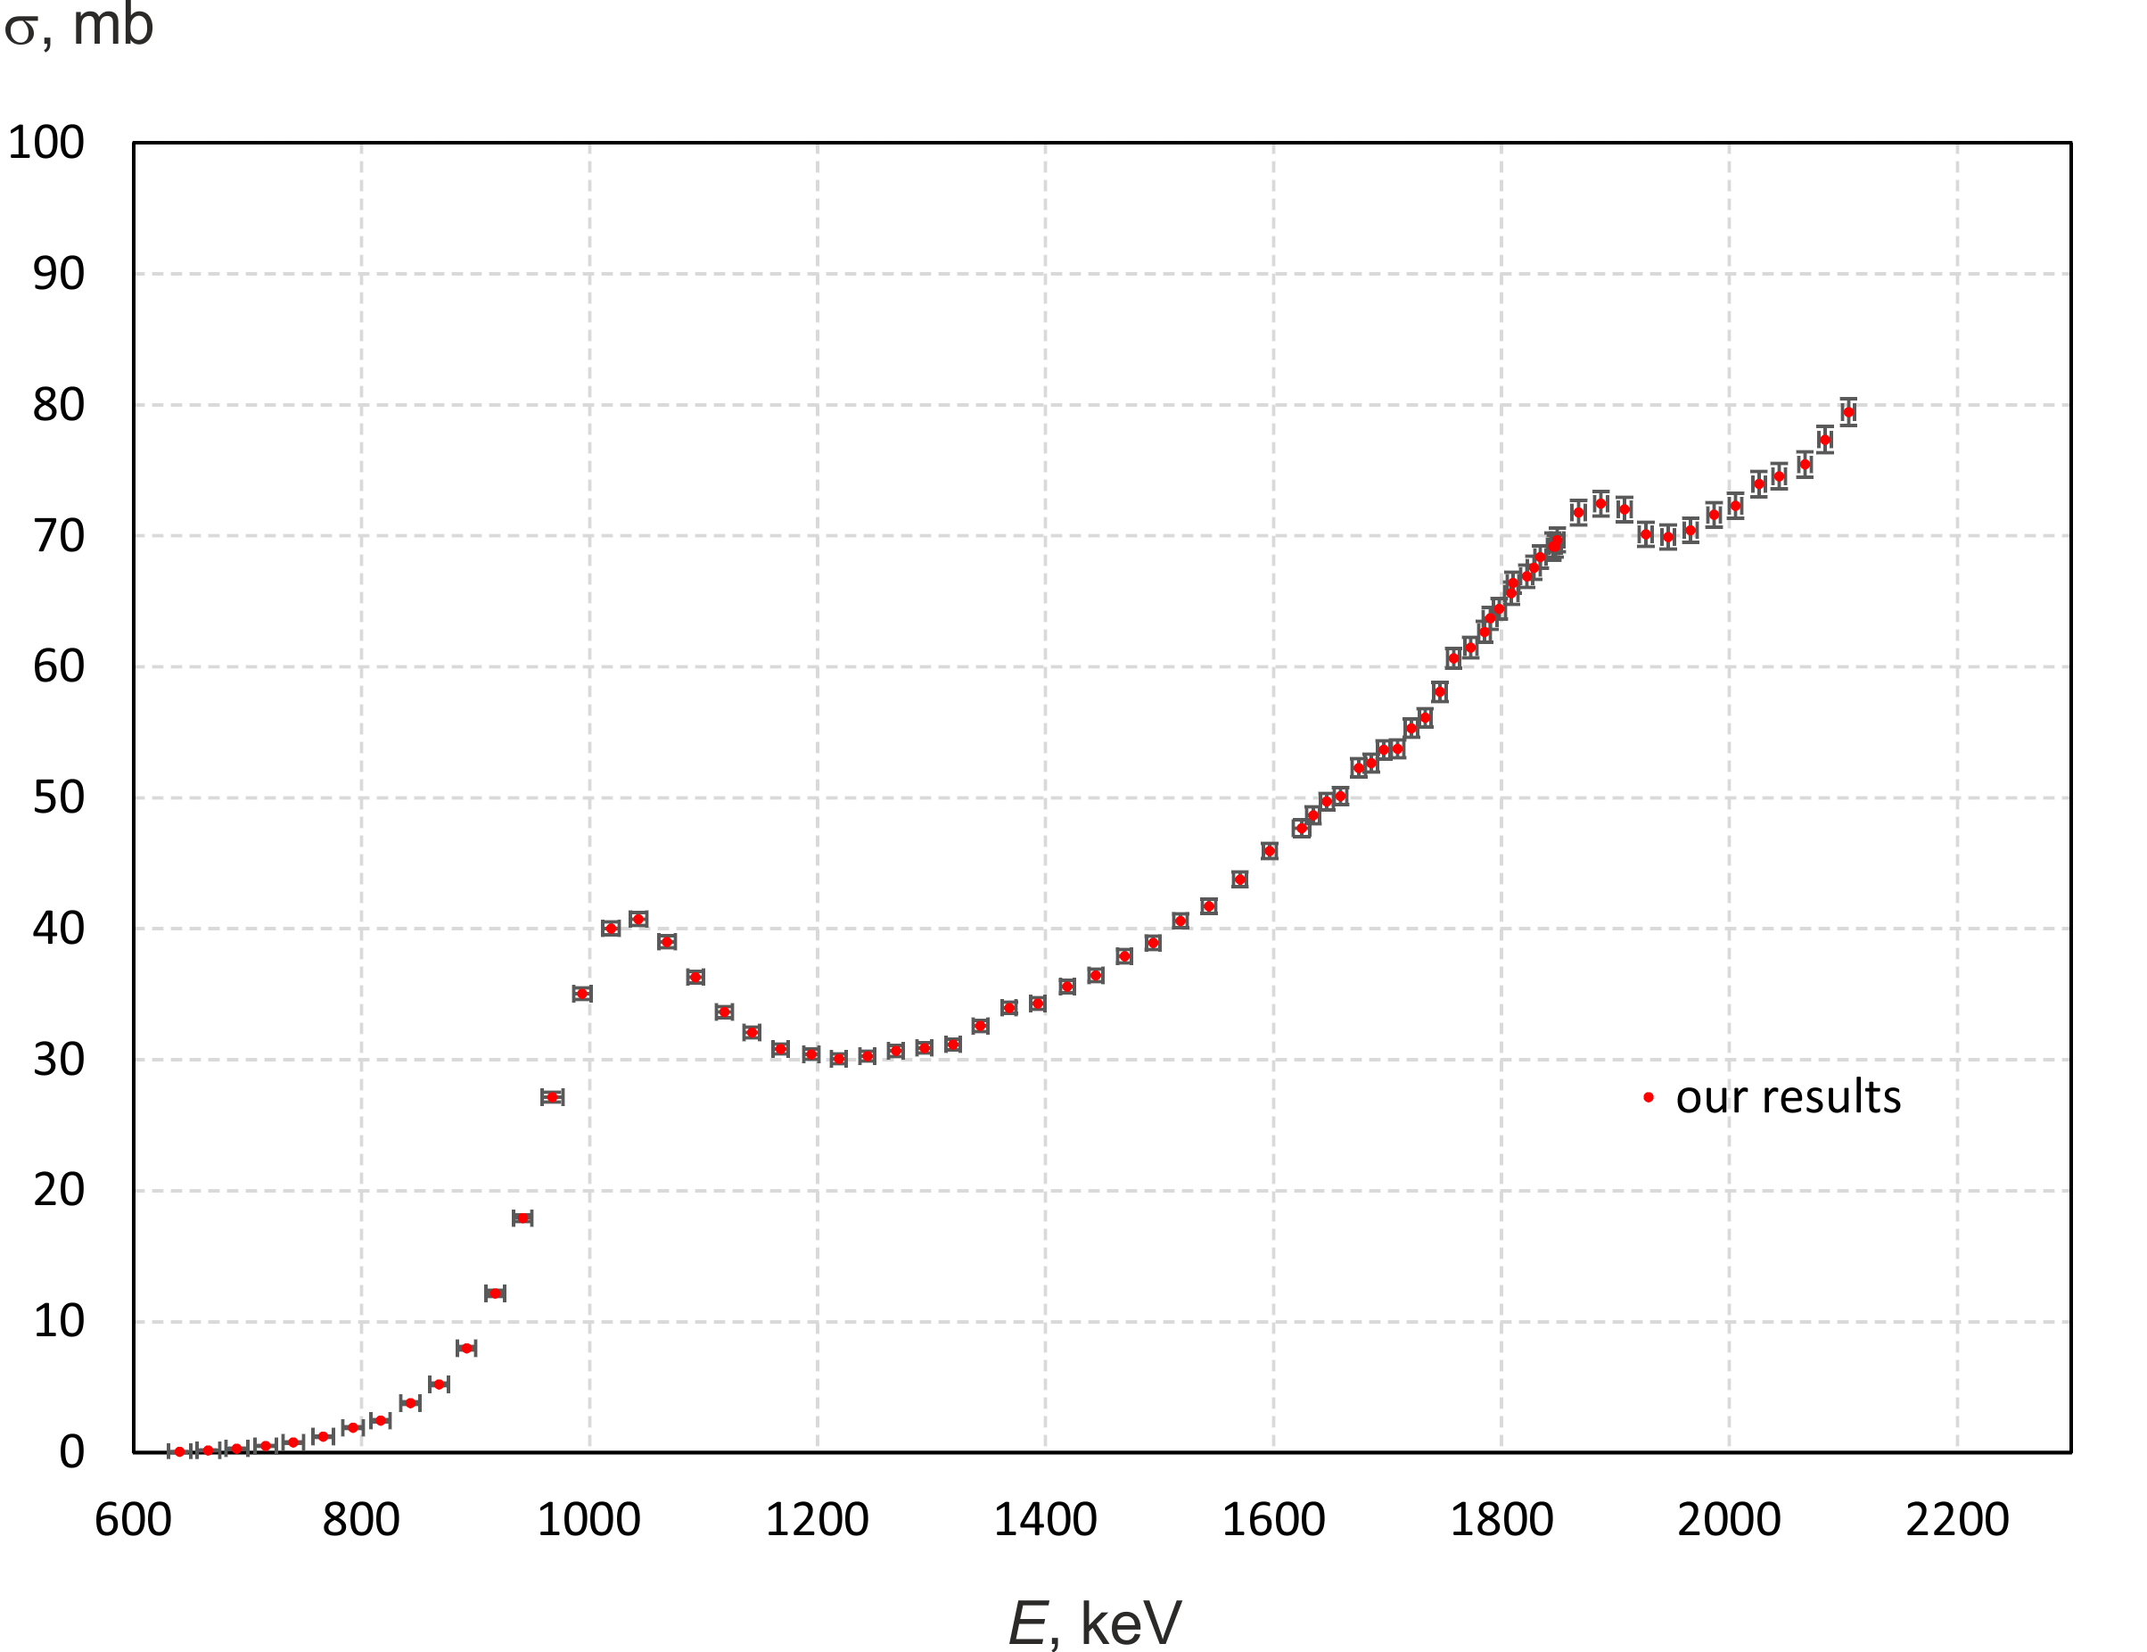
Application # 2: Fundamental knowledge
⁷Li(p,p‘γ)⁷Li reaction cross-section
[Nucl. Instrum. Methods Phys. Res., Sect. B, vol. 502, pp. 85-94, June 2021]

Slide 17
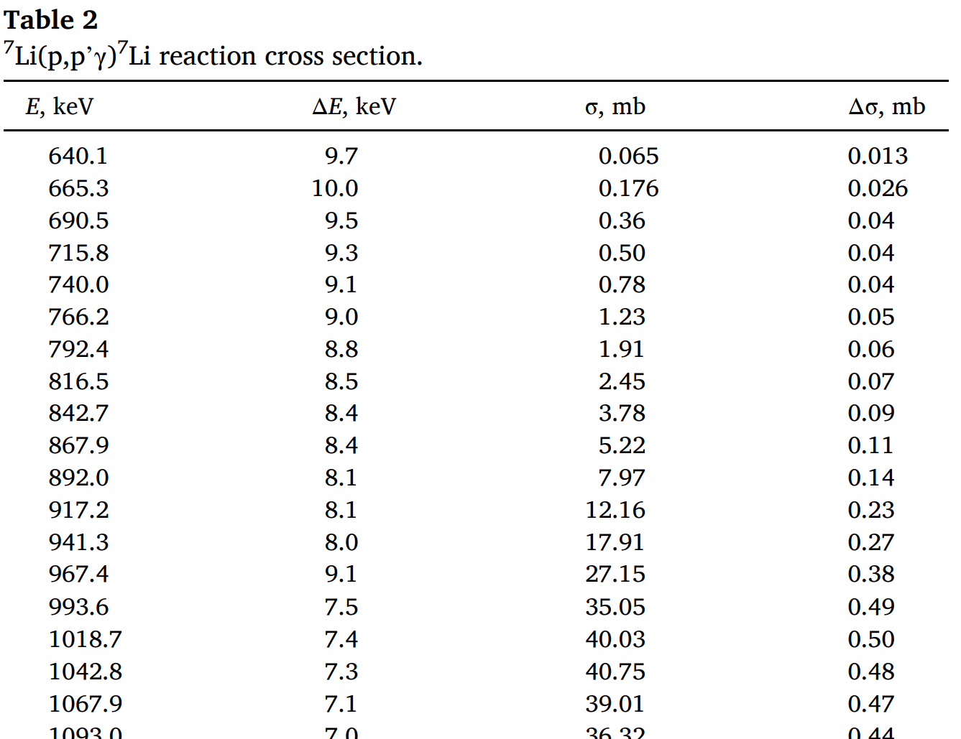
Application # 2: Fundamental knowledge
⁷Li(p,p‘γ)⁷Li reaction cross-section
[Nucl. Instrum. Methods Phys. Res., Sect. B, vol. 502, pp. 85-94, June 2021]

Slide 18
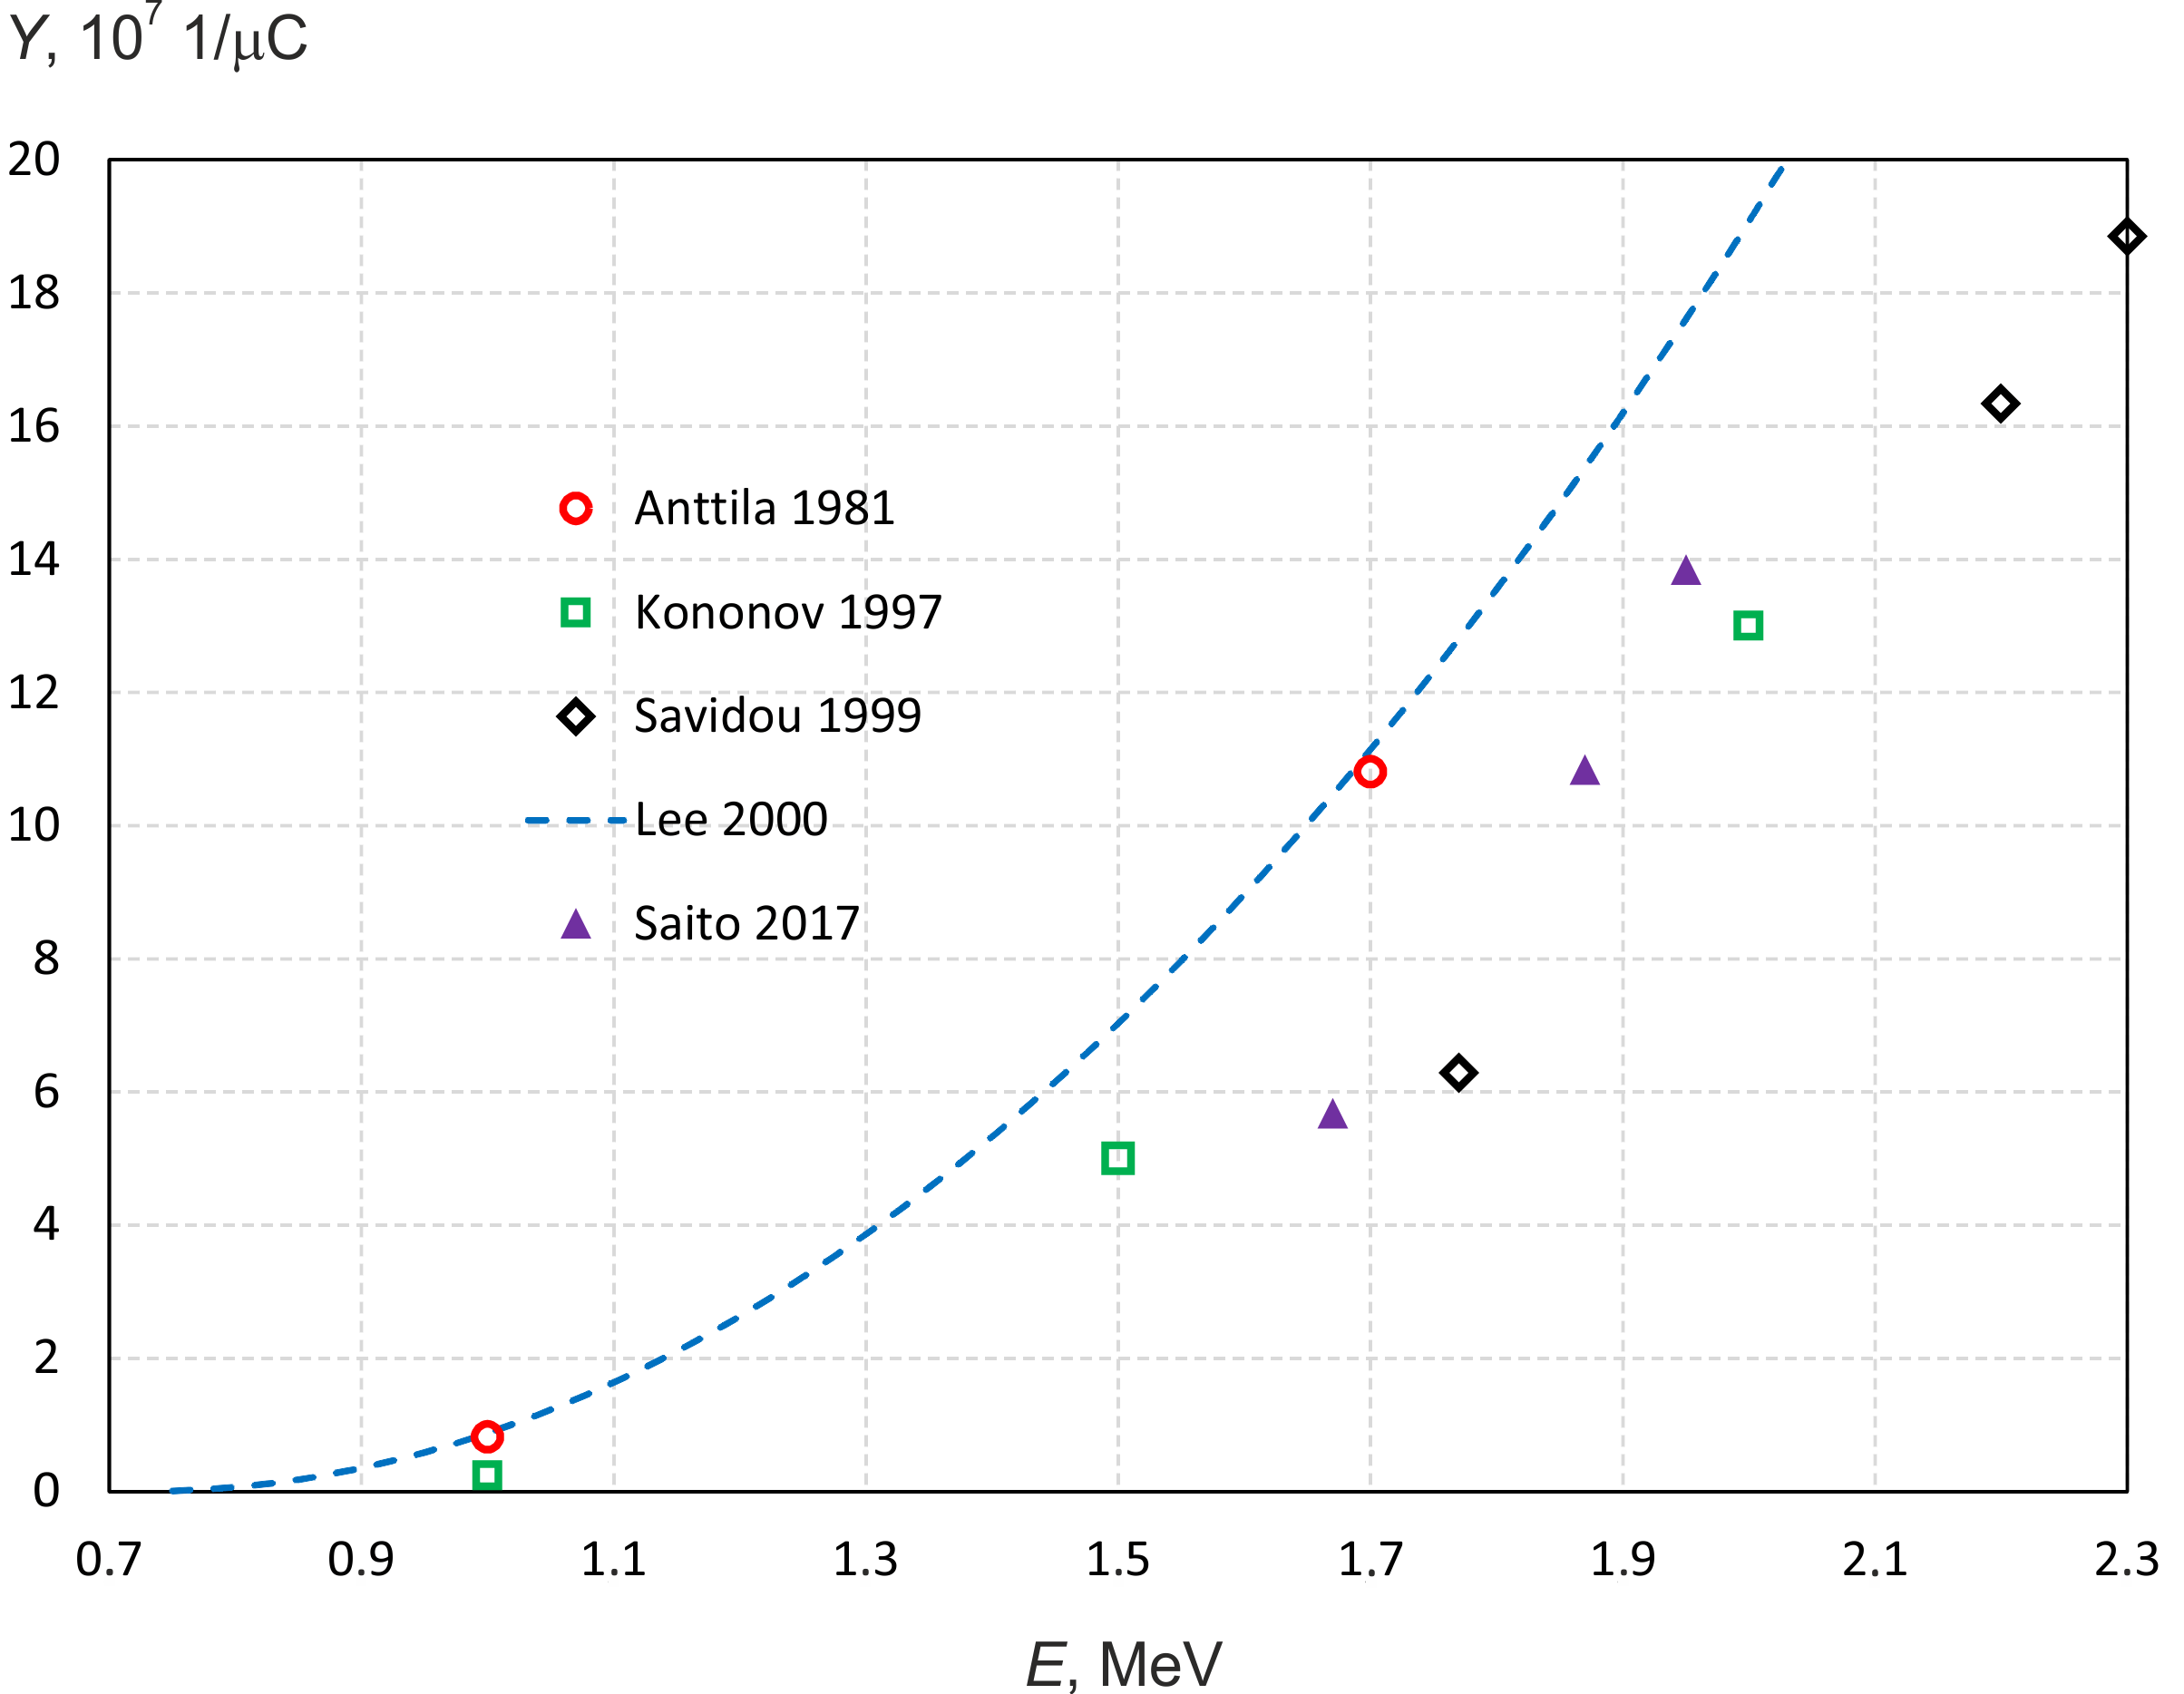
Application # 2: Fundamental knowledge
478 keV photon yield
from a thick lithium target

Slide 19
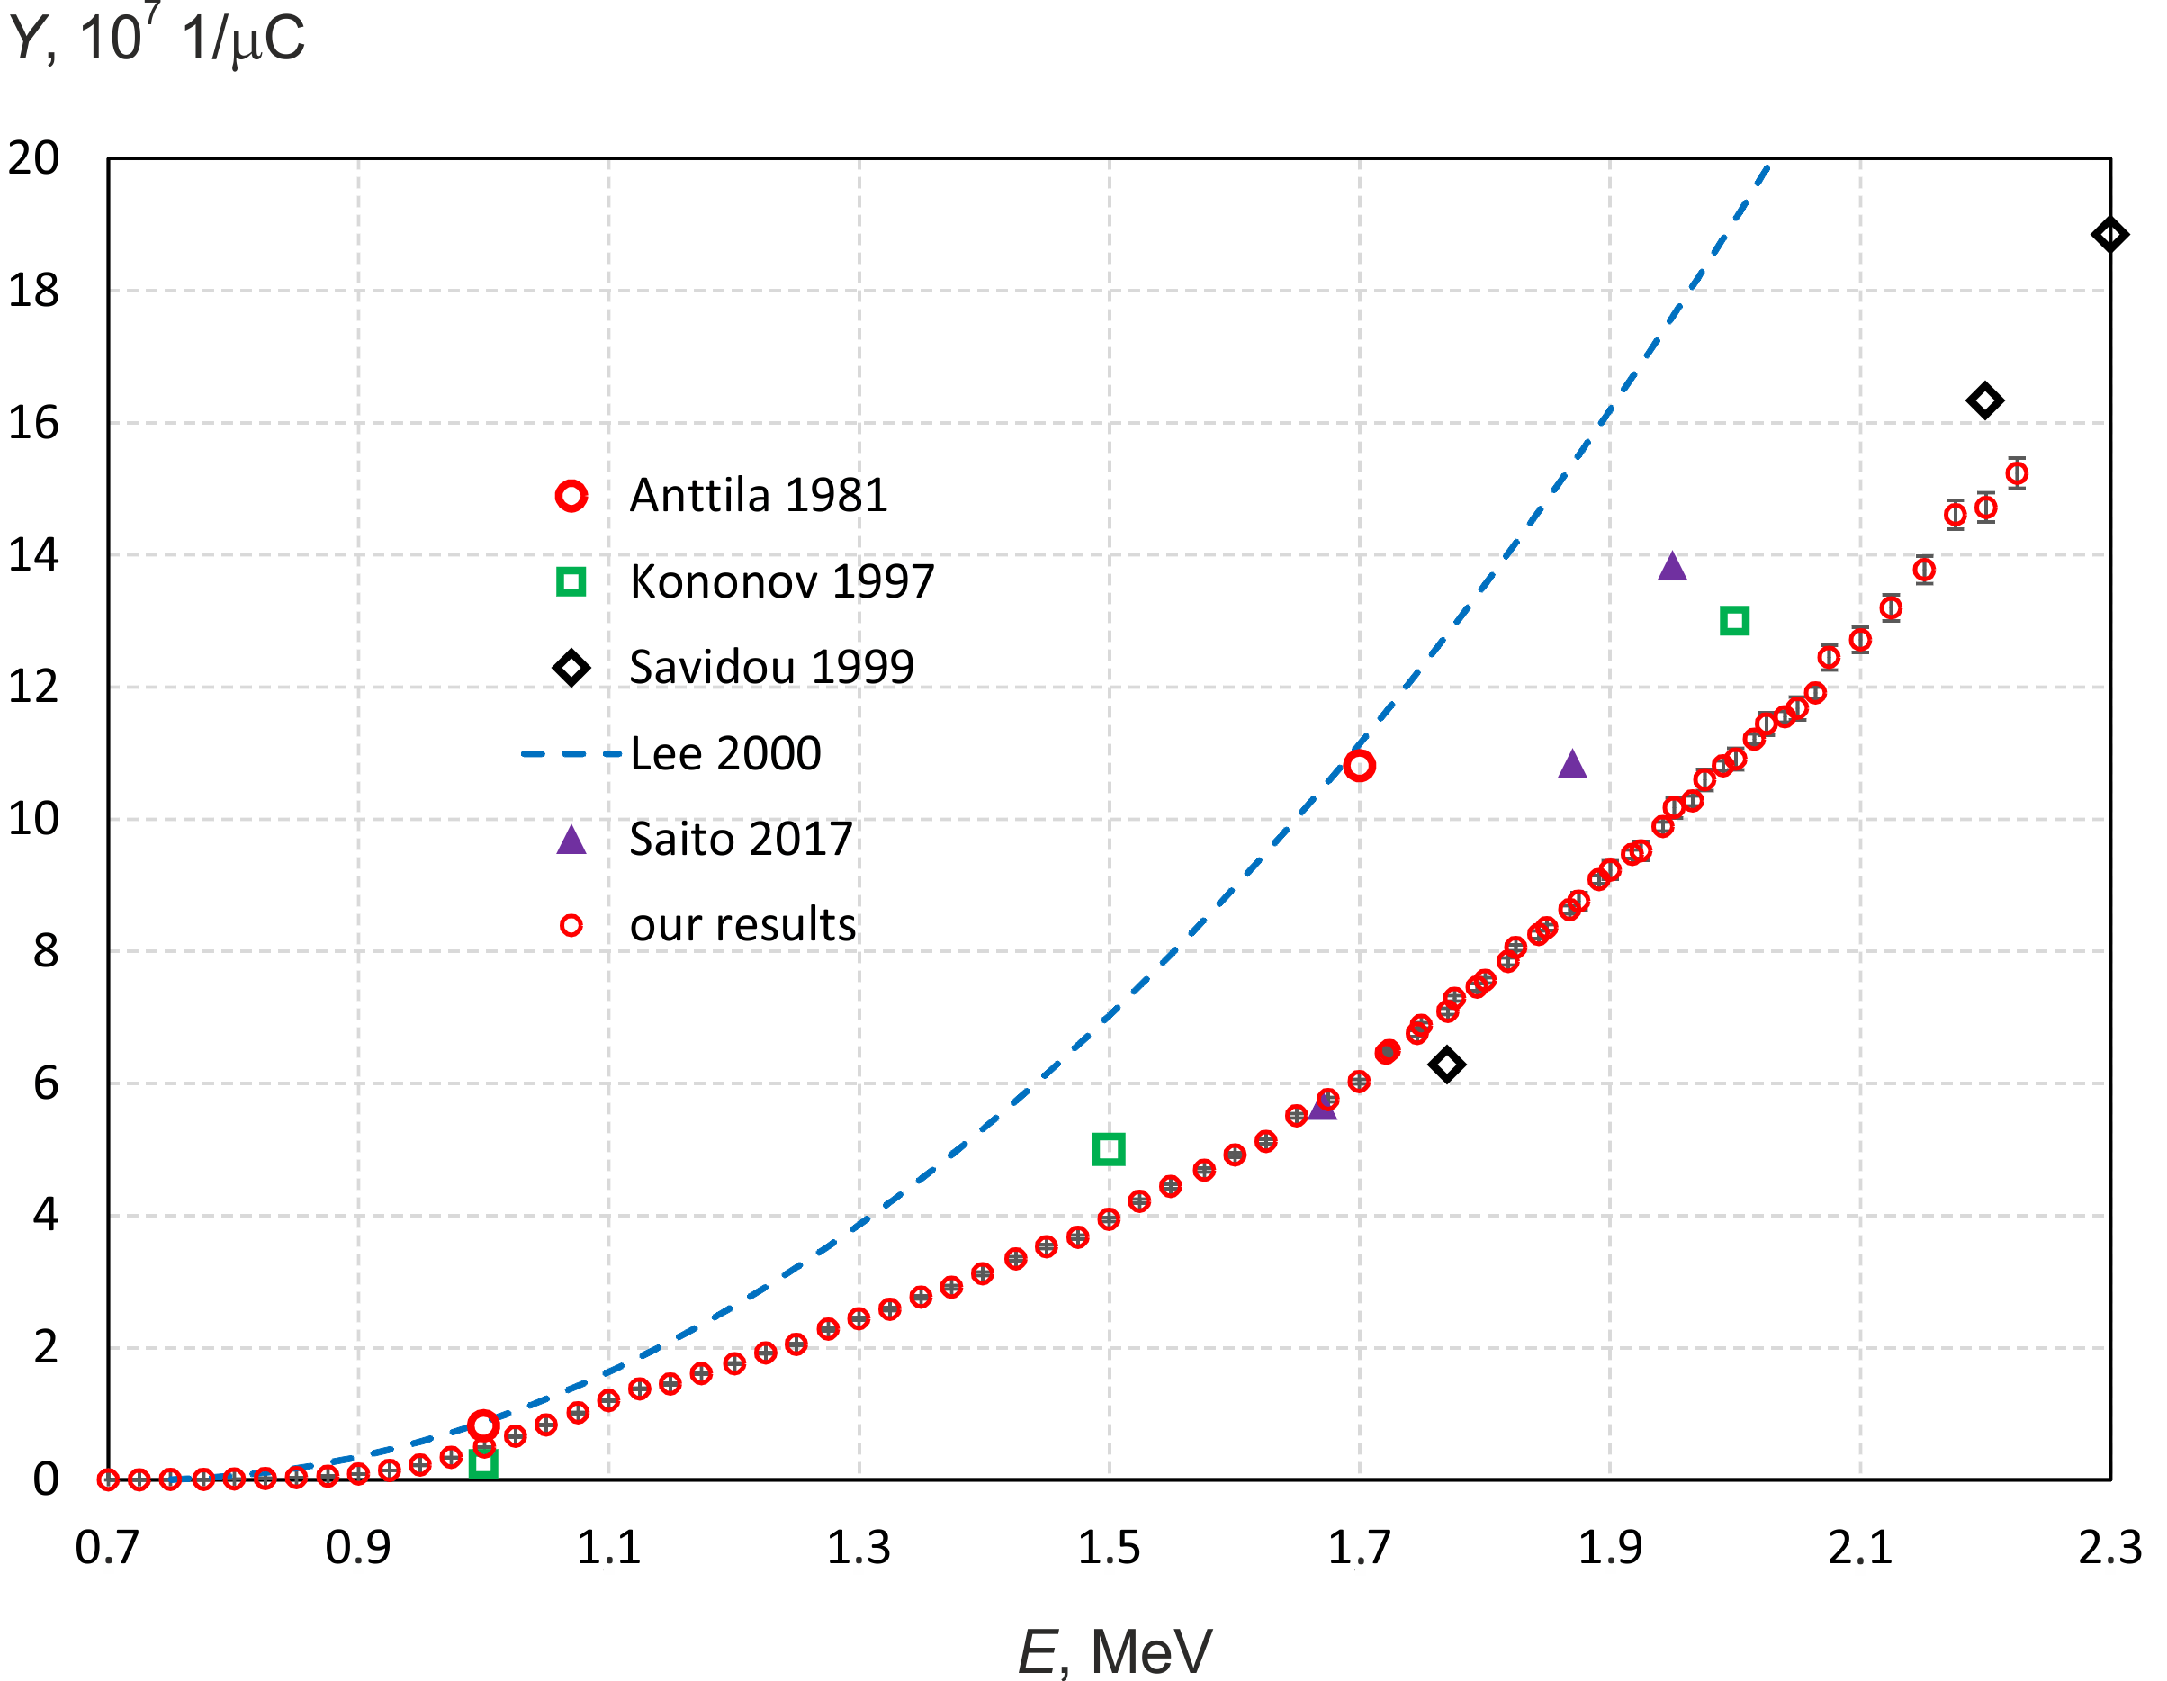
Application # 2: Fundamental knowledge
478 keV photon yield
from a thick lithium target
[Nucl. Instrum. Methods Phys. Res., Sect. B, vol. 502, pp. 85-94, June 2021]

Slide 20
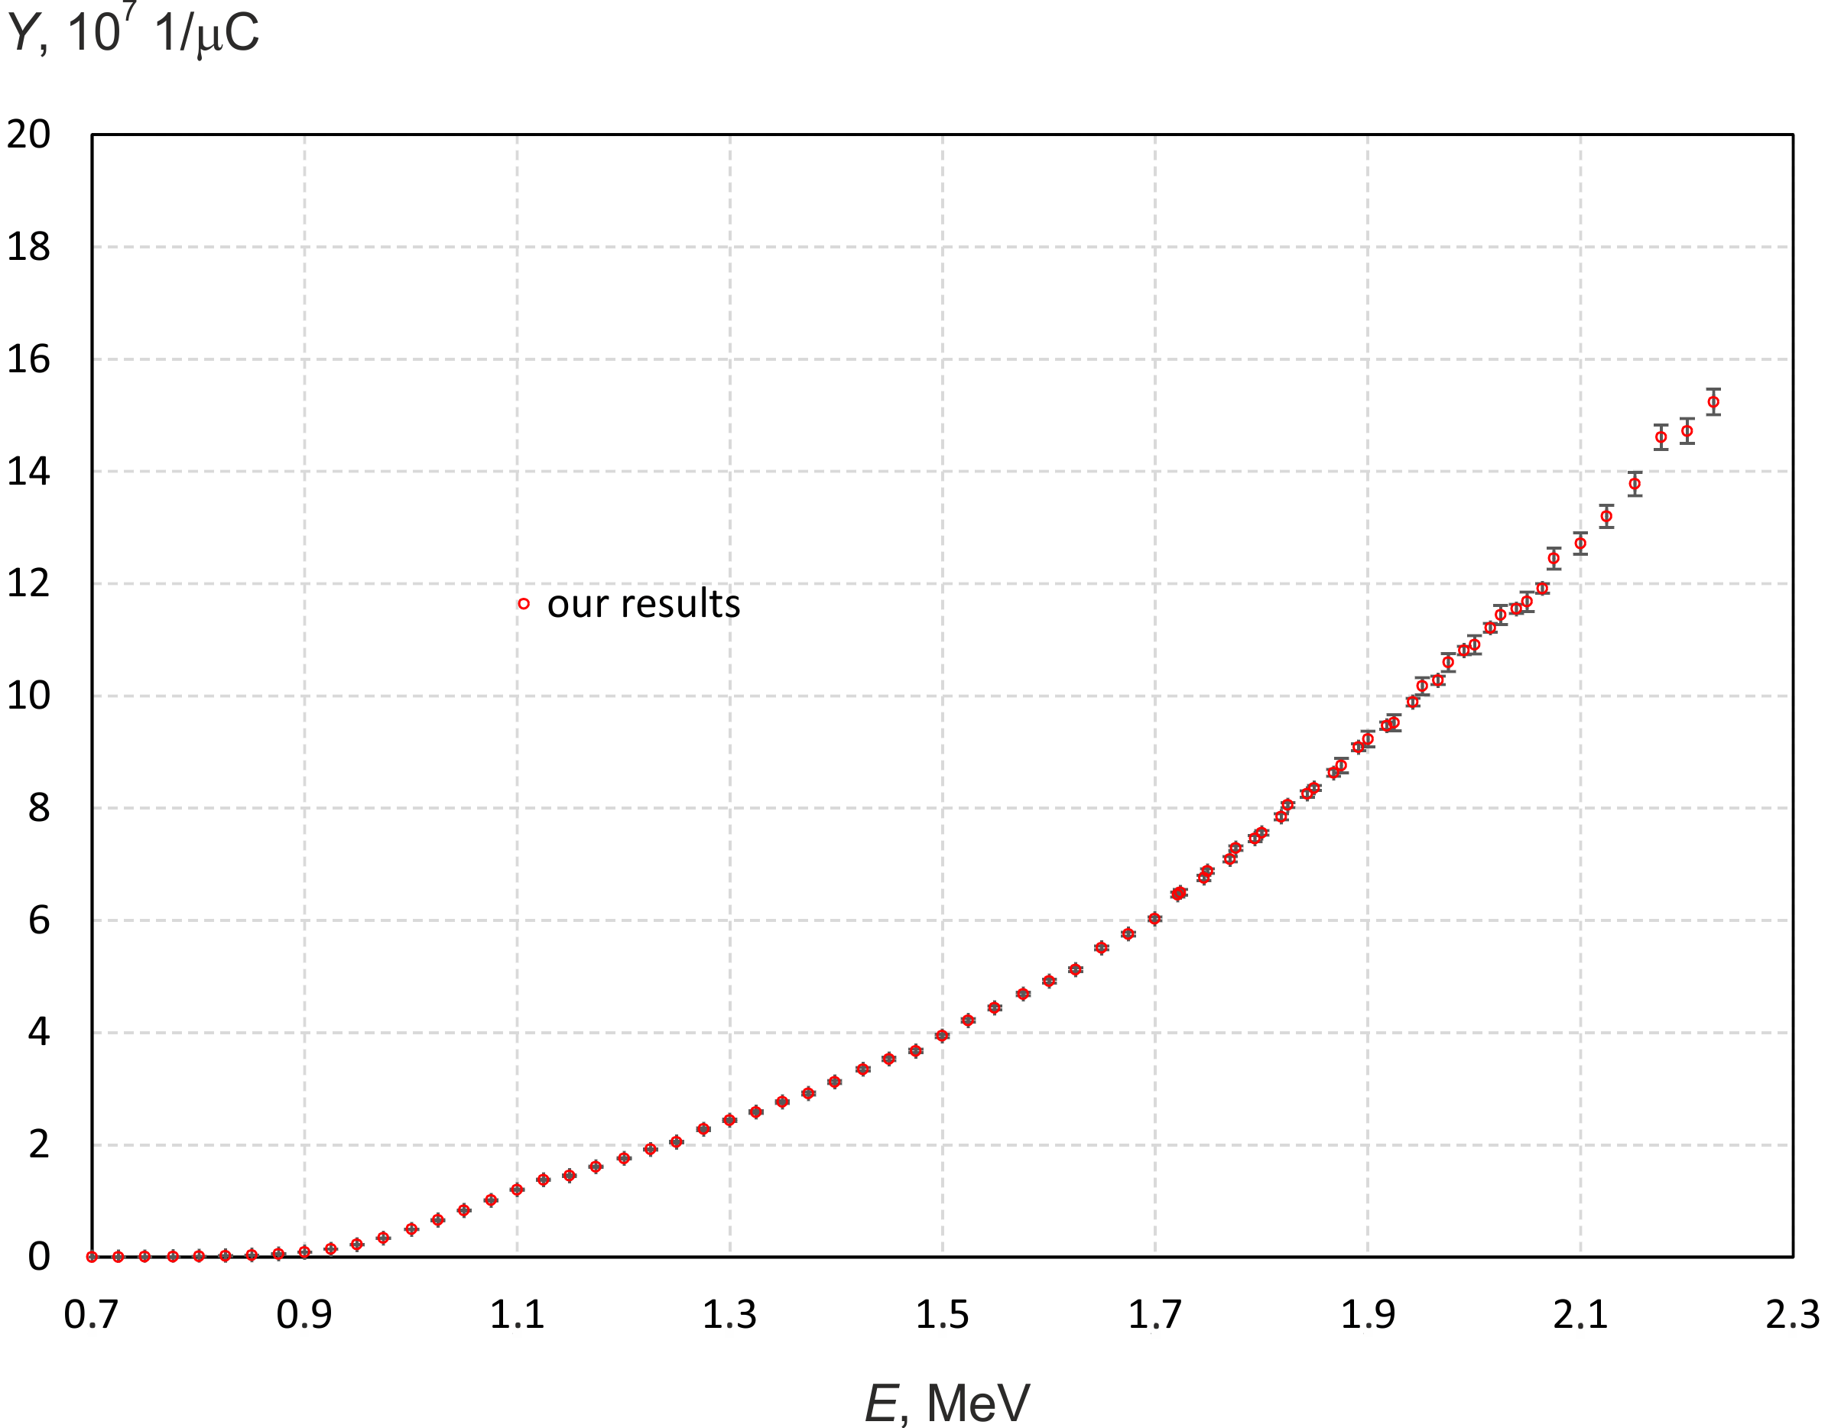
Application # 2: Fundamental knowledge
478 keV photon yield
from a thick lithium target
[Nucl. Instrum. Methods Phys. Res., Sect. B, vol. 502, pp. 85-94, June 2021]

Slide 21
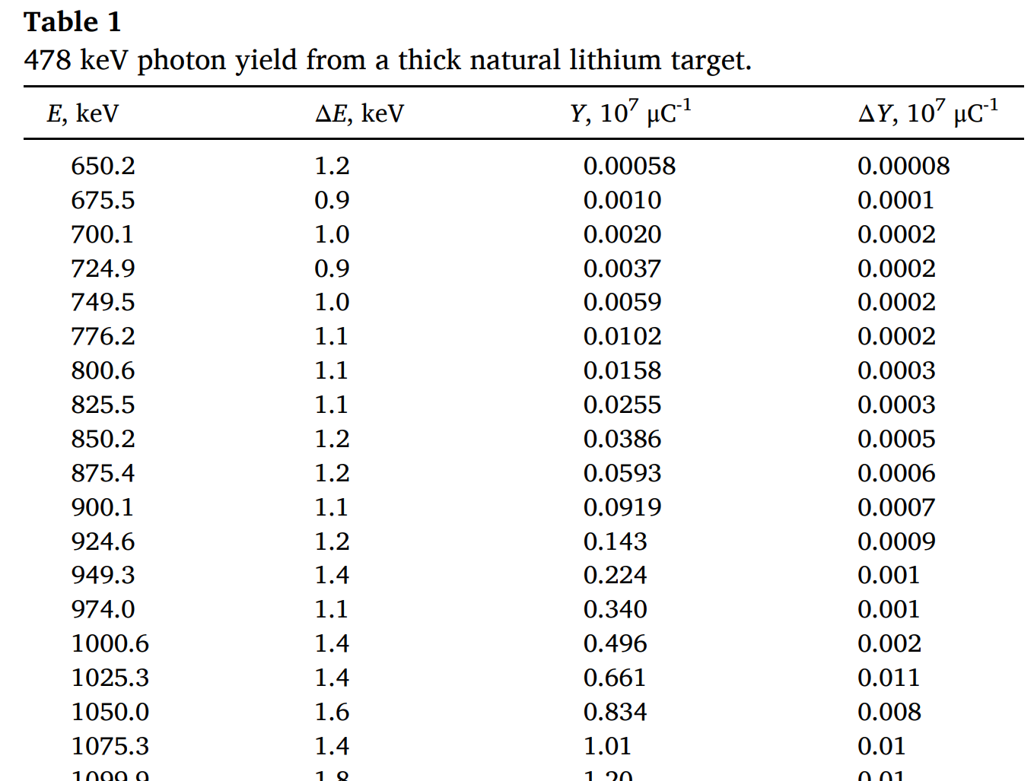
Application # 2: Fundamental knowledge
478 keV photon yield
from a thick lithium target
[Nucl. Instrum. Methods Phys. Res., Sect. B, vol. 502, pp. 85-94, June 2021]

Slide 22
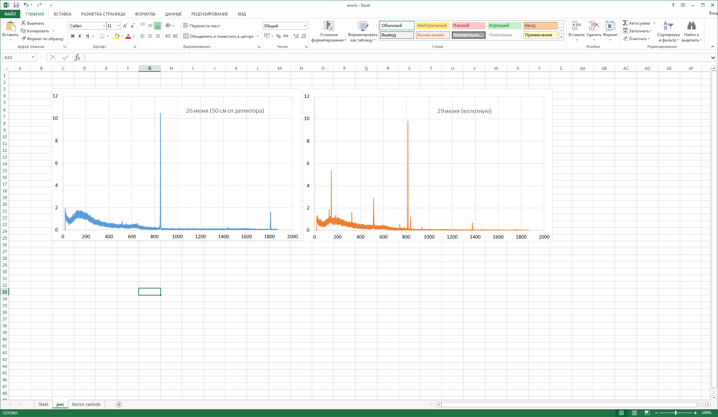

Application # 3: ITER
Boron carbide ceramics and steel 316L(N)-ITER Grade
for ITER (Cadarache, France)
were tested by thermal and fast neutrons
[Fusion Eng. Des., vol. 168, 112426, March 2021; Nuclear Fusion (2021)]

Slide 23

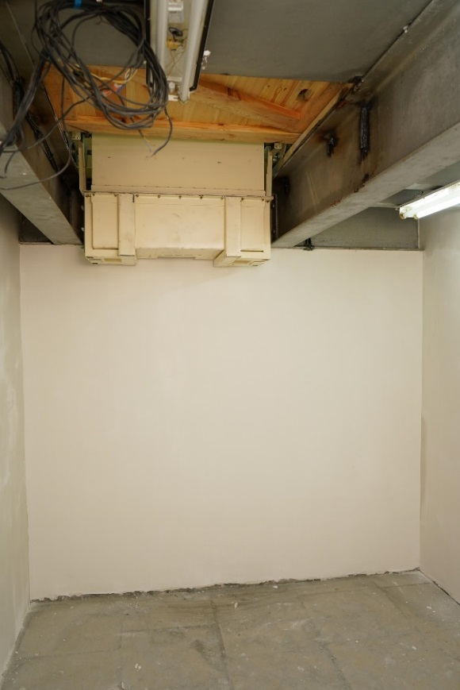
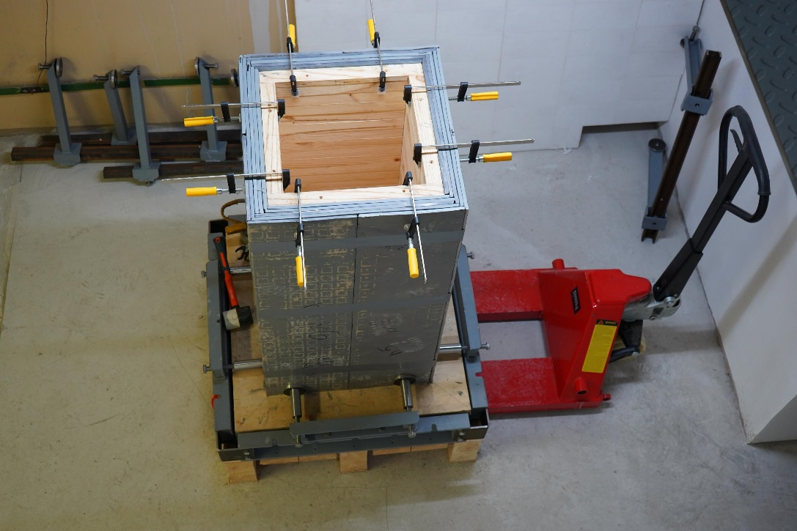
Application # 4: CERN
The neutron source is planned to be used for radiation tests of fibers of the laser calorimeter calibration system of the Compact Muon Solenoid electromagnetic detector developed for the High-Luminosity Large Hadron Collider in CERN

Slide 24
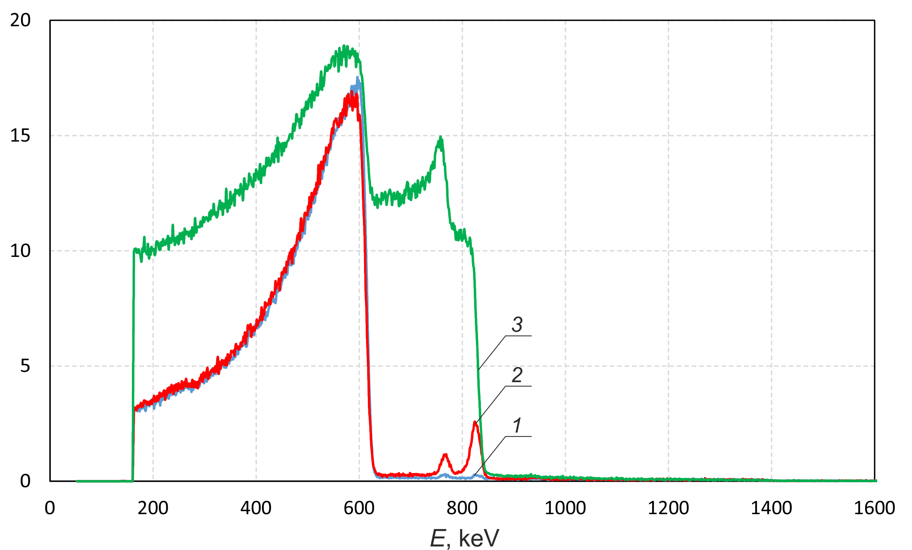
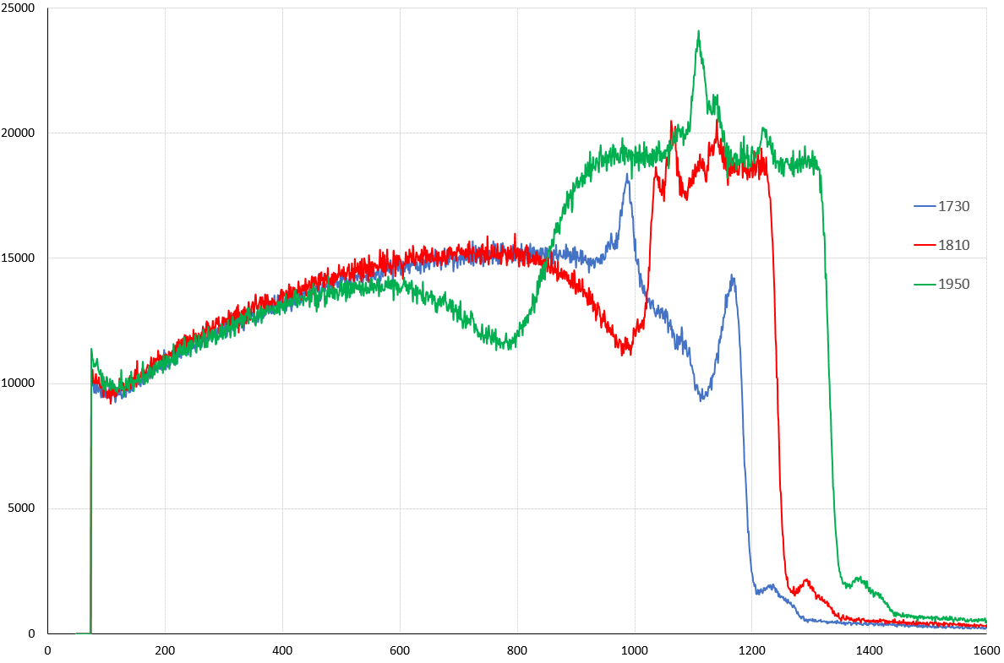
Application # 5: Proton microscope
elemental analysis of the surface of materials by backscattered protons
Signals of the alpha-spectrometer upon irradiation with 1 MeV protons of the freshly deposited lithium layer of the target (1) and the lithium layer after deliberate admission of atmospheric air into the target unit for 10 min (2) and for 1 h (3)
150 nm boron carbonitride film
on 0.5 mm silicon substrate
We determine that on the surface of the freshly deposited lithium layer there are lithium oxide of 2.4 ×10¹⁶ atoms/cm² density
(~ 6 nm of lithium oxide of crystal density) and carbon over it of 6×10¹⁵ atoms/cm² density (~ 0.5 nm of carbon of crystal density)

Slide 25
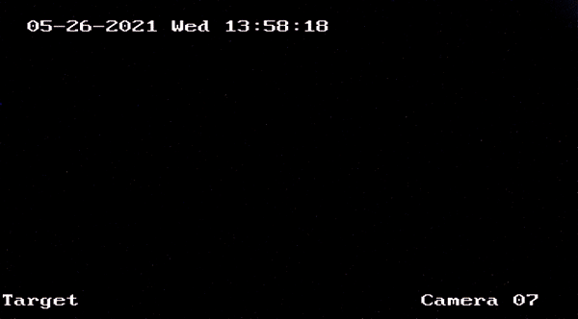
Application # 6: Positrons source

Slide 26
Our plans:
to make a unique proton micro- nanoscope;
to test new boron delivery drugs for many researchers groups;
to study the radiation resistance of optical fibers developed for the High-Luminosity Large Hadron Collider in CERN jointly with Saclay Nuclear Research Center (France);
to study the activation of materials developed for ITER (France) jointly with Russian ITER team;
to study the energy and angular characteristics of the ¹¹B(p,α)αα reaction products jointly with BINP detectors laboratory;
to characterize the epithermal neutron field jointly with the Laboratory of Subatomic Physics and Cosmology CNRS-IN2P3, Grenoble-Alpes University (France) and the Laboratory of Micro-Irradiation, Metrology, and Neutron Dosimetry, IRSN (Cadarache, France);
to develop boron imaging technique jointly with the University of Pavia (Italy), and the Due2lab s.r.l. (Parma, Italy);
to produce ultracold neutrons and focus them jointly with National Laboratory of Frascati (Italy);
to realize new ideas in VITA, lithium target, and BSA for an even better neutron source for BNCT clinics;
…

Slide 27

CONCLUSION
Neutron source based on VITA and lithium target is in operation now
This source produces:
DC proton/deuteron beam (0.6 MeV – 2.3 MeV; 1 pA – 10 mA)
Neutrons – thermal, epithermal, over-epithermal, monoenergetic, fast
Photons – 478 keV, 511 keV
α-particles – ⁷Li(p,α)α, ¹¹B(p,α)αα
Positrons – ¹⁹F(p, αe⁻e⁺)¹⁶O
We are open for joint research
This work was supported by the Russian Science Foundation (grant number 19-72-30005)

Slide 28
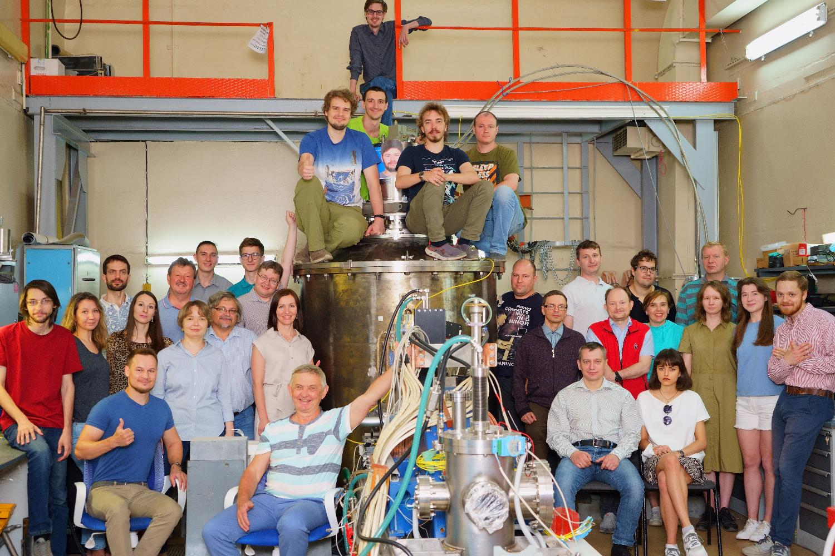

Thank you
for
your attention!

