Slide 1

Budker Institute of Nuclear Physics, Novosibirsk, Russia
UPGRATED THE EXTRACTION DEVICE OF FOCUSED ELECTRON BEAM INTO THE ATMOSPHERE.
E.V. Domarov, N.K. Kuksanov, R.A. Salimov, A.I. Korchagin, S.N. Fadeev, A.V. Lavrukhin V.G. Cherepkov, Y.I. Golubenko, I.K. Chakin, M.G.Golkovsky, P.I.Nemytov, A.V. Semenov
Notes:
Semenova добавить, потому что приводите распределение.

Slide 2
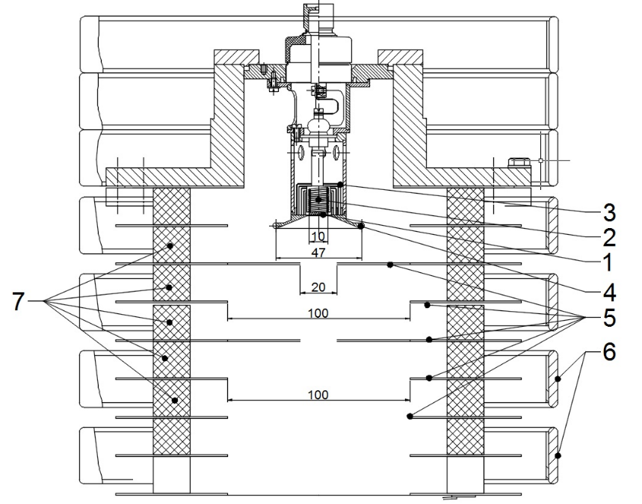
Large aperture accelerating tube design
Cathode part of the accelerating tube
1 - cathode; 2 - cathode heater; 3 - heat shields; 4 - cathode electrode; 5 - accelerating tube electrodes; 6 - shielding rings; 7 - ceramic insulator

Slide 3
Factors affecting the beam size and its angular divergence at the exit from the accelerating tube.
Longitudinal electric field: carries out the main focusing of the beam;
Influence of the magnetic field of heating coil ( the beam acquires an azimuthal momentum Pφ0);
The space charge of the beam;
The ripples of the accelerating voltage;
Aberrations of electromagnetic lenses. They also affect the optimal hole size in the outlet diaphragms;
Transverse component of the magnetic field of the primary and secondary windings, which leads to oscillations of the beam, and leads to the need to increase the holes in the diaphragms.

Slide 4
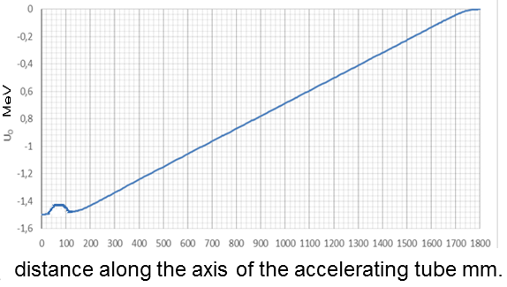
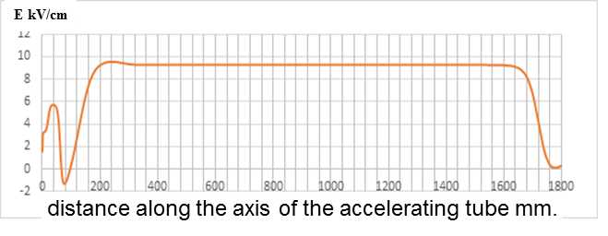
Distribution of potential (a) and electric field (b) along the axis of the accelerating tube
(b)
(a)
The potential and electrical field distributions near cathode prevent the exchange ion-electron processing and improve the accelerating tube operation stability.
Notes:
The potential and electrical field distributions near cathode prevent the exchange ion-electron processing and improve the accelerating tube operation stability.

Slide 5
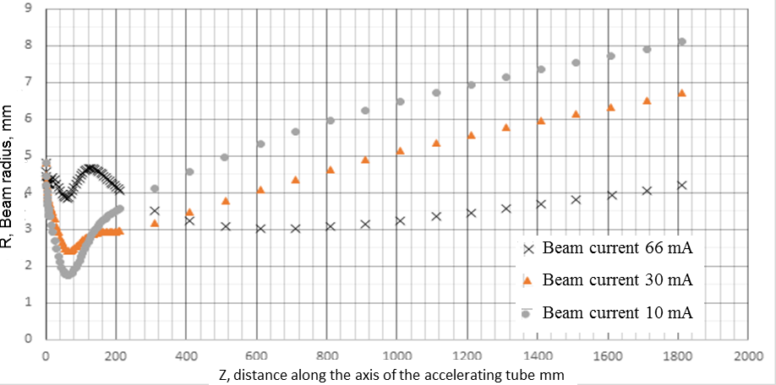
Сalculated beam envelopes
The envelopes for different beam currents at an energy of 1.5 MeV, the length of the accelerating tube is 1800 mm
Notes:
The crossing of axe by beam is absence. It is influence of magnetic field of gun heating coil.

Slide 6
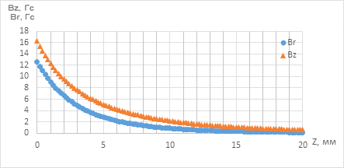
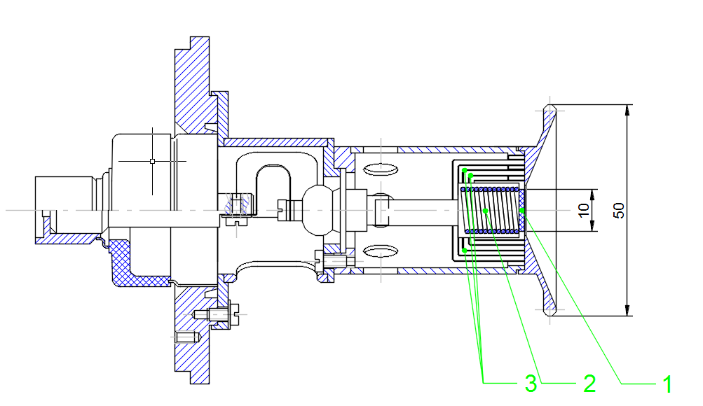
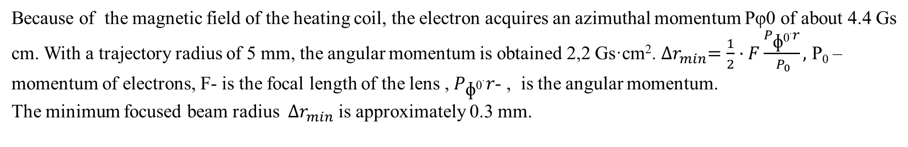
Influence of the magnetic field from the heating coil.
Electron injector heater coil magnetic field. Coordinate z = 0 corresponds to the emitting surface of the tablet.
Injector with near-cathode electrode in Pierce geometry. 1-Cathode LaB6; 2-heating coil; 3- Heat shields.
Because of the magnetic field of the heating coil, the electron acquires an azimuthal momentum Pφ0 of about 4.4 Gs cm. With a trajectory radius of 5 mm, the angular momentum is obtained 2,2 Gs·cm². ${∆r}_{min}=\frac{1}{2}·F\frac{P_{\text{ɸ}\text{0}·}r}{{ P}_{0}},$ P₀ – momentum of electrons, F- is the focal length of the lens , $P_{\text{ɸ}\text{0}·}r$- , is the angular momentum.
The minimum focused beam radius ${∆r}_{min}$ is approximately 0.3 mm.
Notes:
Где minimum focused beam diametr?

Slide 7
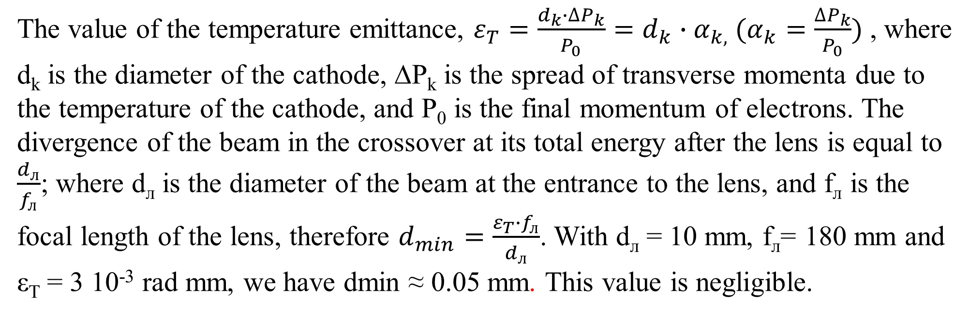
Influence of the emittance associated with the cathode temperature.
The value of the temperature emittance, $ε_{T}=\frac{d_{k}∙{∆P}_{k}}{P_{0}}=d_{k}∙α_{k,} (α_{k}=\frac{∆P_{k}}{P_{0}})$, where d_{k} is the diameter of the cathode, ∆P_{k} is the spread of transverse momenta due to the temperature of the cathode, and P₀ is the final momentum of electrons. The divergence of the beam in the crossover at its total energy after the lens is equal to $\frac{d_{л}}{f_{л}}$; where d_{л} is the diameter of the beam at the entrance to the lens, and f_{л} is the focal length of the lens, therefore $d_{min}=\frac{ε_{T}∙f_{л}}{d_{л}}$. With d_{л} = 10 mm, f_{л}= 180 mm and ε_{T} = 3 10⁻³ rad mm, we have dmin ≈ 0.05 mm. This value is negligible.
Notes:
Откуда появилось 3*10**-3

Slide 8
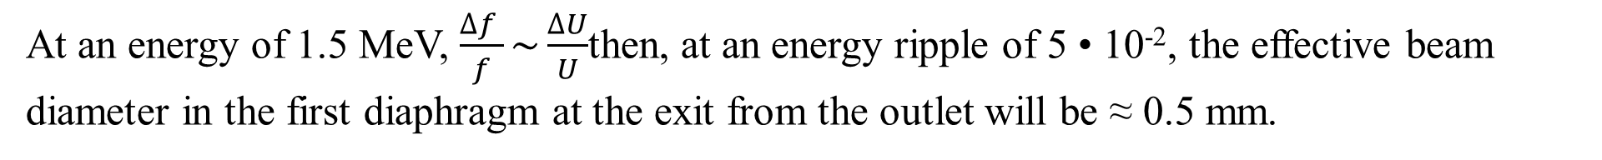
Influence ripples of the accelerating voltage on the beam diameter.
The ripples of the accelerating voltage in this electron accelerator were initially assumed to be 5%. The energy ripple causes the focal length of the lens to change with the pulsation frequency, which leads to an increase in the beam diameter in the crossover.
Where dmin is the minimum diameter of the focused beam cm, dlens is the diameter of the beam at the entrance to the lens, which is 10 mm,
At an energy of 1.5 MeV, $\frac{∆f }{f}\sim \frac{∆U}{U}$then, at an energy ripple of 5 • 10⁻², the effective beam diameter in the first diaphragm at the exit from the outlet will be ≈ 0.5 mm.
Notes:
Надо перевернуть формулу, т.е. изменение фокуса как функция пульсацийю Для энергии 1.5 МэВ коэффициент 1.2 (фокус от энергии) Пульсации +/- ????? А как с радиусом???

Slide 9
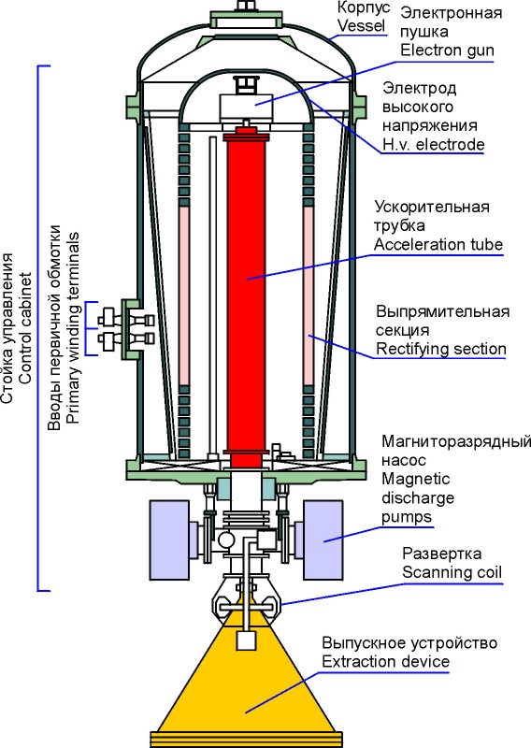
Influence of the transverse component of the magnetic field of the primary and secondary windings of the transformer.
The tube, which is located inside the high-voltage rectifier and the primary winding, is penetrated by a transverse magnetic field associated with the tilt or misalignment of the accelerating tube and the primary or secondary windings of the transformer. Its value can reach B┴ = 0.2 G. This leads to the appearance of variable angles Δα at the exit from the accelerating tube.
Where is the transverse magnetic field of the primary winding, L_{тр} is the length of the accelerating tube, which is 1800 mm, B · ρ0 is the electron momentum, which is 6.5 · 10³ G · cm for a beam energy of 1.5 MeV
Δdmin = f_{Л} · Δα. Where f_{л} is the focal length of the lens 180 mm. In our case, the oscillations of the beam in the output diaphragm will be Δdmin ≈ 5 · 10⁻³ · 18 =9 · 10⁻² cm.=0,9 mm
Notes:
Ьожет быть reach????

Slide 10
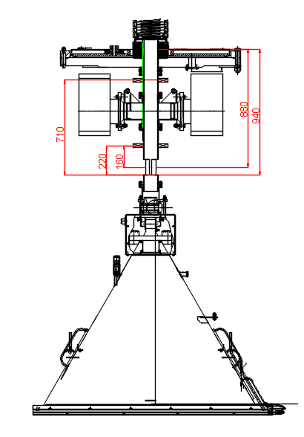
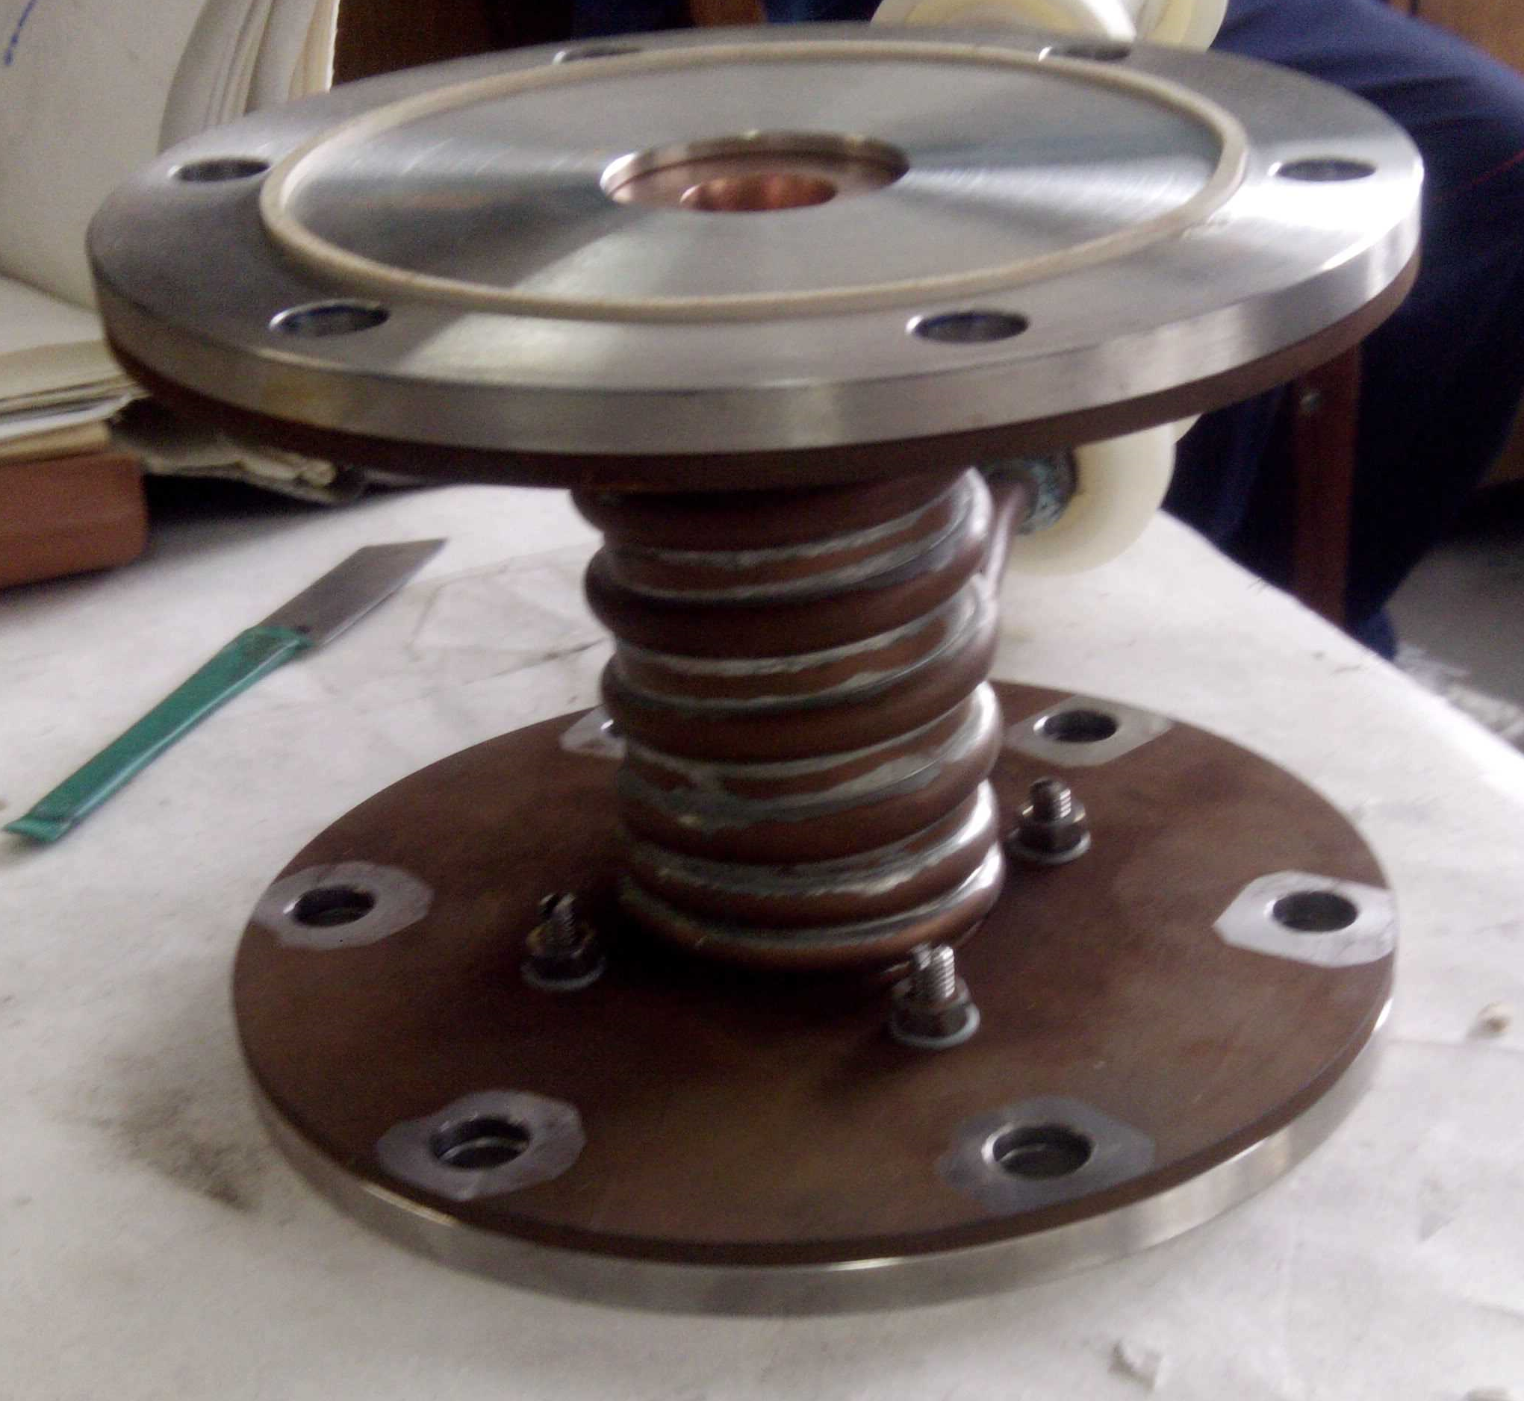
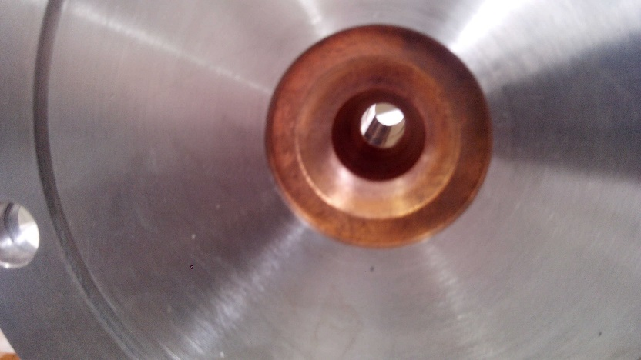

Stand for measuring the beam diameter.
Accelerating tube
Lens
Correction coils
along the X and Y axes
Water cooled diaphragm with 16 mm bore diameter and 120 mm length
extraction device
Water cooled diaphragm with 16 mm bore diameter and 120 mm length
The trajectory of the beam on the foil
Notes:
Для чего стенд? Для понимания динамики и правильности оценок

Slide 11
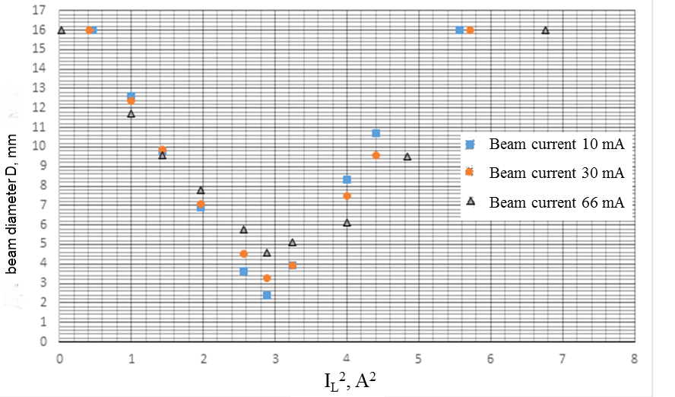
Dependence of the beam size in the diaphragm on the focusing lens current at an energy of 1.5 MeV
Notes:
Может быть поменять этот слайд с последующим?????

Slide 12
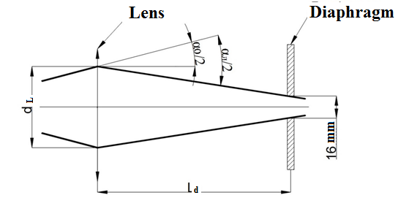
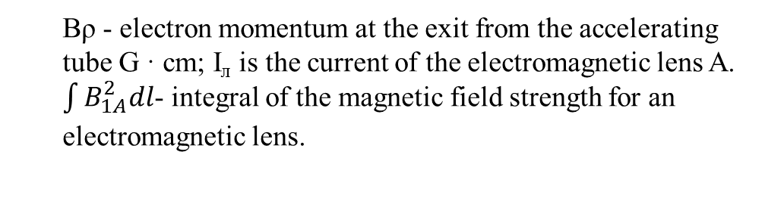
Determination of the beam parameters in the focal lens.
α₀ -is the angle of divergence or convergence of the beam at the entrance to the lens;
α_{L}=d_{L}/f_{L}
Focal length of an electromagnetic lens.
d_{L} - is the diameter of the beam in the lens. Д - measuring diaphragm with a hole diameter of 16 mm. D_{пуч} -is the beam diameter in the diaphragm, L_{d} -is the distance from the lens to the diaphragm, which is 940 mm
Bρ - electron momentum at the exit from the accelerating tube G · cm; I_{л} is the current of the electromagnetic lens A. $\int{B_{1A}^{2}dl}$- integral of the magnetic field strength for an electromagnetic lens.
The beam diameter at the exit from the accelerating tube is d_{л}=9-15 mm. The divergence of the beam at the exit from the accelerating tube α₀ = 7 · 10⁻³ rad.
Notes:
А как при разных токах? На графике 3 тока.

Slide 13
Optical diagram of the extractions device
L1 - focusing lens at the exit from the accelerating tube; L2 - focusing lens, which focuses the electron beam into the diaphragm D1, with a focal length of 180 mm; C1, C2, C3, - correction coils; D1 - diaphragm of the first stage with a hole diameter of 2 mm, D2 - diaphragm of the second stage with a hole diameter of 2,5 mm; D3 - diaphragm of the third stage with a hole diameter of 3,5 mm; D4 - fourth stage diaphragm with a hole diameter of 4 mm; D5 - a diaphragm in the form of a pipe with a hole diameter of 10 mm and a length; D6 - 6th stage diaphragm with a hole diameter of 7mm .
Notes:
Надо отметить, что это было сделано после предыдущих измерений.

Slide 14
The extraction device of focused electron beam into the atmosphere.
1 - Upper lens L1; 2 - upper correctors C1; 3 - water-cooled diaphragm with a hole diameter of 7mm D6; 4- Gate valve; 5- average correctors C2; 6 - water-cooled diaphragm with a hole diameter of 10mm D5; 7 - Lower lens L2; 8- lower correctors C3; 9- diaphragm with a hole diameter of 4 mm D4; 10- diaphragm with a hole diameter of 3.5 mm D3: 11- diaphragm with a hole diameter of 2.5 mm D2; 12 - diaphragm with a hole 2 mm in diameter; 13 - the first stage of pumping (pump AVZ-90); 14 - the second stage of pumping (pump AVZ-90); 15 - the third stage of pumping(pump RUTS ZJ-150+AVZ-20); 16 - fourth stage (turbomolecular pump NVT-450); 17 - fifth stage (turbomolecular pump NVT-450); 18 - sixth stage (two pumps NMD-0.4).
Notes:
Сказать, что финальная версия. И что устройство успешно испытано, получены параметры , работы продолжаются с целью не только улучшения параметров, но и повышения надежности и стабильности в работе

Slide 15
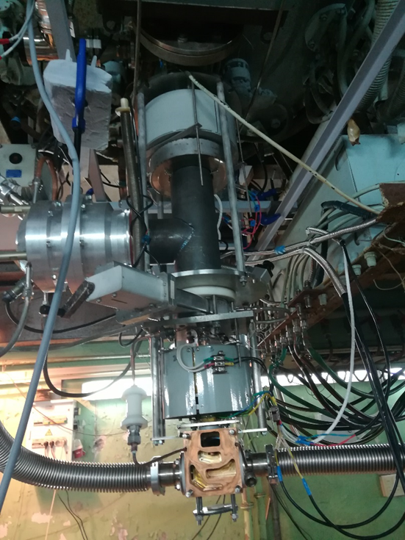
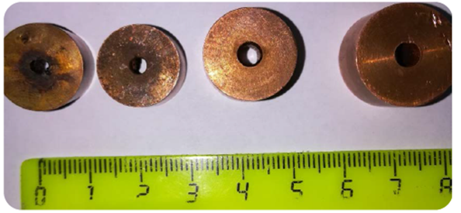
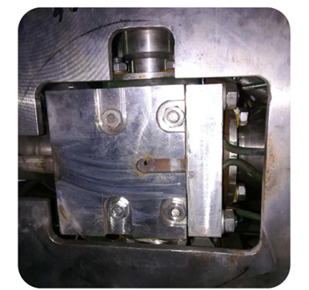
The extraction device of focused electron beam into the atmosphere
Accelerator parameters: Energy 1.4 MeV, Beam current 50 mA, Beam power 70 kW. The beam diameter at the exit from the extraction device is 2,5 mm.
Notes:
There is special modified design of extraction device for focused beam/ Вообще говоря рисунки непонятны.

Slide 16
Thank you for attention

