Slide 1


The Results Obtained on “Radiobiological Stand” Facility, Working With the Extracted Carbon Ion Beam of the U-70 Accelerator.
Report FRB06
NATIONAL RESEARCH CENTRE «KURCHATOV INSTITUTE»
Institute for High Energy Physics
of National Research Centre «Kurchatov Institute»
Vladimir Pikalov

Slide 2
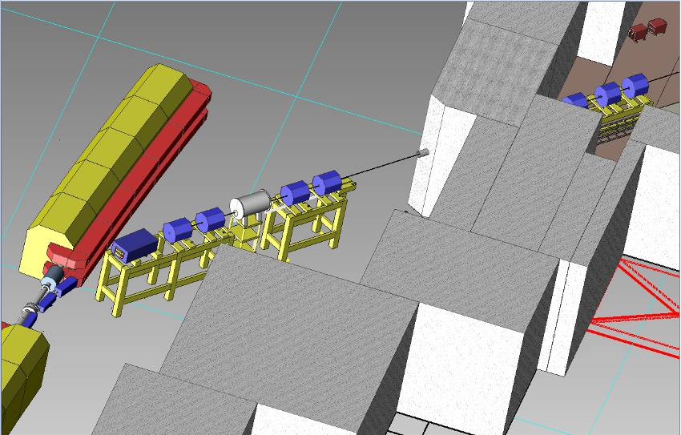
25 channel. Placement of magneto-optical equipment

Slide 3
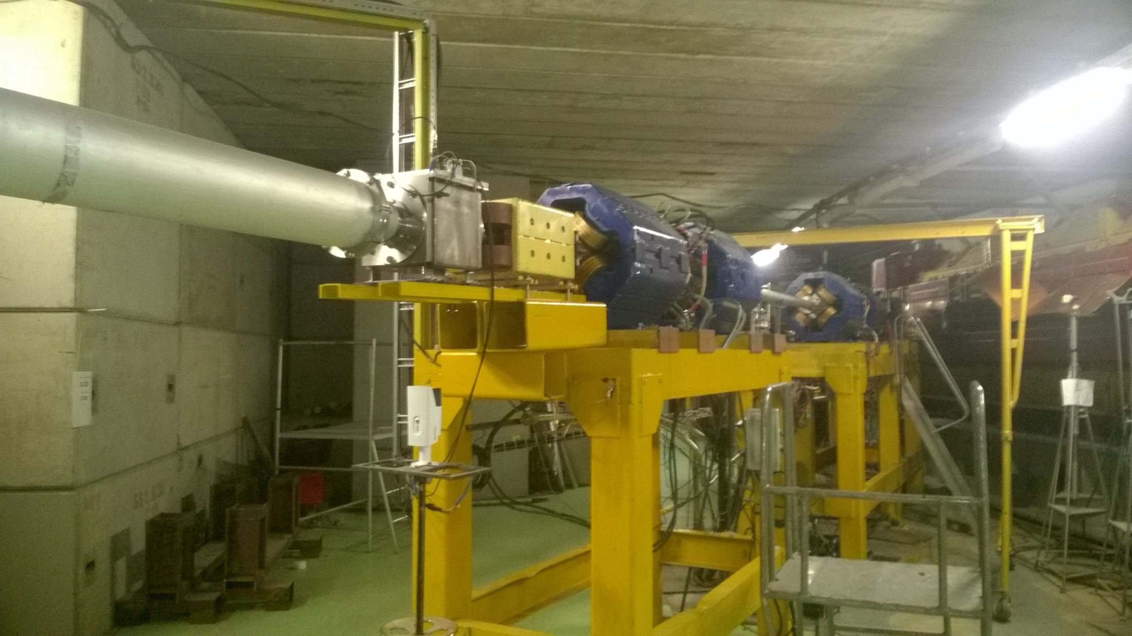
Channel head 25
vacuum chamber
TV box
corrector
quadrupoles

Slide 4
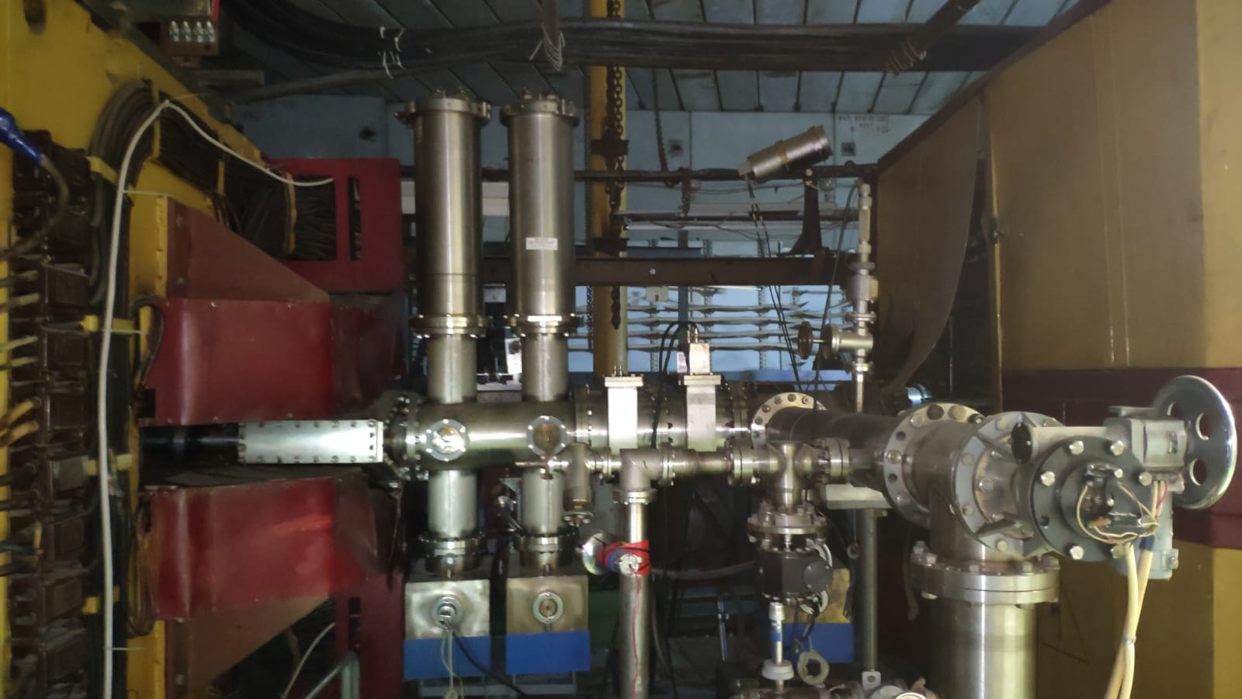
Сhannel 25 target station
Two target boxes with 4 Be targets in each

Slide 5
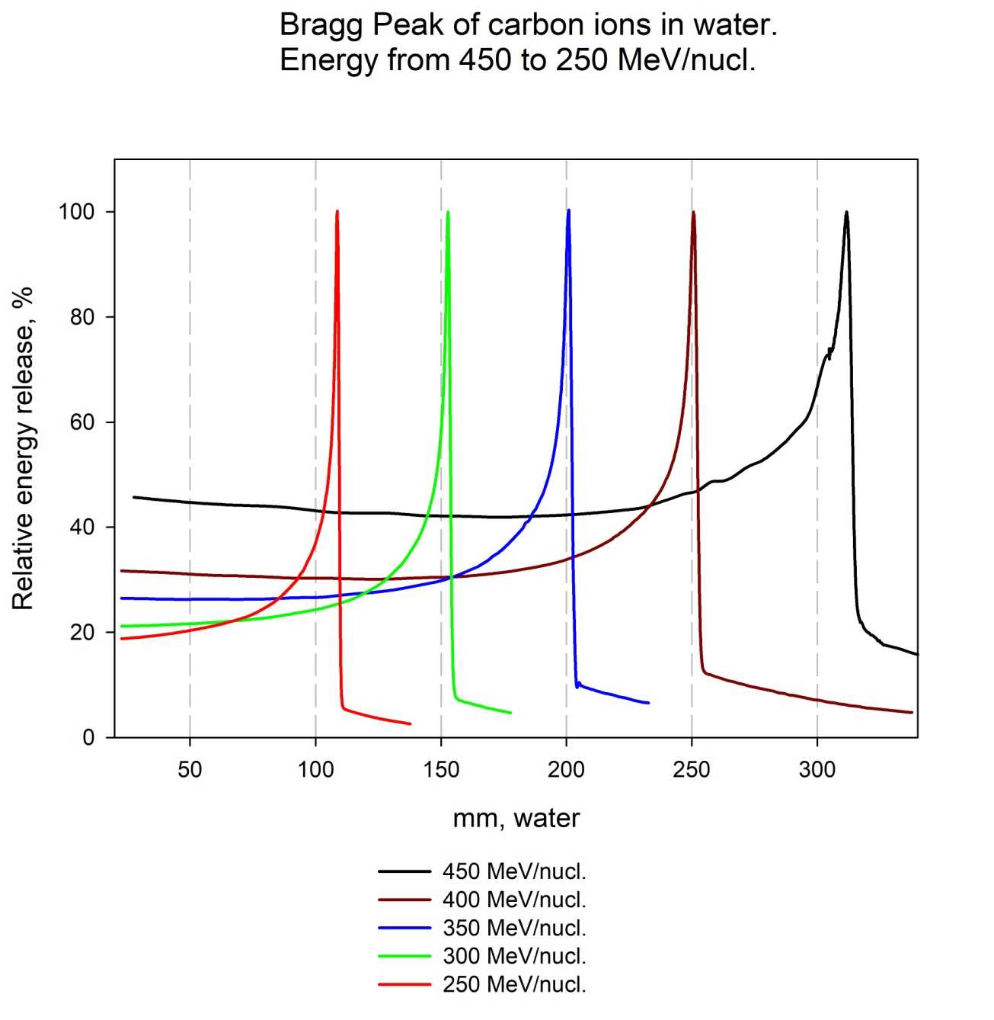
Extraction of carbon beam (different energies)

Slide 6
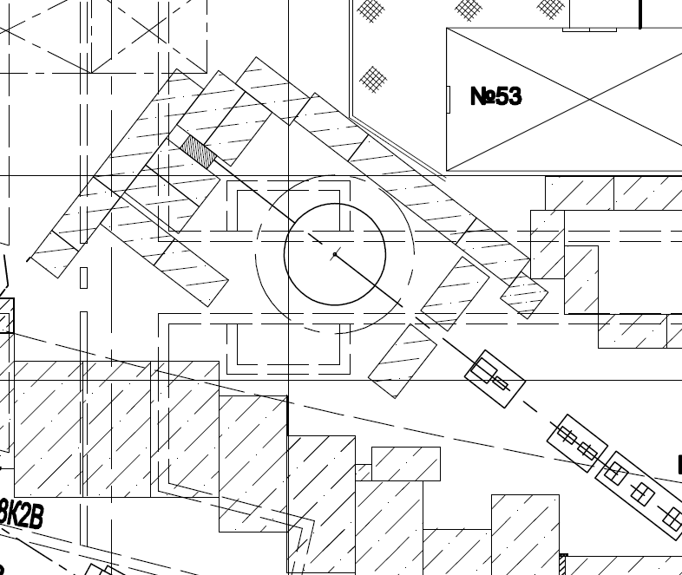
Biological shield of the Radiobiological Stand
medical module
collimator № 1
radiobiology area

Slide 7
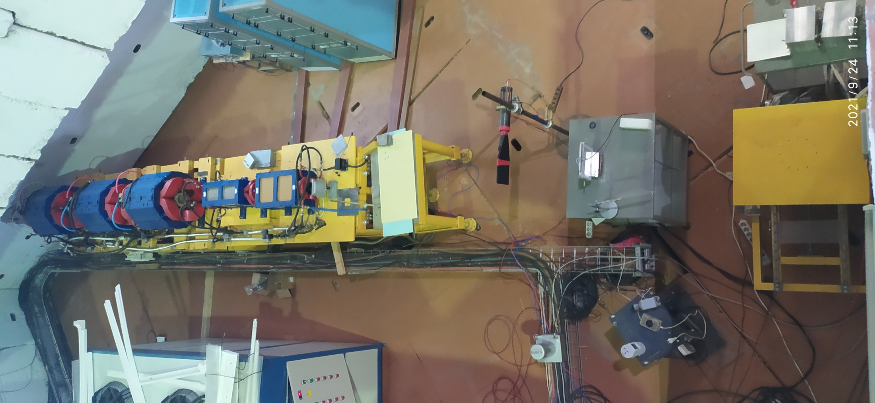
Radiobiology area
electromagnetic scanning system
experimental zone
chiller

Slide 8
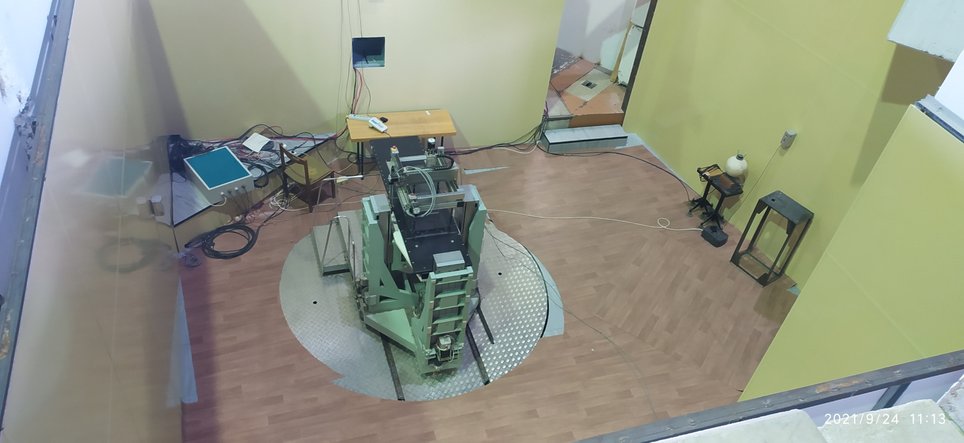
Medical module
collimator № 1
water phantom with 3D movement system
6-axis table
laser centralizer

Slide 9
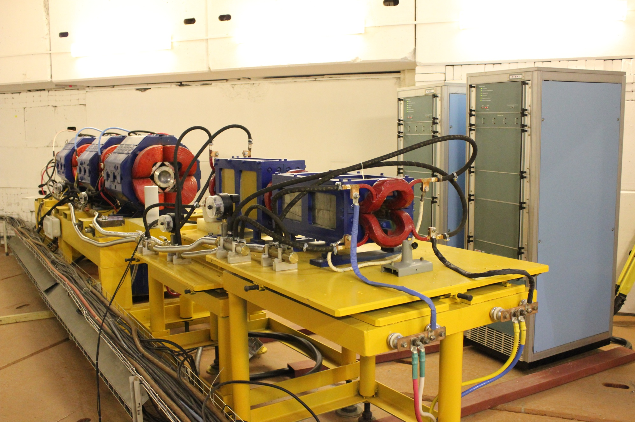
Electromagnetic scanning system
dipole magnets
Power supplies:
Output current amplitude ±700A
Output current frequency 20-60 Hz
Load inductance ≤0.42 mH

Slide 10
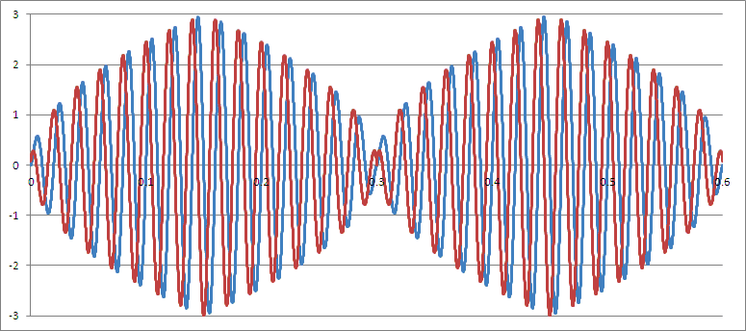
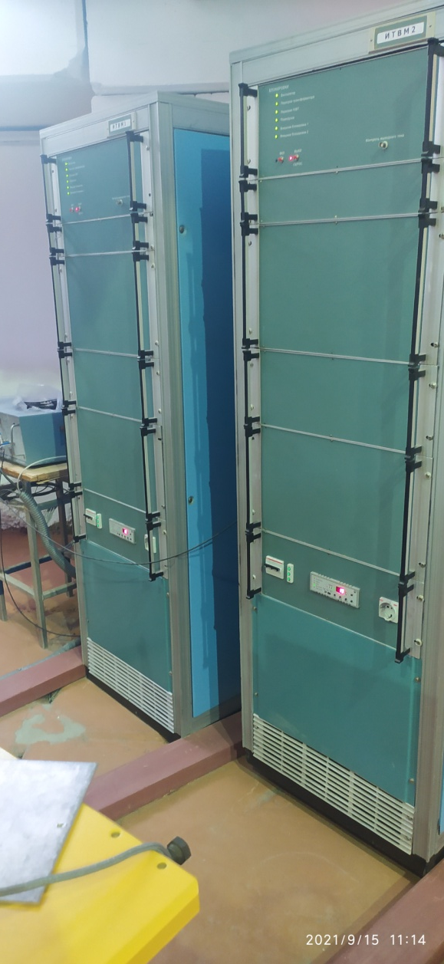
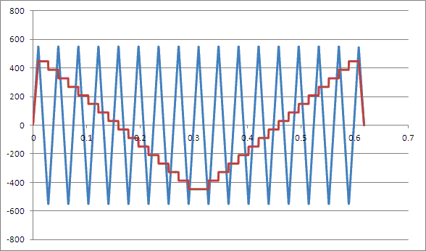
Examples of load current waveforms

Slide 11
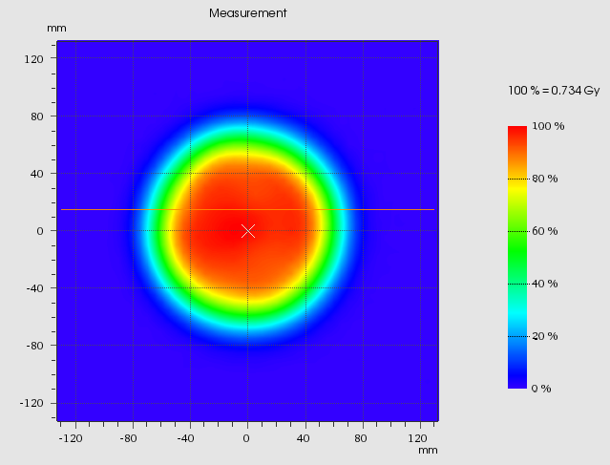
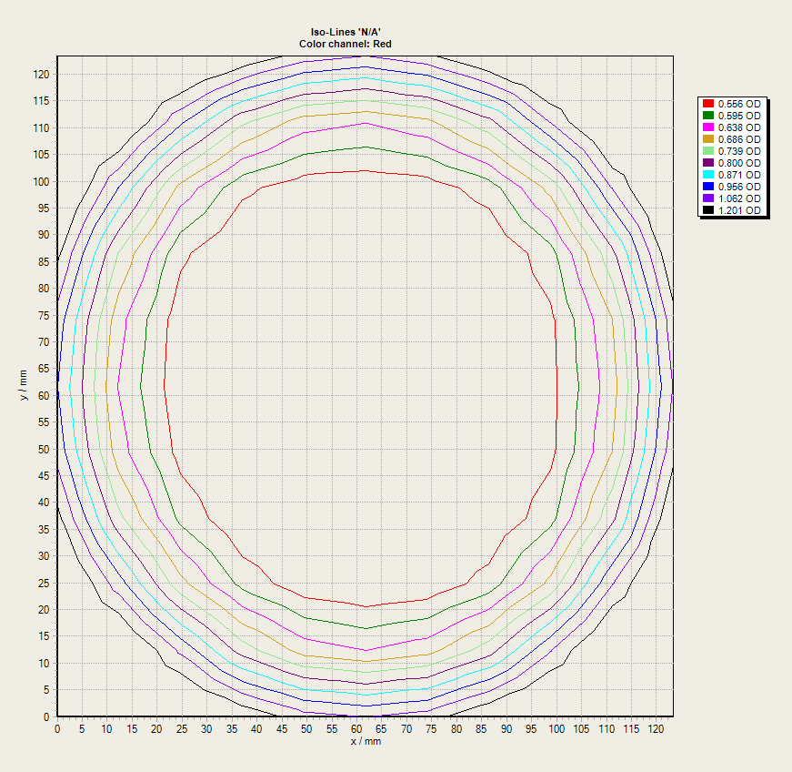
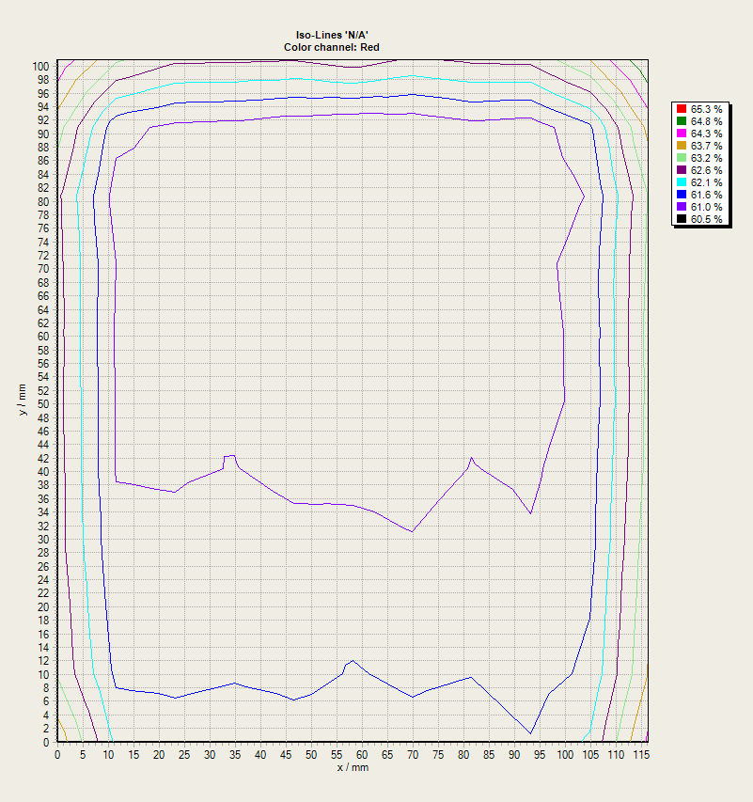
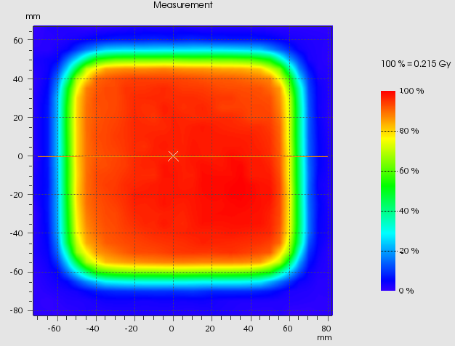
Dose distribution in the irradiation area
spiral
scanning

Slide 12
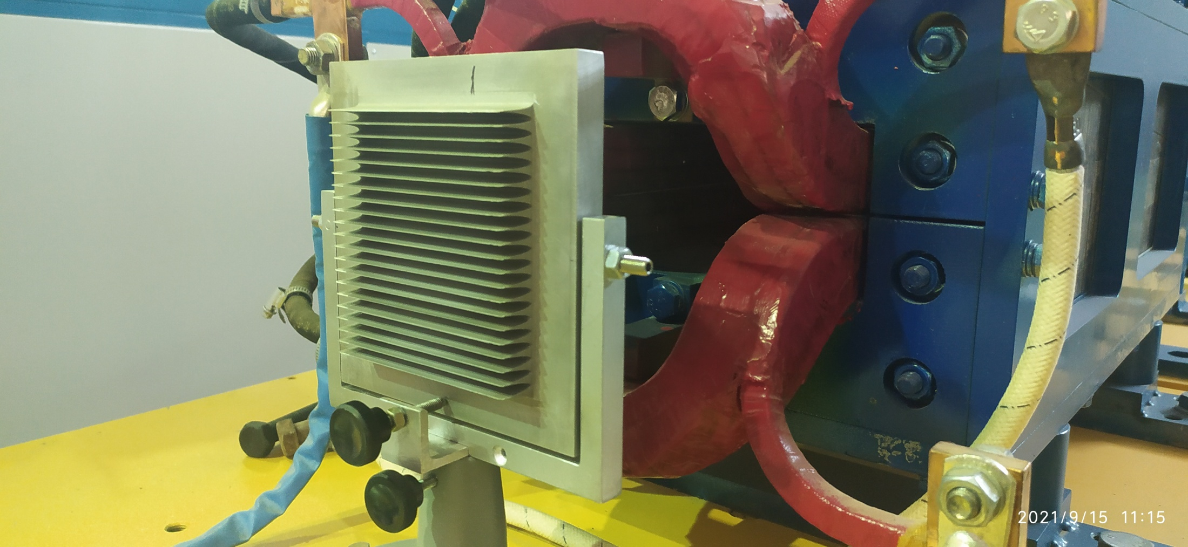
Ripple filter
Al ripple filter 16 mm
alignment stand

Slide 13
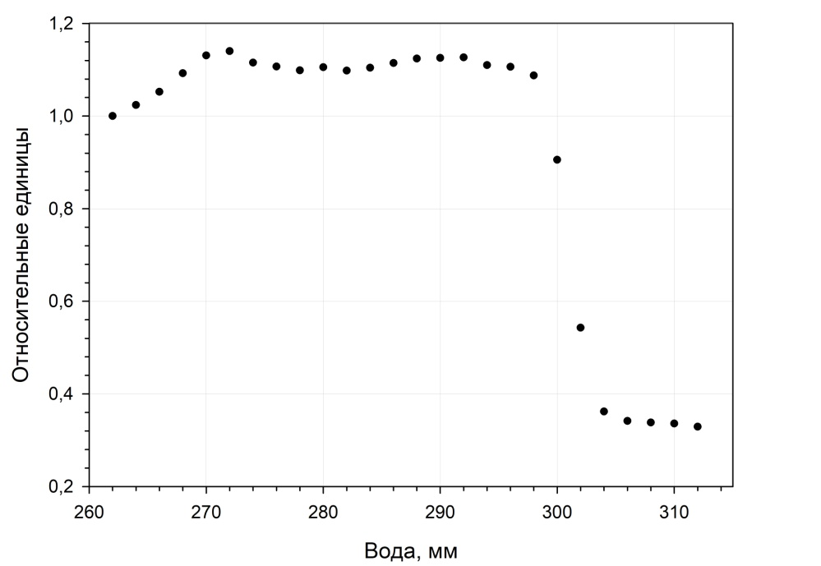
Bragg's Peak with a ripple filter
E=450 MeV/nuc
Water, mm

Slide 14
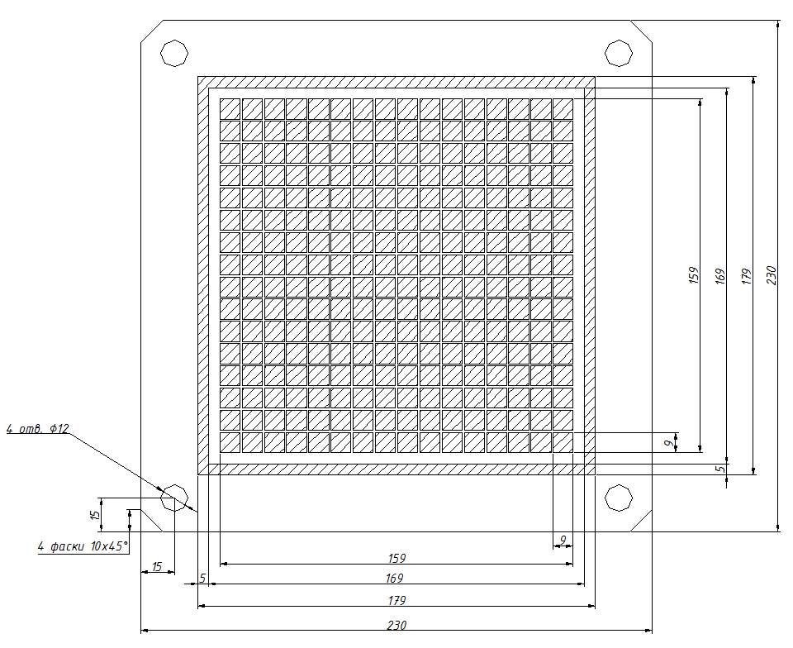
Mosaic 256-cell plane-parallel ionization chamber
drawing

Slide 15
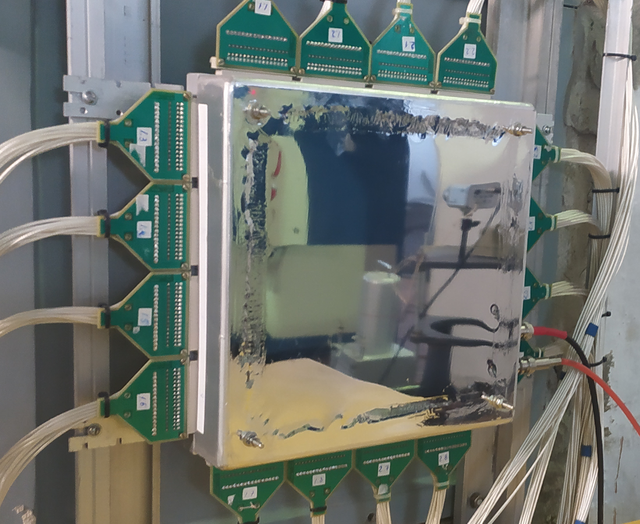
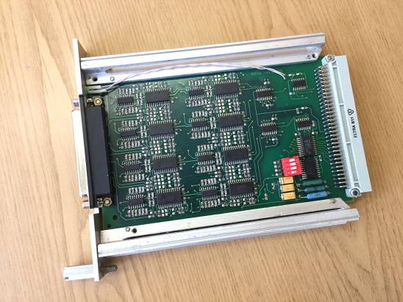
Mosaic 256-cell plane-parallel ionization chamber
camera view without electronics
charge integrator module for 16 channels

Slide 16
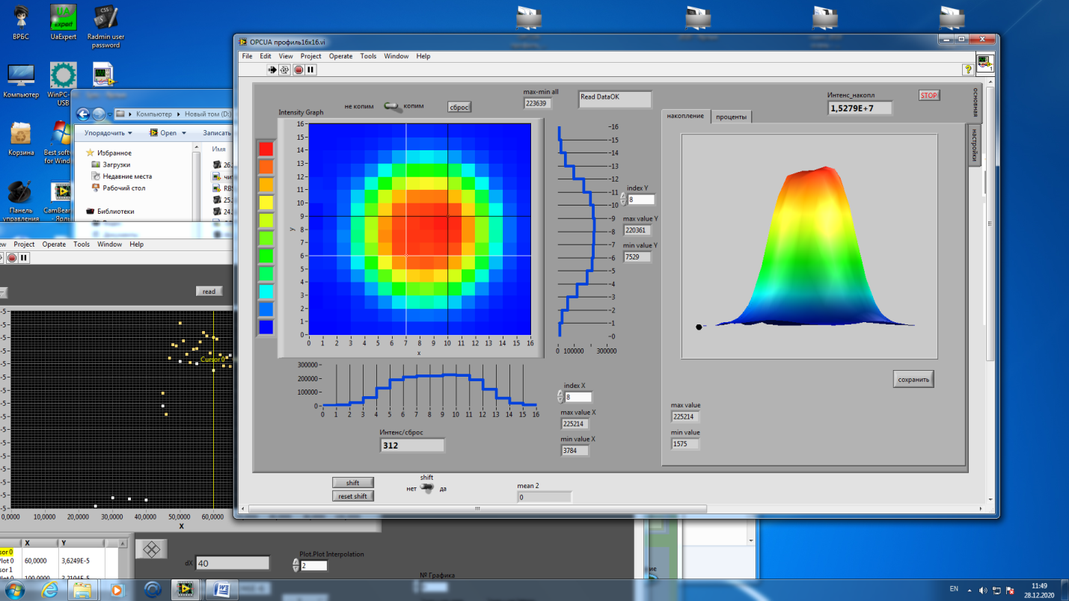
Screenshot of the program for the 256-channel ionization chamber

Slide 17
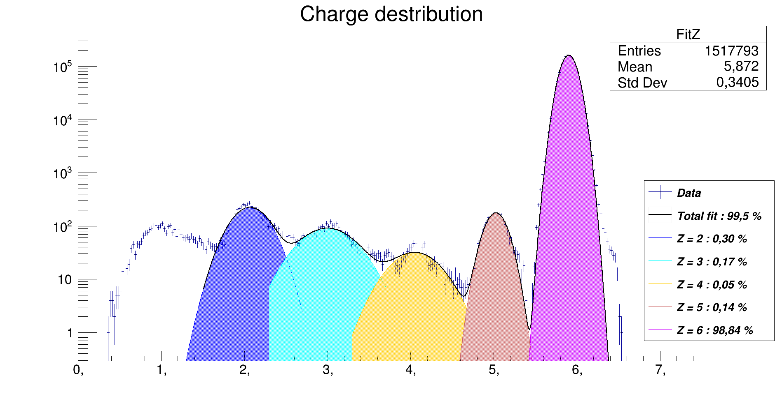
Carbon ion beam composition. 300 MeV / nuc

Slide 18
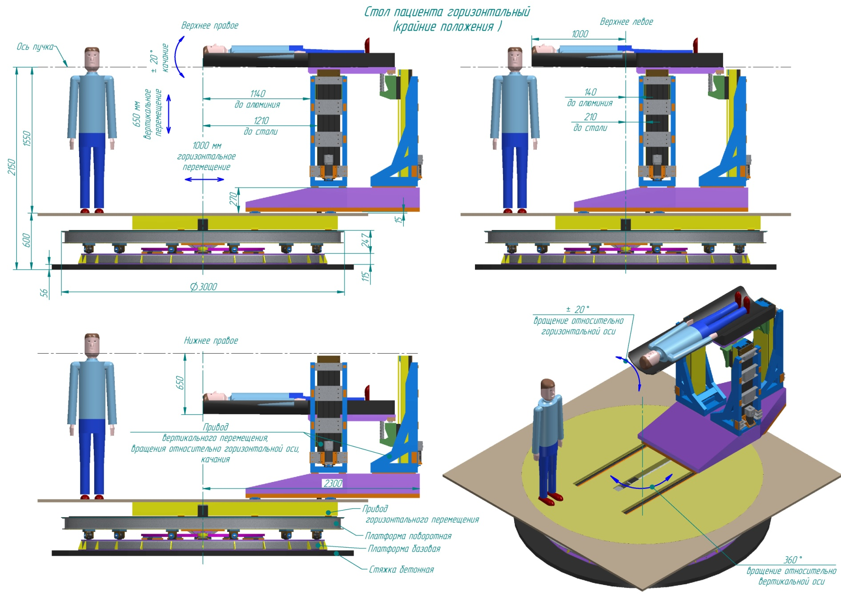
6-axis table. 3D model.

Slide 19
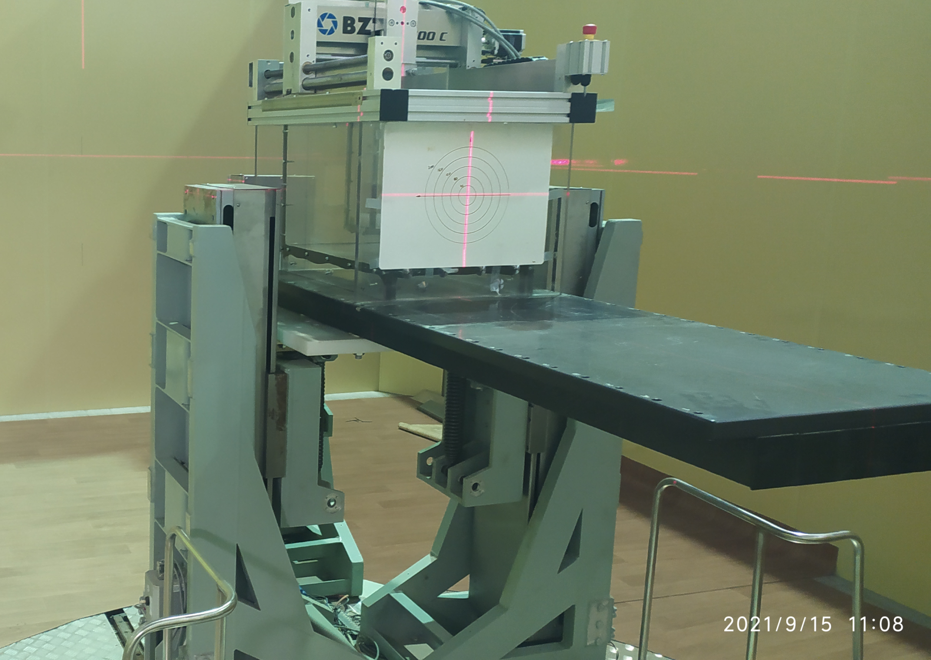
6-axis table in the medical module
positioning accuracy ˂0.5mm
CT scanner deck

Slide 20
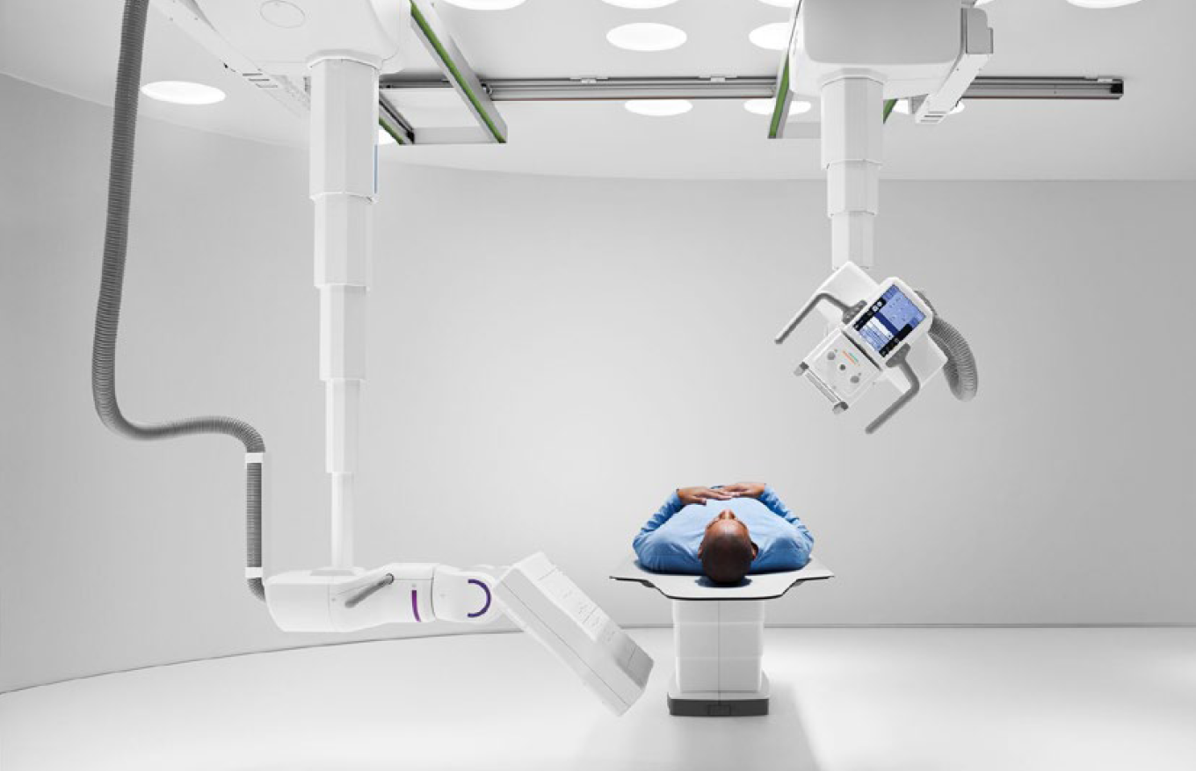
Multitom Rax - Twin Robotic X-ray system for medical module

Slide 21
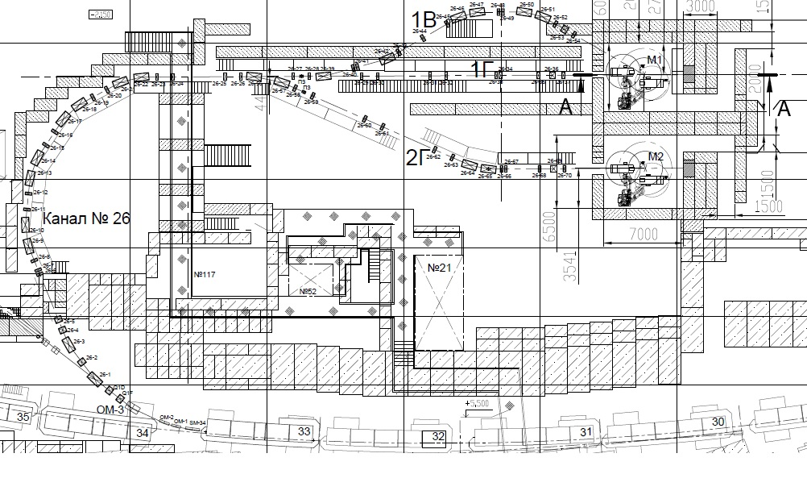
New 26 channel with 3 medical modules

Slide 22
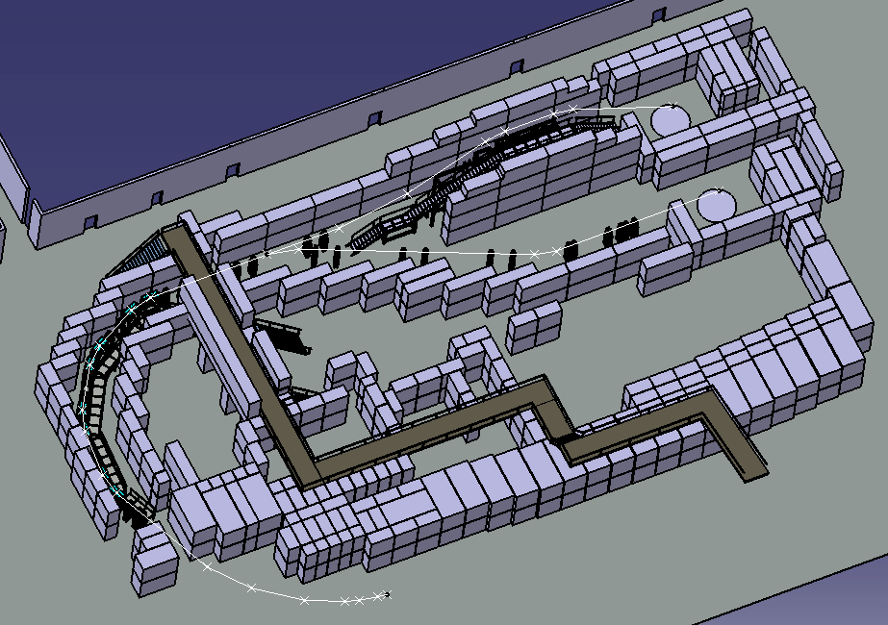
26 channel 3D model

Slide 23
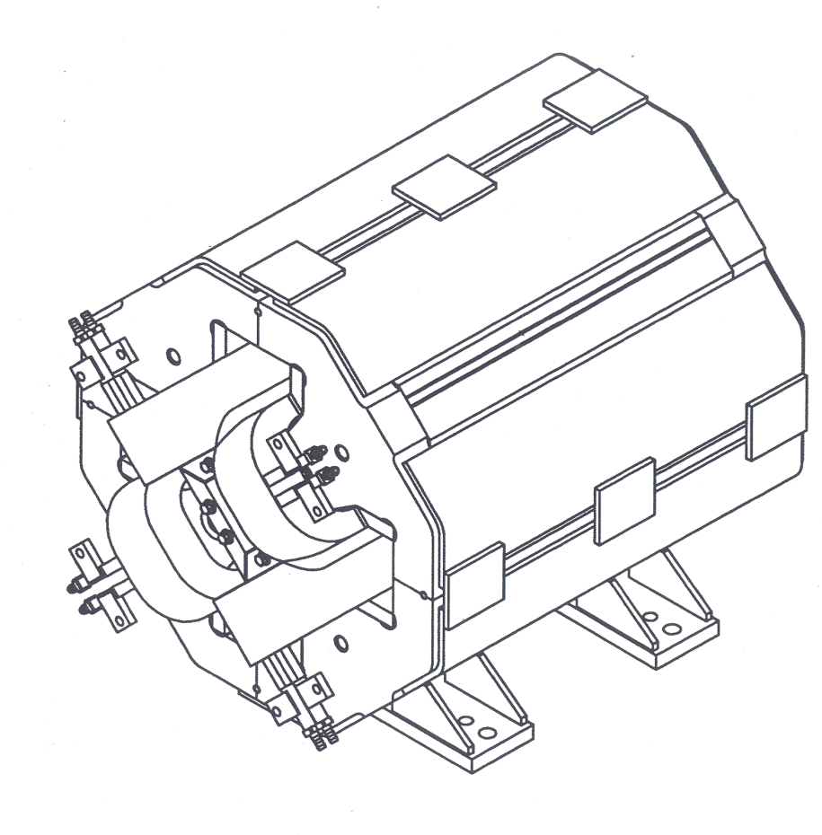
Magneto-optical elements of the 26 channel
lens 220x75 mm
24,6 T/m
dipole
L=1.3 m
B=1,4 T
h=64mm

Slide 24
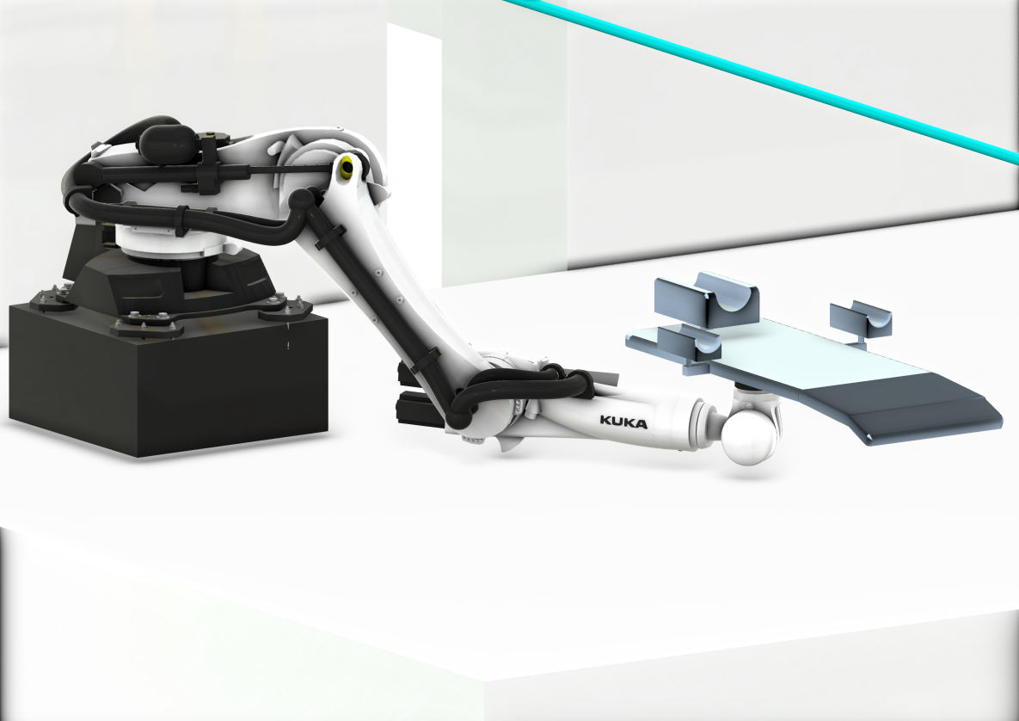
6-axis table based on the KUKA robot

Slide 25
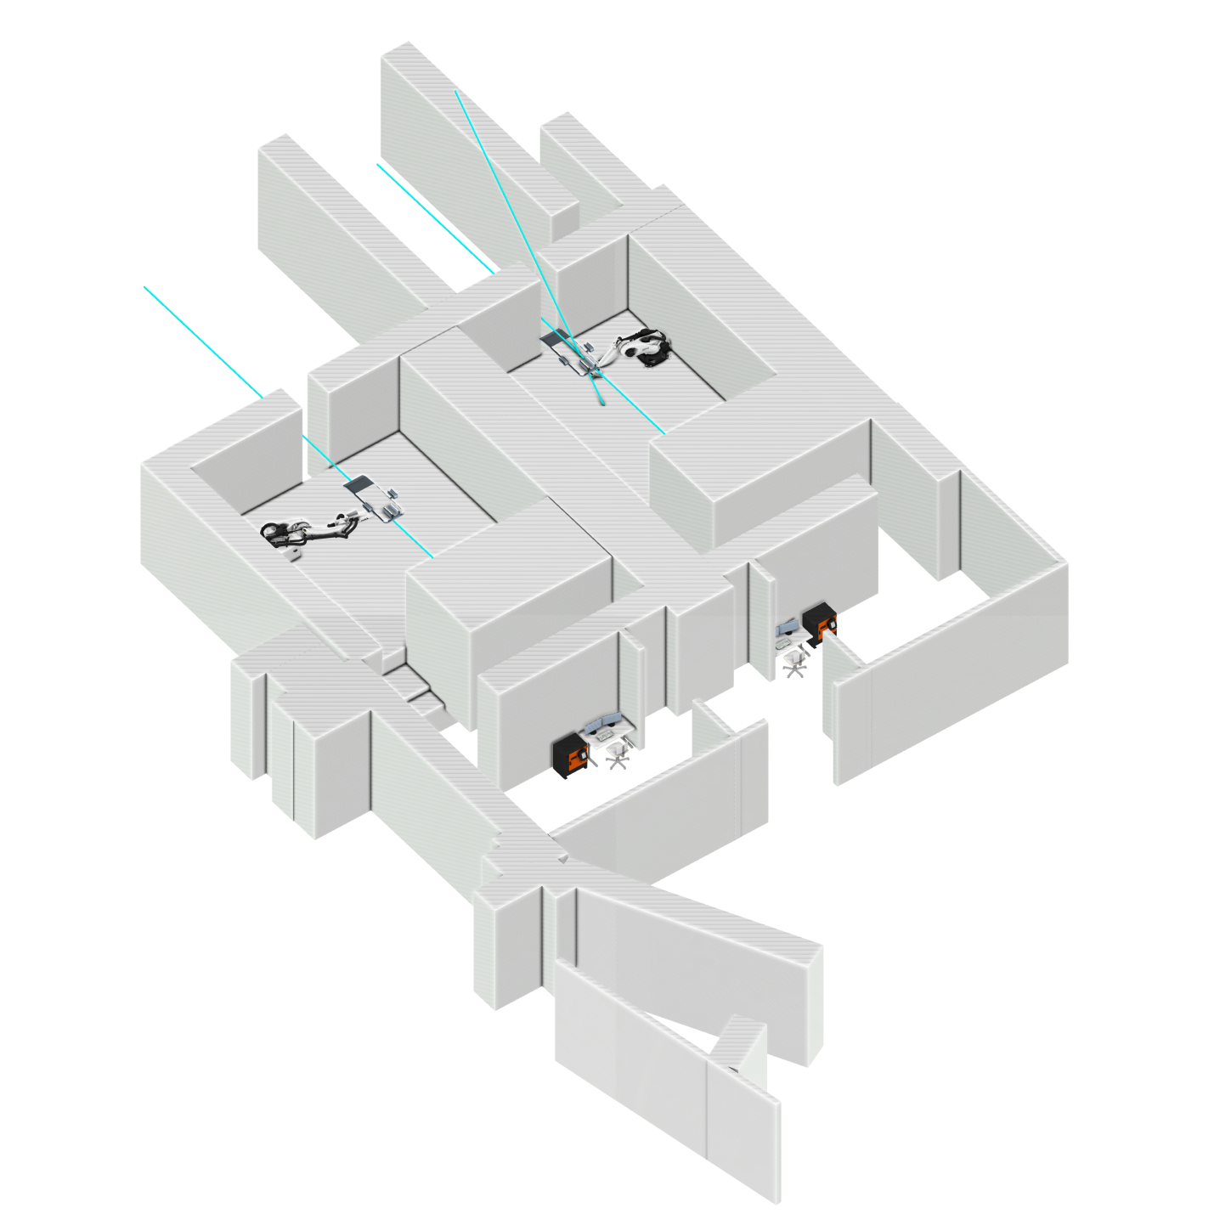
Medical modules biological shield
Calculations performed using the FLUKA program.
Beam absorbers and biological shielding of medical modules are designed

Slide 26
Conclusion
Radiobiological Stand” Facility :
  works in continuous mode;
  according to the results obtained, 21 articles were published over the last 3 years;
  developed and implemented an electromagnetic beam leveling system (wobbler system);
  beam diagnostics tools were developed and manufactured;
  now has slow extraction of 200, 250, 300, 350, 400, 455 MeV per nucleon of ¹²C⁶⁺ beam for radiobiology and future prior-to-therapy studies.
  On the basis of the government decree No. 287 of 04.16.2020, work is underway to design the Ion Radiation Therapy Complex.

Slide 27
Thank you very much
pikalov@ihep.ru

