Slide 1


Laboratory of Physics
Vinča Institute of Nuclear Sciences
University of Belgrade, Belgrade, Serbia
Transmission studies with ion beams within FAMA
Zoran Jovanović
27th Russian Particle Accelerator Conference RuPAC 2021 Alushta, 26 Sept – 02 Oct

Slide 2

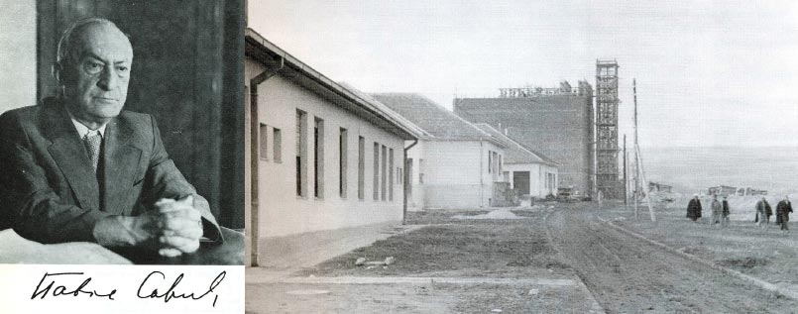
Vinča Institute of nuclear Sciences
Vinča Institute of Nuclear Sciences is founded in 1948 as a research institute in the field of natural sciences – physics, chemistry, biology
In august 1989 the government of Serbia has decided to build accelerator installation TESLA (AIT), a large infrastructure for production, acceleration and use of ion beam in science, technology and medicine in VINS.
27th Russian Particle Accelerator Conference RuPAC 2021 Alushta, 26 Sept – 02 Oct

Slide 3
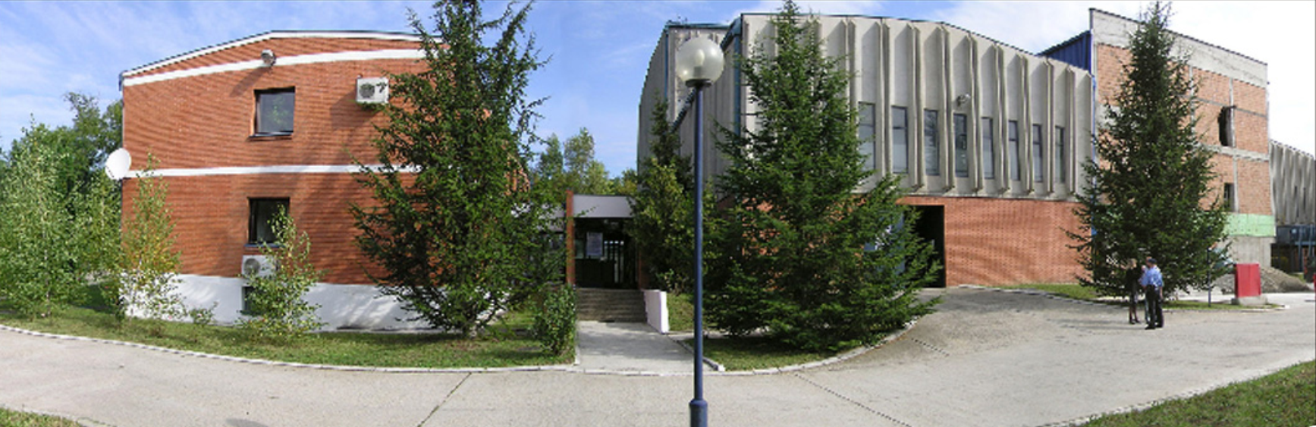
Scientific programs of VINS (until 2030)
Energy and energy efficiency
Nuclear, particle physics and theory of gravity
New materials and nanosciences
Environment and health
Science with accelerators and accelerator technologies
Laboratory of physics at VINS
27th Russian Particle Accelerator Conference RuPAC 2021 Alushta, 26 Sept – 02 Oct

Slide 4
FAMA – Facility for modification and analysis of materials with ion beams

Slide 5
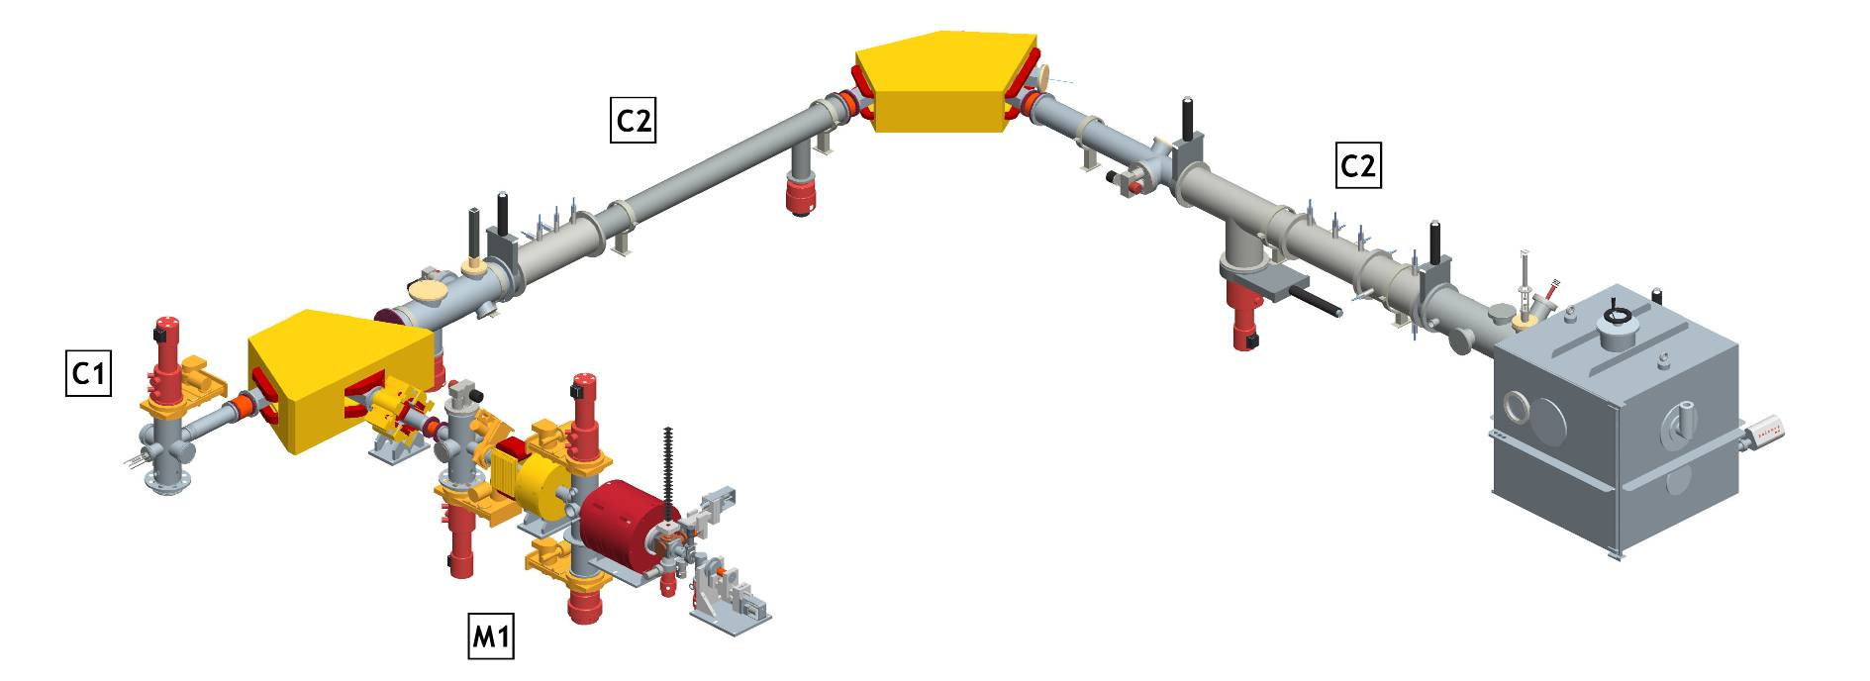
Early FAMA
Commissioned in May 1998.
It then comprised:
- heavy ion source, M1 machine;
- channel for modification of materials, C2;
- light ion source, M2 machine;
A three-dimensional scheme of the M1 machine and C2 channel
27th Russian Particle Accelerator Conference RuPAC 2021 Alushta, 26 Sept – 02 Oct

Slide 6
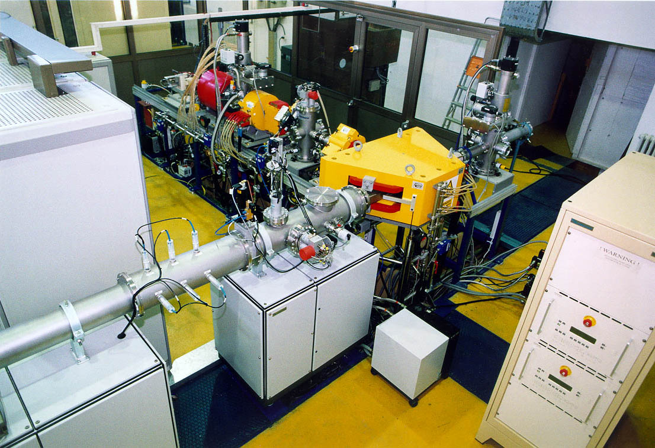
Early FAMA
The M1 machine was commissioned in May 1998.
It was constructed by the Joint Institute for Nuclear Research, Dubna, Russia, in close collaboration with the Vinča Institute.
It was an example of successful combining of the Russian engineering and western technologies.
The M1 machine.
27th Russian Particle Accelerator Conference RuPAC 2021 Alushta, 26 Sept – 02 Oct

Slide 7
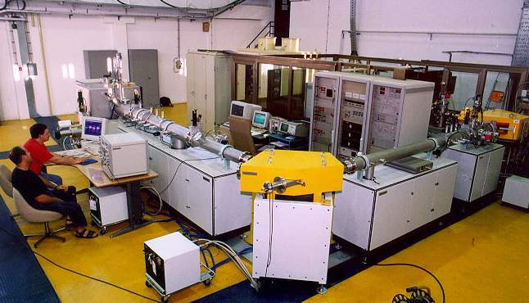
Early FAMA
The C2 channel was also commissioned in May 1998. It was constructed by Danfysik, Jyllinge, Denmark.
The M1 machine and C2 channel are used jointly for modification of materials with heavy ions.
Various metal, semiconductor, carbon, polymer and ceramic targets are bombarded with heavy ions obtained from various gaseous and solid substances.
The C2 channel
27th Russian Particle Accelerator Conference RuPAC 2021 Alushta, 26 Sept – 02 Oct

Slide 8
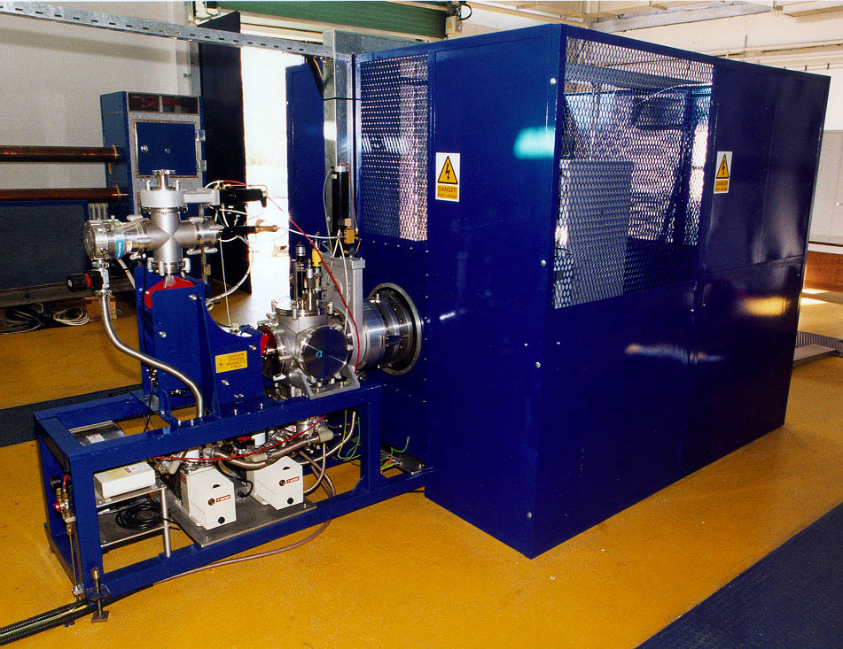
Early FAMA
The M2 machine was commissioned in July 1997, as the light ion source of the VINCY Cyclotron.
It was constructed by AEA Technology, Abingdon, Great Britain.
From January 1998, the machine has been being used for surface modification of materials with light ion beams.
The M2 machine.
27th Russian Particle Accelerator Conference RuPAC 2021 Alushta, 26 Sept – 02 Oct

Slide 9
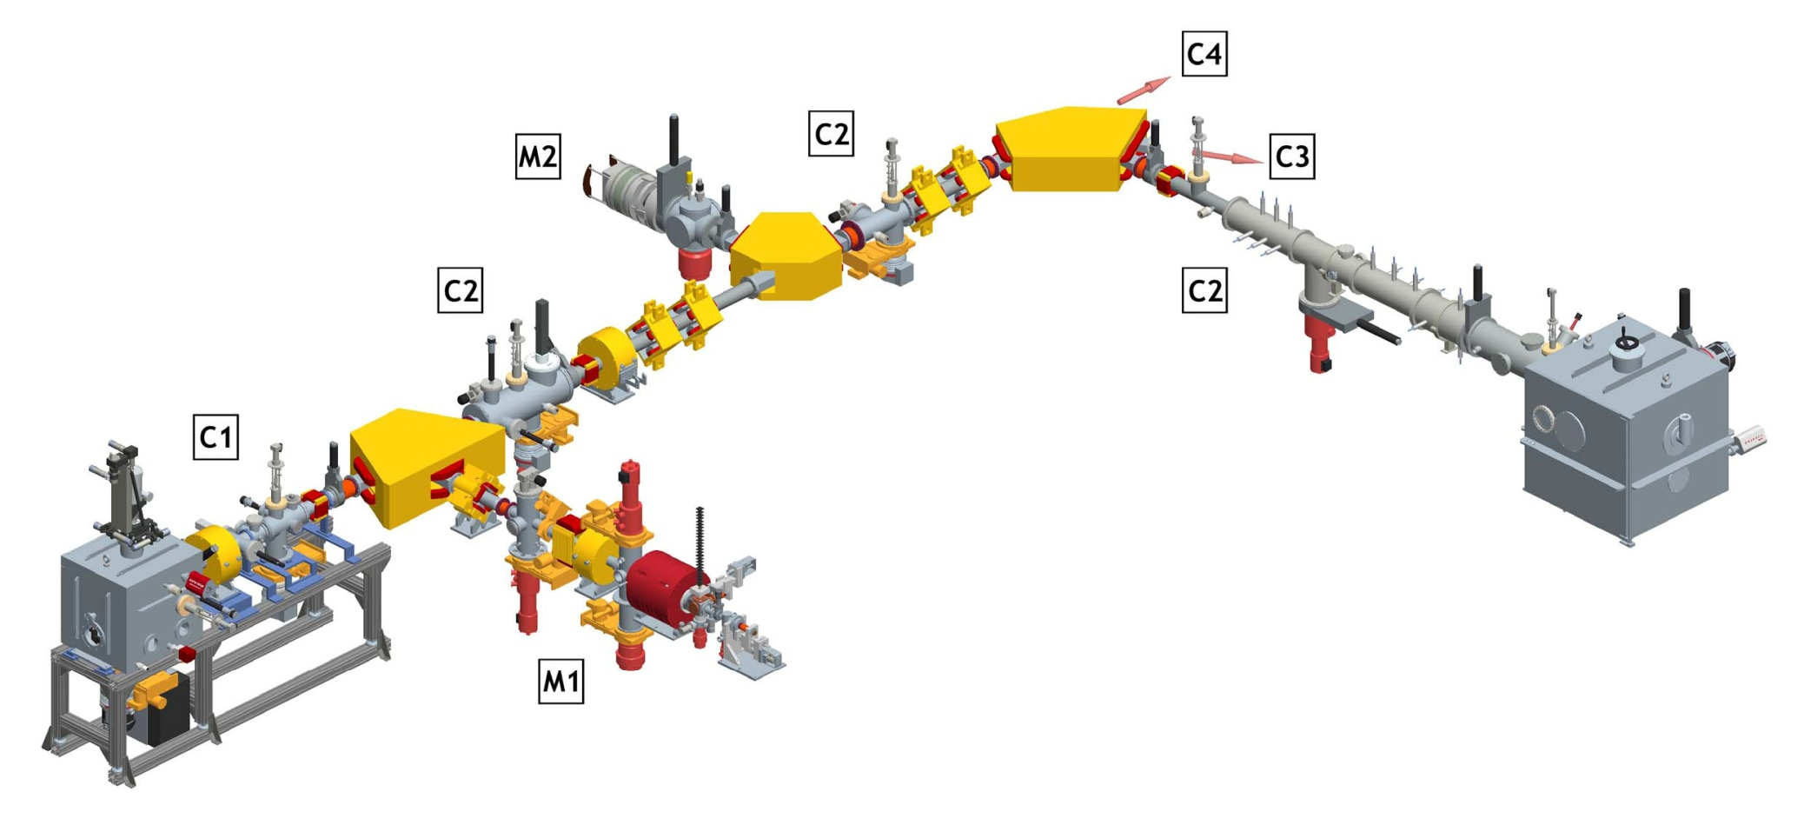
Upgrade(able) FAMA
In June 2010 the upgrading of FAMA began.
This included:
refurbishment of the original FAMA
construction of C1 channel, for channeling implantation
Construction of small cyclotron complex, the M3 machine
Constructions of channels for analysis of materials in vacuum and air, the C5 and C6 channels
A three-dimensional scheme of the M1 and M2 machines and the C1 and C2 channels after the refurbishment .
27th Russian Particle Accelerator Conference RuPAC 2021 Alushta, 26 Sept – 02 Oct

Slide 10
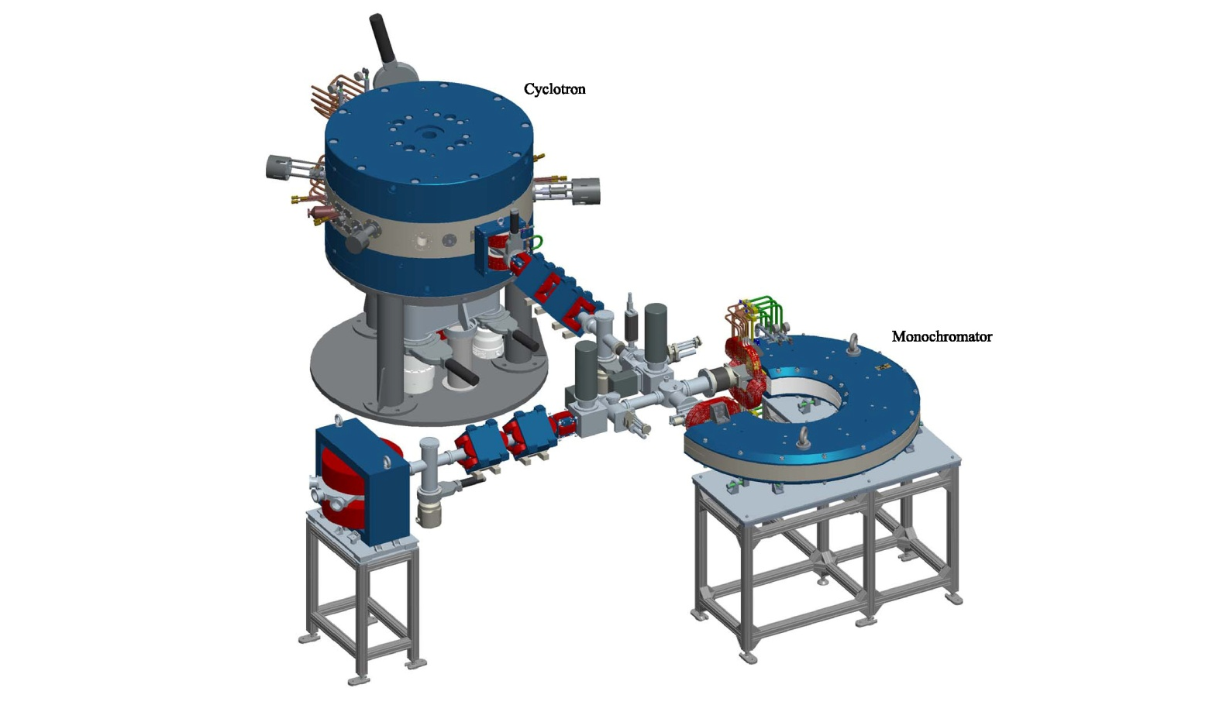
Upgrade(able) FAMA
In June 2010 the upgrading of FAMA began.
This included:
refurbishment of the original FAMA
construction of C1 channel, for channeling implantation
Construction of small cyclotron complex, the M3 machine
Constructions of channels for analysis of materials in vacuum and air, the C5 and C6 channels
Energy – between 1 and 3 MeV
Energy precision – below 1 keV
Energy spread – below 0.1 %
Current – between 10 and 100 nA
A three-dimensional scheme of the M3 machine.
27th Russian Particle Accelerator Conference RuPAC 2021 Alushta, 26 Sept – 02 Oct

Slide 11
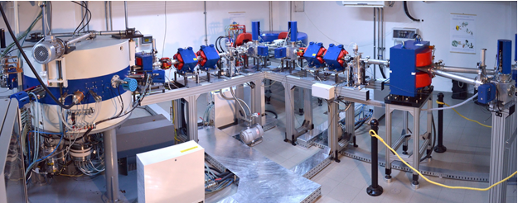
Upgrade(able) FAMA
M3 machine – a small proton cyclotron complex.
27th Russian Particle Accelerator Conference RuPAC 2021 Alushta, 26 Sept – 02 Oct

Slide 12
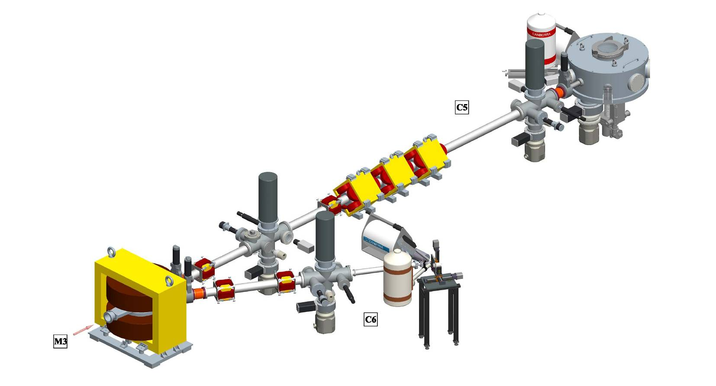
Upgrade(able) FAMA
In June 2010 the upgrading of FAMA began.
This included:
refurbishment of the original FAMA
construction of C1 channel, for channeling implantation
Construction of small cyclotron complex, the M3 machine
Constructions of channels for analysis of materials in vacuum and air, the C5 and C6 channels
A three-dimensional scheme of the C5 and C6 channels.
27th Russian Particle Accelerator Conference RuPAC 2021 Alushta, 26 Sept – 02 Oct

Slide 13
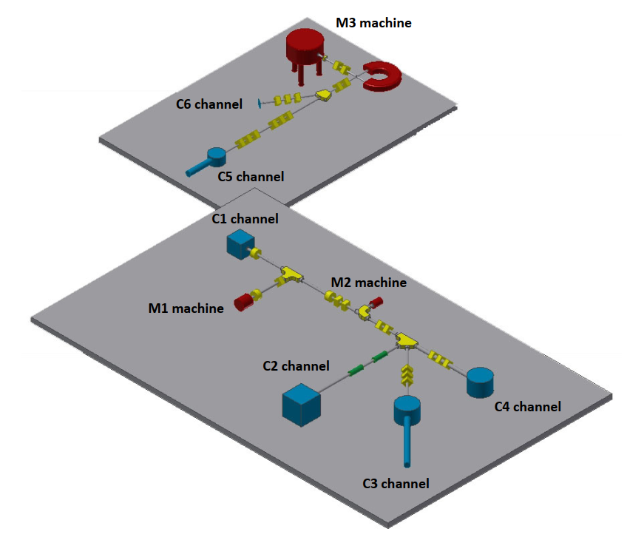
Upgrade(able) FAMA
In march 2020 a plan for additional upgrade of FAMA was made
This should include:
refurbishment of the original FAMA
construction of C3 channel, for transmission studies
Construction of C4 channel, for surface physics
Further upgrade of C5 and C6 channels
A three-dimensional scheme of future FAMA
27th Russian Particle Accelerator Conference RuPAC 2021 Alushta, 26 Sept – 02 Oct

Slide 14
Ion transmission studies with very thin electrostatic lenses

Slide 15
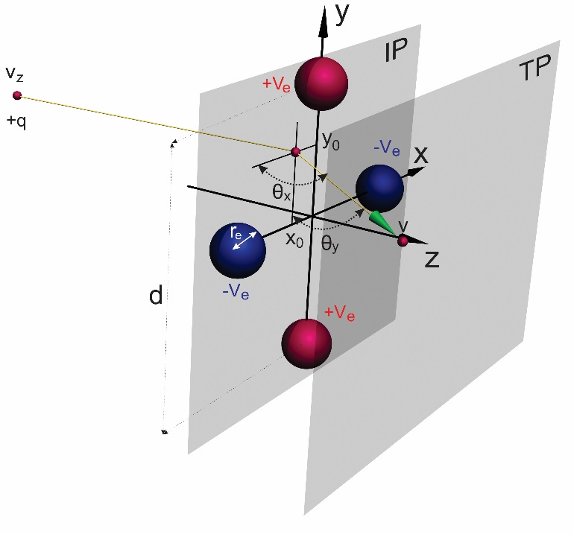

Ion transmission through very thin electrostatic lenses
If lens is sufficiently thin then ion trajectory can be approximated by a straight line. Thus, we can apply the momentum approximation. Transmission angles, are:
The position ion determined by the equations : x= x₀ + θ_{x} and y = y₀ + θ_{y.} The interaction potential is:
x_{i} and y_{i} are the vertical and horizontal positions of the i-th electrode. Equation J_{ρ} = 0 defines the spatial rainbow lines in the IP plane. Their image in transversal plain xy form lines called transversal spatial rainbows or caustic. Equations ∂_{x}J_{ρ} = 0 and ∂_{y}J_{ρ} = 0 define the points in the IP plane at which J_{ρ} is extremal.
and
Illustration of ion trajectory solved in momentum approximation in quadrupole VTEL-s field. In IP for Z=0 every ion has starting $x_{0}$ and $y_{0}$ position. Dimension of quadrupole is r_{e} = 1mm and d = 1cm and DC voltage is V_{e} =1kV. q = e is the ion charge. Ion ienergy E = 10 keV.
27th Russian Particle Accelerator Conference RuPAC 2021 Alushta, 26 Sept – 02 Oct

Slide 16
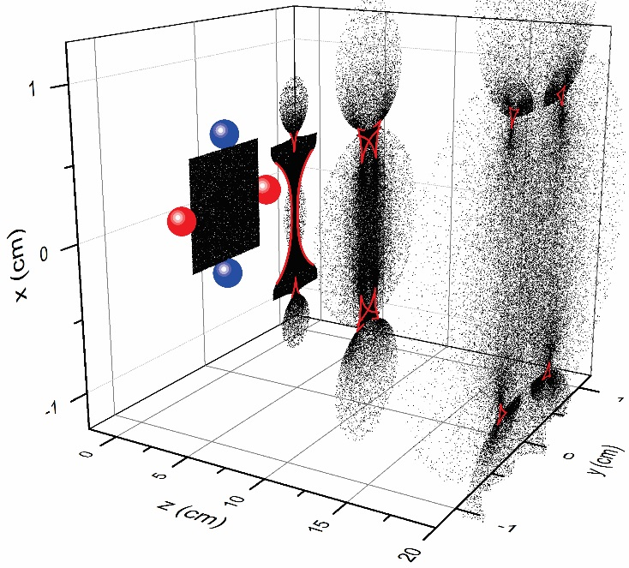
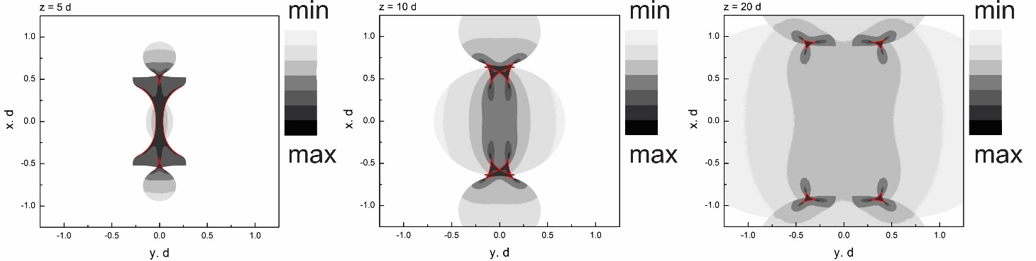
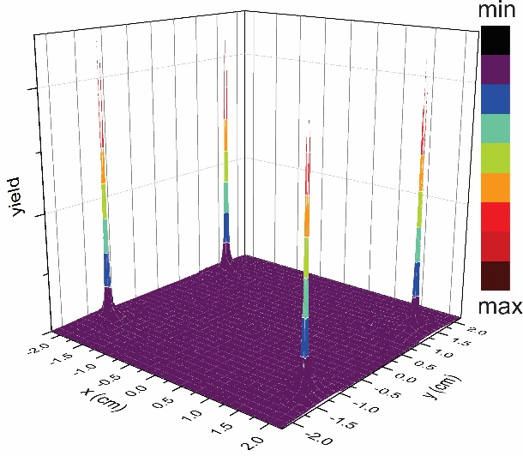
Ion transmission through very thin electrostatic lenses
Two-dimensional spatial distribution of transmitted ions. The ion yield scale is 2^{n} with the yield marked by white up to black colors in 7 steps.
Ion beam in IP and TP plain of quadrupole VTEL-s. The red lines are the images in the TP plane of the fragments of the rainbow patterns in the IP plane lying inside the square aperture.
Three-dimensional distribution of transmitted ions after quadrupole VTEL-s in TP plain for z = 50d.
27th Russian Particle Accelerator Conference RuPAC 2021 Alushta, 26 Sept – 02 Oct

Slide 17
Ion transmission through two-dimensional materials

Slide 18
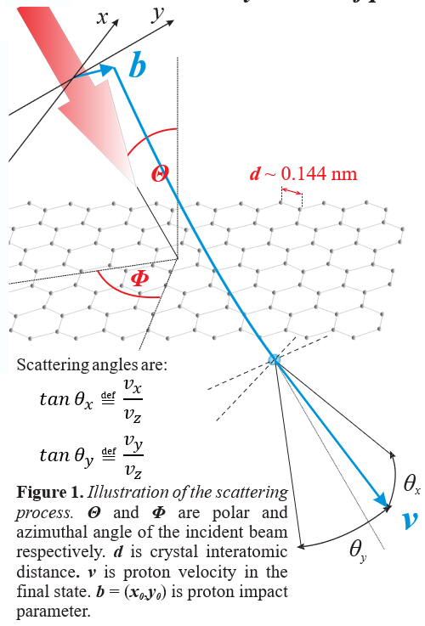
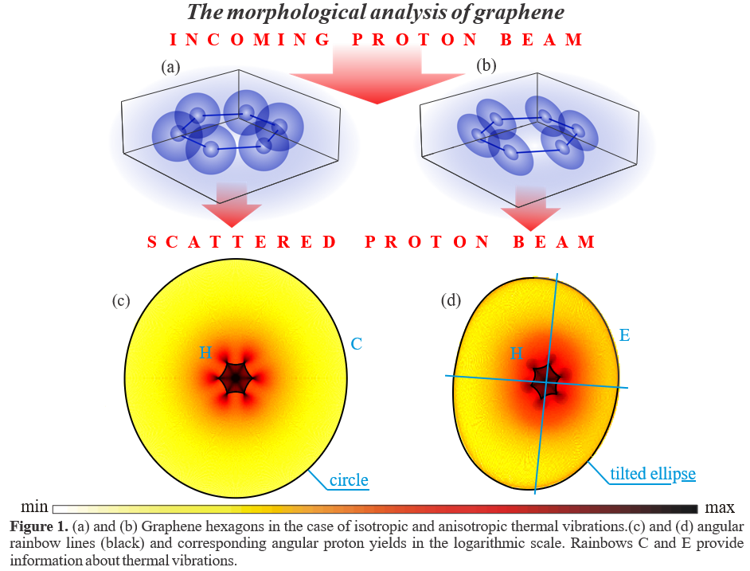
Ion transmission through two-dimensional materials
27th Russian Particle Accelerator Conference RuPAC 2021 Alushta, 26 Sept – 02 Oct

Slide 19
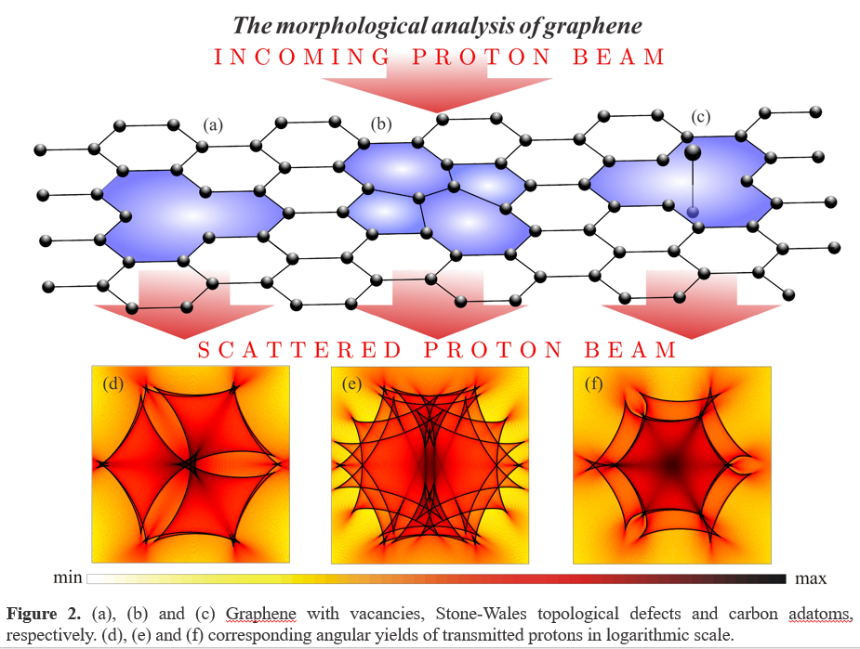
Ion transmission through two-dimensional materials
27th Russian Particle Accelerator Conference RuPAC 2021 Alushta, 26 Sept – 02 Oct

Slide 20
C3 Channel for transmission studies at FAMA

Slide 21
Conceptual design of C3 channel
Transport line
Interaction chamber
Detection chamber
Vacuum system
Safety and control
Vertical and horizontal projections of a scheme of the C3 channel – (a) and (b), respectively.
27th Russian Particle Accelerator Conference RuPAC 2021 Alushta, 26 Sept – 02 Oct

Slide 22
Main components of the C3 channel
Main components of transport line:
two steering magnets
three magnetic quadrupole lenses
Two diagnostic boxes
- a variable circular ion beam collimator
- a Faraday cup
- a beam viewer
Collimators – 5 mm for VTELS and 2 mm for 2D materials
The transport line is terminated with a differential pumping chamber
27th Russian Particle Accelerator Conference RuPAC 2021 Alushta, 26 Sept – 02 Oct

Slide 23
Main components of the C3 channel
Main components of vacuum and control and safety system:
5 TP (700 l/s), 1 TP (300 l/s), and 2 CP (1,200 l/s).
The aim is to ensure the pressure of 5×10⁻⁸ and 5×10⁻¹⁰ mbar in the interaction chamber in the experiments with VTLs and 2D materials, respectively.
The control and safety system of the C3 channel will be composed of the Group 3 Control hardware and the WonderWare In Touch software.
27th Russian Particle Accelerator Conference RuPAC 2021 Alushta, 26 Sept – 02 Oct

Slide 24
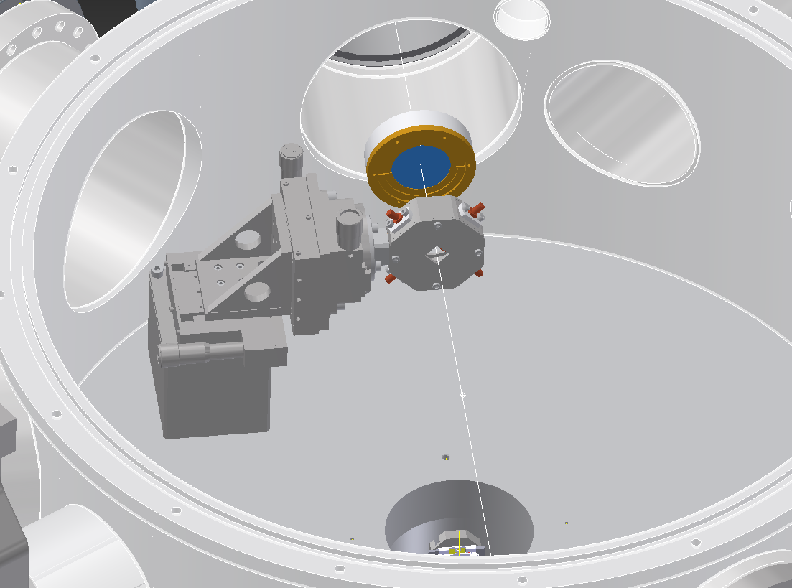
Interaction chamber of the C3 channel
C3-D1
The interaction chamber of the C3 channel
Inner diameter of 580 mm and height of 250 mm
UHV, <5×10⁻¹⁰ mbar
Two target holder assemblies (THAs) - for VTELs and 2D materials
An electrostatic deflector
Two position sensitive detectors (PSD) to record the angular distribution of ions.
The reflection high energy electron diffraction (RHEED) system for monitoring the crystal structure of the chosen 2D material
C3-THA1
In measurements with VTELs: the target holder assembly – C3-THA1; the target is a very thin quadrupole or square rainbow lens; and C3-D1 – the larger 2D detector.
27th Russian Particle Accelerator Conference RuPAC 2021 Alushta, 26 Sept – 02 Oct

Slide 25
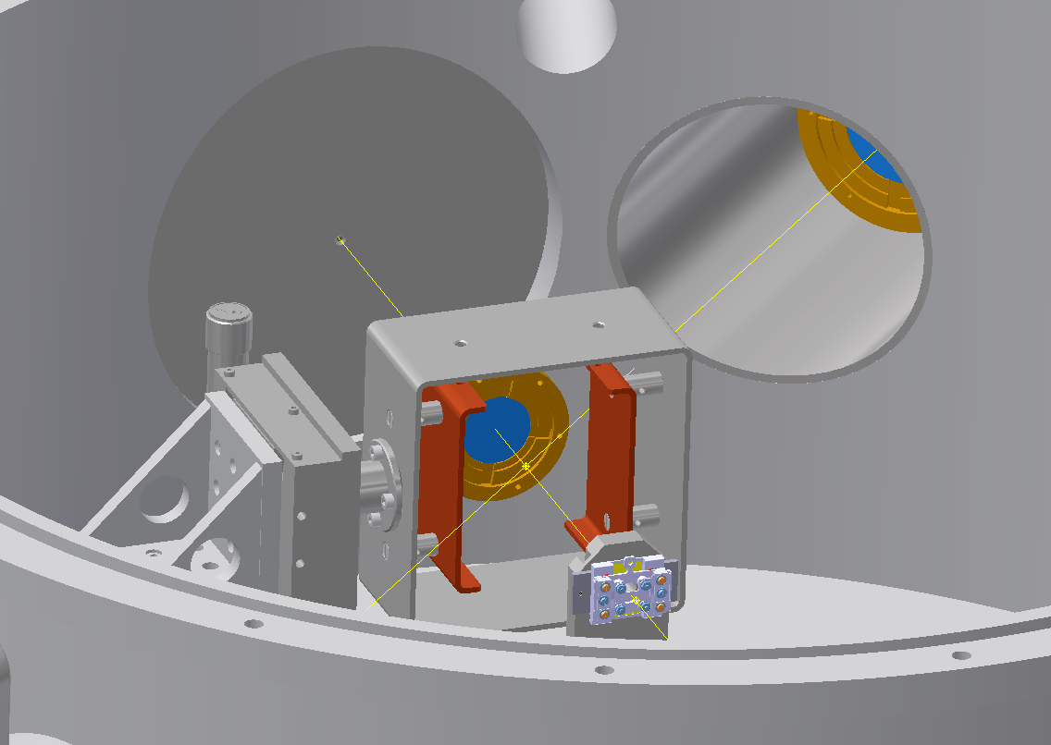
Interaction chamber of the C3 channel
The interaction chamber of the C3 channel
Inner diameter of 580 mm and height of 250 mm
UHV, 5×10⁻¹⁰ mbar
Two target holder assemblies (THAs) - for VTELs and 2D materials
An electrostatic deflector is placed immediately after the target holder assembly for 2D materials
Two position sensitive detectors (PSD) to record the angular distribution of ions.
The reflection high energy electron diffraction (RHEED) system for monitoring the crystal structure of the chosen 2D material
C3-DPA
C3-D1
C3-ESD
C3-D2
C3-THA2
In measurements with 2D materials: the target holder assembly – C3-THA2; C3-ESD – the electrostatic deflector, C3-D2 – the smaller 2D detector; and C3-D1 – the larger 2D detector.
27th Russian Particle Accelerator Conference RuPAC 2021 Alushta, 26 Sept – 02 Oct

Slide 26
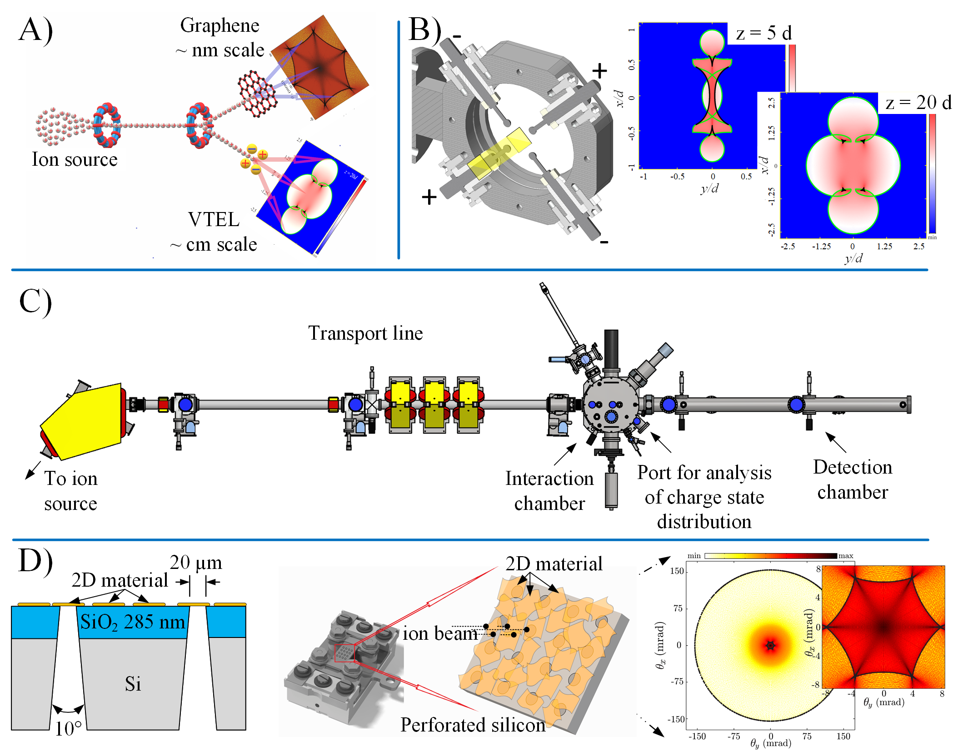

Interaction chamber of the C3 channel
C3-D1
C3-THA1
Illustration of ion trajectory solved in momentum approximation in quadrupole VTEL-s field. In IP for Z=0 every ion has starting $x_{0}$ and $y_{0}$ position. Dimension of quadrupole is r_{e} = 1mm and d = 1cm and DC voltage is V_{e} =1kV. q = e is the ion charge. Ion ienergy E = 10 keV.
In measurements with VTELs: the target holder assembly – C3-THA1; the target is a very thin quadrupole or square rainbow lens; and C3-D1 – the larger 2D detector.
The radius of electrodes will be 1.5 mm, the distance between positively or negatively charged electrodes, d, will be 15 mm, the voltages of the lens electrodes will be +3 keV and -3 keV
27th Russian Particle Accelerator Conference RuPAC 2021 Alushta, 26 Sept – 02 Oct

Slide 27
Interaction chamber of the C3 channel
C3-DPA
C3-D1
C3-ESD
C3-D2
C3-THA2
A scheme of the experimental arrangement in measurements with 2D materials: the target holder assembly – C3-THA2; C3-ESD – the electrostatic deflector, C3-D2 – the smaller 2D detector; and C3-D1 – the larger 2D detector.
27th Russian Particle Accelerator Conference RuPAC 2021 Alushta, 26 Sept – 02 Oct

Slide 28
Detection chamber of the C3 channel
The C3 channel also contains:
a load lock chamber (LLC)
a detector chamber (C3-DC)
In C3-DC there will be two 2D position-sensitive detectors. The larger detector, with the diameter of 40 mm, will be used for measuring the spatial distributions of ions transmitted through the chosen VTL at different distances from it while the smaller detector, with the diameter is 25 mm, will be employed for recording different parts of the angular distribution of ions transmitted through the chosen 2D material.
The larger detector, placed in the interaction chamber, will be also used to measure the charge state distribution of transmitted ions.
Vertical and horizontal projections of a scheme of the C3 channel – (a) and (b), respectively.
27th Russian Particle Accelerator Conference RuPAC 2021 Alushta, 26 Sept – 02 Oct

Slide 29
technological challenges of C3 channel
production and diagnostics of the closely parallel ion beams to be directed to VTELs and 2D materials
Ion beam of a low current, < 1000 ions/s
Divergence ~0.3-0.5 mrad
Pepper-pot, small apertures, alignment
Selection and design of diagnostic elements
registration of the transmitted ion beams with 2D detectors
Calibration (sensitivity, linearity, etc.)
Differentiation between single and multilayers
Time-frame to record spectra vs. radiation damage vs. impurity build-up
27th Russian Particle Accelerator Conference RuPAC 2021 Alushta, 26 Sept – 02 Oct

Slide 30
technological challenges of C3 channel
preparation of 2D materials and maintaining their cleanliness during the measurements
high quality (similar to HOPG)
High lateral sizes, > 30 µm
Preparation, size-selection and assembly procedures
providing the ultra-high vacuum conditions in measurements with 2D materials.
In operando, 5×10⁻¹⁰ mbar or better
Calculation of vacuum in different compartments
Selection of vacuum elements and their distribution
Bake-out approaches and procedures
27th Russian Particle Accelerator Conference RuPAC 2021 Alushta, 26 Sept – 02 Oct

Slide 31
Acknowledgement
N. Nešković, I. Telečki, M. Ćosić, and R. Balvanović
FAMA team
M. Rajčević, B. Jovanović, I. Trajić, Lj. Vukosavljević, V. Jocić
Serbia – JINR collaboration
Thank you for your attention!
27th Russian Particle Accelerator Conference RuPAC 2021 Alushta, 26 Sept – 02 Oct

