Slide 1
SUPERHEAVY ELEMENTS:
PRESENT & future
М. ITKIS
RUPAC 26.09.2021

Slide 2
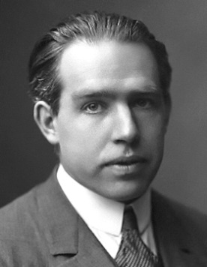
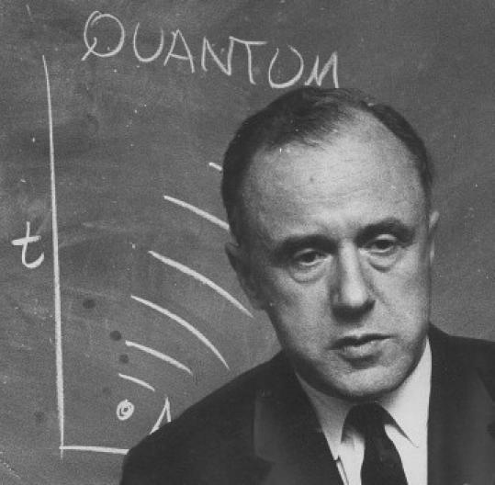
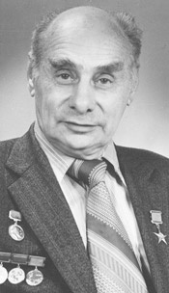
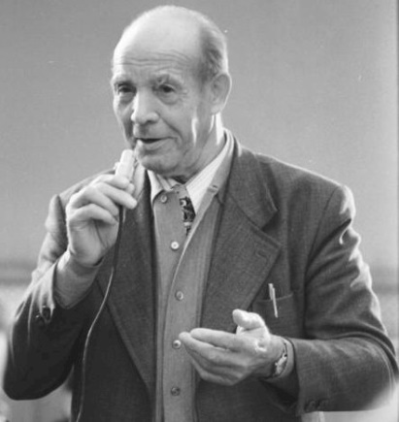
Nuclear fission
N. Bohr
J.A. Wheeler
1939
1940
G.N. Flerov
B_{f}=6 MeV
10¹⁶ years (exp.)
10⁻¹⁹ s
B_{f}=0
Z≥100
K.A. Petrzhak

Slide 3

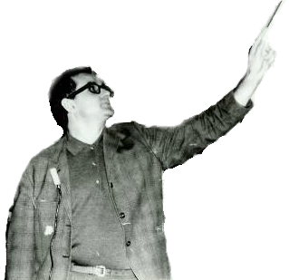
1967
Shell effect
Liquid drop energy
deformation
Macro-microscopic theory
(E^{d})_{Tot} = (E^{d})_{LD} + (E^{d})_{Shell}
macro
micro
V.M. Strutinski 1967

Slide 4
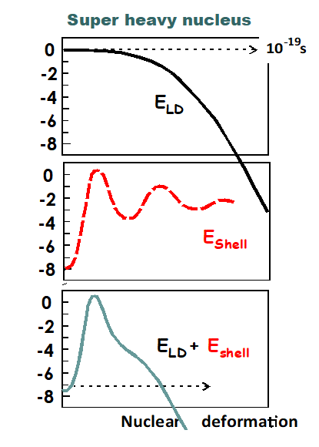
-2
-4
-6
-8
0
-2
-4
-6
-8

Slide 5
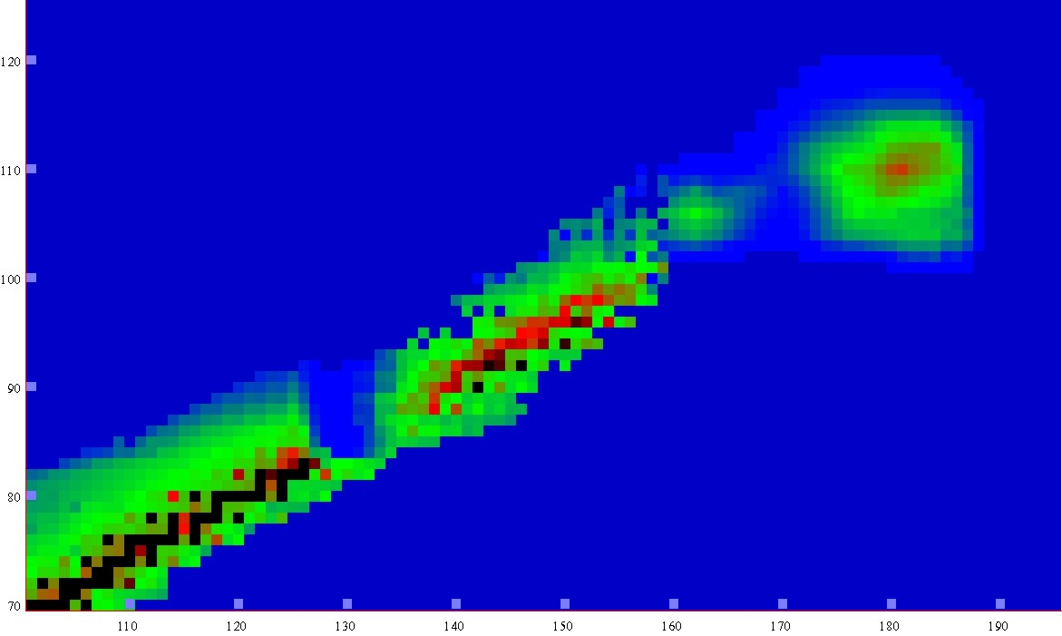
Half-lives
Macroscopic theory
-5
0
5
10
15
LogT_{1/2} s
New lands
New lands
1μs
1s
1h
d
1Myear
Island of
Stability
120
Island of
Stability
A limit of SHE
existence
Shoal
110
shoal
Proton number
T_{1/2} ≤ 10⁻¹⁴ s
Peninsula
100
peninsula
Sea of Instability
90
Continent
continent
80
70
100
110
120
130
140
150
160
170
180
190
Neutron number
Notes:
5

Slide 6
15-year long assault on the “Islands of Stability”
1970-1985
Los Alamos (USA)
Berkeley (USA)
Dubna (JINR)
Oak Ridge (USA)
Mainz (Germany)
Darmstadt (Germany)
Orsay (France)
Würenlingen (Switzerland)
Tokyo (Japan) some later

Slide 7
The task of every laboratory was:
To find the method of producing
Search in nature:
earth/lunar objects, cosmic rays,
Artificial synthesis:
high-flux reactor,
nuclear explosion,
powerful accelerator
To develop setups:
separator/detector,
spectrometers,
chemical methods, etc.

Slide 8
Unfortunately in all attempts super heavy elements were not found
The problem of artificial synthesis of SHE is related with reaction of synthesis
Notes:
8

Slide 9
Reactions of synthesis
Act.+⁴⁸Ca
Cold fusion
Nh
Light ions
target from
“peninsula”
Neutron
capture
Notes:
9
9

Slide 10
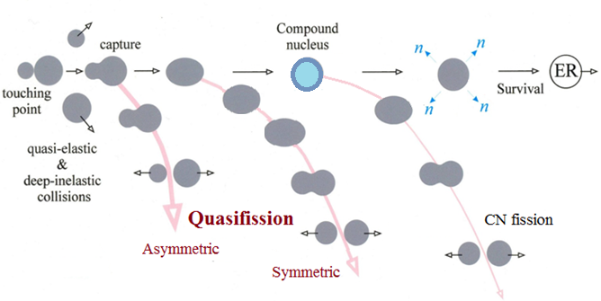
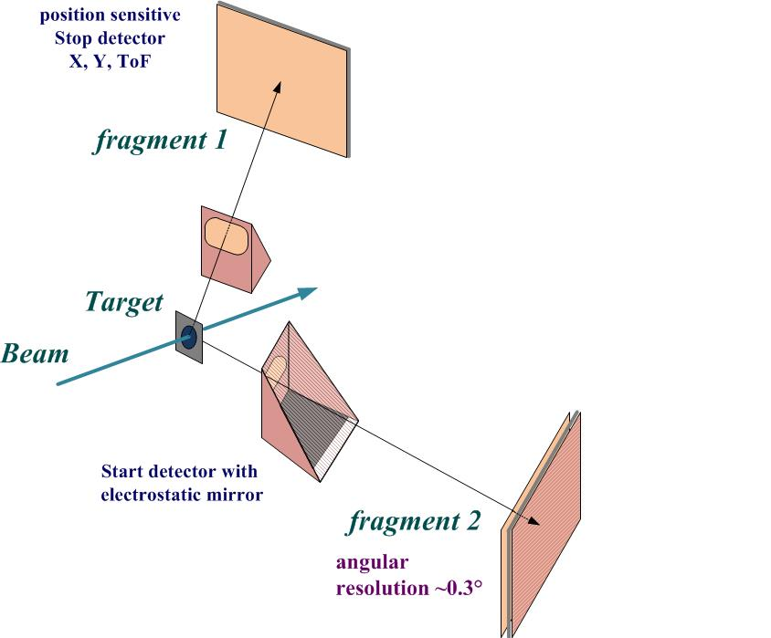
Reaction channels in the collisions of heavy ions
Double arm Time-of-Flight spectrometer CORSET
The study of binary channel of heavy-ion-induced reactions (fusion-fission, quasifission and deep-inelastic processes).
Time resolution | 150-180 ps
ToF base | 10-30 cm
ToF arm rotation range | 15°-165°
Solid angle | 100 -200 msr
Angular resolution | 0.3°
Mass resolution | 2-4 u
Notes:
at energies around the Coulomb barrier the complete fusion of two massive nuclei is suppressed by competing binary process, the quasifission (QF), in which the composite system separates in two main fragments without forming a CN.
QF happens to be the most important mechanism that prevents the formation of SHE in the fusion of heavy nuclei.

Slide 11
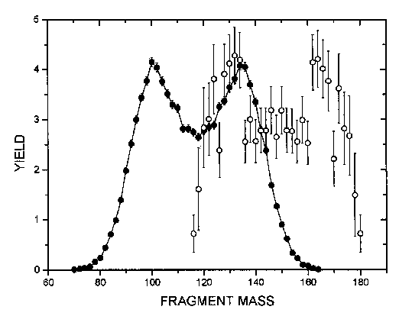
Reactions with ⁴⁸Ca
E*≈ 33 MeV
The sharp change of the MED triangular shape for the reaction ⁴⁸Ca + ²⁰⁸Pb, where Fusion-Fission process dominates, to the Quasifission shape of MED for the ²⁸⁶112-²⁹⁶116 nuclei.
The wide two-humped mass distribution with high peak of heavy fragment near double magic lead (M_{H}≈208) for the Quasifission process.
In spite of the dominating role of the Quasifission process for these reactions we assume that in the symmetric region of the fragment masses (A/2±20) FF process coexists with QF.
The Fusion-Fission mass distribution is asymmetric in shape with mass of the light fragment M_{L}≈132-134 amu (see on the framings)
Yield,%
Fragment mass (u)
FLNR 1999

Slide 12
Cold fusion reactions
Hot fusion reactions
Notes:
Cold and hot fusion reactions are characterized by a strongly different entrance channel. Cold fusion reactions involve ²⁰⁸Pb or ²⁰⁸Bi target nuclei and ER with an excitation energy of about 10-15 MeV which leads to a high survival against fission. Hot fusion reactions involve actinide target nuclei and lead to ER with excitation energy between 30 and 60 MeV, which results in higher neutron evaporation and lower survival against fission.
It is readily seen that in the transition from ⁵⁰Ti to ⁸⁶Kr the shape of mass-energy distributions of binary reaction fragments changes strongly due to the QF and deep-inelastic processes. For the ⁵⁰Ti ion the contribution of symmetric fragments into the capture cross-section is around 60%; in the case of ⁸⁶Kr QF and deep-inelastic scattering are dominant processes.
For the heaviest system ¹³⁶Xe + ²⁰⁸Pb the main process is deep-inelastic scattering
For the hot reactions induced by ⁴⁸Ca ions the mass-energy distributions are similar for all the reactions: a pronounced asymmetric QF with heavy fragments near the double magic lead is observed.
The red rectangles show the regions of masses and TKE’s where the main part of CN-ﬁssion fragments is expected.
The comparison between the two sets of mass-TKE matrices shows convincingly that hot fusion reactions are more suitable for producing SHE.

Slide 13
Reaction of synthesis
artificial element made in
high flux nuclear reactor
target
n
48
288
292
from
accelerator
244
to separator
Ca
Pu
Fl
Fl
projectiles
n
n
rare and very
expensive isotope of Ca
fusion & cooling

Slide 14
Isotope
enrichment (%)
Targets
Isotope
Facility
²³³U SM-3 99.97
²³⁸U -
²³⁷Np SM-3 99.3
²⁴²Pu SM-3 99.98
²⁴⁴Pu HFIR 98.6
²⁴³Am SM-3 / HFIR 99.9
²⁴⁵Cm SM-3 / HFIR 98.7
²⁴⁸Cm HFIR 97.4
²⁴⁹Bk HFIR 97.3
²⁴⁹Cf SM-3 / HFIR 97.3
⁴⁸Ca -beam
Energy:
235-250 MeV
Intensity:
1.0-1.2 pμA
Consumption:
0.5 mg/h
Notes:
14

Slide 15

BEAM
100,000 hours beam time of Ca-48
Heavy Ion Accelerator U-400
Joint Institute for Nuclear Research (Dubna, Russia)

Slide 16
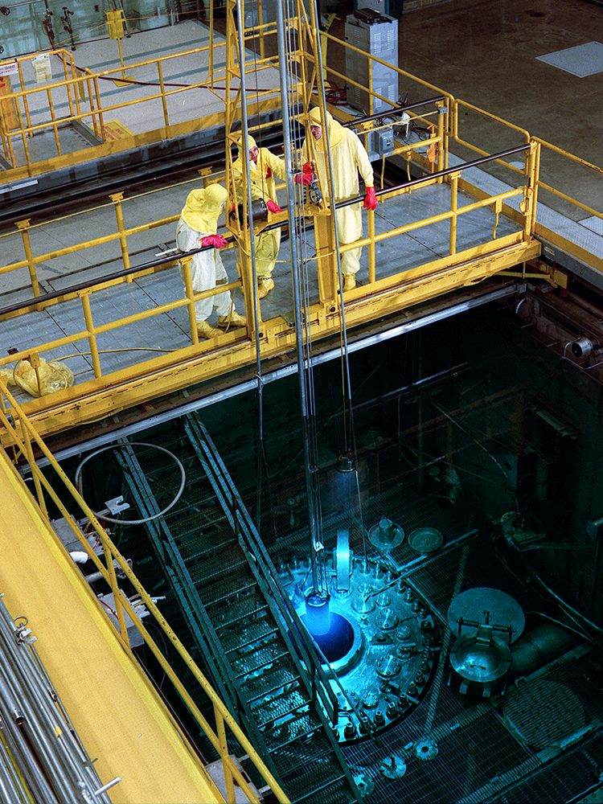
TARGET
Yu. Oganessian 2010
50 Ci
High Flux Isotope Reactor
Oak Ridge National Laboratory (USA)
22 mg of ²⁴⁹Bk
have been produced in 250 days irradiation
at HFIR (ORNL)

Slide 17
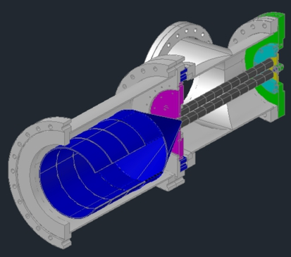
Experimental l technique
ε=0.5 mm·mrad
ΔE=0.5 eV
Dubna
Gas
Filled
Recoil
Separator
beam
⁴⁸Ca
target
Notes:
17

Slide 18
Decay
chains
1999 - 2000
²⁴⁸Cm + ⁴⁸Ca →
²⁴⁴Pu + ⁴⁸Ca →
Z=116
0.06 s
114
2.5 s
114
0.7 ms
112
0.5 min
170 μs
110
11s
184

Slide 19
Confirmations of DGFRS data 2007 - 2014
A/Z | Setup | Laboratory | Publications
²⁸³112 | SHIP | GSI Darmstadt | Eur. Phys. J. A32, 251 (2007)
²⁸³112 | COLD | PSI-FLNR (JINR) | NATURE 447, 72 (2007)
^{286, 287}114 | BGS | LBNL (Berkeley) | P.R. Lett. 103, 132502 (2009)
^{288, 289}114 ^{292, 293}116 | TASCA SHIP | GSI – Mainz GSI Darmstadt | P.R. Lett. 104, 252701 (2010) Eur. Phys. J. A48, 62 (2012)
^{287, 288}115 ^{293, 294}117 | TASCA TASCA | GSI – Mainz GSI – Mainz | P.R. Lett. 111, 112502 (2013) P.R. Lett. 112, 172501 (2014)
^{292, 293}116 | GARIS | RIKEN Tokyo | Accelerator Progress Rep. (2013)

Slide 20
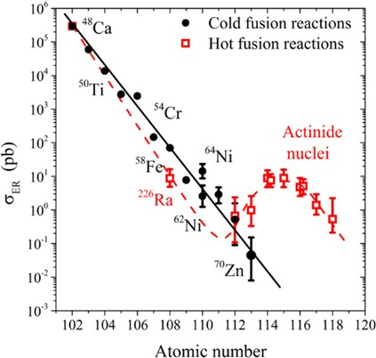

Slide 21
Super heavy islanders and their daughter products are
a large family of the 55 new neutron-rich isotopes with unique properties.
2015

Slide 22
Reactions of Synthesis
Reactions of Synthesis
A. Sobiczewski, K. Pomorski, PPNP 58, 292, 2007
LDM + Shell Corrections
SHE
(10y) 6 elem.
1999 - 2010
protons →
Cold fusion
Cold fusion
Act. + ⁴⁸Ca
(38y) 6 elem.
1974 - 2012
Act. + ⁴⁸Ca
Hot
fusion
Hot
fusion
1955 - 1975
(20y) 6 elem.
Neutron capture
Neutron capture
1940 - 1955
(15y) 8 elem.
Historical background:
After discovery of nuclear fission 80 - years ago - 26 new chemical elements heavier than uranium was synthesized
Pb
neutrons →
Notes:
22

Slide 23
With Z > 40% larger than that of Bi, the heaviest stable element,
we see an impressive extension in nuclear survivability.
Although SHN are at the limits of Coulomb stability,
shell stabilization lowers ground-state energy,
creates a fission barrier,
and thereby enables SHN to exist.
.
The fundamentals of the modern theory
concerning the mass limits of nuclear matter
have obtained experimental verification

Slide 24
Where are the super heavy elements located
in the Periodic Table?
Are they similar to their light homologues?
Where is the boundary of the Periodic Table
and how many elements can it contain?

Slide 25
Decay modes and the half-lives of the isotopes with Z ≥ 110
available for
chemical studies
N=162
Symbols: open – α decay
filled – spontaneous fission

Slide 26
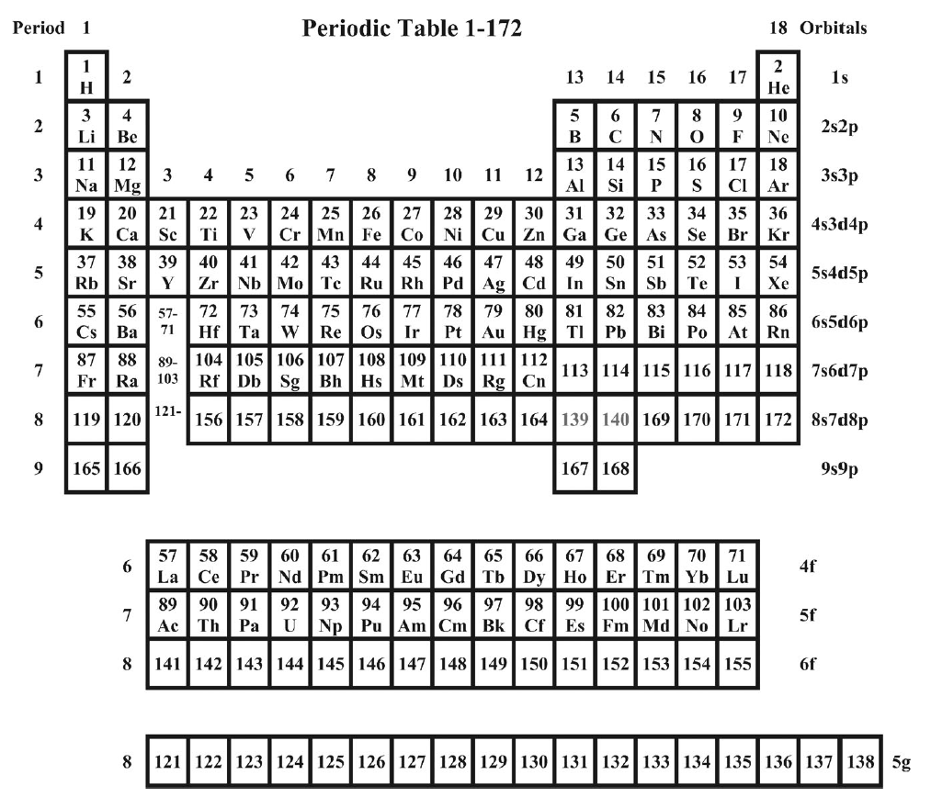
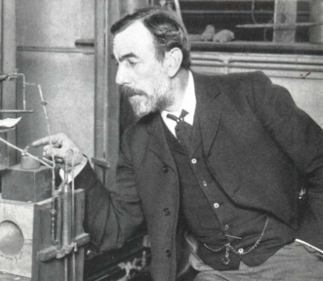
Periodic Table Z=1-138
1
2
Calculated in non-relativistic
Dirac-Fock approximation
3
4
Sir
William
1904 Ramsay
5
6
86
Rn
Completion of
the 7-th row
113
114
115
Fl
Nh
Ms
116
117
118
2004
Fl
Lv
Ts
Og
Does element 118 look like a noble gas?
6
L A N T A N I D E S
4f
7
A C T I N I D E S
5f
8
6f
8

Slide 27
126
PRESENT
The
NEW YORKER
Z
118
we are here
⁴⁸Ca - traction
112
170
175
180
184
N

Slide 28
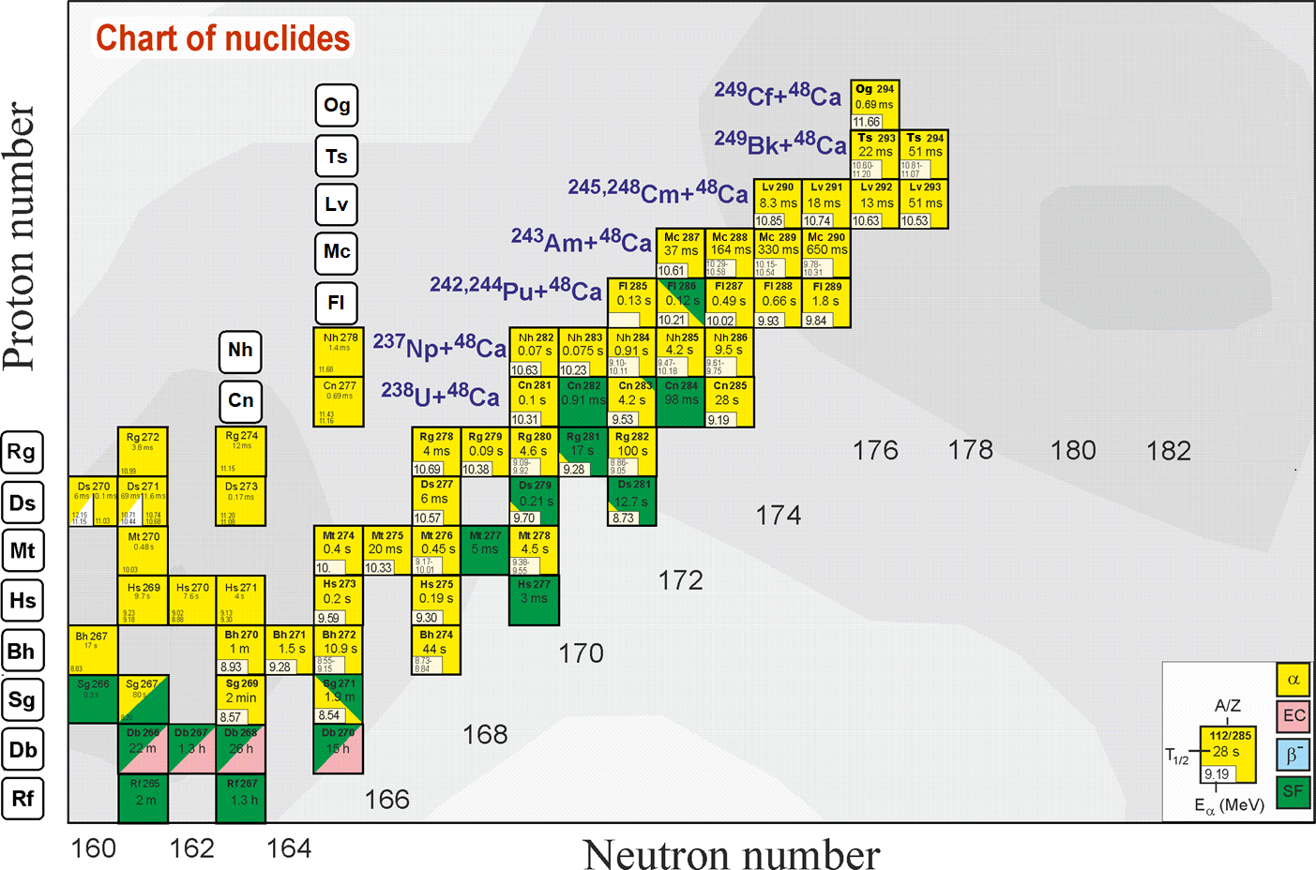
Search for superheavies
What is the next step?
Ti, Cr, Ni, Fe ?
Z = 120
Still far from the “island of stability” !!!
What is the next double magic superheavy nucleus?
Z = 114
184
“Inverse” quasifission
can be used to produce
new neutron-rich
SHE
Notes:
50 years ago The existence of island of stability in the region of nuclei with Z = 114 and N = 184 was predicted theoretically [A. Sobiczewski, F. A. Gareev, and B. N. Kalinkin, Phys. Lett. 22, 500 (1966)]
That caused the experimental investigations in the field of the superheavy element (SHE) synthesis.
Nowadays more than 30 isotopes of superheavy elements with Z = 108-118 have been synthesized both in cold an hot fusion reactions
In the Flerov Laboratory of Nuclear Reactions a great success was achieved in the synthesis of superheavy elements in hot fusion reactions of ⁴⁸Ca ions with actinide target nuclei.
Unfortunately, nuclei with Z > 118 cannot be synthesized in ⁴⁸Ca-induced reactions since ²⁴⁹Cf is the heaviest target material available for these purposes.
One of the possible pathways to synthesize new isotopes of superheavy elements with Z = 118 -126 is the reactions of actinide targets with Ti, Cr, Fe and Ni ions.
The interest in damped collisions of heavy nuclei is conditioned by the necessity to find new ways to produce neutron-rich superheavy elements (SHE). Few years ago the inverse (antisymmetrizing) quasifission (QF) process, was proposed to produce SHE in the collisions of transactinides [1]. The low-energy damped collisions of intermediate mass nuclei are less difficult for experimental study than the reactions with transactinides. One may expect that the antisymmetrizing shell effect will be similar in both cases [2].
To study the role of shell effects in inverse QF, the binary reaction channels in the reactions ^{156,160}Gd + ¹⁸⁶W at the Coulomb barrier energy have been investigated. In these reactions the projectile and target nuclei are located between the closed shells with Z = 50, N = 82 (double magic tin) and Z = 82, N = 126 (double magic lead) which should play a significant role in the nucleon transfer process. To form lead-like fragment the projectile nucleus has to transfer about 22 nucleons to the target.

Slide 29

FUTURE
SHE
SHE-Factory

Slide 30
Superheavy Elements (SHE) Factory – the Goals
Experiments at the extremely low (σ<100 fb) cross sections:
Synthesis of new SHE in reactions with ⁵⁰Ti, ⁵⁴Cr ...(119, 120);
Shaping of the region of SHE (synthesis of new isotopes of SHE);
Study of decay properties of SHE;
Study of excitation functions.
Experiments requiring high statistics:
Nuclear spectroscopy of SHE;
Precise mass measurements;
Study of chemical properties of SHE.

Slide 31
SHE-Factory
joining of efforts
Isotope production:
Cm-248
Bk-249
Cf-251
New accelerator
High beam
dose of : Ca-48
Ti-50
Ni-64
SC- recoil separator
equipped with
Gas Catcher
On-line separator
& sophisticated
Detectors
To be increased
10 times
Factor 10-20
Depend of
target durability
Factor 3-5
is closely linked
to the intellect

Slide 32
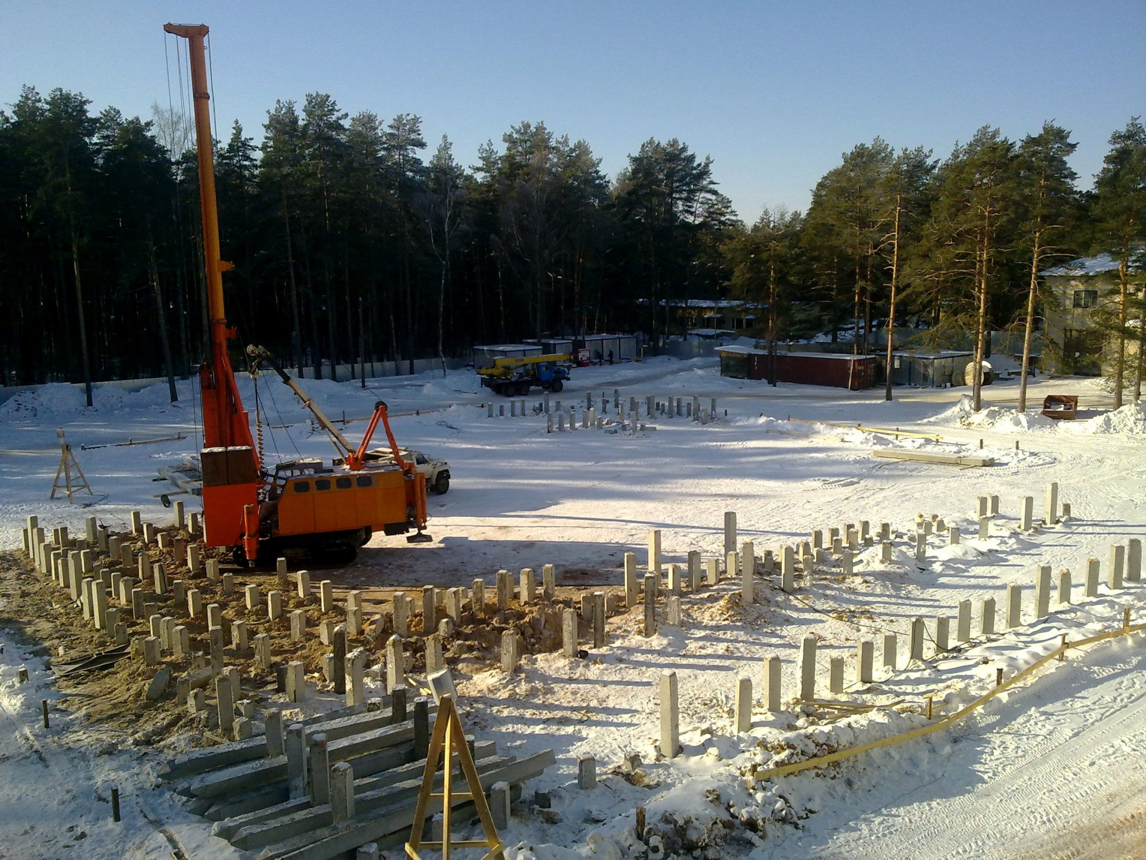
1
March 2012, Dubna

Slide 33
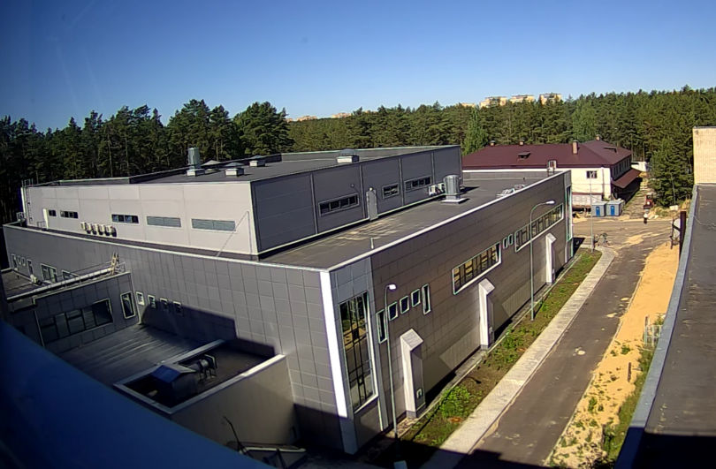
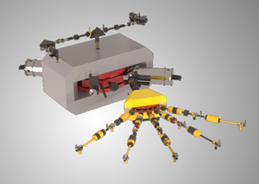
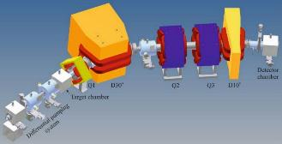
SuperHeavy Elements (SHE) Factory
SHE Factory Building
High-current cyclotron DC-280
New gas-filled separator

Slide 34
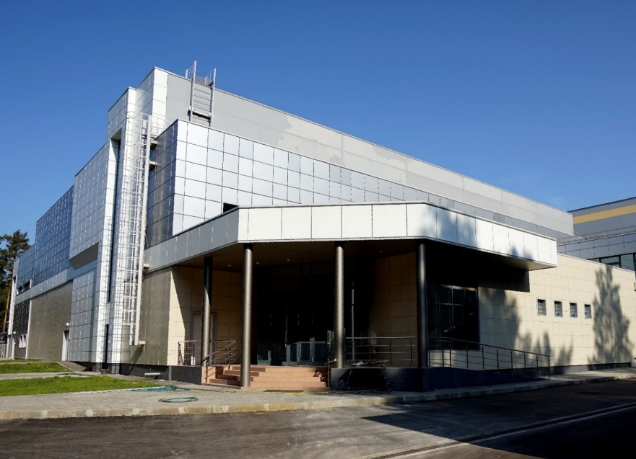
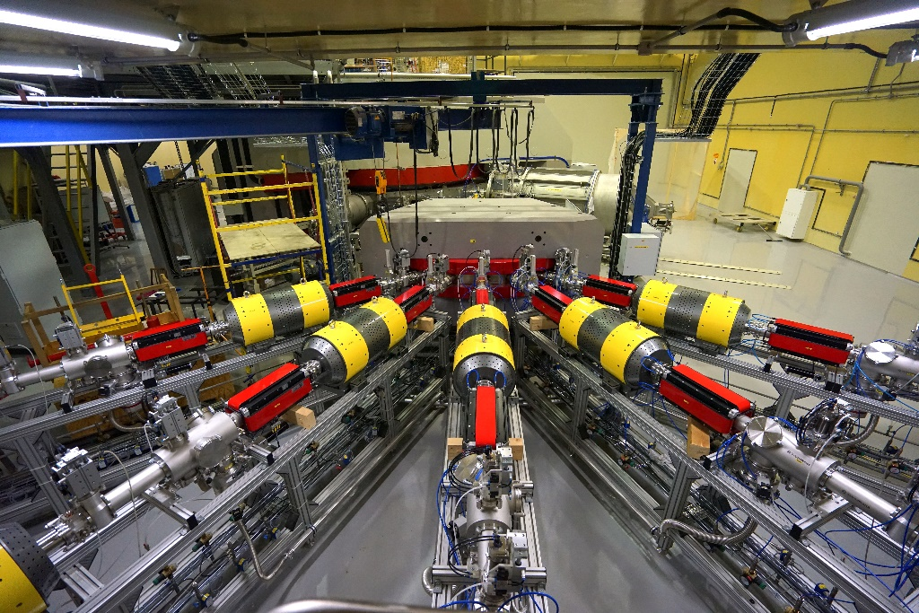
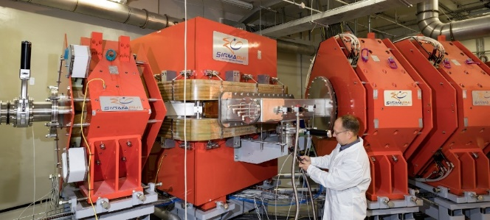
Commissioning of the Superheavy Elements Factory
DC-280 cyclotron:
(26 December 2018-first test beam)
SHE Factory building
Gas-Filled Recoil Separator
Notes:
Завершается создание Фабрики сверхтяжёлых элементов (СТЭ) на базе циклотрона ДЦ-280. Строительные работы по зданию Фабрики СТЭ окончены. Получено заключение Ростехнадзора о соответствии построенного объекта требованиям технических регламентов. Проведены комплексные пусконаладочные работы на циклотроне ДЦ-280. 26 декабря 2018 года получен первый пучок ускоренных тяжелых ионов. В первом квартале 2019 года планируется продолжить работы на ДЦ-280 по получению пучков тяжелых ионов проектных параметров.
Первой экспериментальной установкой Фабрики СТЭ является новый газонаполненный сепаратор ГНС-2. Сепаратор спроектирован в ЛЯР и произведен фирмой SIGMAPHI (Франция). В течение 2018 г. выполнен монтаж основных узлов сепаратора. В первом квартале 2019 года планируется продолжить пусконаладочные работы на сепараторе ГНС-2. Это позволит во втором квартале 2019 года приступить к реализации экспериментальной программы на Фабрике СТЭ. Первым экспериментом будет синтез изотопов московия в реакции ⁴⁸Ca+²⁴³Am.
Следующим экспериментом на Фабрике СТЭ станет синтез элемента 120 в реакции ⁵⁰Ti+²⁴⁹⁻²⁵¹Cf. Подготовка и проведение этого эксперимента является важнейшей задачей ЛЯР на вторую половину 2019 года.

Slide 35
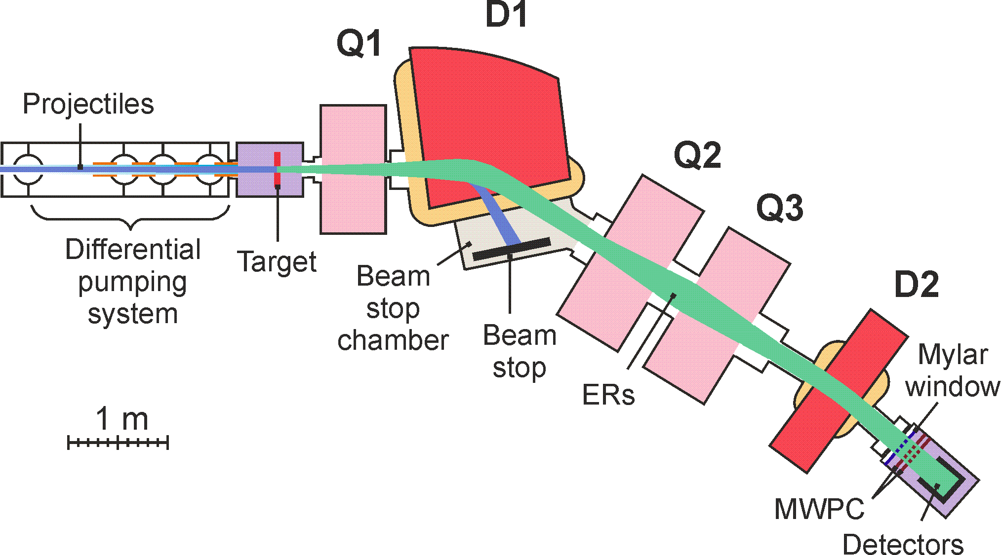
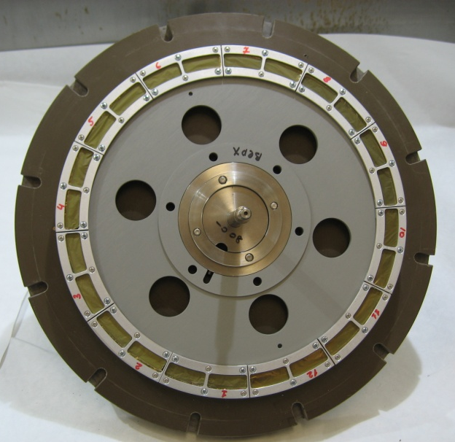
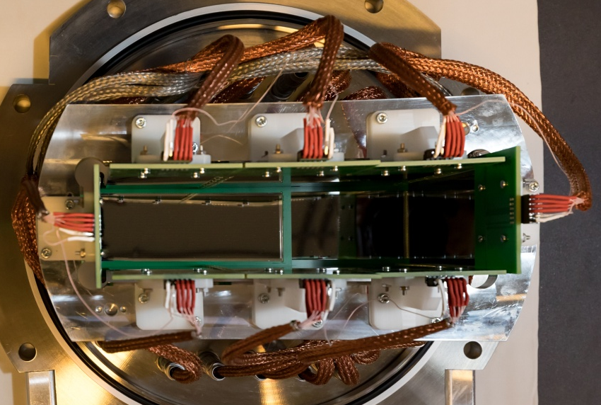
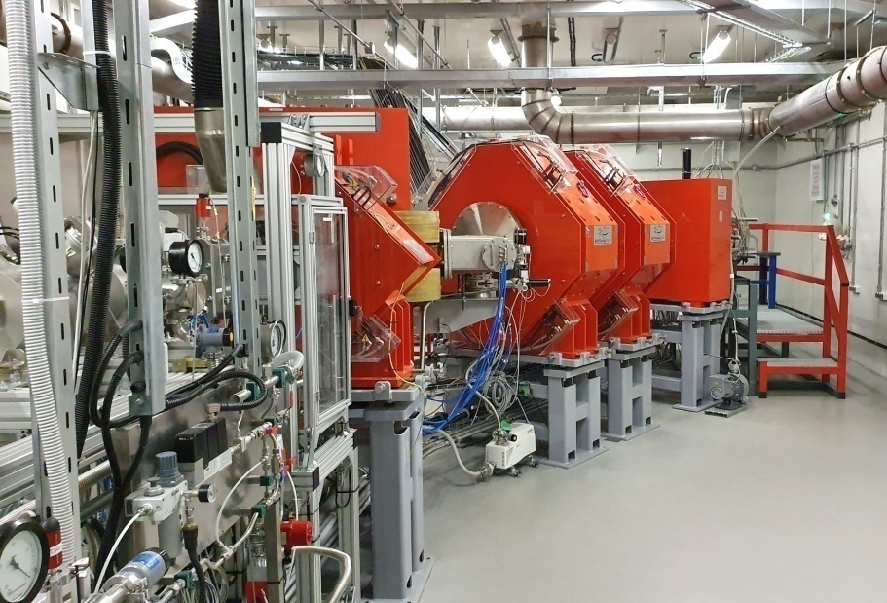
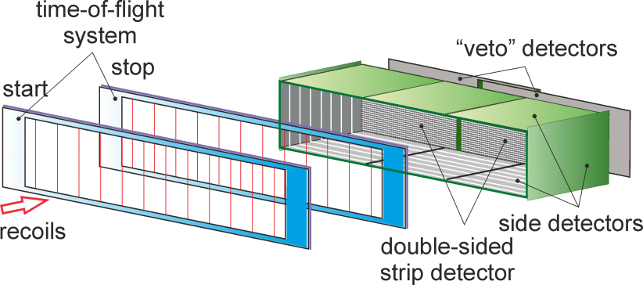
Газонаполненный сепаратор DGFRS-2
²⁴²Pu 24-cm target wheel , 12 sectors
Rotating target, magnets (Q1, D1, Q2, Q3, D2), beam-stop chamber, and detector chamber are shown.
48×220 DSSD & 60×120 SSSD
Digital and analog
electronics

Slide 36
Transmission:
From ²⁰⁶Pb(⁴⁸Ca,2n)²⁵²No test reaction: 55±7%
Cross section
From ²⁴³Am(⁴⁸Ca,2-3n)^{288,289}Mc reaction:
Comparison of results at the same ⁴⁸Ca energy
 | DGFRS | DGFRS-2
Target thickness, mg/cm² | 0.37 | 0.43
Beam dose, 10¹⁸ | 3.3 | 3.4
No decay chains | ²⁸⁸Mc – 6 ²⁸⁹Mc – 0 | ²⁸⁸Mc – 13 ²⁸⁹Mc – 2
Yield | 1 | 1.8-2.1

Slide 37
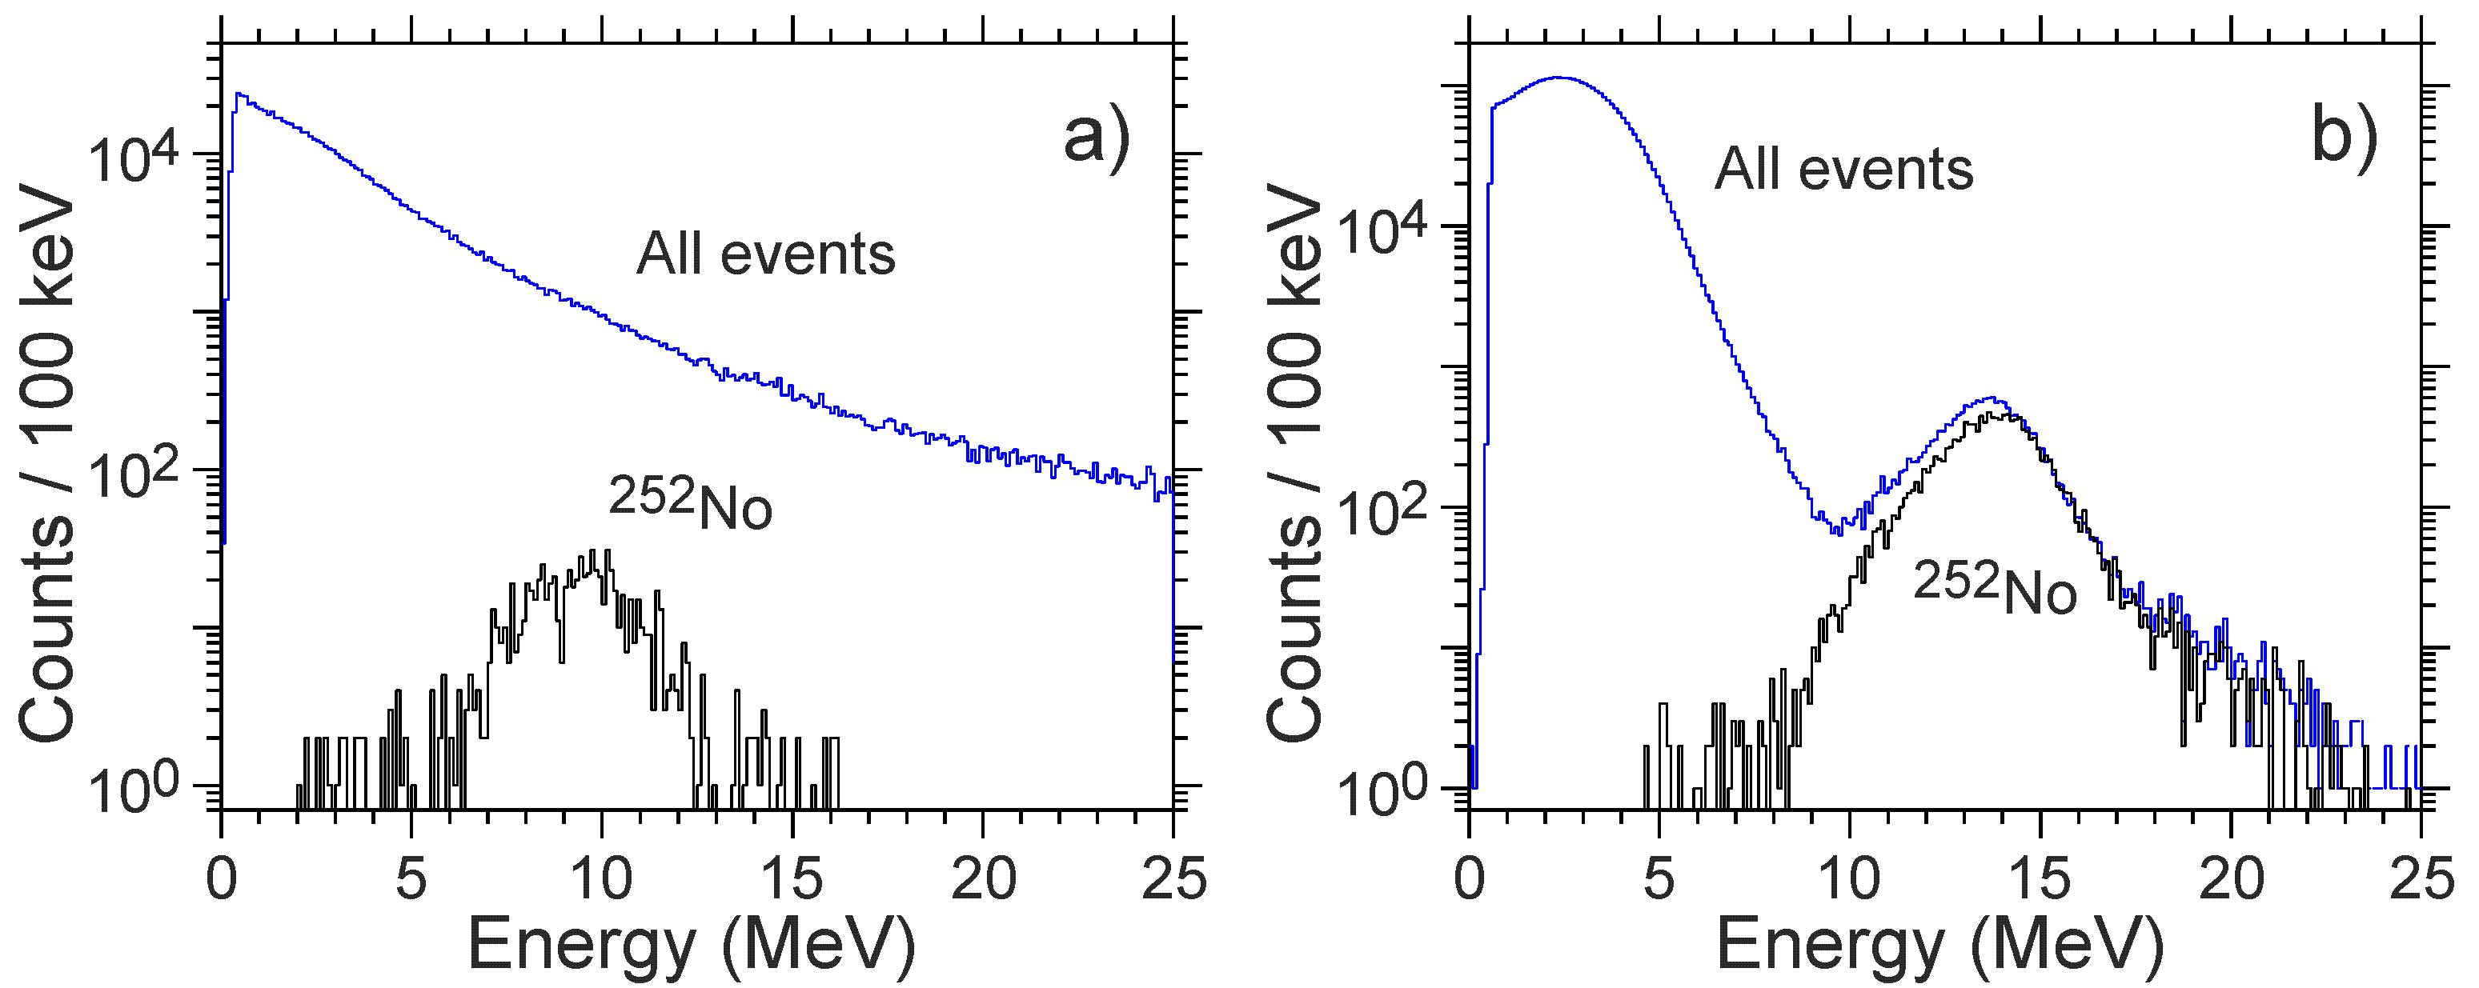
Test reaction:
²⁰⁶Pb+⁴⁸Ca →²⁵²No
Cross section 0.5 μb
Increase of suppression of background nuclei
by more than factor of 200
Energy spectra of all the particles registered by MWPC (top blue line) and
of ²⁵²No (bottom black line) nuclei produced in the ²⁰⁶Pb(⁴⁸Ca,2n) reaction
using separators DGFRS (a) and DGFRS-2 (b).

Slide 38
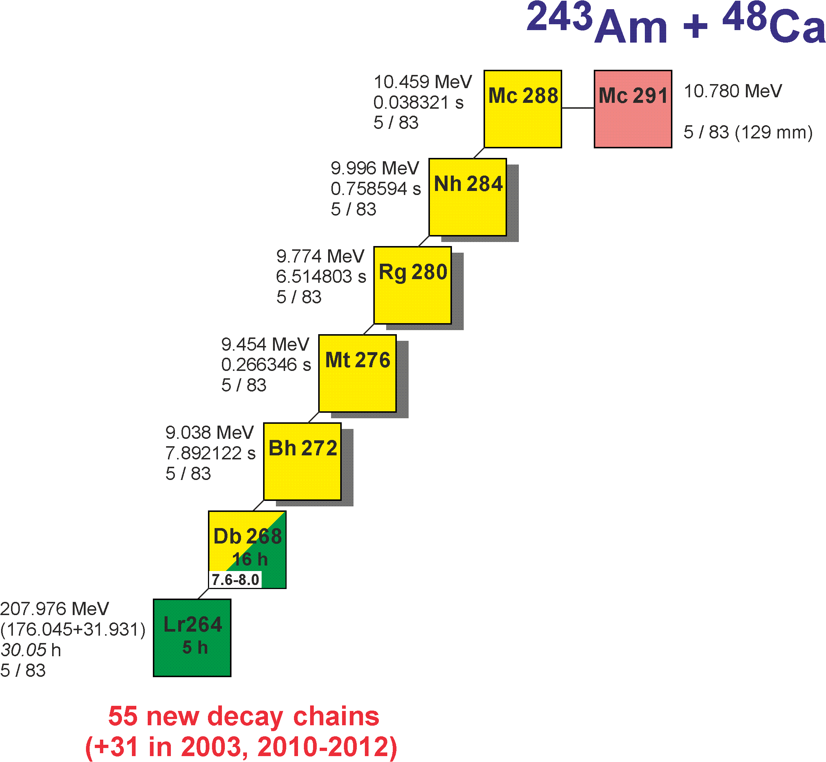
Results of the first experiment
Excitation function for the 3n-evaporation channel
- Two decay times of ²⁷⁶Mt
- Level of cross section for the pxn channel
- Level of EC branch for ²⁸⁸Mc and ²⁸⁴Nh
- α decay of ²⁶⁸Db !
- Cross section

Slide 39
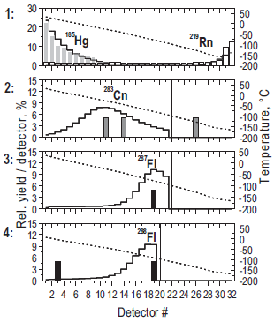
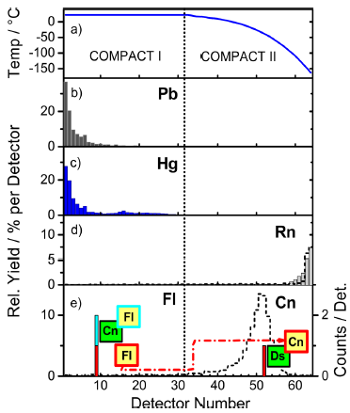
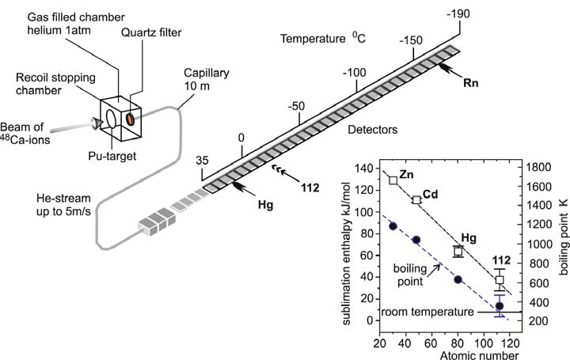
First experiments at SHE Factory
²⁴²Pu + ⁴⁸Ca - chemical properties of Cn and Fl
Is flerovium a metal or a noble-gas-like?
DGFRS-2(3) – pre-separator before a chemical setup
²⁴²Pu+⁴⁸Ca - for synthesis of Cn and Fl
Essentially larger statistical level.
From the distributions of atoms over the detectors:
1. Adsorption properties of Cn and Fl
2. Thermodynamic characteristics of Cn and Fl
compared with their light homologues Hg and Pb
3. Experimental determination of the influence of
relativistic effects on the chemical properties of the
heaviest elements.
4. Degree of compliance of the chemical behavior
of the SHE with the law of periodicity of properties
R. Eichler et al.,
Radiochim. Acta 98, 133 (2010)
A. Yakushev et al.,
Inorg. Chem. 53, 1624 (2014)

Slide 40
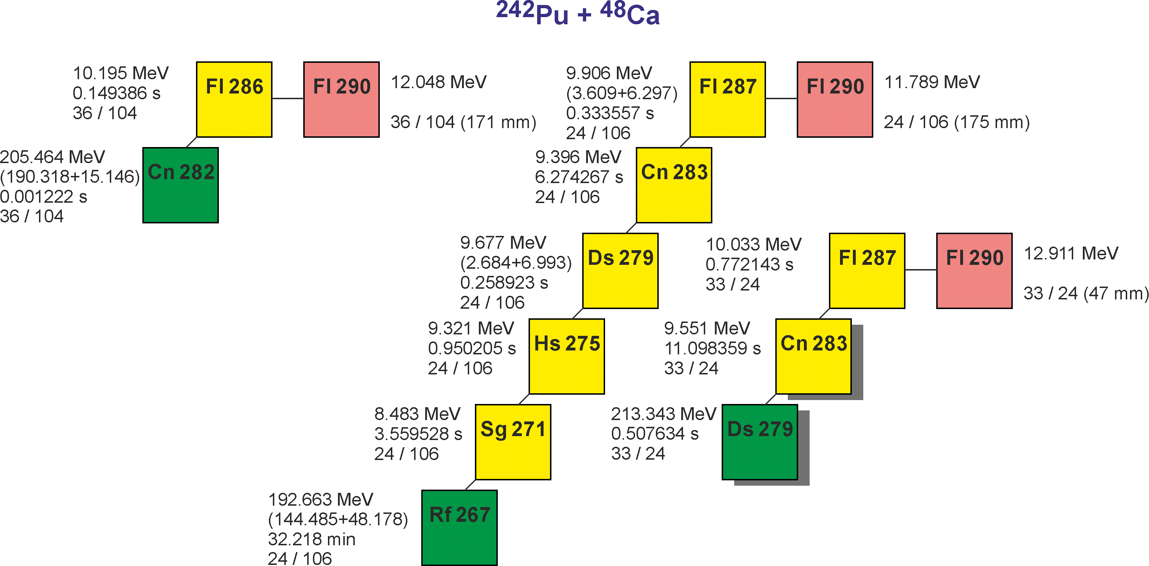
Results of the first experiment ²⁴²Pu+⁴⁸Ca
27
64
9

Slide 41
Synthesis of new elements 119 and 120

Slide 42
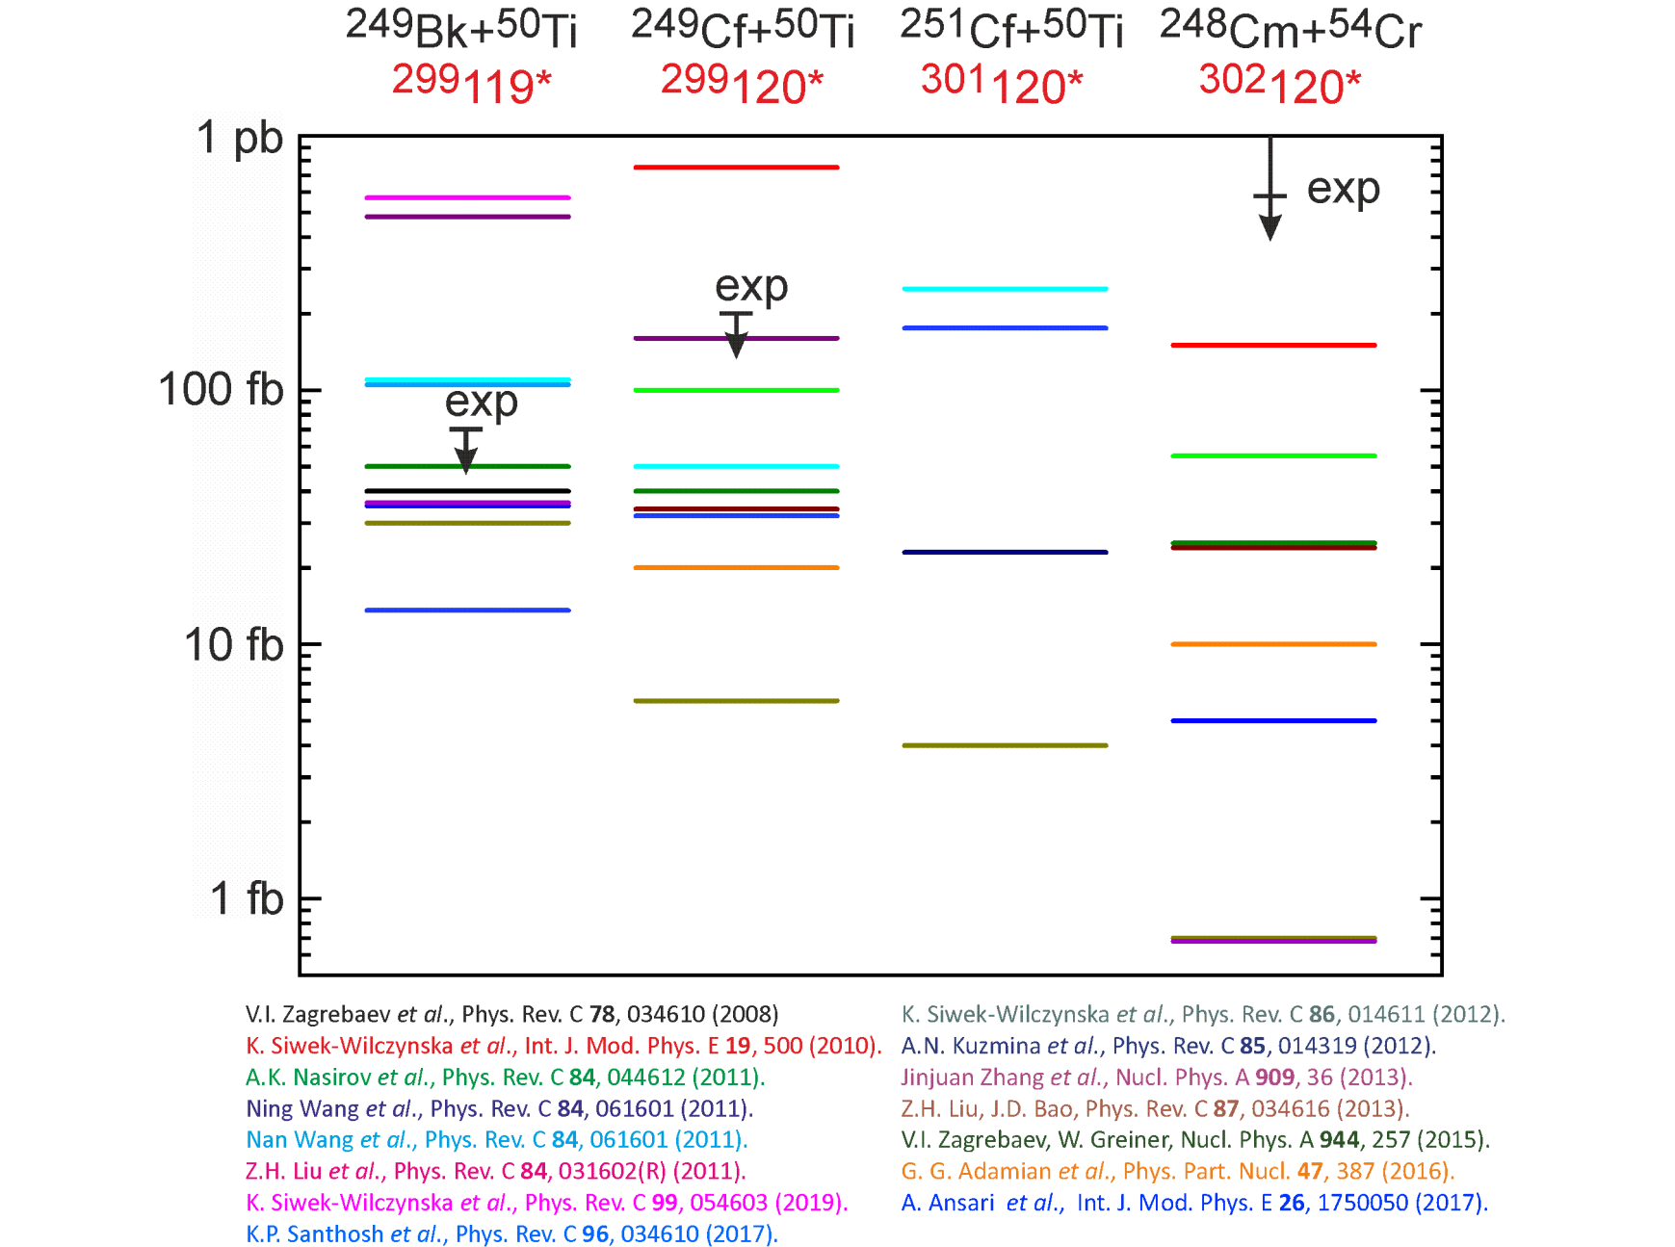
Predicted cross sections for production of isotopes of elements 119 and 120
in the ²⁴⁹Bk+⁵⁰Ti, ²⁴⁹⁻²⁵¹Cf+⁵⁰Ti , ²⁴⁸Cm+⁵⁴Cr reactions
differ by 2-3 orders of magnitude
Test reactions are needed

Slide 45
Fusion Probability
Fusion
Probability
drops down
⁵⁰Ti + ²⁴⁸Cm → ²⁹⁸Og
>10 times
50-100 times

Slide 46
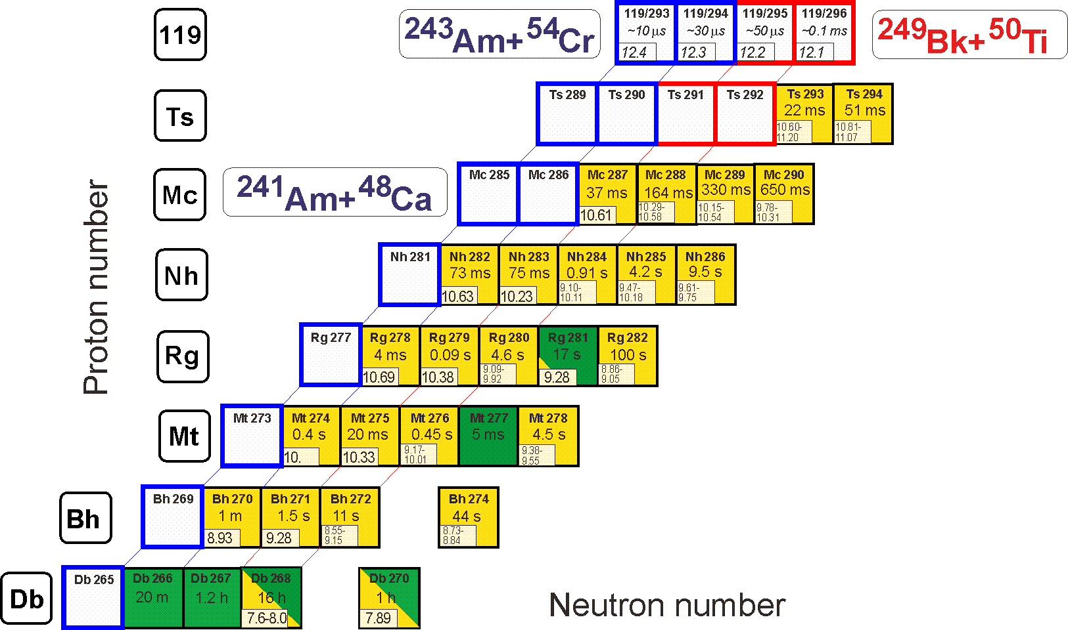
Synthesis of Element 119: ²⁴³Am+⁵⁴Cr (1) ²⁴⁹Bk+⁵⁰Ti (2)
Beam intensity: 1+ 2+/–
Target: 1+ 2+/–
Cross section: 1– 2+
Identification: 1+ 2+
²⁴¹Am+⁴⁸Ca
σ=0.05 pb, h_{t}=0.4 mg/cm², ε_{coll}=0.7+, I_{beam}=3 pμA → ≈1 event per month

Slide 47
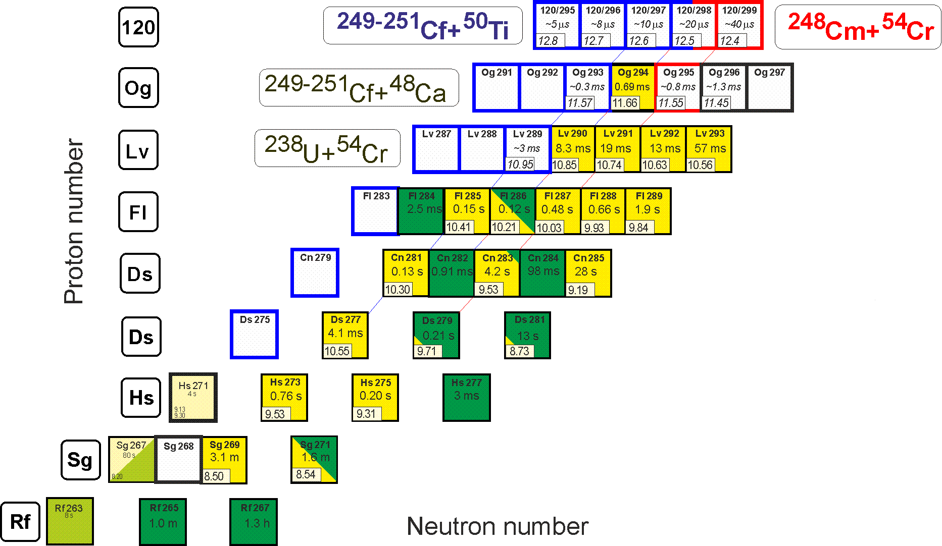
Synthesis of Element 120: ²⁴⁹⁻²⁵¹Cf+⁵⁰Ti (1) ²⁴⁸Cm+⁵⁴Cr (2)
Beam intensity: 1+/- 2+
Target: 1+/- 2+
Cross section: 1+ 2–
Identification: 1+ 2+
²⁵¹Cf+⁴⁸Ca, ²³⁸U+⁵⁴Cr
σ=0.05 pb, h_{t}=0.4 mg/cm², ε_{coll}=0.7+, I_{beam}=3 pμA → ≈1 event per month

Slide 48


Thank You!

