Slide 1
CERN Departments:
Physics (EP)
Theoretical Physics (TH)
Research & Computer Sector (RCS)
Information Technology (IT)
Accelerator Technology Sector (ATS)
Beams Department (BE)
Engineering Department (EN)
Technology Department (TE)
Directorate Services Unit
International Relations (IR)
Procurement and Knowledge Transfer
Human Resources (HR)
Finance & Administrative Processes (FAP)
Pension Fund (PF)
v

Slide 2
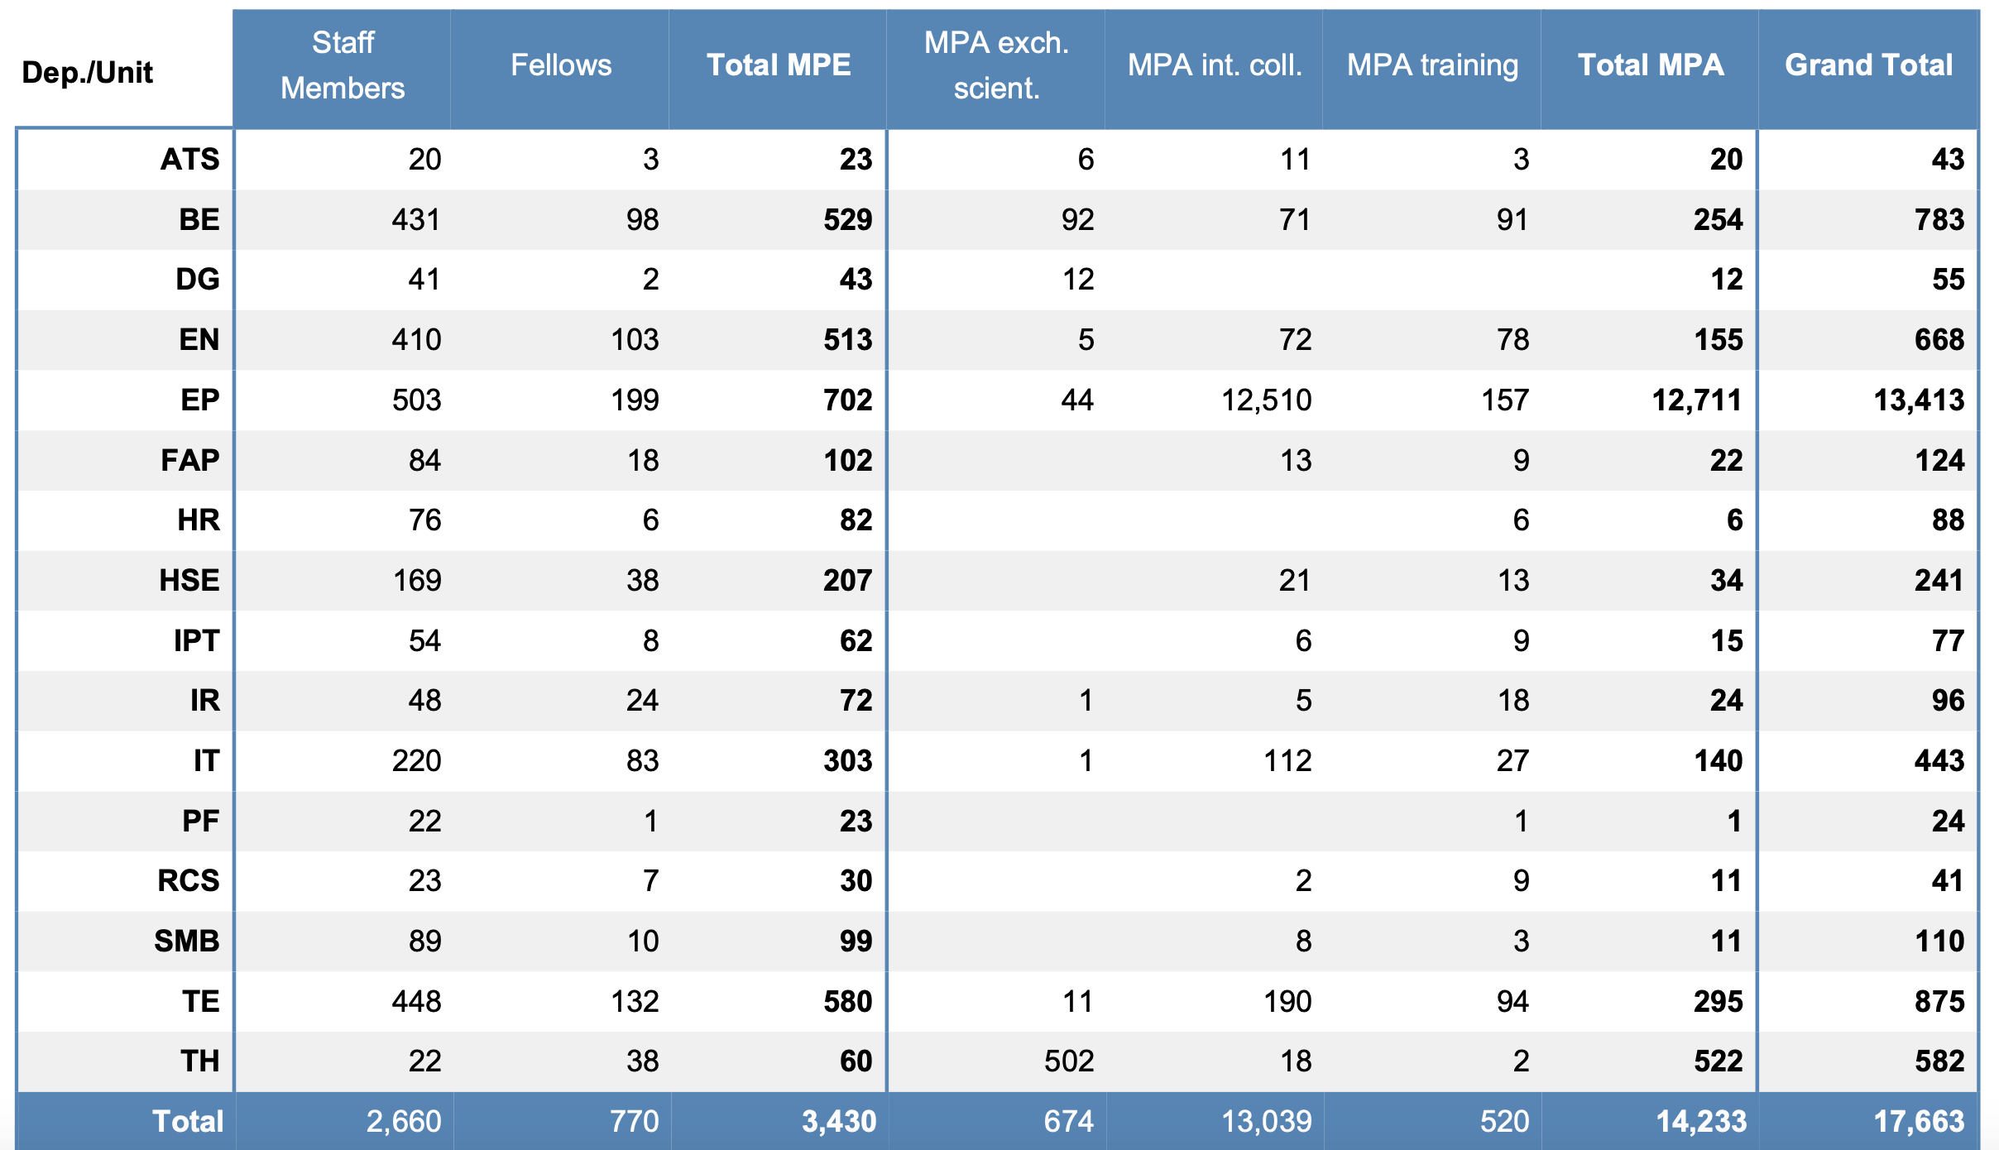

Slide 3
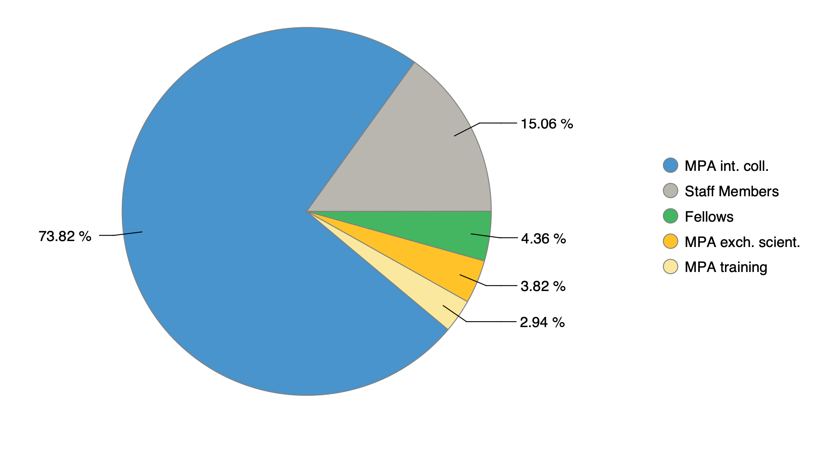

Slide 4
WinCC Open Architecture
universal control system for automatization
SIEMENS core - licenses
Frameworks from CERN - free

