Slide 1
Status of MPD infrastructure focused on cryogenics
V. Benda

Slide 2
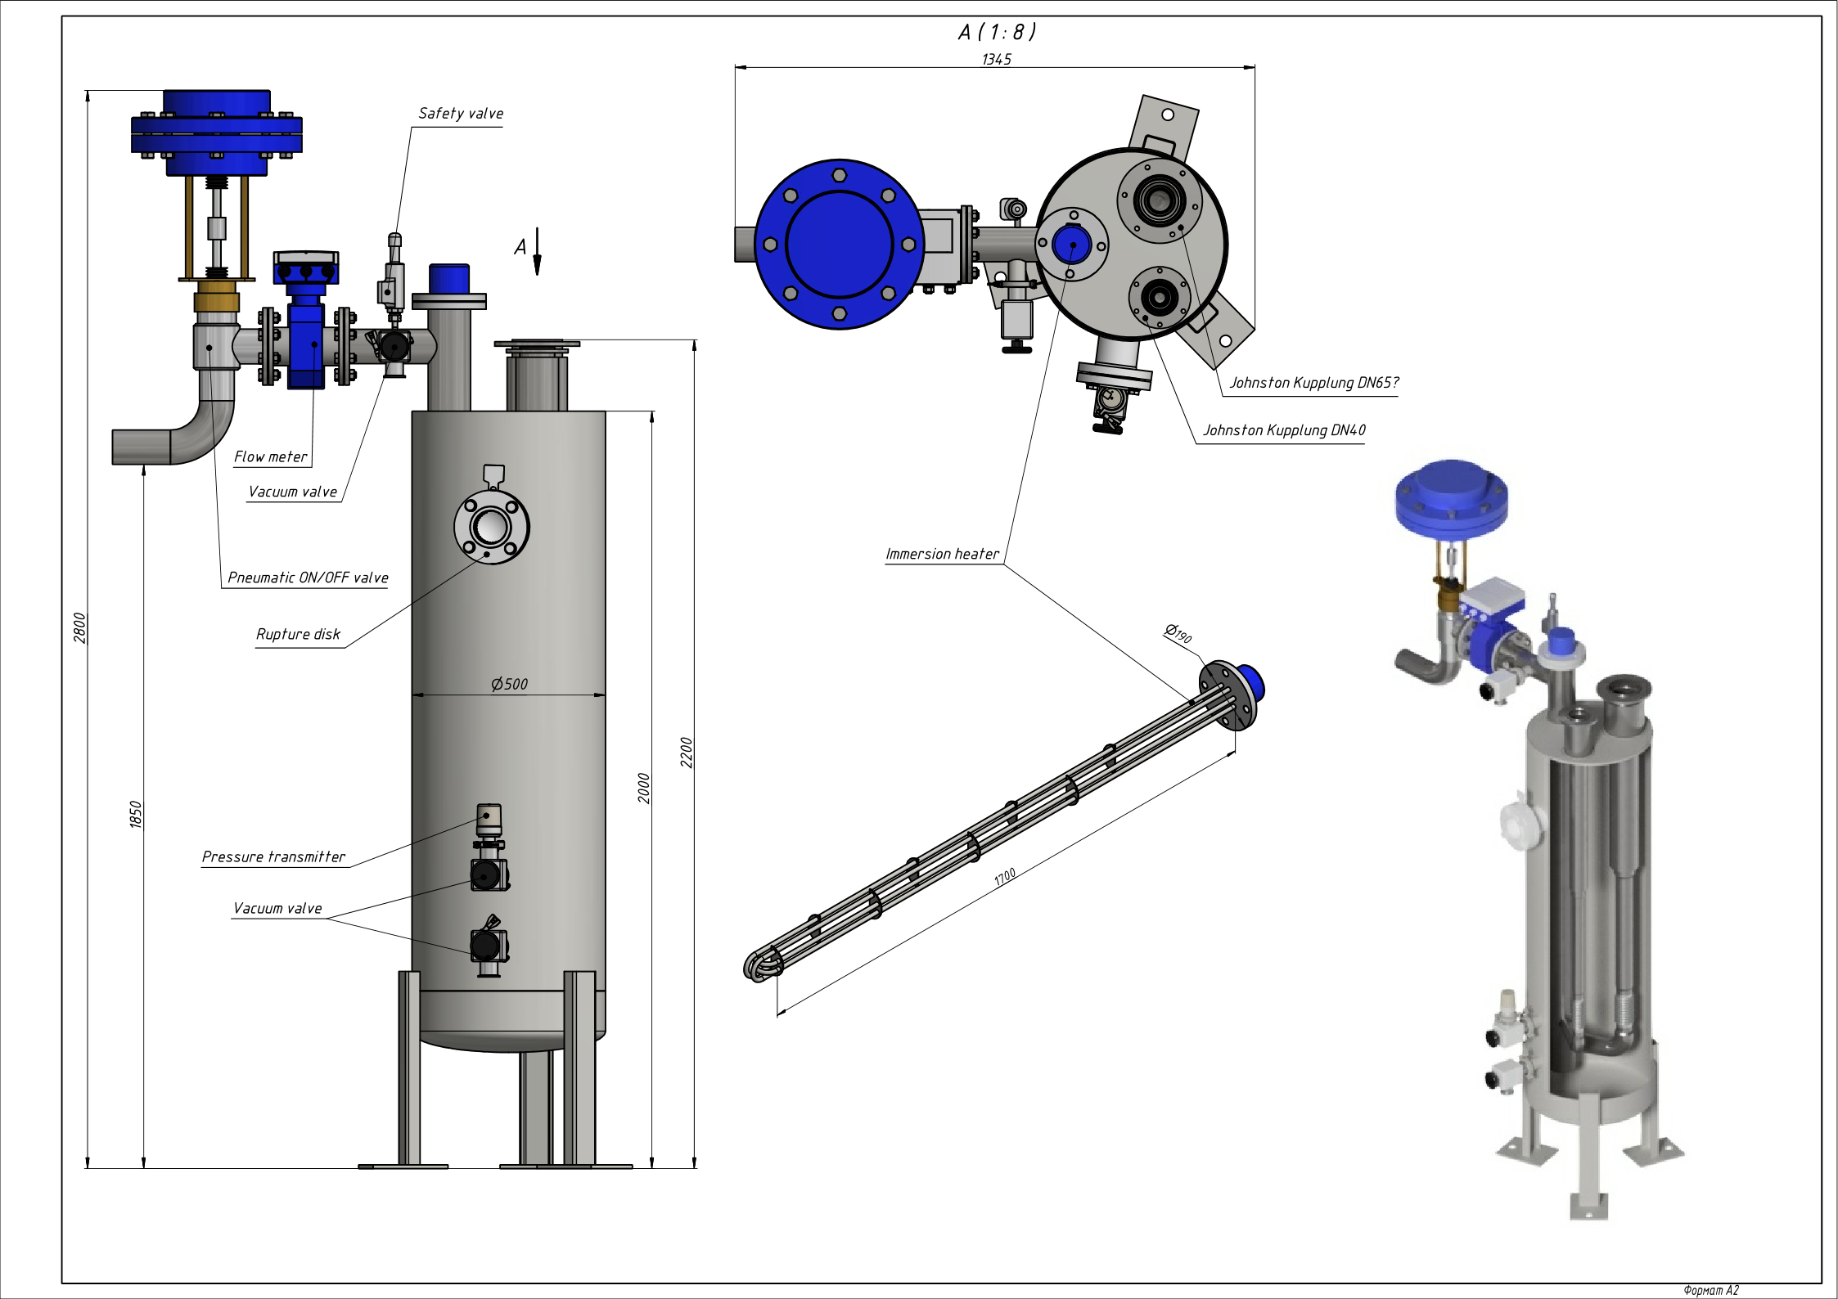
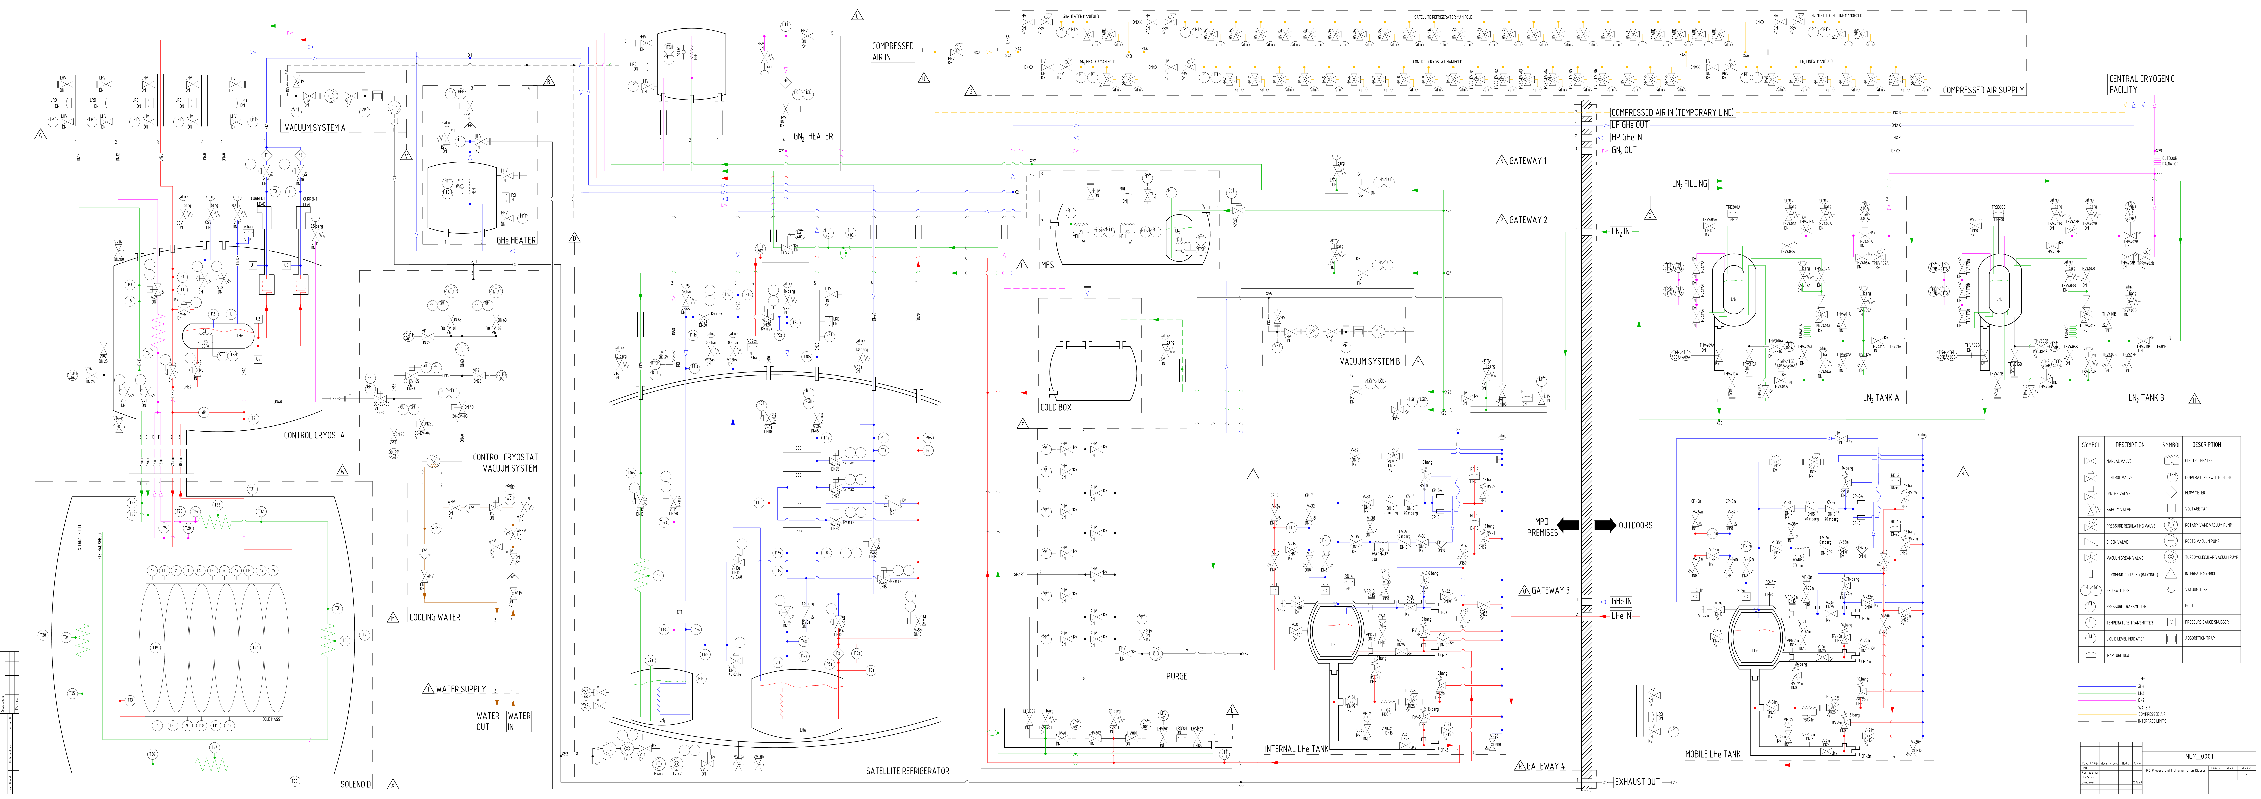


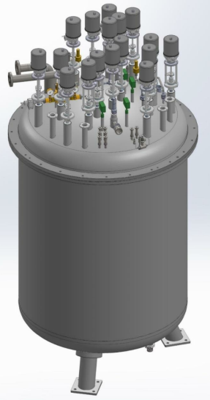
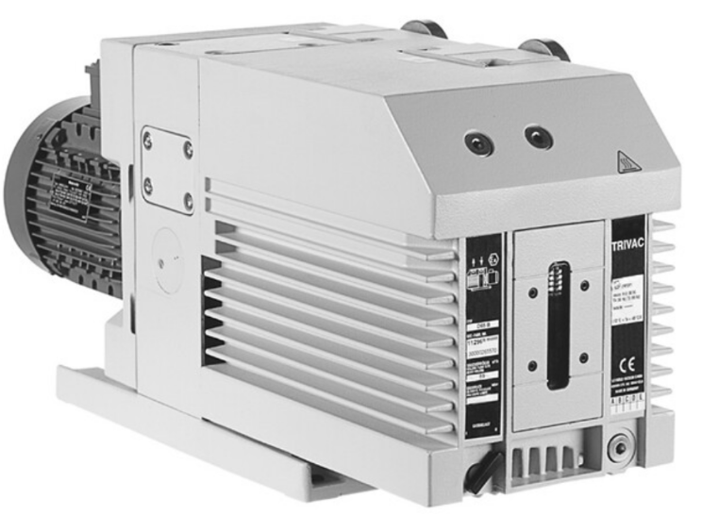
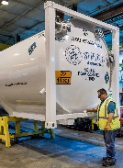
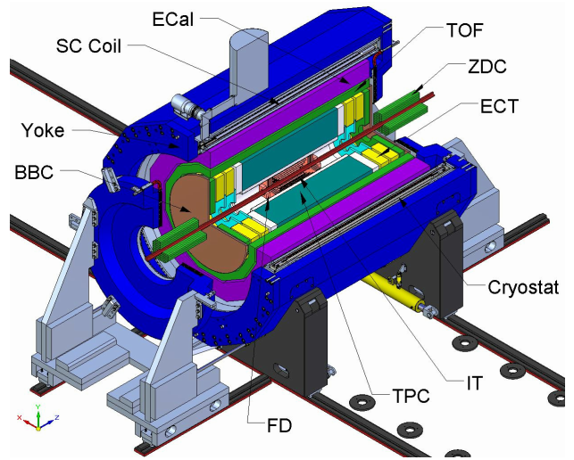
MPD P&I, Process and Instrumentation diagram
Names of interfaces
GN₂ heater
Compressed air for valve actuators
GHe heater
MFS
LN₂ tank
LN₂ tank
Control cryostat
LN₂ line
Refrigerator
Solenoid
Purge pump
LHe line
LHe tank
LHe tank
Final infrastructure for cool down to 4.5 K by LHe

Slide 3
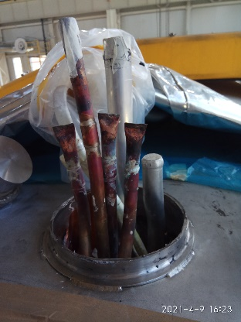
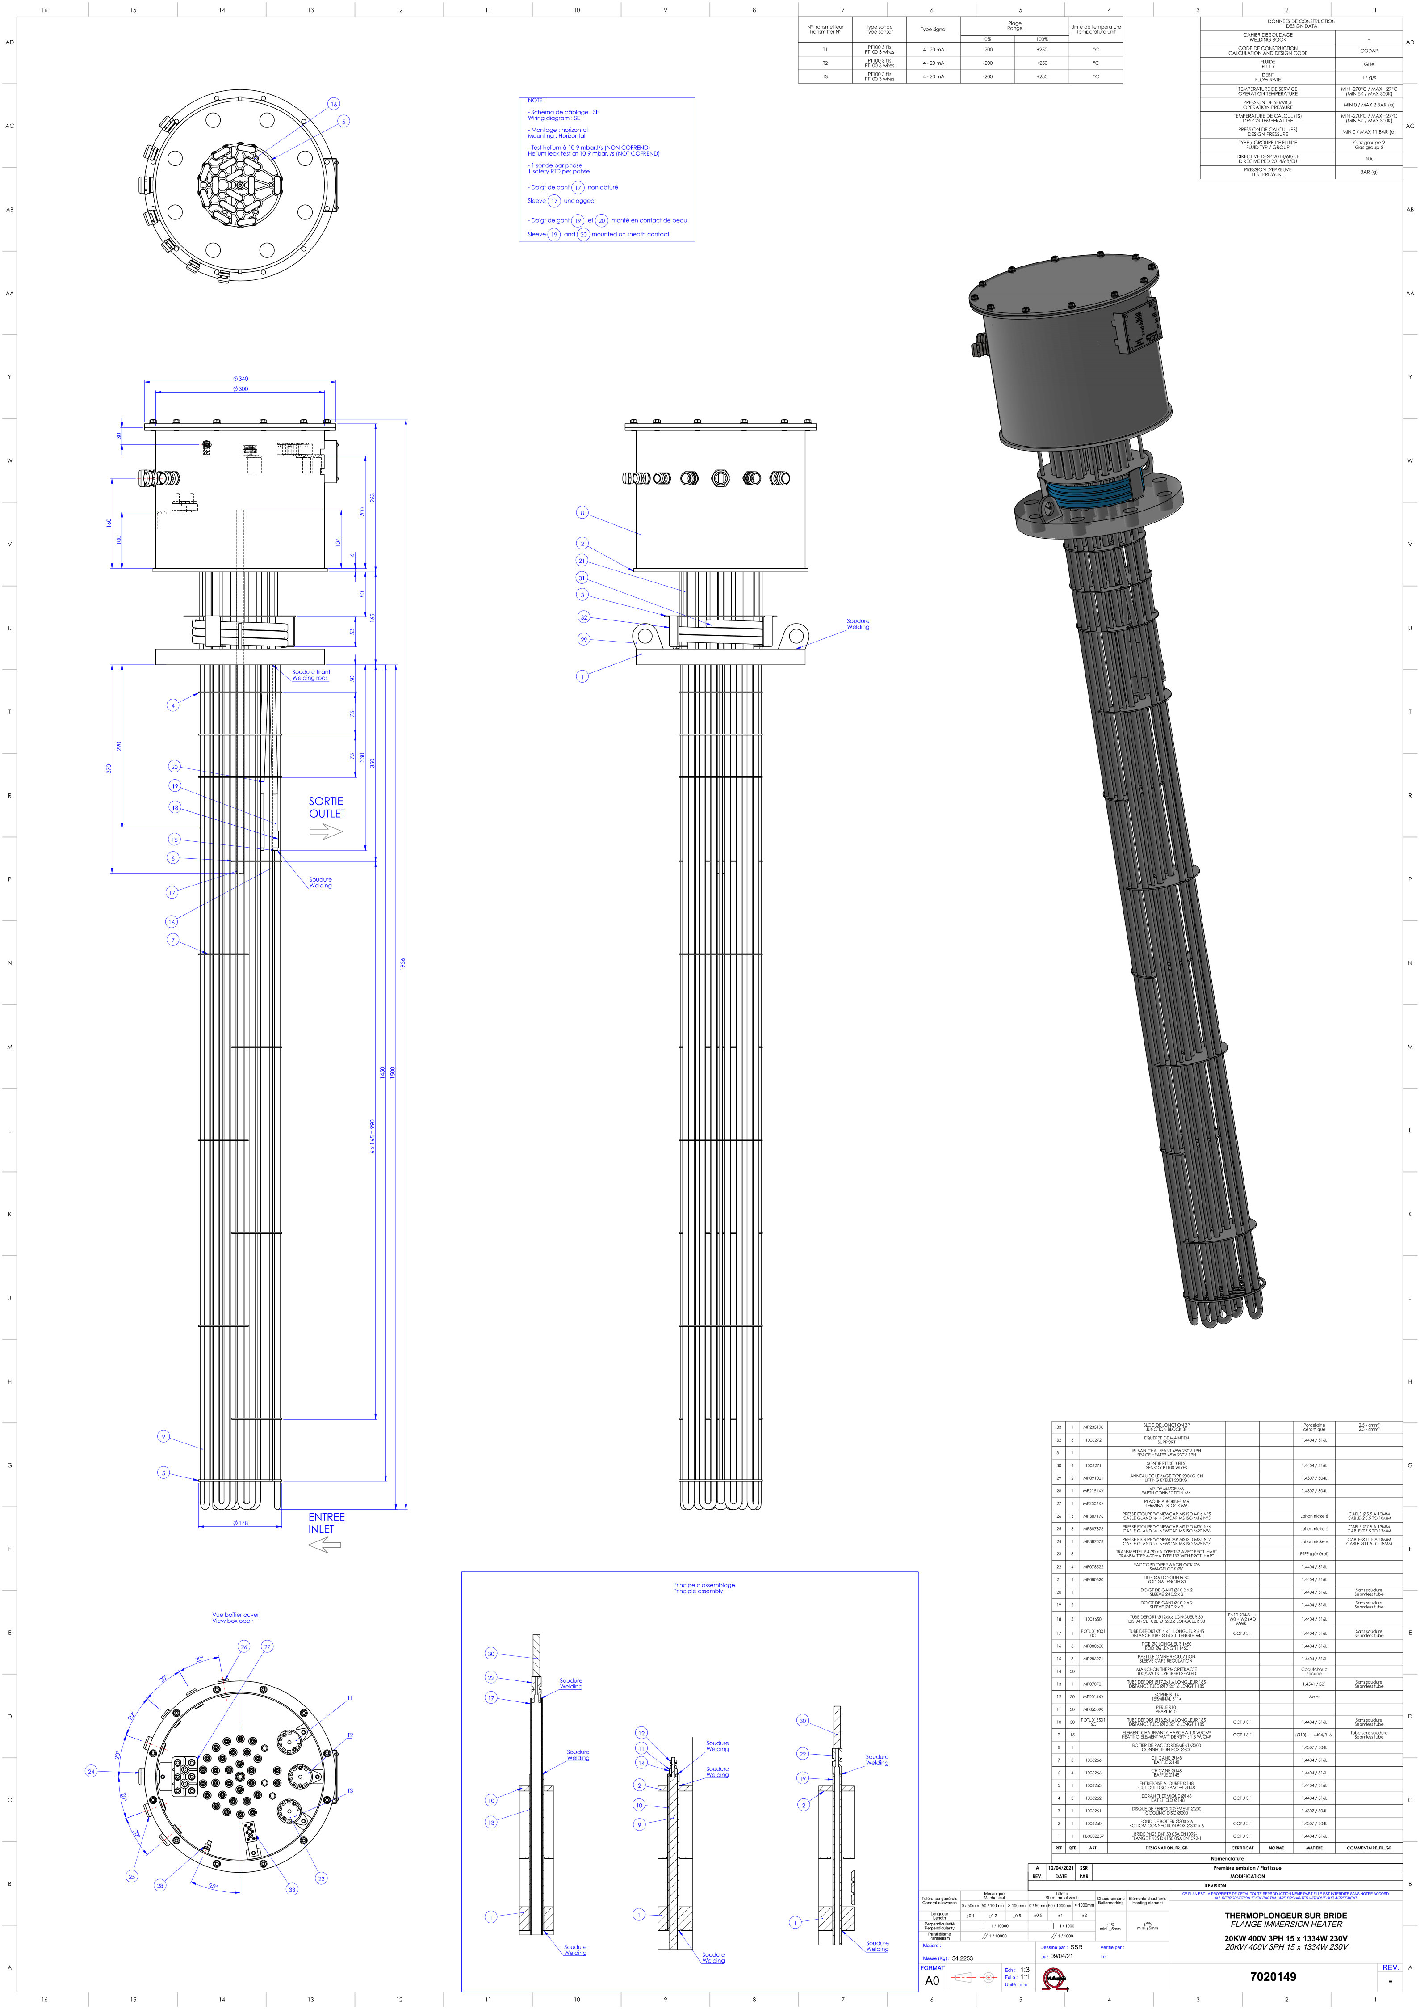
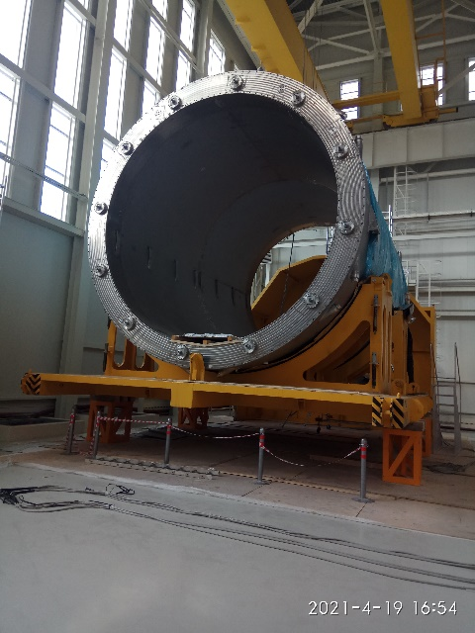
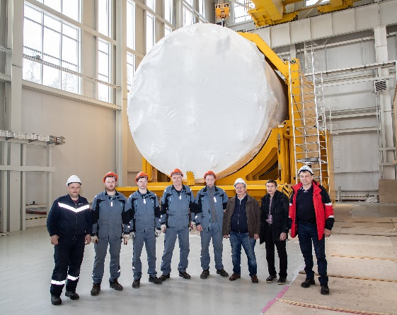
MPD – Infrastructure and their key components
LN₂ tanks (2): Chart-Ferox started production on April 2021. Required: foundation, including the road, roof, lighting etc.
LHe line: A.S.Scientific UK will start the production on April 2021
MFS arrived from CERN to JINR b. 203A on 19 March
  In process of restoration: test, ordering of missing elements, control system
GHe & GN₂ heater: Heating cartridge-waiting for final quotation. Technical Specification for the envelop in progress
LHe tanks (2) to be borrow from Gelimash. Required: foundation, roof, lighting etc.
Vacuum pump: Technical Specification in progress
Lines: see the next slide
ILK (D) – Refrigerator and Control cryostat future collaboration
  Spare parts
  Assembly of the Satellite refrigerator & modification
  Dummy in negotiation
  Control system (PLC automat) - discussion
ASG (It) – Solenoid. ASG experts arrived on Monday 19 April for 3 days
  Opening of the MPD magnet transport box – done.
  Visual and electrical test – done
  Preparation for next visit – pumping & leak test
MPD Control system (PLC)
  P&I is ready
  List of instrumentation and nomenclatures is in process, see next slides
  Function Specification to be done
  Hardware to be defined and ordered. Software to be written
Document server – highest priority, in trial operation
Heating cartridge
Chimney of solenoid
2021-3-23
Solenoid

Slide 4
Cold and warm pipes required
Interfaces are defined in P&I diagram

Slide 5
List of Instrumentation, example from other project as illustration & MPD draft
№ п.п. | Обозначение на схеме | Наименование | Принадлежность | Среда | Параметры |  |  |  |  |  |  |  | Описание |  | Сигнал | Подрядчик
 |  |  |  |  | Температура, К
 |  |  |  |  | Рабочая температура, К | min | max | РN, bar | Давление на входе, bar | Давление на выходе, bar | DN | Kv | ТИП ПРИВОДА | Тип
48 | V-2 | on/off valve | CONTROL CRYOSTAT | N2 L/G (GN2) |  | 77,15 | 313,15 | 25 |  |  | 15 |  | Пневматический мембранный привод (vonRohr) | МА16А6-162mm | PROFIBUS PA | weka
49 | V-3 | control valve | CONTROL CRYOSTAT | N2 L/G (GN2) |  | 77,15 | 313,15 | 25 |  |  | 8 |  | Пневматический мембранный привод (vonRohr) | МА16А6-162mm | PROFIBUS PA | weka
50 | V-4 | control valve | CONTROL CRYOSTAT | Helium L/G GN2 |  | 4,15 | 313,15 | 25 |  |  | 25 |  | Пневматический мембранный привод (vonRohr) | МА16А6-162mm |  | weka
51 | V-5 | control valve | CONTROL CRYOSTAT | Helium L/G GN2 |  | 4,15 | 313,15 | 25 |  |  | 10 |  | Пневматический мембранный привод (vonRohr) | МА16А6-162mm | PROFIBUS PA | weka
52 | V-6 | control valve | CONTROL CRYOSTAT | Helium L/G GN2 |  | 4,15 | 313,15 | 25 |  |  | 10 |  | Пневматический мембранный привод (vonRohr) | МА16А6-162mm | PROFIBUS PA | weka
53 | V-7 | control valve | CONTROL CRYOSTAT | Helium L/G GN2 |  | 4,15 | 313,15 | 25 |  |  | 20 |  | Пневматический мембранный привод (vonRohr) | МА16А6-162mm | PROFIBUS PA | weka
54 | V-8 | control valve | CONTROL CRYOSTAT | Helium L/G GN2 |  | 4,15 | 313,15 | 25 |  |  | 40 |  | Пневматический мембранный привод (vonRohr) | МА16А6-162mm | PROFIBUS PA | weka
55 | V-9 | control valve | CONTROL CRYOSTAT | Helium L/G (GN2) |  | 300 | 313,15 | 25 |  |  | 6 |  | Пневматический мембранный привод (vonRohr) | МА16А6-162mm | PROFIBUS PA | weka
56 | V-10 | control valve | CONTROL CRYOSTAT | Helium L/G (GN2) |  | 300 | 313,15 | 25 |  |  | 6 |  | Пневматический мембранный привод (vonRohr) | МА16А6-162mm | PROFIBUS PA | weka
57 | V-11 | safety valve | CONTROL CRYOSTAT | GN2 |  |  |  | 2,5
58 | V-14 | vacuum break valve | CONTROL CRYOSTAT | GN2 |  |  |  |  |  |  | 200
59 | V-16 | safety valve | CONTROL CRYOSTAT | GN2 |  |  |  | 0,6
Draft of MPD List of Instrumentation

Slide 6
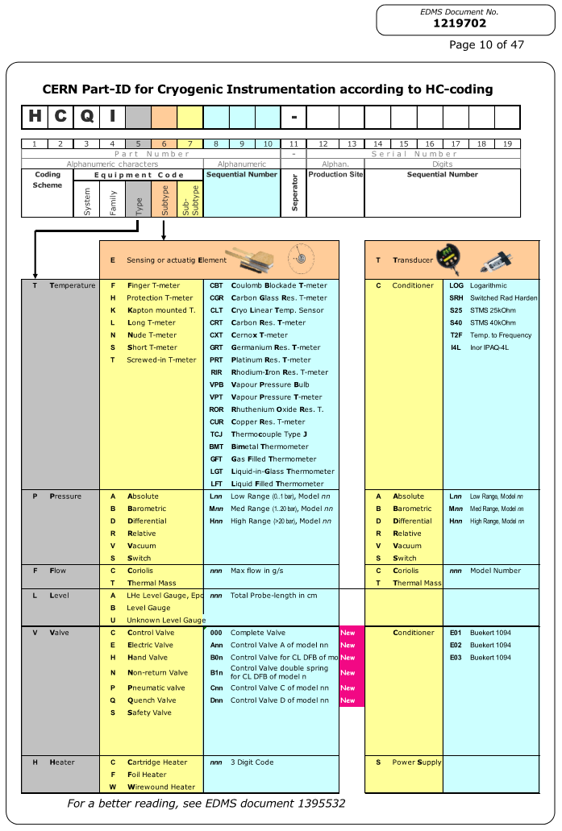
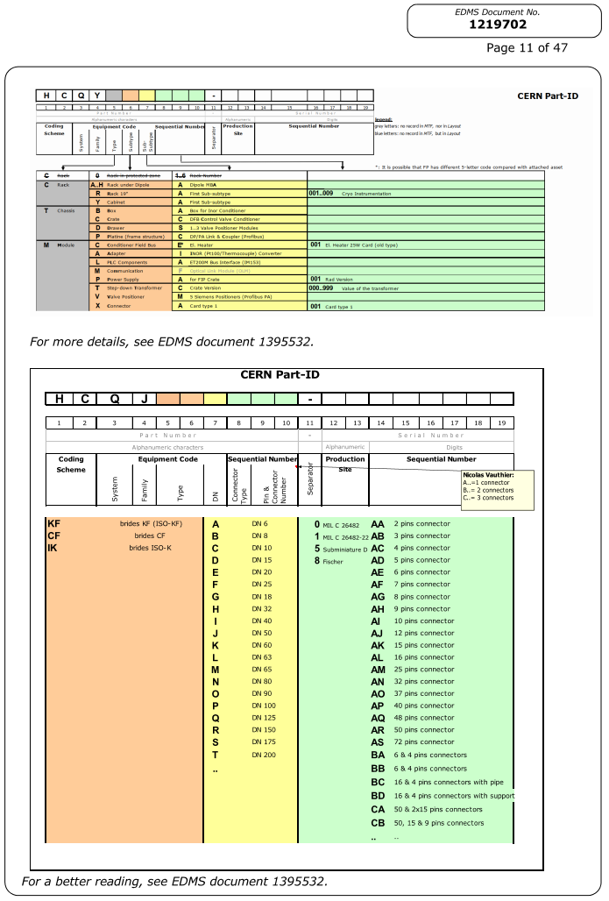
Sensor naming - Nomenclature to be done sample from CERN system…

Slide 7
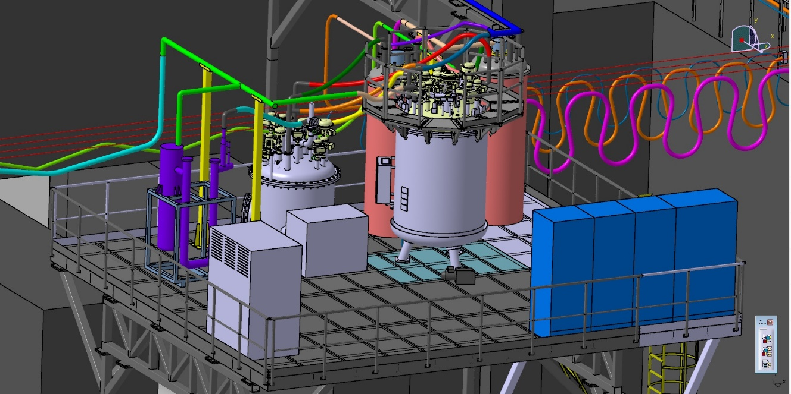
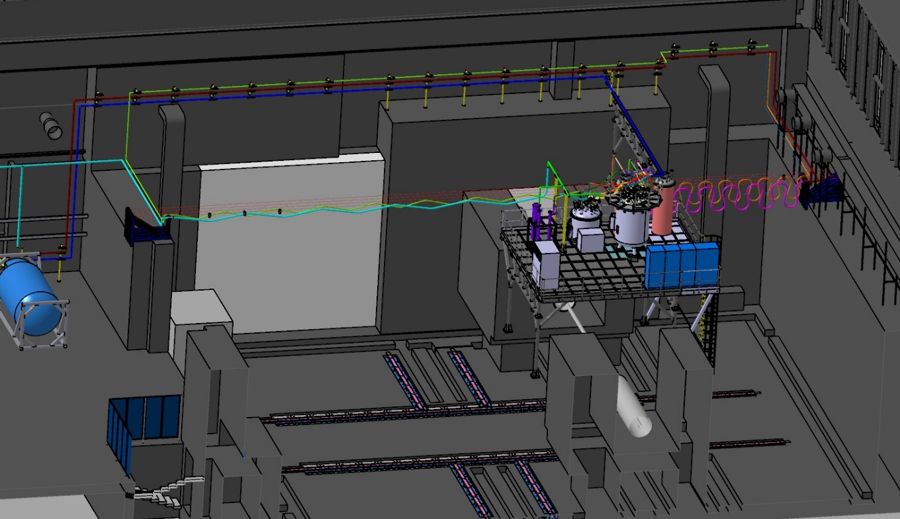
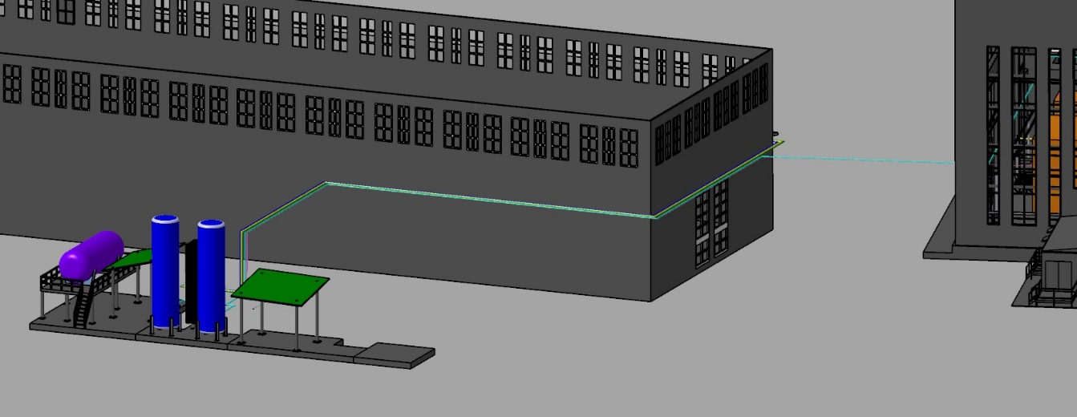
Layout

Slide 8
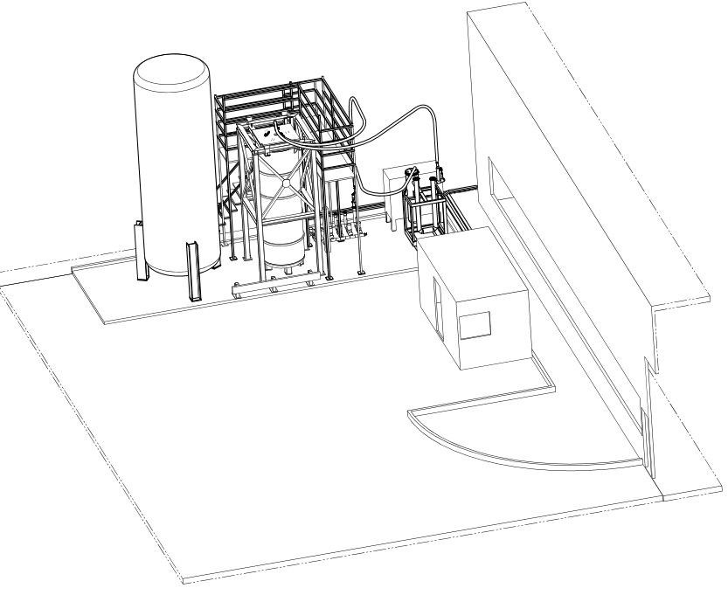
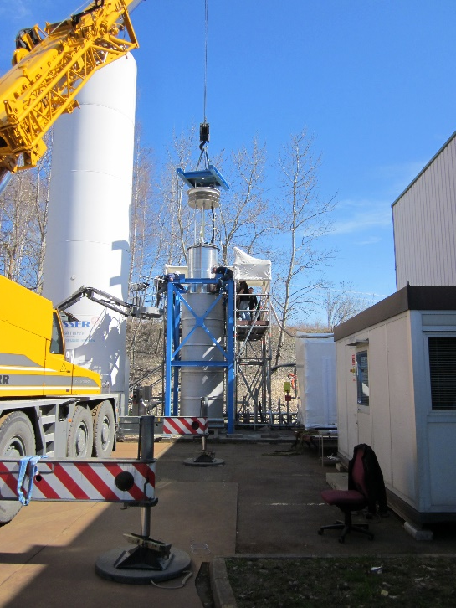
MPD magnet cool-down to 80K by LN₂
  To increase the speed of work on the MPD project, cooling to 80 K is being prepared
  At 80K, most of the possible problems will appear
    Cold leak and electrical short circuit coil to ground
  This cooling will demonstrate the progress of the project
  In the event of the magnet malfunction, there will be enough time to repair it
  For this purpose, the MFS (Magnet Flushing Station), which was used at CERN for a similar task was brought and it is under preparation
Slow magnet cool-down at CERN
LN₂ storage container
Test cryostat
MFS
PLC control system

Slide 9
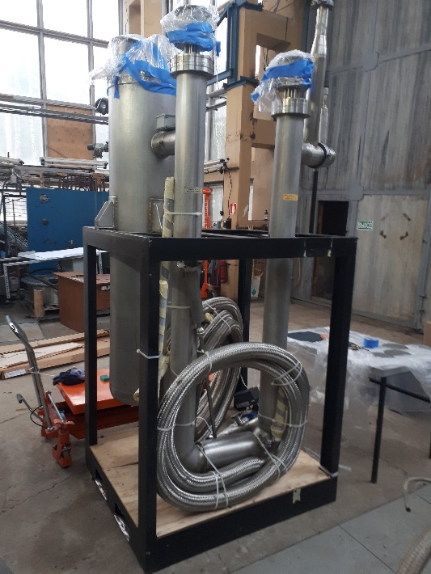
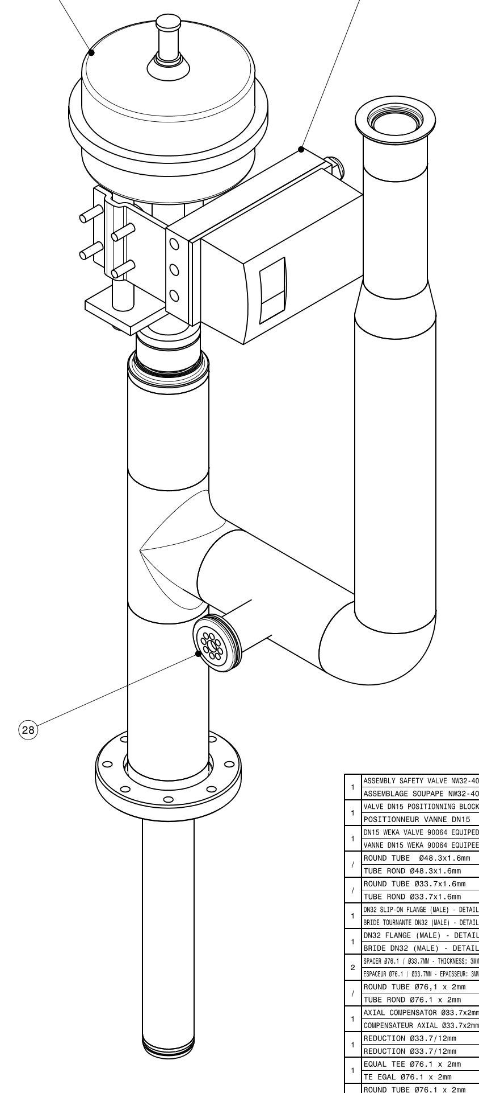
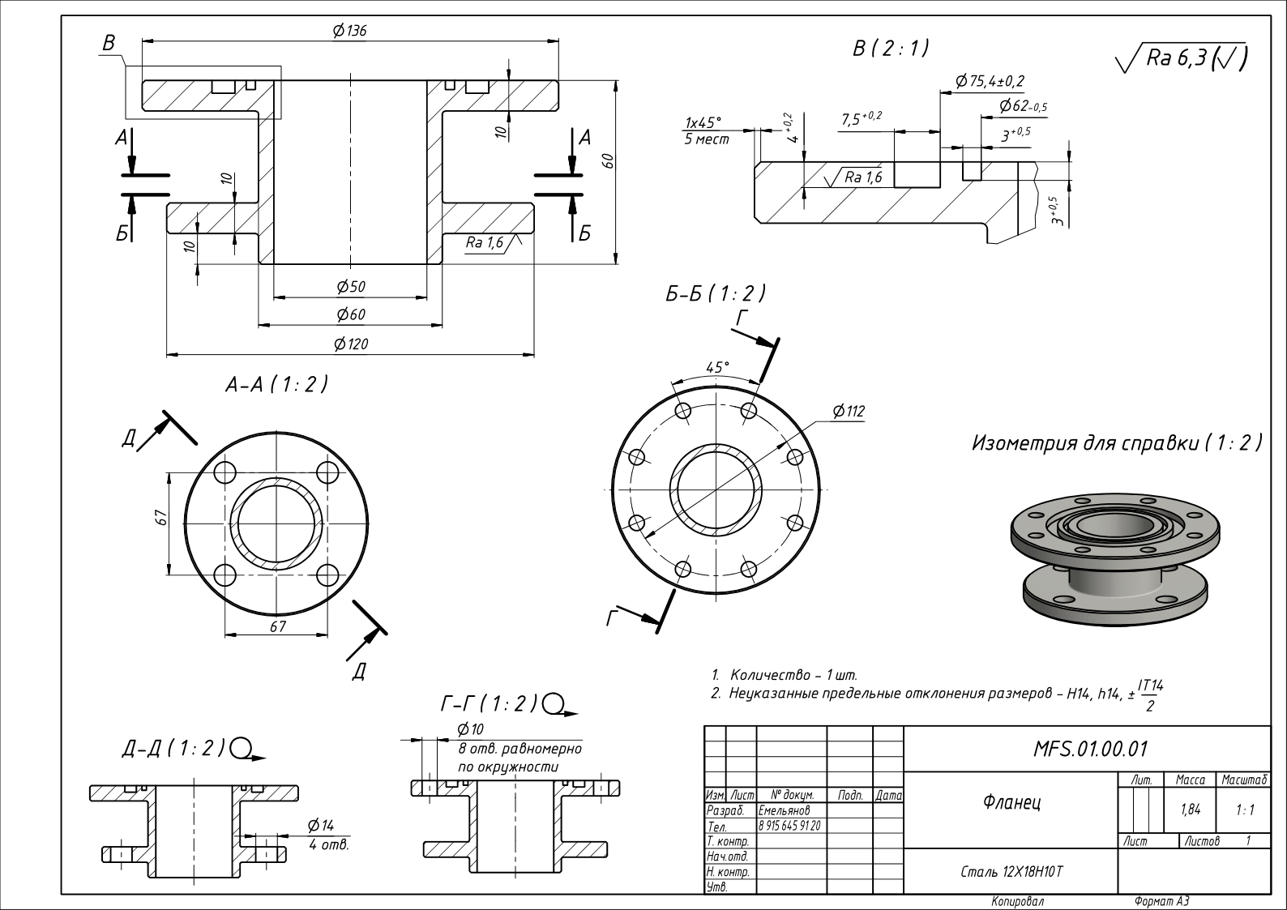
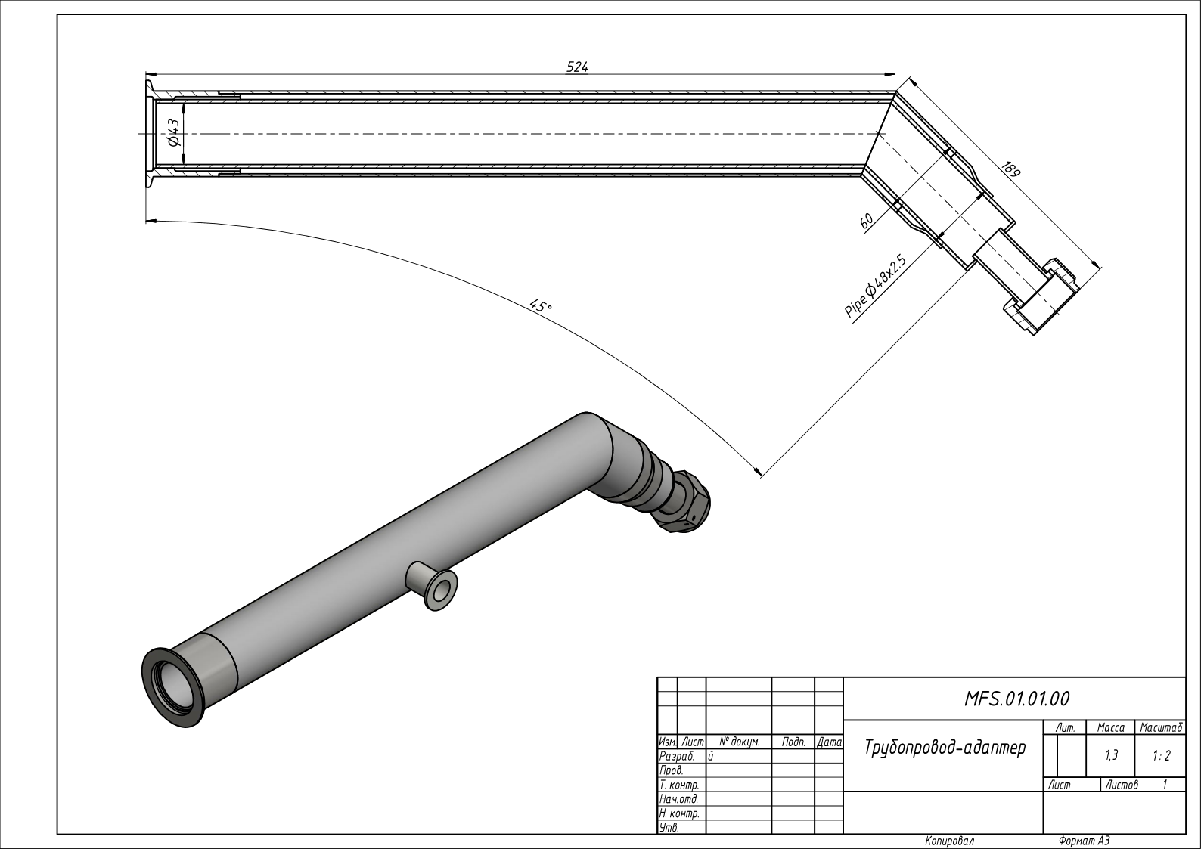
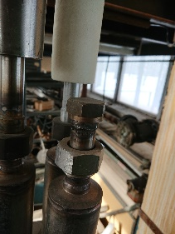
MPD solenoid cool-down to 80K at JINR, MFS preparation
MFS
Existing valve
Preparation and testing in b.203A
LN₂ distribution in b.203A

Slide 10
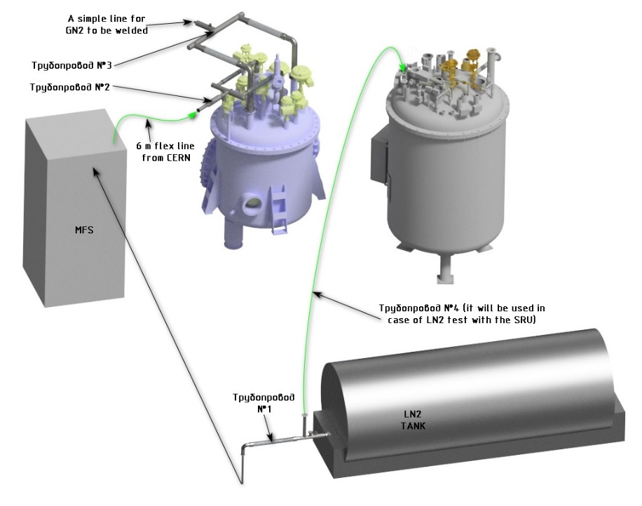
MPD solenoid cool-down to 80K
Control cryostat
Draft of Technical Specification for the transient parts is ready

Slide 11
Thank you for your attention

