Slide 1


Booster and Nuclotron development
E.Syresin
at behalf of Accelerator team

Slide 2



Injection complex
Two linacs:
HILAC & LILAC
Two Linear Injectors
& sources
Booster
Booster & beam line
Nuclotron ring

Slide 3
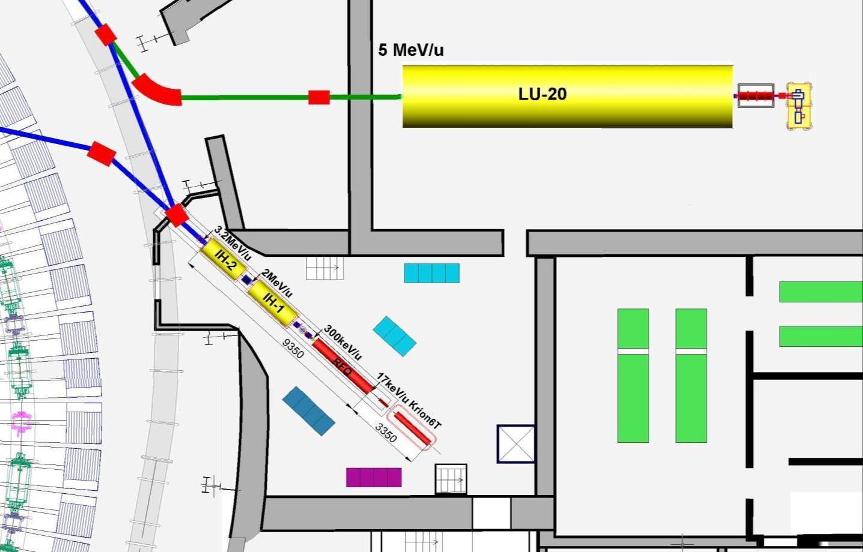
Layout of the linear Injectors
p↑, d↑, ions Z/A>0,3
Booster
Injection
channel
Ions Z/A>0,3
LIS
RFQ
SPI
p↑,d↑
10mA
LU-20 building
HILAc
HILAc building
^{Booster}
Nuclotron
RF amplifier for LU-20

Slide 4
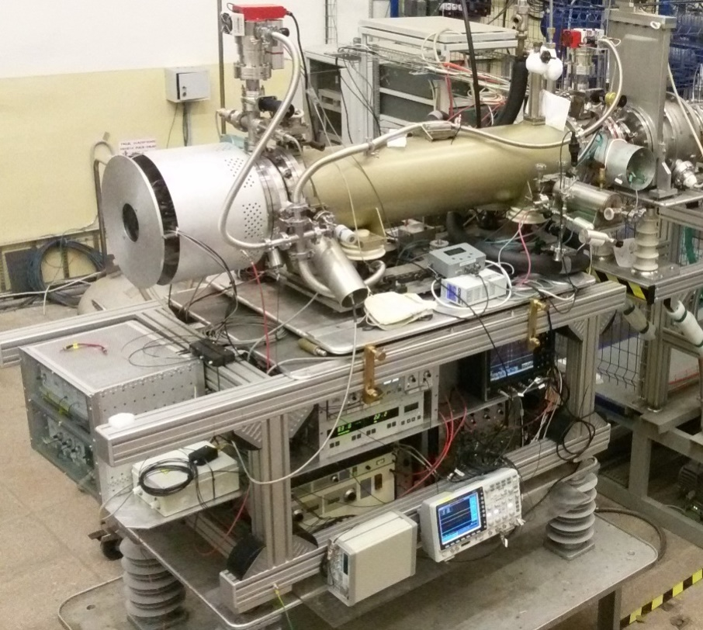
ESIS “KRION -6T”
Investigations and development in progress
Theoretical and achieved parameters:
1) Magnetic field up to B= 6.0 Т, (5.0 T)
2) Energy of electron string E_{e} ≤ 25keV (E_{e}≤12keV)
KRION 6T – heavy ion source was used during Nuclotron RUN #55 for SRC & BM@N experiments (Ar & Kr beams)

Slide 5
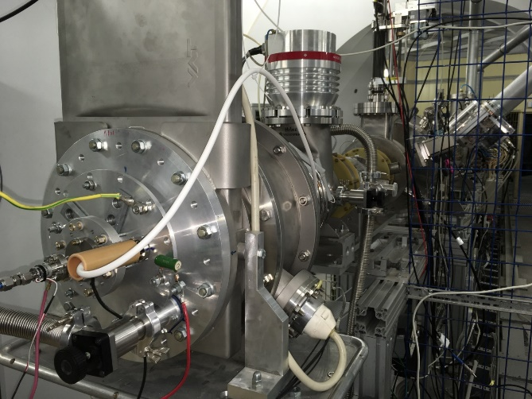
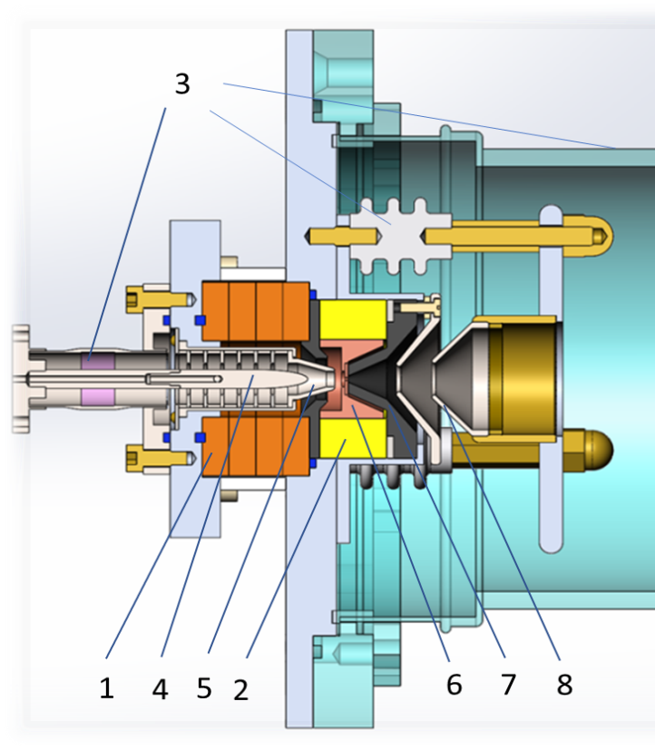
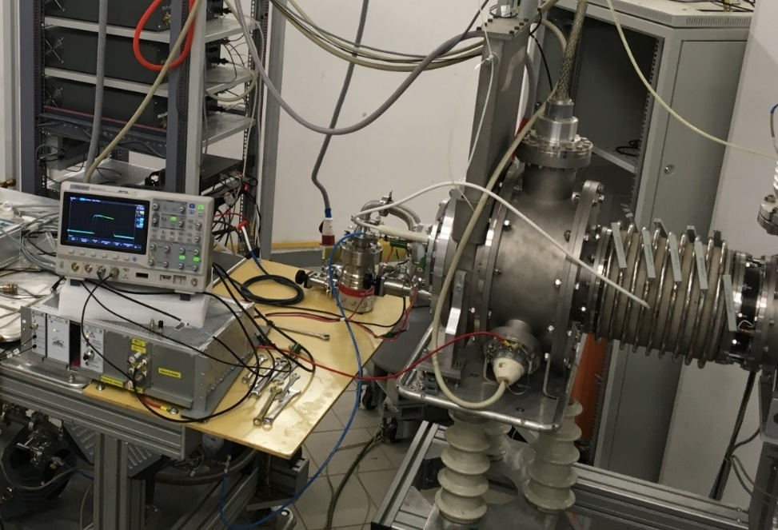
Ion source for commissioning
Ion source with a cold magnetron cathode and magnetic plasma compression.
For the Booster commissioning
the He¹⁺ ion beam wos used.
Ion Source Design:
1 - ring ferrite magnets, 2 - ring NdFeB magnets,
3 - ceramic insulator, 4 - magnetron anode,
5 - magnetron cathode, 6 – anode, 7 - emission electrode, 8 - extracting electrode

Slide 6
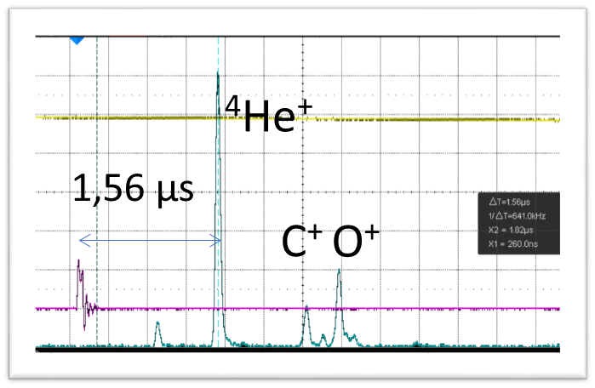
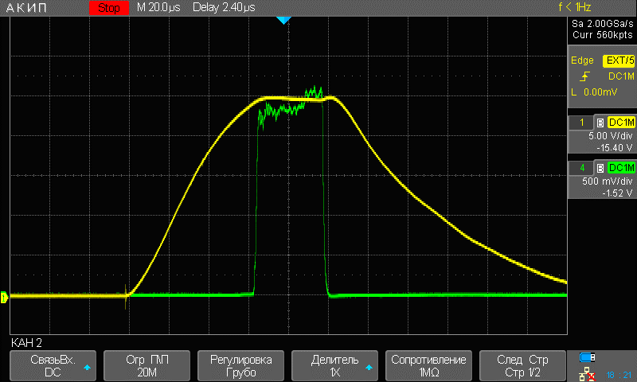
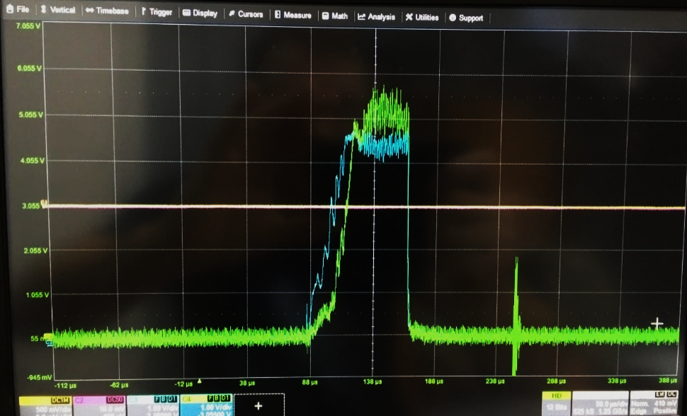
Ion source for commissioning
Why do we plan to use He¹⁺ ions?
“Mono” beam after the
linear injector (no other species)
99% of He¹⁺
A/q = 4 more closer to the project beam for
the linac and Booster ring (compare to
other possible ions). Magnetic rigidity.
Good beam for measuring of integral
vacuum conditions in the ring beam pipe.
Very stable in time, high current, simple
source in operation.
Beam spectra from the ion source
Beam at the entrance of the Linac
3.2 MeV/u beam at the exit of the Linac and
exit of the channel

Slide 7
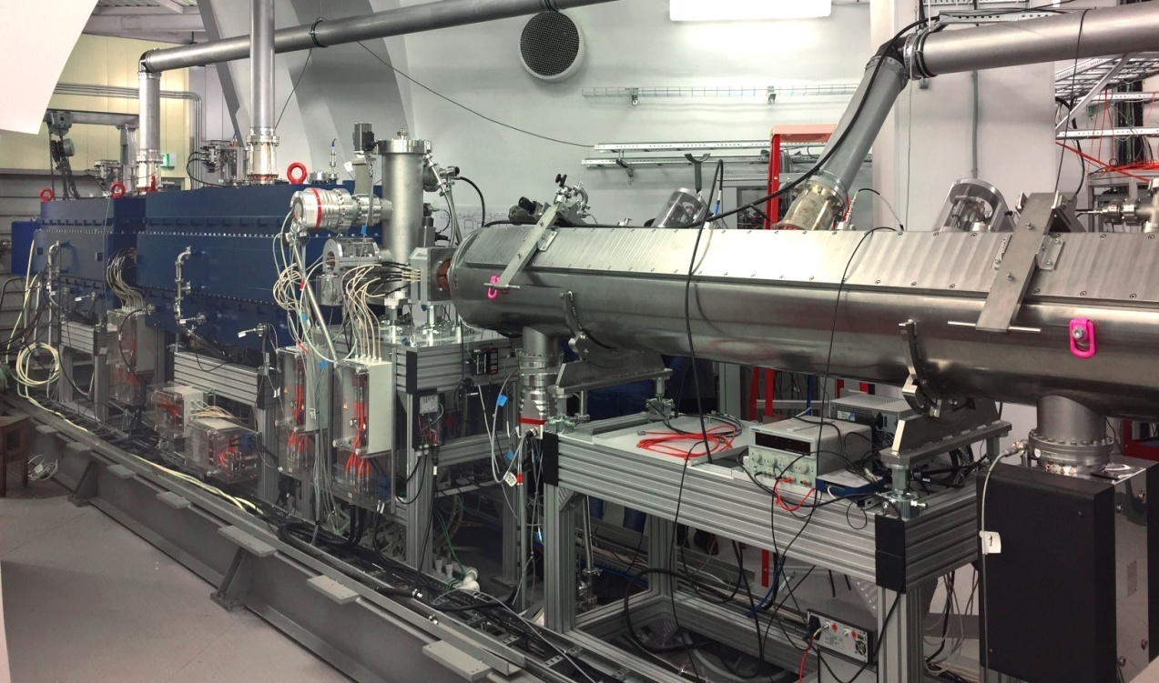
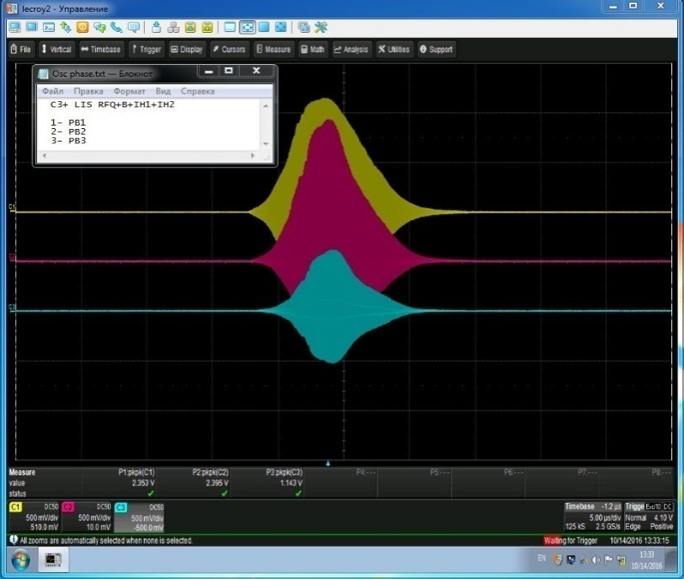
HILac status
HILAc status
Last beam time in summer 2020 with the new source, He¹⁺ beam q/A=0.25
Transmission of Carbon 3+ ions about 75% from RFQ to the exit of the HILAc,
3.2 MeV/u
Phase probes signals
RFQ (red), IH1 (yellow), IH2 (blue)
Commissioned &
ready for Booster commissioning
A/q (Target Ion Au³¹⁺) | 6.25
Beam current | < 10 emA
Repetition rate | < 10 Hz
Output energy | 3.2 MeV/u

Slide 8
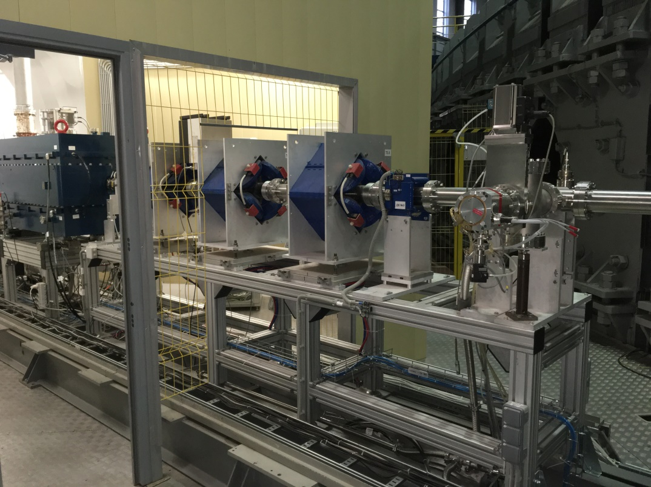
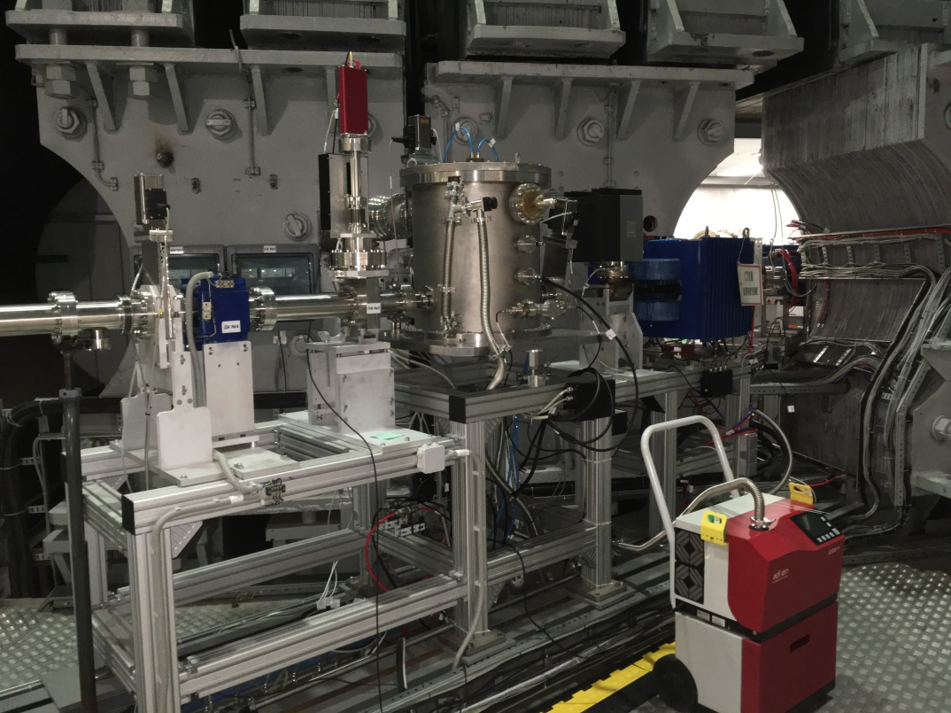
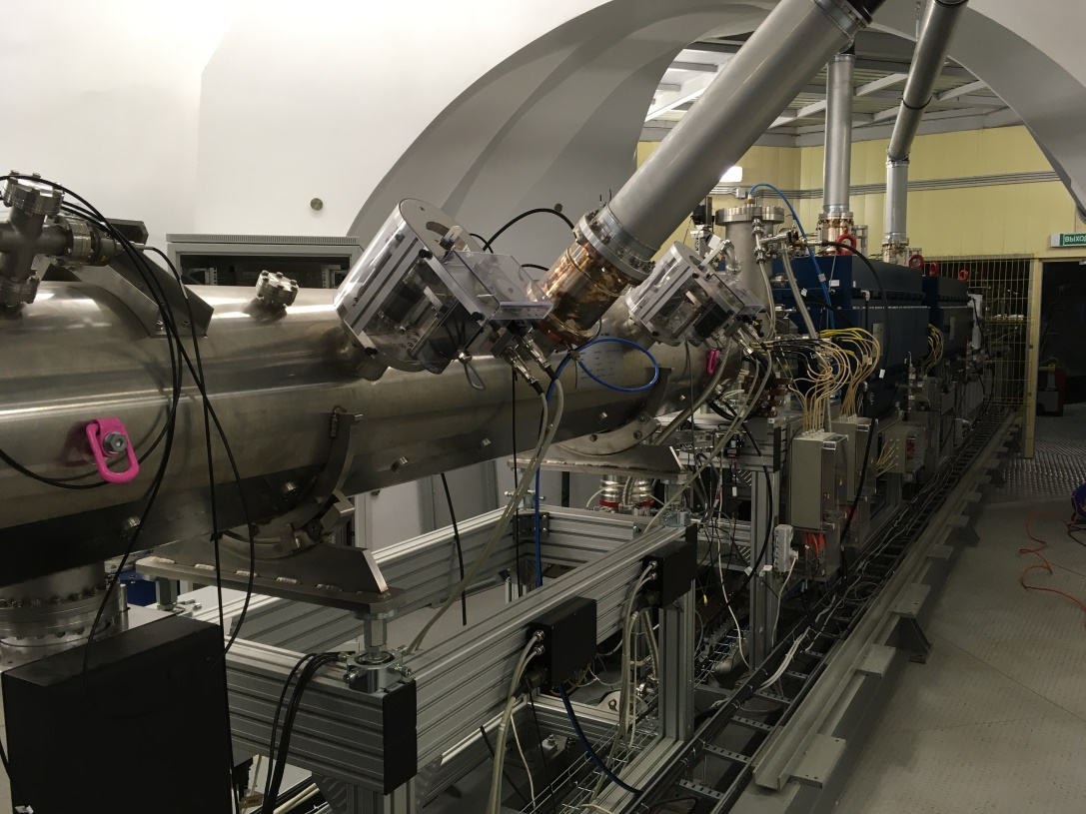
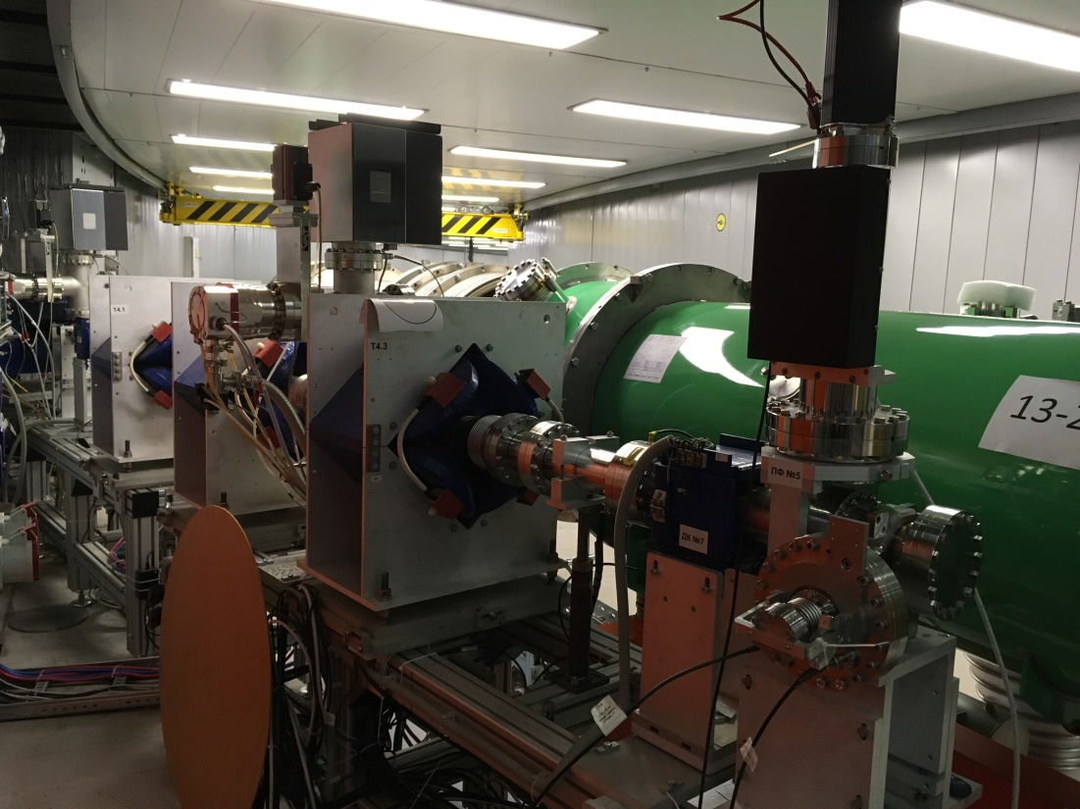
2021 г

Slide 9
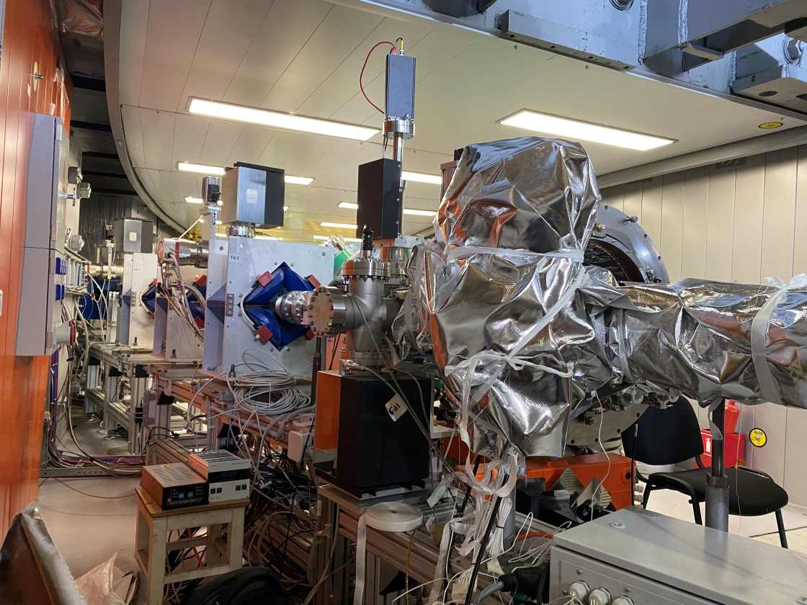
HILAC – Booster transfer line
A.Tuzikov

Slide 10
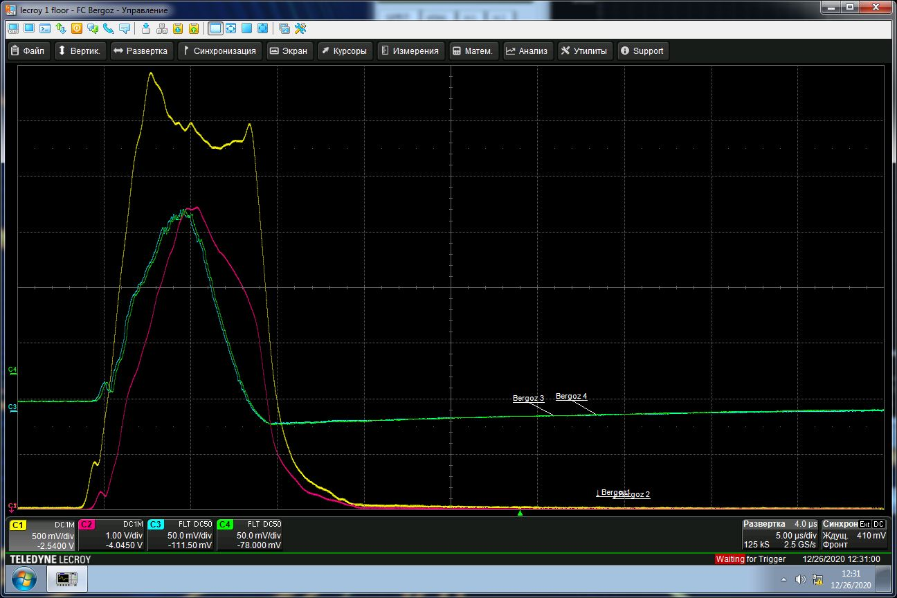
Beam transportation through Booster –HILAC channel
СТ1 5V/10mA | СТ2 10V/10mA | СТ3 5V/1A (20 dB)= 50мВ/1мА | СТ4 5V/1A (20 dB)= 50мВ/1мА | СТ5 5V/1A (40 dB)= 500мВ/1мА
7 мА | 5.5 мА | 3.4 мА | 3.4 мА | 3 мА
100% | 78% | 49% | 49% | 43%
СТ1
7мА
СТ2
5.5 мА
СТ3
3.4 мА
СТ4
3.4 мА

Slide 11
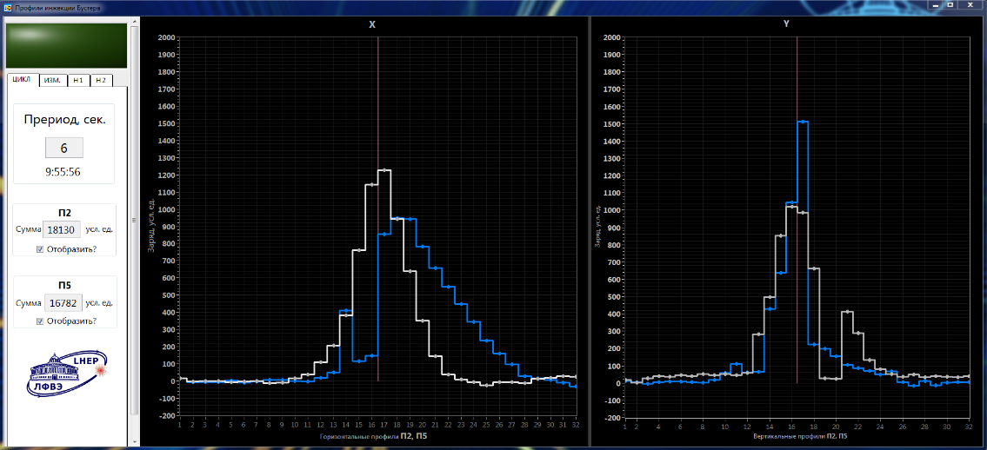
Beam profiles obtained by РМ2 и РМ5

Slide 12
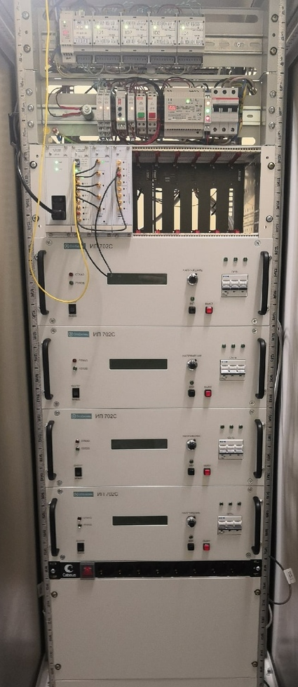
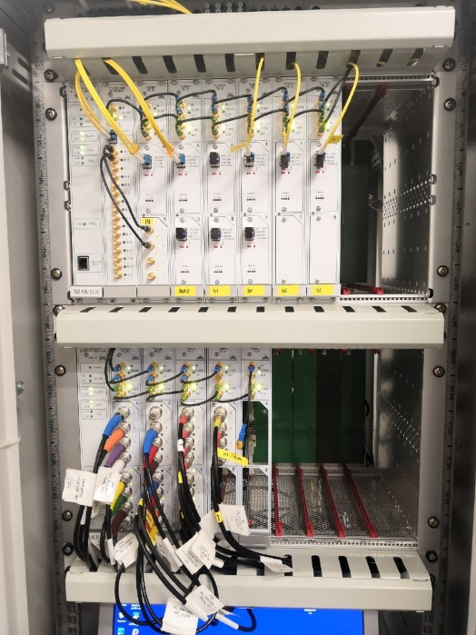
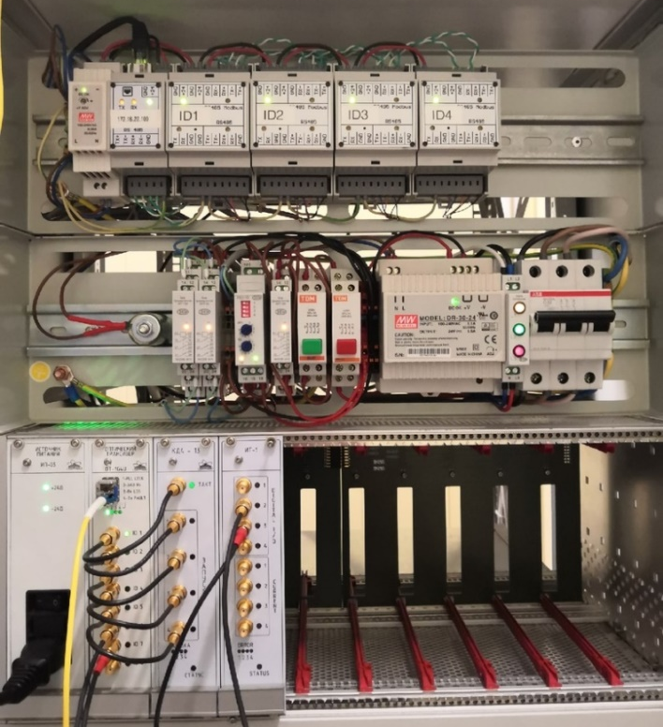
HILAC Synchronization system

Slide 13
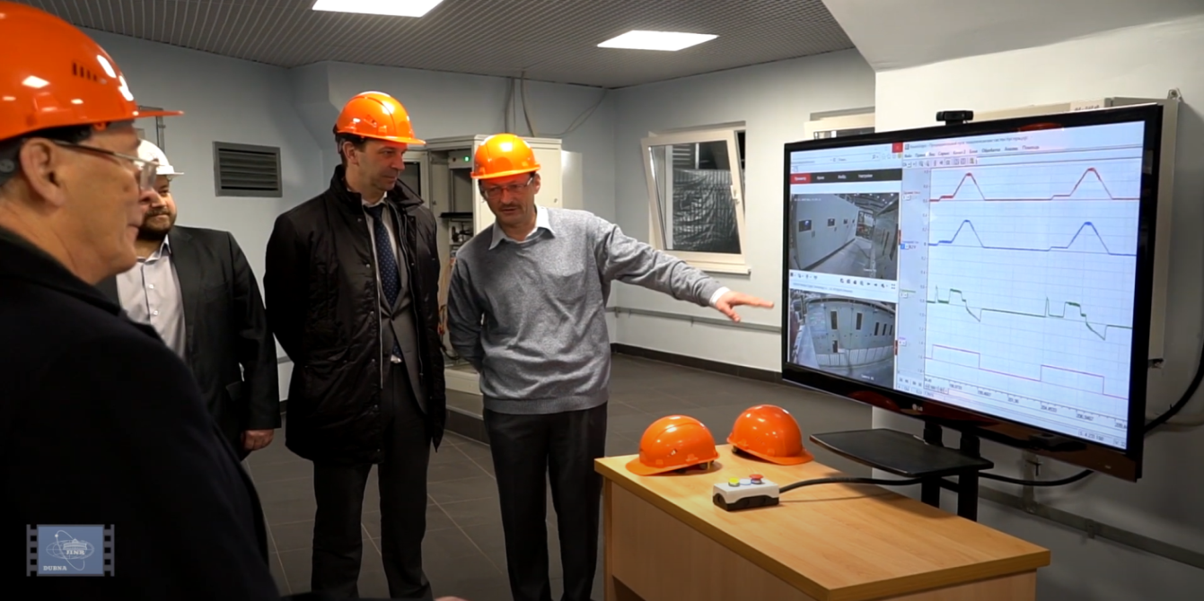
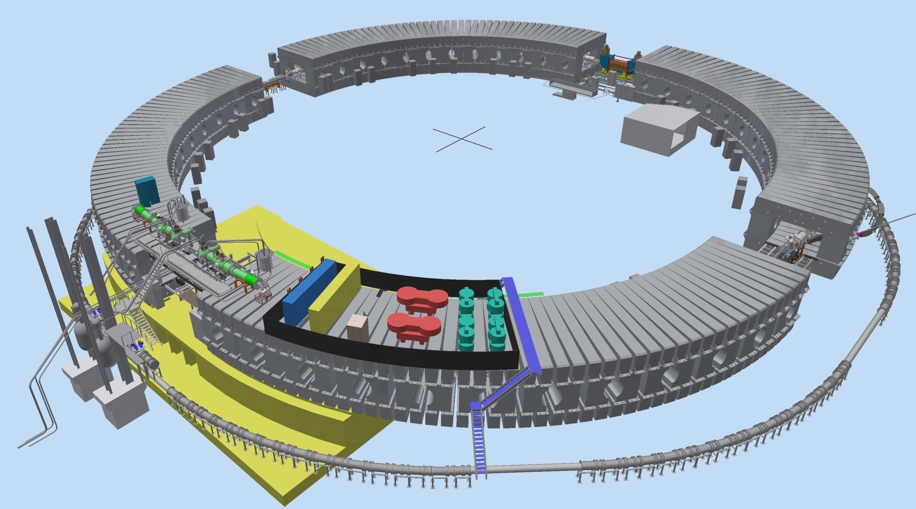
Booster ring layout
E-cooling system
Injection system
On 23/12/2019 technological testing cycle was started
Synchrophasotron iron yoke
Reference section
Fast Extraction system
Power supply & energy evacuation
RF system
Nuclotron

Slide 14

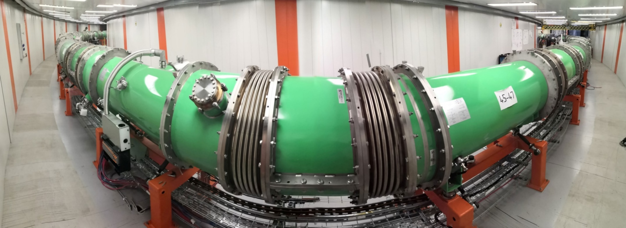
Booster
Cryo-magnetic system in assembly
12 November – 30 December 2020 – technological run
23 December 2019

Slide 15
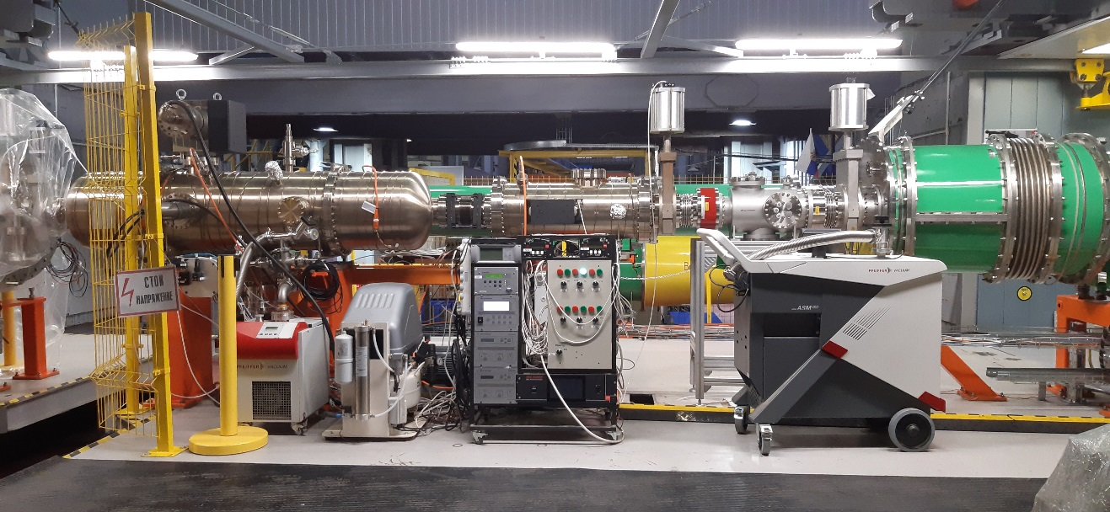
Injection section
Х
Х
Dubna 2021

Slide 16
1. Cooling of Booster half rings

Slide 17
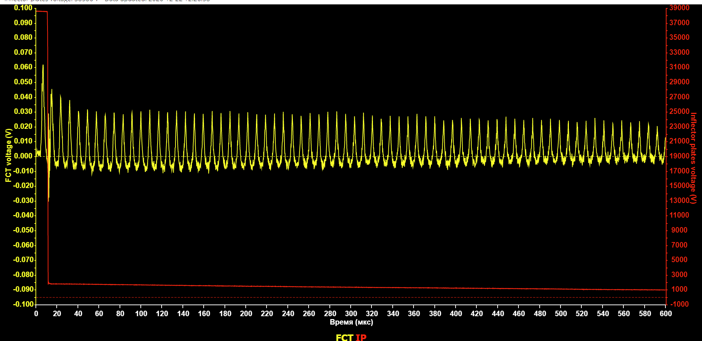
First run of the Booster
12.11 – 03.12: assembly and test of vacuum system
04.12 – 11.12: cooling, thermometry commissioning
12.12 – 18.12: commissioning of quench protection system, tuning of power supply,
tuning of the HILAC – Booster transfer line
19.12: first circulating beam He¹⁺
Fast current transformer
600 μs

Slide 18
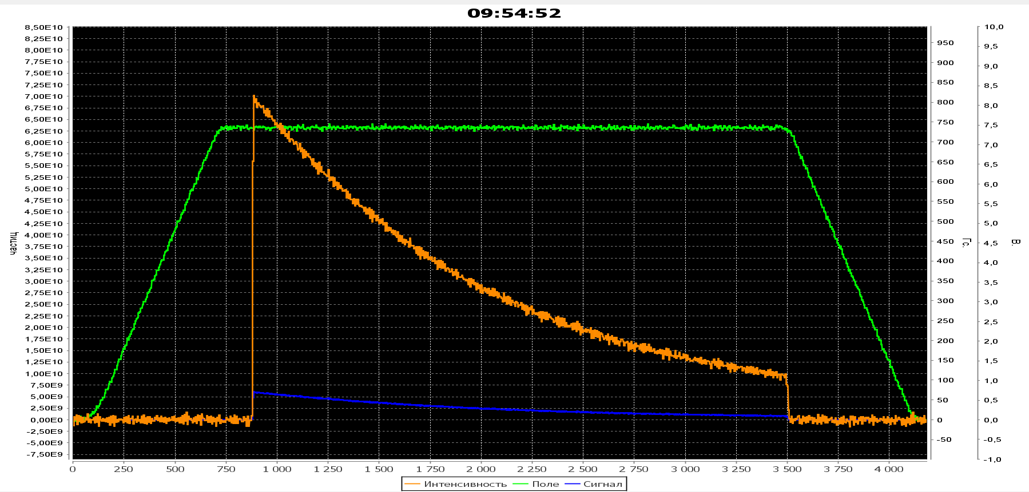
Beam circulation in Booster
26-29 December 2020 г.
Circulated beam intensity 7∙10¹⁰ He¹⁺ ions( average current 1,3 мА), ion energy 100 MeV/u
Dubna 2021

Slide 19
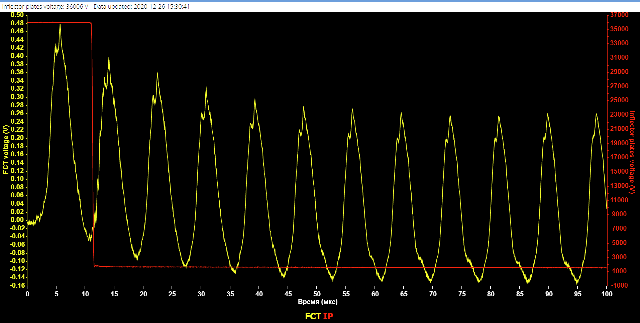
Booster beam circulation
26-29 December.
7∙10¹⁰ ions He¹⁺ (current 1,3 мА)
Beam losses after injection is about 10%
Dubna 2021

Slide 20
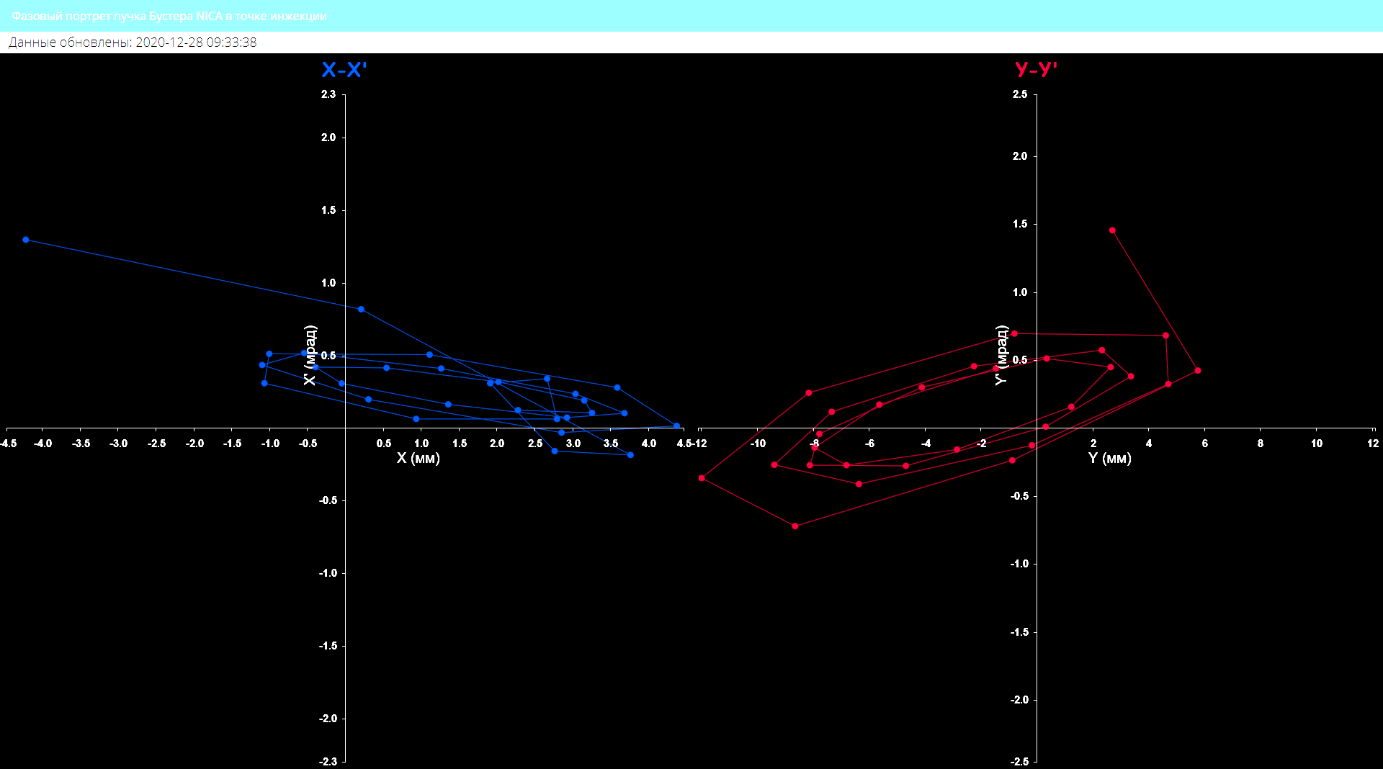
Beam circulation in Booster
Meshurement of closed orbit in injection section
Dubna 2021

Slide 21
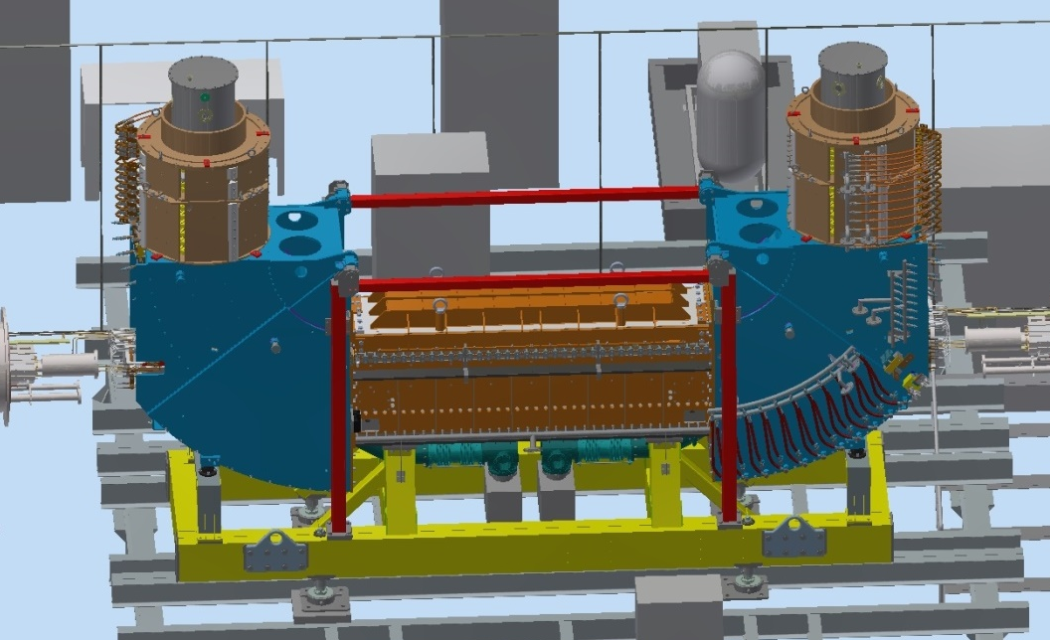
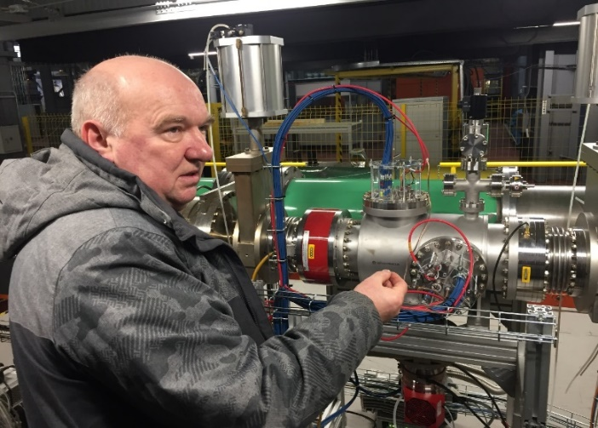
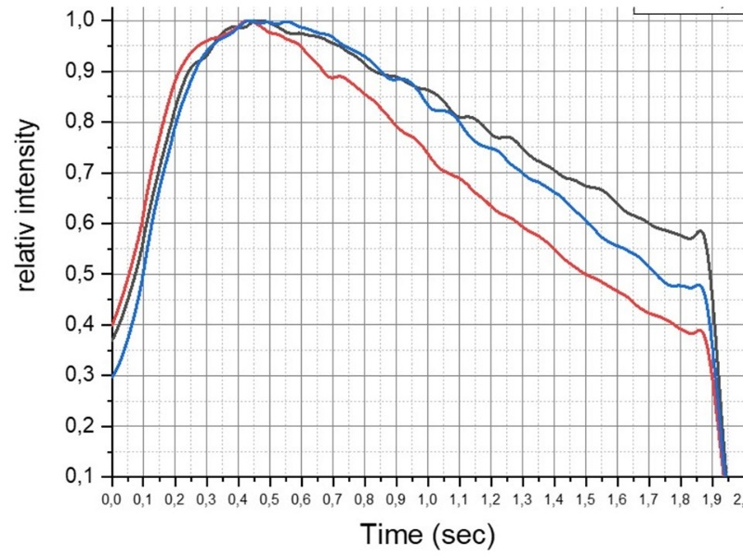
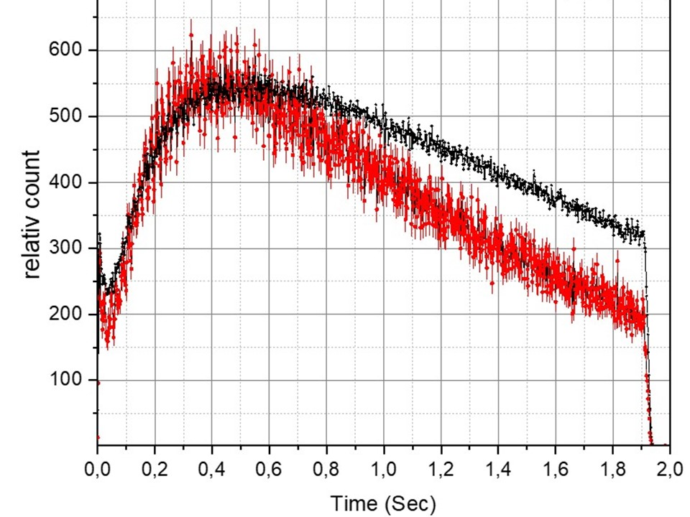
First run of the Booster
28.12: test of electron cooling
Ionization profilometer
Solenoid magnetic field 700 Gs
Electron beam current 150 mA
Optimal electron energy 1.76 keV
Residual gas pressure 4⋅10⁻⁸ Pa
Action of the electron beam leads
to decrease of the ion beam life-time
due to ion-electron recombination
Black – 1.82 keV
Blue – 1.72 keV
Red – 1.76 keV
23 December 2019
Black – e-beam off
Red – e-beam on, 1.76 keV
21

Slide 22
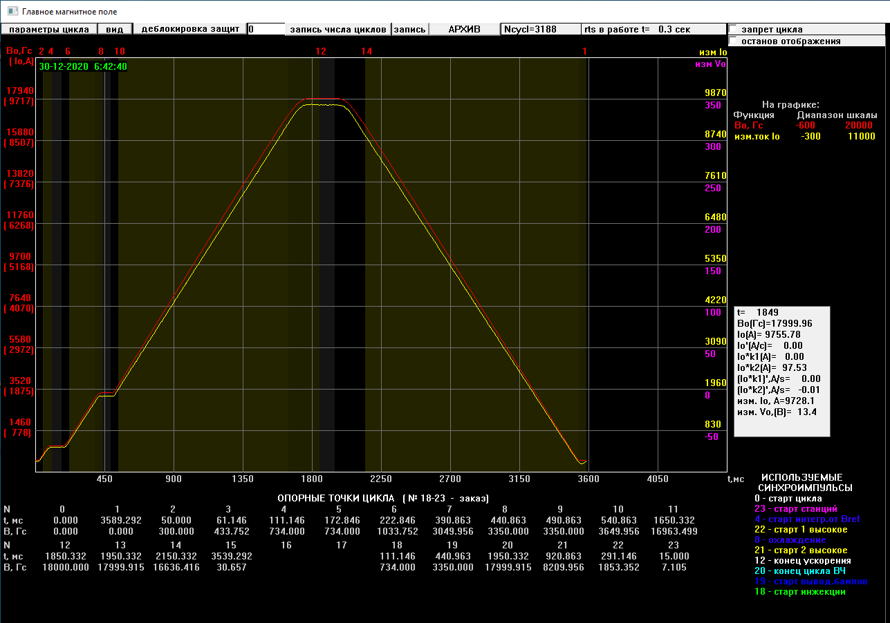
First run of the Booster
30.12: design magnetic field cycle
1.8 T
dB/dt = 1.2 T/s
Electron cooling plateau
Injection plateau
23 December 2019

Slide 23
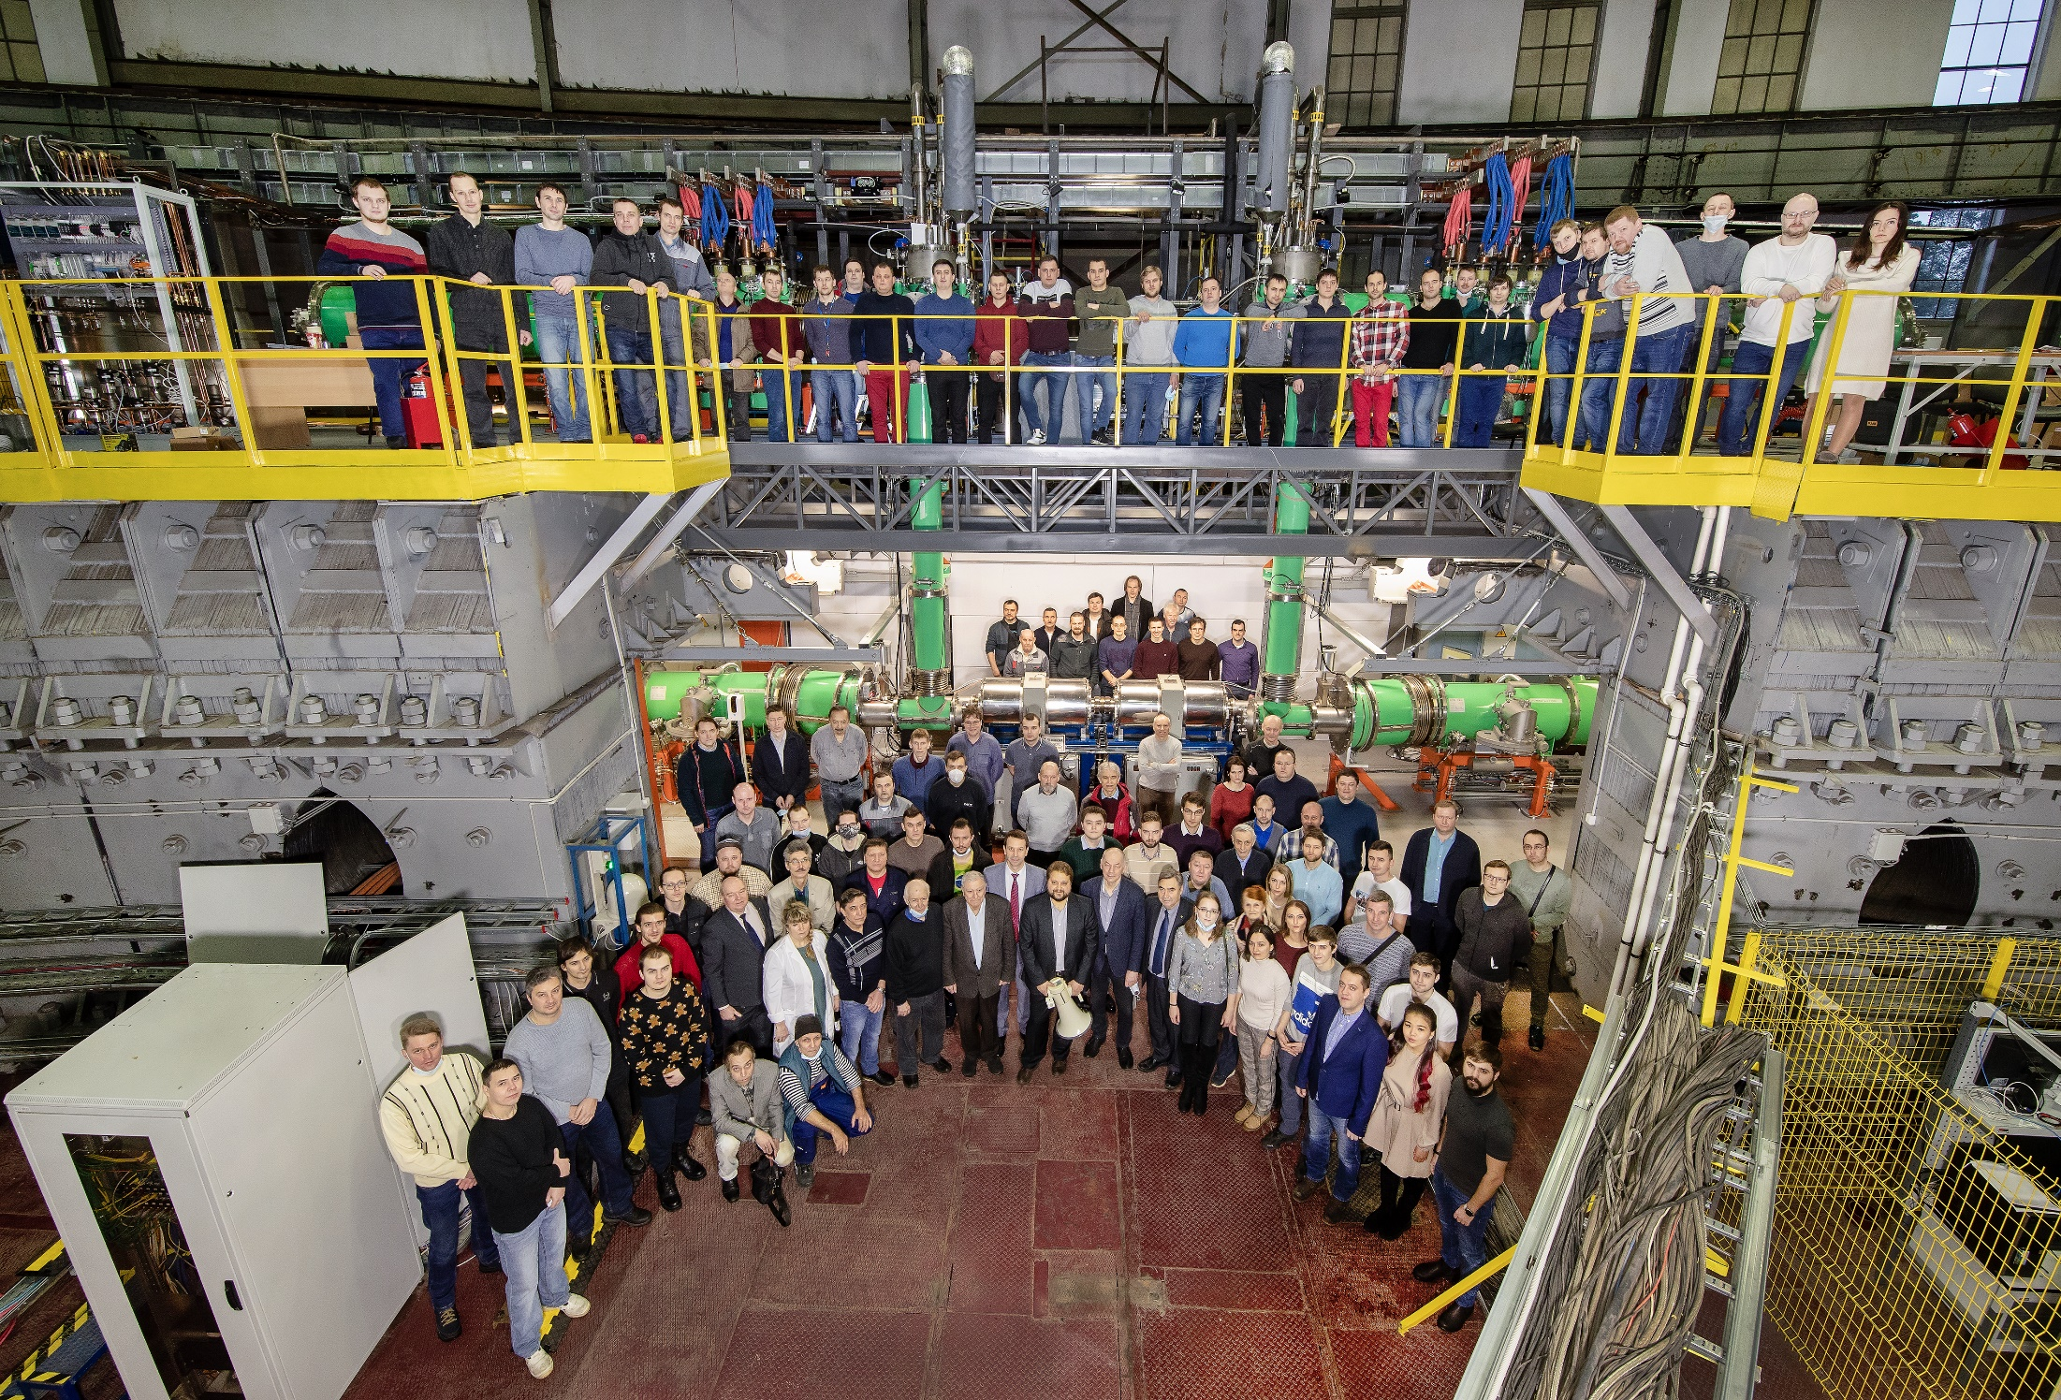
We wish you happy New year!

Slide 24
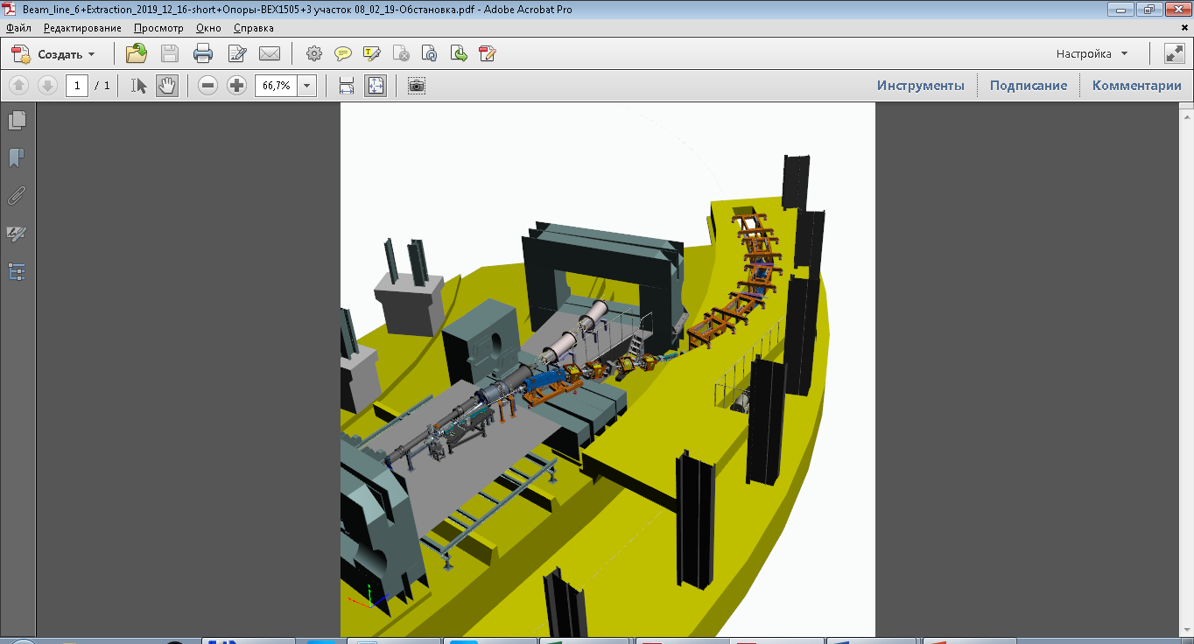
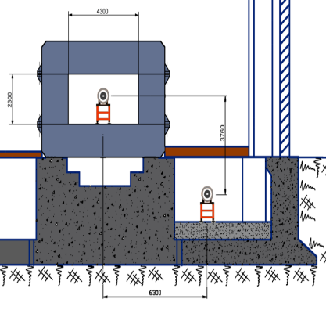
Booster-Nuclotron transfer channel
A.Tuzikov
production @ BINP
Delivery of 8 lenses and 5 magnets in JINR- April –May 2021
Montage of magnetic elements of Transfer line-19 April-30 May 2021
Booster –Nuclotron transfer line beam tests with ions -15 June- 15 July 2021
⁴He¹⁺
Booster
Nuclotron

Slide 25
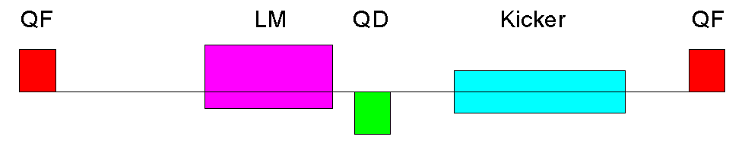
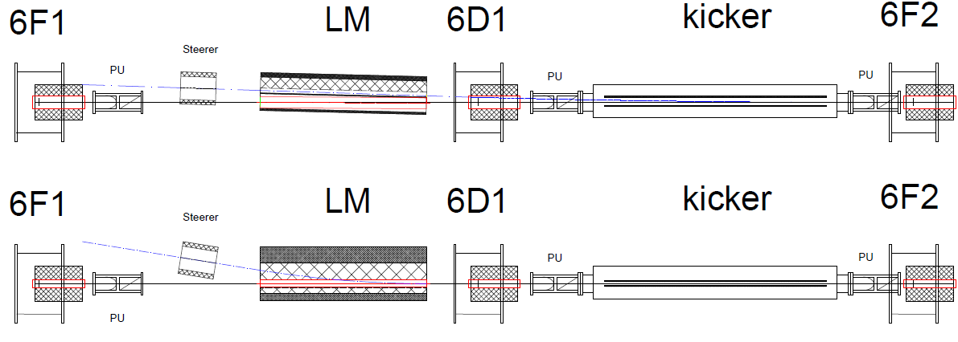
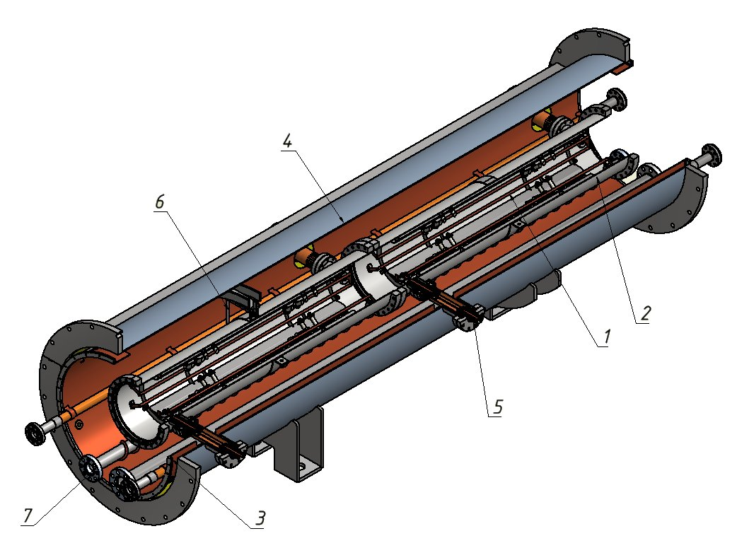
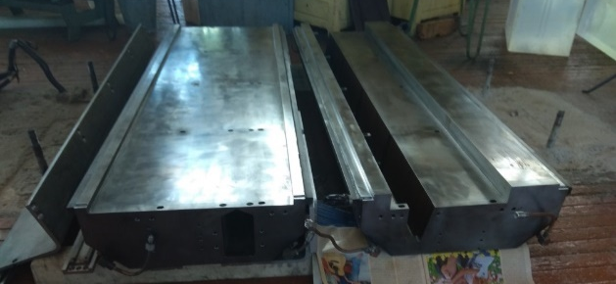
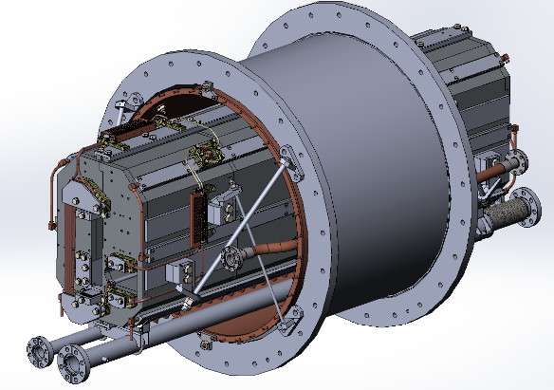
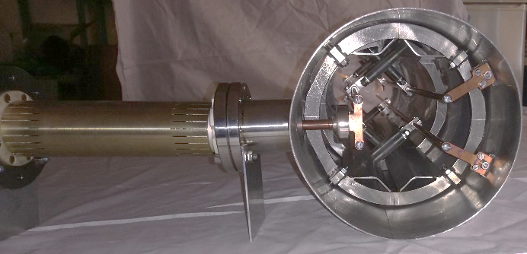
A. Tuzikov
Nuclotron high energy beam injection system
Nuclotron
LM, kicker production => April-August 2021
PS production => End of 2021
(Booster spare kicker PS)
Injection System => November 2021
17

Slide 26
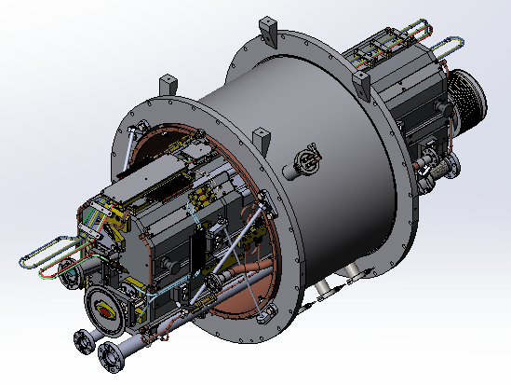
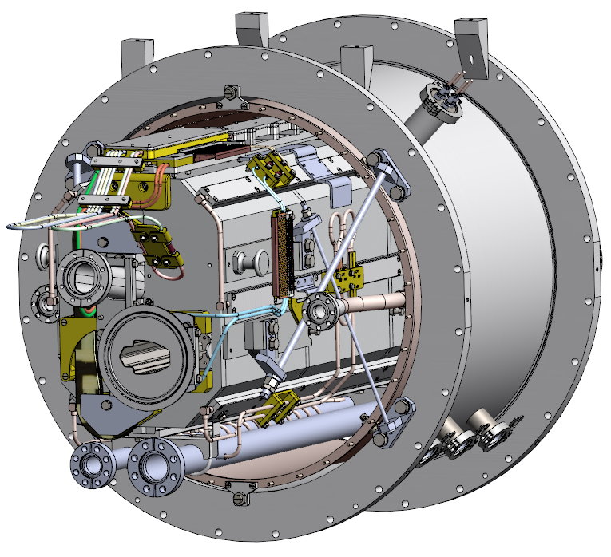
Lambertson magnet of Nuclotron injection system
Lambertson magnet is based on spare Nuclotron yoke
1.Additional machining of yoke in LHEP Workshop
May 2021
2.Coil construction in LHEP factory of 217 building
May 2021
3. Cryostat construction GKMP, Brjansk-June 2021
4.Construction of Lambertson magnet vacuum chamber
FMB, Germany December 2020-May 2021
5.Construction of neighbor vacuum chambers,
IZAN-Chernogolovka (not ordered)- August 2021
6. Power supply, EVPU, Slovac republic –was ready
7.Construction of power supply control system,
LHEP-August 2021
8. Montage of Lambertson magnet-1 May-1 August 2021
18

Slide 27
Kicker of Nuclotron injection
A. Tuzikov
1.Kicker drawings are ready
3.Construction of cryostat and vacuum
chamber, Vacuum systems and technologies (Belgorod), December 2020-July 2021
4.Montage, until of August 2021
5. Booster –Transfer line-Nuclotron beam tests
October 2021
Peculiarity of Nuclotron injection system test
Power supply only for one kicker module on base of spare Booster kicker power supply
Δθ=ZeB_{p}l_{k}/βγAm_{p}c²
Bkickl=0,6Bnoml Einj=300 MeV/n
Three Nuclotron kicker power supplies in accordance with Contract will be ready in
November-December 2021, BINP, Novosibirsk
BM@N Run-October-November 2021
Pessimistic scenario-Power supply only for one kicker module
Einj =300 MeV/u
Optimistic scenario-spare Booster kicker power supply and one new Nuclotron kicker power supply Einj = 600 MeV/n,
19

Slide 28

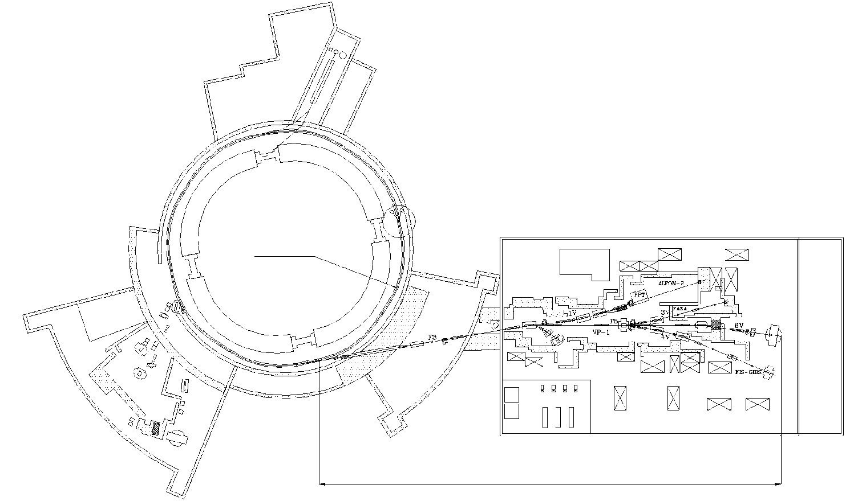
Nuclotron - BM@N transfer beam line
►Upgrade of Nuclotron - BM@N transfer line for heavy ion program:
→ replace air intervals / foils with vacuum beam pipe along 160 m of BM@N transfer line to get minimum dead material (Contract Vacuum Technologies and System, Belgorod, August 2021, JINR S. Anisimov)
Necessary:
- modernization of 2 substations SG-K and SG15,
- to make a distribution and reservation subsystem over a 0.69 kV network,
- to produce 35 precision current sources,
- to make a DC reservation subsystem,
to create a subsystem for managing and controlling the all complex.
V. Karpinsky, N. Semin
Nuclotron
~160 m
Building 205
20

Slide 29
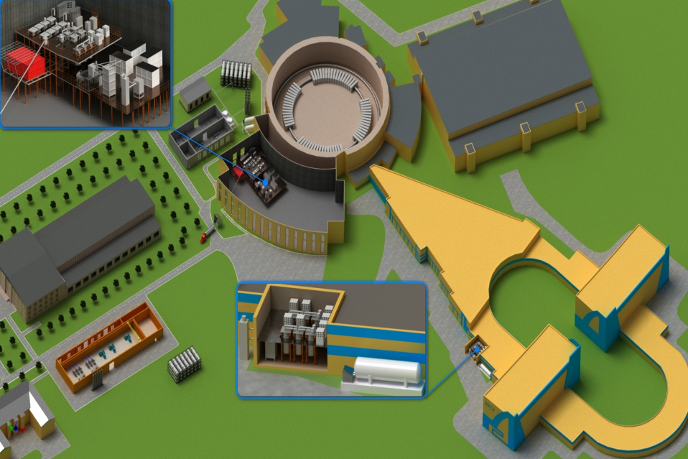
New Cryogenic Equipment of the NICA Complex
New compressor hall is required for simultaneous Booster and Nuclotron operation
1000 m³ helium gasholder
completed W04, 2021
Central cryogenic plant (bld. 1B)
comiss W29, 2021
New compressor hall
constr completed July 2021, commissioning August 2021
N. Agapov
1000 m³ nitrogen gasholder
completed W49, 2020
Bld. 17
completed W52, 2021
21

Slide 30
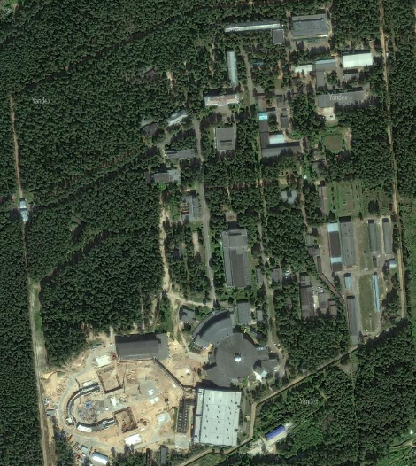
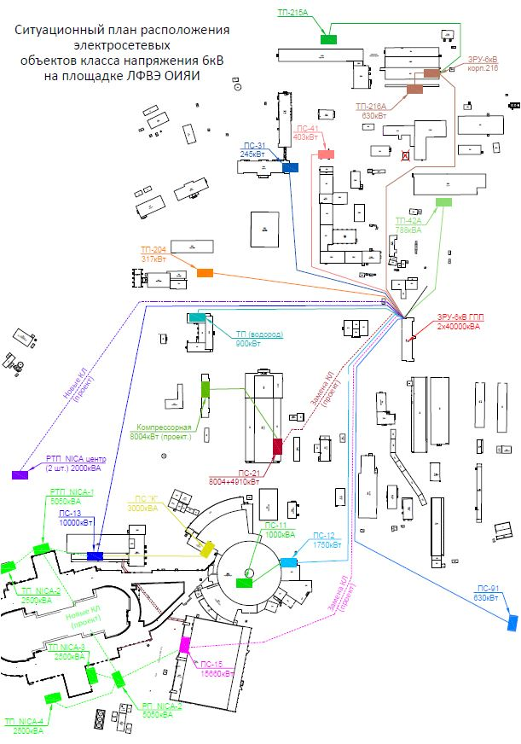

Power scheme VBLHPH
SG 13, SG-K substations have been upgraded
All the required documentation SG12, SG15, SG21 has been developed and agreed in all authorities.
Substation SG-K
(1MW) is ready
GPP1
Main substation step-down GPP1
(40.8 MW) July-September 2021
Substation SG13
(10MW)
Bld.2
Bld.1A
Substation SG21
(12MW) July 2021
5 substation bld.17
(11MW)
Bld.17
Bld.1
Substation SG12
(1.7MW)
Bld.205
Substation SG15
(8MW) July 2021
Power supply system for channel
Power supply system for beam channel
August 2021

Slide 31
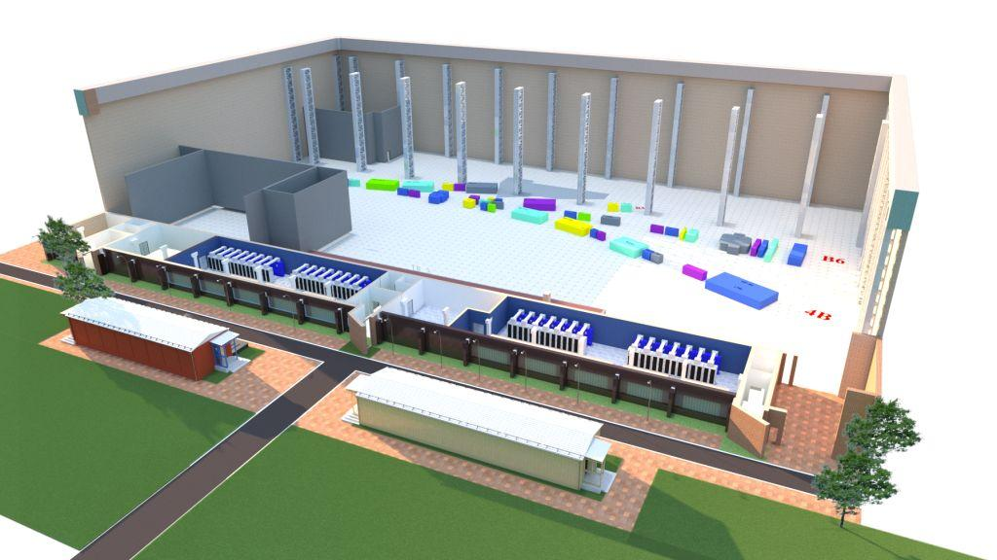
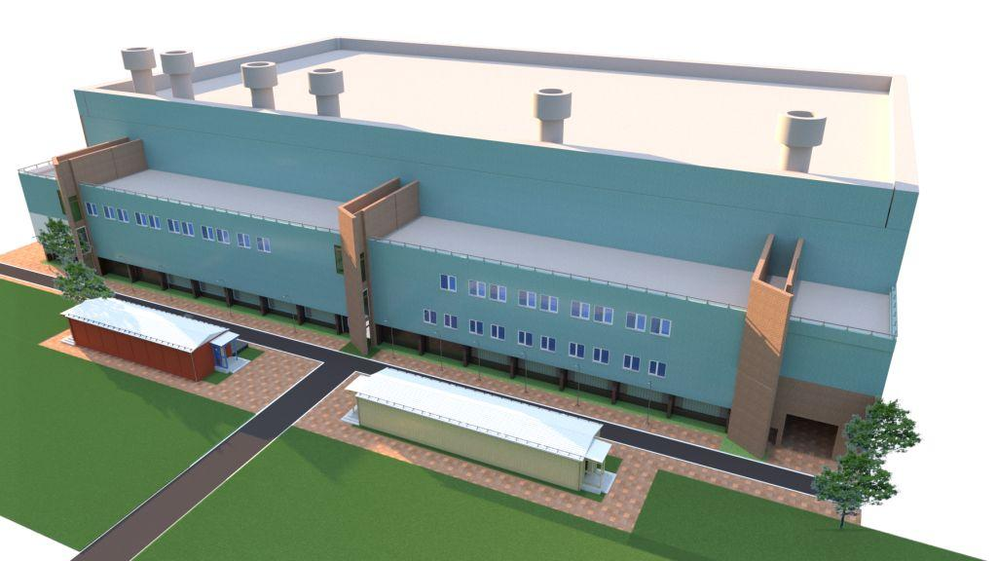


Power supply system for magnetic elements of transport channel for particle beam of the Accelerator complex, BM@N NICA
Equipment PSS are ready for installation
Reconstruction of 205 corpus-April 2021
Commissioning May 2021
Rostehnadzor –June 2021
Input in exploitation-July 2021
Chillers of water cooling(no tender procedure)-August 2021
Location of the equipment PSS
bld.205
Magnets of channels
Magnets of chanels
Equipment PSS
Modular bld. Transformers
October 2020
Mounting, December 2020
Modular bld. substation SG15
Installation-January2021
Rostehnadzor –January-May
Input in Exploitation-July 2021

Slide 32

Collider building
End of April 2021 starts of equipment mounting

Slide 33


Progress in the collider construction & design
Main elements of the magnetic optics of the Nuclotron-collider transport channel were fabricated and delivered in JINR, fabrication of the power supply system, beam diagnostics devices are in the final stage.
Serial production of the collider cryo-magnetic system is in progress, 80% of the dipole magnets are fabricated and tested
Two RF1 stations are constructed and transferred to JINR; construction of RF2 is in the final stage, prototypes of RF3 are tested,
Construction of the collider electron cooling system, construction of the Light Ion Linear Accelerator LILAc.
-

Slide 34
Thanks for your attention

