Slide 1
Silicon Vertex Detector Front-end electronics
25.03.2021

Slide 2
Relevant FEE DAQ numbers
# layer | 1 (MAPS) | 2 (MAPS) | 3 (MAPS) | 4 (DSSD) | 5 (DSSD) | Total
Sensor numbers /layer | 448 | 840 | 1736 | 228 | 368 | 596(DSSD) + 3024(MAPS)
Ladder numbers | 11 | 20 | 28 | 19 | 23 | 101
Sensor numbers /stave (module) | 28 | 28 | 28 | 2 | 2
Numbers stave (modules)/layer | 16 | 30 | 62 | 114 | 184
Numbers e-links/stave | 8 | 8 | 8
Numbers analog MUX-OUT/module |  |  |  | 10 | 10
Read-out channels / layer | 128 e-links | 240 e-links | 496 e-links | 1140 | 1840 | 864 e-links + 2980 analog MUX-OUT

Slide 3
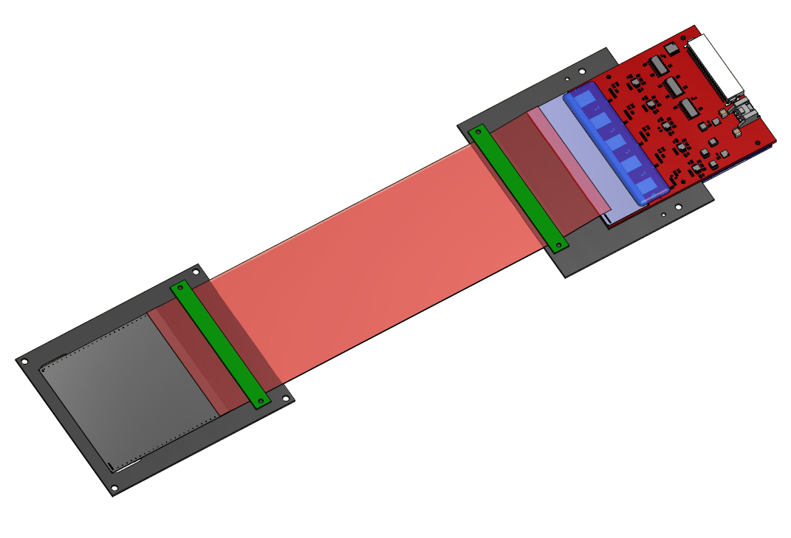
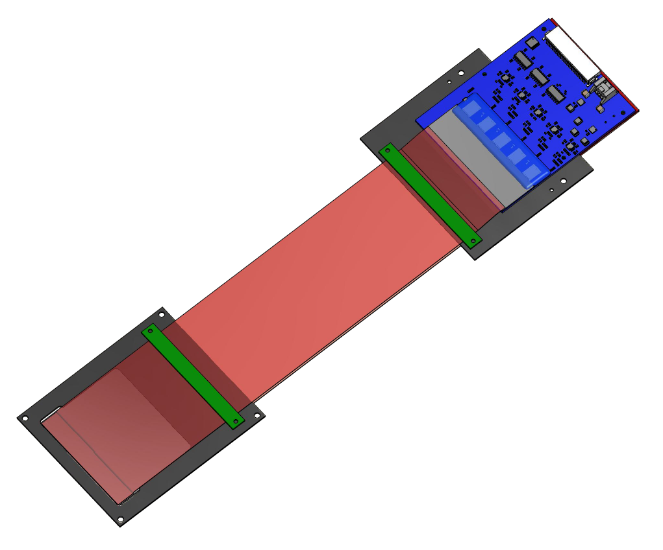
Current SPD Si module prototype
FEE n+
589 channels
BM@N Si-Module
FEE p+
640 channels
DSSD parameters:
Polyimide microcables
(300 and 600 mm length)
Size: 63x63x0.3 mm³ (on 4” – FZ-Si wafers)
Topology: double side microstrip (DSSD)
(DC coupling)
Pitch p⁺ strips: 95 μm;
Pitch n⁺ strips 103 μm;
Stereo angle between p⁺/n⁺ strips: 2.5⁰
Number of strips: 640 (p⁺)$×$ 614(n⁺)
$z$ –coordinates
DSSD
The module consists of one silicon detector,
glued to the frame and connected with front-end electronics
via thin polyimide cable. FEE based on VATAGP7.1 ASICs
$φ$ –coordinates

Slide 4
Parameters of read-out chips
 | ASIC VATAGP7.1
Number of CSA | 128 channels
Input charges (dynamic range) | $±$30 fC
Peaking time (slow shaper) | 500 ns (typ.)
Peaking time (fast shaper) | 50 ns
Noise (ENC) | 70e +12e/pF (typ.)
Lowest threshold (no capacitance) | 0.12 fC
Voltage supply | +1.5V, -2.0 V
Gain from input to output buffer (diff. output currents) | 16.5 µA/fC
Output Serial analog multiplexer clock speed | 3.9 MHz
Power dissipation per channel | 2.2 mW

Slide 5
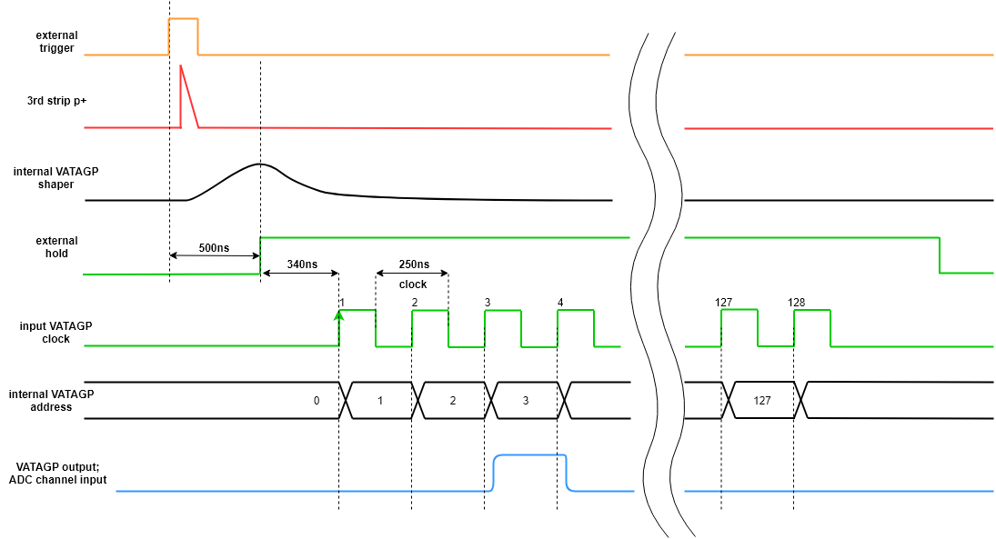
Serial read-out diagram
Detector
ADC
Control Unit
Silicon
Based on FPGA
Multichannel
> 50 MSPS
DAQ System
VATAGP7.1
IDEAS ASICs
Front–end electronics

Slide 6
Possible solutions for ASIC read-out
ASIC | APV25 | VATAGP7.3 | n-XYTER | TIGER | ToASt
Channels number | 128 | 128 | 128 | 64 | 64
Dynamic Range | -40fC ÷ 40fC | -30fC ÷ 30fC | Input current 10nA Polarity - and+ | 1÷50fC | 1÷40fC
Gain | 25mV/fC | 20µA/fC | 59.4 mV/fC | 10.35mV/fc | ToT gain 40ns/fC
Noise | 246e⁻+36 e⁻/pF | 70e⁻+12 e⁻/pF | 900e⁻ at 30pF | 2000e⁻ at 100pF | 1500e⁻
Peaking time | 50ns | 50ns/500ns | 30ns/ 280ns | 60ns/ 170ns | 50 / ≥ 100ns
Power consumption | 1.15mW/ch. | 2.18mW/ch. | 10mW/ch. | 12mW/ch. | 4mW/ch.
ADC | No | No | 16fC, 5 bit | 10-bit Wilkinson ADC | 8 bit
TDC | No | No | Timestamp resolution < 3.125ns | Timestamp resolution < 5ns | Timestamp resolution < 6.25ns

