Slide 1
SPD-setup

Slide 2
ECAL Front End Readout
Front End electronic for SPD ECAL based of:
ADC-64 – 14 bit digitizer, 64 MHz – 64 channels
16 channels Front END card with Power control for SiPms
16 SiPM board + 1 Temperature sensor

Slide 3
ECAL Barrel = 8 Sectors

Slide 4
One Sector

Slide 5
One Sector = 1/8 ECAL The Frame divided on 8 Sectors Each sector has 4 Gaskets Each Gasket has 10 Sections One Sector – consist of 64 cells 64 cells readout of one ADC-64 ADC-64 Numbers for: One Sector = 40 One Barrel of 8 Sect.= 40x8=320 Two End Cups = 75x2=150 N_Front_End_Card=4 x N_ADC
Sector
Basket
Section

Slide 6
64 channel Wave form digitizer Specially designed for ECAL ADC_64Ecal – https://afi-project.jinr.ru/projects/adc64ecal/wiki
64 MHz – samples frequency
14 – bit/per sample
White Rabbit provides sub-nanosecond synchronization accuracy
Zero suppression mode
Can operate in Streamer mode – Trigger less DAQ
Water cooling
Can operate in Magnetic Field
Power : ~ 50 Wt.

Slide 7
64 channel Wave form digitizer – general purposes ADC_64s2 – produced in https://afi.jinr.ru/ADC64
64 MHz – samples frequency
12-14 – bit/per sample
White Rabbit provides sub-nanosecond synchronization accuracy.
Can operate in Streamer mode – Trigger less DAQ
Air cooling
Not operate in Magnetic Field
Power ~ 50 Wt.

Slide 8
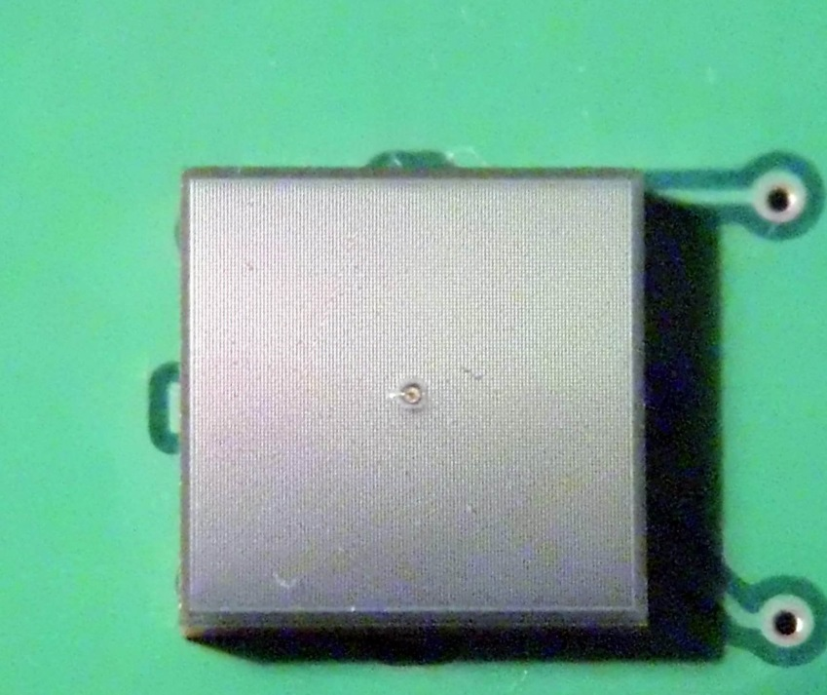
PCB board with 4 MPPC 6x6 mm2 (left) Single MPPS type S14160-6050 or S14160-6015
MPPC series of S14160-6050 (6015):
Low Operation Power: 40 V
Low temperature dependencies : 0.034 mv/⁰C
High PDE : 50% for 480 nm
Pixel pitch = 50 mc – or 15 mc – should designed in 2021
Pixel Number =14.400 (160.000)
-------------------------------
Hamamatsu promise produce
the MPPC series type with Pitch 15 mc – in 2021
Pixel Number = 160.000

Slide 9
16 channels Front End – card Produced in http://hvsys.ru/en
This board controlled of 16 MPPC H/V power:
36 – 44 V
Connected to ADC – with differential input
Flat cable with twist pail ~ 1 m
Measurement the temperature
Controlled using RS485 protocol
4-pair of flat cable up to 100 m
Remote control by Ethernet
H/V Temperature compensation done with software
160 – board / per sector
Power: ~ 1 Wt / per 16 ch. Board

Slide 10
Control unit for Front END card
For H/V control:
Can operate with 128 Front End Card:
Ethernet control
RS 485 interface
Power ~150 Wt. for Output Load
AC 220 V current
4 Unit/per sector
32 Units/per Barrel
32 Units/per 2 End Cups

Slide 11
End of Report
Thanks to all for attention

