Slide 1
Proton radiation therapy
FLASH Therapy Method
Speaker: Gritskova Evgenia
Сo-author: Shirkov Stepan
JINR Alushta
2021

Slide 2
JINR Innovative research center
One of the tasks of the center is to study the method of FLASH proton radiation therapy
Development of a research complex based on a superconducting cyclotron SC230

Slide 3
Introduction
Radiation therapy - treatment with ionizing radiation
Purpose: to maximize the irradiation of the tumor and the minimum to irradiate healthy tissue
Radiation therapy methods:
Electrons
Photons
Protons
Heavy ions

Slide 4
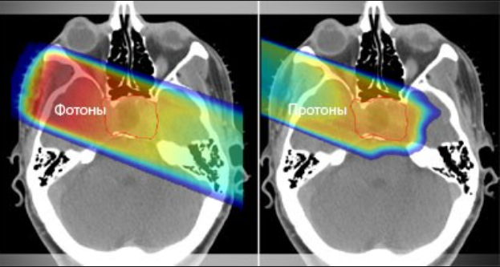
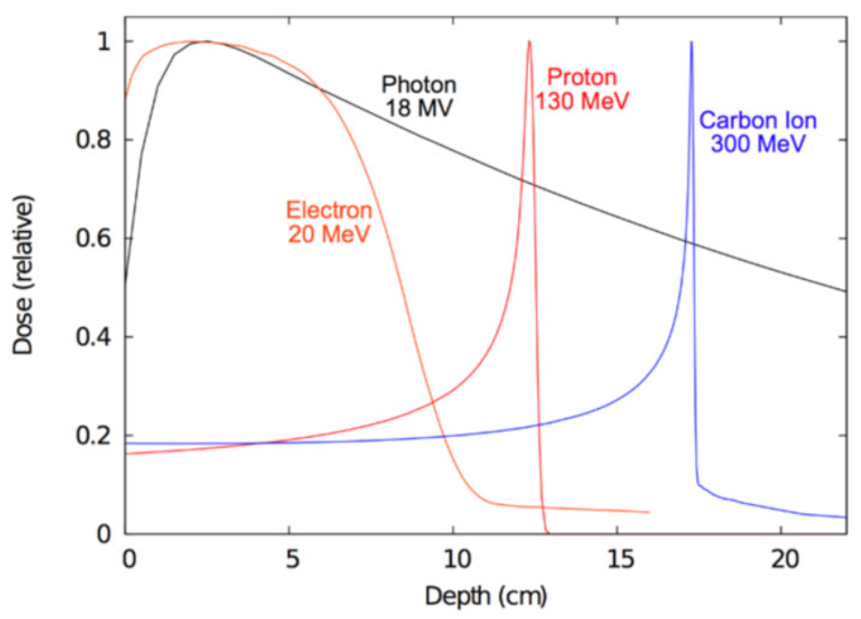
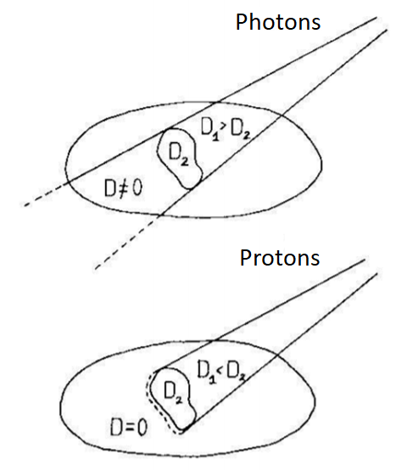
Interaction of ionizing radiation with matter
Dose field formation
Qualitative comparison of doses generated in different areas by beams of photons and protons
Depth distribution of the absorbed dose in water for different types of ionizing radiation

Slide 5
Proton beam characteristics
Parameter | Value
Energy of protons, MeV | 60-230
Depth of path of beam particles in tissues, cm | 1-30
Radiation dose, Gy/fraction | 2-4
Average number of fractions | 10-30
Irradiation time, min | 1-3

Slide 6
Historical reference
World
  Proposed by Robert R. Wilson in 1946 in the article "Radiological Uses of Fast Protons“
  First experiments on irradiation of patients: Radiation laboratory in Berkeley in 1954 and at the University of Uppsala (Sweden) in 1957
  Harvard, USA - 1961, before closing in 2002
  1990 - Loma Linda University Medical Center (LLUMC) (recently renamed James M. Slater Proton Therapy Center) built a dedicated proton therapy clinical center in Loma Linda, California
  1967 - JINR
  1969 - ITEP in Moscow
  Currently: MIBS (St. Petersburg), Dimitrovgrad, Obninsk
Russia

Slide 7
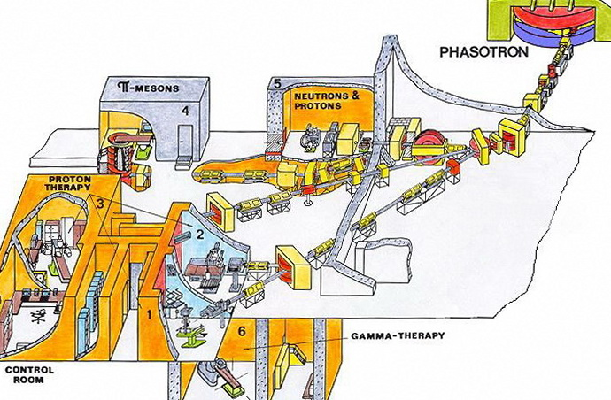
JINR experience
1967 - the beginning of research on proton therapy at JINR, Dubna
For the first time in Russia, a technique of three-dimensional conformal irradiation with a proton beam has been implemented

Slide 8
FLASH proton therapy
Parameter | Traditional | FLASH
Energy, MeV | 60-230 | 60-230
Radiation dose per fraction, Gy | 2-4 | >60
Irradiation time | 3-4 min | <0,5 sec
Notes:
Основные отличия традиционной протонной терапии и Флэш

Slide 9
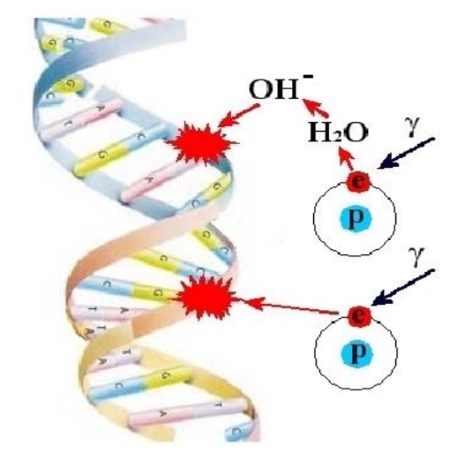
Damage mechanisms
The method of radiation therapy is based on the modifying effect of beams of carbon ions or protons on biological structures. It leads to single- and double-stranded breaks of DNA molecules due to direct ionization
The resulting secondary particles (slow electrons) lead to DNA ionization along their trajectories, as a result of which radiation damage occurs in the track region with transverse dimensions of several nm - on the order of the transverse dimensions of the DNA molecule

Slide 10
Comparison of Tissue in Traditional Proton Therapy and FLASH Therapy
Analysis of fibrosis of the small intestine after irradiation of the abdominal cavity
Ultra-high dose rate of FLASH radiation increases differential response between normal and tumor tissues in mice

Slide 11
The biological effect of FLASH therapy
Main hypotheses:
  Oxygen depletion (hypoxia)
  ROS (Reactive oxygen species)

Slide 12
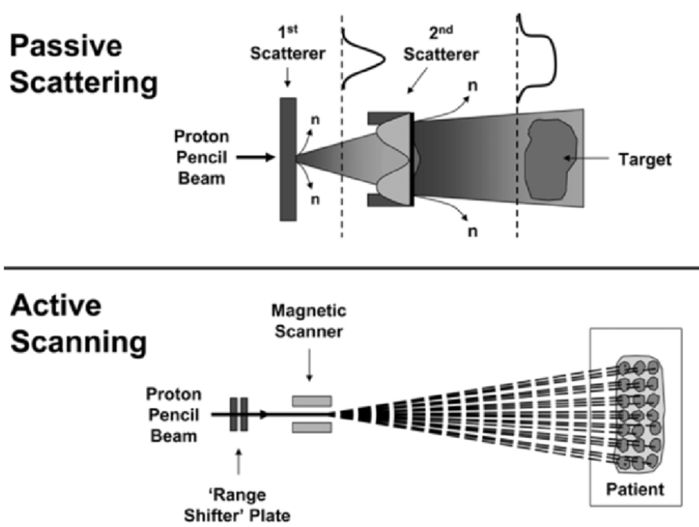
Beam delivery methods
Wide-beam scanning
Pencil-beam scanning

Slide 13
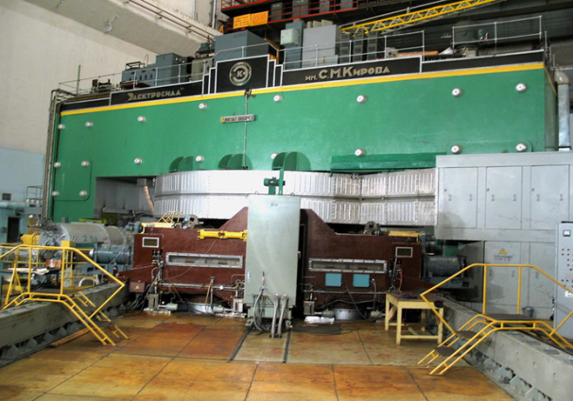
Flash therapy at JINR
A proton FLASH beam with a dose rate of 80 Gy/sec and an aperture of 4x4 cm was obtained at the phasotron

Slide 14
Unresolved tasks
Building a high current accelerator
Patient safety system
Dosimetry
Electronics system

Slide 15
Thanks for attention

